Slide 1
Atomic ionization by scalar dark matter and solar scalars
H. B. Tran Tan, A. Derevianko, V. Dzuba, V.V. Flambaum
Relativistic Hartree-Fock calculations corrected several orders of magnitude error. Born approximation does not work due to violation of orthogonality condition between bound and continuum electron wave functions.
New limits on electron-scalar coupling from Xenon1T data.
Data files for scalars and axions: arXiv:2105.08296.
Calculations for Na, I, Tl, Xe, Ar, Ge atoms

Slide 2
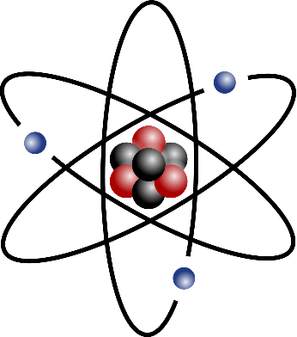
Atomic ionization by scalars
φ : scalar familon, sgoldstino, dilaton, relaxon, moduli, Higgs-portal DM, etc.
Absorption of scalar causes atomic ionization (similar to photoelectric effect)→ detectable by current DM and solar axion searches.
Xenon1T, PandaX-II, EDELWEISS-III, DAMA/LIBRA, SABRE, SuperCDMS, ArDM, DarkSide-20k, DEAP-3600.
Detector
e⁻
E_{d}
φ
e⁻
φ

Slide 3
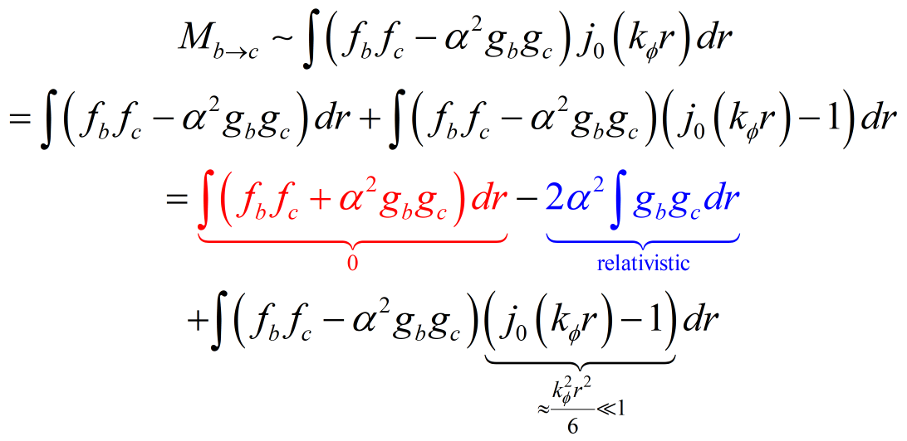
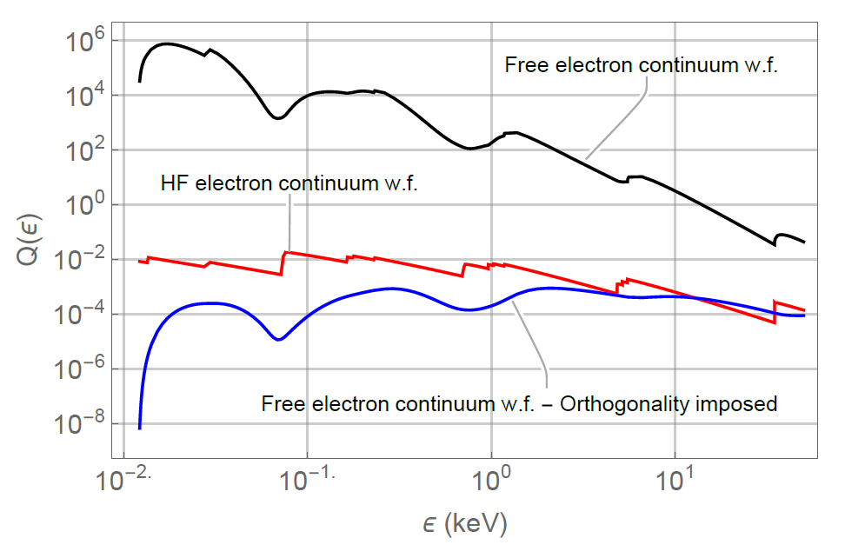
Pitfall: wrong wave functions → wrong results
Orthogonality condition → Born approximation does not work!
Previous work Int. J. Mod. Phys. A 21:1445-1470, 2006: plane wave continuum function → errors by many orders of magnitude.
Pitfall also exists for axioelectric effect → affects low-energy cross section only.
Relativistic Hartree-Fock calculations for scalars and axions.

Slide 4
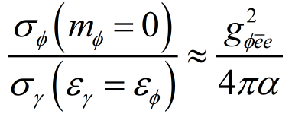
Results: cross sections for Na, Ar, Ge, I, Xe, Tl
With and without 1 keV cutoff.
Accuracy a few %, up to 10% near threshold.
Accurate scalar and axion data, relativistic Hartree-Fock calculations: arXiv:2105.08296.
Check against photoelectric experimental data

Slide 5
Scalar DM and solar scalar limits from Xenon1T data
Detection rate for scalar DM:
Detection rate for solar scalar:
New limits from Xenon1T data:

Slide 6
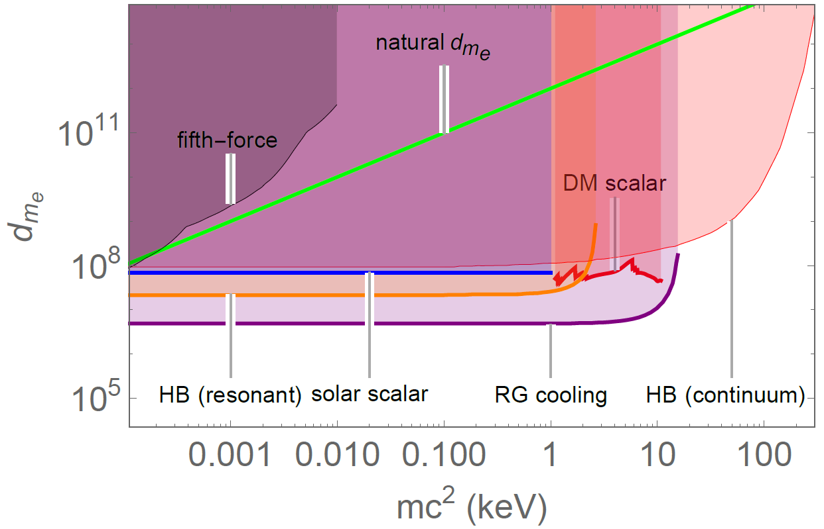
Comparison with astrophysical bounds
Direct limits well inside naturalness region.
Always better than fifth-force & comparable to HB star cooling.
An order of magnitude less stringent than RG star cooling → similar to Xenon1T axion limit.

Slide 7
Relativistic effects increase ionisation by WIMP scattering on electrons by up to 3 orders of magnitude!
Ionization of atoms by slow heavy particles, including dark matter
B.M. Roberts, V.V. Flambaum, G.F. Gribakin, Phys. Rev. Lett. 116, 023201 (2016)]
Dark matter scattering on electrons: Accurate calculations of atomic excitations and implications for the DAMA signal. B. M. Roberts, V. A. Dzuba, V. V. Flambaum, M. Pospelov, and Y. V. Stadnik, Phys. Rev. D 93, 115037 (2016)
Electron-interacting dark matter: implications from DAMA/LIBRA-phase2 and prospects for liquid xenon and NaI detectors, B. M. Roberts, V. V. Flambaum, Phys. Rev. D 100, 063017 (2019).
Relativistic Hartree-Fock calculations for Na, I, Xe, Tl, Ge atoms, scalar and vector portals. Annual modulation due to variation of velocity of WIMPs 20 - 50%
Notes:
7
Update formula to have: obs \propto (1/\Lambda)^n !
A summary slide with all effects and systems (pseudoscalar ~ spin-dep.) versus (scalar ~ VFCs) would be nice --- can also use for the conclusions…
And also mention that for scalars, these are new possibilities for VFCs… (some methods are modification of existing methods, while others are new)

Slide 8
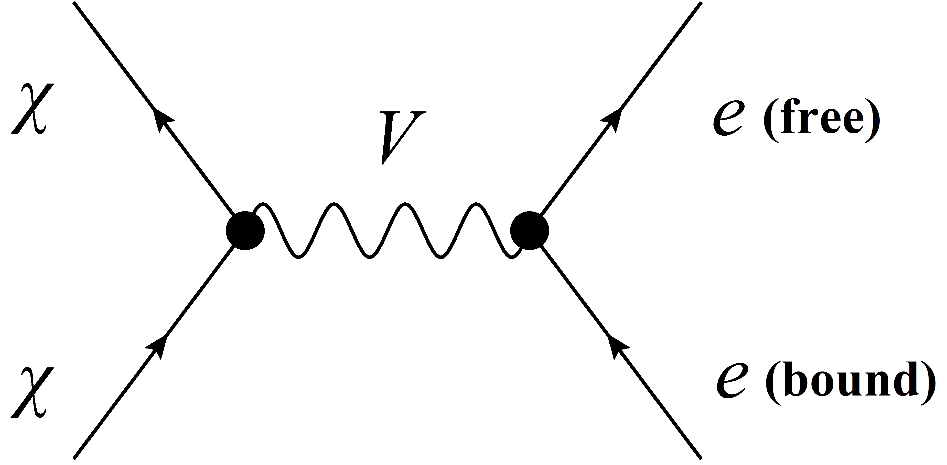
WIMP-Electron Ionising Scattering
Search for annual modulation in σ_{χe} (velocity dependent)
Previous analyses treated atomic electrons non-relativistically. Plane wave for outgoing electron, Z_{effective} for bound electrons.
Non-relativistic treatment of atomic electrons inadequate for m_{χ} > 1 GeV. Coulomb interaction is important for outgoing electron.
Notes:
8

Slide 9
Why are electron relativistic effects so important?
[Roberts, Flambaum, Gribakin, PRL 116, 023201 (2016)],
[Roberts, Dzuba, Flambaum, Pospelov, Stadnik, PRD 93, 115037 (2016)]
Non-relativistic and relativistic contributions to σ_{χe} are very different for large q
(for scalar, pseudoscalar, vector and pseudovector interaction portals):
Non-relativistic [s-wave, ψ ∝ r ⁰ (1 - Zr/a_{B}) as r → 0)], tends to constant as r → 0:
dσ_{χe} ∝ 1/q ⁸
Relativistic [s_{1/2}, p_{1/2}-wave, ψ ∝ r ^{γ-1} as r → 0, γ² = 1 - (Zα)²], increases as r → 0:
dσ_{χe} ∝ ^{(Zα)2}/q ^{6-2(Zα)2} (dσ_{χe} ∝ 1/q ^{5.7} for Xe and I)
Relativistic contribution to σ_{χe} dominates by several orders of magnitude for large q!
Notes:
9
Note: these q scalings are for both scintillation and ionisation! And the ψ asymptotic forms are the same for both discrete and continuum states (non-relativistic and relativistic)!

Slide 10
Accurate relativistic atomic calculations
[Roberts, Flambaum, Gribakin, PRL 116, 023201 (2016)],
[Roberts, Dzuba, Flambaum, Pospelov, Stadnik, PRD 93, 115037 (2016)]
Performed accurate (ab initio Hartree-Fock-Dirac) relativistic atomic calculations of σ_{χe} for Na, Ge, I, Xe and Tl, and event rates of various experiments: DAMA, XENON10, XENON100
Outgoing electron in the Hartree-Fock field (not plane wave, the problem is not reduced to momentum distribution of atomic electrons!)
3 parameter problem: m_{χ}, m_{V}, α_{χ}; vector or scalar interaction vertex
Notes:
10
DAMA (scintillation, ΔE ~ 2 – 6 keV)
XENON10 (ionisation, arbitrary energy deposition, 1+ electrons)
XENON100 (scintillation, ΔE ~ 2 – 6 keV, 3 – 14 photoelectrons)
What is low-energy cutoff in Xe100 experiment?
DAMA looks for events in 2-6 keV interval; XENON10 looks for ionisation with an arbitrary energy deposition; XENON100 looks for electron recoil with Delta(E) > 1 keV

Slide 11
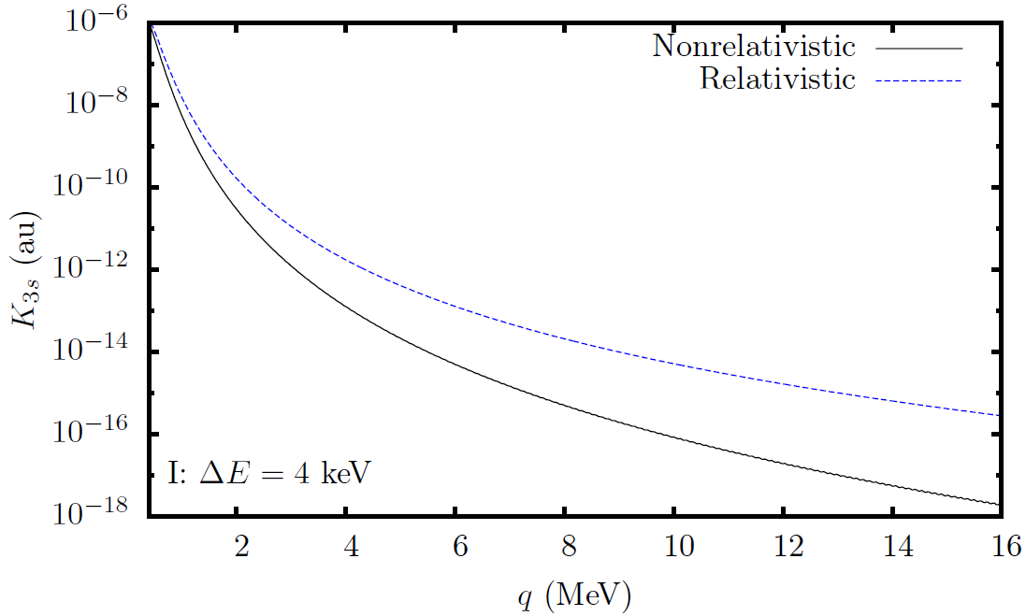
Why are electron relativistic effects so important?
[Roberts, Flambaum, Gribakin, PRL 116, 023201 (2016)],
[Roberts, Dzuba, Flambaum, Pospelov, Stadnik, PRD 93, 115037 (2016)]
Calculated atomic-structure functions for ionisation of I from 3s atomic orbital as a function of q ; ΔE = 4 keV, vector interaction portal
Notes:
11
Scalar and vector portals here!

Slide 12
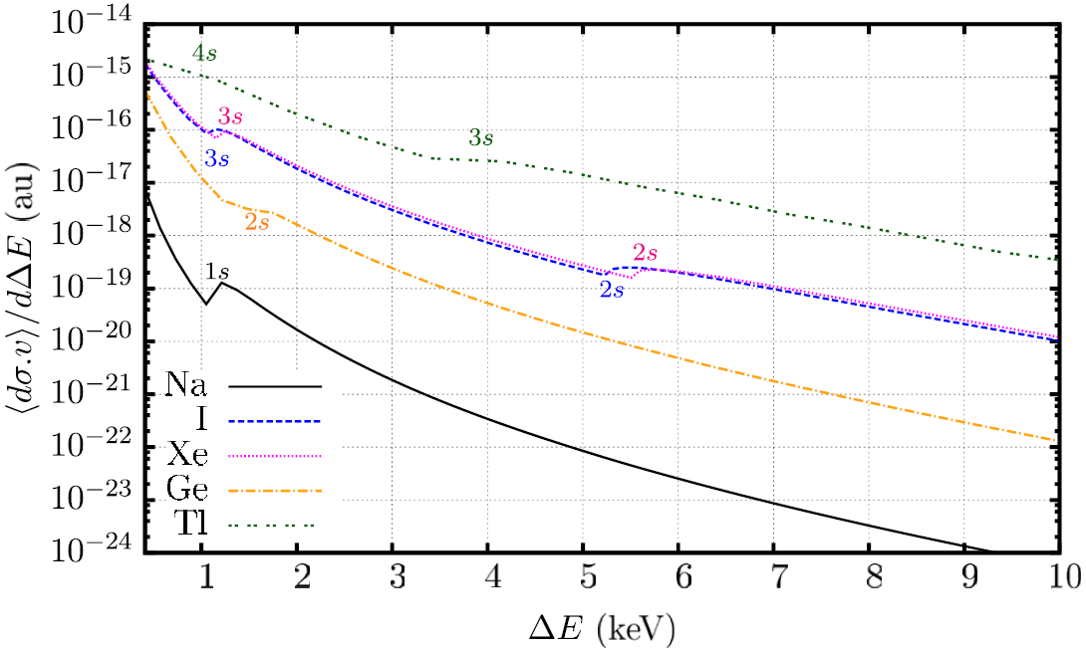
Accurate relativistic atomic calculations
[Roberts, Flambaum, Gribakin, PRL 116, 023201 (2016)],
[Roberts, Dzuba, Flambaum, Pospelov, Stadnik, PRD 93, 115037 (2016)]
Calculated differential σ_{χe} as a function of total energy deposition (ΔE); m_{χ} = 10 GeV, m_{V} = 10 MeV, α_{χ} = 1, vector interaction portal. Annual modulation due to variation of velocity of WIMPs 20 - 50%
Notes:
12
DAMA -> Main contribution comes from I (there is larger effect per atom from Tl, but the relative abundance of Tl atoms is much smaller)

Slide 13
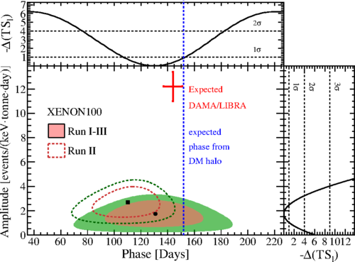
Constraints from XENON Collaboration using our atomic calculations
[XENON Collaboration, PRL 118, 101101 (2017)]
Notes:
13
Strictly, this is only true for the scalar and vector portals which we examined; but probably also true for other portals!!!
Read up on constraints on alpha_xhi and m_V!!!

Slide 14
Low-mass Spin-0 Dark Matter field: effects linear in interaction strength!
Dark Matter
Scalars
(Dilatons):
φ → +φ
Pseudoscalars
(Axions):
φ → -φ
P
P
→ Time-varying spin-dependent effects, oscillating Electric Dipole Moments, 10³ improvement
nEDM collaboration, CASPEr electric, JILA (E. Cornell and Jun Ye group)
→ Time-varying fundamental constants
10¹⁵ improvement
Notes:
14

Slide 15
Dark Matter-Induced Cosmological Evolution of the Fundamental Constants
Consider an oscillating classical scalar field, φ(t) = φ₀ cos(m_{φ}t), that interacts with SM fields (e.g. a fermion f) via quadratic couplings in φ.
‘Slow’ drifts [Astrophysics (high ρ_{DM}): BBN, CMB]
Oscillating variations [Laboratory (high precision)]
Notes:
15
Update references… Explain that electromagnetic fine-structure constant governs the strength of all electromagnetic processes in Nature and interactions.
RA: less talk --- only explain cos()^2 part…

Slide 16
Dark Matter-Induced Cosmological Evolution of the Fundamental Constants
[Stadnik, and V.F. PRL 114, 161301 (2015); PRL 115, 201301 (2015)]
Fermions:
Photon:
W and Z Bosons:
Notes:
16

Slide 17
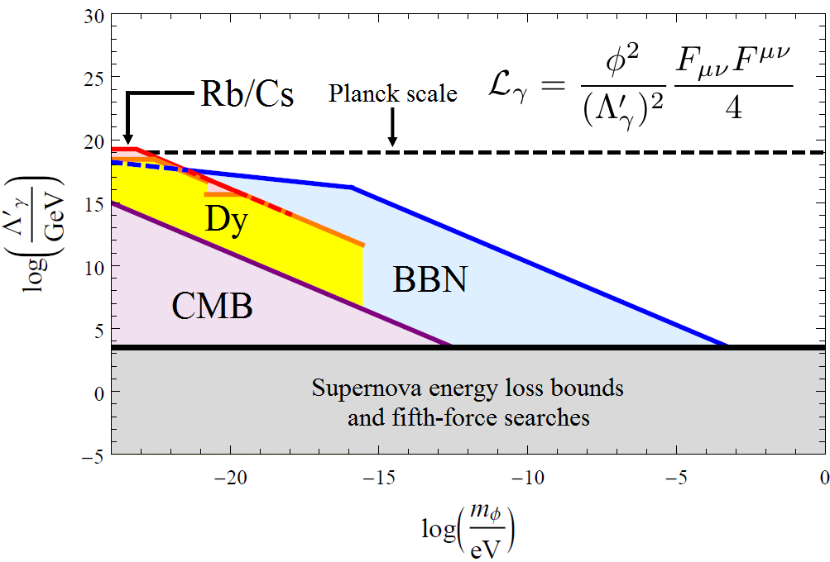
Constraints on Quadratic Interaction of Scalar Dark Matter with the Photon
BBN, CMB, Dy and Rb/Cs constraints: [Stadnik and V.F., PRL 115, 201301 (2015) + Phys. Rev. D 2016] 15 orders of magnitude improvement!
Notes:
17
Emphasise 15 orders of magnitude improvement for the lightest masses! – Mention also constraints on other interactions (photon, electron, light quarks (u,d), massive vector bosons (W+/-,Z)

Slide 18
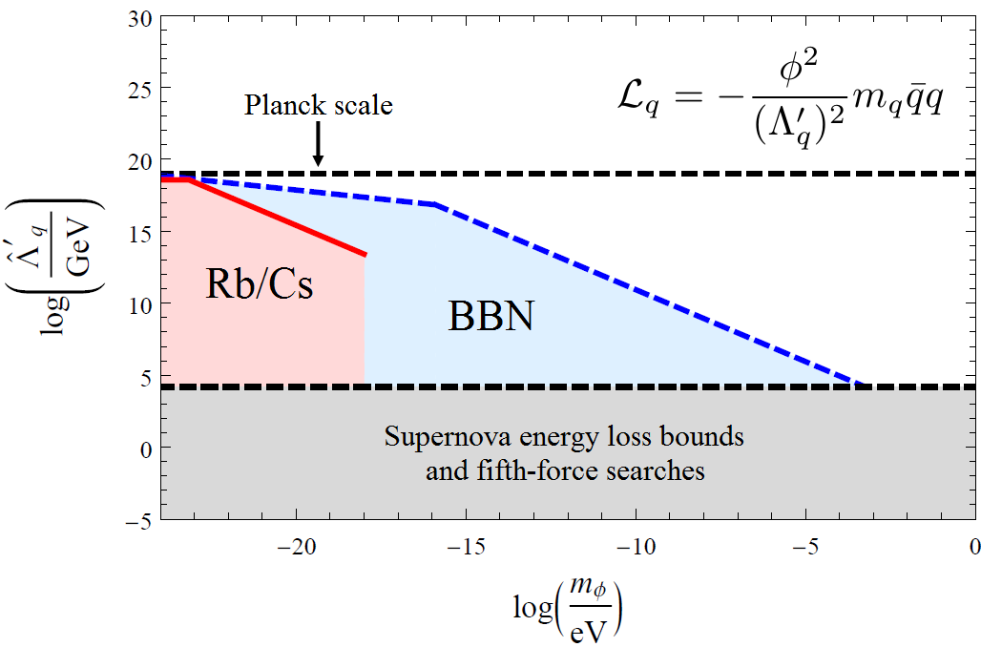
Constraints on Quadratic Interactions of Scalar Dark Matter with Light Quarks
BBN and Rb/Cs constraints: [Stadnik and V.F., PRL 115, 201301 (2015) + Phys. Rev. D 2016]
Notes:
18
Emphasise 15 orders of magnitude improvement for the lightest masses! – Mention also constraints on other interactions (photon, electron, light quarks (u,d), massive vector bosons (W+/-,Z)

Slide 19
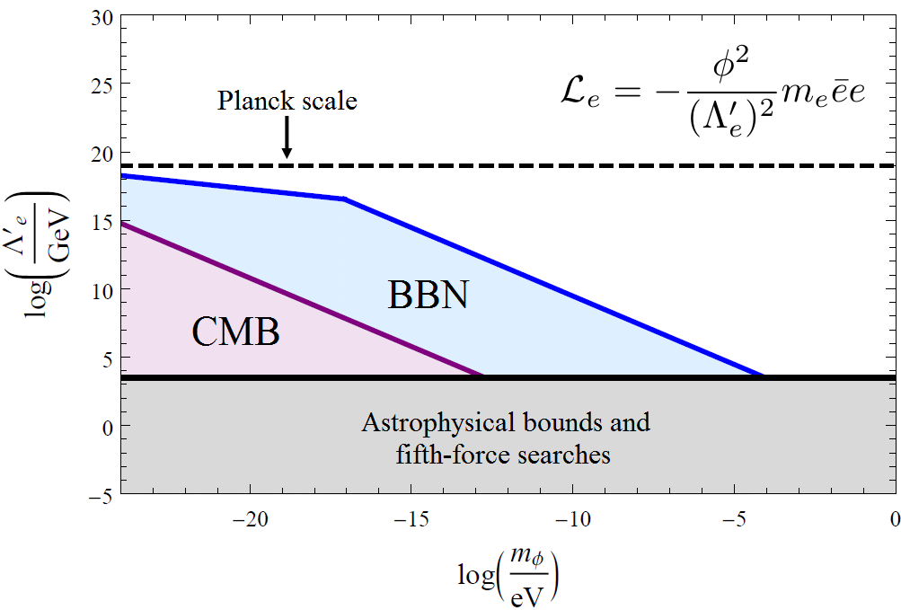
Constraints on Quadratic Interaction of Scalar Dark Matter with the Electron
BBN and CMB constraints: [Stadnik and V.F., PRL 115, 201301 (2015)]
Notes:
19
Emphasise 15 orders of magnitude improvement for the lightest masses! – Mention also constraints on other interactions (photon, electron, light quarks (u,d), massive vector bosons (W+/-,Z)

Slide 20
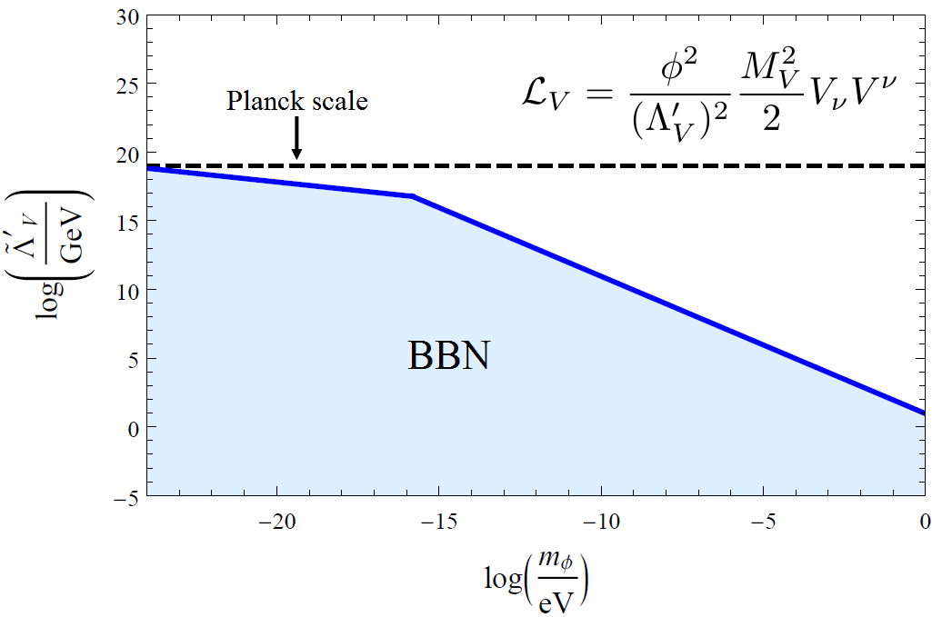
Constraints on Quadratic Interactions of Scalar Dark Matter with W and Z Bosons
BBN constraints: [Stadnik and V.F., PRL 115, 201301 (2015)]
Notes:
20
Emphasise 15 orders of magnitude improvement for the lightest masses! – Mention also constraints on other interactions (photon, electron, light quarks (u,d), massive vector bosons (W+/-,Z)

Slide 21
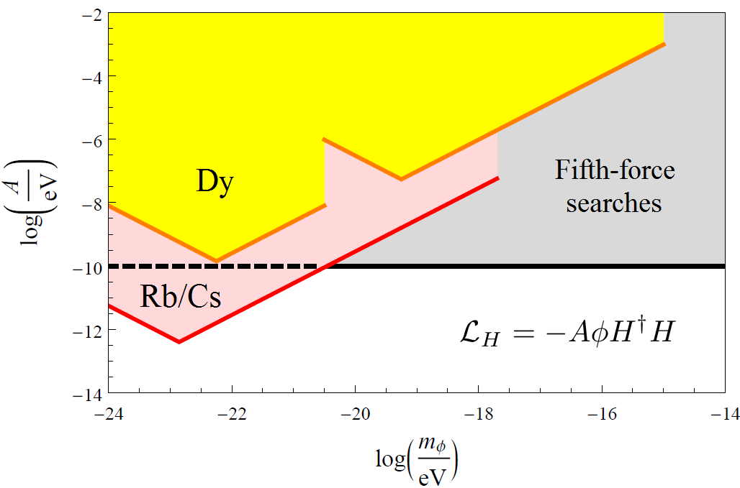
Constraints on Linear Interaction of Scalar Dark Matter with the Higgs Boson
Rb/Cs constraints: [Stadnik and V.F., PRA 94, 022111 (2016)]
2 – 3 orders of magnitude improvement!
Notes:
21

Slide 22
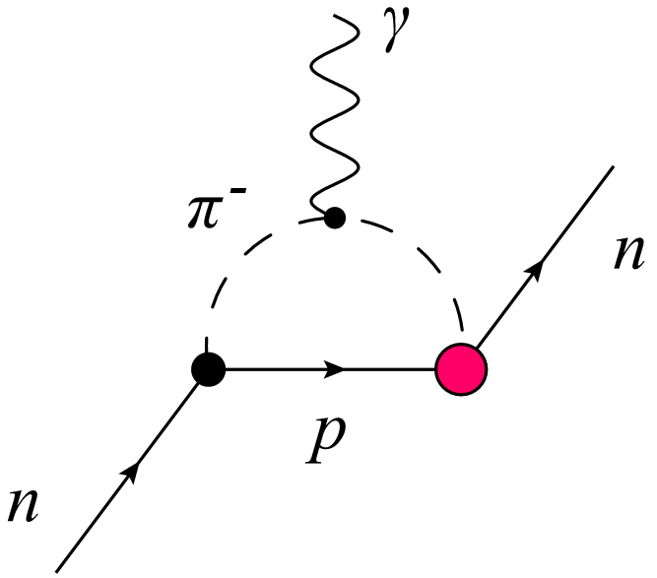
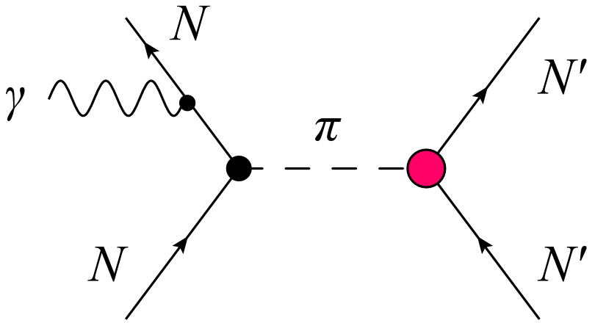
Axion-Induced Oscillating Atomic and Molecular EDMs
[O. Sushkov, Flambaum, Khriplovich, JETP 60, 873 (1984)], [Stadnik , Flambaum, PRD 89, 043522 (2014)]
Induced through hadronic mechanisms:
Oscillating nuclear Schiff moments (I ≥ 1/2 => J ≥ 0)
Oscillating nuclear magnetic quadrupole moments (I ≥ 1 => J ≥ 1/2; magnetic => no Schiff screening)
Underlying mechanisms:
Intrinsic oscillating nucleon EDMs (1-loop level)
Oscillating P,T-violating intranuclear forces (tree level => larger by ~4π² ≈ 40; up to extra 1000-fold enhancement in deformed nuclei)
(1)
(2)
Notes:
22
Axion-induced P,T-odd forces due arise at tree level, while axion-induced intrinsic nucleon EDMs arise at 1-loop level -> avoid ~4*pi (or 8*pi^2 – check) loop suppression factor! (Which far outweighs the chiral log enhancement factor for instrinic nucleon EDM: ln(m_N^2/m_\pi^2) \approx 4 numerically).
Nuclear enhancement factor: for d_nucleus c.f. d_nucleons! [Read up more!]
Closely-spaced energy spacing enhancement and collective enhancement are possible in deformed nuclei → (Is this only for P,T-odd forces??!)

Slide 23
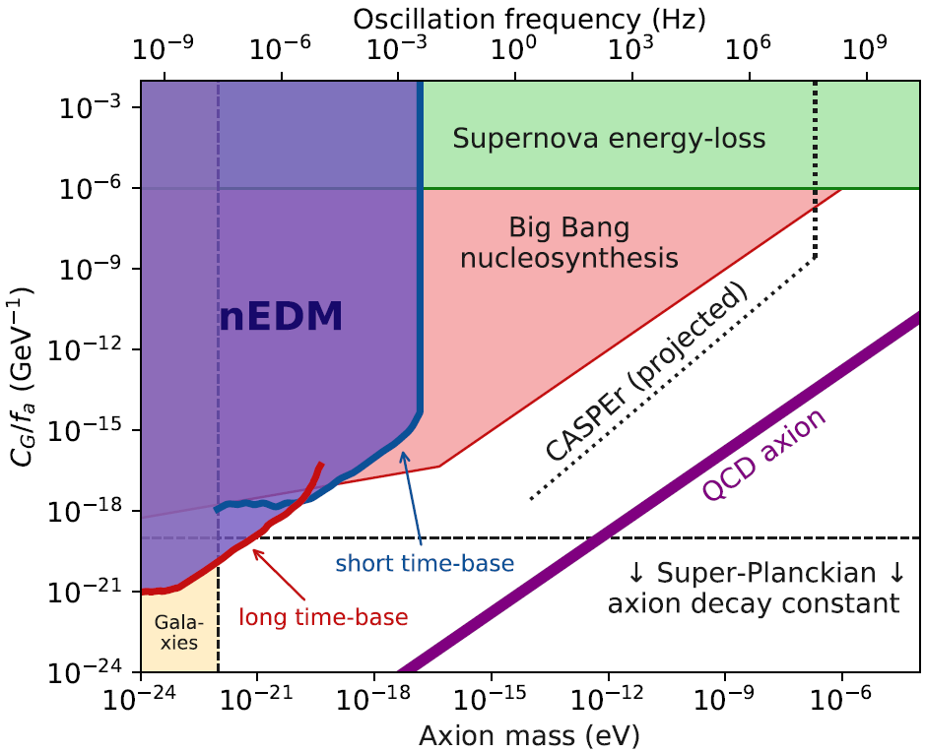
Constraints on Interaction of Axion Dark Matter with Gluons
nEDM constraints: [nEDM collaboration, PRX 2017]
3 orders of magnitude improvement!
Notes:
23
Point out the Planck scale for comparison

Slide 24
Conclusion
Relativistic Hartree-Fock calculations correct several orders of magnitude error for the dark matter scalars and solar scalars.
Plane wave approximation does not work due to violation of orthogonality condition between bound and continuum electron wave functions → Error up to 8 orders of magnitude!
Such effect also exists for axions but the error is significant for small axion energies only.
New limits on electron-scalar coupling from Xenon1T data.
Data files for scalars and axions: arXiv:2105.08296.
Relativistic effects increase ionisation by WIMP scattering on electrons by up to 3 orders of magnitude. Plane wave approximation does not work. Annual modulation due to variation of velocity of WIMPs is 20 - 50%. Results for DAMA/LIBRA and XENON collaborations.

Slide 25
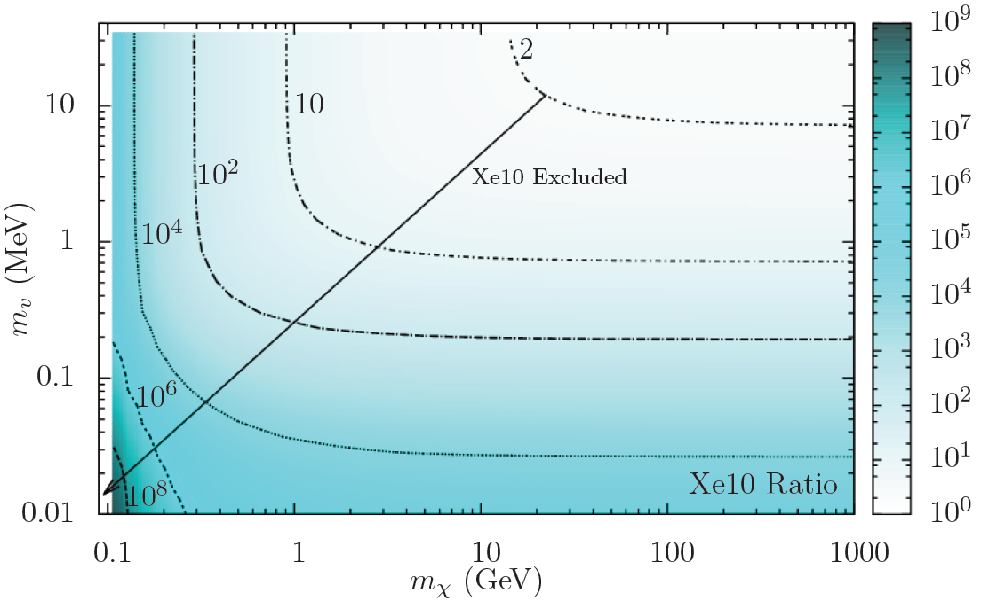
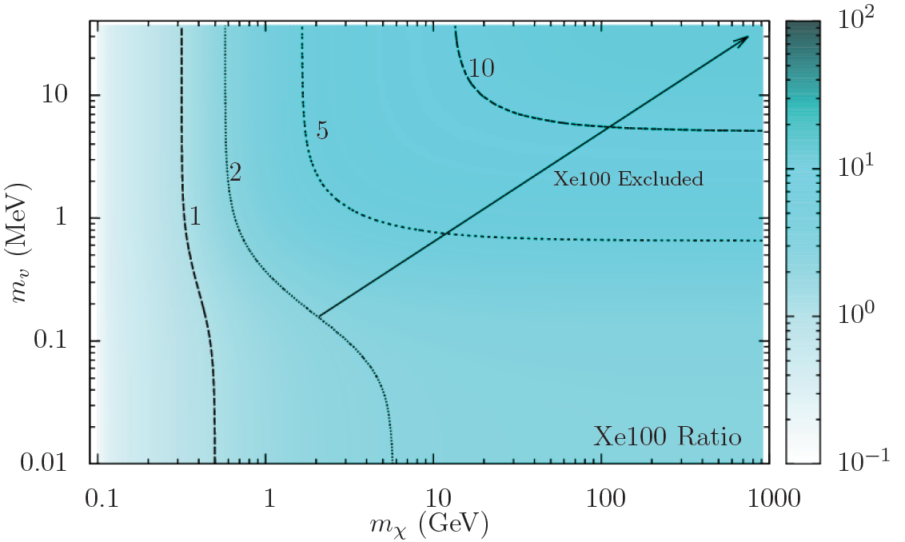
Can the DAMA result be explained by the ionising scattering of WIMPs on electrons?
[Roberts, Flambaum, Gribakin, PRL 116, 023201 (2016)],
[Roberts, Dzuba, Flambaum, Pospelov, Stadnik, PRD 93, 115037 (2016)]
XENON10 (expected/observed ratio)
XENON100 (expected/observed ratio)
Using results of XENON10 and XENON100, we find no region of parameter space in m_{χ} and m_{V} that is consistent with interpretation of DAMA result in terms of “ionising scattering on electrons” scenario.
Notes:
25
Strictly, this is only true for the scalar and vector portals which we examined; but probably also true for other portals!!!
Read up on constraints on alpha_xhi and m_V!!!

Slide 26
Why are electron relativistic effects so important?
[Roberts, Flambaum, Gribakin, PRL 116, 023201 (2016)],
[Roberts, Dzuba, Flambaum, Pospelov, Stadnik, PRD 93, 115037 (2016)]
Consider m_{χ} ~ 10 GeV, <v_{χ}> ~ 10⁻³c
<q> ~ <p_{χ}> ~ 10 MeV >> m_{e} =0.5 MeV
=> Relativistic process on atomic scale!
Large q ~ 1000 a.u. corresponds to small r ~ 1/q << a_{B}/Z
Largest contribution to σ_{χe} comes from innermost atomic orbitals – for <ΔE> ~ <T_{χ}> ~ 5 keV:
Na (1s)
Ge (2s)
I (3s/2s)
Xe (3s/2s)
Tl (3s)
Notes:
26

Slide 27
Why are electron relativistic effects so important?
[Roberts, Flambaum, Gribakin, PRL 116, 023201 (2016)],
Slow heavy particle produces an adiabatic perturbation of atom. Usually transitions produced by an adiabatic perturbation are suppressed exponentially, as exp(-q² R²), q is the momentum transfer. No ionization?
However, the singular Coulomb potential produces a cusp of electron wave function near the nucleus or even infinity for the relativistic Dirac s-wave function at r=0 for a point-like nucleus. As a result, the exponential suppression is replaced by a power suppression q^{-n} . The effect comes from small distances where the electron is ultra-relativistic.
Notes:
27
Note: these q scalings are for both scintillation and ionisation! And the ψ asymptotic forms are the same for both discrete and continuum states (non-relativistic and relativistic)!

Slide 28
Relativistic effects increase ionisation by dark matter WIMP scattering on electrons by up to 3 orders of magnitude!
[Roberts, Flambaum, Gribakin, PRL 116, 023201 (2016)]
Important for numerous existing and future dark matter detectors.
Detailed relativistic many-body calculations in [Roberts, Dzuba, Flambaum, Pospelov, Stadnik, Phys. Rev. D 93, 115037, 2016,
Roberts, Flambaum, Phys. Rev. D 2019,]
DAMA collaboration claims detection of dark matter, others – no detection. Possible explanation: scattering of dark matter on electrons (instead of scattering on nuclei).
Our calculations show tension between DAMA and XENON results. XENON used our calculations in PRL 2017.
Notes:
28
Update formula to have: obs \propto (1/\Lambda)^n !
A summary slide with all effects and systems (pseudoscalar ~ spin-dep.) versus (scalar ~ VFCs) would be nice --- can also use for the conclusions…
And also mention that for scalars, these are new possibilities for VFCs… (some methods are modification of existing methods, while others are new)

