Slide 1
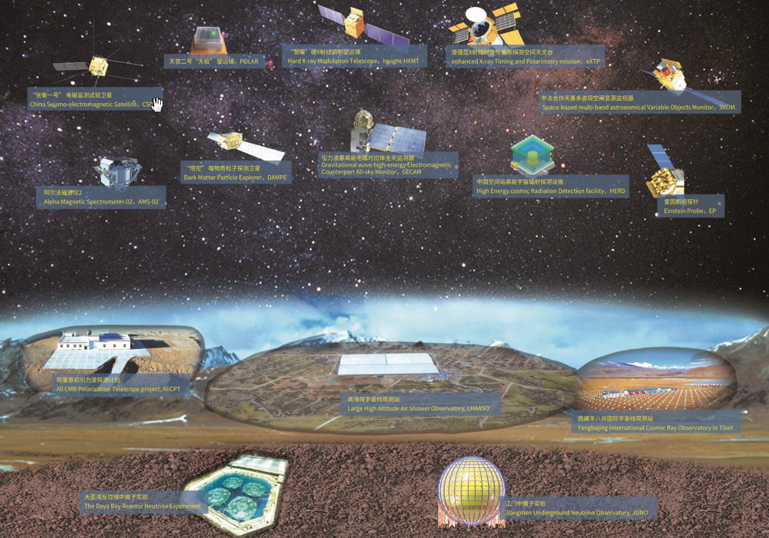
Highlights of Insight-HXMT and Perspectives of eXTP
Shuang-Nan Zhang（张双南）
zhangsn@ihep.ac.cn
Particle Astrophysics Division
Institute of High Energy Physics
Chinese Academy of Sciences

Slide 2
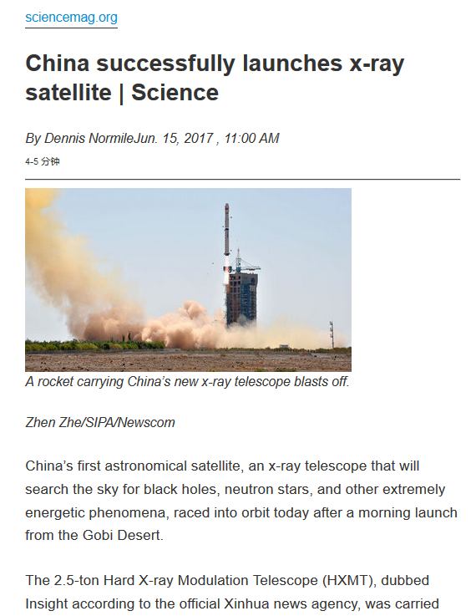
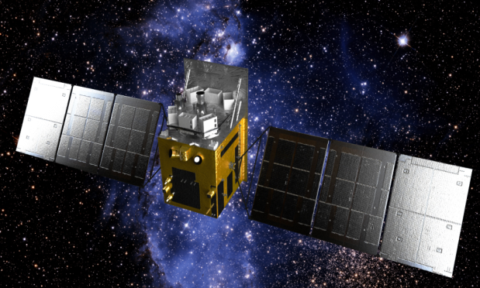
慧眼Insight-HXMT
CAS-CAST
The 1st X-ray satellite in China, 06/15/2017
Features:
  Large effective area @ > 30 keV
  High timing resolution: single event mode
  Wide energy bands (1-250 keV narrow FoV, 0.2-3 MeV as ASM）
Status:
  All instruments perform well
  Focus on bright sources
  Unrestricted number of ToOs
    Response time: hours to days
    Ad hoc ToO data public immediately
  In AO3; AO4 starts in Aug., Guest program is open world wide
  To stay in orbit for >8 years
PI: Shuang-Nan Zhang (IHEP)

Slide 3
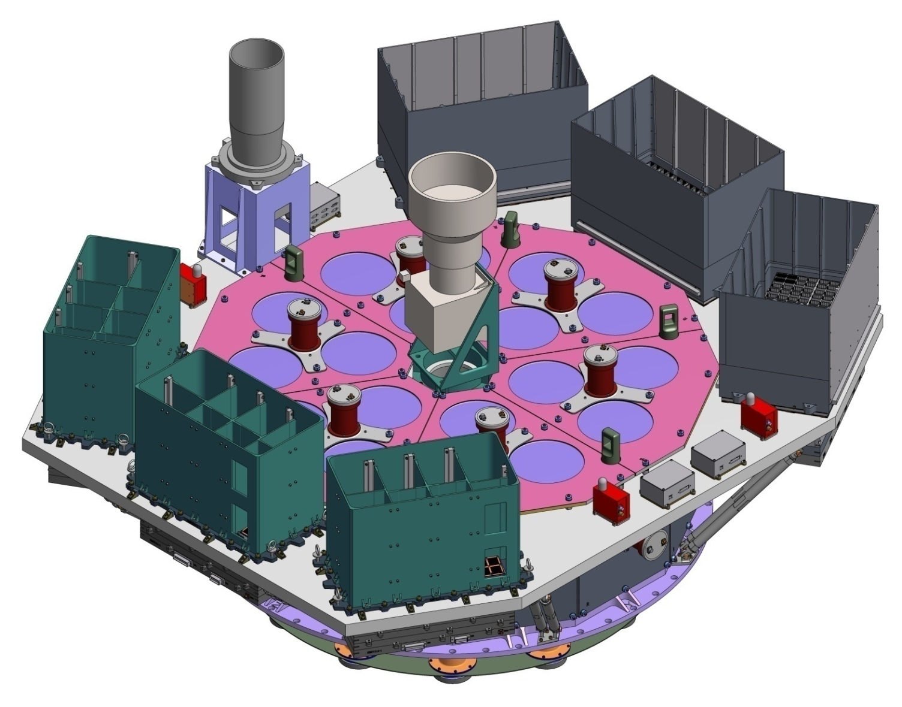
Science payloads
ME:Si-PIN,5-30 keV, 952 cm²
Star tracker
LE:SCD,1-15 keV, 384 cm²
HE: NaI/CsI, 20-250 keV, 5000 cm²

Slide 4
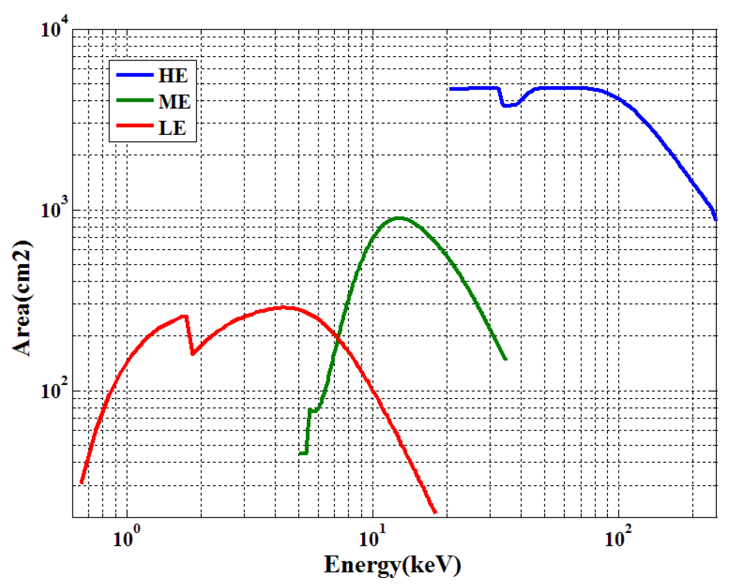
Effective area for pointing observations

Slide 5
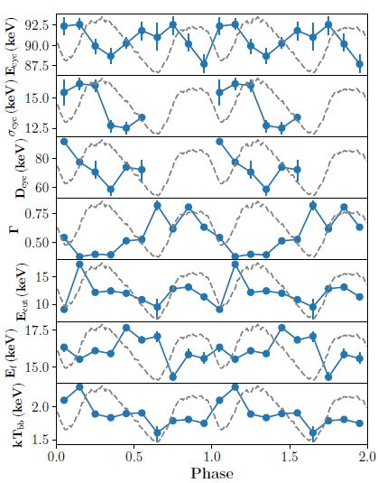
Highest-E Neutron star cyclotron absorption line
GRO J1008-57：~90 keV → highest B directly measured in the universe ~10¹³, ~ 4σ with NuSTAR & Suzaku ~79 keV
4 HXMT observations ~235 ks
~ 20σ detection
Allow for phase resolved and flux dependent studies
Ge et al. 2020, ApJL

Slide 6
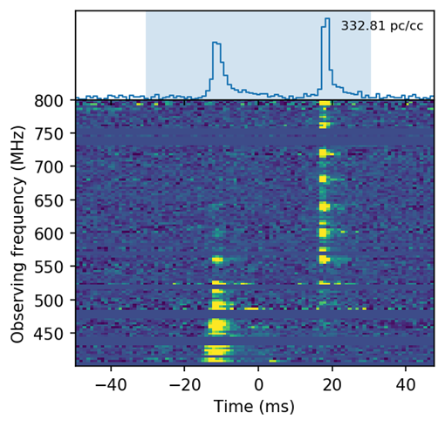
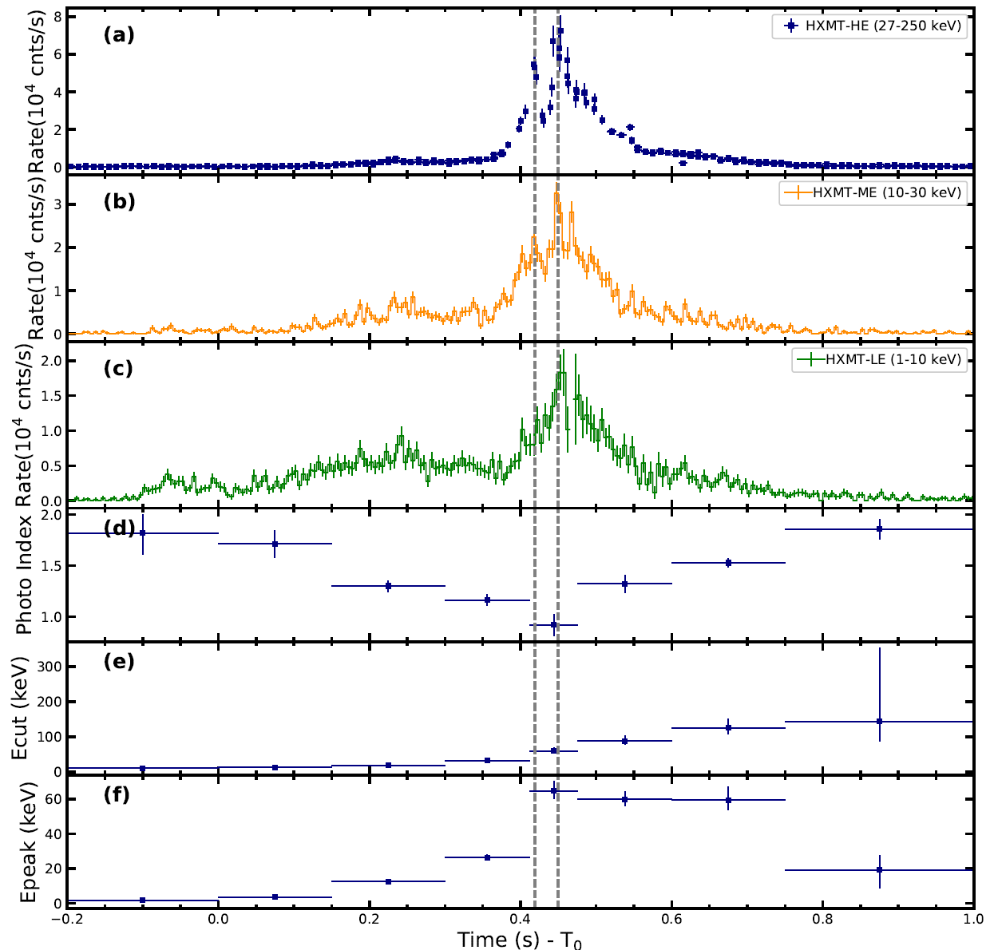
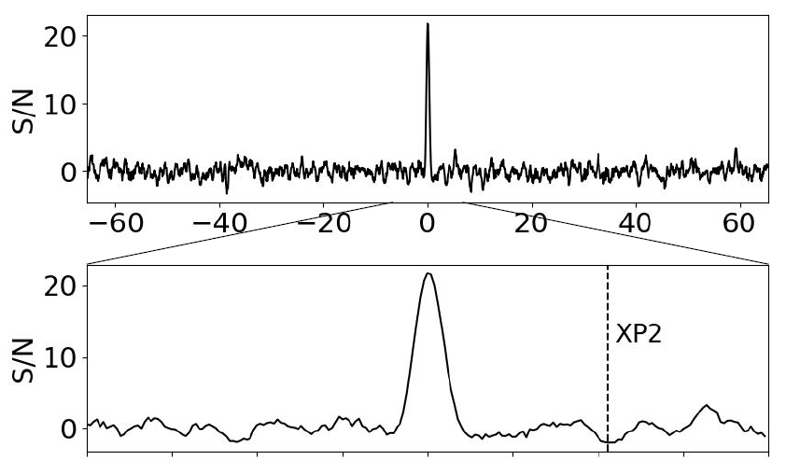
Historic event on April 28th 2020: FRB 200428
CHIME
Insight-HXMT
Stare2
CHIME/FRB Collaboration+; Bochenek+; Li+, 2021, Nature Astronomy

Slide 7
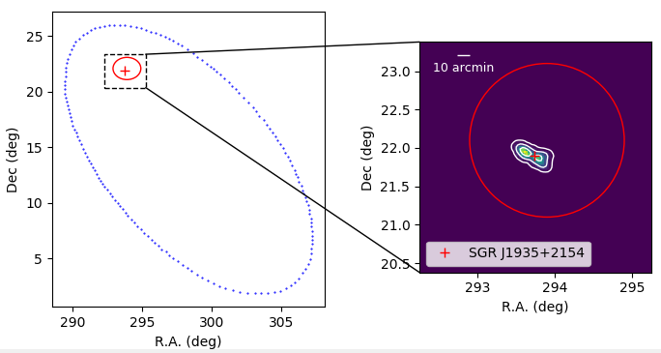
Localization of the X-ray burst
CHIME
Insight-HXMT
Stare2: 95%
X-ray burst 3.7’ off SGR1935 with σ=10’’
Identification of the X-ray burst with SGR1935, Li+ (Insight-HXMT team), 2021, Nature Astronomy

Slide 8
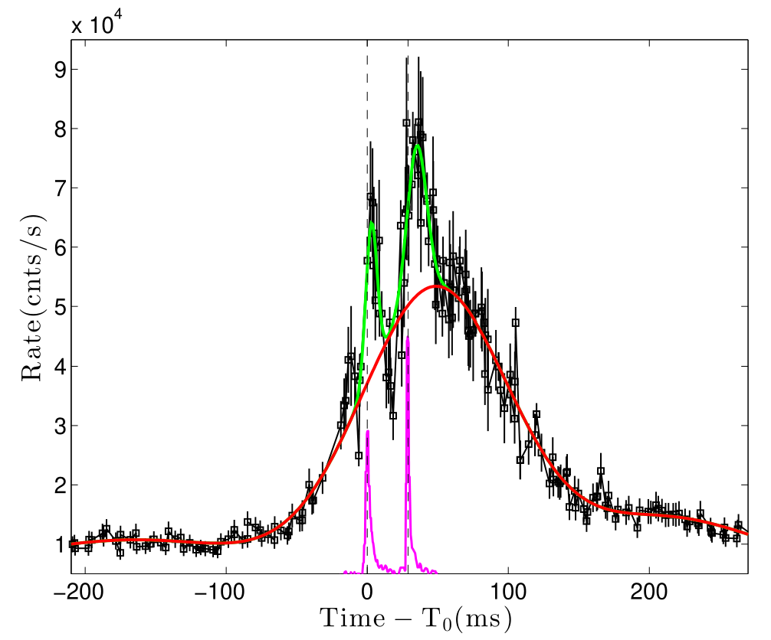
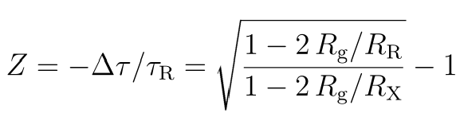
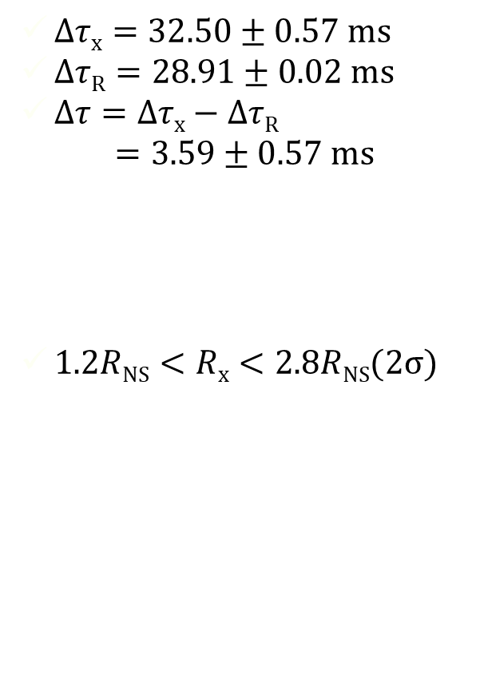
Gravitational redshift detected→location of XRB
$∆τx=32.50±0.57 ms$
$∆τR=28.91±0.02 ms$
$∆τ=∆τx−∆τR$
$$=3.59±0.57 ms$$
$1.2RNS<Rx<2.8RNS(2σ)$
XRB
Insight-HXMT/HE
FRB
CHIME
ZZ, SNZ, ZGD+ submitted

Slide 9
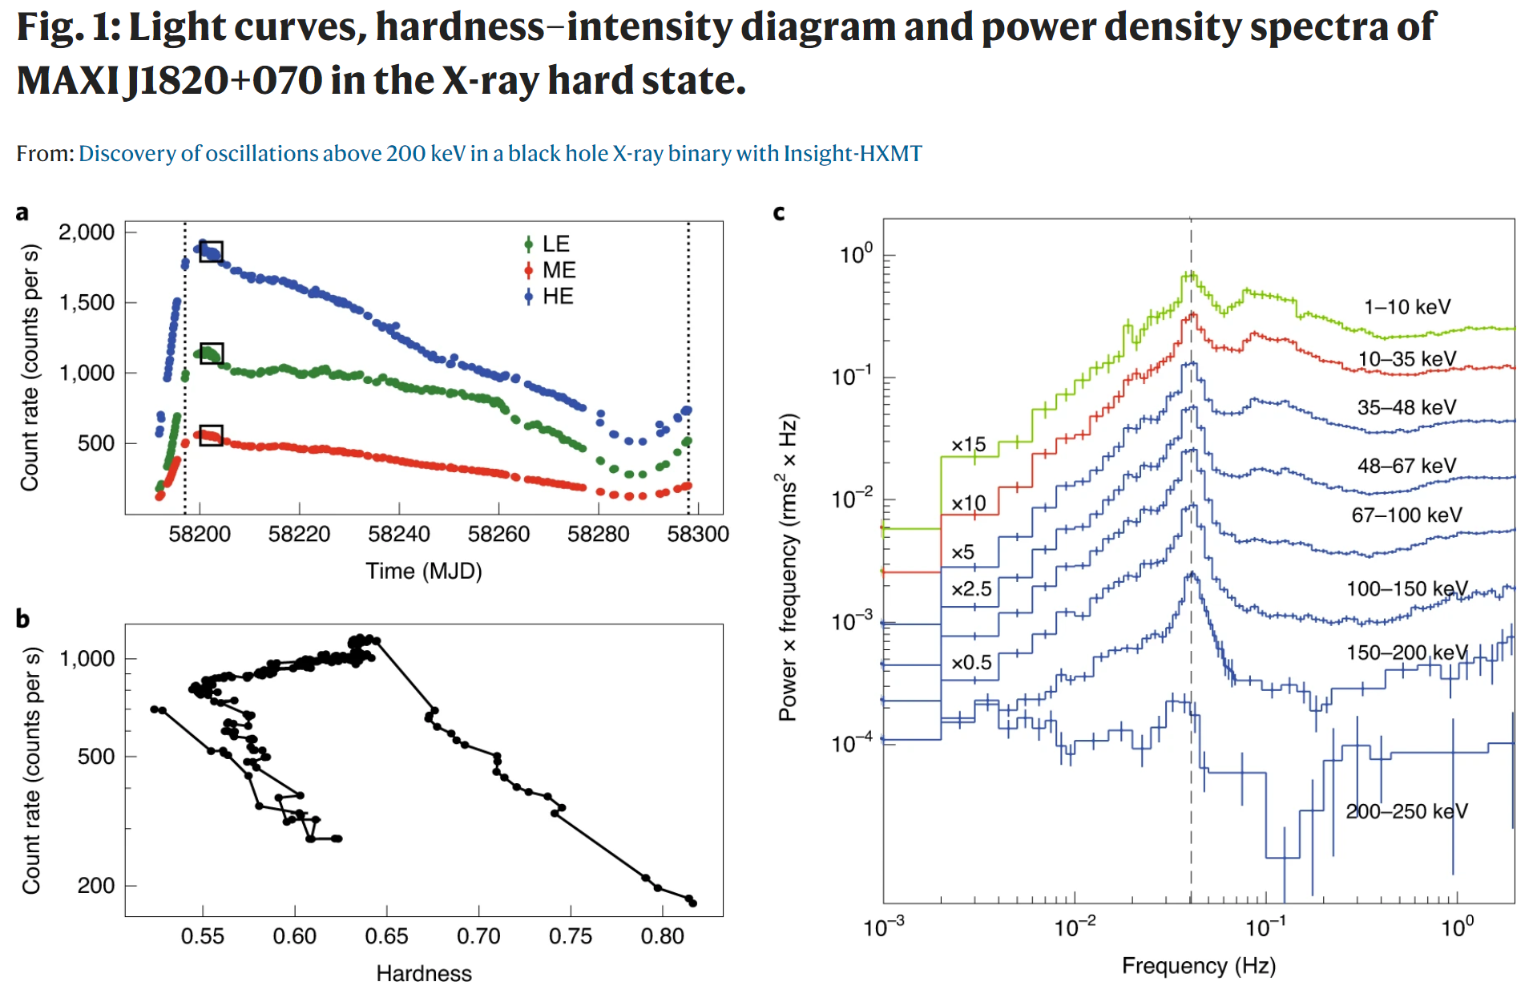
QPOs of BH binaries: < 30 keV → >200 keV
Ma, Tao, SNZ+ 2021, Nature Astronomy

Slide 10
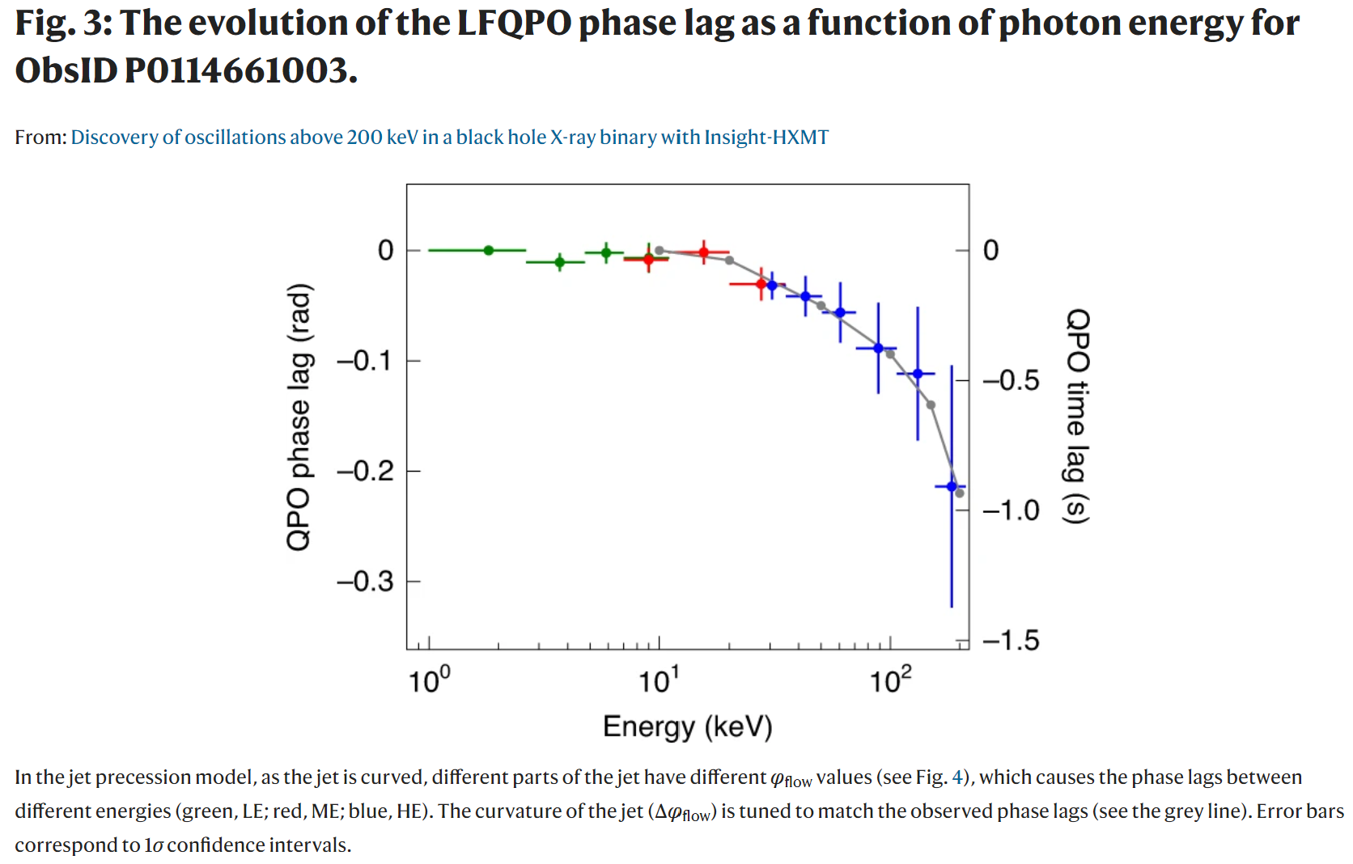
Lag contradicts Comptonization delay in corona: Geometrical effect outside inner disk
Very large & soft lag:
not precessing corona
Ma, Tao, SNZ+ 2021, Nature Astronomy

Slide 11
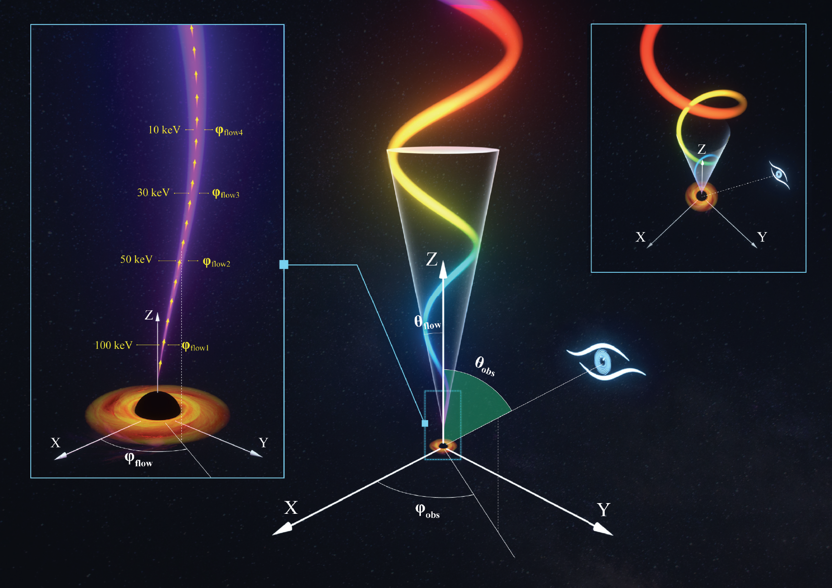

New model of BH QPOs: L-T precession Jet
Ma et al. 2020, Nature Astronomy

Slide 12
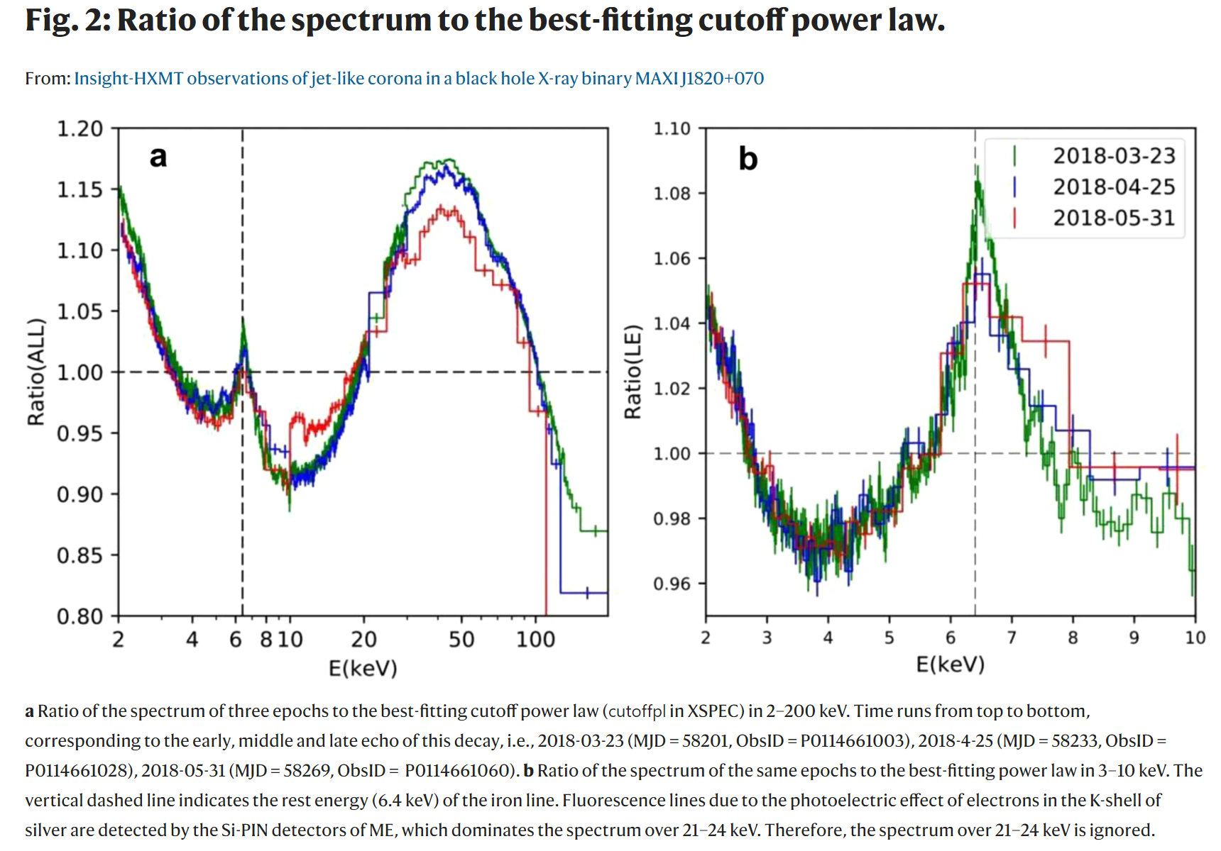
Broad band energy spectra with Insight-HXMT
You+2021, Nature Communications

Slide 13
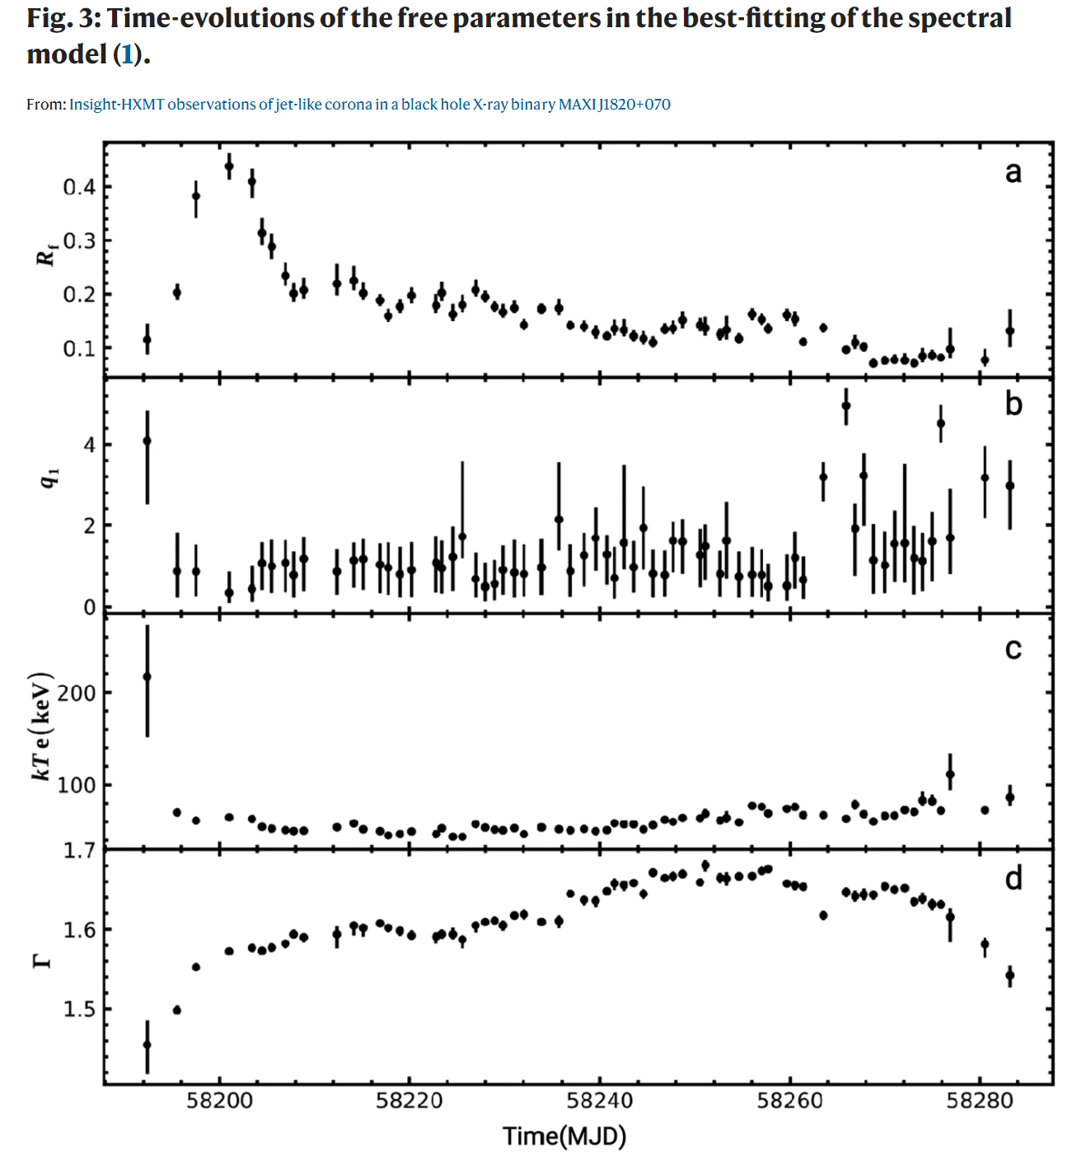
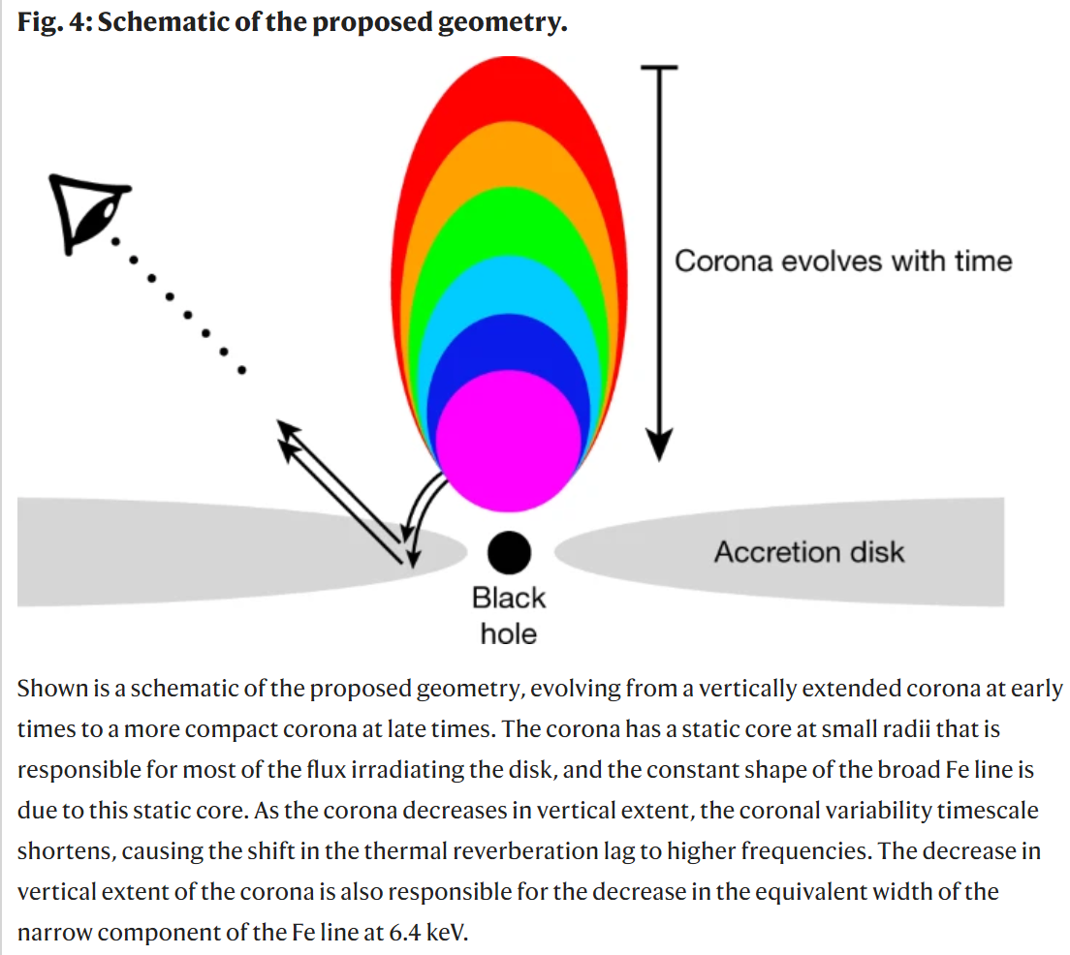
Decreasing reflection contradicts contracting corona
Reflection should increase, but actually decreases
Kara+2020, Nature

Slide 14
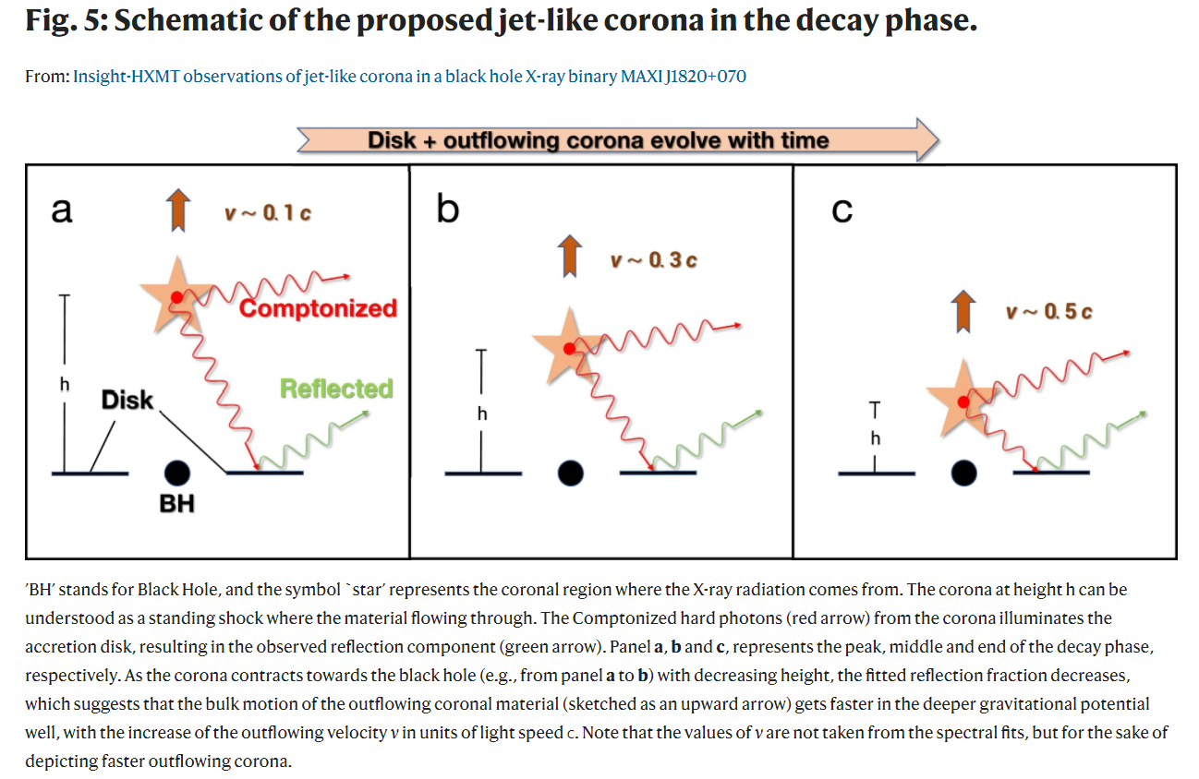
The contracting corona is an X-ray jet!
You+2021, Nature Communications

Slide 15
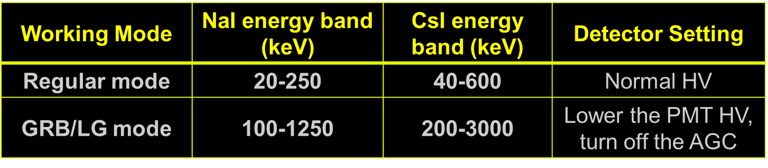
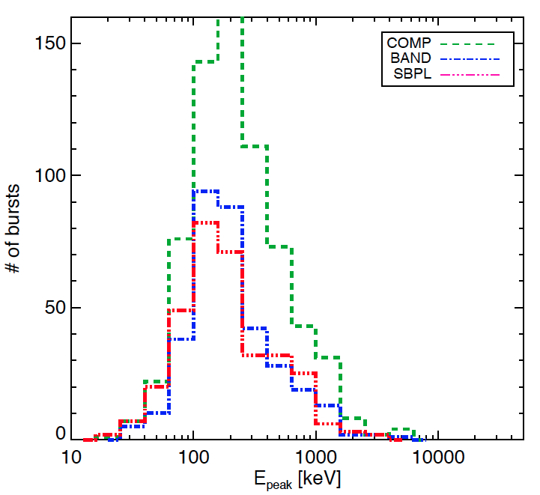
Dedicated working mode for GRB
GRB mode better energy range:
  According to the simulation, det. efficiency is good for >200 keV
  GRB Epeak distribution
GRB mode: ~30% of obs. time
  When the targeted source is occulted by the Earth in pointed observation
  When HE regular mode is not very useful in an observation
GRB Epeak measured by Fermi/GBM
（Gruber+, ApJS, 2014）

Slide 16
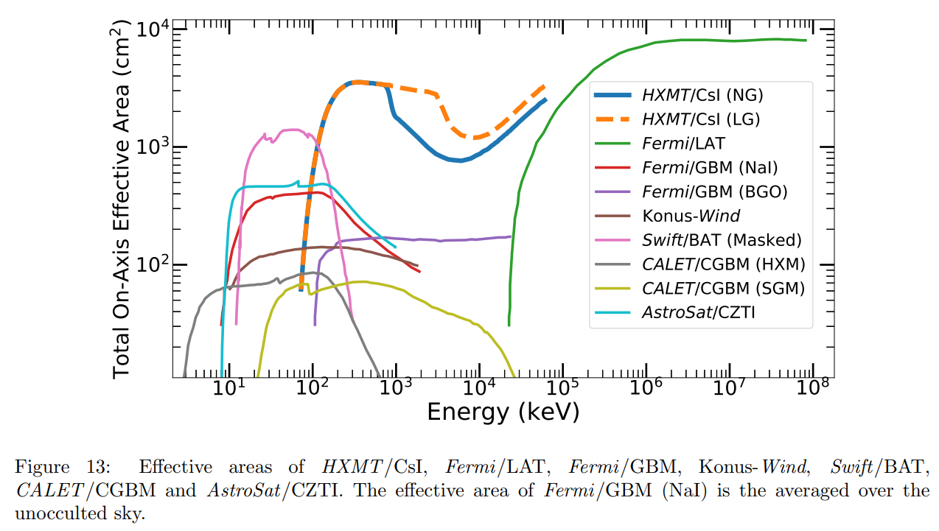
Effective Area for GRBs & Pulsars
Can detect GRBs in both regular & GRB/LG modes (lower HV for PMT)
GRB monitoring FOV: all sky un-occulted by the Earth
500~3000 cm² ~ MeV range with single photon counting and energy measurement, ~80 GRBs/year
Luo et al. 2020

Slide 17
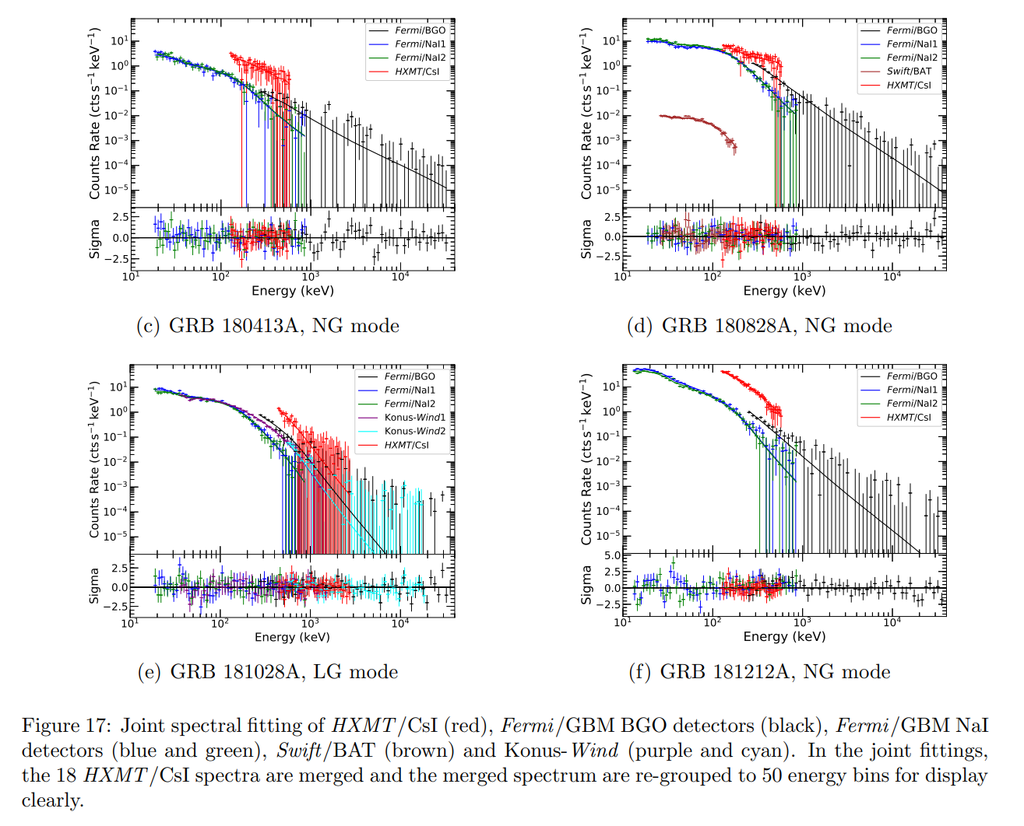
Multi-instrument GRB spectral fitting
Luo et al. 2020

Slide 18
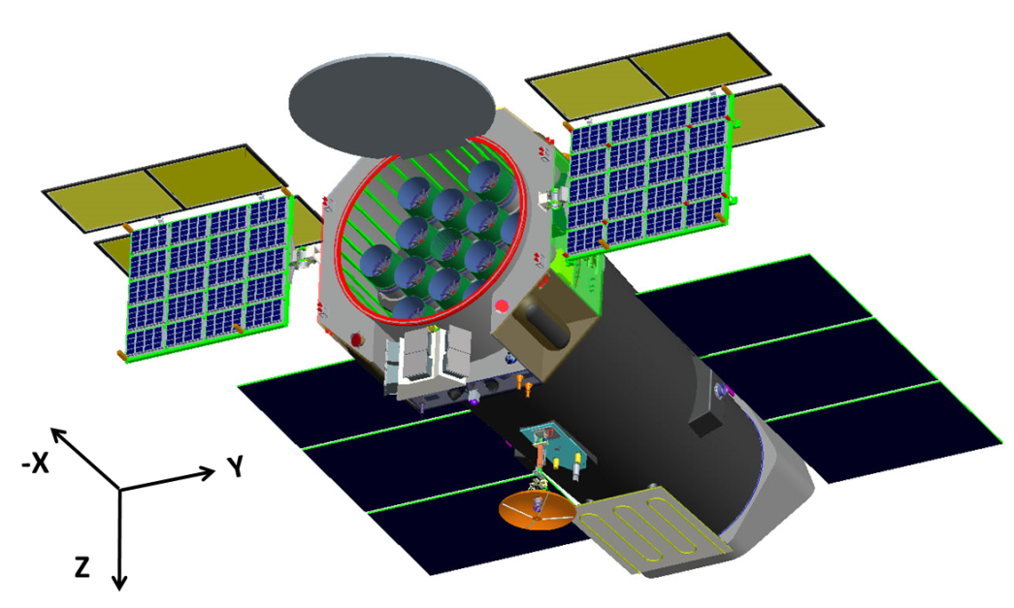


eXTP: enhanced X-ray Timing and Polarimetry
--The next international flagship X-ray mission: 2027?
一奇二星三极端
Sciences
  BH Singularity
  Neutron or Quark Star?
  Extreme gravity/magnetism/density
Capabilities
  Spectral, polarization, timing, imaging
  Large eff. Area (~3.8 m²@6 keV)
  High spec. resol.(<180 eV@6 keV)
Payload | Configuration | Eff. area (m²) | Timing res. (μs)
Spectroscopy Focusing Array (SFA) | 9 telescopes | 0.54m²@1keV | 10
Large Area Detector (LAD) | 40 modules | 3.4m²@8keV | 10
Polarimetry Focusing Array (PFA) | 4 telescopes | 380cm²@3keV | 500
Wide Field Monitor (WFM) | 6 cameras | 3.2 Sr （FOV） | 10
PI: Shuang-Nan Zhang (IHEP); Europe: Marco Feroci (INAF, Rome)

Slide 19
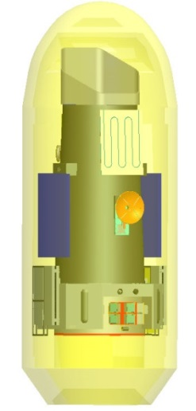

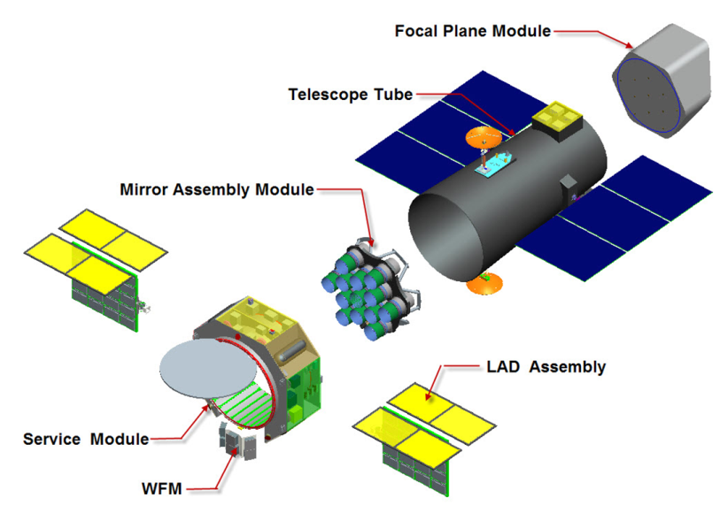
eXTP Mission overview
Parameter | Value
Orbit | 550 km, inclination 0°
Pointing | 3-axis stabilized, < 0.01°(3σ)
Launch | LM7 + upper stage, @Wenchang
Launch mass | 4500 kg
Telemetry | 3.2 Tb/day (X-band or Ka-band)
Burst alert | BeiDou Navigation Satellite System; VHF transmitter (SVOM); Tracking and Data Relay Satellite System
Ground Stations | Sanya (China), Malindi (Italy)
Mission duration | 5 years (goal 8 years)
Launch date | ~ 2027 (in phase B now)
  16.8 mm × 3.95 mm × 11.4m
Accommodation concept by CAST

Slide 20
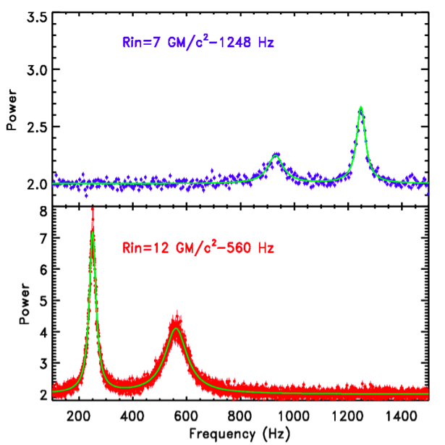
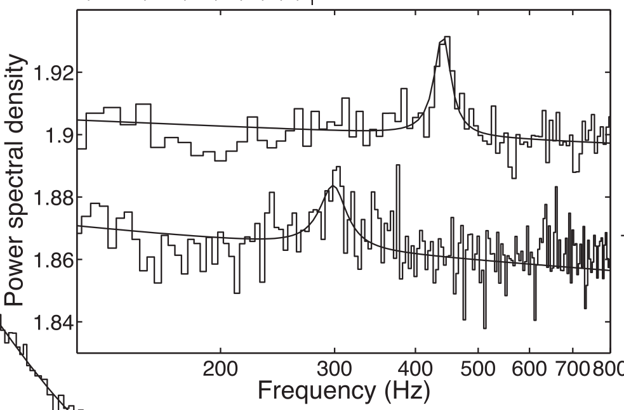
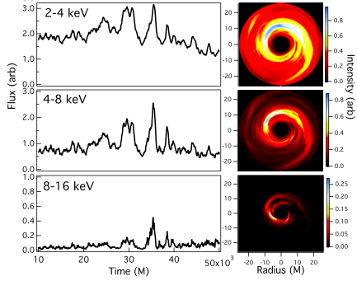
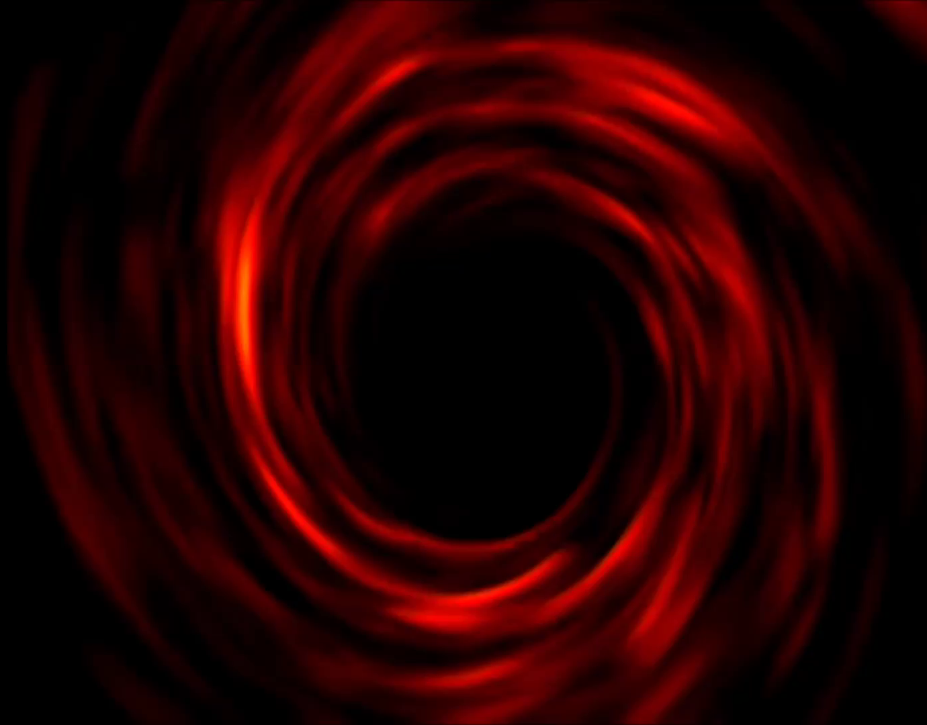
Spectral-Timing for extreme gravity
General Relativity predicts precise
orbital and epicyclic frequencies
at each radius
eXTP:
10x the SNR
Motta et al. 2013
Strong gravity dynamical frequencies just detected in current (RXTE) data
eXTP diagnoses strong field gravity very precisely by:
  timing of the flux variations
  time resolved spectroscopy
  at very high signal to noise
Uses known phenomena
Wellons et al. 2013
Orbiting inhomogeneities make frequencies observable

Slide 21
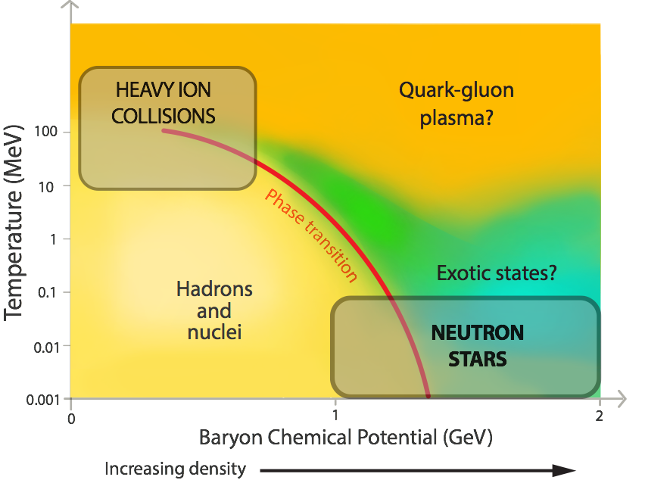
Neutron Stars EoS
eXTP
(eXTP)
eXTP will study nucleonic matter in a unique regime, and exotic states of matter (e.g., quark stars) that could never exist in the laboratory.
Using only known sources, pulse profile modelling measurements will map the M-R relation and hence the Equation of State (EoS).

Slide 22
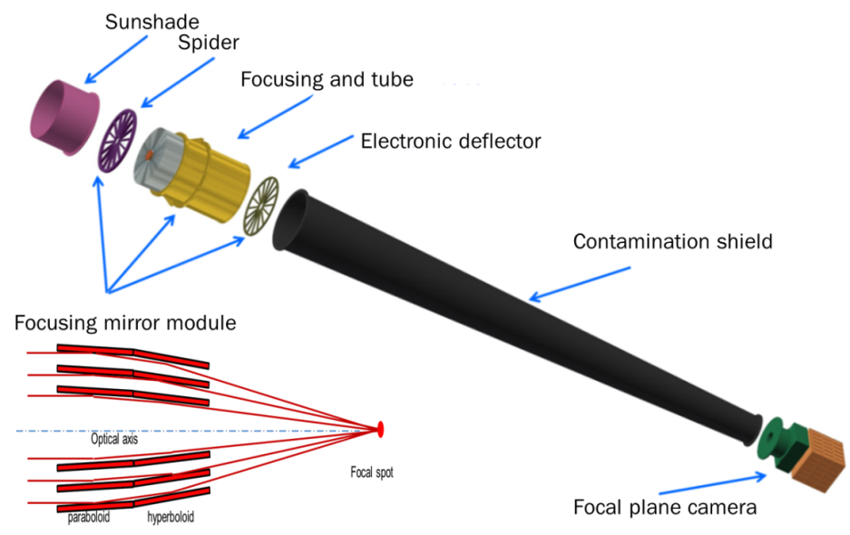
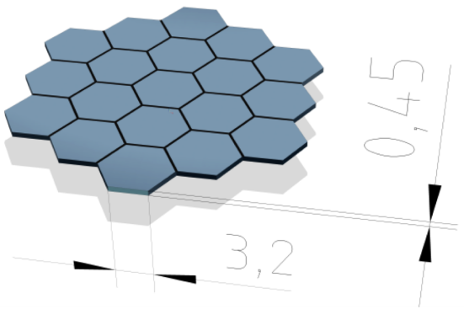
eXTP Scientific Payload:
SFA – Spectroscopy Focusing Array
Large collecting area achieved by multiple optics with short focal length.
9 grazing incidence Wolter-I optics with 5.25m F.L., 40 shells/module
Non-imaging, 1′ (HPD), 3′ (W90), 12′ FoV
19-cell SDD array: multi-pixel to enable background subtraction
Energy range: 0.5-10 keV
Energy resolution: ≤ 180 eV @ 6keV
Time resolution: 10μs
Absolute timing accuracy: 2μs
Dead time: < 5% @ 1Crab
Sensitivity: 4.1x10⁻¹⁵ erg/cm²/s (3σ, 10ks)
×9

Slide 23
eXTP Scientific Payload:
SFA – Spectroscopy Focusing Array
Large collecting area achieved by multiple optics with short focal length.
9 grazing incidence Wolter-I optics with 5.25m F.L., 40 shells/module
Non-imaging, 1′ (HPD), 3′ (W90), 12′ FoV
19-cell SDD array: multi-pixel to enable background subtraction
Energy range: 0.5-10 keV
Energy resolution: ≤ 180 eV @ 6keV
Time resolution: 10μs
Absolute timing accuracy: 2μs
Dead time: < 5% @ 1Crab
Sensitivity: 4.1x10⁻¹⁵ erg/cm²/s (3σ, 10ks)

Slide 24
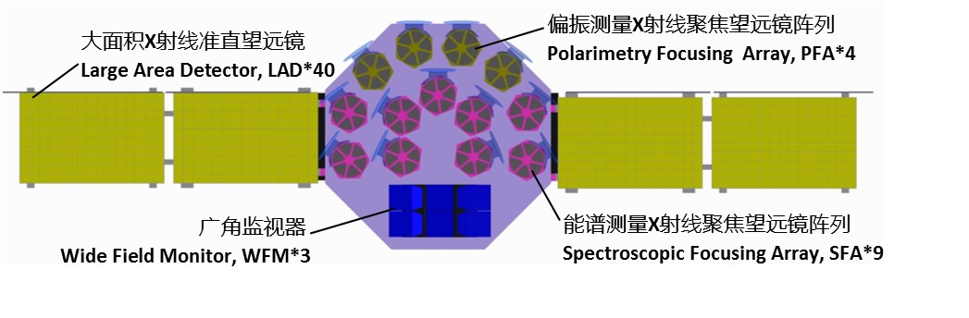
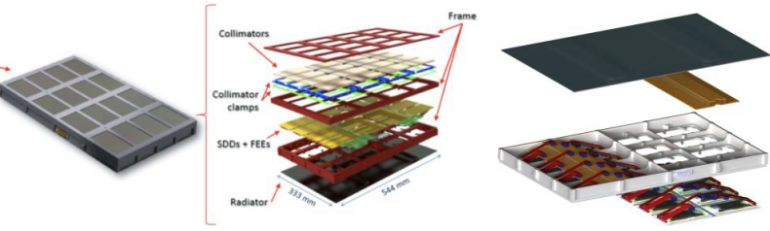
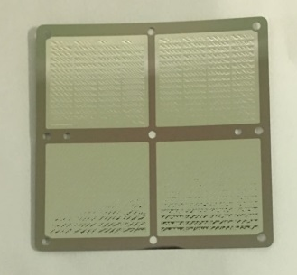
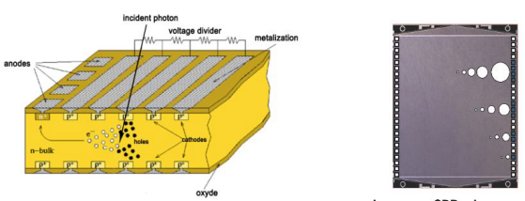
eXTP Scientific Payload: LAD – Large Area Detector
Spectral and timing observation
40 modules on 2 deployable panels
Collimated, large area SDD detector
Energy range: 2-30 keV (goal 50keV)
Energy resolution: < 240eV @ 6keV
Field of View: 1°(FWHM)
Time resolution: 10μs
Absolute time accuracy: 2μs
Dead time: < 0.5% @ 1Crab
Background: < 3mCrab
Total effective area: 3.4m² @ 8keV
module
SDD: 2x112 anodes, pitch = 970μm
Thermal/optical filter
MCP collimator

Slide 25
eXTP Scientific Payload: LAD – Large Area Detector
Spectral and timing observation
40 modules on 2 deployable panels
Collimated, large area SDD detector
Energy range: 2-30 keV (goal 50keV)
Energy resolution: < 240eV @ 6keV
Field of View: 1°(FWHM)
Time resolution: 10μs
Absolute time accuracy: 2μs
Dead time: < 0.5% @ 1Crab
Background: < 3mCrab
Total effective area: 3.4m² @ 8keV

Slide 26
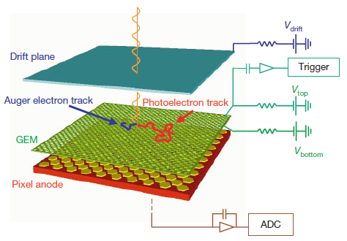
eXTP Scientific Payload:
PFA – Polarimetry Focusing Array
Large collecting area achieved by multiple optics with short focal length.
4 grazing incidence Wolter-I optics with 5.25m F.L., 40 shells/module
Imaging, resolution ≤ 30″(HPD, goal 15″)
Field of view: 8′
Gas Pixel Detector (GPD): photo-electron tracking
Energy range: 2-8 keV
Energy resolution: ≤ 1.8 keV @ 6keV
Time resolution: 500μs
Absolute timing accuracy: 2μs
MDP: < 1.6% (10⁶s, 1mCrab)
×4
Designed by the INFN-Pisa group (Bellazzini et al.)
GPD prototype (Tsinghua)

Slide 27
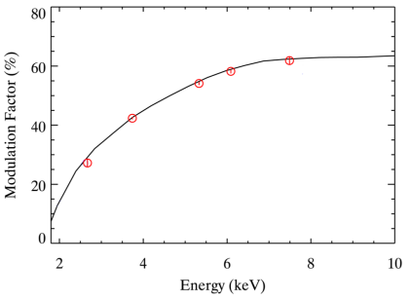
eXTP Scientific Payload:
PFA – Polarimetry Focusing Array
Large collecting area achieved by multiple optics with short focal length.
4 grazing incidence Wolter-I optics with 5.25m F.L., 40 shells/module
Imaging, resolution ≤ 30″(HPD, goal 15″)
Field of view: 8′
Gas Pixel Detector (GPD): photo-electron tracking
Energy range: 2-8 keV
Energy resolution: ≤ 1.8 keV @ 6keV
Time resolution: 500μs
Absolute timing accuracy: 2μs
MDP: < 1.6% (10⁶s, 1mCrab)

Slide 28
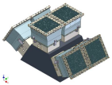
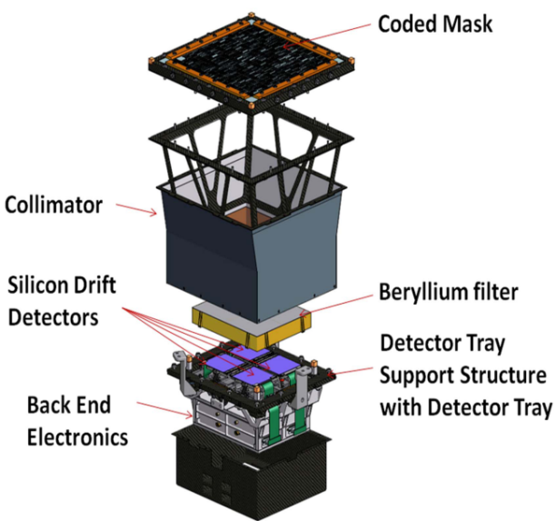
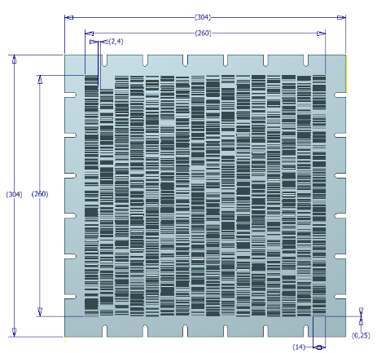
eXTP Scientific Payload: WFM – Wide Field Monitor
3 units (6 cameras)
2D Imaging, 5′ (FWHM) resolution
Location accuracy: ≤ 1′
Field of view: ≥ 3.2 Sr (at 20% response)
Energy range: 2-50 keV
Energy res.: ≤ 300eV @ 6keV
Time resolution: 10μs
Absolute time accuracy: 2μs
Peak sensitivity (5σ): 1Crab (1s),
5mCrab (50ks)
Camera module
SDD: 2x384 anodes, pitch = 169μm
1.5D coded mask

Slide 29
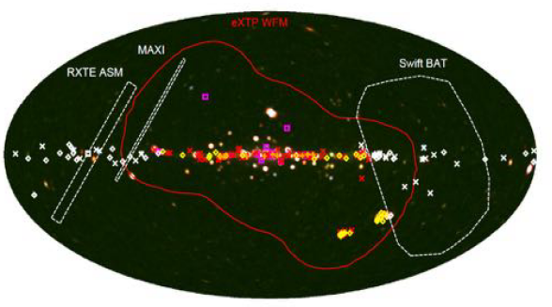
eXTP Scientific Payload: WFM – Wide Field Monitor
3 units (6 cameras)
2D Imaging, 5′ (FWHM) resolution
Location accuracy: ≤ 1′
Field of view: ≥ 3.2 Sr (at 20% response)
Energy range: 2-50 keV
Energy res.: ≤ 300eV @ 6keV
Time resolution: 10μs
Absolute time accuracy: 2μs
Peak sensitivity (5σ): 1Crab (1s),
5mCrab (50ks)
WFM field of View. (Background map courtesy of T. Mihara, RIKEN, JAXA, and the MAXI team)

Slide 30
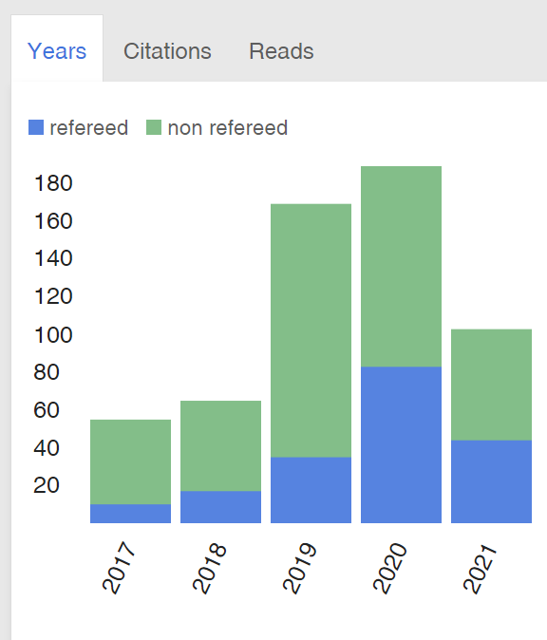
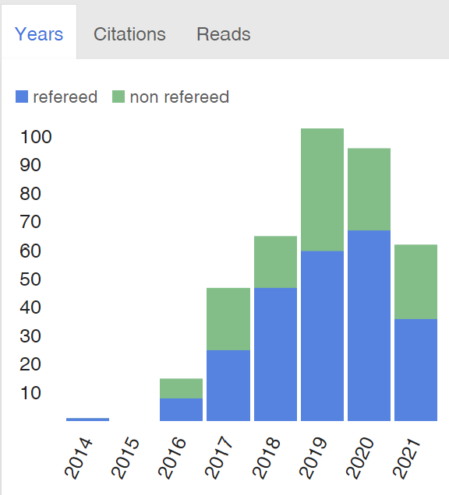
Impacts of Insight-HXMT and eXTP
Insight-HXMT
eXTP
ADS citations to Insight-HXMT and eXTP: until 2021/07/03
Thanks!
Thanks!

