Slide 1
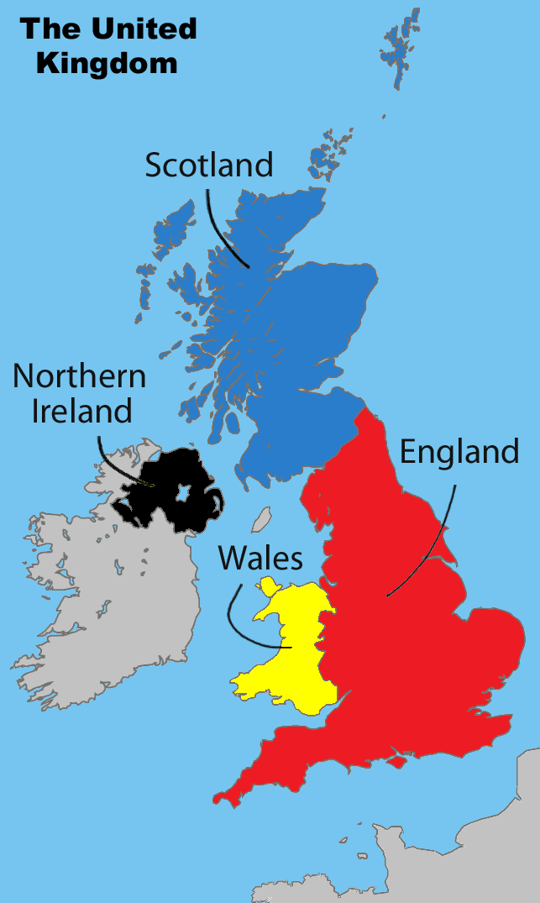


Physical insights from multi-messenger observations of compact binary mergers and their afterglows
Hendrik van Eerten
Senior Lecturer
University of Bath
United Kingdom
Geoffrey Ryan (University of Maryland)
16th Marcel Grossmann meeting
July 8, 2021

Slide 2
Physical insights from multi-messenger observations of compact binary mergers and their afterglows
Hendrik van Eerten
Senior Lecturer
University of Bath
United Kingdom
Geoffrey Ryan (University of Maryland)
16th Marcel Grossmann meeting
July 8, 2021

Slide 3
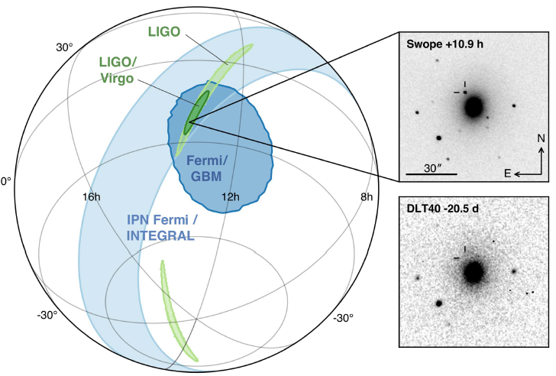
GW170817 / GRB 170817A
August 17, 2017
Abbott+ ApJL 848, L12 (2017)

Slide 4
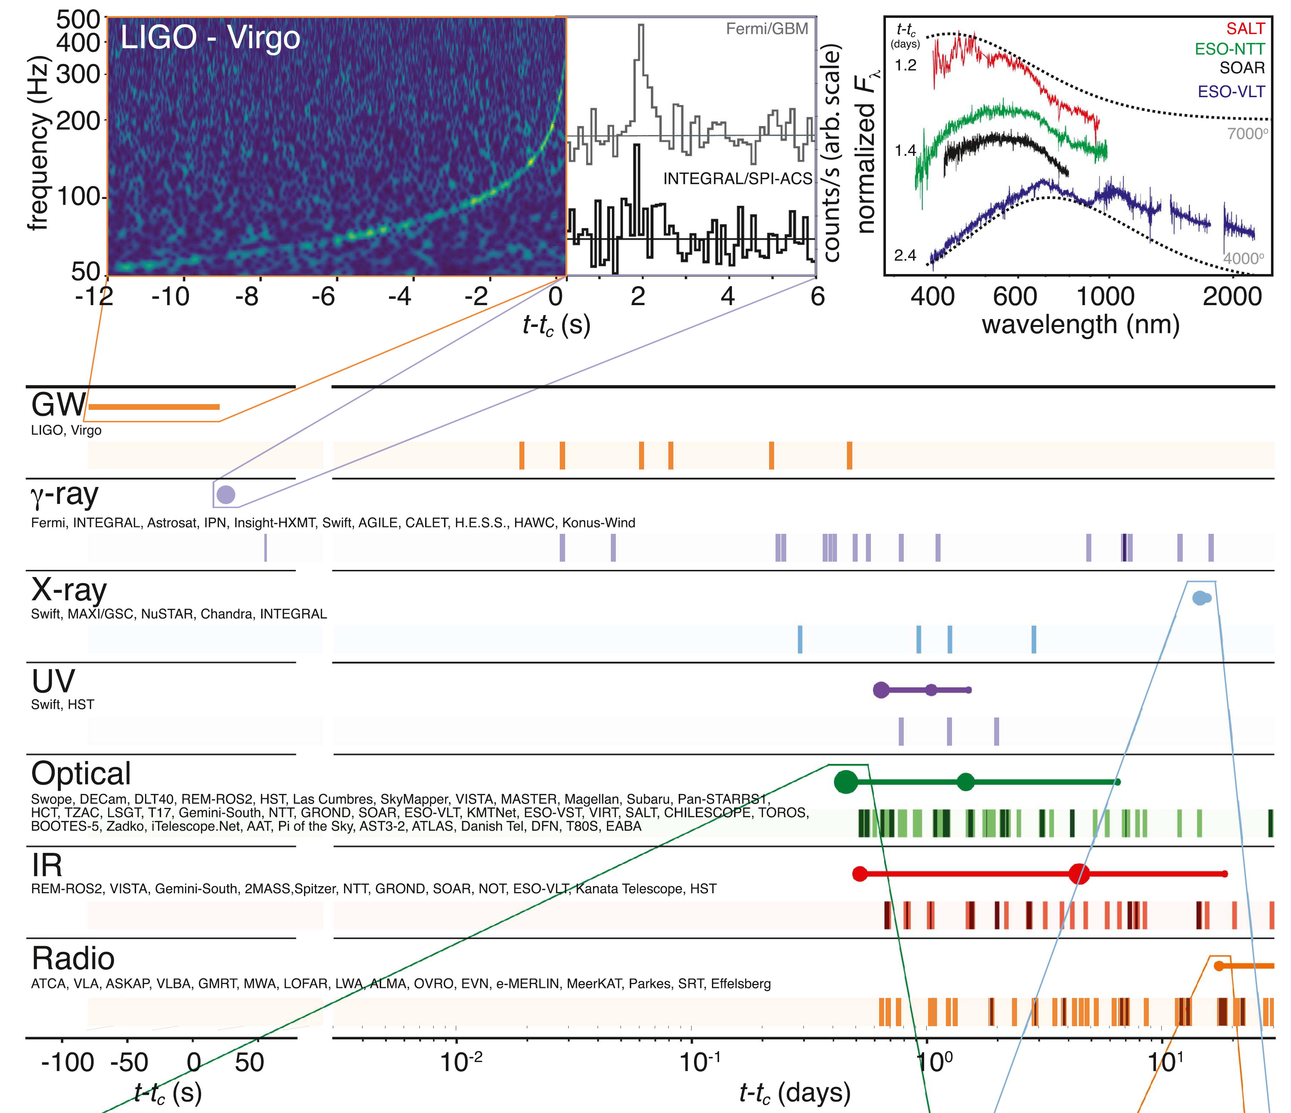
A massive broadband follow-up campaign to GW170817, first two weeks:
Abbott+ ApJL 848, L12 (2017)

Slide 5
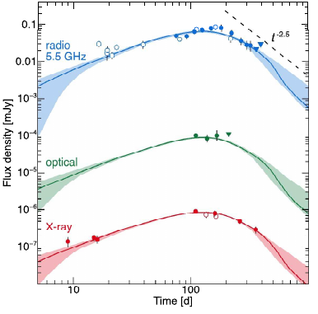
Where we stand in long-term follow-up
Troja, van Eerten+ 2019
see also Haggard+ 2017, Hallinan+2017, Kasliwal+ 2017, Mooley+2018, D’Avanzo+ 2018,
Lyman+ 2018, Dobie+ 2018, Ruan+ 2018, Margutti+ 2018, Troja+ 2017, 2018, Lamb+ 2019, ...

Slide 6
Follow-up, latest (radio & X-rays)
Blue data points: shifted radio
Black data points: X-rays
left figure had X-ray data rebinned
Troja, .., HJvE+ 2021
see also Hajela+ 2021, Balasubramanian+ 2021, ...

Slide 7
other channels: Very-large baseline interferometry (VLBI)
3
2
1
Ghirlanda+ 2019
Mooley+ 2018
Source moves to the left over time, displaying apparent superluminal motion, indicating tight jet
see also Zrake+ 2018 for counterpoint to ‘tight jet’ conclusion

Slide 8
In general, many questions that can be addressed with multi-messenger observations
What merged?
What is the fate of the remnant?
what is the neutron star equation-of-state?
What is the distance to the source?
What is the orientation of the merger plane?
Any implications for cosmology?
What heavy metals are produced by the kilonova?
What are the characteristics of the kilonova ejecta?
do we have the missing evidence for the nature of short GRBs?
What is the nature of the afterglow (jet? choked flow?)
....

Slide 9
Lessons from the gravitational wave detection of GW170817
Abbott+ 2017
Note: viewing angle is degenerate with distance, but NGC 4993 distance can be used for that

Slide 10
multi-messenger modelling efforts including the kilonova
Nicholl+ 2021

Slide 11

multi-messenger modelling efforts including the kilonova
$$\arccos\left(0.89\right)≈{27}^{°}$$
Note the strong prior on viewing angle
Nicholl+ 2021

Slide 12
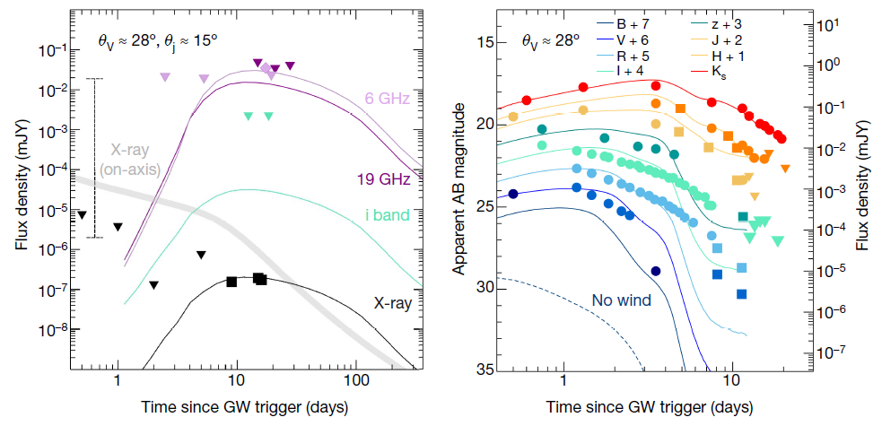
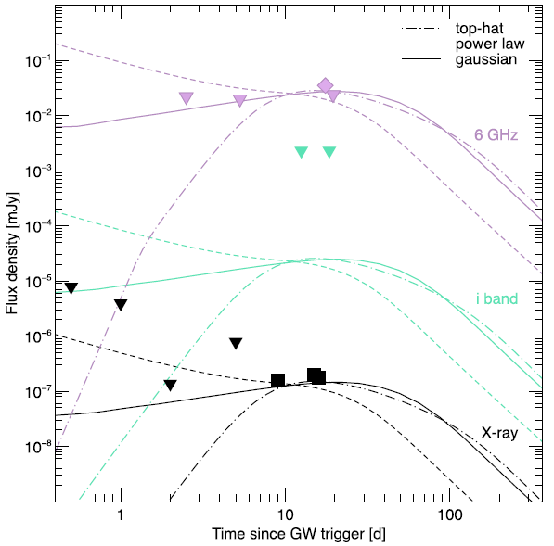
lessons from the afterglow 1: it’s actually there...eventually
Troja, Piro, van Eerten et al. 2017, Nature 551, 71
see also Haggard+ 2017, Hallinan+2017, Kasliwal+ 2017, Mooley+2018, D’Avanzo+ 2018,
Lyman+ 2018, Dobie+ 2018, Ruan+ 2018, Margutti+ 2018, Troja+ 2017, 2018, Lamb+ 2019, ...

Slide 13
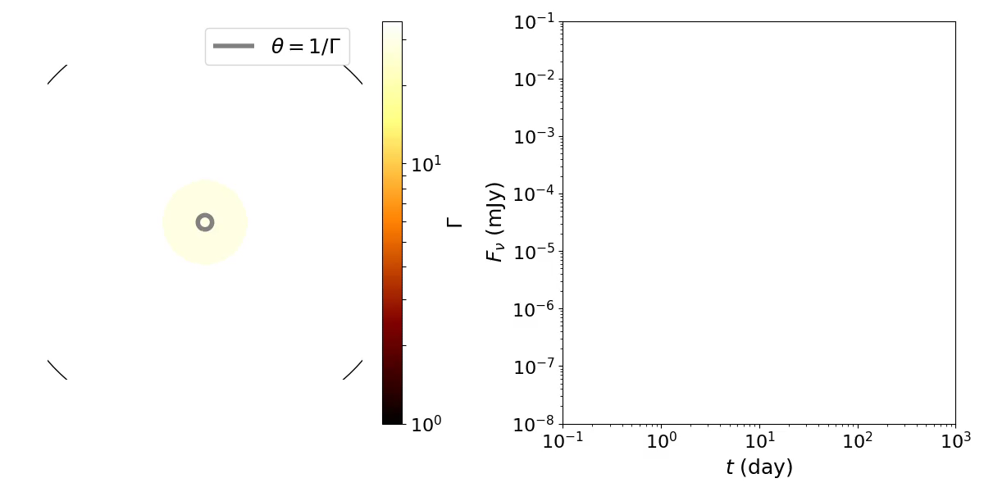
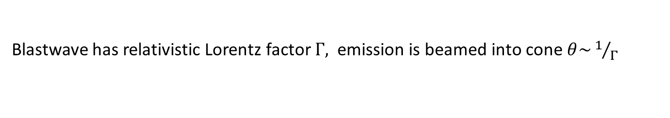
        Classic picture: On-axis “Top Hat” jet
Jet opening angle $θ_{c}=0.2 rad={11}^{°}$, observed on-axis at $θ_{v}=0$
Blastwave has relativistic Lorentz factor $Γ,$ emission is beamed into cone $θ\sim 1/Γ$
t^{3(1-p)/4}
t^{-3p/4}
tb ~ θc^{8/3}

Slide 14
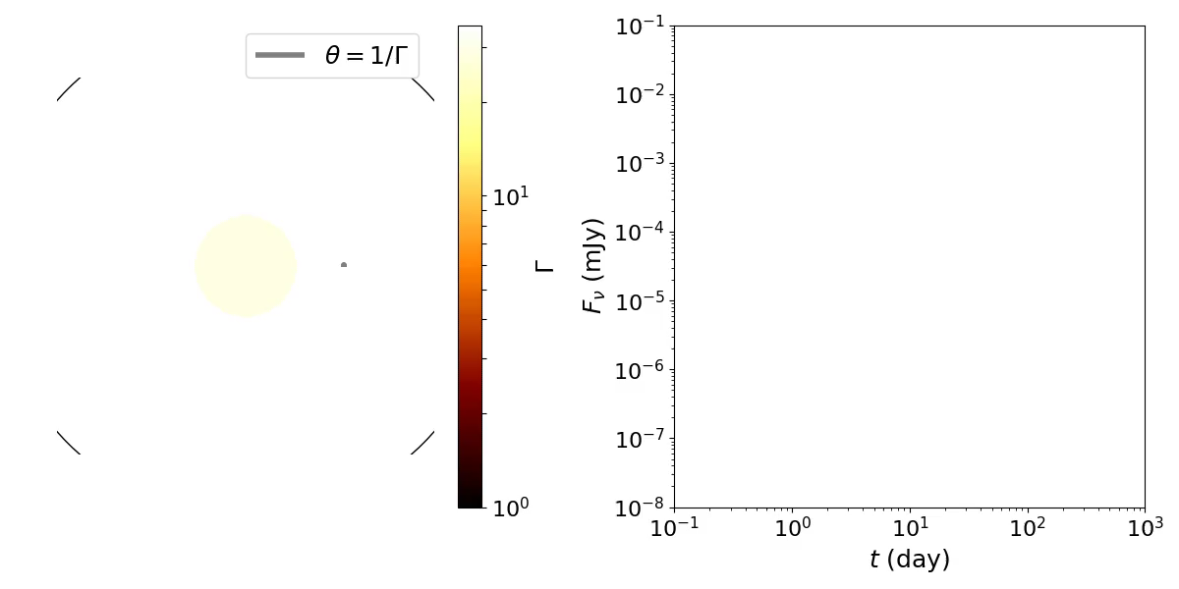
        Completely off-axis “Top Hat” jet
Jet opening angle $θ_{c}=0.2 rad={11}^{°}$, observed on-axis at $θ_{v}=0.4 rad$
Emission initially beamed away
t^{-3p/4}
t^{3(p-5)/2}
(θv±θc)^{8/3}

Slide 15
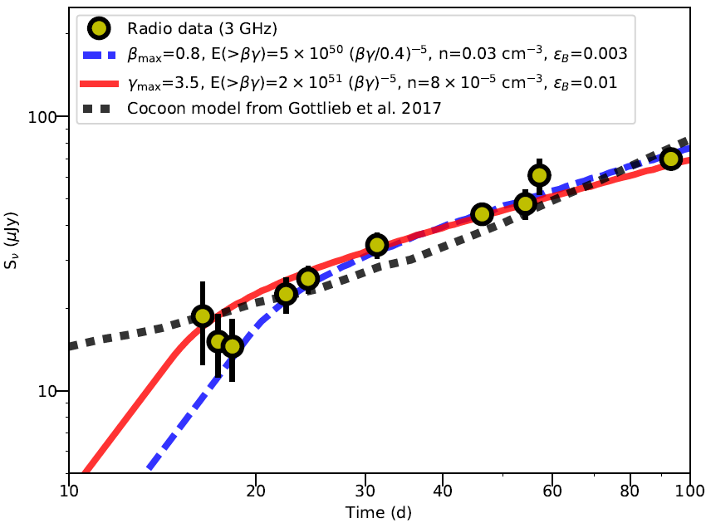
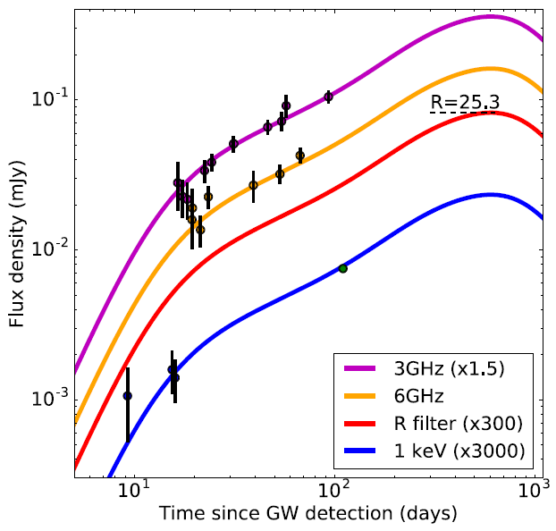
lessons from the afterglow 2: we must account for extended gradual rise
Mooley et al. 2018, Nature, 554, 207
Data until ~Nov 30, 2017
either
the missing link between
short gamma-ray bursts and
merging neutron stars
A cocoon model
where the jet fails to
emerge and late gas flow
catches up
a structured jet
model, structure
imprinted by
jet emergence
or a whole new phenomenon
Lazzati et al. 2018, Phys Rev Lett. 120, 241103
Based on jet simulations that include angular
energy profile introduced by jet breakout,
then mapped to afterglow emission radii
But see also:
Gill+ 2018 (ignore first X-ray?)
Lamb+ 2020 (inject energy in jet?)

Slide 16
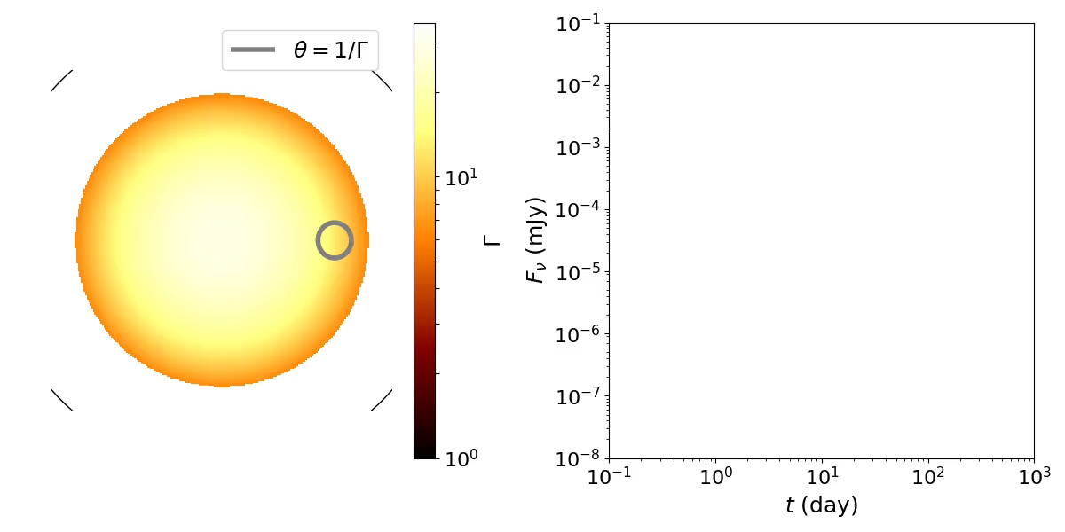
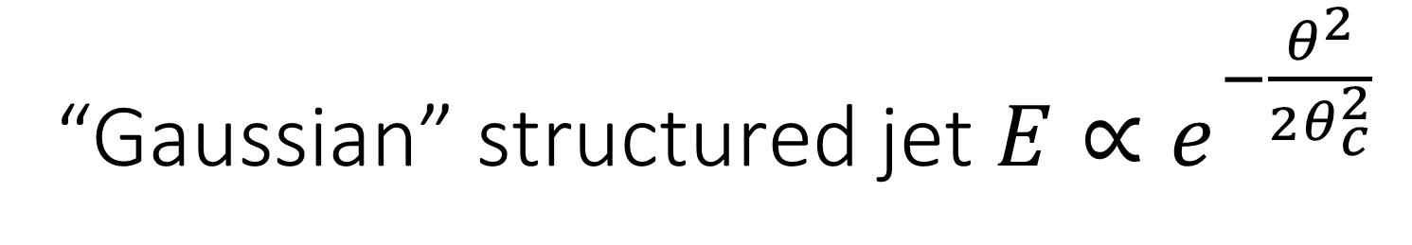
        “Gaussian” structured jet $E∝e^{−\frac{θ^{2}}{2θ_{c}^{2}}}$
Jet core $θ_{c}=0.1 rad=6^{°}$, observed off-axis at $θ_{v}=0.5 rad= {30}^{°}$
Energy gradient compensates for deceleration
t?

Slide 17
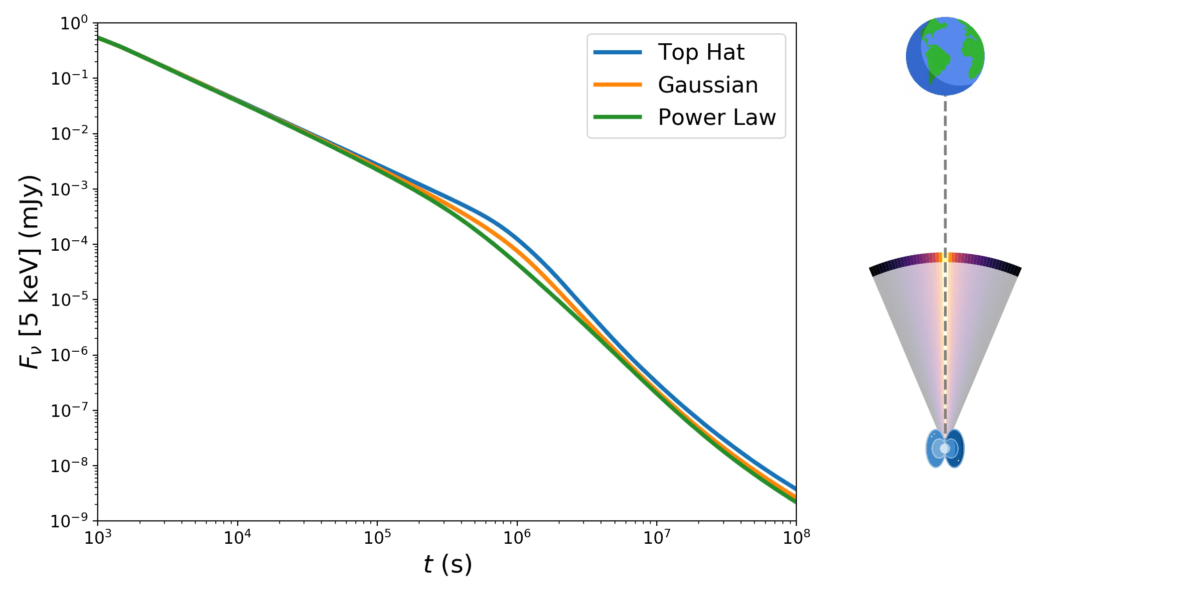
initial structure was always there, but only key feature for off-axis observers
Ryan, van Eerten+ 2020, ApJ 896, 166
structured jet models go back decades, eg Kumar & Granot 2003, Rossi+ 2002

Slide 18
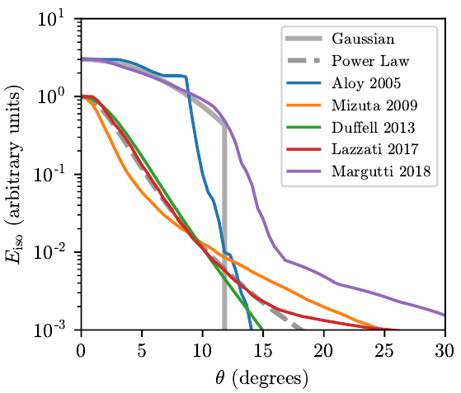
Structure is natural outcome of simulations (with and without kilonova debris)
Ryan, van Eerten+ 2020, ApJ 896, 166
Kathirgamaraju+ 2019
see also Pavan+ 2021, Urrutia+ 2021, Nathanail+ 2021, Fernandez+ 2018, ...

Slide 19
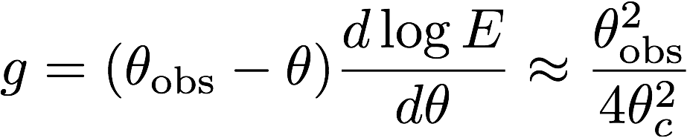
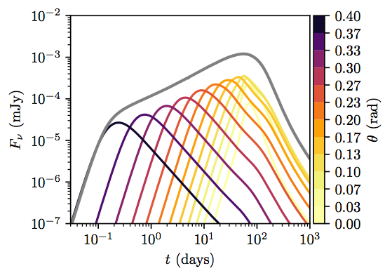

Anatomy of a structured jet
(for a Gaussian)
t^{3(1-2p+g)/(8+g)}
Ryan, van Eerten+ 2020, ApJ 896, 166

Slide 20
Anatomy of a structured jet
(for a Gaussian)
A direct handle on the jet collimation and observer angle!
GW 170817A
α = 0.90±0.06
⟹ g=8.2
⟹ θobs=5.7θc
t^{3(1-2p+g)/(8+g)}
Ryan, van Eerten+ 2020, ApJ 896, 166

Slide 21
Structured jets & prompt emission
Image credit: Abbott+ 2017 ApJL 848, L13
Caveats:
top hat jet (uniform core): beaming effect too strong, prompt would be extremely faint
structured jet: outflow in line-of-sight too slow, opacity issues

Slide 22
Structured jets & prompt emission
Ioka & Nakamura 2019
One escape from caveats has both structured jet and emission from outside line-of-sight
see also Goldstein+ 2017, Matsumoto+ 2019, Beniamini & Nakar 2019, ...

Slide 23
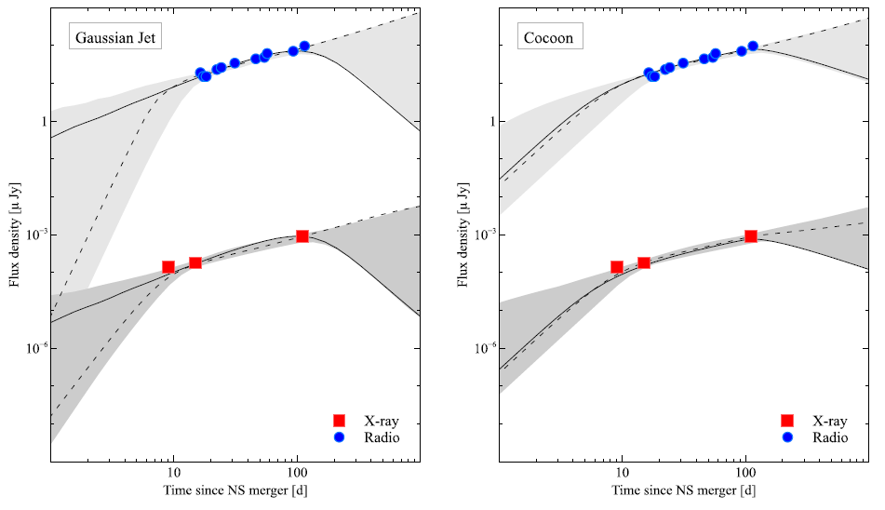
Structured jets and choked jets
Troja, Piro, Ryan, van Eerten et al., 2018, MNRAS 478, L18

Slide 24
Structured jets and choked jets
Note: Eventual downturn slope will be very telling
Troja, Piro, Ryan, van Eerten et al., 2018, MNRAS 478, L18

Slide 25
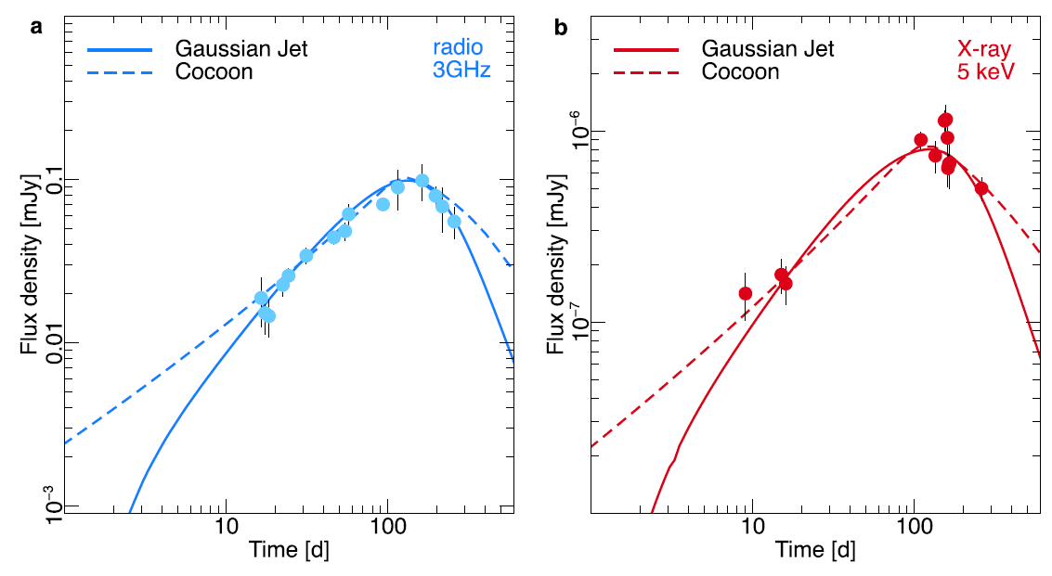
Lessons from the afterglow 3: downturn reveals either choked or successful jet
Piro, Troja, Zhang, Ryan, van Eerten et al., 2019, MNRAS 483, 1912
... eventually

Slide 26
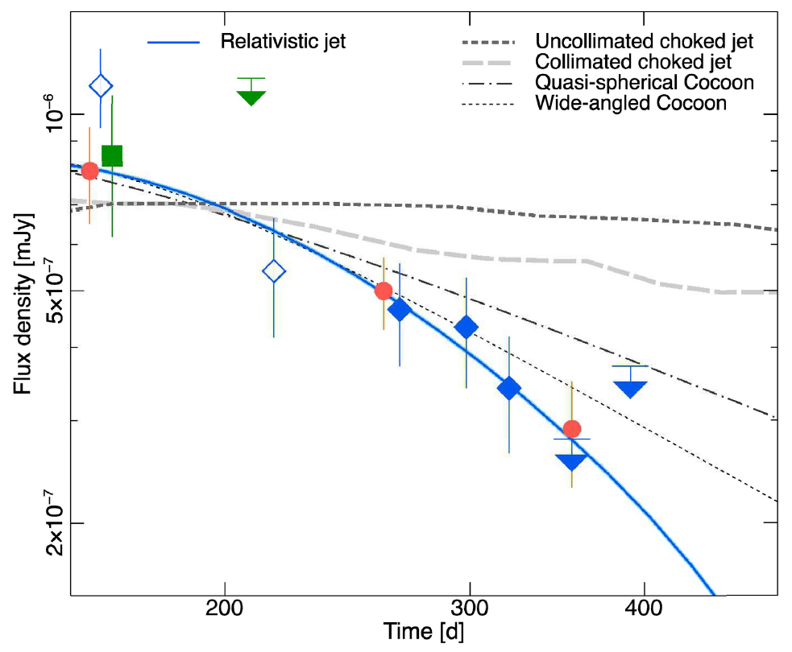
Lessons from the afterglow 4: at least GRB 170817A supports successful jet, and thus the NS merger origin of short GRBs
Troja, van Eerten+, 2019, MNRAS 489, 1919

Slide 27
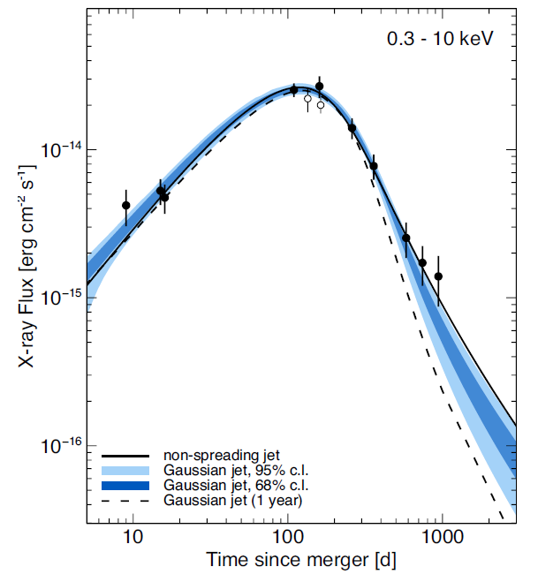
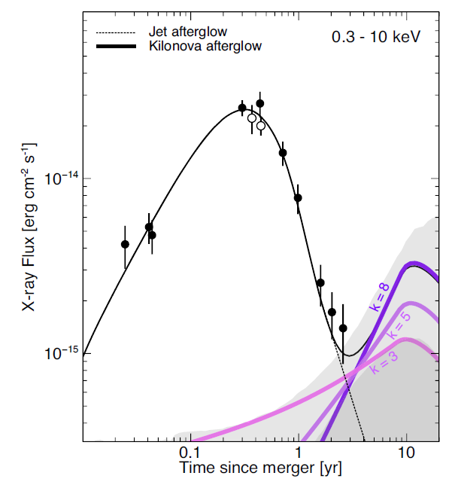
Lessons from the afterglow 5: 1,000+ days might show additional features
Troja, van Eerten+, 2020, MNRAS 498, 5643
see also Hajela+ 2021, Balasubramanian+ 2021, ...

Slide 28
1,000 days of GRB 170817A
Troja, van Eerten+, 2020, MNRAS 498, 5643

Slide 29
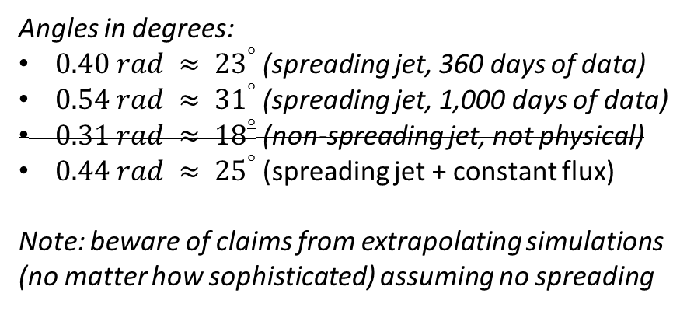
1,000 days of GRB 170817A
Angles in degrees:
$0.40 rad ≈ {23}^{°}$ (spreading jet, 360 days of data)
$0.54 rad ≈ {31}^{°}$ (spreading jet, 1,000 days of data)
$0.31 rad ≈ {18}^{°}$ (non-spreading jet, not physical)
$0.44 rad ≈ {25}^{°}$ (spreading jet + constant flux)
Note: beware of claims from extrapolating simulations
(no matter how sophisticated) assuming no spreading
Troja, van Eerten+, 2020, MNRAS 498, 5643

Slide 30
Light curves, assuming no extra component

Slide 31
Adding an extra luminosity to the fit

Slide 32
Late-time evolution of the light curve
Blue data points: shifted radio
Black data points: X-rays
left figure had X-ray data rebinned
Troja, .., HJvE+ 2021
Latest observations are in tension with basic structured jet models at around $3.5σ$,
if compared solely to expanding structured jet fit to light curve data

Slide 33
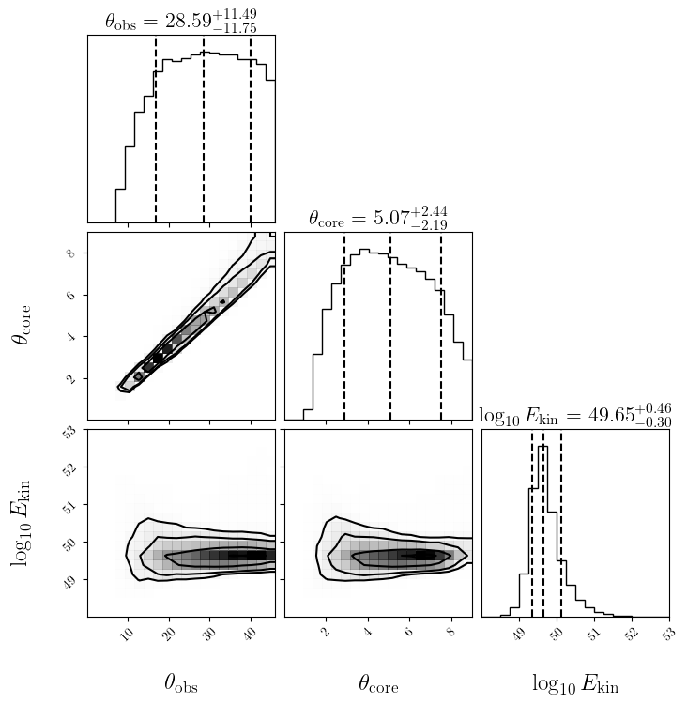
Evolution of the posterior of Gaussian jet model
180 days
random sky orientation prior
The actual fit included more
model parameters (environment,
synchrotron model, etc). These are
not shown here to avoid clutter
preliminary
version of figures

Slide 34
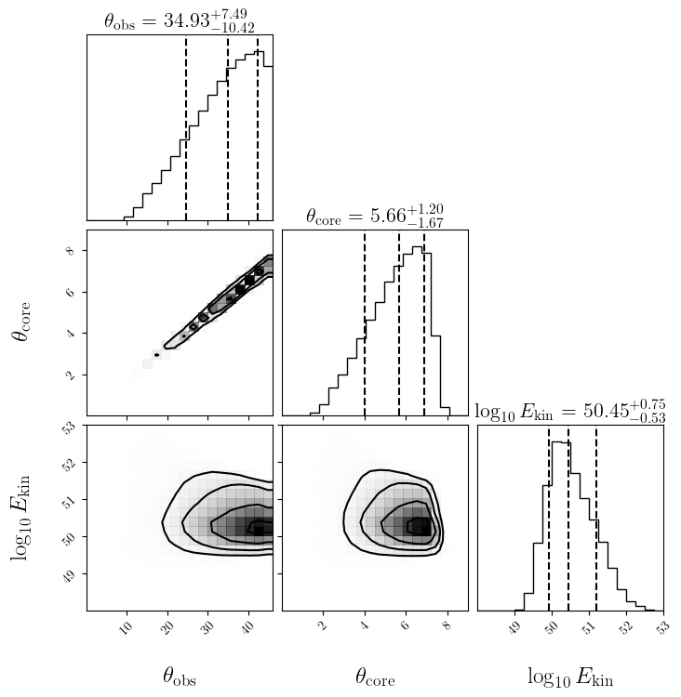
Evolution of the posterior of Gaussian jet model
360 days
random sky orientation prior
preliminary
version of figures

Slide 35
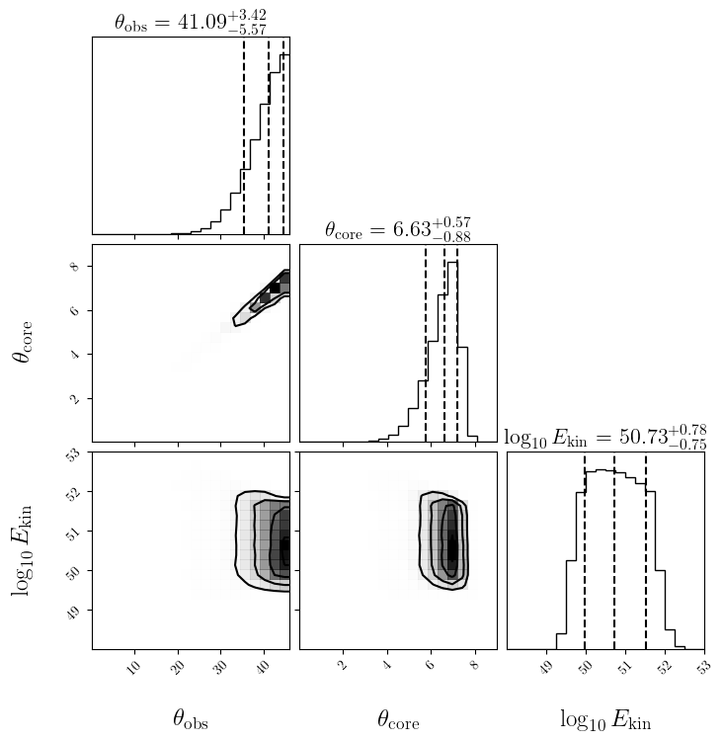
Evolution of the posterior of Gaussian jet model
940 days
random sky orientation prior
preliminary
version of figures

Slide 36
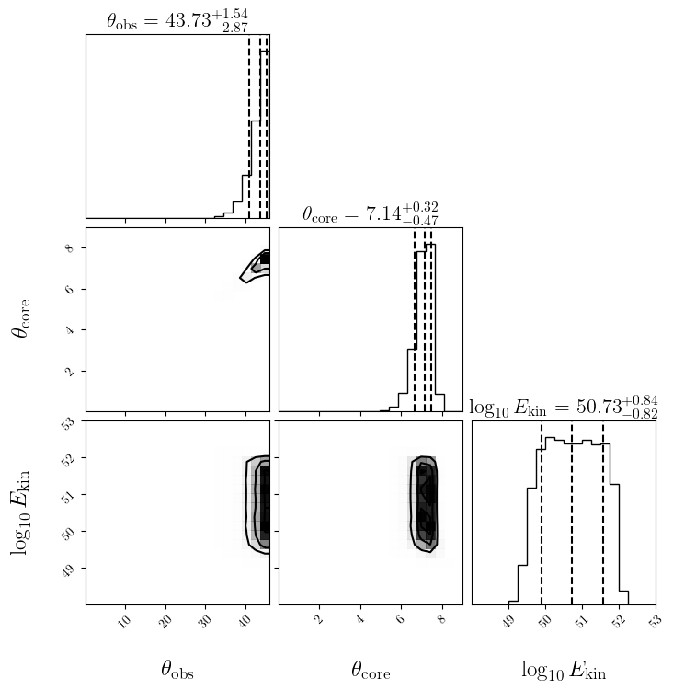
Evolution of the posterior of Gaussian jet model
1250 days
random sky orientation prior
preliminary
version of figures

Slide 37
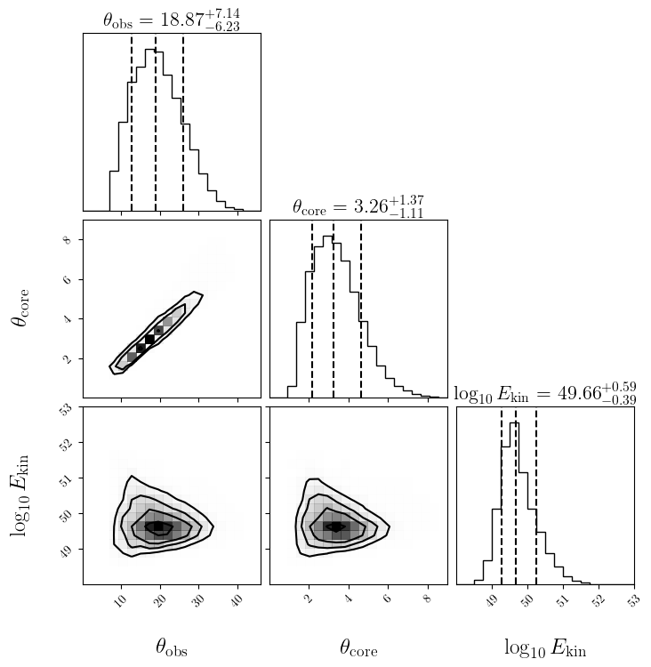
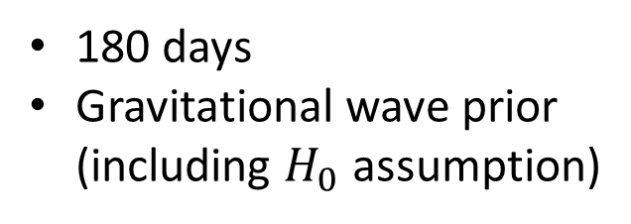
Evolution of the posterior of Gaussian jet model
180 days
Gravitational wave prior
(including $H_{0}$ assumption)
preliminary
version of figures

Slide 38
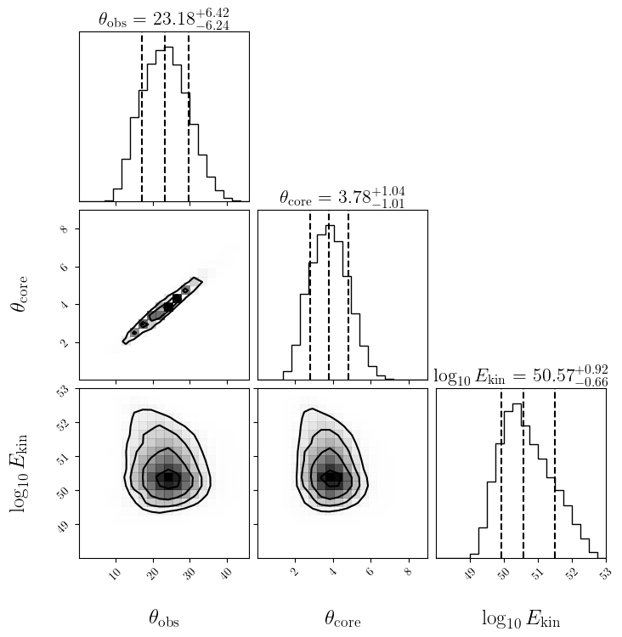
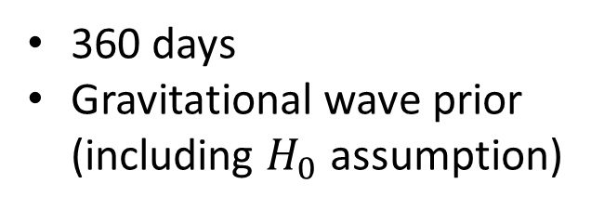
Evolution of the posterior of Gaussian jet model
360 days
Gravitational wave prior
(including $H_{0}$ assumption)
preliminary
version of figures

Slide 39
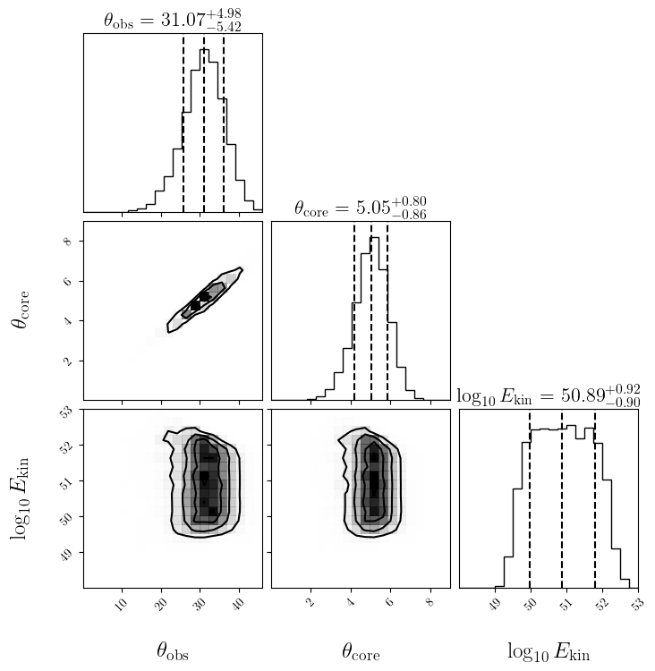
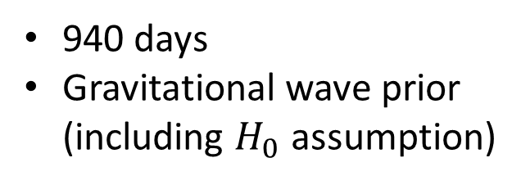
Evolution of the posterior of Gaussian jet model
940 days
Gravitational wave prior
(including $H_{0}$ assumption)
preliminary
version of figures

Slide 40
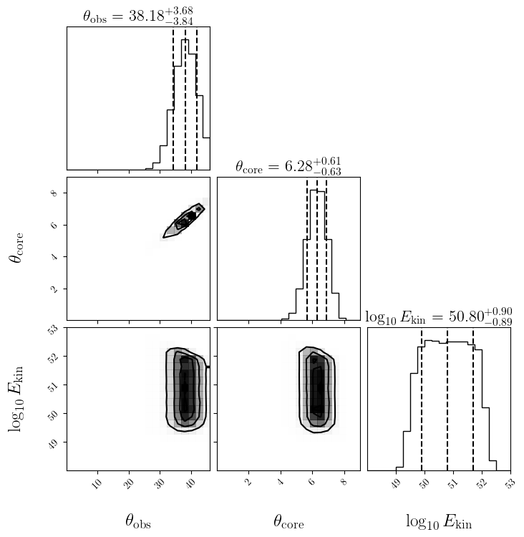
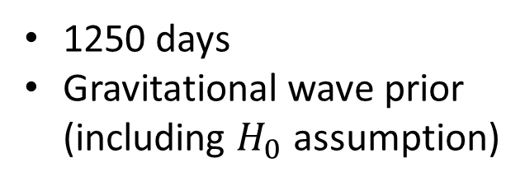
Evolution of the posterior of Gaussian jet model
1250 days
Gravitational wave prior
(including $H_{0}$ assumption)
preliminary
version of figures

Slide 41
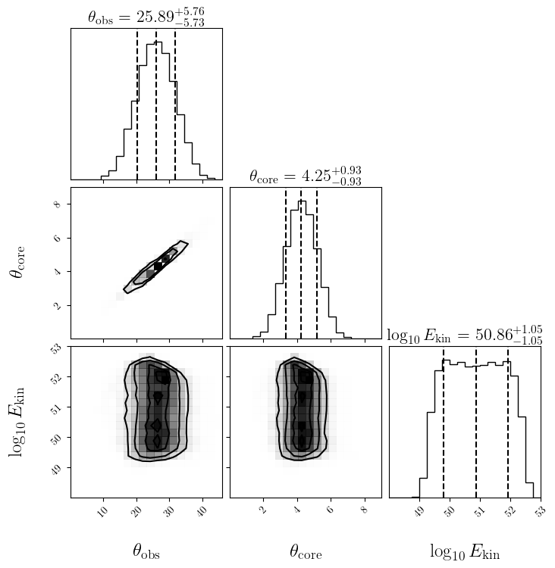
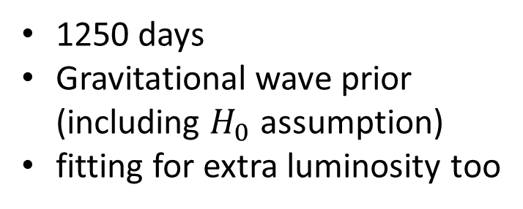
Evolution of the posterior of Gaussian jet model
1250 days
Gravitational wave prior
(including $H_{0}$ assumption)
fitting for extra luminosity too
preliminary
version of figures

Slide 42
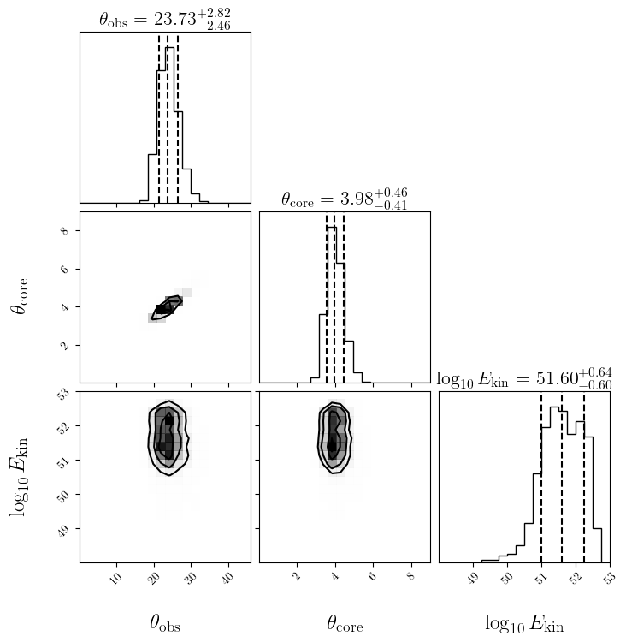
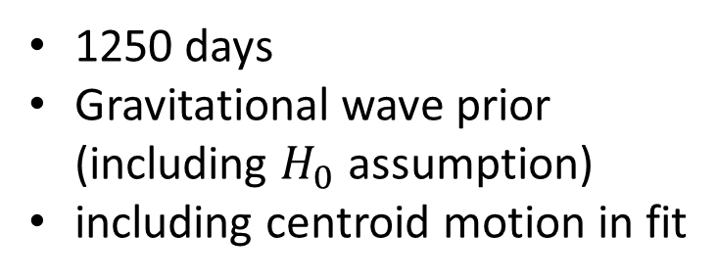
Evolution of the posterior of Gaussian jet model
1250 days
Gravitational wave prior
(including $H_{0}$ assumption)
including centroid motion in fit
preliminary
version of figures

Slide 43
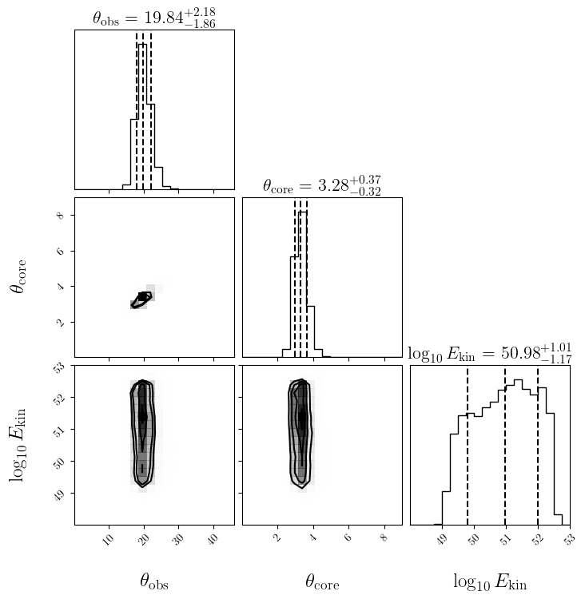
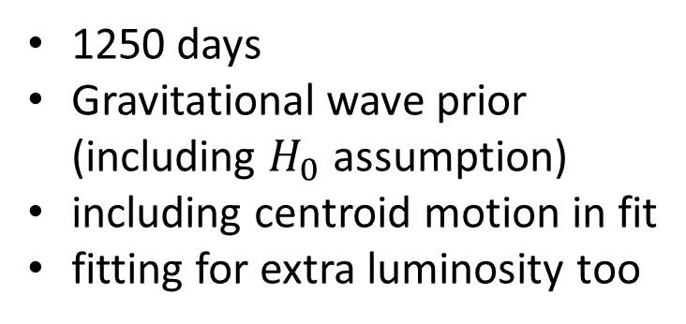
Evolution of the posterior of Gaussian jet model
1250 days
Gravitational wave prior
(including $H_{0}$ assumption)
including centroid motion in fit
fitting for extra luminosity too
preliminary
version of figures

Slide 44
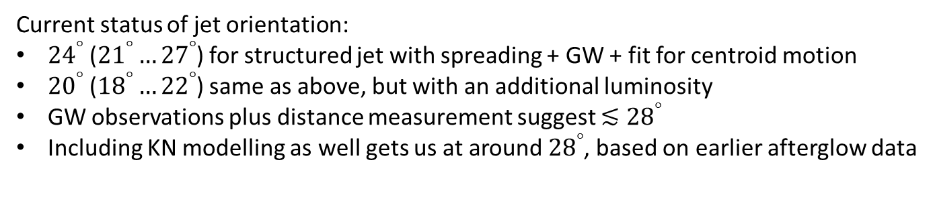
Conclusions
GW observations and EM observations connect in diverse ways
Prominently among these, the orientation of the merging system, which helps to break the degeneracy between angle and distance from the GW measurements
Lessons from the afterglow:
Even if not there immediately, likely to show up within weeks
(when is instrument-dependent, as well as distance/orientation-dependent)
Gradual afterglow rise ties directly to collimation & observation angle
(with actual full model fits further improving upon these constraints)
Decay slope differentiates directly between choked and successful jets
GW170817 at least was followed by a successfully launched collimated jet
Very late stage GRB 170817A observations show clear hints of flattening signal
(and not evidence --yet?-- for a genuine rise in signal)
Current status of jet orientation:
${24}^{°}$ (${21}^{°}…{27}^{°}$) for structured jet with spreading + GW + fit for centroid motion
${20}^{°}$ (${18}^{°}…{22}^{°}$) same as above, but with an additional luminosity
GW observations plus distance measurement suggest $≲{28}^{°}$
Including KN modelling as well gets us at around ${28}^{°}$, based on earlier afterglow data

Slide 45
reserve slides

Slide 46
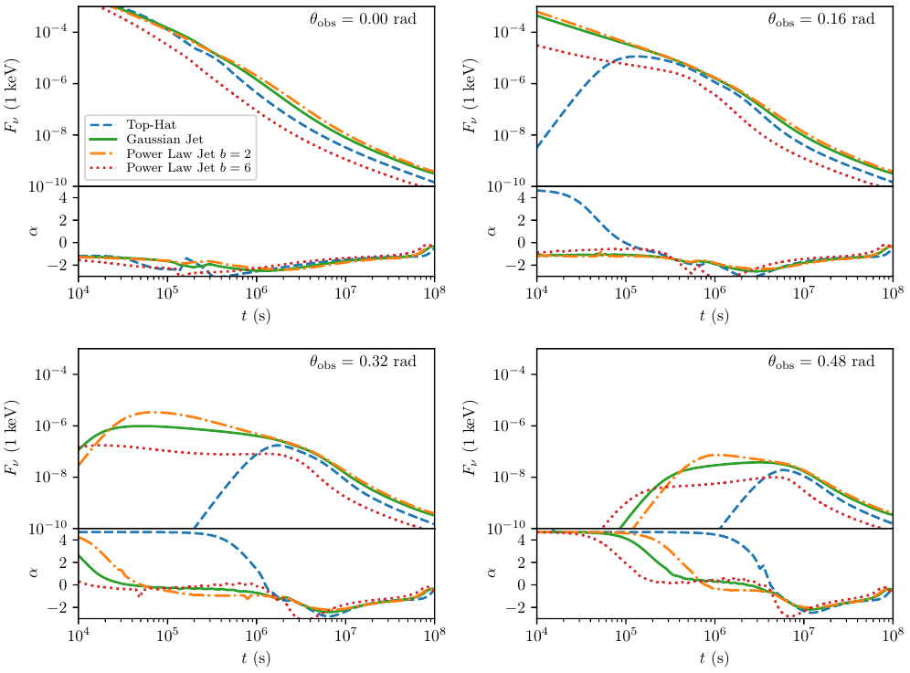
initial structure was always there, but only key feature for off-axis observers
Ryan, van Eerten+ 2020, ApJ 896, 166

Slide 47
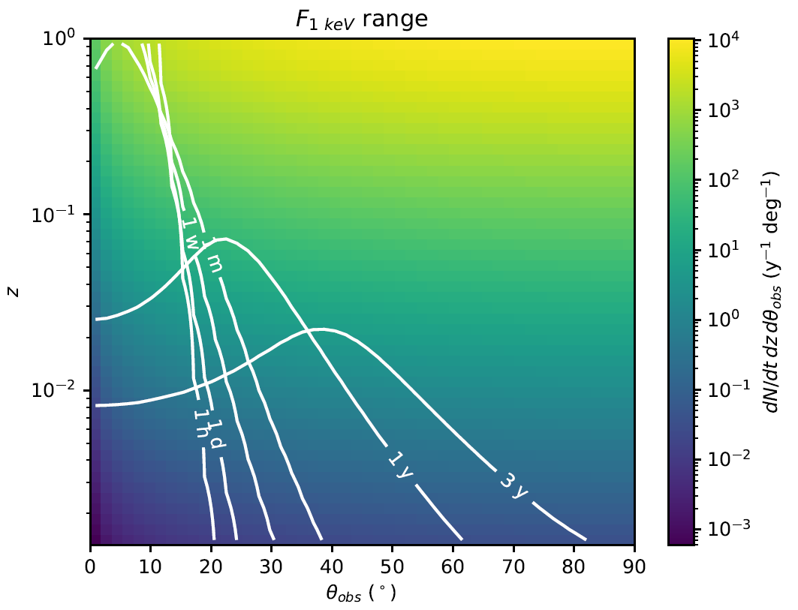
Athena and the off-axis afterglow rate
Moving GRB 170817A in distance and orientation. When can we still detect it with Athena?
The rate shown here is the absolute merger rate

Slide 48
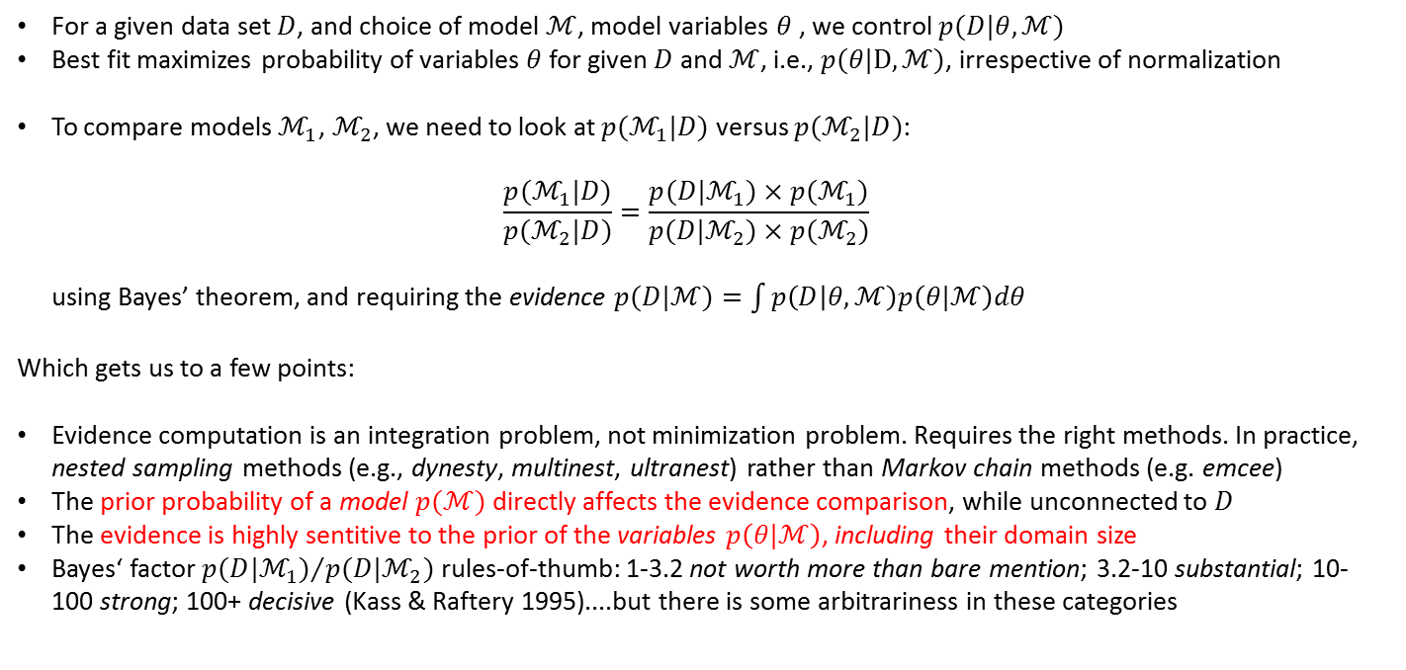
Some points about Bayesian model comparison
For a given data set $D$, and choice of model $ℳ$, model variables $θ$ , we control $p(D|θ,ℳ)$
Best fit maximizes probability of variables $θ$for given $D$ and $ℳ$, i.e., $p(θ|D,ℳ)$, irrespective of normalization
To compare models $ℳ_{1}$, $ℳ_{2}$, we need to look at $p(ℳ_{1}|D)$ versus $p(ℳ_{2}|D)$:
$\frac{p(ℳ_{1}|D)}{p(ℳ_{2}|D)}=\frac{p(D|ℳ_{1})×p(ℳ_{1})}{p(D|ℳ_{2})×p(ℳ_{2})}$
using Bayes’ theorem, and requiring the evidence $p(D|ℳ)=\int{p\left(D | θ,ℳ\right)p\left(θ|ℳ\right)dθ}$
Which gets us to a few points:
Evidence computation is an integration problem, not minimization problem. Requires the right methods. In practice, nested sampling methods (e.g., dynesty, multinest, ultranest) rather than Markov chain methods (e.g. emcee)
The prior probability of a model $p(ℳ)$ directly affects the evidence comparison, while unconnected to $D$
The evidence is highly sentitive to the prior of the variables $p\left(θ|ℳ\right)$, including their domain size
Bayes‘ factor ${p(D|ℳ_{1})}/{p(D|ℳ_{2})}$ rules-of-thumb: 1-3.2 not worth more than bare mention; 3.2-10 substantial; 10-100 strong; 100+ decisive (Kass & Raftery 1995)....but there is some arbitrariness in these categories
...preaching to the choir, in a GW session?

Slide 49
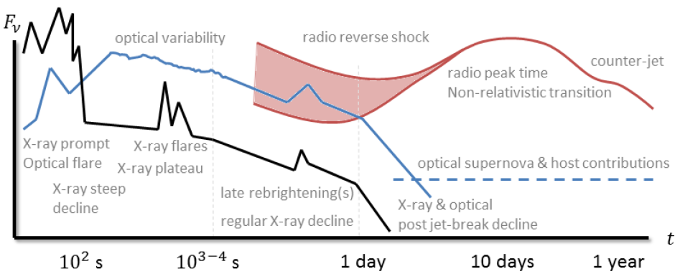
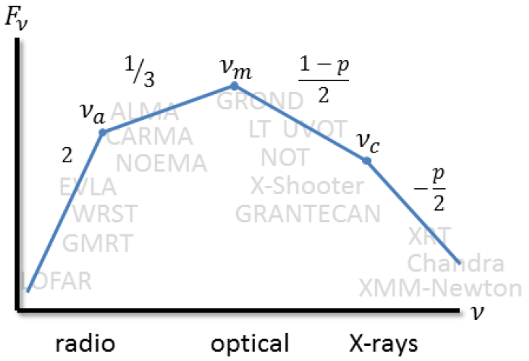
We rely on afterglow for information
images from:
van der Horst, van Eerten & Fong
‘observations & theory of gamma-ray burst jets’
New Astronomy Reviews, in prep

Slide 50
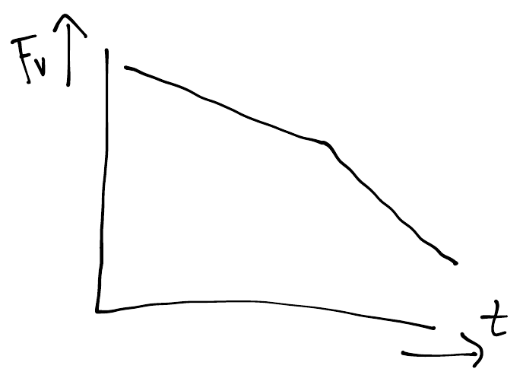
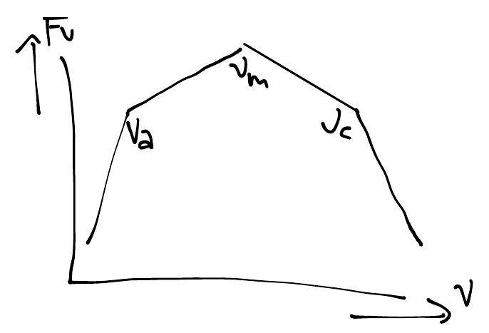
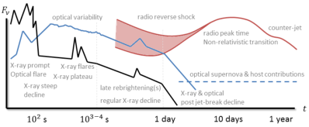






GRB afterglow models & closure relations
$$−β=\frac{\left(1−p\right)}{2}\sim −0.6$$
$$−α=\frac{3\left(1−p\right)}{4}\sim −0.9$$
$$F_{ν}∝t^{−α}ν^{−β}$$
$$F_{ν}∝t^{−α}ν^{−β}$$
Theoretical models predict temporal decay slope and spectral shape. Example:
time: forward shock in homogeneous interstellar medium, no jet structure, relativistic limit
frequency: slow-cooling synchrotron spectrum above particle injection break
$p\sim 2.2$ is the power-law slope of the non-thermal electron population $n_{e}∝γ_{e}^{−p}$ in energy
“closure” relation: solve for p left and right, and equate results: $2α+1=β$

