Slide 1






The SaToR-G experiment: testing metric and non-metric theories of gravity in the Earth’s field via laser tracking to geodetic satellites
16th Marcel Grossmann Meeting
July 5 – 10, 2021
David Lucchesi, Luciano Anselmo, Massimo Bassan, Marco Lucente, Carmelo Magnafico, Carmen Pardini, Roberto Peron, Giuseppe Pucacco, Feliciana Sapio, Massimo Visco
Istituto Nazionale di Astrofisica (IAPS-INAF), Via Fosso del Cavaliere n. 100, 00133 Tor Vergata - Roma
Consiglio Nazionale delle Ricerche (ISTI-CNR), Via Moruzzi n. 1, 56124 Pisa
Dipartimento di Fisica (Univ. Tor Vergata), Via della Ricerca Scientifica n. 1, 00133 Tor Vergata - Roma
Istituto Nazionale di Fisica Nucleare (INFN-RM2), Via della Ricerca Scientifica n. 1, 00133 Tor Vergata - Roma
david.lucchesi@inaf.it

Slide 2
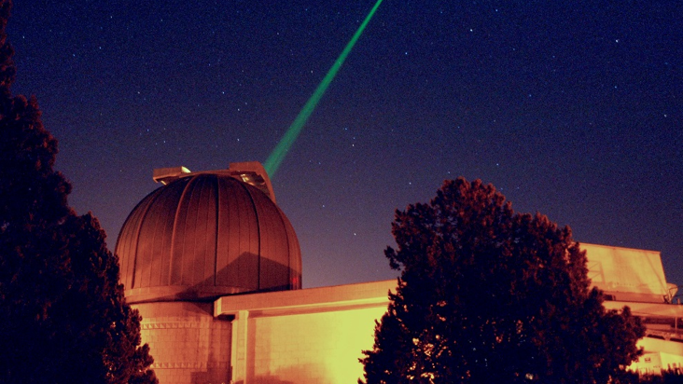
Summary
Photo by Franco Ambrico (courtesy of G. Bianco, ASI-CGS)
SaToR-G: theoretical and experimental framework
Main goals and preliminary results of SaToR-G
The analysis of orbital residuals
Conclusions

Slide 3
SaToR-G: theoretical and experimental framework
Satellite Tests of Relativistic Gravity (SaToR-G) is a new experiment in fundamental physics of the National Scientific Committee 2 (CSN2) of the Italian National Institute for Nuclear Physics (INFN)
The experiment aims at testing gravitation beyond the predictions of Einstein’s Theory of General Relativity (GR) in its weak-field and slow-motion (WFSM) limit, searching for effects foreseen by alternative theories of gravitation (ATG) and possibly connected with ‘’new physics’’
SaToR-G builds on the improved dynamical model of the two LAGEOS and LARES satellites achieved within the previous project LARASE (LAser RAnged Satellites Experiment)
The improvements concern the modeling of both gravitational and non-gravitational perturbations

Slide 4
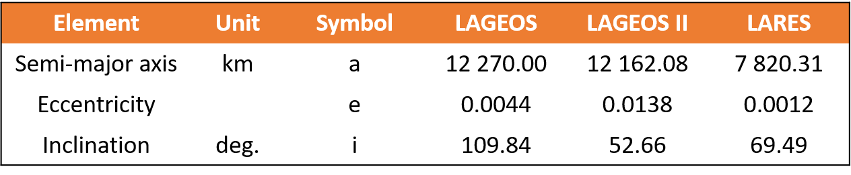
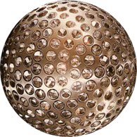
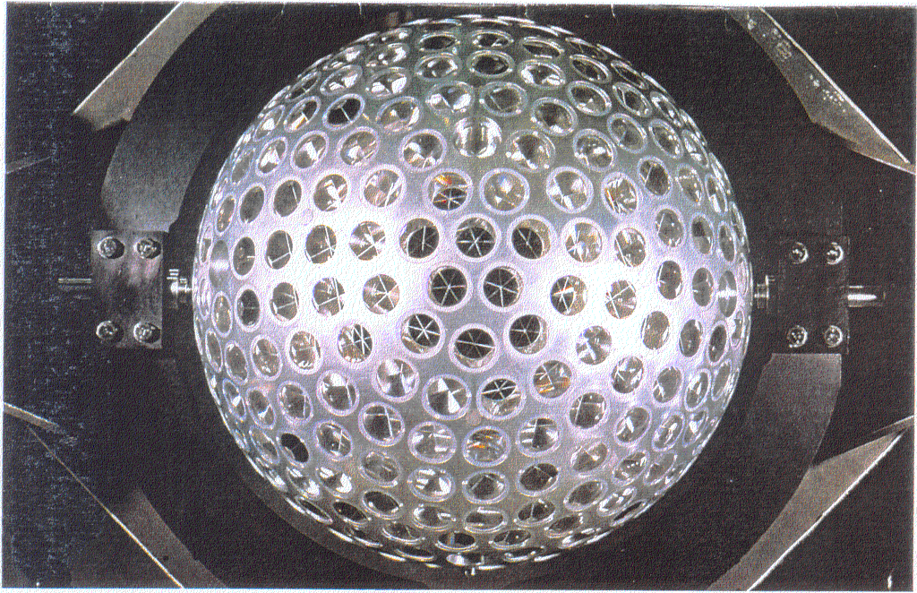
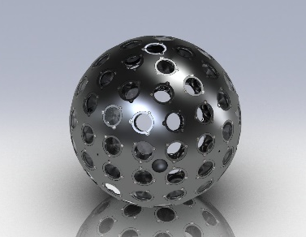
SaToR-G: theoretical and experimental framework
The predictions of GR on the orbits of geodetic satellites, which play the role of test masses, will be compared with those of ATG both metric and non-metric in their essence
LAGEOS (NASA, 1976)
LAGEOS II (ASI/NASA, 1992)
LARES (ASI, 2012)

Slide 5
SaToR-G: theoretical and experimental framework
At the foundation of GR and of all metric theories of gravitation is Einstein Equivalence Principle
Weak Equivalence Principle (WEP)
two different bodies fall with the same acceleration: Universality of the Free Fall (UFF)
the inertial mass is proportional to the gravitational (passive) mass
the trajectory of a freely falling “test” body is independent of its internal structure and composition
in every local and non-rotating falling frame, the trajectory of a freely falling test body is a straight line, in agreement with special relativity
Einstein Equivalence Principle (EEP)
WEP
Local Lorentz Invariance (LLI)
  The outcome of any local non-gravitational experiment is independent of the velocity of the freely-falling reference frame in which it is performed
Local Position Invariance (LPI)
  The outcome of any local non-gravitational experiment is independent of where and when in the Universe it is performed

Slide 6





SaToR-G: theoretical and experimental framework
Metric theories
GR is a metric theory of gravity and all metric theories obey the EEP
Indeed, the experimental results supporting the EEP supports the conclusion that the only theories of gravity that have a hope of being viable are metric theories, or possibly theories that are metric apart from very weak or short-range non-metric couplings (as in string theory)
there exist a symmetric metric
tests masses follow geodesics of the metric
in Local Lorentz Frames, the non-gravitational laws of physics are those of Special Relativity
$$g_{αβ}=g_{βα}$$
$$G_{αβ}=8π\frac{G}{c^{4}}T_{αβ}$$
$$det\left(g_{αβ}\right)≠0$$
$$G_{αβ}=R_{αβ}−\frac{1}{2}Rg_{αβ}+Λg_{αβ}$$
${ds}^{2}=g_{αβ}{dx}^{α}$ ${dx}^{β}$

Slide 7
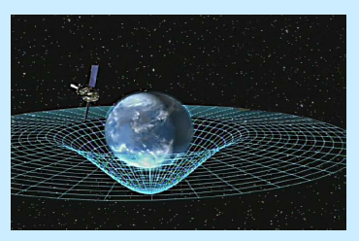
SaToR-G: theoretical and experimental framework
Metric theories
Metric theories different from GR provide additional fields beside the metric tensor g_{αβ}, that act as “new” gravitational fields:
  Scalars, Vectors, Tensors,…
The role of these gravitational fields is to “mediate” how the matter and the non-gravitational fields generate the gravitational fields and produce the metric
In Metric theories different from GR
spacetime geometry tells mass-energy how to move as in GR
but mass-energy tells spacetime geometry how to curve in a different way from GR
the metric alone acts back on the mass in agreement with EEP as in GR

Slide 8
SaToR-G: theoretical and experimental framework
The parametrized post-Newtonian (PPN) formalism
  One way to test a theory of gravitation is by studying its post-Newtonian limit
  Post-Newtonian formalism or PPN formalism details the parameters in which different metric theories of gravity, under WFSM conditions, can differ from Newtonian gravity
C.M. Will Living Rev. Relativity, 17, (2014), 4
Metric Potentials
Metric
Stress-Energy Tensor

Slide 9
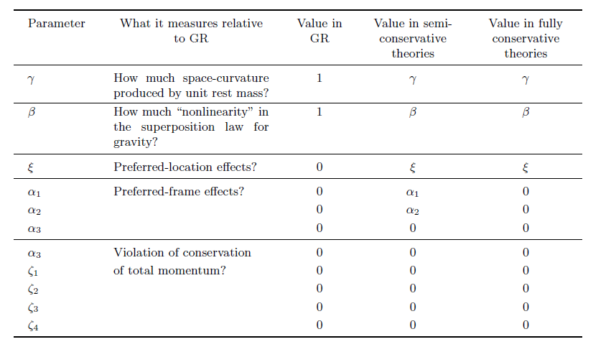
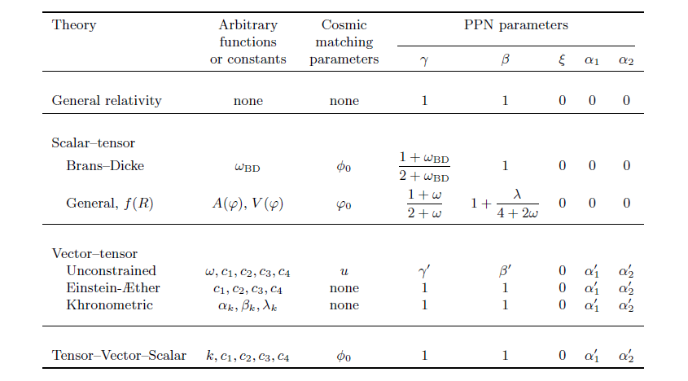
SaToR-G: theoretical and experimental framework
The parametrized post-Newtonian (PPN) formalism
C.M. Will Living Rev. Relativity, 17, (2014), 4

Slide 10
SaToR-G: theoretical and experimental framework
Consequently, the natural theoretical framework to test gravitation will be that of the Parameterized Post-Newtonian (PPN) formalism
However, we will also try to apply, as far as possible, the approach suggested by R. H. Dicke more than 50 years ago, usually referred to as the Dicke framework
This is a fairly general framework that allows us to conceive experiments not connected, a priori, with a given physical theory and also provides a way to analyze the results of an experiment under primary hypotheses
Dicke, R.H. The Theoretical Significance of Experimental Relativity; Blackie and Son Ltd.: London/Glasgow, UK, 1964

Slide 11
SaToR-G: theoretical and experimental framework
In his work Dicke defined the limits within which one should move to identify the fundamental characteristics of a relativistic theory of gravitation. Following Thorne and Will (1971), Dicke’s framework can be summarized as follows:
Spacetime is a 4-dimensional differentiable manifold, with each point in the manifold corresponding to a physical event. The manifold need not a priori have either a metric or an affine connection
The theory of gravity will be expressed in a form that is independent of the particular coordinates used; that is, the equations of gravity and the mathematical entities in them will be put into covariant form
These two statements focus on the basic mathematical formalism to employ when discussing experiments in gravitation
Thorne, K.S.; Will, C.M. Theoretical Frameworks for Testing Relativistic Gravity. I. Foundations. Astrophys. J. 1971, 163, 595

Slide 12
SaToR-G: theoretical and experimental framework
With two further statements, Dicke introduces two important constraints that an acceptable theory of gravitation should satisfy (Thorne and Will (1971)):
Gravity must be associated with one or more fields of tensorial character, that is, scalars, vectors, and tensors of various ranks
The dynamical equations which govern gravity must be derivable from an invariant action principle
Finally, the last point discussed by Dicke is based on Ockham’s razor approach and can be considered a practical guiding principle for choosing the theories of gravitation that are most likely to be correct:
Nature likes things as simple as possible
Thorne, K.S.; Will, C.M. Theoretical Frameworks for Testing Relativistic Gravity. I. Foundations. Astrophys. J. 1971, 163, 595

Slide 13
SaToR-G: theoretical and experimental framework
The first statement of Dicke’s framework is particularly important because it immediately defines the role of a gravitational experiment:
it is expected to naturally lead to the existence of a metric and of an affine connection for the differential manifold
The second statement relates to what Einstein’s Principle of General Covariance actually is and, therefore, what its validity actually is:
this point goes to the foundations of GR and to those of the ATG
For example, the mentioned covariance is obtained in some cases, only after the introduction of “absolute” elements or “prior geometric” elements in the theory:
this means that these elements are not determined by the dynamical equations of the theory, and this can be interpreted as a failure of general covariance
this rigidity can be overcome by assuming the invariance of the coordinates instead of their covariance, i.e., by a weaker hypothesis

Slide 14
SaToR-G: theoretical and experimental framework
The two constraints of Dicke’s framework seem to strongly confine what an acceptable theory of gravitation is. Indeed, Thorne and Will wrote in this regard:
“ . . . These constraints have deep significance; they strongly confine the theory. For this reason, we should be willing to accept them only if they are fundamental to our subsequent arguments. For most applications of the Dicke framework, they are not needed at all. Therefore, we shall usually not assume them. If we ever need and use them, we shall state so explicitly . . . ”
It is true that, for most applications, these two constraints are not necessary. However, we note that the theories that are still of interest today are those satisfying the two “strong” constraints suggested by Dicke

Slide 15
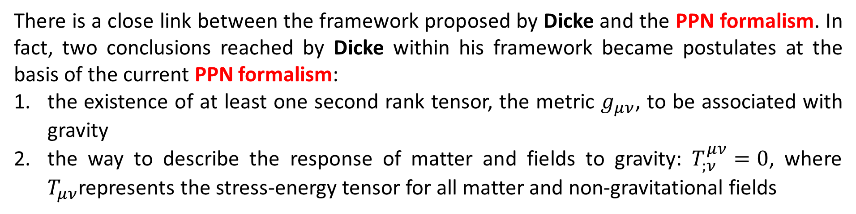
SaToR-G: theoretical and experimental framework
There is a close link between the framework proposed by Dicke and the PPN formalism. In fact, two conclusions reached by Dicke within his framework became postulates at the basis of the current PPN formalism:
the existence of at least one second rank tensor, the metric $g_{μν}$, to be associated with gravity
the way to describe the response of matter and fields to gravity: $T_{;ν}^{μν}=0$, where $T_{μν}$represents the stress-energy tensor for all matter and non-gravitational fields
In their paper, Thorne and Will also remarked that:
“ . . . It is important for the future that experimenters concentrate not only on measuring the PPN parameters. They should also perform new experiments within the Dicke framework to strengthen—or destroy—the foundation it lays for the PPN framework . . . ”

Slide 16
SaToR-G: theoretical and experimental framework
The framework proposed by Dicke is not easy to apply in every context, it is powerful for:
discussing the null experiments
delineating the qualitative nature of gravity
devising new covariant theories of gravity
A possible attempt to apply Dicke's framework is to search for the signature of the effects of a possible ATG on all the orbital elements of a satellite, thus not limiting the analysis to only possible secular effects
This approach, of considerable significance, is far from simple to pursue, requiring in fact a greater understanding of the periodic perturbative effects that characterize the residuals in the different orbital elements of a satellite. We refer to Lucchesi et al., (2021) for details
D. Lucchesi, L. Anselo, M. Bassan, et al., Testing Gravitational Theories in the Field of the Earth with the SaToR-G Experiment. Universe 7, 192, https://doi.org/10.3390/universe7060192, 2021

Slide 17
Main goals and preliminary results of SaToR-G
From the analysis of the orbits of the satellites it is possible to obtain a whole series of gravitational measurements with consequent constraints on different theories of gravitation. Among the main measures we can consider:
Constraints on long-range interactions
PPN parameters and their combinations: β, γ, α1, α2
Relativistic precessions and non-linearity of the gravitational interaction
EEP and Nordtvedt effect
…
Looking at the effects on the orbits of artificial satellites allows us to test GR vs. other metric theories, in their deeper aspects, related to the curvature of spacetime, motion on geodesics and field equations
The goal is to provide precise and accurate measurements, in the sense of a robust and reliable evaluation of the systematics errors, in order to obtain significant constraints for the different theories

Slide 18
Main goals and preliminary results of SaToR-G
The activities of SaToR-G will therefore develop according to two main guidelines:
first, in verifying the predictions of GR in the WFSM limit and, in particular, in those areas not yet fully taken into consideration from the experimental point of view, as in the aspects related to the non-linearity of the gravitational interaction
secondly, in going beyond the predictions of GR in search of possible effects linked to other ATG and, consequently, towards a “new physics”

Slide 19
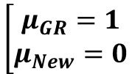
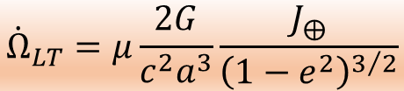
Main goals and preliminary results of SaToR-G
In 2019/2020, we obtained a precise and accurate measurement of the Lense-Thirring precession by the analysis of the orbit residuals of the satellites LAGEOS, LAGEOS II and LARES on a time span of about 6.5 years:
Discrepancy
Error @ 95% CL
Systematic error
$${\dot{Ω}}_{LT}=μ\frac{2G}{c^{2}a^{3}}\frac{J_{⨁}}{{\left(1−e^{2}\right)}^{3/2}}$$
$$\left[\begin{matrix}μ_{GR}=1 \\ μ_{New}=0\end{matrix}\right.$$
$$μ_{meas}−1=1.5×{10}^{−3}±7.4×{10}^{−3}±16×{10}^{−3}$$
D. Lucchesi, M. Visco, R. Peron, et al., A 1% Measurement of the Gravitomagnetic Field of the Earth with Laser-Traked Satellites. Universe 6, 139, doi:10.3390/universe6090139, 2020
This result can be exploited to preliminary constrain some ATG, such as:
a scalar-tensor theory, i.e., a metric theory of gravity
a torsion theory, i.e., a non-metric theory of gravity

Slide 20
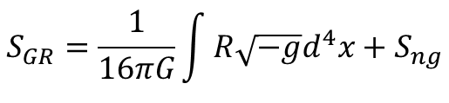

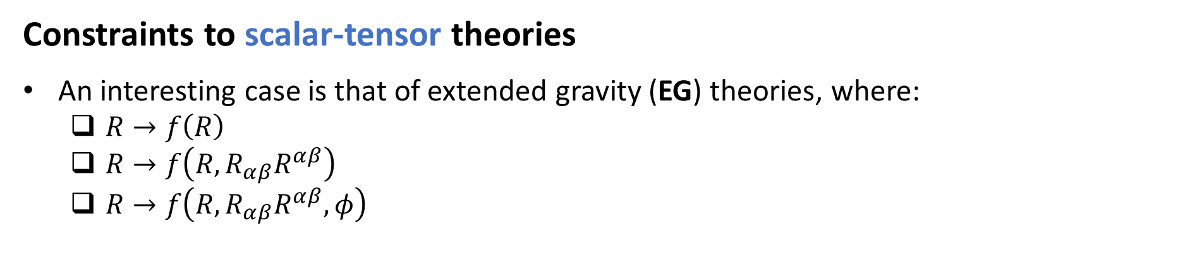
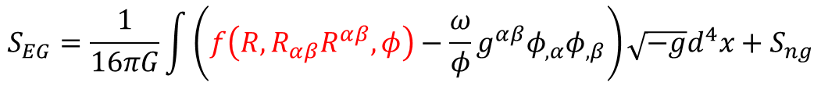
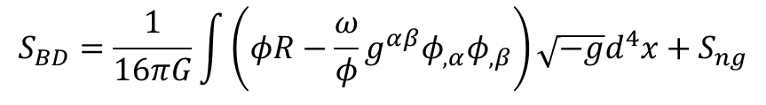
Main goals and preliminary results of SaToR-G
Constraints to scalar-tensor theories
An interesting case is that of extended gravity (EG) theories, where:
  $R→f\left(R\right)$
  $R→f\left(R,R_{αβ}R^{αβ}\right)$
  $R→f\left(R,R_{αβ}R^{αβ},φ\right)$
S. Capozziello, G. Lambiase, et al., Constraining models of extended gravity using Gravity Probe B and LARES experiments. PRD 91, 044012, 2015
$$S_{GR}=\frac{1}{16πG}\int{R\sqrt{−g}d^{4}x}+S_{ng}$$
$$S_{BD}=\frac{1}{16πG}\int{\left(φR−\frac{ω}{φ}g^{αβ}φ_{,α}φ_{,β}\right)\sqrt{−g}d^{4}x}+S_{ng}$$
$$S_{EG}=\frac{1}{16πG}\int{\left(f\left(R,R_{αβ}R^{αβ},φ\right)−\frac{ω}{φ}g^{αβ}φ_{,α}φ_{,β}\right)\sqrt{−g}d^{4}x}+S_{ng}$$
→ Introduces effective masses: $m_{R}, m_{φ}, m_{Y}$
$$Y=R_{αβ}R^{αβ}$$
Where φ is a scalar field and ω represents the dimensionless Dicke’s coupling constant: it is tested by the experiments

Slide 21




Main goals and preliminary results of SaToR-G
Constraints to scalar-tensor theories
An interesting case is that of extended gravity (EG) theories, where:
  $R→f\left(R\right)$
  $R→f\left(R,R_{αβ}R^{αβ}\right)$
  $R→f\left(R,R_{αβ}R^{αβ},φ\right)$
S. Capozziello, G. Lambiase, et al., Constraining models of extended gravity using Gravity Probe B and LARES experiments. PRD 91, 044012, 2015
$$μ_{meas}−1=1.5×{10}^{−3}±7.4×{10}^{−3}±16×{10}^{−3}$$
$${\dot{Ω}}_{LT}^{EG}=−\frac{1+m_{Y}r+{\left(m_{Y}r\right)}^{2}}{e^{m_{Y}r}}{\dot{Ω}}_{LT}^{GR}$$
$$S_{GR}=\frac{1}{16πG}\int{R\sqrt{−g}d^{4}x}+S_{ng}$$
$${{\dot{Ω}}_{grav}={\dot{Ω}}_{LT}^{GR}+\dot{Ω}}_{LT}^{EG}$$
$$S_{BD}=\frac{1}{16πG}\int{\left(φR−\frac{ω}{φ}g^{αβ}φ_{,α}φ_{,β}\right)\sqrt{−g}d^{4}x}+S_{ng}$$
$$m_{Y}>1.9×{10}^{−6} m^{−1}$$
$$S_{EG}=\frac{1}{16πG}\int{\left(f\left(R,R_{αβ}R^{αβ},φ\right)−\frac{ω}{φ}g^{αβ}φ_{,α}φ_{,β}\right)\sqrt{−g}d^{4}x}+S_{ng}$$
→ Introduces effective masses: $m_{R}, m_{φ}, m_{Y}$
$$Y=R_{αβ}R^{αβ}$$
Where φ is a scalar field and ω represents the dimensionless Dicke’s coupling constant: it is tested by the experiments

Slide 22
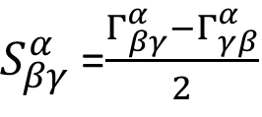
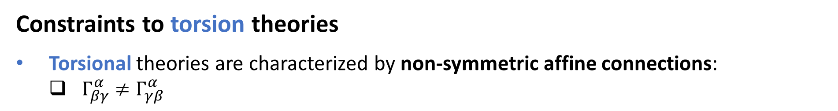



Main goals and preliminary results of SaToR-G
Constraints to torsion theories
Torsional theories are characterized by non-symmetric affine connections:
  $Γ_{βγ}^{α}≠Γ_{γβ}^{α}$
$S_{βγ}^{α}$=$\frac{Γ_{βγ}^{α}−Γ_{γβ}^{α}}{2}$
Tensor that describes the torsion phenomena
torsion parameters that must be constrained by measurements
$$t_{1},t_{2},t_{3},w_{1},w_{2},w_{3},w_{4},w_{5}$$
${\dot{Ω}}_{tor}$= ${\left\langle {\dot{Ω}}^{LT}\right\rangle }_{sec}\left[μ−\frac{w_{2}−w_{4}}{4}\right]+{\left\langle {\dot{Ω}}^{dS}\right\rangle }_{sec}\left[\frac{t_{2}}{2}\right]$
March, R., Bellettini, G., Tauraso, R., Dell’Agnello, S., Constraining spacetime torsion with LAGEOS. Gen. Relativ. Gravit., 43, 3099–3126, 2011
$$−0.36<w_{2}−w_{4}<+0.44$$
From a previous measurement of the Lense-Thirring effect with an estimated error budget of about 10%
Ciufolini, I.; Pavlis, E.C. A confirmation of the general relativistic prediction of the Lense-Thirring effect. Nature, 431, 958–960, 2004

Slide 23



Main goals and preliminary results of SaToR-G
Constraints to torsion theories
Torsional theories are characterized by non-symmetric affine connections:
  $Γ_{βγ}^{α}≠Γ_{γβ}^{α}$
$$μ_{meas}−1=1.5×{10}^{−3}±7.4×{10}^{−3}±16×{10}^{−3}$$
$S_{βγ}^{α}$=$\frac{Γ_{βγ}^{α}−Γ_{γβ}^{α}}{2}$
Tensor that describes the torsion phenomena
torsion parameters that must be constrained by measurements
$${\dot{Ω}}_{tor}\text{= }{\left\langle {\dot{Ω}}^{LT}\right\rangle }_{sec}\left[μ−\frac{w_{2}−w_{4}}{4}\right]$$
$$t_{1},t_{2},t_{3},w_{1},w_{2},w_{3},w_{4},w_{5}$$
$${{\dot{Ω}}_{grav}={\dot{Ω}}_{LT}^{GR}+\dot{Ω}}_{dS}^{GR}+{\dot{Ω}}_{tor}$$
${\dot{Ω}}_{tor}$= ${\left\langle {\dot{Ω}}^{LT}\right\rangle }_{sec}\left[μ−\frac{w_{2}−w_{4}}{4}\right]+{\left\langle {\dot{Ω}}^{dS}\right\rangle }_{sec}\left[\frac{t_{2}}{2}\right]$
March, R., Bellettini, G., Tauraso, R., Dell’Agnello, S., Constraining spacetime torsion with LAGEOS. Gen. Relativ. Gravit., 43, 3099–3126, 2011
$$w_{2}−w_{4}=−0.006±0.064$$
$$−0.36<w_{2}−w_{4}<+0.44$$
From a previous measurement of the Lense-Thirring effect with an estimated error budget of about 10%
Ciufolini, I.; Pavlis, E.C. A confirmation of the general relativistic prediction of the Lense-Thirring effect. Nature, 431, 958–960, 2004

Slide 24



Main goals and preliminary results of SaToR-G
The two constraints obtained, especially the one on the effective mass, are to be considered preliminary:
In fact, although they have been derived from an orbital element subject to effects of a secular type, before we can draw a reliable conclusion, it will be necessary to investigate the possible signature of the two theories on the entire orbit of satellites
Moreover, other possible ATG must be considered and studied in this analysis
$$m_{Y}>1.9×{10}^{−6} m^{−1}$$
Metric theory
Non-metric theory
$$w_{2}−w_{4}=−0.006±0.064$$

Slide 25
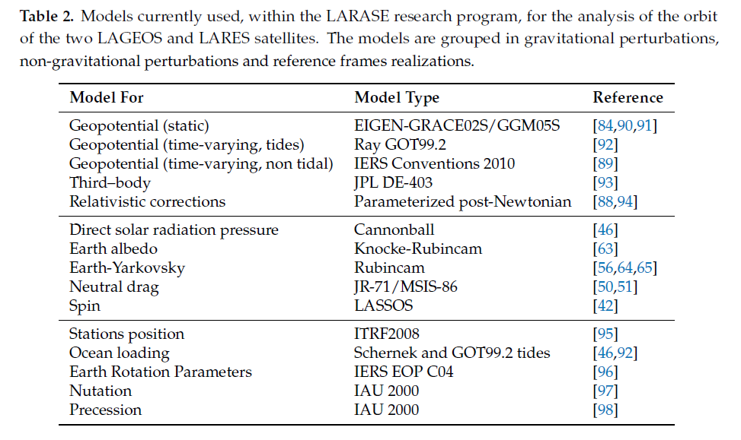
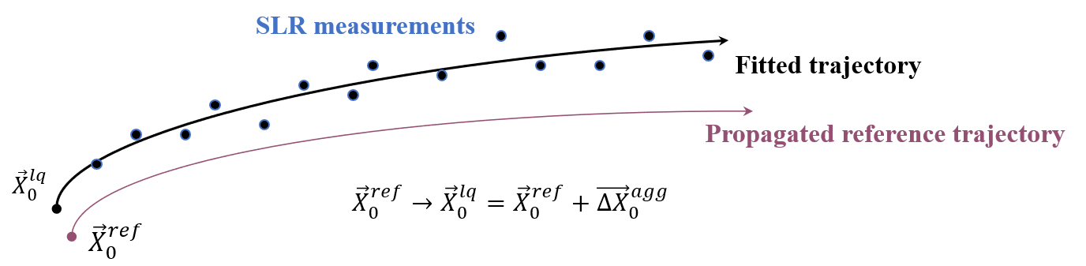
The analysis of orbital residuals
Preliminary quasi-POD of LAGEOS II on a time span of about 28 years
GEODYN II s/w
  Arc length, 7 days
  GR and thermal thrust effects: not modeled
  Empirical accelerations, CR, …: not estimated
  Quadrupole coefficient optimized with two linear trends
  State-vector adjusted to best fit the tracking data
  …

Slide 26
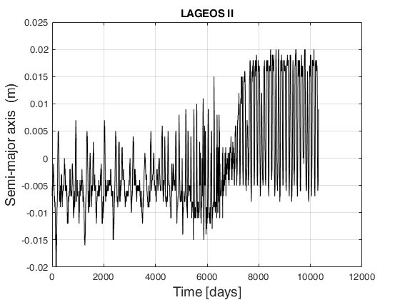
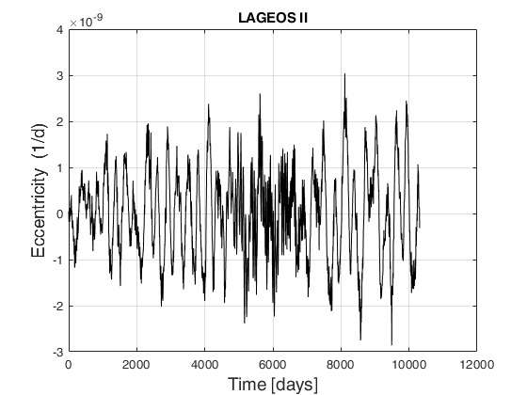
The analysis of orbital residuals
Orbital residuals: these are rate in the elements over 7 days

Slide 27
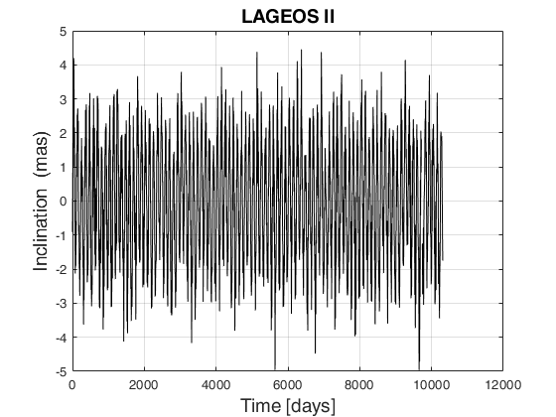
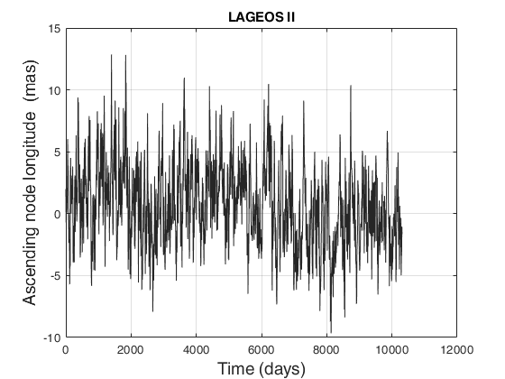
The analysis of orbital residuals
Orbital residuals: these are rate in the elements over 7 days

Slide 28
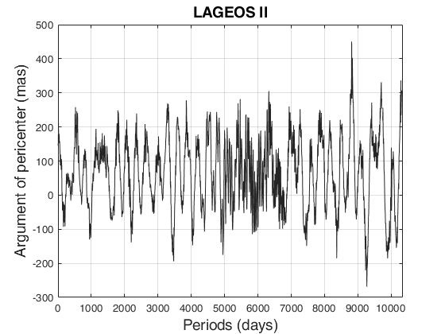
The analysis of orbital residuals
Orbital residuals: these are rate in the elements over 7 days
Therefore, all the computed residuals show both periodic and secular effects
Periodic effects:
  Gravitational effects, mainly due to the mismodeling of
    Gravity field
    Tides
      Ocean
      Solid
  Non-gravitational perturbations, mainly due to
    Thermal thrust effects
    Asymmetric reflectivity
Secular effects:
  GR precession
    Schwarzschild
    Lense-Thirring
    Nonlinearity: mainly Earth’s quadrupole J₂
  Thermal thrust effects, mainly due to
    Earth Yarkovsky effect
    Solar Yarkovsky-Schach effect

Slide 29
The analysis of orbital residuals
However, the correct separation of the various periodic effects (hence of their understanding) represents a very difficult task to achieve:
it represents a challenge that is anything but simple to face
the overcoming of which is of fundamental importance to better verify the gravitational interaction in the WFSM limit
The current periodic effects non modeled or mismodeled in the residuals:
mask the measurement of any periodic effects of a relativistic nature
constitute a kind of noise superimposed on the secular relativistic effects

Slide 30
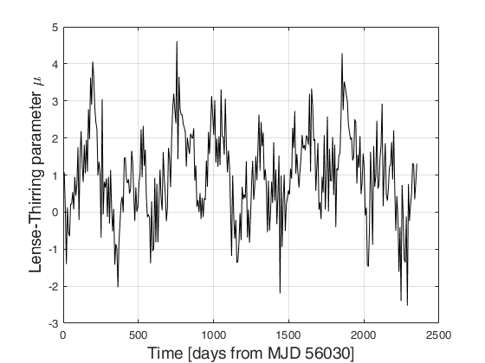



The analysis of orbital residuals
However, the correct separation of the various periodic effects (hence of their understanding) represents a very difficult task to achieve:
it represents a challenge that is anything but simple to face
the overcoming of which is of fundamental importance to better verify the gravitational interaction in the WFSM limit
The current periodic effects non modeled or mismodeled in the residuals:
mask the measurement of any periodic effects of a relativistic nature
constitute a kind of noise superimposed on the secular relativistic effects
$$μ_{GR}=1$$
Gussian-like distribution for μ
K ≅ +3.097 S ≅ − 8.4×10⁻³
$$μ_{meas}=0.99±0.13$$
S.D.=1.20

Slide 31
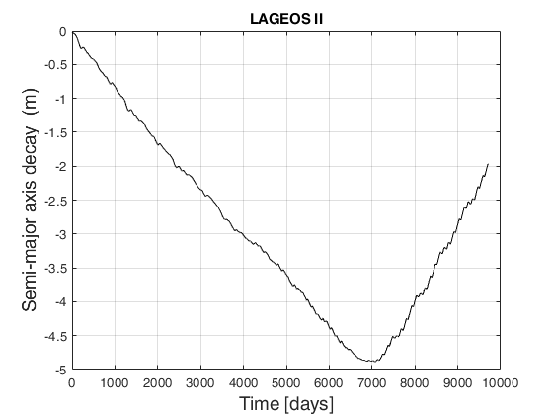
The analysis of orbital residuals
Residuals in the semi-major axis

Slide 32
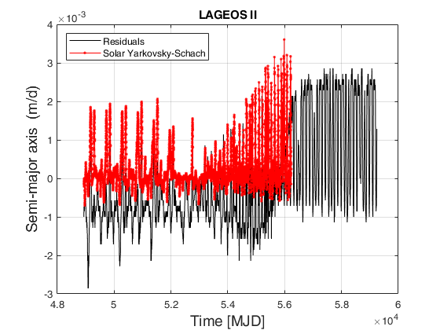
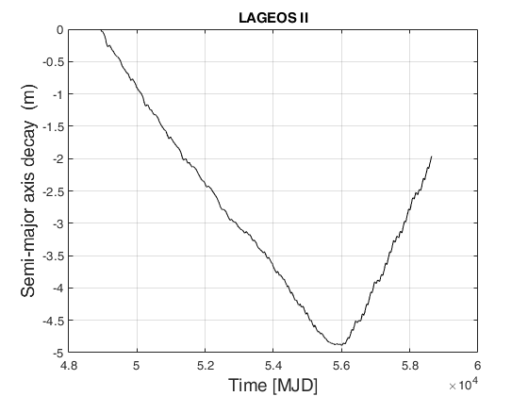


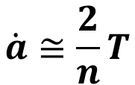


The analysis of orbital residuals
Residuals in the semi-major axis and their comparison with the solar Yarkovsky-Schach effect
Earth-Yarkovsky deceleration vs. solar Yarkovsky-Schach acceleration
$$\dot{a}≅\frac{2}{n}T$$
$${\dot{Ω}}_{YS}<\left|{\dot{Ω}}_{EY}\right|$$
$${\dot{Ω}}_{YS}>\left|{\dot{Ω}}_{EY}\right|$$
$$\dot{a}≅−25.6 \frac{cm}{yr}$$
$$\dot{a}≅+41.8 \frac{cm}{yr}$$

Slide 33
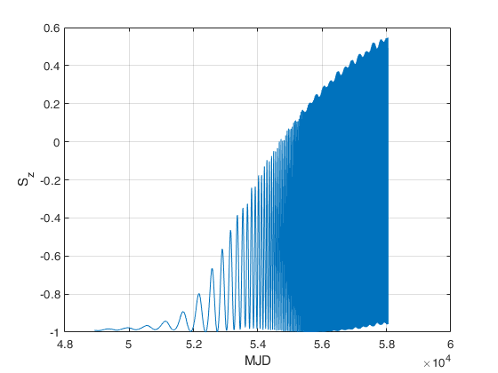
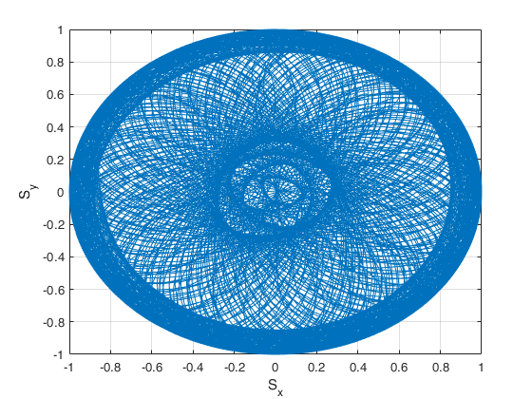
The analysis of orbital residuals
The LASSOS (LArase Satellites Spin mOdel Solutions) Spin model in cartesian coordinates: LAGEOS II
J2000.0
M. Visco, D. Lucchesi, Comprehensive model for the spin evolution of the LAGEOS and LARES satellites. Phys. Rev. D 98, 044034 doi:10.3390/universe6090139, 2018

Slide 34
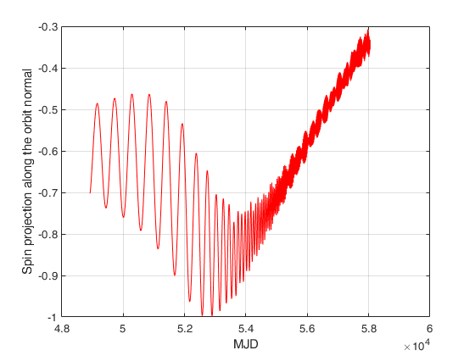
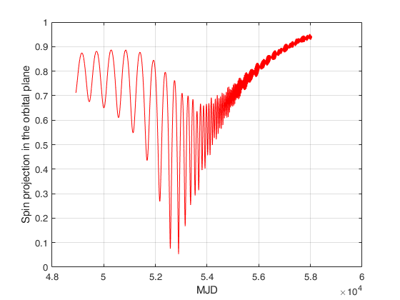
The analysis of orbital residuals
LAGEOS II spin projections along the orbit normal and in the orbital plane

Slide 35
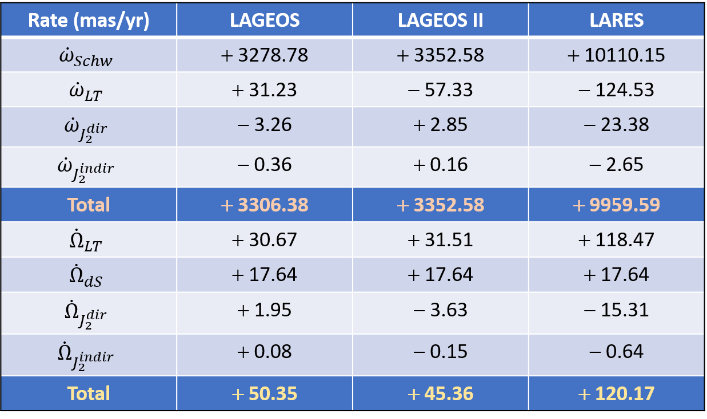
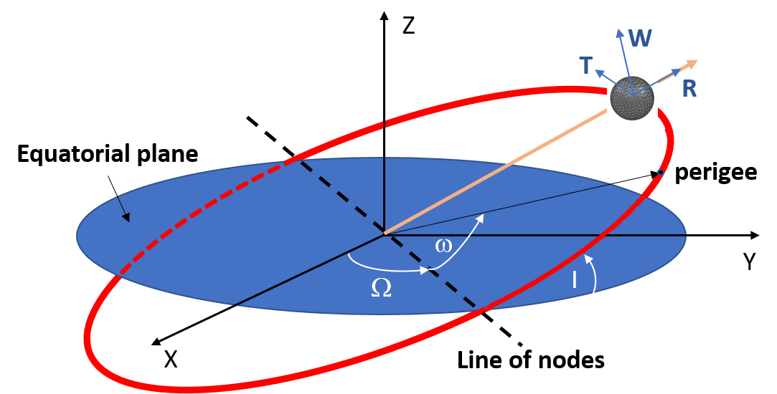
The analysis of orbital residuals
Relativistic precessions: argument of pericenter and right ascension of the ascending node

Slide 36
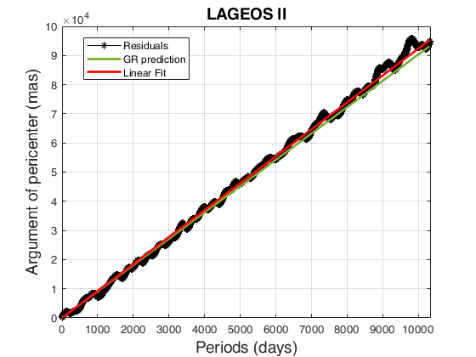
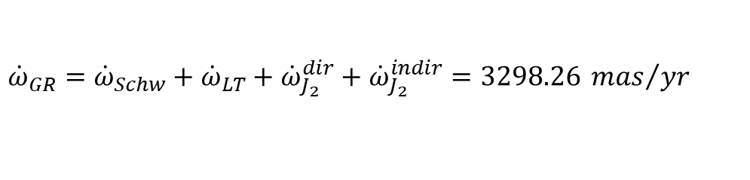

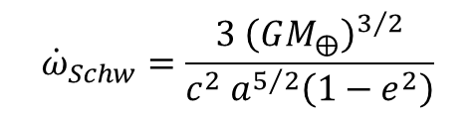

The analysis of orbital residuals
The total relativistic precession of the argument of pericenter: 28 years
Although the POD performed on the LAGEOS II satellite is not yet optimized, the preliminary results are encouraging
${\dot{ω}}_{GR}={\dot{ω}}_{Schw}+$ ${\dot{ω}}_{LT}+{\dot{ω}}_{J_{2}}^{dir}+{\dot{ω}}_{J_{2}}^{indir}=3298.26 {mas}/{yr}$
$${\dot{ω}}_{Schw}=\frac{3 {\left(GM_{⨁}\right)}^{3/2}}{c^{2} a^{5/2}\left(1−e^{2}\right)}$$
$${\dot{ω}}_{LT}=−\frac{6G}{c^{2}a^{3}}\frac{J_{⨁}}{{\left(1−e^{2}\right)}^{3/2}}\cos{i}$$
$${\dot{ω}}_{J_{2}}^{dir}=\frac{3n^{3}J_{2}R_{⨁}^{2}}{8c^{2}{\left(1−e^{2}\right)}^{7/2}}\left[30+19\sqrt{1−e^{2}}+6e^{2}\left(−5+6\sqrt{1−e^{2}}\right)+\left(9\left(6+5\sqrt{1−e^{2}}\right)+6e^{2}\left(−9+10\sqrt{1−e^{2}}\right)\right)\cos{i}\right]$$
$${\dot{ω}}_{J_{2}}^{indir}=−\frac{3n^{3}J_{2}R_{⨁}^{2}}{8c^{2}}\frac{5\left(1+e^{2}\right)−\left(17+25e^{2}\right){\cos{i}}^{2}}{{\left(1−e^{2}\right)}^{3}}$$

Slide 37

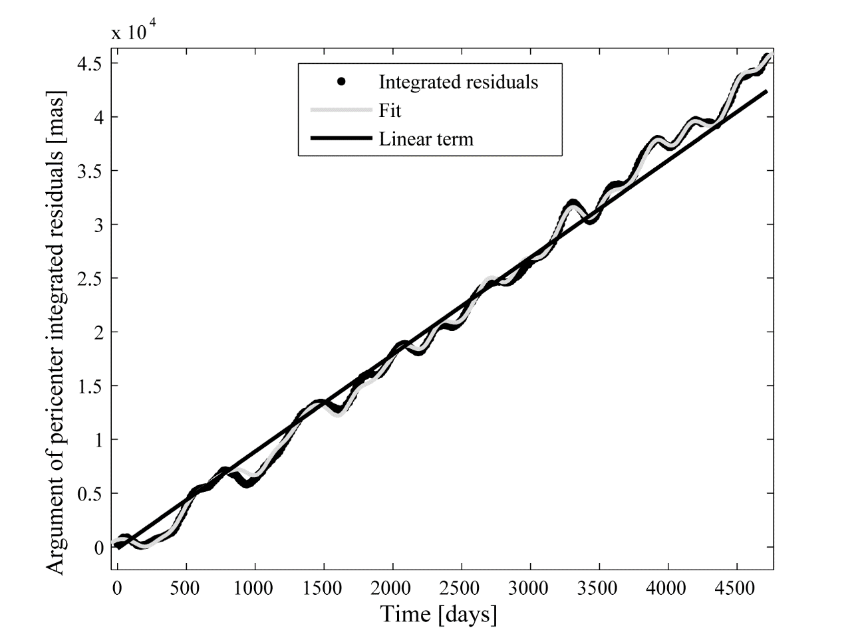
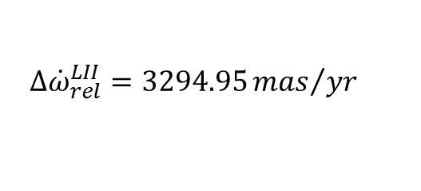
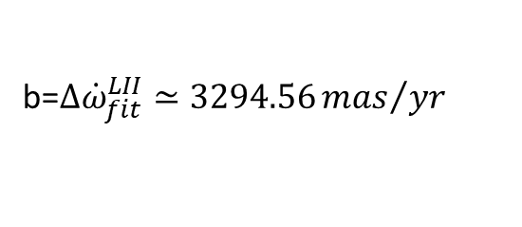
The analysis of orbital residuals
The total relativistic precession of the argument of pericenter: a previous result on 13 years
D. Lucchesi, R. Peron, LAGEOS II pericenter general relativistic precession (1993-2005): Error budget and constraints in gravitational physics. Phys. Rev. D 89, 082002, doi:10.1103/PhysRevD.89.082002, 2014
We obtained b ≅ 3294.6 mas/yr, very close to the prediction of GR
The discrepancy is just 0.01%
From a sensitivity analysis, with constraints on some of the parameters that enter into the least squares fit, we obtained an upper bound of 0.2%
Target:
$$Δ{\dot{ω}}_{rel}^{LII}=3294.95{mas}/{yr}$$
Fit:
b=$Δ{\dot{ω}}_{fit}^{LII}≃3294.56{mas}/{yr}$
$$ε=1−(0.12±2.10)∙{10}^{−3}±2.5∙{10}^{−2}$$

Slide 38
The analysis of orbital residuals
The total relativistic precession of the argument of pericenter: a previous result on 13 years
Summary of the constraints obtained
PPN →
Yukawa →
ATGs →

Slide 39
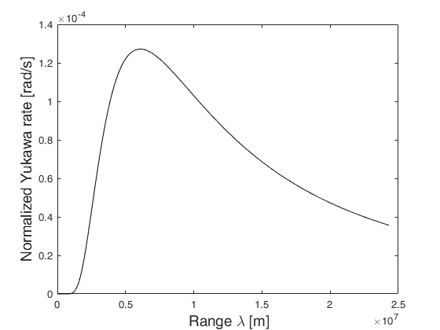
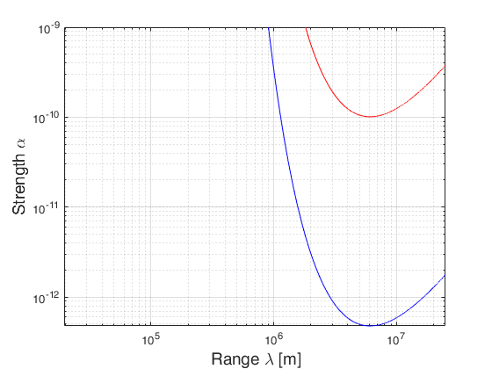


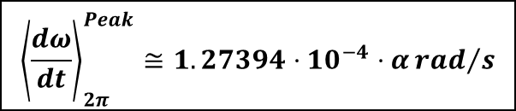



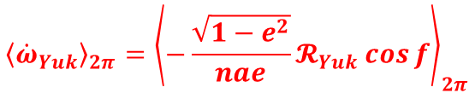
The analysis of orbital residuals
Violation of 1/r^2 law: Yukawa-like potential
$${\vec{ℛ}}_{Yuk}=−α\frac{G_{∞}M_{⨁}}{r^{2}}\left(1+\frac{r}{λ}\right)e^{−r/λ}\hat{r}$$
$$λ≅6,081\begin{matrix}km≈1R_{⊕} & \end{matrix}$$
$$\left|α\right|≅\left|\left(0.5±8\right)∙{10}^{−12}±101∙{10}^{−12}\right|$$
$$\frac{a}{λ}≅2$$
$$\frac{a}{λ}≅2$$
$${\left\langle {\dot{ω}}_{Yuk}\right\rangle }_{2π}={\left\langle −\frac{\sqrt{1−e^{2}}}{nae}𝓡_{Yuk}\cos{f}\right\rangle }_{2π}$$
$$λ≅6,081\begin{matrix}km≈1R_{⊕} & \end{matrix}$$
$${\left\langle \frac{dω}{dt}\right\rangle }_{2π}^{Peak}≅1.27394⋅10^{−4}⋅α{rad}/s$$

Slide 40
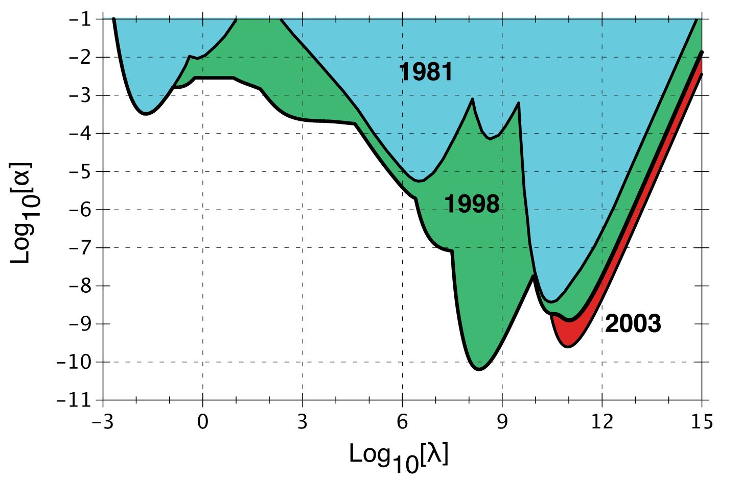


The analysis of orbital residuals
Constraints on a long-range force: Yukawa like interaction
$$\left|α\right|≅\left|\left(0.5±8\right)∙{10}^{−12}±101∙{10}^{−12}\right|$$
The region above each curve is ruled out at the 95.5% confidence level
Composition independent experiments
Previous limits with LAGEOS’s:
Lake
Laboratory
Tower
Earth-LAGEOS
$$\left|α\right|≅1∙{10}^{−10}$$
LAGEOS-Lunar
Lunar Precession
Planetary
$$\left|α\right|≅5∙{10}^{−13}$$
meters

Slide 41


Conclusions
SaToR-G started its activities in 2020, and can be considered a continuation of LARASE
The theoretical and experimental framework of the experiment was presented
The experiment aims at testing gravitation beyond the predictions of Einstein’s Theory of GR in its WFSM limit, searching for effects foreseen by ATGs and possibly connected with ‘’new physics’’
We presented two preliminary results:
The improvements of the dynamical model for the data reduction is underway together with the optimization of the setup with the ultimate goal of performing a POD of the LAGEOS, LAGEOS II, LARES and other satellites that can be considered for future analysis and gravitational physics measurements
Metric theory
Non-metric theory
$$m_{Y}>1.9×{10}^{−6} m^{−1}$$
$$w_{2}−w_{4}=−0.006±0.064$$

Slide 42
Many thanks for your kind attention

