Slide 1
Possible effects of fractal distribution of wormholes
Kirillov A.A., Savelova E.P. and Vladykina P.O.

Slide 2
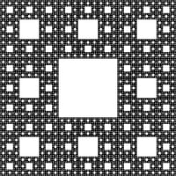









Fractal structure of space
Wormholes
$$R$$
Dimension depends on the properties and distribution of wormholes
$$x$$
$$y$$
$$l\left(x,y\right)<R$$
$$V_{x}\left(R\right)\sim R^{d}$$
Sierpinski carpet
by angular coordinates
0
$$φ$$
$$2π$$
Our universe can
have a difficult
topological nature
on the scale of galaxies
We will see a picture
similar to
Sierpinski carpet
$$θ$$
$$π$$

Slide 3
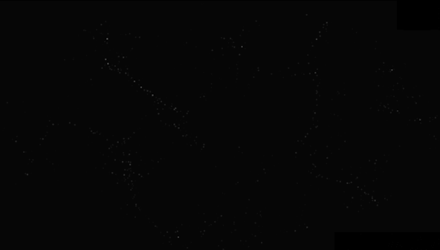

Slide 4
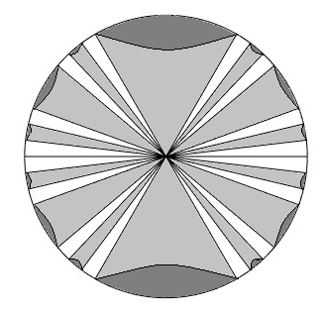
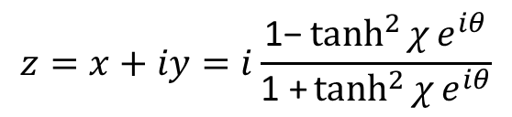
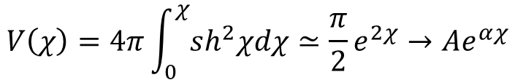
Assumption
Open
model
Lobachevsky
space
Wormholes
The volume of the factorized Lobachevsky space
Volume in Lobachevsky space
$$dl^{2}=dχ^{2}+sh^{2}χ\left(\sin^{2}{θ}dφ^{2}+dθ^{2}\right)$$
$$V\left(χ\right)=4π\int_{0}^{χ}{sh^{2}χdχ}≃\frac{π}{2}e^{2χ}→Ae^{αχ}$$
$$z=x+iy=i\frac{\text{1−}\tanh^{2}{χ}e^{iθ}}{\text{1}\text{ +}\tanh^{2}{χ}e^{iθ}}$$
Dark Matter Effect
Fractal model

Slide 5

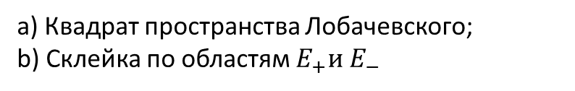
Gluing
Any two points of the plane represent the same point, if they are connected by the relation:
а) Квадрат пространства Лобачевского;
b) Склейка по областям $E_{+}и E_{−}$

Slide 6
After inflation
Fractal
structure
of space
Particle
birth
Flat
model
Relics of
fractal structure
Distribution
of wormholes
It leads to
Modification of Newton's Law
Dark Matter Effects

Slide 7

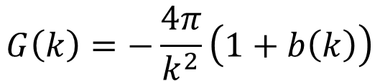


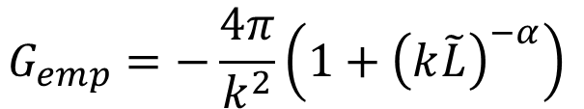
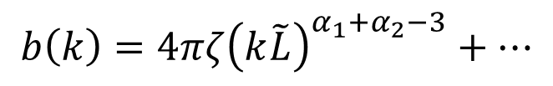

presence of wormhole distribution
leads to specific
modification of Newton's law
Green's
function
$$G\left(k\right)=−\frac{4π}{k^{2}}\left(1+b\left(k\right)\right)$$
$$b\left(k\right)=4πζ{\left(k\tilde{L}\right)}_{}^{α_{1}+α_{2}−3}+…$$
These parameters correspond to the fractal distribution of wormholes over the distances between the inlet and outlet and the size of the throats.
Empirical Green's function
$$G_{emp}=−\frac{4π}{k^{2}}\left(1+{\left(k\tilde{L}\right)}^{−α}\right)$$
$$α_{1}+α_{2}≃2$$
Defining
parameters
$$\tilde{L}\sim 5Kpc$$
$$α≃1$$
$$ζ≃1$$

Slide 8
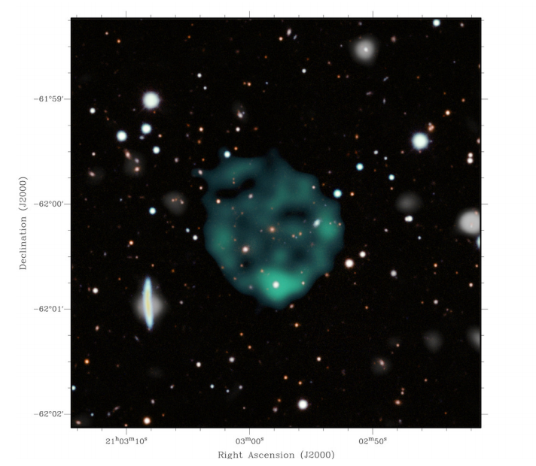
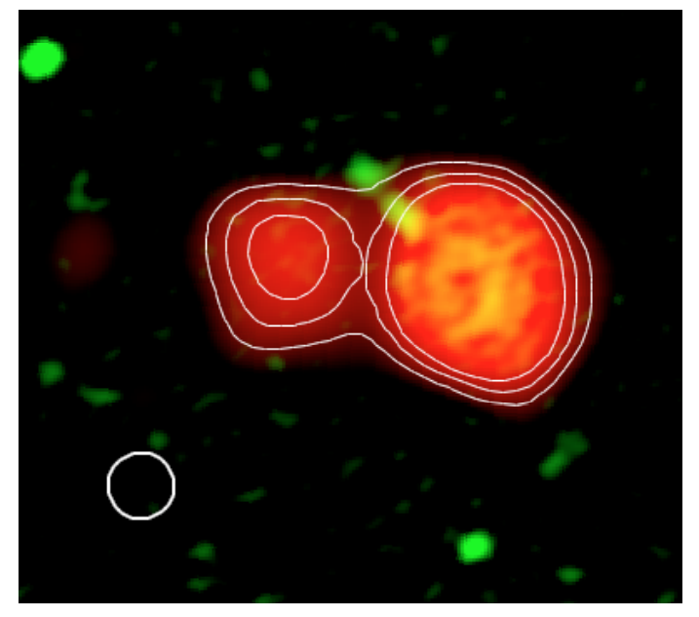
Plans?

