Slide 1
Laue lenses: focusing optics for hard-X/soft-Gamma rays
16th Marcel Grossmann Meeting
L. Ferro⁽¹⁾, E. Virgilli⁽²⁾, M. Moita⁽¹⁾, P. Rosati⁽¹⁾, F. Frontera⁽¹⁾, S. Squerzanti⁽³⁾, C. Ferrari⁽⁴⁾, R. Lolli⁽¹⁾ ⁽⁴⁾, E. Caroli⁽²⁾, N. Auricchio⁽²⁾, J. B. Stephen⁽²⁾, C. Labanti⁽²⁾, F. Fuschino⁽²⁾, R. Campana⁽²⁾, S. del Sordo⁽⁵⁾, C. Gargano⁽⁵⁾
1 – University of Ferrara, Dept. of Physics and Earth Science 2 – INAF/OAS Bologna 3 – INFN Ferrara 4 – IMEM/CNR Parma 5 – INAF/OAS Palermo

Slide 2
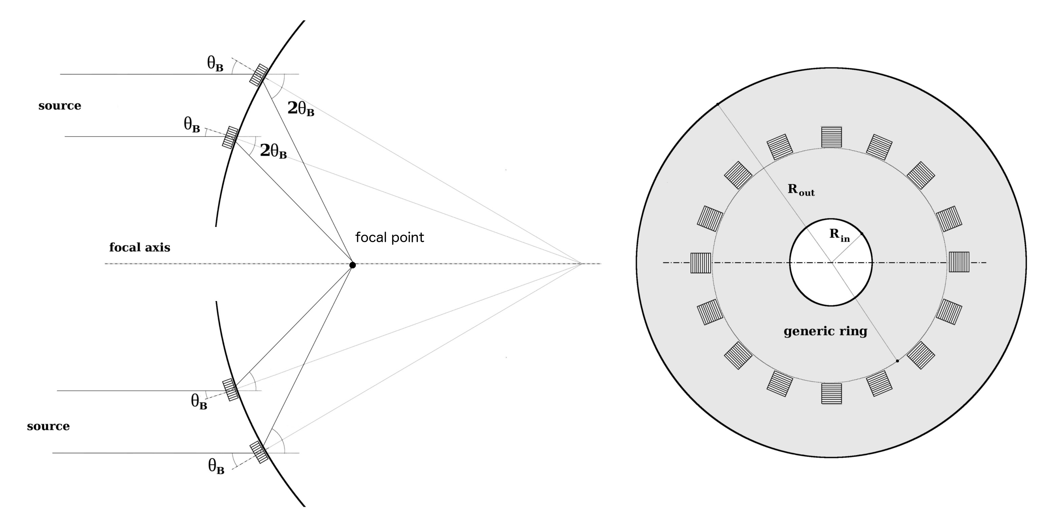
Laue lenses: hard X-soft Gamma ray optics based on Bragg’s Law of Diffraction
$$2d_{hkl}\sin{θ_{B}}=n\frac{hc}{E}$$
Focal distance equal to half the curvature radius of the lens

Slide 3
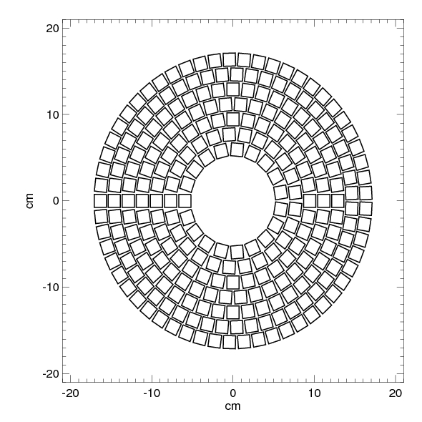
Laue lenses: hard X-soft Gamma ray optics based on Bragg’s Law of Diffraction
Single ring: (almost) monochromatic response
Multiple rings: broad band lens

Slide 4
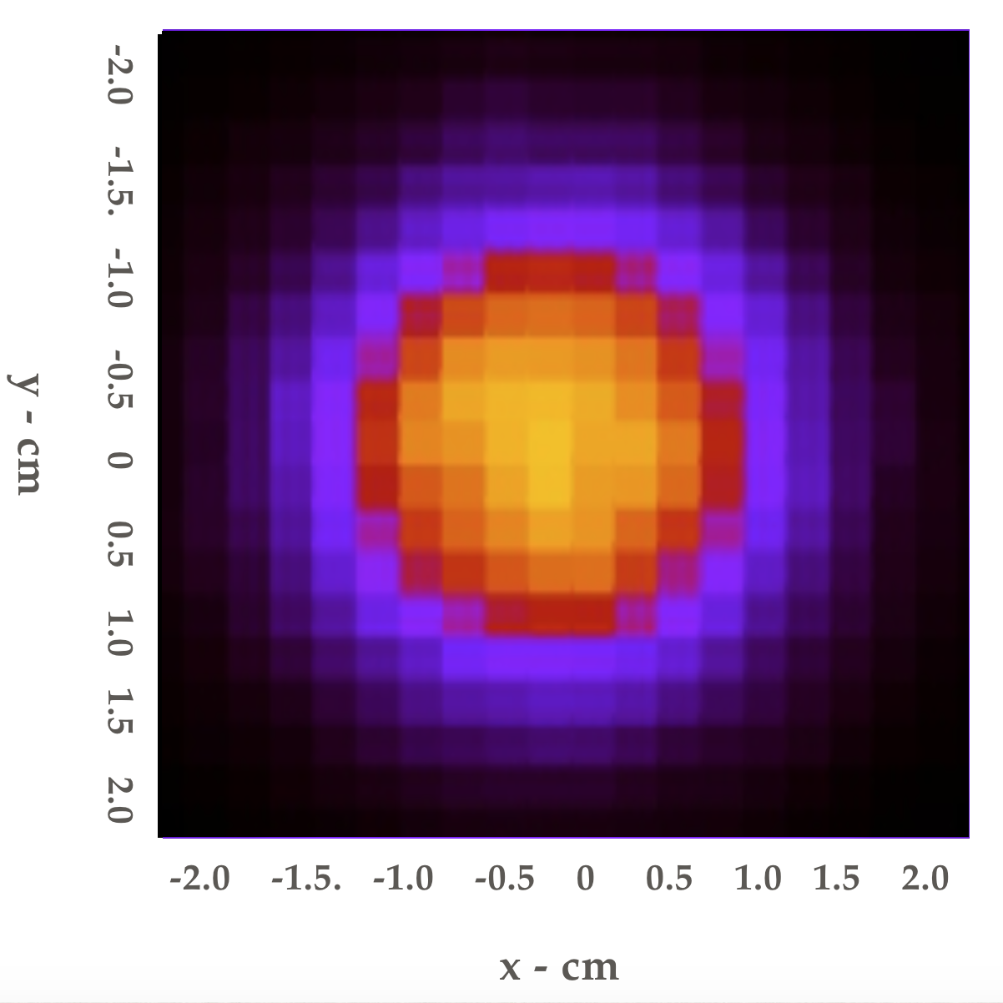
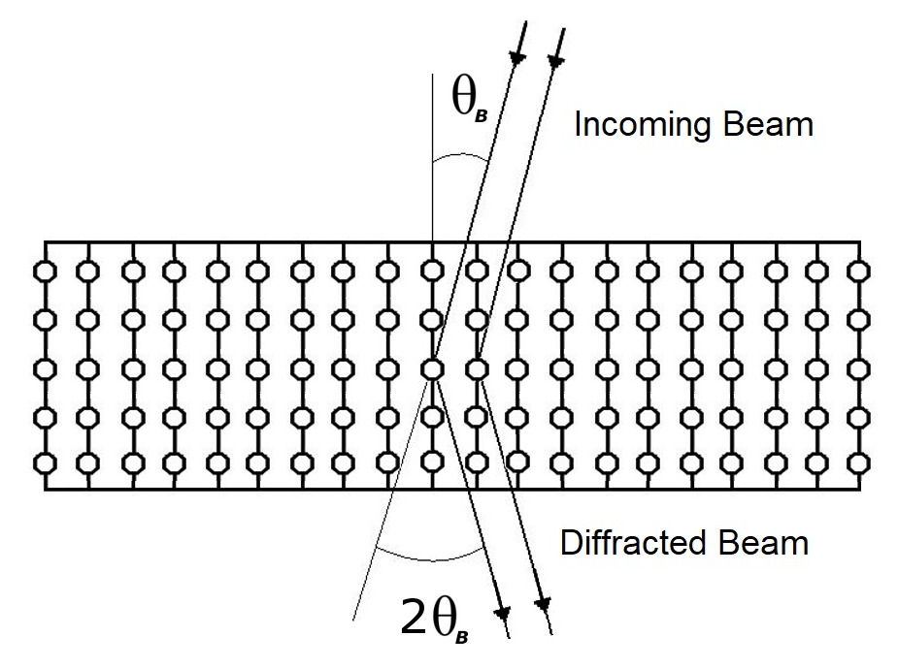
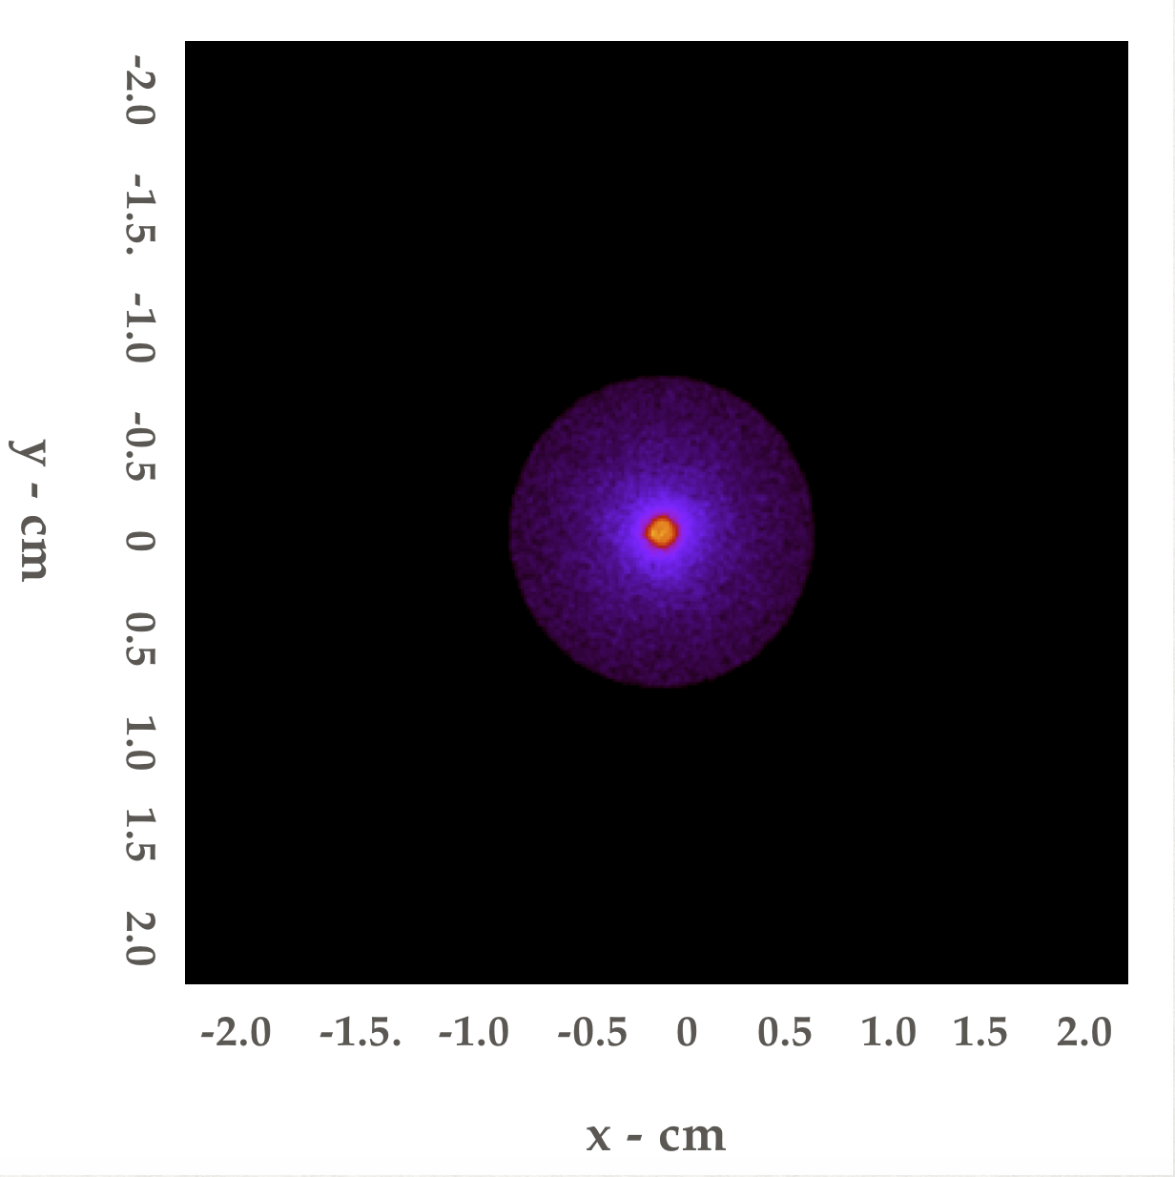
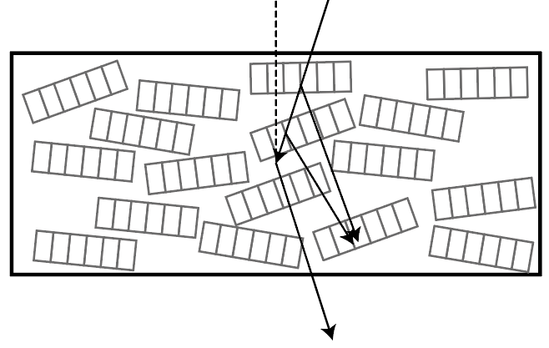
The crystals: flat vs bent, mosaic vs perfect
Simulations
FLAT
PERFECT
BENT
MOSAIC

Slide 5
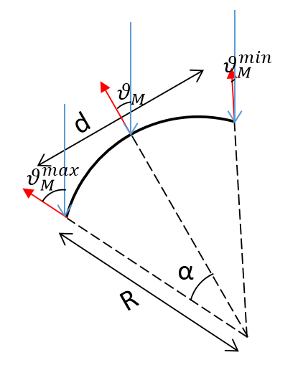
Our choice: bent perfect crystals (BPC)
Bent crystals act as concentrator of radiation
Bent crystals have a larger energy passband
Increased diffraction efficiency w.r.t. flat perfect crystals and mosaic crystals
Internal planes misalignment of BPC (quasi-mosaicity) smaller than the typical mosaicity of mosaic crystals ➛ better focalization

Slide 6
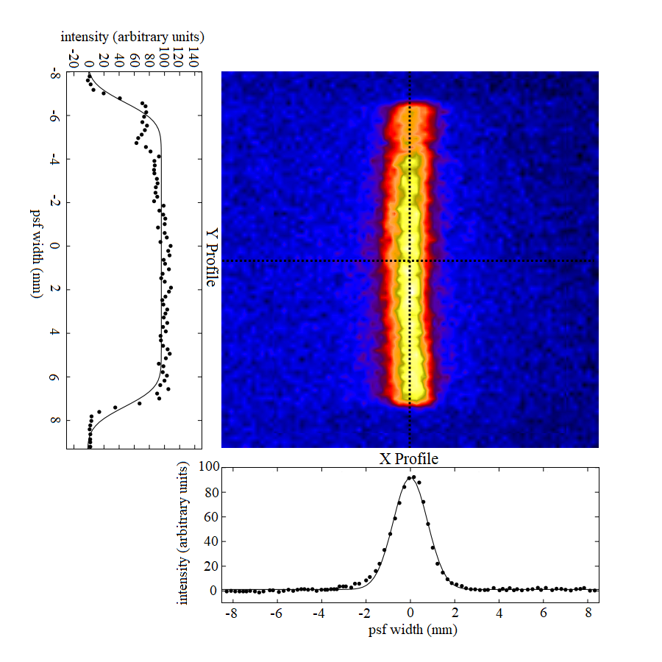
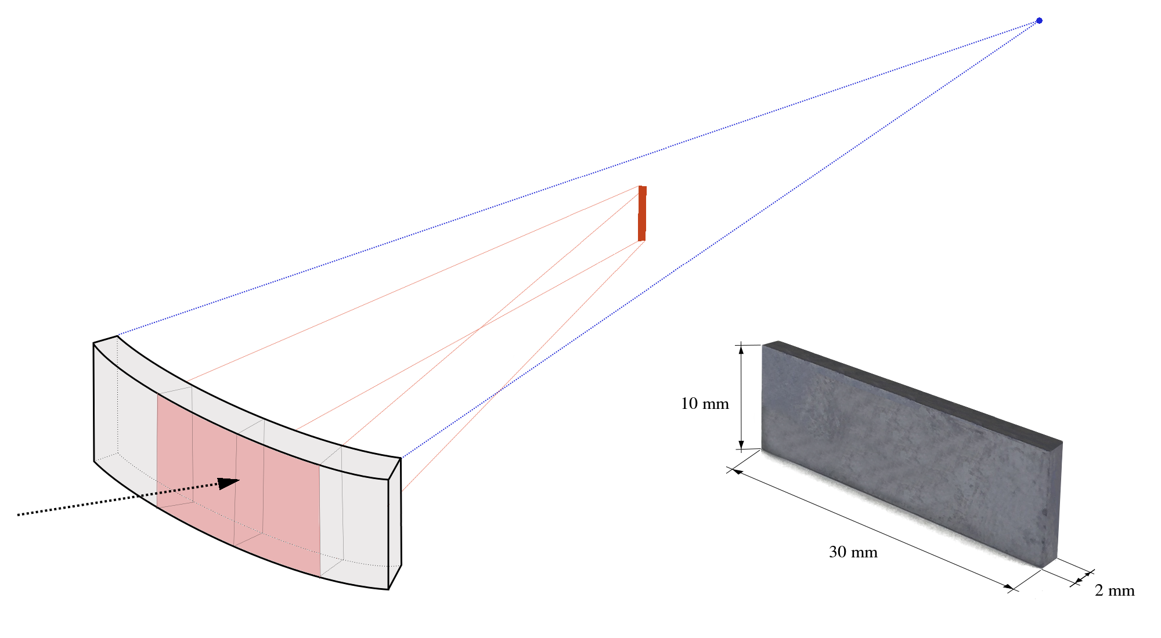
Our choice: bent perfect crystals (BPC)
Experimental Result @150 keV
From 30 x 10 cm² crystal area to 0.1 x 10 cm² image area → 30 times smaller
X-profile: ~8 arcsec FWHM
Crystal curvature radius = 40 m (Focal length = 20 m)

Slide 7
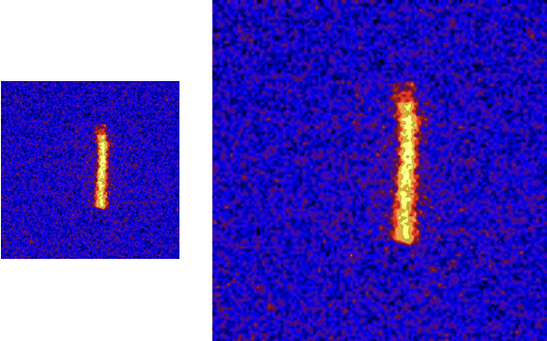
What can we achieve with Laue lenses?
Unprecedentend imaging capabilities: Better PSF than coded masks imaging (INTEGRAL/IBIS = 12’). Goal ~30”
Enable real concentration/imaging. Concentration of radiation up 600 keV!
Lightweight, stable optics. Less than 150 kg optics
Combined with an adequate focal plane detector, can allow us to make X-ray spectroscopy and polarimetry with an unparalleled quality

Slide 8
The TRILL project: building a first prototype of broadband Laue lens
Aim: To increase the Technological Readiness Level (TRL) of Laue lenses
Repeatable and affordable method to bend the crystals
Assembly of four modules of a Laue lens
Study of a way to connect and orient the modules in a single prototype

Slide 9
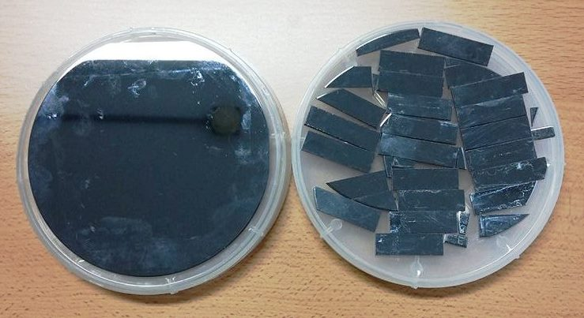
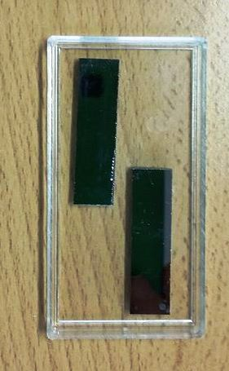
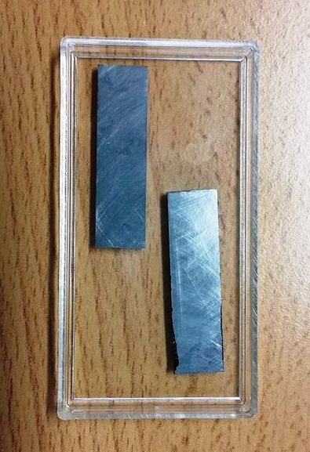
1. Bent Perfect Crystals (@CNR/IMEM-Parma)
Perfect crystals of Silicon and Germanium are cut and bent by surface lapping
Surface lapping of the crystals
Cut to obtain 30 x 10 x 2 mm³ tiles

Slide 10
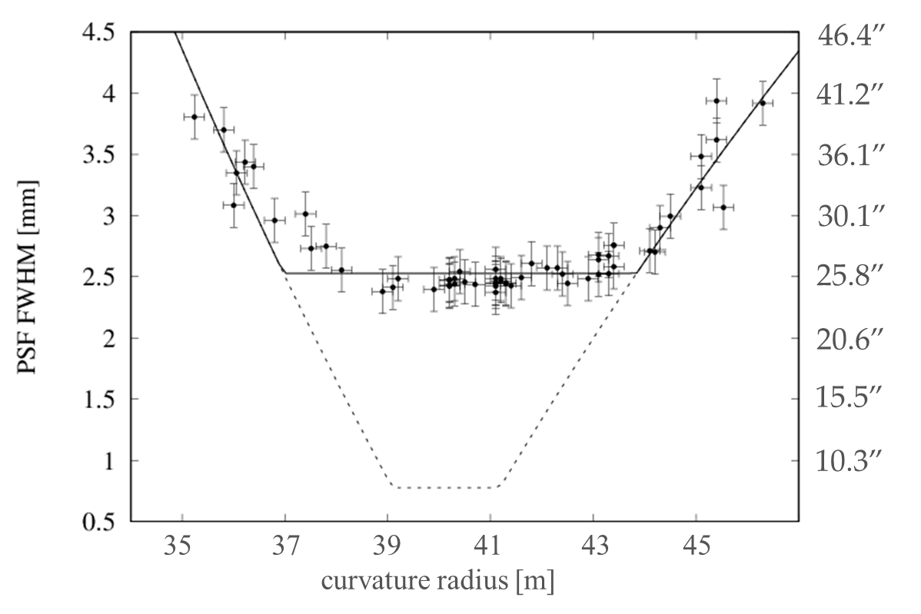
1. Bent Perfect Crystals: previous results on mosaic GaAs crystals
Previous crystals: Bent mosaic crystals
(tentatively 40 m curvature radius)
mosaicity ~ 13 arcsec
Target: perfect crystal spread
We need an accuracy on the curvature radius < 2 m

Slide 11
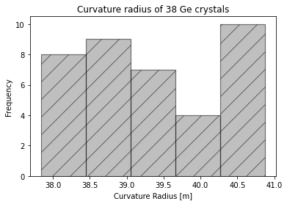
1. TRL Improvement: Bent Perfect Crystals (@CNR/IMEM-Parma)
First 38 crystals of Germanium(022) bent with surface lapping technique.
Average curvature radius = 39.3±0.2 m, with standard deviation of 1 m
High precision and highly repeatable way to bend the crystals!
A reliable bending technique has been defined!

Slide 12
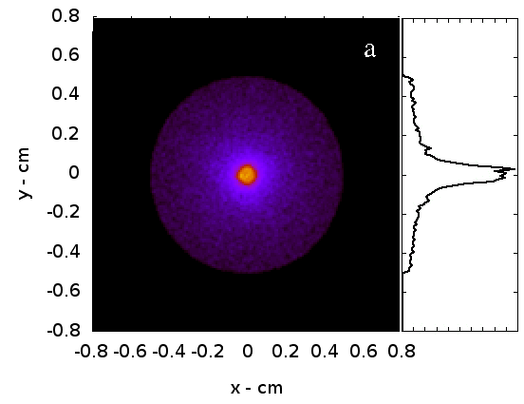
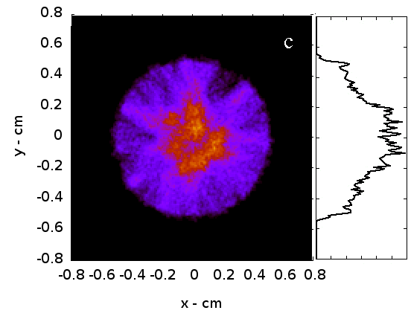
2. Module assembly (@UniFE): required positional accuracy
Bent Perfect crystals of Ge (111)
Nominally bent to 40 m
No construction inaccuracies
Bent Perfect crystals of Ge (111)
15’’ average mounting inaccuracy
We need a mounting accuracy < 10 arcsec
HPD ~ 1.5 mm (15”)
HPD ~ 3.1 mm (30”)

Slide 13
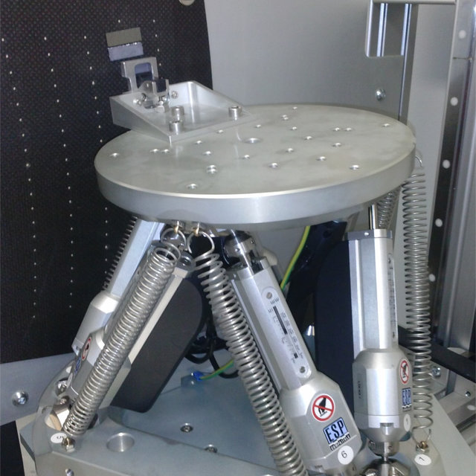
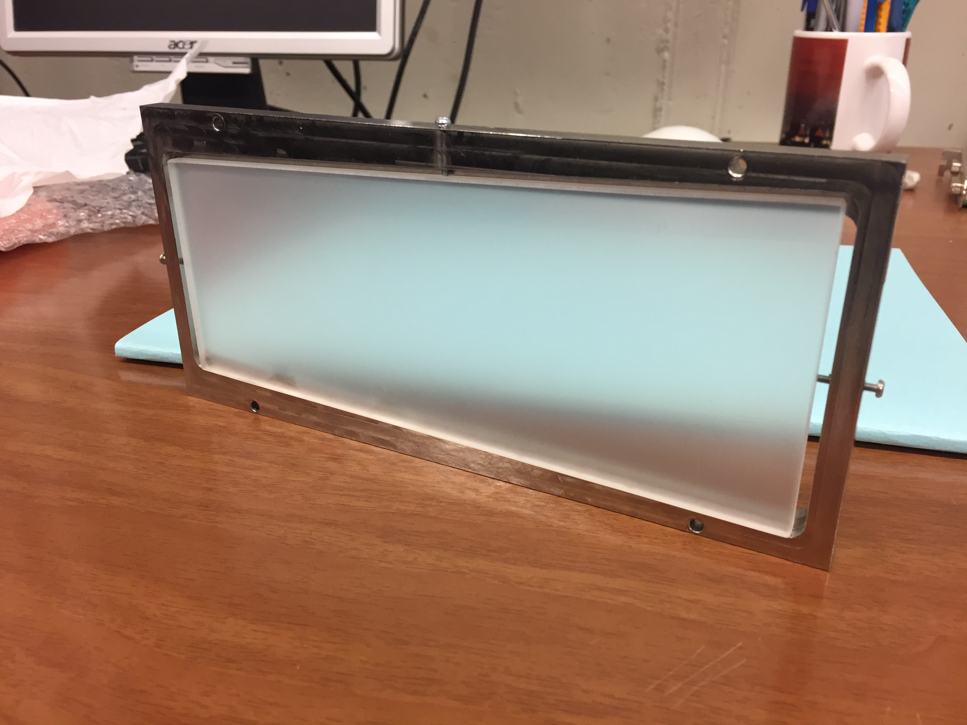
2. Module assembly (@UniFE)
Crystals are glued on a clear quartz substrate by using a low-shrinkage, space qualified glue and a motorized positioning hexapod
-Six degrees of freedom
-Micrometric accuracy
-Controlled from remote
-Transparent to UV
-Low CTE
-Bent to the same curvature radius of the crystals (40 m)

Slide 14
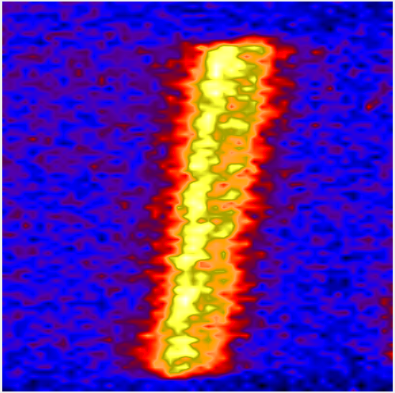
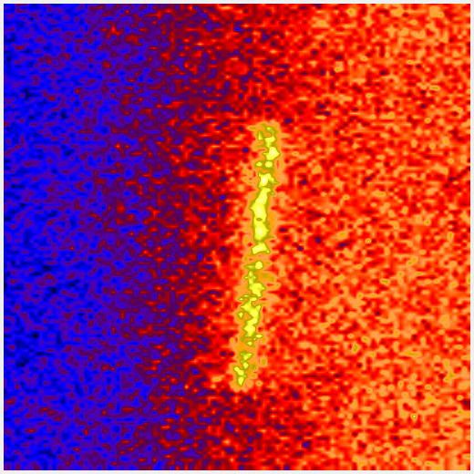
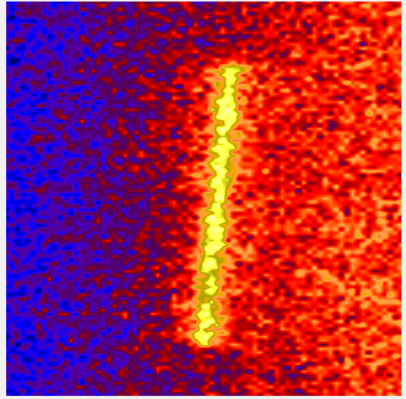
2. Module assembly (@UniFE) : first experimental image of 2 aligned crystals
+
=
Crystals aligned with a misalignment ~ 15 arcsec

Slide 15
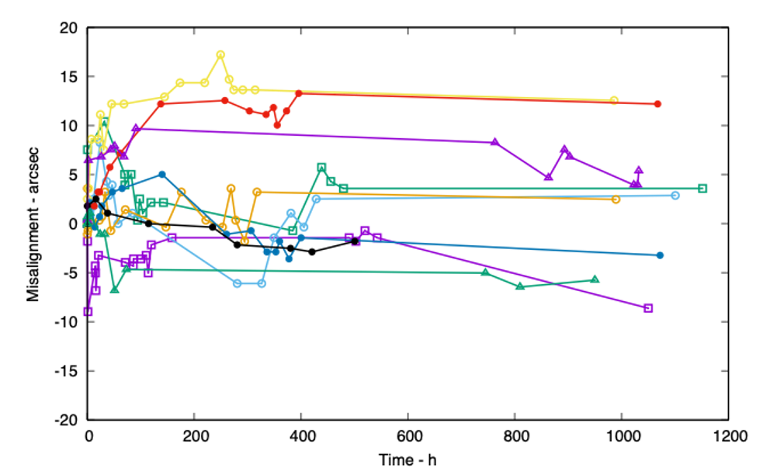
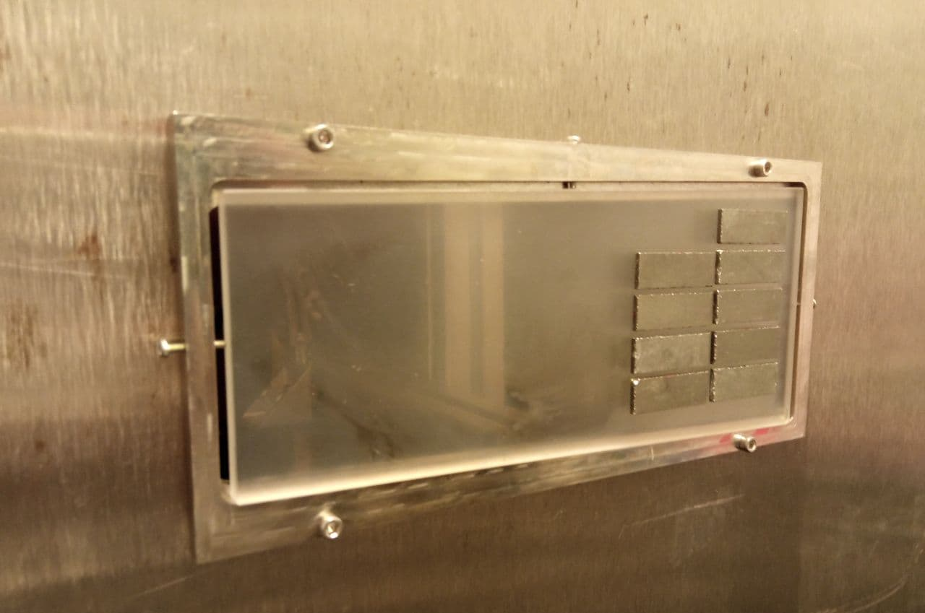
2. Module assembly (@UniFE): improving the assembly accuracy
Misalignment within the +15/-10 arcsec after 50 days
Getting close to target (10 arcsec)
…but there is a problem of stability in time!

Slide 16
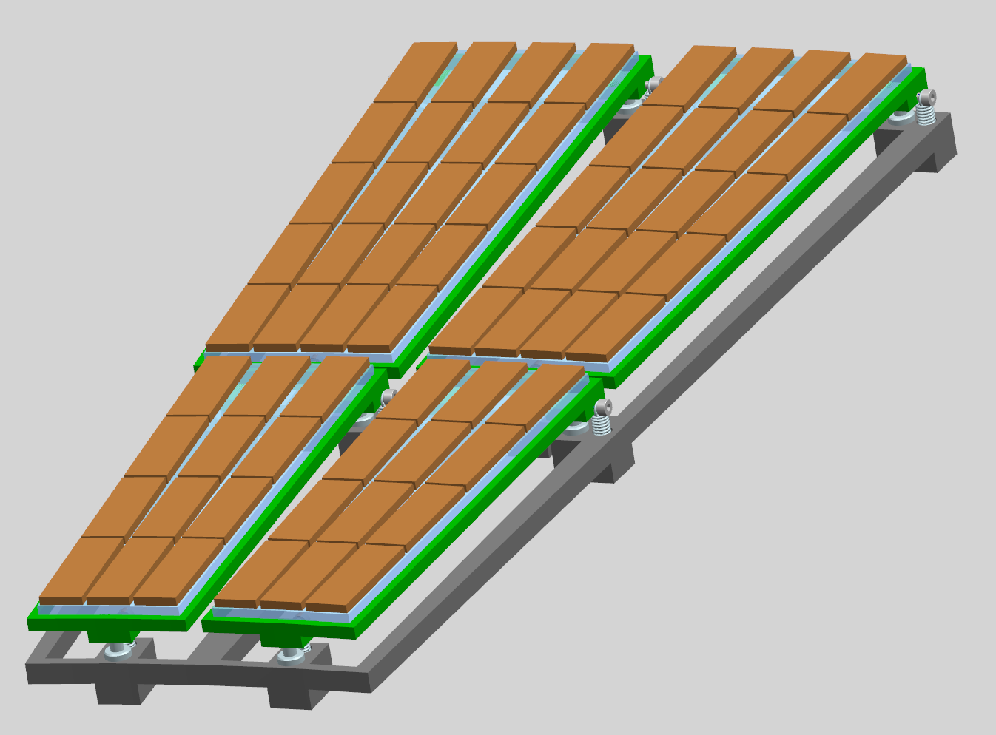
Next steps of TRILL
Production of ~80 bent Germanium (111) crystals, with ultralow miscut angle of the planes (<10 arcsec)
Further refining the mounting procedure for a single module
Define and test new assembly technique: elastic bending and gluing of the crystals on a curved substrate or non-glue based bonding (ex: anodic bonding)
Assembly of the 4 modules prototype

Slide 17
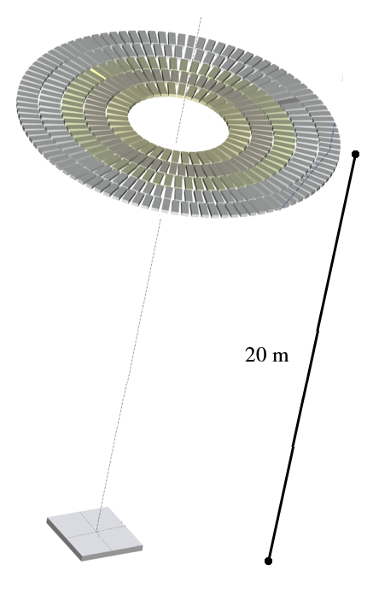
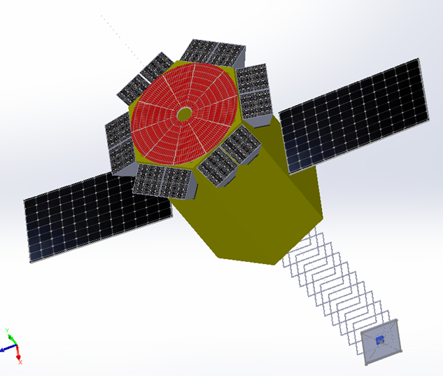
Our final goal: the Narrow Field Telescope (NFT) aboard ASTENA
Laue Lens optics with 20 m focal radius
~19500 crystal tiles of Si(111) and Ge(111)
Energy passband: 50 – 600 keV
FoV: 4 arcmin
~30 arcsec Half Power Diameter (HPD)
1.5 m
3D CdZTe (CZT) focal plane detector
Detection efficiency > 80%
300 μm spatial resolution
No need for cooling

Slide 18
Thank you for your attention!
Further readings:
Frontera et al., Understanding the origin of the positron annihilation line and the physics of the supernova explosions, 2019
Guidorzi et al., A Deep Study of the High-Energy Transient Sky, 2019
Virgilli et al., The Narrow Field Telescope aboard ASTENA
Virgilli et al., Expected performances of a Laue lens made with bent crystals
Virgilli et al., State-of-the-art of the hard X-/soft γ-ray focusing telescopes: The LAUE project status
Contact us!
Dott. Lisa Ferro: lisa.ferro@unife.it
Dott. Enrico Virgilli: enrico.virgilli@inaf.it
Dott. Miguel Moita: mmoita@fe.infn.it
Prof. Piero Rosati: rosati@fe.infn.it
Prof. Filippo Frontera: frontera@fe.infn.it

Slide 19
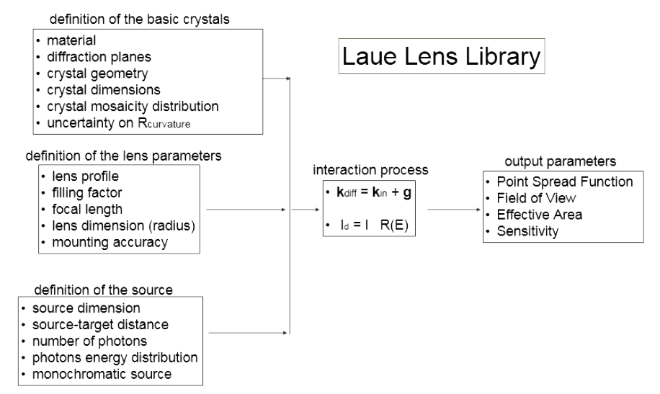
The Laue Lens Library (LLL) simulation software
Monte Carlo Simulation + Ray Tracing
Input Parameters

