Slide 1



Fuzzy Dark Matter
David J. E. Marsh,
Marcel Grossman Meeting, 2021

Slide 2
Fuzzy dark matter physics

Slide 3
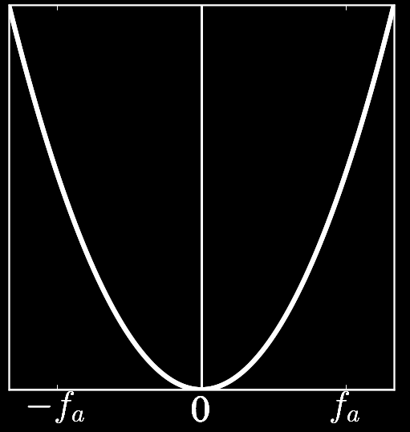
Vacuum Realignment
Scalar condensate evolves according to Klein-Gordon:
Field is “frozen” by Hubble friction term.
FDM is “DE-like” at early times

Slide 4
Vacuum Realignment
Scalar condensate evolves according to Klein-Gordon:
Field oscillates & damps.
WKB (or exact) →
Osc. scalar ~ matter

Slide 5
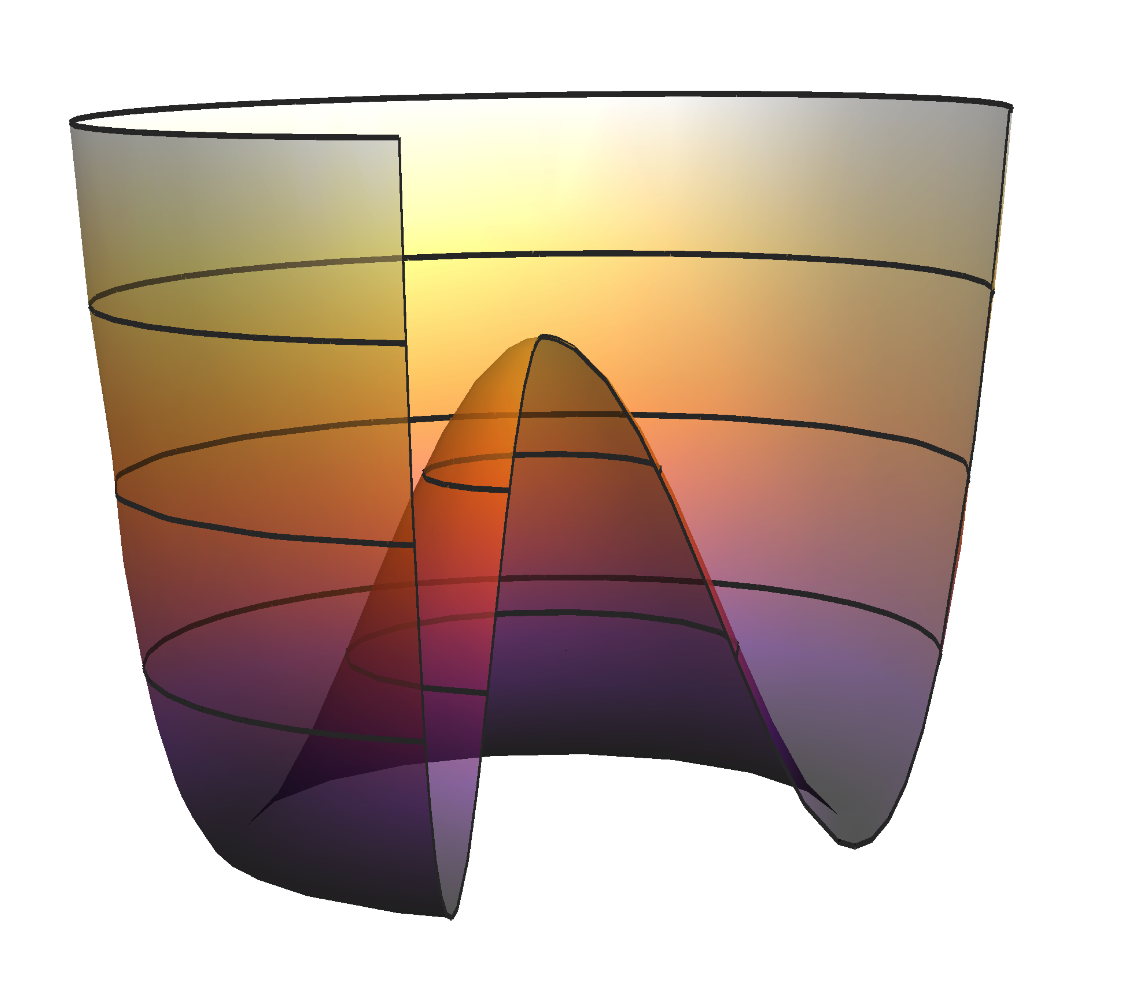
Predictions for Ω_{a}
Assume symmetry breaking → f_{a} ~ GUT scale, θ=1, m=const.
Correct amount of DM
Dark Matter
Too much DM → reduce f or θ @ high m
Neutrinos
A sub-dominant population of light axions to search for

Slide 6
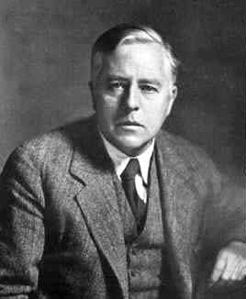
The FDM Jeans Scale
Khlopov et al (1985)
Consider equation for field perts. as effective fluid dens, δ.
Gradient energy → scalar DM has effective sound speed:
pressure
gravity
WKB approx, e.g. Park et al (2012)

Slide 7
Inside Galaxies
e.g. Widrow & Kaiser (1993); DJEM (2015+); Hui et al (2016)
Fundamentally different from CDM/WDM/SIDM etc.
Non-rel limit of Klein-Gordon-Einstein → Schrodinger-Poisson:
Challenge: simulate this equation over a wide range of scales.
Cosmology covers Gpc → kpc lengths, and overdensities ~ 10⁵.
Gradient “pressure” → formation of stable boson stars.
Waves → interference, fluctuations.

Slide 8

Movie: Jan Veltmaat (Veltmaat et al 2018)

Slide 9
Heating & Cooling
Hui et al (2016); Bar-Or et al (2018)
The fluctuating FDM halo can be considered as quasi-particles:
Two-body relaxation for particles mass m in host of M:
For tracers of mass m_{t}>>m_{qp} → cooling. Otherwise, heating.
On this timescale, FDM departs from CDM.

Slide 10
cosmological constraints

Slide 11
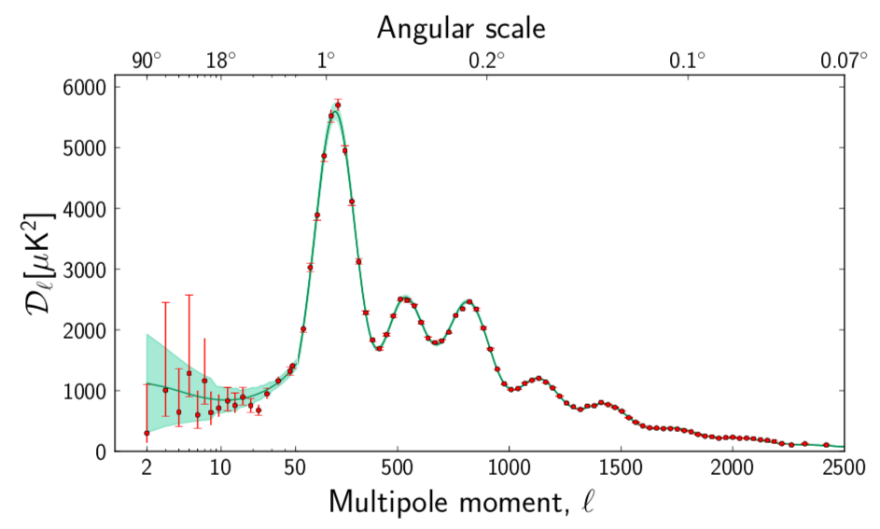
The CMB Power Spectrum
Features predicted from linear perturbations. Sound waves in plasma.
Diffusion damping → probe early matter content
~ distance to CMB → probe DE

Slide 12
The CMB Power Spectrum
Features predicted from linear perturbations. Sound waves in plasma.
Use axionCAMB

Slide 13
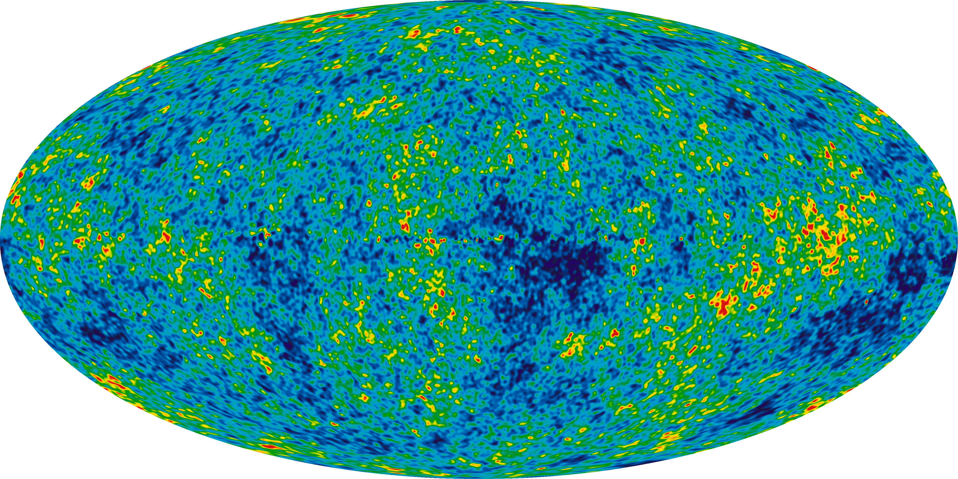
CMB Constraints on Ω_{a}
Heavier FDM allowed
Constrained to few percent
CMB anisotropies constrain lightest region to < 2.5% of DM.
Absolute lower bound on DM particle mass:
Future prospects with high-definition cosmic-variance, e,g. CMB-S4+.

Slide 14
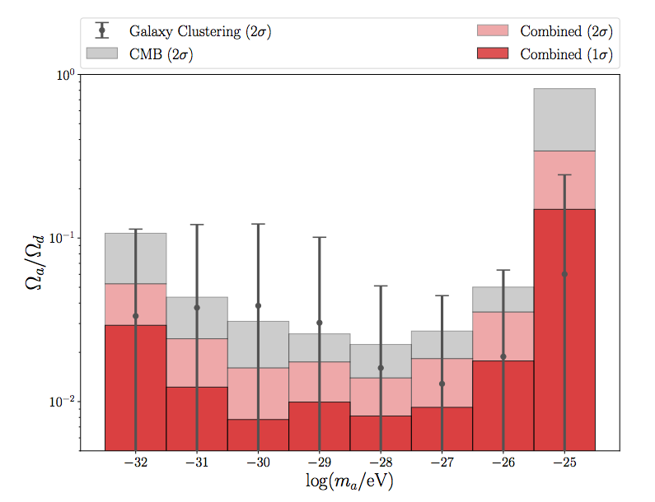
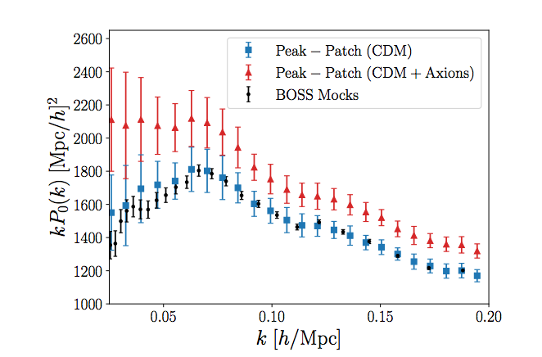
BOSS Galaxy Clustering
Lague, DJEM et al (2021)
Simulate the galaxy bias: FDM increases large scale power.
CMB+galaxy clustering breaks degeneracies: factor ~3 improved limit.

Slide 15
DES Cosmic Shear
Dentler, DJEM et al (forthcoming)
Marginalise nuisance params for halo formation and quasi-linear scale.
Preliminary bound from non-linear scales:

Slide 16
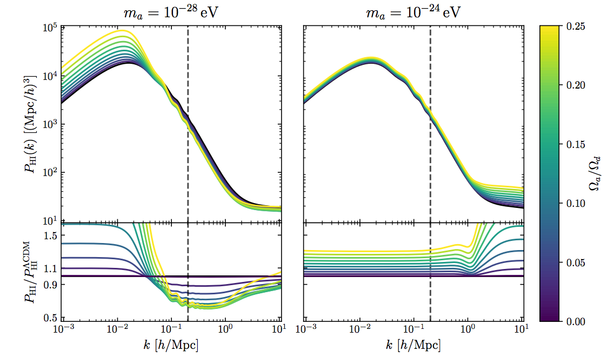
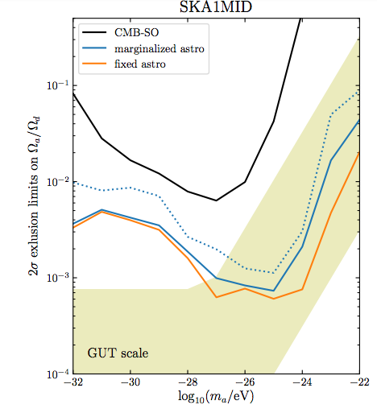
HI Intensity Mapping
Bauer, DJEM et al (2020)
Similar biasing effect appears for neutral hydrogen.
Forecast SKA could test connection relic density ←→GUT scale.

Slide 17
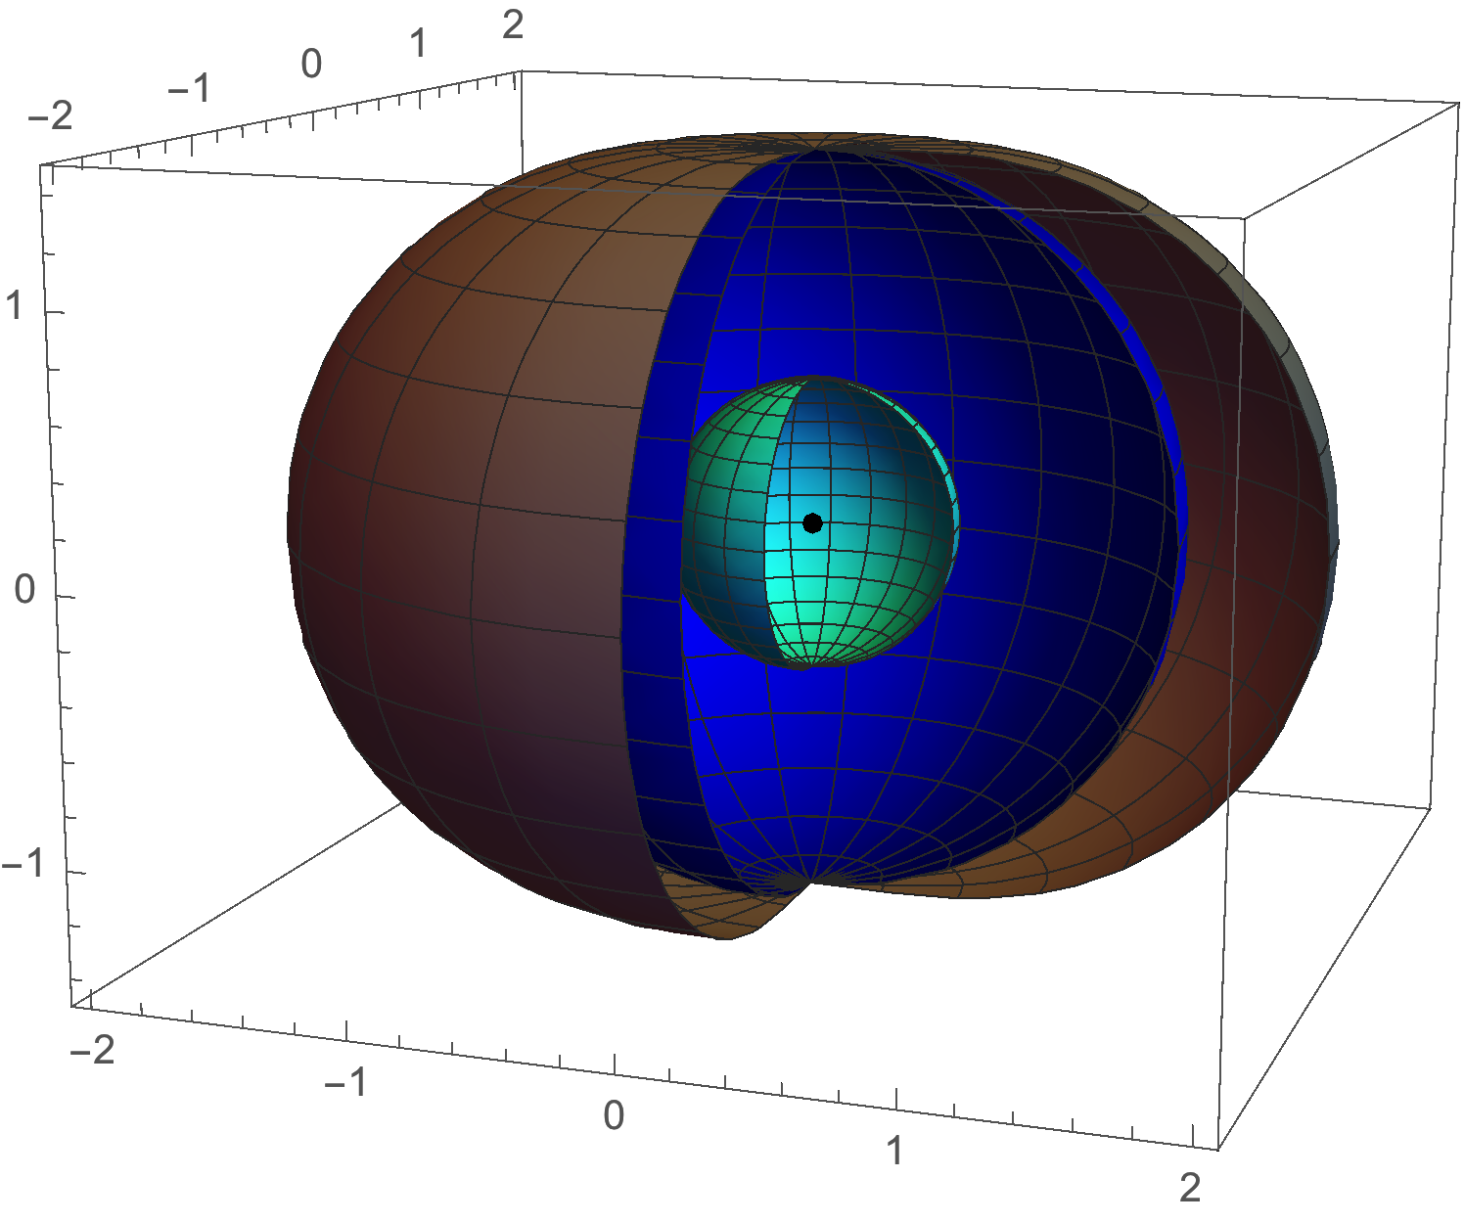
Superradiance
[1] DJEM & Stott, Phys. Rev. D96, 083006 (2018)
Vacuum fluctuation, bounds on (m,λ). Linear (no backreaction).

Slide 18
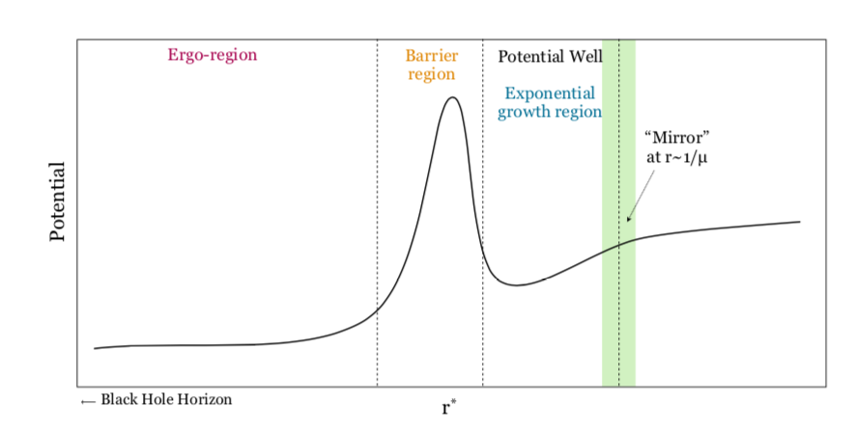
Kerr spacetime excites boson vacuum fluctuations.
The angular momentum and boson mass lead to a confining potential:
Penrose (1969)
Fig: Arvanitaki & Dubovsky (2010)
Infalling waves rescatter and the amplitude grows exponantially, extracting spin from the Kerr BH.
Press & Teukolsky (1972)

Slide 19
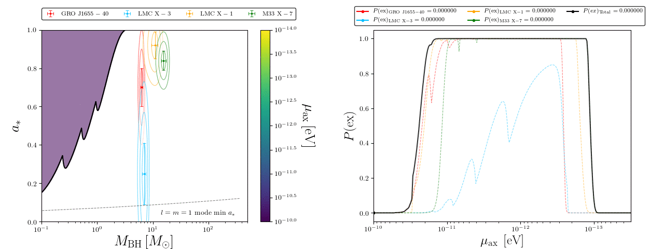
BHs should not be observed in regions where SR is effective.
Compute exclusion probabilities for astrophysical BHs.
Mass-spin measured by e.g. X-ray reflection spectroscopy.
Figs: Matthew J. Stott
Vacuum fluctuations → constraints independent of DM density.

Slide 20
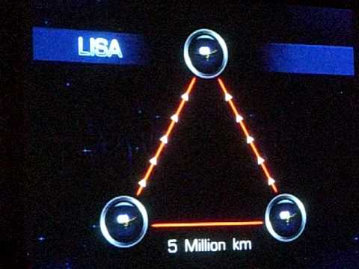
Black Hole Superradiance
Exclusions from observed stellar and supermassive black hole spins.
“1 Hz FDM window” accessible from IMBH inspirals (LISA).
1 Hz axion + strong CP problem → measurable neutron EDM
Win & DJEM (2020)

Slide 21
Calabi-Yau Topologies
Mehta, DJEM et al (2020,2021)
Axions in Type-IIB CY models. Hodge# → # of axion flavours.
Construct ~10⁵ Kreuzer-Skarke CYs. Sample moduli space.
Axions in BHSR windows → geometry is excluded!

Slide 22
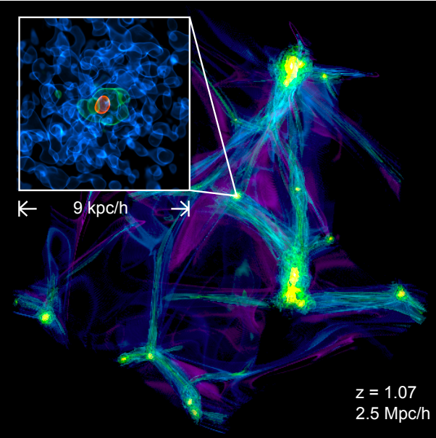
Fig: Veltmaat, Schwabe & Niemeyer (2018)
FDM Galaxy Formation
[1] DJEM & Silk, MNRAS 437, 2652 (2014)
[2] Bozek, DJEM, Silk & Wyse, MNRAS 450, 209 (2015)
[3] DJEM & Niemeyer, PRL123, 051103 (2019)
[4] Review: Niemeyer
arXiv:1912.07064
Jeans scale, quasiparticles, and solitons: strong bounds on m. Non-linear.

Slide 23
FDM window: 10⁻²⁴ eV< m <10⁻¹⁹ eV. Linear physics, few assumptions.
A “GUT scale miracle” gives the correct relic density.
Could this solve CDM’s “small scale crises”?
(DJEM & Silk, 2014, Hui et al 2016)

Slide 24
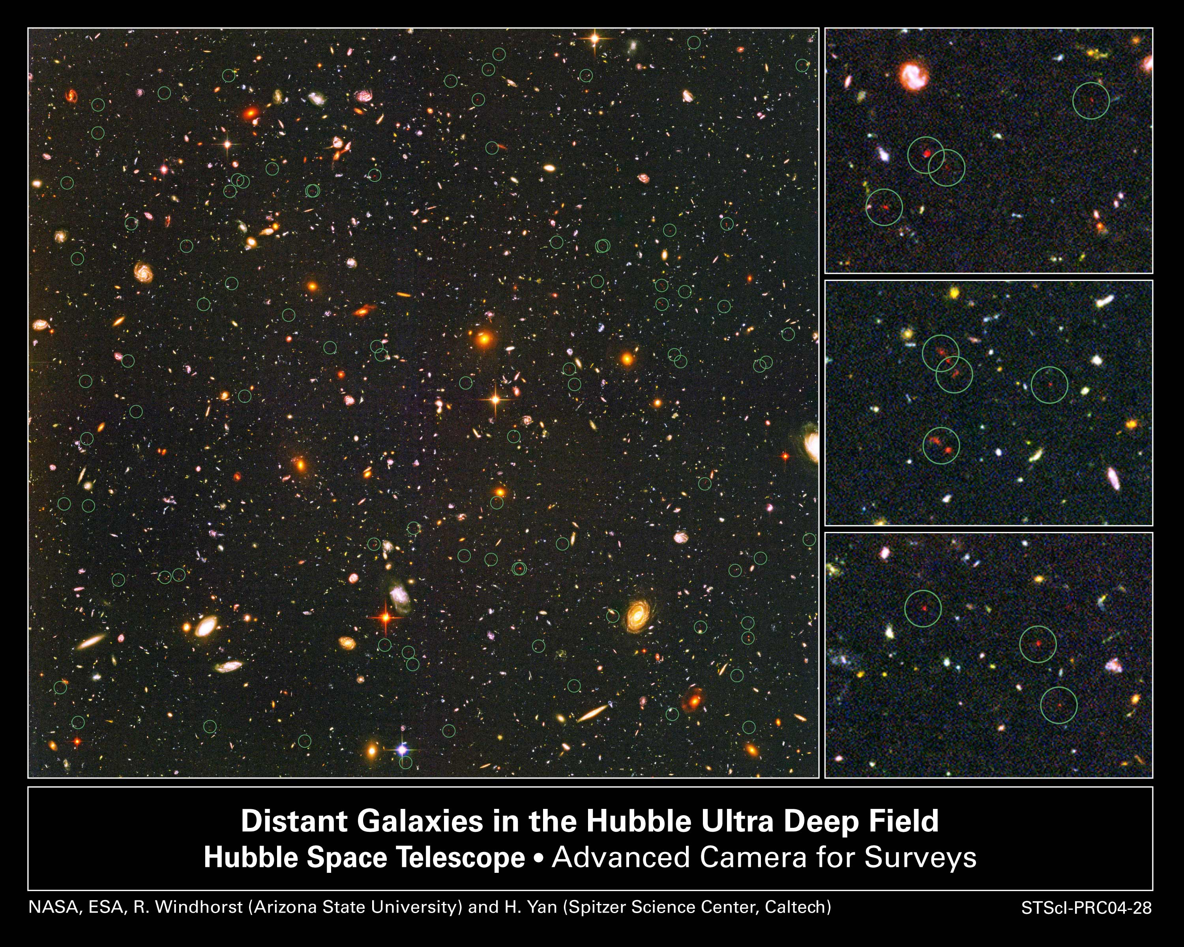

Slide 25
FDM Jeans mass:
“Abundance matching” relates DM halo mass to UV luminosity:
FDM bound:
Limit on Jeans scale
HUDF luminosity data:
Bouwens et al (2014)
Bright
Galaxies
Faint
Fig: Schultz et al (2014)
Limit: Bozek, DJEM et al (2014)

Slide 26
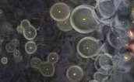
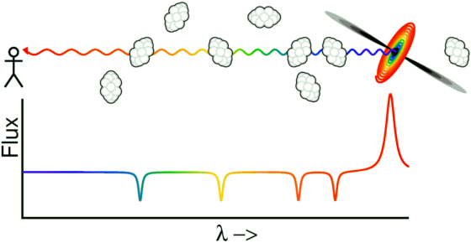
Galaxy Formation Constraints
Ly-a forest P(k) increases the lower bound on mass:
Rogers & Peiris (2020)
Future precision with errors reduced to 10%, e.g. by WFIRST.

Slide 27
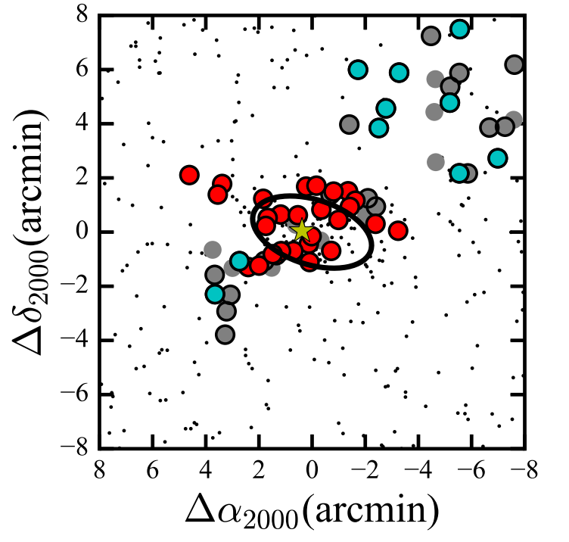
Eridanus-II
Li et al (2016)
Eri-II is an ultrafaint dwarf galaxy:
with a centrally located star cluster:

Slide 28
The ULA halo has a time-dependent potential with period:
In the diffusion approximation, this leads to heating of the star cluster:
Brandt (2016)
In perturbation theory, core oscillations lead to oribtal resonances:
Impose constraints by demanding:
See also El-Zant et al (2016,2019)
Notes:
Coulomb logarithm. Shot noise power.

Slide 29
Core oscillations →
Orbital resonances
Quasiparticle heating
~40% amplitude variation
Excluded by formation of Eri-II if
Ω_{a}/Ω_{d}=1
Possibility to avoid constraints?
DJEM & Niemeyer (2018)

Slide 30
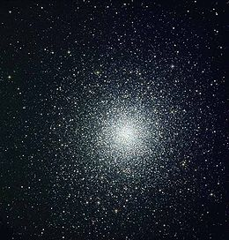
Survival of Eri-II Cluster
Resonance → strong bound on FDM density.
Increase lower bound on FDM mass to
However: need for better modeling, simulation, and data.

Slide 31
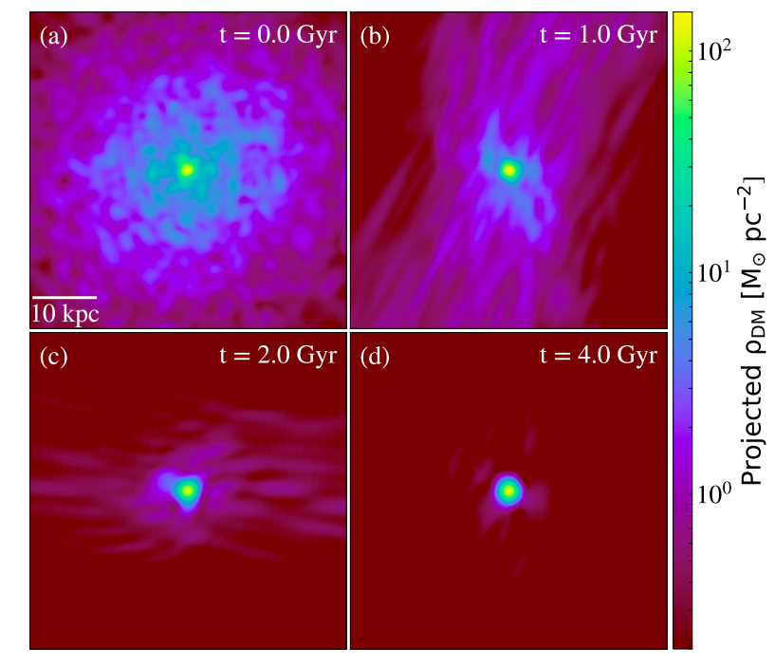
Tides to the Rescue?
Schive et al (2019)
MW tidal field strips quasiparticle atmosphere → no heating.
Eri-II survives with m=10⁻²² eV. Fitted initial halo mass very large.

Slide 32
Compton Wavelength
Astrophysical Scales
Dark Energy
“QCD axion”
Fuzzy Dark Matter

Slide 33
Backup slides

Slide 34
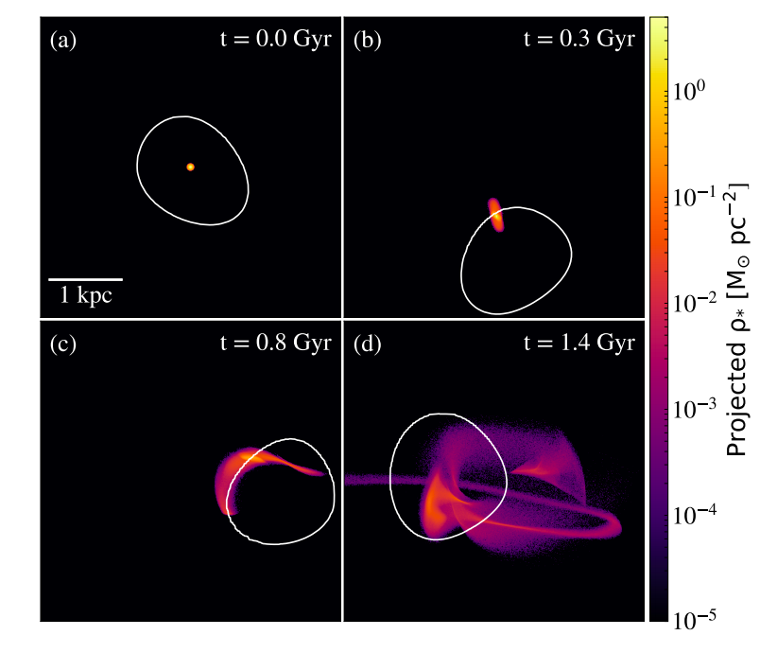
Soliton “Random Walk”
Schive et al (2019)
Previous analysis fails when m<10⁻²¹ eV: oscillations are adiabatic.
However, quasiparticles → soliton random walk w.r.t halo c.o.m.

Slide 35
Penrose Process
Figs: Viraf Mehta
Particle enters Kerr ergoregion, splits in two, one part emerges with more energy than it went in with → spin down BH.

Slide 36
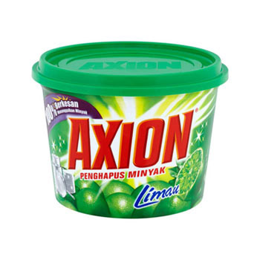
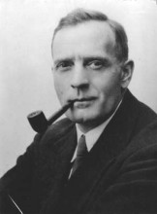
Jeans Scale Intuition
Consider an observer and an axion moving with the Hubble flow:
We cannot localise the axion unless:

Slide 37
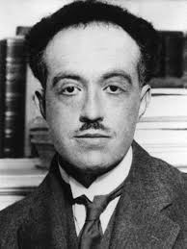
Jeans Scale Intuition
Consider an observer and an axion moving with the Hubble flow:

Slide 38
Jeans Scale Intuition
Increasing distance → increasing v → decreasing wavelength:
=
Equality when separated by exactly Jeans scale:

Slide 39
Boson Stars and Cores
Schve et al (2014+); DJEM & Pop (2015);
Gonzales-Morales, DJEM et al (2016)
The FDM soliton can explain dSph cores only if m<10⁻²² eV.

Slide 40
FDM Boson Star Miscellania
Boson stars form in the centre of all FDM halos and obey the “core halo mass relation” (Schive et al, 2014):

Slide 41
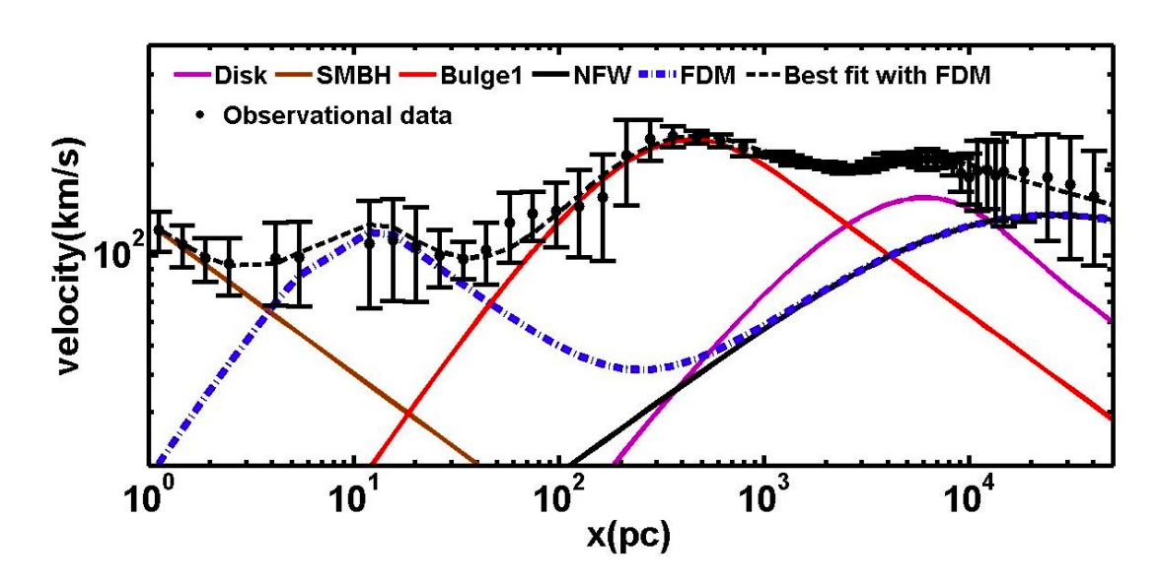
FDM Boson Star Miscellania
Milky Way inner bulge? Maleki et al (2020)

Slide 42
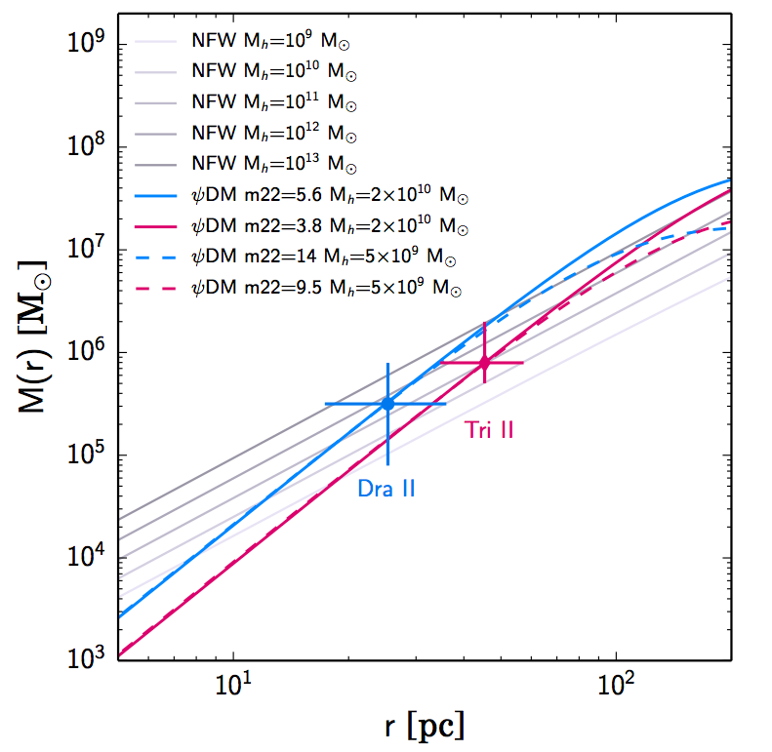
FDM Boson Star Miscellania
Ultrafaint dwarfs? Calabrese & Spergel (2016)
NFW → UFD halo masses too large

Slide 43
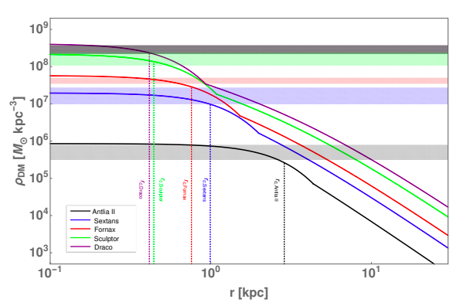
FDM Boson Star Miscellania
Ultrafaint dwarfs? De Martino et al (2019)

Slide 44
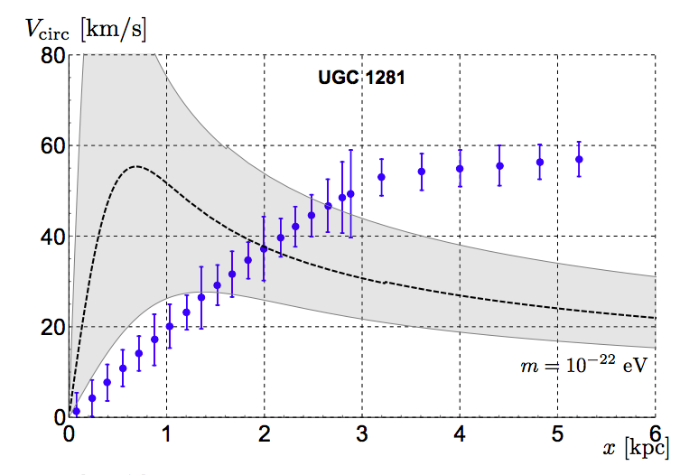
FDM Boson Star Miscellania
Mc-Mh relation is problematic in LSBs. Bar et al (2018)
NFW piece not included
Soliton → V too lagre at r ~ kpc

Slide 45
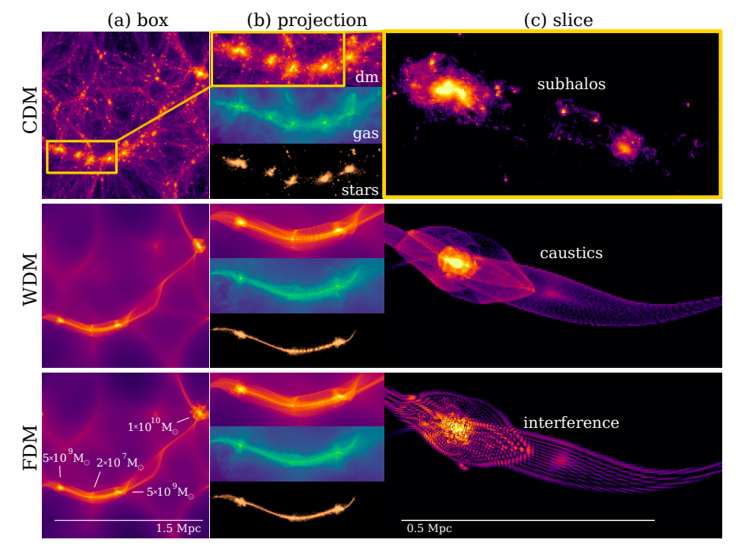
Fringes and Filaments
Mocz et al (2019)
Striking effects inside filaments: smooth gas, DM fringes.

Slide 46
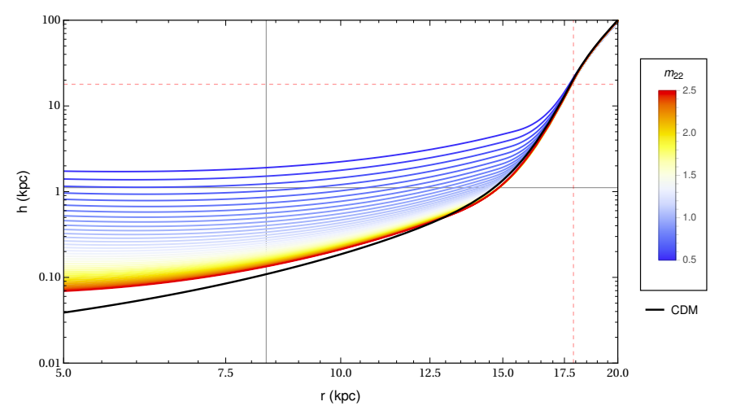
Heating & Cooling Bounds
Church et al (2019)
See also: Bar-Or et al (2018) and others
In the solar neighbourhood, m_{qp}>m* → heating of disk stars.
This may explain the “thick disk”, but need t_{rel} not too short.
m₂₂<0.6 excluded
Correct
thickness
m₂₂~1 just right
R_{sun}

Slide 47
Suppressed clustering → suppressed lensing below the Jeans scale.
High multipoles → small angular scales → larger axion masses probed.
Notes:
Clustering effects dominate constraints for high axion mass. In the CMB, this is seen in secondary lensing anisotropies. Measure lensing to extremely high L to improve lower bound on dominant DM component.

Slide 48
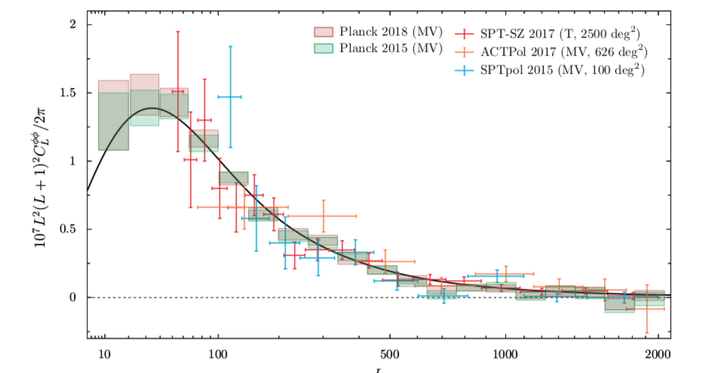
Used in analysis
Contaminated with non-linearities

Slide 49
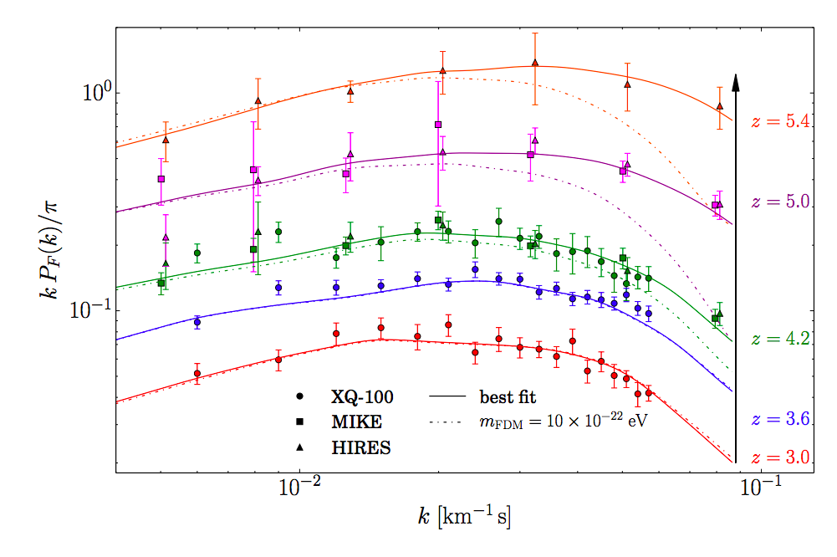
Lyman-alpha forest
Quasar flux along line of sight probes the small scale power spectrum → measure clustering consistent with cold DM.
m_{a}>2-3 x 10⁻²¹ eV Irsic et al (2017)

Slide 50
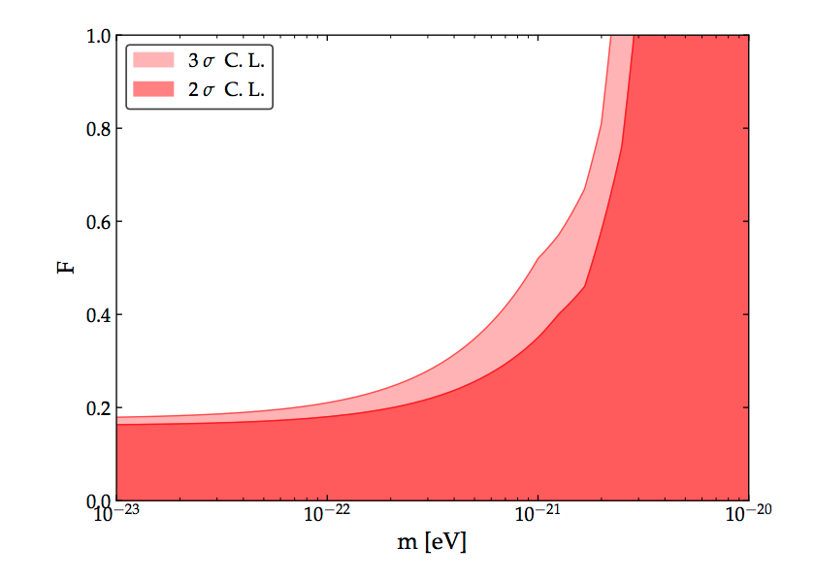
Lyman-alpha Forest
Axion DM Fraction
Koabayashi et al (2017)

Slide 51
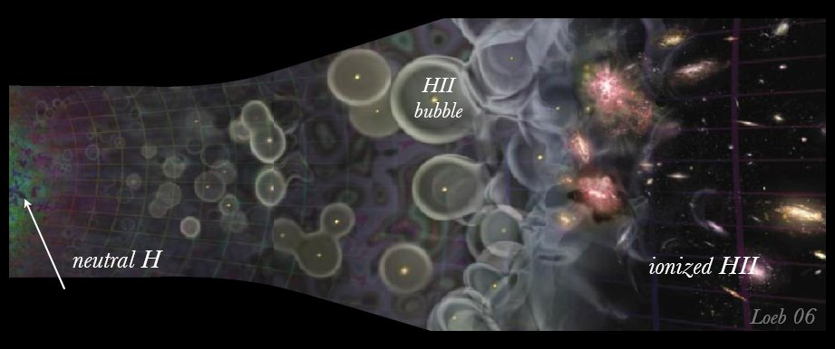
Reionization & Galaxy Formation
Image: Loeb, Scientific American
TIME
CMB
Earth
Earlier galaxy formation → reionize earlier
The formation of the first galaxies “reionizies” the Universe.
Axions: de Broglie → fewer early galaxies → later reionization than CDM.

Slide 52
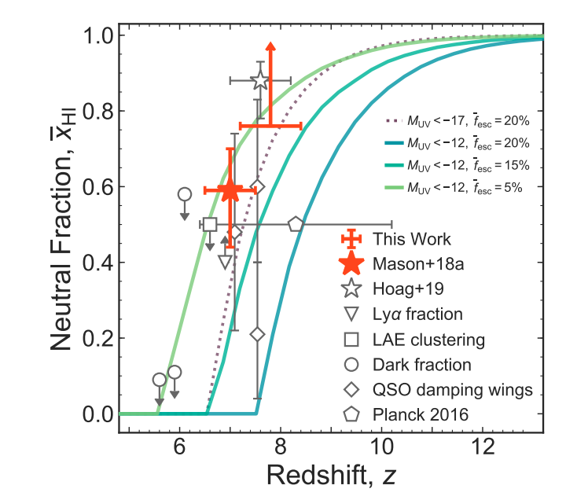
Reionization
FDM model: Bozek, DJEM et al (2015)
Data: Mason et al (2019)
Compute ionized fraction from UV flux:
Ionized Fraction
Reionization is occurring at z = 7. Constrains modeling for CDM.
Axions → bound on m ~ 1e-22 eV, prediction of model.

Slide 53
BHSR is shut-off by axion self-interactions. Attractive φ⁴ → cloud collapses in Bosenova.
Fig: Arvanitaki et al (2014)

Slide 54
BHSR is shut-off by axion self-interactions. Attractive φ⁴ → cloud collapses in Bosenova.
Fig: Arvanitaki et al (2014)

Slide 55
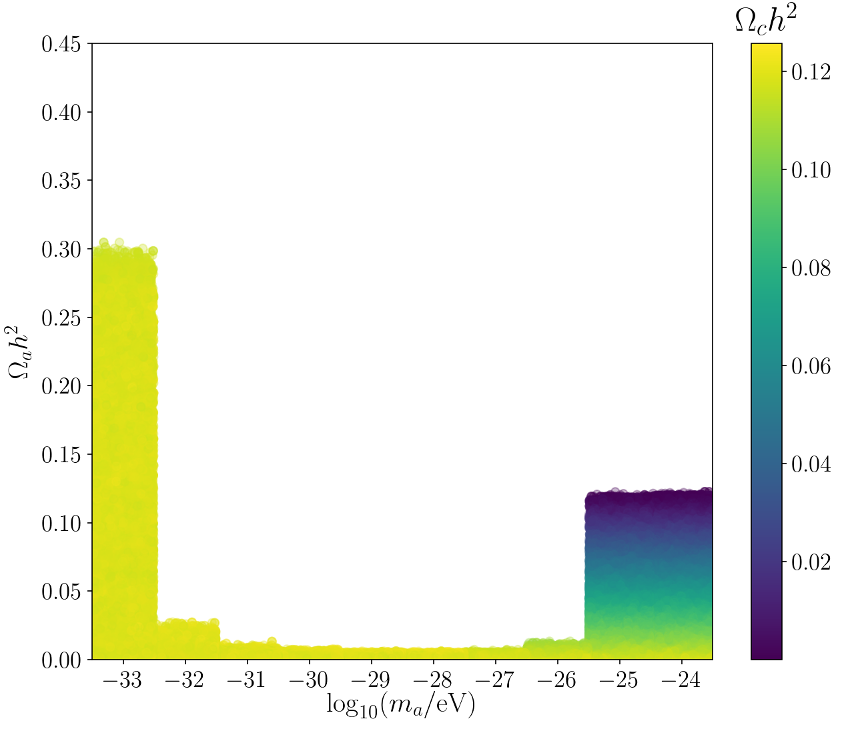
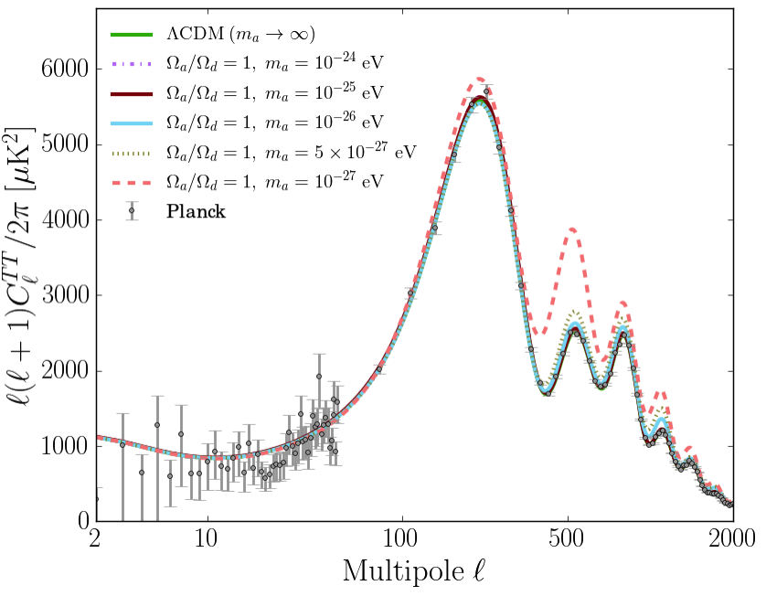
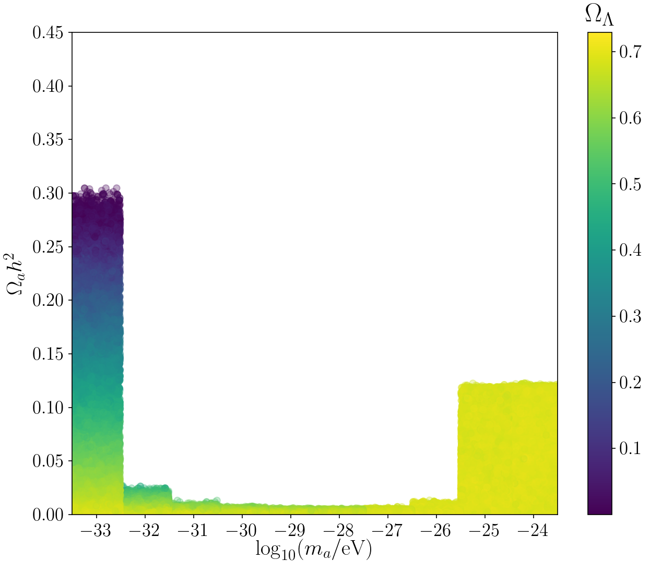
DE-like axions affect angular size + ISW by expansion rate in matter dom. era.
Effects vanish for small m → mimic cosmological constant.
DM-like axions affect acoustic peaks by expansion rate in rad. dom. era.
Effects vanish for large m → mimic CDM.
Notes:
Removing DM at early times →Expansion rate effects drive precision constraints at low axion mass in primary anisotropies. Improve high L acoustic peaks to get better precision DM constraints.

Slide 56
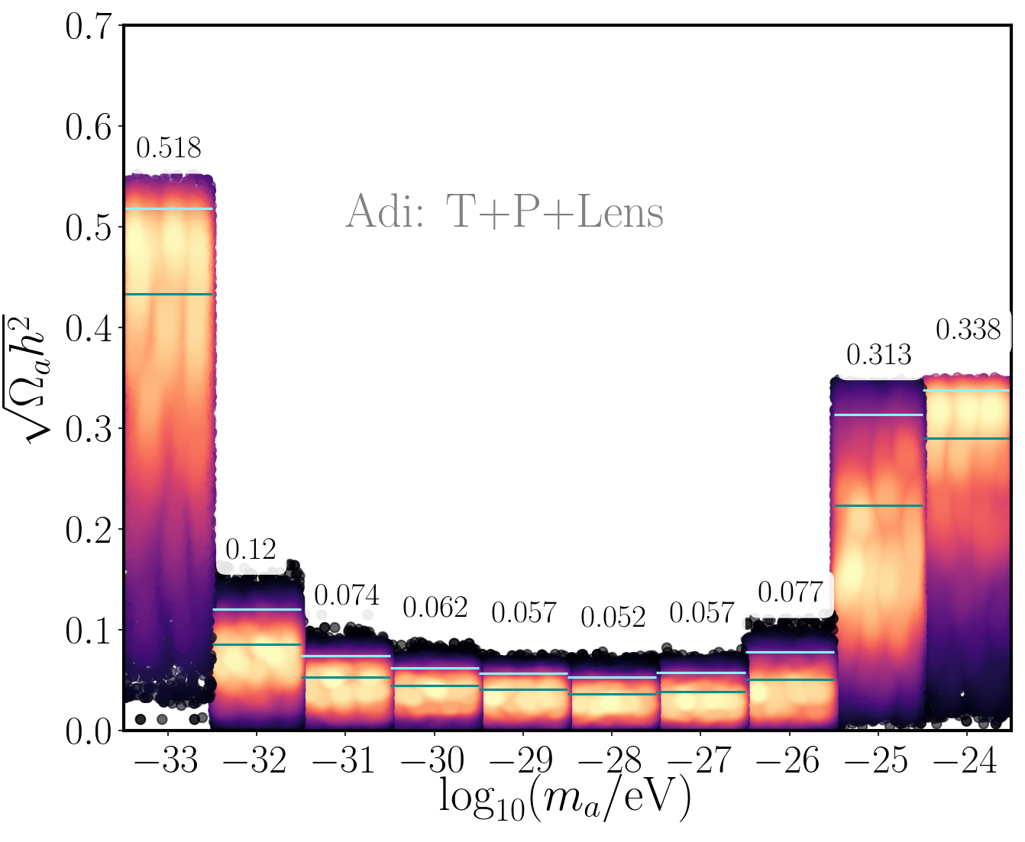
State of the Art: full CMB
Hlozek et al (2017)
Uses CAMB, COSMOSIS
Absolute lower bound on DM particle mass:
Dark Energy
(linear, well understood physics)
Precision constraints cover 7 orders of magnitude:
Notes:
DM fraction 2.5%. CMB leads the way.
Lower bound: stronger bounds form e.g. high-z galaxies, Lyman alpha, but non-linear, messier. Can the CMB catch up?
Not discussing Dark Energy

