Slide 1

Binary neutron star mergers of quark matter based equations of state
Atul Kedia
University of Notre Dame
akedia@nd.edu
Collaborators: Grant Mathews^{[1]} , Hee Il Kim^{[2]}, In-Saeng Suh^{[1]}
^{[1]} University of Notre Dame, ^{[2]} Sogang University
8th July 2021 | The 16th Marcel Grossmann Meeting

Slide 2
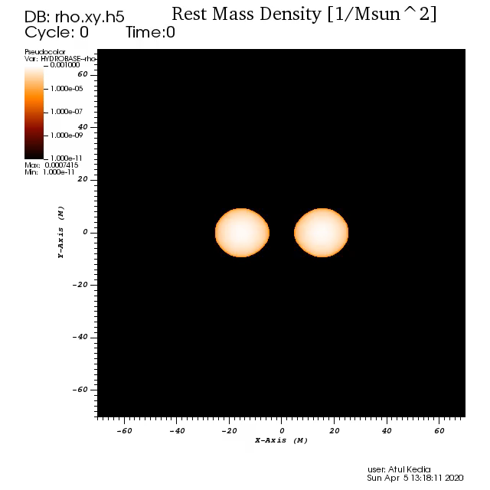
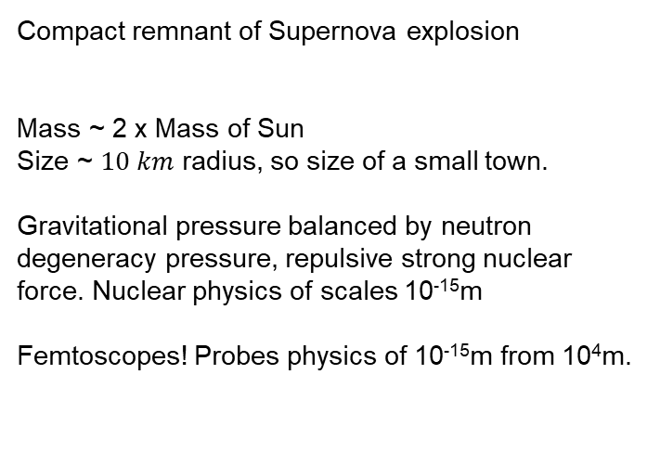
Neutron stars
Compact remnant of Supernova explosion
Mass ~ 2 x Mass of Sun
Size ~ $10 km$ radius, so size of a small town.
Gravitational pressure balanced by neutron degeneracy pressure, repulsive strong nuclear force. Nuclear physics of scales 10⁻¹⁵m
Femtoscopes! Probes physics of 10⁻¹⁵m from 10⁴m.
Binary Neutron stars merger (BNSM)

Slide 3
Interesting problems in binary neutron star mergers (BNSM)
Nuclear Equation of State (EoS) at core (Stiff v. Soft)
Inspirals at large separations well approximated by Post-Newtonian?
Sources of Short Gamma ray bursts? (M. Ruiz et al. (2016) in GRMHD)
Remnant of Mergers? Hypermassive Neutron star or Black hole? (Margalit, Metzger (2017))

Slide 4
Introduction to Numerical Relativity
GR: 3+1 (space-time) split and BSSN formalism.
Equations of State + Relativistic hydrodynamics to describe the flow of matter
Numerical relativity codes that do this: Einstein Toolkit, SpECTRE, Dendro, etc.
LORENE: Solves the TOV equation and prepares Initial data (ID) of the two Neutron stars separated.
lorene.obspm.fr
Einstein Toolkit: State-of-the-art numerical relativity evolution software platform
Vast library of pre-written modules for GR, hydrodynamics, adaptive mesh refinement (AMR).
Carpet and PUGH (AMR).
Built on Cactus code framework, highly modular.
einsteintoolkit.org

Slide 5
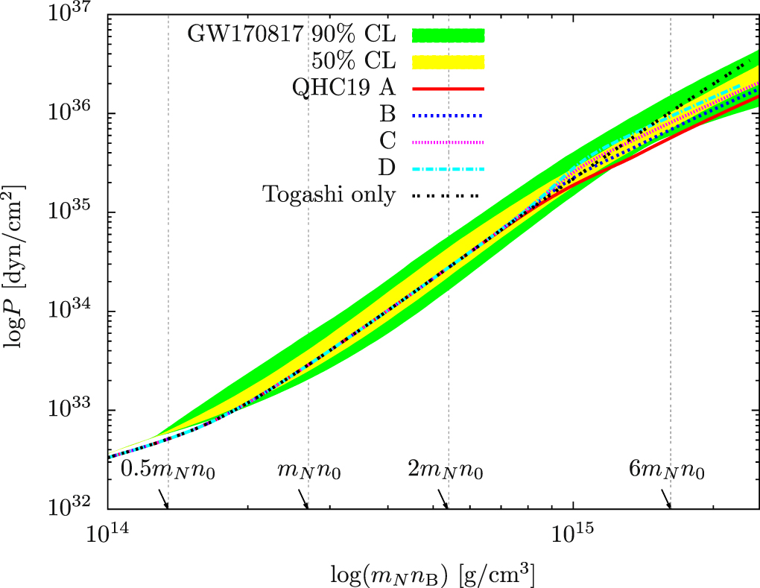
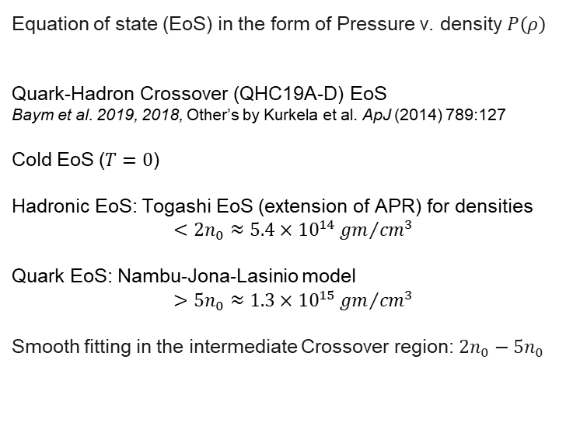
Dense matter Equation of State
Equation of state (EoS) in the form of Pressure v. density $P\left(ρ\right)$
Quark-Hadron Crossover (QHC19A-D) EoS
Baym et al. 2019, 2018, Other’s by Kurkela et al. ApJ (2014) 789:127
Cold EoS ($T=0$)
Hadronic EoS: Togashi EoS (extension of APR) for densities
$$<2n_{0}≈5.4×{10}^{14}{gm}/{{cm}^{3}}$$
Quark EoS: Nambu-Jona-Lasinio model
$$>5n_{0}≈1.3×{10}^{15}{gm}/{{cm}^{3}}$$
Smooth fitting in the intermediate Crossover region: $2n_{0}−5n_{0}$
Baym, Furusawa, Hatsuda et al. ApJ (2019) 885:42

Slide 6
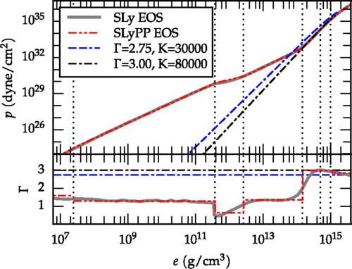

Piecewise polytropic fitting scheme
Piecewise polytropic(PP) EoS.
Fitting conditions:
Pressure-density relation: $P(ρ)=K_{i}ρ^{Γ_{i}}$
Internal energy density $ε=a_{i} ρ+\frac{K_{i}}{Γ_{i}−1}ρ^{Γ_{i}}$
Continuity of pressure, internal energy is imposed.
Read, Lackey, Owen, Friedman PRD (2009) 79, 124032.
3 piece piecewise scheme (high density) capture all
essential structure of the EoS, + SLy EoS at low densities.
Non-zero temperature corrections by $Γ_{thermal}$contribution.
Pietri, Feo, Maione, Löffler PRD (2016) 93, 064047

Slide 7
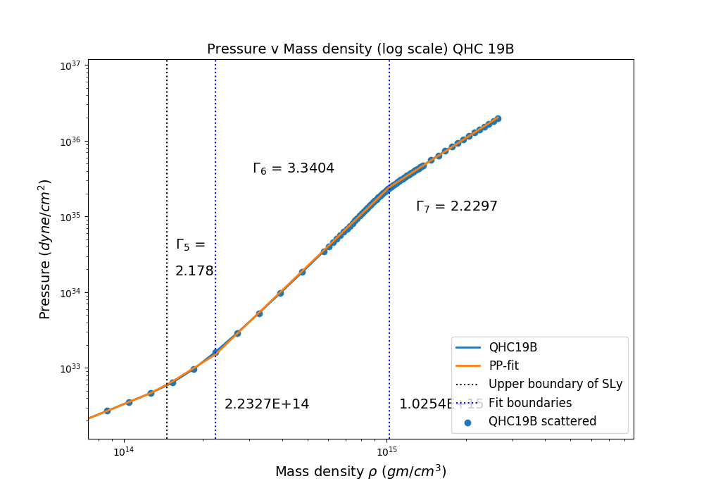
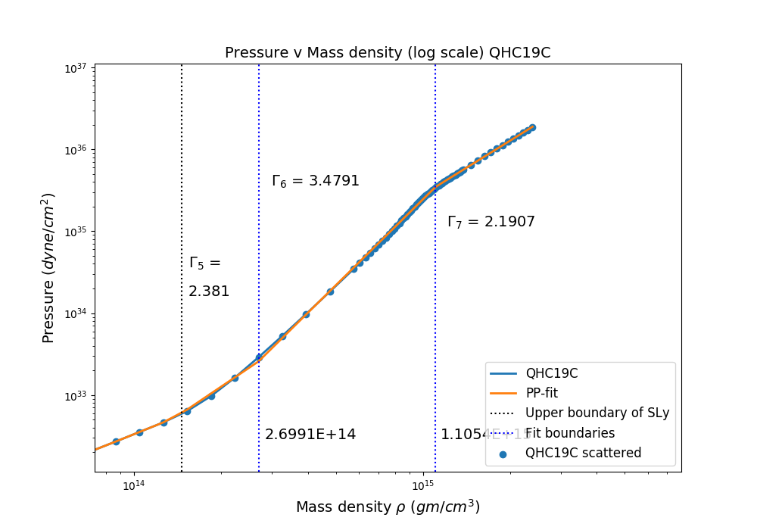

Parameterized QHC EoS piecewise
We fit the High density QHC region using this scheme and obtain the EoS Pieces:
Degrees of freedom in fitting $(Γ_{5}, ρ_{5},Γ_{6}, ρ_{6}, Γ_{7})$
RMS Residual = $\sqrt{\frac{1}{m} (\sum_{i (Pieces)}{\sum_{j(Densities)}{{(\log{P_{j}}{ − \log{K_{i}}−Γ_{i} \log{ρ_{j}}})}^{2}}})}=0.014$ i.e. $\log{P}=35 ±0.014$.

Slide 8
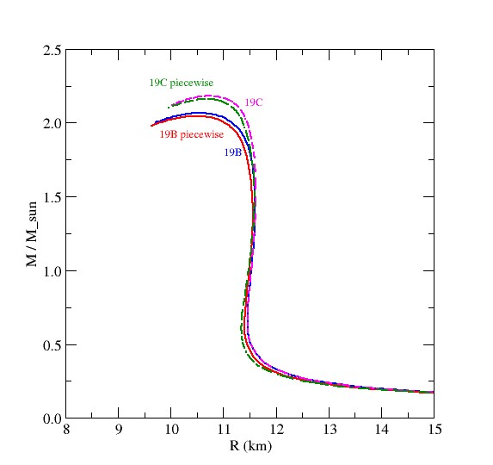
Mass-Radius relations of QHC19

Slide 9
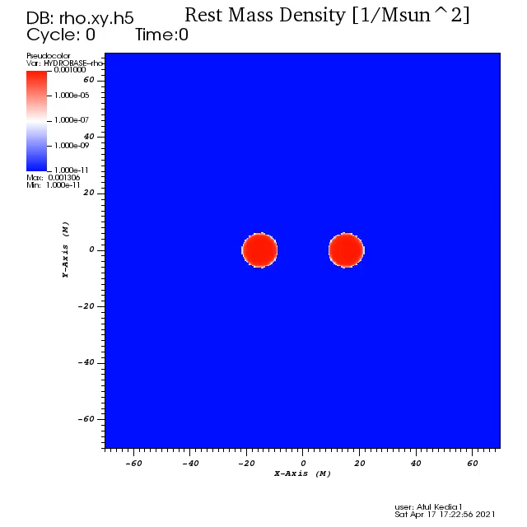

Merger for QHC19C

Slide 10
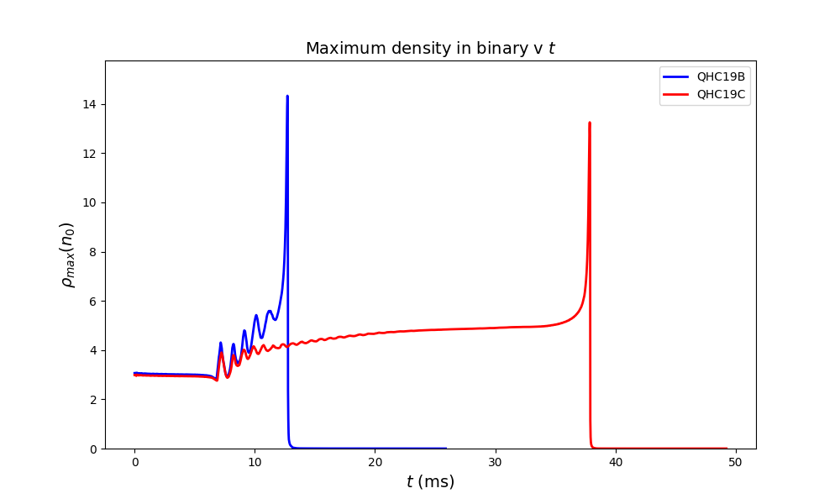
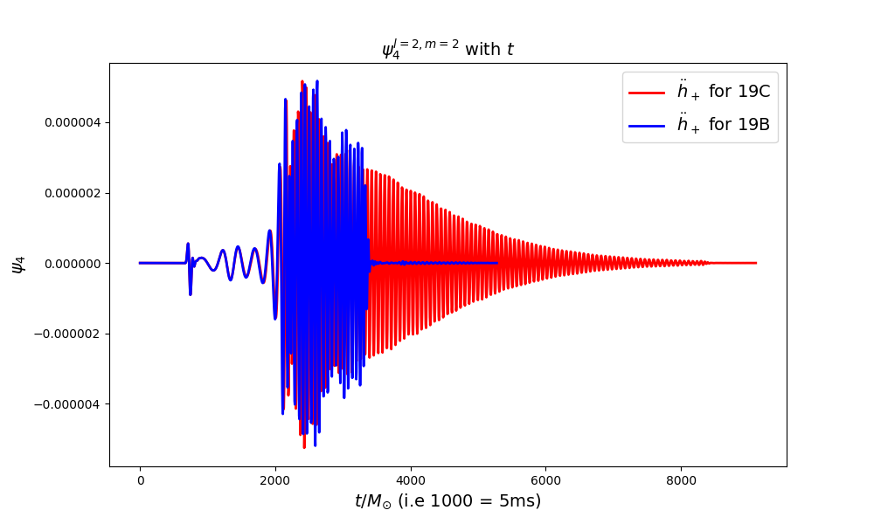
Mergers of 19B v 19C

Slide 11
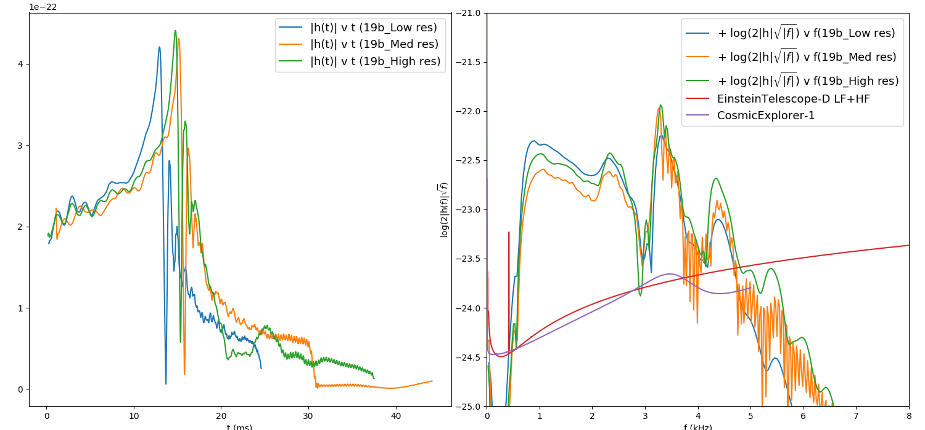
Convergence and Spectrum of 19B

Slide 12
Summary and Conclusion
Summary :
The high density EoS is uncertain, and can be studied via BNSMs.
QHC19 EoS endeavors to explain the behaviour at the phase transition and quark matter state.
We parameterized the QHC19B-C EoS and performed mergers to see stark differences in the post merger evolution.
Future work :
Convergence tests for the evolution for massive NS simulations.
Detailed Gravitational waves analysis.
Evolutions of all four QHC19A-D
  Email: akedia@nd.edu
Thank you! Questions?
This work is supported by the U.S. DOE under Nuclear Theory Grant DE-FG02-95-ER40934.

