Slide 1
A MANMADE EXPERIMENT AIMED TO CLARIFY THE GRAVITY LAW IN THE SOLAR SYSTEM
Alexander P. Yefremov and Alexandra A. Vorobyeva
Institute of gravitation and cosmology
RUDN University
Russia

Slide 2
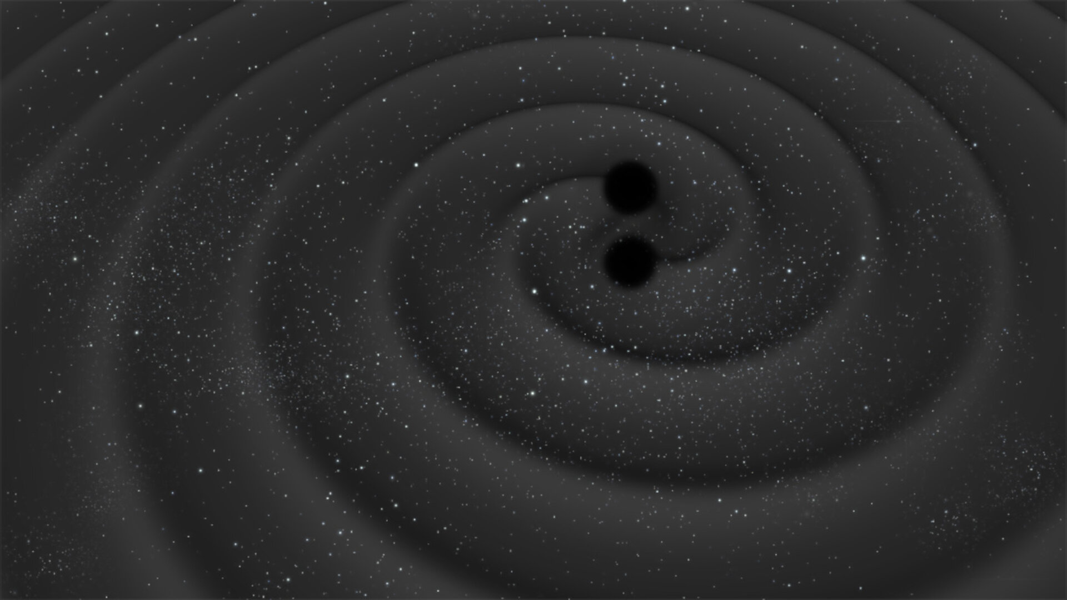
Introduction
two weak features of recent experiments supporting GR
- we deal with isolated observations very rare natural phenomena
- these objects are very far from the observer: we examine the past
This violates the basic principles of an experiment:
possibility to repeated it and to deal with physical laws “valid here and now"
therefore, an absolute acceptability of GR gravity is not convincing enough

Slide 3
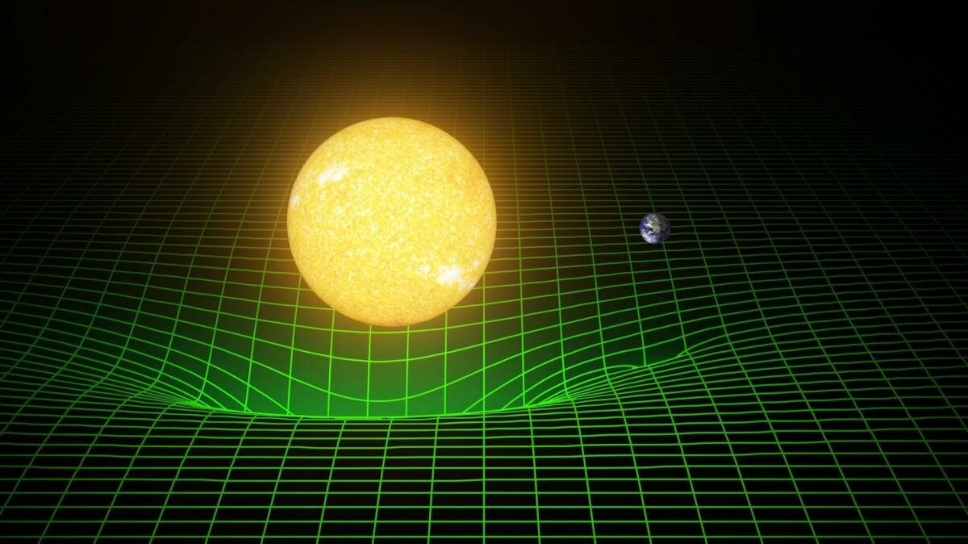
Repeatable experiment testing very small effects of Einstein’s gravity
in the Solar system is a challenging task
In this presentation we’ll try to demonstrate that such an experiment aimed to specify the law of the Sun's gravity with good accuracy is possible

Slide 4
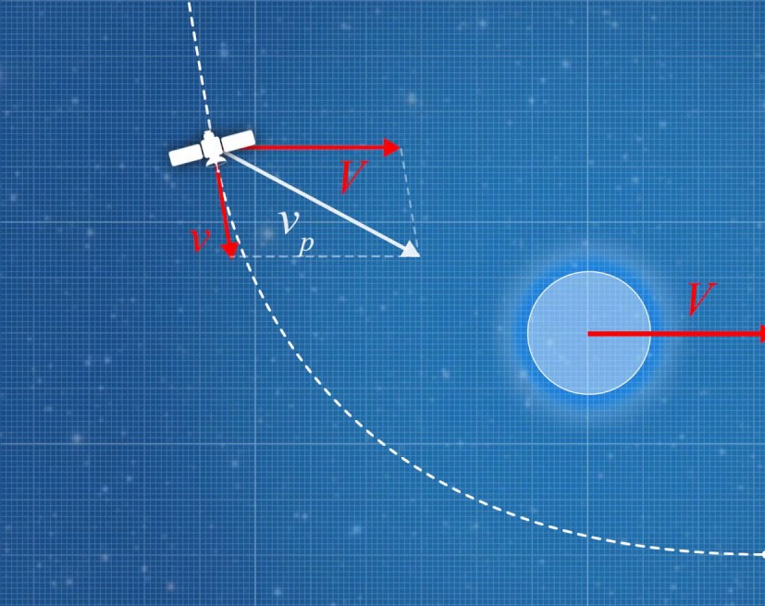
The gravity assist maneuver

Slide 5
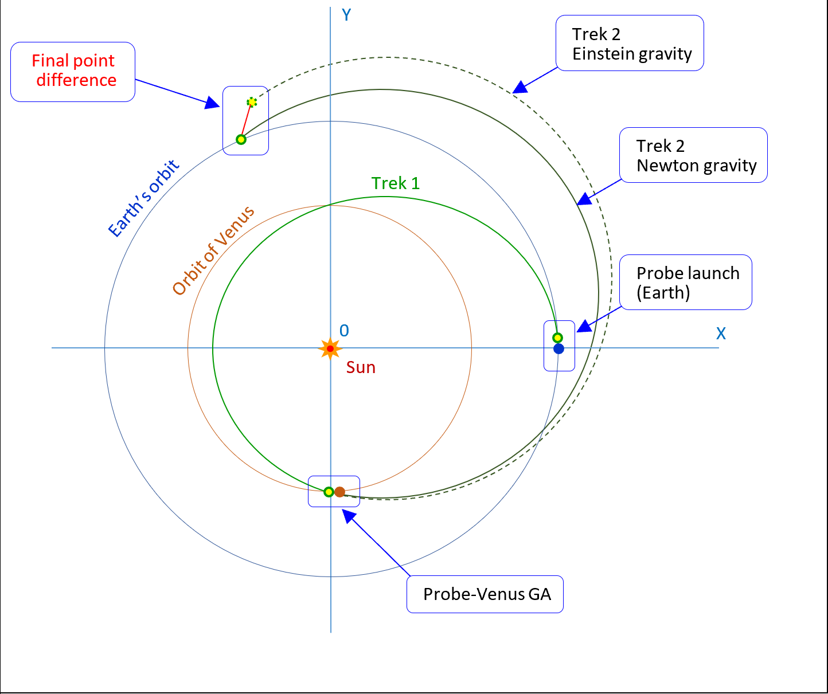
The standard flight

Slide 6
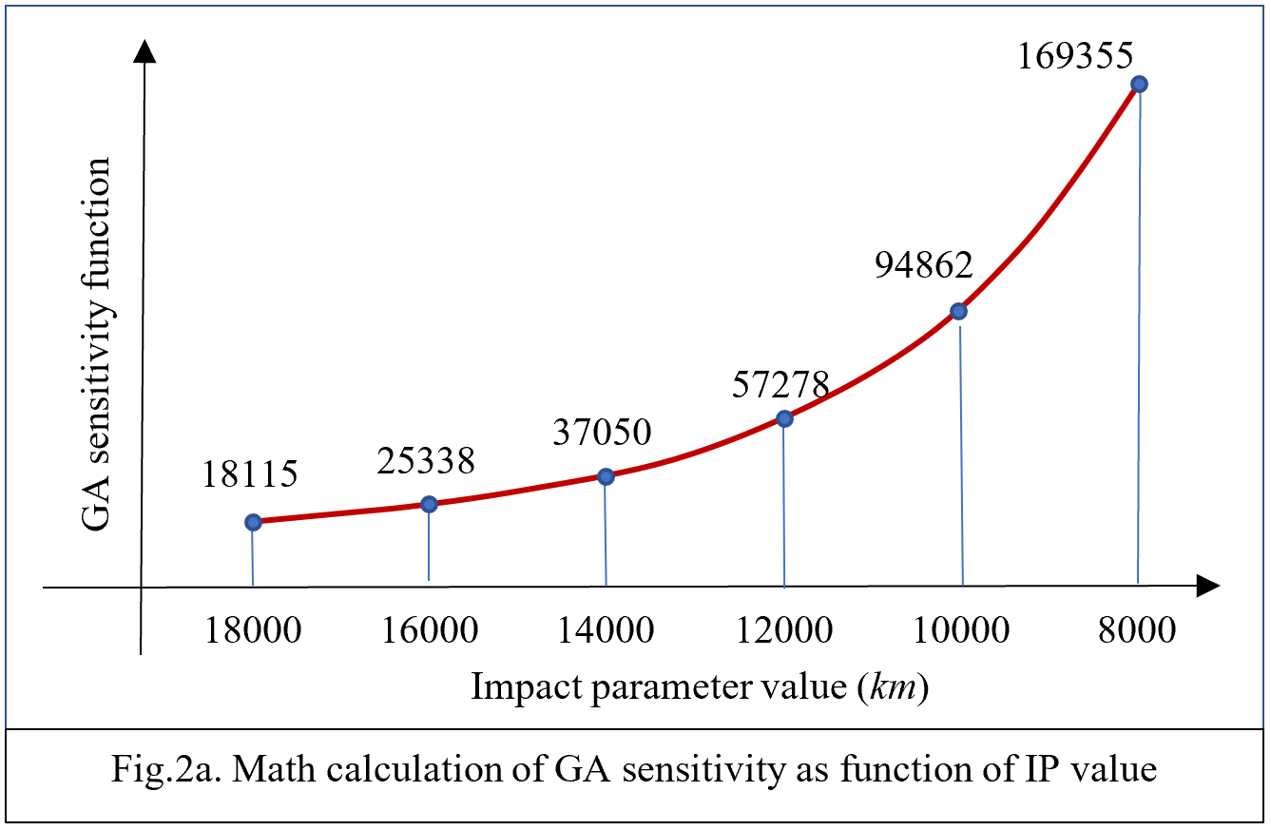
The gravity-assist sensitivity as function of pericenter (analytical method)

Slide 7
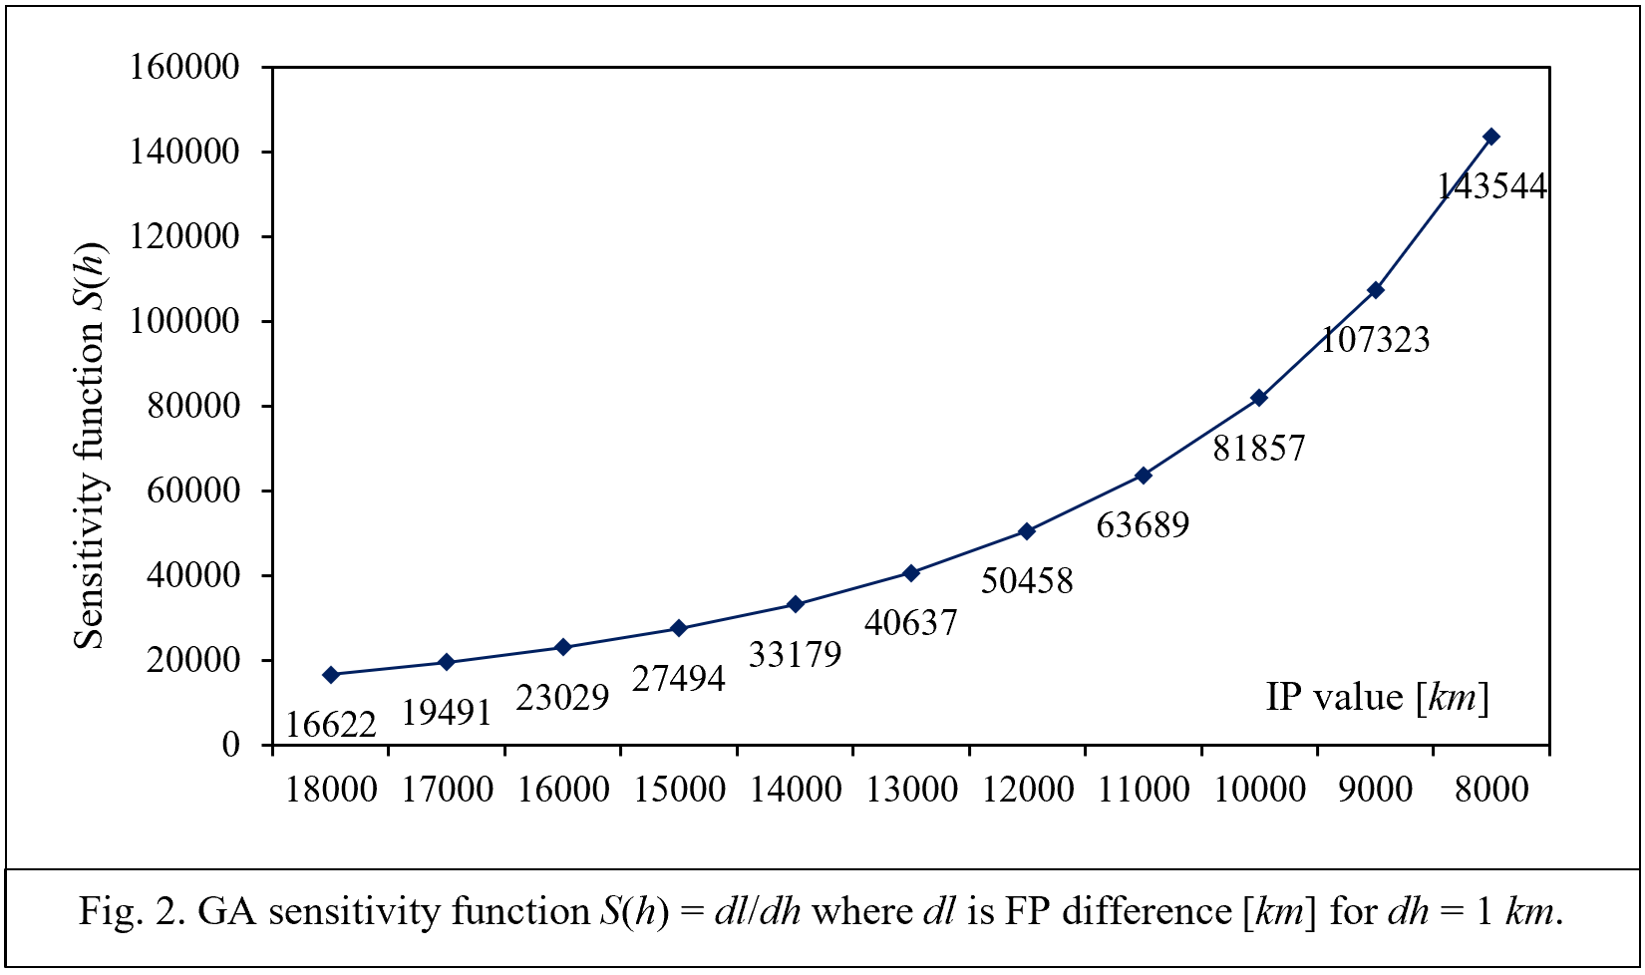
Numerical computation of sensitivity function

Slide 8
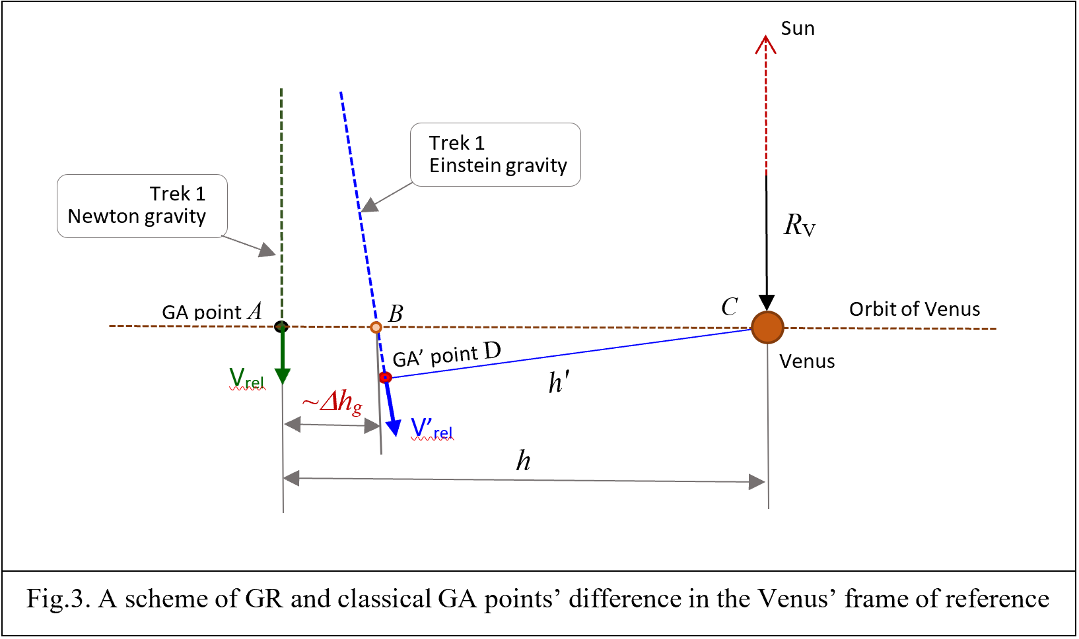
GR gravity makes the gravity assist pericenter shorter

Slide 9
We can check the gravity law in the Solar System
If Δh = 40 km then
for h = 18 000 km → Δl = S*Δh = 724 560 km
for h = 10 000 km → Δl = S*Δh = 3 794 600 km

Slide 10
Difficulties…?
The experiment seems not too hard to perform
computational means will distinguish pure gravity effects from:
influence of other planets
Sun’s oblateness
solar wind, etc.
The space probe may be a primitive space-ball able to send receivable signals
We are sure: many cosmic agencies and private companies can afford the job
We hope, someone will be the first

Slide 11
Thank you!
a.yefremov@rudn.ru
https://www.researchgate.net/profile/Alexander_Yefremov2
vorobyeva-aa@rudn.ru
https://www.researchgate.net/profile/Alexandra_Vorobyeva

