Slide 1
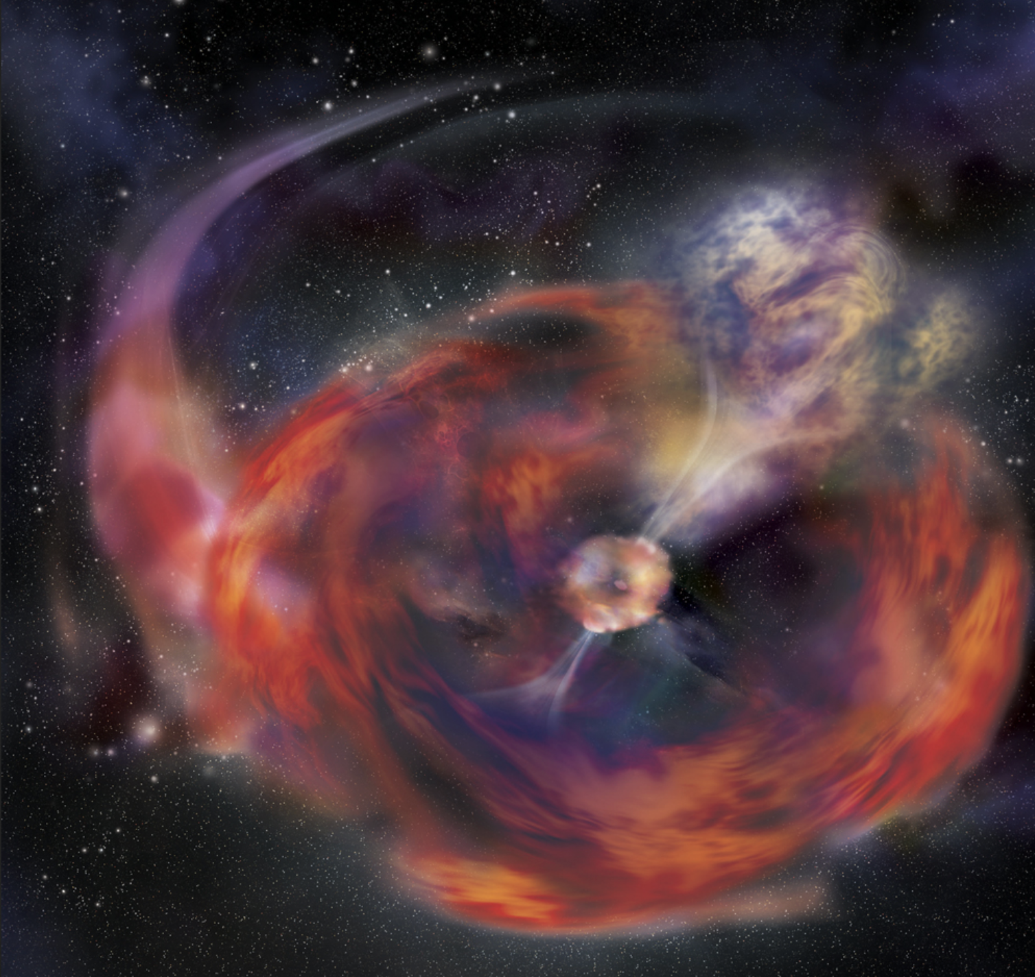
Equations of State and Their Role in Astrophysical Transients
Chris Fryer
Los Alamos National Laboratory

Slide 2
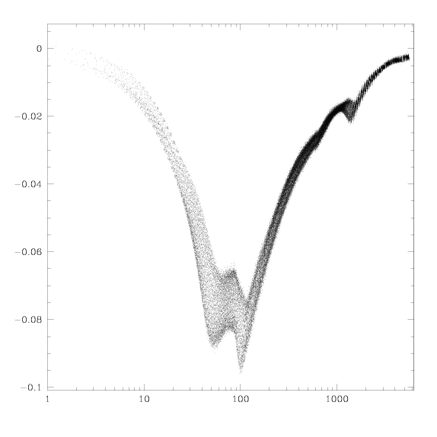
Stellar Core Collapse (for SNe and Long Duration GRBs)
Stellar
Core
electron degeneracy
56Ni α particles
p + e⁻ n + ν_{e}
Velocity (c)
Thermal pressure (γ)
When the core reaches nuclear densities, nuclear forces and neutron degeneracy pressure halt the collapse, causing a bounce. Neutrino losses cause the bounce shock to stall. But for low mass stars, the shock is easy to revive and the bounce is critical.
Radius (km)

Slide 3
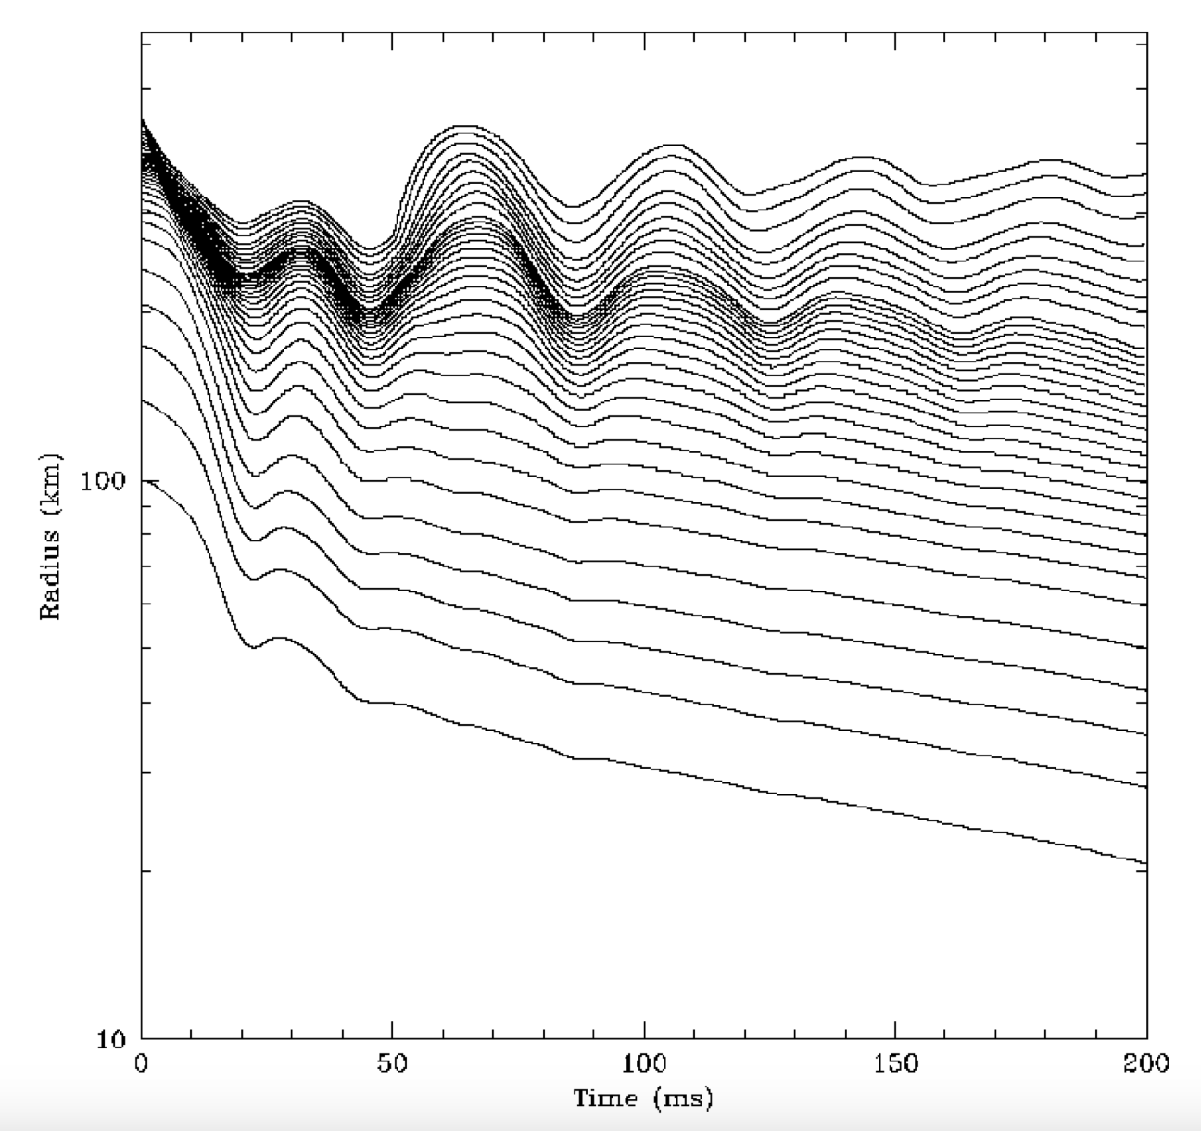
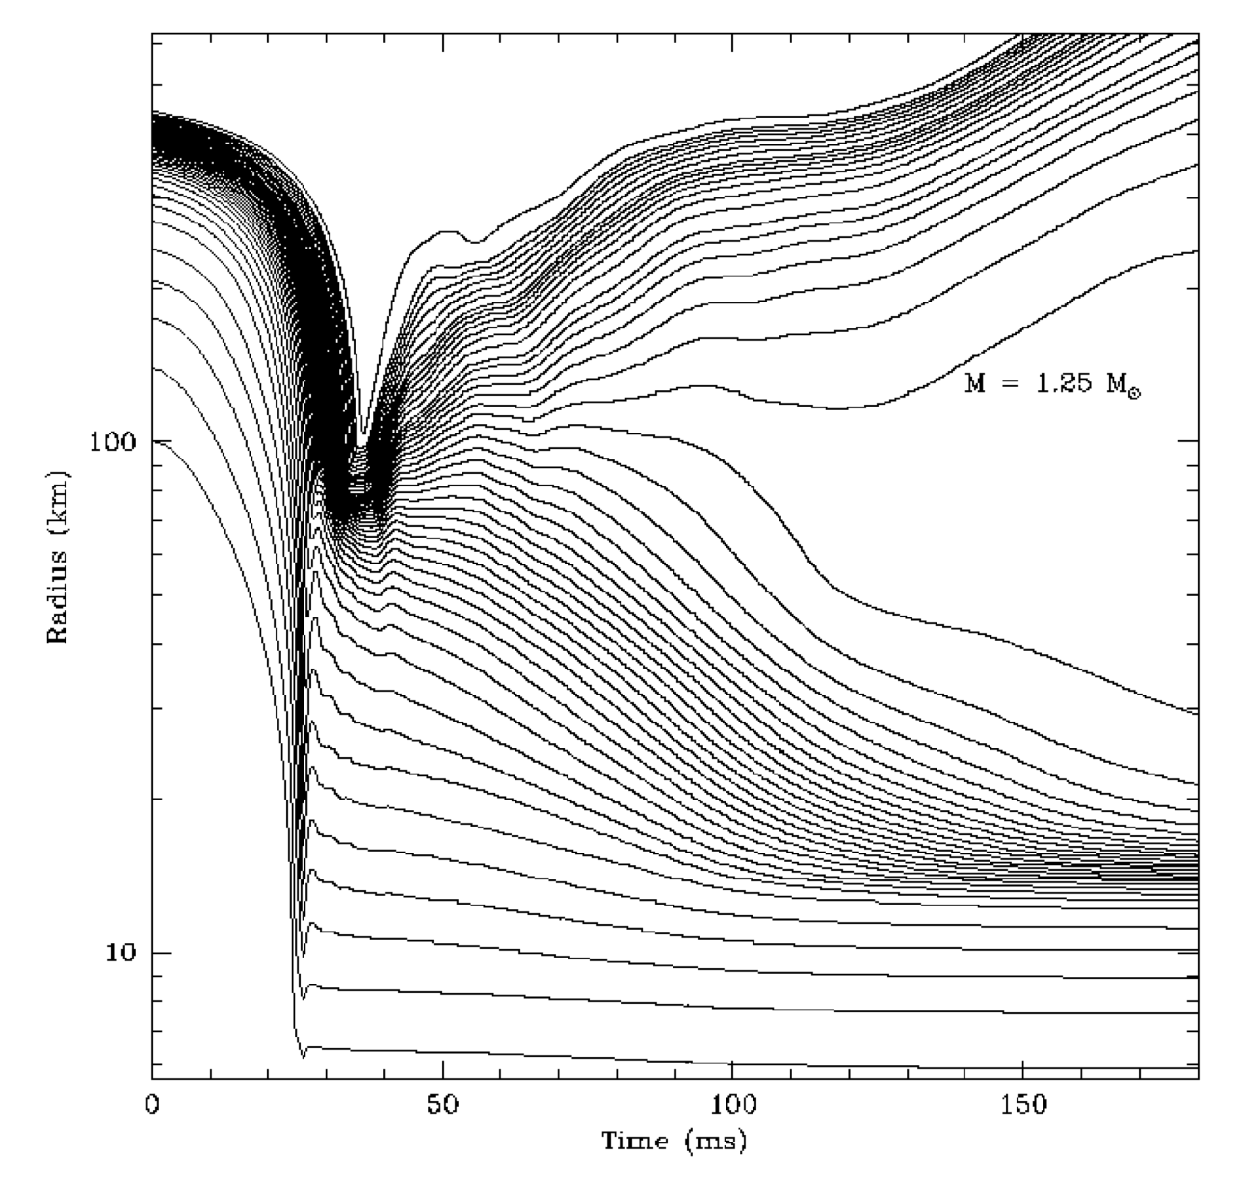
EOS effects on low-mass SN Progenitors
For low mass stars (<10 solar masses, a sizable fraction of SNe), the bounce shock is relatively easy to revive. The fate depends sensitively on the equation of state (Baron, Bethe et al. 1987 argued for a soft EOS).
Swesty & Lattimer EOS
Baron, Cooperstein and Kahana EOS
Fryer et al. 1999

Slide 4
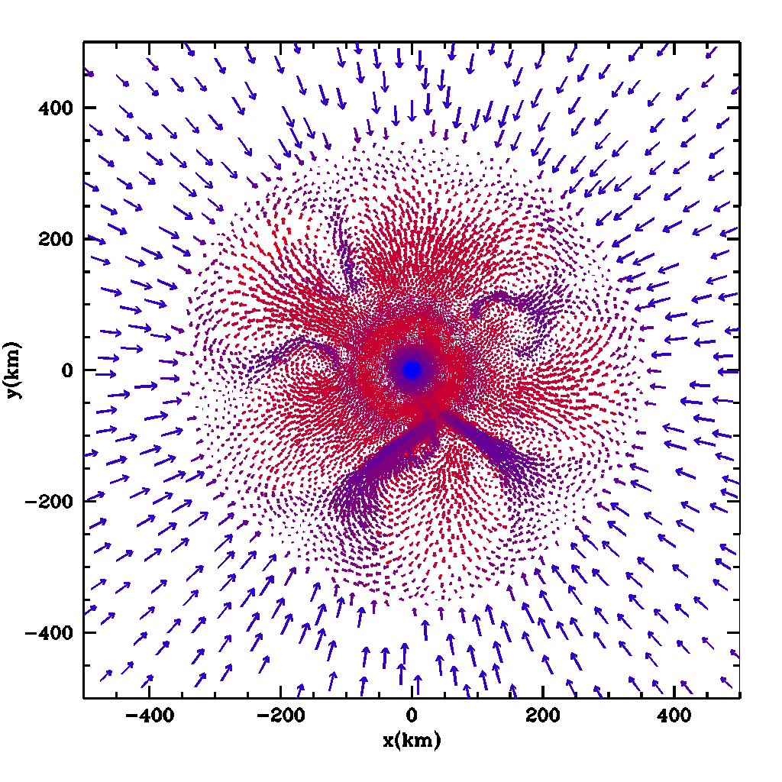
SN engines for higher mass stars
Anatomy
Of the
Convection
Region
After the stall of the bounce, the region between the proto-neutron star (~30km) and the stalled shock is unstable to convection (dS/dr < 0).
The current “standard” engine for supernovae argues that Rayleigh-Taylor (and perhaps other instabilities, e.g. Standing Accretion Shock Instability) convert the energy in the NS to drive an explosion.
Proto-
Neutron
Star
Upflow
Accretion
Shock
Downflow
Fryer & Warren 2002

Slide 5
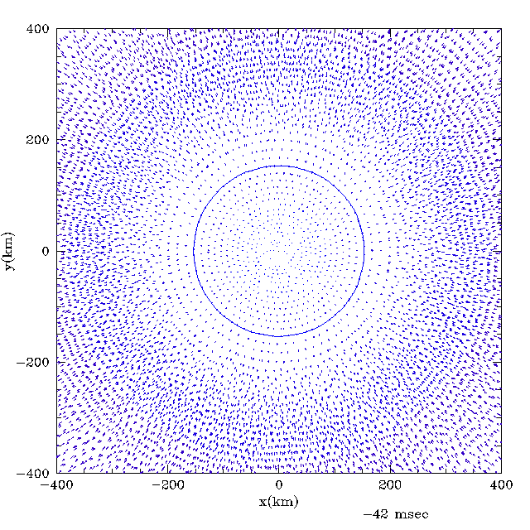
Role of EOS changes as our understanding of the supernova engine grows:
Below 10-12 solar masses, neutrinos from the NS quick revive the shock. The EOS dictates the bounce and the neutrino flux (1-D picture fairly accurate - except for getting kicks).
Above 10-12 solar masses, convection is critical. It dominates the explosion. Here the bounce sets the initial entropy profile and the onset of convection. The EOS effect is less extreme but remains important.

Slide 6
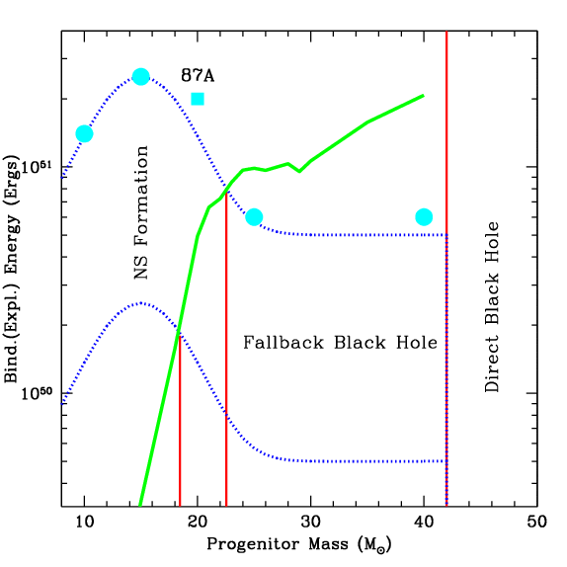
Energies
Fryer 1999
The different explosion mechanisms: quick revival versus convective engine. make clear predictions for the supernova energies:
low mass stars have weaker explosions
high mass stars (convective engine) produce a range of explosions.
New models with more detailed progenitors change some specifics but keep these basic trends.
Here I have ignored jet-driven explosions (these are likely rare)
Binding
Energy
Of the
Outer
Layers
Of the
Star
(M_{star}
-3 solar
Masses)

Slide 7
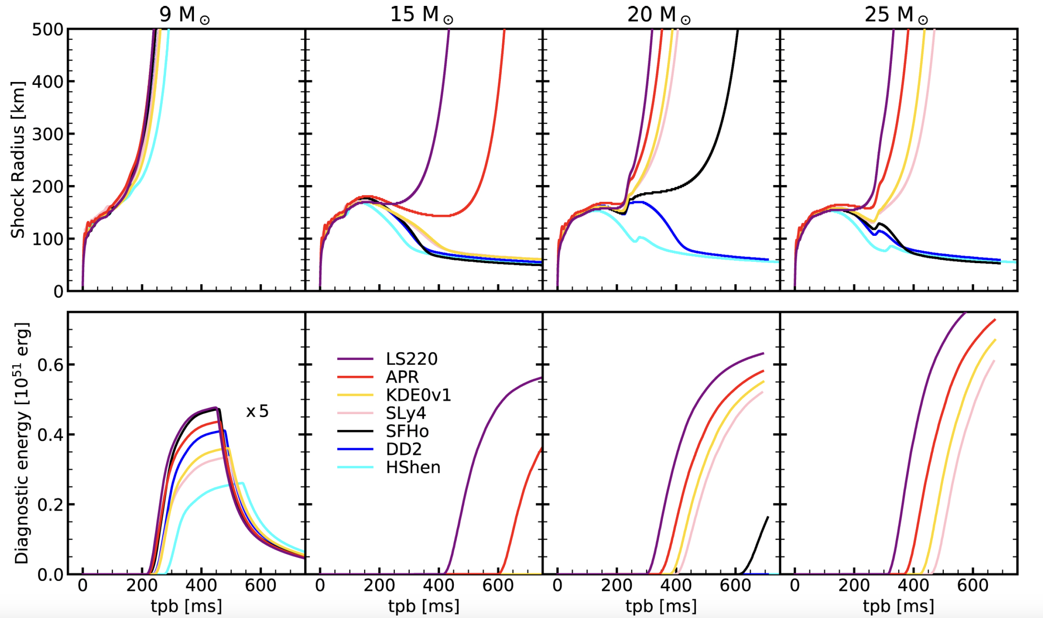
Models continue to improve, continually testing the role of the EOS
EOS effects energetics in low mass stars, but it can make the difference between a failed versus successful explosion in more massive stars.
However, all current models lack both resolution and physics, so no result is quantitative at this time.
Boccioli et al. 2022

Slide 8
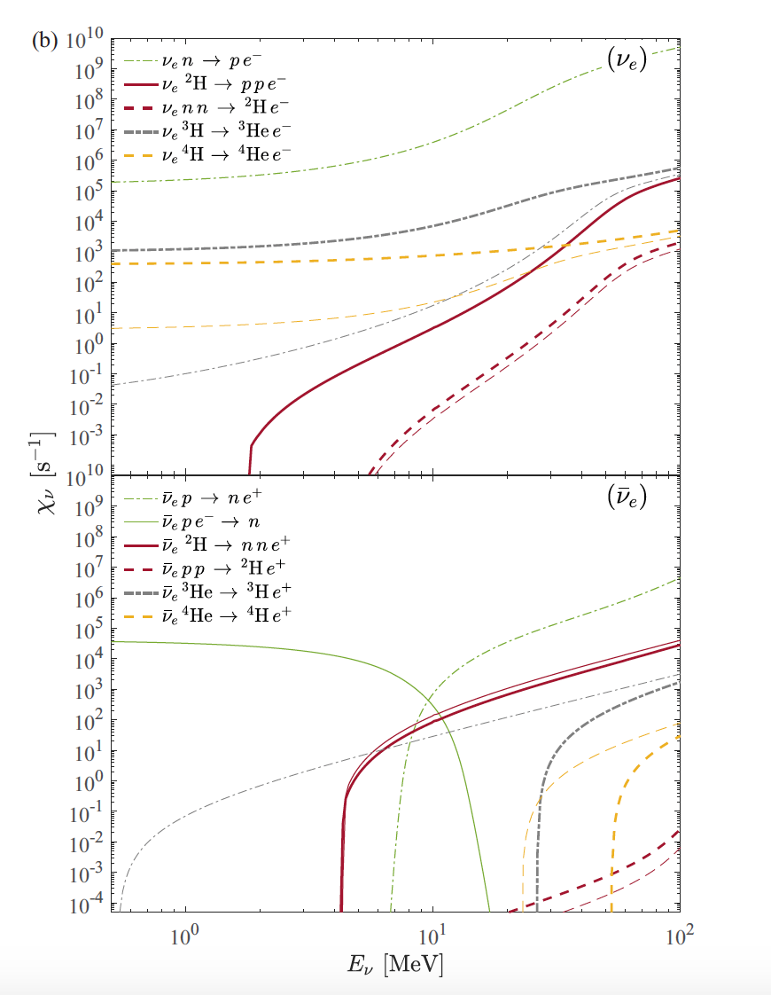
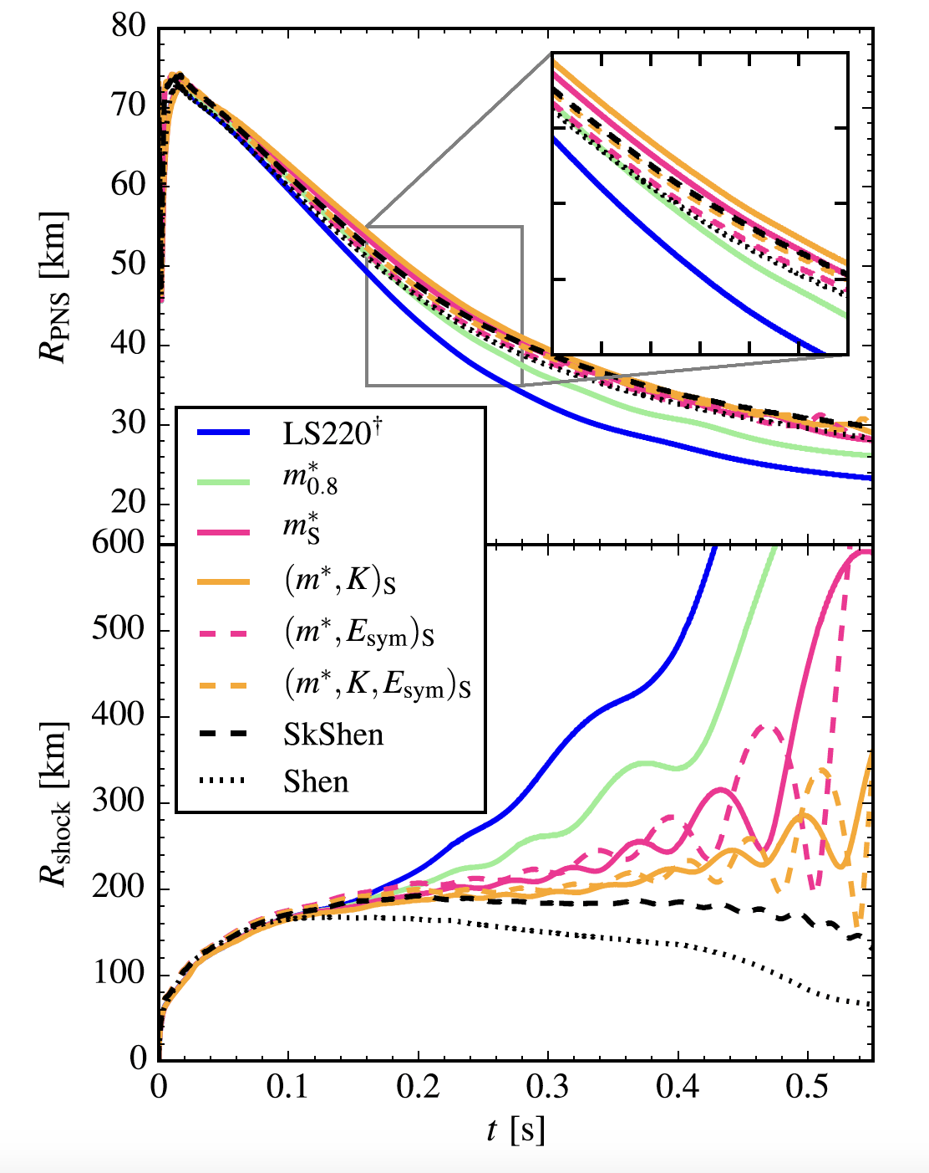
Many active studies,
Including work studying neutrino interactions (left: Fischer et al 2020) as well as specifics properties of the EOS (right: Yasin et al. 2020).
With these, we begin to understand both the trends and, ultimately, a more quantitative understanding.

Slide 9
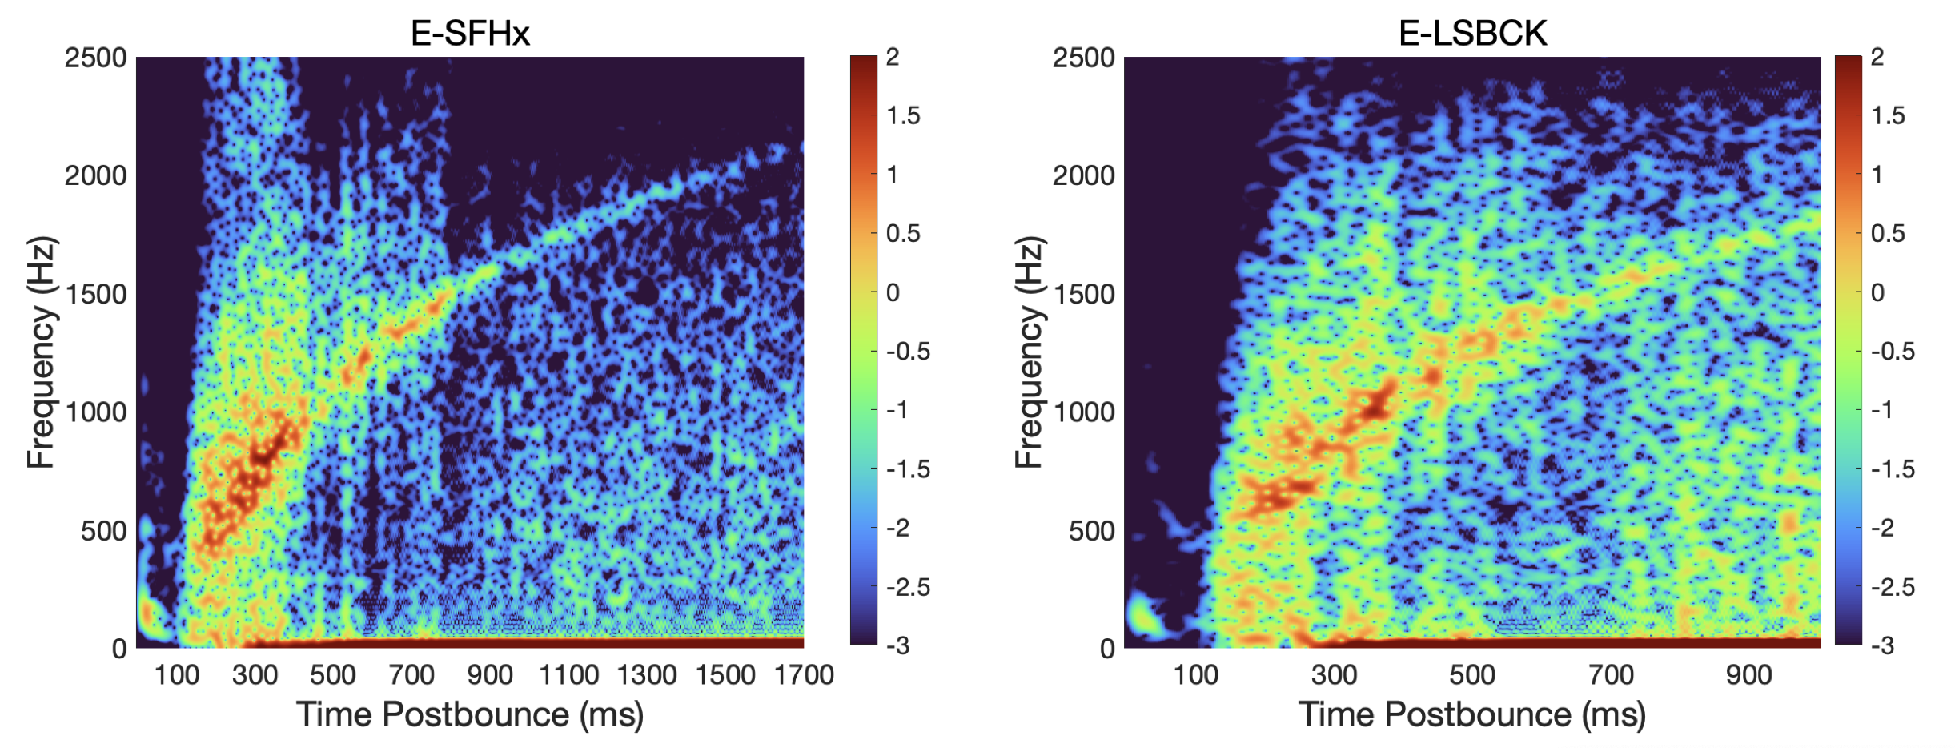
SN Summary
The EOS has long been known to play an important role in the core bounce (when the core reaches nuclear densities) in core-collapse supernovae (e.g. Baron, Bethe et al. 1997).
The bounce is critical in low mass (stars below 10-12 solar masses) explosions. But also sets the stage for the convection engine for more massive core-collapse stars.
Scientists have further studied this and other nuclear physics (e.g. neutrino effects).
In large calculations, integrated results are insufficient. We must be able to analyze the specific effects of the EOS and not the net result.
GWs?

Slide 10
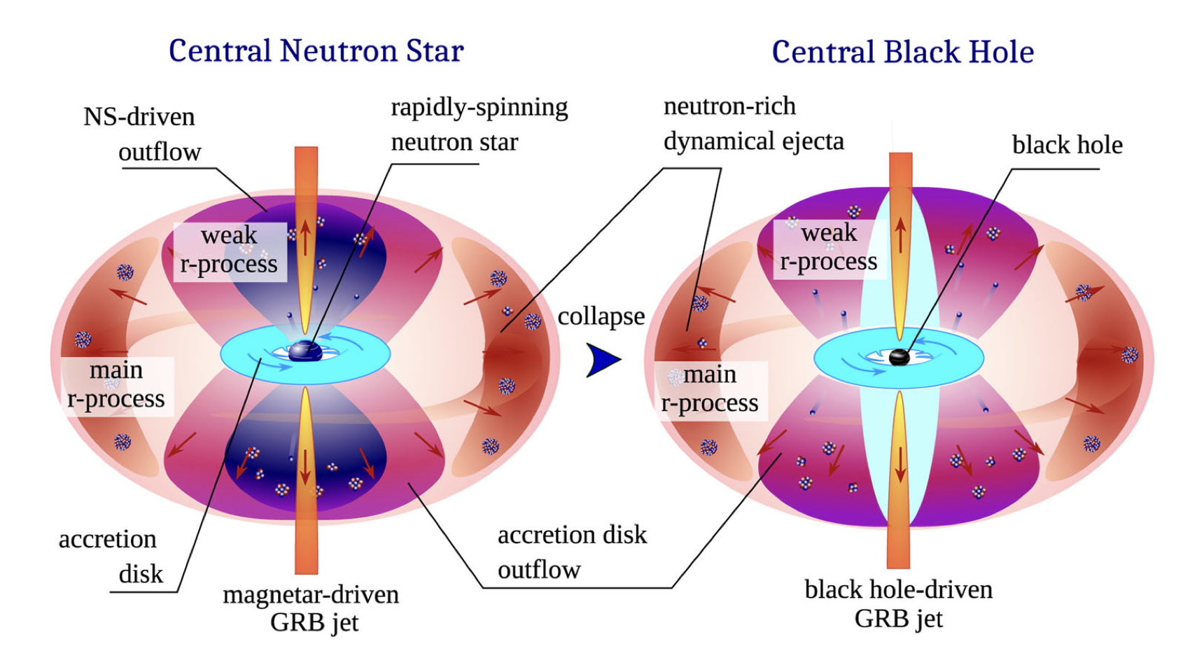
Observing EOS effects in NS mergers (without GWs)
Korobkin & Rosswog 2024

Slide 11
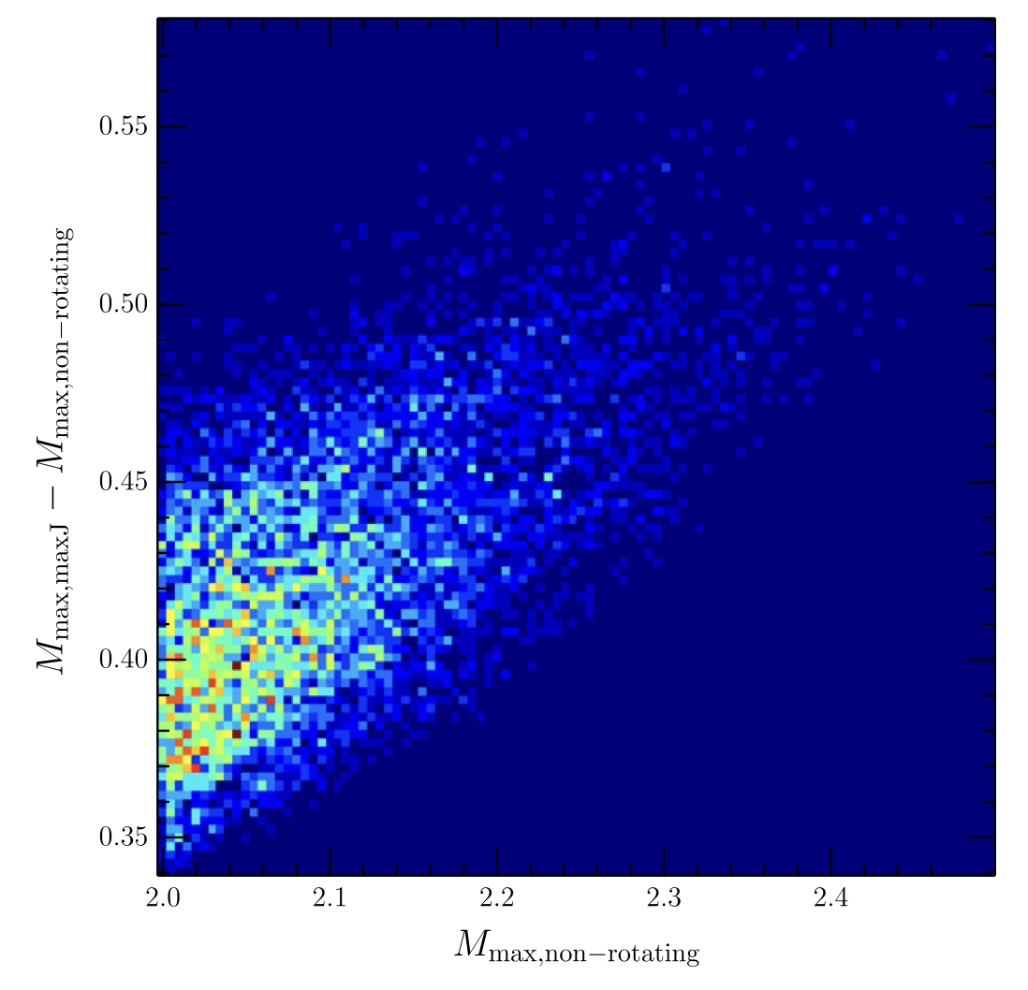
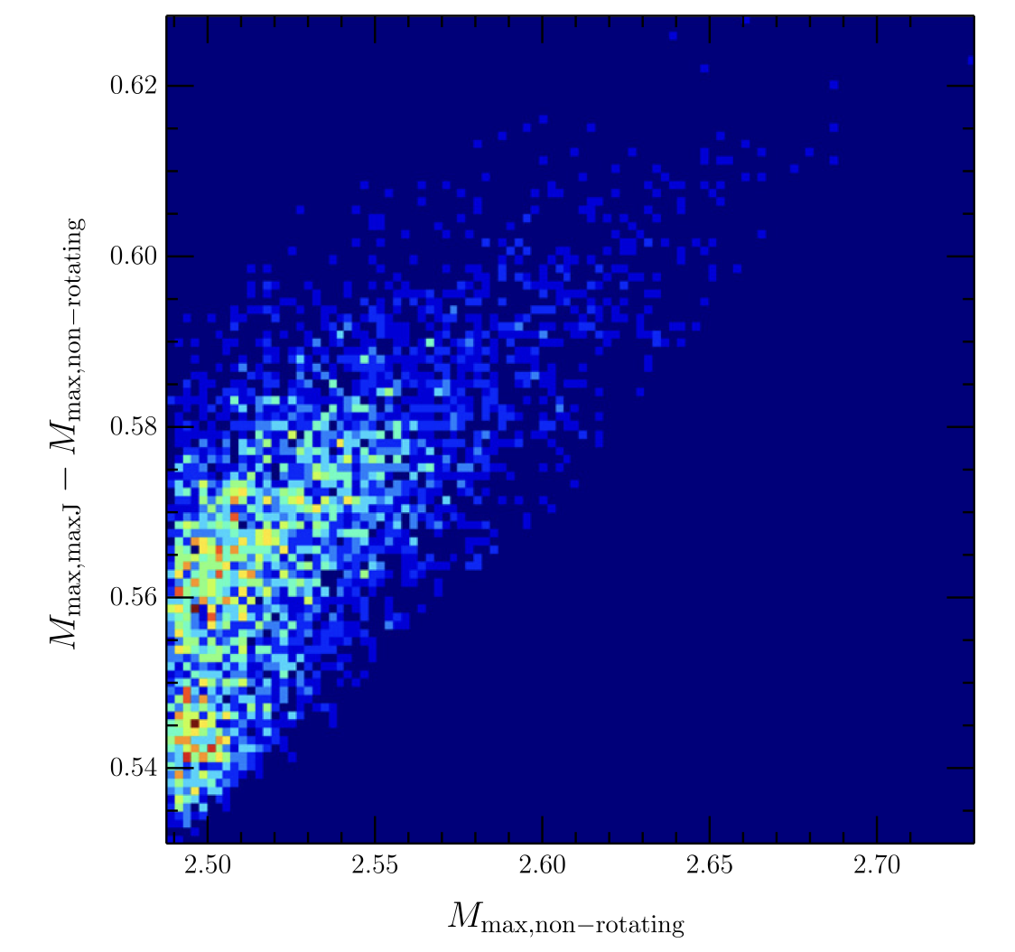
The EOS dictates If/When the merger forms a BH
Probability distribution of the maximum NS masses as a function of rotation for Andrew Steiner’s (2014 papers) parameterized study of equation of state (Fryer et al. 2015).

Slide 12
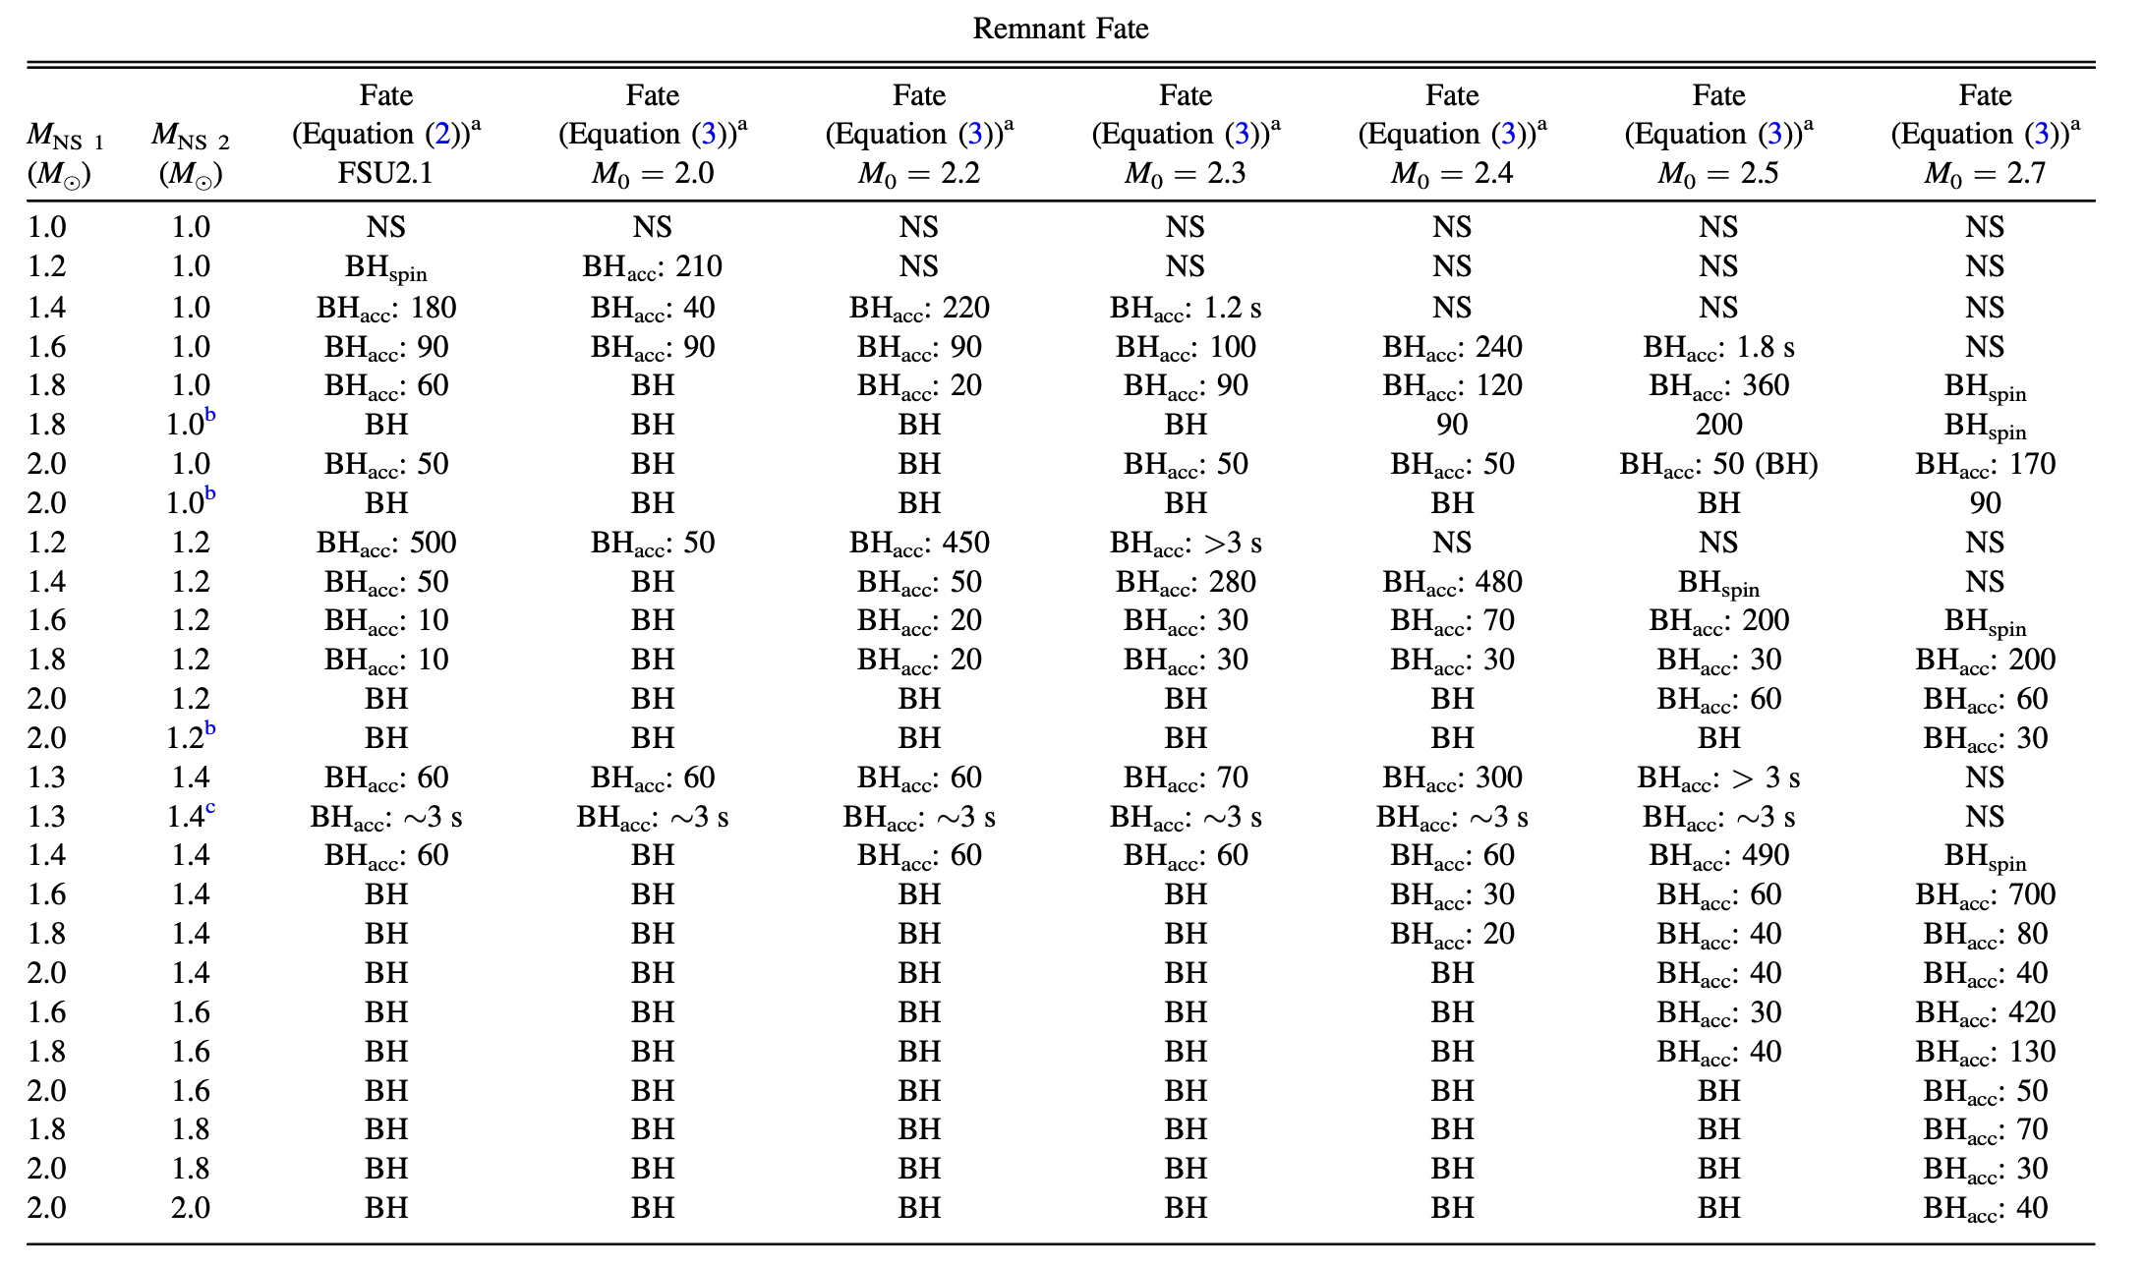
StarTrack (Belczynski) population synthesis models using Korobkin & Rosswog merger results (much more work to do here)

Slide 13
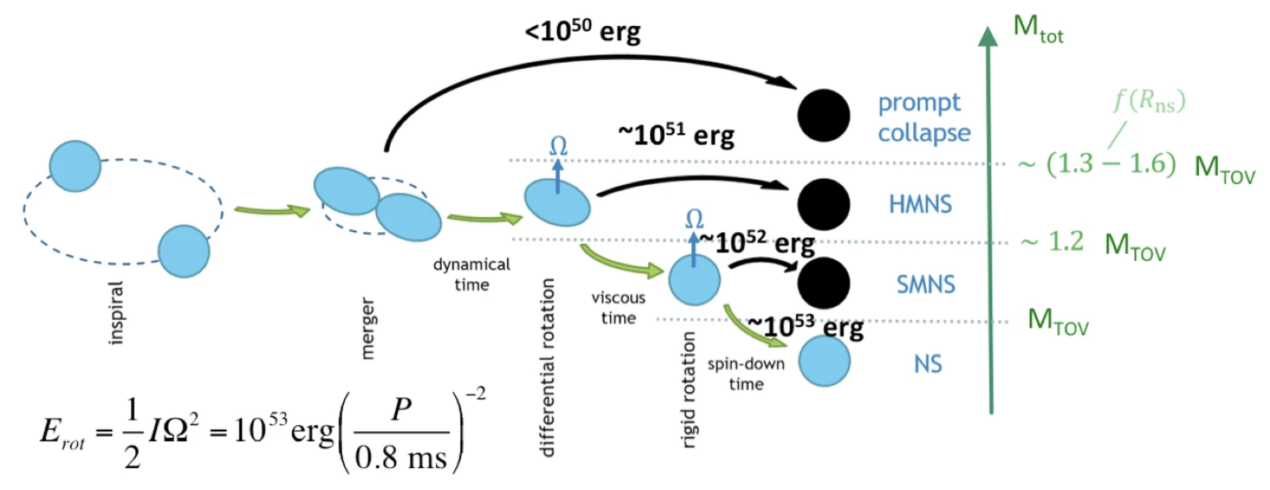
Neutron Star vs. Black Hole Central Object
Misconception 1: Hypermassive neutron stars formed in mergers can be supported by differential rotation.
This would be true if the core of the central compact object were rotating faster than the outer part. But, for mergers, the opposite is the case.
Note that this was explained in Fryer et al. 2015 and understood well before.
Metzger 2020

Slide 14
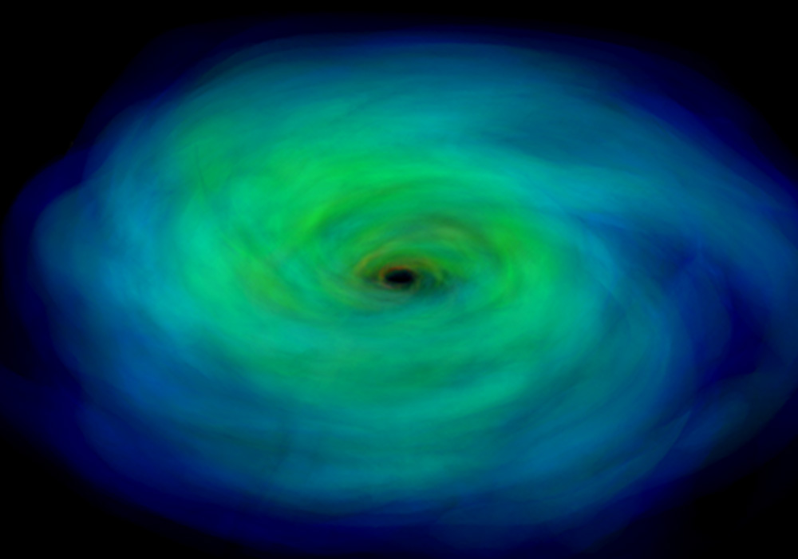
But how do we tell when a BH is formed
Various ideas (but many are based on incomplete or incorrect assumptions)
Misconception 2: The collapse to form a BH will produce an explosion – typically, the Innermost Stable Circular Orbit of a BH is within the radius of a maximum-mass NS. Unless this changes the jet or disk properties (which it may), this will not produce an observable effect.
Red vs. Blue Kilonovae (yields)
Presence or not of a magnetar
GWs may be the most direct observable.

Slide 15
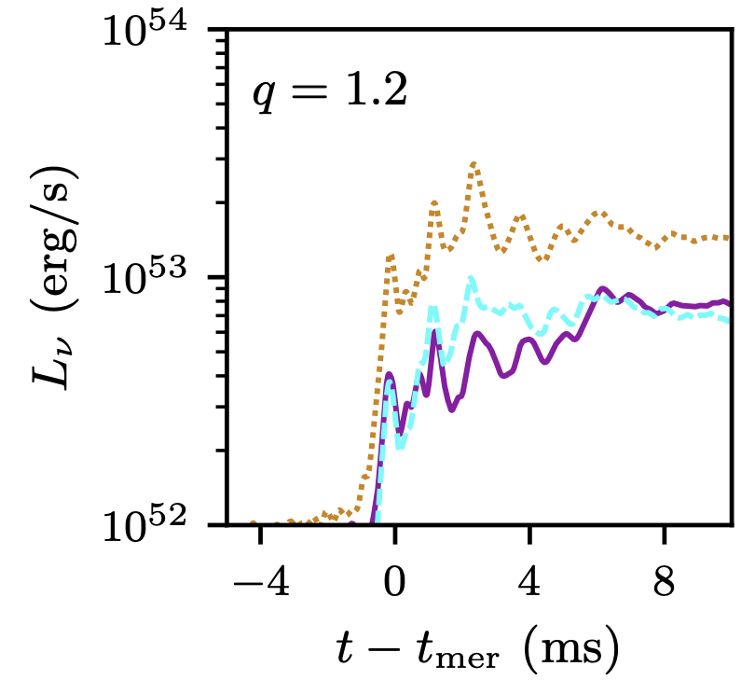
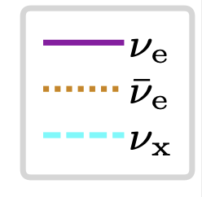
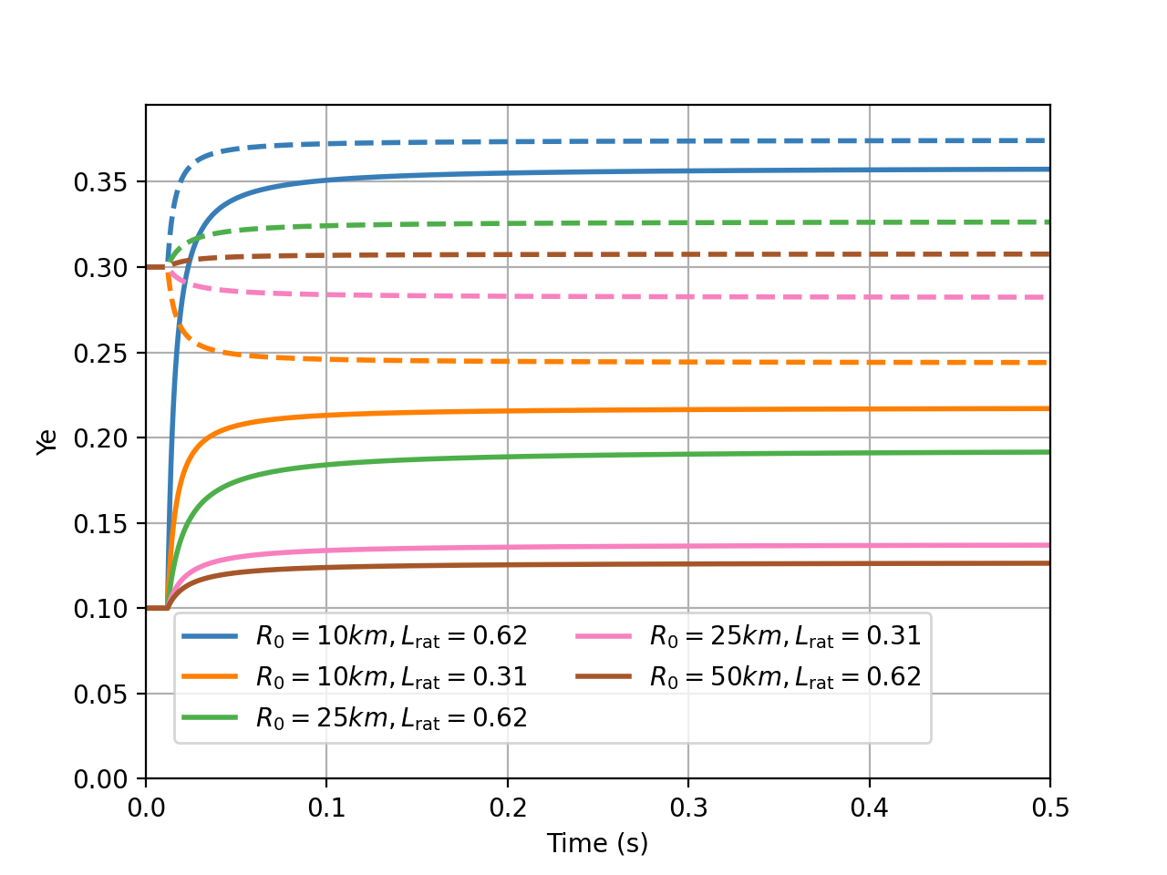
Neutrinos and Yields
Misconception 3: Neutrinos from NS will dramatically raise the electron fraction altering yields. This is the argument for the red/blue (NS/BH) claim.
Complications:
Unlike SN NSs, the source of neutrinos in mergers is not from electron capture (no electrons), but from pair/plasma processes and positron capture. The ν_{e} flux dominates (which can lower the Y_{e}). The flux depends on the details of the merger (including the EOS)
The effect of the neutrinos also depends on the proximity to the NS. Neutrinos from the disk can be more important beyond 15-25km. NS neutrinos ineffective beyond 30-40km (unlikely to affect tidal ejecta)
Espino et al. 2024
Neutrino reactions that alter Y_{e}
p + e⁻ n + ν_{e}
n + e⁺ p + ν_{e}

Slide 16
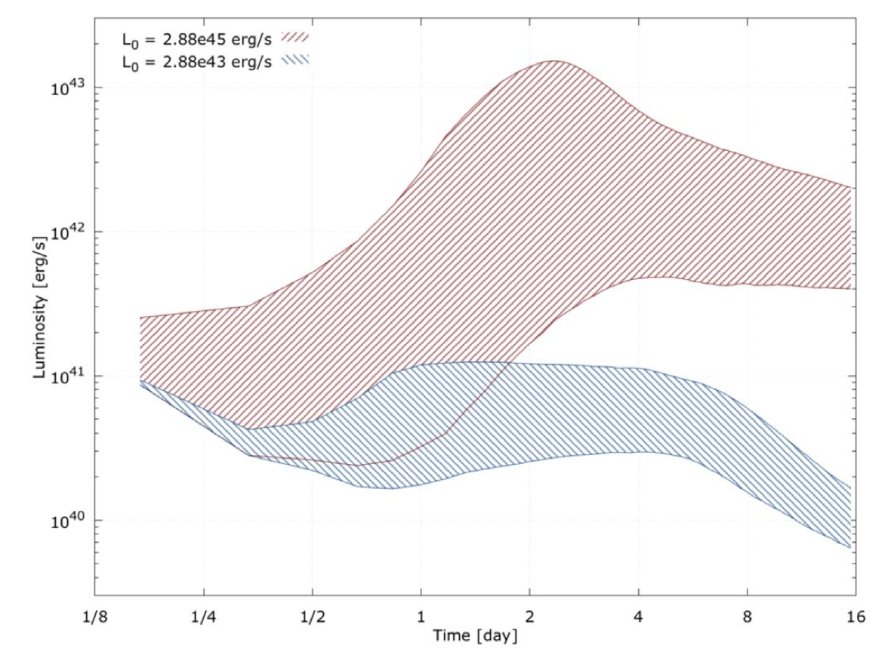
NS vs. Black Hole (Role of the Magnetar)
Misconception 4: GW170817 could not have had a long-lived NS because we do not see the magnetar
We don’t know how magnetars are seen. Li et al. (2018) argued that a pulsar could explain the emission from the kilonova of GW170817 (confirmed by Wollaeger et al. 2019).
This adds another wrinkle into estimating the r-process yields.
Wollaeger et al. 2019

Slide 17
Conclusions
The EOS (and broader nuclear physics effects – neutrinos, nuclear cross sections), play a huge role in astrophysical transients (both SN and NS Mergers).
Despite these effects, identifying diagnostics of the EOS beyond GWs have proven difficult.
As we develop better models in SNe, we may be able to predict trends that can differentiate EOS properties. EOS studies remain critical in developing a quantitative SN model.
For NS mergers, the primary effect of the EOS is determining whether the compact remnant becomes a NS or BH. Many misconceptions have allowed scientists to misinterpret current NS merger calculations, particularly in tying the fate of the compact remnant to EM observations.
NS masses and GW signals remain the better constraints on the EOS.

