Slide 1
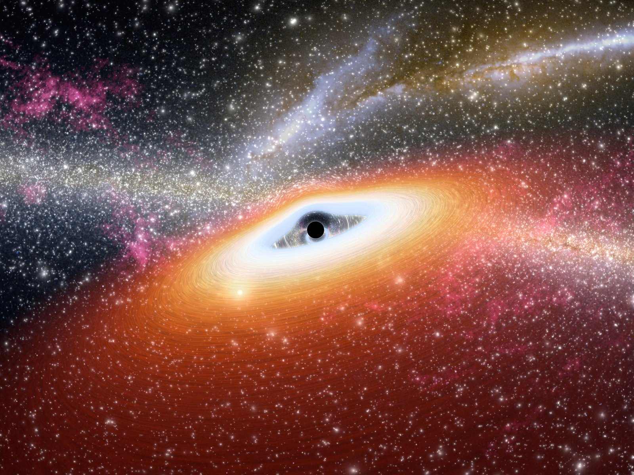
Irreducible Mass Reveals Rotational-energy Storage in Black-hole Growth
Speaker: Shurui Zhang – ICRANet
Collaborators: Jose Rodriguez, Jorge Rueda, Remo Ruffini
The 6th Zeldovich meeting
Pescara, Italy
Date 2026/07/16

Slide 2
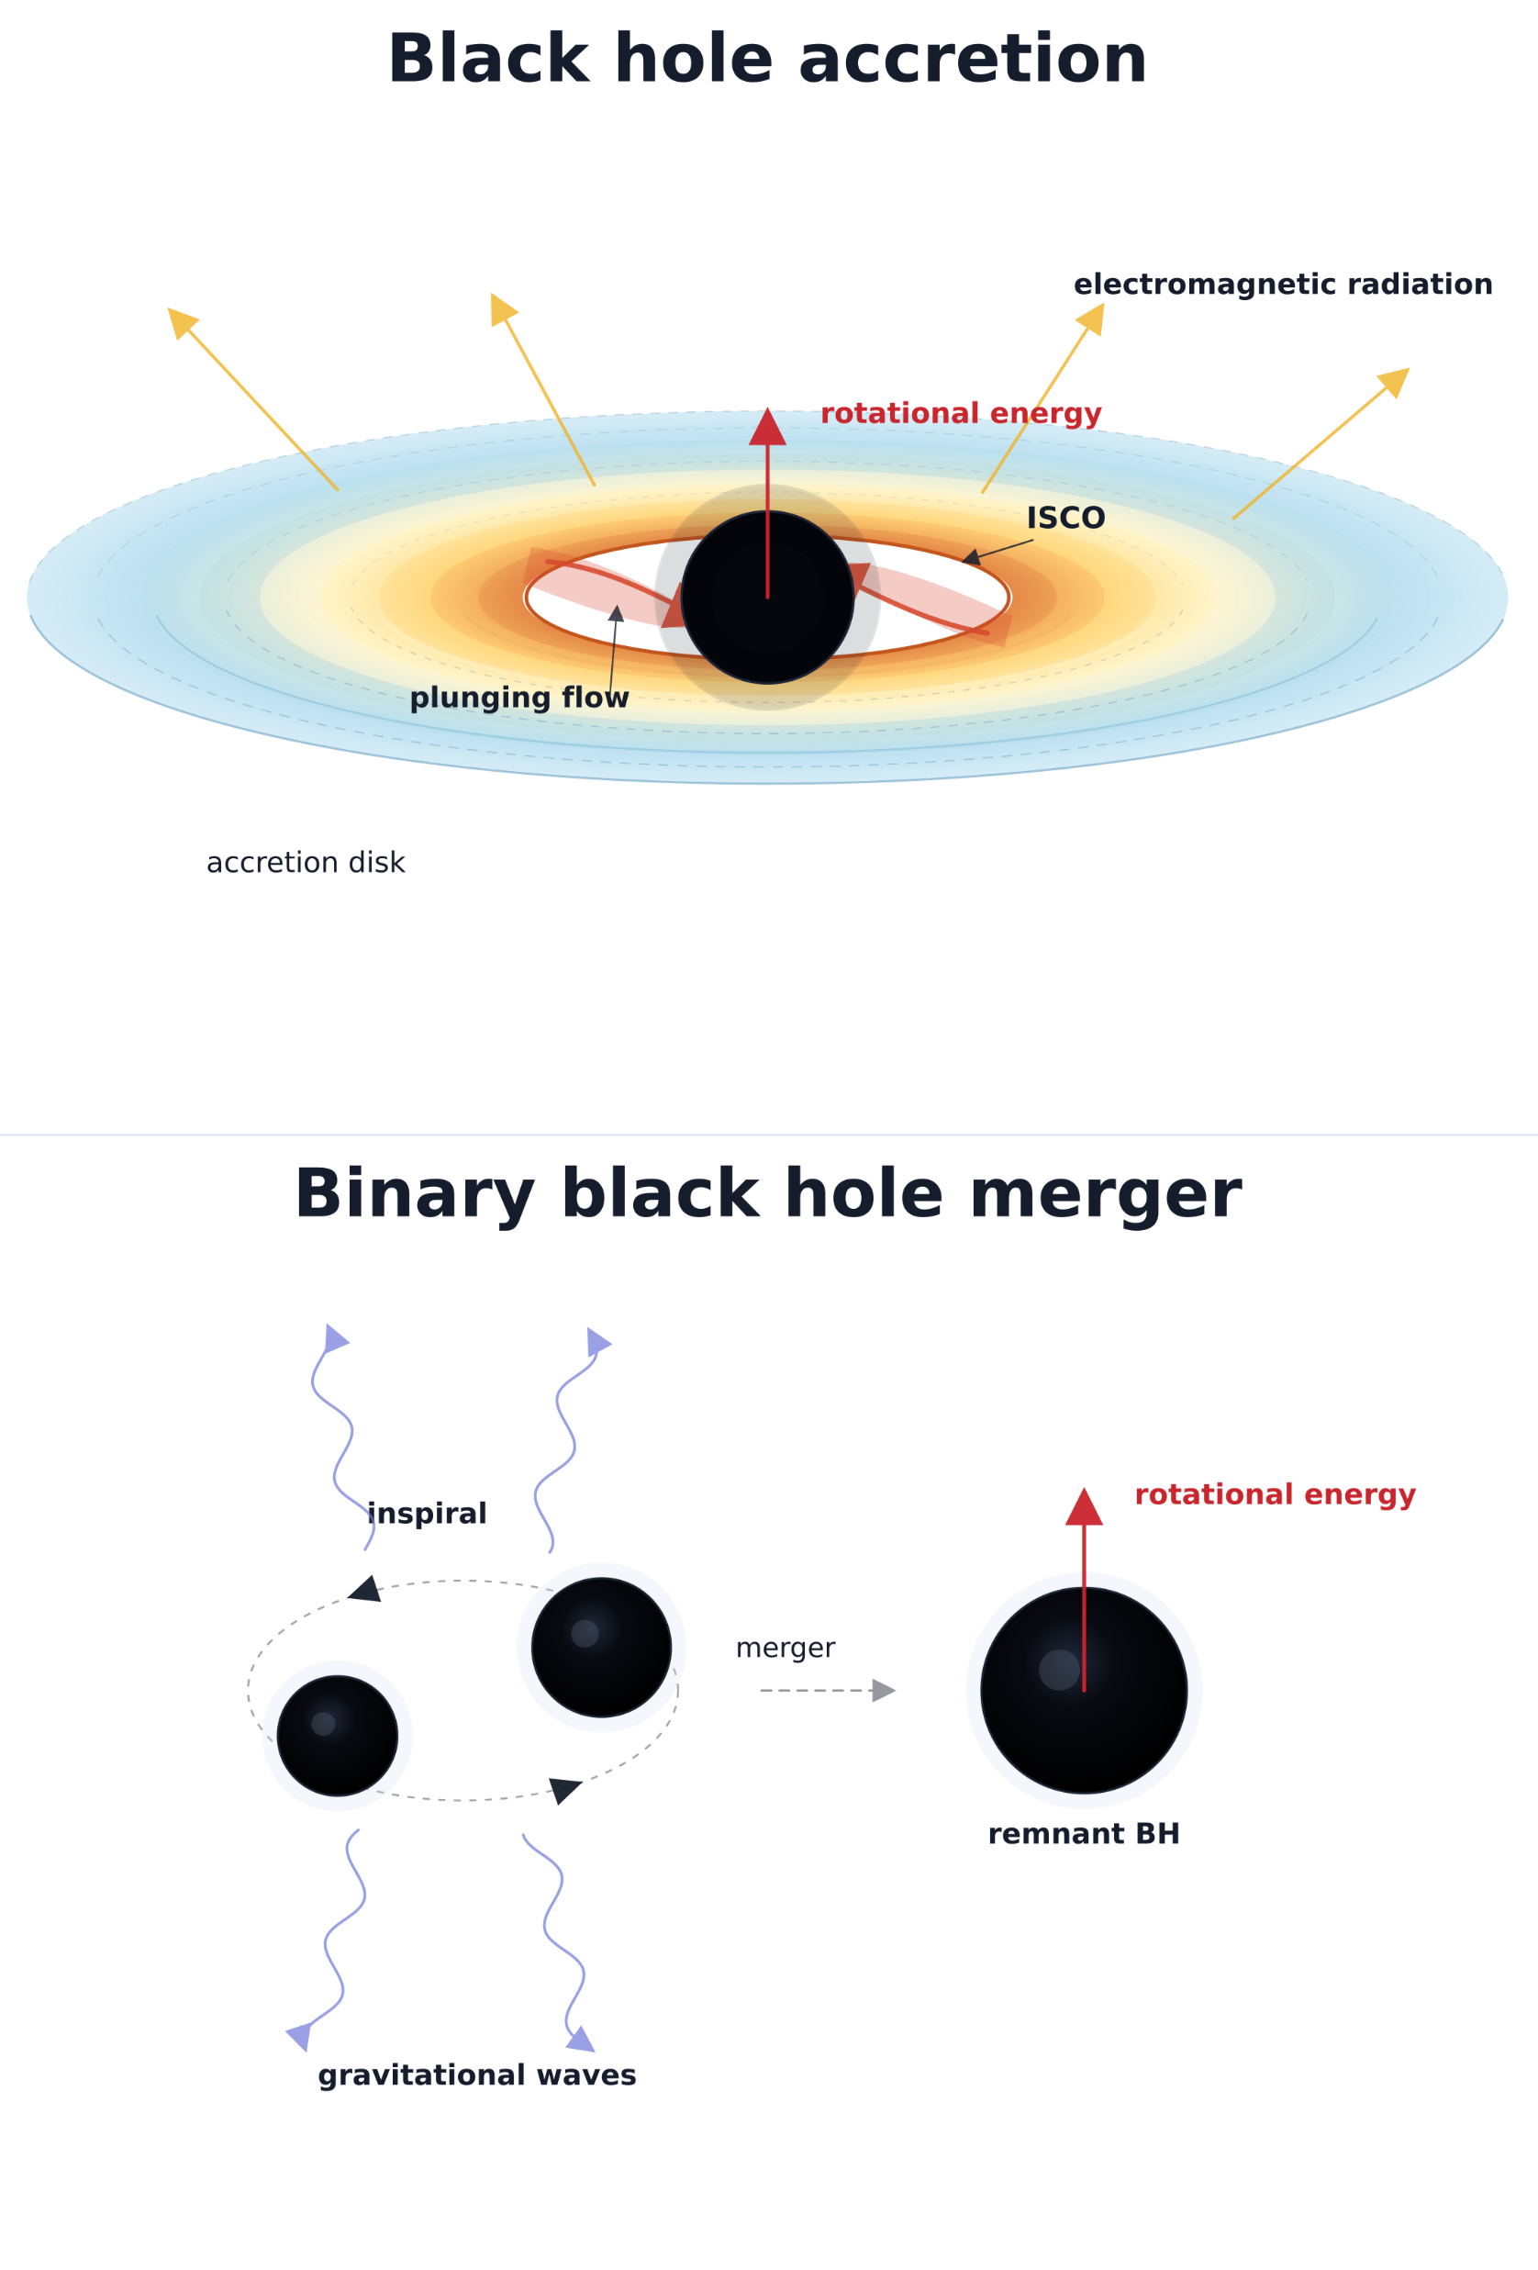
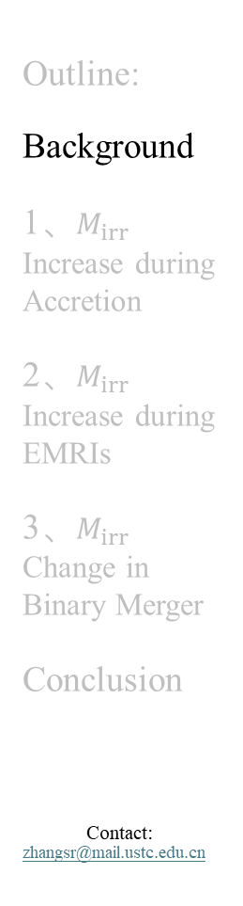
The Main Objective and Key Insight
Outline:
Background
1、$M_{irr}$ Increase during Accretion
2、$M_{irr}$ Increase during EMRIs
3、$M_{irr}$ Change in Binary Merger
Conclusion
Contact:
zhangsr@mail.ustc.edu.cn
Black hole (BH) accretion and mergers are the primary channels for BH growth over cosmic time and are associated with the ubiquitous energetic astrophysical events.
How the mass–energy and angular momentum transfer at different scale, especially in the strong-field environments?
1
From accretion to binary mergers, in most of the astrophysically relevant parameter space, the rotational energy stored in the BH reservoir is larger than the radiated energy.
18

Slide 3
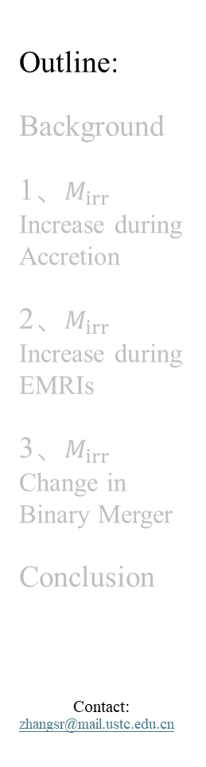
Outline
Outline:
Background
1、$M_{irr}$ Increase during Accretion
2、$M_{irr}$ Increase during EMRIs
3、$M_{irr}$ Change in Binary Merger
Conclusion
Contact:
zhangsr@mail.ustc.edu.cn
2
Background
Irreducible Mass Increase during Accretion
Irreducible Mass Increase during RMRIs
Irreducible Mass Change in Binary Merger
Conclusion and Outlook
18

Slide 4
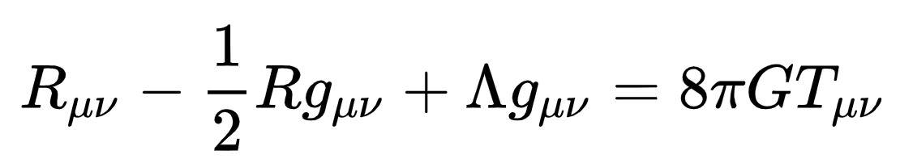

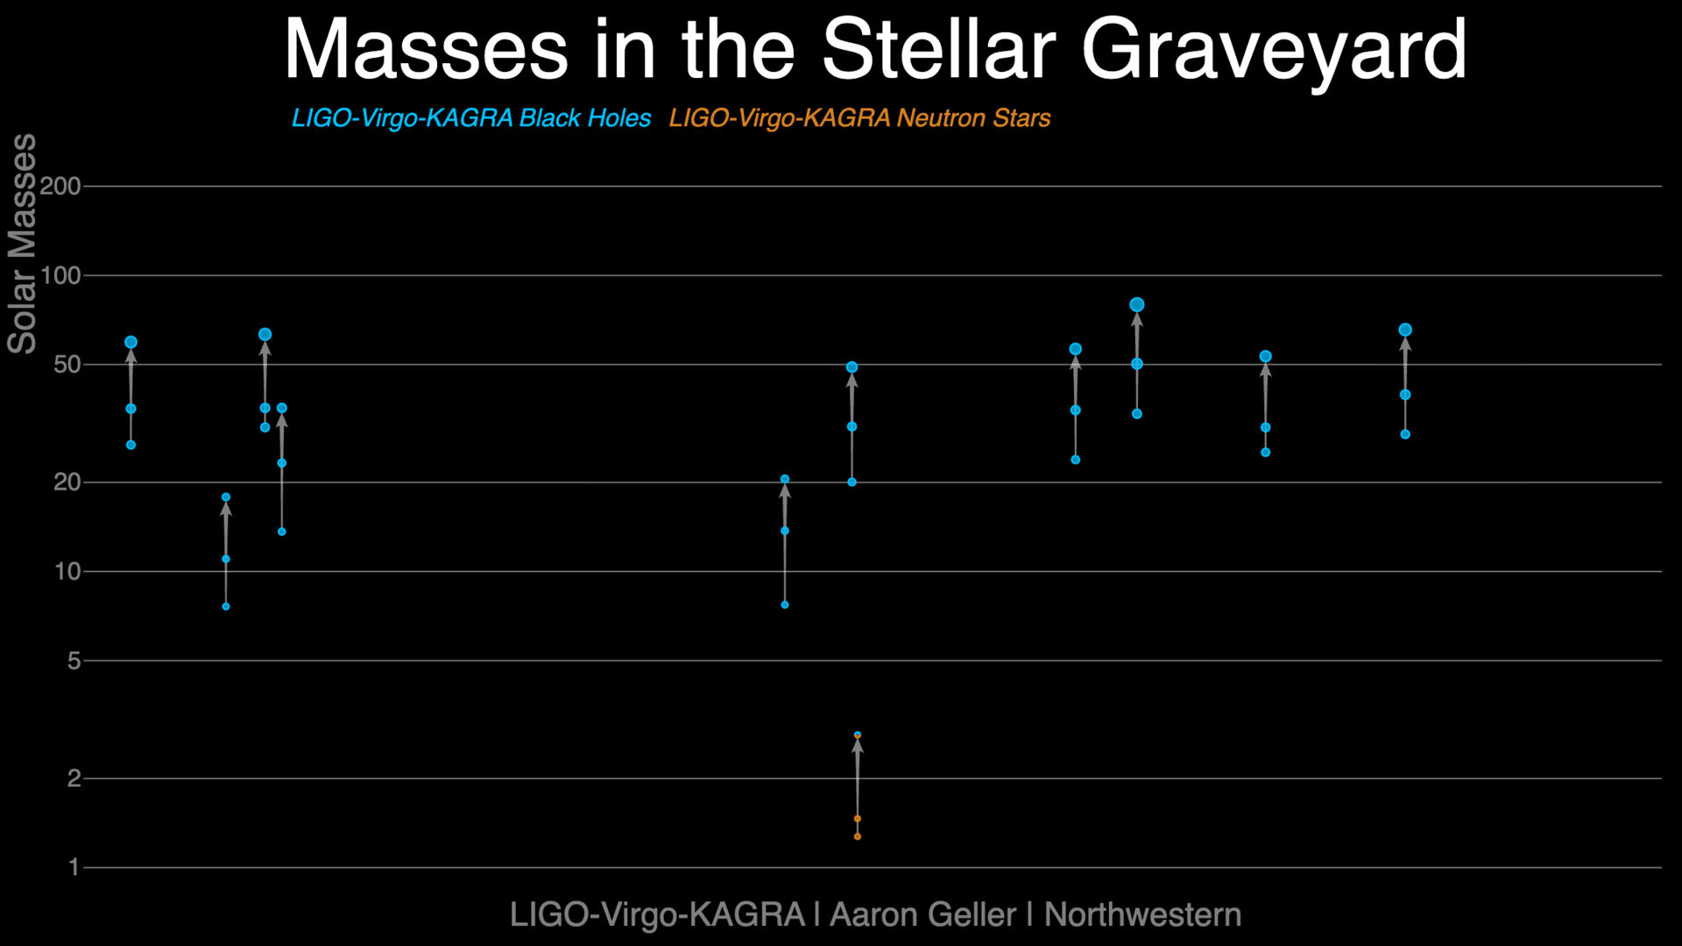
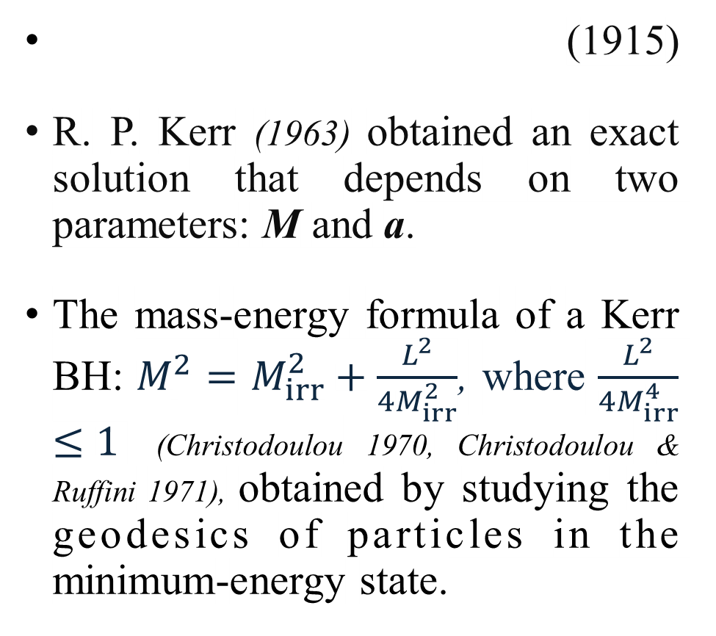
Opening the Gates of Black Hole Study
Outline:
Background
1、$M_{irr}$ Increase during Accretion
2、$M_{irr}$ Increase during EMRIs
3、$M_{irr}$ Change in Binary Merger
Conclusion
Contact:
zhangsr@mail.ustc.edu.cn
(1915)
R. P. Kerr (1963) obtained an exact solution that depends on two parameters: M and a.
The mass-energy formula of a Kerr BH: $M_{ }^{2}=$ $M_{irr}^{2}+\frac{L_{ }^{2}}{4M_{irr}^{2}}$, where $\frac{L_{ }^{2}}{4M_{irr}^{4}}≤1$ (Christodoulou 1970, Christodoulou & Ruffini 1971), obtained by studying the geodesics of particles in the minimum-energy state.
3
EHT. (2019)
18

Slide 5
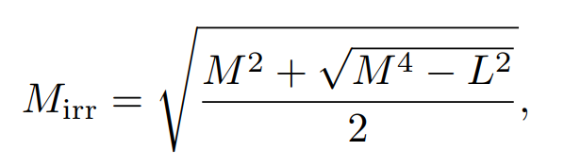
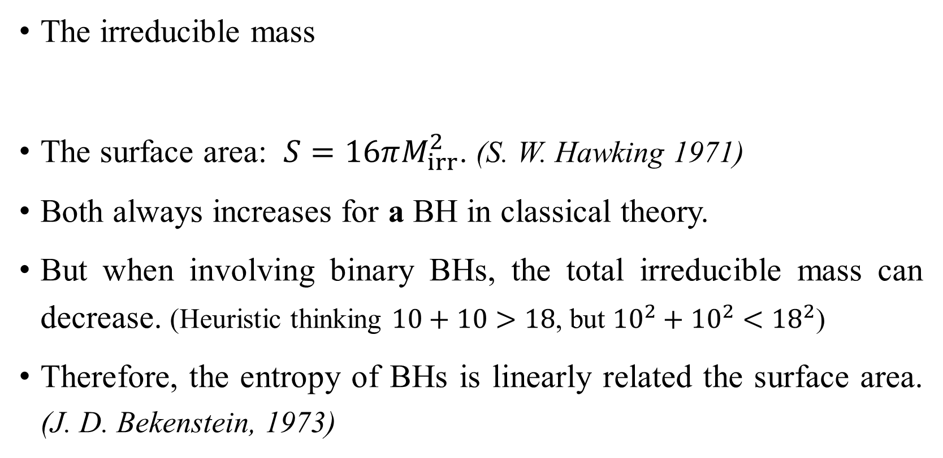
The Irreducible Mass and Surface Area
Outline:
Background
1、$M_{irr}$ Increase during Accretion
2、$M_{irr}$ Increase during EMRIs
3、$M_{irr}$ Change in Binary Merger
Conclusion
Contact:
zhangsr@mail.ustc.edu.cn
The irreducible mass
The surface area: $S=16πM_{irr}^{2}$. (S. W. Hawking 1971)
Both always increases for a BH in classical theory.
But when involving binary BHs, the total irreducible mass can decrease. (Heuristic thinking $10+10>18$, but ${10}^{2}+{10}^{2}<{18}^{2}$)
Therefore, the entropy of BHs is linearly related the surface area. (J. D. Bekenstein, 1973)
4
18

Slide 6
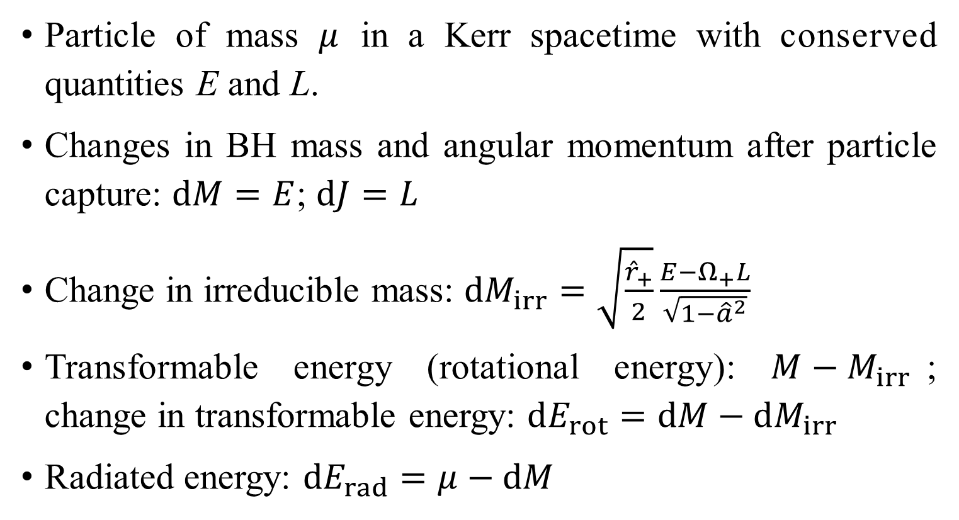
Changes in BH Quantities after Particle Capture
Outline:
Background
1、$M_{irr}$ Increase during Accretion
2、$M_{irr}$ Increase during EMRIs
3、$M_{irr}$ Change in Binary Merger
Conclusion
Contact:
zhangsr@mail.ustc.edu.cn
Particle of mass $μ$ in a Kerr spacetime with conserved quantities E and L.
Changes in BH mass and angular momentum after particle capture: $dM=E$; $dJ=L$
Change in irreducible mass: $dM_{irr}=\sqrt{\frac{{\hat{r}}_{+}}{2}}\frac{E−Ω_{+}L}{\sqrt{1−{\hat{a}}^{2}}}$
Transformable energy (rotational energy): $M−M_{irr}$; change in transformable energy: $dE_{rot}=dM−dM_{irr}$
Radiated energy: $dE_{rad}=μ−dM$
5
18

Slide 7
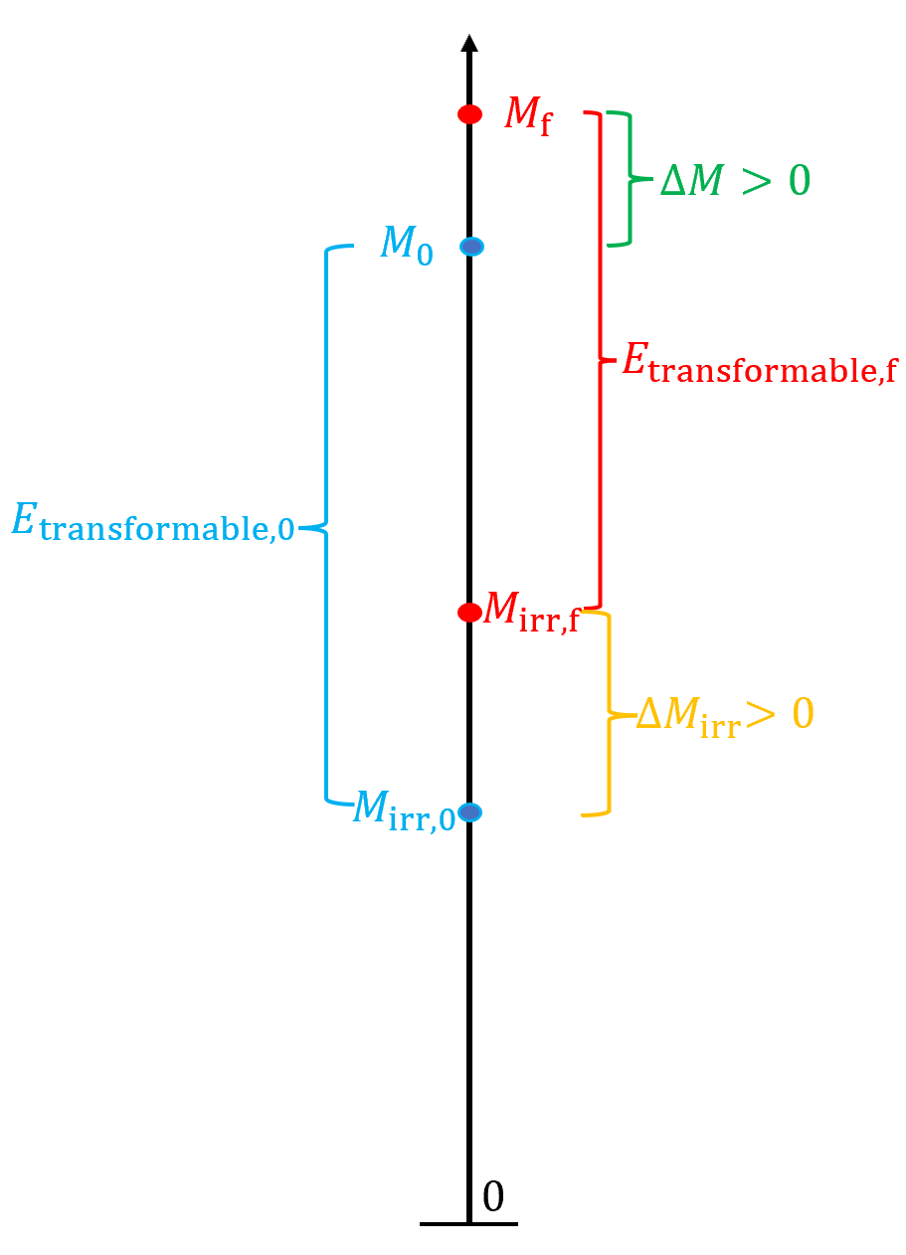









The Irreducible Mass and Energy Reservoir
Outline:
Background
1、$M_{irr}$ Increase during Accretion
2、$M_{irr}$ Increase during EMRIs
3、$M_{irr}$ Change in Binary Merger
Conclusion
Contact:
zhangsr@mail.ustc.edu.cn
$$M_{0}$$
Zhang & Prakapenia,
2024, CQG.;
Ruffini, Prakapenia, Quevedo & Zhang, 2025, PRL.
Ruffini, et al., 2025, PRR.
$$E_{extracted}=−∆M$$
$$M_{f}$$
6
$$E_{\begin{aligned}transformable,0 \\ \end{aligned}}$$
$$E_{transformable,f}$$
$$M_{irr,f}$$
$${∆M}_{irr}$$
Binary BH Merger
$$M_{irr,0}$$
$$0$$
Energy Extraction
Accretion
The change of irreducible mass reflects reversibility and renders the calculation of changes in the surface area and BH entropy effortless.
The change of irreducible mass also provides insights into how the “reservoir” of BH energy undergoes contraction or expansion.
18

Slide 8

$M_{irr}$ Increase during Accretion

Slide 9
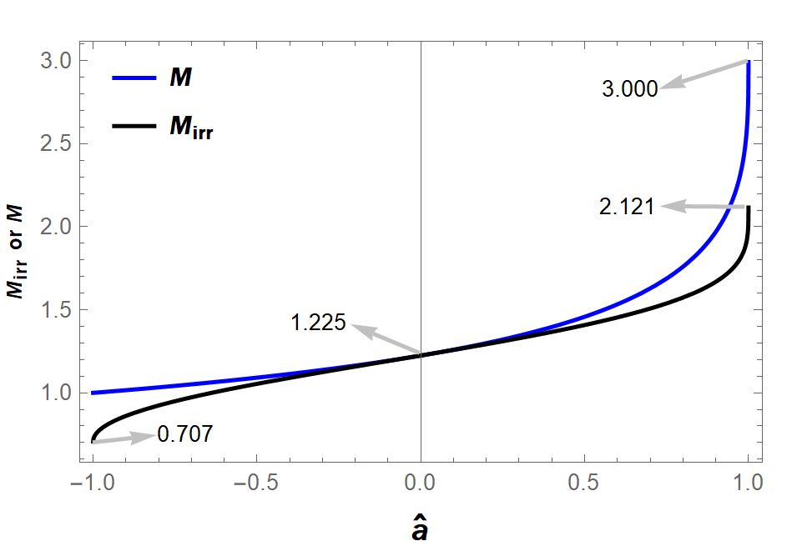
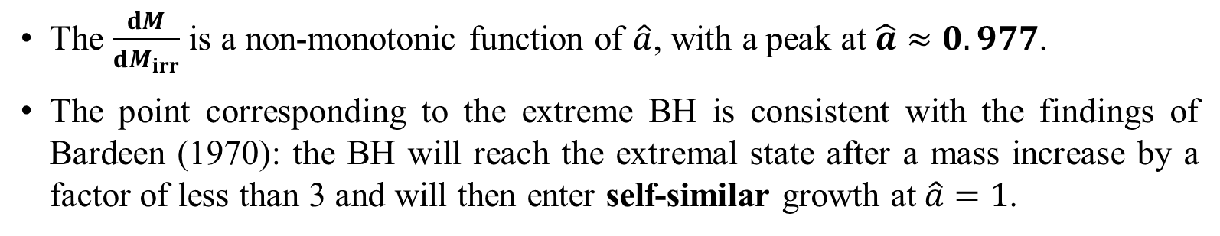
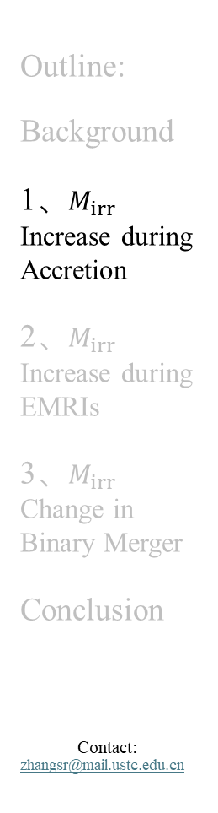
Conservation Approximation (Accretion)
Outline:
Background
1、$M_{irr}$ Increase during Accretion
2、$M_{irr}$ Increase during EMRIs
3、$M_{irr}$ Change in Binary Merger
Conclusion
Contact:
zhangsr@mail.ustc.edu.cn
Massive particles fall into BHs along the inner-most stable circular orbit (ISCO)
7
retrograde
prograde
The $\frac{dM}{dM_{irr}}$ is a non-monotonic function of $\hat{a}$, with a peak at $\hat{a}≈0.977$.
The point corresponding to the extreme BH is consistent with the findings of Bardeen (1970): the BH will reach the extremal state after a mass increase by a factor of less than 3 and will then enter self-similar growth at $\hat{a}=1$.
18

Slide 10
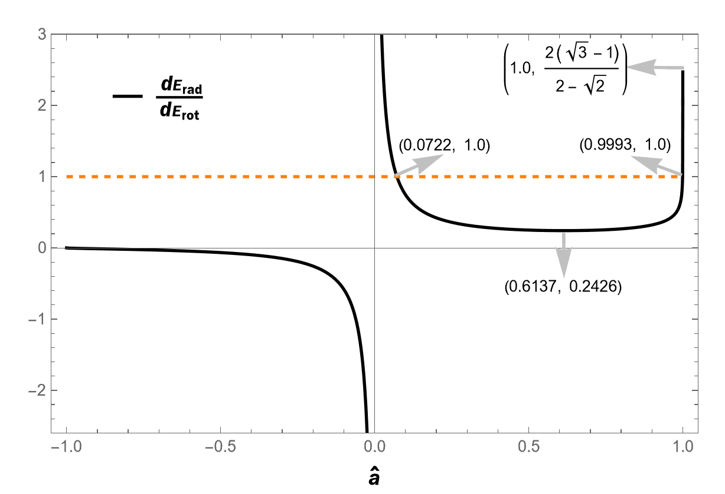
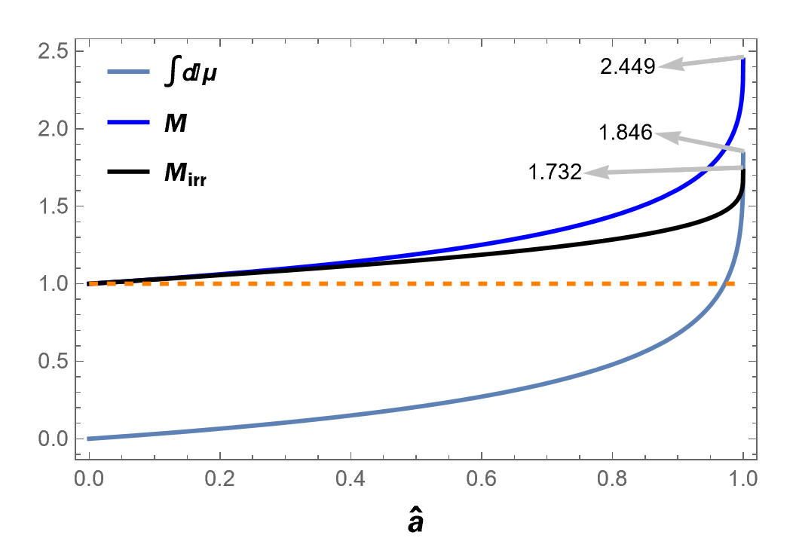
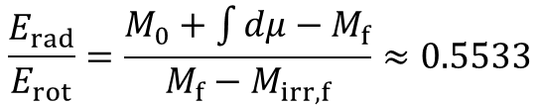
Energy Budget in the Conservation Approximation
Outline:
Background
1、$M_{irr}$ Increase during Accretion
2、$M_{irr}$ Increase during EMRIs
3、$M_{irr}$ Change in Binary Merger
Conclusion
Contact:
zhangsr@mail.ustc.edu.cn
8
retrograde
prograde
Therefore, in most astrophysically relevant accretion regimes, the energy budget is dominated not by radiative losses, but by the rotational energy stored in the BH.
The whole accretion process from an initially non-spinning BH to an extremal Kerr BH:
$$\frac{E_{rad}}{E_{rot}}=\frac{M_{0}+\int{dμ}−M_{f}}{M_{f}−M_{irr,f}}≈0.5533$$
18

Slide 11
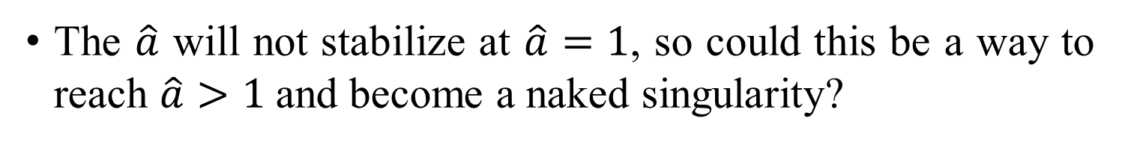
Massless Particles Fall into BHs Along the Unstable Circular Orbit
Outline:
Background
1、$M_{irr}$ Increase during Accretion
2、$M_{irr}$ Increase during EMRIs
3、$M_{irr}$ Change in Binary Merger
Conclusion
Contact:
zhangsr@mail.ustc.edu.cn
Accretion of massless particles
Accretion of massive particles
9
The $\hat{a}$ will not stabilize at $\hat{a}=1$, so could this be a way to reach $\hat{a}>1$and become a naked singularity?
18

Slide 12

$M_{irr}$ Increase during EMRIs

Slide 13
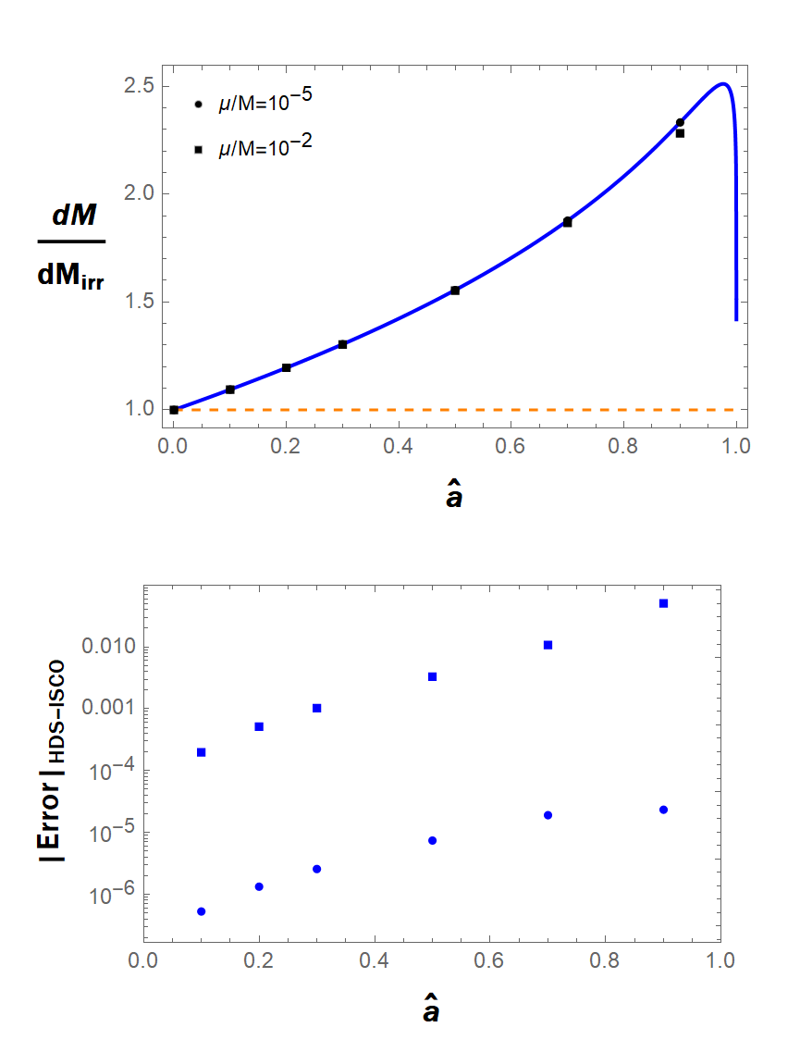


$M_{irr}$ Increase during EMRIs
Outline:
Background
1、$M_{irr}$ Increase during Accretion
2、$M_{irr}$ Increase during EMRIs
3、$M_{irr}$ Change in Binary Merger
Conclusion
Contact:
zhangsr@mail.ustc.edu.cn
Helicoidal-Drifting-Sequence (HDS) Approximation
The HDS considered a correction to the conservative approximation due to GW emission, accounting for the radial momentum in the particle’s motion along the entire trajectory, even far before the ISCO. The GW radiation information is solved from the Teukolsky equation.
10
EMRIs introduces only a small correction to the energy bookkeeping.
18

Slide 14
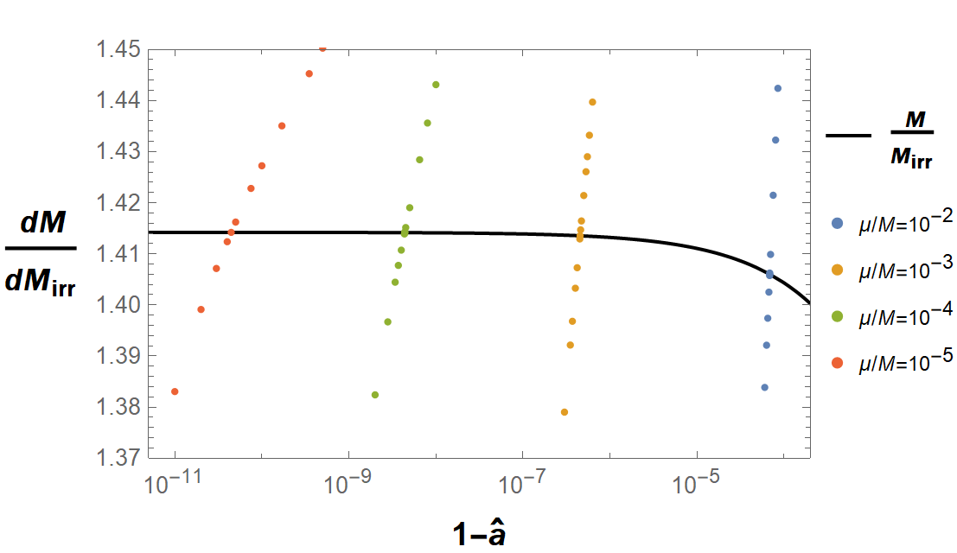
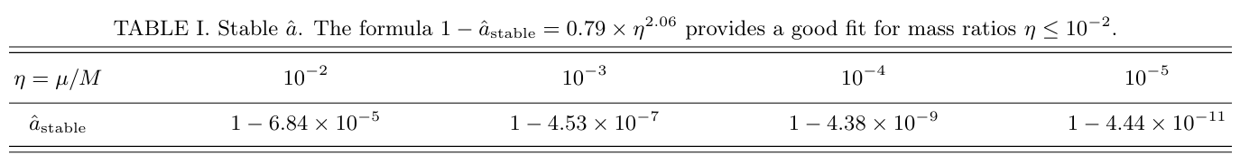
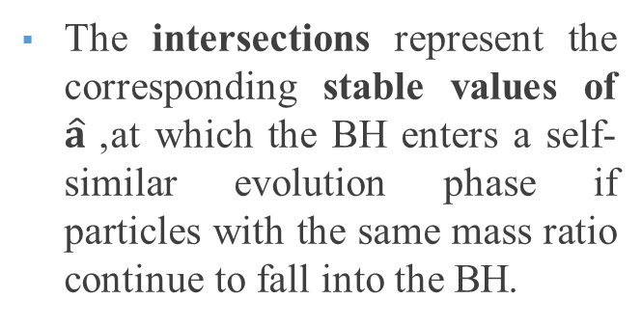
EMRIs Near the Extremal Kerr Limit
Outline:
Background
1、$M_{irr}$ Increase during Accretion
2、$M_{irr}$ Increase during EMRIs
3、$M_{irr}$ Change in Binary Merger
Conclusion
Contact:
zhangsr@mail.ustc.edu.cn
The intersections represent the corresponding stable values of $\hat{a}$, at which the BH enters a self-similar evolution phase if particles with the same mass ratio continue to fall into the BH.
11
When a BH simultaneously accretes matter from a disk and its generated radiation, the BH stabilizes the spin parameter at ${\hat{a}}_{stable}$≈0.998. (Thorne, 1974, ApJ.)
18

Slide 15

$M_{irr}$ Change in Binary Merger

Slide 16
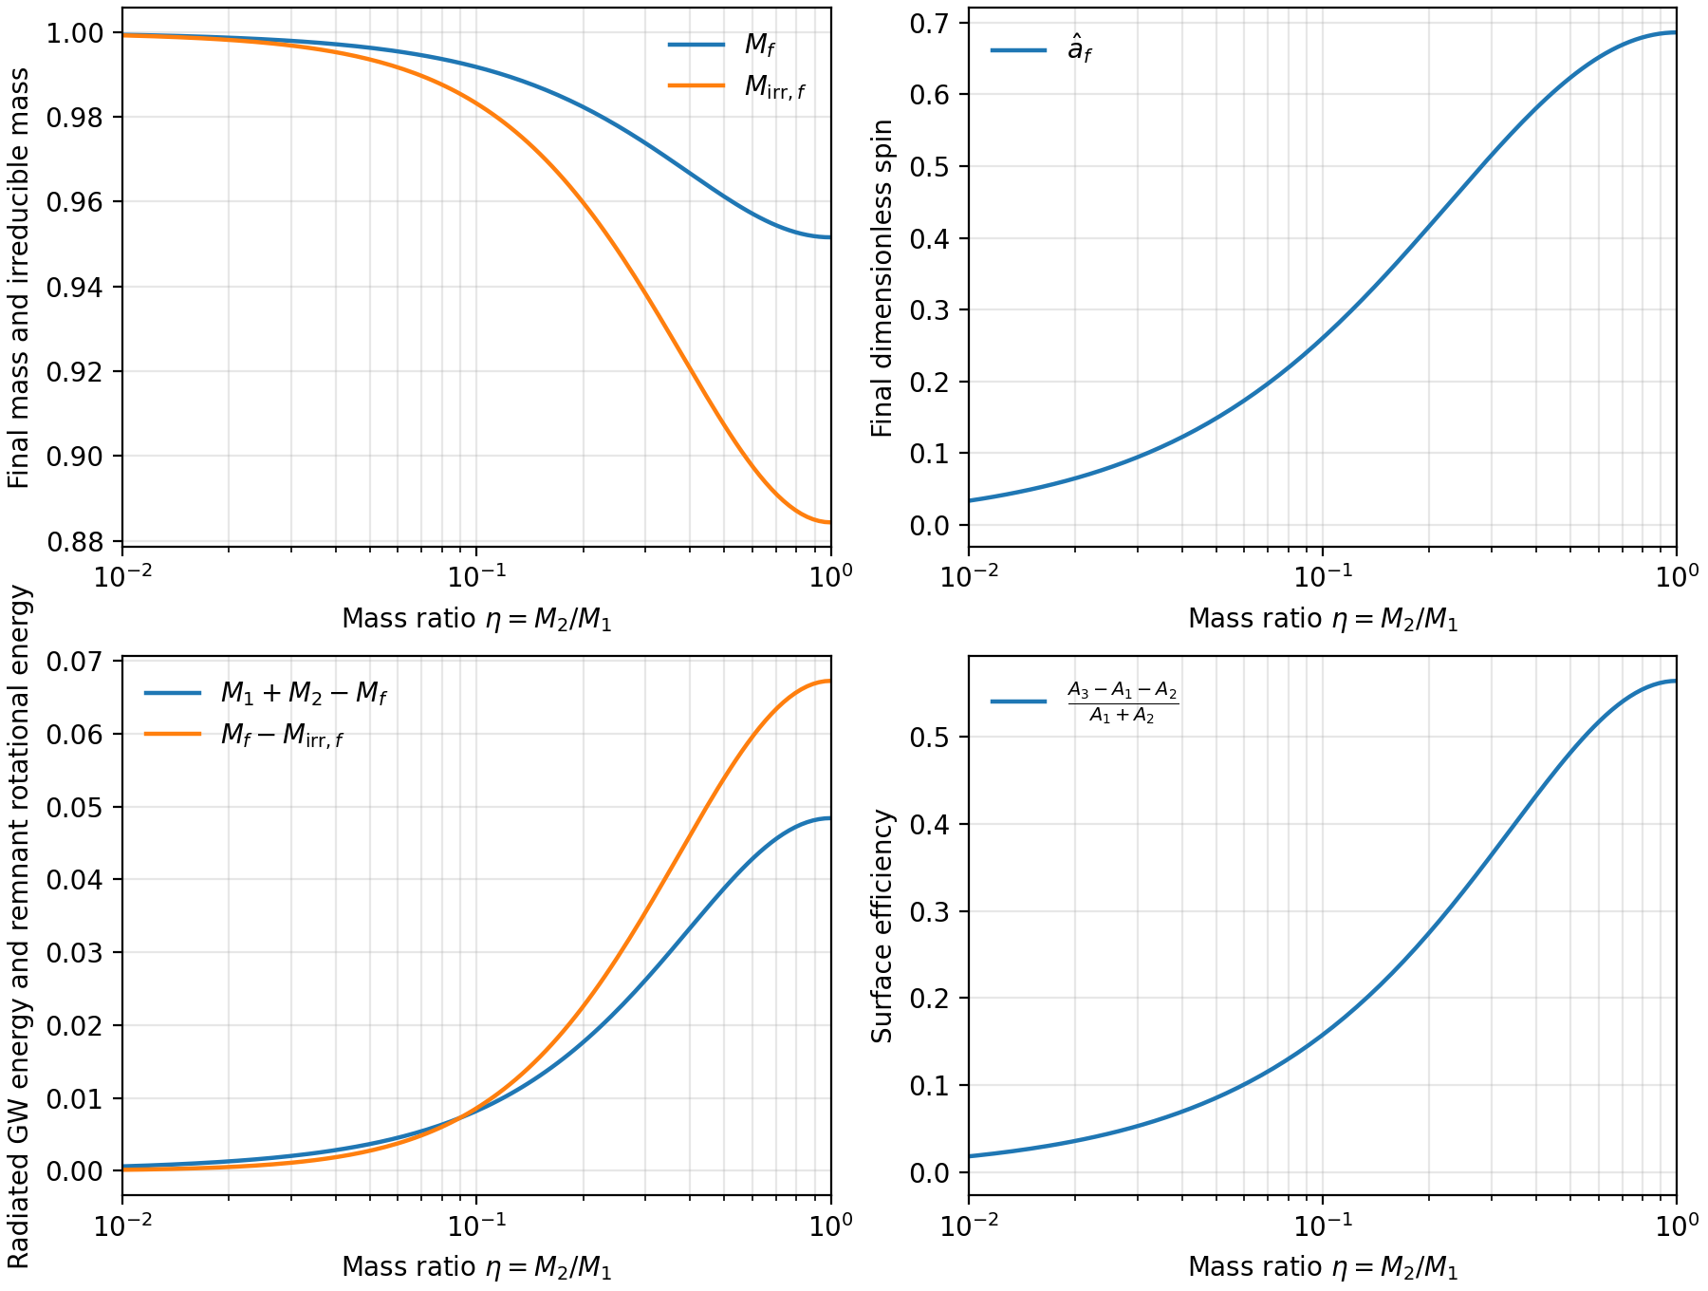

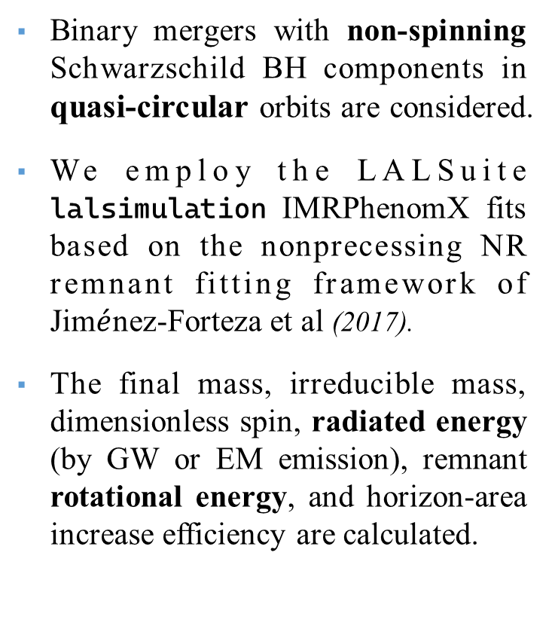

$M_{irr}$ Change in Binary Merger
Outline:
Background
1、$M_{irr}$ Increase during Accretion
2、$M_{irr}$ Increase during EMRIs
3、$M_{irr}$ Change in Binary Merger
Conclusion
Contact:
zhangsr@mail.ustc.edu.cn
Binary mergers with non-spinning Schwarzschild BH components in quasi-circular orbits are considered.
We employ the LALSuite lalsimulation IMRPhenomX fits based on the nonprecessing NR remnant fitting framework of Jim$\acute{e}$nez-Forteza et al (2017).
The final mass, irreducible mass, dimensionless spin, radiated energy (by GW or EM emission), remnant rotational energy, and horizon-area increase efficiency are calculated.
12
18

Slide 17
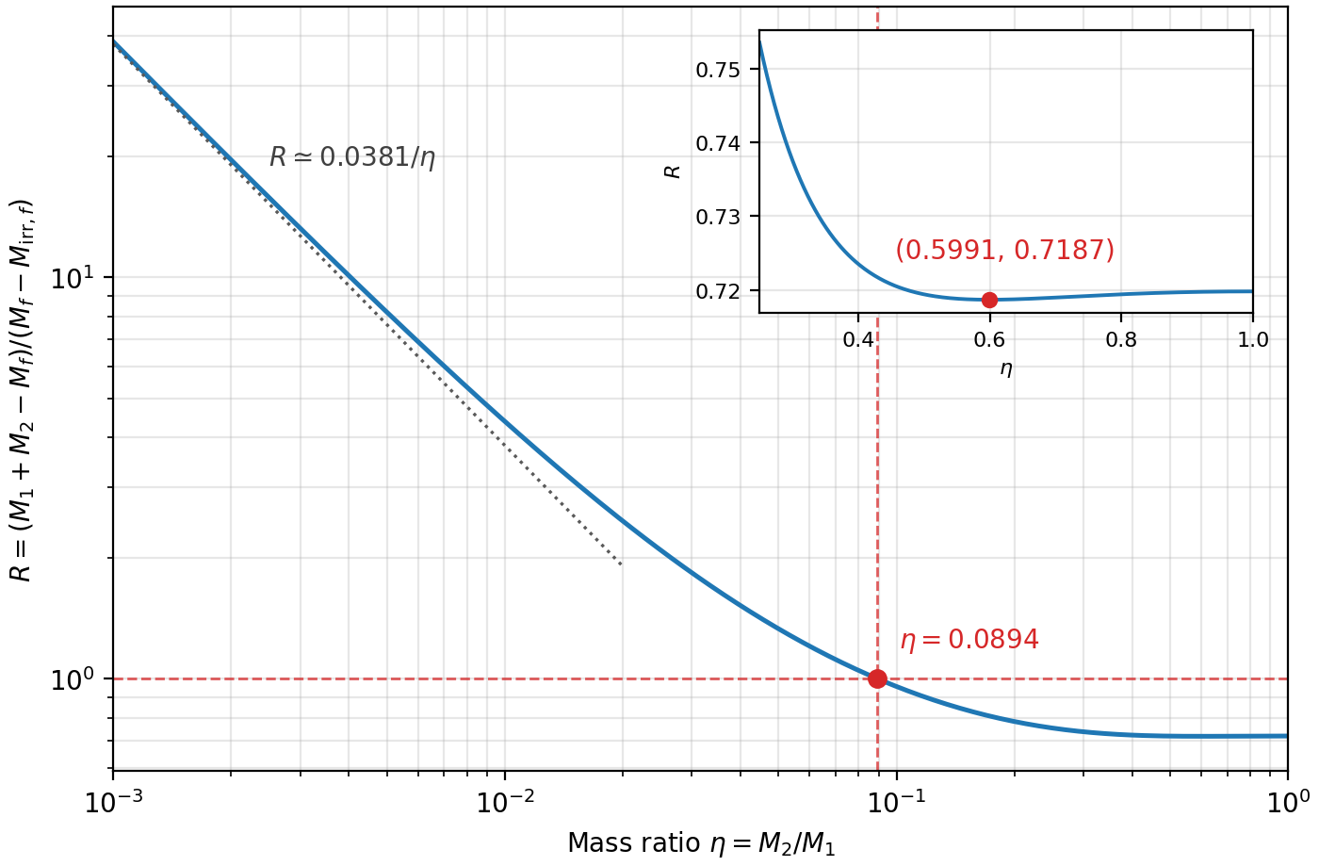
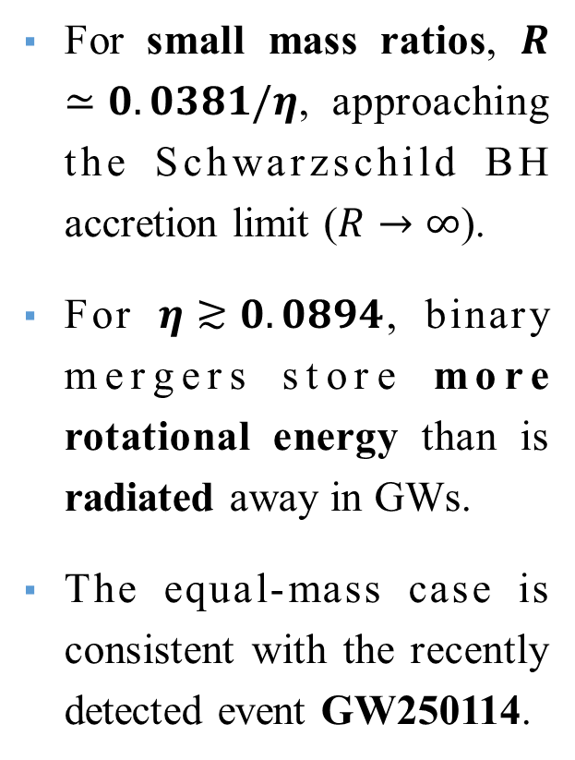
Radiated Energy vs Stored Rotational Energy
Outline:
Background
1、$M_{irr}$ Increase during Accretion
2、$M_{irr}$ Increase during EMRIs
3、$M_{irr}$ Change in Binary Merger
Conclusion
Contact:
zhangsr@mail.ustc.edu.cn
For small mass ratios, $R≃0.0381/η$, approaching the Schwarzschild BH accretion limit ($R→∞$).
For $η≳0.0894$, binary mergers store more rotational energy than is radiated away in GWs.
The equal-mass case is consistent with the recently detected event GW250114.
13
18

Slide 18
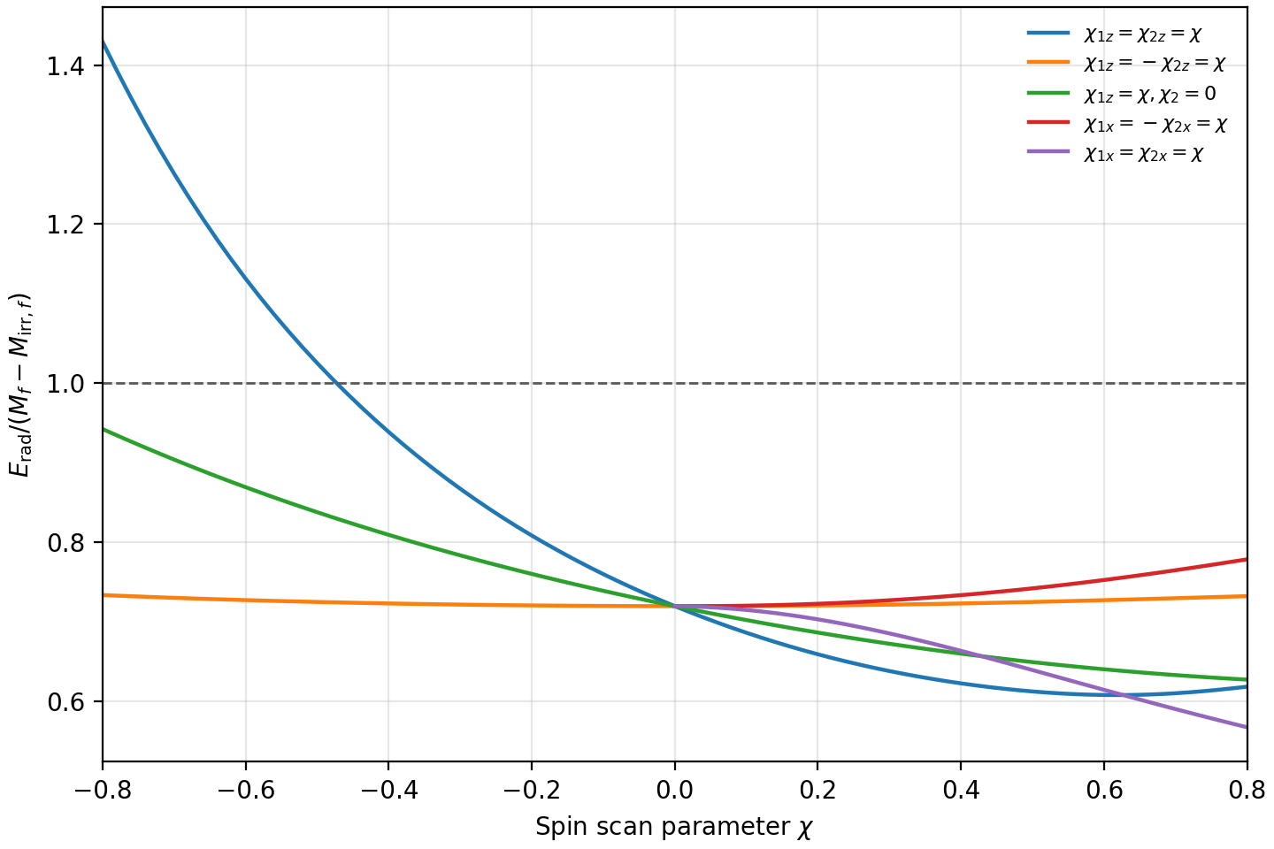
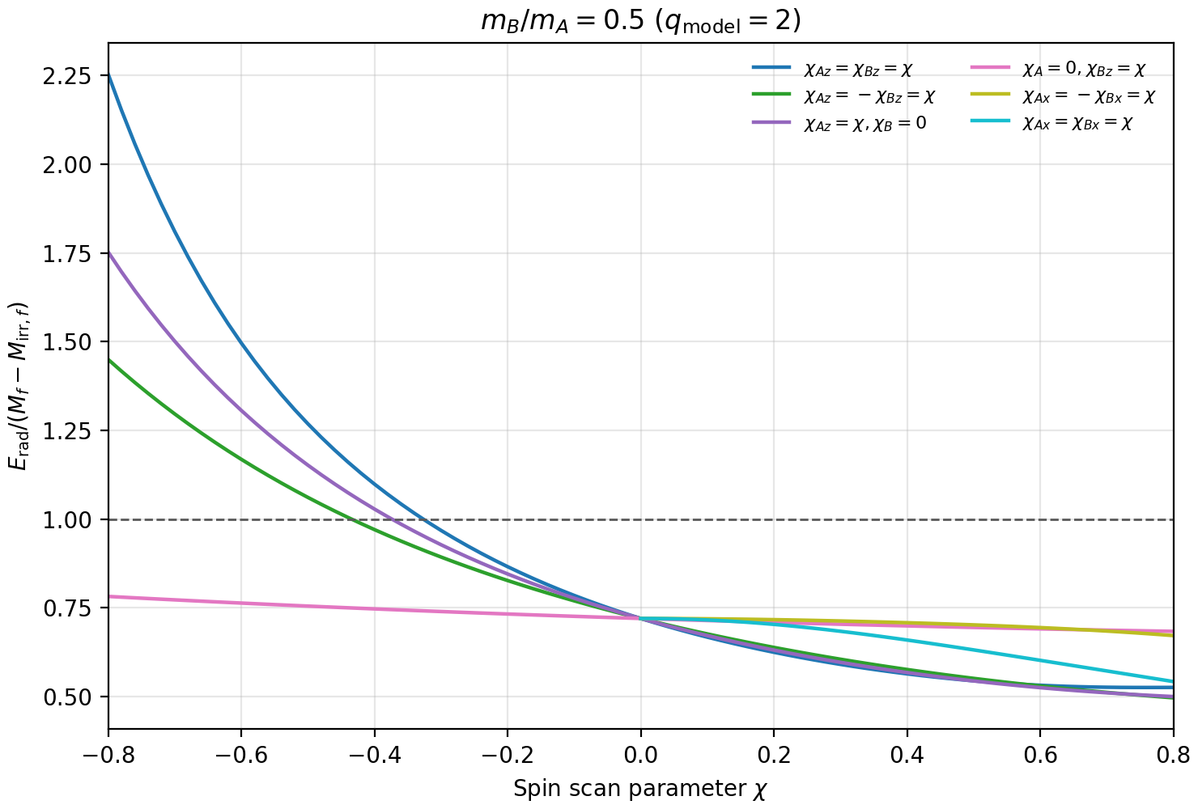



Binary BH with Different Spin Configurations
Outline:
Background
1、$M_{irr}$ Increase during Accretion
2、$M_{irr}$ Increase during EMRIs
3、$M_{irr}$ Change in Binary Merger
Conclusion
Contact:
zhangsr@mail.ustc.edu.cn
$$q=\frac{M_{B}}{M_{A}}=1$$
$$q=\frac{M_{B}}{M_{A}}=0.5$$
14
Observationally, all publicly released LVK events:
$E_{rot}$ > $E_{rad}$
18

Slide 19
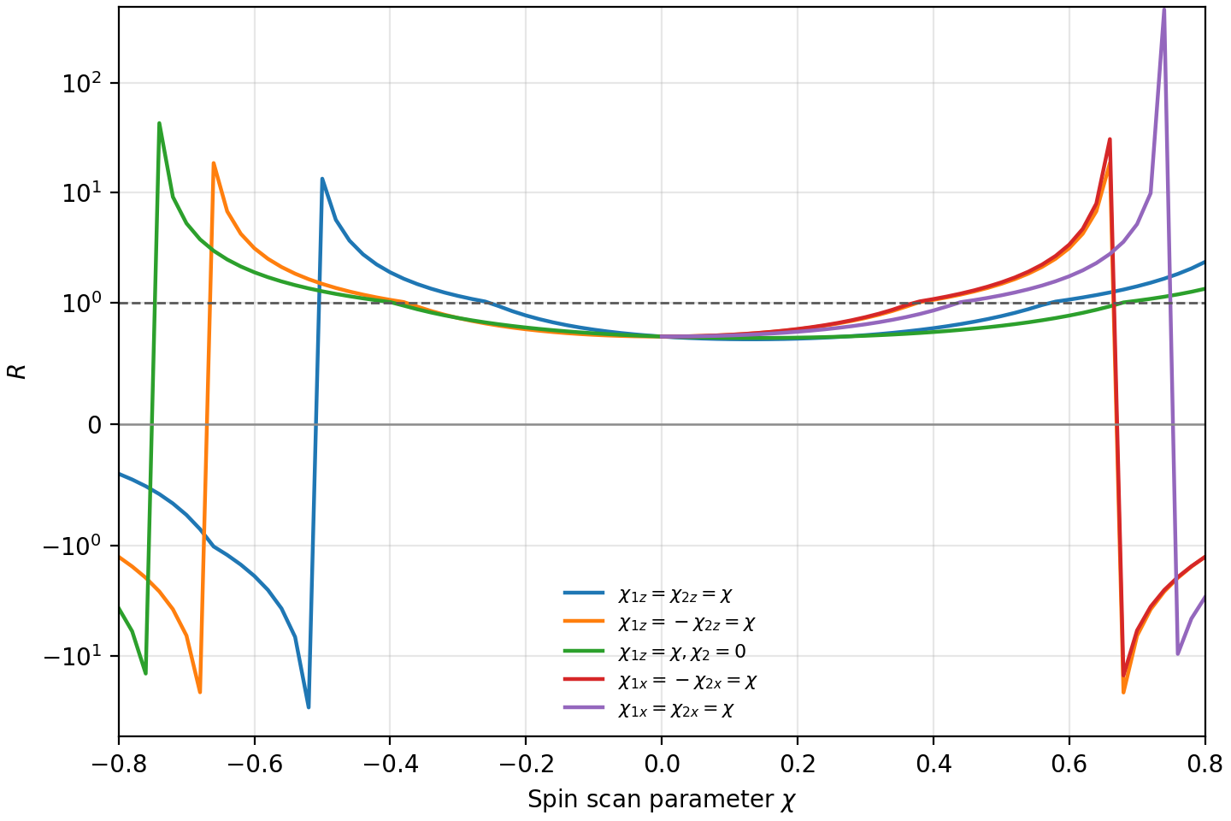
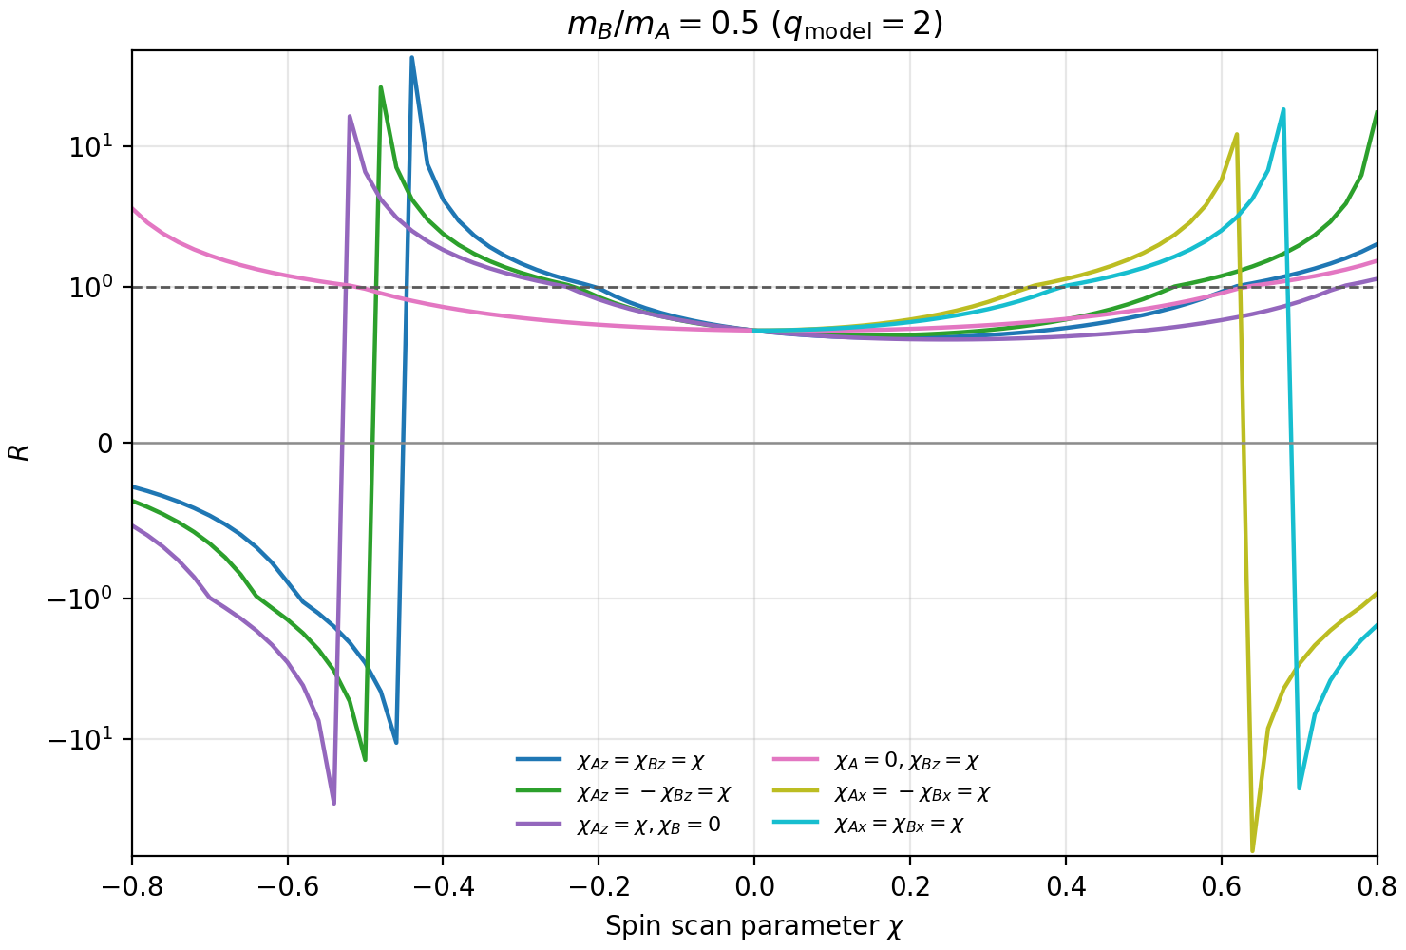


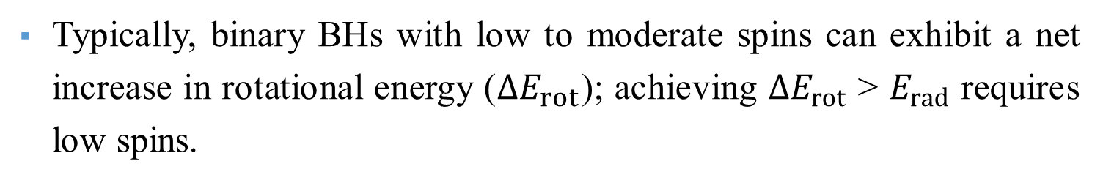

Net Increase in $E_{rot}$of Spinning Binary BHs
Outline:
Background
1、$M_{irr}$ Increase during Accretion
2、$M_{irr}$ Increase during EMRIs
3、$M_{irr}$ Change in Binary Merger
Conclusion
Contact:
zhangsr@mail.ustc.edu.cn
$$q=\frac{M_{B}}{M_{A}}=1$$
$$q=\frac{M_{B}}{M_{A}}=0.5$$
$$E_{rad}/∆E_{rot}$$
$$E_{rad}/∆E_{rot}$$
15
Typically, binary BHs with low to moderate spins can exhibit a net increase in rotational energy ($∆E_{rot}$); achieving ${∆E}_{rot}$ > $E_{rad}$ requires low spins.
18

Slide 20
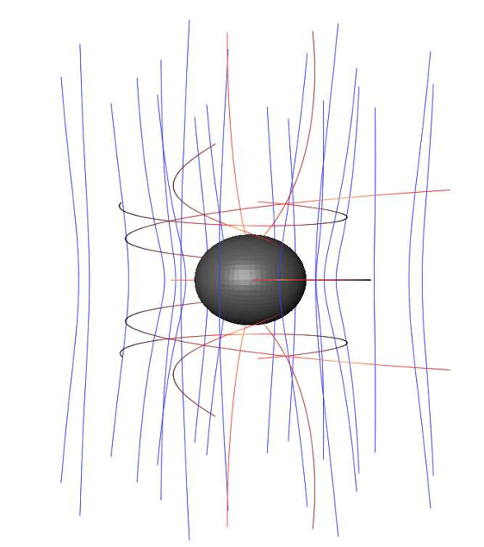

Summary of Related Studies
Outline:
Background
1、$M_{irr}$ Increase during Accretion
2、$M_{irr}$ Increase during EMRIs
3、$M_{irr}$ Change in Binary Merger
Conclusion
Contact:
zhangsr@mail.ustc.edu.cn
Charged black hole
(Hu, Cai & Wang 2026)
The evolution of BH energy reservoirs and energy extraction events over cosmic time.
How to observationally trace BH energy reservoirs?
What is the mass-energy of dynamic BHs?
Immersed in magnetic field
(Rueda & Ruffini 2023)
External Field,
Non-Kerr
Penrose process
(Zhang et al. 2024, CQG;
Ruffini &.. Zhang 2025 PRL;
Ruffini &.. Zhang 2025 PRR)
0
Mass Ratio
1
16
Accretion process
(Zhang et al. 2023, AR)
Observationally verified by LOGO, 2025, PRL
EMRIs and binary merger
(to be submitted..)
18

Slide 21
Take-home Messages
Outline:
Background
1、$M_{irr}$ Increase during Accretion
2、$M_{irr}$ Increase during EMRIs
3、$M_{irr}$ Change in Binary Merger
Conclusion
Contact:
zhangsr@mail.ustc.edu.cn
Stored Rotational Energy > Radiated Energy
From accretion to binary mergers, in most of the astrophysically relevant parameter range, rotational energy stored in the BH is larger than radiated energy (GW + EM).
The enormous energy stored in BHs can be used for subsequent energy extraction processes. Our results connect accretion, binary mergers, and energy extraction together, clearly showing the energy bookkeeping between BHs and infinity.
17
18

Slide 22
Thanks !

