Slide 1




Blackhole-Halo Mass Relation from UNIONS Weak Lensing
Wentao Luo
wtluo@ustc.edu.cn
In collaboration with: Qinxun Li (Utah Univ.), Martin Kilbinger (CEA, Saclay) et al
The 6th Zel’dovich Meeting
ICRANet, Pescara, Italy
2026.7

Slide 2
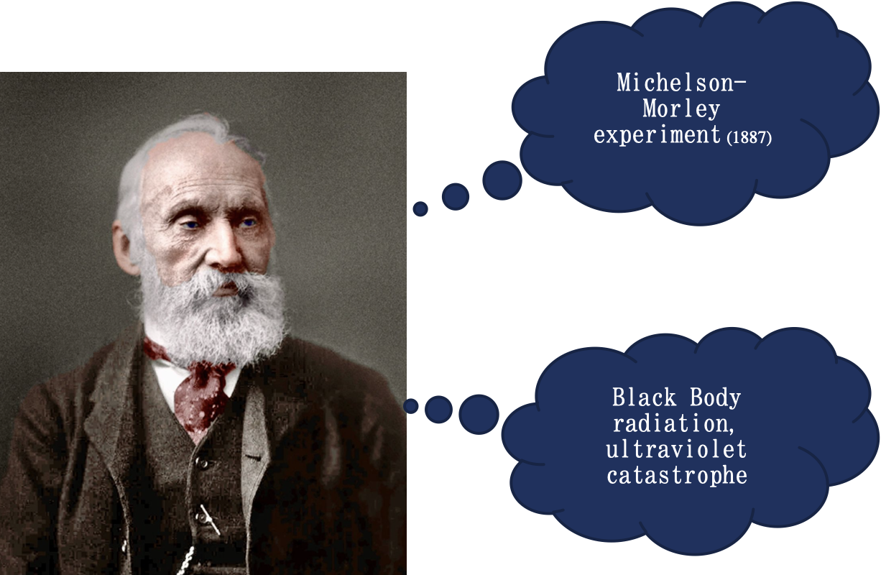
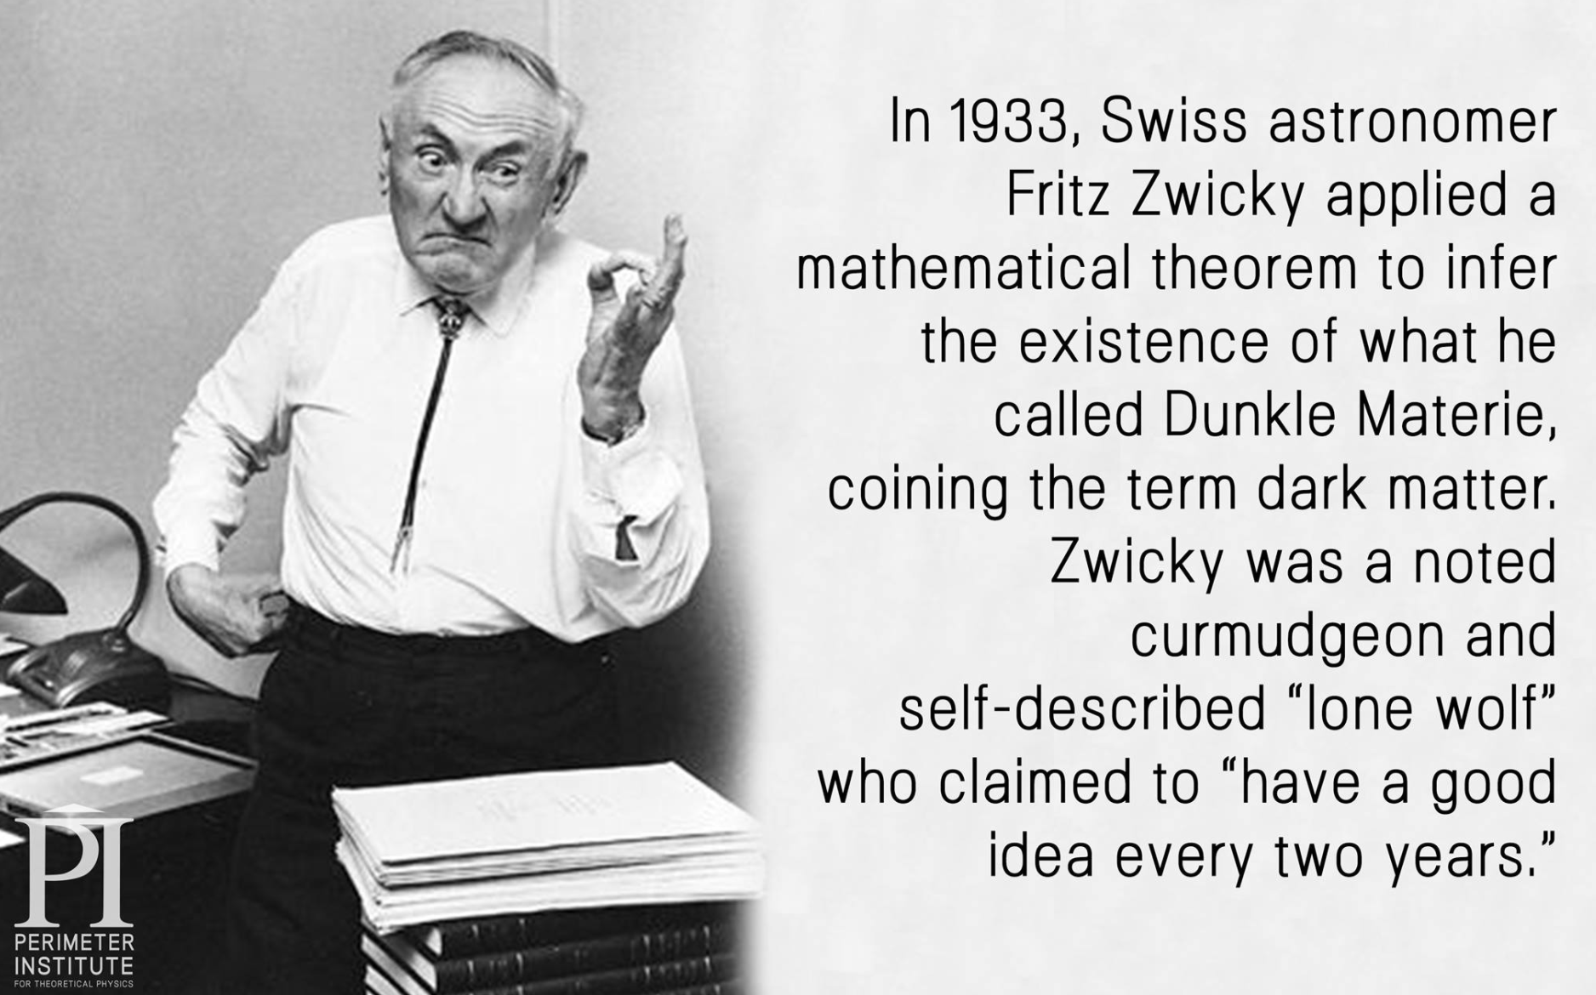
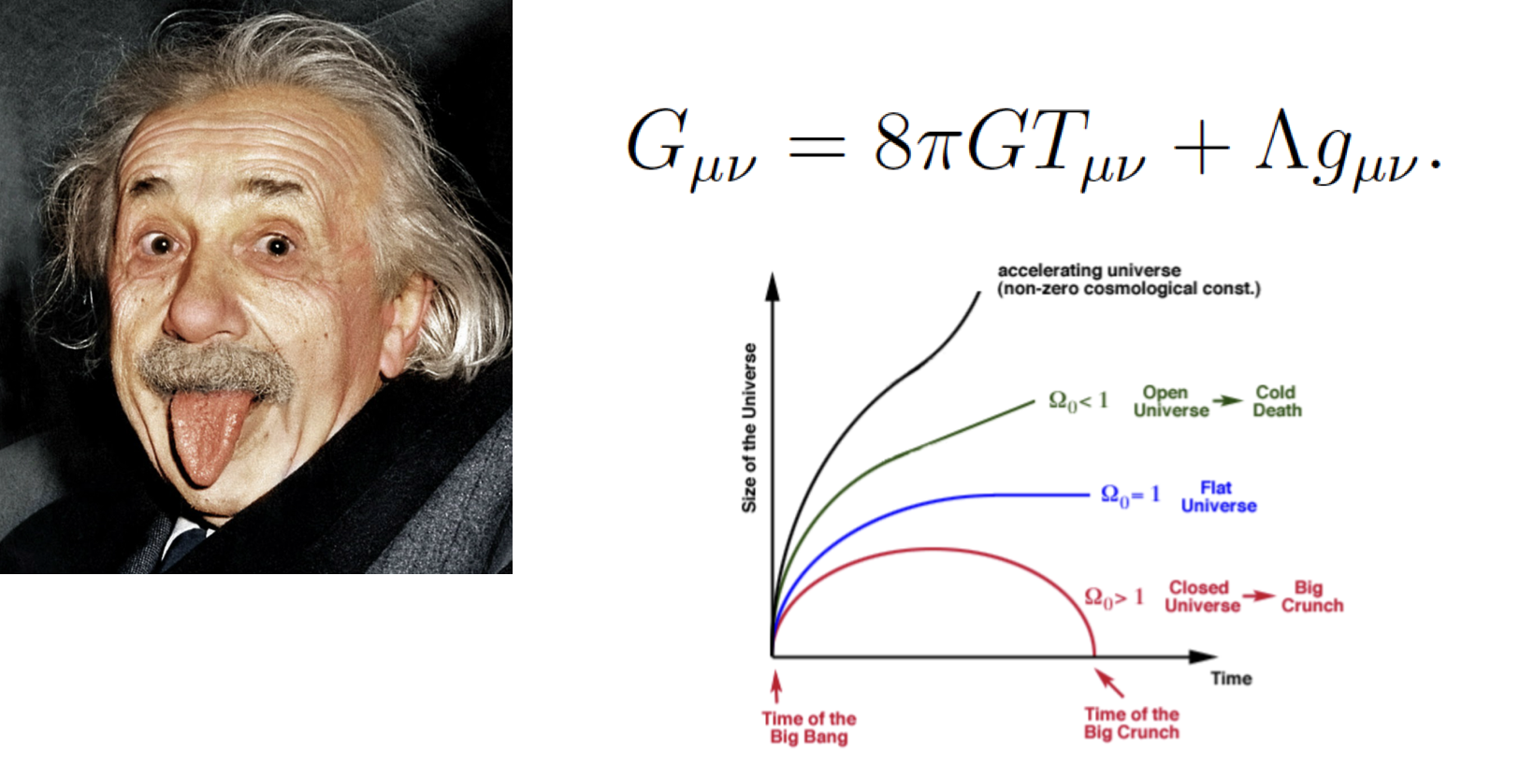
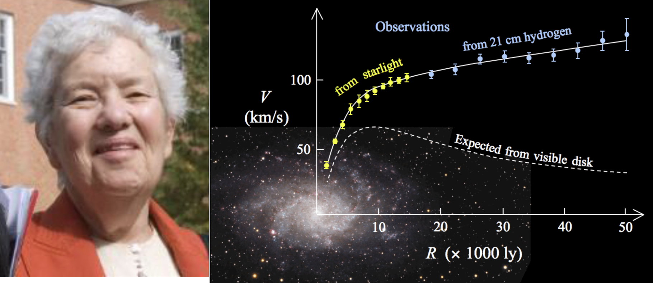
猜测(deduction)-猜(guess)测（measurement）
1’

Slide 3
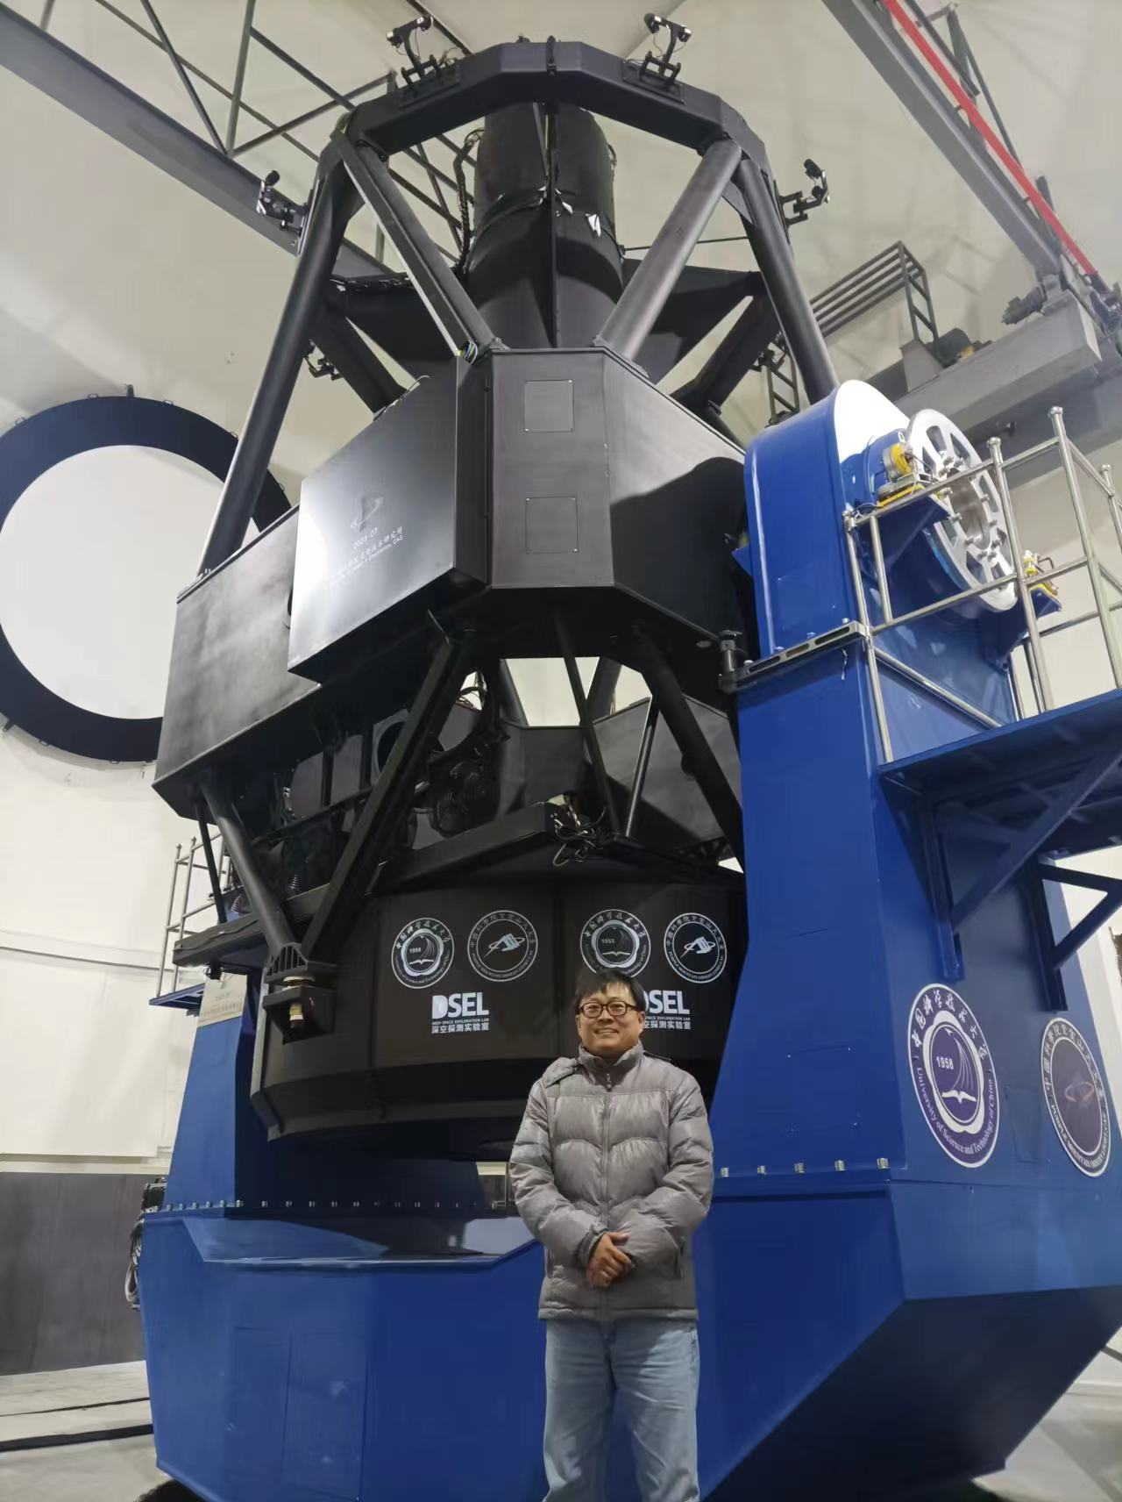
Contents
Why do we want to study this connection?
How do we study this connection?
What do we learn from this study?
Takehome message
1’

Slide 4

Why? -- Observational Mysteries
Galaxy
Halo
SMBH
Halo -> Galaxy: Accretion and Merger
    $M_{∗}−M_{h}$ relation
Galaxy -> Supermassive Black Hole: Accretion and Merger
    $M_{BH}−σ_{bulge}$relation
    $M_{BH}−M_{∗}$ relation
SMBH -> Galaxy: Feedback
  Kinematic and Thermal
1’
?

Slide 5
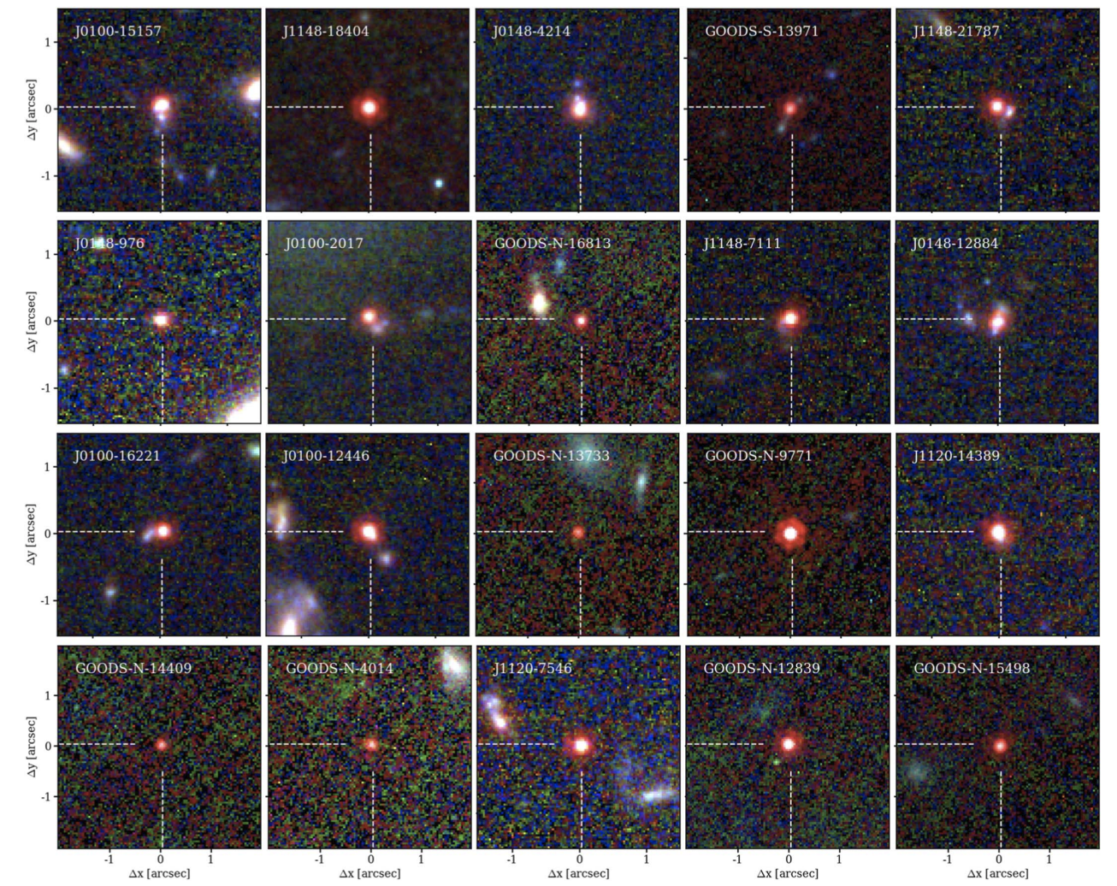
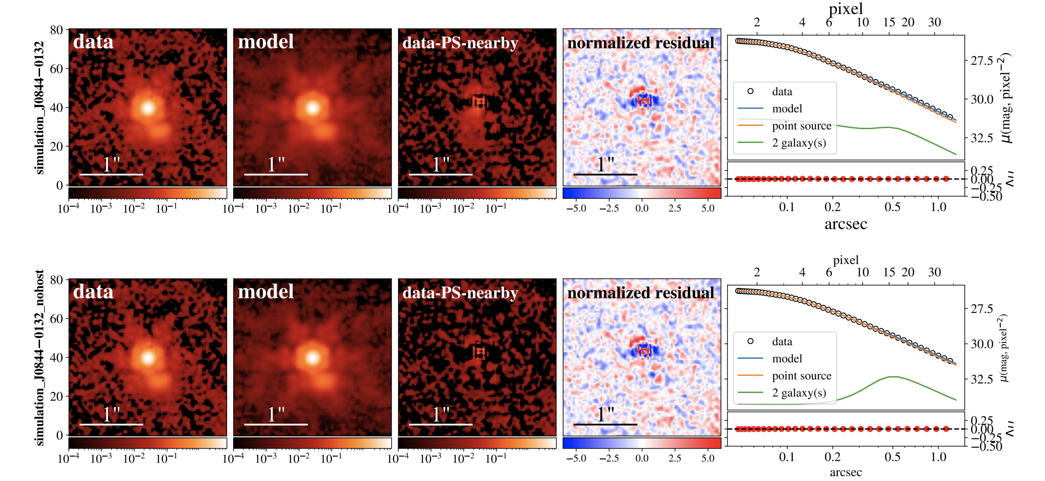
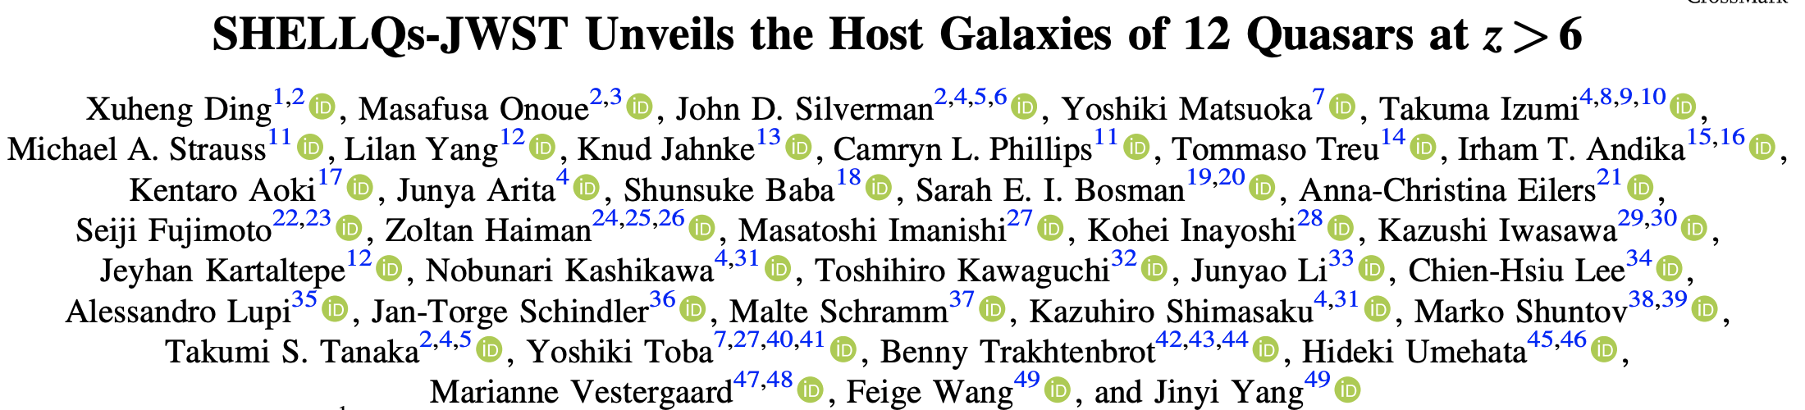
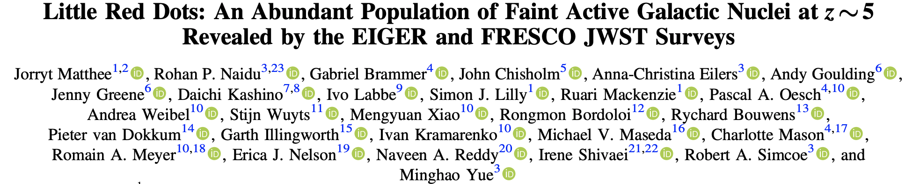
Why? -- Observational Mysteries
1’

Slide 6
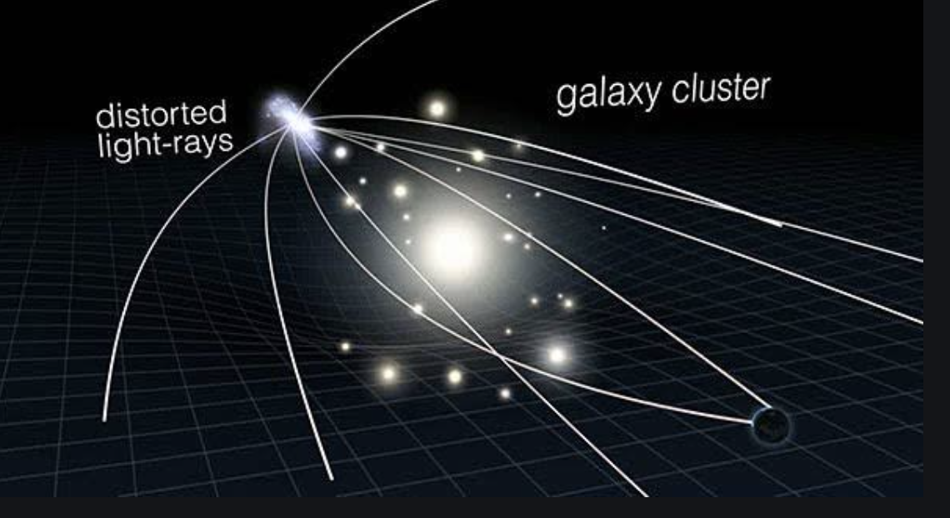
How? -- Gravitational Lensing
1’

Slide 7
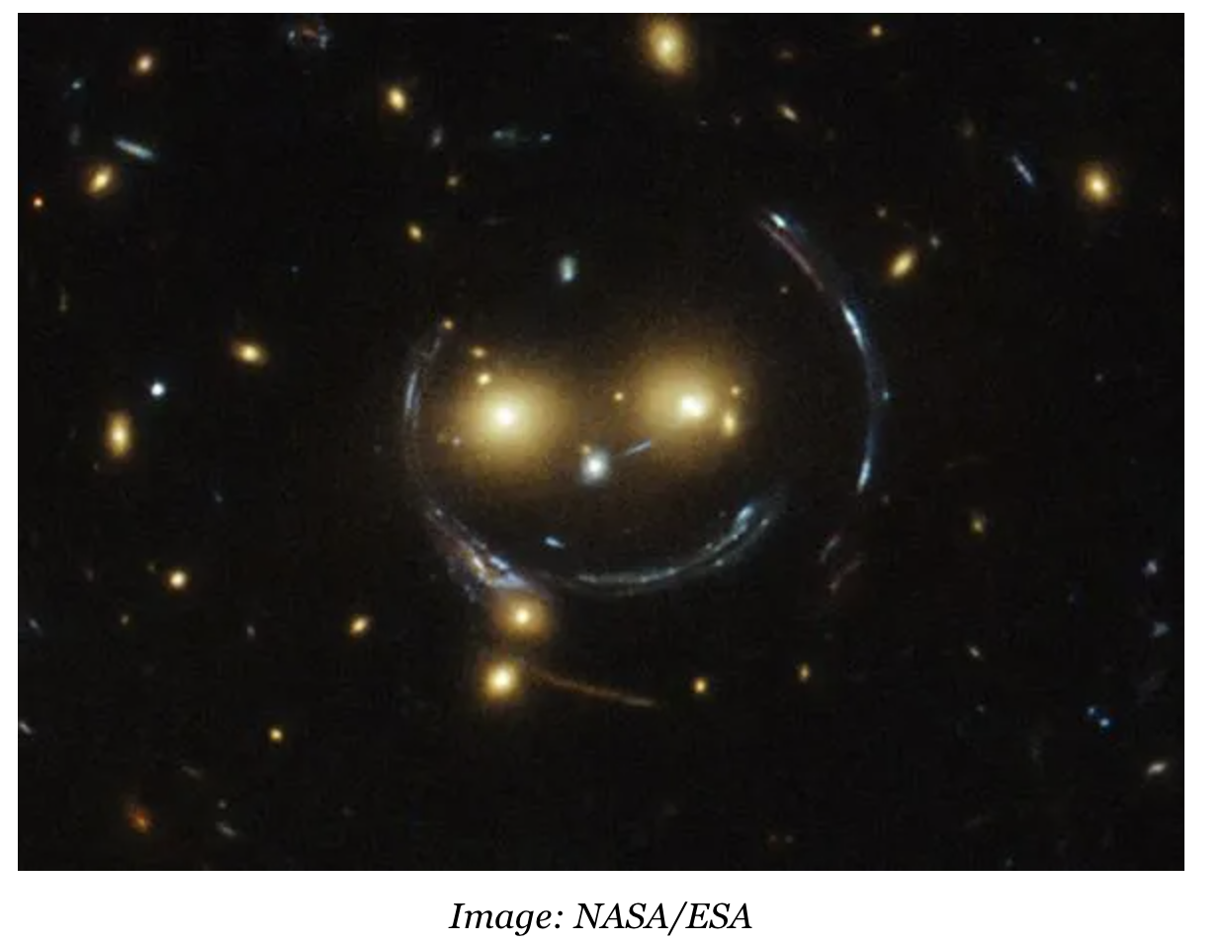
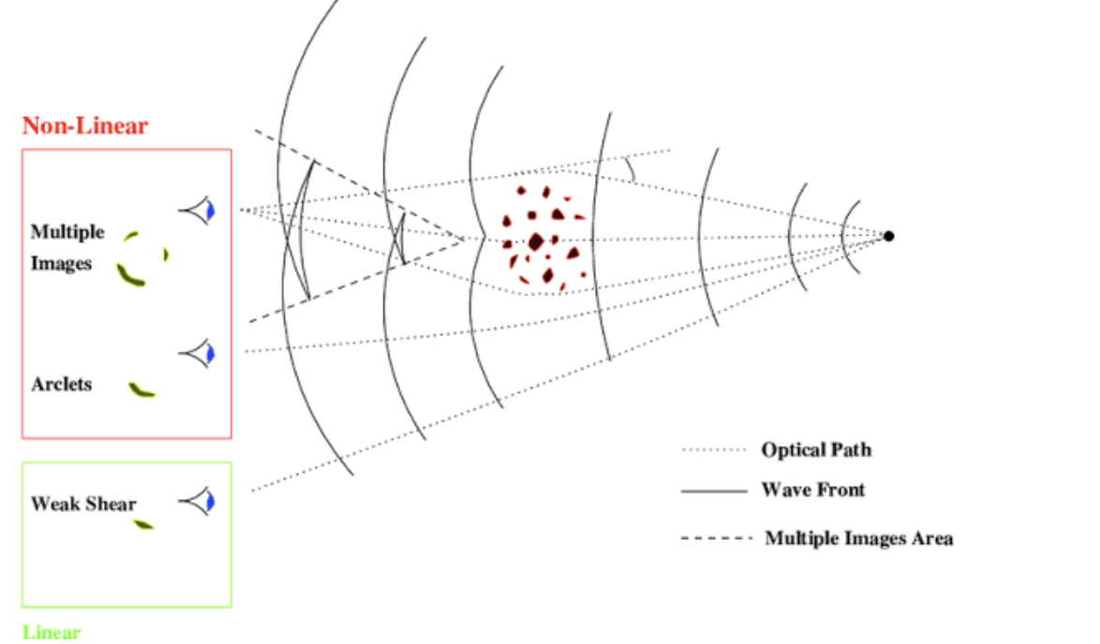
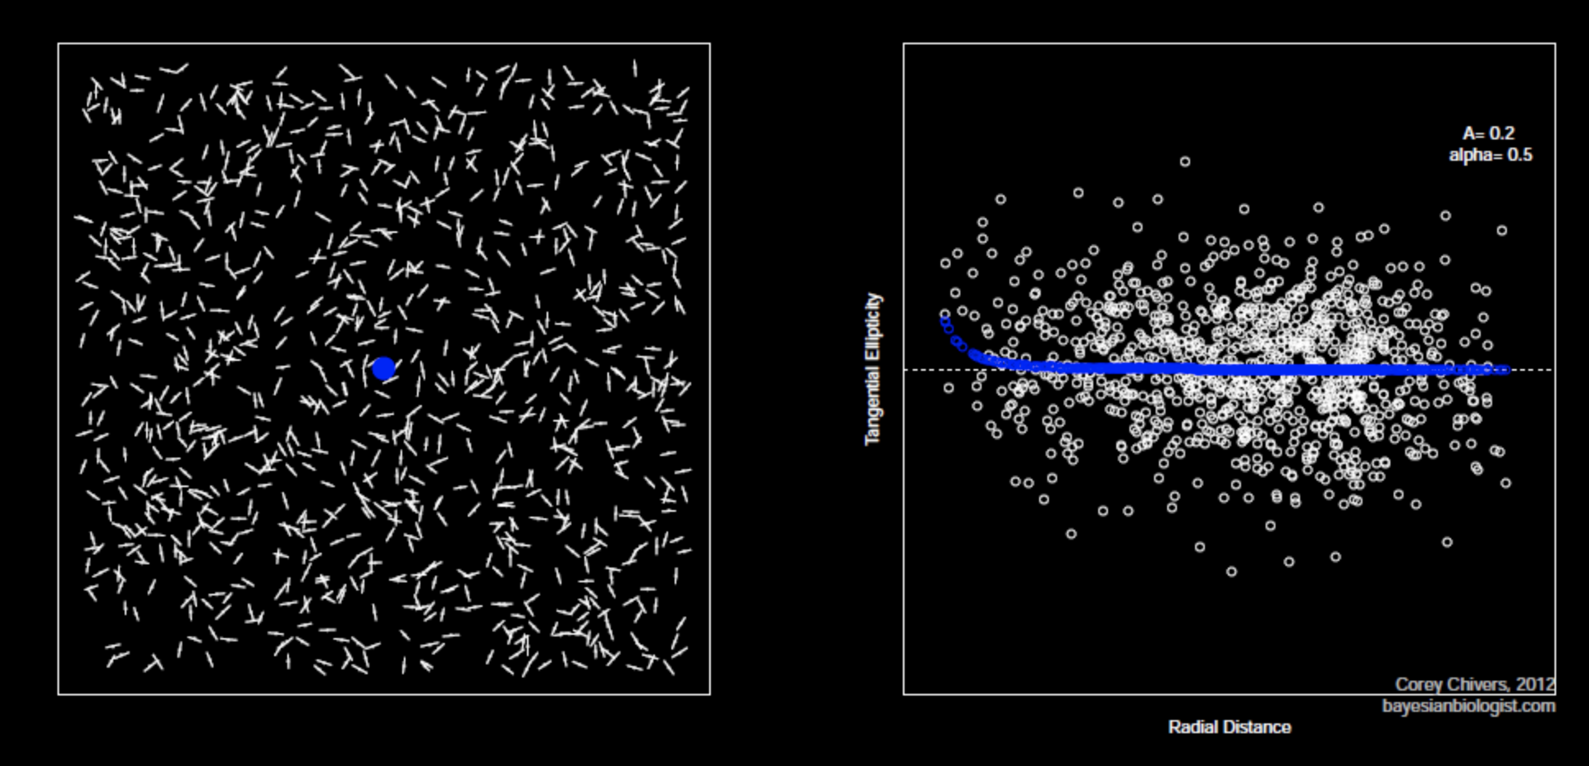
How?--Weak Gravitational Lensing
1’

Slide 8
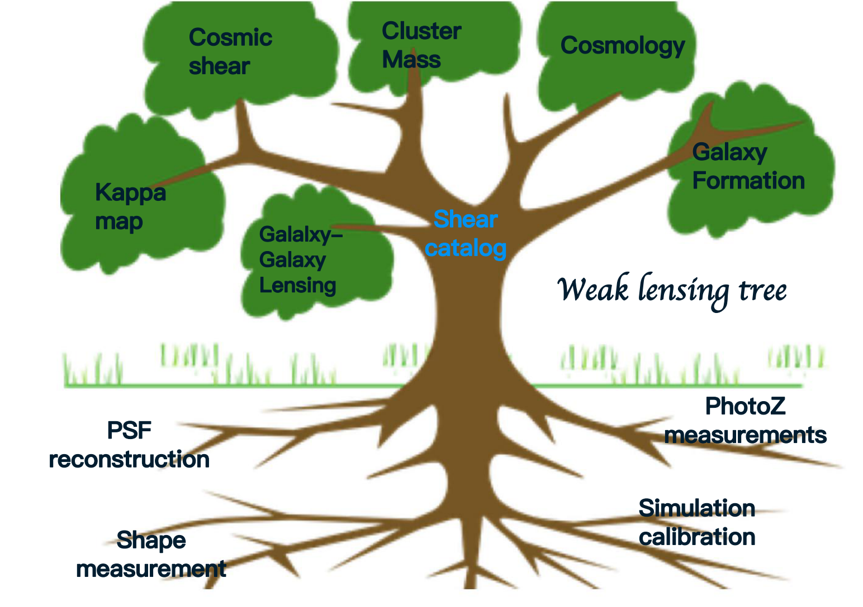
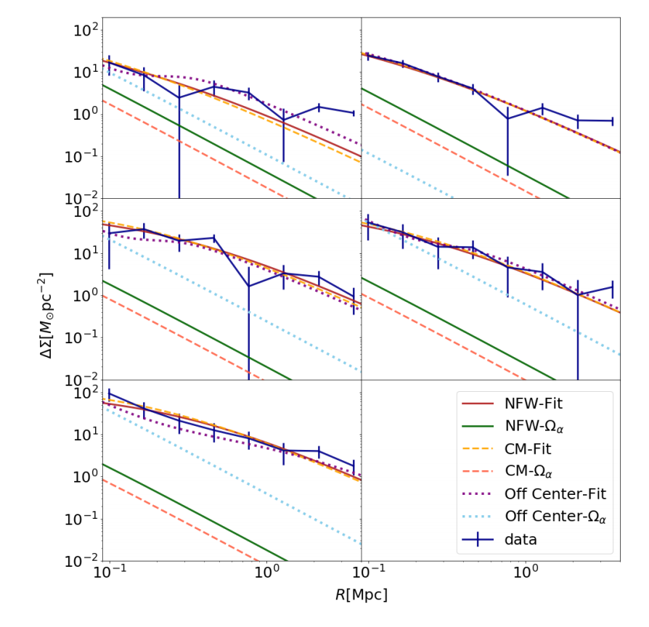
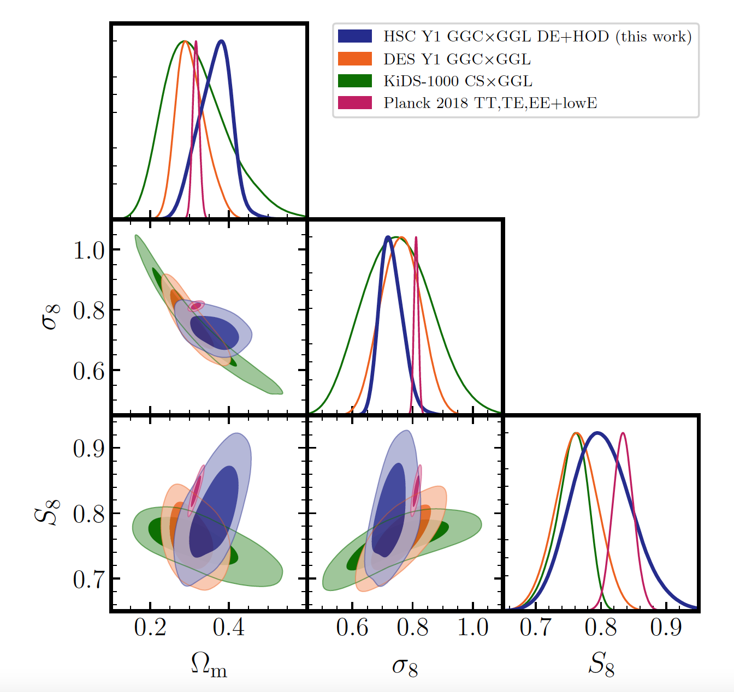
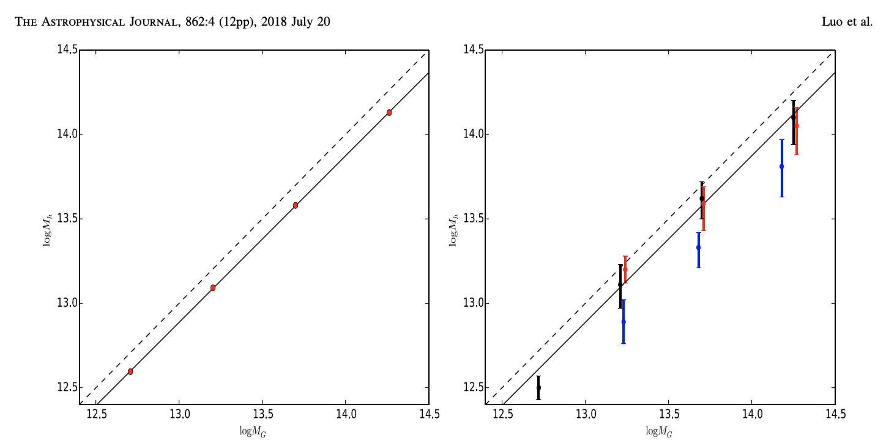
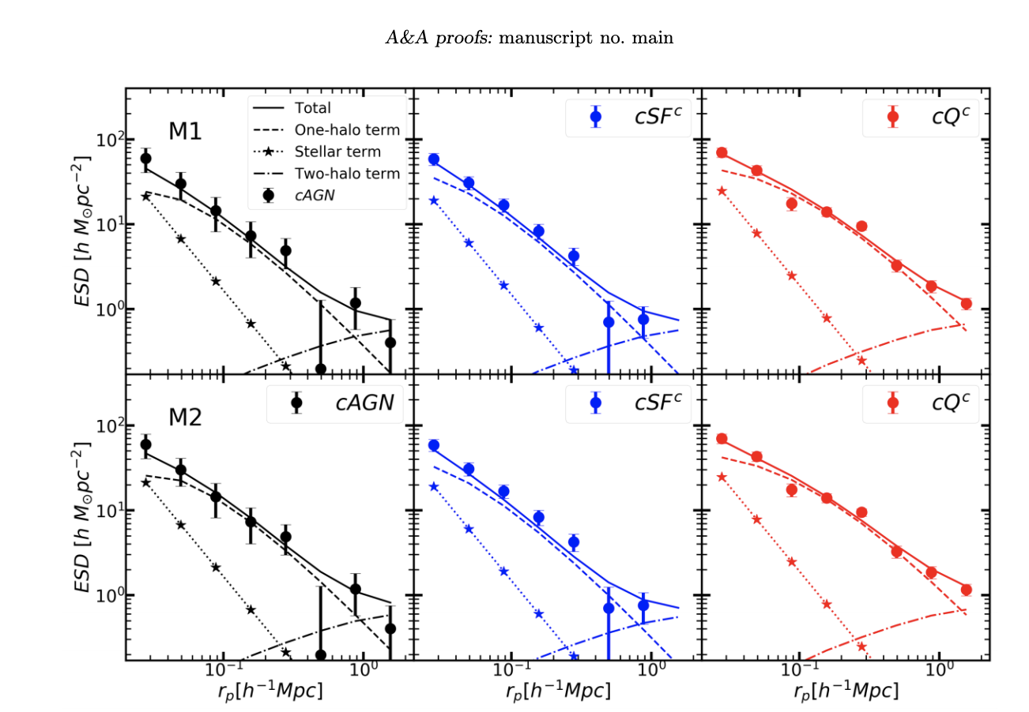
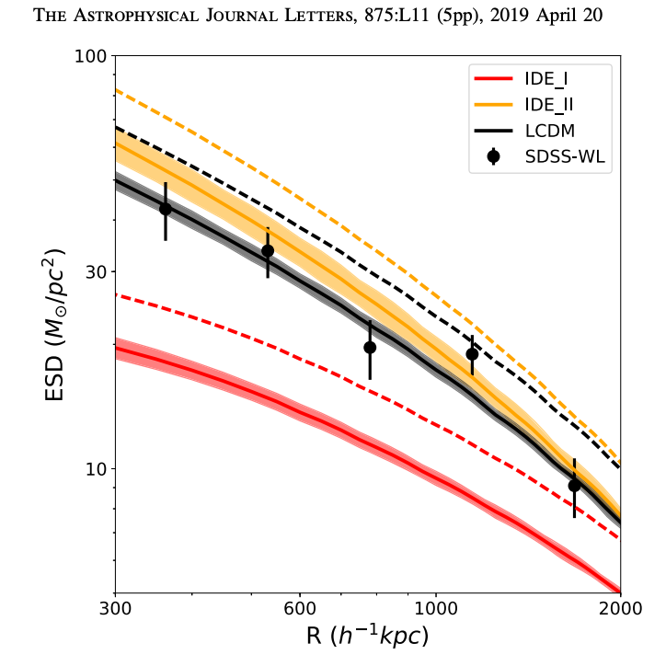
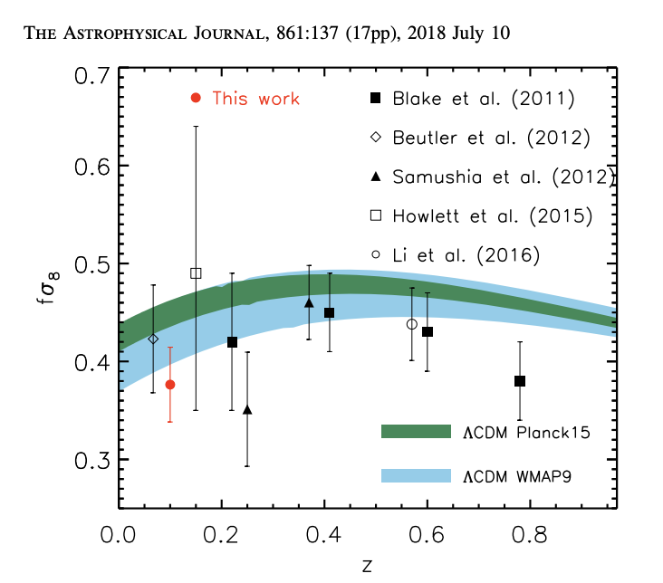
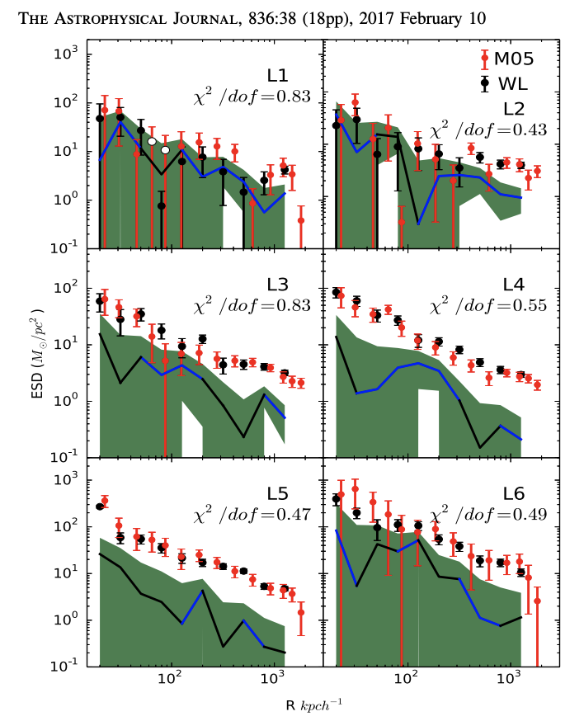
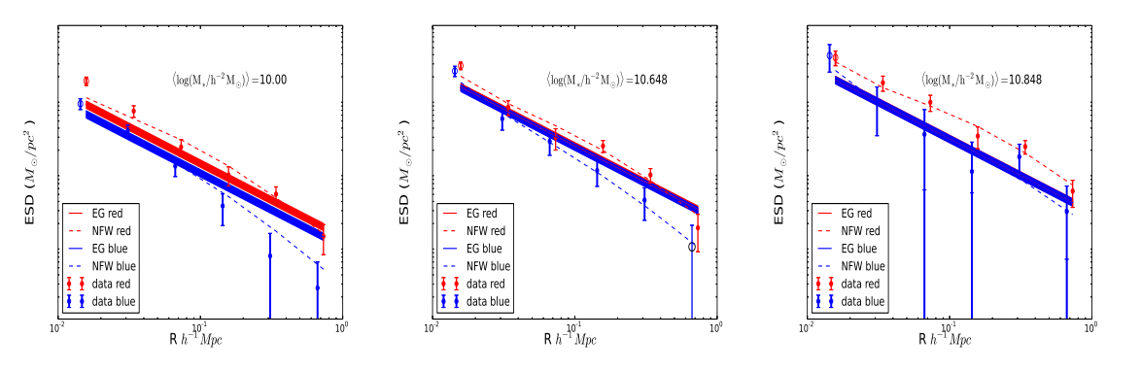
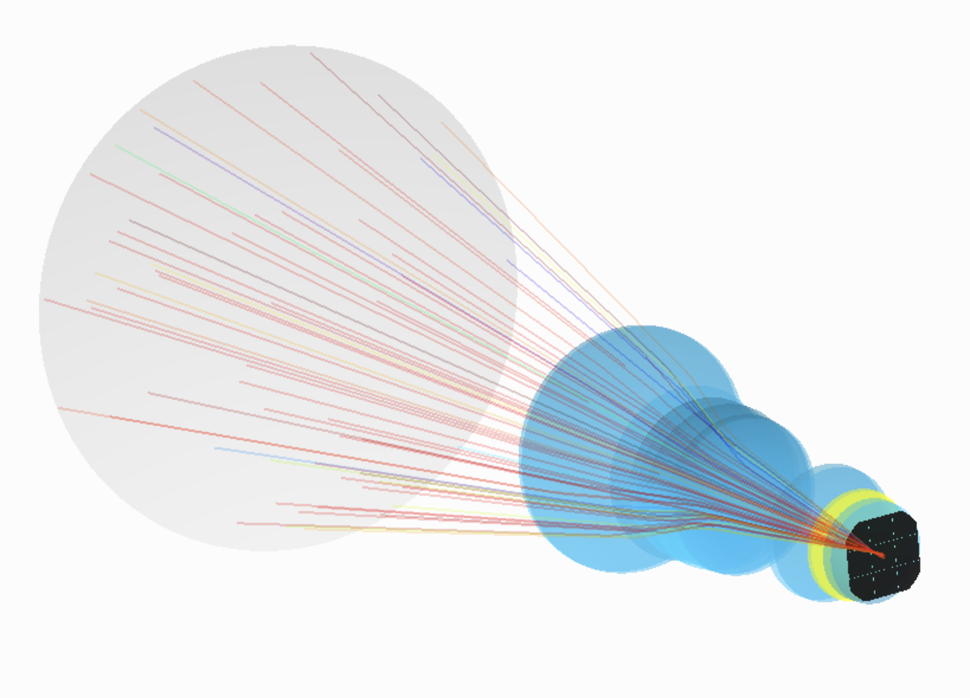
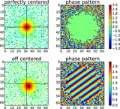
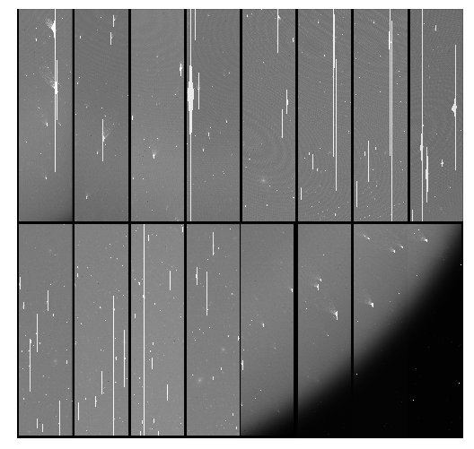
How?--Weak Gravitational Lensing
Chen, W。.L2020
W.L. + 2018 ApJ
Zhang , Wang, W.L 2021 A&A
Miyatake+ 2023
1’
Zhang, An, W.L.2020
Shi + 2018 ApJ
W.L.+ 2021 ApJ
W.L. + 2017 ApJ
Lu, W.L.2018 AJ

Slide 9
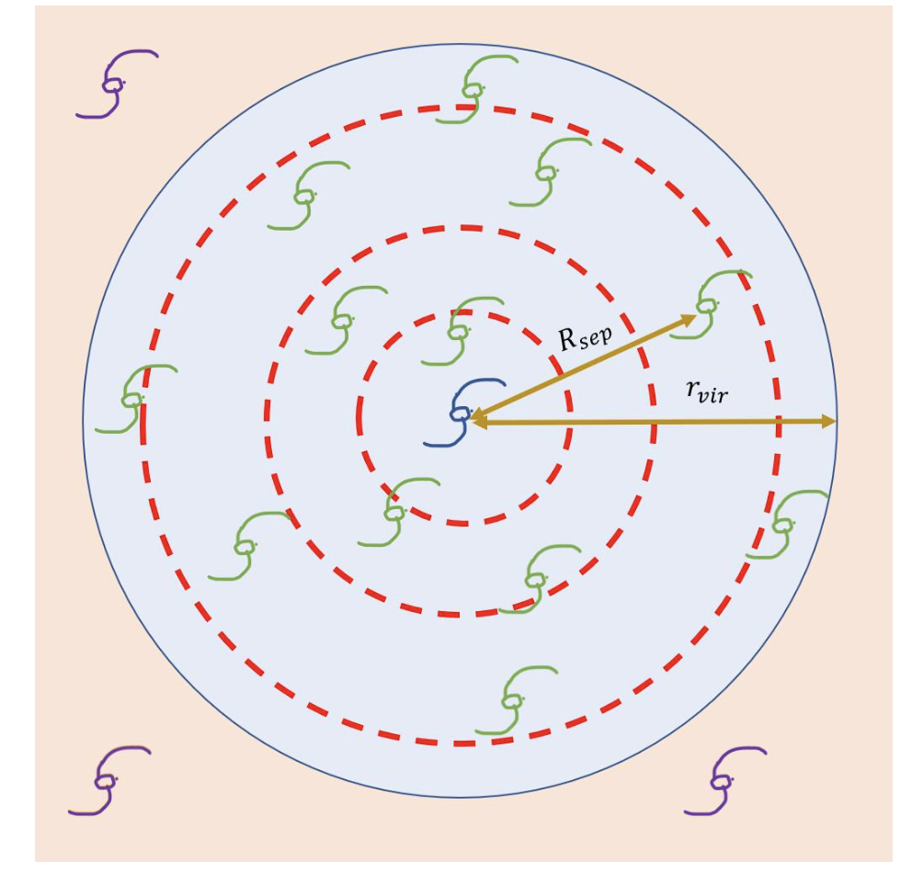
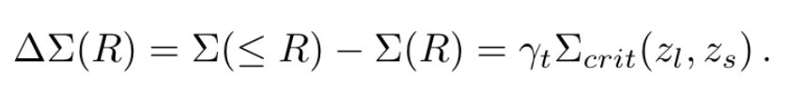
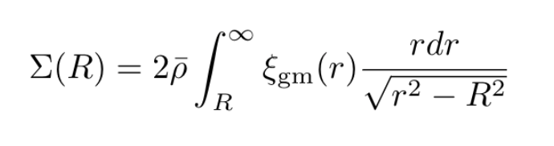
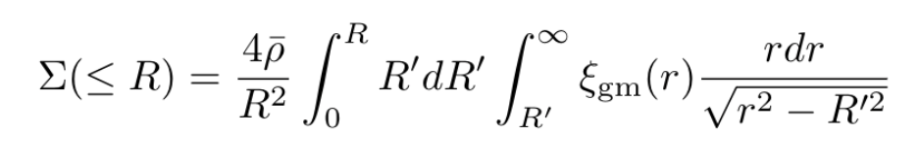
Galaxy-Galaxy Lensing
1’
Li, Q, W.L in prep 2024

Slide 10
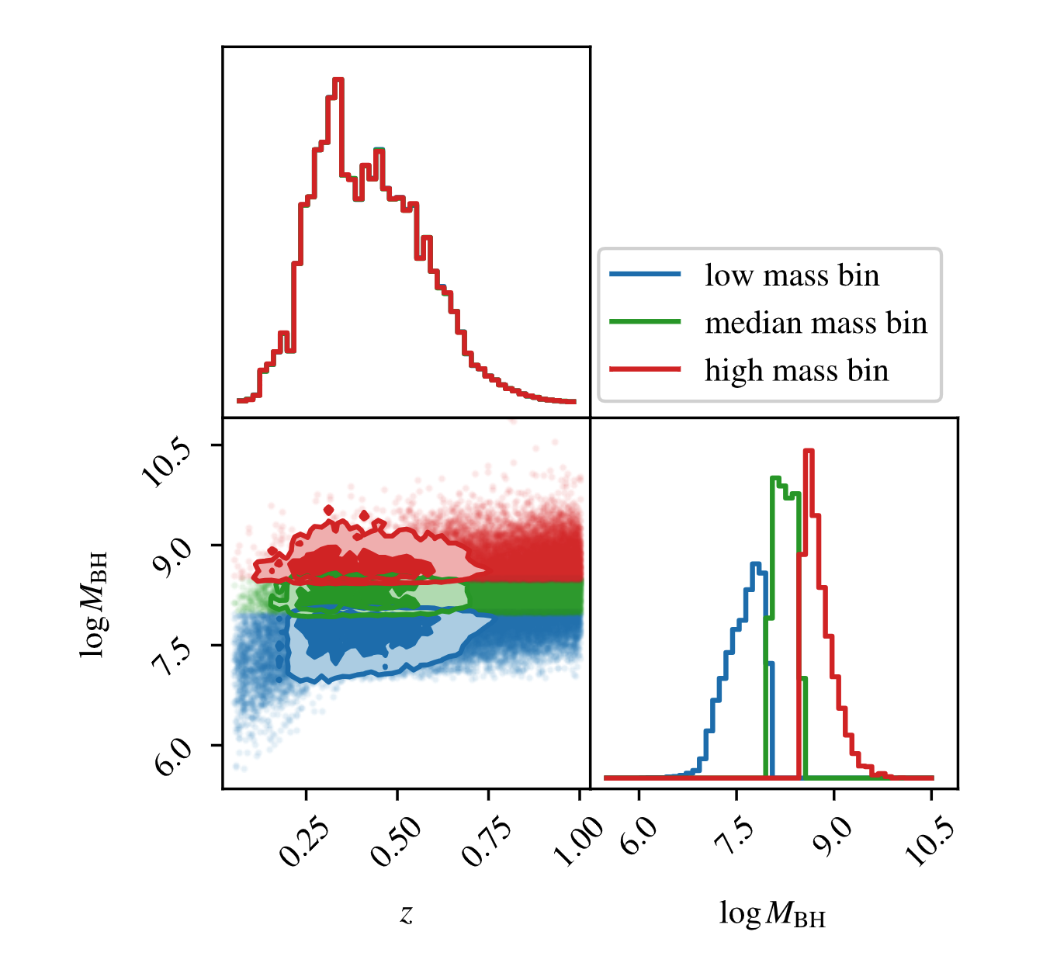
Lens sample-SMBHs
 | Number | Mean Mass log10(Mbh) | Mean Z
Mbin 1 | 16308 | 7.5 | 0.26
Mbin 2 | 15950 | 8.3 | 0.31
Mbin 3 | 17311 | 8.8 | 0.45
1’
Li, Q, Kilbinger, M, W.L + ApJL 2024

Slide 11
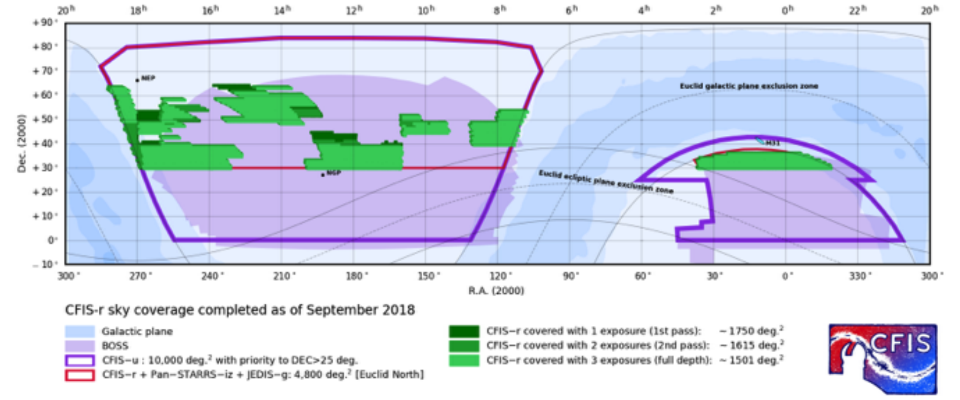
Shape catalog--UNIONS
1’

Slide 12
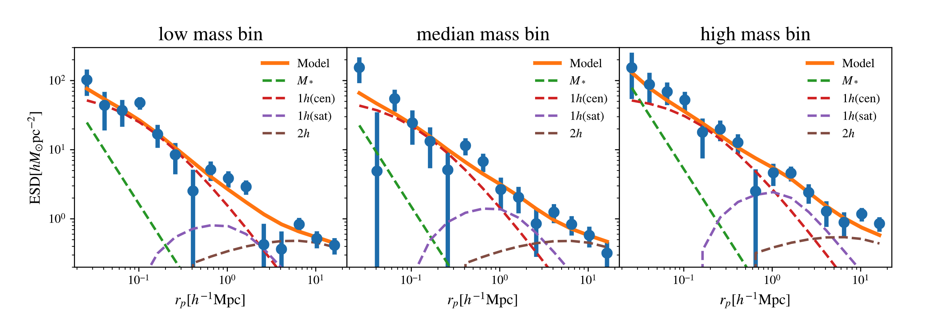
Measurements and Modeling
1’

Slide 13
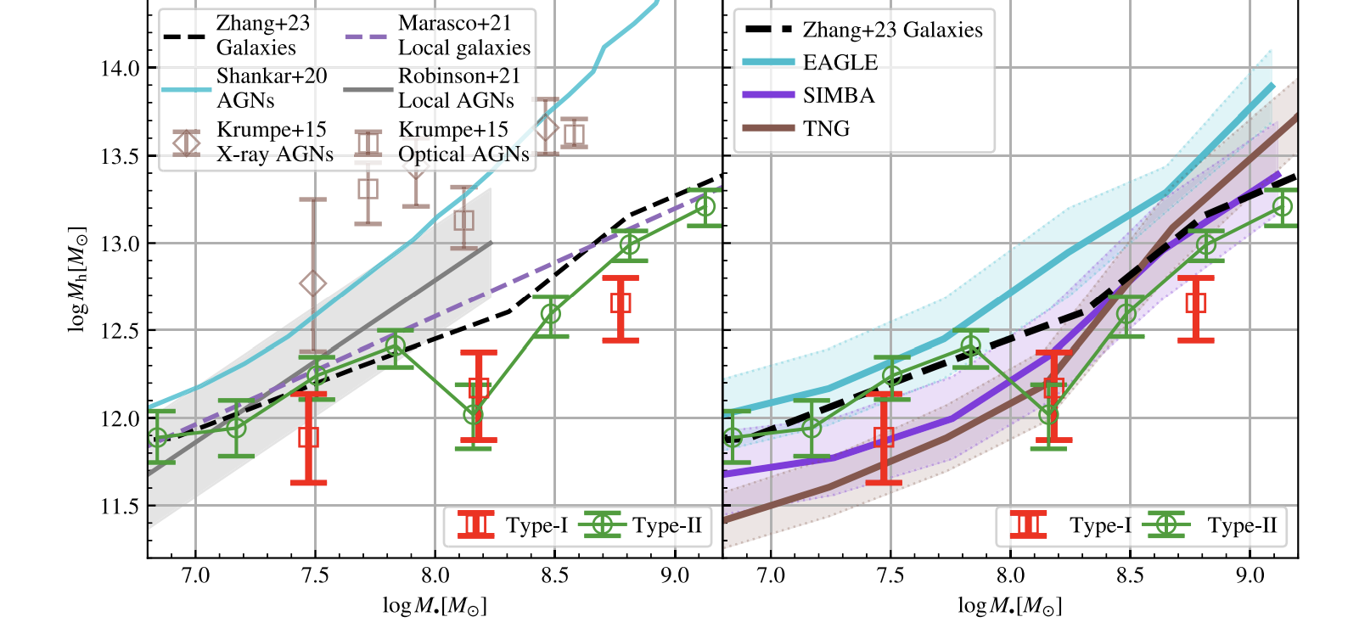
Results
1’

Slide 14
Take home message
Chen, W。.L2020
Zhang , Wang, W.L 2021 A&A
Miyatake+ 2023
1’
Zhang, An, W.L.2020
Shi + 2018 ApJ
W.L.+ 2021 ApJ
W.L. + 2017 ApJ
Lu, W.L.2018 AJ

Slide 15
Thank You!

