Slide 1

Evolution of Virial Clouds– II: From the Formation of First Stars up to Their Explosion
The Sixth Zeldovich Meeting , 12 – 17 July 2026
Noraiz Tahir^{1,*}
¹ Department of Physics and Astronomy, School of Natural Sciences, NUST, Islamabad, Pakistan.
*noraiz.tahir@sns.nust.edu.pk

Slide 2
What are Virial Clouds?
The observations of the luminous Universe show only half of the ~5% of baryons that are required to match the cosmological data.
It had been proposed that a large fraction of the missing baryons may be present in the form of pure-molecular hydrogen (H₂) clouds, with temperature close to their background – the cosmic microwave background radiation (CMB) [De Paolis et al. PRL, 74, 14 (1995)], and they make up a significant fraction of the galactic halos.

Slide 3
What are Virial Clouds?
To see such clouds it was proposed to look for a Doppler shift towards the galactic halos [De Paolis, F. , Ingrosso, G., Jetzer, P. AQ & Roncadelli, M. A&A, 299, 647 (1995)].
The frequency independent temperature asymmetry was first detected by WMAP towards M31 [De Paolis, F. et al. A&A, 534, L8 (2011)] and later by the Planck data towards seven additional nearby edge-on spirals [De Paolis, F., et al. A&A, 564, L3 (2014)].
  A strong indication of the presence of these clouds in the halos.
Since the clouds were formed subject to the virial theorem, we called them “virial clouds” [NT, AQ, and Muhammad Sakhi, PRD, 100, 043028 (2019)].

Slide 4
Some Objections
There were two objections: (i) the virial clouds can not be pure H₂ clouds there could be a significant amount of dust contaminating the clouds; (ii) the clouds are thermodynamically unstable under gravitational collapse; and (iii) even if they are stable the asymmetry can not be completely due to virial clouds. A fraction of the asymmetry could be due to the hot gas component e.g., the rotational kinematic Sunyaev-Zeldovich (rkSZ) effect, and due to the dust grains themselves, the Anomalous Microwave Emission (AME) by dust grains.

Slide 5
Some Objections
To counter the first objection we modeled the virial clouds, and found that dust does not give much of the contribution to change the physical parameters. It was also seen that the clouds were stable. The estimated time required for the cloud to collapse came out to be 1.6 Myr, and time required for the clouds to reach equilibrium came out to be 1.5 kyr.
For the second objection we considered M31 and modeled the hot gas and dust in the halo. It was seen that the rkSZ effect is contribution >1% and AME was contributing >7% in the overall temperature asymmetry observed towards the galaxy [NT, De Paolis, F., AQ, and Nucita, A. A., A&A, 664, A30 (2022); De Paolis, F., Naseem, F., & NT, A&A, 704, A128 (2025)].
The objections were taken care of, but this still does not reveal the true nature of virial clouds and physics behind their formation.

Slide 6
The Evolution of Virial Clouds
It is clearly seen that all the other possible candidates have no significant effect in the observed temperature asymmetry. One needs to understand the true nature of virial clouds.
It is proposed that the clouds were formed at the surface of last scattering (LSS) at redshift (z) = 1100 in the mini dark matter halos, and evolved since then.
One can try to trace their evolution from LSS to the present to understand the exact nature of the clouds without relying on ad-hoc models.

Slide 7
The Evolution of Virial Clouds
We divided the evolution in two stages:
from LSS at z = 1100, up to the formation of population – III at z = 50;
from z = 50 when the population – III were forming, and consequently the composition of the interstellar medium (ISM) changed (and hence the clouds), to the present.

Slide 8
Evolution – I
At LSS the Universe consists of primordial abundance of atomic hydrogen and helium i.e. ∼ 75% H, and ∼ 25% He by mass, this ratio should have remained almost the same till the formation and explosion of population – III stars.
During the time span under study the ratio of molecular hydrogen to atomic hydrogen is ≈ 10⁻⁶.
Moreover, the ratio of other elements like deuterium, helium-3, and lithium to atomic hydrogen is negligible.

Slide 9
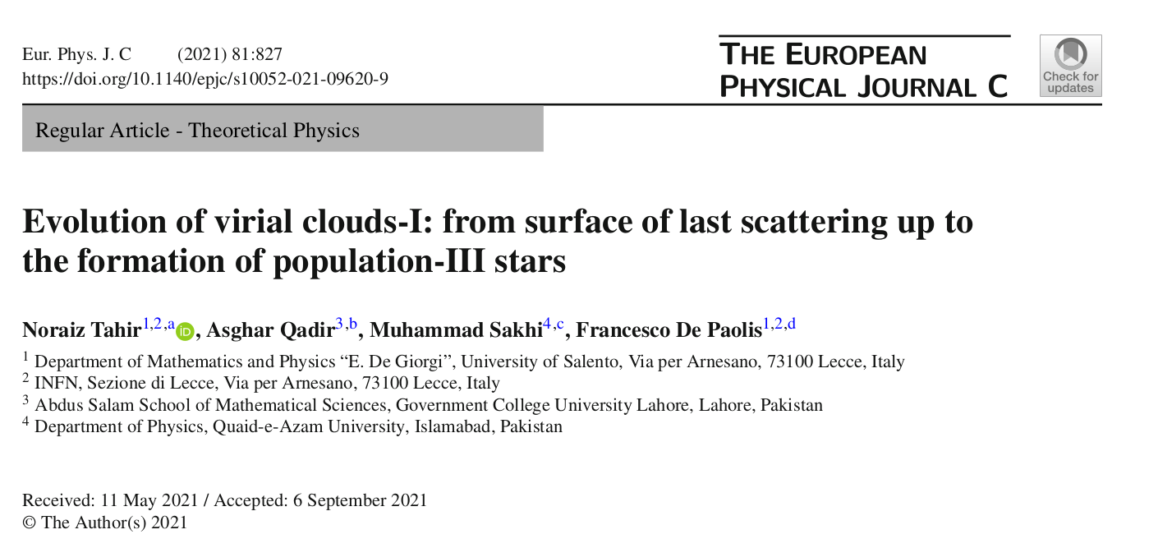
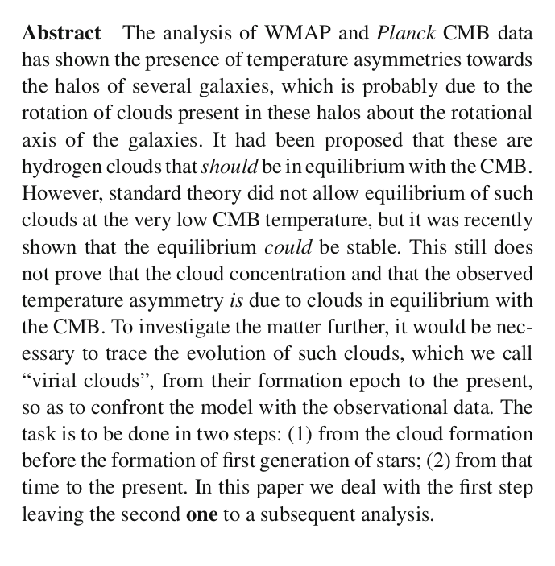
Evolution – I
Since the clouds must be considered to be in thermal equilibrium because they are immersed in the heat bath of the CMB.
We needed to use the canonical distribution function for a fixed temperature and use the cooling of the heat bath to provide a quasistatic-equilibrium [NT, AQ, Sakhi, M, and De Paolis, F. The Sixteenth Marcel Grossmann Meeting, (2023)].

Slide 10
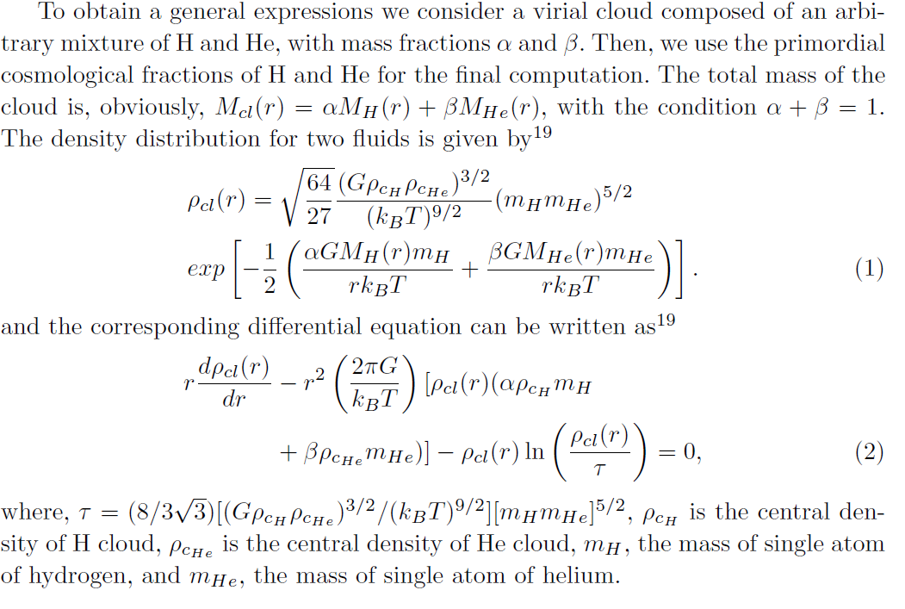
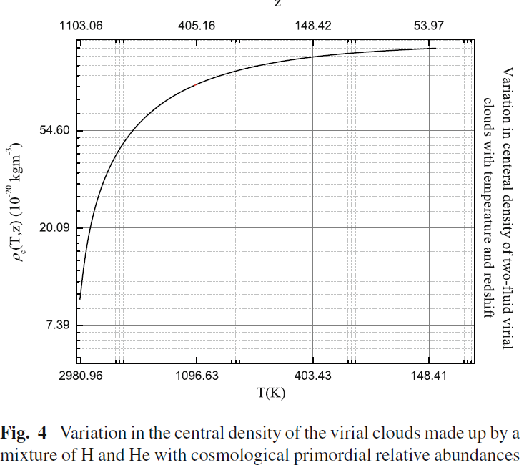

Slide 11
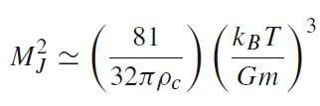

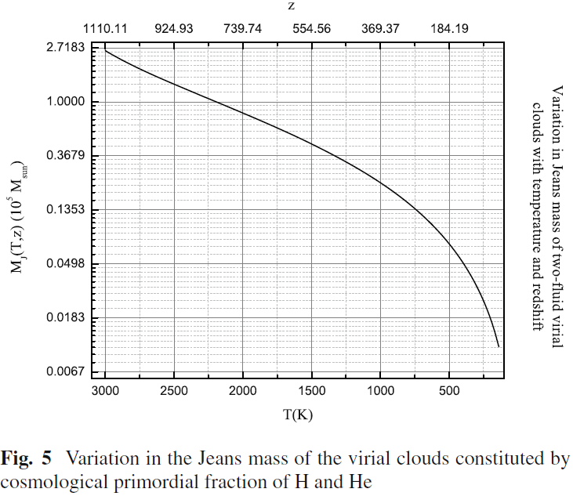
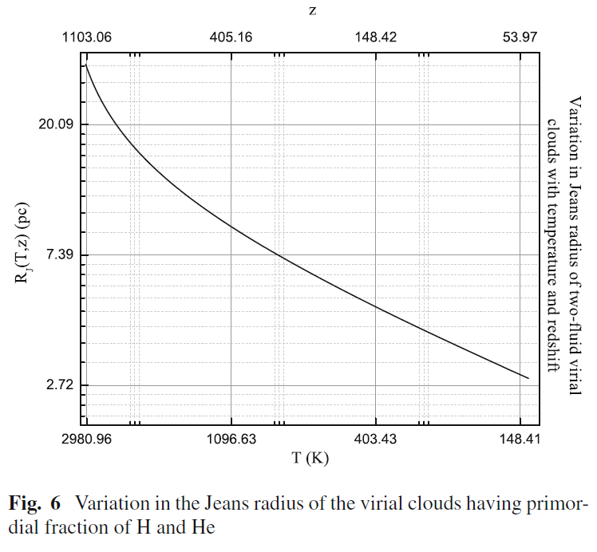

Slide 12
Evolution – II
The first stage of the evolution was very simple, since no nuclear reactions took place during Evolution – I, we only had a primordial mix of H and He as a result there was no external heating or cooling.
The second stage of evolution starts at z = 50 when pop III stars were forming two important changes occur: (i) the external heating becomes episodic, i.e. pop III stars formed in bursts, hence contaminating the virial clouds with heavy elements; and (ii) the cloud contracts gravitationally, i.e., as it loses energy via radiation, its density increases, and the work of compression heats the gas.

Slide 13
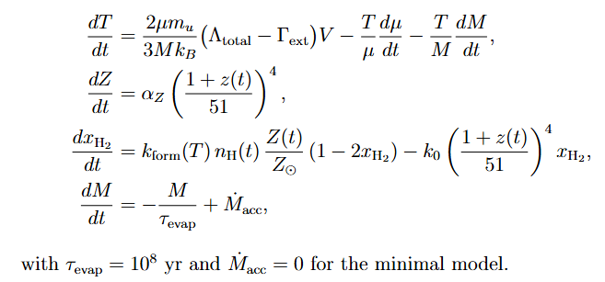
Evolution – II
We assume a standard ΛCDM cosmology with cold dark matter (CDM) particles that interact only gravitationally with baryonic matter. The virial cloud is embedded in a dark matter halo that provides a confining gravitational potential well.
The system will yield four coupled ordinary differential equations (ODEs) as

Slide 14
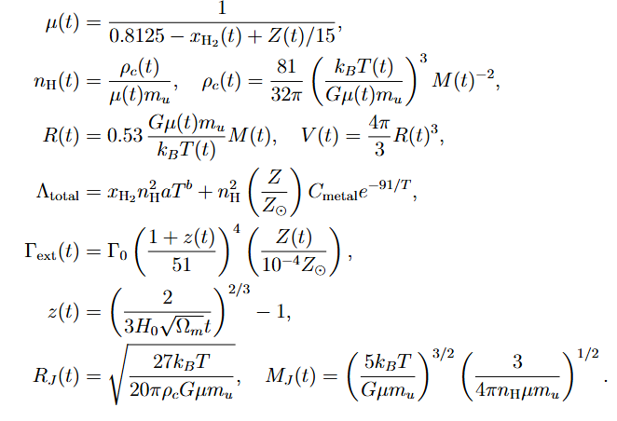
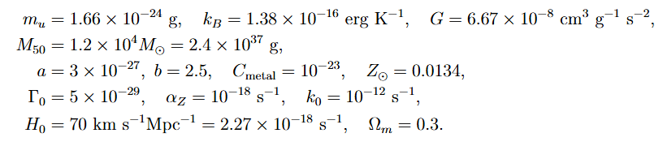
Evolution – II

Slide 15
Discussion
It is clear that dark matter has shaped the Universe and missing baryons are in cold dense regions around the galaxies – the galactic halos.
Virial clouds populating these regions can be seen with the CMB data analysis, and it has been checked that the most dominant effects contribute only a small fraction to the observed temperature asymmetry in the CMB.

Slide 16
Discussion
The evolution of these clouds is needed to understand the true nature of virial clouds and will open a window for us to understand the formation and evolution of galaxies more precisely.
The first stage of the evolution of these clouds was the simplest one as the temperature is comparatively very high so quantum effects can be neglected.
In the second stage those neglected effects need to be incorporated leading to a stiff system of equations that can be solved numerically.

