Slide 1
Weyl Incorporated Gravity (WIG)and Galactic Halo Rotation
Asghar Qadir
Pakistan Academy of Science
6th Zeldovich Meeting2, 16th July 2026

Slide 2
Why Modify Einstein’s
General Relativity -1
Einstein’s theory of General Relativity (GR) is, as Wheeler would say, “battle-tried” and tested to an extremely high precision by using the PPN formalism of Nordvedt and Will.
Why ever would one want to modify it?
The most significant reason is that GR and Quantum Theory are incompatible, so one, or both, need to be modified.
It is also claimed that for cosmology one needs to introduce some “dark energy” and some “dark matter” for GR to fit with observations.

Slide 3
Why Modify Einstein’s
General Relativity -2
However, the “battle-tried” standard model of Particle Physics, as it stands, does not allow these additions.
In the 16th Marcel Grossman Meeting I pointed out that there is no good reason to appeal to any “dark energy”, as the old cosmological constant used by Lemaitre is good enough.
It had been hoped that dark matter would be provided by a supersymmetric (SUSY) extension of the standard model.
Despite having gone well beyond the expected energy for it, SUSY has not signaled us, so this problem remains.

Slide 4
Why Modify Einstein’s
General Relativity -3
The strongest evidence for dark matter was the flat rotation curves of galaxies seen by Vera Rubin. They indicated that the galaxies extended well beyond the visible stars as haloes.
The earliest attempt to explain them was in 1983 by Mordehai Milgrom with his Modified Newtonian Dynamics (MoND).
Since it was non-relativistic, it was a non-starter. There was a slew of various further generalizations of GR proposed, but they either have too many free-parameters or give predictions that are inconsistent and require further modifications.

Slide 5
MoRD -1
Instead of an ad hoc modification any proposal should have some physical justification and should also have a physical basis for hoping to resolve some other fundamental problem.
Lee Hyung Won and I proposed a minimal modification of the relativistic law of gravity [AQ, H.W. Lee, K.Y. Kim, IJMPD 26 (2017) 1741002; HW L, AQ, IJMPD, 28 (2019) 2040014]. The physical reason is that GR only indirectly gives the interaction of the gravitational field and the source of gravity, namely the stress-energy tensor. The source can be shifted from the RHS to the LHS, but there is no term containing the source and the field (like j_{μ}A ^{μ} for electrodynamics).

Slide 6
MoRD -2
The simplest linear Lagrangian, ℒ =Λ+√gR —κT, gives the Einstein field equations with cosmological constant, and as discussed, gives the Lemaitre model which fits with observation, if exotic dark matter is provided.
The simplest looking addition is CRT, which was tried. It will obviously alter the Einstein-field equations. One then needs a single constant, C, to fit the required modification of the rotation curves for all seven galaxies observed and the Milky Way.

Slide 7
MoRD -3
The revised field equations in this case are:
where c₁ = 1, c₀ = Λ, c₂ = κ and c₄ has to be determined by
observations of rotational curves.

Slide 8
MoRD -4
The divergence of the stress-energy tensor here is:
The equations of motion of test particles for a perfect fluid are
where f^{μ} is the force 4-vector and h ^{μν} = g^{μν}—u ^{μ}u^{ν} is the projection of the metric tensor along the direction of motion.

Slide 9
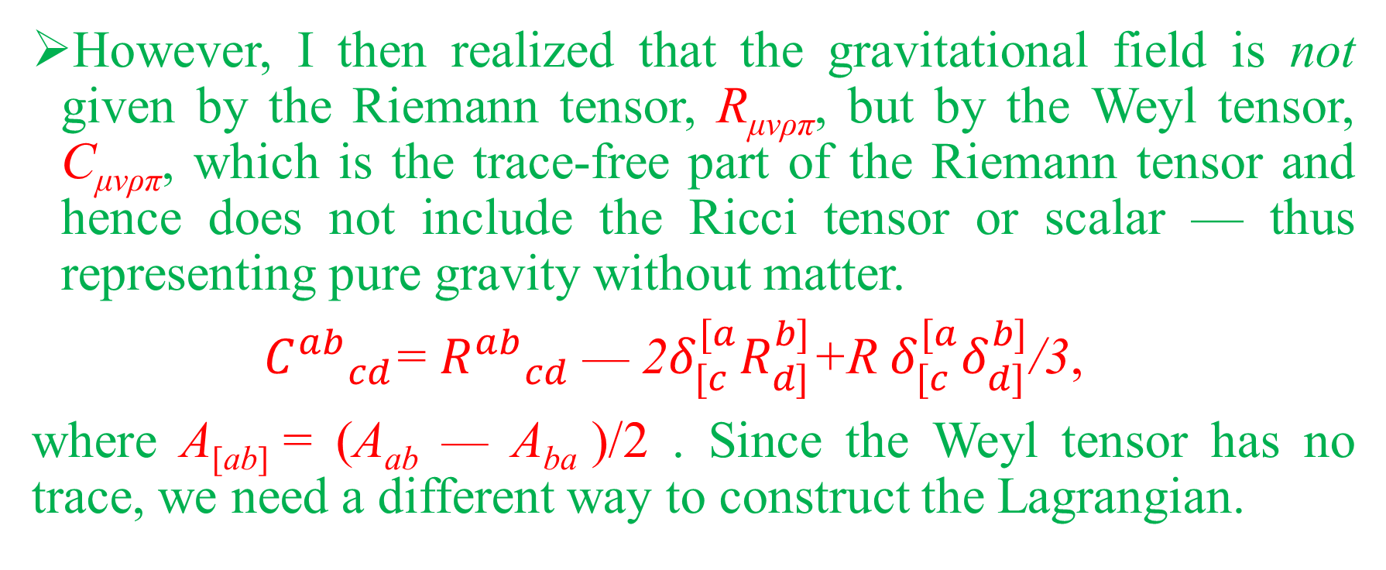
MoRD -5
However, I then realized that the gravitational field is not given by the Riemann tensor, R_{μνρπ}, but by the Weyl tensor, C_{μνρπ}, which is the trace-free part of the Riemann tensor and hence does not include the Ricci tensor or scalar — thus representing pure gravity without matter.
${C^{ab}}_{cd}$= ${R^{ab}}_{cd}$ — 2$δ_{[c}^{[a}R_{d]}^{b]}$+R $δ_{[c}^{[a}δ_{d]}^{b]}$/3,
where A_{[ab]} = (A_{ab} — A_{ba} )/2 . Since the Weyl tensor has no trace, we need a different way to construct the Lagrangian.

Slide 10
MoRD -6
For electrodynamics, the source is the scalar product of two vectors, or a pair of (spin half) spinors for the charge, and for the field a (spin one) vector representing the photon.
For gravity, it should be a spin two field represented by the 4th rank tensor, C_{μνρπ}, and hence for the matter part two copies of a 2nd rank tensor, T^{μρ}: C_{μνρπ} T^{μρ} T^{νπ}.
Note that the index of the electron is quadrupled to get the matter, but of the photon is just doubled — which is because of the higher rank of the Weyl tensor, as it is trace-free.

Slide 11
MoRD -7
Notice the similarity of the source terms for QED and MoRD.
This was missing from GR
The Lagrangian for the Weyl modified gravity interaction is ℒ = √g (Λ + R —κT + λC_{μνρπ}T^{μρ}T^{νπ}), leading to a different modification of the field equations and equations of motion.
matter
ravity
matter

Slide 12
Testing MoRD -1
For simplicity, assuming a spherically symmetry metric (with μ instead of λ), ds²=e^{ν}dt²-e^{μ}dr²-r²dΩ², the resulting rotational velocity turns out to be:
Here ρ(r) is the density distribution function.
Since the density has to be differentiated and integrated, the first attempt took a constant density.

Slide 13
Testing MoRD -2
This led to the rotational velocity:
Here ρ_{c} is the core density, and this does not fit well.
However, Bilal and I [M. Bilal, AQ: Proc. 16th Marcel Grossmann Meeting, 2023] found that the λ which fit M31 and the Milky Way at a given distance was the same. There was an error in the calculation, which negated this claim as well.

Slide 14
Testing MoRD -3
The calculations were repeated using the standard spherical density distribution models for galaxies and used for all 7 galaxies of the local cluster studied by us and the Milky Way [AQ, A. Shahid, NT, Arabian Journal of Mathematics, 2026(2026), 1-9] at 100 kpc.
The actual curves show a slight downturn later, while MoRD predicts an upturn. However, for all eight galaxies at 100 kpc, the value of λ turns out to be (7.2360± 0.0006)x10¹³s⁴km²/kg².
The difference is expected: a soccer ball cannot be a good model for a rugby ball or a pancake.

Slide 15
Discussion -1
The dark side of the Universe turns out to be a grey area in that the so-called “dark energy” is just a constant to be determined by observation/experiment.
The dark matter splits into two parts: baryonic and whatever. The baryonic is in a way to being fully investigated.
For the other part, there is a meaningful proposal of heavy sterile neutrinos by Ruffini, Arguelles and Rueda, which only requires one parameter (the mass of the neutrinos) and solves one outstanding problem (the very early supermassive black holes) but lacks any real test for it. (Worth looking for one.)

Slide 16
Discussion -2
Most proposals have too many free parameters and no tests.
MoRD, which I will now call Weyl Incorporated Gravity (WIG), has only one free parameter which seems to fit a very minimal requirement. However, much better modelling of the galaxies is required, incorporating a slow rotation approximation galaxy.
This provides a test by using the vertical velocity component.
If the rotation curves fit well enough, then one needs to check if this WIG fits the head of Quantum Gravity!

