Slide 1
Kalpa*-Self-Regulating CosmologY
(A self-regulating Framework for cosmic evolution)
6th Zeldovich Symposium
(13th July 2026)
By
Manasse Mbonye
University of Rwanda
University of Connecticut
ICRANet
Kalpa* (Sanskrit): a cosmic cycle
Notes:
20s. Good afternoon: My pleasure to present work on Self-regulating cosmology• In this framework, the Universe evolves through successive kalpas (phases). Dynamics governed by one principle: self regulation. Today I will briefly describe model’s physical motivation, its conceptual framework and its observational implications.

Slide 2
Why Need for a broader cosmological framework
(Successes and Remaining challenges)
LCDM Successes
Remaining Challenges
CMB
Baryon Acoustic Oscillations (BAO)
Type Ia Supernovae Obaservations
Large Scale Structure
Precision Cosmology
Conceptual
Initial Singularity
Initial Entropy Problem
Inflation Mechanism
Graceful Exit from Inflation
Observational
Hubble Tension
S8 Tension
JWST Early Structures
Dynamical Lambda
Can one physical principle explain these successes while naturally addressing these challenges?
Notes:
70s. The standard ΛCDM model has been remarkably successful. It accurately describes the cosmic microwave background, baryon acoustic oscillations, supernova observations, and the large-scale structure of the Universe.
Nevertheless, a number of important conceptual and observational questions remain. These include the initial singularity, the origin of the Universe's extraordinarily low entropy, the physical origin of inflation and its graceful exit, and more recent observational tensions such as unexpectedly mature galaxies seen by JWST together with the Hubble and S₈ tensions. The question motivating this work is therefore simple: can one underlying physical principle preserve the successes of ΛCDM while naturally addressing these remaining challenges?

Slide 3
Dynamic equilibrium protection principle (depp)
(the governing physical Principle)
Dynamic Equilibrium
Natural Departures
Self-Regulating Response
Return toward Equilibrium
Preferred dynamic equilibrium
[w = -1/3]
Natural departures
Self-regulating restoration
↺
A single physical principle governs the evolution of every kalpa.
Notes:
75s. The central idea is the Dynamic Equilibrium Protection Principle, or DEPP. The Universe possesses a preferred dynamical equilibrium state. Natural departures from this equilibrium occur during cosmic evolution, but these departures are not left unchecked. Instead, they induce restorative dynamics that regulate the evolution back toward equilibrium. In this picture, cosmic evolution is understood as a sequence of self-regulating departures and restorations rather than arbitrary initial conditions or disconnected epochs. This single feedback principle governs every kalpa.

Slide 4
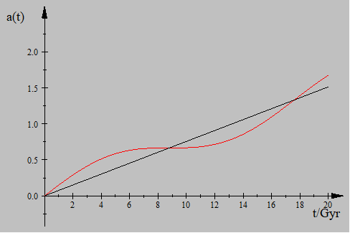
An Analytic model for cosmic evolution
(From dynamic equilibrium to successive kalpas)
Notes:
90s. We implement this idea analytically by describing the cosmic scale factor as a steadily expanding background together with a self-regulating oscillatory component. The corresponding Hubble parameter follows directly from this evolution.
Each oscillation represents one kalpa, while the underlying linear expansion represents the continuing evolution of the background universe.

Slide 5
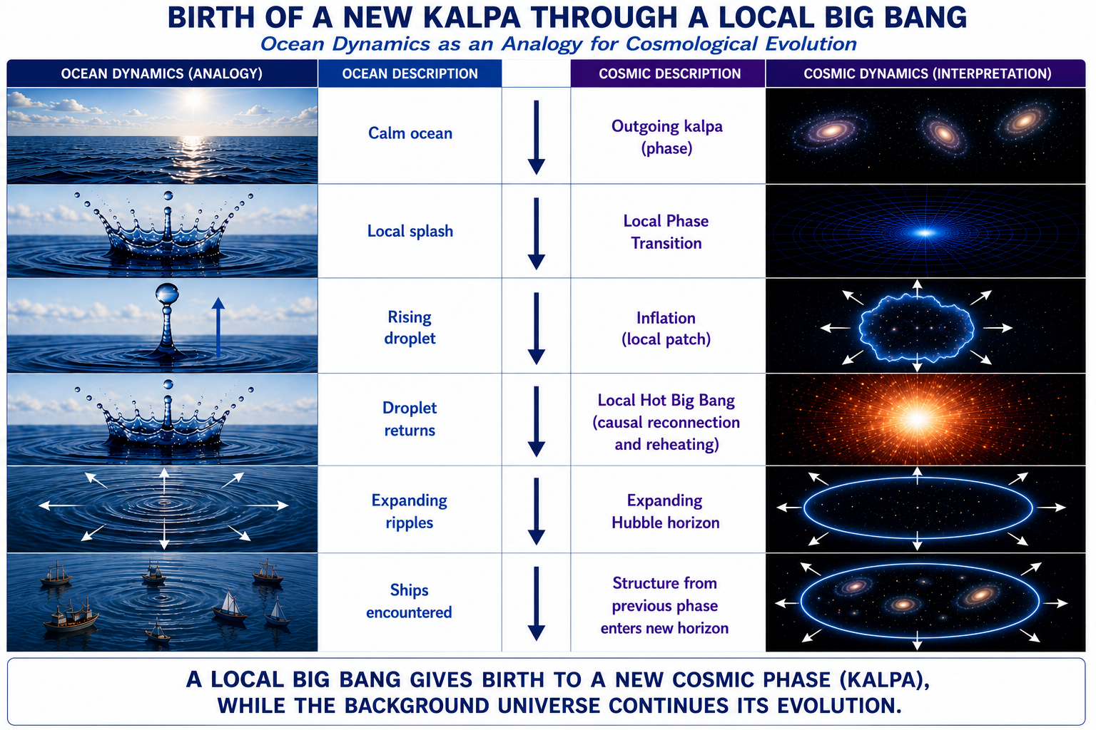
Birth of a kalpa (new phase) through a local phase transition
(Ocean dynamics to cosmological dynamics)
)
Ocean dynamics to cosmological dynamics
Notes:
2.5min: This figure summarizes the physical picture behind Kalpa-SRC using an analogy with ocean dynamics.
A calm ocean represents the outgoing cosmic phase evolving near dynamic equilibrium.
A local disturbance creates a splash, corresponding to a localized phase transition that initiates the next cosmic phase. –
The rising droplet represents inflation, during which the new region undergoes rapid expansion and temporary causal isolation.
As the restoring dynamics act, the droplet returns to the ocean. This corresponds to the Local Hot Big Bang, where causal contact is restored and reheating begins the new kalpa.
The new phase then expands causally as an enlarging Hubble horizon, analogous to ripples spreading across the ocean surface.
As this horizon grows, it encounters structures that already existed in the outgoing phase while simultaneously allowing new structures to form within the present phase.
This provides a natural framework for interpreting the unexpectedly mature structures observed at high redshift by JWST (and without requiring the entire Universe to begin everywhere simultaneously).

Slide 6
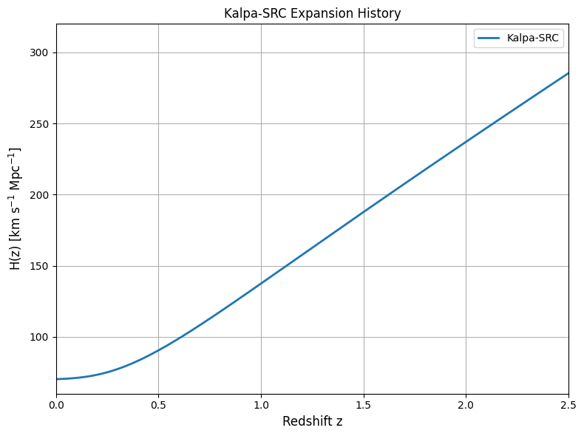
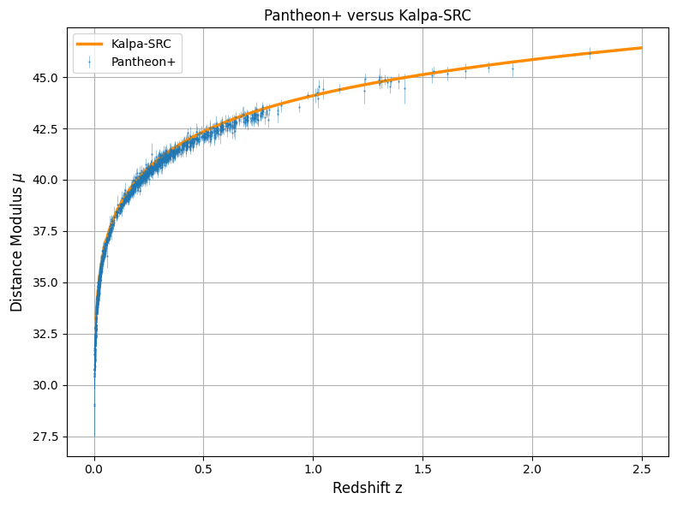
Observational tests of kalpa-src
(From cosmic origins to present universe)
)
Supernova luminosity distances reproduced.
This reconstruction curve agrees well with
the DESI expansion-history measurements.
This reconstruction curve agrees well with
Pantheon measurements.
Notes:
90s A cosmological framework must ultimately be judged by observation. Here I show 2 results: expansion history• H(z)• Supernovae Luminocity distances• Ongoing growth sector also shows consistency with observations.

Slide 7
Kalpa-SRG in Perspective
(A self-regulating framework from cosmic origins to present universe)
Cosmic Road map described by Kalpa-SRC
From Previous kalpa
Local Phase transition
Inflation
Hot Big Bang
Structure Formation
Present Universe
Kalpa-SRC Physical Framework:
From DEPP
Non-Singular Origin
Natural inflation
Hot Big Bang
Successive Kalpas
Observational Tests past
Expansion History
Supernovae Distances
Structure Growth
JWST phenomenology
Hubble/S8 relief
Kalpa-SRC therefore provides a continuous physical description of cosmic evolution—from one Hot Big Bang to the next.
Notes:
60s. To conclude, Kalpa-SRC proposes that cosmic evolution is governed by one self-regulating physical principle acting across successive kalpas.
From that principle emerge a non-singular origin, natural inflation, a Local Hot Big Bang, structure formation, and a Universe that remains consistent with the principal observational tests considered so far.
Kalpa-SRC therefore provides a continuous physical description of cosmic evolution—from one Hot Big Bang to the next.

Slide 8
Thank You!
Sources:
M. Mbonye, Is Cosmic Dynamics Self-Regulating?, Int. J. Mod. Phys. D 32 (2023), arXiv:2404.10799.
M. Mbonye, The Big Bang: Origins and Initial Conditions from Self-Regulating Cosmology, Int. J. Mod. Phys. D 35 (2026); arXiv:2404.10799.
Current work on Kalpa-SRC (2026).

