Slide 1
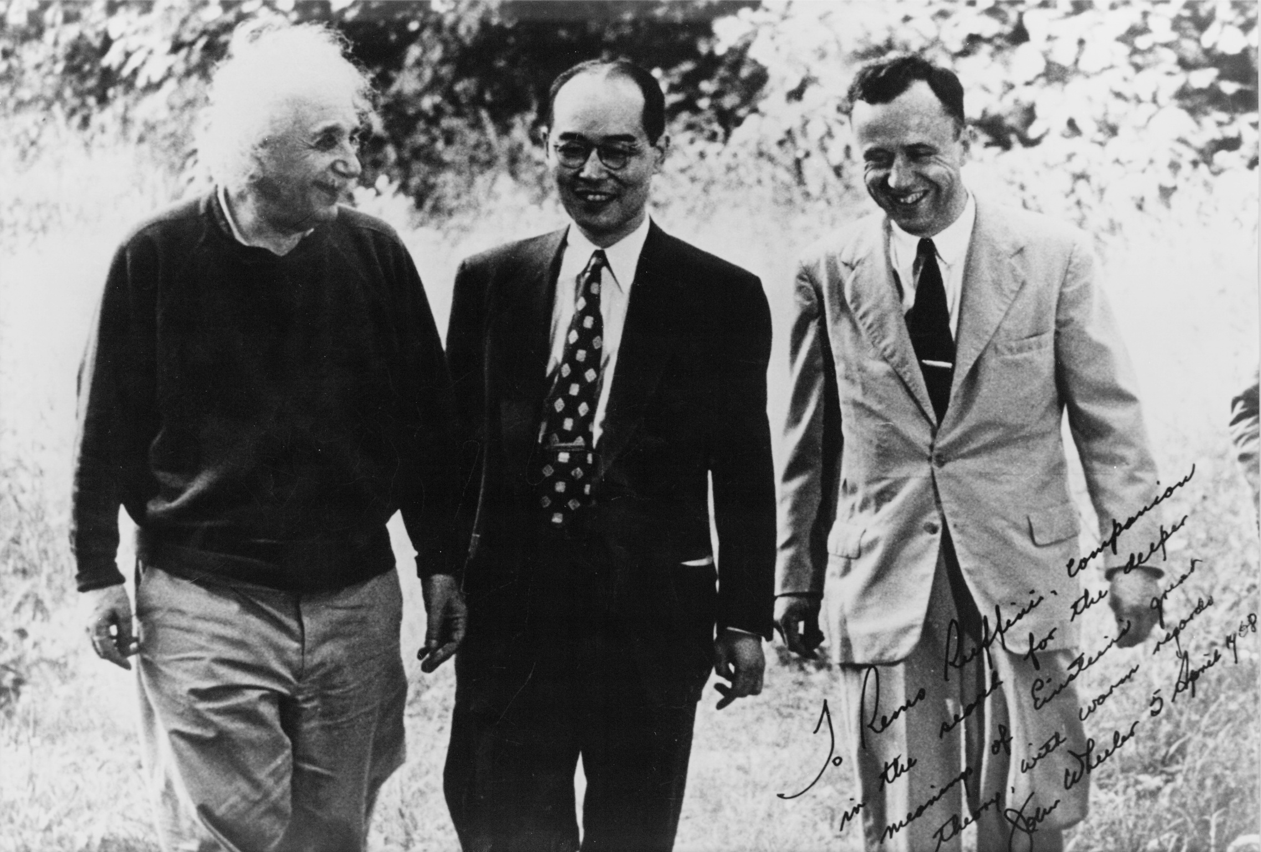

Slide 2
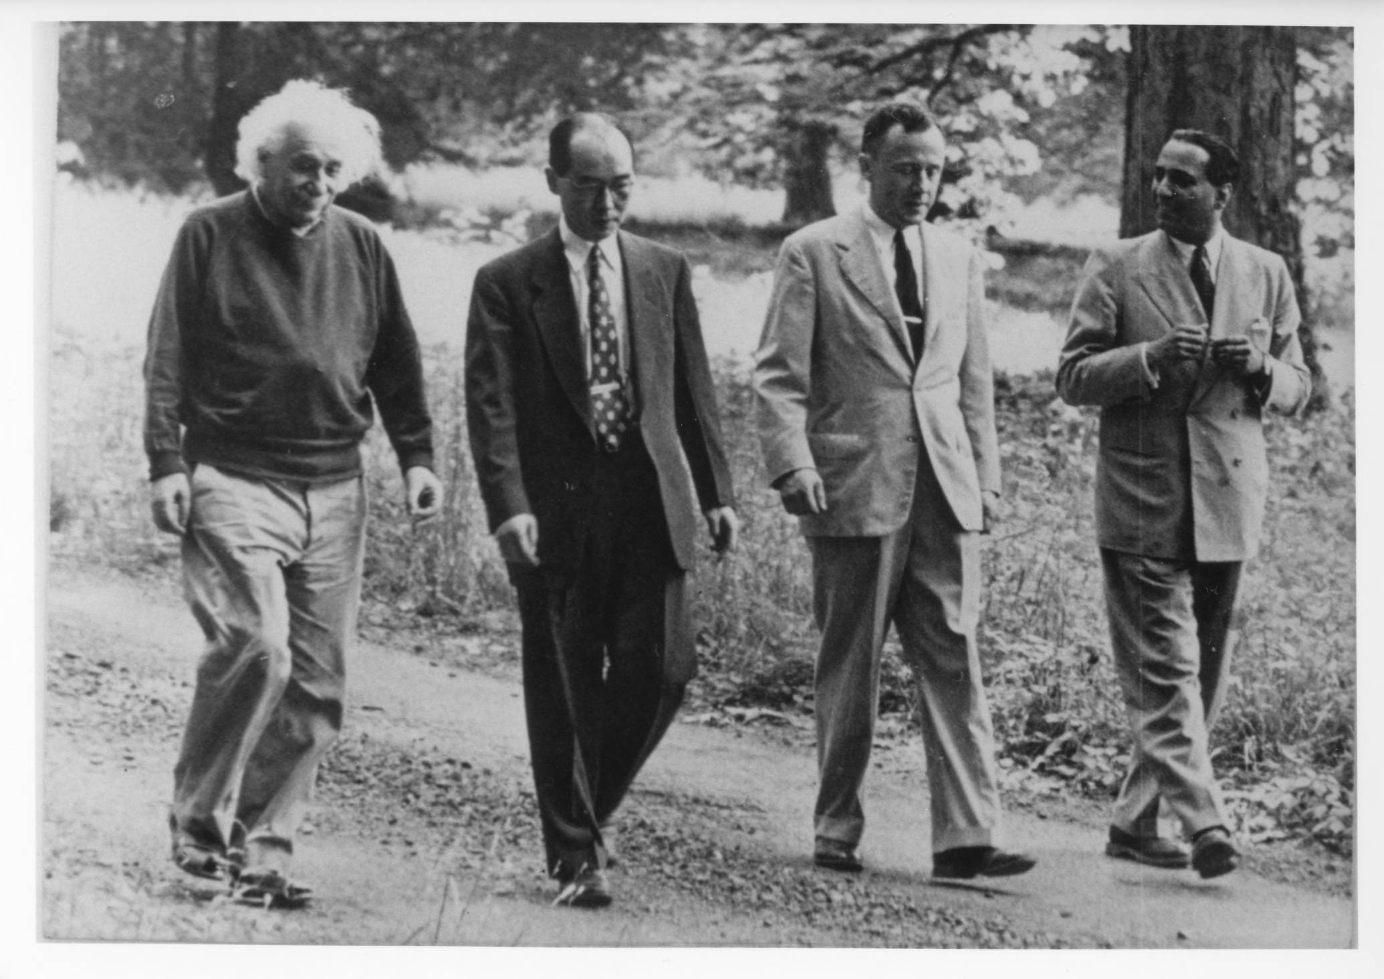

Slide 3
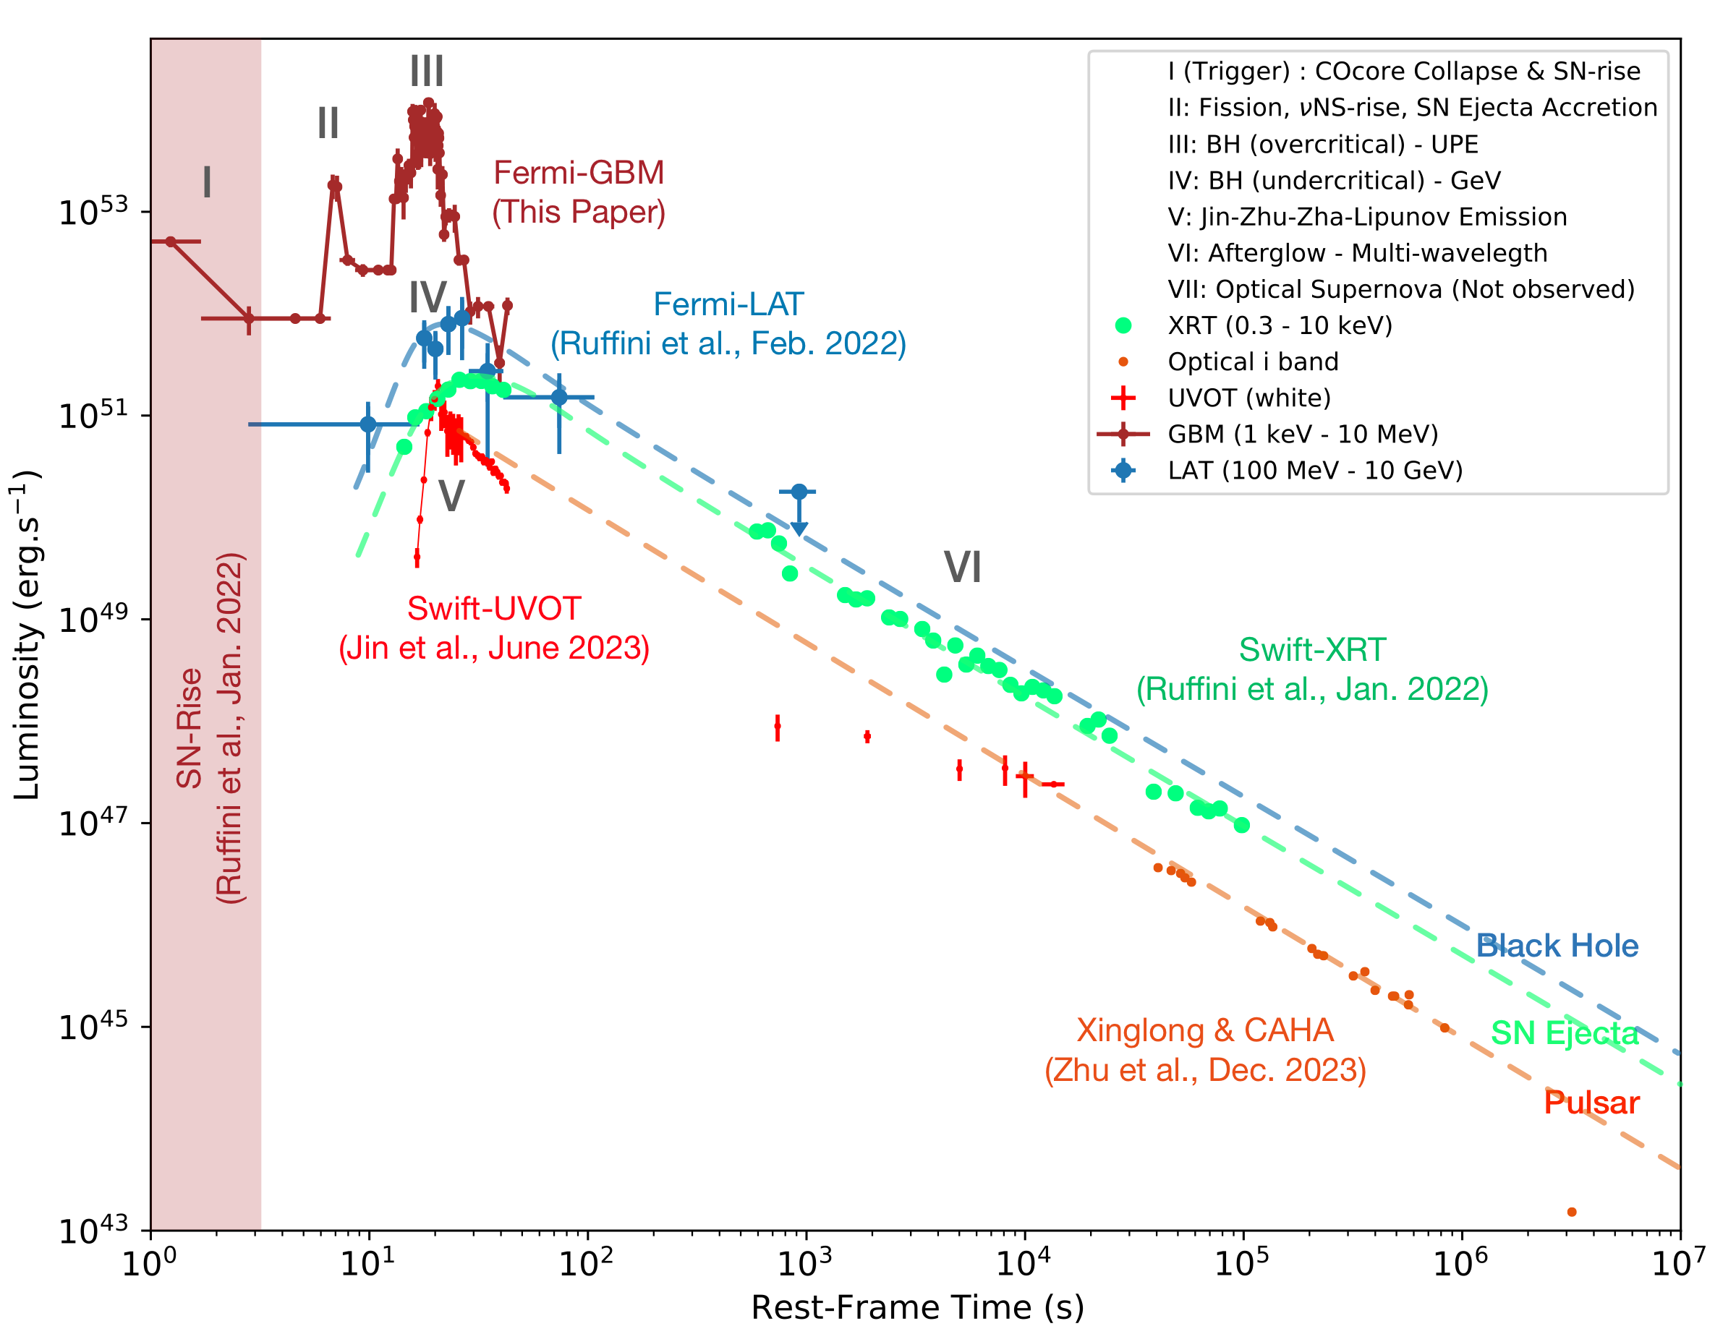
GRB 220101A
01 / 15
Multi-wavelength Luminosity Evolution
Rest-frame luminosity evolution from prompt emission to late afterglow across GBM, LAT, XRT, UVOT, and optical bands.
Dashed trends highlight the GeV, X-ray, and optical components associated with the BH, SN ejecta, and pulsar.

Slide 4
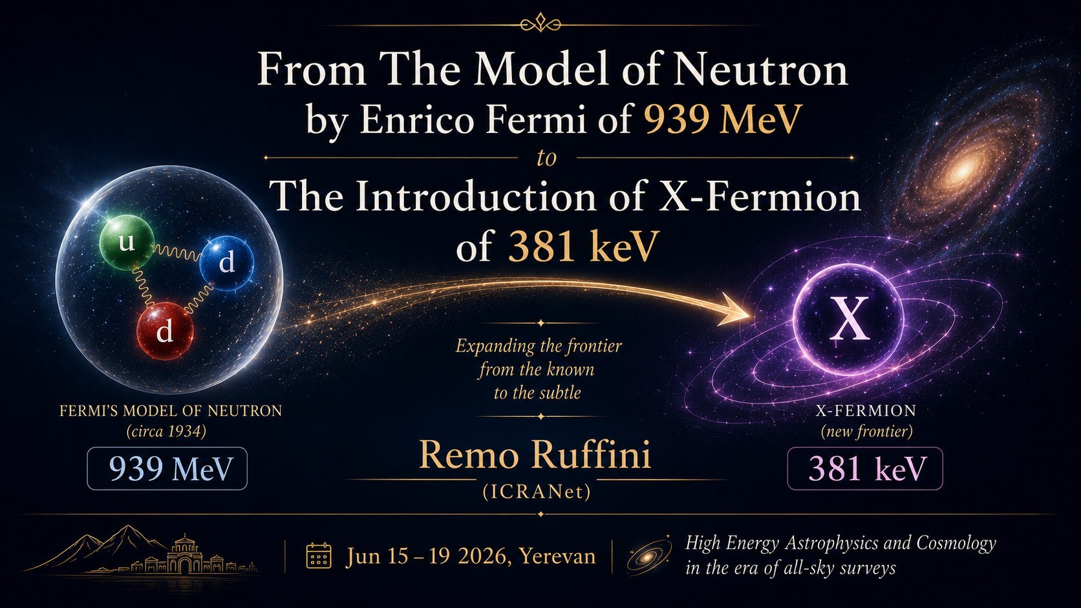
From The Model of Neutron by Fermi of 939 MeV
to The Introduction of X-Fermion of 381 keV
Remo Ruffini (ICRANet)
Jun 15 – 19 2026, Yerevan. High Energy Astrophysics and Cosmology in the era of all-sky surveys

Slide 5
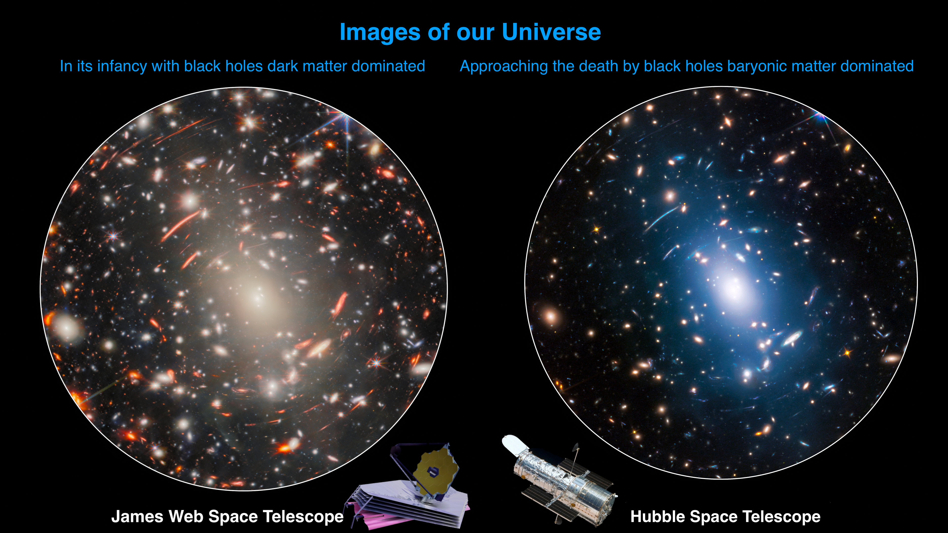

Slide 6
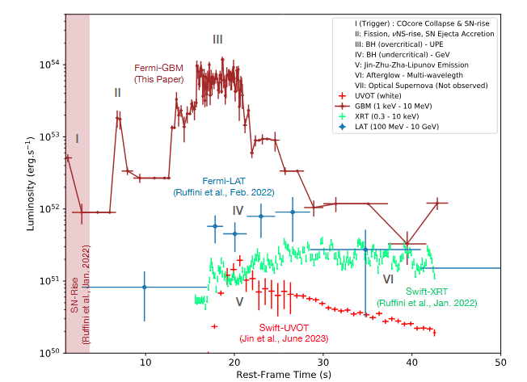

Slide 7
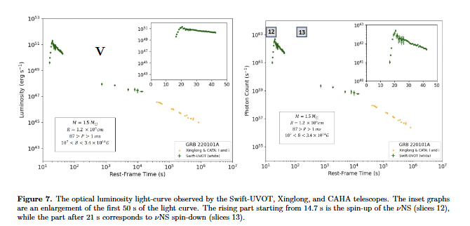

Slide 8


Slide 9
