Slide 1
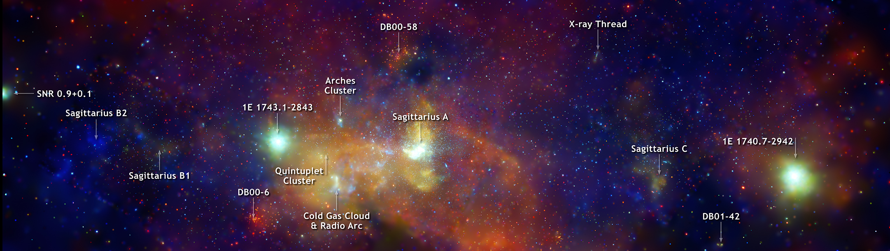
[From far to] The closest environment of the supermassive black hole
Sagittarius A* in X-rays
Roman Krivonos
Space Research Institute (IKI), Moscow, Russia
Notes:
Hello!

Slide 2
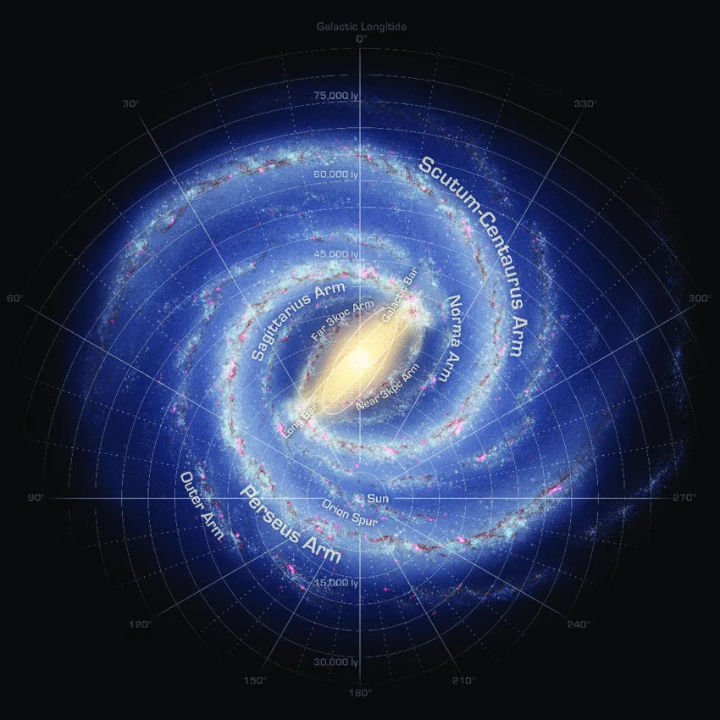
X-ray emission of the Milky Way
at different scales
1000 pc → 100 pc → 10 pc → 1 pc
around Sgr A*

Slide 3
Part I
~1000 pc scale around Sgr A*

Slide 4
~100-1000 pc scale around the Sun

Slide 5
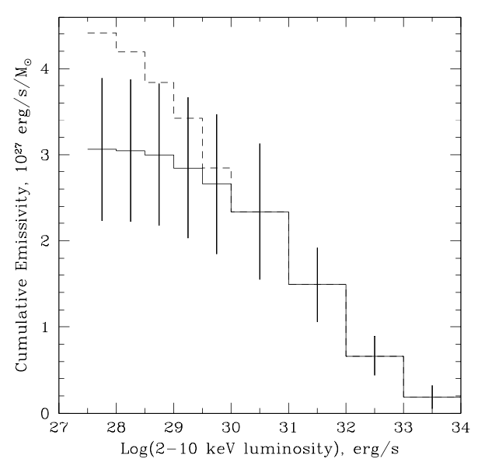
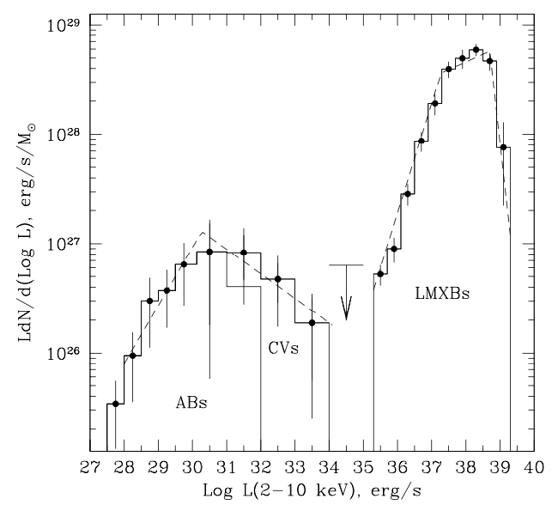
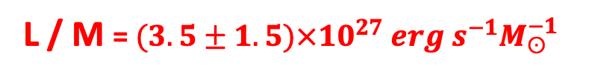
X-ray emitting stellar population ~100-1000 pc around the Sun
Active binaries (ABs) and Cataclysmic Variables (CVs)
L / M = $(3. 5±1.5)×{10}^{27} erg s^{−1}M_{ʘ}^{−1}$
Galactic X-ray Luminosity Function
Cumulative emissivity of ABs and CVs as a function of luminosity
Sazonov et al., 2006

Slide 6
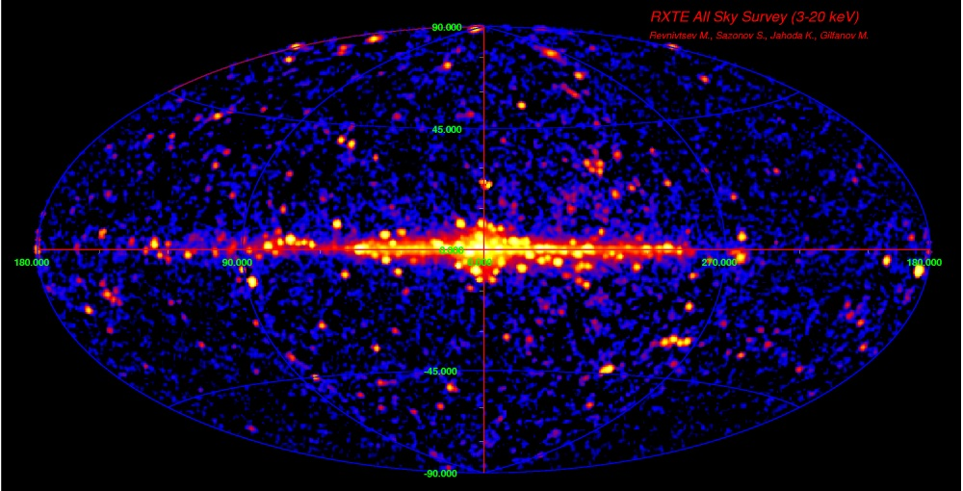
High energy view of the Milky Way
RXTE 3-20 keV all sky survey
Revnivtsev M., Sazonov S., Jahoda K., Gilfanov M. 2004

Slide 7
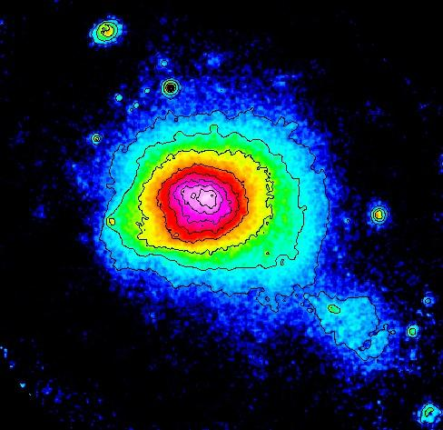
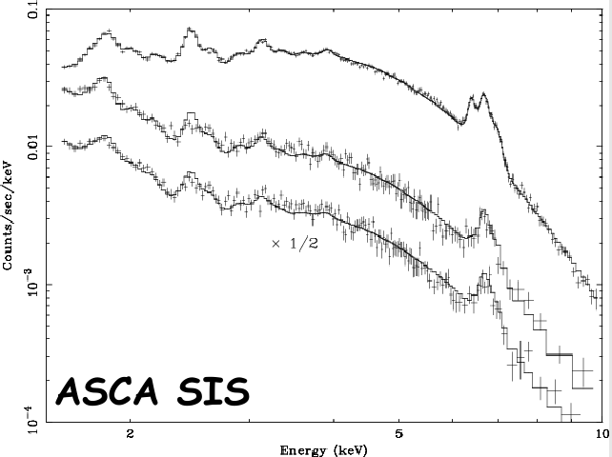
Galactic Ridge X-ray Emission (GRXE)
origin explanations
1) Emission of optically thin plasma
To explain spectrum necessary to have very hot (7-10 keV) gas
Coma cluster
2) Superposition of point sources ?
Notes:
Because non-thermal emission processes, synchrotron or inverse-Compton scattering, do not produce atomic emission lines, these discoveries strongly suggest existence of optically-thin thermal plasma with a temperature of several keV

Slide 8

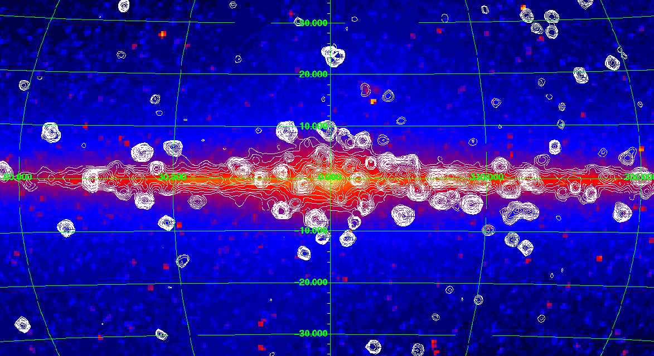
COBE/DIRBE (3.5 μm)
RXTE (3-20 кэВ)
M. Revnivtsev
1974-2016
GRXE follows near-infrared emission revealing stellar origin
GRXE is formed by a large population of low-luminosity sources
Type of these sources is known (accreting WDs)
GRXE properties are uniform across Galaxy
Unit-stellar-mass emissivity is in good agreement with that measured in Solar neighbourhood

Slide 9
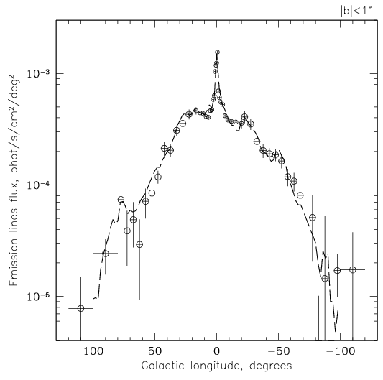
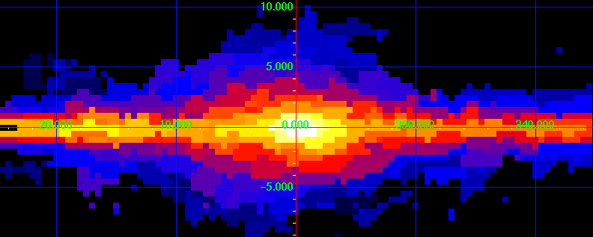
GRXE is traced by 6.7 keV iron line emission
GRXE 6.7 keV map
RXTE
Revnivtsev et al., (2006)
Galactic longitude profile
L_{2-10 keV/M} = (3.5±0.5) x 10²⁷ erg/s/Msun

Slide 10
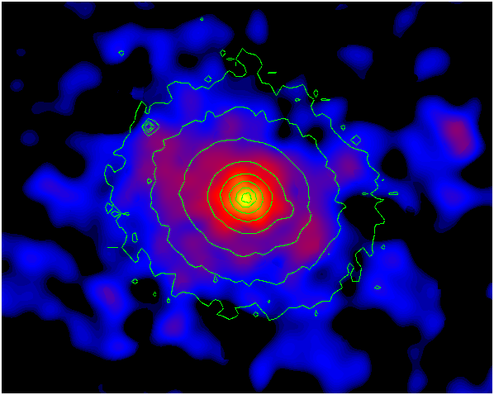
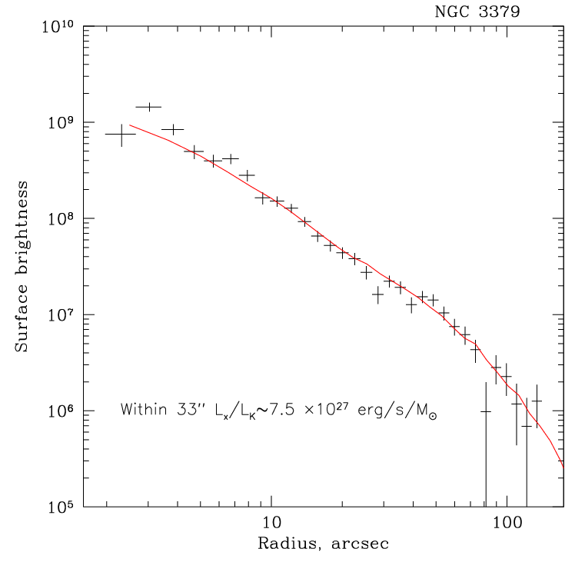
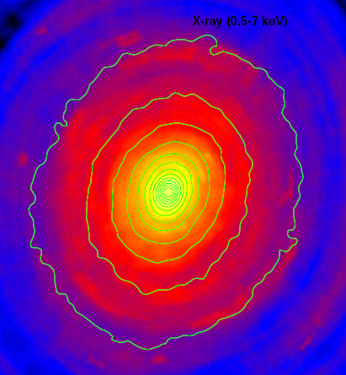
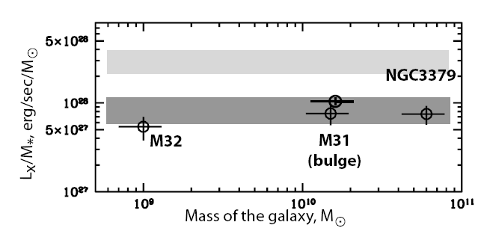
The same phenomena in other galaxies
NGC 3379
Elliptical galaxy
M32
Revnivtsev et al., (2008)
Revnivtsev et al., (2007)

Slide 11
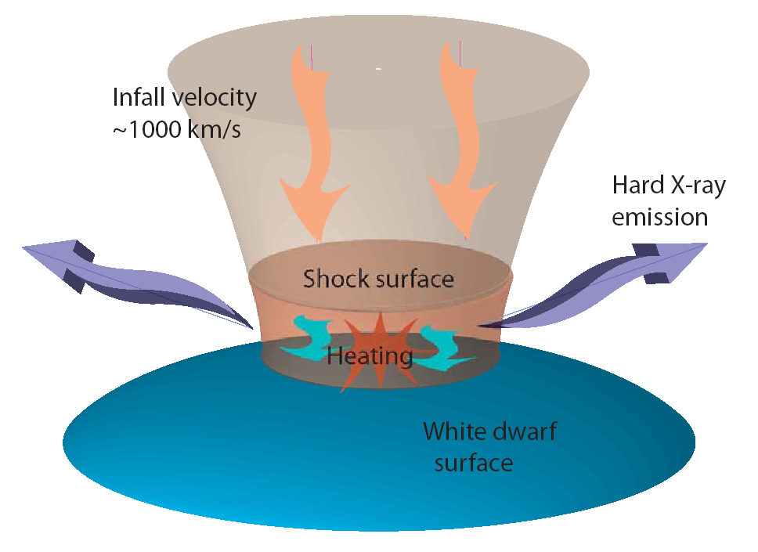
RXTE main results
* GRXE follows near-infrared emission revealing stellar origin
* Unit-stellar-mass emissivity is in good agreement with that measured in Solar neighbourhood
Prediction:
* Energy cut-off in GRXE spectrum depends on the mass of typical WD
=> The observed spectral shape can be translated to the WD mass
Notes:
PREDICTION: Assuming stellar origin of the Galactic X-ray emission one can make the prediction of the energy cut-off in the spectra above 20 keV. In this energy band the main contributors are accreting WDs. Hard X-ray emission of such systems depends on temperature of the emitting plasma. The maximal temperature of the gas directly depends on the mass of the WD. On the plot we show schematically accretion process in such systems. Accreting flow hits the WD surface and shock is appeared. The gas is heated up and hard X-ray emission is generated. The maximal temperature of the emitting optically thin plasma is the measure of the virial temperature of the protons near the WD surface which depends on its mass.
Accreting WDs are binary systems which contain a WD as a compact object and a low-mass late-type star like the Sun as a mass donor
The observer spectral shape can be translated to the WD mass
As presented in Figure 2.9, heavier WDs have smaller radius, and therefore, deeper gravitational
potential depths than lighter ones. i.e maximum temperature of a PSR of a magnetic CV is
almost proportional to the star’s gravitational potential depth, harder X-ray spectra (i.e. higher
temperature emission) are expected from systems harboring heavier WDs. Thus, observed X-ray
spectral shapes can be translated into the WD masses.

Slide 12
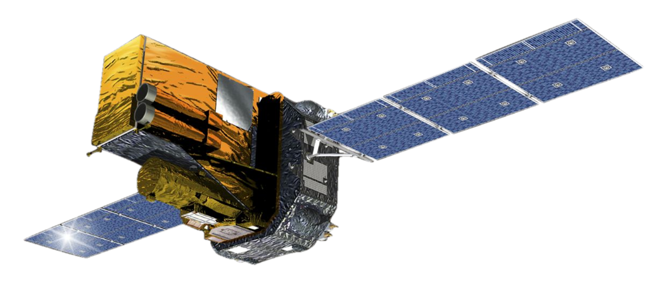
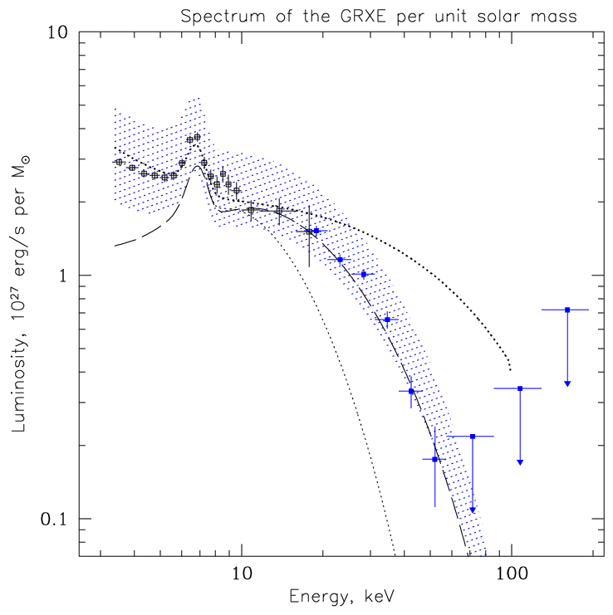
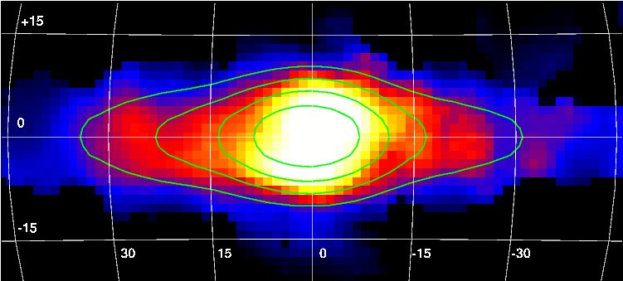
GRXE study with INTEGRAL
GRXE Spectrum
17-60 keV
Krivonos et al., 2007
WD model
by Sulejmanov et al., (2005)
1.0 Msun
0.3 Msun
0.5 Msun
High energy cutoff found ~50 keV
accreting WD mass ~0.5 Msun

Slide 13
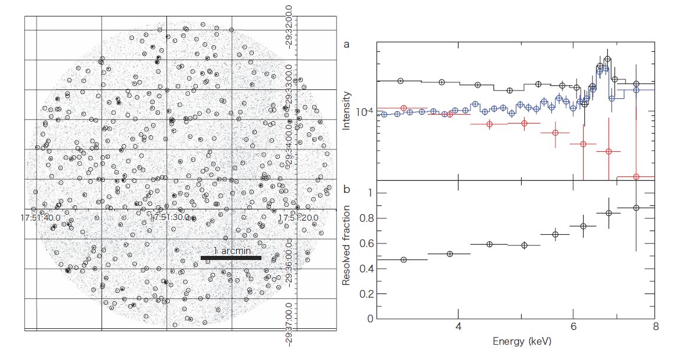
Chandra ultradeep field in GC (1Ms)
Revnivtsev et al., (2009)
At least 80% of GRXE is explained by point X-ray sources

Slide 14
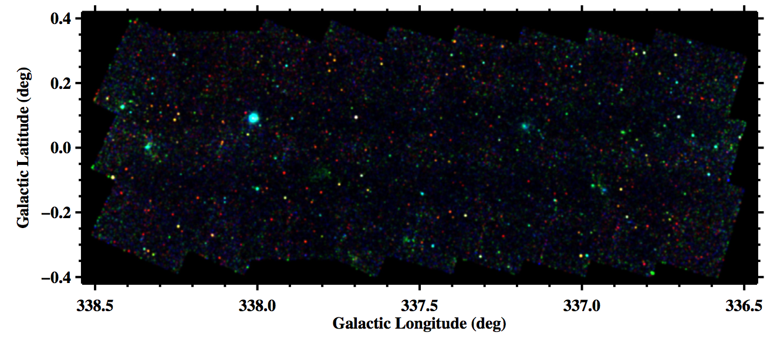
Chandra deep field in Norma Spiral Arm
Fornasini et al., (2013)
1415 sources
Fornasini et al., 2014

Slide 15
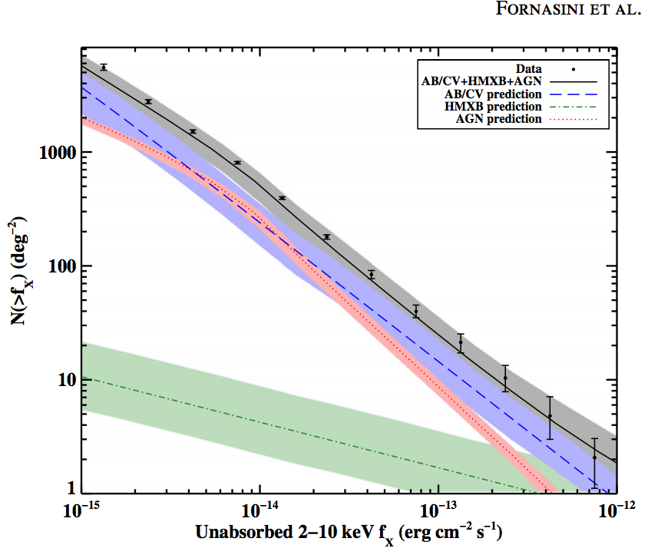
Chandra deep field in Norma Spiral Arm
Fornasini et al., (2013)
1415 sources
Fornasini et al., 2014
Based on Galactic stellar mass models and L/M measured in solar neighborhood

Slide 16
Part II
~100 pc scale around Sgr A*

Slide 17
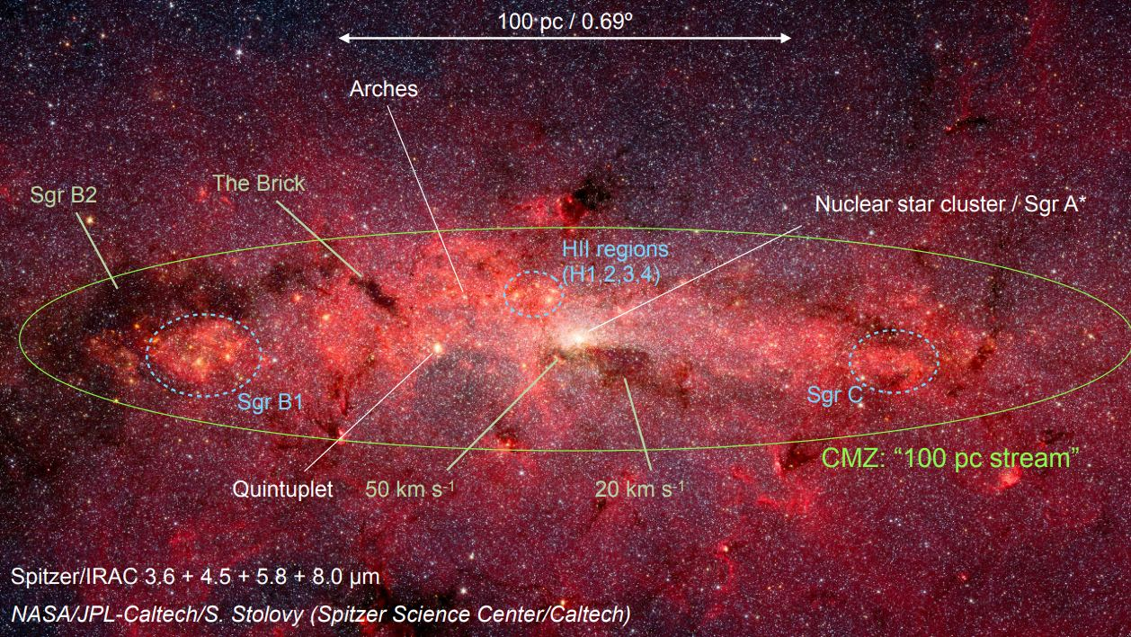
Densely-packed environment of Galactic Center

Slide 18
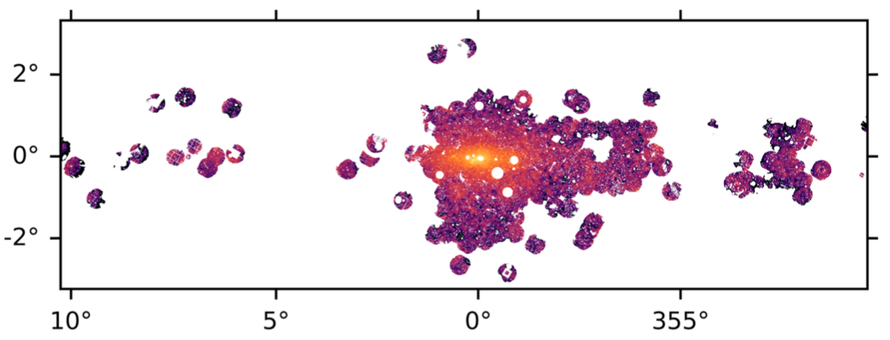
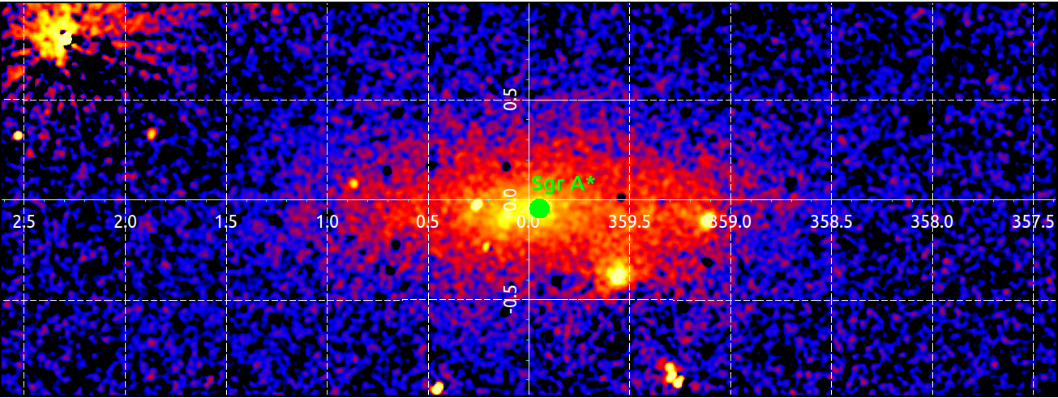
~100 pc scale around Sgr A*
XMM 6.7 keV Anastasopoulou et al., (2023)
SRG/ART-XC 4-12 keV
Wide-field X-ray imaging of GC

Slide 19
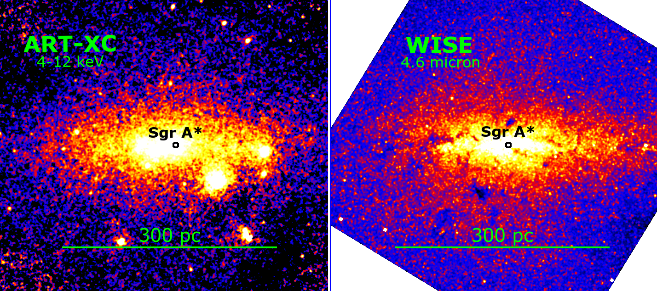
The Nuclear Stellar Disc of the Milky Way
Nezabudkin et al., (2025)

Slide 20
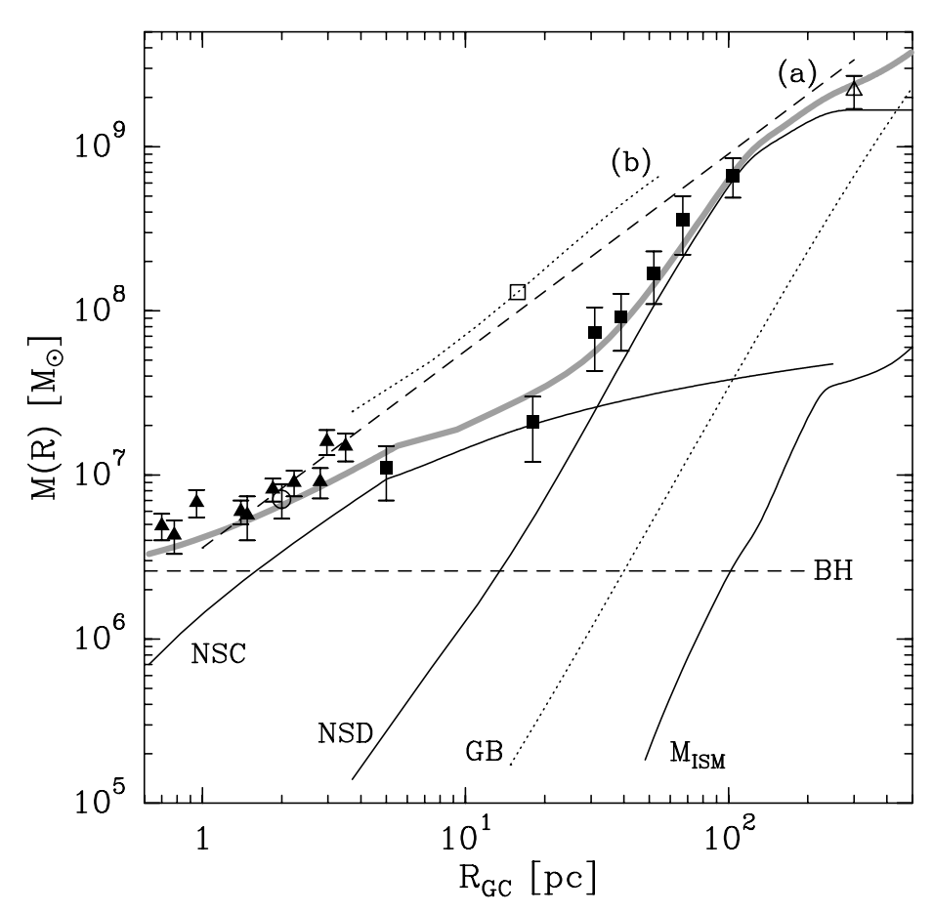
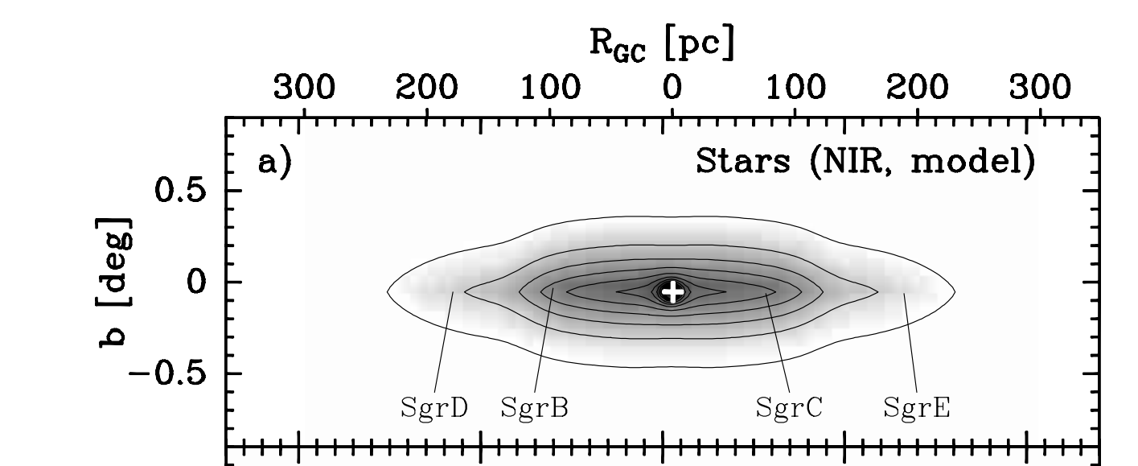
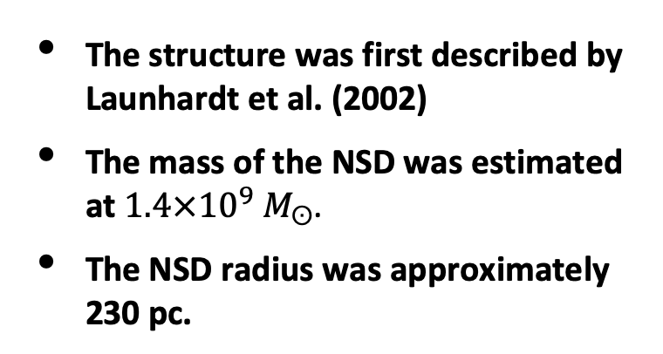
Nuclear Stellar Disk (NSD)
The structure was first described by Launhardt et al. (2002)
The mass of the NSD was estimated at $1.4×{10}^{9} M_{ʘ}$.
The NSD radius was approximately 230 pc.
Radial profile of cumulative mass
Model surface brightness map

Slide 21
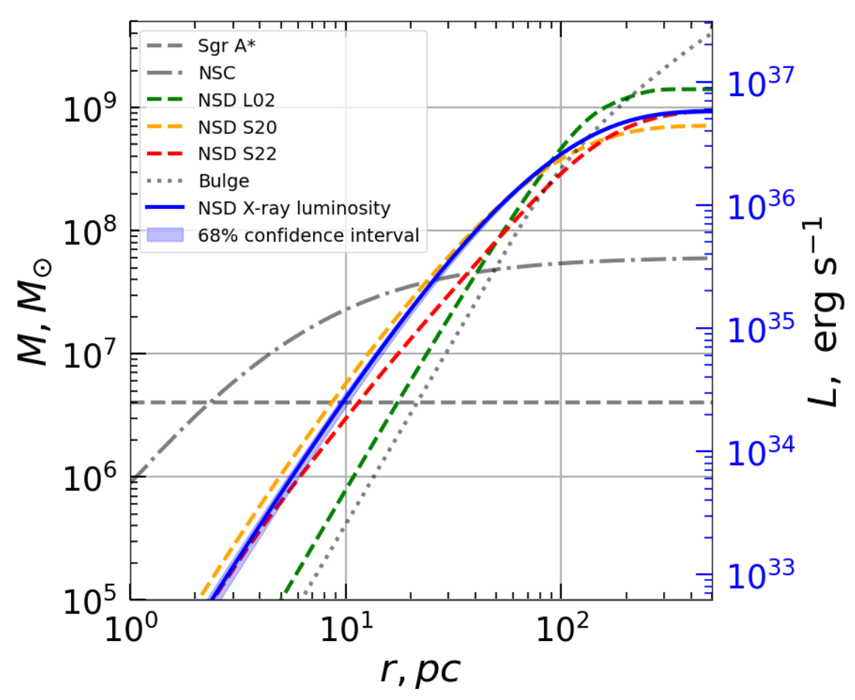
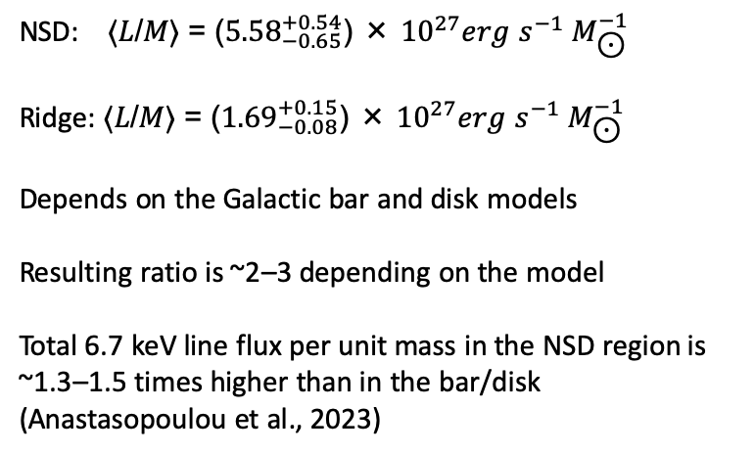
X-Ray Emission of the NSD
NSD X-ray flux model (2D)
NSD X-ray luminosity model (3D)
NSD: ⟨𝐿/𝑀⟩ = (${5.58}_{−0.65}^{+0.54}$) × ${10}^{27}erg$ $s^{−1} M_{\text{⊙}}^{−1}$
Ridge: ⟨𝐿/𝑀⟩ = (${1.69}_{−0.08}^{+0.15}$) × ${10}^{27}erg$ $s^{−1} M_{\text{⊙}}^{−1}$
Depends on the Galactic bar and disk models
Resulting ratio is ~2–3 depending on the model
Total 6.7 keV line flux per unit mass in the NSD region is ~1.3–1.5 times higher than in the bar/disk (Anastasopoulou et al., 2023)
Nezabudkin et al. (2025)

Slide 22
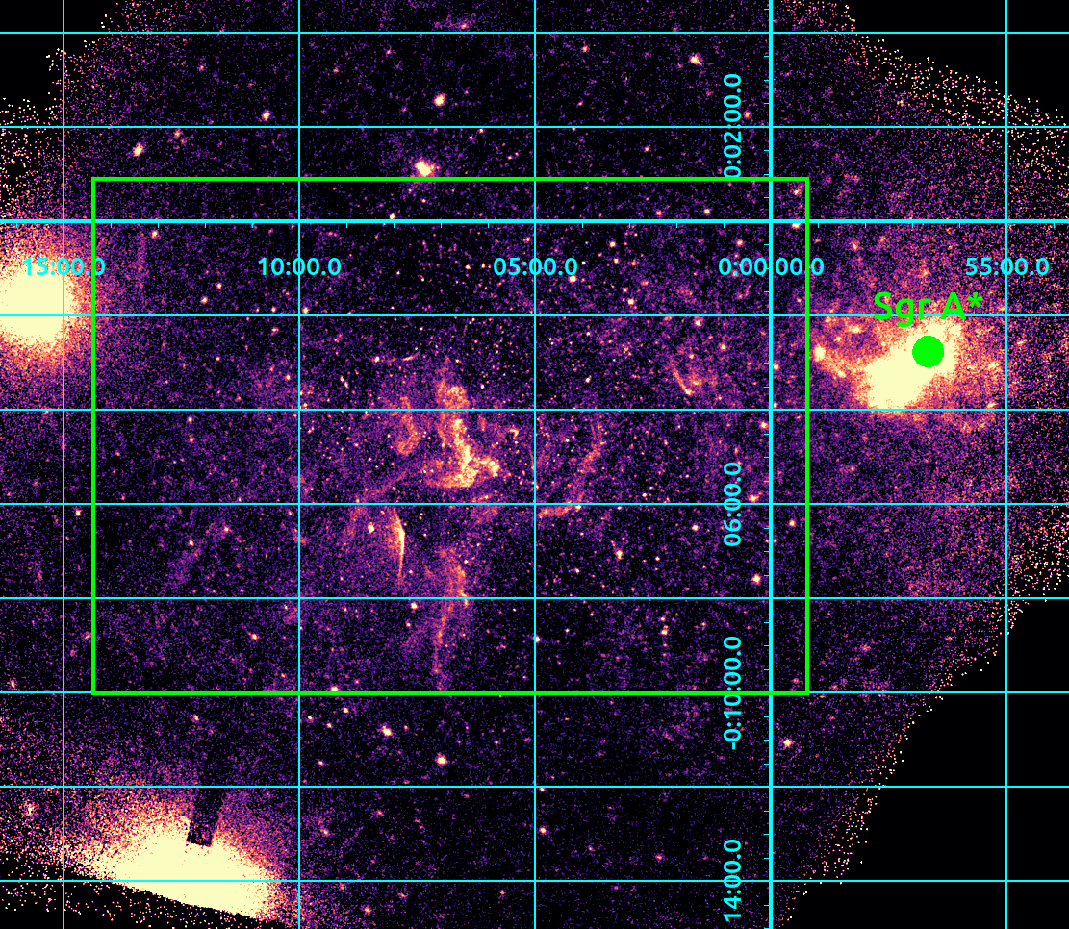
Deep Chandra Observations
Target: CMZ region with molecular clouds
Dataset: Chandra deep field
Energy range: 4-8 keV
Peak exposure: 800 ks
Total 1725 sources
(165 arcmin^2)

Slide 23
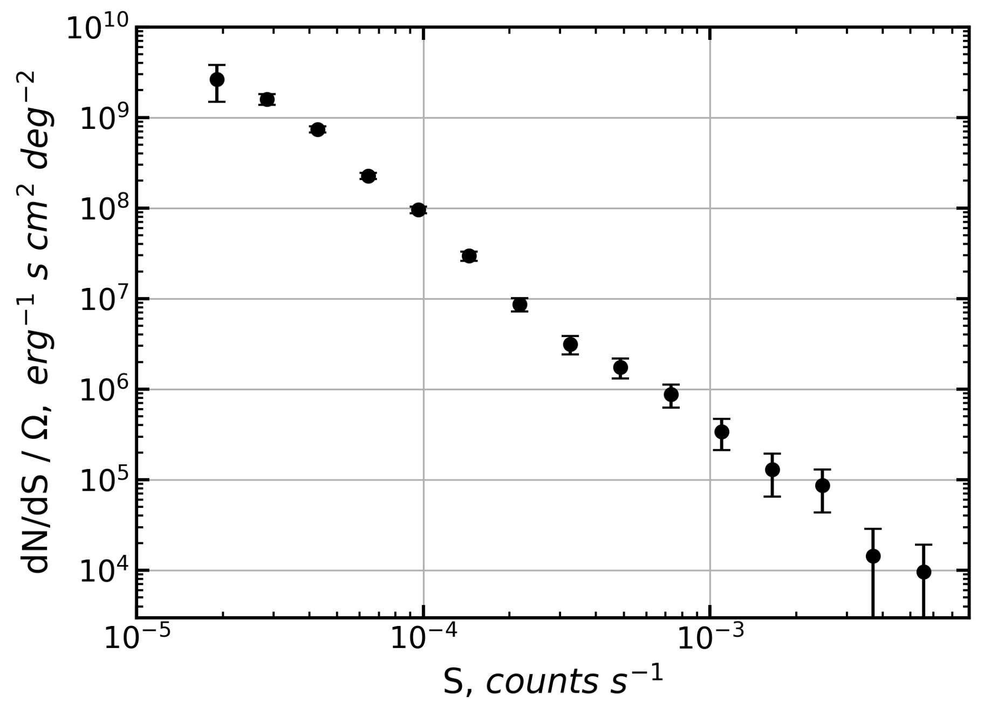
dN/dS Distribution of Sources in CMZ (NSD region)

Slide 24
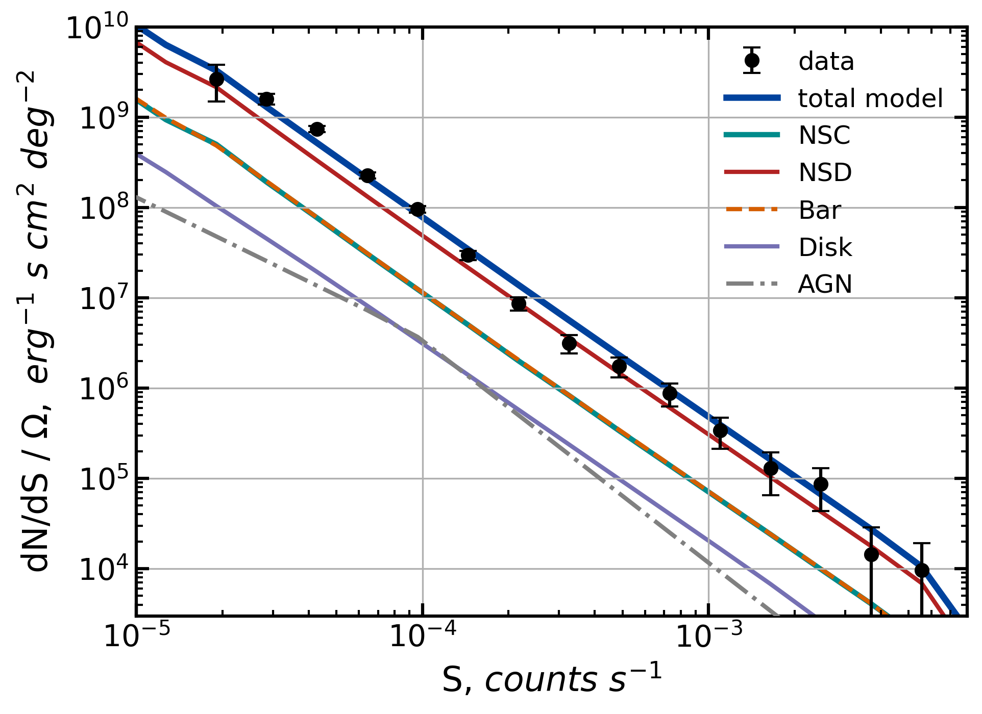
LogN-LogS modelling
NSC – 14.5%
NSD – 62.5%
Bulge/Bar – 14.7%
Disk – 4.0%
AGN – 4.3%
Based on Galactic stellar mass models and L/M measured in solar neighborhood

Slide 25
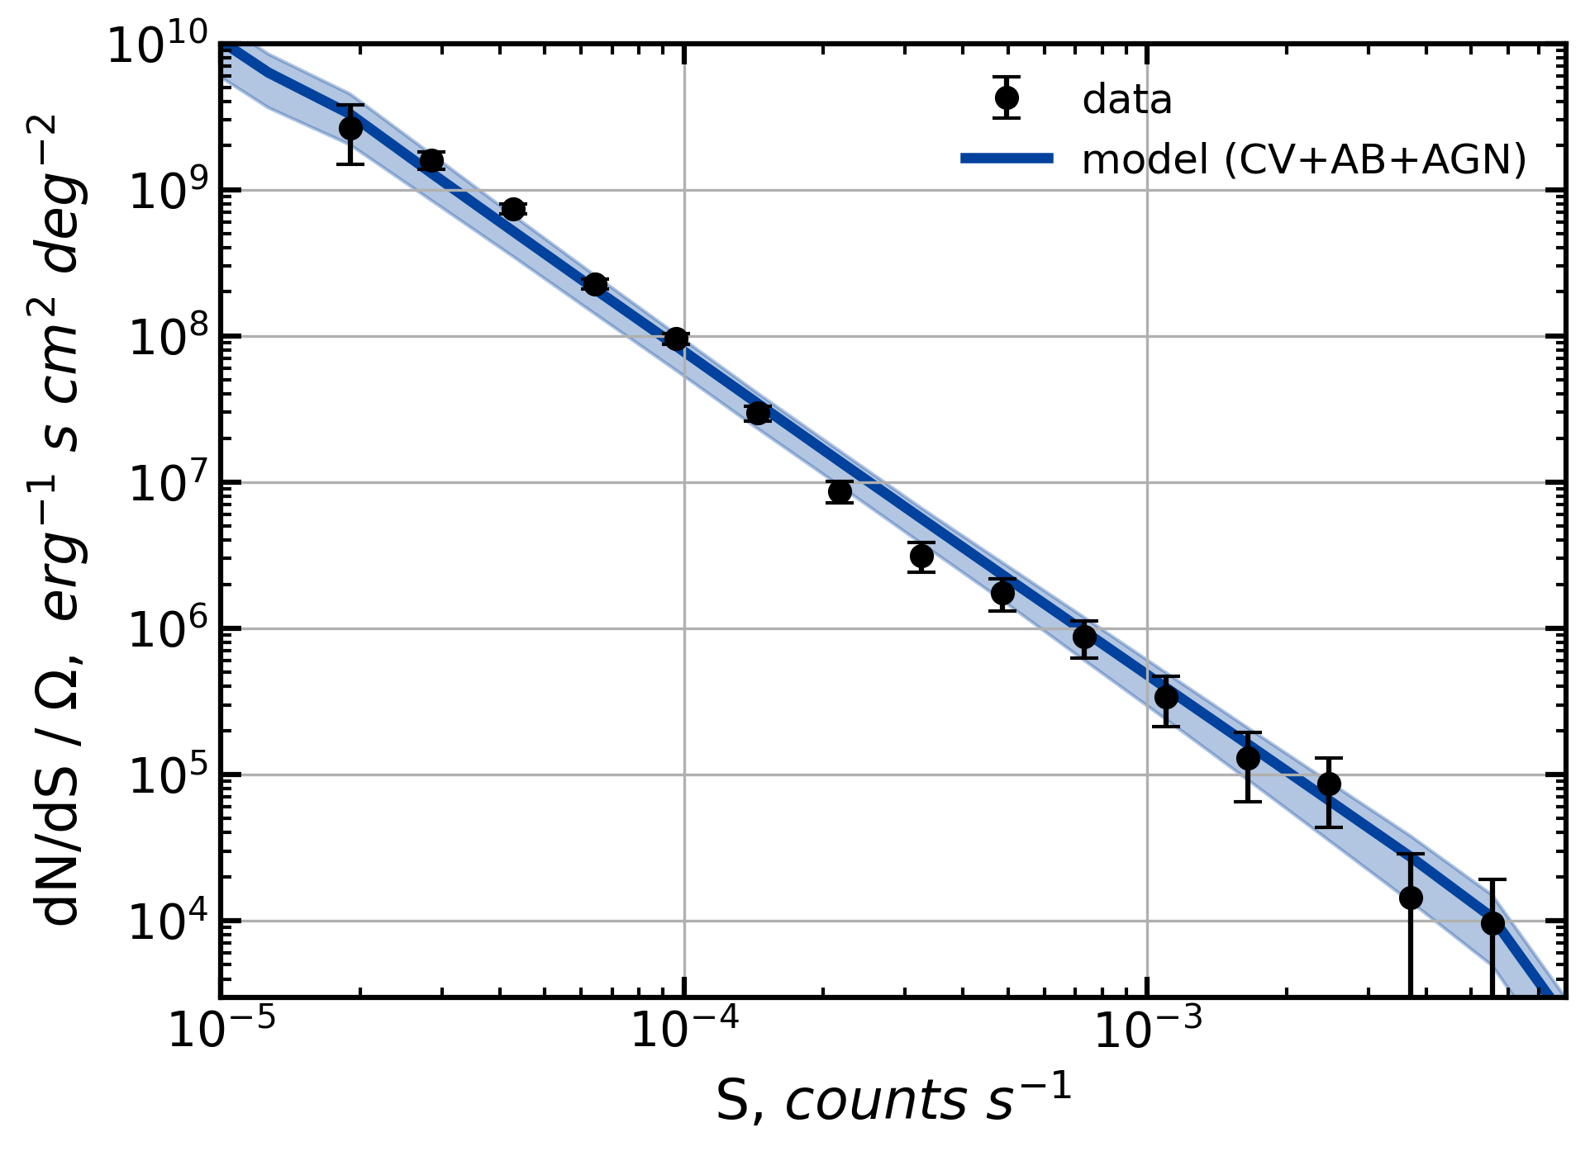
LogN-LogS modelling
The total model
Based on Galactic stellar mass models and L/M measured in solar neighborhood

Slide 26
Part III
~10 pc scale around Sgr A*

Slide 27
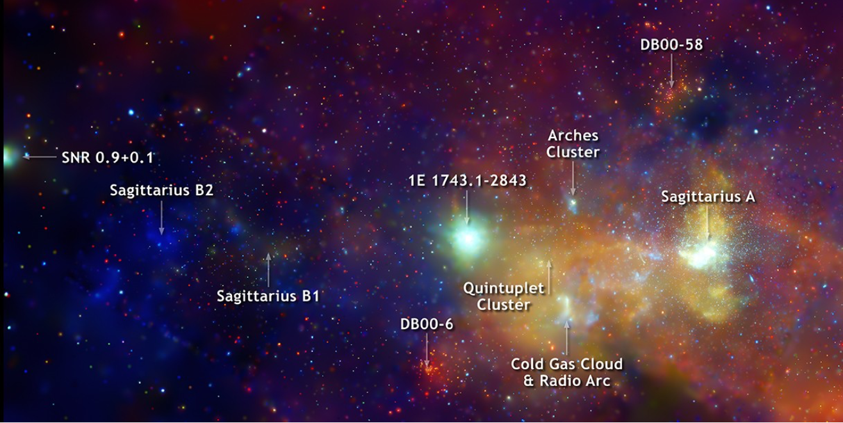
Galactic Center in X-rays

Slide 28

Central Hard X-ray diffuse emission
Inner ~10 pc around Sgr A*

Slide 29
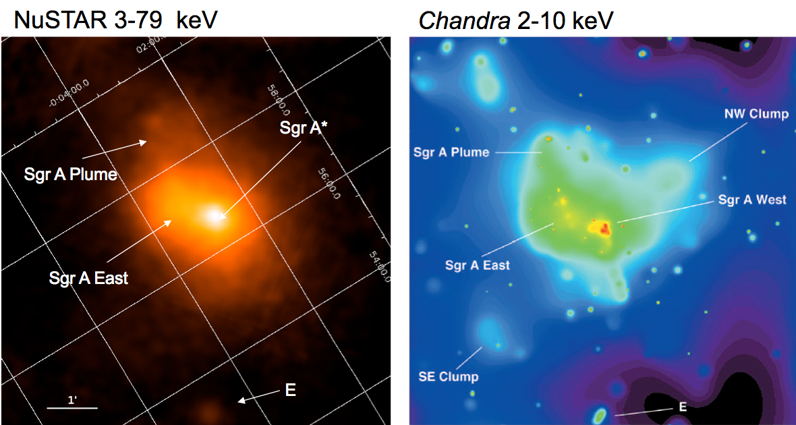
NuSTAR morphology of GC is similar to Chandra
Baganoff et al., 2003
hard X-rays from Sgr A-East are purely thermal
Credit: Kerstin Perez

Slide 30
Central Diffuse Hard X-ray Emission
Nature 520, 646–649 (30 April 2015):
Kerstin Perez, Charles J. Hailey, Franz E. Bauer, Kaya Mori, Frederick K. Baganoff, Nicolas M. Barriere, Steven E. Boggs, Finn E. Christensen, William W. Craig, Brian W. Grefenstette, Jonathan E. Grindlay, Fiona A. Harrison, Jaesub Hong, Roman Krivonos, Kristin Madsen, Melania Nynka, Daniel Stern, John Tomsick, Daniel R. Wik, Shuo Zhang, William W. Zhang, Andreas Zoglauer
The CHXE exhibits an elliptical profile similar to
the surface brightness distribution of the nuclear
star cluster (NSC) where a high stellar density is
observed in the IR band with a total luminosity of
∼ 10⁷L⊙ and mass of ∼ 10⁷M⊙ .
The similarity between the two spatial distributions strongly suggests a stellar origin of the CHXE.
Credit: Kerstin Perez
Notes:
First region: inner parsecs –this purple blob here, why the combination of NuSTAR energy range and spatial resolution key to its discovery
stop for a moment to differentiate emission of the very central parsecs
This is a region that is very crowded in bright soft X-ray sources, so not really able to investigate with Chandra, XMM
But also so dense that couldn’t really resolve with INTEGRAL
NuSTAR was really the Goldilocks instrument to look at this

Slide 32
Credit: Kerstin Perez

Slide 33
Credit: Kerstin Perez

Slide 34
Credit: Kerstin Perez

Slide 35
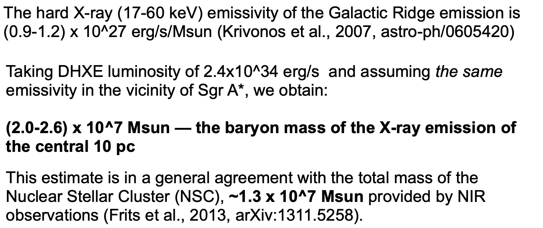
The baryon mass estimate of central 10 pc

Slide 36
Part IV
~1 pc scale around Sgr A*

Slide 37
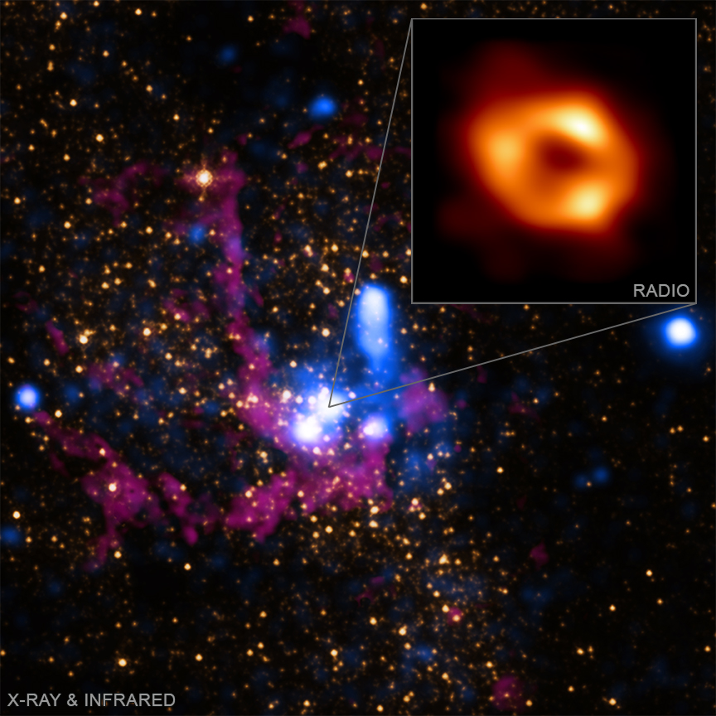
The Event Horizon Telescope collaboration
~1 pc scale around Sgr A*

Slide 38
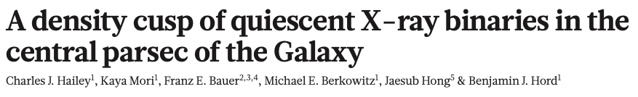
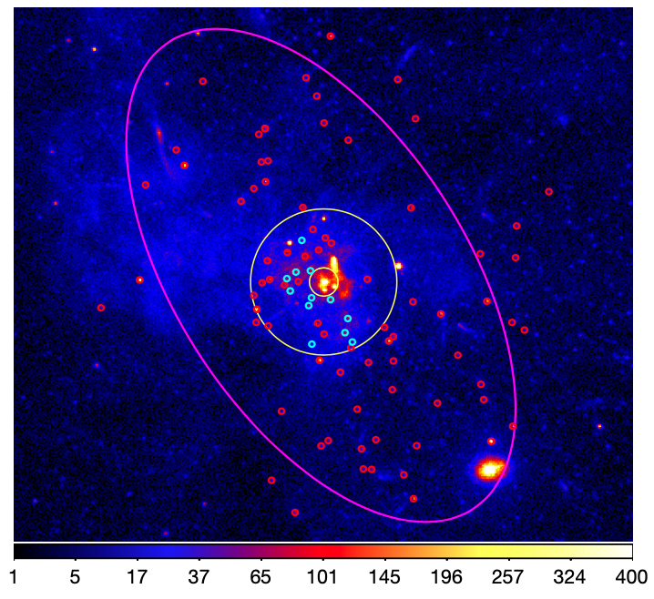
The close vicinity of Sgr A*
92 X-ray sources with net counts > 100 selected for analysis (26 within 1 pc)
Hardness ratio is used to separate thermal and non-thermal sources

Slide 39
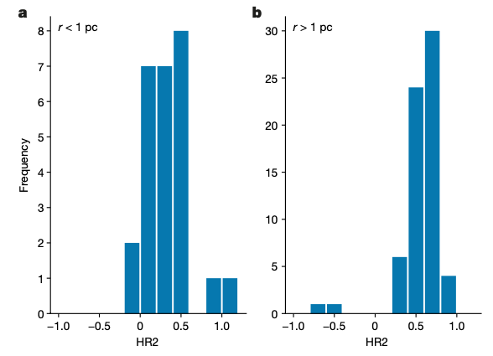
The close vicinity of Sgr A*
non-Therm. Therm.
non-Therm. Therm.
Thermal HR > 0.3
Non-thermal HR < 0.3

Slide 40
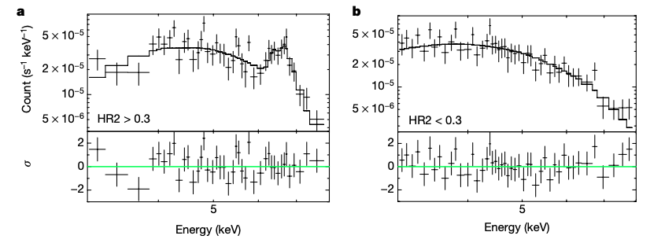
The close vicinity of Sgr A*
Г ~ 2
kT ~ 6 keV
The stacked spectra of the HR < 0.3 and HR > 0.3 sources in the inner parsec

Slide 41
The close vicinity of Sgr A*
The newly identified HR < 0.3 population is prominent only inside the central parsec.
unresolved magnetic cataclysmic variable stars (thermal spectra)
Hypothesis: quiescent black-hole low-mass X-ray binaries (qBH-LMXBs)
rotation-powered millisecond pulsars (rMSPs) cannot be excluded
LogN-LogS estimation gives 600–1,000 qBH-LMXBs within 1 pc
Expected 10,000 isolated black holes
black holes in binary systems
(non-thermal spectra)

Slide 42
Conclusions
The X-ray output (L/M) of the stellar population of Milky Way is very uniform at different scales:
  around the Sun
  1000 pc (GRXE)
  100 pc (NSD)
  10 pc (NSC)
Deep Chandra observations of the inner parsec reveal ~1,000 black holes in binary systems which implies 10,000 isolated black holes around Sgr A*

