Slide 1
Gravitational Refraction of Compact Objects with Quadrupoles
Sixth Zeldovich meeting, Pescara, Italy
Beissen Nurzada
Al-Farabi Kazakh National University, Almaty, Kazakhstan
ICRANet · Pescara, Italy · July 13-17, 2026

Slide 2
Talk storyline
One question, two sectors, one degeneracy
1
Physical motivation
Compact objects are multipolar; optical signals are not purely Schwarzschild.
Central question
Can a weak optical signal tell us whether the compact object is slowly rotating or statically deformed?
2
Material-medium formulation
Light bending is rewritten as propagation in an effective medium.
3
Static vs rotating sectors
Compute n(r) for a static quadrupole and for linearized Kerr.
conference focus
4
Mimicking and inference
A compact theoretical result on gravitational optics, lensing degeneracies, and multipolar diagnostics.
Identify the first-order equivalence and its diagnostic limitation.
Pescara 2026
2/11

Slide 3
Motivation
Quadrupoles enter compact-object optics
Physical source
Optical signal
Diagnostic problem
A realistic source is characterized by mass M, angular momentum J, and multipolar structure Q.
Light deflection may be described as refraction by an inhomogeneous effective medium.
Different mechanisms can generate similar first-order optical corrections.
Comparison:
Static deformation
same optical observable
Slow rotation
Approximate quadrupolar metric; deformation parameter q
Linearized Kerr geometry; spin parameter a = J/M
Pescara 2026
3/11

Slide 4

Material-medium formulation
Curved-spacetime light propagation as effective refraction
metric
isotropic coordinates
light velocity
refractive index
Interpretation
deflection angle
The gravitational field is treated as an inhomogeneous optical medium. The central observable is the effective refractive index n(r), from which weak-field bending can be obtained.
Same pipeline for both sectors.
Pescara 2026
4/11

Slide 5
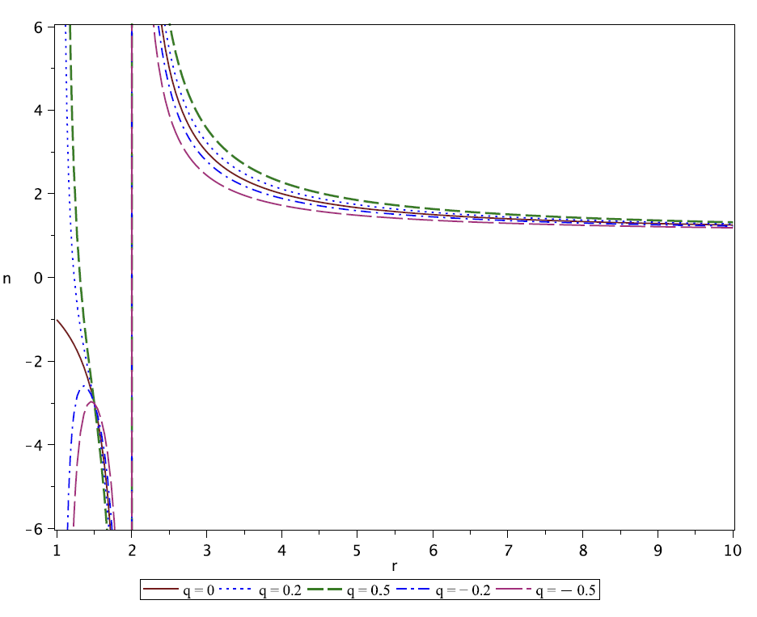

Static quadrupolar refraction
First-order deformation imprint in n(r)
Readout
The Schwarzschild term is recovered at q = 0. The linear q-term represents the first-order optical imprint of static quadrupolar deformation.
q > 0
q < 0
enhanced refractive contribution
reduced refractive contribution
Controlled external region: the optical analogy is most reliable in the weak-field domain outside the compact object.
Fig.1. Refractive index as a function of r for different values of q and m = 1. In the interval r ∈ (1, 2), the refractive index can become negative, depending on the value of q.
Pescara 2026
5/11

Slide 6


Static deflection angle
Weak-field bending receives a linear q correction
Physical meaning
Positive q
bending angle larger than Schwarzschild
Negative q
bending angle smaller than Schwarzschild
This is not a strong-field statement: it is a first-order, weak-field correction in the static quadrupole sector.
Pescara 2026
6/11

Slide 7
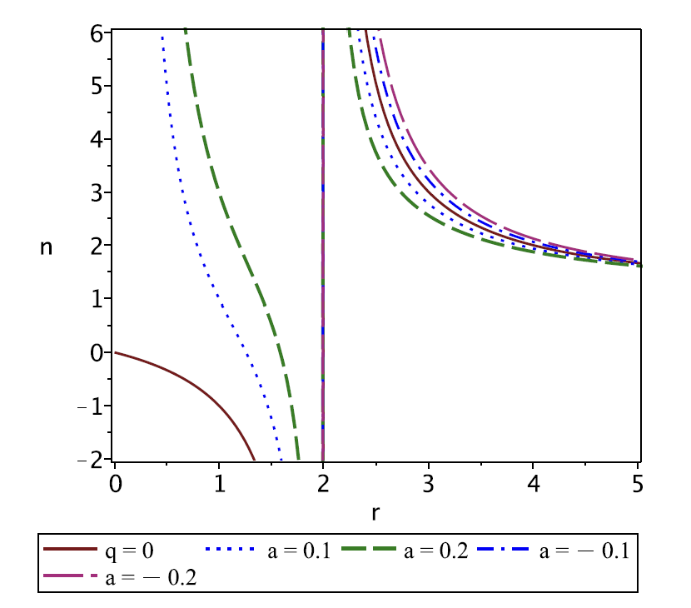



Slow-rotation refraction
Linearized Kerr correction is caused by frame dragging
Here a = J/M is the specific angular momentum and b is the impact parameter. The first-order correction is a frame-dragging contribution, not the full Kerr quadrupole Q ∼ a².
Fig.2. The refractive index as a function of the radial distance for different values of the specific angular momentum a. Here, we set m = 1 and b = 10.
Pescara 2026
7/11

Slide 8
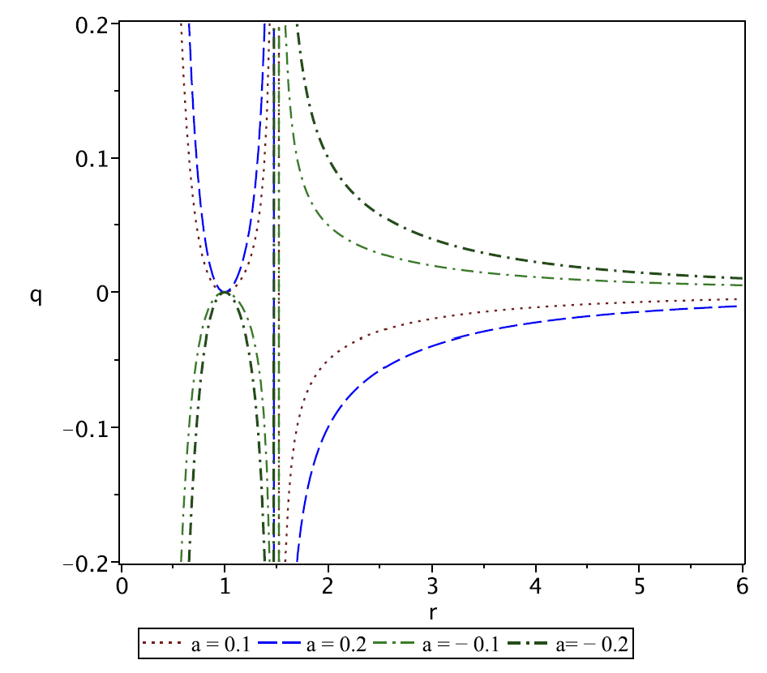

Main result: optical mimicking
Static deformation and slow rotation can be equivalent at first order
At a fixed radius, the first-order frame-dragging correction in the rotating sector can be reproduced by an effective static quadrupolar deformation.
Core consequence
A single weak optical measurement does not uniquely identify the physical origin of the signal.
Fig.3. Equivalence between the static quadrupole q and the stationary quadrupole a in terms of the radial distance r.
Pescara 2026
8/11

Slide 9
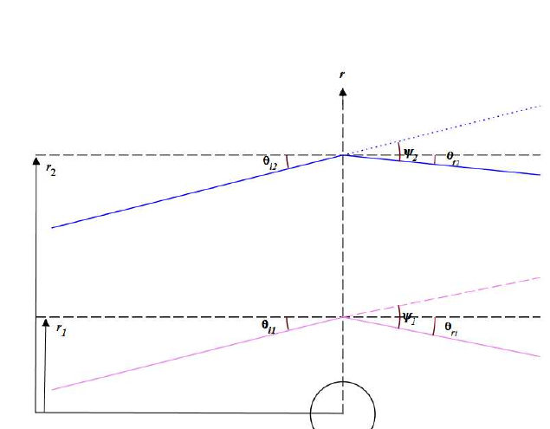

Interpretation and inference
What can and cannot be extracted from optical data
Within the rotating-sector model, two refracted rays can be used to solve for m and a.
Two measured refractive indices provide two equations.
The inferred spin can be mapped to an effective q through q_eff.
Breaking the degeneracy requires additional observables.
Useful diagnostics: image morphology, timing, polarization, finite-distance lensing, or strong-field photon-ring observables.
Fig.4. Parameters of two light rays that are deflected in a gravitational field.
Pescara 2026
9/11

Slide 10
Conclusions
Short summary of the result
Effective optical description
The material-medium approach assigns a refractive index n(r) to the gravitational field of a compact object.
Static and rotating corrections
A static quadrupole q and slow rotation a modify the refractive index and bending angle in calculable first-order ways.
Optical degeneracy
At fixed radius, the first-order rotating-sector correction can be mimicked by an effective static quadrupole q_eff.
Diagnostic lesson
A single weak-field optical measurement is insufficient; degeneracy breaking needs complementary observables.
Natural extension: test whether this first-order degeneracy survives, changes, or breaks in exact metrics and strong-lensing observables.
Pescara 2026
10/11

Slide 11
Thank you
Questions and discussion
Gravitational Refraction of Compact Objects with Quadrupoles
Sixth Zeldovich Meeting · ICRANet · Pescara, Italy · July 13-17, 2026
Beissen Nurzada
Al-Farabi Kazakh National University
Pescara 2026

