Slide 1




Cosmology with Gamma-Ray Bursts
Lorenzo Amati
(INAF – OAS Bologna)
(11 July 2022)

Slide 2
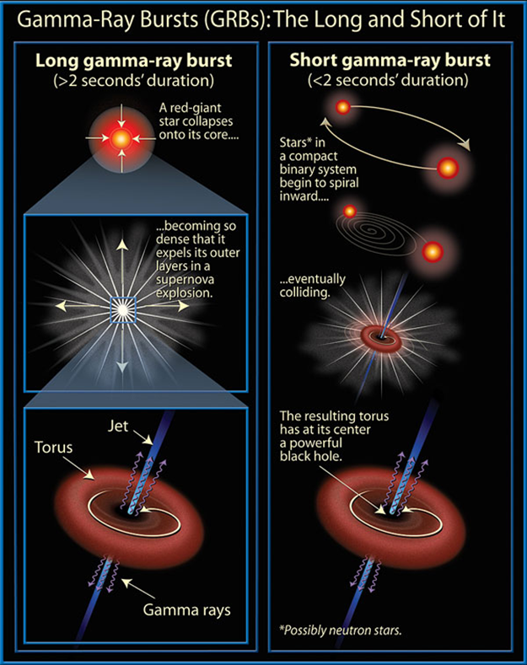
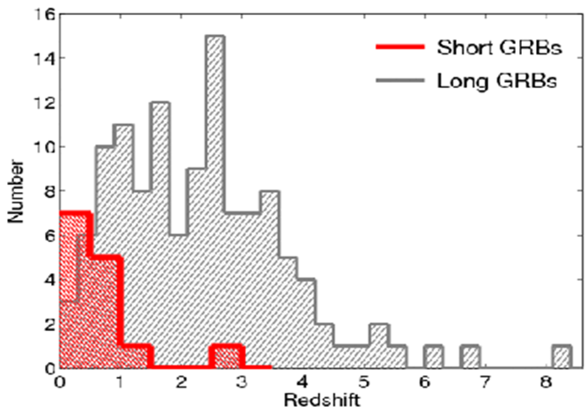
Gamma-Ray Bursts: the most extreme phenomena in the Universe
Long GRBs: core collapse of pecular massive stars, association with SN
Short GRBs: NS-NS or NS-BH mergers, association with GW sources

Slide 3
The power of long GRBs for cosmology
Most luminous and remote phenomena in the Universe, with isotropic-equivalent radiated energies in X-gamma rays up to more than 10⁵⁴ erg released in a few tens of seconds and a redshift distribution extending to at least z = 9-10.

Slide 4
The power of long GRBs for cosmology
Most luminous and remote phenomena in the Universe, with isotropic-equivalent radiated energies in X-gamma rays up to more than 10⁵⁴ erg released in a few tens of seconds and a redshift distribution extending to at least z = 9-10.
GRBs as tools for exploring the early Universe at the end of the "dark ages" (reionization, first stars, star formation rate and metallicity evolution in the first billion of years)

Slide 5
The power of long GRBs for cosmology
Most luminous and remote phenomena in the Universe, with isotropic-equivalent radiated energies in X-gamma rays up to more than 10⁵⁴ erg released in a few tens of seconds and a redshift distribution extending to at least z = 9-10.
GRBs as tools for exploring the early Universe at the end of the "dark ages" (reionization, first stars, star formation rate and metallicity evolution in the first billion of years)
Using GRBs to investigate the expansion rate and geometry of the Universe, thus getting clues to "dark energy" properties and evolution

Slide 6
The power of long GRBs for cosmology
Most luminous and remote phenomena in the Universe, with isotropic-equivalent radiated energies in X-gamma rays up to more than 10⁵⁴ erg released in a few tens of seconds and a redshift distribution extending to at least z = 9-10.
GRBs as tools for exploring the early Universe at the end of the "dark ages" (reionization, first stars, star formation rate and metallicity evolution in the first billion of years)
Using GRBs to investigate the expansion rate and geometry of the Universe, thus getting clues to "dark energy" properties and evolution

Slide 7
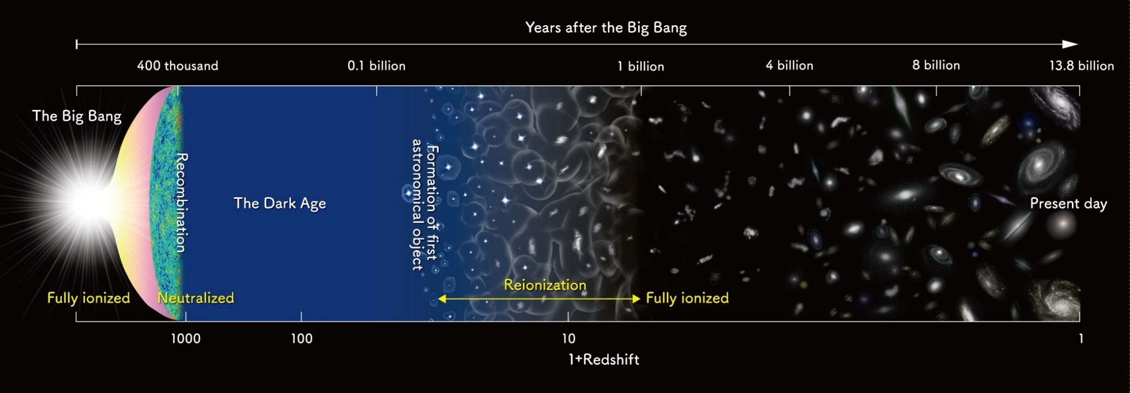
Shedding light on the early Universe with GRBs
A major goal of contemporary cosmology is to reveal the emergence of primordial stars and galaxies, and the contemporaneous reionization of the intergalactic medium, in the first billion years of the Universe
What was the timeline of reionization?
What sources were responsible?
How did the chemical elements build up?
Notes:
Presenter’s note:
First collapsed objects (stars, protogalaxies, and BHs)

Slide 8
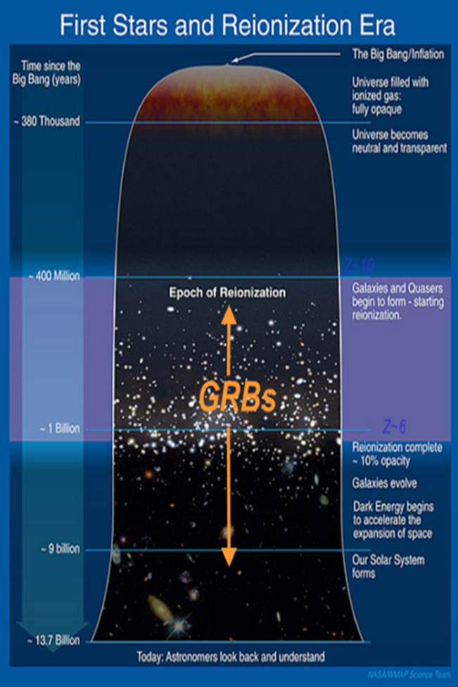
Shedding light on the early Universe with GRBs
Long GRBs: huge luminosities, mostly emitted in the X and gamma-rays
Redshift distribution extending at least to z ~9-10
Association with exploding massive stars in star forming regions of their host galaxies
Powerful tools for early Universe: SFR evolution, physics of re-ionization, high-z low luminosity galaxies, pop III stars

Slide 9
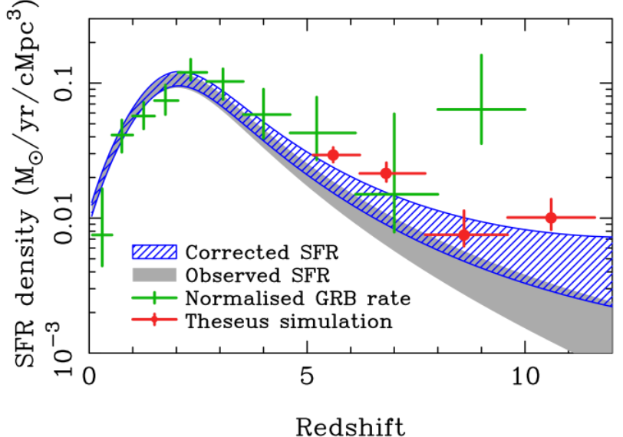
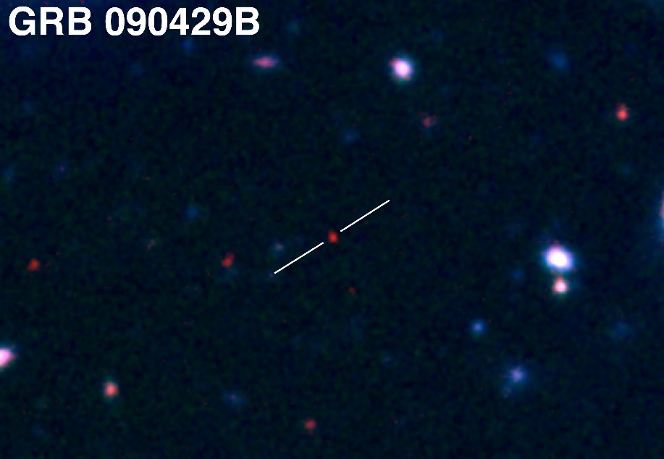
Shedding light on the early Universe with GRBs
A statistical sample of high–z GRBs can provide fundamental information:
measure independently the cosmic star–formation rate, even beyond the limits of current and future galaxy surveys
directly (or indirectly) detect the first population of stars (pop III)
Z = 9.2
Robertson&Ellis12

Slide 10
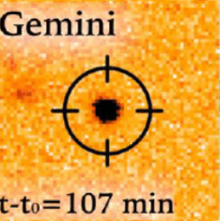
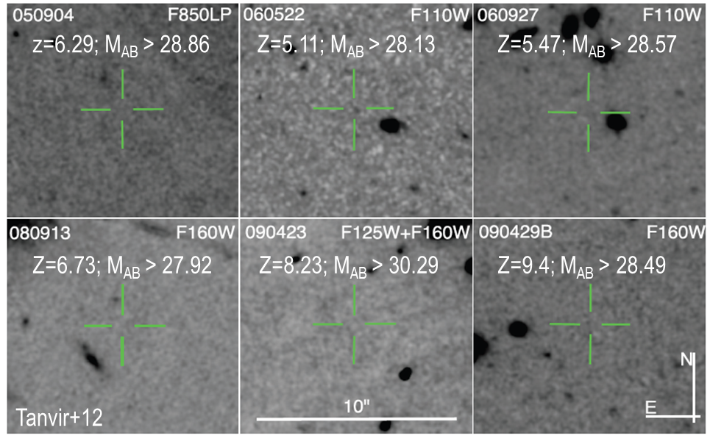
Detecting and studying primordial invisible galaxies
Robertson&Ellis12
Even JWST and ELTs surveys will be not able to probe the faint end of the galaxy Luminosity Function at high redshifts (z>6-8)

Slide 11
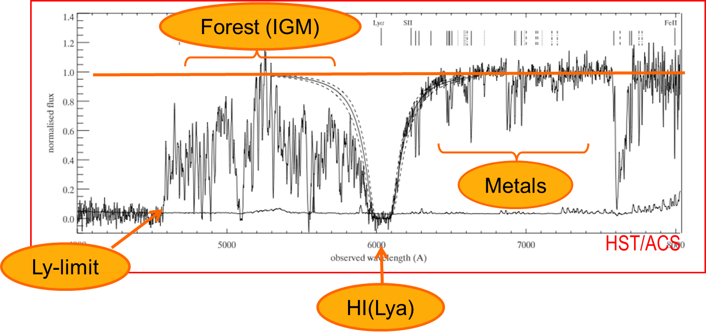
Detecting and studying primordial invisible galaxies
neutral hydrogen fraction
escape fraction of UV photons from high-z galaxies
early metallicity of the ISM and IGM and its evolution
Robertson&Ellis12
Robertson&Ellis12

Slide 12
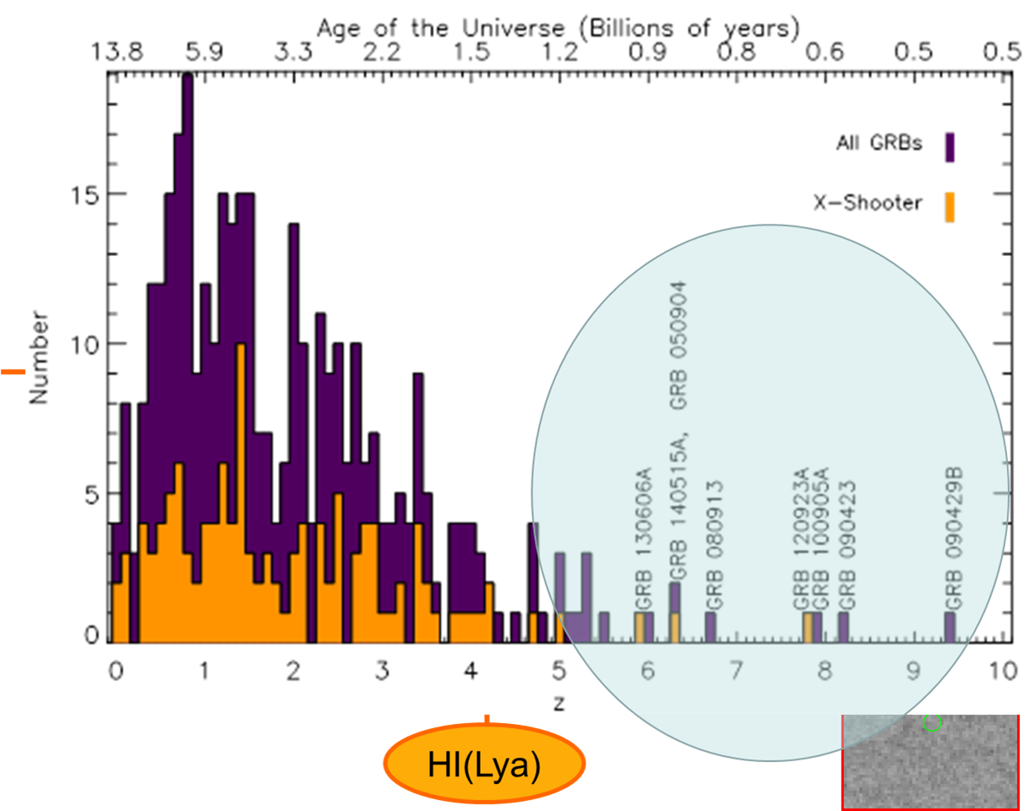
Detecting and studying primordial invisible galaxies

Slide 13
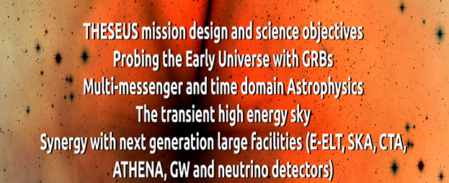
Future GRB missions (late‘20s and ‘30s)
THESEUS (studied for ESA Cosmic Vision / M5), HiZ-GUNDAM (JAXA, under study), TAP (idea for NASA probe-class mission), Gamow Explorer (proposal for NASA MIDEX): prompt emission down to soft X-rays, source location accuracy of few arcmin, prompt follow-up with NIR telescope, on-board REDSHIFT

Slide 14

THESEUS Transient High Energy Sky and Early Universe Surveyor Lead Proposer (ESA/M5): Lorenzo Amati (INAF – OAS Bologna, Italy) Coordinators (ESA/M5): Lorenzo Amati, Paul O’Brien (Univ. Leicester, UK), Diego Gotz (CEA-Paris, France), A. Santangelo (Univ. Tuebingen, D), E. Bozzo (Univ. Genève, CH) Payload consortium: Italy, UK, France, Germany, Switzerland, Spain, Poland, Denmark, Belgium, Czech Republic, Slovenia, Ireland, NL, ESA

Slide 15
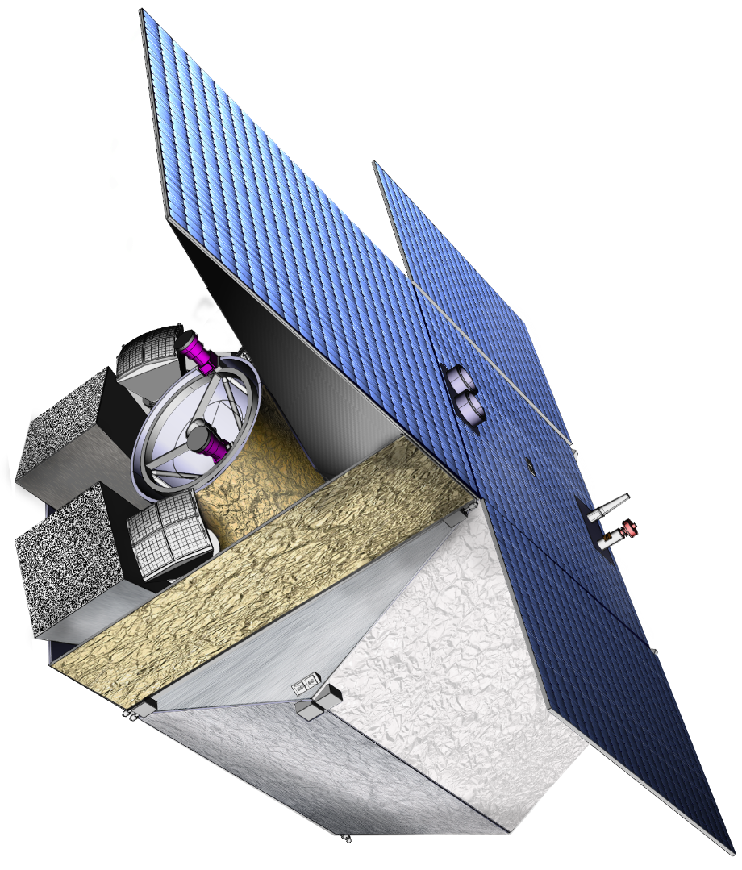
Future GRB missions: the case of THESEUS (led by Italy; ESA/M5 Phase-A study, re-proposed for M7)
THIS BREAKTHROUGH WILL BE ACHIEVED BY A MISSION CONCEPT OVERCOMING MAIN LIMITATIONS OF CURRENT FACILITIES
Set of innovative wide-field monitors with unprecedented combination of broad energy range, sensitivity, FOV and localization accuracy
Notes:
Presenter’s note:

Slide 16
Future GRB missions: the case of THESEUS (led by Italy; ESA/M5 Phase-A study, re-proposed for M7)
THIS BREAKTHROUGH WILL BE ACHIEVED BY A MISSION CONCEPT OVERCOMING MAIN LIMITATIONS OF CURRENT FACILITIES
Set of innovative wide-field monitors with unprecedented combination of broad energy range, sensitivity, FOV and localization accuracy
On-board autonomous fast follow-up in optical/NIR, arcsec location and redshift measurement of detected GRB/transients
Notes:
Presenter’s note:

Slide 17
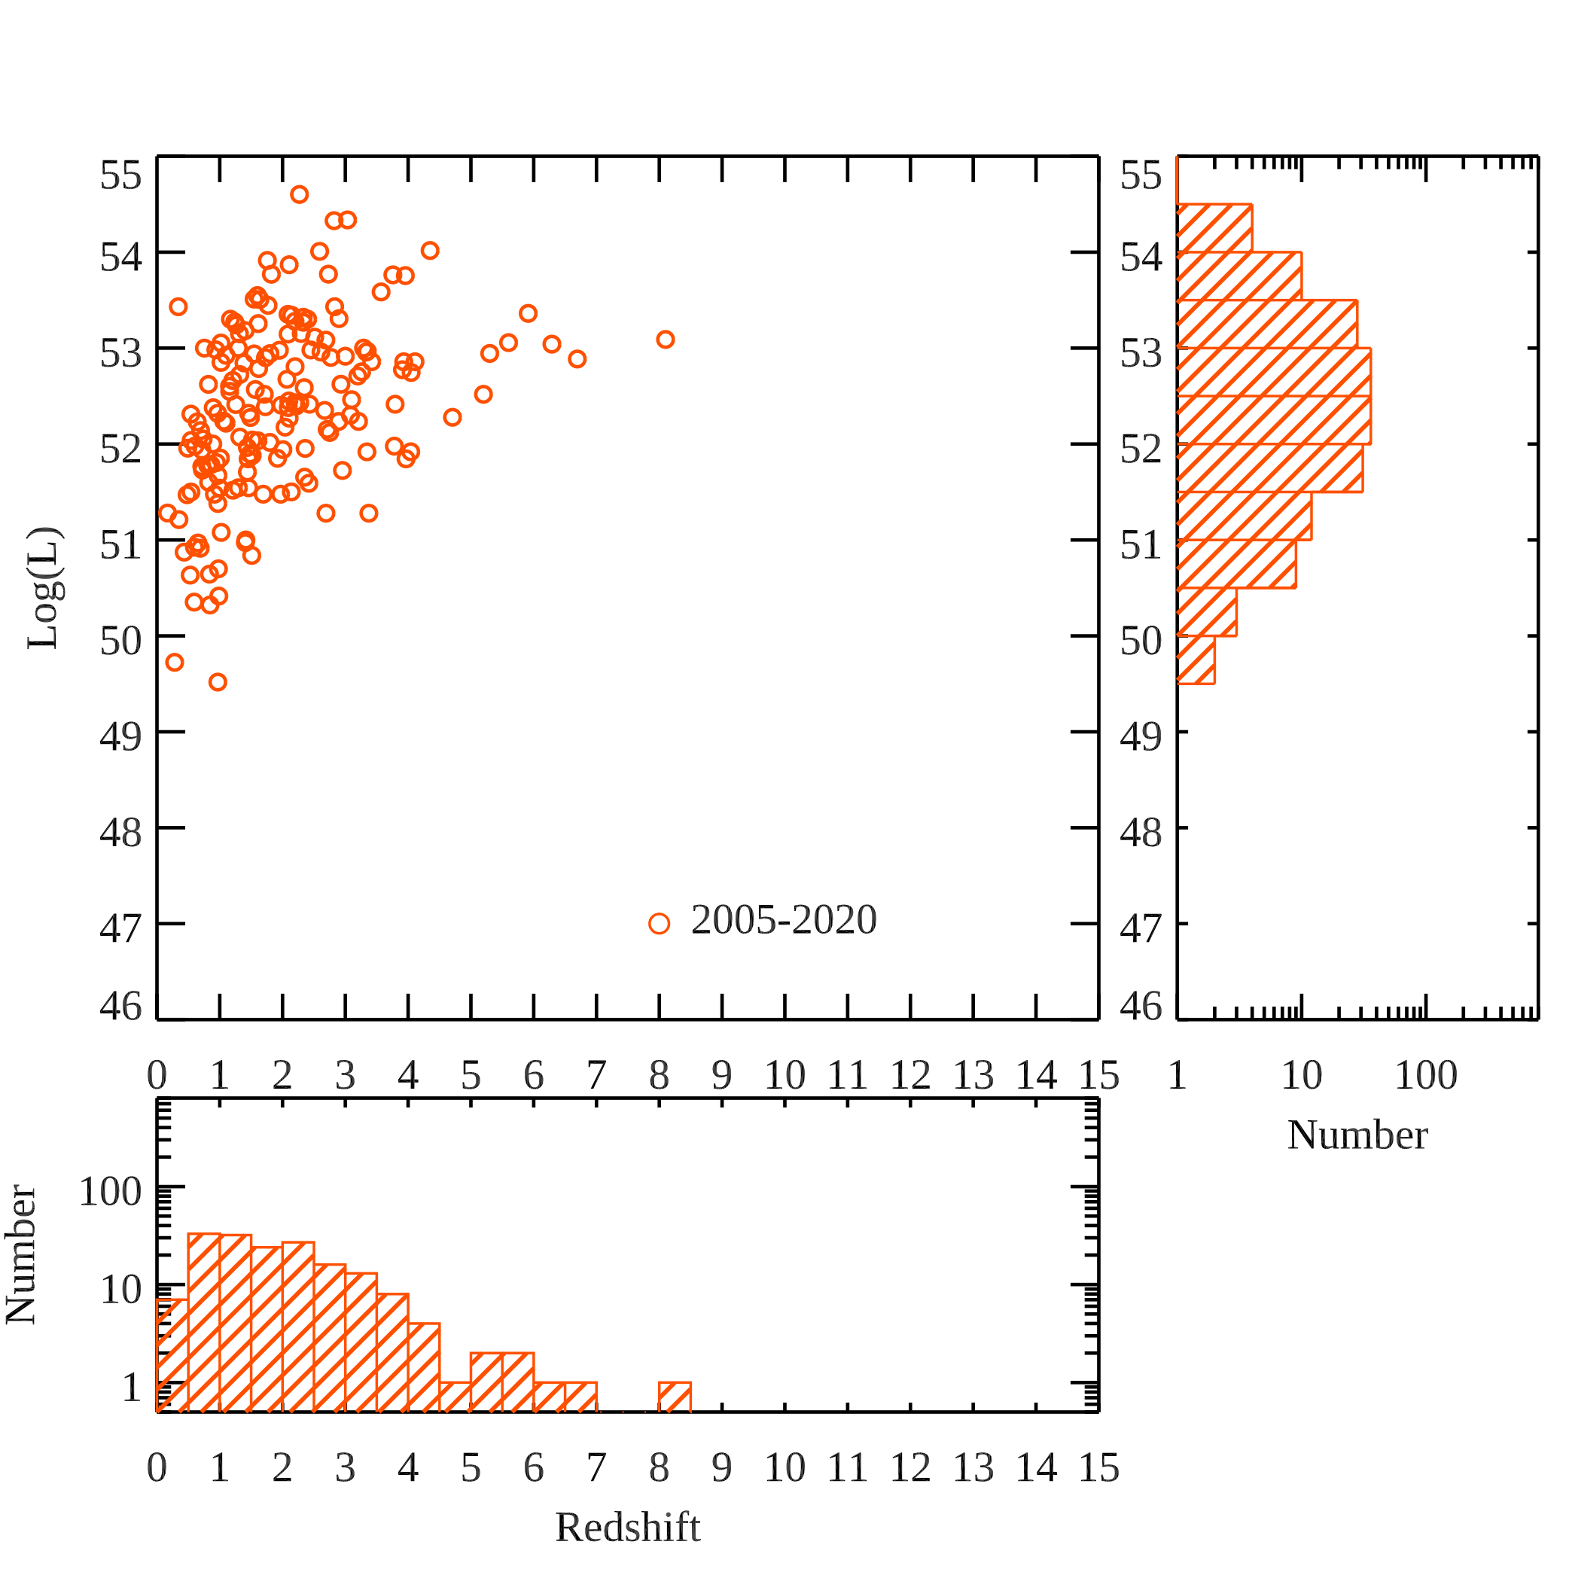
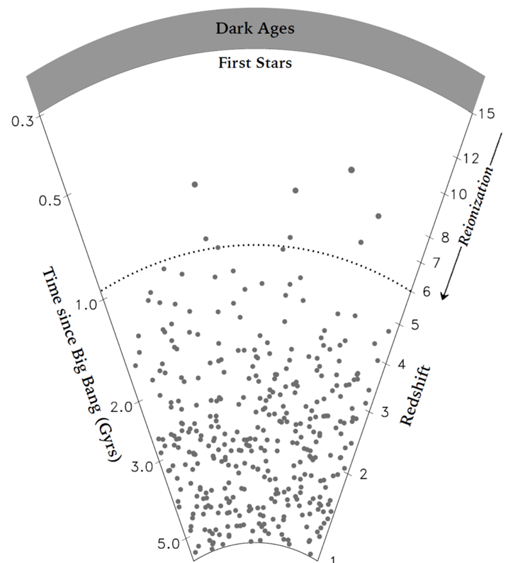
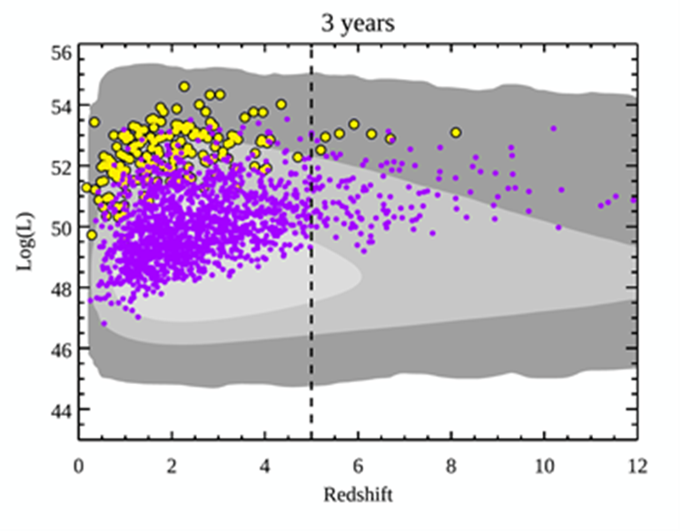
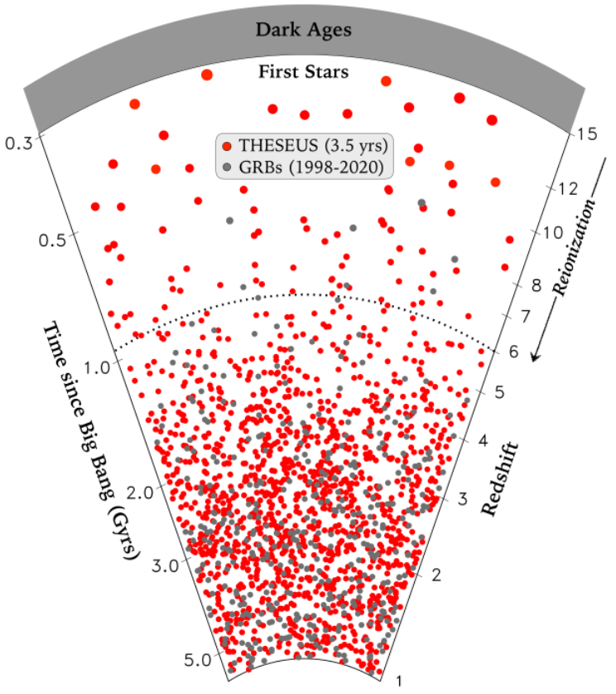
Shedding light on the early Universe with GRBs

Slide 18
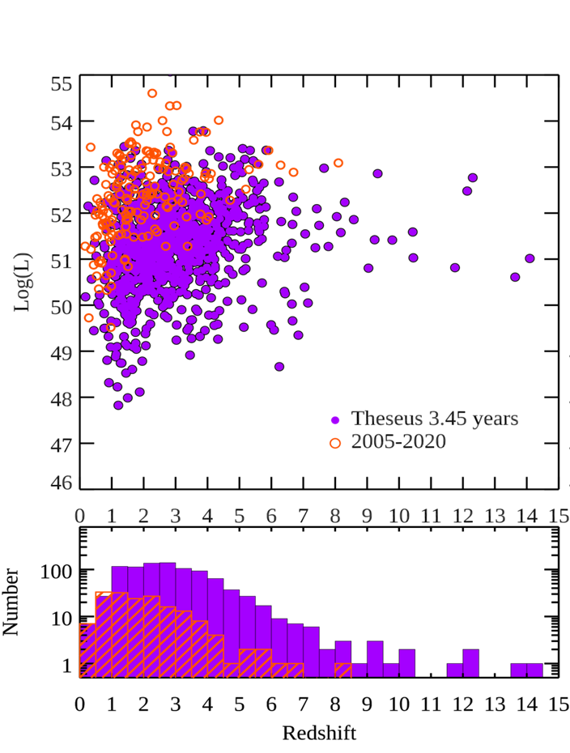
Shedding light on the early Universe with GRBs

Slide 19
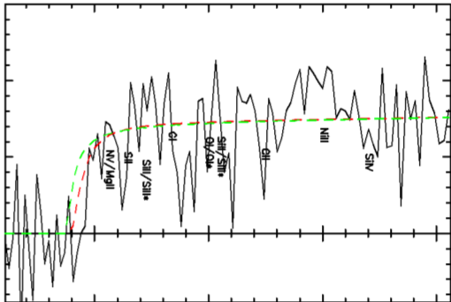
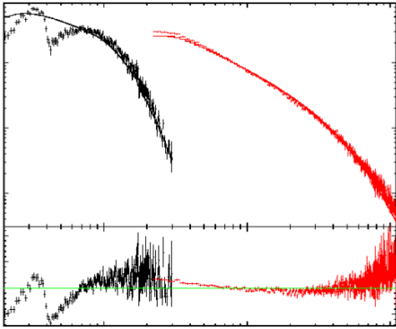
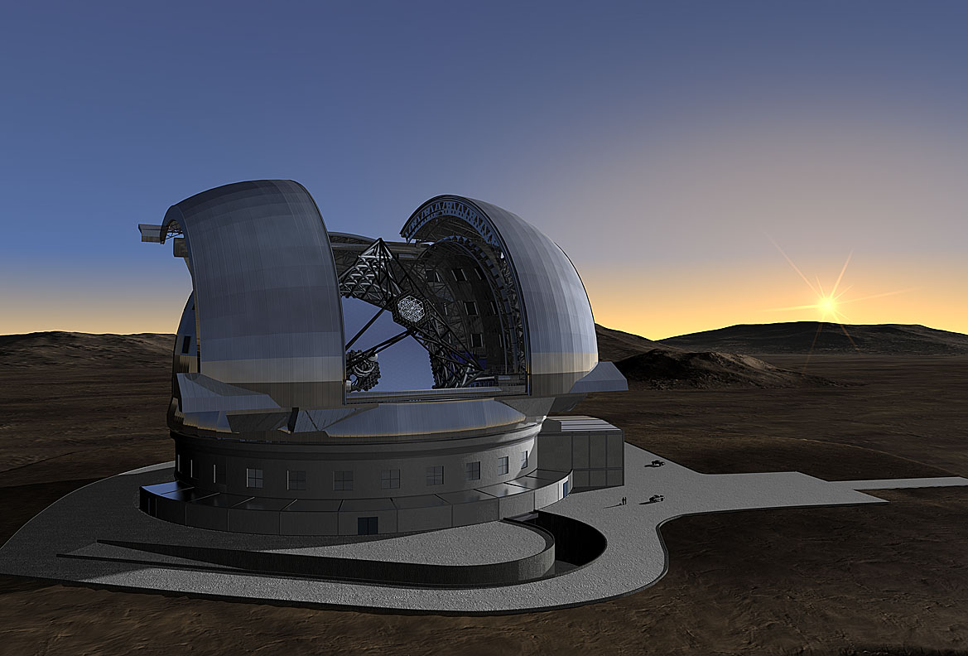
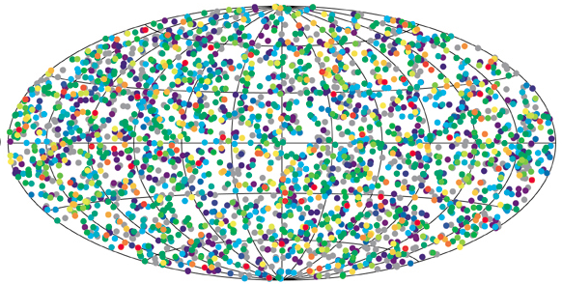
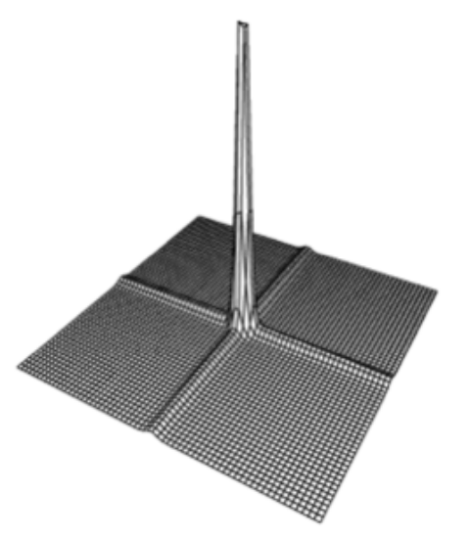

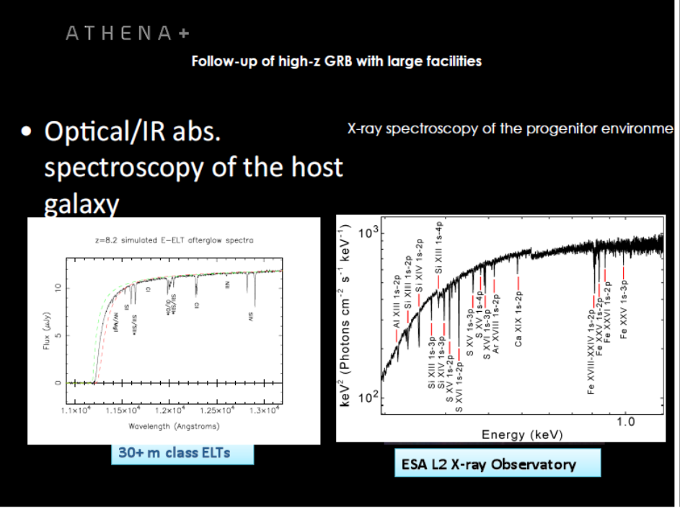
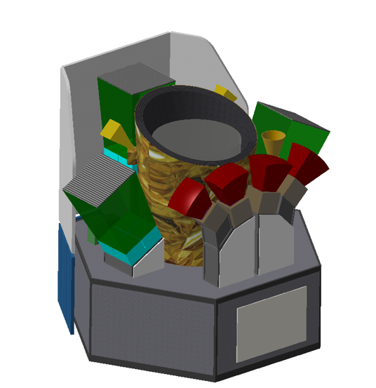
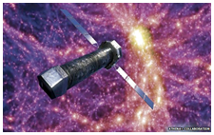
  Star formation history, primordial galaxies
  GRB accurate localization and NIR, X-ray, Gamma-ray characterization, redshift
ELT TMT GMT
Neutral fraction of IGM, ionizing radiation escape fraction
Cosmic chemical evolution, Pop III
ELT TMT GMT
ATHENA
THESEUS SYNERGIES
Notes:
Darach mentions paper on envelope stripping by the general environment in rich OB assocs.

Slide 20
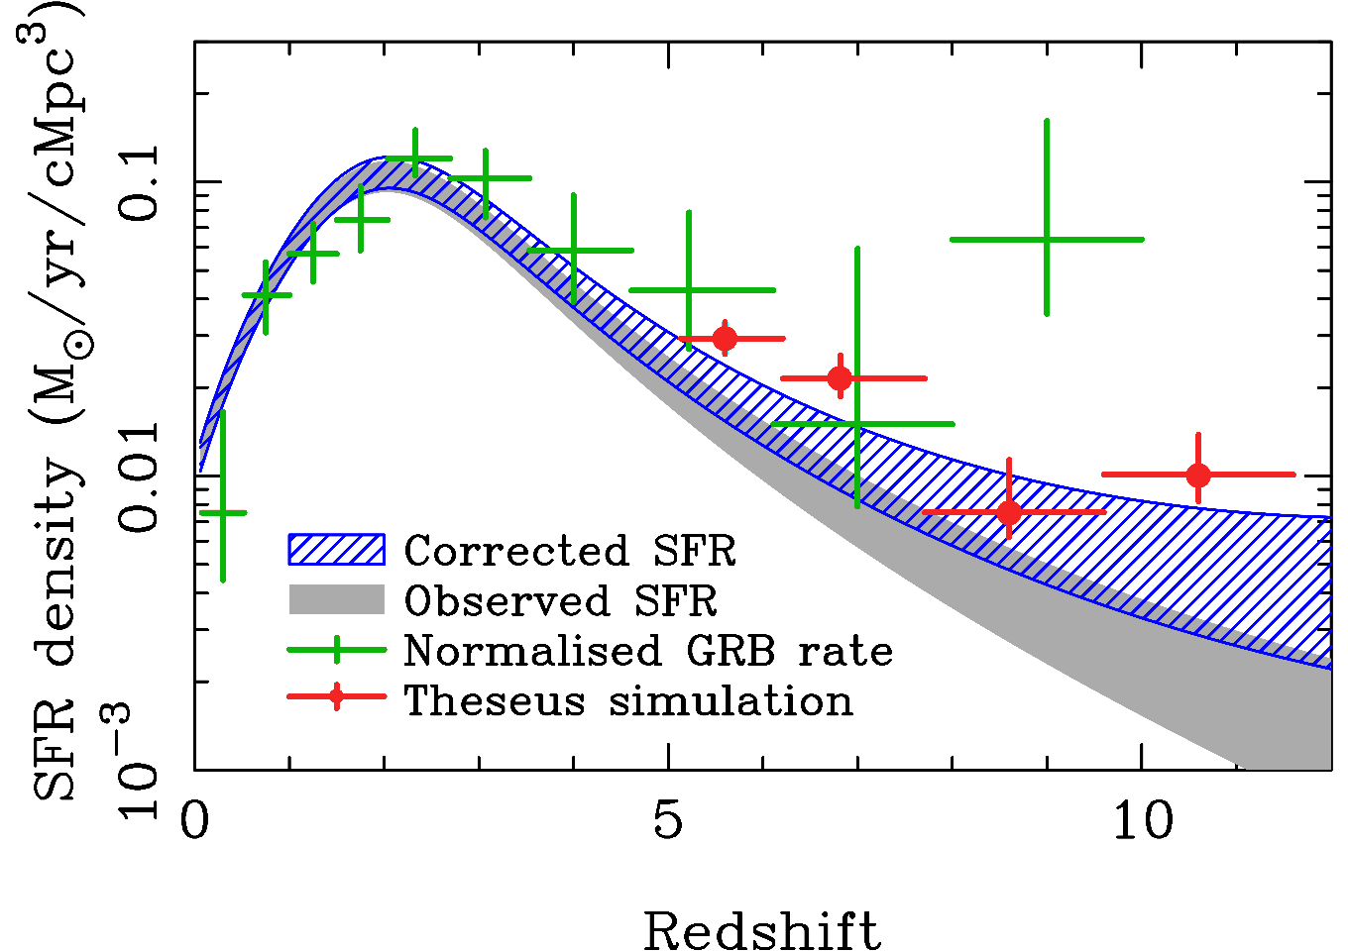
Independent measure of cosmic SFR at high-z (possibly including pop-III stars)
A statistical sample of high–z GRBs will give access to star formation in the faintest galaxies, overcoming limits of current and future galaxy surveys
THESEUS Consortium 2021
Notes:
Presenter’s note:

Slide 21
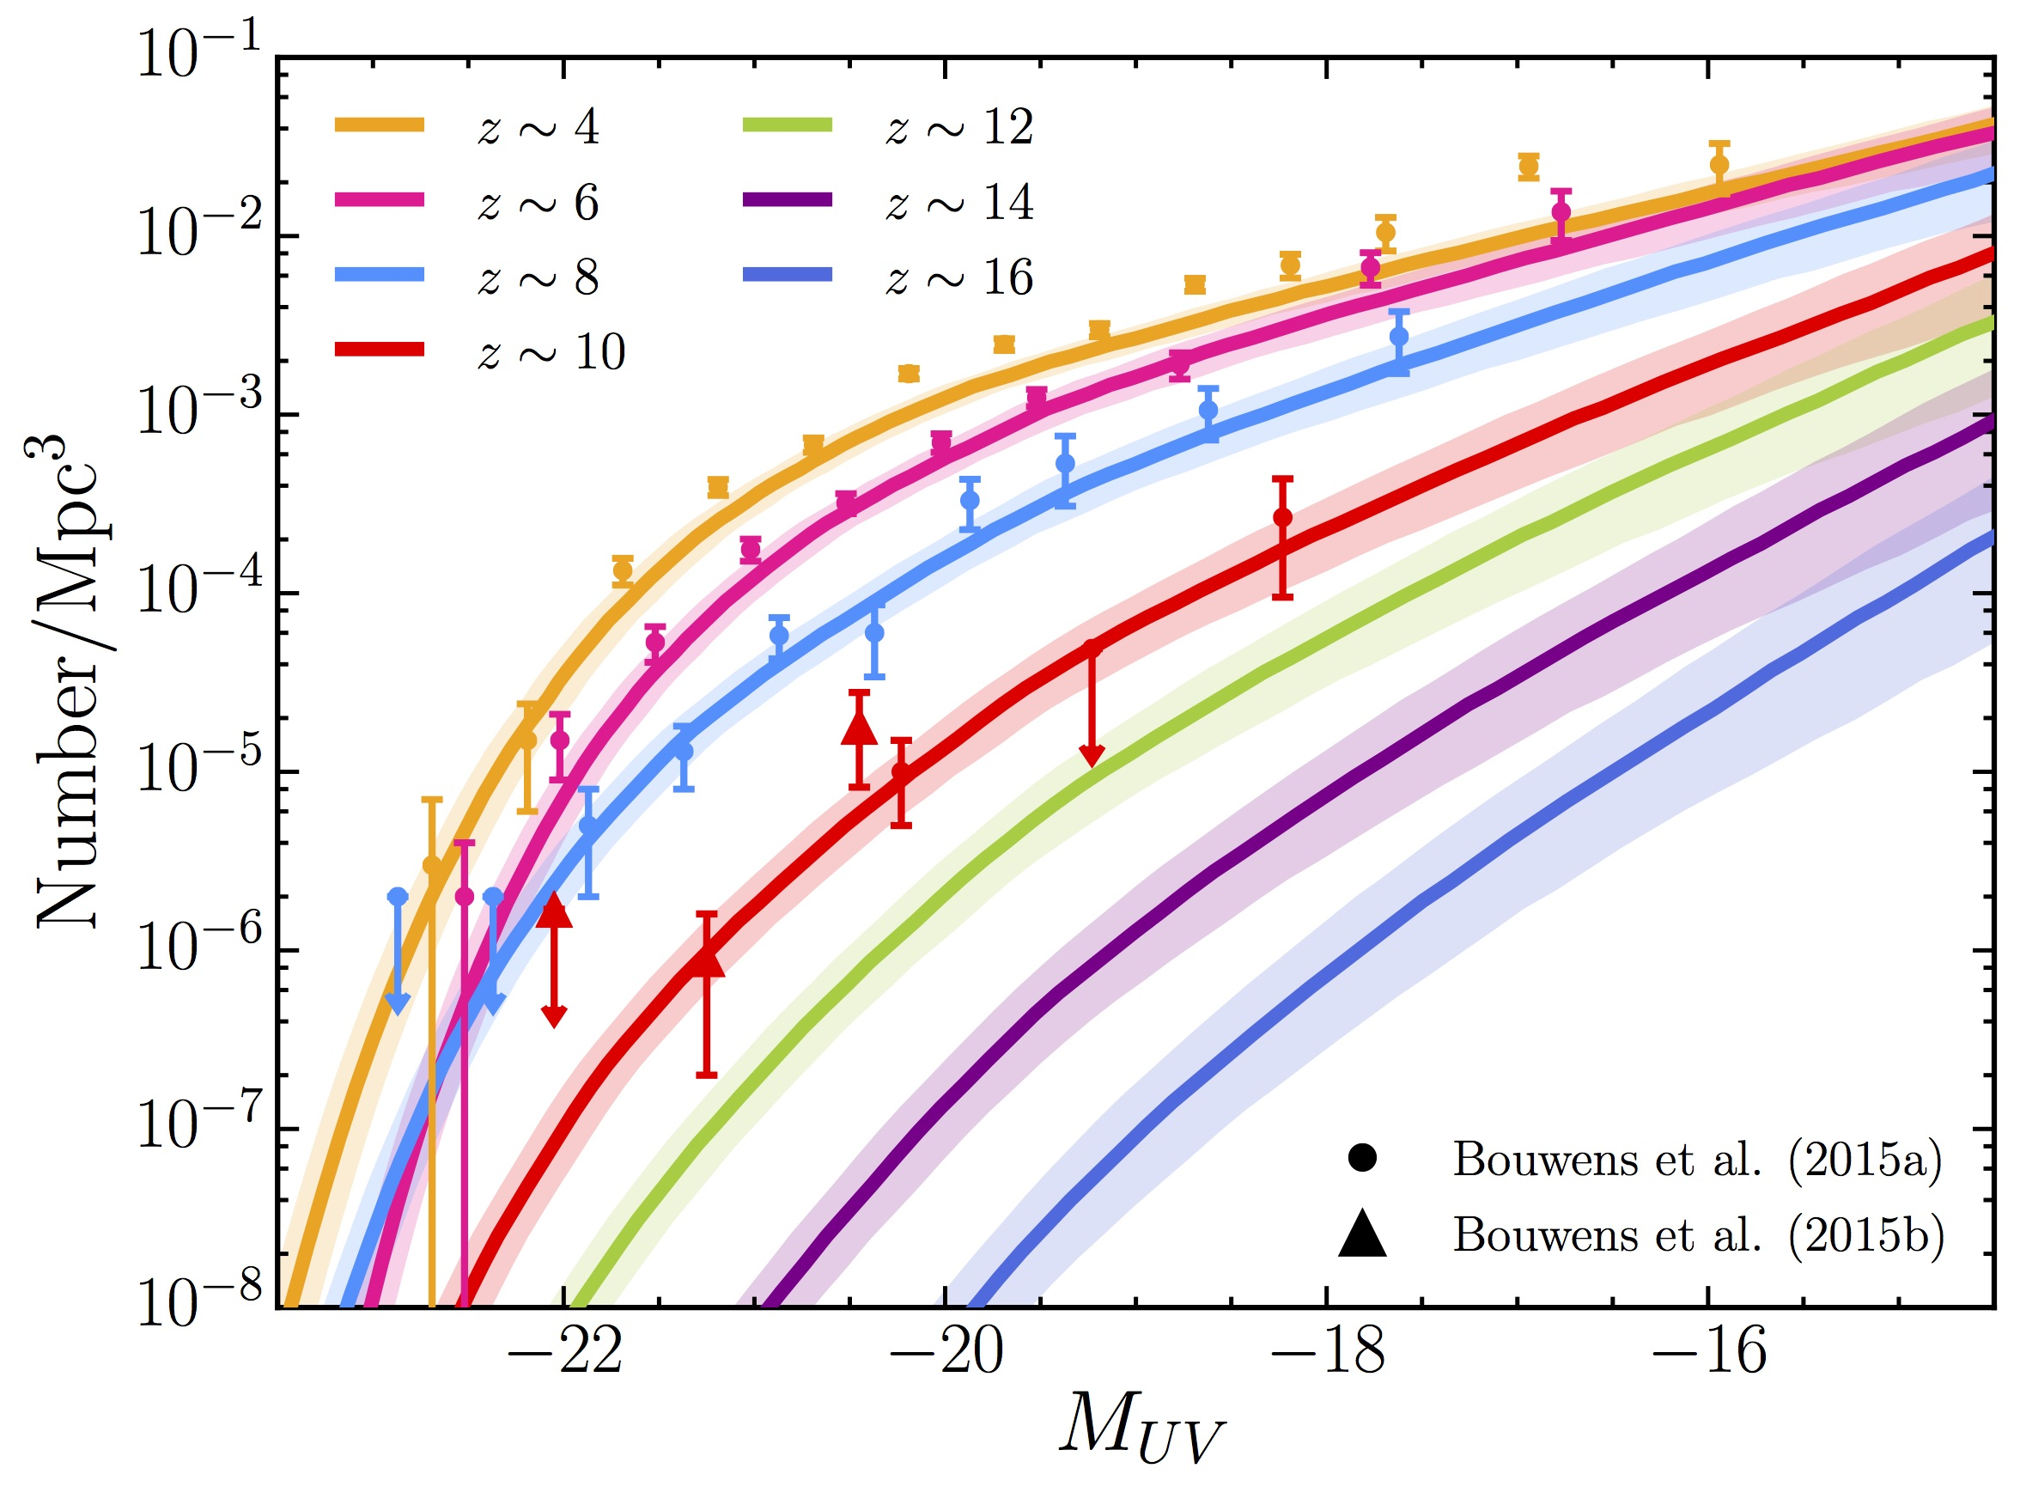
Detecting and studying primordial invisible galaxies
The proportion of GRB hosts below a given detection limit provides an estimate of the fraction of star formation “hidden” in such faint galaxies
m_{UV} ≈ 30
?
Bright
Faint
THESEUS Consortium 2021
Notes:
Presenter’s note:

Slide 22
Shedding light on cosmic reionization
Combination of massive star formation rate and ionizing escape fraction will establish whether stellar radiation was sufficient to reionize the universe, and indicate the galaxy populations responsible
THESEUS Consortium 2021
Notes:
Presenter’s note:

Slide 23
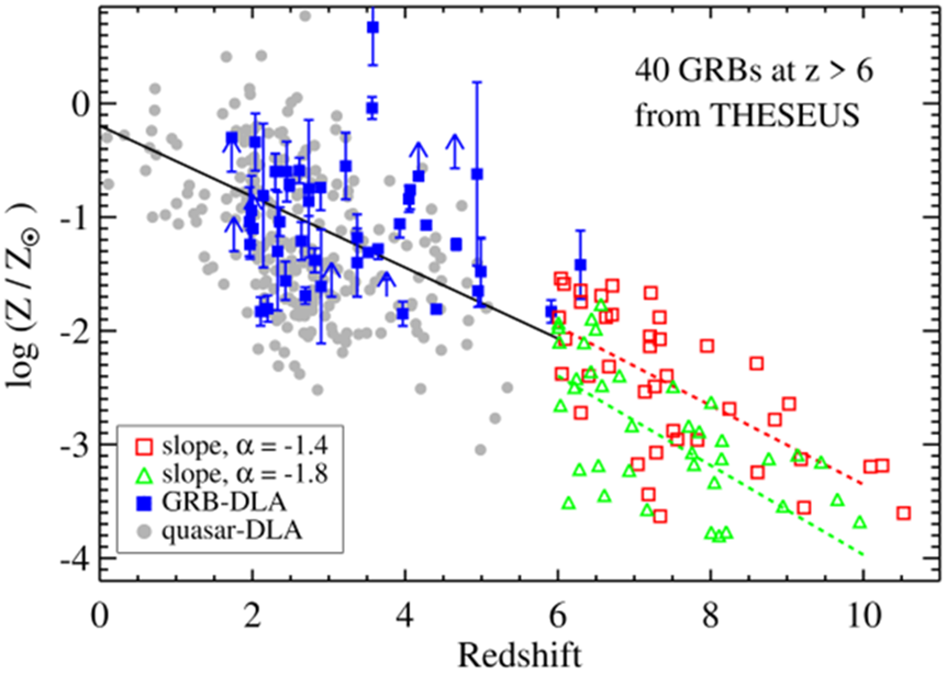
Cosmic chemical evolution at high-z
THESEUS Consortium 2021
Notes:
Presenter’s note:

Slide 24
The power of long GRBs for cosmology
Most luminous and remote phenomena in the Universe, with isotropic-equivalent radiated energies in X-gamma rays up to more than 10⁵⁴ erg released in a few tens of seconds and a redshift distribution extending to at least z = 9-10.
GRBs as tools for exploring the early Universe at the end of the "dark ages" (reionization, first stars, star formation rate and metallicity evolution in the first billion of years)
Using GRBs to investigate the expansion rate and geometry of the Universe, thus getting clues to "dark energy" properties and evolution

Slide 25
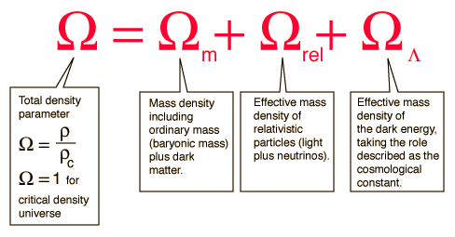
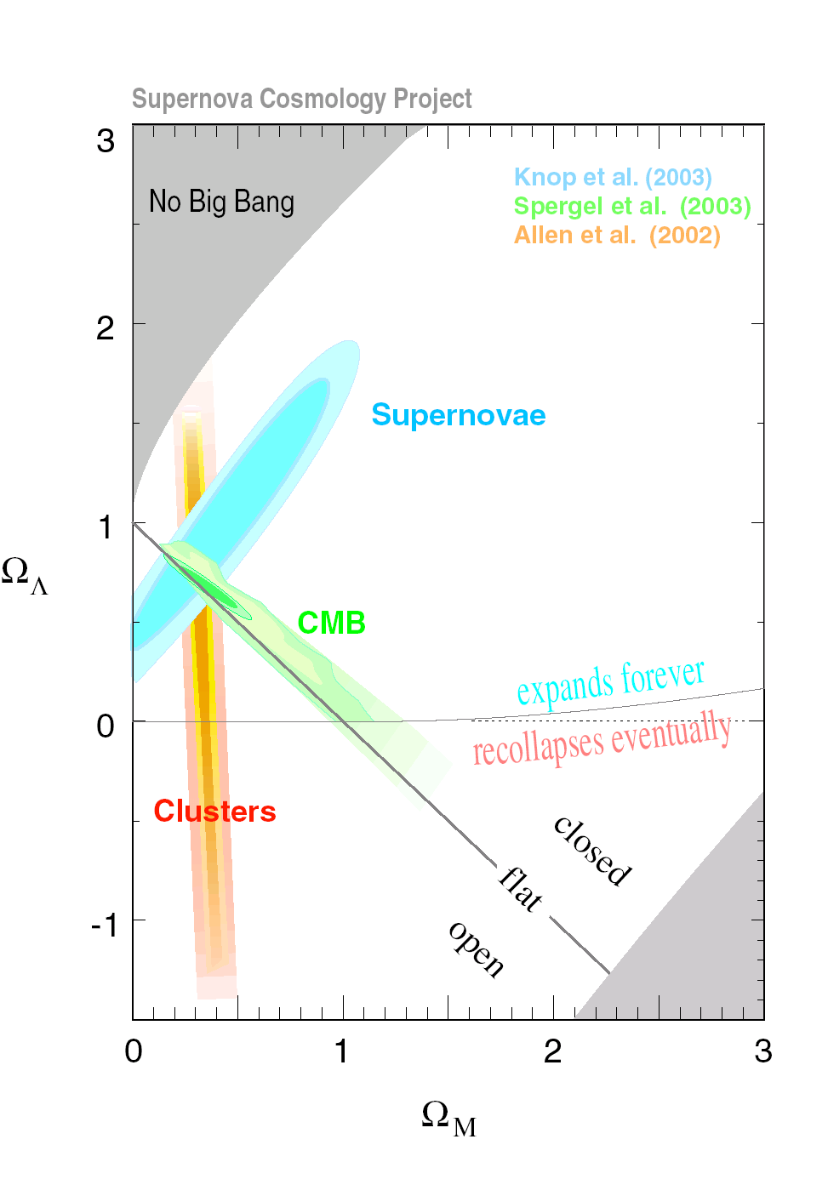
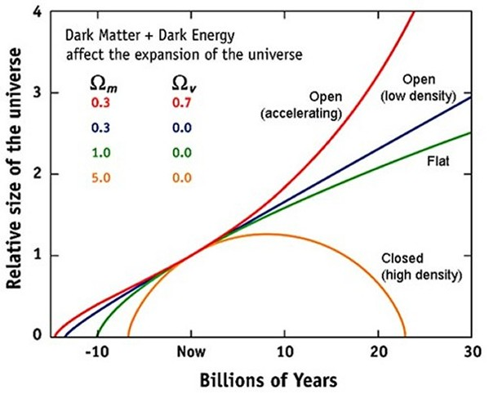
Why looking for more cosmological probes ?
different distribution in redshift and methods-> different sensitivity to different cosmological parameters

Slide 26
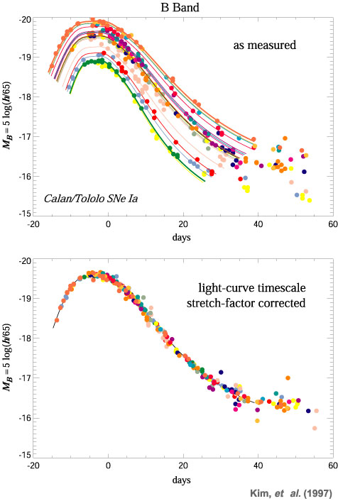
Each cosmological probe is characterized by possible systematics
e.g SN Ia:
different explosion mechanism and progenitor systems ? May depend on z ?
light curve shape correction for the luminosity normalisation may depend on z
signatures of evolution in the colours
correction for dust extinction
anomalous luminosity-color relation
contaminations of the Hubble Diagram by no-standard SNe-Ia and/or bright SNe-Ibc (e.g. HNe)

Slide 27

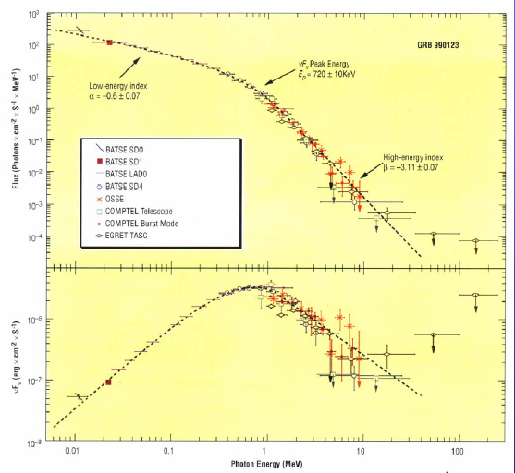
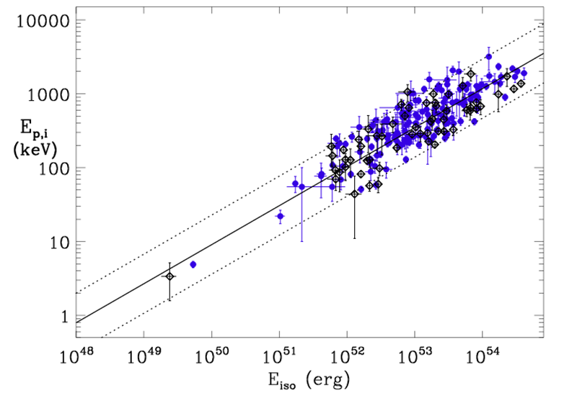
Measuring cosmological parameters with GRBs
GRB νFν spectra typically show a peak at a characteristic photon energy E_{p}
measured spectrum + measured redshift -> intrinsic peak enery and radiated energy
E_{p,i} = E_{p} x (1 + z)
Ep
Amati et al. (2002,2006,2008, 2013)

Slide 28
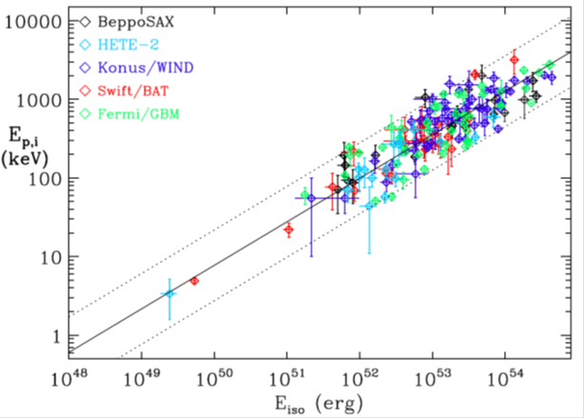
“Standardizing” GRBs through the Ep-Eiso correlation
E_{p,i} = E_{p,obs} x (1 + z)
D_{l} = D_{l} (z , H₀ , Ω_{M} , Ω_{Λ} ,…)
not enough low-z GRBs for cosmology-independent calibration -> circularity is avoided by fitting simultaneously the parameters of the correlation and cosmological parameters
does the extrinsic scatter and goodness of fit of the Ep,i-Eiso correlation vary with the cosmological parameters used to compute Eiso ?

Slide 29
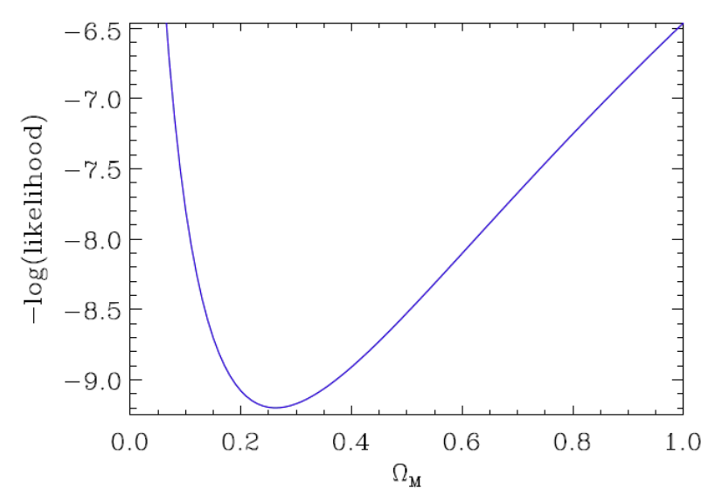
a fraction of the extrinsic scatter of the E_{p,i}-E_{iso} correlation is indeed due to the cosmological parameters used to compute E_{iso}
Evidence, independent on other cosmological probes, that, if we are in a flat Universe , Ω_{M} is lower than 1 and around 0.3
Amati et al. 2008, Amati & Della Valle 2013, Moresco, Amati et al. 2022

Slide 30
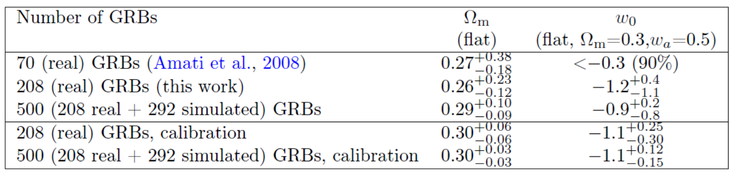
a fraction of the extrinsic scatter of the E_{p,i}-E_{iso} correlation is indeed due to the cosmological parameters used to compute E_{iso}
Evidence, independent on other cosmological probes, that, if we are in a flat Universe , Ω_{M} is lower than 1 and around 0.3
Amati et al. 2008, Amati & Della Valle 2013, Moresco et al. 2022

Slide 31
GRB

Slide 32
Calibration with SNe-Ia
SNe-Ia
The GRB Hubble diagram extends to much higher z w/r to SNe Ia
The GRB Hubble diagram is consistent with SNe Ia Hubble diagram and BAO points at low redshifts: reliability
e.g., Capozziello et al., Kodama et al., Tsutsui et al., Demianski et al.):
GRB

Slide 33
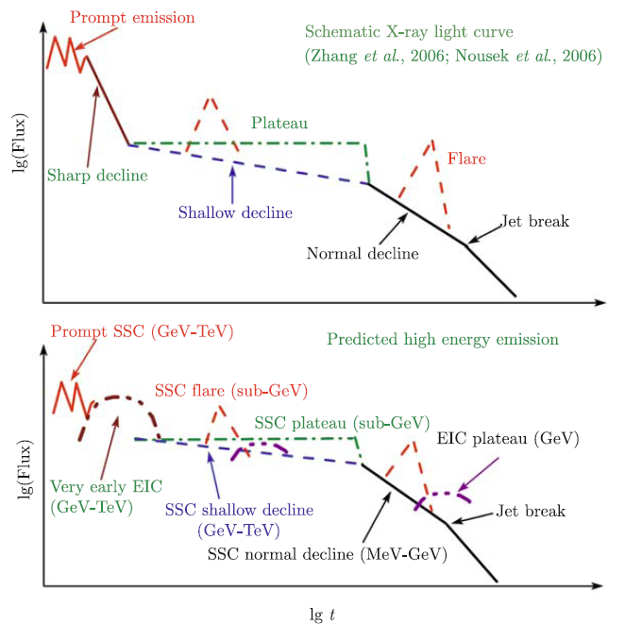
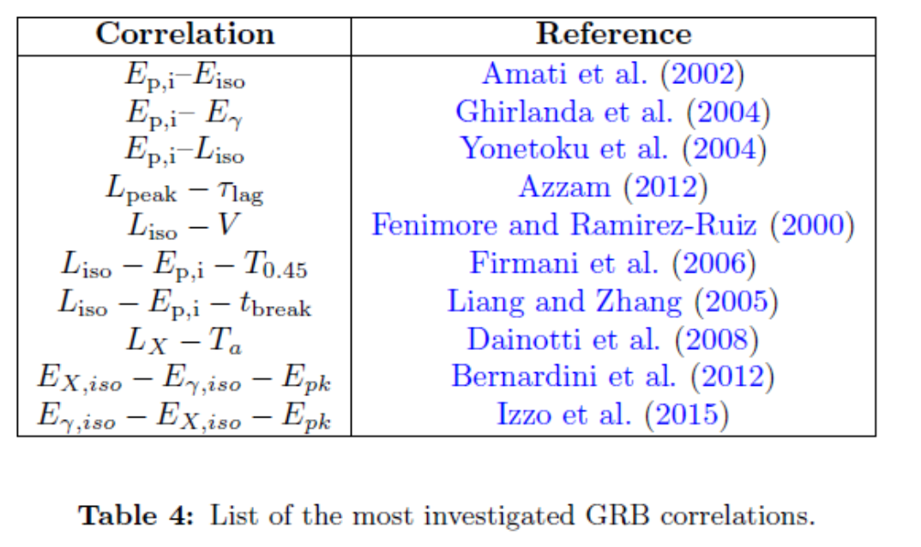
Involving other GRB observables
Extending or replacing the Ep-Intensity correlation by involving other prompt or afterglow properties: e.g., “Combo relation” (Izzo et al., Muccino et al.) , Lx-Ta and Lx-Ta-Lp relations (Dainotti et al.)
Moresco et al. 2022

Slide 34
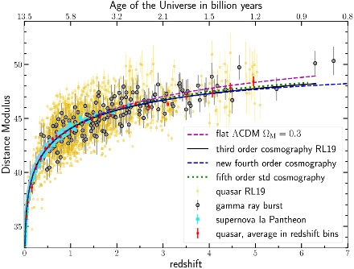
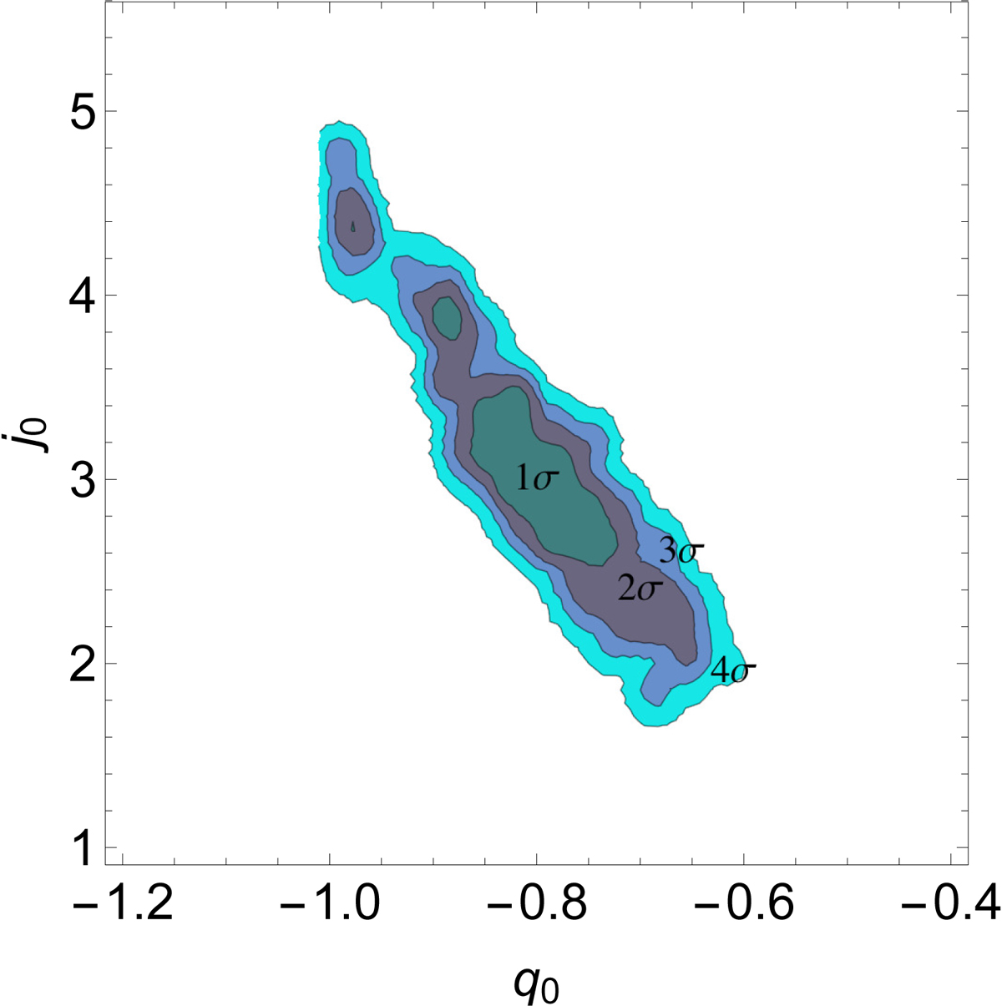
Joining GRBs with other probes: e.g., high-z GNs
Lusso et al. 2019

Slide 35
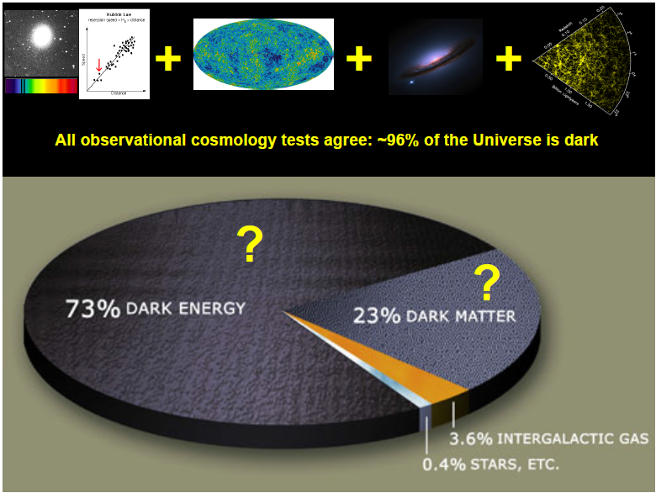
What we are aiming at ?

Slide 36
What we are aiming at ?

Slide 37
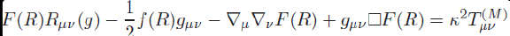
What we are aiming at ?

Slide 38
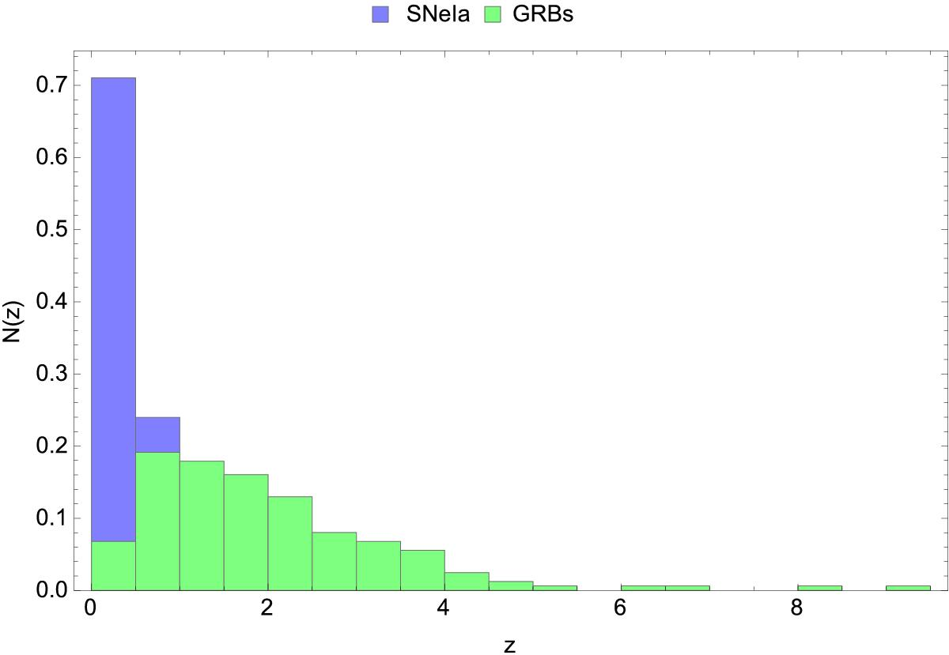
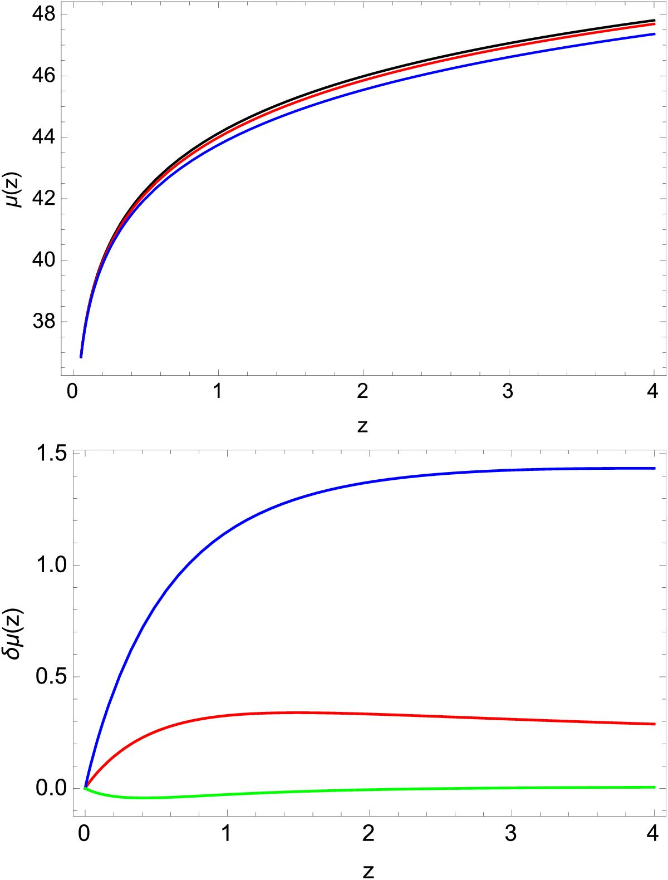
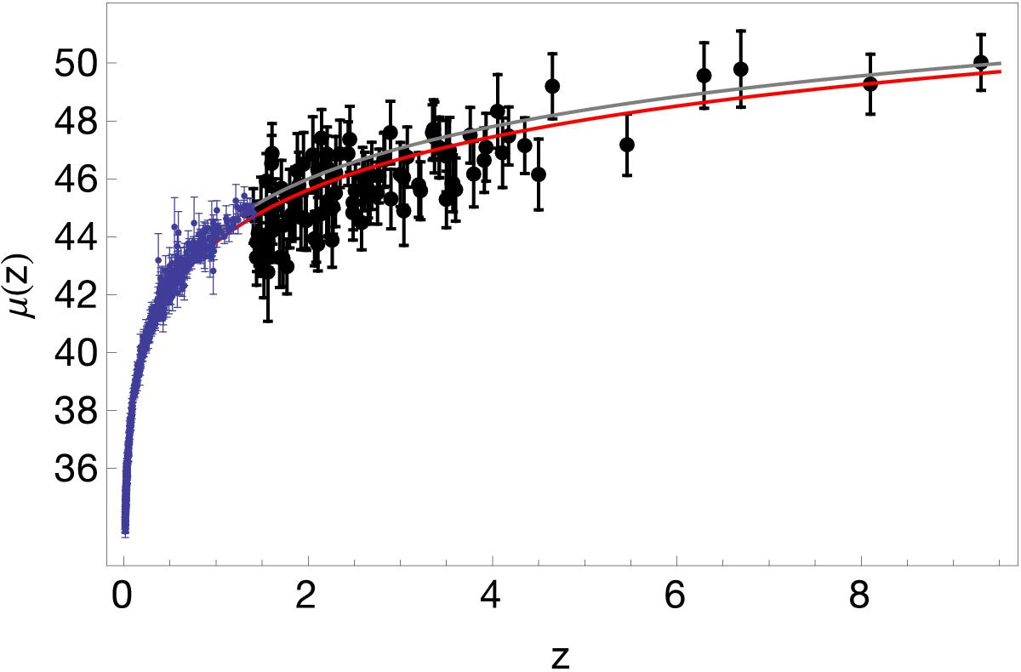
The power of GRBs
Demianski et al. 2017

Slide 39
THESEUS: substantial leap in GRB with redshift

Slide 40
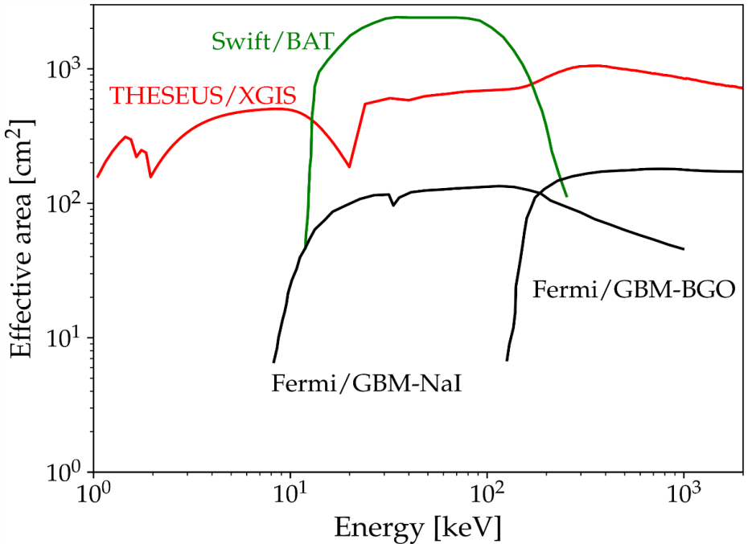
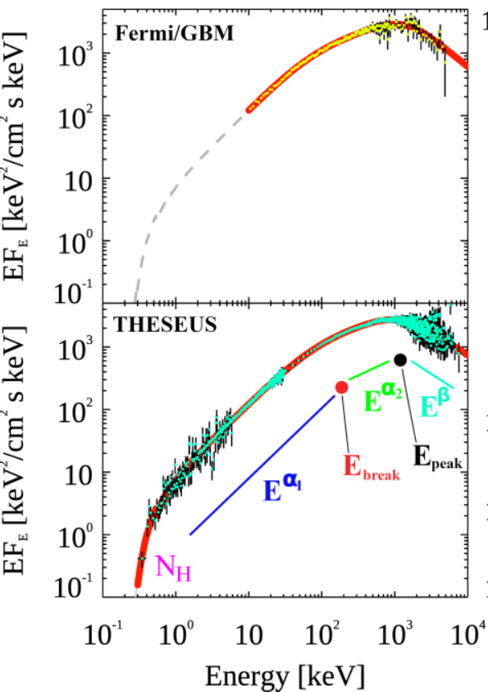
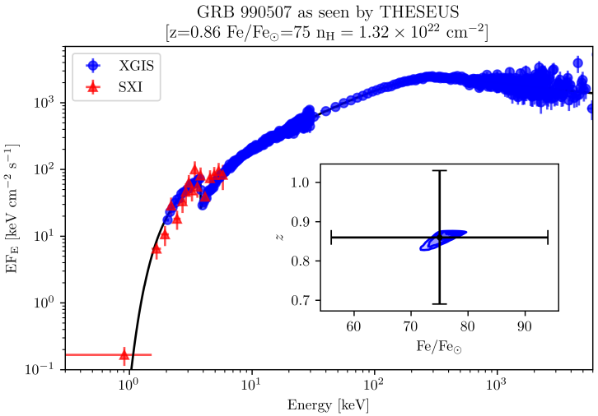
THESEUS: unprecedented spectroscopy of GRB
Notes:
Presenter’s note:
LOFT is being designed to address one of the key science themes of Cosmic Vision: matter under extreme conditions.
Two are the objectives at the core of the LOFT mission:
- First, to probe the state of matter at supra nuclear densities, the ones only reached in the interiors of Neutron Stars.
- Second, to probe the theory of gravity, general relativity, in the very strong environment of Black holes.
LOFT is therefore an observatory designed to probe two key questions of nature, through astrophysics.
But of course LOFT is an observatory and will explore, in addition to its core science, the physics of hundred of
galactic and extragalactic sources.

Slide 41
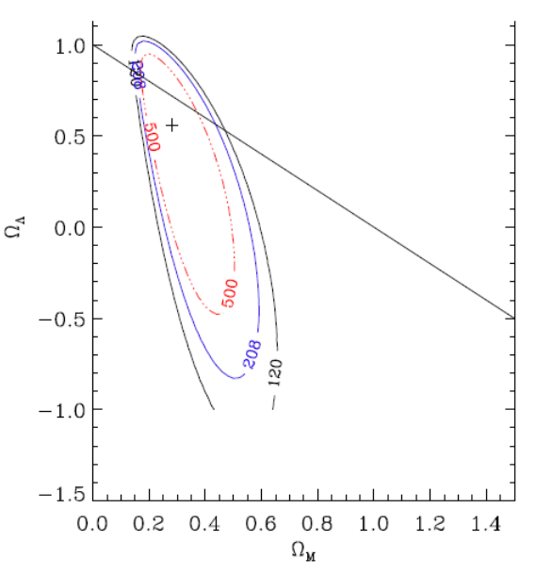

Future GRB experiments (e.g., SVOM, HERMES, THESEUS, …) and more investigations (in particular: reliable estimates of jet angles and self-calibration) will improve the significance and reliability of the results and allow to go beyond SN Ia cosmology (e.g. investigation of dark energy)
Moresco et al. 2022, Amati & Della Valle 2013

Slide 42


Short GRBs and multi-messenger astrophysics
GW170817 + SHORT GRB 170817A + KN AT2017GFO (~40 Mpc): the birth of multi-.messenger astrophysics
Notes:
Presenter’s note:

Slide 43

Short GRBs and multi-messenger astrophysics
GW170817 + SHORT GRB 170817A + KN AT2017GFO (~40 Mpc): the birth of multi-.messenger astrophysics
Notes:
Presenter’s note:

Slide 44

THESEUS:
short GRB detection over large FOV with arcmin localization
Kilonova detection, arcsec localization and characterization
Possible detection of weaker isotropic X-ray emission

Slide 45


Multi-messenger cosmology through GRBs
MEASURING THE EXPANSION RATE AND GEOMETRY OF SPACE-TIME
~20 joint GRB + GW events
Notes:
Presenter’s note:

Slide 46

Fundamental physics with GRBs: testing LI / QG
Using time delay between low and high energy photons to put Limits on Lorentz Invariance Violation (allowed by unprecedent Fermi GBM + LAT broad energy band)
GRB 990510

Slide 47
In summary
GRBs are a key phenomenon for cosmology (ealry Universe, cosmological parameters) and fundamental physics
Next generation GRB missions, like THESEUS, developed by a large European collaboration and already studied by ESA (M5 Phase A) will fully exploit these potentialities and will provide us with unprecedented clues to GRB physics and sub-classes.
THESEUS is a unique occasion for fully exploiting the European leadership in time-domain and multi-messenger astrophysics and in related key-enabling technologies
THESEUS observations will impact on several fields of astrophysics, cosmology and fundamental physics and will enhance importantly the scientific return of next generation multi messenger (aLIGO/aVirgo, LISA, ET, or Km3NET;) and e.m. facilities (e.g., LSST, E-ELT, SKA, CTA, ATHENA)
THESEUS Phase A study by ESA very successful and base for further dev.
SPIE articles on instruments and Exp.Astr. Articles on science on arXiv
http://www.isdc.unige.ch/theseus/

