Slide 1
Plausible detection of rotating magnetized neutron stars
by their continuous gravitational waves
arXiv: 2302.03706
Mayusree Das
With Banibrata Mukhopadhyay
Department of Physics
Indian Institute of Science, Bangalore
The Fifth Zeldovich Meeting, 12-16th June 2023
Notes:
I am Mayusree Das from IISc Bangalore, I am going to present the project I have done for Astro tech course, which is extracting non linear properties of compact objects.I will use publicly available XNS code to study non linear properties of neutron stars

Slide 2
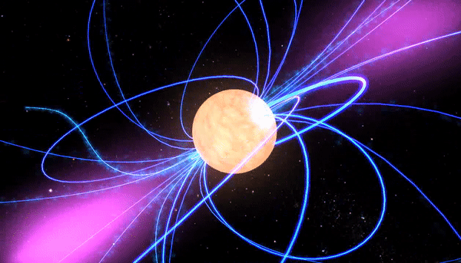
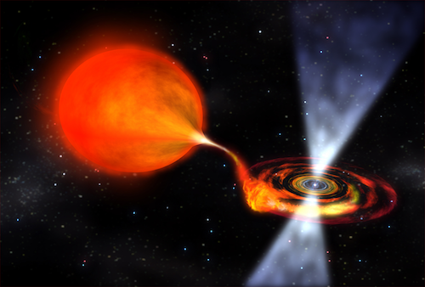
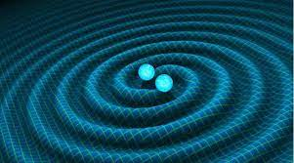
Detection of Neutron stars (NSs):
Electromagnetic radiation: Pulsar (magnetized rotating NSs) emits beams of electromagnetic radiation out of its magnetic poles. The magnetic poles do not coincide with the rotational axis, so the emission beams are detected as pulse (Lighthouse effect).
Accretion-powered NSs: locate in binary systems and manifest themselves as X-ray sources.
Gravitational wave (GW) from Binary merger: NSs in binary system are strong sources of gravitational waves (due to nonzero time varying quadrupole moment)

Slide 3
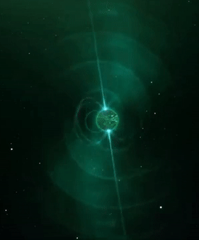
Detection of Neutron stars (NSs):
Electromagnetic radiation: Pulsar (magnetized rotating NSs) emits beams of electromagnetic radiation out of its magnetic poles. The magnetic poles do not coincide with the rotational axis, so the emission beams are detected as pulse (Lighthouse effect).
Accretion-powered NSs: locate in binary systems and manifest themselves as X-ray sources.
Gravitational wave (GW) from Binary merger: NSs in binary system are strong sources of gravitational waves (due to nonzero time varying quadrupole moment)
How to Detect ‘Isolated’ or ‘Invisible’ NSs and WDs?
Isolated NSs (not in binary system or with negligible electromagnetic radiation) tiny size and no source of thermal energy lowly luminous (or pulse not directing towards earth) thus Invisible.
But isolated NSs and WDs can produce continuous GW!
GW is emitted continuously, as long as star is magnetized and spinning (like a singer holding a single note for a long time).
Direct detection of invisible stars! provide idea about their mass, magnetic field, spin and equation of state.

Slide 4
Introduction
NSs are generally born with mass $1.4−1.6M_{ʘ}$. GW from merger GW190814 (${M=2.50−2.67M}_{ʘ}$; Abbott et al. 2020) suggests the possible existence of NSs with ${M>2M}_{ʘ}$, similar to pulsar timing study of PSR J0740 + 6620 (Cromartie et al. 2020).
NSs are generally born with mass 1.4−1.6M_ʘ. GW from merger GW190814 (〖𝑀=2.50−2.67𝑀〗_ʘ; Abbott et al. 2020) suggests the possible existence of NSs with 〖𝑀>2𝑀〗_ʘ, similar to pulsar timing study of PSR J0740 + 6620 (Cromartie et al. 2020).
Notes:
As I will study rotating highly magnetized neutron stars it is convenient to explain how they generated
If a highly magnetized star of million gauss collapses due flux freeze it can create highly magnetized neutron star.
Also dynamo and differencial rotation can enhance the field which can reach even around 10 17 18 gauss.

Slide 5
Introduction
NSs are generally born with mass $1.4−1.6M_{ʘ}$. GW from merger GW190814 (${M=2.50−2.67M}_{ʘ}$; Abbott et al. 2020) suggests the possible existence of NSs with ${M>2M}_{ʘ}$, similar to pulsar timing study of PSR J0740 + 6620 (Cromartie et al. 2020).
NSs are generally born with mass 1.4−1.6M_ʘ. GW from merger GW190814 (〖𝑀=2.50−2.67𝑀〗_ʘ; Abbott et al. 2020) suggests the possible existence of NSs with 〖𝑀>2𝑀〗_ʘ, similar to pulsar timing study of PSR J0740 + 6620 (Cromartie et al. 2020).
One of the most exciting possibilities to explain such high mass is by high magnetic field along with rotation (Pili et. al. 2014, Das et. al. 2013).
This in turn would lead them to emit continuous GW (CGW).
Origin of strong magnetic field: Collapse of highly magnetised star $\text{→} \text{F}$lux freezing →Dynamo (α-Ω)$\text{→}$amplify up to ~${10}^{17−18}$G for NS (Thompson & Duncan 1993)
Origin of strong magnetic field: Collapse of highly magnetised star "→ F"lux freezing →Dynamo (α-Ω)"→ "amplify up to ~10^(17−18)G for NS (Thompson & Duncan 1993)
Notes:
As I will study rotating highly magnetized neutron stars it is convenient to explain how they generated
If a highly magnetized star of million gauss collapses due flux freeze it can create highly magnetized neutron star.
Also dynamo and differencial rotation can enhance the field which can reach even around 10 17 18 gauss.

Slide 6
Introduction
NSs are generally born with mass $1.4−1.6M_{ʘ}$. GW from merger GW190814 (${M=2.50−2.67M}_{ʘ}$; Abbott et al. 2020) suggests the possible existence of NSs with ${M>2M}_{ʘ}$, similar to pulsar timing study of PSR J0740 + 6620 (Cromartie et al. 2020).
NSs are generally born with mass 1.4−1.6M_ʘ. GW from merger GW190814 (〖𝑀=2.50−2.67𝑀〗_ʘ; Abbott et al. 2020) suggests the possible existence of NSs with 〖𝑀>2𝑀〗_ʘ, similar to pulsar timing study of PSR J0740 + 6620 (Cromartie et al. 2020).
One of the most exciting possibilities to explain such high mass is by high magnetic field along with rotation (Pili et. al. 2014, Das et. al. 2013).
We simulate CGW from isolated magnetized rotating NSs and WDs and try to understand observation plausibility.
This in turn would lead them to emit continuous GW (CGW).
Origin of strong magnetic field: Collapse of highly magnetised star $\text{→} \text{F}$lux freezing →Dynamo (α-Ω)$\text{→}$amplify up to ~${10}^{17−18}$G for NS (Thompson & Duncan 1993)
Origin of strong magnetic field: Collapse of highly magnetised star "→ F"lux freezing →Dynamo (α-Ω)"→ "amplify up to ~10^(17−18)G for NS (Thompson & Duncan 1993)
Notes:
As I will study rotating highly magnetized neutron stars it is convenient to explain how they generated
If a highly magnetized star of million gauss collapses due flux freeze it can create highly magnetized neutron star.
Also dynamo and differencial rotation can enhance the field which can reach even around 10 17 18 gauss.

Slide 7
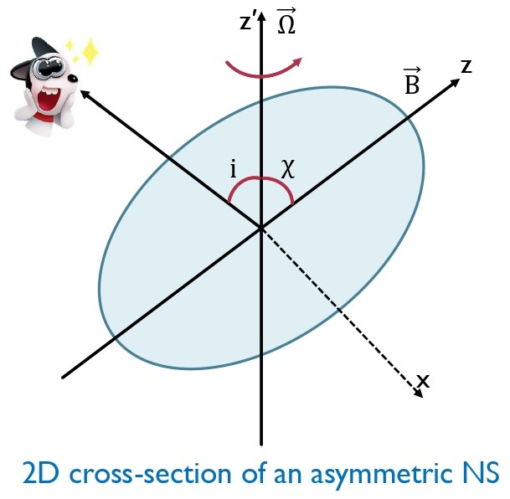
GRAVITATIONAL WAVES FROM PULSATING COMPACT STARS
Magnetic field
Deformation
Rotation
Deformation
&
Misalignment
Triaxial
symmetry
Time varying, non zero quadrupole moment
Continuous GW
d
$$h_{+}=h_{0}\sin{χ}\left[\frac{1}{2}\cos{i}\sin{i}\cos{χ\cos{Ωt}}−\frac{1+\cos^{2}{i}}{2}\sin{χ}\cos{2Ωt}\right]$$
$$h_{×}=h_{0}\sin{χ}\left[\frac{1}{2}\sin{i}\cos{χ\sin{Ωt}}−\cos{i}\sin{χ}\sin{2Ωt}\right]$$
χ → 0 $h_{0}=\frac{4G}{c^{4}}Ω^{2}ε\frac{I_{xx}}{d}$, $ε=\frac{I_{zz}−I_{xx}}{I_{xx}}$
Bonazzola & Gourgoulhon 1996
Notes:
As I will study rotating highly magnetized neutron stars it is convenient to explain how they generated
If a highly magnetized star of million gauss collapses due flux freeze it can create highly magnetized neutron star.
Also dynamo and differencial rotation can enhance the field which can reach even around 10 17 18 gauss.

Slide 8
Modelling NS
Using XNS
Pili et al. 2014
Einstein’s equation solver in GRMHD

Slide 9
XNS (A code to study magnetized NSs)
Einstein’s equation (describes space-time metric)
$$G_{μν}=8πT_{μν}$$
$$ⅆs^{2}=−α^{2}ⅆt^{2}+ψ^{4}\left[ⅆr^{2}+r^{2}ⅆθ^{2}+r^{2}\sin^{2}{θ{\left(ⅆ∅+β^{∅}ⅆt\right)}^{2}}\right]$$
Einstein’s equation (describes space-time metric)
𝐺_𝜇𝜈=8𝜋𝑇_𝜇𝜈
ⅆ𝑠^2=−𝛼^2 ⅆ𝑡^2+𝜓^4 [ⅆ𝑟^2+𝑟^2 ⅆ𝜃^2+𝑟^2 〖𝑠𝑖𝑛〗^2⁡〖𝜃(ⅆ∅+𝛽^∅ ⅆ𝑡)^2 〗 ]
Magneto-Hydrostatic Equilibrium
(provides distribution of matter/energy)
$T^{μν}=\left(ⅇ+p+b^{2}\right)u^{μ}u^{ν}−b^{μ}b^{ν}+\left(p+\frac{b^{2}}{2}\right)g^{μν}$
Momentum-energy conservation: $∇_{μ}T^{μν}=0$
Magneto-Hydrostatic Equilibrium
(provides distribution of matter/energy)
𝑇^𝜇𝜈=(ⅇ+𝑝+𝑏^2 ) 𝑢^𝜇 𝑢^𝜈−𝑏^𝜇 𝑏^𝜈+(𝑝+𝑏^2/2) 𝑔^𝜇𝜈
Momentum-energy conservation: 𝛻_𝜇 𝑇^𝜇𝜈=0
Axisymmetric equilibrium configuration (Uniformly/differentially rotating & Poloidal/Toroidal/mixed field)
of NSs in GRMHD
TOV eq
Notes:
Now Let me briefly explain what xns code does.It simultaneously solves Einstein’s equation and Magneto-Hydrostatic Equilibrium to achieve axisymmetric equilibrium configuration of Neutron stars. Using this GRMHD framework we can model differentially rotating magnetized ns with toroidal or poloidal or mixed magnetic field. The einsteins eq are solved using conformally flat condition in spherical coordinate using 3+1 formalism.
We will visualise the properties of NS at a particular time thus we need to sort out special and temporal coordinate, so we use 3+1 formalism where spacetime is foliated in hypersurfaces as a function of time. Using CFC we can have this line element. Now einsteins equation can be written as elliptical PDE

Slide 10
Input
EOS: polytropic law $P=kρ^{1+\frac{1}{n}}$, adiabatic index 𝛾 = 1 + 1/n (We use K=100, 𝛾=2)
The differential rotation: $j\left(Ω\right)=A^{2}\left(Ω_{C}−Ω\right)$ , Ω = $Ω_{C}$ ( A → ∞)
Magnetic field: magnetic polytropic law $B\sim k_{m}ρ^{m}$, m =polytropic index, $k_{m}$= magnetization index.
Output$M,R, I_{xx},I_{zz}$
Notes:
The energy momentum tensor for matter and field is. $ⅇ$ is the energy density, $p$ is the pressure, $b$ is the comoving magnetic field.
Momentum energy conservation gives us TOV eqs. All parameters are r,theta dependent only

Slide 11
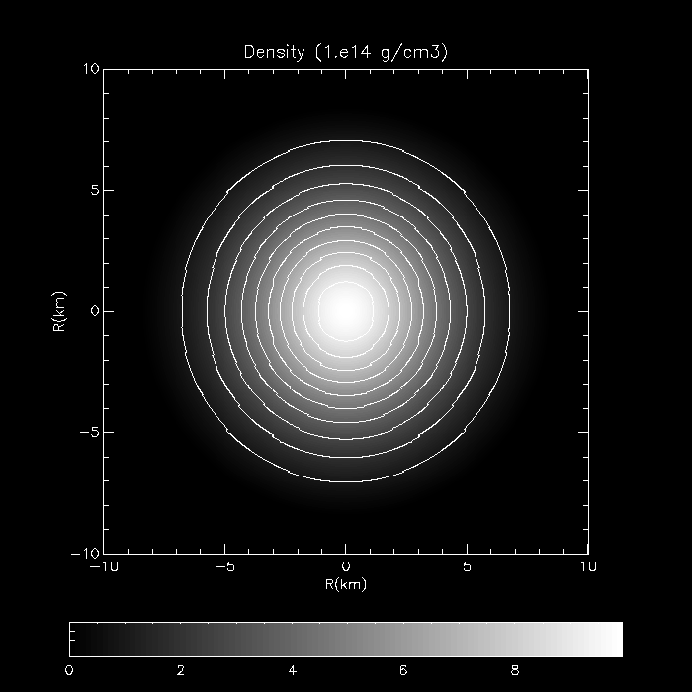
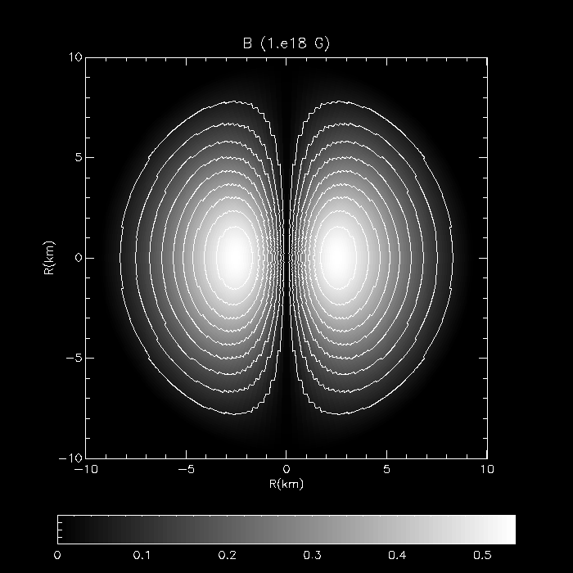
Toroidal Magnetic field ($\vec{B}=B_{φ}\hat{φ}$) with rotation
Density isocontour
Magnetic field isocontour
MD & Mukhopadhyay 2023
arXiv:2302.03706
$$ρ_{c}={10}^{15}g/cc,B_{max}=5×{10}^{17}G,ν=500Hz M=2M_{ʘ},R_{E}=14km{,R_{P}}/{R_{E}}=0.92, ME/GE=0.056$$

Slide 12
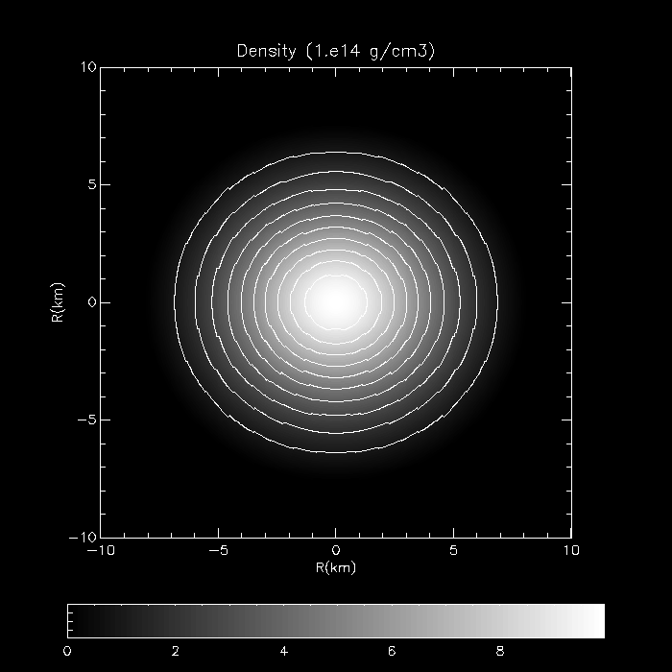
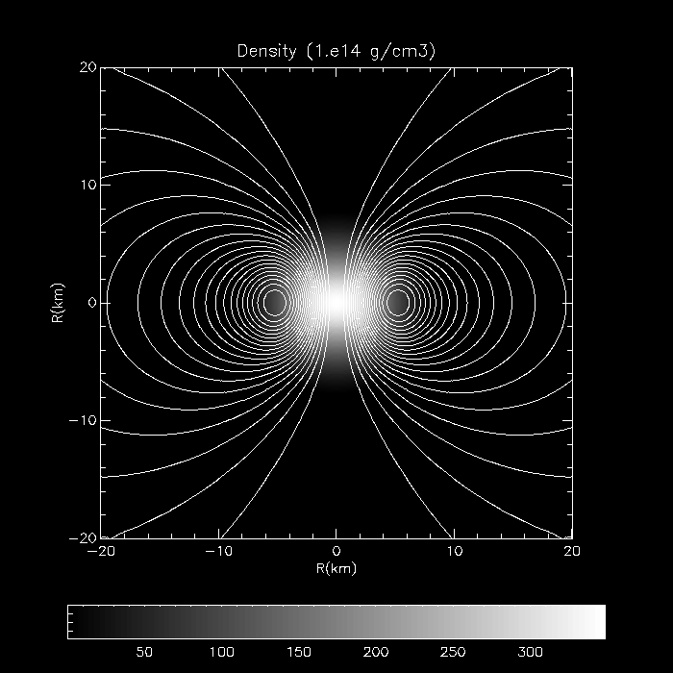
Poloidal Magnetic field ($\vec{B}=B_{r}\hat{r}+B_{θ}\hat{θ}$) with rotation
Density isocontour
Magnetic field isocontour
MD & Mukhopadhyay 2023)
arXiv:2302.03706
$$ρ_{c}={10}^{15}g/cc,B_{max}=5×{10}^{17}G,ν=50Hz, M=2M_{ʘ},R_{E}=12km{,R_{P}}/{R_{E}}=0.81, ME/GE=0.02$$

Slide 13
Gravitational wave
detection
Notes:
We have seen how Ns get deformed due to rotation and magnetic field now we will try to obtain massive NS and detectable GW amplitude

Slide 14
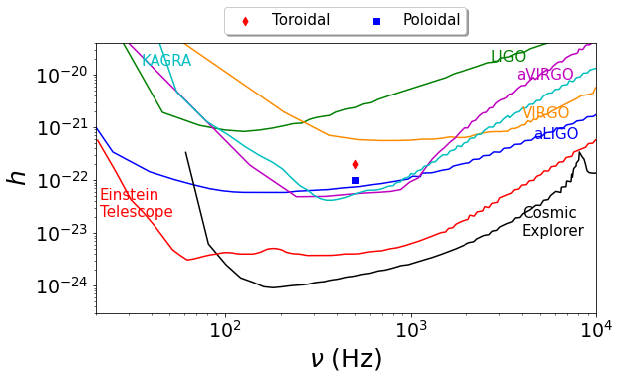
GW strain for various magnetic configuration (modelled from XNS) as a function of frequency along with the sensitivity curves of various detectors.
$h$ = 0.0110297$h_{0}$ for χ = 3◦, d=10 kpc
$$B_{max}=5×{10}^{17}G,$$
$$ν=500Hz$$
Actually not detected yet, REASON?
MD & Mukhopadhyay 2023
arXiv:2302.03706
Notes:
Here we plotted GW amplitude produced by ns along with sensitivity curve of various detectors,We can see that the gravitational wave produced by NS can be detected by them.

Slide 15
}
Rotation frequency (Ω)
Obliquity angle (χ)
Magnetic field strength (B)
GW strain (h) ∝
Decays with time!
Then how long we can detect them?
Notes:
As I will study rotating highly magnetized neutron stars it is convenient to explain how they generated
If a highly magnetized star of million gauss collapses due flux freeze it can create highly magnetized neutron star.
Also dynamo and differencial rotation can enhance the field which can reach even around 10 17 18 gauss.

Slide 16
}
Rotation frequency (Ω)
Obliquity angle (χ)
Magnetic field strength (B)
GW strain (h) ∝
Decays with time!
Then how long we can detect them?
Ω and χ evolution:
Electromagnetic (dipole) radiation & GW (quadrupole) radiation : Ω, χ
(Timescale~years)
Viscous & thermal effect: Negligible, in few hours χ increases 3% and saturates
Chau & Henriksen 1970
Notes:
As I will study rotating highly magnetized neutron stars it is convenient to explain how they generated
If a highly magnetized star of million gauss collapses due flux freeze it can create highly magnetized neutron star.
Also dynamo and differencial rotation can enhance the field which can reach even around 10 17 18 gauss.

Slide 17
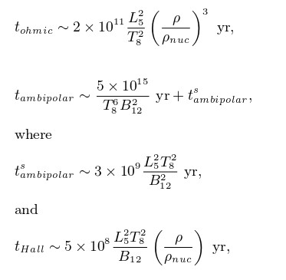
}
Rotation frequency (Ω)
Obliquity angle (χ)
Magnetic field strength (B)
GW strain (h) ∝
Decays with time!
Then how long we can detect them?
Ohmic dissipation
Ambipolar diffusion
Hall drift
Ω and χ evolution:
Magnetic field decay:
Electromagnetic (dipole) radiation & GW (quadrupole) radiation : Ω, χ
(Timescale~years)
Viscous & thermal effect: Negligible, in few hours χ increases 3% and saturates
Chau & Henriksen 1970
Heyl & Kulkarni 1998
Goldreich & Reisenegger 1992
Notes:
As I will study rotating highly magnetized neutron stars it is convenient to explain how they generated
If a highly magnetized star of million gauss collapses due flux freeze it can create highly magnetized neutron star.
Also dynamo and differencial rotation can enhance the field which can reach even around 10 17 18 gauss.

Slide 18
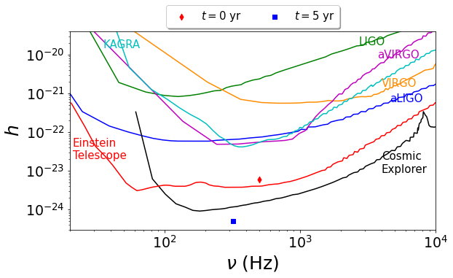
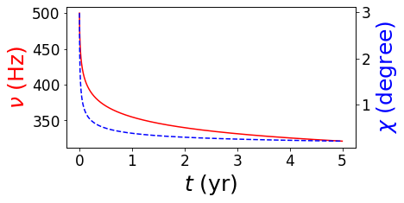
Evolution of $ν$ and χ (B constant): Toroidal magnetic field
$$M=2{.02M}_{ʘ}, B_{max}^{Toroidal}\left(initial\right)=1.4×{10}^{17}G,ν\left(initial\right)=500Hz$$
However, for $B_{max}^{Poloidal}\left(initial\right)={10}^{15}G,$ Ω, χ decays in few days of time,
but stable NSs are actually toroidally dominated. (Wickramasinghe et al. 2014)
MD & Mukhopadhyay 2023
arXiv:2302.03706
Notes:
A non-axisymmetric deformation of a rotating & magnetized NS with respective axes not alignes with each other will lead to a time-varying quadrupole moment thus can produce cont GW. i is the angle between the rotation axis of the object and our line of sight. The code implicitly assumes χ to be zero or does not include information about χ and, hence, we make small angle approximation to overcome this limitation. Had we run an efficient code with appropriately chosen χ, we would have been able to generate gravitational wave with much higher strength as the strength monotonically increases with the angle χ and it becomes maximum at χ = 90◦.
We get the maximum amplitude received by detector which is h, the code provides us h0, we have used d 10kpc

Slide 19
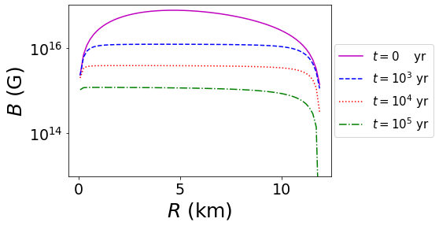
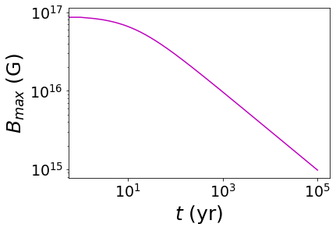
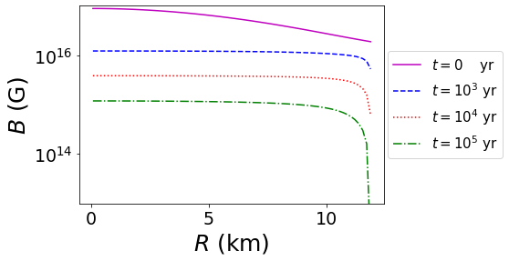
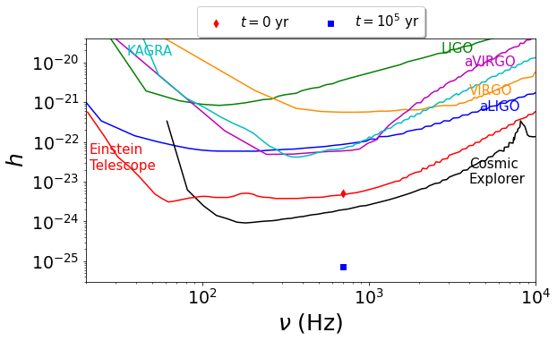
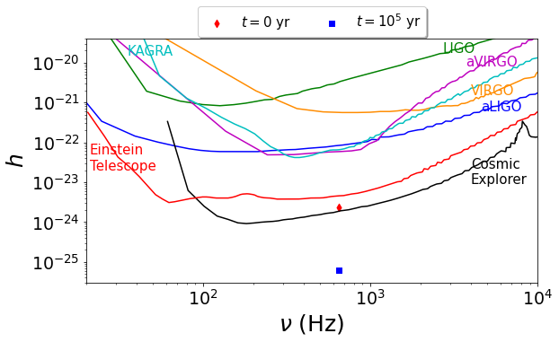
Evolution of B ($ν,$ χ constant)
Toroidal
Poloidal
$$M=2{.02M}_{ʘ}, B_{max}^{Toroidal/poloidal}\left(initial\right)=9×{10}^{16}G$$
$ν=700Hz$, $ν=650Hz$
MD & Mukhopadhyay 2023
arXiv:2302.03706
Notes:
A non-axisymmetric deformation of a rotating & magnetized NS with respective axes not alignes with each other will lead to a time-varying quadrupole moment thus can produce cont GW. i is the angle between the rotation axis of the object and our line of sight. The code implicitly assumes χ to be zero or does not include information about χ and, hence, we make small angle approximation to overcome this limitation. Had we run an efficient code with appropriately chosen χ, we would have been able to generate gravitational wave with much higher strength as the strength monotonically increases with the angle χ and it becomes maximum at χ = 90◦.
We get the maximum amplitude received by detector which is h, the code provides us h0, we have used d 10kpc

Slide 20
Timescale for $ν,$ χ decay << Timescale for B decay
Decay of $ν,$ χ is more important to study GW amplitude decay

Slide 21
To Increase GW detection possibility:
Notes:
We have seen how Ns get deformed due to rotation and magnetic field now we will try to obtain massive NS and detectable GW amplitude

Slide 22
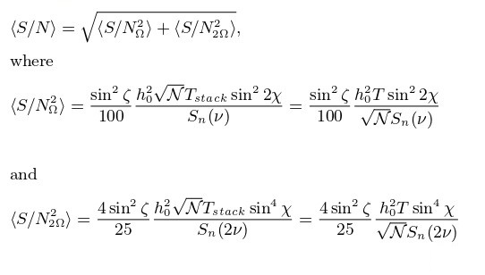
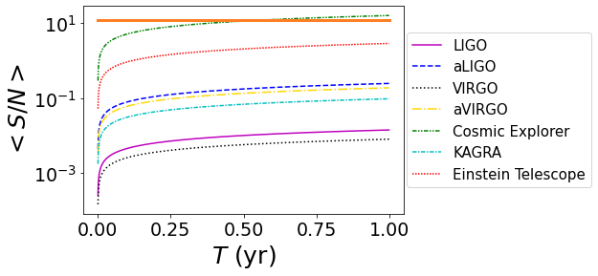
Signal to noise ratio (SNR) for 1 Year integration time
Maggiore et al. 2020
$$M=2M_{ʘ},B_{max}^{Toroidal}=9×{10}^{16}G,ν\left(initial\right)=200Hz$$
$$SNR\left(threshold\right)=12$$
MD & Mukhopadhyay; 2023
arXiv:2302.03706
The signal is not detectable instantaneously.
After one month of integration time, it will be detectable!!

Slide 23
Conclusion

Slide 24
Highly magnetized rotating NSs can explain existence of massive NS >2$M_{ʘ} ($and also possibly the NS candidate of GW190814 belonging to mass gap ${2.5M}_{ʘ}<M<{5M}_{ʘ})$.
Highly magnetized rotating NSs can explain existence of massive NS >2𝑀_ʘ (and also possibly the NS candidate of GW190814 belonging to mass gap 〖2.5𝑀〗_ʘ<𝑀<〖5𝑀〗_ʘ).

Slide 25
We can try to increase the detection probability by calculating SNR over 1 year leading to direct detection of NSs (which cumulatively adds up the SNR, thus can have better probability to detect after some time).
Uniformly rotating massive NSs, which are detectable after birth, may not be detectable forever. Because its GW amplitude decays due to decay of B, Ω and χ (that we have first time studied simultaneously). Perhaps this is why we have not yet detected CGW from NSs by aLIGO, aVIRGO, KAGRA.
Highly magnetized rotating NSs can explain existence of massive NS >2$M_{ʘ} ($and also possibly the NS candidate of GW190814 belonging to mass gap ${2.5M}_{ʘ}<M<{5M}_{ʘ})$.
Highly magnetized rotating NSs can explain existence of massive NS >2𝑀_ʘ (and also possibly the NS candidate of GW190814 belonging to mass gap 〖2.5𝑀〗_ʘ<𝑀<〖5𝑀〗_ʘ).

Slide 26
We can try to increase the detection probability by calculating SNR over 1 year leading to direct detection of NSs (which cumulatively adds up the SNR, thus can have better probability to detect after some time).
Uniformly rotating massive NSs, which are detectable after birth, may not be detectable forever. Because its GW amplitude decays due to decay of B, Ω and χ (that we have first time studied simultaneously). Perhaps this is why we have not yet detected CGW from NSs by aLIGO, aVIRGO, KAGRA.
Future gravitational wave missions with Einstein Telescope and Cosmic Explorer should be planned accordingly to detect such massive NSs, which, if successful can provide us an idea about its spin, magnetic field, as well as about the equation of state.
Highly magnetized rotating NSs can explain existence of massive NS >2$M_{ʘ} ($and also possibly the NS candidate of GW190814 belonging to mass gap ${2.5M}_{ʘ}<M<{5M}_{ʘ})$.
Highly magnetized rotating NSs can explain existence of massive NS >2𝑀_ʘ (and also possibly the NS candidate of GW190814 belonging to mass gap 〖2.5𝑀〗_ʘ<𝑀<〖5𝑀〗_ʘ).
Further, we have shown in the paper, that differentially rotating massive NSs does not remain massive for long and settles into a uniformly rotating, less massive NS due to magnetic braking in (0.01-100 seconds).

Slide 27
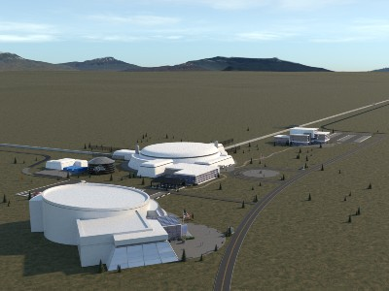
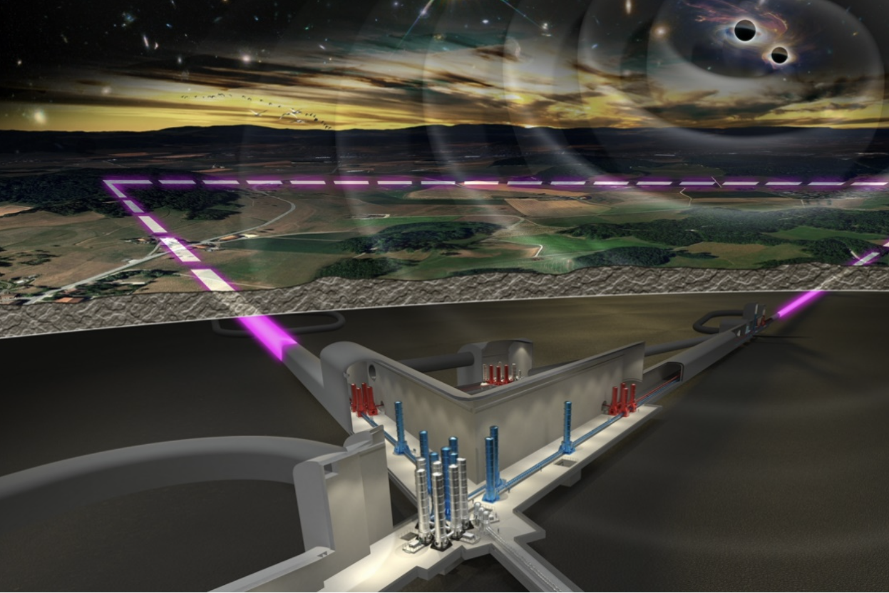
Future Objectives
Future objectives:
Ligo-Virgo collaboration have not yet detected any CGW
Einstein telescope and cosmic explorer may detect them instantaneously or after 1 year of integration time

Slide 28
Thank You

Slide 29
Cromartie, H.T., Fonseca, E., Ransom, S.M. et al., 2020 Nat Astron 4, 72
Abbott R. et al 2020 ApJL 896 L44
Hulse R. A., Taylor J. H., 1975, ApJ, 195, L51
Thompson, C., & Duncan, R. C. 1993, ApJ, 408, 194
Pili A. G., Bucciantini N., Del Zanna L., 2014, MNRAS, 439, 3541
Deb D., Mukhopadhyay B., Weber F., 2021, ApJ, 922, 149
Bonazzola S., Gourgoulhon E., 1996, A&A, 312, 675
Kalita S., Mukhopadhyay B., 2019, MNRAS, 490, 2692
Heyl J. S., Kulkarni S. R., 1998, ApJ, 506, L61
Goldreich, P., & Reisenegger, A. 1992, ApJ, 395, 250
Kalita S., B. Mukhopadhyay, T. Mondal, T. Bulik, 2020, ApJ, 896, 69
Kalita S., Mondal T., Tout C. A., Bulik T., Mukhopadhyay B., 2021, MNRAS, 508, 842
Chau W. Y., Henriksen R. N., 1970, ApJ, 161, L137
Maggiore M., et al., 2020, J. Cosmology Astropart. Phys., 050
Shapiro S. L., 2000, The Astrophysical Journal, 544, 397
Cook J., Shapiro S., Stephens B., 2003, ApJ, 599
Cutler C., Lindblom L., 1987, ApJ, 314, 234
References

Slide 30
Appendix D
$$\frac{ⅆv_{i}}{ⅆt}+\frac{1}{ρ}\frac{∂}{∂x_{j}}\left(P_{ij}+M_{ij}\right)=F_{i}$$
$M^{ⅈj}=\frac{B^{2}}{8π}δ^{ij}−\frac{B^{ⅈ}B^{j}}{4π}$ , $T_{f}^{μν}={\frac{B^{2}}{4π}u}^{μ}u^{ν}−\frac{B^{ⅈ}B^{j}}{4π}+\frac{B^{2}}{8π}g^{μν}$
$\vec{B}=B^{r}\hat{r}⇒ M^{ⅈj}=\left(\begin{matrix}\begin{matrix}−B^{2} \\ \overline{8π} \\ 0 \\ 0\end{matrix} & \begin{matrix}0 \\ B^{2} \\ \overline{8π} \\ 0\end{matrix} & \begin{matrix}0 \\ 0 \\ B^{2} \\ \overline{8π}\end{matrix}\end{matrix}\right)$,
$$\vec{B}=B^{θ}\hat{θ}⇒ M^{ⅈj}=\left(\begin{matrix}\begin{matrix}B^{2} \\ \overline{8π} \\ 0 \\ 0\end{matrix} & −\begin{matrix}0 \\ B^{2} \\ \overline{8π} \\ 0\end{matrix} & \begin{matrix}0 \\ 0 \\ B^{2} \\ \overline{8π}\end{matrix}\end{matrix}\right)$$
$$\vec{B}=B^{∅}\hat{Φ}⇒ M^{ⅈj}=\left(\begin{matrix}\begin{matrix}B^{2} \\ \overline{8π} \\ 0 \\ 0\end{matrix} & \begin{matrix}0 \\ B^{2} \\ \overline{8π} \\ 0\end{matrix} & \begin{matrix}0 \\ 0 \\ {−B}^{2} \\ \overline{8π}\end{matrix}\end{matrix}\right)$$

Slide 31
$h_{+}$ and $h_{×}$ will be suppressed by some factors.
At χ = 3, t = 0 and i = $i_{max}$= 46.5
maximum of $\sin{χ}\left[\frac{1}{2}\cos{i}\sin{i}\cos{χ\cos{Ωt}}−\frac{1+\cos^{2}{i}}{2}\sin{χ}\cos{2Ωt}\right]$ = 0.011029
$h_{max}$= 0.0110297$h_{0}$.
We assume the distance between the NS and the detector d=10 kpc
Kalita & Mukhopadhyay 2019
Notes:
As I will study rotating highly magnetized neutron stars it is convenient to explain how they generated
If a highly magnetized star of million gauss collapses due flux freeze it can create highly magnetized neutron star.
Also dynamo and differencial rotation can enhance the field which can reach even around 10 17 18 gauss.

Slide 32
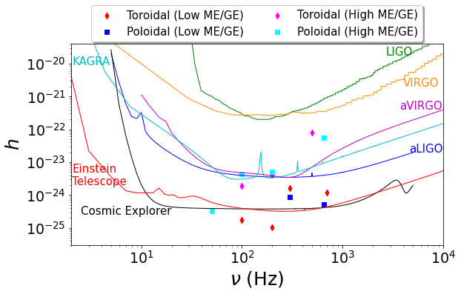
GW strain for NSs with various magnetic field and rotation as a function of frequency along with the sensitivity curves of various detectors.
$h$ = 0.0110297$h_{0}$ for χ = 3◦, d=10 kpc
Das & Mukhopadhyay; Submitted (MNRAS)
Notes:
Here we plotted GW amplitude produced by ns along with sensitivity curve of various detectors,We can see that the gravitational wave produced by NS can be detected by them.

Slide 33
Appendix E
The system is closed by Ohm’s law for a perfectly conducting plasma, which becomes a constraint for a vanishing electric field in the frame comoving with the fluid i.e., the freely moving charges in a plasma are always supposed to be able to screen any electric field that may arise locally.
$$\vec{E}=\frac{\vec{J}}{σ}−\frac{\vec{v}×\vec{B}}{c}$$
$${\vec{E}}^{′}=\left(\vec{E}+\frac{\vec{v}}{c}×\vec{B}\right),γ=1$$
$$E^{′}→0$$

Slide 34
Appendix F
Grad-Shfranov equation: (in 2D)
Lets consider a pressure balanced magnetic field ( in cartesian coordinate) in which variables are independent of z, $\frac{∂}{∂z}=0$. $\vec{∇}⋅\vec{B}=0, \vec{∇}⋅\left(\vec{∇}×\vec{A}\right)=0$
$$\vec{A}=A\hat{z}$$
$$\vec{B}=B_{z}\left(x,y\right)\hat{z}+\vec{∇}×\left[\vec{A}\left(x,y\right)\right]$$
Then the magnetic field can be written as,
$$B=\left(\frac{∂A}{∂y},−\frac{∂A}{∂x},B_{z}\left(x,y\right)\right)$$
Pressure Balance condition:
$$\vec{∇}P=−\vec{∇}\left(\frac{B^{2}}{8π}\right)+\frac{\left(\vec{B}⋅\vec{∇}\right)\vec{B}}{4π}$$
We have to substitude B in pressure balance eq
$$∇^{2}A=−4π\frac{ⅆ}{ⅆA}\left(P+\frac{B_{z}^{2}}{8π}\right)$$
Detailed sol: PTO

Slide 35
$$\frac{ⅆ\vec{v}}{ⅆt}={\vec{F}}_{g}−\frac{1}{ρ}\vec{∇}\left(P+\frac{B^{2}}{8π}\right)+\frac{\left(\vec{B}⋅\vec{∇}\right)\vec{B}}{4πρ}$$
$$ρ{\vec{F}}_{g}=\vec{∇}\left(p+\frac{B^{2}}{8π}\right)+\frac{\left(\vec{B}⋅\vec{∇}\right)\vec{B}}{4π}$$

Slide 36
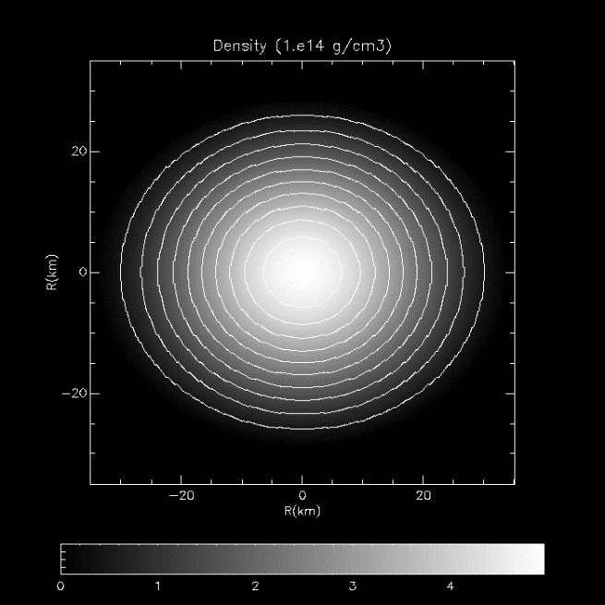
Non-Magnetized Uniformly Rotating
Centrifugal force makes the star oblate
$ρ_{c}=5.1×{10}^{14}g/cc,ν=477 Hz,M=1.24 M_{ʘ}$
$R_{E}=15 km, {R_{P}}/{R_{E}}=0.83$
Density isocontour
Notes:
This is the deformation due to uniform rotation

Slide 37
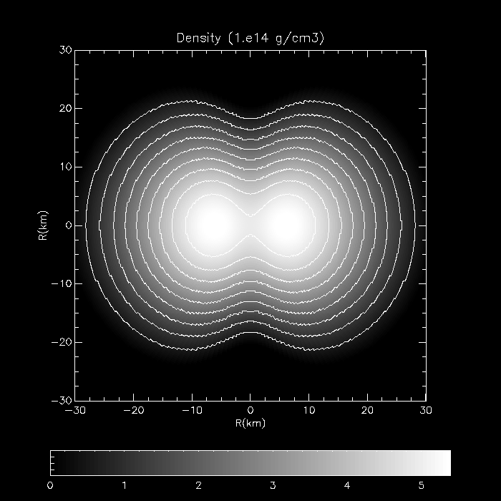
Non-Magnetized Differentially Rotating
Polar hollow structure.
$$ρ_{c}=5.4×{10}^{14}\frac{g}{cc},ν\left(cen\right)=3342 Hz,ν\left(eq\right)=282 Hz$$
$$M=1.52M_{ʘ}, R_{E}=13.55 km,{R_{P}}/{R_{E}}=0.64$$
Density isocontour
Notes:
This is the deformation for differential rot. We can see polar hollow kind of structure, this is because the inner region rotates at very high speed which makes the matter dispersed to the outed region and make it very oblate, however outer region hass less rotation which makes it less oblate

Slide 38
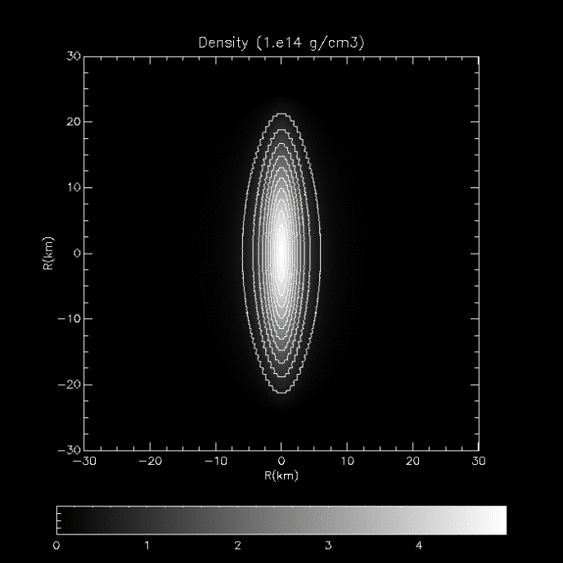
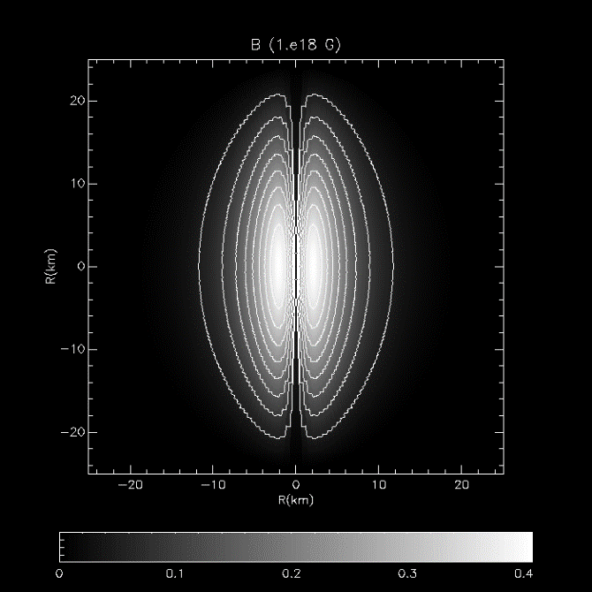
Toroidal Magnetic field ($\vec{B}=B_{φ}\hat{φ}$) without rotation
Density isocontour
Magnetic field isocontour
$$ρ_{c}=5×{10}^{14}g/cc,B_{max}=4.1×{10}^{17}G, M=1.32M_{ʘ},R_{E}=16km{,R_{P}}/{R_{E}}=1.4,ME/GE=0.45$$

Slide 39
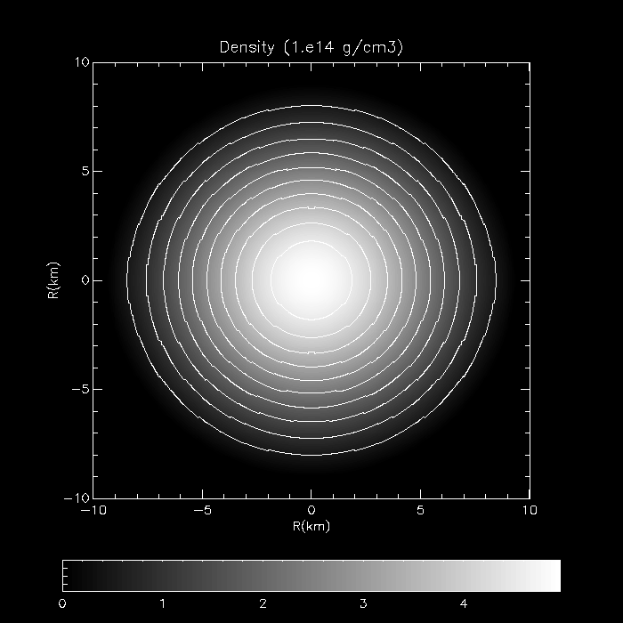
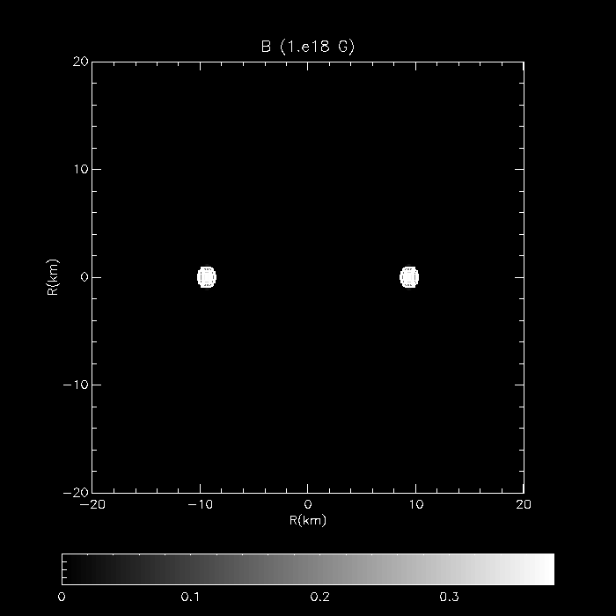
Twisted torus configuration
The poloidal magnetic field extends throughout the star and in the exterior, whereas the toroidal field is confined into a torus shaped region inside the star, where the field lines are closed.
$$ρ_{c}=5.1×{10}^{14}g/cc,B_{max}=1.45×{10}^{17}G M=1.17 M_{ʘ}, R_{E}=13.82 km,{R_{P}}/{R_{E}}=0.95, ME/GE=0.017$$
Density isocontour Poloidal Magnetic field isocontour Toroidal Magnetic field isocontour
Notes:
NOW lets see how ns is deformed due to mixed mag field

Slide 40
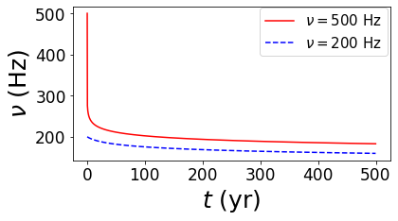
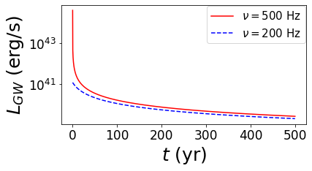
Evolution of $ν$ and χ (B constant): Toroidal magnetic field
$$M=2{.02M}_{ʘ}, B_{max}^{Toroidal}\left(initial\right)=1.4×{10}^{17}G$$
Das & Mukhopadhyay; Submitted (MNRAS)
arXiv:2302.03706
Notes:
A non-axisymmetric deformation of a rotating & magnetized NS with respective axes not alignes with each other will lead to a time-varying quadrupole moment thus can produce cont GW. i is the angle between the rotation axis of the object and our line of sight. The code implicitly assumes χ to be zero or does not include information about χ and, hence, we make small angle approximation to overcome this limitation. Had we run an efficient code with appropriately chosen χ, we would have been able to generate gravitational wave with much higher strength as the strength monotonically increases with the angle χ and it becomes maximum at χ = 90◦.
We get the maximum amplitude received by detector which is h, the code provides us h0, we have used d 10kpc

Slide 41
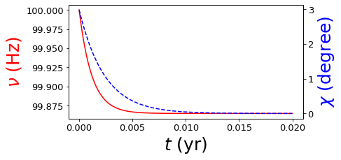
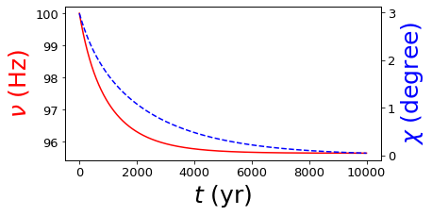
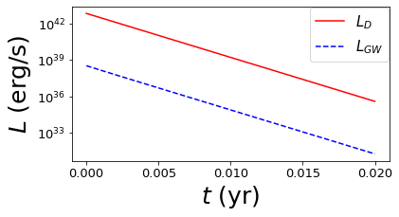
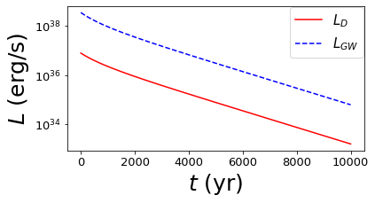
Evolution of $ν$ and χ (B constant): Poloidal magnetic field
Das & Mukhopadhyay; Submitted (MNRAS)
$$M=2{.02M}_{ʘ}, ν\left(initial\right)=100Hz$$
$B_{max}^{Poloidal}\left(initial\right)={10}^{15}G,$ $L_{D}≫L_{GW} B_{max}^{Poloidal}\left(initial\right)={10}^{12}G,L_{GW}≫L_{D}$
Notes:
A non-axisymmetric deformation of a rotating & magnetized NS with respective axes not alignes with each other will lead to a time-varying quadrupole moment thus can produce cont GW. i is the angle between the rotation axis of the object and our line of sight. The code implicitly assumes χ to be zero or does not include information about χ and, hence, we make small angle approximation to overcome this limitation. Had we run an efficient code with appropriately chosen χ, we would have been able to generate gravitational wave with much higher strength as the strength monotonically increases with the angle χ and it becomes maximum at χ = 90◦.
We get the maximum amplitude received by detector which is h, the code provides us h0, we have used d 10kpc

Slide 42
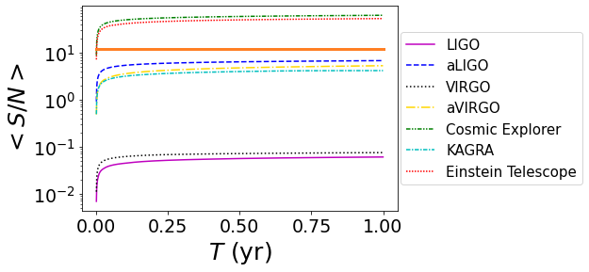
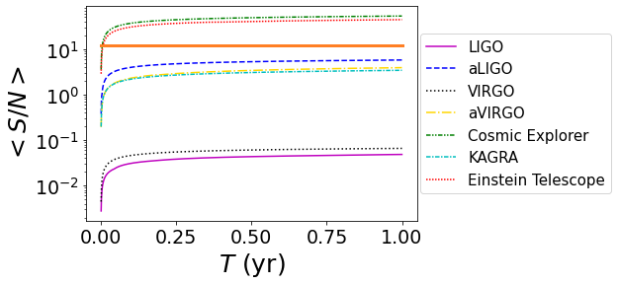
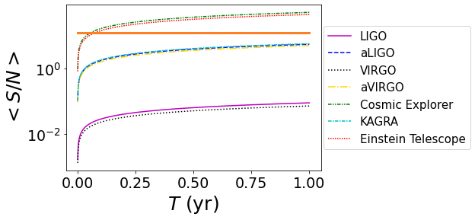
$$B_{max}^{Toroidal}=1.4×{10}^{17}G,ν=500Hz$$
$$B_{max}^{Toroidal}=9×{10}^{16}G,ν=500Hz$$
$$B_{max}^{Toroidal}=9×{10}^{16}G,ν=200Hz$$
SNR: Toroidal magnetic field
Das & Mukhopadhyay; Submitted (MNRAS)
arXiv:2302.03706
Notes:
A non-axisymmetric deformation of a rotating & magnetized NS with respective axes not alignes with each other will lead to a time-varying quadrupole moment thus can produce cont GW. i is the angle between the rotation axis of the object and our line of sight. The code implicitly assumes χ to be zero or does not include information about χ and, hence, we make small angle approximation to overcome this limitation. Had we run an efficient code with appropriately chosen χ, we would have been able to generate gravitational wave with much higher strength as the strength monotonically increases with the angle χ and it becomes maximum at χ = 90◦.
We get the maximum amplitude received by detector which is h, the code provides us h0, we have used d 10kpc

Slide 43
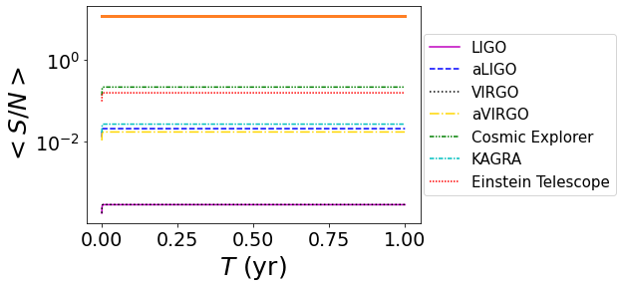
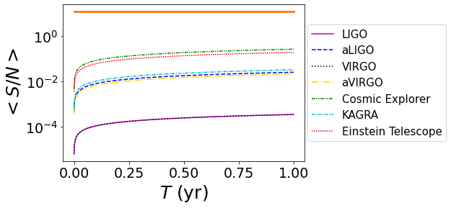
$$B_{max}^{Poloidal}={10}^{15}G,ν=100Hz$$
$$B_{max}^{Poloidal}={10}^{12}G,ν=100Hz$$
SNR: poloidal magnetic field
Das & Mukhopadhyay; Submitted (MNRAS)
arXiv:2302.03706
Notes:
A non-axisymmetric deformation of a rotating & magnetized NS with respective axes not alignes with each other will lead to a time-varying quadrupole moment thus can produce cont GW. i is the angle between the rotation axis of the object and our line of sight. The code implicitly assumes χ to be zero or does not include information about χ and, hence, we make small angle approximation to overcome this limitation. Had we run an efficient code with appropriately chosen χ, we would have been able to generate gravitational wave with much higher strength as the strength monotonically increases with the angle χ and it becomes maximum at χ = 90◦.
We get the maximum amplitude received by detector which is h, the code provides us h0, we have used d 10kpc

Slide 44
Magnetic braking
Differentially rotating NS (massive) with seed poloidal field
Magnetic braking and viscous damping
Uniformly rotating (less massive NS)
Magnetic braking: Alfvén timescale
Viscous damping: Viscous timescale
Shapiro 2000
Cook et. al 2003
Magnetic field line configurations at selected times. The twisting of the field lines is due to differential rotation. Snapshots are given at time intervals of PA/4, where PA is the standing Alfvén wave period. Each frozen-in field line passes through the same fluid elements at all times. The bold field line is an arbitrarily chosen fiducial line.
Cutler & Lindblom (1987)

Slide 45
Modelling NS
Using XNS
Einstein’s equation solver in GRMHD
Input
EOS: polytropic law $P=kρ^{1+\frac{1}{n}}$,
Magnetic field: $B\sim k_{m}ρ^{m}$(Toroidal and/or Poloidal)
Output$M,R, I_{xx},I_{zz}$
Pili et al. 2014

Slide 46
Evolution of $ν$ and χ (B constant)
Evolution of B ($ν,$ χ constant)
MD & Mukhopadhyay 2023
arXiv:2302.03706
$M=2{.02M}_{ʘ}, B_{max}^{Toroidal}\left(initial\right)=9×{10}^{16}G$, $ν(initial)=500Hz$
Timescale for $ν,$ χ decay << Timescale for B decay
Notes:
A non-axisymmetric deformation of a rotating & magnetized NS with respective axes not alignes with each other will lead to a time-varying quadrupole moment thus can produce cont GW. i is the angle between the rotation axis of the object and our line of sight. The code implicitly assumes χ to be zero or does not include information about χ and, hence, we make small angle approximation to overcome this limitation. Had we run an efficient code with appropriately chosen χ, we would have been able to generate gravitational wave with much higher strength as the strength monotonically increases with the angle χ and it becomes maximum at χ = 90◦.
We get the maximum amplitude received by detector which is h, the code provides us h0, we have used d 10kpc

Slide 47
Differentially rotating and uniformly rotating poloidally dominated NSs, where ν_{cen} and ν_{eq} are respectively central and equatorial frequencies.
Shapiro 2000
Energy evolution for a differentially rotating star. The dotted line: E(rot), dashed line: E(mag) and dot-dashed line E(vis). Energies are normalized to the sum of the energies. Total E=1
Das & Mukhopadhyay; Submitted (MNRAS)
arXiv:2302.03706

