Slide 1
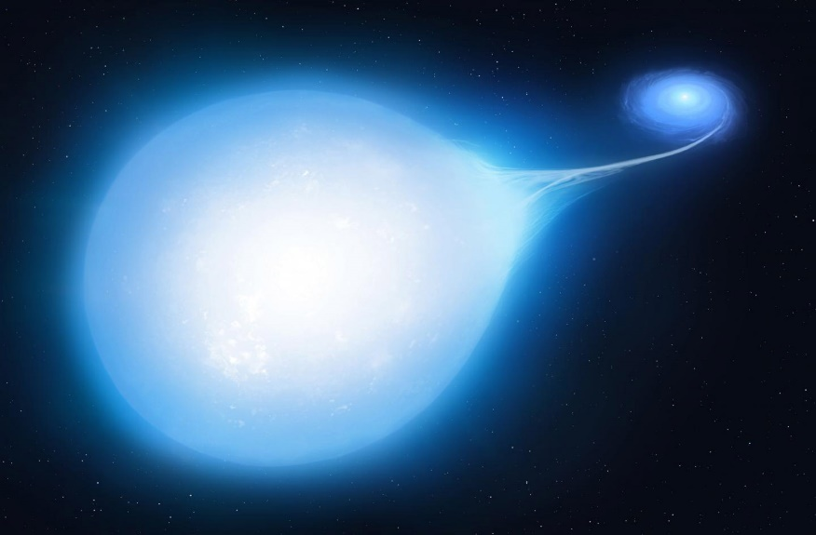


Constraining Supernova Ia progenitors by their locations in host galactic disc
Artur Hakobyan
Arpine Karapetyan & Lilit Barkhudaryan
Center for Cosmology and Astrophysics,
Alikhanian National Science Laboratory

Slide 2
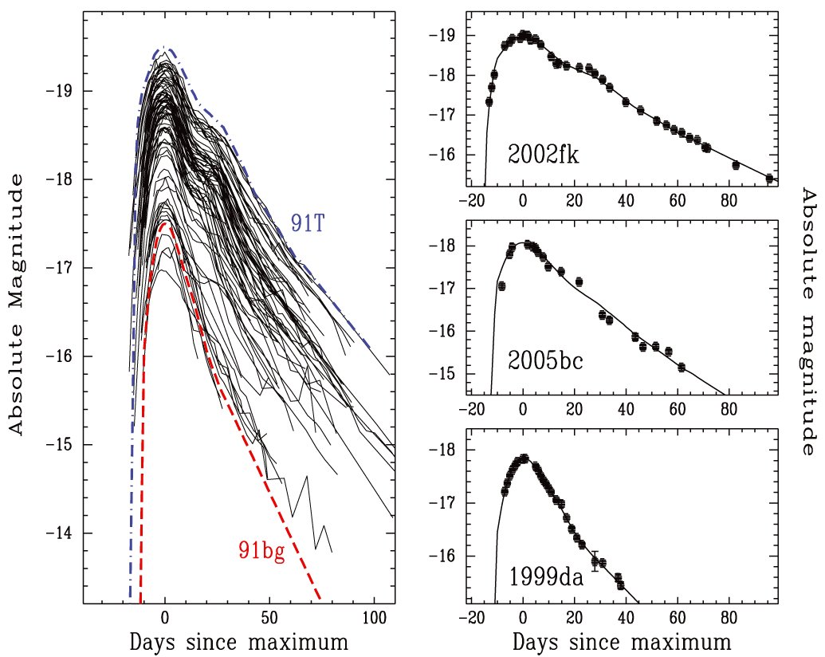
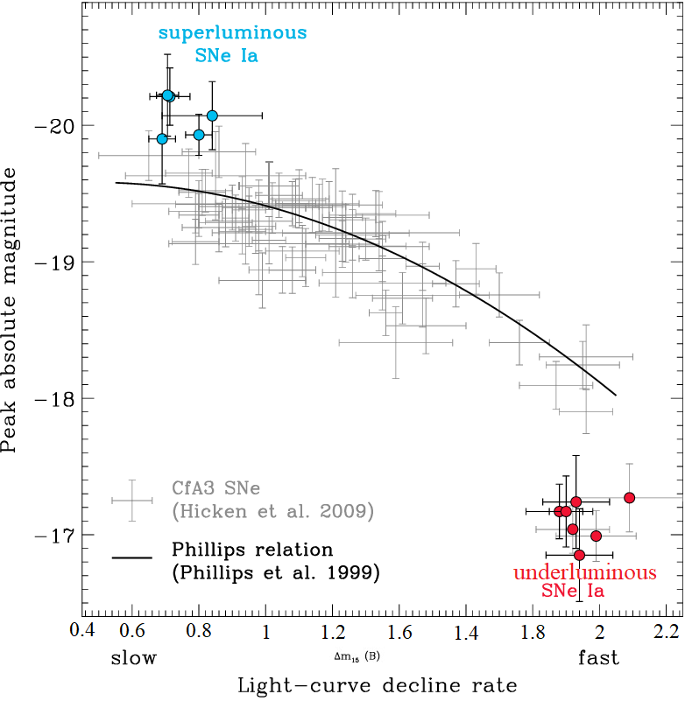
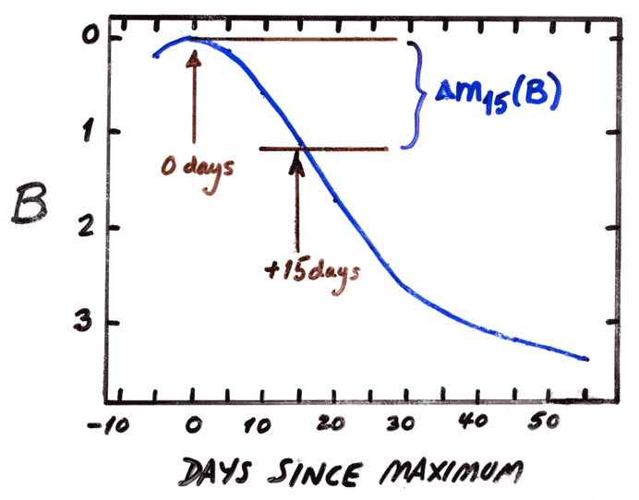
SNe Ia (light curve; LC)
-19.5 mag
Li+ 2011
Slow
The width-luminosity relation
more luminous
-17.5 mag
less luminous
Average
Fast
Δm₁₅ is a practically extinction-independent parameter
faster declining SNe Ia are fainter

Slide 3
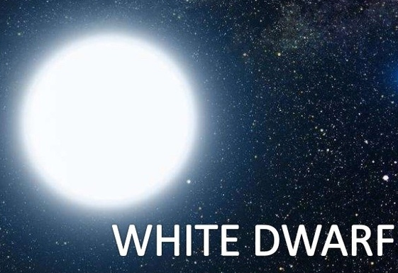
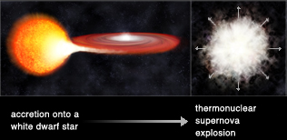
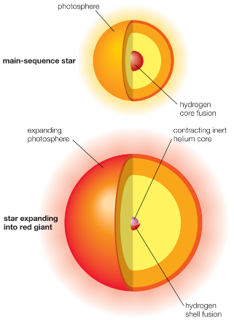
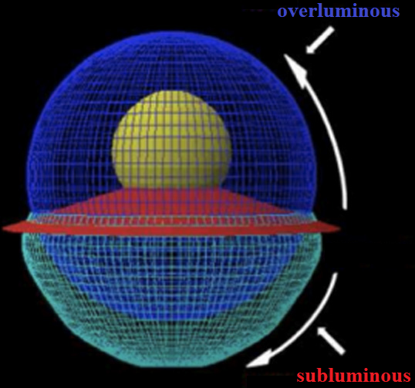
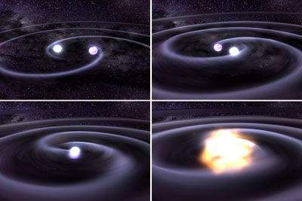
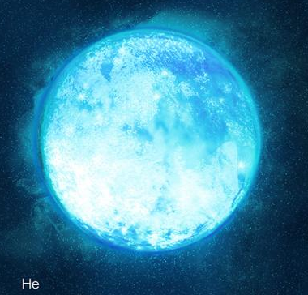
Type Ia Supernova (toy models)
The width-luminosity relation
A binary system
Single-Degenerate
Progenitors of SNe Ia (thermonuclear)
the Chandrasekhar mass limit
of white dwarf (∼ 1.4 M⦿ )
← non-degenerate star
degenerate star
degenerate star
mainsequence/subgiant star →
degenerate star →
← degenerate star
The asymmetric explosion model faces complications
red giant or AGB star →
Supernovae explode asymmetrically
A binary system
Double-Degenerate
Gravitational wave emission
helium (He) star →
+ + Alternative Models

Slide 4
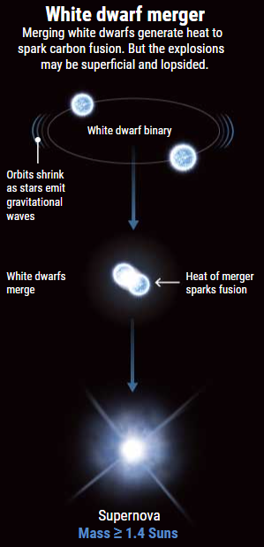
Type Ia Supernova (toy models)
The width-luminosity relation
A binary system
Double-Degenerate

Slide 5
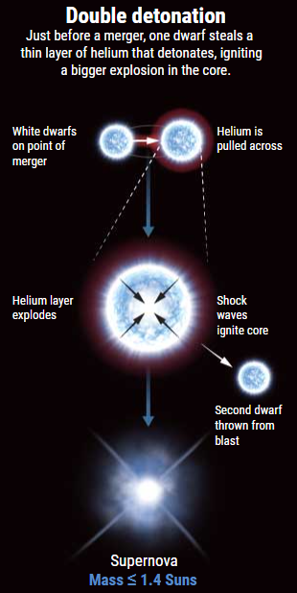
Type Ia Supernova (toy models)
The width-luminosity relation
A binary system
Double-Degenerate
Sub-Chandrasekhar-Mass White Dwarf Explosions

Slide 6
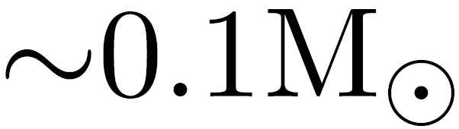
Type Ia Supernova (toy models)
the mass of the He-shell is expected to be
The width-luminosity relation
Shen+ 2021
model
several 100 Myr
∼1 Gyr
A binary system
Double-Degenerate
WD masses
several Gyr or more
the older SN progenitors →
the faster decline of light curves
the younger SN progenitors →
the slower decline of light curves
Sub-Chandrasekhar-Mass White Dwarf Explosions
progenitor stellar age
+ gravitational inspiral/accretion timescales

Slide 7
Relations between SNe Ia and properties of host galaxy
To constrain models, we could check the potential correlation between the SN Ia local/global host properties (an age indicator) and their LC decline rates.
The problem is to find appropriate stellar population age indicators.

Slide 8
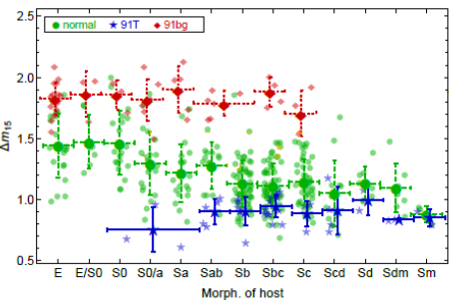
Relations between SNe Ia and properties of host galaxy
All properties of galaxy are from the spectra and/or photometry!
On average, those SNe Ia that are in early-type, massive, red, old host galaxies have faster declining LCs in comparison with those from late-type, less massive, bluer, younger hosts.
Such results have been obtained also from the local properties of SN sites.
other age-constrain ?
e.g. dynamical age-constrain ?
Hakobyan+ 2020
subluminous →
normal →
overluminous →
Older stellar population
Younger population

Slide 9
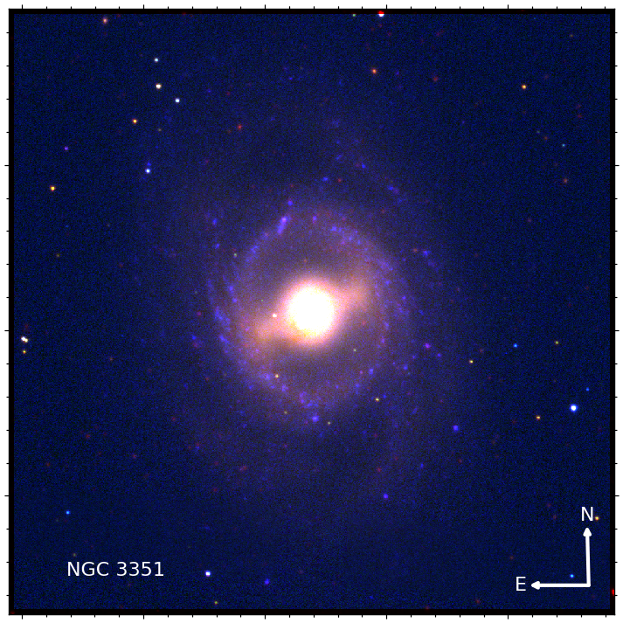
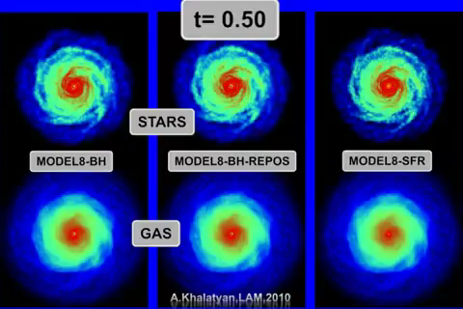
the dynamical age-constrain of SFD is  2 Gyr
The effect of stellar bar
Bar formation in isolated galaxy model.
Cosmological simulation by A. Khalatyan (AIP, Germany).
Recent References
Donohoe-Keyes+ 2019
Zana+ 2018; 2019
George+ 2019
James & Percival 2016; 2018
Khoperskov+ 2018
Spinoso+ 2017
Consolandi 2016
…

Slide 10
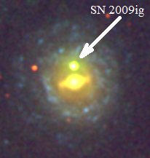
Star formation deserts (SFDs) of spiral galaxies
from Hakobyan+ 2020
archival Galaxy Evolution Explorer (GALEX) far- and near-UV (Martin+ 2005), Swift UV (Roming+ 2005), and available Hα images (Sanchez-Menguiano+ 2018)
Spectroscopically classified 185 Type Ia SNe with available Δm₁₅
distances within 150 Mpc
inclinations i < 70°

Slide 11
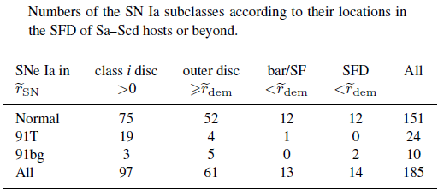
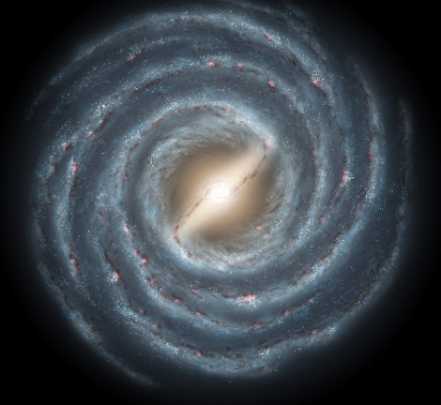
Principal results
R_{SN}
R_{SFD}
R₂₅

Slide 12
R_{SN}
R_{SFD}
R₂₅
Principal results

Slide 13
R_{SN}
R_{SFD}
R₂₅
Principal results

Slide 14
Principal results
(SNe Ia in SFD)
For the first time, we demonstrate that from the perspective of the dynamical timescale of the SFD, its old stellar population (2 Gyr) hosts mostly faster declining SNe Ia (Δm₁₅ > 1.25).
By linking the LC decline rate and progenitor age, we show that the SFD phenomenon gives an excellent possibility to constrain the nature of SNe Ia.
(Hakobyan+ 2021, MNRAS, 505, L52)

Slide 15
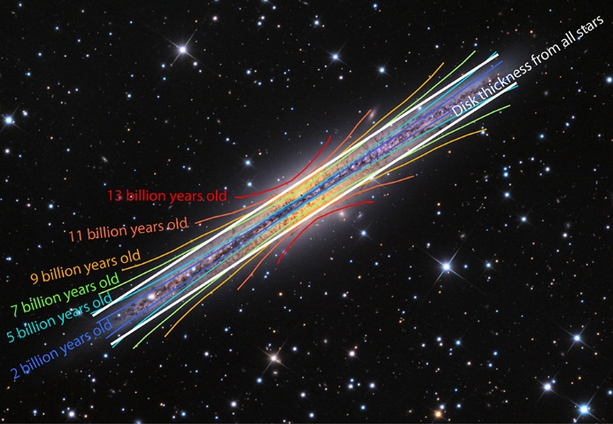
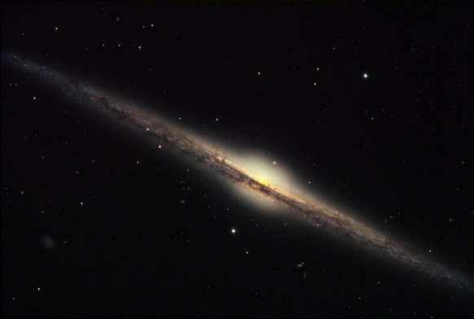
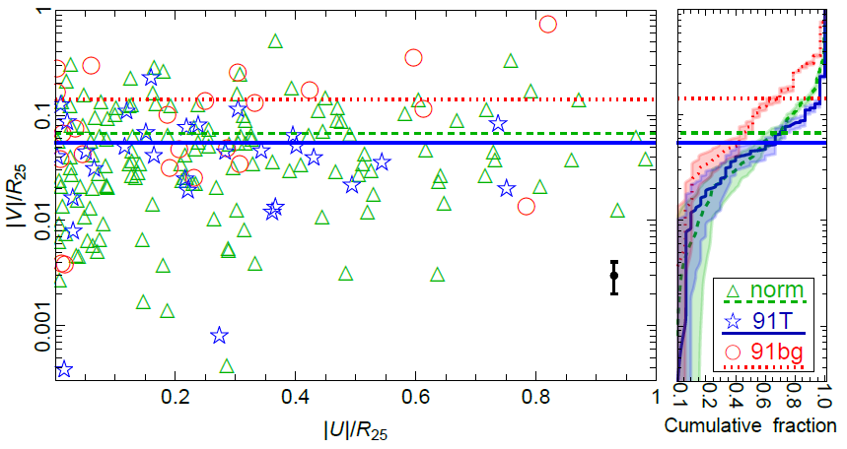
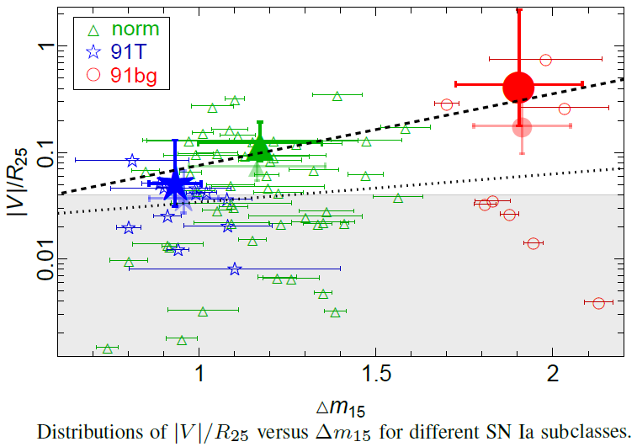

Constraining Type Ia supernovae through their heights in edge-on galaxies
The vertical age gradients of disc stars
Location of the SN within its edge-on host galaxy (Hakobyan+ 2017).
Minchev+ 2015
69 SNe Ia with ${∆m}_{15}$
197 SNe Ia in total (Barkhudaryan 2023)
Barkhudaryan 2023
The vertical distribution of 91T-like SNe is significantly different from that of 91bg-like SNe, being 2.8±0.03 times more concentrated to the plane of the host disc.

Slide 16
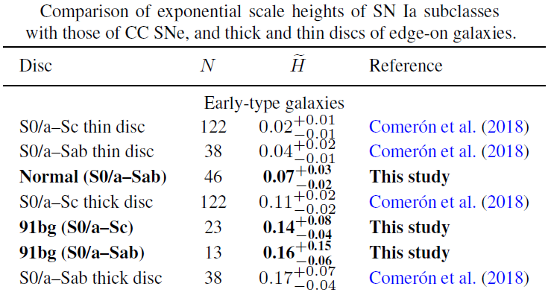
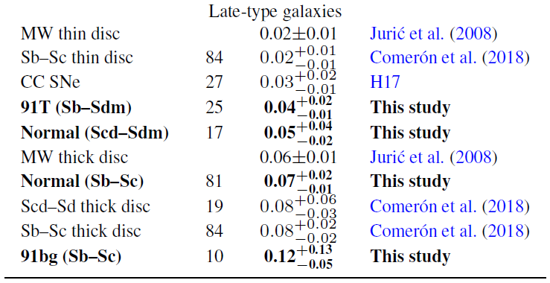
Constraining Type Ia supernovae through their heights in edge-on galaxies
about one, but up to ∼ 10 Gyr
significantly older ∼ 10 Gyr
Extragalactic thick and thin discs
several 100 Myr
Barkhudaryan 2023

Slide 17
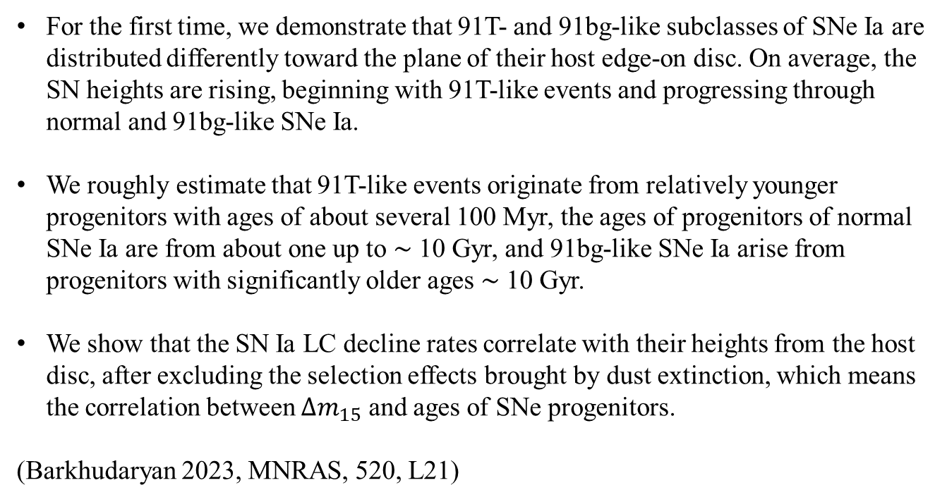
Principal results
(SNe Ia heights)
For the first time, we demonstrate that 91T- and 91bg-like subclasses of SNe Ia are distributed differently toward the plane of their host edge-on disc. On average, the SN heights are rising, beginning with 91T-like events and progressing through normal and 91bg-like SNe Ia.
We roughly estimate that 91T-like events originate from relatively younger progenitors with ages of about several 100 Myr, the ages of progenitors of normal SNe Ia are from about one up to ∼ 10 Gyr, and 91bg-like SNe Ia arise from progenitors with significantly older ages ∼ 10 Gyr.
We show that the SN Ia LC decline rates correlate with their heights from the host disc, after excluding the selection effects brought by dust extinction, which means the correlation between ${∆m}_{15}$ and ages of SNe progenitors.
(Barkhudaryan 2023, MNRAS, 520, L21)

Slide 18
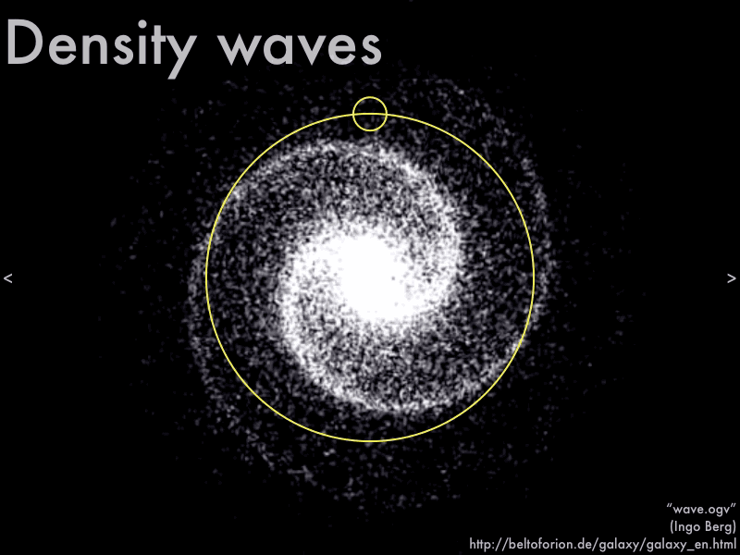
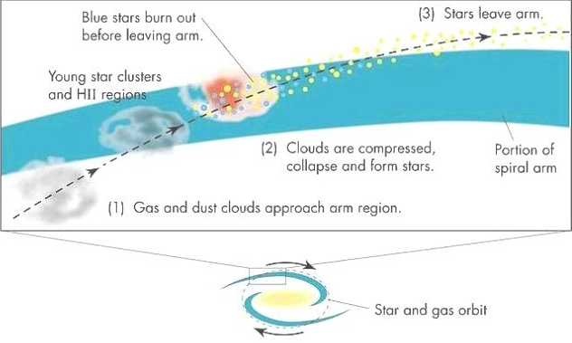
Constraining Type Ia supernovae via their distances from spiral arms
Spiral density wave & star formation
pioneering work of Lin & Shu (1964)
semi-permanent spiral patterns in GD galaxies are created by long-lived quasi-stationary density waves (DWs)
Massive star formation triggering by DWs in a GD galaxy with two logarithmic spiral arms
originally proposed by Roberts (1969)
outer edge
shock front
direction of rotation
inner edge
corotation region
shock front
shock front
inner edge
direction of rotation
shock front
outer edge

Slide 19
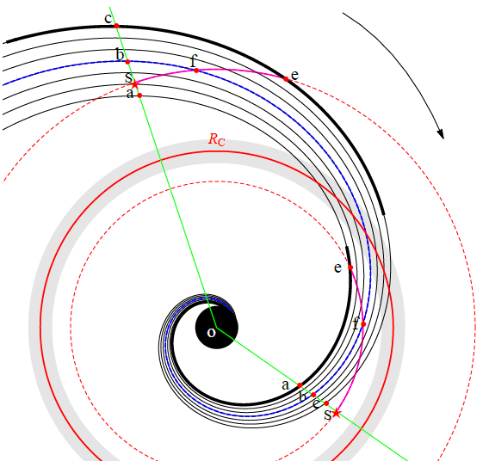
Constraining Type Ia supernovae via their distances from spiral arms
77 SNe Ia (Karapetyan 2022)
Karapetyan 2022
SN distance from arm peak
Karapetyan 2022
SN distance from the shock front

Slide 20

Principal results
(SNe Ia distances from spiral arm)
We encourage further analysis (e.g. integral field observations) using the mentioned properties on larger datasets of SNe Ia and their host galaxies to better constrain SN Ia progenitor ages.
Fortunately, a far larger spectroscopic and photometric sample of nearby SNe Ia will be made available by the ongoing robotic telescope surveys at various locations throughout the globe (e.g. All Sky Automated Survey for SuperNovae) and by the forthcoming Vera C. Rubin Observatory (the Large Synoptic Survey Telescope), which will allow for statistically more powerful and accurate analysis.
In GD spiral galaxies, Arm SNe Ia have younger progenitors in comparison with those of Interarm SNe.
We demonstrate that the SN Ia distances from the spiral arms and their galactocentric radii are correlated: before and after the average corotation radius, SNe Ia are located near the inner and outer edges (shock fronts) of spiral arms, respectively.
The positive correlation between ${∆m}_{15}$ and the distances of SNe Ia from the shock fronts means that there is an important relation between ${∆m}_{15}$ and ages of SNe Ia progenitors.
(Karapetyan 2022, MNRAS, 517, L132)

Slide 21
Thank You
Acknowledgements
The work was supported by the Science Committee of RA, in the frames of the research project ‹ 21T–1C236.

