Slide 1
Listening to the long ringdown
Luciano Rezzolla
Institute for Theoretical Physics, Frankfurt
Pescara,11.07.24
Ecker, Gorda, Kurkela, LR, 2403.03246 (2024)

Slide 2
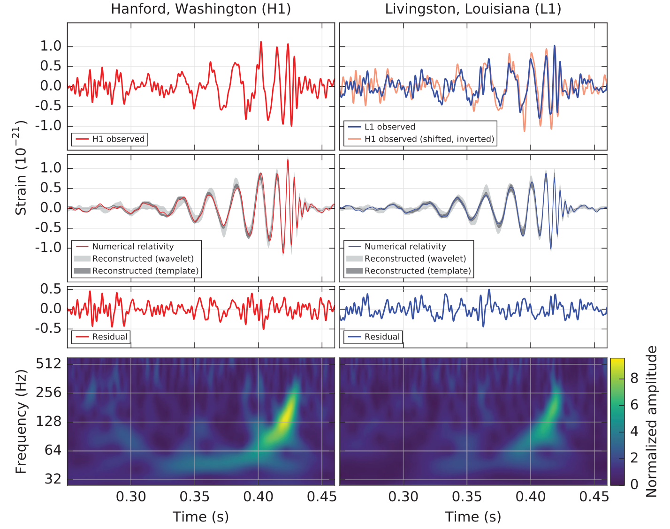
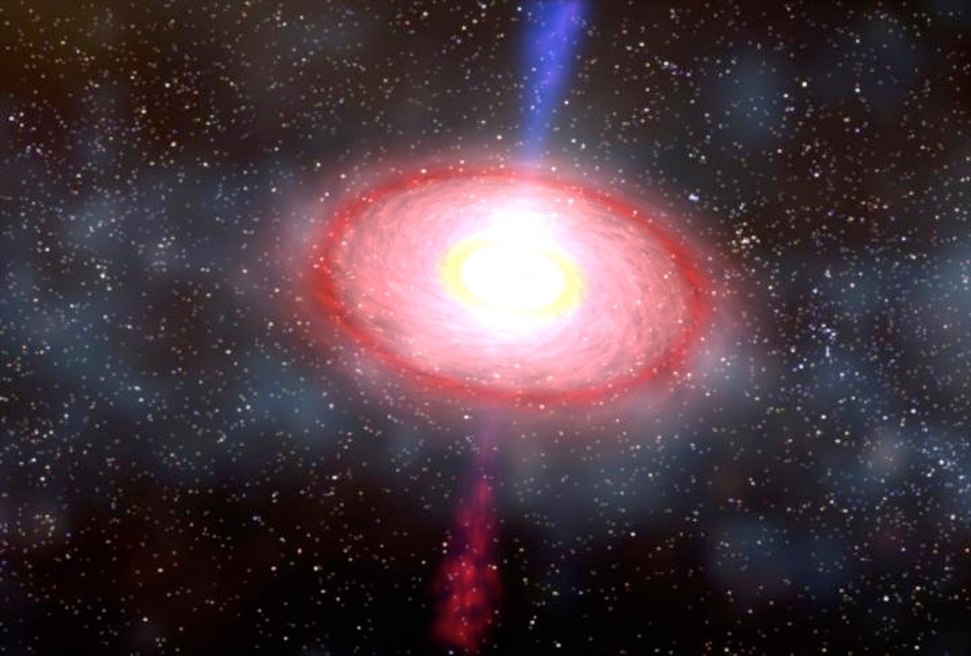
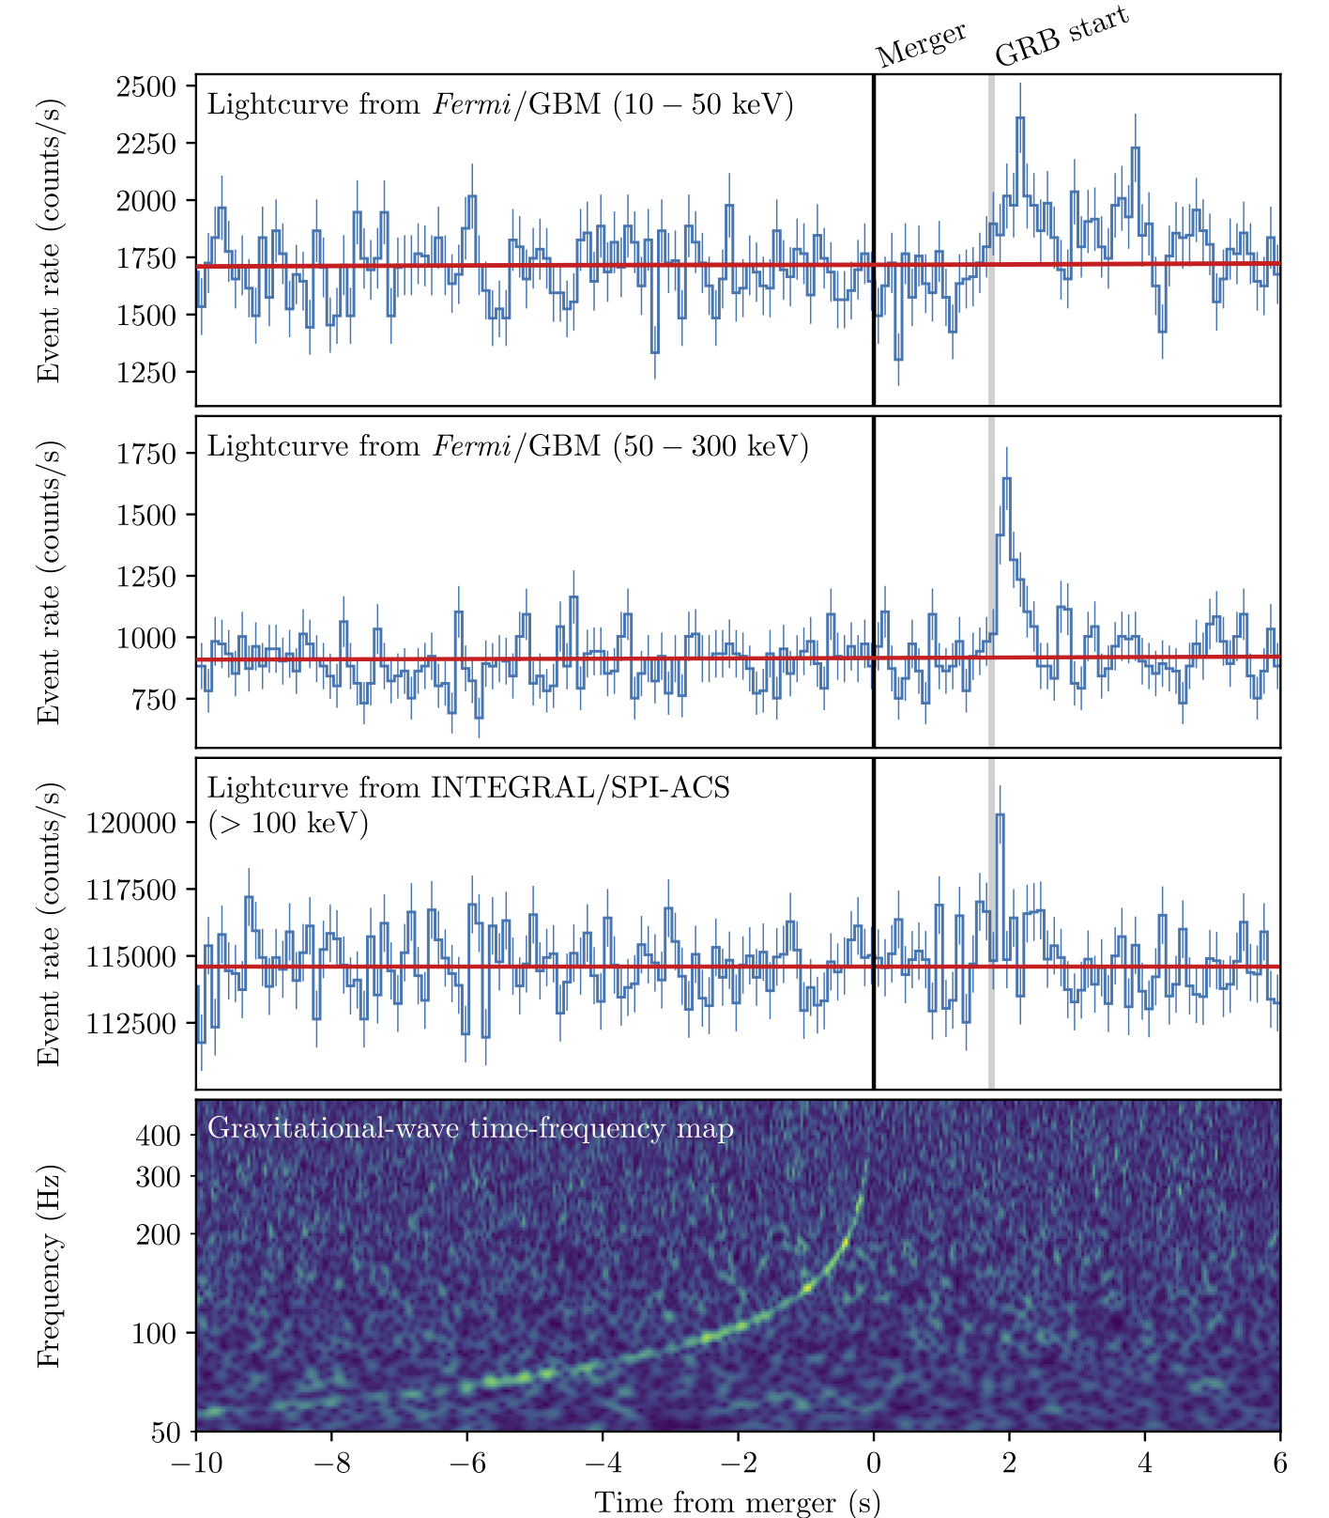
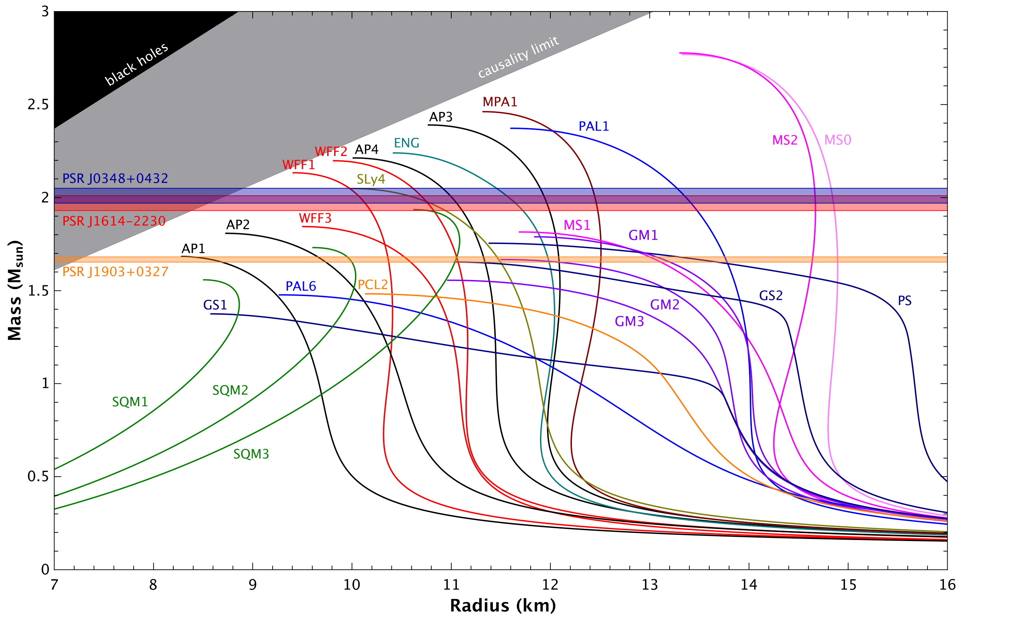
The two-body problem in GR
For black holes the process is very simple:
BH + BH BH + GWs
For NSs the question is more subtle: the merger leads to an hyper-massive neutron star (HMNS), ie a metastable equilibrium:
NS + NS HMNS+... ? BH+torus+... ? BH + GWs
HMNS gives information on EOS: GW spectroscopy
GW150914
Abbott+ 2016
BH+torus reveal engine of GRBs and other EM emissions
Wex 2016
GW170817

Slide 3
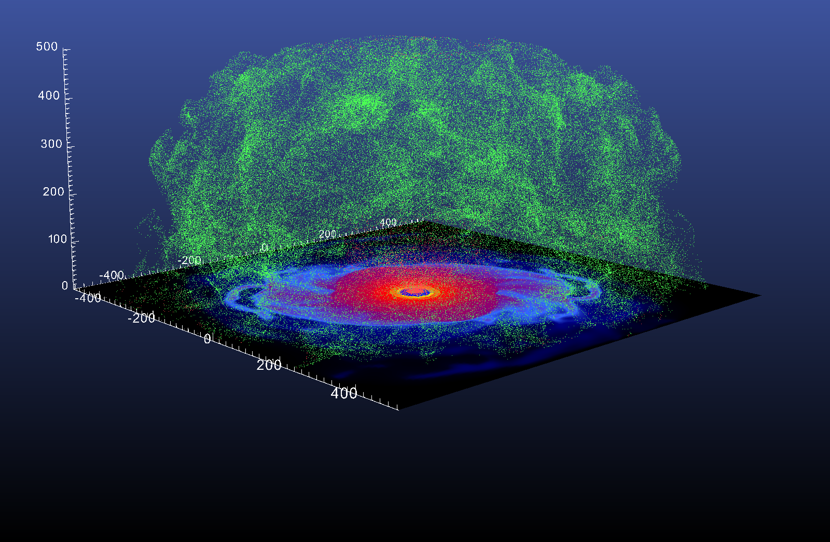
The two-body problem in GR
For black holes the process is very simple:
BH + BH BH + GWs
For NSs the question is more subtle: the merger leads to an hyper-massive neutron star (HMNS), ie a metastable equilibrium:
NS + NS HMNS+... ? BH+torus+... ? BH + GWs
ejected matter undergoes nucleosynthesis of heavy elements

Slide 4
Mathematical setup
3D, no symmetries

Slide 6
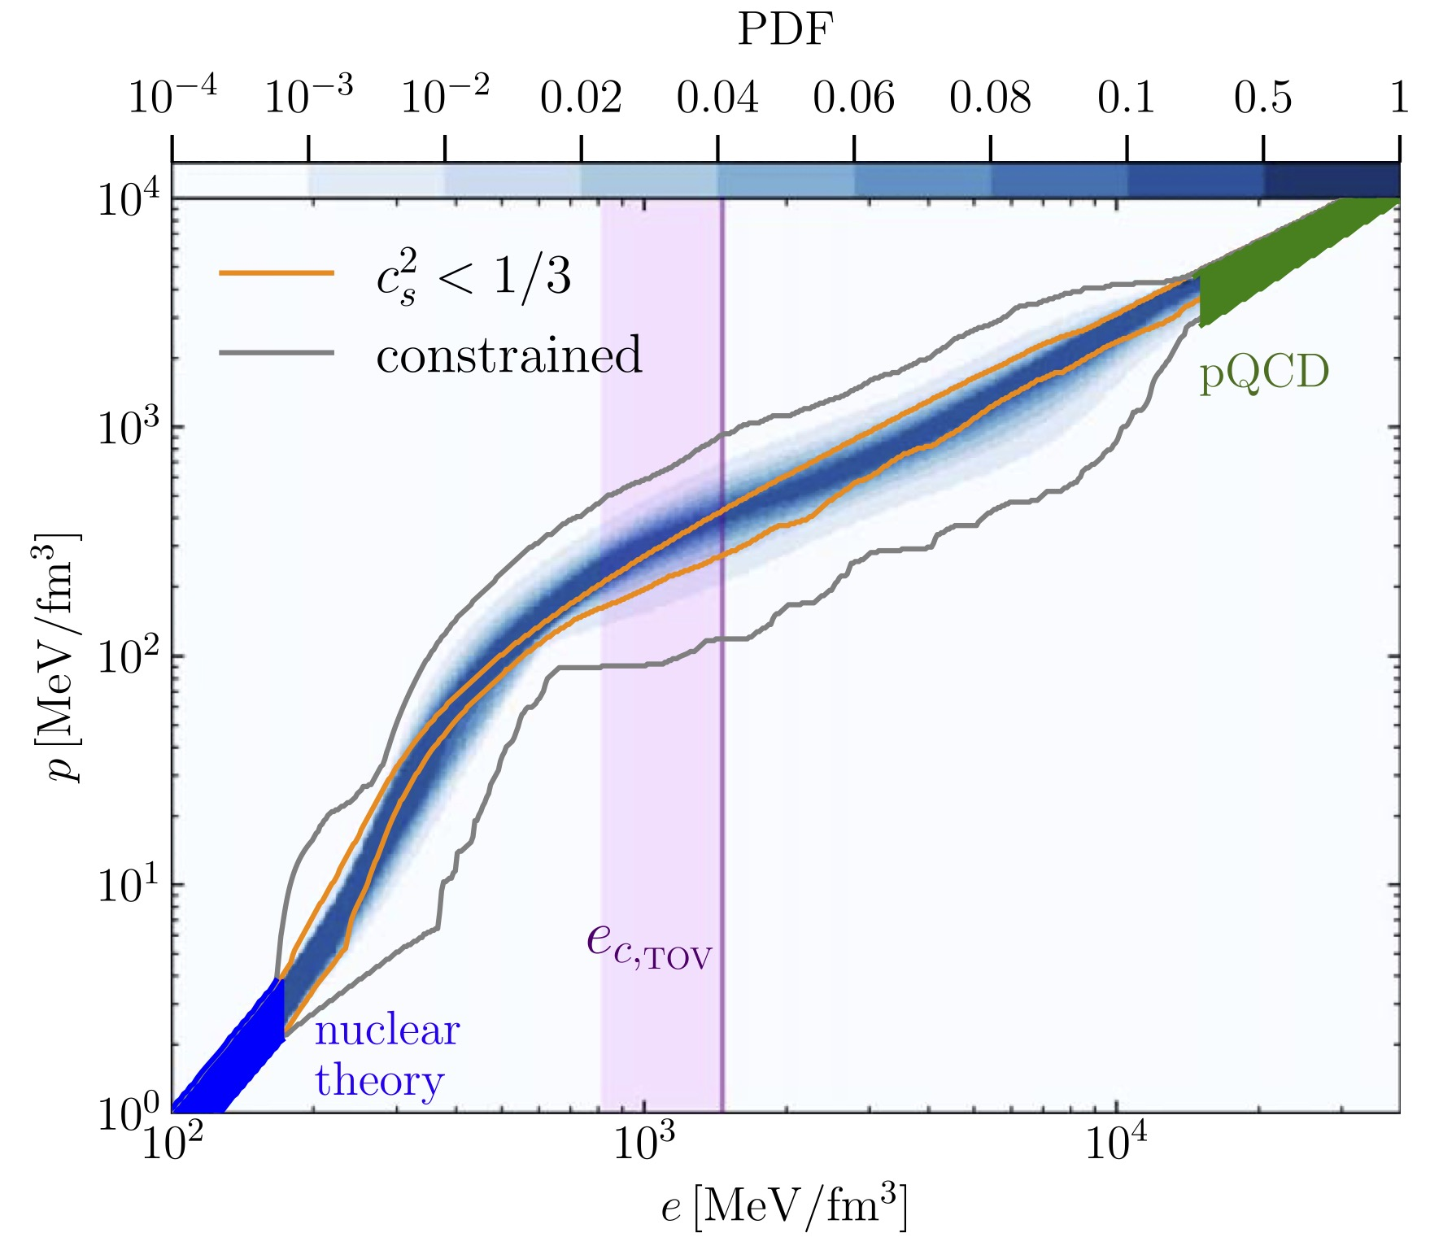
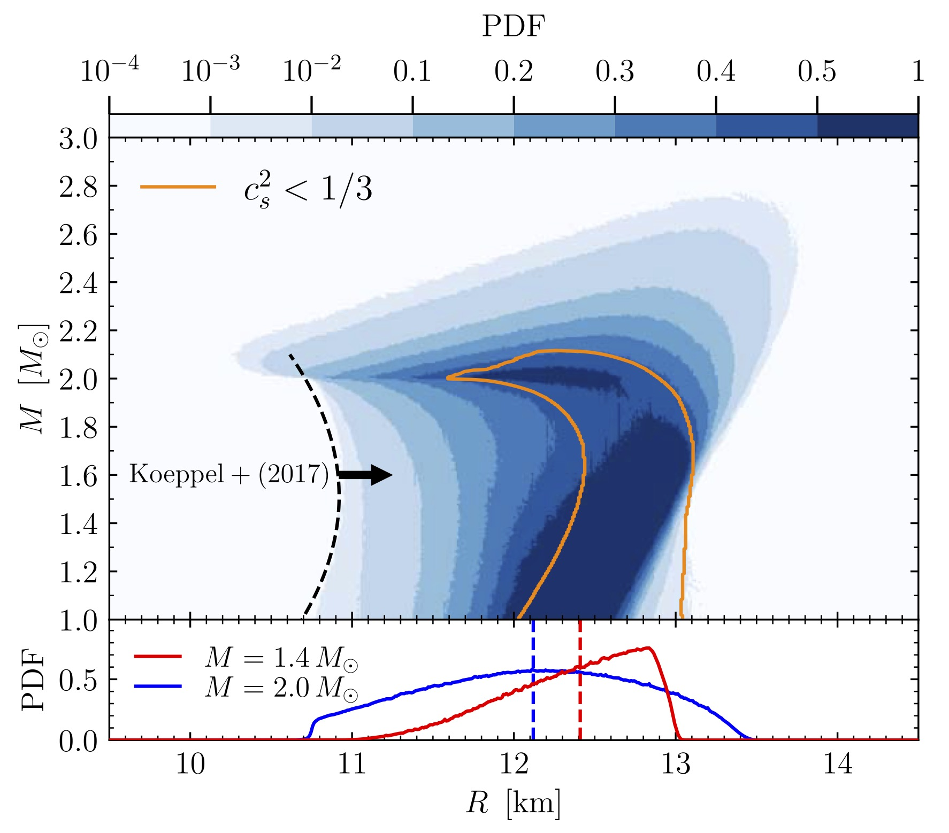
Agnostic EOS
Perform simulations is possible but EOS is main unknown. Agnostic approach can highlight generic behaviours.
However, how to choose the relevant EOS?

Slide 7
Principal-component analysis (PCA)
Decompose space of EOSs into four principal-component vectors
and select the EOSs that represent extrema, at a given confidence level, in the posterior distributions.
We can the isolate 6 EOS that are the corner cases of the space of solutions: “golden EOSs”, A-F.

Slide 8
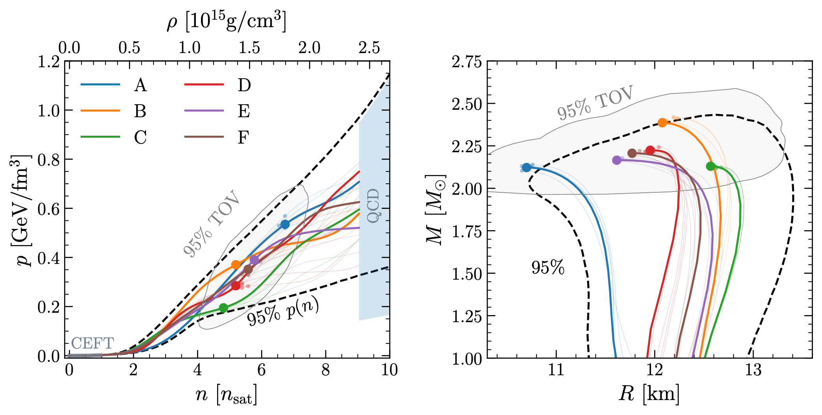
The six golden EOSs
Different lines show the properties of the EOSs in terms of $(p,e)$ or $(M,R)$ diagrams.

Slide 9
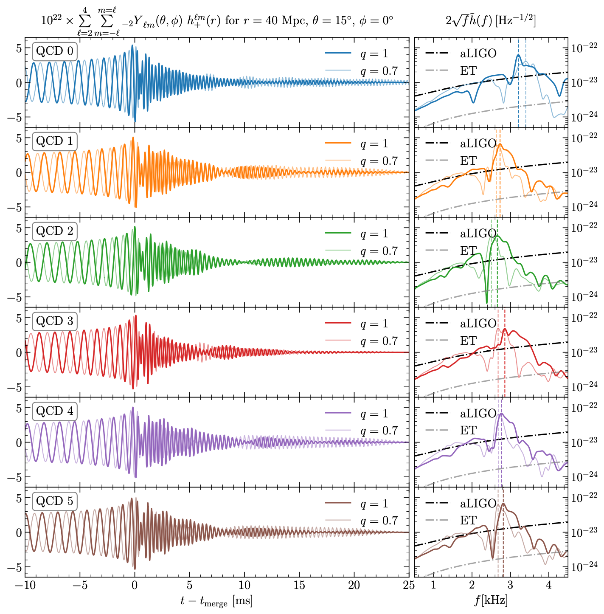
The evolution the six golden EOSs
For each of the six EOSs (A-F):
the full gravitational waveform,
the spectral decomposition
the comparison with the sensitivity curves of aLIGO and ET.

Slide 10
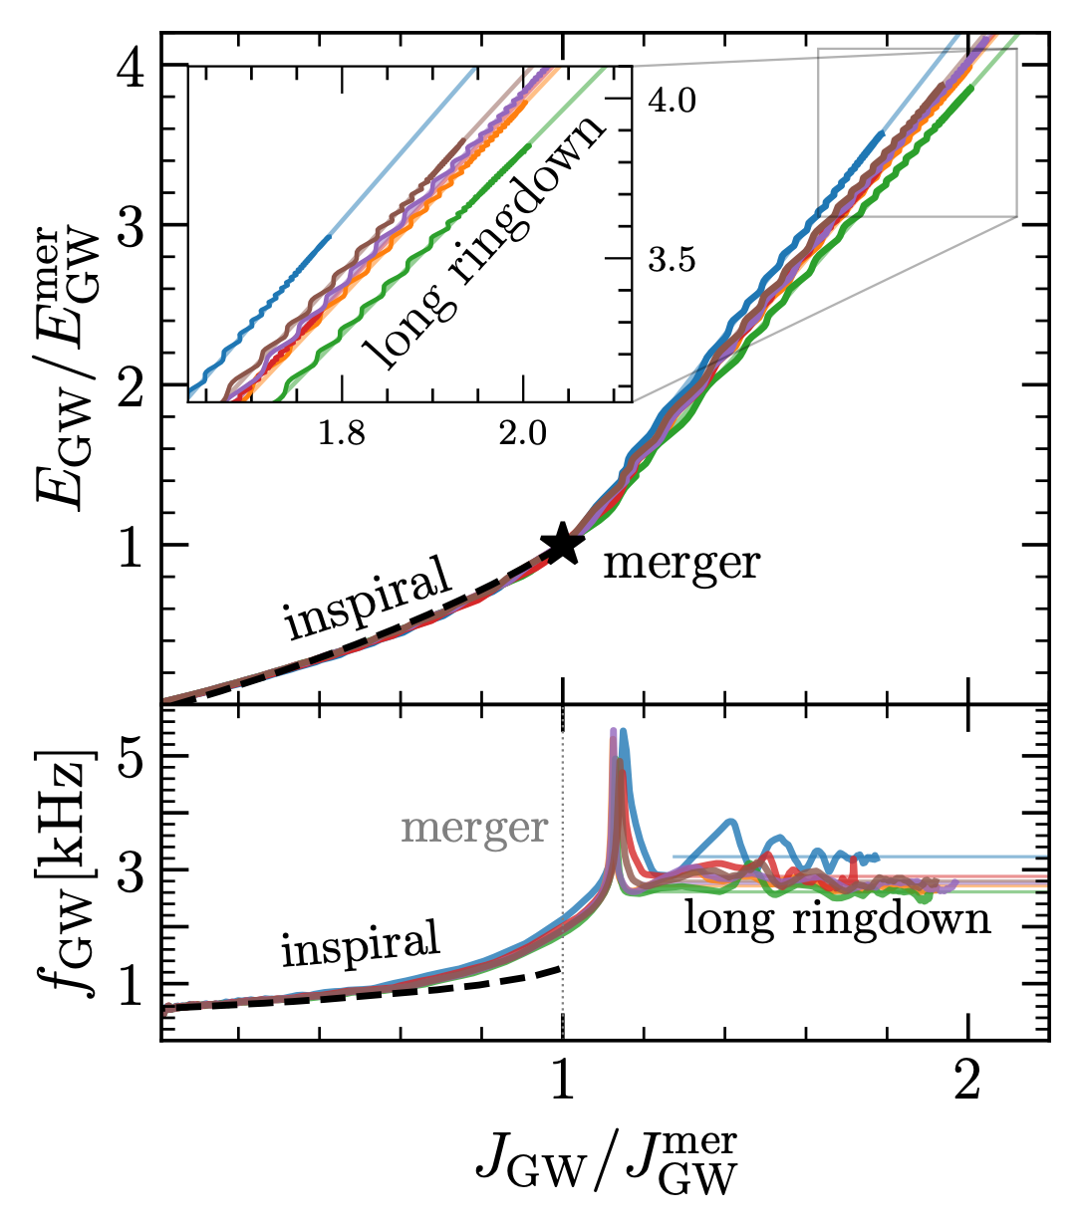
A novel representation of the waveforms
Novel behaviour when looking at energy radiated in GWs, $E_{GW}$, as a function of the radiated angular momentum $J_{GW}$.
The “slope” $dE_{GW}/dJ_{GW}$ is different for different EOSs
Note that the behaviour is essentially linear at late times. This is expected for a monochromatic GW signal

Slide 11
A novel representation of the waveforms
Novel behaviour when looking at energy radiated in GWs, $E_{GW}$, as a function of the radiated angular momentum $J_{GW}$.
The “slope” $dE_{GW}/dJ_{GW}$ is different for different EOSs
Almost constant asymptotic GW frequency is evident when looking at evolution of GW frequency.

Slide 12
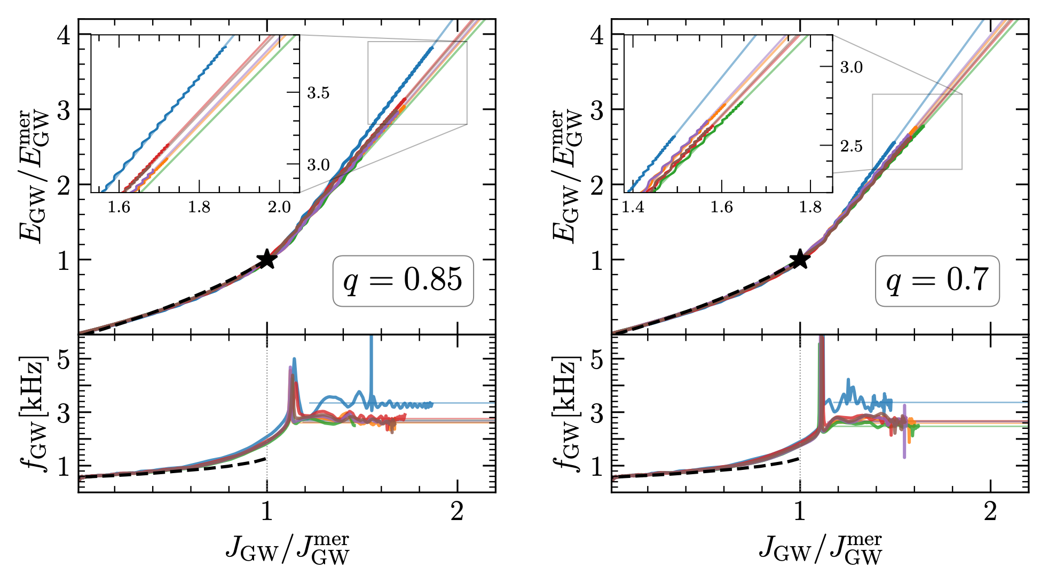
A novel representation of the waveforms
Behaviour is robust also when considering unequal-mass binaries and physics-motivated EOSs.

Slide 13
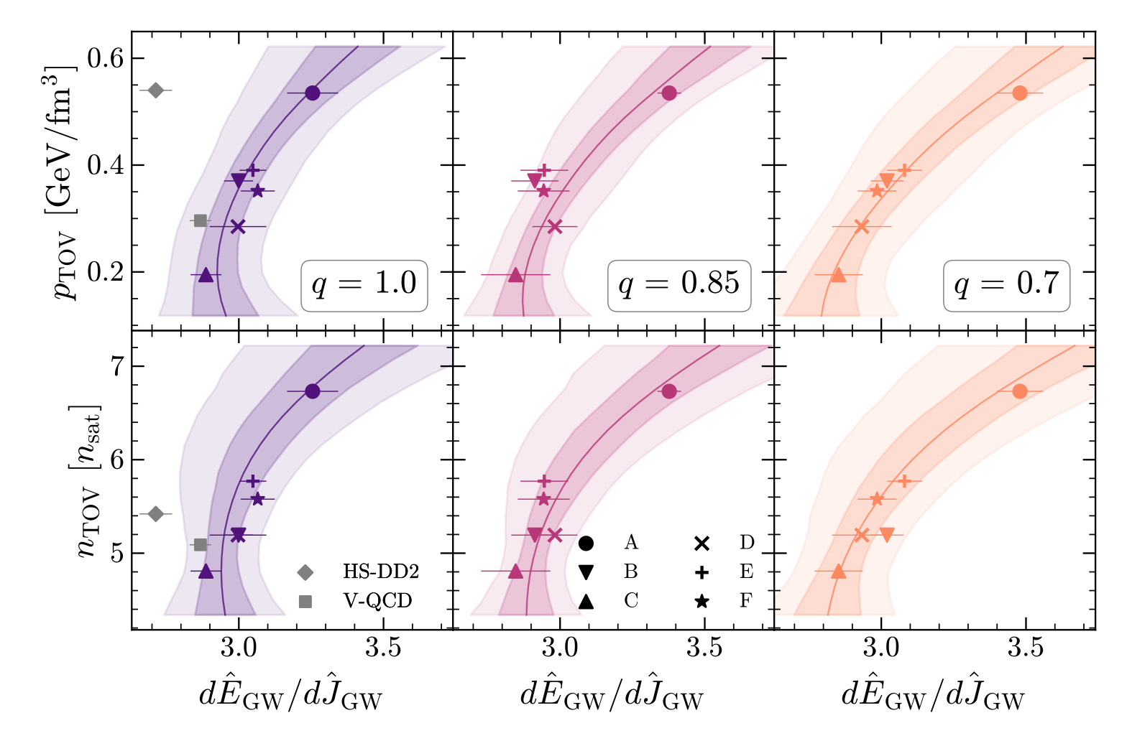
How do we use this?
GW data provides measure of slope, which is correlated with properties of the EOS.
Hence, $dE_{GW}/dJ_{GW}$ provides information on the EOS.

Slide 14
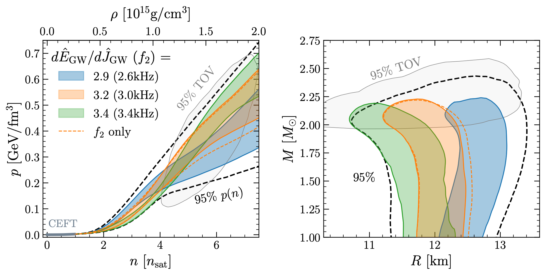
How do we use this?
Using correlations found, we have assessed 68% credibility values on $(p,e)$ and $(M,R)$ planes from joint measurements of slope and $f_{2}$ post-merger freq.

Slide 15
Conclusions
Agnostic EOSs represent a powerful tool to explore the properties of the the post-merger GW signal.
Using a principal-component analysis we have selected six “golden” EOSs that provide optimal examples of different EOSs.
The late post-merger GW signal shows relation between radiated energy and angular momentum: $dE_{GW}/dJ_{GW}$ or “slope"
Correlations exist between the slope and the properties of the EOS at the highest densities and pressure.
The long ringdown, used together with “traditional” approaches represents new tool to constrain neutron-star properties.

