Slide 1
Status of Birkhoff ’s theorem in polymerized semiclassical regime of Loop Quantum Gravity
Luca Cafaro
LC, Jerzy Lewandowski (2024) arXiv:2403.01910
Seventeenth Marcel Grossmann Meeting – Pescara, 7-12 July 2024

Slide 2
Introduction
Collapse of a spherically symmetric cloud of homogeneous pressureless dust
Modified Einstein’s equations
Oppenheimer-Snyder model
(by matching)
Seventeenth Marcel Grossmann Meeting – Pescara, 7-12 July 2024

Slide 3
Einstein’s Equations

Slide 4
Classical theory
General spherically symmetric line element:
$${ds}^{2}=−N{dτ}^{2}+ \frac{{(E}^{φ})^{2}}{E^{x}}{(dx+N}^{x} dτ)^{2}+E^{x}{dΩ}^{2}$$
(PG coordinates)
$$\left\{{K_{x}\left(y_{1}\right), E}^{x}\left(y_{2}\right)\right\}=2γδ(y_{1}−y_{2})$$
$$G=c=1$$
$$\left\{{K_{φ}\left(y_{1}\right), E}^{φ}\left(y_{2}\right)\right\}=γδ(y_{1}−y_{2})$$
Dust Gauge
($dust field=τ$)
$$N=1$$
Areal Gauge
$$E^{x}=x^{2}$$
$$E^{φ}=±\frac{x}{\sqrt{1+ε(τ,x)}}$$
Seventeenth Marcel Grossmann Meeting – Pescara, 7-12 July 2024

Slide 5
Polymerization
J. G. Kelly, R. Santacruz, E. Wilson-Ewing. (2020)
V. Husain, J. G. Kelly, R. Santacruz, E. Wilson-Ewing. (2022)
$$\text{|}E_{j−1}^{φ}\text{⟩}$$
$$\text{|}E_{j}^{φ}\text{⟩}$$
$$\text{|}E_{j+1}^{φ}\text{⟩}$$
1-dimensional graph:
$$x$$
$$x_{j−1}$$
$$x_{j}$$
$$x_{j+1}$$
Discretization: $x⟶x_{j}$
$$E^{φ}⟹{\hat{E}}_{j}^{φ}$$
$K_{φ} ⟹$ ${\hat{U}}_{j}=e^{i {\overline{μ}}_{j}K_{φ}(x_{j})}$
Operators:
$${\overline{μ}}_{j}=\frac{\sqrt{Δ}}{x_{j}}$$
Polymerization:
$${\hat{U}}_{j}=e^{i {\overline{μ}}_{j}K_{φ}(x_{j})}$$
$$\frac{{\hat{U}}_{j}−{\hat{U}}_{j}^{†}}{2 i {\overline{μ}}_{j}}=\frac{\sin{{(\overline{μ}}_{j}K_{φ}(x_{j})})}{{\overline{μ}}_{j}}$$
Seventeenth Marcel Grossmann Meeting – Pescara, 7-12 July 2024

Slide 6
Semiclassical theory
J. G. Kelly, R. Santacruz, E. Wilson-Ewing. (2020)
V. Husain, J. G. Kelly, R. Santacruz, E. Wilson-Ewing. (2022)
$${ds}^{2}=−{dτ}^{2}+ \frac{{(E}^{φ})^{2}}{x^{2}}{(dx+N}^{x} dτ)^{2}+x^{2}{dΩ}^{2}$$
$$β≔ \frac{\sqrt{∆}}{x}K_{φ}$$
$${\dot{E}}^{φ}=−\frac{x^{2}}{γ\sqrt{Δ}}∂_{x}\left(\frac{E^{φ}}{x}\right)\sin{β}\cos{β}$$
$$\}$$
Polymerized Einstein Field Equations (PEFE)
$$\dot{F}=\{F,H\}$$
$${\dot{K}}_{φ}=\frac{γx}{2{\left(E^{φ}\right)}^{2}}−\frac{γ}{2x}−\frac{∂_{x}\left(x^{3}\sin^{2}{β}\right)}{2γΔx}$$
$$ρ=−\frac{ℋ}{4πxE^{φ}}$$
$$ρ=\frac{1}{8πxE^{φ}}\left[\frac{E^{φ}}{γ^{2}Δx}∂_{x}\left(x^{3}\sin^{2}{β}\right)+\frac{x}{E^{φ}}+\frac{E^{φ}}{x}−2∂_{x}\left(\frac{x^{2}}{E^{φ}}\right)\right]$$
$$N^{x}=−\frac{K_{φ}}{γ}$$
$N^{x}=−\frac{x}{γ\sqrt{Δ}}$ $\sin{β}\cos{β}$
Seventeenth Marcel Grossmann Meeting – Pescara, 7-12 July 2024

Slide 7
Interior $\left(ρ≠0, { ∂}_{x}ρ=0\right)$
M. Bojowald, J. D. Reyes, R. Tibrewala (2009)
K. Giesel, H. Liu, E. Rullit, P. Singh, S. A. Weigl (2023)
$$E^{φ}=±\frac{x}{\sqrt{1+ε(τ,x)}}$$
$$\{$$
$$\dot{ε}=ε^{′}\sqrt{\frac{8π}{3}ρx^{2}+ε}\sqrt{1−\frac{ρ}{ρ_{c}}−\frac{3}{8πρ_{c}}\frac{ε}{x^{2}}}$$
$$ρ_{c}≔\frac{3}{8πγ^{2}Δ}$$
PEFE
$$\sin^{2}{β}=γ^{2}Δ\left(\frac{8π}{3}ρ+\frac{ε}{x^{2}}\right)$$
$$x=ξ\left(T,R\right)$$
$$τ=T$$
$N^{x}=−∂_{T}ξ$
$$ε=E(R)$$
$${ds}^{2}=−{dT}^{2}+ \frac{{\left(∂_{R}ξ\right)}^{2}}{1+E(R)}{dR}^{2}+ξ^{2}{dΩ}^{2}$$
(LTB coordinates)
$${\left(\frac{∂_{T}ξ}{ξ}\right)}^{2}=\left(\frac{8π}{3}ρ−\frac{E}{ξ^{2}}\right)\left(1−\frac{ρ}{ρ_{c}}+\frac{3}{8πρ_{c}}\frac{E}{ξ^{2}}\right)$$
Seventeenth Marcel Grossmann Meeting – Pescara, 7-12 July 2024

Slide 8
Interior $\left(ρ≠0, { ∂}_{x}ρ=0\right)$
From ${ds}^{2}=−{dT}^{2}+ \frac{{\left(∂_{R}ξ\right)}^{2}}{1+E(R)}{dR}^{2}+ξ^{2}{dΩ}^{2}$
$ξ=a(T)χ_{k}\left(R\right)$
$$E(R) =−kχ_{k}^{2}$$
The Friedmann dust ball: ${ds}^{2}=−{dT}^{2}+ a^{2}{dR}^{2}+a^{2}χ_{k}^{2}{dΩ}^{2}$ with $χ_{k}\left(R\right)=\frac{1}{\sqrt{k}}\sin\left(\sqrt{k}R\right)$
$${\left(\frac{\dot{a}}{a}\right)}^{2}=\left(\frac{8π}{3}ρ−\frac{k}{a^{2}}\right)\left(1−\frac{ρ}{ρ_{c}}+\frac{3}{8πρ_{c}}\frac{k}{a^{2}}\right)$$
$ρ∝1/{a^{3}}$ (pressureless dust)
Classical Friedmann equation for $ρ_{c}⟶∞$ ($Δ⟶0$)
Seventeenth Marcel Grossmann Meeting – Pescara, 7-12 July 2024

Slide 9
Static Exterior $\left(ρ=0\right)$
$${\dot{E}}^{φ}=−\frac{x^{2}}{γ\sqrt{Δ}}∂_{x}\left(\frac{E^{φ}}{x}\right)\sin{β}\cos{β}$$
$$=0$$
$$E^{φ}=Ax=±\frac{x}{\sqrt{1+B}}$$
$$\}$$
$${\dot{K}}^{φ}=0$$
The metric is fully determined by these 2 expressions
$${\left(N^{x}\right)}^{2}=\frac{2M}{x}−\frac{α}{x^{2}}{\left(\frac{M}{x}+\frac{B}{2}\right)}^{2}+B$$
$$α≔4γ^{2}Δ$$
$${ds}^{2}=−{dτ}^{2}+A^{2}{(dx+N}^{x} dτ)^{2}+x^{2}{dΩ}^{2}$$
In Schwarzschild coordinates:${ ds}^{2}=−f(r){dt}^{2}+\frac{{dr}^{2}}{f(r)}+r^{2}{dΩ}^{2}$
$$f\left(r\right)=1−\frac{2M}{r}+\frac{α}{r^{2}}{\left(\frac{M}{r}+\frac{B}{2}\right)}^{2}$$
Seventeenth Marcel Grossmann Meeting – Pescara, 7-12 July 2024

Slide 10
Time dependent Exterior $\left(ρ=0\right)$
$${\dot{E}}^{φ}=−\frac{x^{2}}{γ\sqrt{Δ}}∂_{x}\left(\frac{E^{φ}}{x}\right)\sin{β}\cos{β}$$
$$E^{φ}=±\frac{x}{\sqrt{1+ε(τ,x)}}$$
$$≠0$$
$$\{$$
$$\dot{ε}=ε^{′}\sqrt{ε+\frac{2M}{x}}\sqrt{1−γ^{2}Δ\left(\frac{ε}{x^{2}}+\frac{2M}{x^{3}}\right)}$$
PEFE
$$\sin^{2}{β}=γ^{2}Δ\left(\frac{ε}{x^{2}}+\frac{2M}{x^{3}}\right)$$
$ε=const$ or $ε=ε(τ,x)$
If $ε≠ε(τ,x)$ then the only line element is given by $f\left(r\right)=1−\frac{2M}{r}+\frac{α}{r^{2}}{\left(\frac{M}{r}+\frac{B}{2}\right)}^{2}$
Seventeenth Marcel Grossmann Meeting – Pescara, 7-12 July 2024

Slide 11
Oppenheimer-Snyder model
(by matching)

Slide 12
Oppenheimer-Snyder model
H. Ziaie, Y. Tavakoli (2020)
Parvizi, T. Pawlowski, Y. Tavakoli, J. Lewandowski (2022)
J. Lewandowski, Y. Ma, J. Yang, C. Zhang (2023)
VACUUM
$$\left(t,r,θ,φ\right)$$
$${ ds}^{2}=−f(r){dt}^{2}+\frac{{dr}^{2}}{f(r)}+r^{2}{dΩ}^{2}$$
$$f\left(r\right)=1−\frac{2M}{r}+\frac{α}{r^{2}}{\left(\frac{M}{r}−\frac{kχ_{k,0}^{2}}{2}\right)}^{2}$$
DUST
$$\left(T,R,θ,φ\right)$$
$$ρ=\frac{C}{a^{3}}$$
${ds}^{2}=−{dT}^{2}+ a^{2}{dR}^{2}+a^{2}χ_{k}^{2}{dΩ}^{2}$ with $χ_{k}\left(R\right)=\frac{1}{\sqrt{k}}\sin\left(\sqrt{k}R\right)$
$${\left(\frac{\dot{a}}{a}\right)}^{2}=\left(\frac{8π}{3}ρ−\frac{k}{a^{2}}\right)\left(1−\frac{ρ}{ρ_{c}}+\frac{3}{8πρ_{c}}\frac{k}{a^{2}}\right)$$
$$\left(\frac{\ddot{a}}{a}\right)=−\frac{4π}{3}ρ\left(1−\frac{ρ}{ρ_{c}}+\frac{3}{8πρ_{c}}\frac{k}{a^{2}}\right)+\left(\frac{8π}{3}ρ−\frac{k}{a^{2}}\right)\left(\frac{3}{2}\frac{ρ}{ρ_{c}}−\frac{3}{8πρ_{c}}\frac{k}{a^{2}}\right)$$
Seventeenth Marcel Grossmann Meeting – Pescara, 7-12 July 2024

Slide 13
Critical mass and horizons
$$f\left(r\right)=1−\frac{2M}{r}+\frac{α}{r^{2}}{\left(\frac{M}{r}−\frac{kχ_{k,0}^{2}}{2}\right)}^{2}$$
If $M_{−}≤M≤ M_{+} ⇒ ∄$ real solutions of $f\left(r\right)=0$ (no horizons)
$$M_{±}^{2}= \frac{α}{216}\left[64−96 kχ_{k,0}^{2}+30 k^{2}χ_{k,0}^{4}+k^{3}χ_{k,0}^{6} ±{\left(16−16 kχ_{k,0}^{2}+k^{2}χ_{k,0}^{4}\right)}^{3/2}\right]$$
If $M≥ M_{+} ∪ M≤M_{−} ⇒ ∃$ 2 real solutions to $f\left(r\right)=0$
$$r_{−}={\left(\frac{αM}{2}\right)}^{1/3}+\frac{1−2 kχ_{k,0}^{2}}{6M}{\left(\frac{αM}{2}\right)}^{2/3}+\frac{{\left(1−kχ_{k,0}^{2}\right)}^{2}}{24 M}α+O\left(α^{4/3}\right)$$
$$r_{+}=2M−\frac{{\left(1−kχ_{k,0}^{2}\right)}^{2}}{8 M}α+O\left(α^{4/3}\right)$$
Seventeenth Marcel Grossmann Meeting – Pescara, 7-12 July 2024

Slide 14
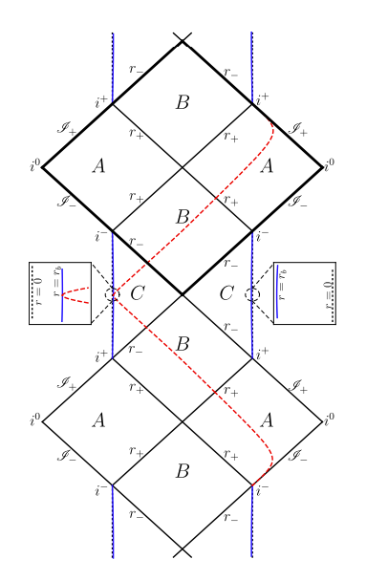
k=0
H. Ziaie, Y. Tavakoli (2020)
Parvizi, T. Pawlowski, Y. Tavakoli, J. Lewandowski (2022)
J. Lewandowski, Y. Ma, J. Yang, C. Zhang (2023)
$f\left(r\right)=1−\frac{2M}{r}+α\frac{ M^{2}}{r^{4}}$
Exact solution to the PEFE with $B=0$
$M_{−}=0$, $M_{+}=\frac{4}{3\sqrt{3}}\sqrt{α}$
$${\left(\frac{\dot{a}}{a}\right)}^{2}=\left(\frac{8π}{3}ρ\right)\left(1−\frac{ρ}{ρ_{c}}\right)$$
$$\left(\frac{\ddot{a}}{a}\right)=−\frac{4π}{3}ρ\left(1−\frac{ρ}{ρ_{c}}\right)+4π\frac{ρ^{2}}{ρ_{c}}$$
Credits:
J. Lewandowski,
Y. Ma,
J. Yang,
C. Zhang
Seventeenth Marcel Grossmann Meeting – Pescara, 7-12 July 2024

Slide 15
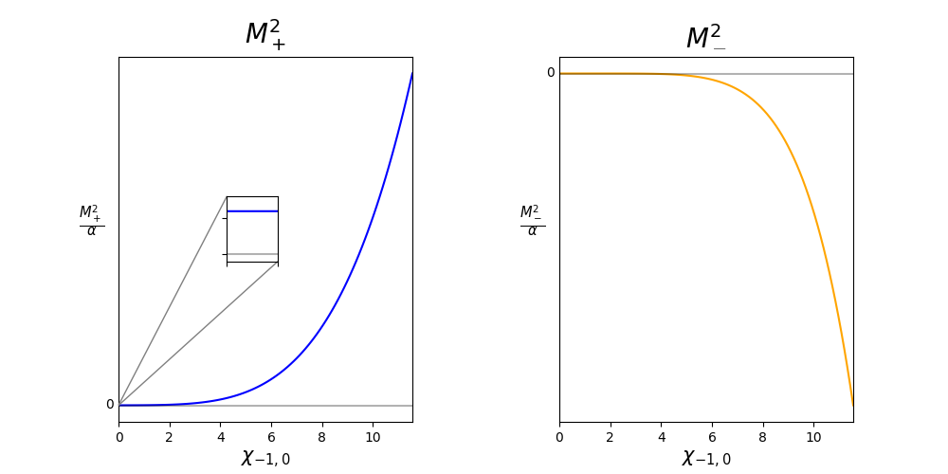
k= -1
$f\left(r\right)=1−\frac{2M}{r}+\frac{α}{r^{2}}{\left(\frac{M}{r}+\frac{χ_{−1,0}^{2}}{2}\right)}^{2}$
Exact solution to the PEFE with $B=$ $χ_{−1,0}^{2}$
$${\left(\frac{\dot{a}}{a}\right)}^{2}=\left(\frac{8π}{3}ρ+\frac{1}{a^{2}}\right)\left(1−\frac{ρ}{ρ_{c}}−\frac{3}{8πρ_{c}}\frac{1}{a^{2}}\right)$$
$$\left(\frac{\ddot{a}}{a}\right)=−\frac{4π}{3}ρ\left(1−\frac{ρ}{ρ_{c}}−\frac{3}{8πρ_{c}}\frac{1}{a^{2}}\right)+\left(\frac{8π}{3}ρ+\frac{1}{a^{2}}\right)\left(\frac{3}{2}\frac{ρ}{ρ_{c}}+\frac{3}{8πρ_{c}}\frac{1}{a^{2}}\right)$$
Credits:
J. Lewandowski, Y. Ma, J. Yang, C. Zhang
Seventeenth Marcel Grossmann Meeting – Pescara, 7-12 July 2024

Slide 16
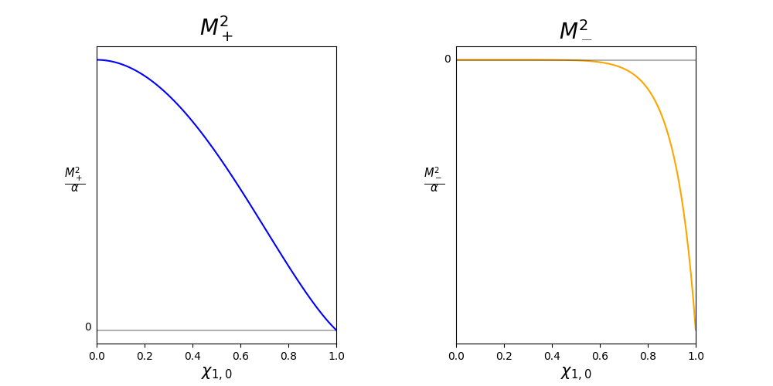
k=1
$f\left(r\right)=1−\frac{2M}{r}+\frac{α}{r^{2}}{\left(\frac{M}{r}−\frac{χ_{1,0}^{2}}{2}\right)}^{2}$
Exact solution to the PEFE with $B=$ ${−χ}_{1,0}^{2}<0$
$${\left(\frac{\dot{a}}{a}\right)}^{2}=\left(\frac{8π}{3}ρ−\frac{1}{a^{2}}\right)\left(1−\frac{ρ}{ρ_{c}}+\frac{3}{8πρ_{c}}\frac{1}{a^{2}}\right)$$
$$\left(\frac{\ddot{a}}{a}\right)=−\frac{4π}{3}ρ\left(1−\frac{ρ}{ρ_{c}}+\frac{3}{8πρ_{c}}\frac{1}{a^{2}}\right)+\left(\frac{8π}{3}ρ−\frac{1}{a^{2}}\right)\left(\frac{3}{2}\frac{ρ}{ρ_{c}}−\frac{3}{8πρ_{c}}\frac{1}{a^{2}}\right)$$
Credits:
J. Lewandowski, Y. Ma, J. Yang, C. Zhang
Seventeenth Marcel Grossmann Meeting – Pescara, 7-12 July 2024

Slide 17
Conclusion
Two independent methods lead to the very same metric.
Static exterior solutions to the Einsten’s equation are Schwarzschild-like but depend on two parameters (M and B).
There may exist other non-static solutions.
If this possibility is ruled out $⇒$ Birkhoff’s theorem.
Seventeenth Marcel Grossmann Meeting – Pescara, 7-12 July 2024

Slide 18
Seventeenth Marcel Grossmann Meeting – Pescara, 7-12 July 2024

Slide 19
Classical theory
Gravity + Dust:
$S=\int{dτ}\int{dx\left[\frac{{\dot{K}}_{x}E^{x}+2{\dot{K}}_{φ}E^{φ}}{2γ}+4π \dot{𝒯}p_{𝒯}−N(ℋ^{g}+ℋ^{d})−N^{x}(ℋ_{x}^{g}+ℋ_{x}^{d})\right]}$
$$ℋ^{g}=−\frac{1}{2γ^{2}}\left[2K_{x}K_{φ}\sqrt{E^{x}}+\frac{E^{φ}}{\sqrt{E^{x}}}\left(K_{φ}^{2}+γ^{2}\right)−\frac{γ^{2}}{4}\frac{{\left(∂_{x}E^{x}\right)}^{2}}{E^{φ}\sqrt{E^{x}}}−γ^{2}\sqrt{E^{x}}∂_{x}\left(\frac{∂_{x}E^{x}}{E^{φ}}\right)\right]$$
$$ℋ^{d}=4π\sqrt{p_{𝒯}^{2}+\frac{E^{x}}{{\left(E^{φ}\right)}^{2}}p_{𝒯}^{2}{\left(∂_{x}𝒯\right)}^{2}}$$
$$ℋ_{x}^{g}=\frac{1}{2γ}\left(2E^{φ}∂_{x}K_{φ}−K_{x}∂_{x}E^{x}\right)$$
$$ℋ_{x}^{d}=−4πp_{𝒯}∂_{x}𝒯$$
Seventeenth Marcel Grossmann Meeting – Pescara, 7-12 July 2024

Slide 20
Classical theory
Gravity + Dust: $S=\int{dτ}\int{dx\left[\frac{{\dot{K}}_{x}E^{x}+2{\dot{K}}_{φ}E^{φ}}{2γ}+4π \dot{𝒯}p_{𝒯}−N(ℋ^{g}+ℋ^{d})−N^{x}(ℋ_{x}^{g}+ℋ_{x}^{d})\right]}$
Dust Gauge ($𝒯=τ$)
$$N=1$$
Areal Gauge ($E^{x}=x^{2}$)
$$N^{x}=−\frac{K_{φ}}{γ}$$
$$S=\int{dτ}\int{dx\left[\frac{{\dot{K}}_{φ}E^{φ}}{γ}−ℋ\right]}$$
$$\left\{{K_{φ}\left(y_{1}\right), E}^{φ}\left(y_{2}\right)\right\}=γδ(y_{1}−y_{2})$$
$$ℋ=−4πp_{𝒯}=−\frac{1}{2γ}\left[\frac{E^{φ}}{γx}{ ∂}_{x}\left(xK_{φ}^{2}\right)+\frac{{γE}^{φ}}{x}+\frac{γx}{E^{φ}}−2γ∂_{x}\left(\frac{x^{2}}{E^{φ}}\right)\right]$$
Seventeenth Marcel Grossmann Meeting – Pescara, 7-12 July 2024

Slide 21
Dust density $ρ$
From the Dust Gauge: $ℋ^{d}=4πp_{𝒯}$
By solving the Scalar Constraint: $ℋ^{g}=−4πp_{𝒯}=ℋ$
The density $ρ$ is defined by $ℋ^{d}=\int{dΩ\sqrt{q}ρ}$
$$ρ=\frac{p_{𝒯}}{xE^{φ}}=−\frac{ℋ}{4πxE^{φ}}$$
Seventeenth Marcel Grossmann Meeting – Pescara, 7-12 July 2024

Slide 22
Quantum theory
$$\left(E^{φ},K_{φ}, \frac{1}{E^{φ}}\right)$$
$$\left({\hat{E}}_{j}^{φ},{\hat{U}}_{j}, \hat{\frac{1}{E_{j}^{φ}}}\right)$$
Quantization:
$$\text{|}E_{j−1}^{φ}\text{⟩}$$
$$\text{|}E_{j}^{φ}\text{⟩}$$
$$\text{|}E_{j+1}^{φ}\text{⟩}$$
1-dimensional graph:
$$x$$
$$x_{j−1}$$
$$x_{j}$$
$$x_{j+1}$$
Triad operator: ${\hat{E}}_{j}^{φ}$ $\text{|}E_{j}^{φ}\text{⟩}\text{=}E_{j}^{φ}\text{|}E_{j}^{φ}\text{⟩}$
Polymerization
Holonomy:
$${\hat{U}}_{j}=e^{i {\overline{μ}}_{j}K_{φ}(x_{j})}$$
$$\frac{{\hat{U}}_{j}−{\hat{U}}_{j}^{†}}{2 i {\overline{μ}}_{j}}=\frac{\sin{{(\overline{μ}}_{j}K_{φ}(x_{j})})}{{\overline{μ}}_{j}}$$
$${\overline{μ}}_{j}=\frac{\sqrt{Δ}}{x_{j}}$$
${\hat{U}}_{j}\text{|}E_{j}^{φ}\text{⟩=}$ $\text{|}E_{j}^{φ}\text{+}{\overline{μ}}_{j}\text{⟩}$
$$\hat{\frac{1}{E_{j}^{φ}}}\text{|}E_{j}^{φ}\text{⟩}=\left\{\begin{aligned}0 \\ \\ 1/{E_{j}^{φ}}\text{|}E_{j}^{φ}\text{⟩}\end{aligned}\right.$$
If ${\hat{E}}_{j}^{φ}$ $\text{|}E_{j}^{φ}\text{⟩=} 0$
Inverse triad:
If ${\hat{E}}_{j}^{φ}$ $\text{|}E_{j}^{φ}\text{⟩=}E_{j}^{φ}\text{|}E_{j}^{φ}\text{⟩}$
Seventeenth Marcel Grossmann Meeting – Pescara, 7-12 July 2024

