Slide 1
Properties of dynamical regular black holes in semiclassical gravity
Ioannis Soranidis
Macquarie University
Seventeenth Marcel Grossmann meeting
Sydney, Australia
7-12 July 2024

Slide 2
Ultracompact Objects
Cardoso, Pani: 1904.05363
Compact enough to have a light ring!
Murk: 2210.03750

Slide 3
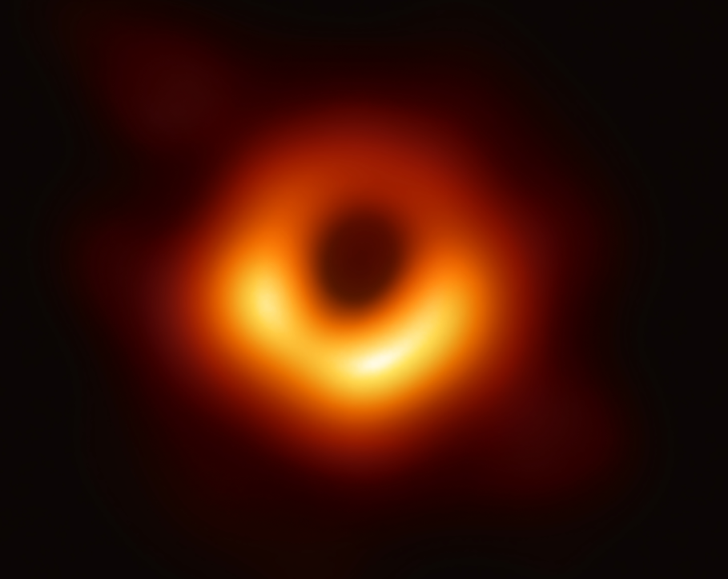
Ultracompact Objects
Cardoso, Pani: 1904.05363
Compact enough to have a light ring!
Murk: 2210.03750

Slide 4
Ultracompact Objects
Cardoso, Pani: 1904.05363
Compact enough to have a light ring!
Murk: 2210.03750
True nature?

Slide 5
Ultracompact Objects
Cardoso, Pani: 1904.05363
Compact enough to have a light ring!
Murk: 2210.03750
True nature?
✓
Horizon(s)
Singular black holes
Singularity
✓

Slide 6
Ultracompact Objects
Cardoso, Pani: 1904.05363
Compact enough to have a light ring!
Murk: 2210.03750
True nature?
✓
Horizon(s)
Singular black holes
Singularity
✓
Horizon(s)
✓
✗
Regular black holes
Singularity

Slide 7
Ultracompact Objects
Cardoso, Pani: 1904.05363
Compact enough to have a light ring!
Murk: 2210.03750
True nature?
✓
Horizon(s)
Singular black holes
Singularity
✓
Horizon(s)
✓
✗
Regular black holes
Singularity
✗
Horizon(s)
Horizonless configurations
✗
Singularity

Slide 8
Ultracompact Objects
Cardoso, Pani: 1904.05363
Compact enough to have a light ring!
Murk: 2210.03750
True nature?
✓
Horizon(s)
Singular black holes
Singularity
✓
Horizon(s)
✓
✗
Regular black holes
Singularity
✗
Horizon(s)
Horizonless configurations
✗
Singularity

Slide 9
Part I
Framework

Slide 10
Self-consistent description
Spherical symmetry
Finite formation time according to a distant observer
Finite curvature scalars on the apparent horizon
Mann, Murk, Terno: 2112.06515

Slide 11
Self-consistent description
Spherical symmetry
Finite formation time according to a distant observer
Finite curvature scalars on the apparent horizon
Mann, Murk, Terno: 2112.06515
Evaporating future horizons (Black holes)
Accreting anti-trapping horizons (White holes)

Slide 12
Self-consistent description
Spherical symmetry
Finite formation time according to a distant observer
Finite curvature scalars on the apparent horizon
Mann, Murk, Terno: 2112.06515
Extensions to axial symmetry and cosmological spacetimes:
Evaporating future horizons (Black holes)
Accreting anti-trapping horizons (White holes)
Dahal, Simovic, Soranidis, Terno: 2303.15793
Dahal, Maharana, Simovic, Terno: 2311.02981
Dahal, Maharana, Simovic, Soranidis, Terno: 2312.16804

Slide 13
Self-consistent description (Black holes)
Mann, Murk, Terno: 2112.06515

Slide 14
Self-consistent description (Black holes)
Mann, Murk, Terno: 2112.06515

Slide 15
Self-consistent description (Black holes)
Mann, Murk, Terno: 2112.06515
For the majority of RBH models:

Slide 16
Self-consistent description (Black holes)
Mann, Murk, Terno: 2112.06515
For the majority of RBH models:

Slide 17
Self-consistent description (Black holes)
Mann, Murk, Terno: 2112.06515
For the majority of RBH models:

Slide 18
Self-consistent description (Black holes)
Mann, Murk, Terno: 2112.06515
For the majority of RBH models:
Misner-Sharp mass:

Slide 19
Part II
Regular Black Holes

Slide 20
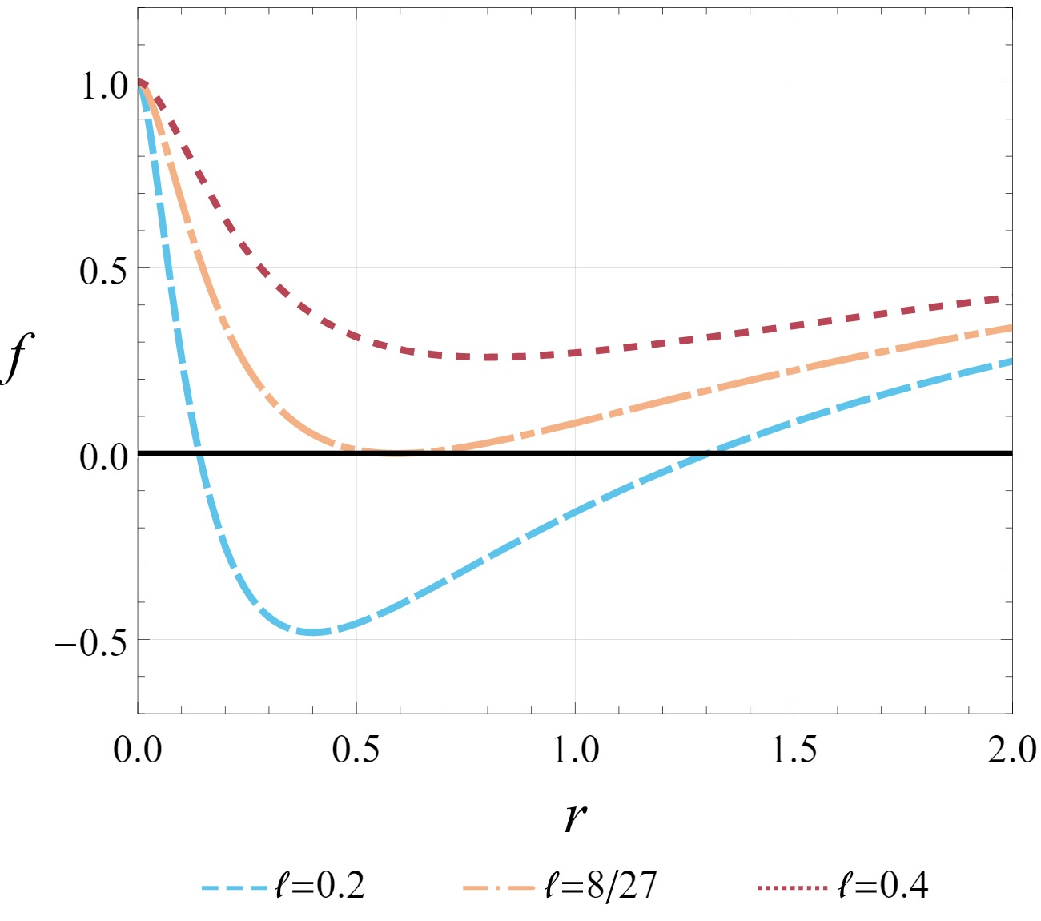
Regular UCOs
Cadoni et al.

Slide 21
Regular UCOs
Cadoni et al.
Critical length

Slide 22
Regular UCOs
Cadoni et al.
Horizons
✓
RBH
Trapped region
✓
Critical length

Slide 23
Regular UCOs
Cadoni et al.
Horizons
✓
RBH
Trapped region
✓
Horizon
✓
Extremal RBH
Trapped region
✗
Critical length

Slide 24
Regular UCOs
Cadoni et al.
Horizons
✓
RBH
Trapped region
✓
Horizon
✓
Extremal RBH
Trapped region
✗
Horizon
✗
Horizonless UCO
Trapped region
✗
Critical length

Slide 25
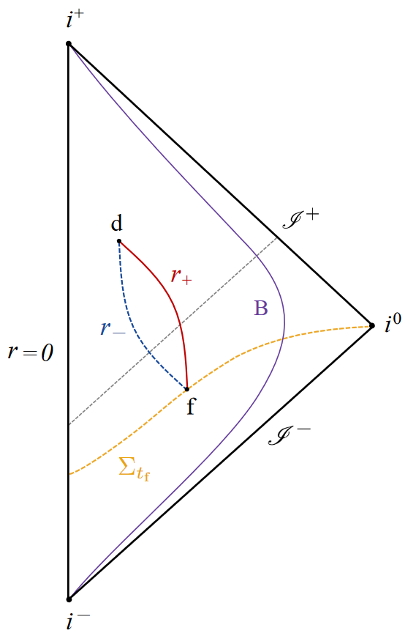
Time evolution
Carballo-Rubio, Di Filippo, Liberati, Pacilio, Visser: 2205.13556
Murk, Soranidis: 2309.06002

Slide 26
Time evolution
Carballo-Rubio, Di Filippo, Liberati, Pacilio, Visser: 2205.13556
Murk, Soranidis: 2309.06002
Trapped region
No mass inflation (Degenerate inner horizon)
Non-zero temperature (Non-degenerate outer horizon)

Slide 27
Time evolution
Carballo-Rubio, Di Filippo, Liberati, Pacilio, Visser: 2205.13556
Murk, Soranidis: 2309.06002
Trapped region
No mass inflation (Degenerate inner horizon)
Non-zero temperature (Non-degenerate outer horizon)
Timelike horizons!

Slide 28
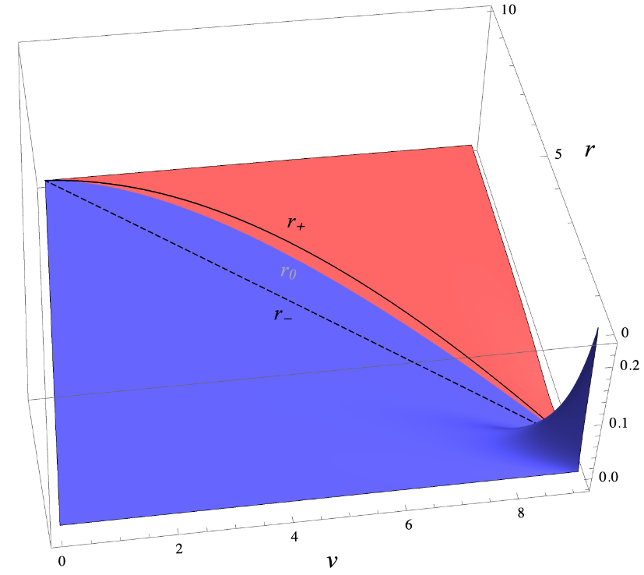
Energy conditions
Murk, Soranidis: 2309.06002

Slide 29
Energy conditions
Murk, Soranidis: 2309.06002
Boundary of the NEC!

Slide 30
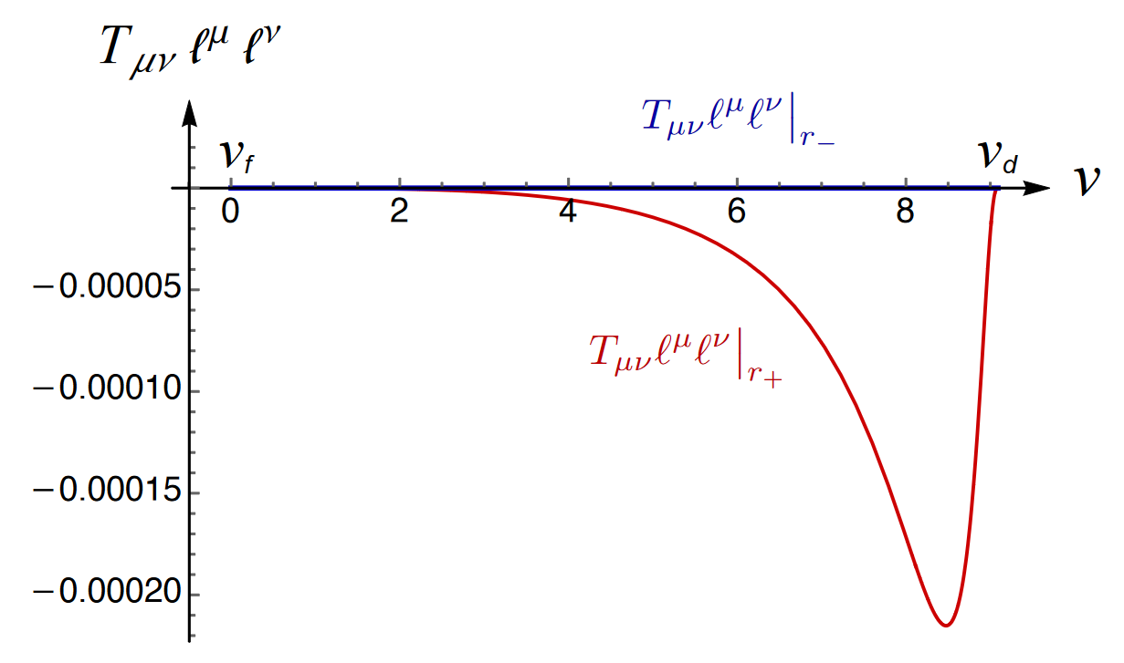
Energy conditions
Murk, Soranidis: 2309.06002
Maximum violation close to the evaporation endpoint!

Slide 31
Can we escape and how?
Dahal, Soranidis, Terno: 2209.10766
Radially moving massive particles:
Murk, Soranidis: 2309.06002
Real solutions:
Untrapped region
Trapped region
Ingoing
Outgoing
Ingoing
Outgoing

Slide 32
Can we escape and how?
Dahal, Soranidis, Terno: 2209.10766
Murk, Soranidis: 2309.06002
Ingoing
Ingoing
Outgoing
Outgoing
Outgoing

Slide 33
Can we escape and how?
Dahal, Soranidis, Terno: 2209.10766
Murk, Soranidis: 2309.06002
Ingoing
Ingoing
Outgoing
Outgoing
Outgoing
Until the spaceship reaches

Slide 34
Can we escape and how?
Dahal, Soranidis, Terno: 2209.10766
Murk, Soranidis: 2309.06002
Ingoing
Ingoing
Outgoing
Outgoing
Outgoing
Until the spaceship reaches

Slide 35
Can we escape and how?
Dahal, Soranidis, Terno: 2209.10766
Murk, Soranidis: 2309.06002
Ingoing
Ingoing
Outgoing
Outgoing
Outgoing
Until the spaceship reaches

Slide 36
Can we escape and how?
Dahal, Soranidis, Terno: 2209.10766
Murk, Soranidis: 2309.06002
Ingoing
Ingoing
Outgoing
Outgoing
Outgoing
The spaceship is free!
Horizon crossing ONLY on ingoing trajectories!

Slide 37
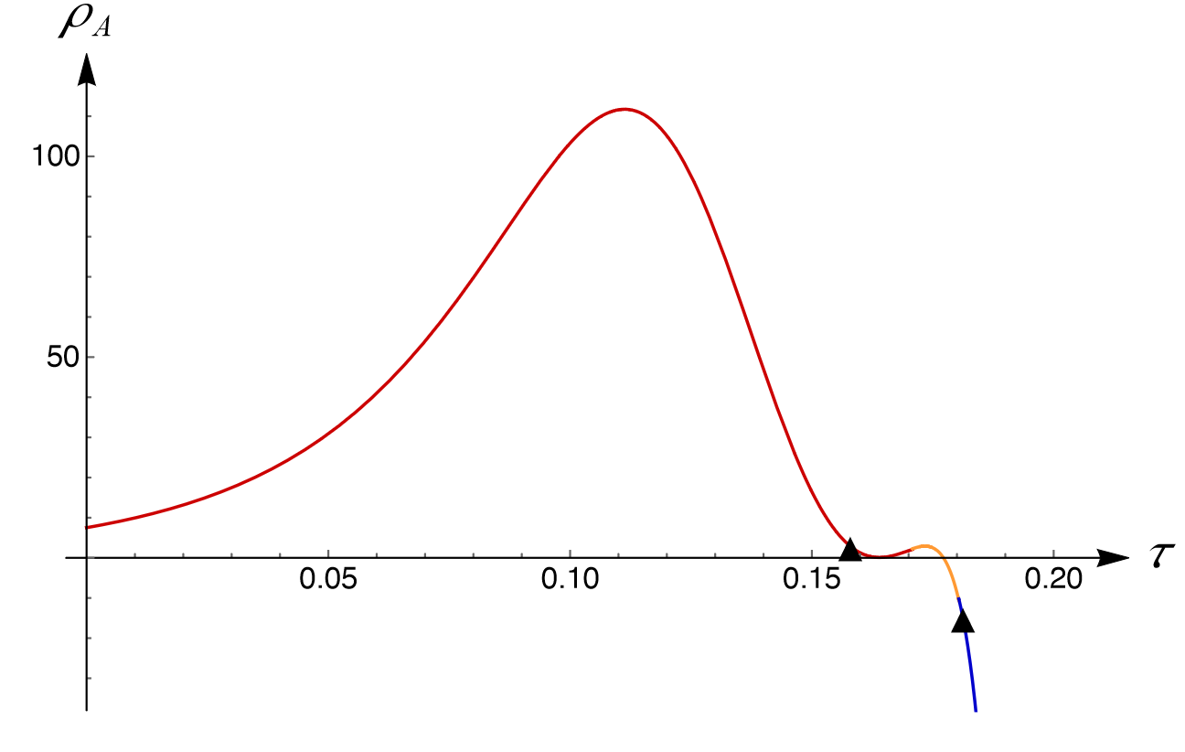
Firewalls?
Murk, Soranidis: 2309.06002
Finite energy density!
Negative near the outer apparent horizon

Slide 38
Part III
Conclusions

Slide 39
Summary of Results
NEC is violated in the vicinity of the outer apparent horizon and satisfied near the inner
Maximal violation of the NEC near the endpoint of evaporation
Massive particles can escape on ingoing geodesic trajectories
Finite energy density at horizon crossing
Thank you!

Slide 40
Back-up
Slides

Slide 41
Equations of motion
Murk, Soranidis: 2309.06002
Equations of motion
Approaching inner horizon on outgoing trajectory
Approaching outer horizon on outgoing trajectory

Slide 42
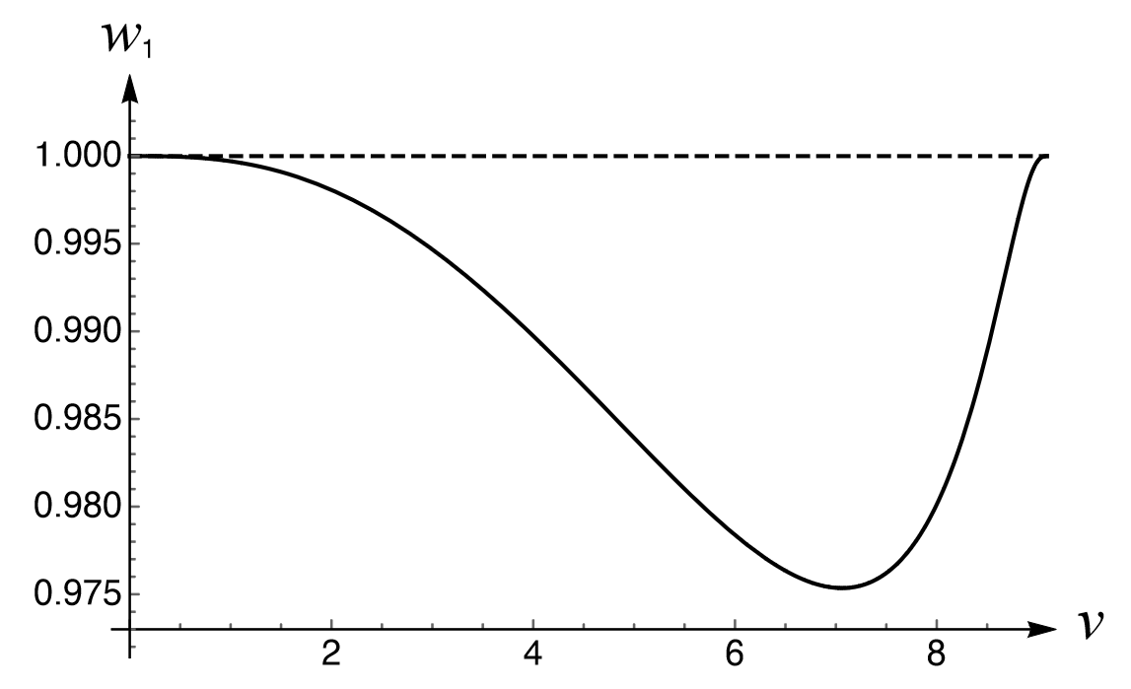
Evolution of
Murk, Soranidis: 2304.05421
Formation of trapped region
Disappearance of trapped region
Vanishing temperature!

Slide 43
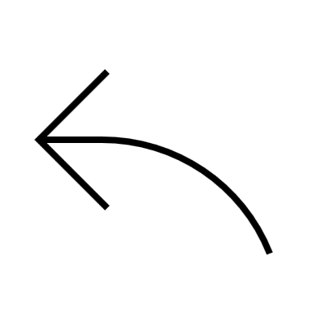
How do we source them?
GR + Nonlinear Electrodynamics
Fan, Wang: 1610.02636
Nojiri, Nashed: 2306.14162
4D scalar-Einstein-Gauss-Bonnet
Ashtekar, Olmedo, Singh: 2301.01309
Loop Quantum Gravity
Action of the theory
NED Lagrangian density
Field Strength

Slide 44
Regular UCOs
Hayward Model
Bardeen Model
Cadoni et al. Model
Metric function:
NED Lagrangian:
Weak field limit:
Parameters:

Slide 45
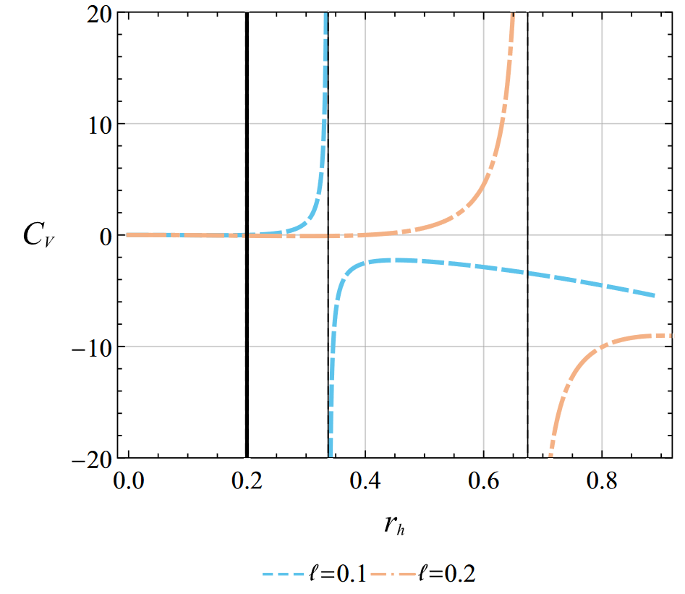
Minimal Length Constraints
Small Cosmological constant
Thermodynamic quantities in Minkowski
Thermodynamic Stability
Extremal Limit
Observational Constraints
Soranidis: 2310.07228
Cadoni et al. : 2211.11585

Slide 46
Birefringence, light rings, causality
Murk, Soranidis: 2406.07957
The nonlinearity of the theory affects light propagation!
Treating light as perturbation!
Unpolarized light ray splits into two light rays!
Background:
Effective:

Slide 47
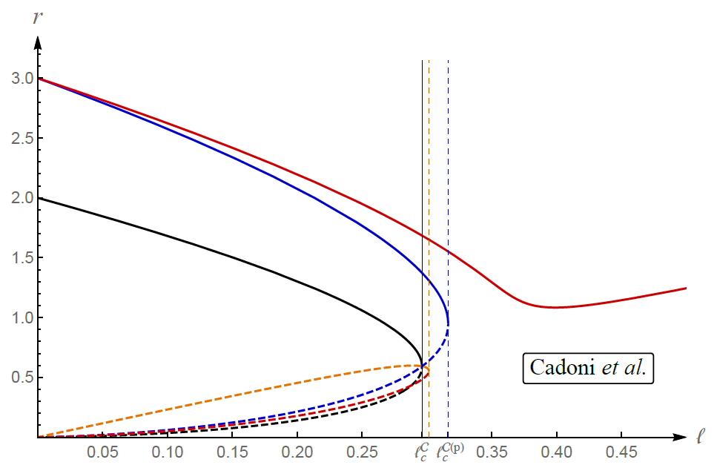
Birefringence, light rings, causality
Murk, Soranidis: 2406.07957

Slide 48
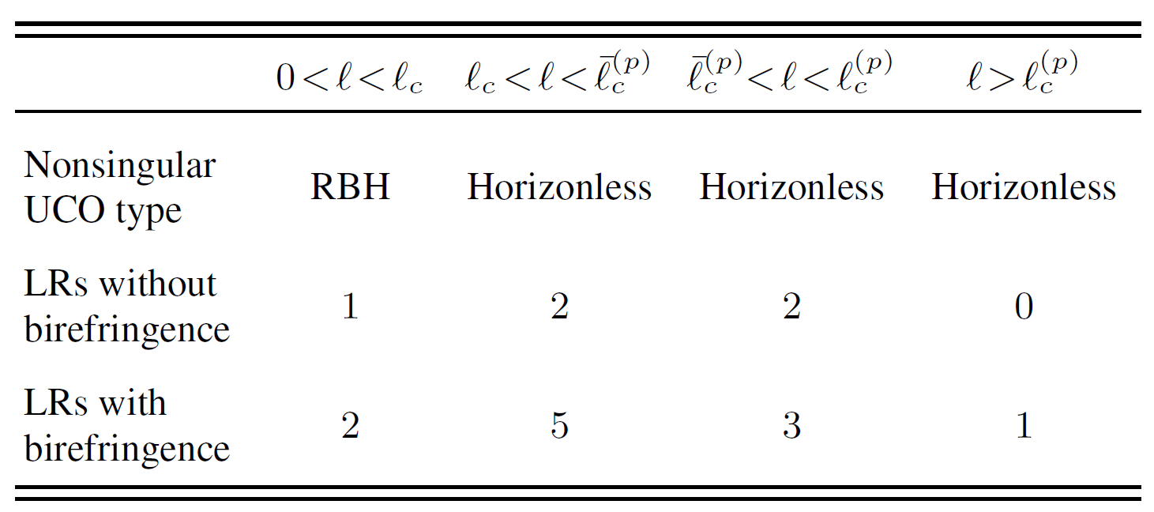
Birefringence, light rings, causality
Murk, Soranidis: 2406.07957
Knowledge of underlying theory is necessary!

Slide 49
Birefringence, light rings, causality
Murk, Soranidis: 2406.07957
Propagation vector
Background Geometry
Effective Geometry

Slide 50
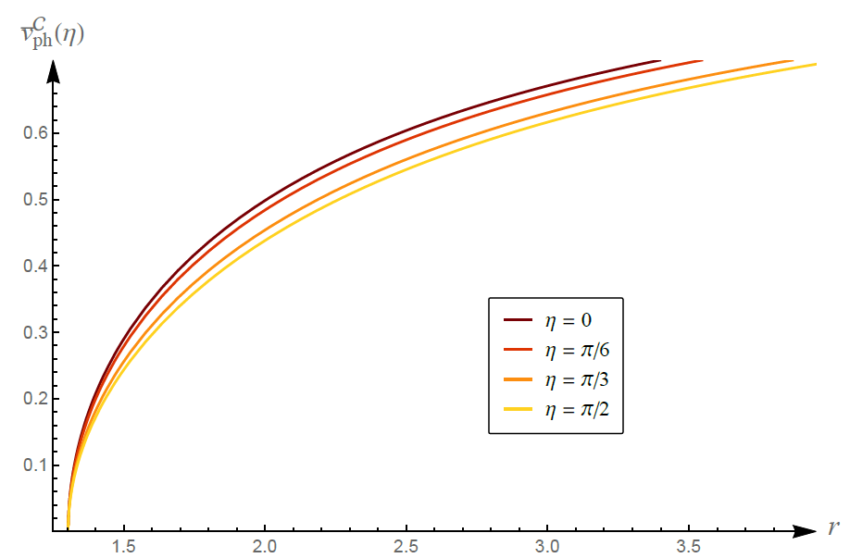
Birefringence, light rings, causality
Murk, Soranidis: 2406.07957

Slide 51
Birefringence, light rings, causality
Murk, Soranidis: 2406.07957

Slide 52
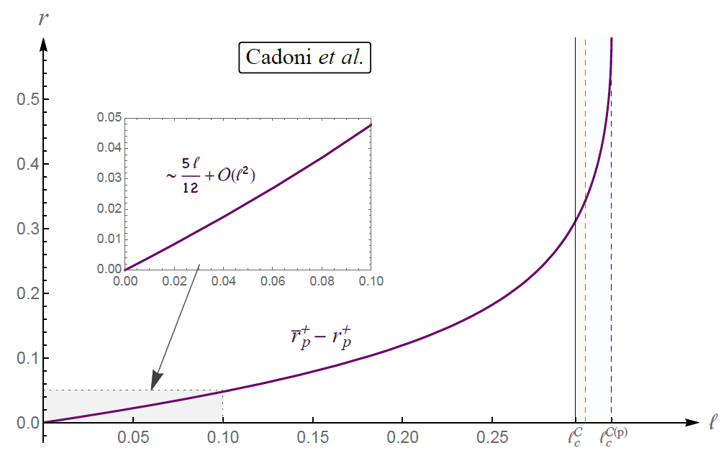
Birefringence, light rings, causality
Murk, Soranidis: 2406.07957

Slide 53
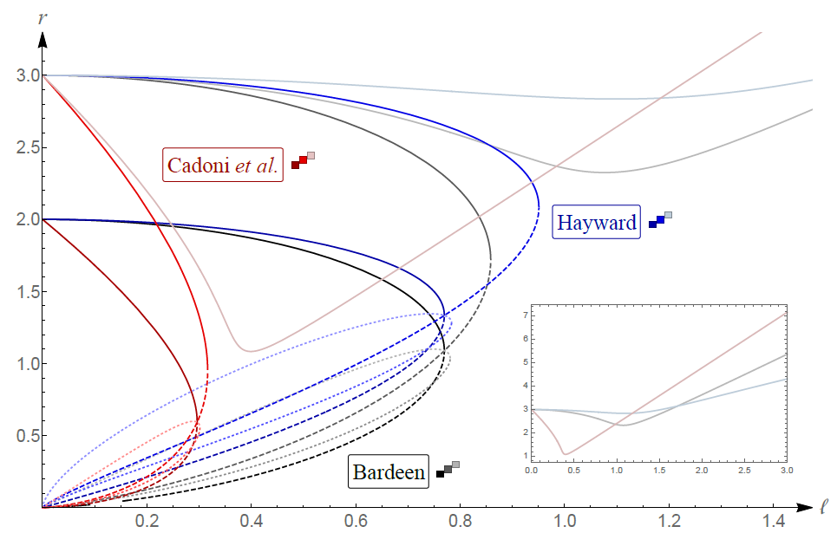
Birefringence, light rings, causality
Murk, Soranidis: 2406.07957

Slide 54
