Slide 1

Pseudo Redshifts of Gamma-Ray Bursts
with a Plateau phase
Yong-Feng Huang
(Nanjing University)
Collaboration: Chen Deng, Fan Xu

Slide 2
Outline
Correlations of prompt GRBs
Correlations of GRBs with a plateau phase
L-T-E correlation as a redshift estimator
Conclusions

Slide 3
Outline
Correlations of prompt GRBs
Correlations of GRBs with a plateau phase
L-T-E correlation as a redshift estimator
Conclusions

Slide 4
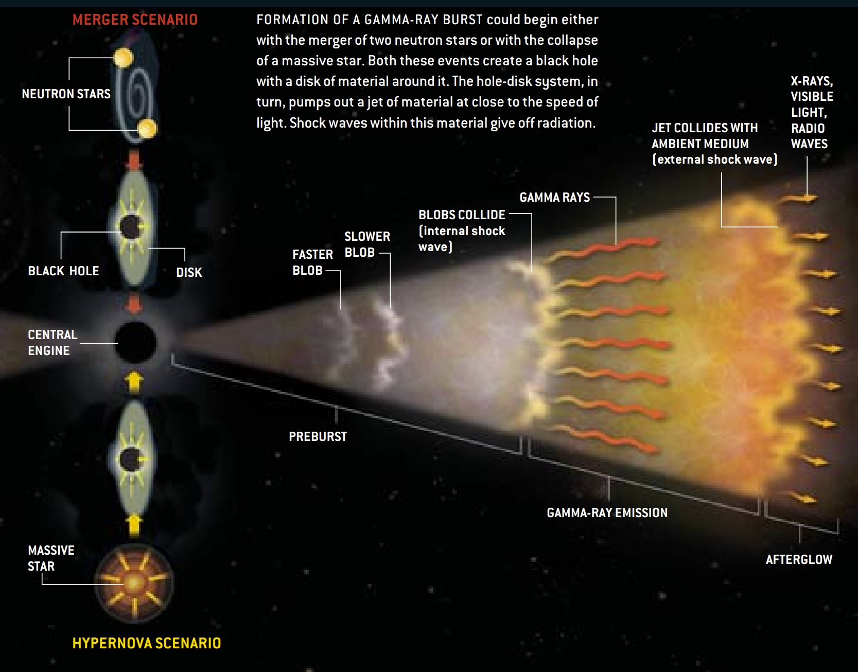
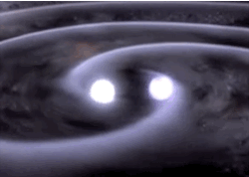
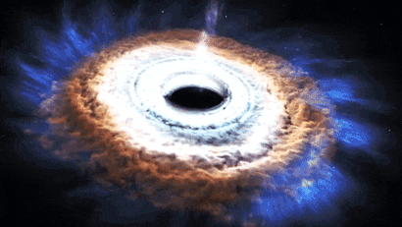
An overall picture of GRBs
Merger
Collapsar
Gehrels, Piro, & Leonard, 2002, SCIENTIFIC AMERICAN

Slide 5
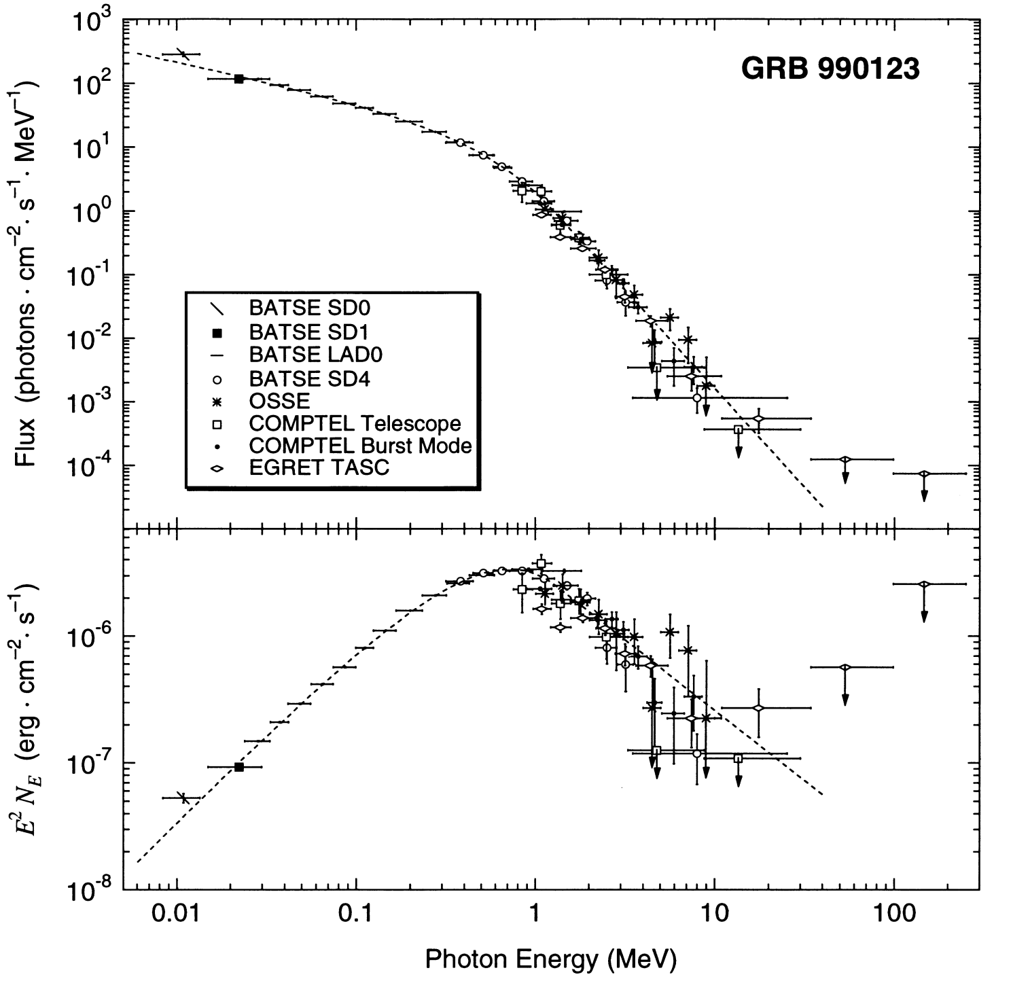
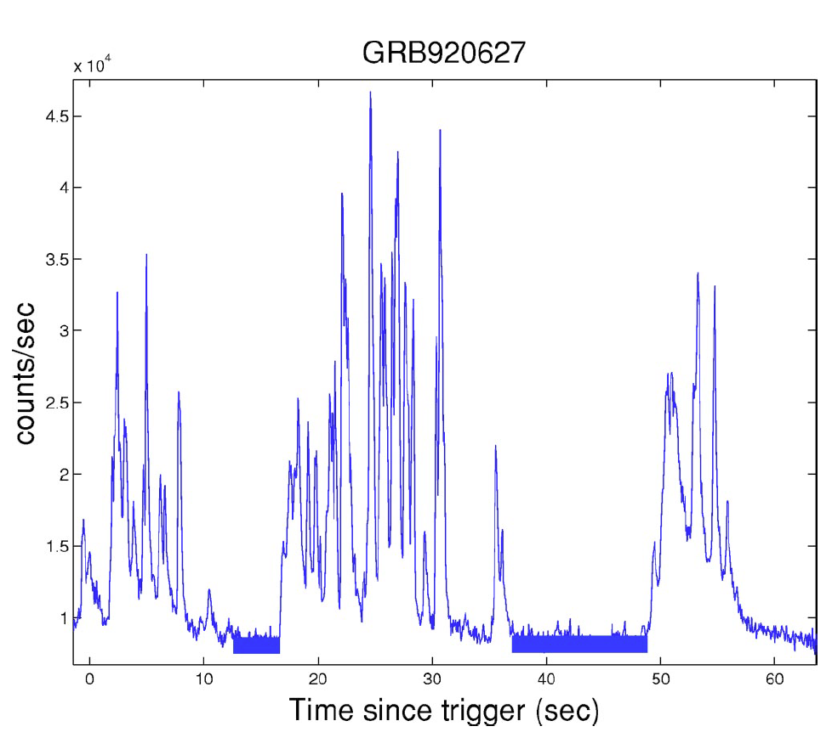
Prompt light curve and spectrum of GRBs
Piran, 2004, Rev. Mod. Phys.
Briggs et al., 1999, ApJ

Slide 6
Some correlations of prompt GRB emissions
correlation (Amati relation)
Amati et al., 2002, A&A, Amati et al., 2008, MNRAS
correlation (Yonetoku relation)
Yonetoku et al., 2004, ApJ
correlation (Ghirlanda relation)
Ghirlanda, Ghisellini & Lazzati, 2004, ApJ
correlation (Norris relation)
Norris, Marani & Bonnell, 2000, ApJ
……

Slide 7
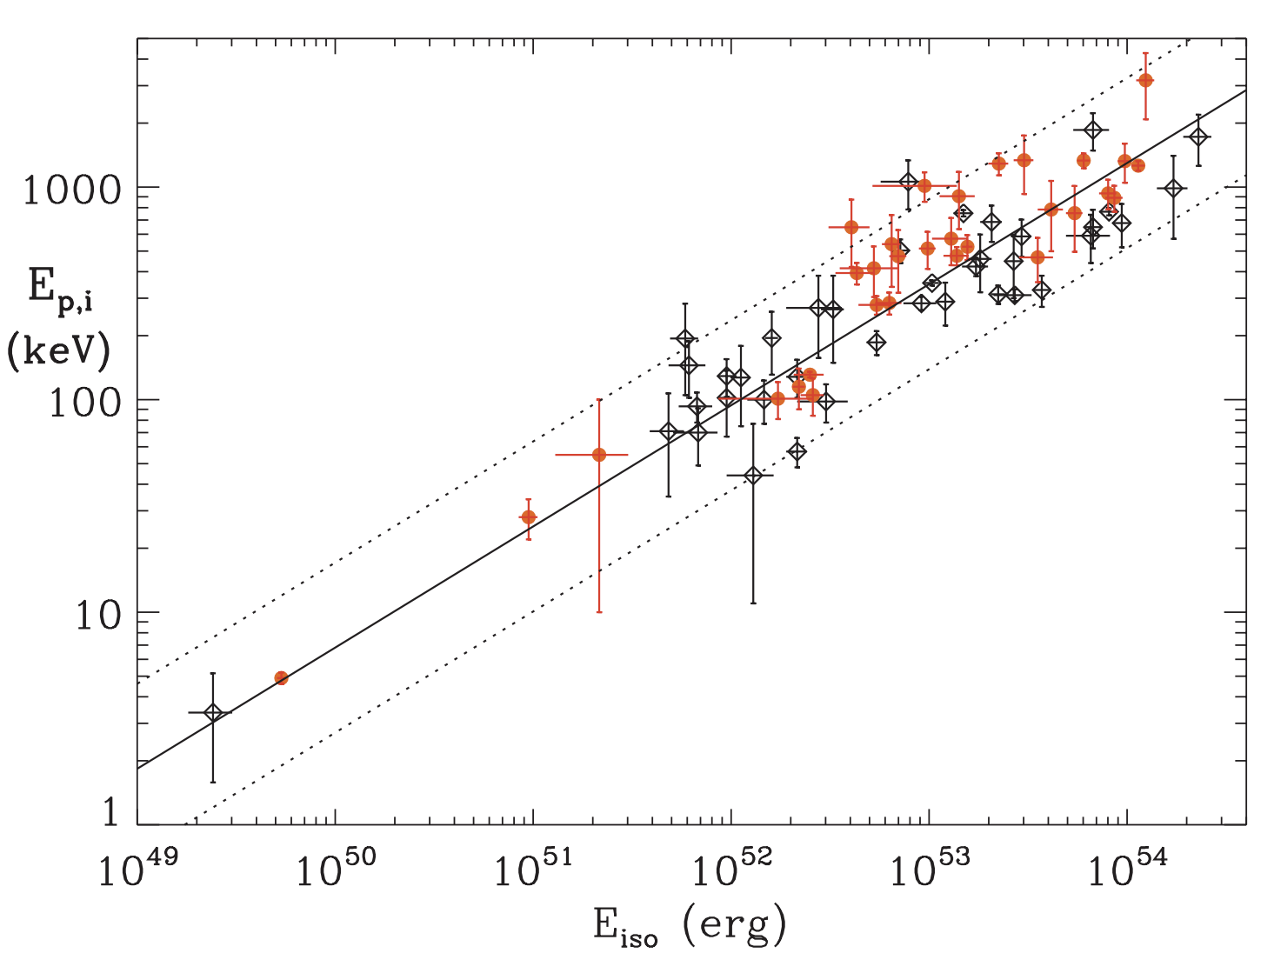
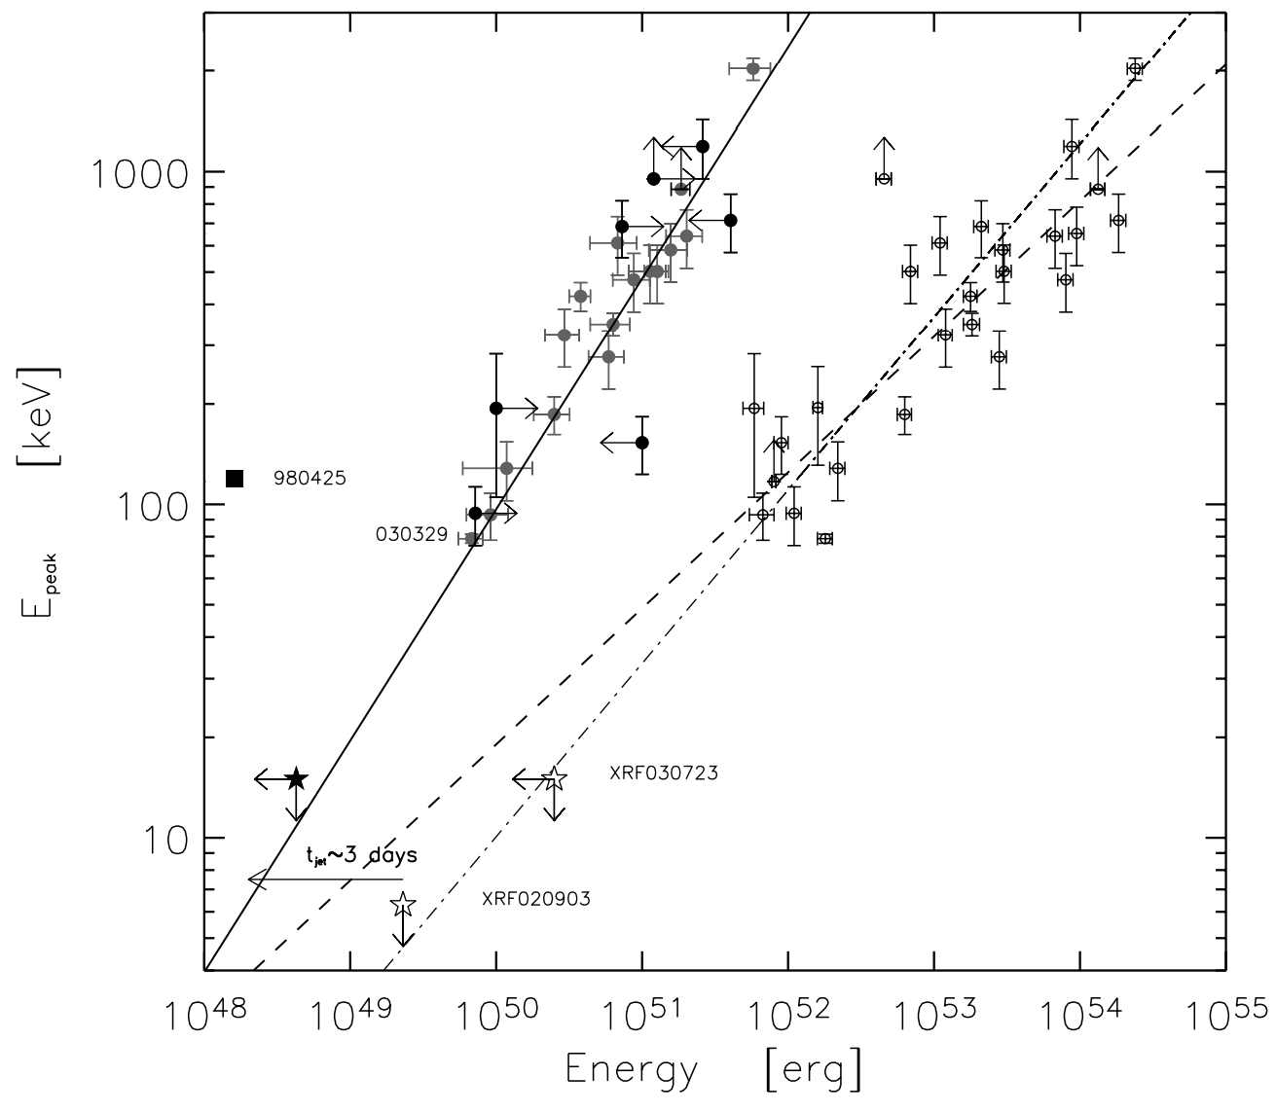
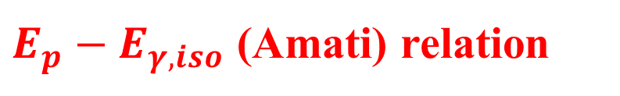
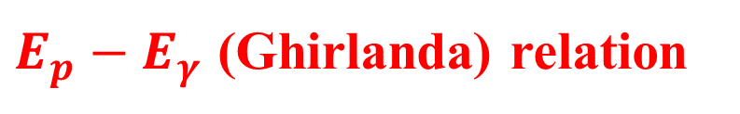
$E_{p}−E_{γ,iso}$ (Amati) relation
$E_{p}−E_{γ}$ (Ghirlanda) relation
corrected for the collimation angle
Amati et al., 2008, MNRAS
Ghirlanda, Ghisellini & Lazzati, 2004, ApJ

Slide 8
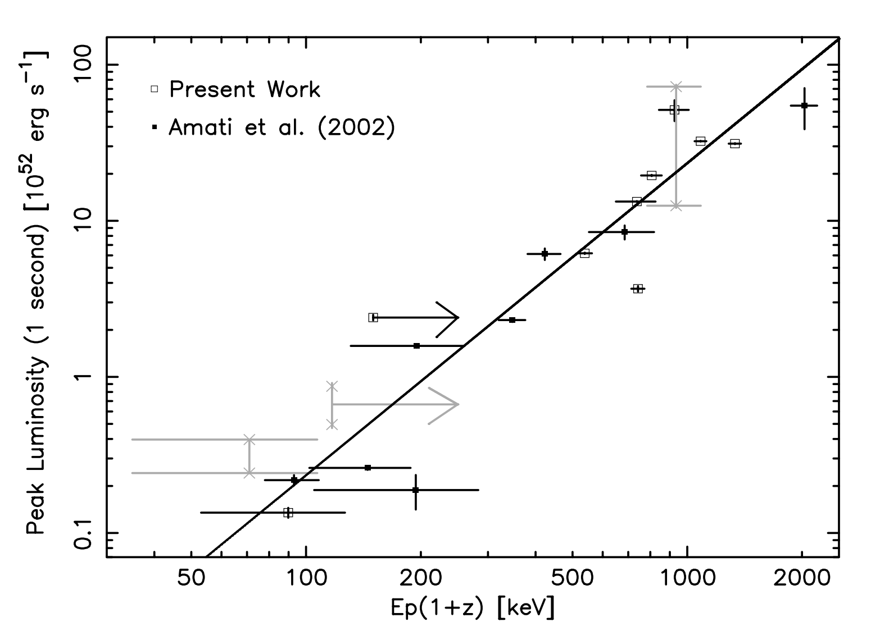
$E_{p}−L_{p,iso}$ (Yonetoku) relation
Yonetoku et al., 2004, ApJ

Slide 9
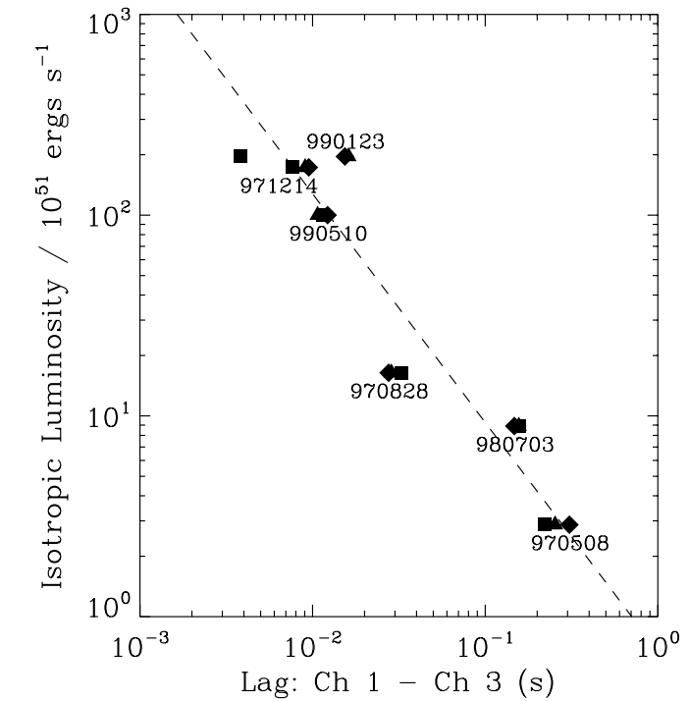
${L_{p,iso}−Tau}_{lag}$ (Norris) relation
Channel 1: 25-50 keV
Channel 3: 100-300 keV
Norris, Marani & Bonnell, 2000, ApJ

Slide 10
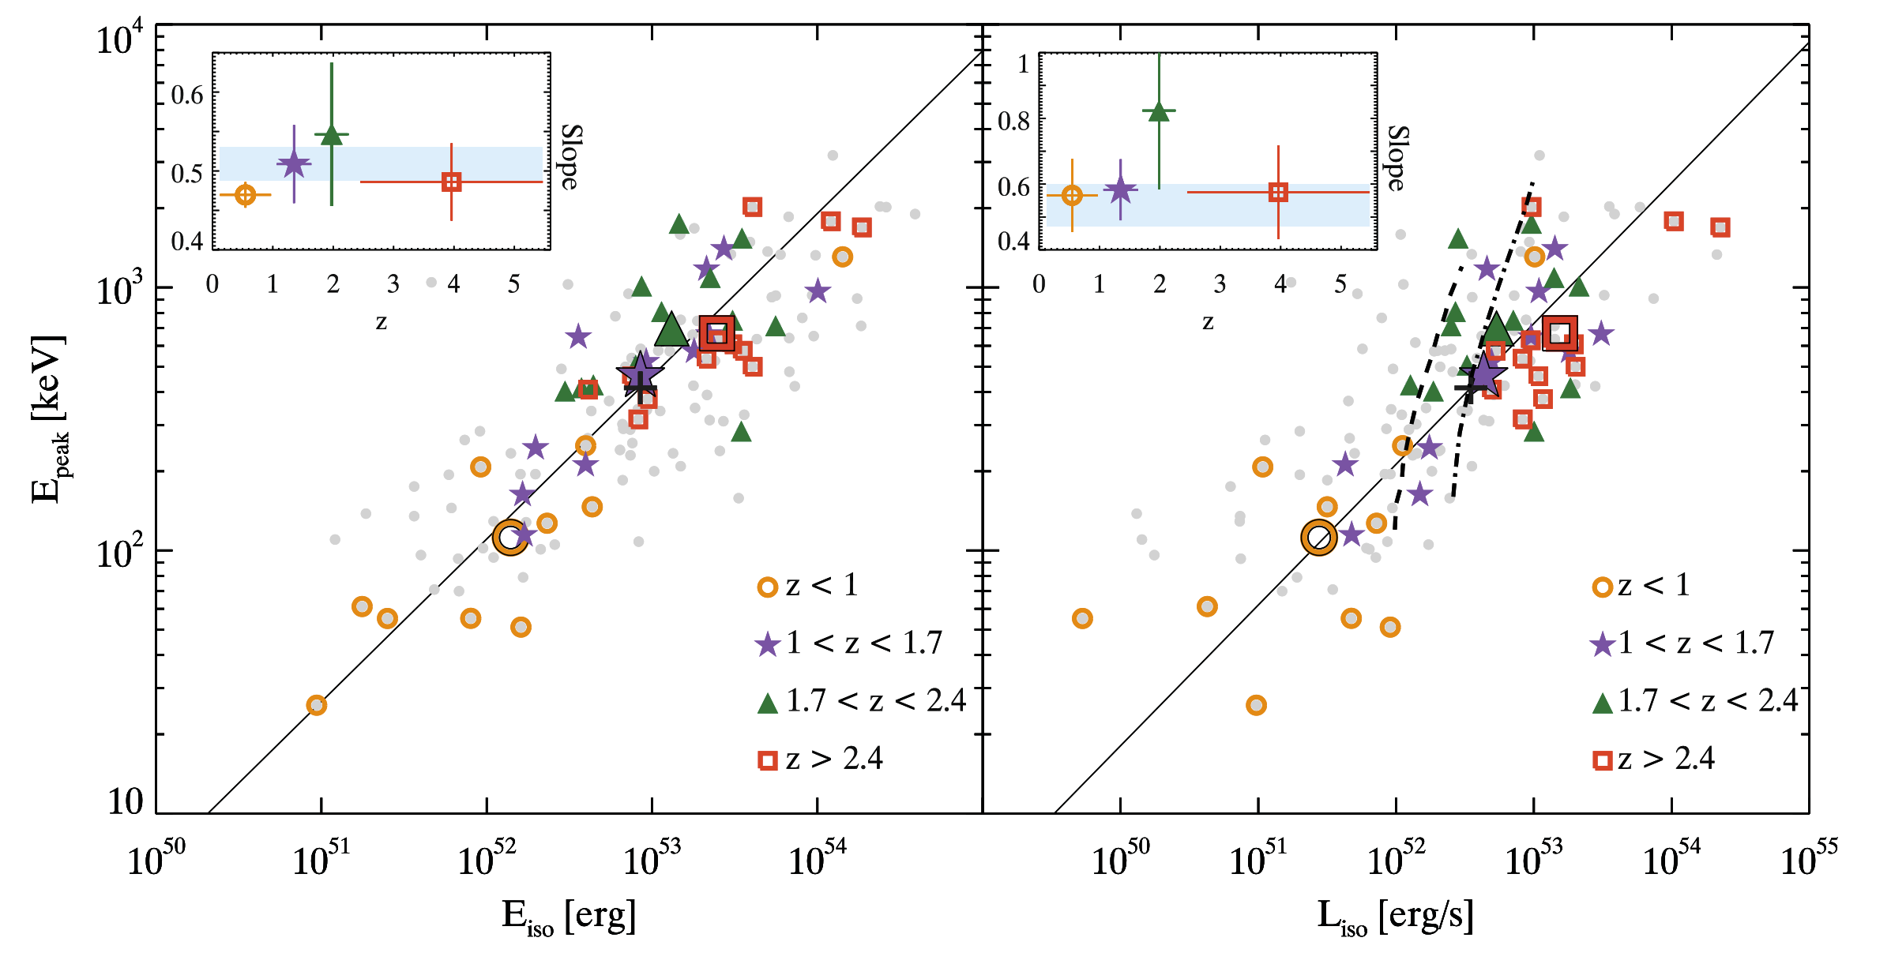
No redshift evolution in the slopes of Amati and Yonetoku relations
Nava et al., 2012, MNRAS

Slide 11
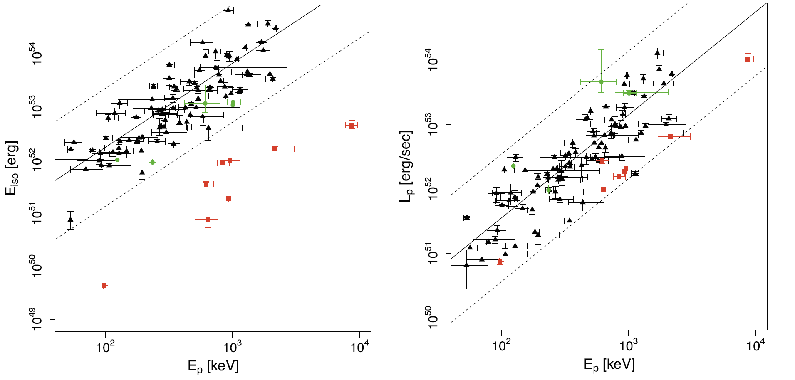
The Amati and Yonetoku relations for SGRBs
Tsutsui et al., 2013, MNRAS
Notes:
红色椭圆内为短暴。

Slide 12
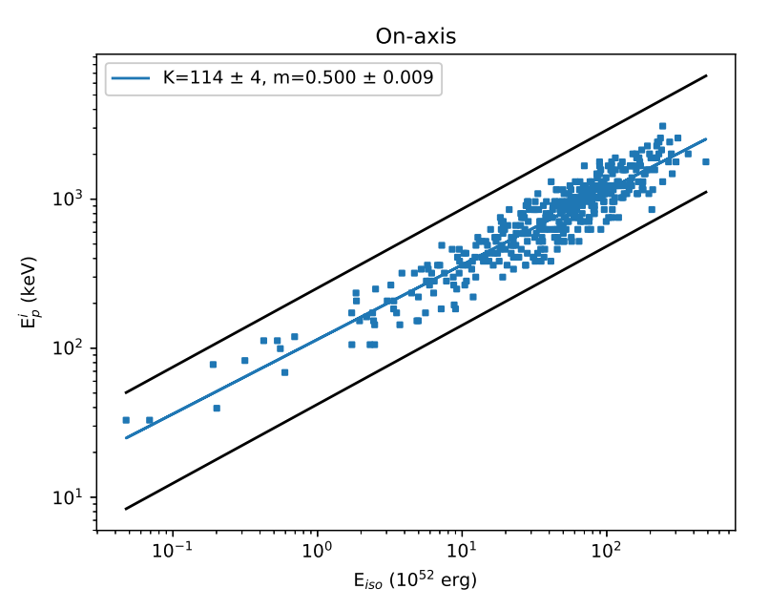
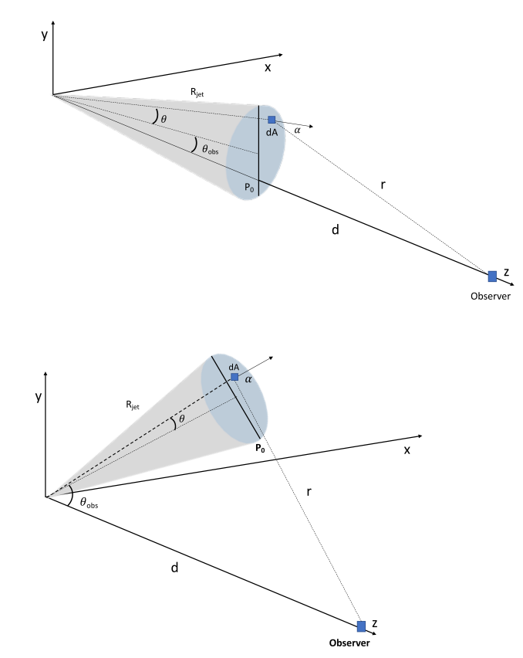
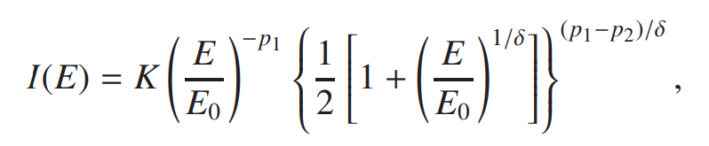
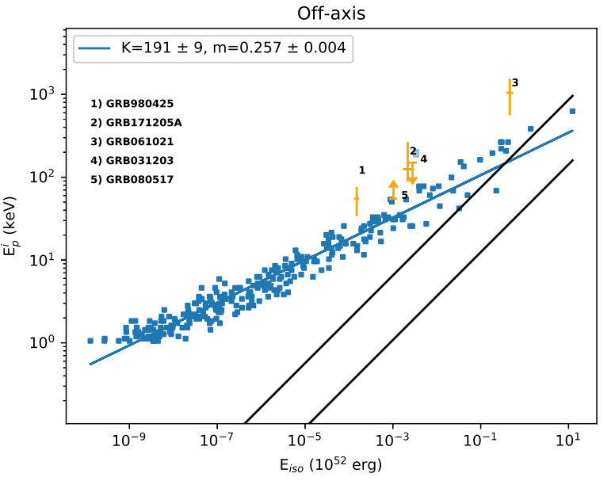
A numerical explanation of the Amati relation
geometric model
smoothly broken power-law emissivity law
Farinelli et al., 2021, MNRAS
Notes:
右下图的平行线就是右上的两条平行线。

Slide 13
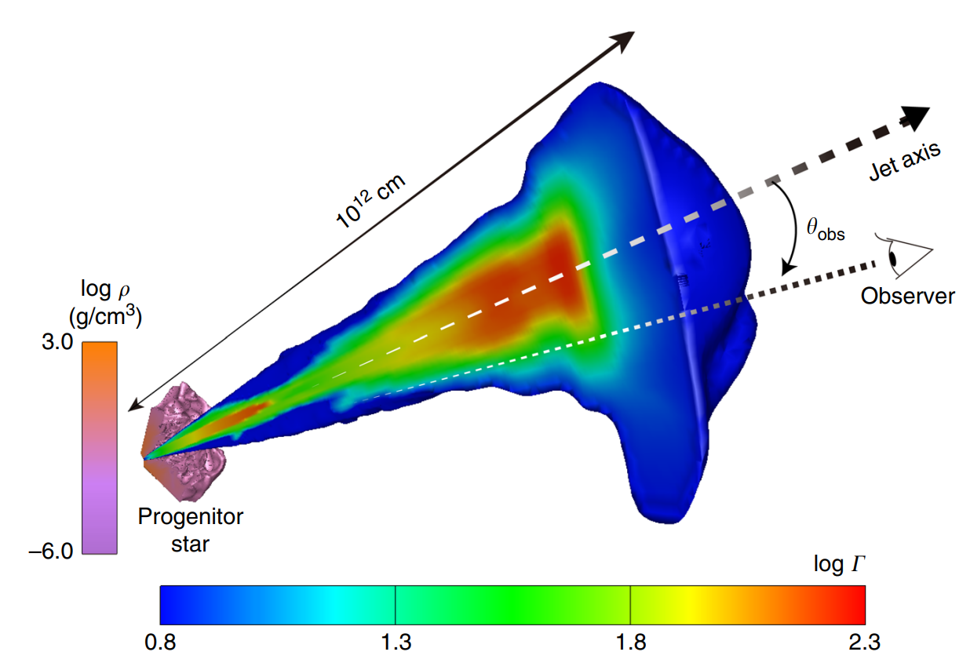
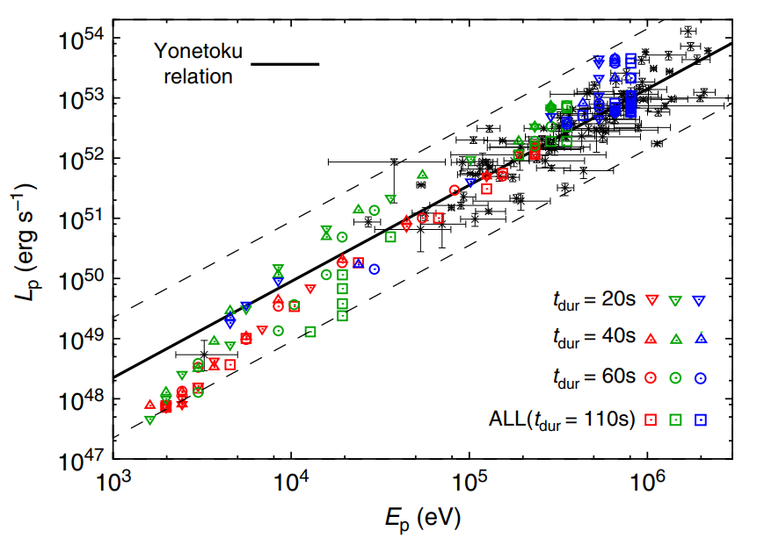
The photospheric origin of the Yonetoku relation
the Yonetoku relation as a natural consequence of viewing angle
Ito et al., 2019, Nat. Commun.

Slide 14
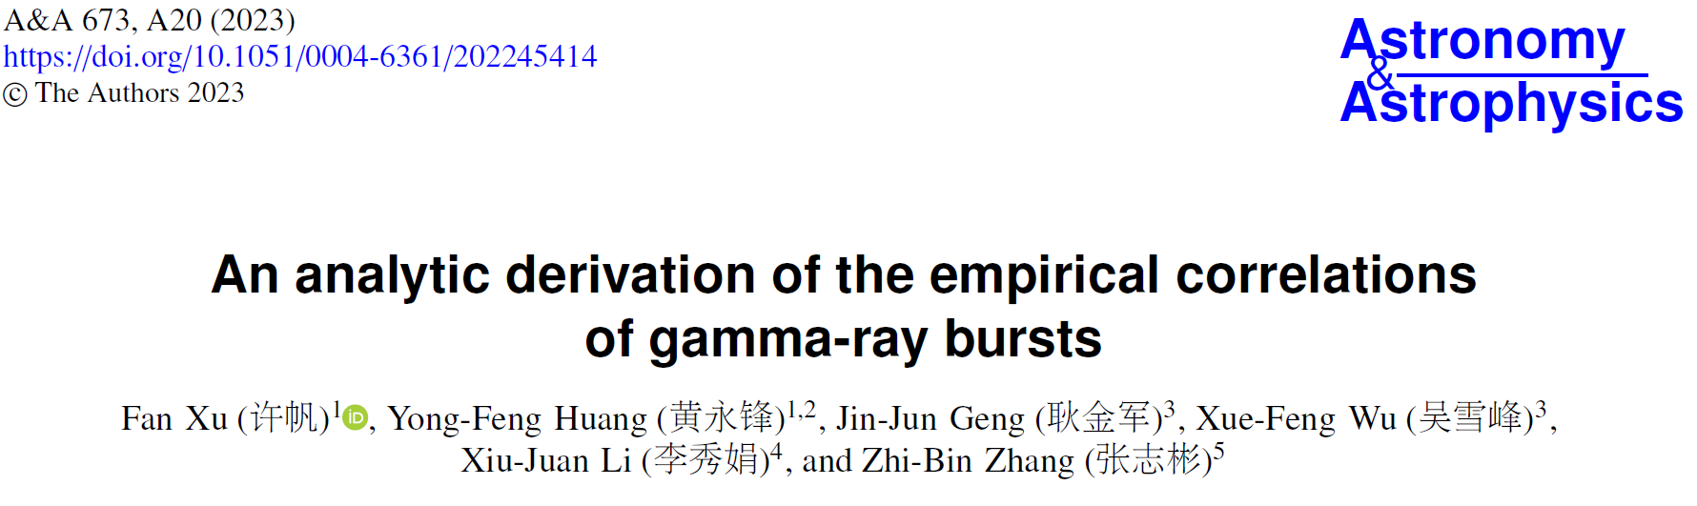
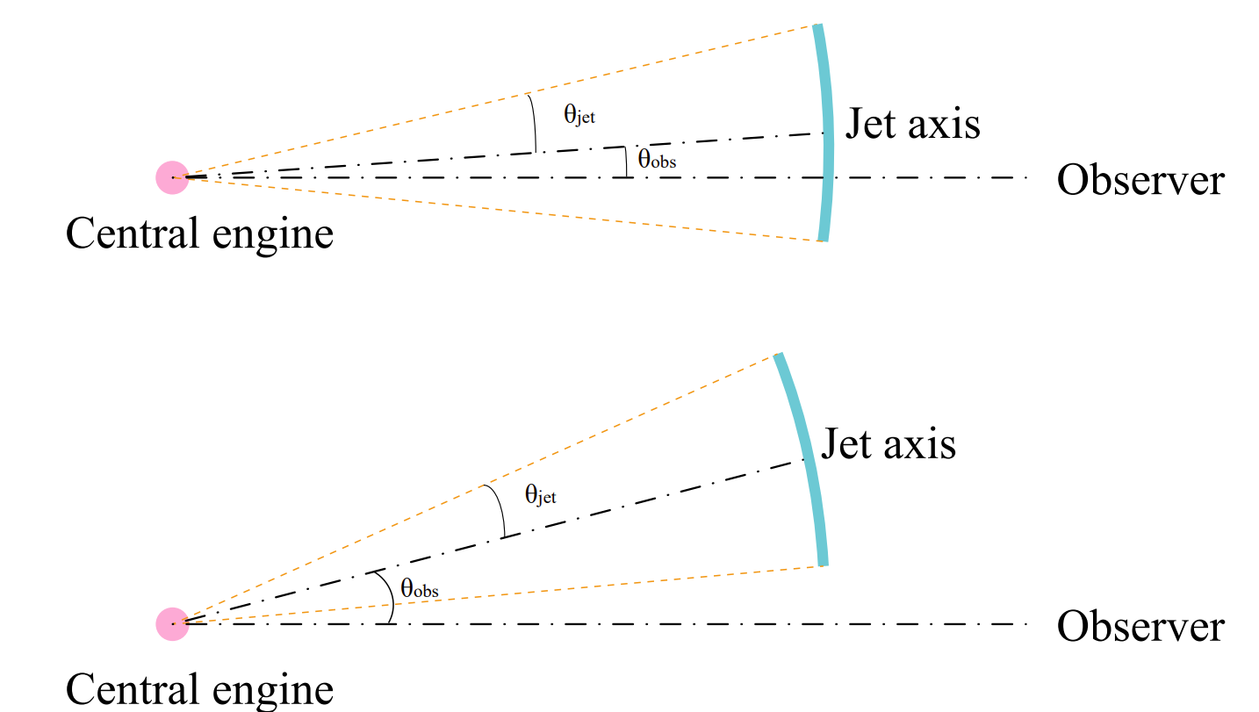


1.Jet structure:
Top-hat jet
2.Prompt emission mechanism:
Internal shock model
3.Radiation process:
Flash and curvature effect
4.Radiation mechanism:
Synchrotron radiation
On-axis ($θ_{jet}>θ_{obs}$)
Xu et al., 2023, A&A
Off-axis ($θ_{jet}<θ_{obs}$)

Slide 15
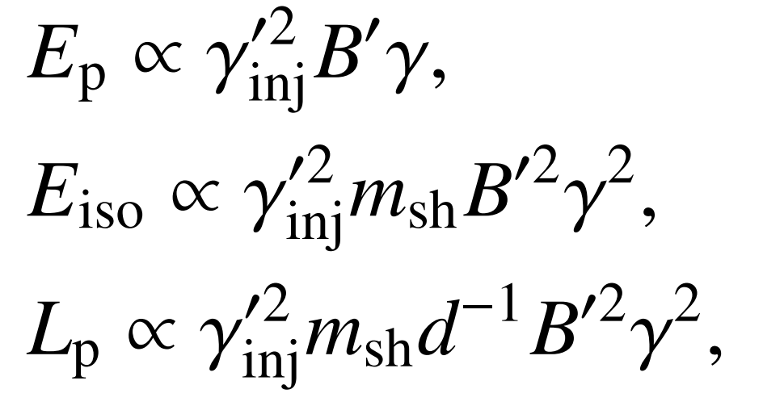
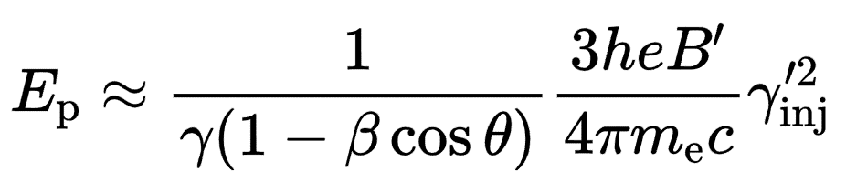
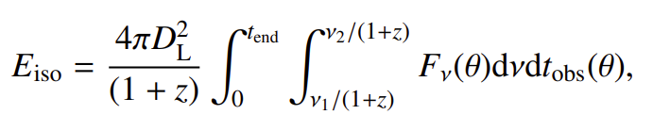
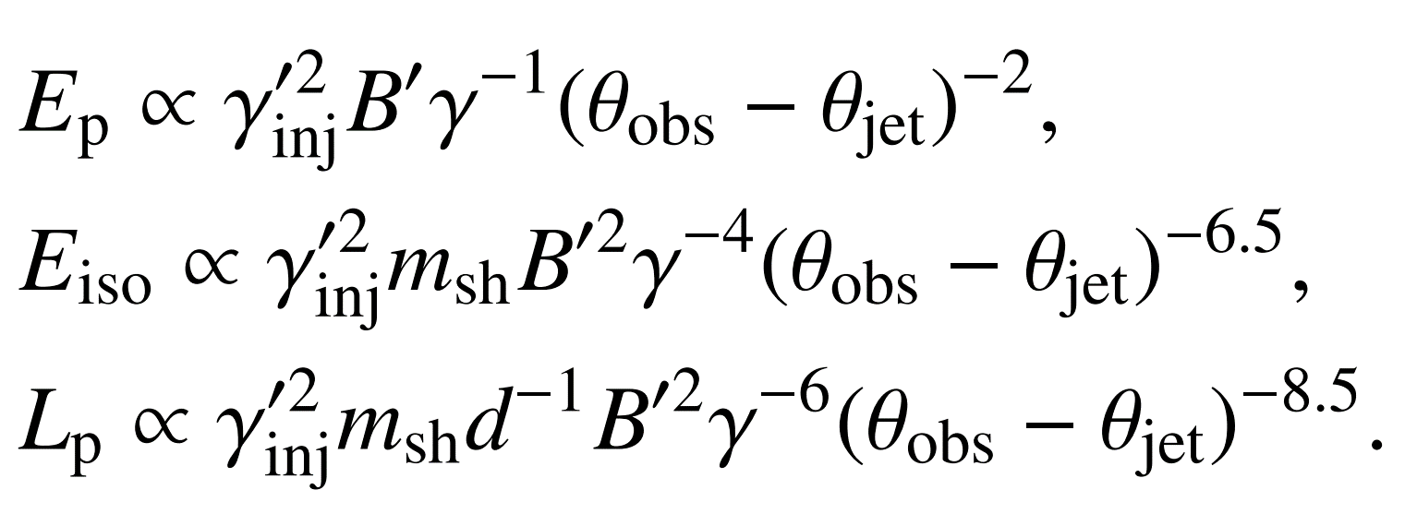
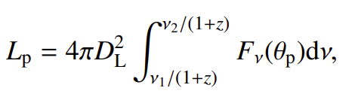

Analytic derivation of $E_{p}$, $E_{iso}$, and $L_{p}$
On-axis case
Xu et al., 2023, A&A
Off-axis case

Slide 16
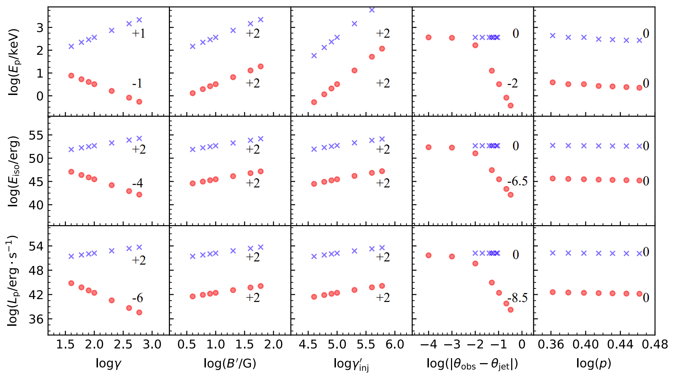
Numerical simulation
On-axis case
1
1
Off-axis case
Xu et al., 2023, A&A
Notes:
双参数之间的相关性：每个框图中其他参数均固定。

Slide 17
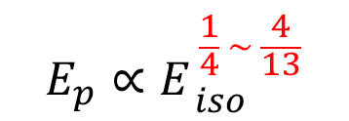
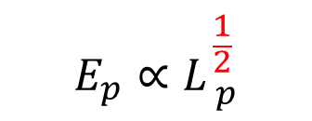
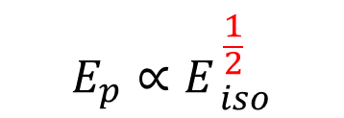

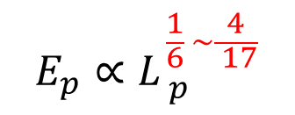
Relations between $E_{p}$, $E_{iso}$, and $L_{p}$
On-axis case
$$E_{p}∝E_{ iso}^{ \frac{1}{2}}$$
Amati relation
$$E_{p}∝L_{ p}^{ \frac{1}{2}}$$
Yonetoku relation
Off-axis case
$$E_{p}∝E_{ iso}^{ \frac{1}{4} \sim \frac{4}{13}}$$
Amati relation
$$E_{p}∝L_{ p}^{ \frac{1}{6} \sim \frac{4}{ 17}}$$
Yonetoku relation
Xu et al., 2023, A&A

Slide 18
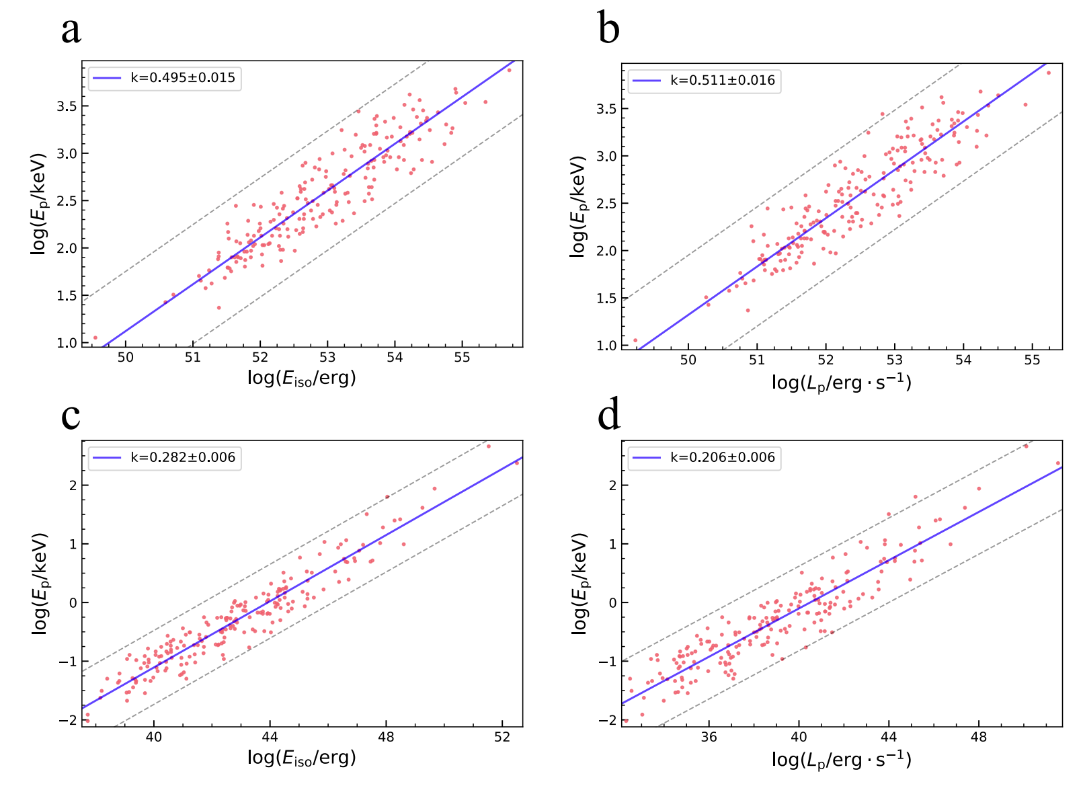
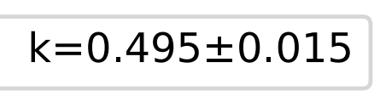
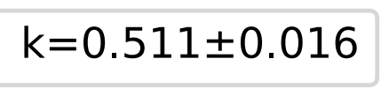
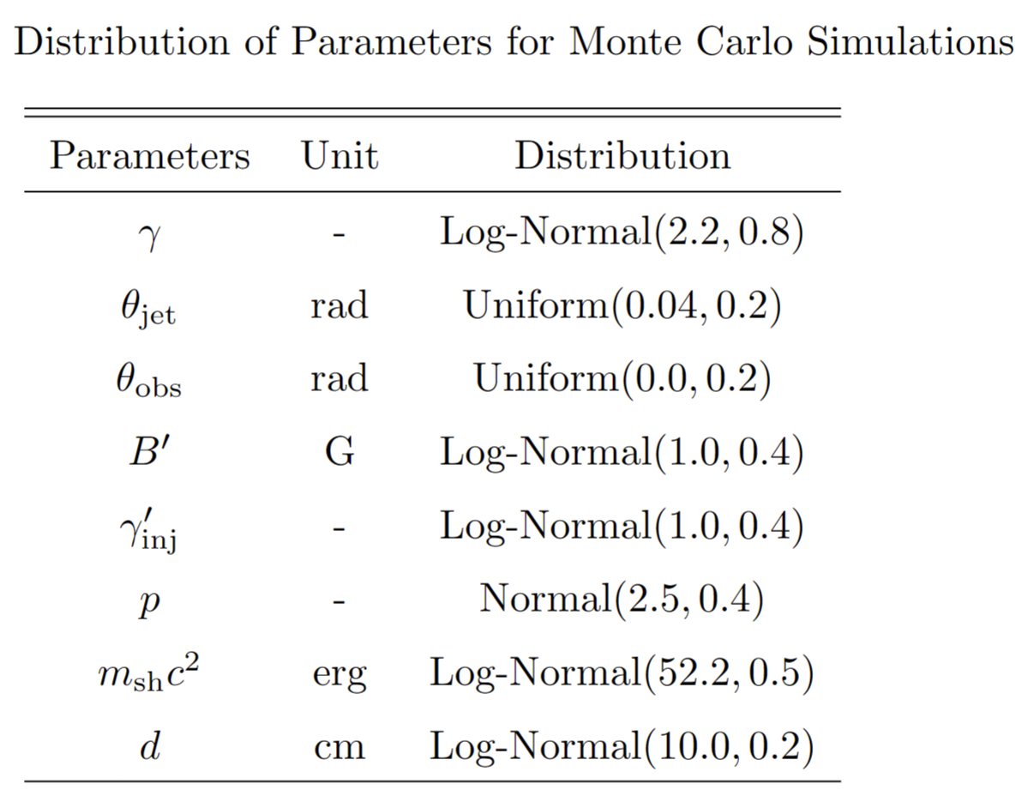
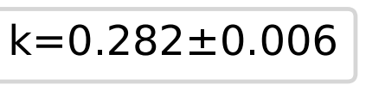
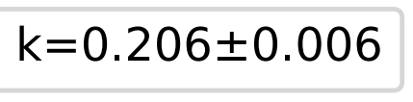
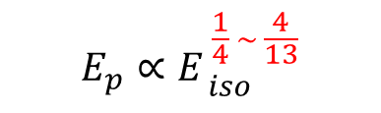
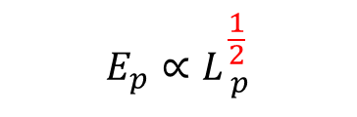
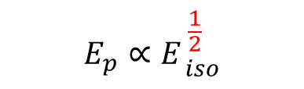
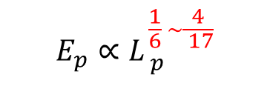
Monte Carlo simulations
On-axis case
$$E_{p}∝E_{ iso}^{ \frac{1}{2}}$$
$$E_{p}∝L_{ p}^{ \frac{1}{2}}$$
$$E_{p}∝E_{ iso}^{ \frac{1}{4} \sim \frac{4}{13}}$$
$$E_{p}∝L_{ p}^{ \frac{1}{6} \sim \frac{4}{ 17}}$$
Off-axis case
Xu et al., 2023, A&A

Slide 19
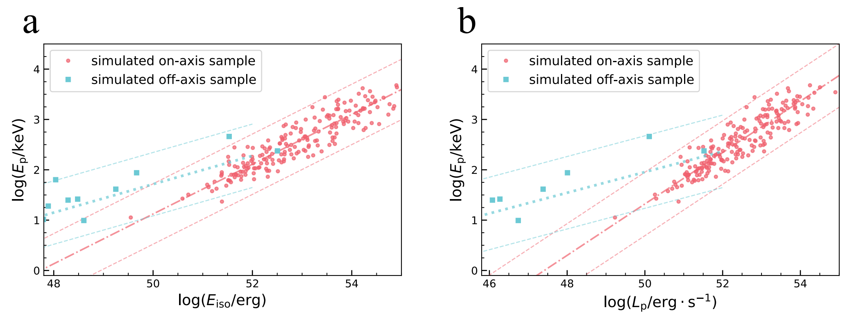
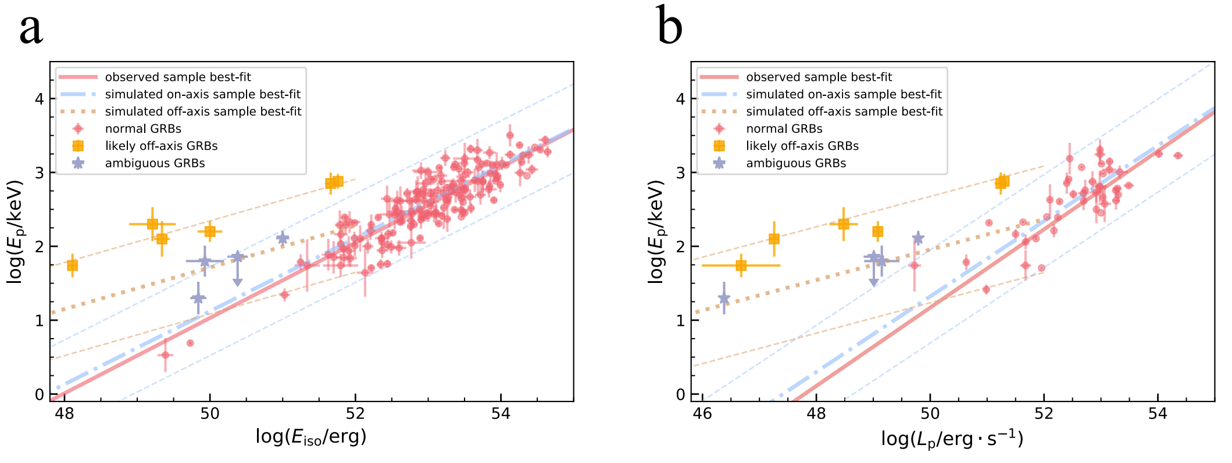


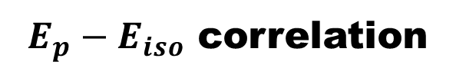
Comparison with observations
$E_{p}−E_{iso}$ correlation
Simulation
Observation
$$E_{p}∝E_{ iso}^{ 0.282±0.006}$$
Outliers of Amati relation
$$E_{p}∝E_{ iso}^{ 0.495±0.015}$$
Xu et al., 2023, A&A

Slide 20

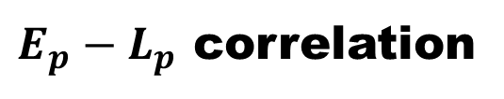

Comparison with observations
$E_{p}−L_{p}$ correlation
Simulation
Observation
$$E_{p}∝L_{ p}^{ 0.206±0.006}$$
$$E_{p}∝L_{ p}^{ 0.511±0.016}$$
Xu et al., 2023, A&A

Slide 21
Outline
Correlations of prompt GRBs
Correlations of GRBs with a plateau phase
L-T-E correlation as a redshift estimator
Conclusions

Slide 22
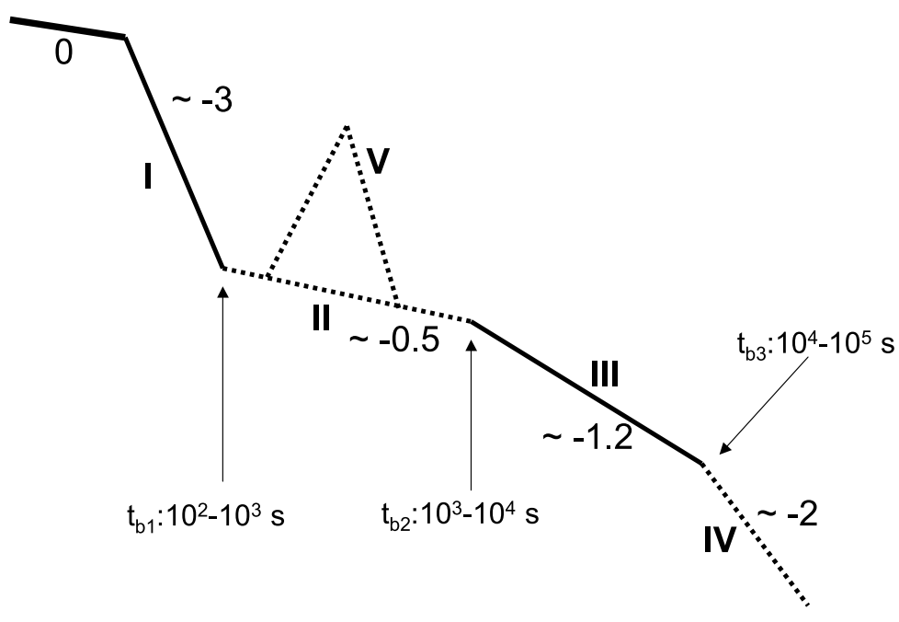
The canonical light curve of GRB X-ray afterglow
Possible origins of the plateau phase:
Plateau phase
Continuous energy injection from the central engine
Evolving microphysical parameters
Two component jet model
Coasting of moderately relativistic jets in a wind-like mediums
High-latitude emission from the structured jet
. . . . . .
Dai & Lu, 1998, Phys. Rev. Lett, Geng et al. 2016, ApJ
Ioka et al., 2006, A&A
Racusin et al. 2008, Nature
Dereli-Bégué et al., 2022, Nat. Commun.
Zhang et al. 2006, ApJ
Oganesyan et al., 2020, ApJ

Slide 23
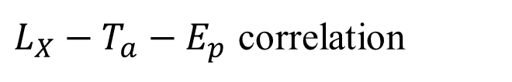
GRB correlations connected with X-ray plateaus
$L_{X}−T_{a}$ correlation (Dainotti relation)
Dainotti, Cardone & Capozziello, 2008 MNRAS, Dainotti et al., 2010, ApJL
$L_{X}−T_{a}−L_{p}$ correlation (Dainotti fundamental plane relation)
Dainotti et al., 2016, ApJL
$E_{X,iso}−E_{γ,iso}−E_{p}$ correlation
Bernardini et al., 2012, MNRAS, Margutti et al., 2013, MNRAS
$L_{X}−T_{a}−E_{γ,iso}$ correlation
Xu & Huang, 2012, A&A, Tang et al., 2019, ApJS
$L_{X}−T_{a}−E_{p}$ correlation
Xu et al., 2021, ApJ
……

Slide 24
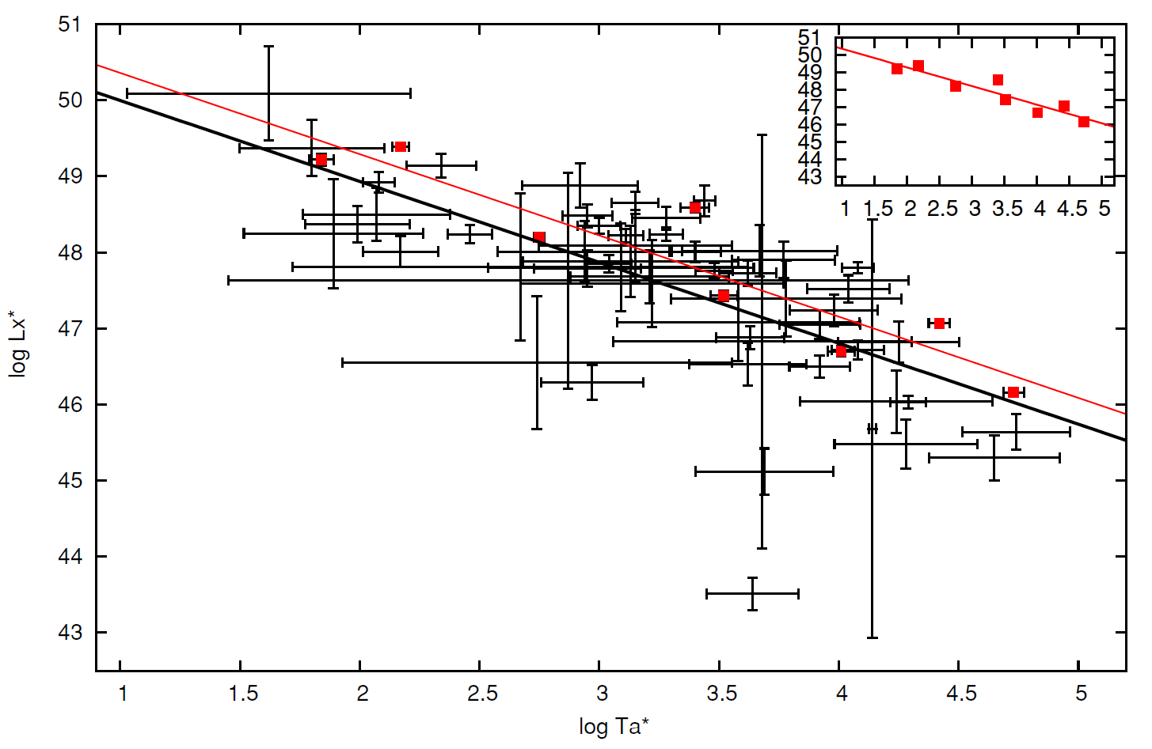
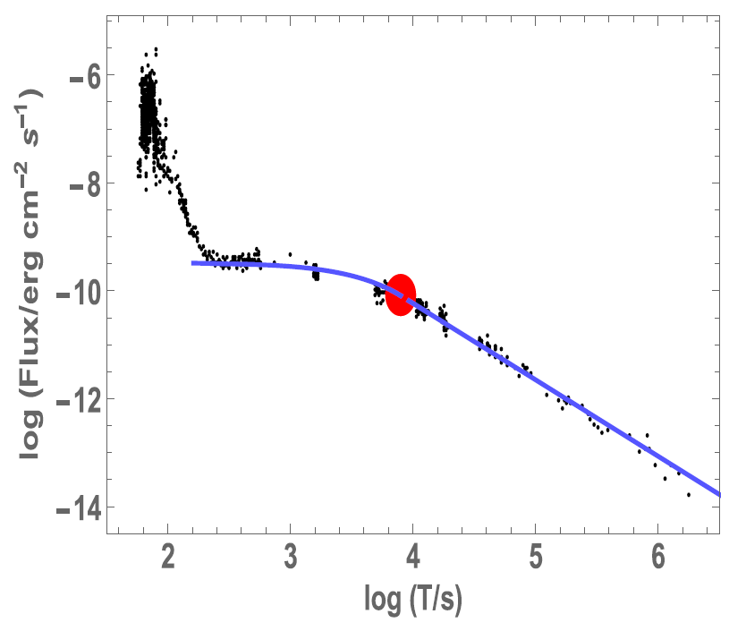

$L_{X}−T_{a}$(Dainotti) relation
the end of plateau
Dainotti et al., 2010, ApJL
Dainotti et al., 2016, ApJL
Dainotti, 2019, Gamma-ray burst correlations: Current status and open questions (Chapter 6). IoP Publishing. (BOOK)

Slide 25
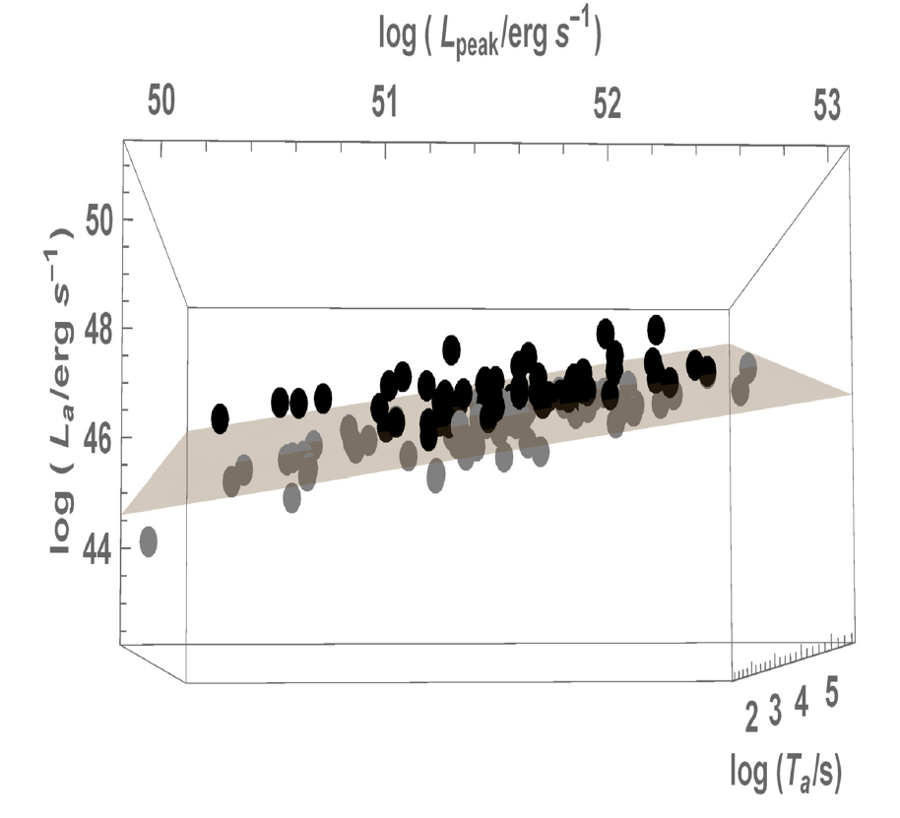
$L_{X}−T_{a}−L_{p}$ (Dainotti fundamental plane) relation
Dainotti et al., 2016, ApJL

Slide 26

Dainotti relation in optical band
Dainotti et al., 2022, ApJS

Slide 27

$E_{X,iso}−E_{γ,iso}−E_{p}$ correlation
Margutti et al., 2013, MNRAS

Slide 28


Constrain cosmological parameters by Dainotti relation
Wang et al., 2022, ApJ

Slide 29





The $L_{X}−T_{a}−E_{p}$ relation
$${ L}_{X} ∝T_{a}^{−1.08}E_{p}^{0.76}$$
It is a combination of the $L_{X}−T_{a}−E_{γ,iso}$
relation (Xu-Huang relation) and
the $E_{p}−E_{γ,iso}$ relation (Amati relation)
Suffer from redshift evolution!

Slide 30






Cosmology with $L_{X}−T_{a}−E_{p}$ relation
Find redshift evolution of $L_{X}−T_{a}−E_{p}$ relation
$$d^{′}=1.78±0.29$$
Calibrated with SNe Ia
 | Ω_{m} | Ω_{Λ} | w
Flat ΛCDM | 0.39±0.17 |  | -1
Non-flat ΛCDM | 0.33±0.17 | 0.35±0.30 | -1
Flat wCDM | 0.37±0.21 |  | -0.97±0.60
Calibrated by Pantheon sample

Slide 31








$$Ω_{Λ}$$
$$w$$
$$Ω_{m}$$
$$Ω_{m}$$
$$Ω_{m}=\text{0.289±0.008}$$
$$Ω_{Λ}=\text{0.710±0.006}$$
$$Ω_{m}=\text{0.295±0.006}$$
$$w=\text{−}\text{1.015±0.015}$$
Xu et al., 2021, ApJ

Slide 32
Outline
Correlations of prompt GRBs
Correlations of GRBs with a plateau phase
L-T-E correlation as a redshift estimator
Conclusions

Slide 33

Redshift estimation from Dainotti relation
Suffer from large uncertainties and intrinsic scatter
Dainotti et al., 2011, ApJ
Dainotti, 2019, Gamma-ray burst correlations: Current status and open questions (Chapter 9). IoP Publishing. (BOOK)

Slide 34


The $L_{X}−T_{a}−E_{γ,iso}$ correlation
55 GRBs
Xu & Huang, 2012, A&A

Slide 35



Sample Selection criteria
174 GRBs
The slope of the plateau is in the range of -1 to 1
Abundant data points are available in the plateau phase
The redshift of these GRBs should well defined
Energy injection from a magnetar?
Tang et al., 2019, ApJS
http://www.eso.org/public/images/eso1527a/

Slide 36


Two samples
Starting Sample (210 GRBs with redshifts)
Target Sample (130 GRBs without redshifts)
Deng et al., 2023, ApJ

Slide 37



Fitting results and relevant parameters of two samples
Deng et al., 2023, ApJ

Slide 38


Fitting results and relevant parameters of two samples
Deng et al., 2023, ApJ

Slide 39




The updated $L_{X}−T_{a}−E_{γ,iso}$ correlation
210 GRBs
Deng et al., 2023, ApJ

Slide 40
Pseudo redshift of the 130 GRBs in the Target Sample
Deng et al., 2023, ApJ

Slide 41


Parameter distributions of the Starting/Target samples
Deng et al., 2023, ApJ

Slide 42


Other luminosity correlations of the two samples
Deng et al., 2023, ApJ

Slide 43

Summary
Conclusions
Our analytical derivation suggests that there should be $E_{p}∝E_{ iso}^{ \frac{1}{2}}$ and $E_{p}∝L_{ p}^{ \frac{1}{2}}$ for on-axis case and $E_{p}∝E_{ iso}^{ \frac{1}{4} \sim \frac{4}{13}}$ and $E_{p}∝L_{ p}^{ \frac{1}{6} \sim \frac{4}{ 17}}$ for off-axis case.
We use de-evolved $L_{X}−T_{a}−E_{p}$ relation to constrain the cosmological parameter.
We have collected 210 plateau GRBs and confirmed the L-T-E correlation as
L-T-E correlation supports that millisecond magnetar can serve as the central engine of plateau GRBs
A tighter L-T-E correlation could help improve the reliability of the derived pseudo-redshifts.
thank you

