Slide 1
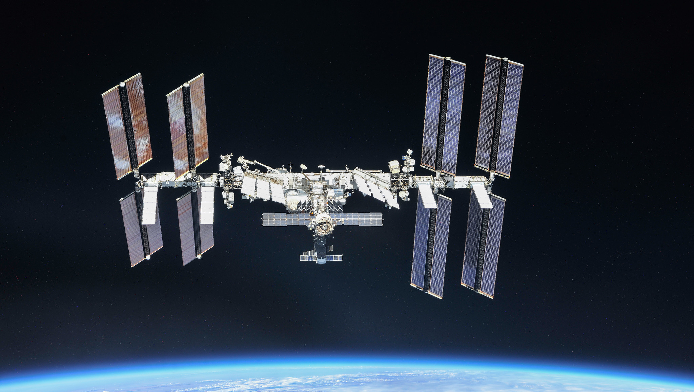
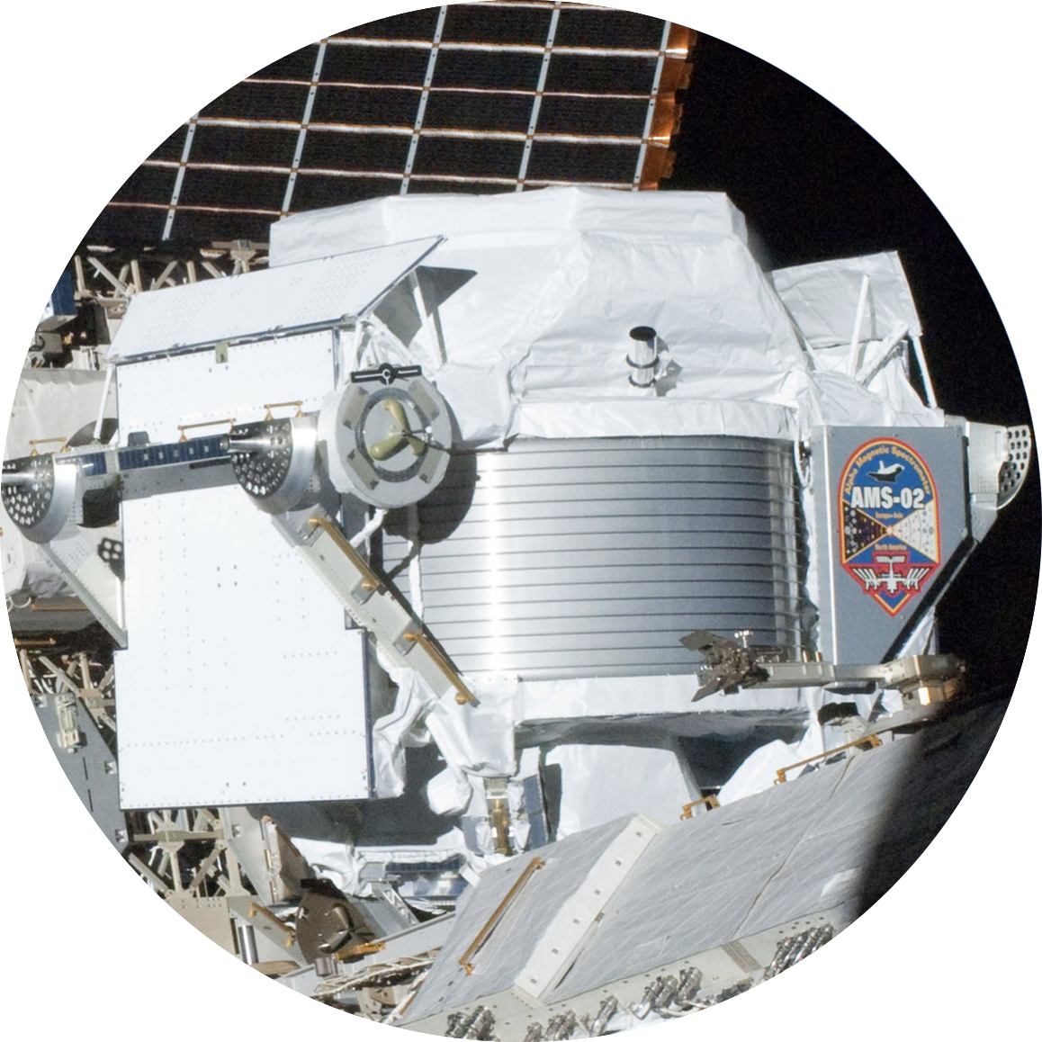


Temporal Evolution of the Daily Proton, Helium, Electron and Positron Fluxes with AMS-02
Francesco Faldi, UniPG, INFN, On Behalf of AMS-02 Collaboration.
Under Agreement ASI-UniPG 2019-2-HH.0
Marcel Grossman Meeting, Pescara, 07-06-2024

Slide 2
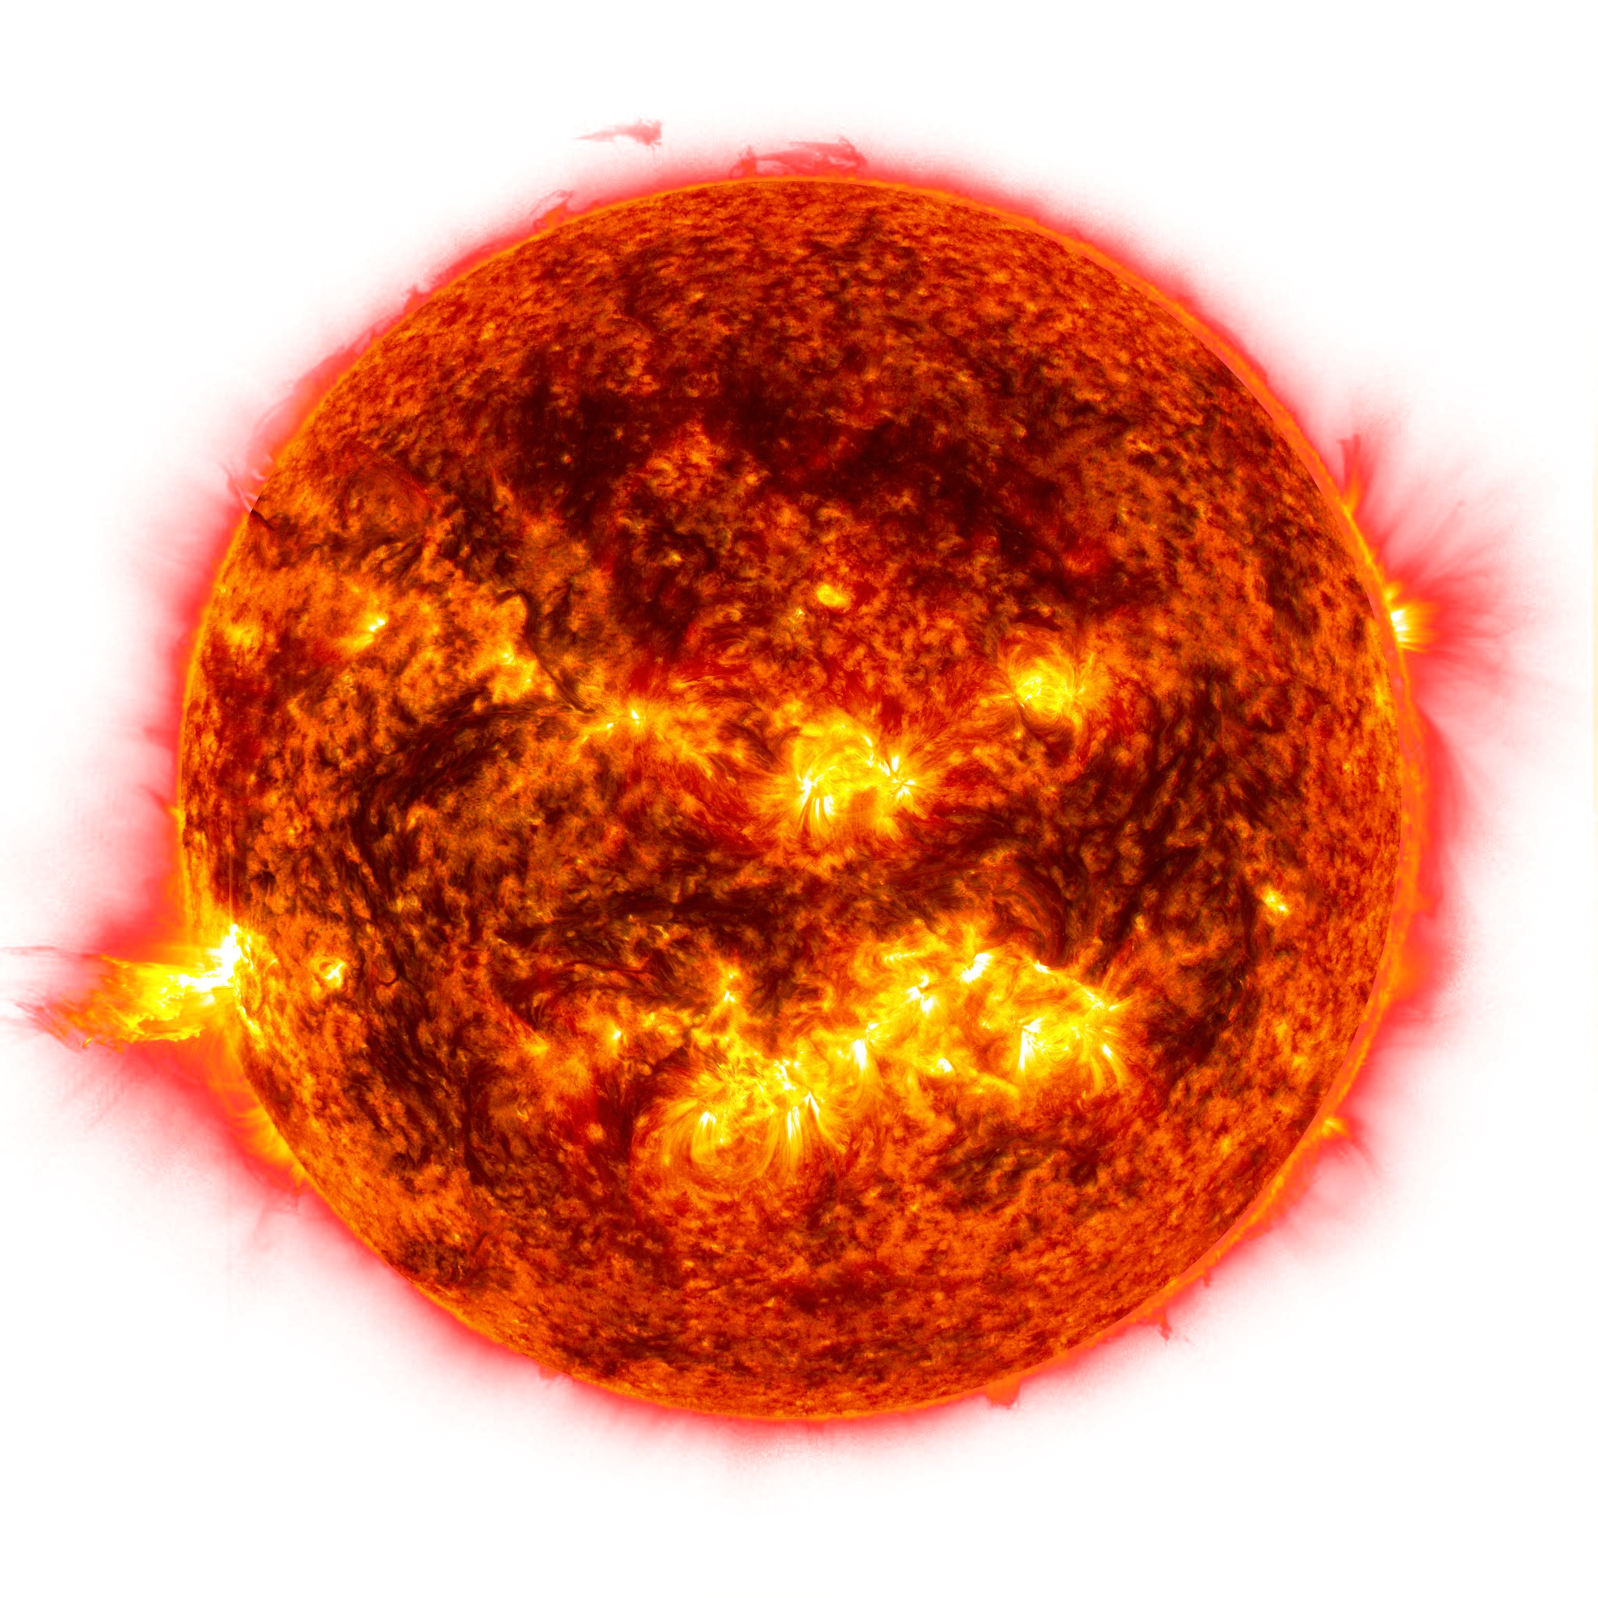

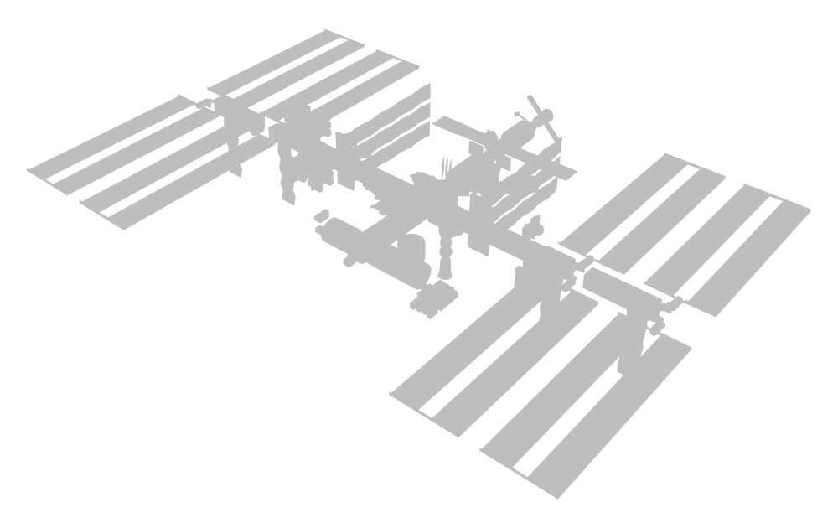
Summary
Long-term and short-term temporal variations in daily CR fluxes.
Periodicities in the daily proton flux: 27, 13.5 and 9 days.
Daily helium flux, similar periodicities, different modulation from proton flux.
Daily electron flux, different modulation from both helium and proton fluxes.
Daily positron flux, similar time dependence and higher modulation with respect to proton fluxes.
Francesco Faldi, UniPG, INFN

Slide 3

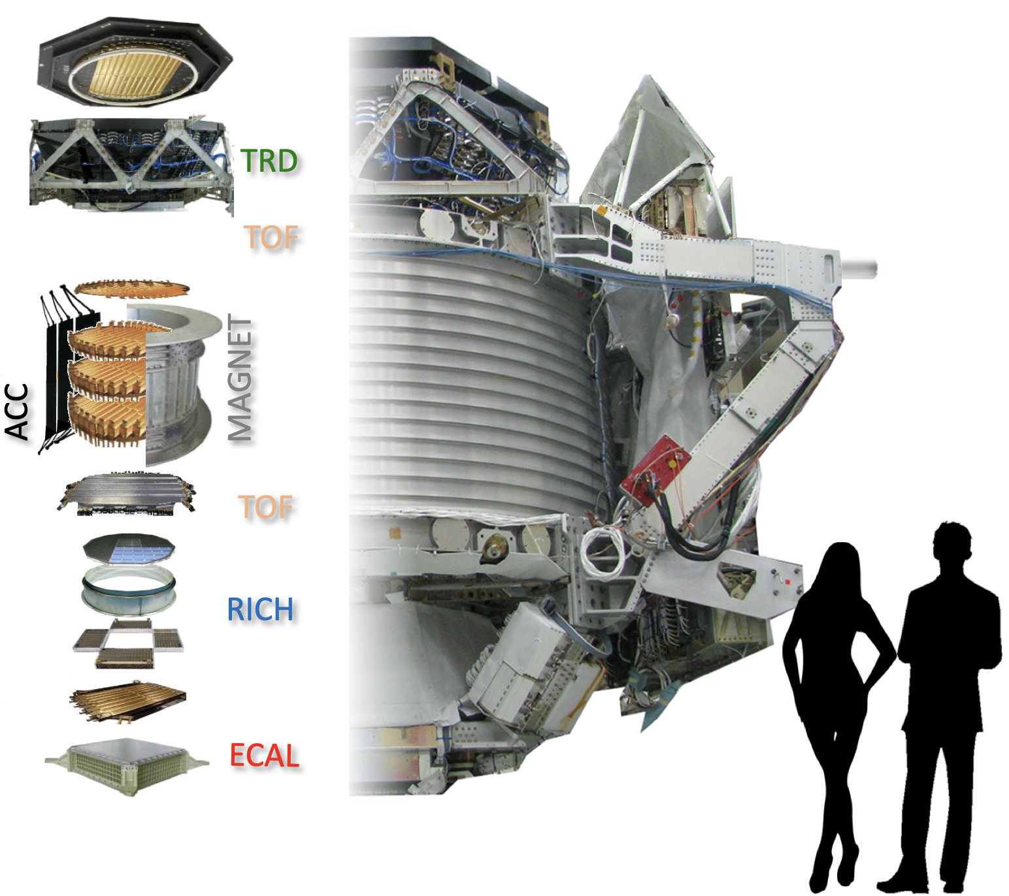
The AMS-02 Experiment
AMS-02 is a precision magnetic spectrometer, in the GeV-TeV energy range, on the ISS since may 2011.
Objectives:
Measure Cosmic Rays fluxes.
Search for primordial antimatter.
Indirect search for dark matter.
Solar modulation of CR in heliosphere.
TRACKER
Francesco Faldi, UniPG, INFN

Slide 4
Flux Measurement
$$Φ_{i}(t,R)=\frac{N_{selected,i}(t,R)}{ΔR_{i}⋅T_{exp,i}(t,R)⋅A_{corr,i}(t,R)}i=i^{th}rigidityinterval$$
$$N_{selected}$$
Selected counts corresponding to proton events
$$T_{exp}$$
Exposure Time in seconds
$$A_{corr}$$
Effective Acceptance: Montecarlo Acceptance
corrected by detector efficiencies

Slide 5
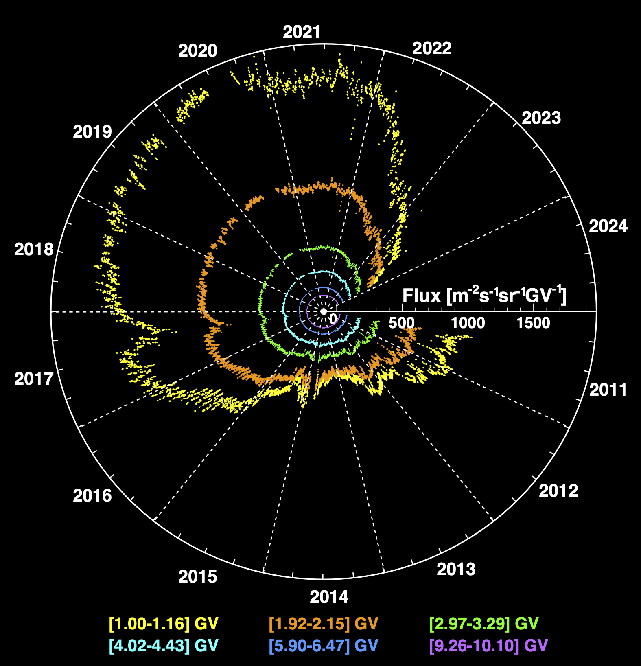
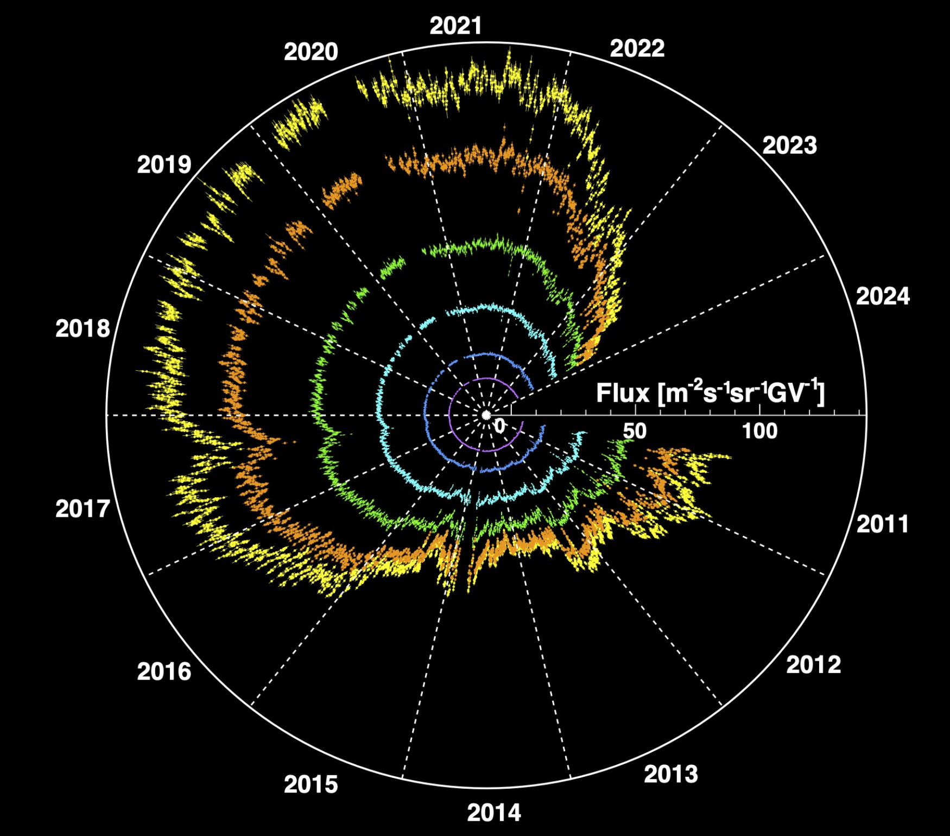
Daily Fluxes
R = p/Z (GV)
Proton Flux
He Flux
[1.00-1.16] GV
[1.92-2.15] GV
[2.97-3.29] GV
[4.02-4.43] GV
[5.90-6.47] GV
[9.26-10.10] GV
[1.71-1.92] GV
[2.15-2.40] GV
[2.97-3.29] GV
[4.02-4.43] GV
[5.90-6.47] GV
[9.26-10.10] GV

Slide 6
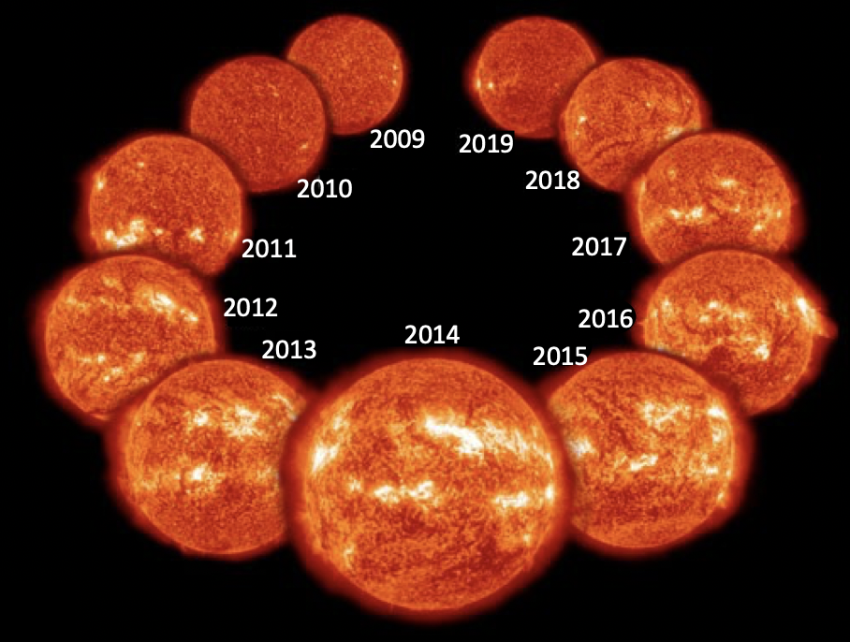
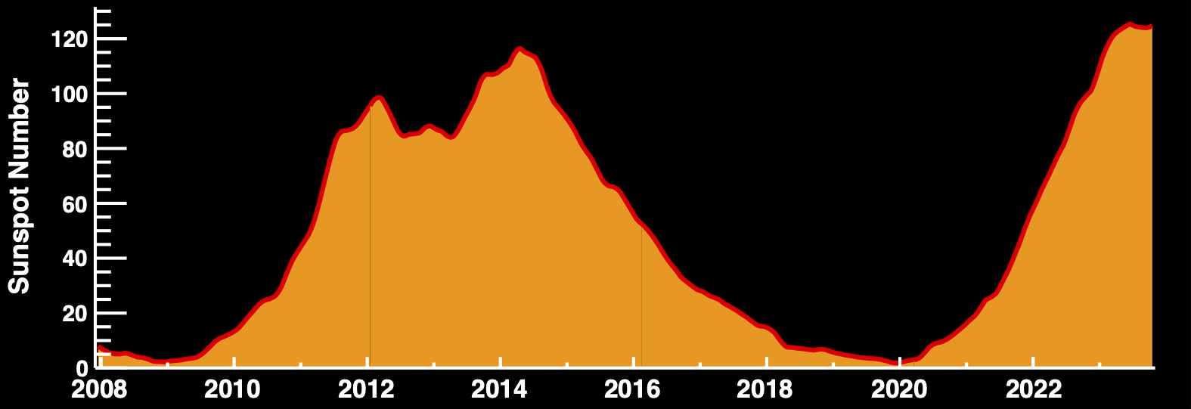
Long-Term Variation: Solar Cycle
The most significant long-term scale variation of CR flux is related to the 11-year solar activity cycle.
May 2011
2030
Solar
Cycle 25
Solar Cycle 24
Francesco Faldi, UniPG, INFN

Slide 7
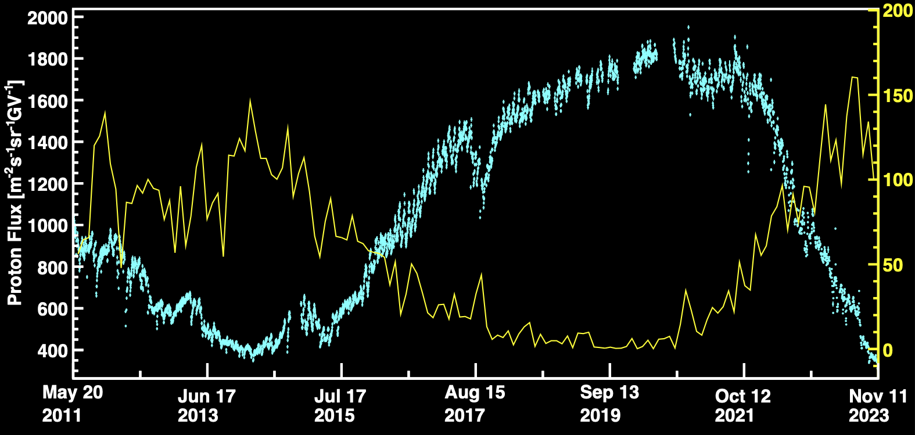
Long-Term Variation: Solar Cycle
Long-term variations are related to the 11-year solar cycle.
Sunspot Number
Proton Flux [1.00-1.16] GV
Francesco Faldi, UniPG, INFN

Slide 8
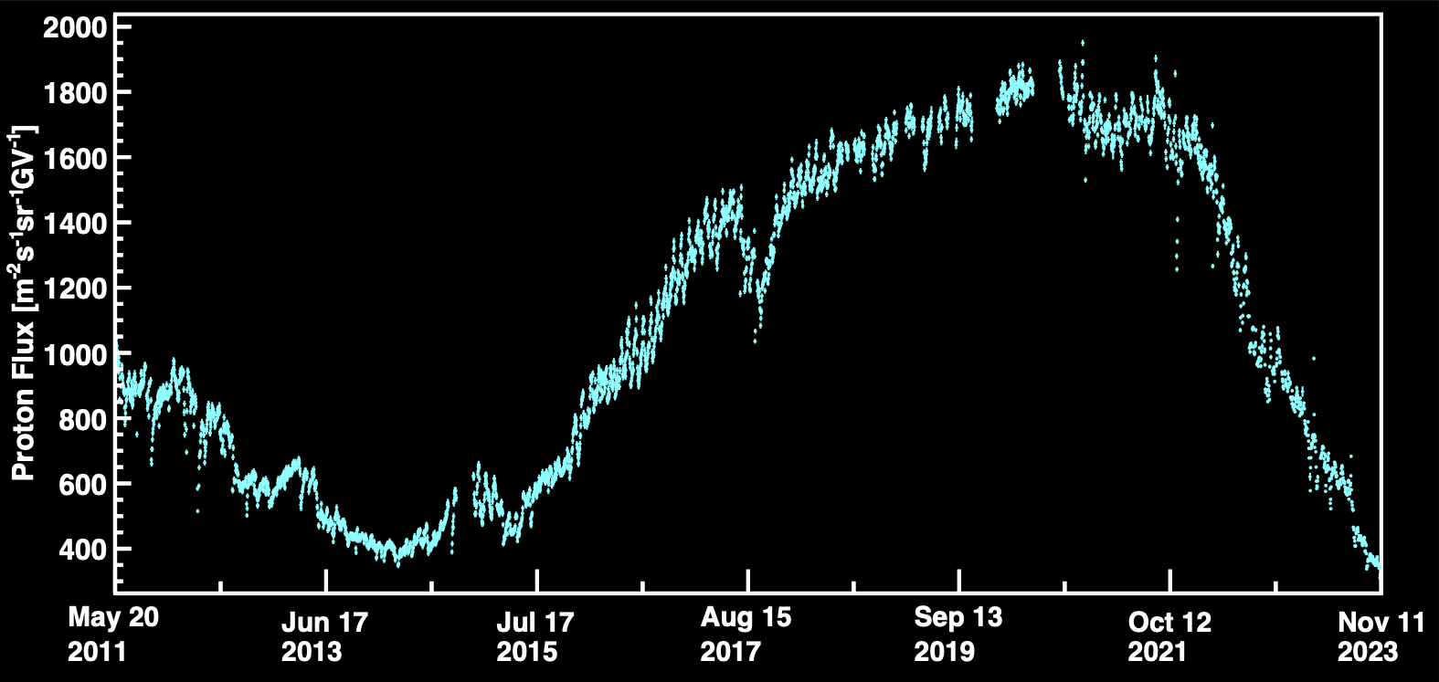
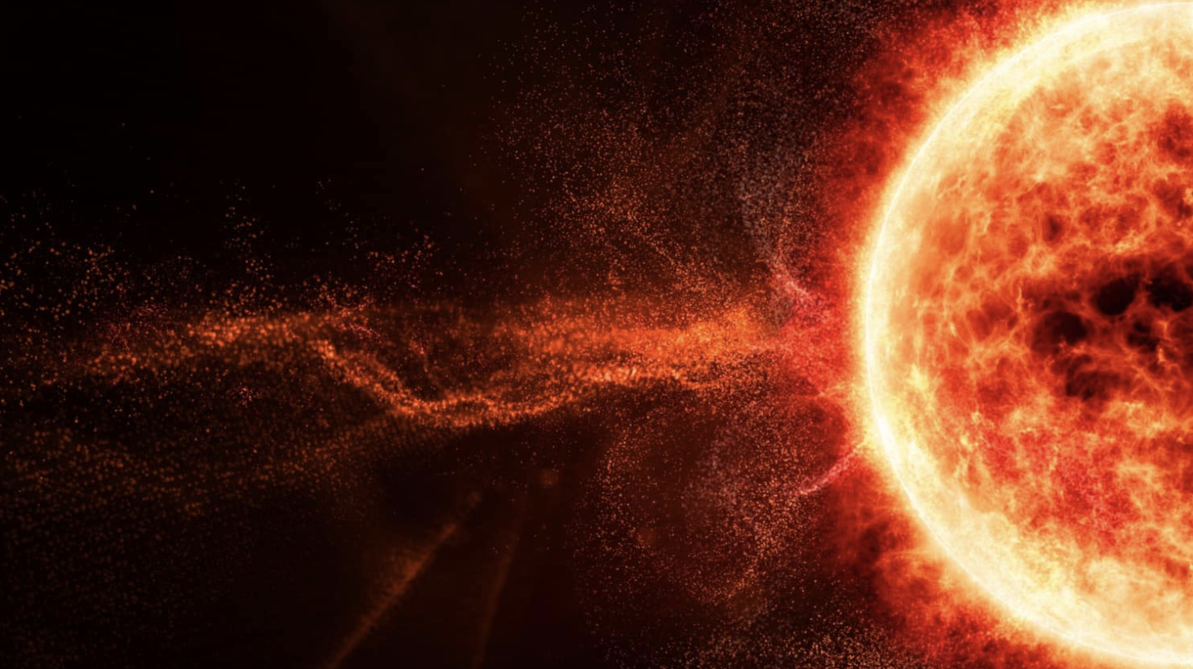
Non-Recurrent Short-Term Variations
Short-term variations can either be non-recurrent or recurrent.
Non-recurrent variations are typically from CMEs, especially during solar maximum
Proton Flux [1.00-1.16] GV
Francesco Faldi, UniPG, INFN

Slide 9
Recurrent Short-Term Variations
Short-term variations can either be non-recurrent or recurrent.
Recurrent variations are related to the Sun’s rotation
Proton Flux [1.00-1.16] GV
Francesco Faldi, UniPG, INFN

Slide 10
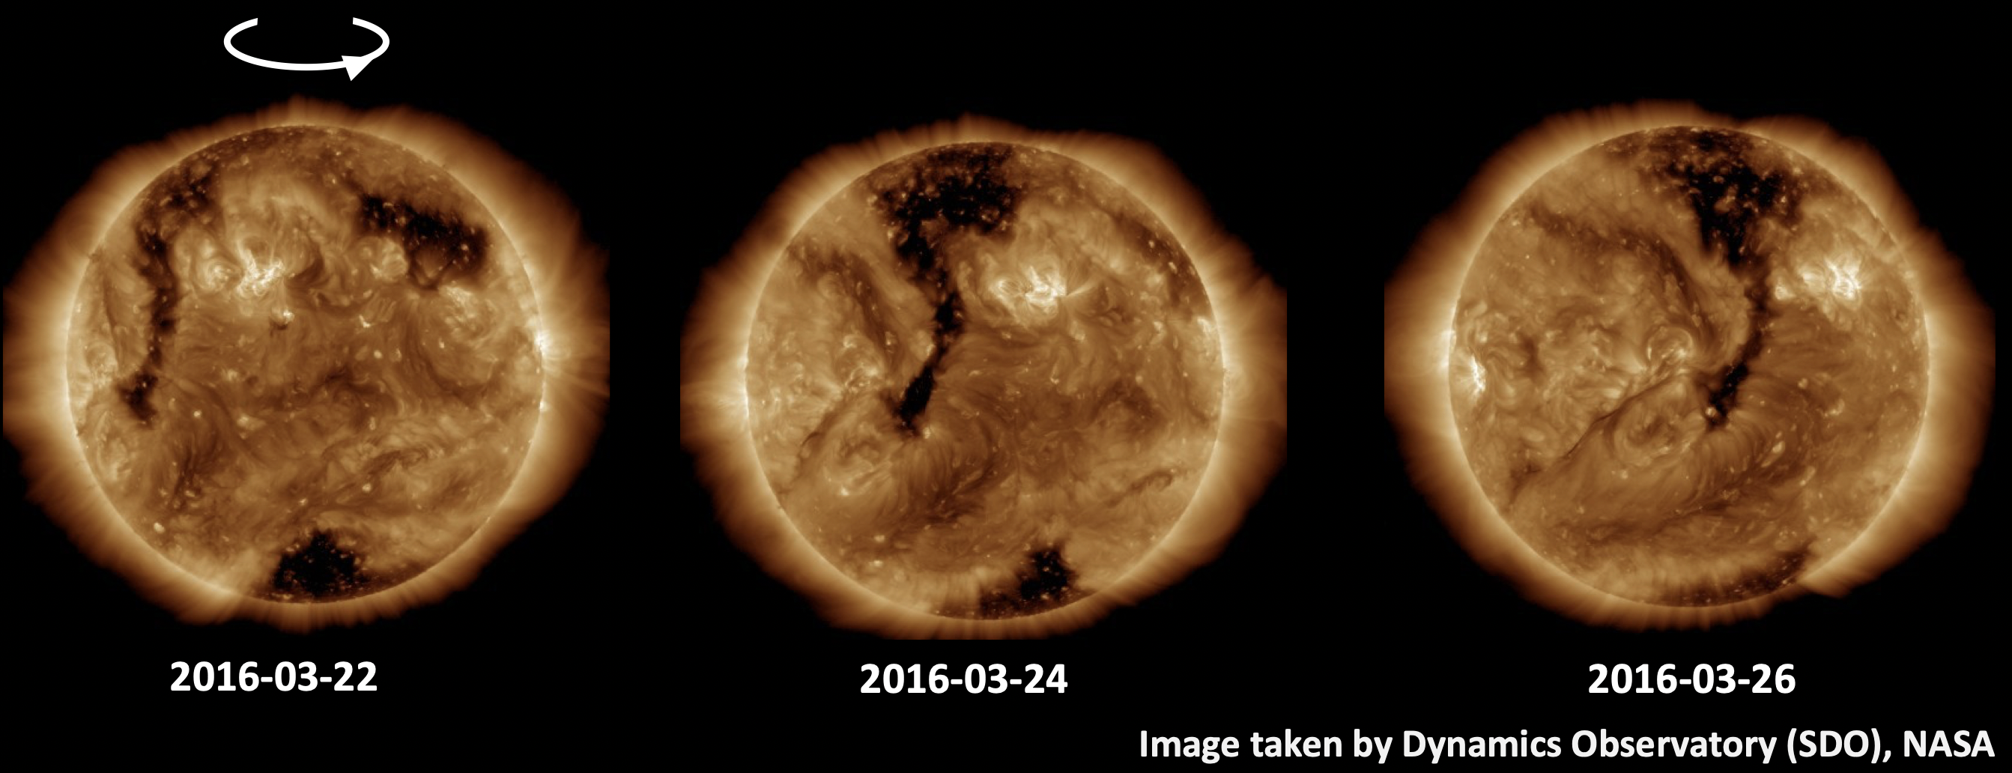
Recurrent Short-Term Variations
Short-term variations are related to Sun’s rotation (Bartels’ rotation: 27 days)
Coronal Holes are regions where plasma density and temperature are lower, so they appear darker in images.
Francesco Faldi, UniPG, INFN

Slide 11
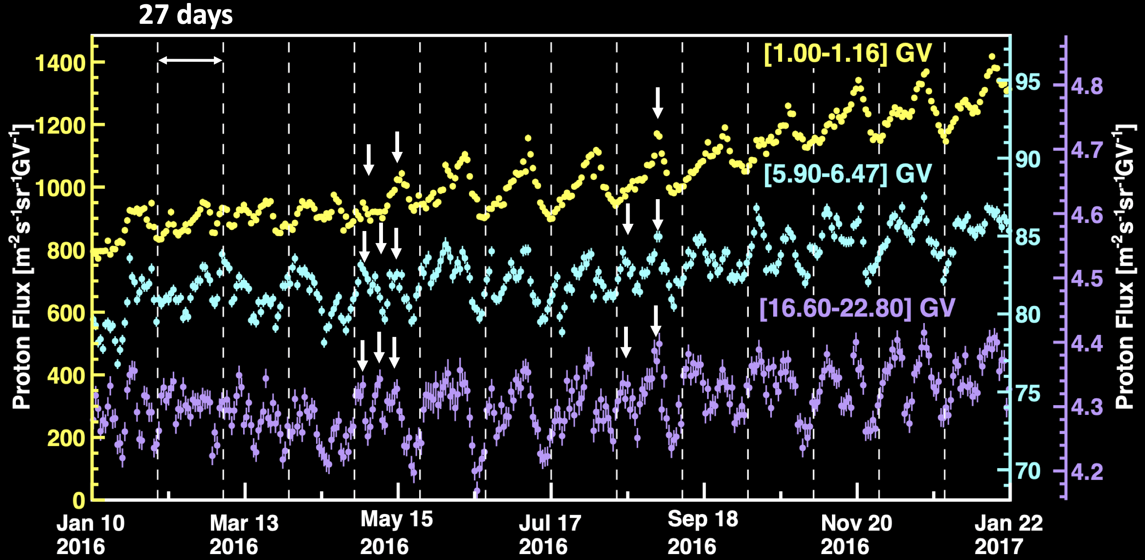
Recurrent Short-Term Variations
2016
Francesco Faldi, UniPG, INFN

Slide 12
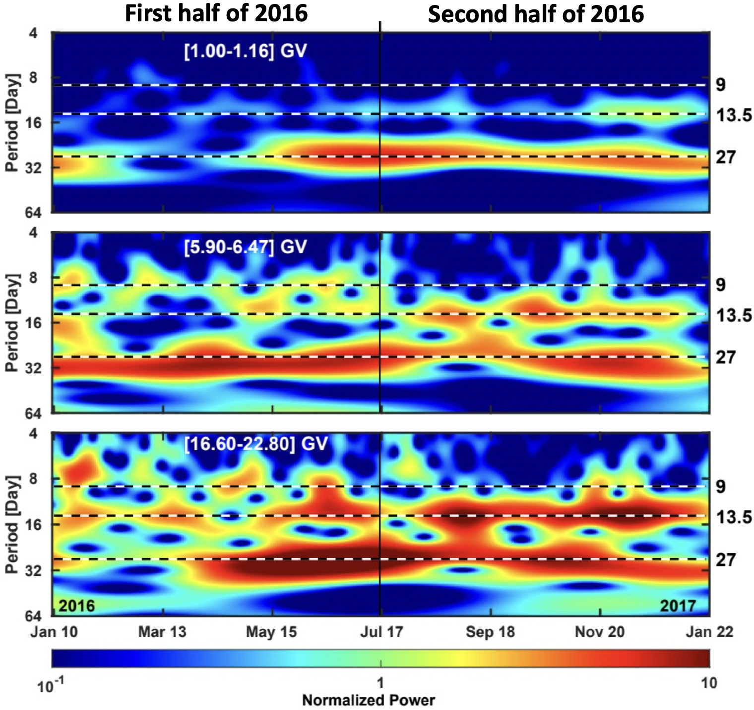
Wavelet Analysis of Proton Flux
Normalized power is defined as the power divided by the variance of the time series.
Periods of 9, 13.5 and 27 days are observed in 2016.
The shorter periods of 9 and 13.5 days, when present, are more visible at 20 GV.
Francesco Faldi, UniPG, INFN

Slide 13
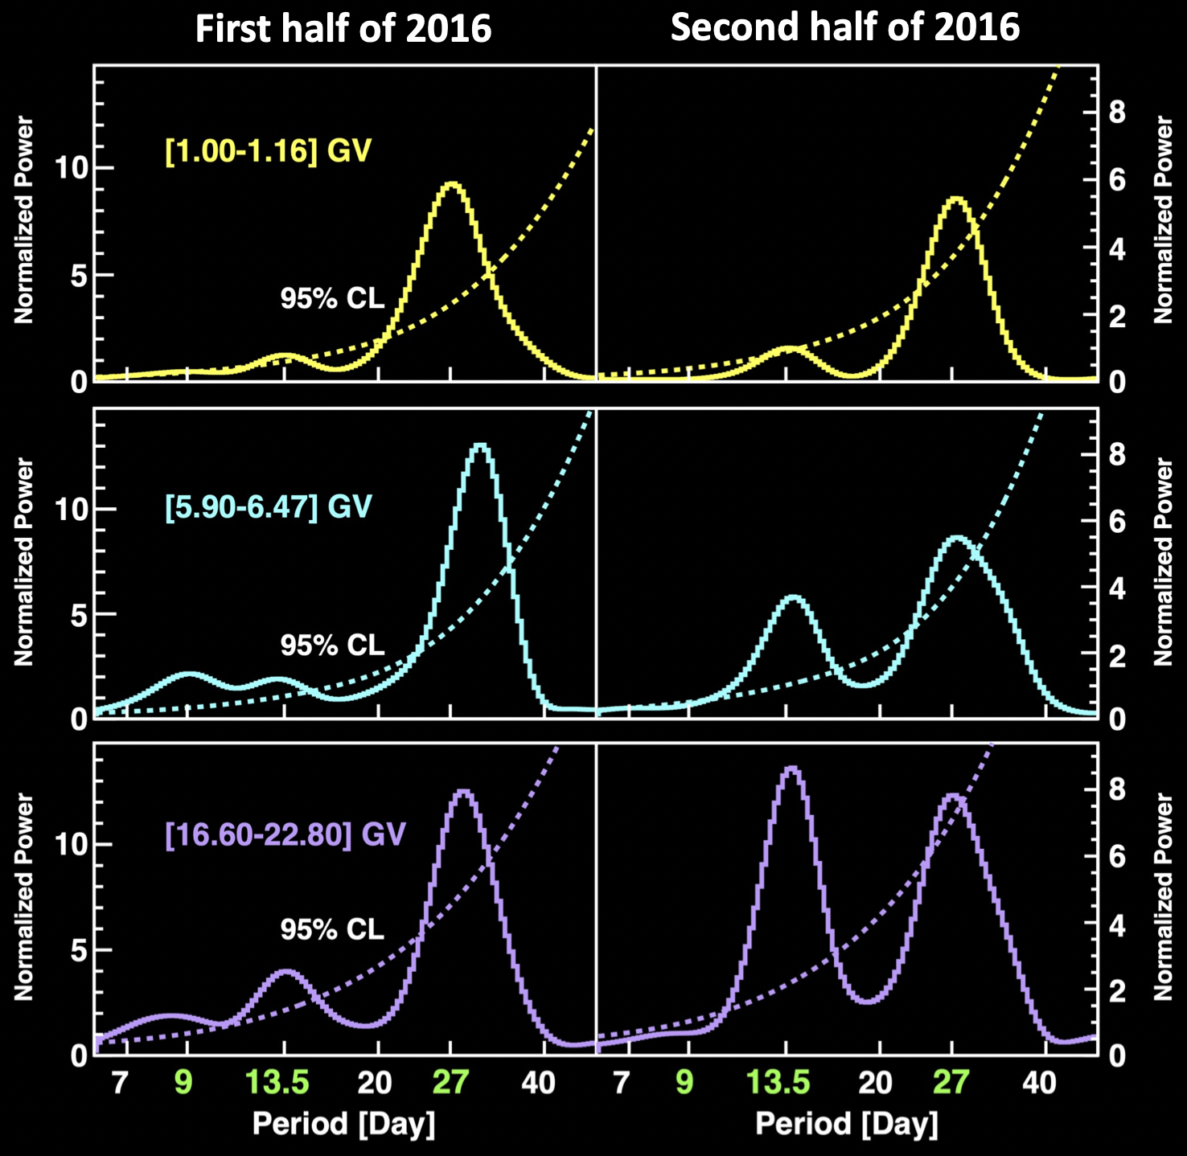
Average Power Spectra
First half of 2016: 9 and 13.5 day periods strength increases with increasing rigidity.
Second half: 13.5 day period strength increases with increasing rigidity, 9 day period not significant.
27 day period varies with rigidity in both time intervals.
Francesco Faldi, UniPG, INFN

Slide 14
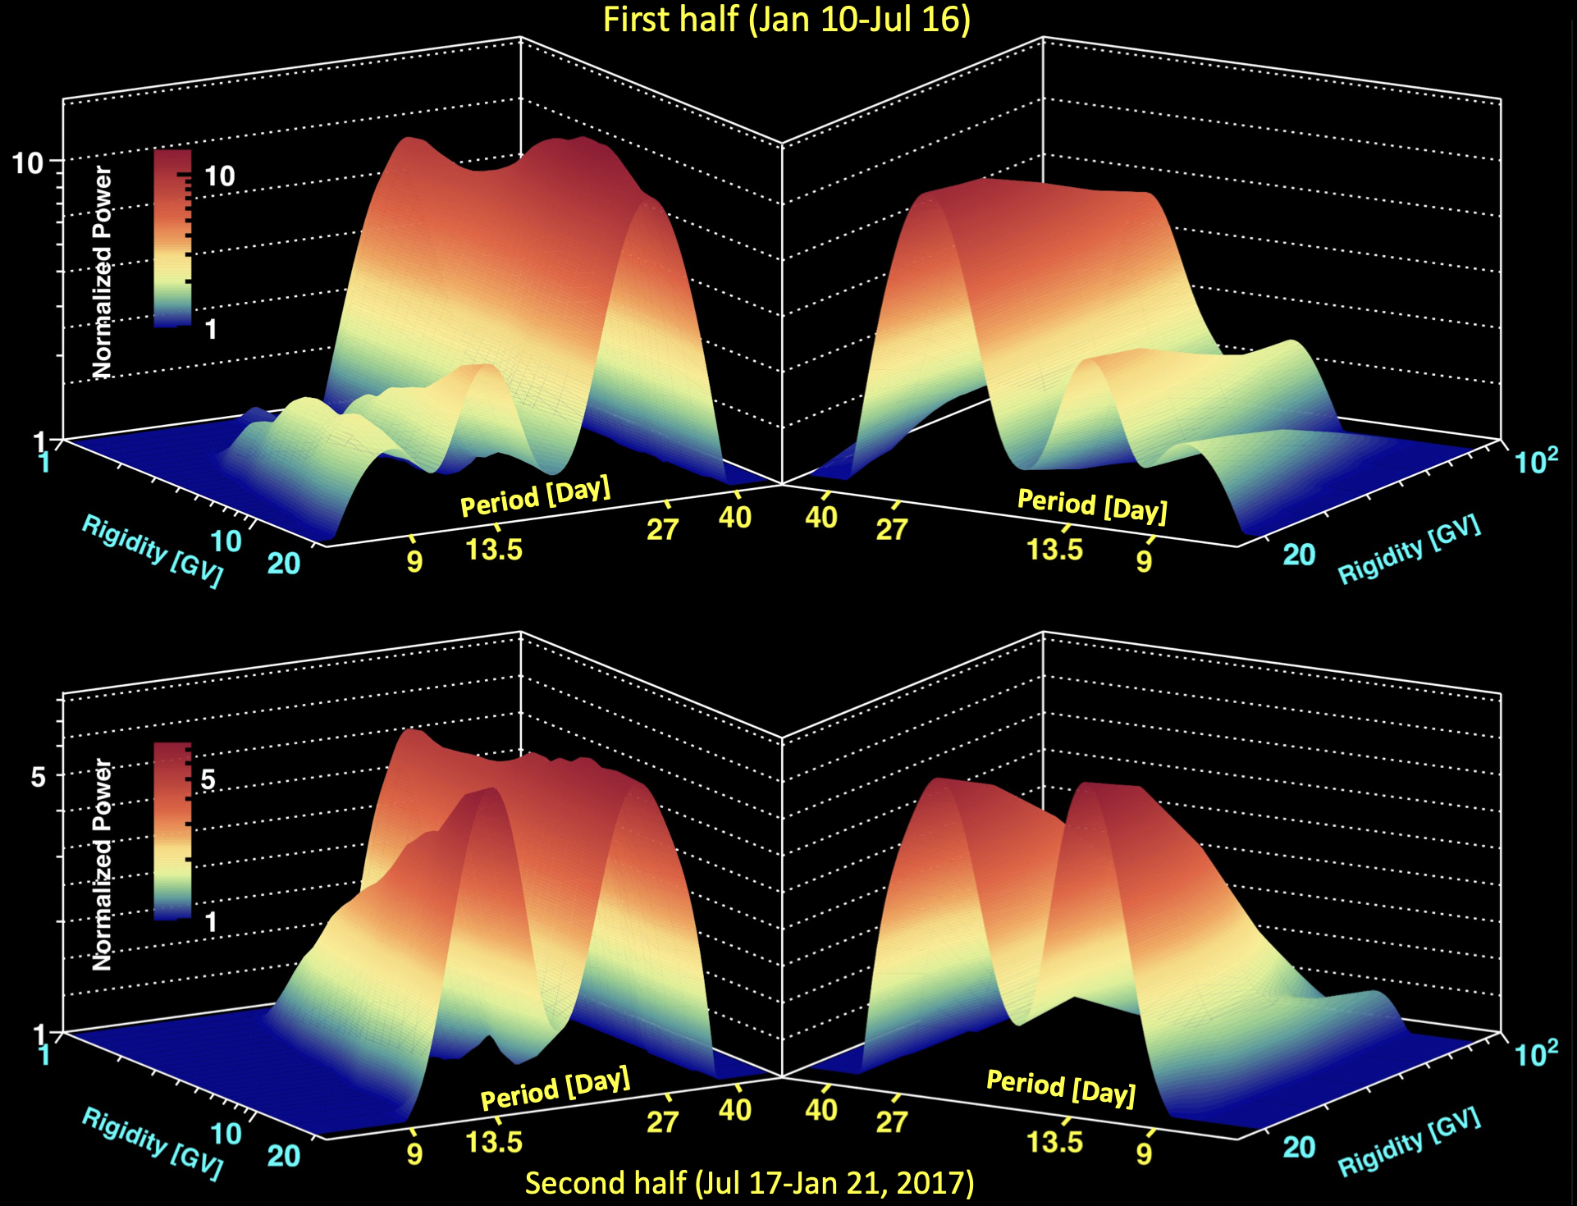
Short-Term Periodicities, Proton Flux
9 and 13.5 day periodicities increase with increasing rigidity up to 10 GV and 20 GV, respectively. Then the strength decreases up to 100 GV.
Thus, the AMS results do not support the general conclusion that the strength of the periodicities always decreases with increasing rigidity.
Phys. Rev. Lett. 127, 271102 (2021)
Francesco Faldi, UniPG, INFN

Slide 15
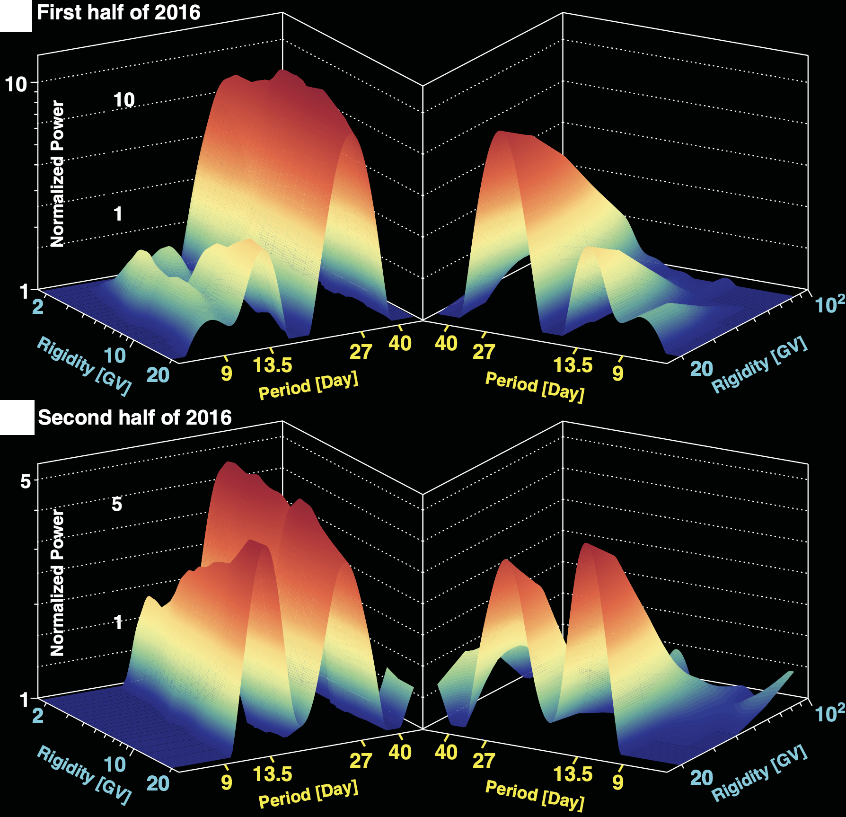
Short-Term Periodicities, Helium Flux
A similar rigidity dependence in the strength of He periodicities is observed.
Thus, the AMS results do not support the general conclusion that the strength of the periodicities always decreases with increasing rigidity.
Phys. Rev. Lett. 128, 271102 (2022)
Francesco Faldi, UniPG, INFN

Slide 16
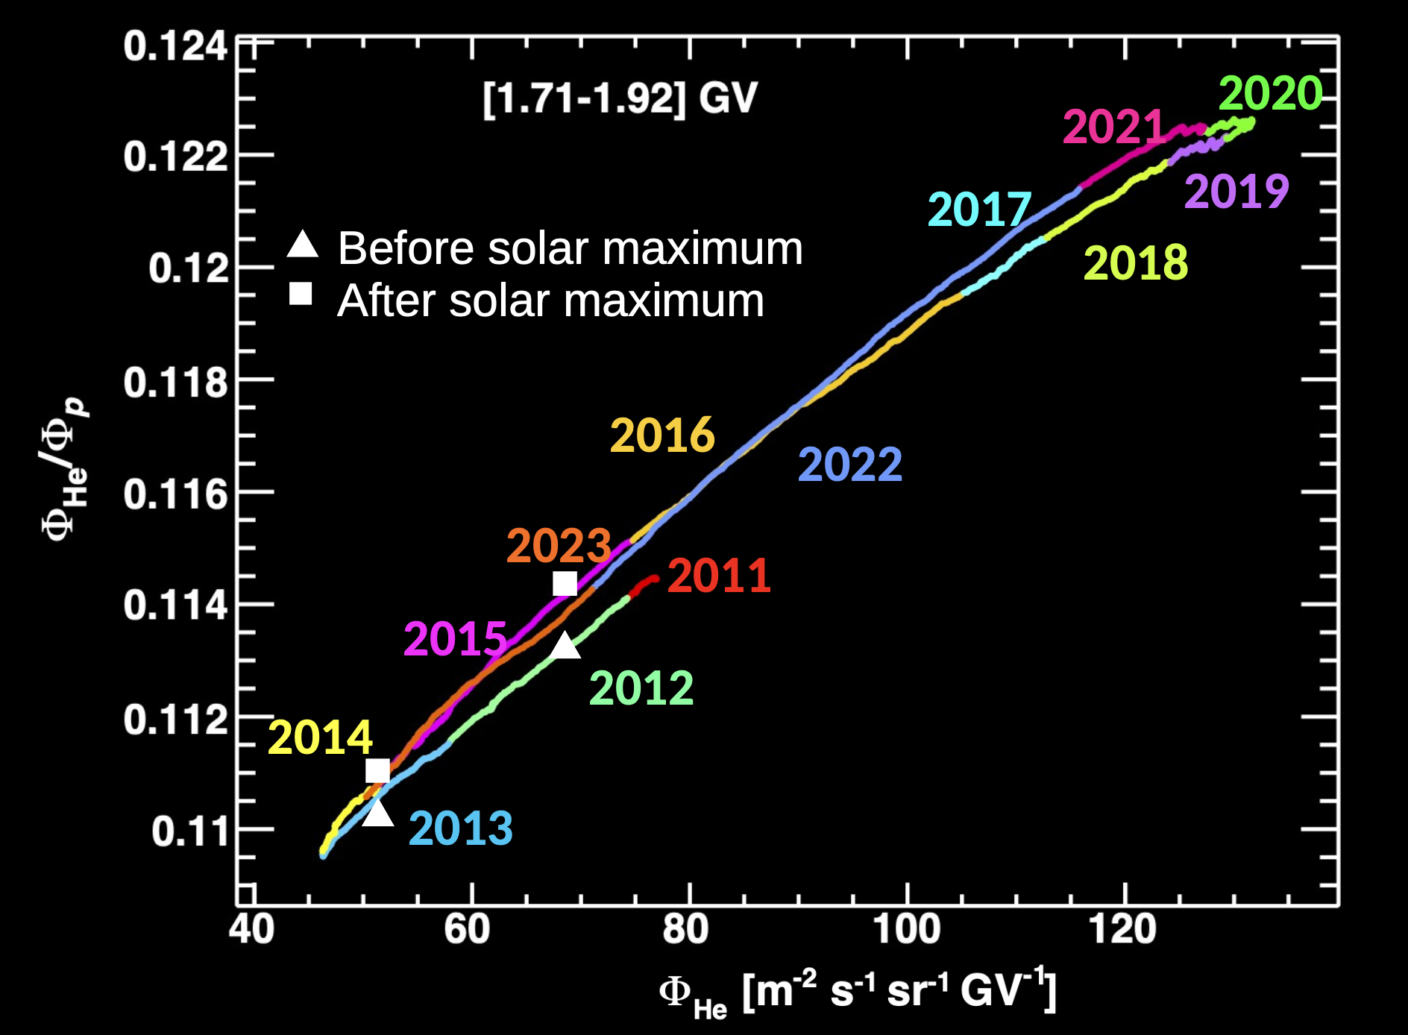
He/p Hysteresis
Correlation plots between helium and proton fluxes. Data points are the moving average of 14 Bartels’ Rotations (BR), with a step of 1 day.
For R < 2.4 GV we observe an hysteresis between proton and helium fluxes.
Hysteresis in the flux ratio indicates a different solar modulation of the two species.
Francesco Faldi, UniPG, INFN

Slide 17
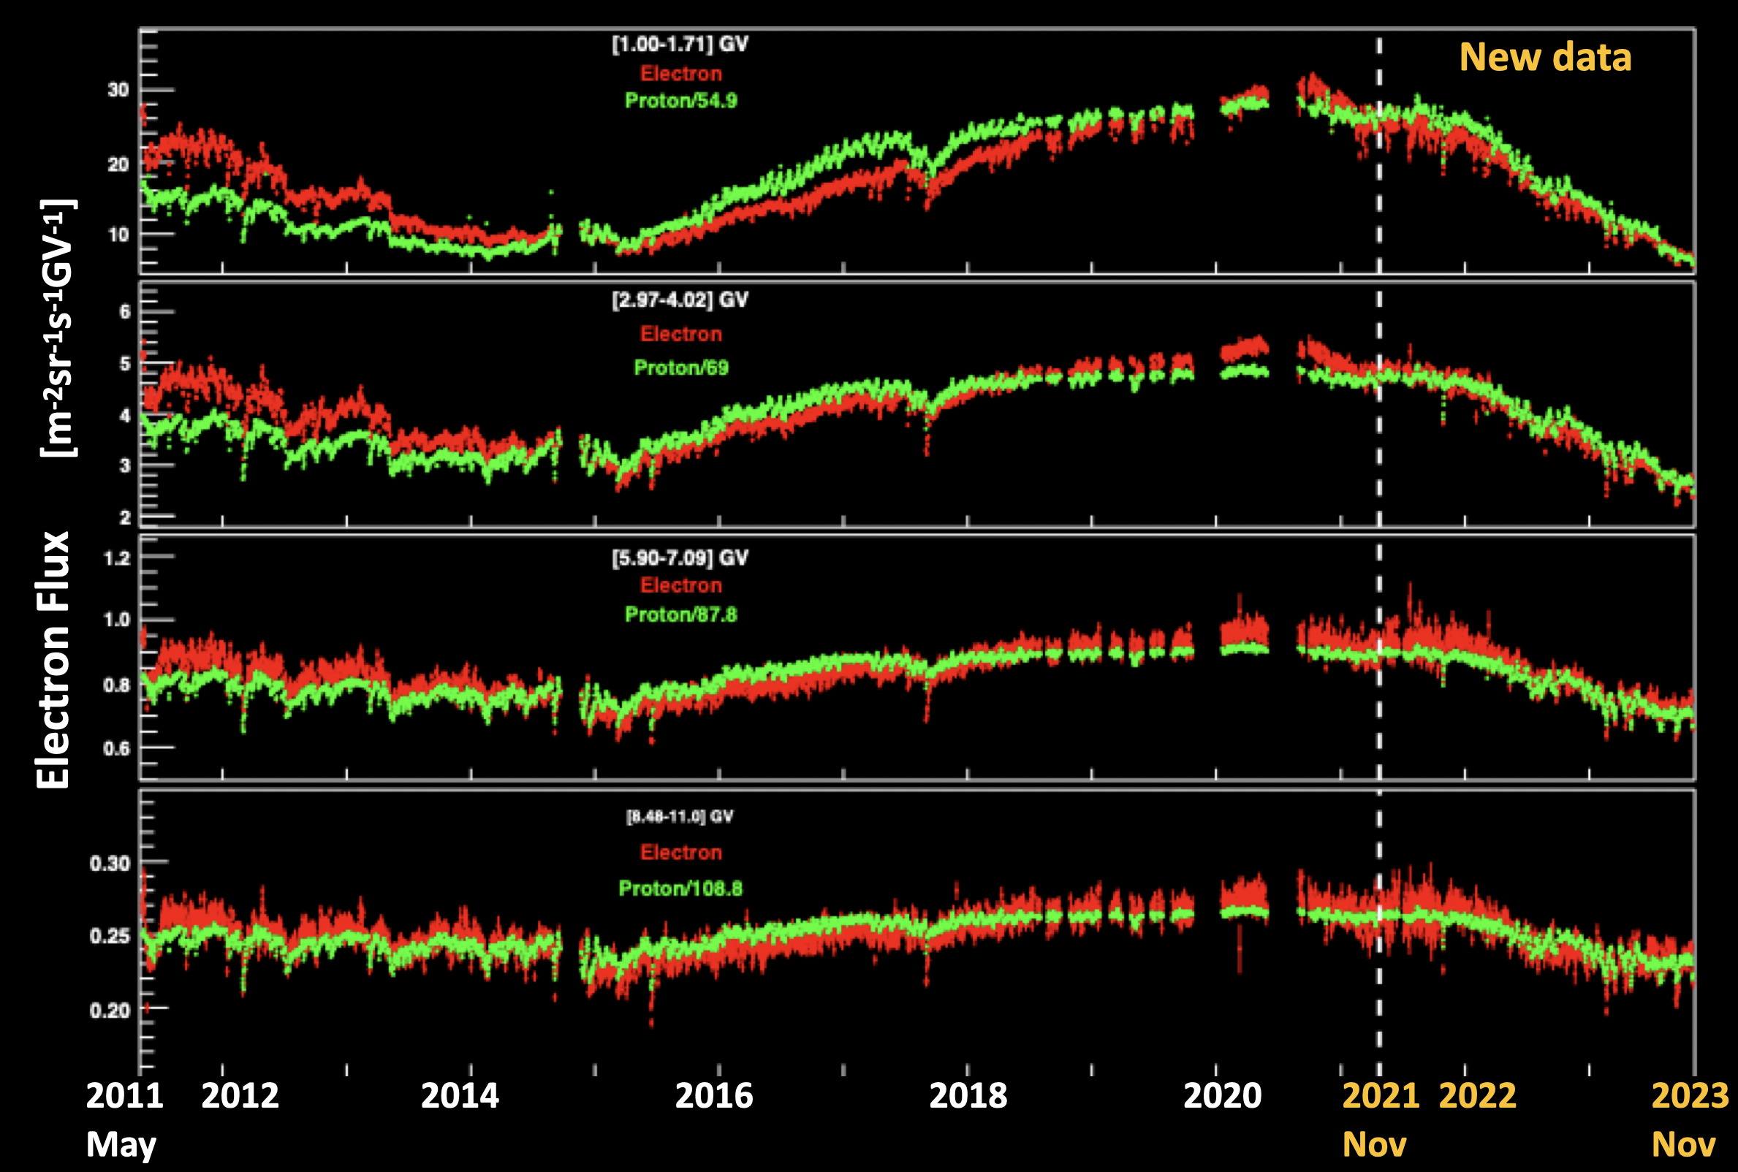
Daily Electron Flux
Electrons are modulated differently than protons for R < 8.5 GV.
Differences are most significant at lower rigidities.
Two distinct regions:
2011-2014 faster decrease of e⁻
2014-2017 slower increase of e⁻
Phys. Rev. Lett. 130, 161001 (2023)
Solar Maximum
Francesco Faldi, UniPG, INFN

Slide 18
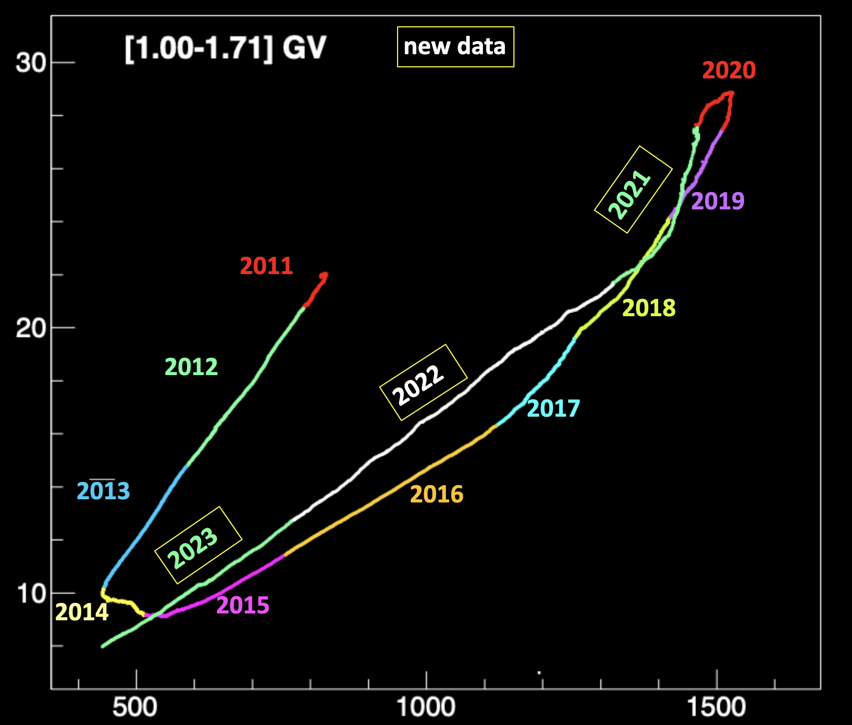
e⁻/p Hysteresis
Correlation plots between electron and proton fluxes. Data points are the moving average of 14 BR, with a step of 1 day.
Hysteresis and change in behaviour at solar maximum, opposite behaviour as seen in the helium comparison with proton.
Charge sign dependence of solar modulation.
Electron Flux [m⁻²sr⁻¹s⁻¹GV⁻¹]
Proton Flux [m⁻²sr⁻¹s⁻¹GV⁻¹]
Francesco Faldi, UniPG, INFN

Slide 19
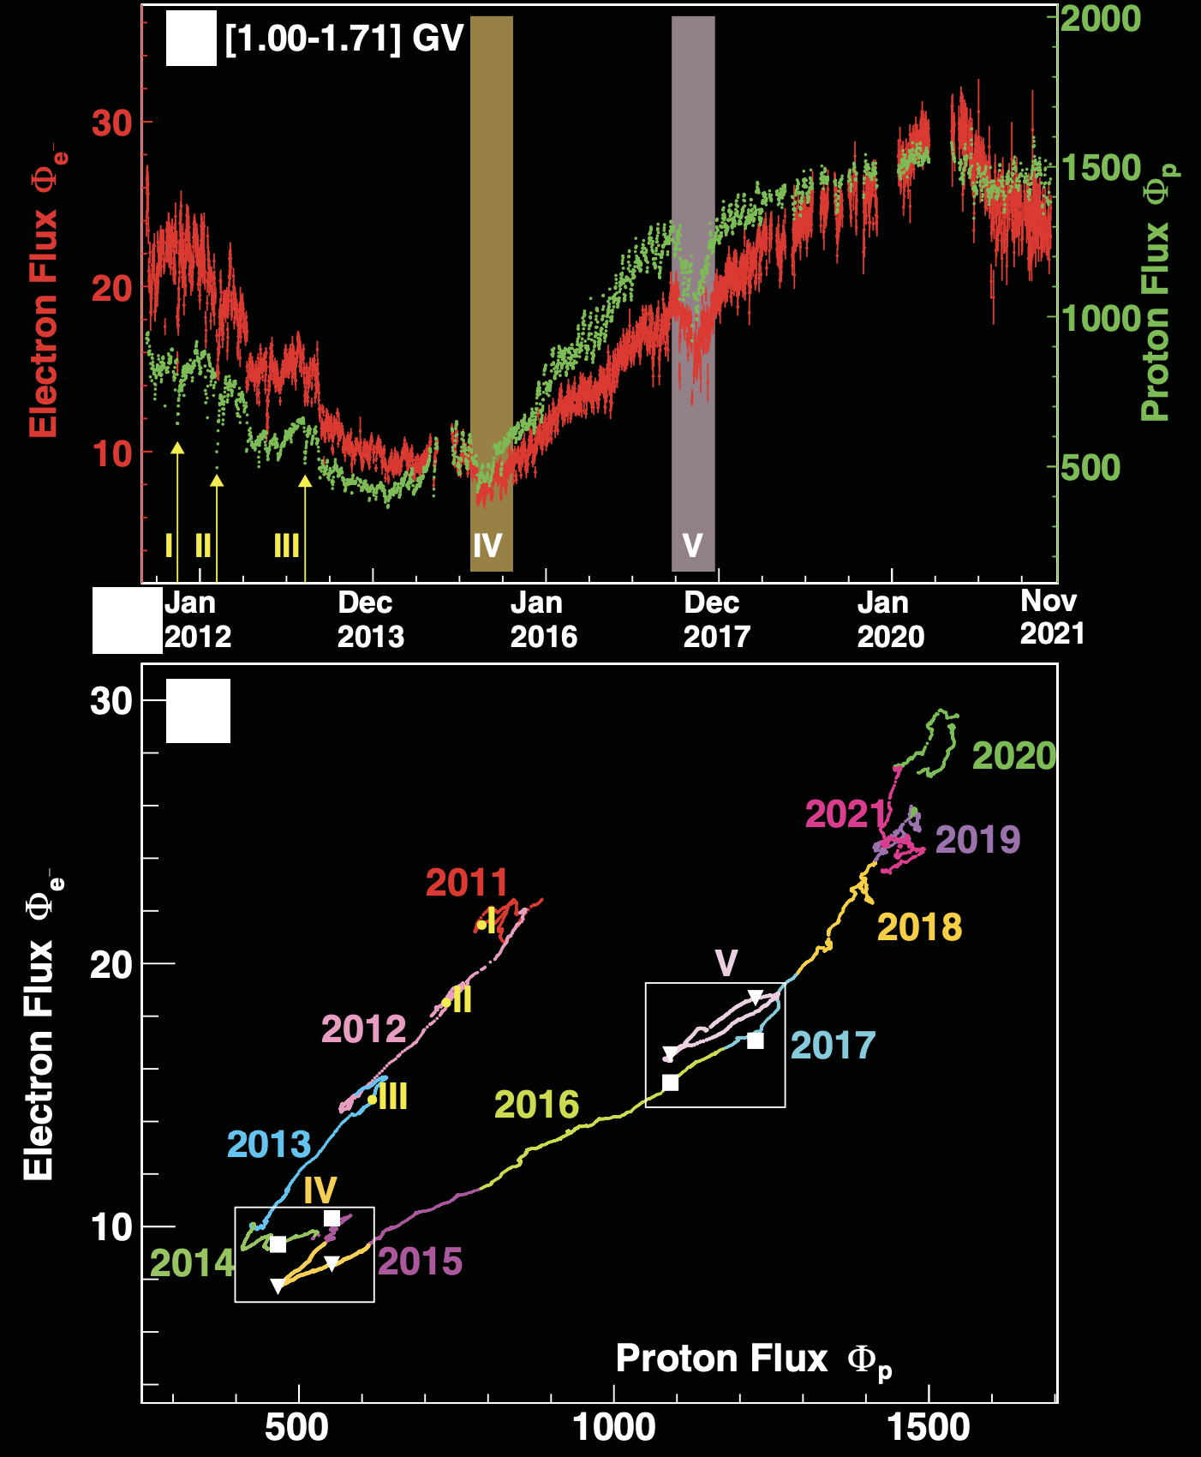
Structures in Electron Hysteresis
A finer moving average (2 BR, 1 day step) shows structures in the correlation plot.
The likely cause of these structures are transient Coronal Mass Ejections.
Charge sign dependence in the modulation during these events, on the timescale of several BRs.
Francesco Faldi, UniPG, INFN

Slide 20
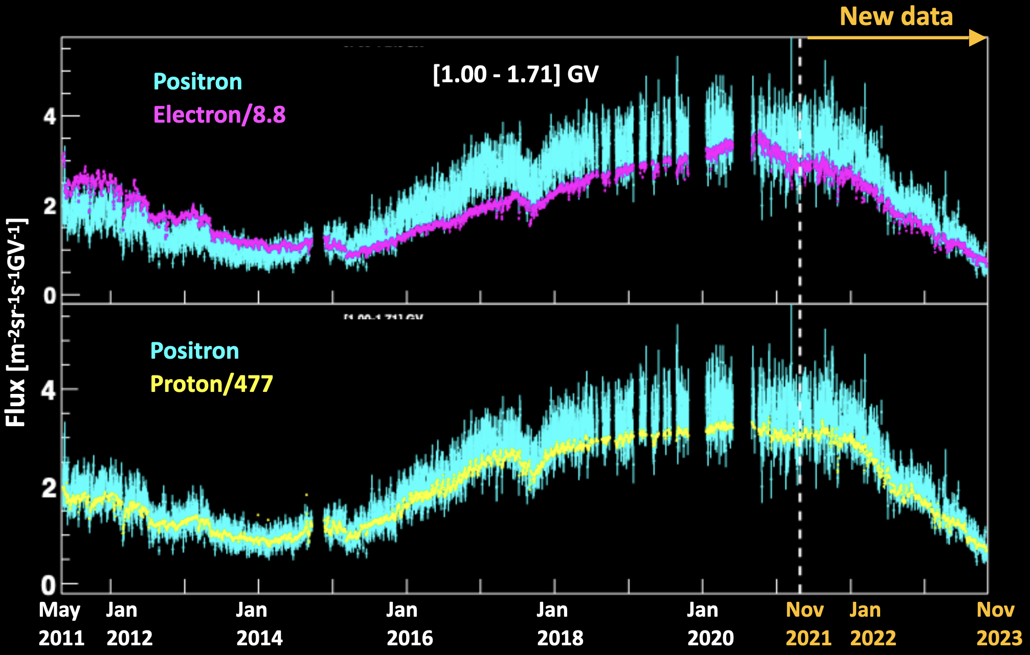
Daily Positron Flux
The positron flux matches the long-term trend of proton flux.
Similar differences with electron flux, as seen in electron VS proton, are observed for R < 8.5 GV.
Phys. Rev. Lett. 131, 151002 (2023)
Francesco Faldi, UniPG, INFN

Slide 21
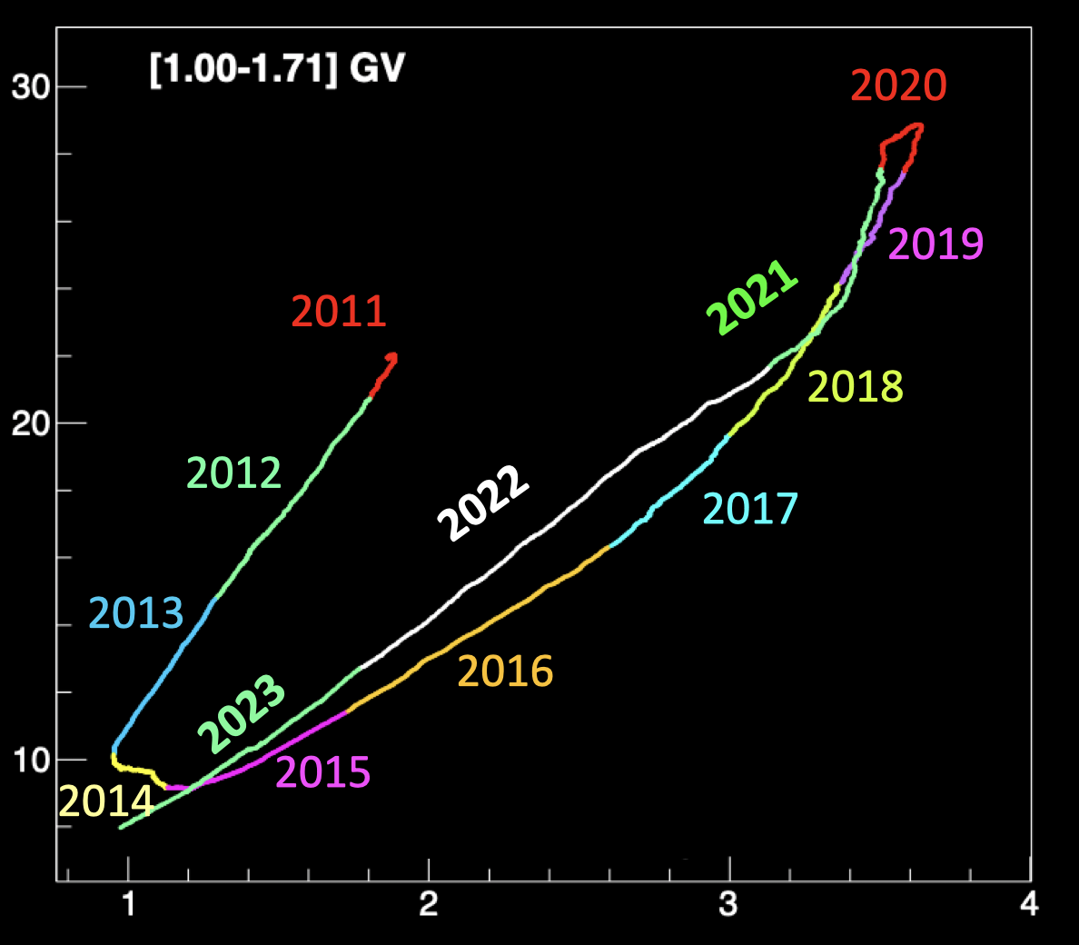
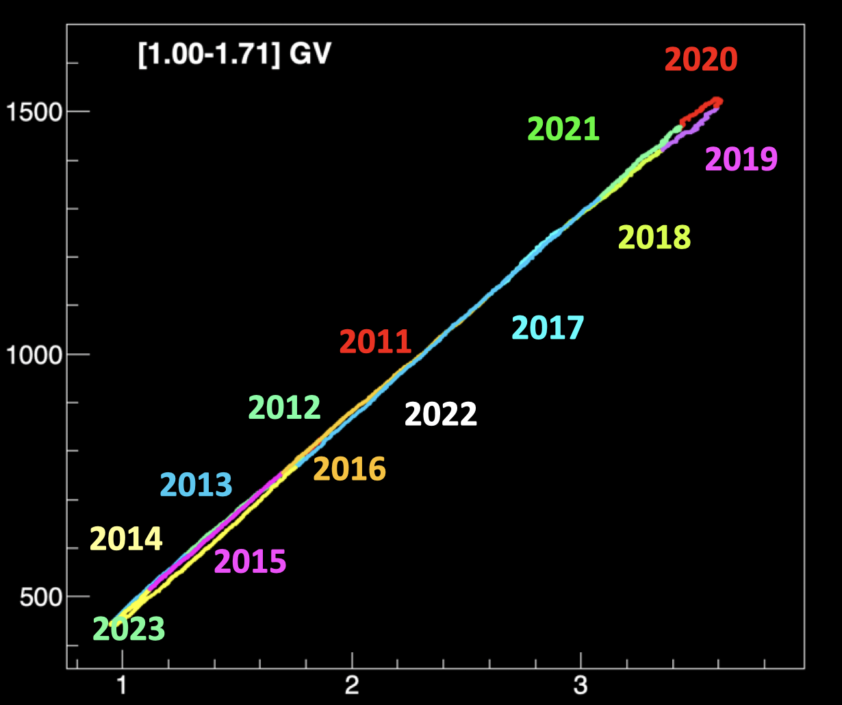
e⁻/e⁺ and p/e⁺ Hysteresis
Correlation plots: electron VS positron and proton VS positron. Moving average of 14 BR, with a step of 3 days.
Similar hysteresis with electron, as seen with electron VS proton.
Linear relation with proton: modulation is the same for equal charge and different mass species.
Electron Flux
Proton Flux
Positron Flux
Francesco Faldi, UniPG, INFN

Slide 22
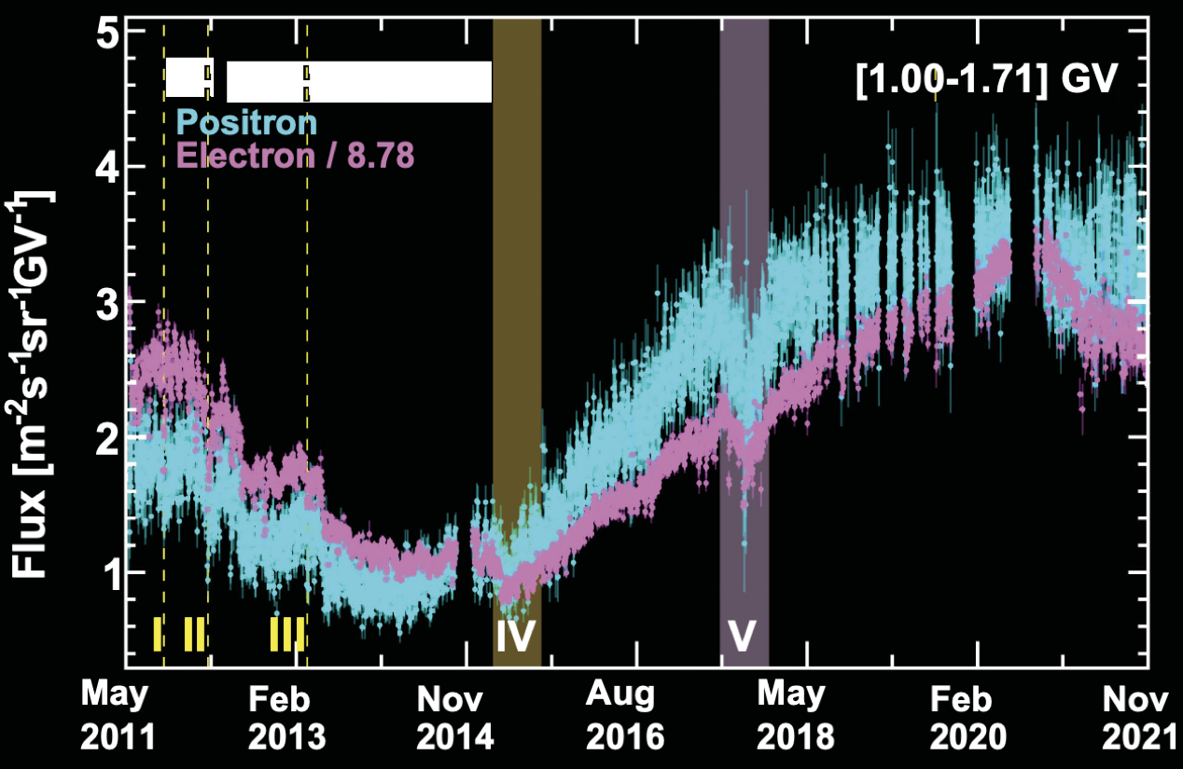
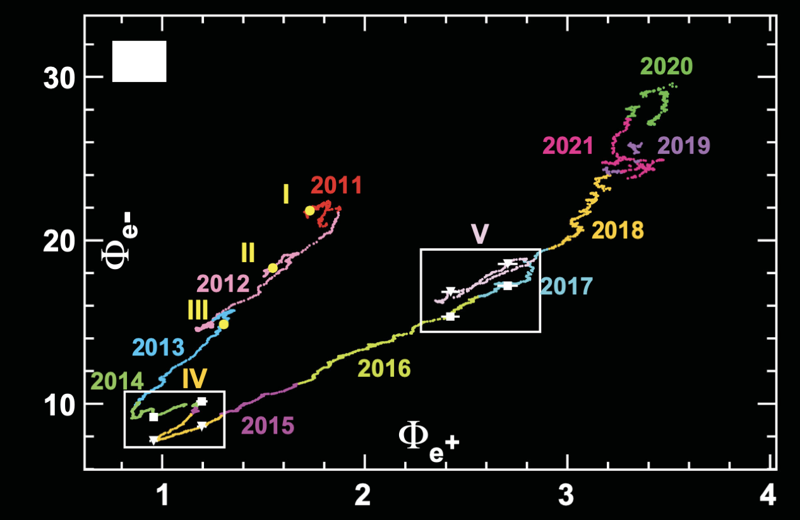
Structures in Positron Hysteresis
Similar finer structures, as in electron VS proton hysteresis, in electron VS positron.
No significant structures in the proton VS positron hysteresis.
Francesco Faldi, UniPG, INFN

Slide 23
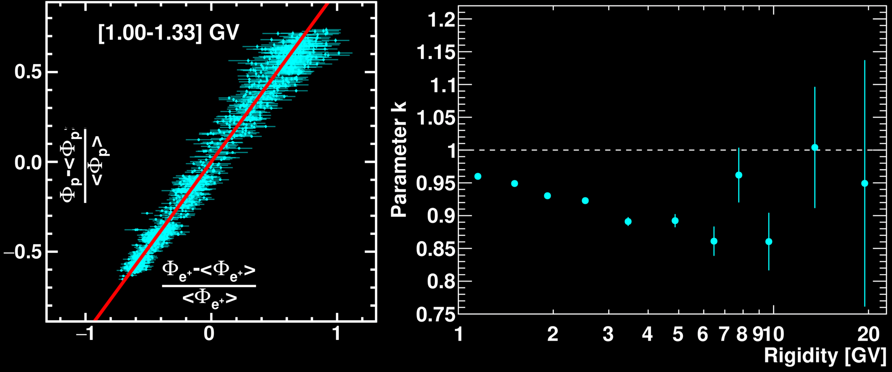
Differences in Solar Modulation in Positrons
K Parameter: linear coefficients between relative daily variations of positron and proton fluxes, for each rigidity bin i.
K < 1 indicates that the positron flux is more modulated than proton flux.
$$\frac{Φ_{p}^{i}-<Φ_{p}^{i}>}{<Φ_{p}^{i}>}=k^{i}\frac{Φ_{e^{+}}^{i}-<Φ_{e^{+}}^{i}>}{<Φ_{e^{+}}^{i}>}$$
Francesco Faldi, UniPG, INFN

Slide 24
Conclusions
Daily charged CR fluxes, from 1 GV to 100 GV in 2011-2023, exhibit variations on different time scales.
Recurrent flux variations with a period of 27, 13.5 and 9 days are observed.
Unexpectedly, the strength of 9 and 13.5 day periodicities reaches a maximum at 10 GV and 20 GV respectively.
Solar modulation shows a clear charge sign dependence, being similar between proton and positron and differing for electrons.
Evident charge sign dependence also during CME events.
Francesco Faldi, UniPG, INFN

Slide 25
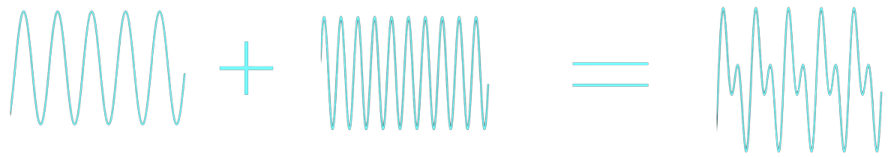
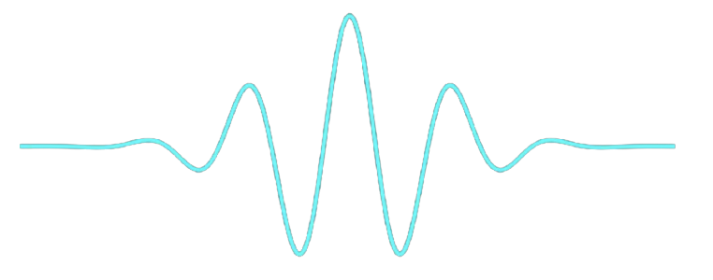
Wavelet Analysis of Proton Flux
Fourier Transform represents data as a function of sinusoidal waves
Sinusoids extend to infinity, not localized in time. Instead we use wavelets, localized both in time and frequency
C. Torrence and G.P. Compo, Bull. Am. Meteorol. Soc. 79, 61 (1998)

