Slide 1
Multi-messenger Astronomy: The Benefit and Contribution of TianQin
Reporter: En-Kun Li
On behalf of: Yi-Ming Hu, Jian-dong Zhang, Jianwei Mei, et al.
TianQin center, Sun Yat-sen University, P.R.China
2024/07/11 @ Pescara
Seventeenth Marcel Grossmann Meeting
Notes:
Good afternoon, everyone. My name is En-Kun Li, from TianQin center, Sun Yat-sen University, China. It's a great honor to be here to give a report about TianQin’s some recent study’s on multi-messenger astronomy. The title of my report is: Multi-messenger Astronomy: the benefit and contribution of TianQin.

Slide 2
Branchesi, M. (2023). Springer Proceedings in Physics, vol 287. Springer, Cham.
Notes:
On August 17, 2017, the Advanced LIGO and Virgo network had observed the first gravitational wave signals from a binary neutronstar system. And 1.7 s later, its electromagnetic counterparts, a weak short gamma-ray burst was detected by the Fermi and INTEGRAL satellites.
This is the first confirmed GW & EM multi-messenger event.
This multi-messenger discoveries are unveiling the rich physics of most energetic transient phenomena in the sky, probing relativistic astrophysics, nuclear physics, nucleosynthesis, and cosmology.
Summary of the major astrophysical fields impacted by the multi-messenger discovery of GW170817

Slide 3
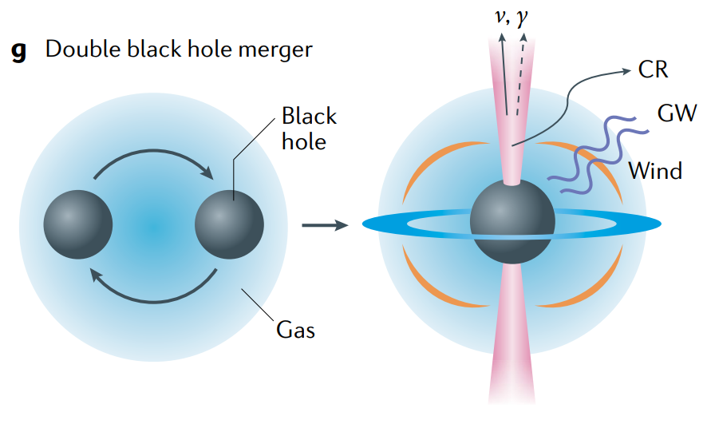
Massive Black Hole Binaries: GW & EM
Potential multi-messenger source: MBHBs merge in gas-rich environments
Inspiral: X-rays, emitted by circumbinary disk
Pre-merger: X-rays declines, shift toward ultraviolet radiation
Merger: super-Eddington flare from the super-Eddington accretion rate, radio emission from the spin flip of the black hole, and jets caused by the surrounding magnetic field.
After coalescence: highly relativistic jets launched along the spin axis of the black hole
Mészáros, P., et al. Nat Rev Phys 1, 585–599 (2019).
Notes:
As we know the binary neutron stars located at more recently Universe, If we want to reach and explore the early Universe, another type of binaries will be help. It is the massive black holes binaries.
MBHBs can merge in gas-rich environments [15], resulting in a high black hole accretion rate and high star formation rate in the galaxy [16,17]. Both of these factors have the potential to cause strong electromagnetic (EM) radiation, making MBHBs promising targets for multi-messenger astronomy.

Slide 4

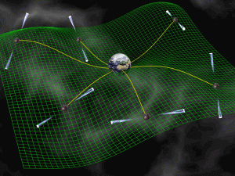
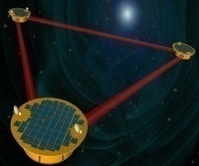
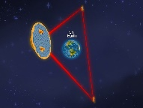




Source mass, Frequency, Detectors
Source
Mass
CMB
（cosmo. scale）
Source’s
Mass
PTA
(1 ly)
$$10^{9}M_{⊙}$$
Space
（10⁵ km）
Wavelength
$$10^{6}M_{⊙}$$
Ground
（~ km）
$$10M_{⊙}$$
Detector’s armlength
Frequency
10⁻¹⁶Hz
10⁻⁹Hz
10⁻³Hz
10²Hz
Notes:
Then how to detect these massive objects?
From this figure we can find that massive black hole binaries will have longer wavelength and smaller frequency.
Meanwhile, different wavelengths will required different lengths of the detector’s armlength.
Such as stellar mass black hole binaries can be detected by the ground-based detectors, such as LIGO, Virgo.
Some massive black hole binaries can be detected by some space-based detectors and PTAs.
We should also note that the Universe is expanded, so the wavelength of the much early event will be expanded, much longer.
Our work is focused on the space-detectors, or simply TianQin.

Slide 5
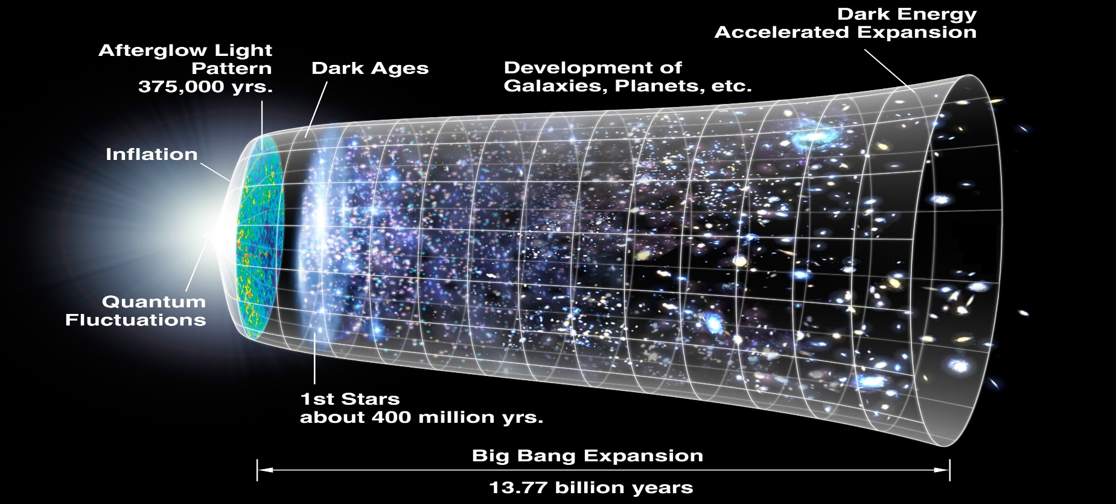
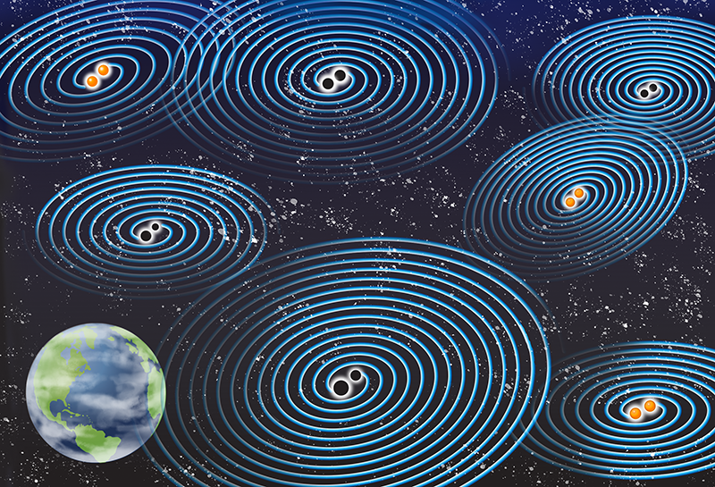
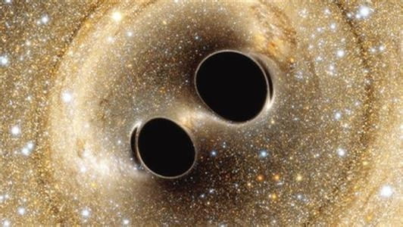
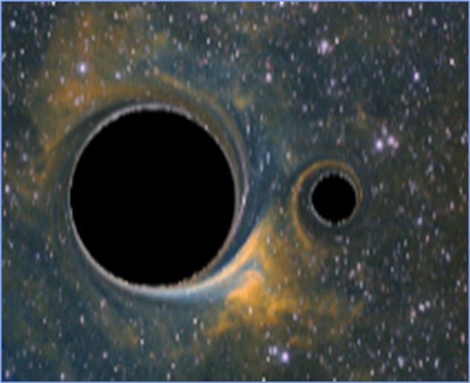
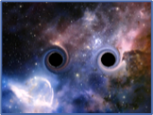
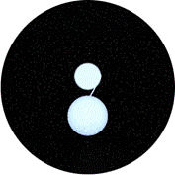
Science with space-based GW detectors
Astrophysics
Origin and growth of compact objects, coevolution of black holes and galaxies, properties of galaxies
Cosmology
Cosmic expansion, inflation, first order phase transitions
Fundamental physics
Nature of gravity and blackholes, new fundamental fields, early universe
SGWB
MBHB
EMRI
SBHB
GCB
FoPT
t<O(10⁻¹⁰s)
z~O(10)
z~O(1)
z~O(0.1)
Galaxy
Mei et al., PTEP 2021 (2021) 5, 05A107
Notes:
For the space-based GW detectors, Massive black hole binaries is one primary sources. They can also detect Galaxy compact binaries in our milk way, some stellar mass black hole binaries up to redshift of 0.1; the Extreme mass ratio inspiral systems up to redshift of 1; Massive black hole binaries up to redshift of 20; and also the fist order phase transition in the very early universe. The detection of these sources can shed light on many aspects in Astrophysics, cosmology and fundamental physics.

Slide 6
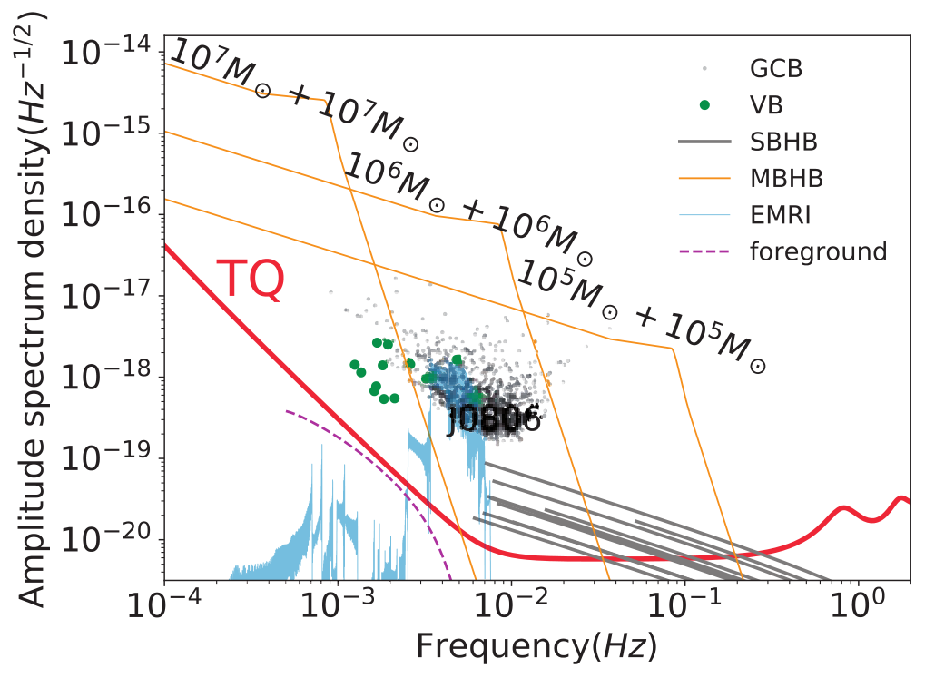
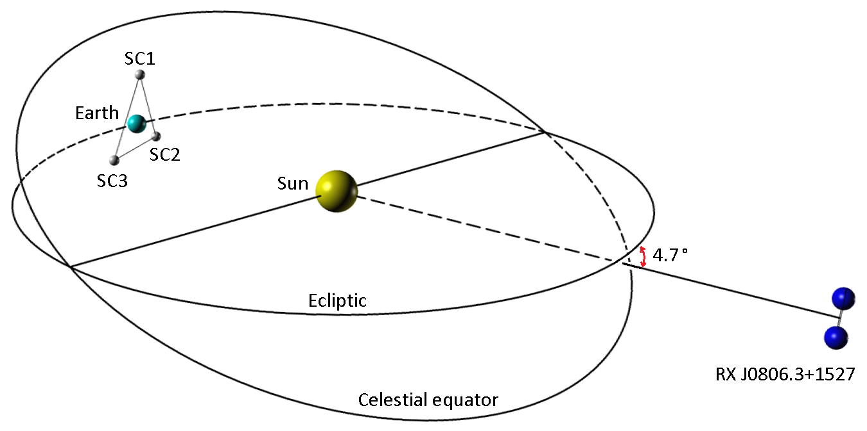
The TianQin Project
Expected launch date: 2035
Orbit: geocentric, radius ~ 10⁵km
Constellation: normal triangle
Scientific: unique frequency band
Technical: easier for deployment, measurement & control, and communication
Luo et al., Class. Quant. Grav. 33 (2016) no.3, 035010.
Mei et al., PTEP 2021 (2021) 5, 05A107 • e-Print: 2008.10332
Notes:
So, what is TianQin?
TianQin is a space-borne gravitational wave detector, raised by Prof. Jun Luo in 24 March, 2014.
TianQin is a constellation of three Earth-orbiting spacecraft in a nearly equilateral triangle formation.
The surface of the three spacecraft is pointing to J0806.
The armlength is about 100, 000 km, and the sensitive frequency bands will be milli-Hz band, from 10^-4 to 1 Hz.

Slide 7
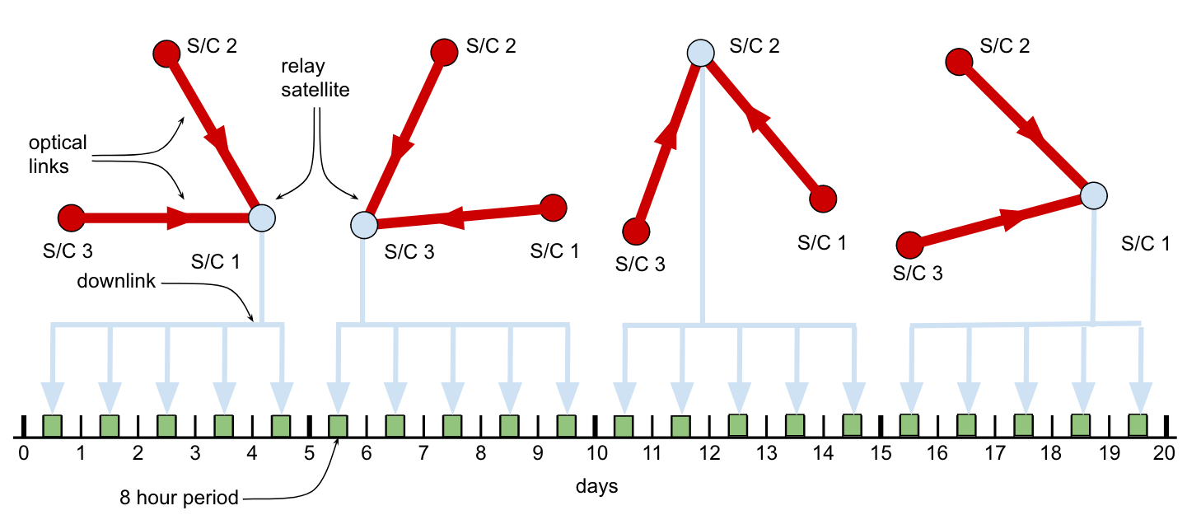
Advantages of TianQin
Data transmission:
LISA: 8 hours/day; time delay: 16 hours
TianQin: continuous; near real time
LISA redbook 2024 [2402.07571]
Notes:
Compared to heliocentric orbits missions, such as LISA and Taiji, the choice of easily accessible geocentric orbits allows the use of more readily available spacecraft technologies, significantly reducing overall mission cost.
Meanwhile, the data transmission from the detectors to the earth needs some time, its hard and expansive to collect data in real time for the heliocentric orbits away from the earth.
Such as LISA, can keep the data transmission 8 hours every day, and the time delay will be 16 hours.
TianQin has the potential to enable near real-time data transmission to Earth.
This will have some advantages in early warning of some multi-messenger events.

Slide 8
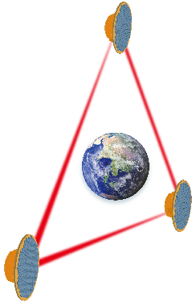
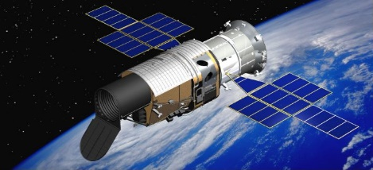
Multi-messenger observation: MBHB
EM telescopes search for merger MBHBs have high false alarm rate [1]
Key to multi-messenger observation: using GW for early warning and positioning.
Up to 99% of total SNR of MBHB will be contained at the last hour until merger.
GW
detectors
MBHBs
early warning localization
Tracking observation
notify
EM
telescope
[1] M. C. Davis, et al. Astrophys.J. 965 (2024) 1, 34
Notes:
Most EM telescopes can not give very precise sky location of the events.
So the key point in multi-messenger observation will be using GW for early warning and positioning.
The Signal-to-Noise-Ratio of an MBHB accumulates in a highly nonlinear way, with the last hour signal containing up to 99% of the total SNR [37] and the sky localization area significantly improved as the MBHB merger approaches [31]. Therefore, the localization of MBHBs before the merger raised a new challenge for achieving near real-time speed for the data downlink, as well as for the data analysis.
So the real-time data-transmission has the potential to provide early warning for follow-up observations of EM detections.

Slide 9
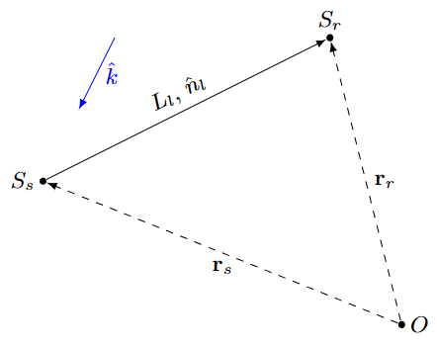
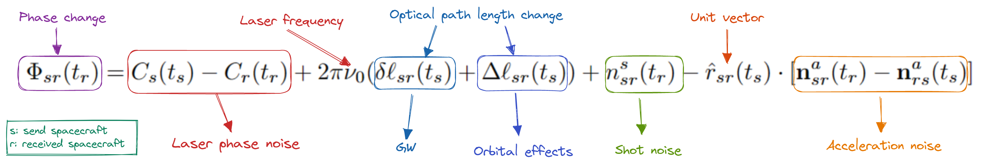
Data stream
Data = Signal + Noise
Single link
Notes:
So, how to figure out the GW signals?
As we know there will be several different components in the data stream. Such as the laser phase noise, the effect of orbits, the GW signals, the shot noise the acceleration noise, etc.
Here is an simple example of how to detect the GW signals between spacecraft sender and spacecraft reciver.

Slide 10
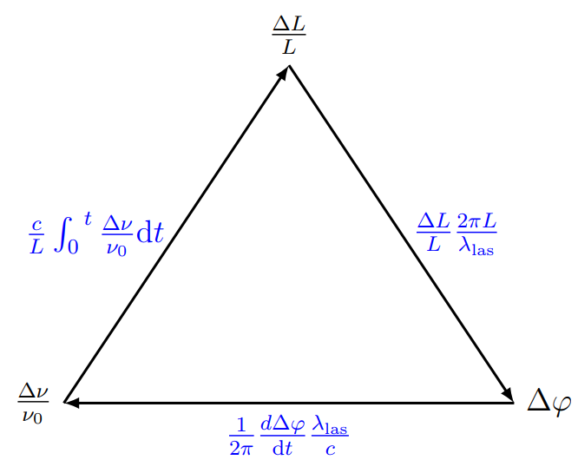

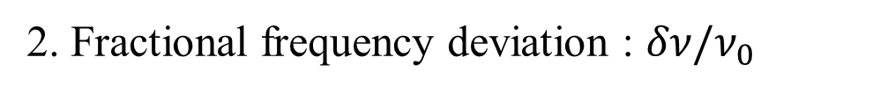
Data stream: GW effects
1. Path length fluctuations :
2. Fractional frequency deviation : $δν/ν_{0}$
TDI-1.0 X channel:
Notes:
Then, how to describe the GW effects?
Here we give the equations, here.
Due to that we did not have real data, so we need to mock the data.
We can mock the data with path length fluctuations or with fractional frequency deviation.
They describes the same effects, with one derivative.
Finally is the Time delay interference technology, in order to cancel the laser phase noise.
Here I will not give too many introduction about it.

Slide 11
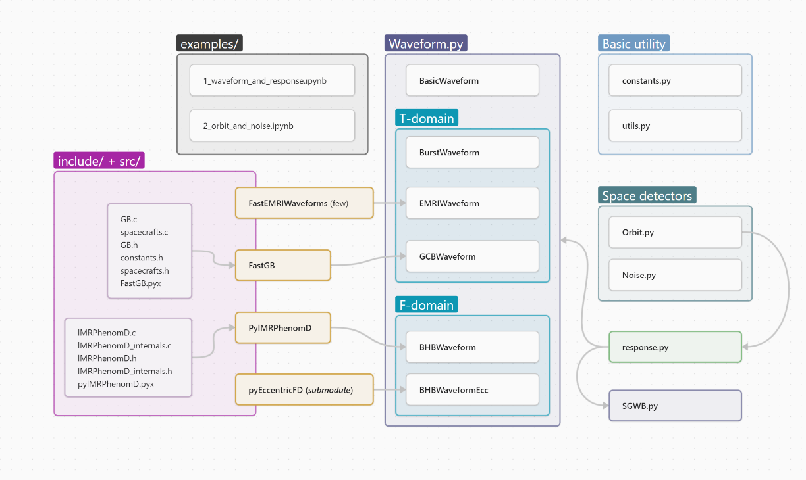
GWSpace
a multi-mission science data simulator for space-based gravitational wave detection
EK LI, et al, et al. 2309.15020
Notes:
We have developed an code to generate the data, named GWSpace, which can generate different type of source’s GW data and for different space-based detectors, such as TianQin, LISA, and Taiji.

Slide 12
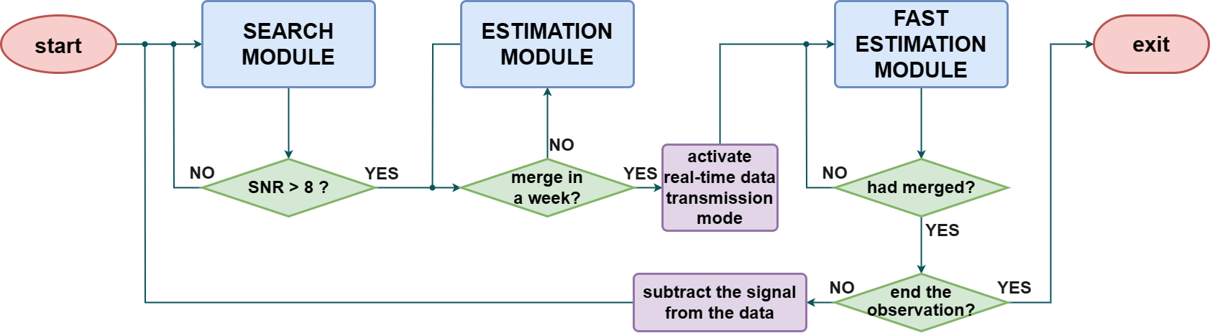
Detect of MBHB for TianQin
Pipeline of detecting the MBHB signal for TianQin
Near merger, analysis need 12 core hour
HY Chen, et al, et al. 2309.06910
Notes:
To detect the loud signals in TianQin’s data, we have developed a pipeline to detect it.
Suppose that we have the data, for week or days, first do the search, to see whether it will merge in a week? If no, do the normal parameter estimation. If yes, activate the real-time data-transmission mode, and do the fast parameter estimation.

Slide 13
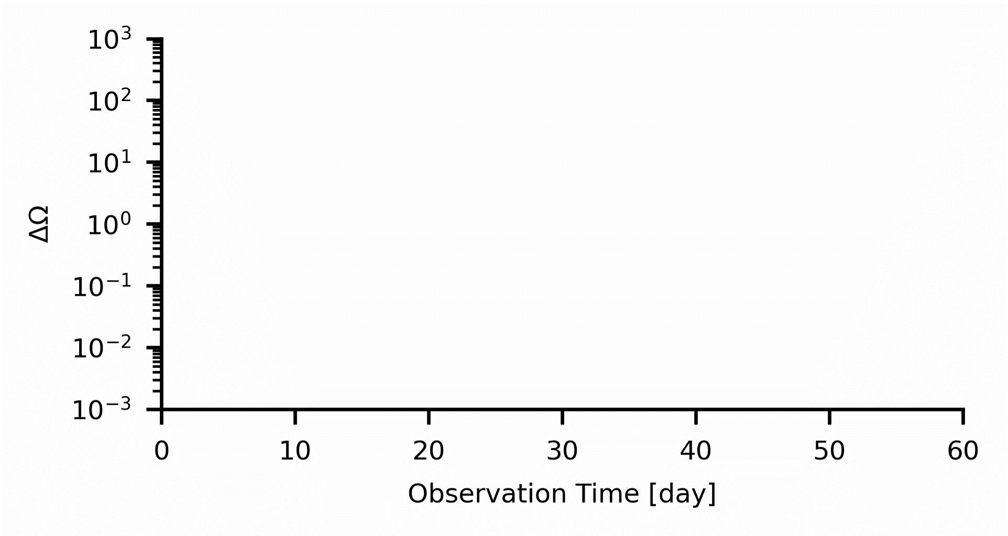
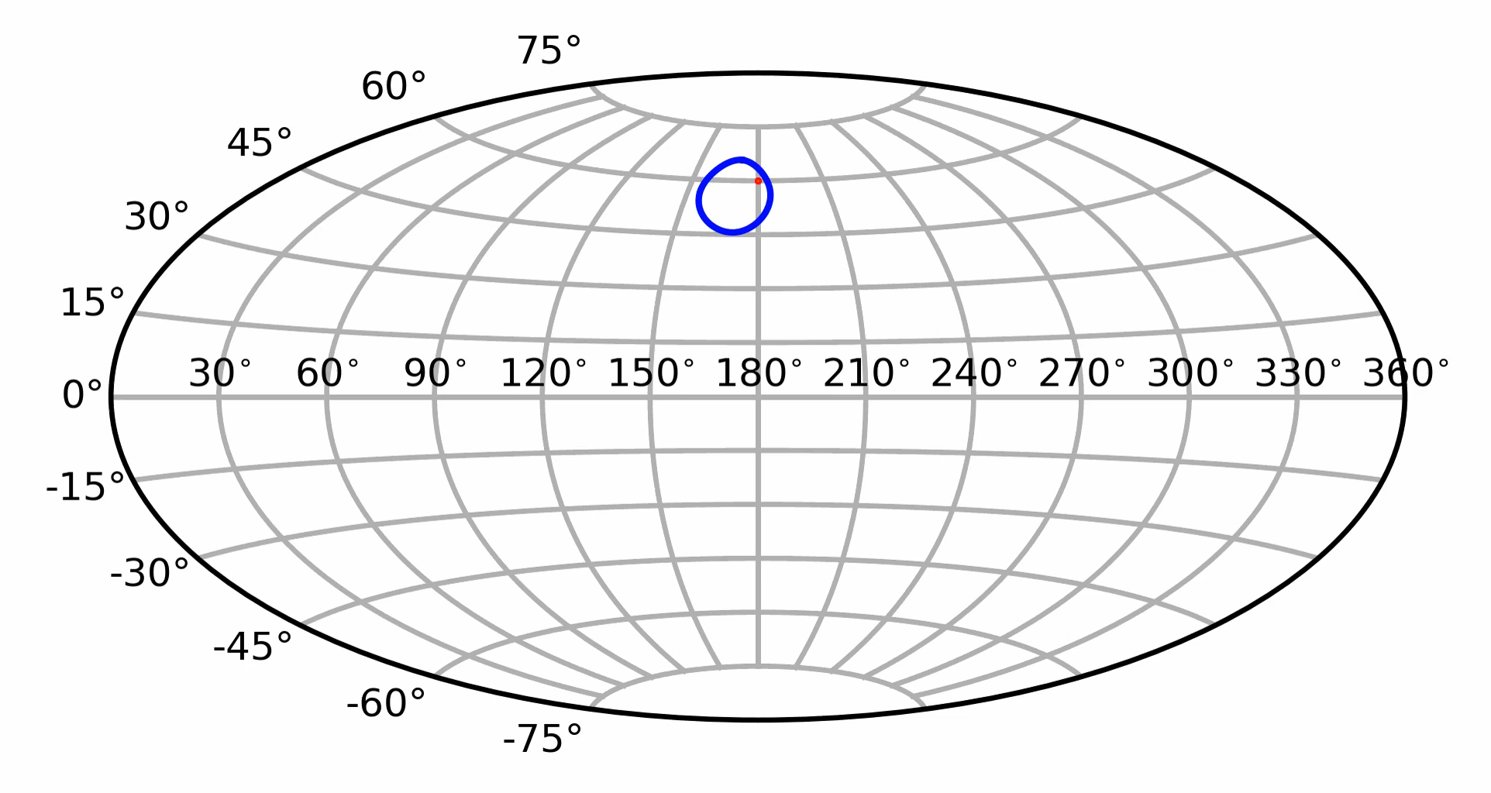
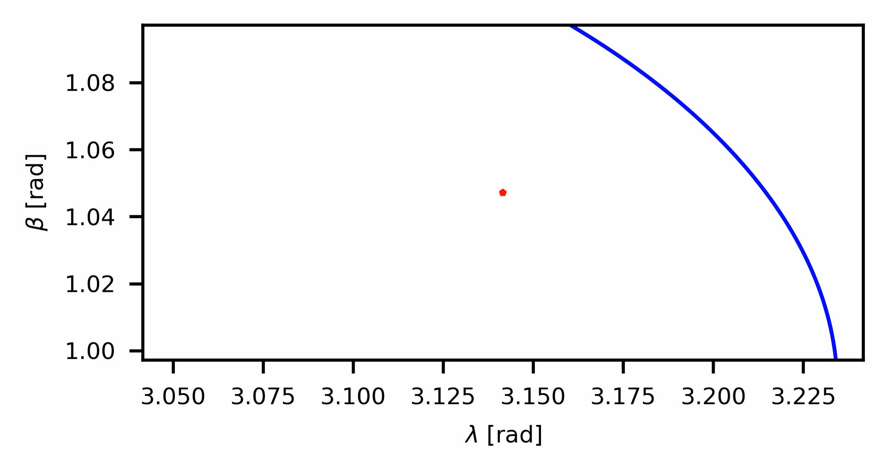
Near real-time analysis of MBHB
Near real-time analysis of MBHB for TianQin
Near real-time analysis
Strong, ideal for multi-messenger astronomy
TQ can transfer data in real-time
Pipeline developed to enable near real-time analysis
Notes:
This is our results.
From the right panels, one can find that detection of the MBHB’s sky location is becoming better and better as more detection time, and improved significantly.
The precision will be 10^-3.
Thus, if there is a MBHB signal detected by TianQin, we can give an effective early warning for EM detection.

Slide 14
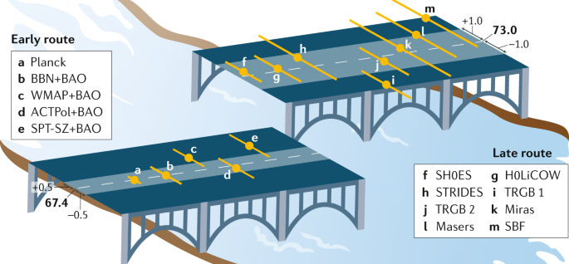
Measurement of Hubble constant
Hubble tension
"Hubble Constant Tension (Crisis)“
Distance measurements rely on a step-by-step calibration process.
GWs: Direct measurement, no need for step-by-step calibration.
A G. Riess Nature Reviews Physics 2, 10–12 (2020)
Notes:
So, what’s the advantage of this, and the Benefit?
Here is an example, about the Hubble constant tension.
EM detections, such as the distance ladder, will rely on a step-by-step calibration process.
But GWs, is a direct measurement of distance.
So, if we can determine the redshift with the EM counterpart, it will help to check out the Hubble tension.

Slide 15
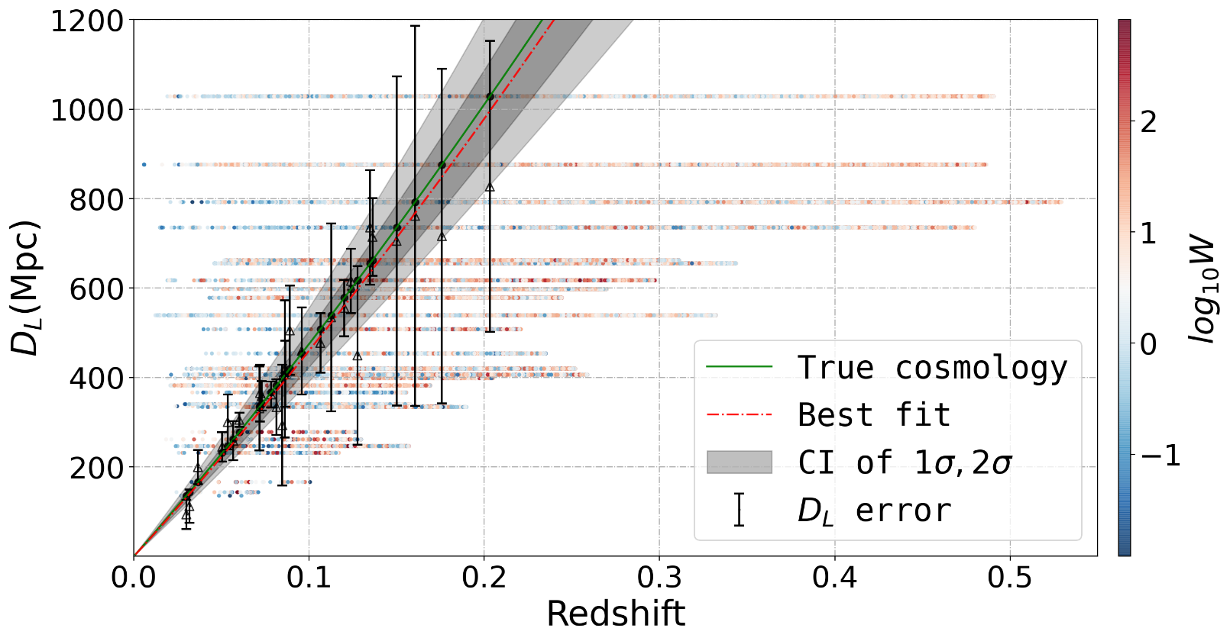
Standard Siren – bright /dark
TianQin: provide luminosity distance information.
Combine the two →"standard siren" → Cosmology
1. EM counterparts provide redshift information.
2. Absence of EM counterparts:
  Redshift: statistical methods
  "dark siren" measurements
Zhu et al. Phys. Rev. Res. 4 (2022) 1, 013247
Zhu et al. Sci. China Phys. Mech. Astron. 65 (2022) 5, 259811
Notes:
The method is called standard siren.
If we can detect the counterparts, then we got its redshift, it will be bright siren.
Otherwise, we can use the sky location to find out the EM catalog, which can also help to determine the redshift distribution.

Slide 16
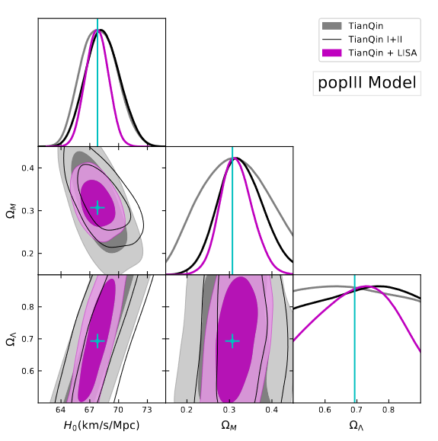
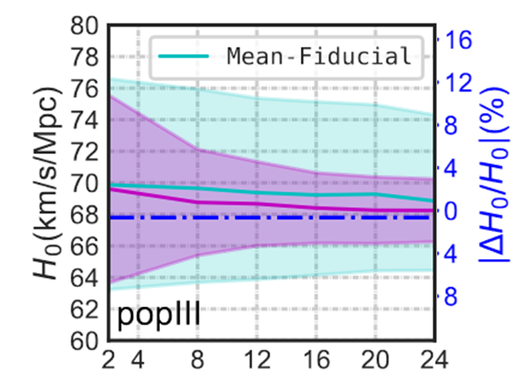

MBHB: constrain $H_{0}$
Zhu et al. Phys. Rev. Res. 4 (2022) 1, 013247
Notes:
Here is one example of our result.
Left is with EM counterparts, and right without.
One can find that with the counterparts, we can determine H0 on a very high precision.
10.1103/PhysRevResearch.4.013247

Slide 17

Stellar mass BHB: constrain $H_{0}$
Constraining $H_{0}$：TianQin joint ET
Constraining the Hubble constant to an precision of about 1% using multi-band dark standard siren detections
17
Zhu et al. Sci. China Phys. Mech. Astron. 65 (2022) 5, 259811
Notes:
Here is another example of our result, using stellar mass black hole binaries to constrain Hubble constant.
This is based on the dark siren method.
We find that with the joint detection of TianQin and ET, we can constraint the Hubble constant to an precision of about 1%.

Slide 18
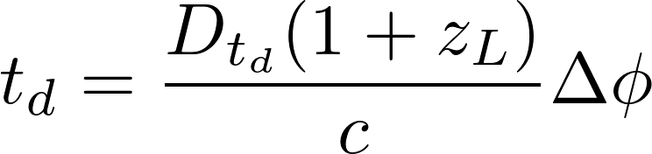

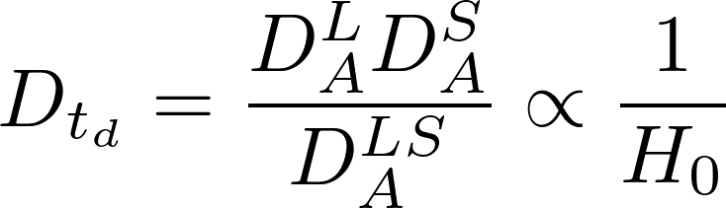






MBHB with strong lensing
GW experience gravitational lensing effects when they pass near massive objects
Gravitational lensing effects: time delays, amplitude changes, and multiple images (strong lensing).
Image 2
$$∆θ$$
Lense
Source
$$ξ$$
Observer
$$\hat{α}$$
$$D_{A}^{L}$$
$$D_{A}^{LS}$$
image1
$$D_{A}^{S}$$
Notes:
A special case, that the signal is lensed by some massive objects, so we may find two images of the events.
If we can determine the sky location and then we will got the redshift of the strong lens with EM detection.

Slide 19
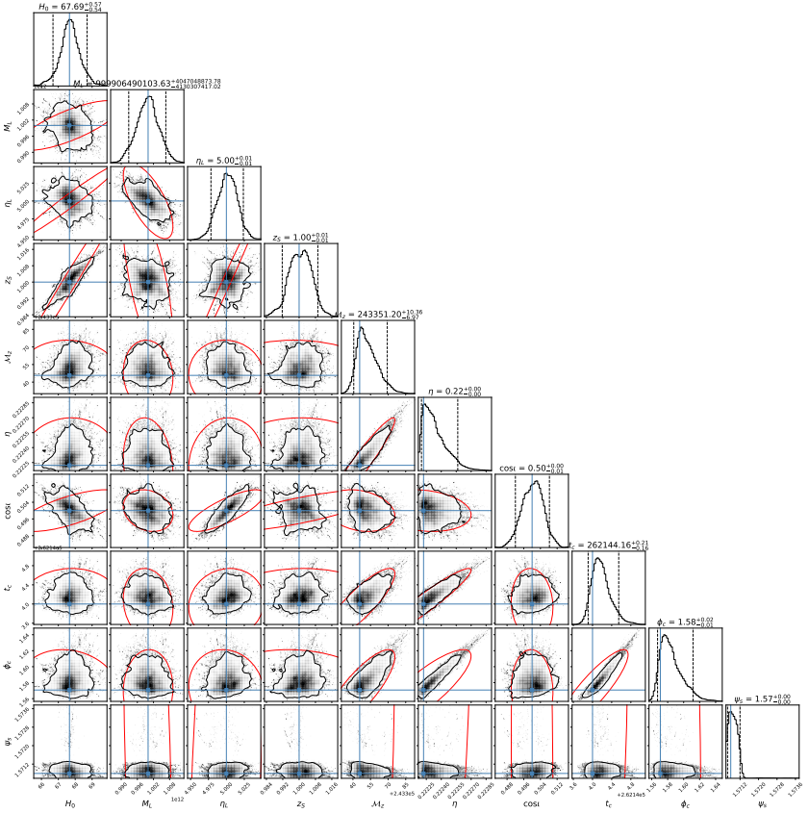
MBHB with strong lensing
Parameter measurement accuracy:
Black represents the posterior distribution given by MCMC.
Red is the confidence ellipse drawn based on the variance-covariance from the FIM (Fisher Information Matrix).
S-J Huang, et al., JCAP 08 (2023) 003
Notes:
So, we do not need the redshift of the MBHBs, but the lens’ redshift.
In this way, only one event, we can constraint the Hubble constants to the precision about 1%.
Which also can help solve Hubble tension.

Slide 20
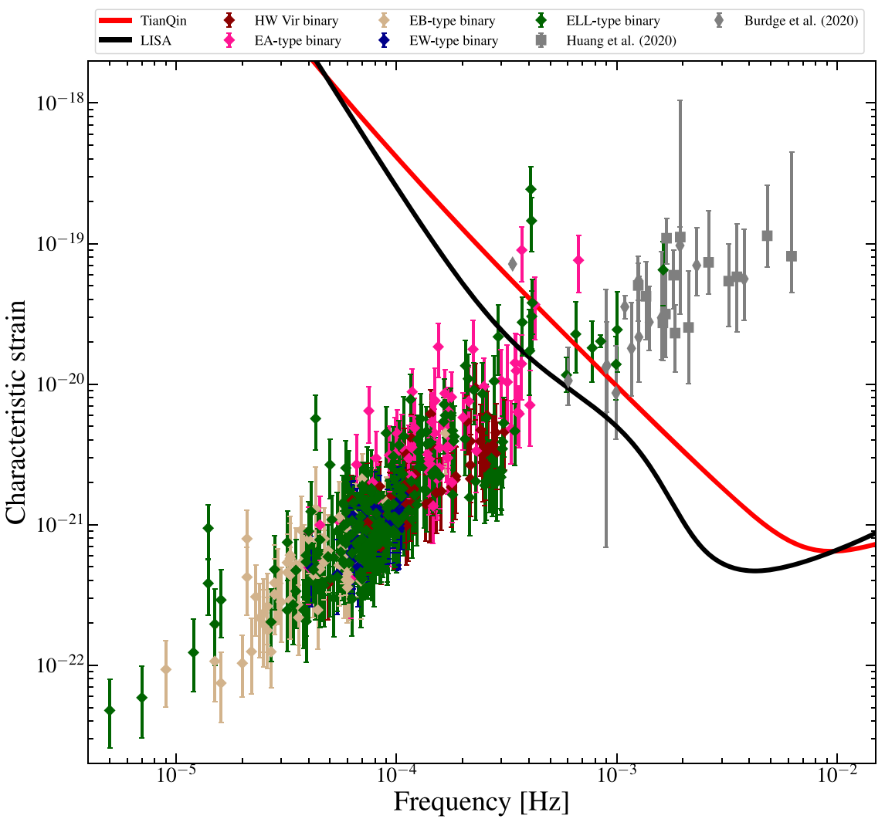
Galactic Compact Binaries
Multi-messenger detection
Combine with Gaia+ZTF measurements
To detect new double white dwarf (DWD)
Find 400+ DWDs
Obtain 2 (6) new potential GW candidates for TianQin (LISA)
Ren, et al. ApJSS.264,2,39(2023) [2302.02802]
Notes:
Besides, the massive black holes.
There are also other multi-messenger sources.
Such as the double white dwarfs.
With the most recent Gaia and ZTF data, our team find two new potential GW candidates for TianQin.

Slide 21
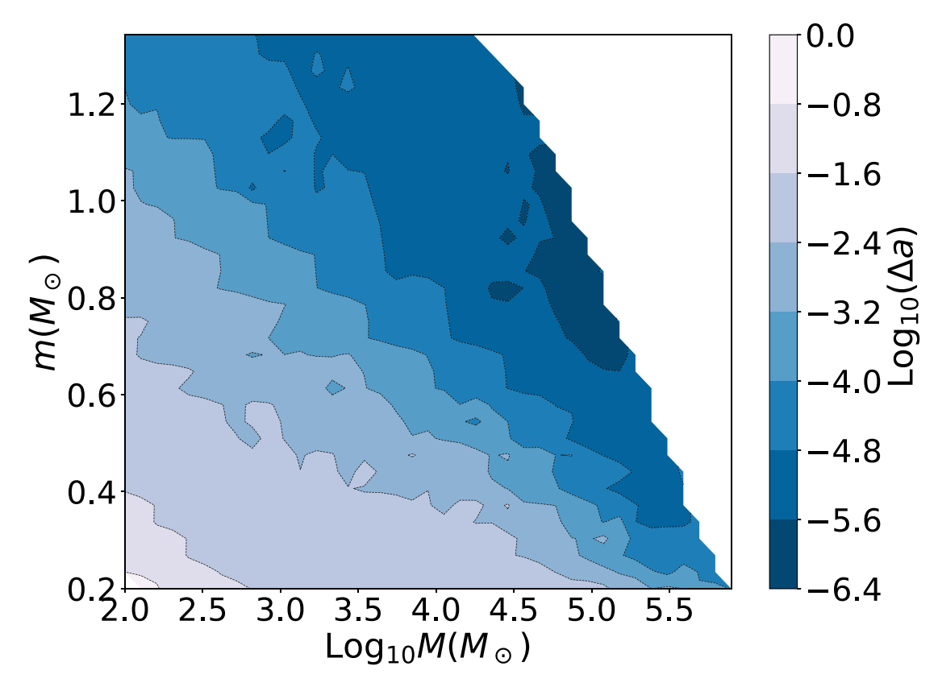
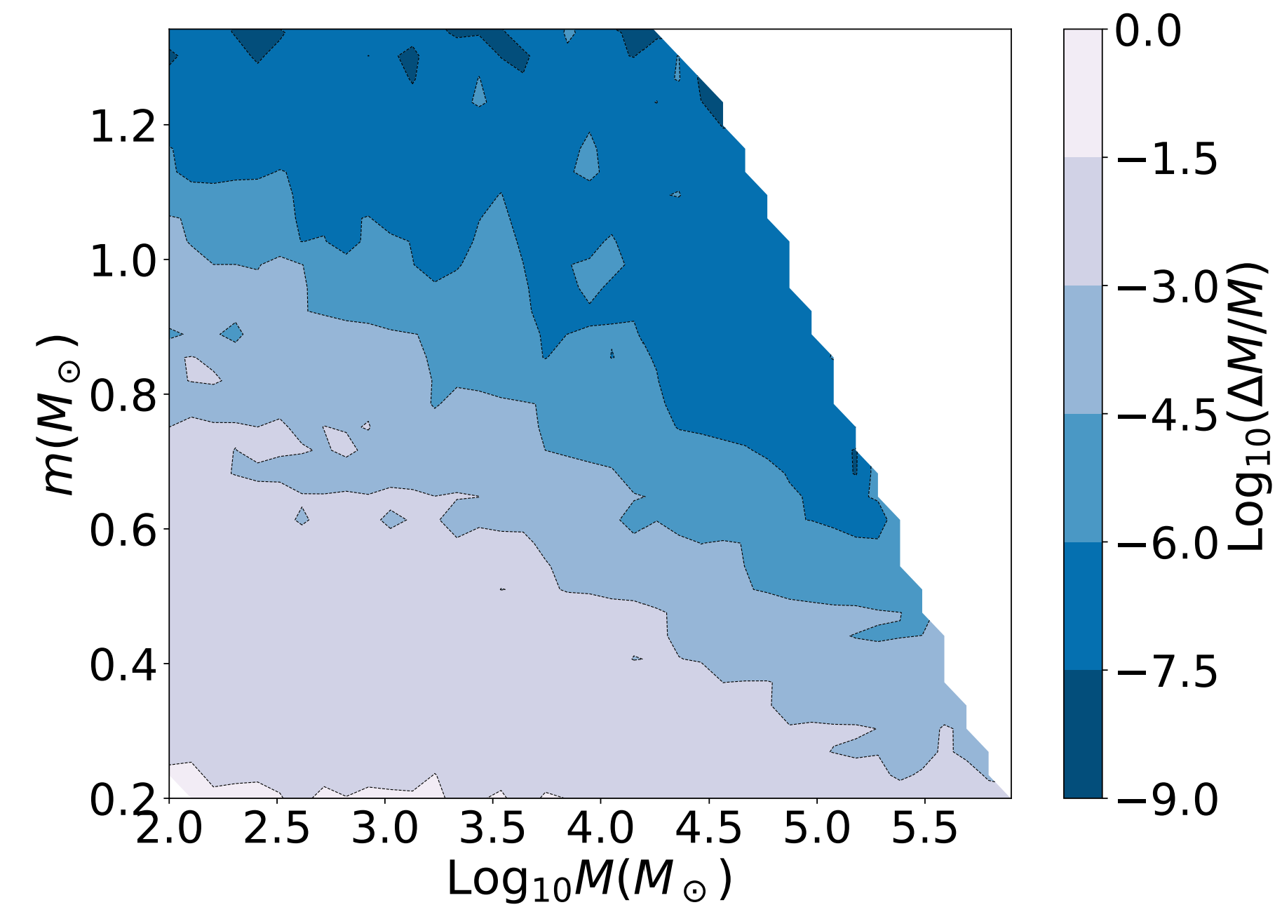
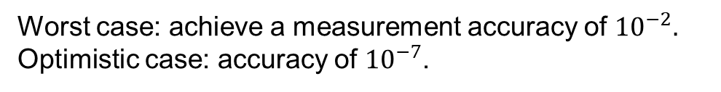
Quasi-Periodic Eruptions
TianQin’s detection capability for QPE
Worst case: achieve a measurement accuracy of ${10}^{−2}.$
Optimistic case: accuracy of ${10}^{−7}$.
C. Ye, et al., MNRAS.527,2,2756() (2023)
Notes:
Some Quasi-periodic eruptions can be explained by EMRI model.
And our team find that TianQin can also give strong constraintments on the masses.
The color-bars is for different parameters, mass and spins.

Slide 22
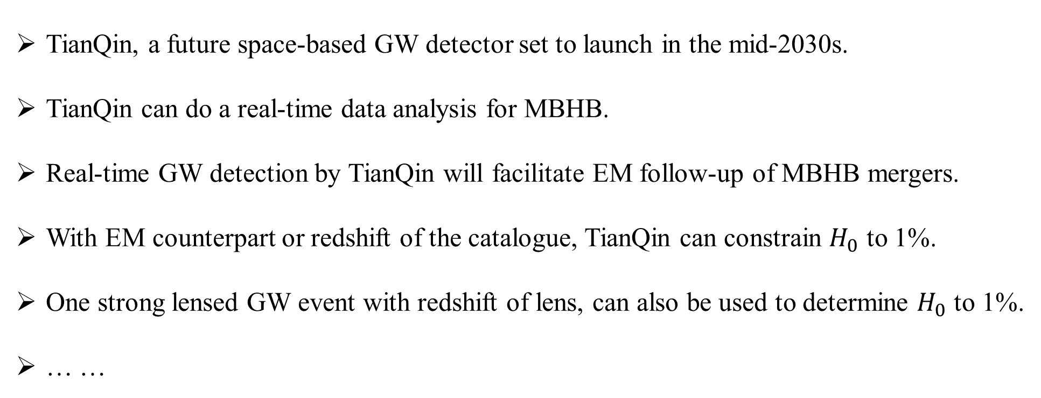
Summary
TianQin, a future space-based GW detector set to launch in the mid-2030s.
TianQin can do a real-time data analysis for MBHB.
Real-time GW detection by TianQin will facilitate EM follow-up of MBHB mergers.
With EM counterpart or redshift of the catalogue, TianQin can constrain $H_{0}$ to 1%.
One strong lensed GW event with redshift of lens, can also be used to determine $H_{0}$ to 1%.
… …

Slide 23
Thanks！

Slide 24
