Slide 1
Notes:
I'm currently a PhD student at The Open University in the UK and today I'll be talking about my current work which is using cGAN's or conditional generative adversarial networks for anomaly detection, more specifically, hunting or searching for gravitational lensing systems in Euclid data.

Slide 2
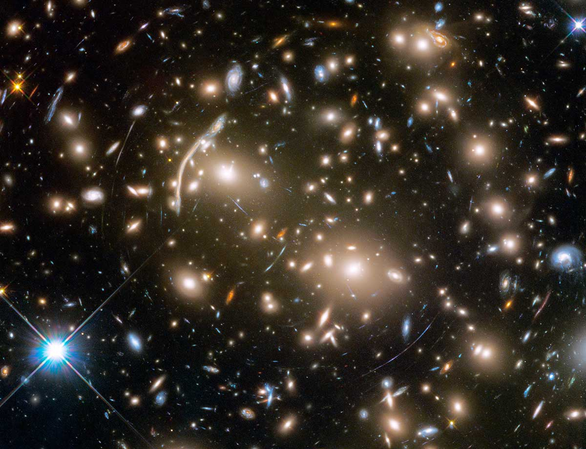
Slide Title 9
Imagine a Galaxy, behind another Galaxy. Think you won’t see it? Think again…
Massive galaxies/galaxy clusters bend and warp space-time around themselves, causing light rays to deflect.
The path of light from a distant galaxy can be curved by such a massive object, causing its light to bend.
Gravitational lenses are the Universe’s own telescope!.. We can use this as a tool to peer into the past.
Lensing by masses.
Credit: NASA/ESA
Slide 2 17th Marcel Grossmann Meeting https://github.com/RubyPC/cGAN_Lens_Finding/
Notes:
Now, I'm aware that the majority or everyone here will have an idea or even be an expert on gravitational lensing, but it doesn't hurt to give a quick lensing primer and revisit the question of what is a gravitational lens. For that, we have to travel back to 1915 where Einstein introduced the theory of general relativity- that's the theory upon which gravitational lensing was born and the major reason why we are all gathered here in Pescara. So, gravitational lensing is an effect on light from a background source that arises as a result of the curvature of spacetime, that is the three dimensions of space with time united into a single entity, caused by mass. This effect is most observable when light from a background source, like a quasar or an entire galaxy, passes a very massive object like another galaxy or cluster of galaxies described as the gravitational lens, causing the light passing by to bend. We can see some arcs here in this image and if the source is circularly symmetrical, we can observe rings known as Einstein rings. However, it's much more than that- gravitational lensing can cause the light from a background object to be amplified. So, we as astronomers can use the lensing arising from galactic clusters as natural cosmic magnifying glasses to investigate the universe when it was in its infancy. In other words, we are able to see light from the earliest galaxies that would be too faint otherwise. This light is NOT focused, but it certainly is magnified.

Slide 3
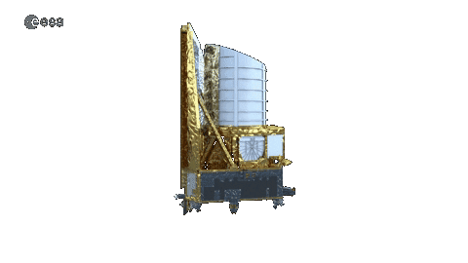
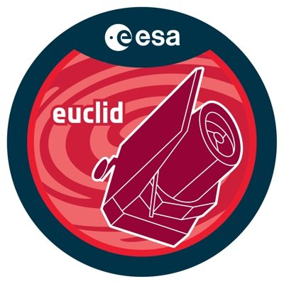
Slide Title 9
But Gravitational Lenses are rare
So far, less than a thousand lenses have been found in total across many heterogeneous data sets. Lensing affects only 1 in ~10,000 galaxies!
However, astronomy is experiencing a boom in data volume and complexity:
The Square Kilometer Array (SKA), Large Synoptic Survey Telescope (LSST) and the Euclid Space Telescope are expected to increase the number of potential lenses by an order of magnitude…yay!
Euclid will approximately observe 200,000 galaxy-galaxy lenses among a billion of potential galaxies.
Slide 4 17th Marcel Grossmann Meeting https://github.com/RubyPC/cGAN_Lens_Finding/
Notes:
However, gravitational lensing, especially the cases we've birefly discussed with clear arcs and Einstein rings, is extremely rare. Lensing only affects roughly one in every 10,000 galaxies. That being said, we are in the field of astronomy which is currently experiencing an accelerated growth in data volume and complexity, so do not panic- we are wealthy if only in terms of data. For example, the SKA, LSST and the Euclid space telescope are expected to increase the number of potential lenses by orders of magnitude, bringing a new era to strong lensing where well defined lens samples will be possible.

Slide 4
Slide Title 9
But Gravitational Lenses are rare
So far, less than a thousand lenses have been found in total across many heterogeneous data sets. Lensing affects only 1 in ~10,000 galaxies!
However, astronomy is experiencing a boom in data volume and complexity:
The Square Kilometer Array (SKA), Large Synoptic Survey Telescope (LSST) and the Euclid Space Telescope are expected to increase the number of potential lenses by an order of magnitude…yay!
Euclid will approximately observe 200,000 galaxy-galaxy lenses among a billion of potential galaxies.
Slide 4 17th Marcel Grossmann Meeting https://github.com/RubyPC/cGAN_Lens_Finding/
Notes:
However, gravitational lensing, especially the cases we've birefly discussed with clear arcs and Einstein rings, is extremely rare. Lensing only affects roughly one in every 10,000 galaxies. That being said, we are in the field of astronomy which is currently experiencing an accelerated growth in data volume and complexity, so do not panic- we are wealthy if only in terms of data. For example, the SKA, LSST and the Euclid space telescope are expected to increase the number of potential lenses by orders of magnitude, bringing a new era to strong lensing where well defined lens samples will be possible.

Slide 5
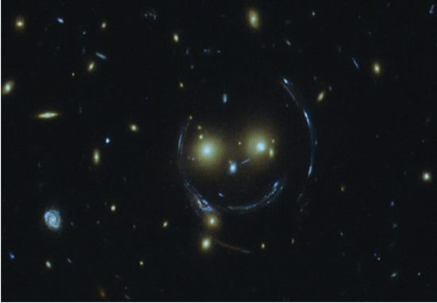
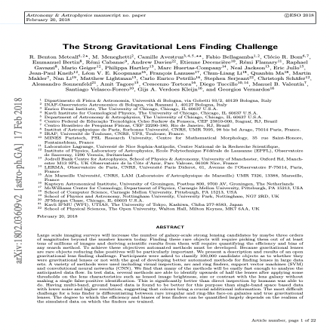
Slide Title 9
Finding Strong Gravitational Lenses with Machine Learning in Euclid
The strong gravitational lens finding challenge. Metcalf et al. (2018)
HST image of cluster SDSS J1038+4849.
Credit: ESA/HST
Slide 6 17th Marcel Grossmann Meeting https://github.com/RubyPC/cGAN_Lens_Finding/
Notes:
Now, applying machine learning and other automated approaches to find lenses gained popularity as of the 2018 strong gravitational lens finding challenge which aimed to tackle the problem of finding lenses in large datasets by a multitude of methods. This came with what could be called a wave of connectionism between astronomy and machine learning with the most powerful and successful approaches to solving this task being machine learning algorithms. However, the majority of these approaches were in a supervised manner- they required labelled data and sometimes, labelled data that is complete is not always available.

Slide 6
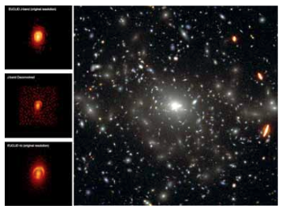
Slide Title 9
Using cGANs for Anomaly Detection to find strong gravitational lenses- this work
Proof of concept for an alternative method of lens finding using a generative model: a conditional Generative Adversarial Network (cGAN).
Use the cGAN to predict NISP-H band flux information of sources extracted from the Perseus cluster of galaxies from NISP-J, NISP-Y and VIS band flux.
Idea: cGAN trained on images of non-lenses such that when tested on images containing a simulated gravitational lens, it identifies them as as anomaly.
Euclid study report: simulated examples of Euclid images of strong lenses.
ESA
Slide 7 17th Marcel Grossmann Meeting https://github.com/RubyPC/cGAN_Lens_Finding/
Notes:
So here, we introduce a more unsupervised approach to finding lenses in the form of anomaly detection using what's called a conditional Generative Adversarial Network. Of course, the goal is to find lenses and we propose to do that by training the network on non-lenses from Euclid VIS and NISP-Y and J bands to predict the NISP-H band flux information. So, if the network is trained on non-lenses, when we test the network on a dataset that does contain lenses, which have not been seen by the network, it should detect them as anomalous. Now, why anomaly detection and a generative model in particular? In the past year, we've shown that cGANs are successful at searching for rare or anomalous galaxy populations in JWST observations.

Slide 7
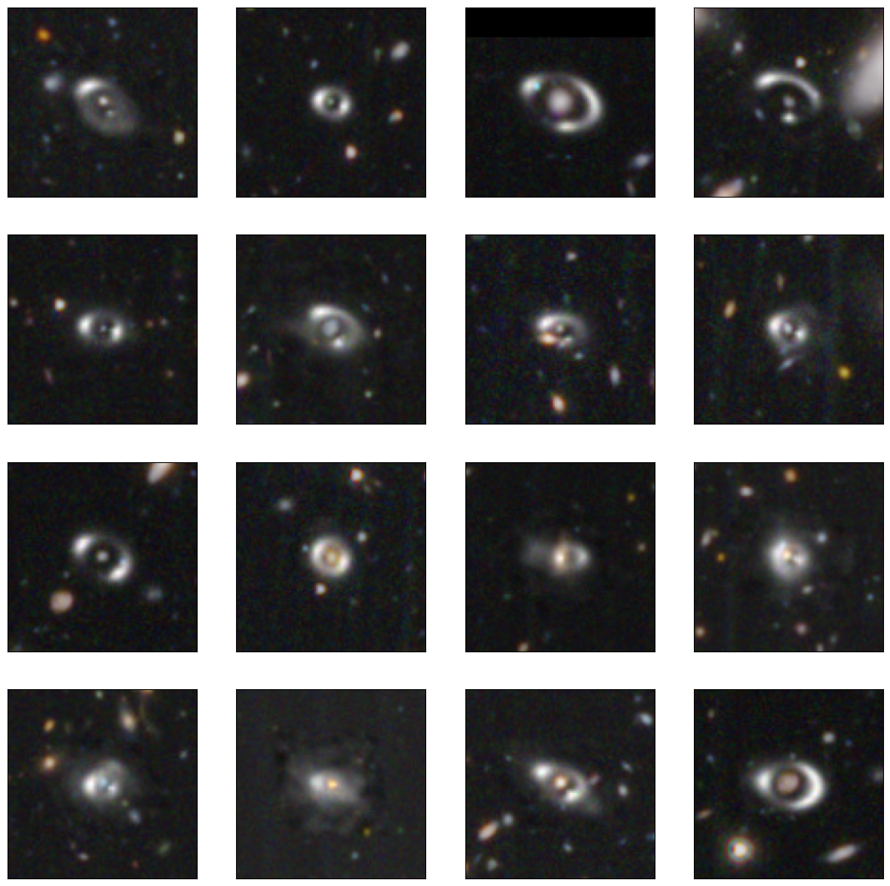
Slide Title 9
Simulated Gravitational Lenses
Since gravitational lensing only affects 1 in 10,000 galaxies, we choose to populate the test set with 10% simulated lenses (500).
Einstein radii, $θ_{E}$, are calculated from lens mass distributions using the Faber-Jackson velocity dispersion relationship:
$$θ_{E}=4π{\left(\frac{σ_{v}}{c}\right)}^{2}\frac{D_{LS}}{D_{S}}$$
Faber & Jackson et al. (1976)
Simulated lenses painted into real Euclid ERO data based on appropriate mass-to-light ratios.
Simulations created using https://github.com/RubyPC/Lenzer
Slide 9 17th Marcel Grossmann Meeting https://github.com/RubyPC/cGAN_Lens_Finding/
Notes:
Now, the cGAN will be trained only on non-lenses and those will be in the form of 10x10 arcsecond cutouts of galaxies from the Perseus cluster as part of the Euclid early release observation data. We've already established that gravitational lenses are rare, so we will have to rely on simulations to populate our test set- which will not have been seen before by the cGAN. We choose to simulate 500 lenses, making up 10% of the entire test set, using Python in a nice package shown here with examples of these simulations of the left. Simulating realistic lenses can be a difficult task and from Euclid's ERO data, we are capable of resolving very small Einstein radii. So, in order to simulate this, we took magnitude and redshift pairs of known lens galaxies and, assuming a flat lambda cdm cosmology, we used the Faber-Jackson relationship to calculate the velocity dispersion of the lens galaxy such that we can calculate appropriate Einstein radii for the lensed images. These lensed images were then painted onto the 10x10 cutouts of galaxies from the Perseus cluster- those not in the training set- to complete our test set for the cGAN.

Slide 8
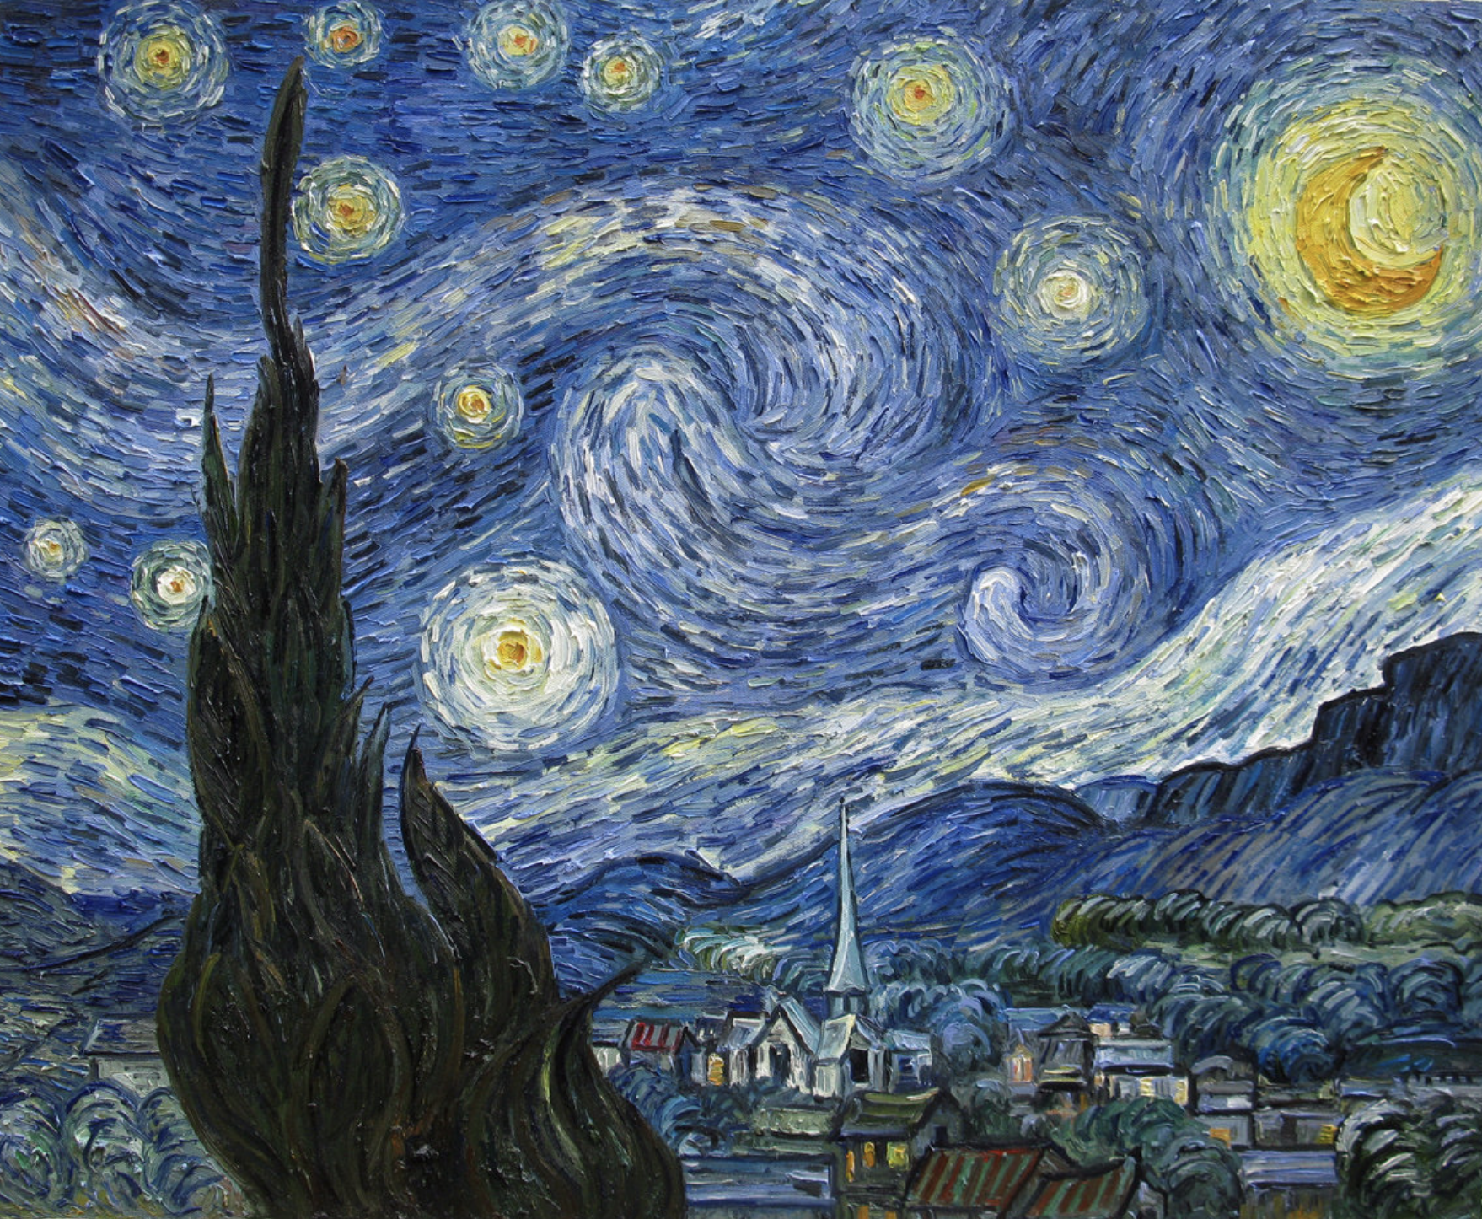
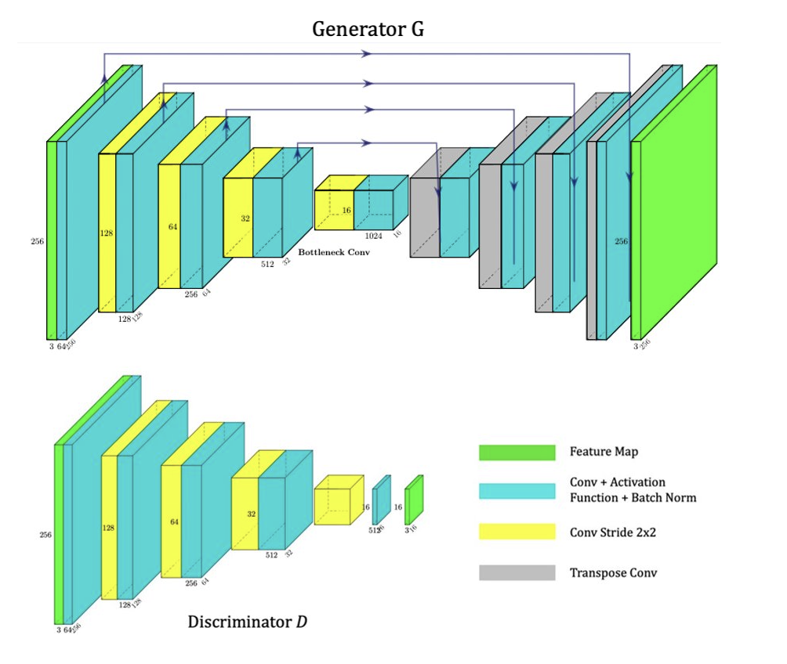
Slide Title 9
Onto Machine Learning: What is a GAN?
ML architecture that frames the problem as a supervised learning task with two competing networks: the Generator and the Discriminator.
Generator generates new samples based on the input data.
Discriminator classifies the samples as real or fake.
Condition, c, is such that the Discriminator also sees real sample images from the input.
Vincent van Gogh: Starry Night
Slide 10 17th Marcel Grossmann Meeting https://github.com/RubyPC/cGAN_Lens_Finding/
Notes:
That's enough astronomy, let's move onto the real topic and that's machine learning. So, we’ll start by asking: what is a GAN? GANs are generative models consisting of two competing networks- a Generator model and a Discriminator model which are typically Neural Nets- although this is not necessary, we’re using an adapted Generator based on a U-Net architecture. How do we suppose this network will predict NISP-H band flux information of the Euclid cutouts? Given the Euclid-VIS and NISP-Y and J bands as input, the goal is for the Generator to learn a representation of the Euclid data and to generate the corresponding NISP-H band data. The Discriminator’s task is to distinguish between the real NISP-H samples, those from the training data, and the “fake” NISP-H samples- those generated by the Generator. As training proceeds, the generated samples become indistinguishable from the real samples. Now, we’re using a conditional GAN and that’s because, in order for the Discriminator to classify real NISP-H samples, it needs to see them. So, that’s what makes this a conditional GAN as opposed to a conventional GAN, the condition being that the Discriminator sees real NISP-H samples from the training data, approaching this task in a more supervised manner.
PAINTER ANALOGY
Funnily enough, this painting is a forgery from this website: the Discriminator would have a hard time here identifying this as a fake.

Slide 9
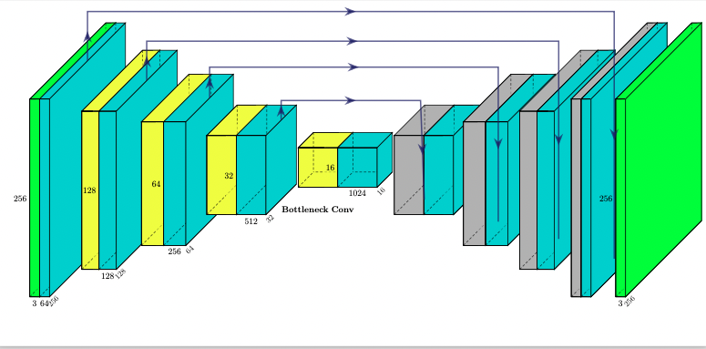
Slide Title 9
Generator Model
Consists of an Encoder and Decoder section with a U-Net architecture which goes 8 layers deep.
Takes a 3-channel (colour) input in the form of VIS band and NISP-J and NISP-Y band cutouts for training and validation. Tested on the test set containing 500 simulated gravitational lenses.
Generator fools the Discriminator by generating NISP-H band data of the cutouts indistinguishable from the real data.
Ronneberger et al (2015)
Slide 11 17th Marcel Grossmann Meeting https://github.com/RubyPC/cGAN_Lens_Finding/
Notes:
The Generator model is based on a U-Net architecture that goes 8 layers deep. U-Net is a CNN originally designed for image segmentation with an encoder and a decoder section in the shape of a U. The encoder section, or first 4 layers, halve the dimensions of the input- the Euclid-VIS and NISP-J and Y bands data, whilst extracting features to learn a representation of the data. This is connected via a bridge to the decoder section, the next 4 layers, to generate a representation of the corresponding NISP-H band information of the cutouts. The arrows here are called skip connections and they connect certain features extracted from the encoder section to the decoder which otherwise could have been lost due to the complexity of the network.

Slide 10
Slide Title 9
Patch Discriminator Model
Architecture is based on the Encoder section of the Generator.
Discriminator learns properties from the real input data (the condition) and from the generated data by the Generator.
Classifies input data as real and generated data as fake.
Slide 12 17th Marcel Grossmann Meeting https://github.com/RubyPC/cGAN_Lens_Finding/
Notes:
The Generator battles a Patch Discriminator with an architecture that is based on the encoder section of the Generator. The Discriminator learns properties from the training data, the real NISP-H samples, and those from the Generator denoted as fake. The classification of the Discriminator on a given sample forces the Generator to generate more realistic NISP-H samples that fool the Discriminator into misclassifying them as real. What makes this a Patch Discriminator is the fact that it classifies whether each patch or section of a given sample is real or fake, rather than the whole sample itself, dealing with the subtleties of this task much better.

Slide 11
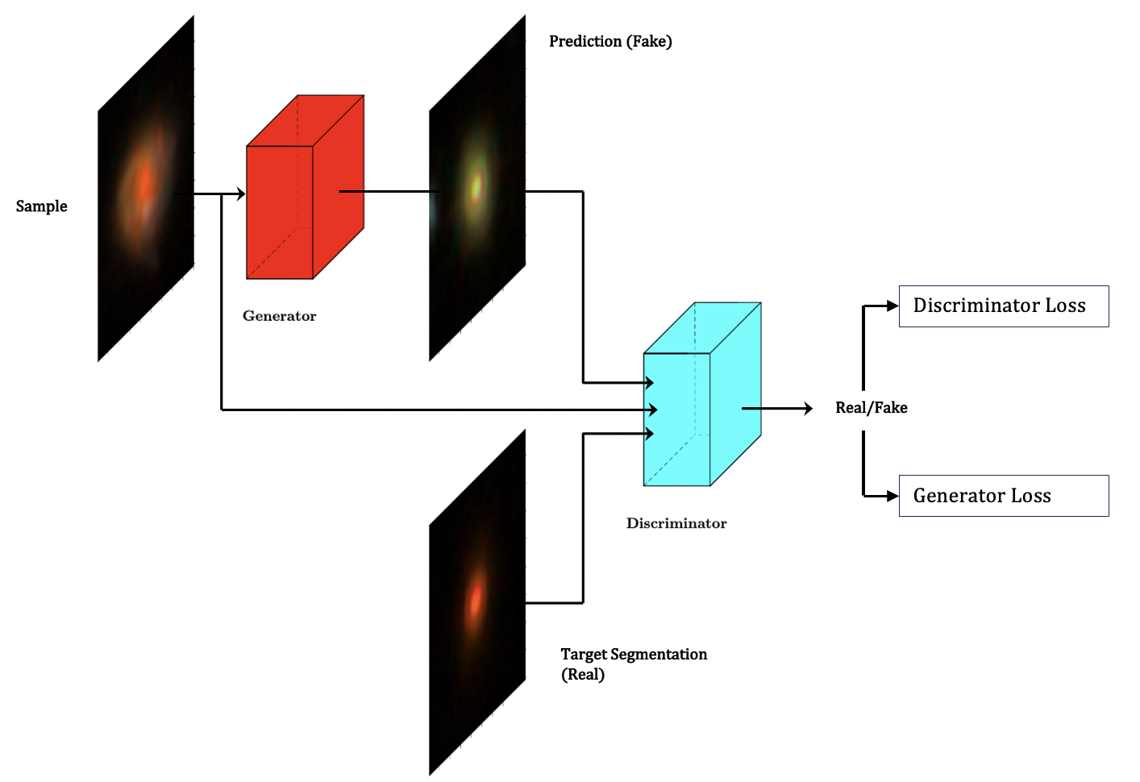
Slide Title 9
Generator+Patch Discriminator+condition=cGAN
Predicted NISP-H band
Generator predicts NISP-H band information from an input cutout from VIS and NISP-J and NISP-Y band.
Discriminator is trained against the generated NISP-H band from the Generator (fake samples).
Condition is such that the Discriminator is also trained for real NISP-H bands.
Discriminator predicts whether a given sample is real or fake.
VIS+NISP-Y+NISP-J bands
Real NISP-H band
Pearce-Casey et al (2023)
Slide 13 17th Marcel Grossmann Meeting https://github.com/RubyPC/cGAN_Lens_Finding/
Notes:
So, putting these two models together, we have our cGAN architecture. We have that the Generator takes as input our sample, a cutout from the Perseus cluster from Euclid VIS and NISP-Y and J bands, and it generates the corresponding NISP-H band data. The Discriminator sees the generated samples and real NISP-H samples- that's the condition- and classifies them as real or fake. So, we can see how this is really a min-max player game between the two models since the Discriminator is trained to maximise the probability of a correct classification whilst the Generator is trained to minimize it by generating samples indistinguishable from the real data.

Slide 12
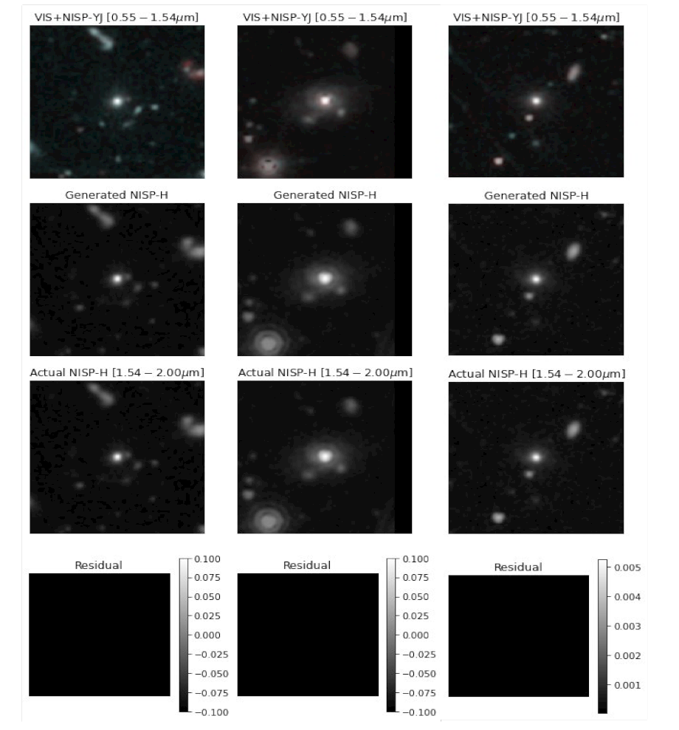
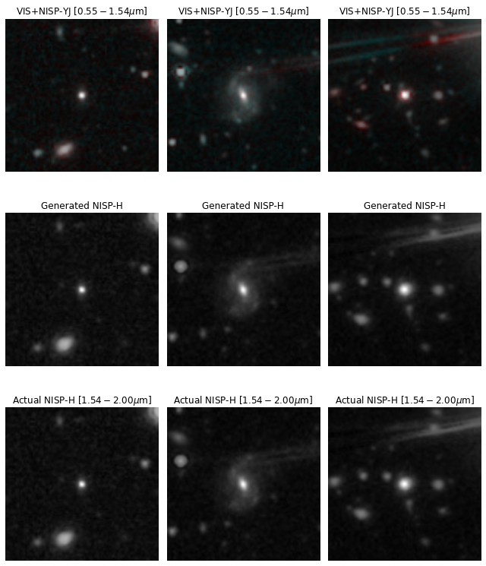
Slide Title 9
Results on Validation Set: No lensing involved here
cGAN trained for 100 epochs on the validation set which does not contain simulated lenses.
VIS band + NISP-J and NISP-Y bands as inputs shown in the top row. cGAN’s prediction shown in the middle row of NISP-H flux compared to the ground truth on bottom row.
NISP-H band is well predicted by the cGAN, with minimal residual images (predicted NISP-H flux subtracted from ground truth NISP-H flux).
This is fantastic for generating Euclid-wide surveys and predicting NIR wavelengths…but what about lensing and lens finding?
Slide 14 17th Marcel Grossmann Meeting https://github.com/RubyPC/cGAN_Lens_Finding/
Notes:
Now, we've warmed up, we've trained, and we have some results. So, we trained the cGAN for 100 epochs with the Euclid VIS and NISP-Y and J bands of the cutouts as the input to predict the corresponding NISP-H band flux. Here, we show results from the validation set which, likewise to the training set, does not contain lenses- with the top row showing the VIS and NISP inputs to the cGAN, the bottom row the ground truth NISP-H band flux- that's our target, and the middle row the prediction by the cGAN. Just by eye, we can see that the cGAN is an excellent predictor of the NISP-H band flux- it can clearly detect the features and predict the luminosities in the cutouts. This becomes clearer when we compute the residuals- that is, the difference between the ground truth NISP-H and the cGAN's prediction and we see that although the prediction is not perfect, there are very miniscule residuals, we can accurately predict the NISP-H data of the cutouts. That's great but we want to find lenses...- how will the cGAN perform on the test set that contains lenses- rare configurations that it has not seen before?

Slide 13
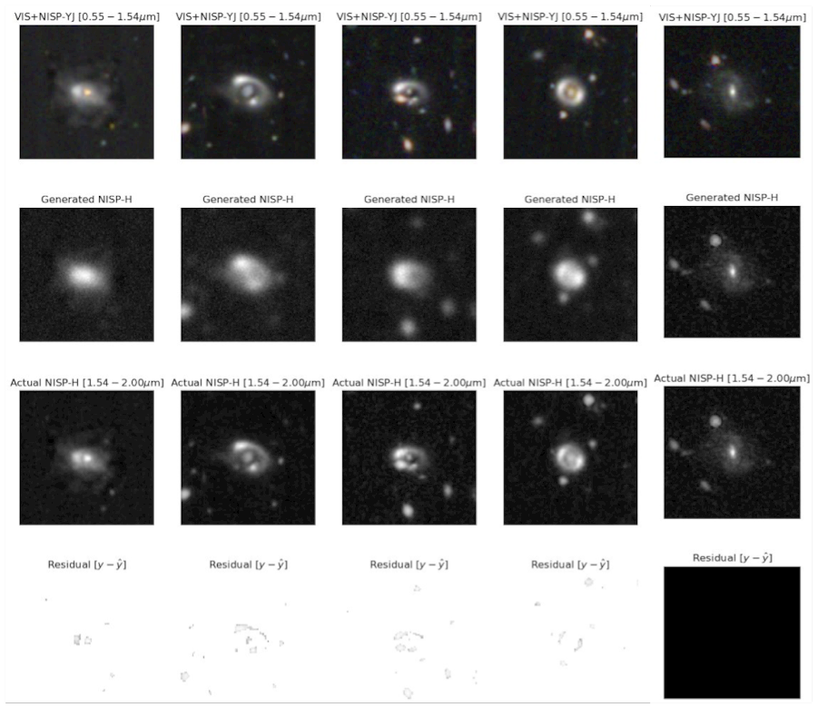
Slide Title 9
Results on Test Set: Can we find lenses?
cGAN cannot accurately predict the NISP-H band flux information of the cutouts with simulated lenses as well as cutouts without lenses (shown in 5th column).
Larger residuals are produced for samples containing a simulated gravitational lens.
Is the cGAN finding all the lenses by not predicting the NISP-H band flux information?
Slide 15 17th Marcel Grossmann Meeting https://github.com/RubyPC/cGAN_Lens_Finding/
Notes:
So, we tested the cGAN on our test set composed of 4500 non-lenses and 500 lenses and remember that our goal is anomaly detection for lens finding. The results are shown similar to before with the input on the top row, then working down we have the cGAN's prediction compared to the ground truth, with the residual images on the bottom. Now, it's clear to see which cutouts are lenses- not just in the large residual values but also the prediction here. We see that the cGAN produces rather blurry and grainy images and although we can see there's some off configuration being predicted in the predictions- it's not well defined and we are missing information certainly in terms of luminosity. This is obvious when we compare these predictions on the lenses to the 5th column here showing a prediction on a non-lens with much smaller residuals and a very well predicted NISP-H band flux. So, the cGAN can detect lenses as some sort of anomaly by not predicting the NISP-H band very well but the real question is: can it find all the lenses this way?

Slide 14
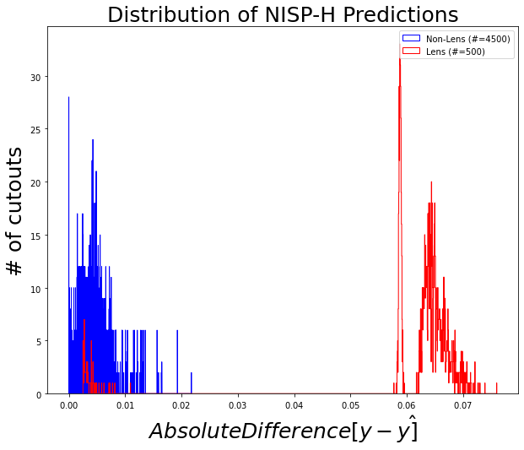
Slide Title 9
Distribution of Test Set Results
The cGAN can accurately predict the NISP-H band flux information for all non-lenses in the test set.
Simulated lenses have a higher error score between the cGAN’s prediction and ground truth.
Roughly ~15 of the simulated lenses are well predicted – these lenses were all multiple image systems that would have been difficult to detect.
cGAN clearly identifies the simulated lenses as anomalies.
Slide 16 17th Marcel Grossmann Meeting https://github.com/RubyPC/cGAN_Lens_Finding/
Notes:
So, we composed a metric to measure the distribution of the residuals in the entire test set normalised by the NISP-H band flux and we see very promising results. We can see two very broad peaks which are separate, showing this metric of difference between the ground truth and the cGAN's prediction for the number of cutouts in the test set. So, this metric is situated mostly around zero for the non-lenses in the test set, shown here in blue, of which there were 4500, meaning that those cutouts were very well predicted by the cGAN. In contrast to that, what was not very well predicted by the cGAN, shown by this divide at a larger metric value, were the lenses in the test set depicted in red. Interestingly, there is a small subset of lenses that were well predicted- roughly 15. With a quick visual inspection, these turned out to be all multiple image systems that were quite faint to see and would have been hard to detect, but nevertheless, that's 2% of the lenses in the test set, not the majority, so, we can confidently say that the cGAN can find gravitational lenses through anomaly detection.

Slide 15
Slide Title 30
Thank you
Notes:
Comprable only nisp-h lenses in Euclid- focus on multi-band Euclid data and not just VIS data James’s paper.

Slide 16
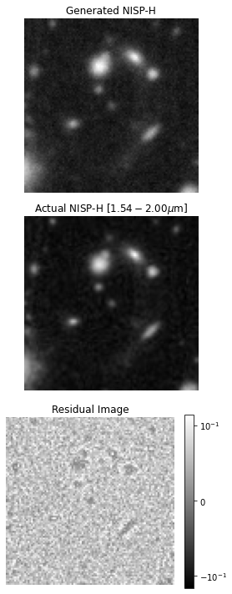
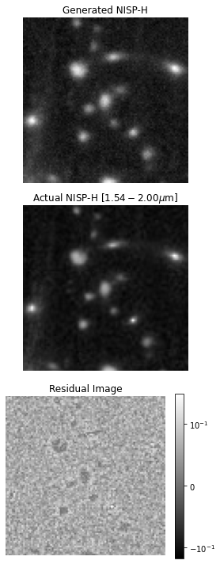
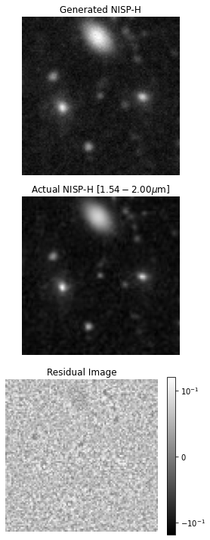
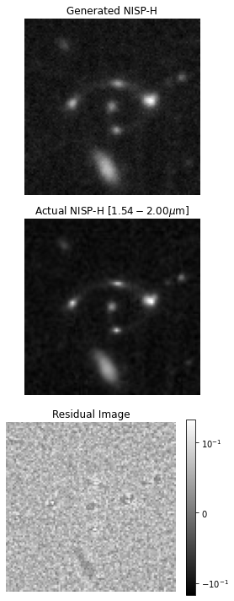
Slide Title 9
Well-Predicted Multiple Image Systems
Appendix 17th Marcel Grossmann Meeting https://github.com/RubyPC/cGAN_Lens_Finding/
Notes:
So, we proposed to use a machine learning architecture called a cGAN to find gravitational lenses in Euclid imaging through the method of anomaly detection, and we have shown that this concept works for simulations where the NISP-H band flux is poorly predicted for lenses. Now, a next step would be to test this method on real data, however, in reality, the data can be very different and much more complicated than our simulations. For example, we expect numerous VIS-band dropouts with Euclid, meaning that gravitational lenses will be moreso difficult to detect and find. However, what we have shown is that we can offer an alternative method of lens finding- a more unsupervised approach - that could be used as a useful tool to find a more pure and complete strong gravitational lens samples in Euclid imaging.

Slide 17
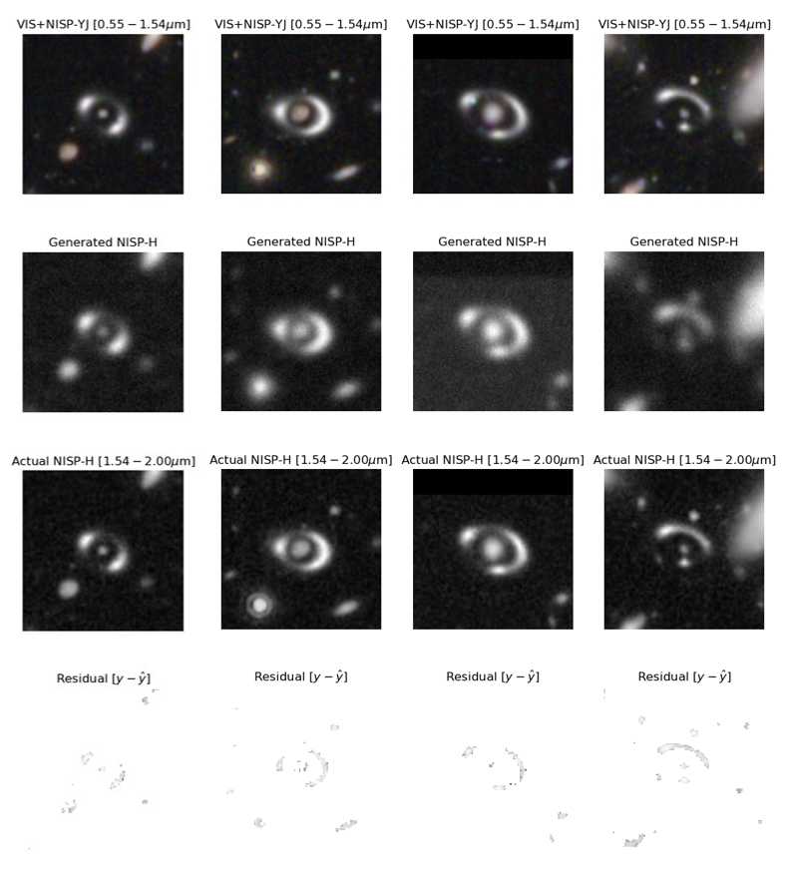
Slide Title 9
Further Examples of Poorly Predicted Lens Systems
Appendix 17th Marcel Grossmann Meeting https://github.com/RubyPC/cGAN_Lens_Finding/
Notes:
So, we proposed to use a machine learning architecture called a cGAN to find gravitational lenses in Euclid imaging through the method of anomaly detection, and we have shown that this concept works for simulations where the NISP-H band flux is poorly predicted for lenses. Now, a next step would be to test this method on real data, however, in reality, the data can be very different and much more complicated than our simulations. For example, we expect numerous VIS-band dropouts with Euclid, meaning that gravitational lenses will be moreso difficult to detect and find. However, what we have shown is that we can offer an alternative method of lens finding- a more unsupervised approach - that could be used as a useful tool to find a more pure and complete strong gravitational lens samples in Euclid imaging.

