Slide 1
GRB Redshift Classifier Using Supervised Machine Learning
Shubham Bhardwaj
Graduate University for Advanced Studies, SOKENDAI, Japan
National Astronomical Observatory of Japan
Maria Giovanna Dainotti, Shubham Bhardwaj, Christopher Cook, Joshua Ange, Nishan Lamichhane, Malgorzata Bogdan, and Agnieszka Pollo
2024/07/08 MG17
<number>

Slide 2
Outline
1. Introduction
2. Motivation
3. Data Sample
4. Methodology
5. Results
6. Conclusion and Future Work
2024/07/08 MG17
<number>

Slide 3
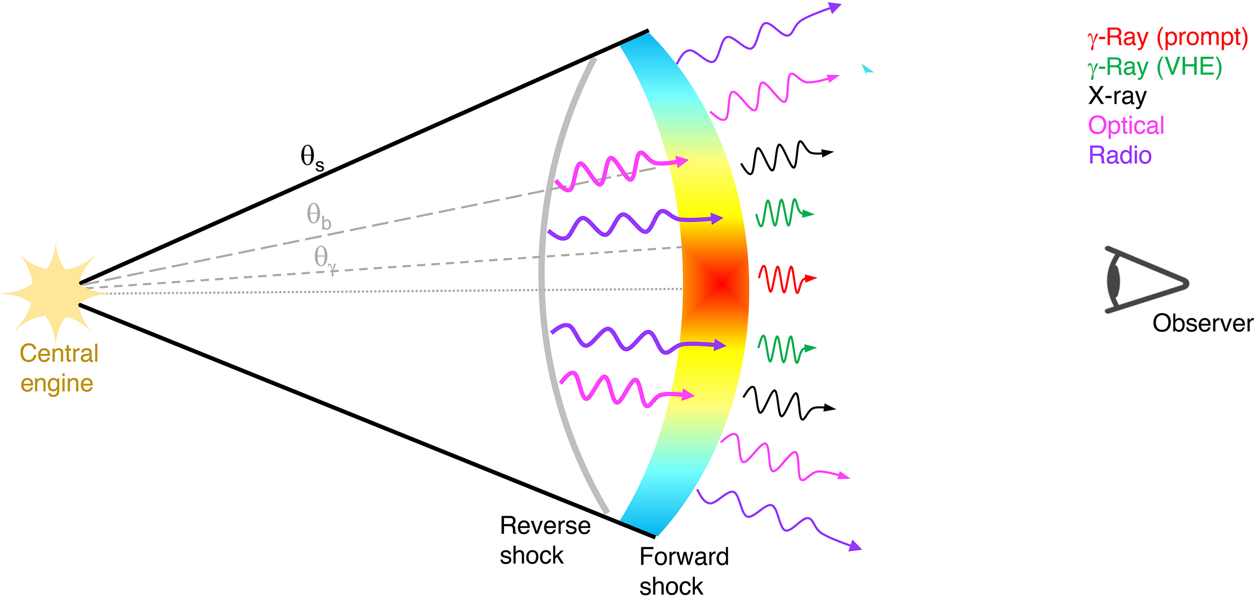
1. Introduction
What are gamma-ray burst (GRBs) ?
Most violent and powerful explosions in the universe.
Highly luminous and observed up to a redshift, z = 9.4.
Emit in a wide range of electromagnetic wavelengths (from gamma-rays to radio).
2024/07/08 MG17
Credit: O’Connor et al. 2023
<number>

Slide 4
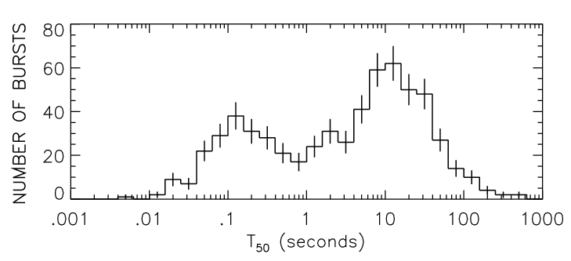
1. Introduction
Classification of GRBs
Compact object mergers (NS-NS, NS-BH)
Short vs Long GRBs
Core collapse of massive stars (M > 30 M_{sun})
Long (soft)
Short (hard)
Short GRBs (SGRBs) → T₉₀ < 2s Long GRBs (LGRBs) → T₉₀ > 2s
T₉₀ is the prompt emission duration, namely the time in which 90% of the counts are detected from 5% to 95% of the total emission.
2024/07/08 MG17
<number>

Slide 5
2. Motivation
Why GRBs are important to study ?
High-z GRBs come from the early universe. Hence, they are crucial for cosmological application.
Possibility of using them as standard candles.
Population studies: to determine the cosmic GRB formation rate, etc…….
Problem?
Not enough samples of high-z GRBs.
Why?
Requires rapid localization and spectral information.
Paucity of follow-up programs.
Limited telescope time.
2024/07/08 MG17
<number>

Slide 6
2. Motivation
Past studies to classify GRB z
Promptly available high-energy data (Grupe at al. 2007; Campana et al. 2007; Salvaterra et al. 2007; Vanden Berk et al. 2008; Ukwatta et al. 2008, 2009; Koen et al. 2009, 2010).
Problem?
Lacked accuracy necessary to facilitate a reliable follow-up program.
Recently, Morgan et al. (2012) and Ukwatta et al. (2016) used supervised machine learning (ML) to identify high-z GRBs.
Problem?
They used only a single algorithm for training the model.
Didn’t included the plateau phase of the GRB light curve (LC).
2024/07/08 MG17
<number>

Slide 7
2. Motivation
Our Approach
Use an ensemble method with multiple models within SuperLearner.
Supervised ML
Included plateau emission phase for the time first.
We train the ML model on GRB photometric properties to classify the z reliably.
ML models are trained using labeled data to predict the output accurately, such as regression and classification.
2024/07/08 MG17
<number>

Slide 8
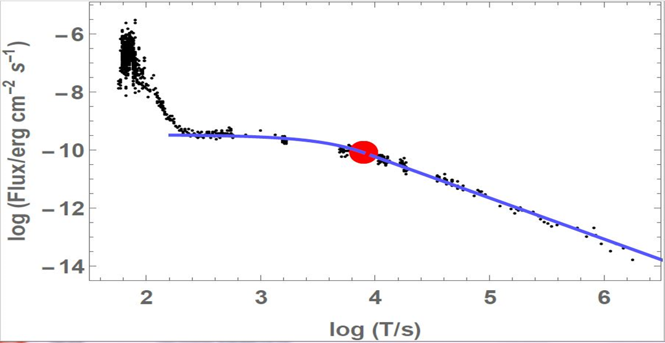
3. Data Sample
Data & Observed Properties
We use 251 GRBs with known z, that exhibit X-ray plateau in the LC.
These are taken from Dainotti et al. (2020) and Srinivasaragavan et al. (2020).
The dataset contains GRBs from the Swift-BAT GRB Catalogue.
We use 10 observed features in this analysis.
5 features from the prompt emission:
T₉₀, Fluence, Peak Flux, Photon Index, γ
4 features from the plateau emission:
T_{a}, F_{a}, α, β
1 feature from the afterglow phase: NH
Afterglow
2024/07/08 MG17
<number>

Slide 9
3. Data Sample
Observed Properties
T₉₀: time in which the energy of the prompt emission is emitted between 5% and 95% of the total emission.
Fluence: energy fluence of the prompt emission.
Peak Flux: peak photon flux of the prompt emission.
Photon Index: photon index of the prompt emission.
γ: spectral index parameter of the prompt emission.
T_{a}: end time of the plateau.
F_{a}: flux at the end of the plateau.
α: temporal decay power law index after the plateau.
β: spectral index of the plateau emission.
NH: neutral hydrogen column density.
2024/07/08 MG17
<number>

Slide 10
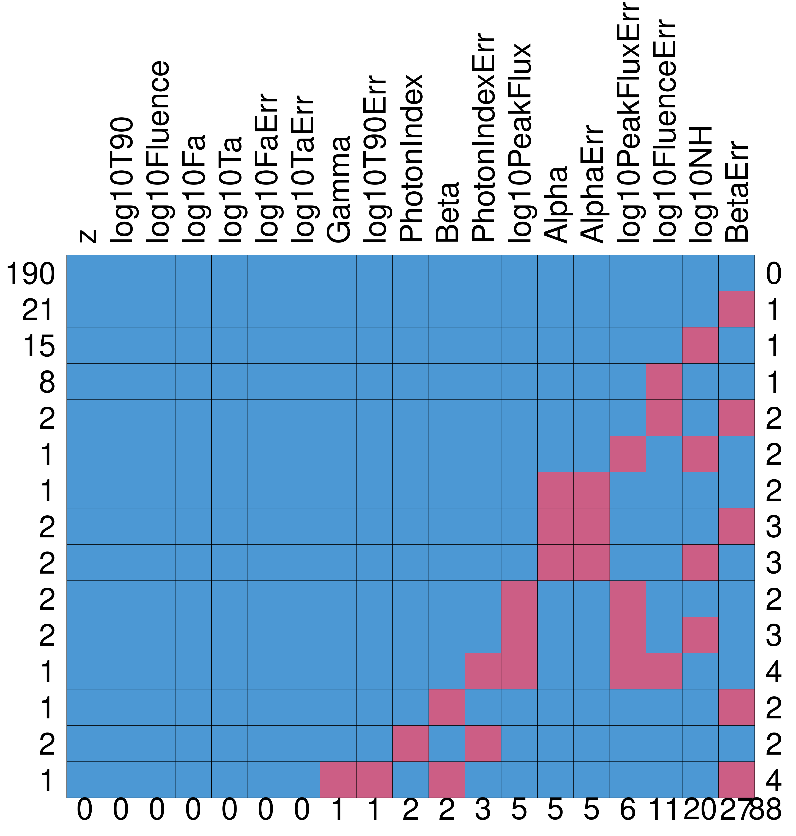
3. Data Sample
MICE Imputation
Multivariate imputation by chained equations (MICE)
Gibson et al. (2020)
The sample contains missing data as well.
The aim is to impute these missing data.
To increase the data sample.
Figure 1. The distribution of missing data in our sample.
Pink boxes indicate the missing data.
2024/07/08 MG17
Dainotti et al. (in prep.)
<number>

Slide 11
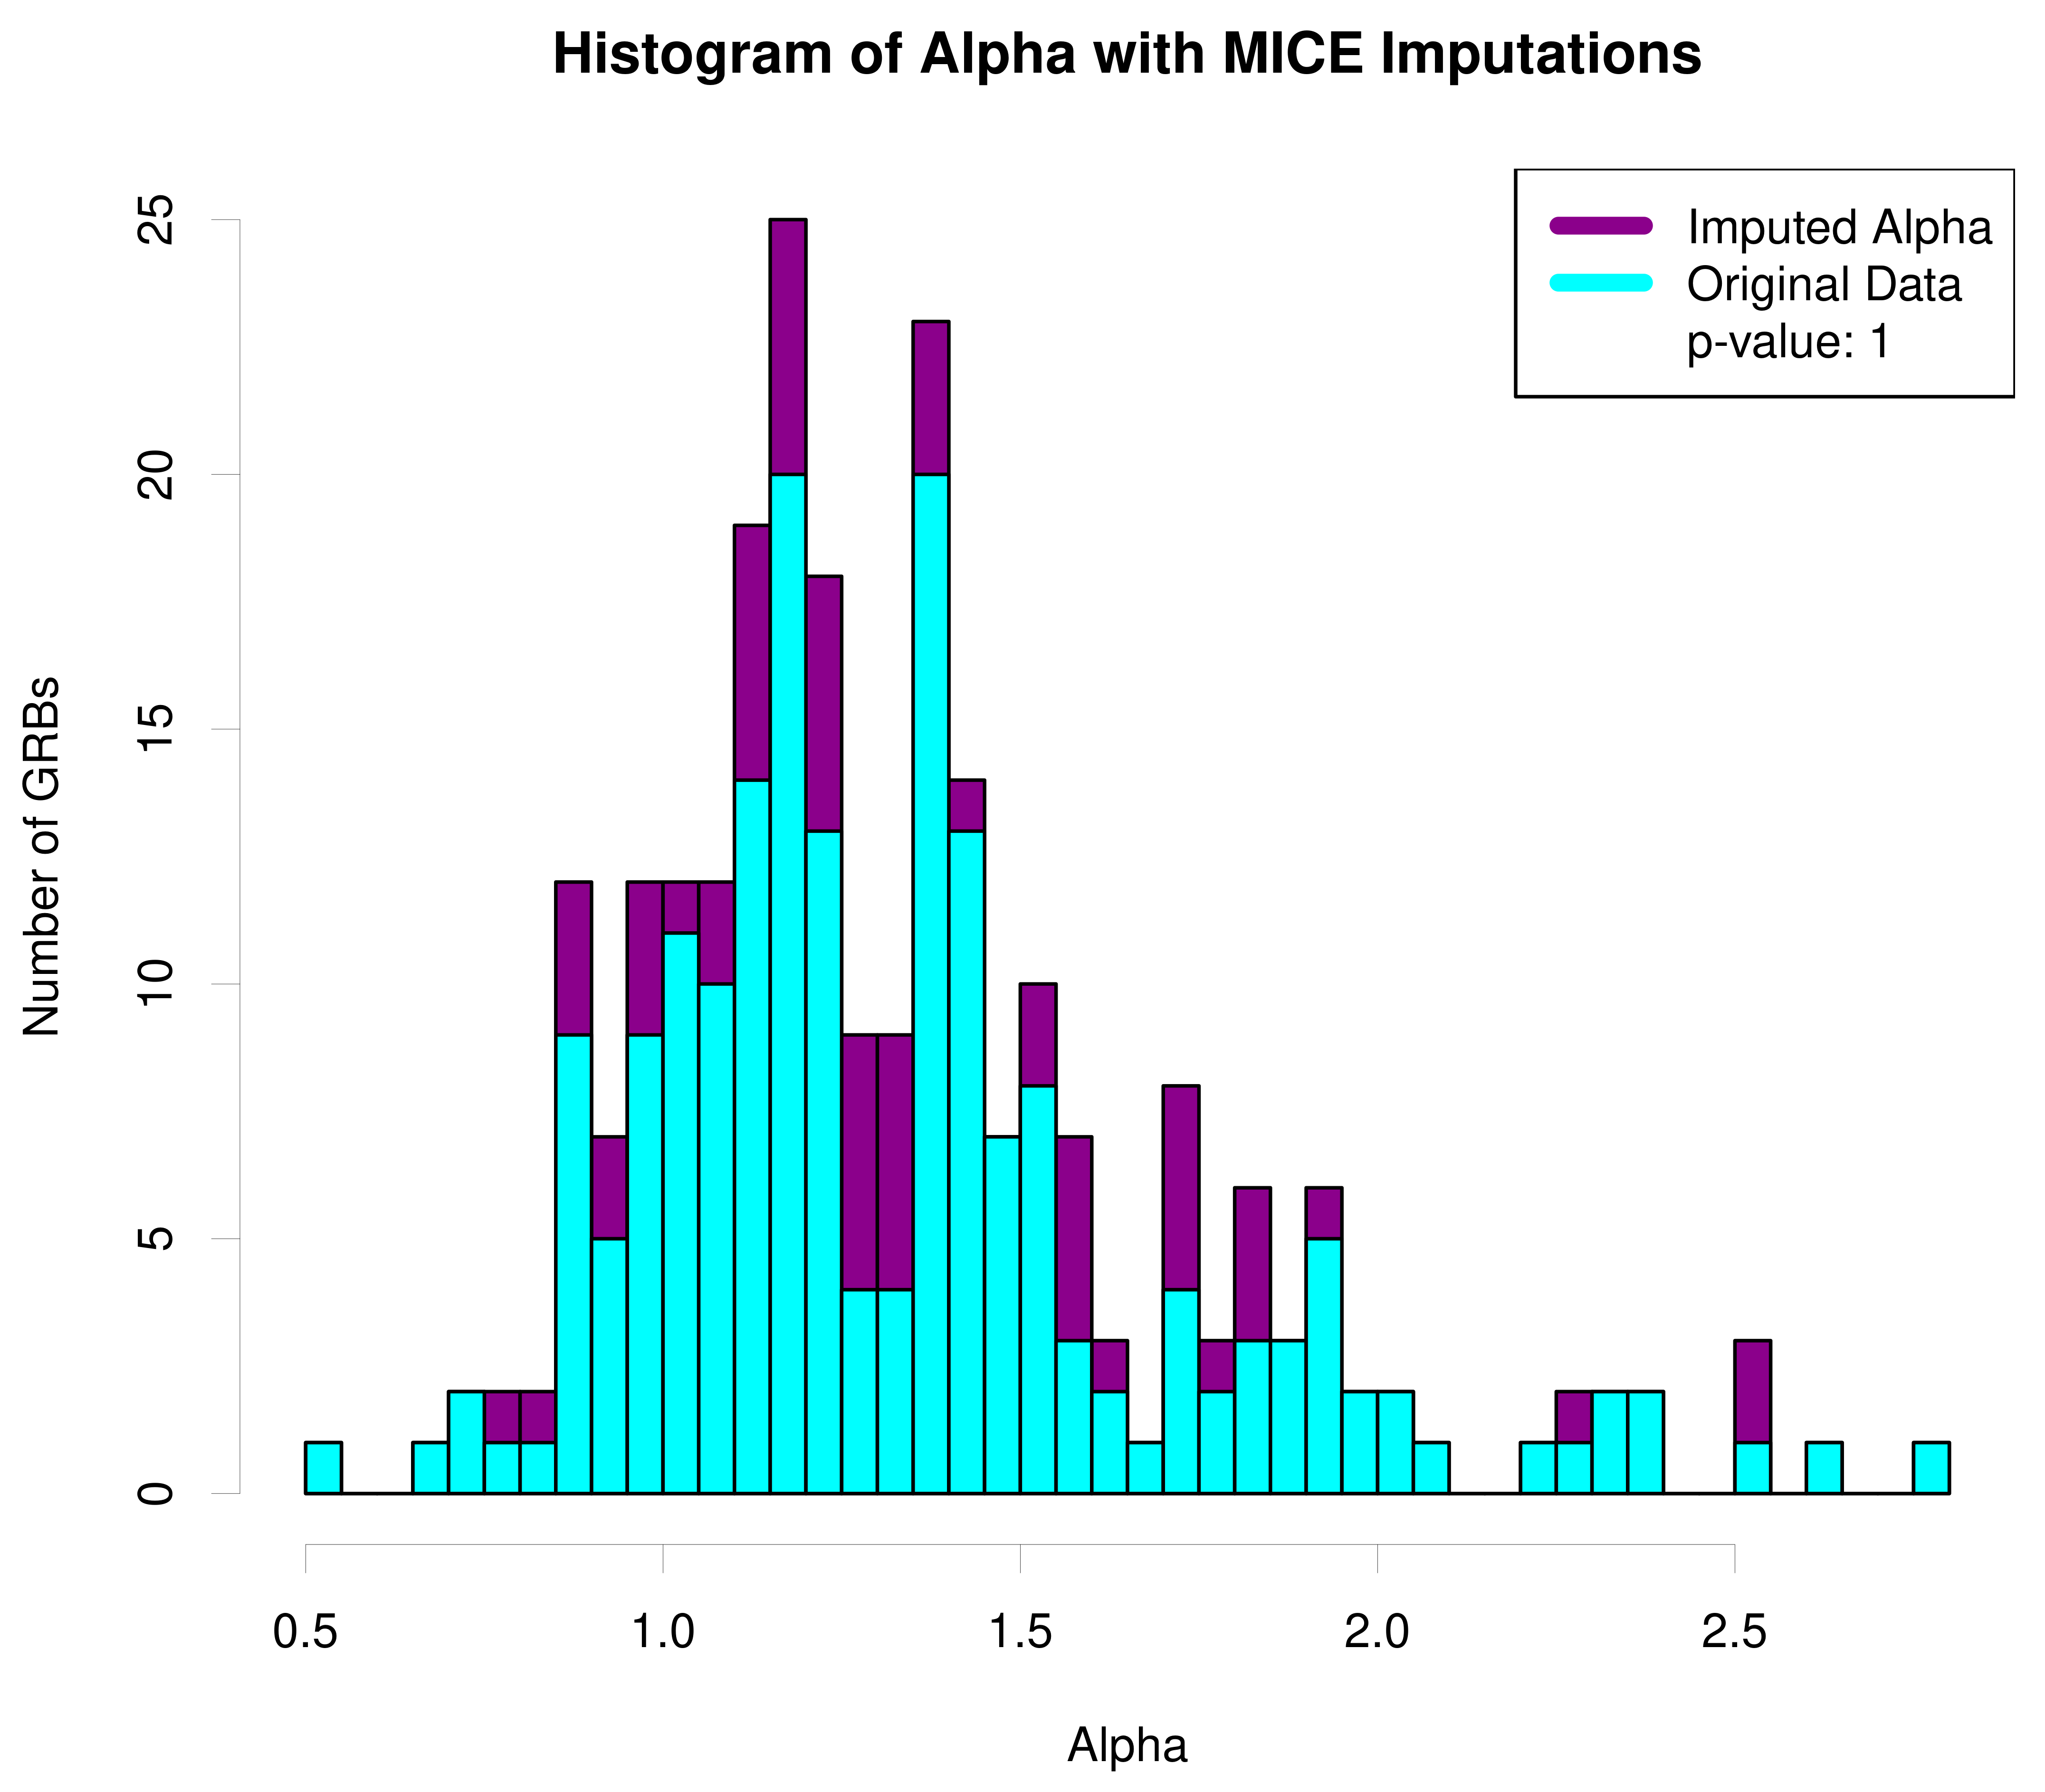
3. Data Sample
MICE Imputation
Figure 2. Histogram of Alpha distribution with MICE imputed data shown in magenta and the original data in blue.
We performed the Kolmogorov-Smirnov (KS) test.
p-value = 1: shows that the imputed values originate from the same parent population as the observed feature values.
2024/07/08 MG17
Dainotti et al. (in prep.)
<number>

Slide 12
3. Data Sample
Outlier Removal
M-estimator
A robust regression method, often used to alter data having outliers.
It tries to minimize the residuals with a function different from the ordinary least square method.
Dainotti et al. (2024a)
Which reduces the influence of the outlier on the data.
We removed 5 GRBs as outliers using the Robust Linear Model (RLM) with M-estimator by selecting a cutoff weight of 0.5.
Training dataset (80%)
Final dataset = 246 GRBs
Test dataset (20%)
2024/07/08 MG17
<number>

Slide 13
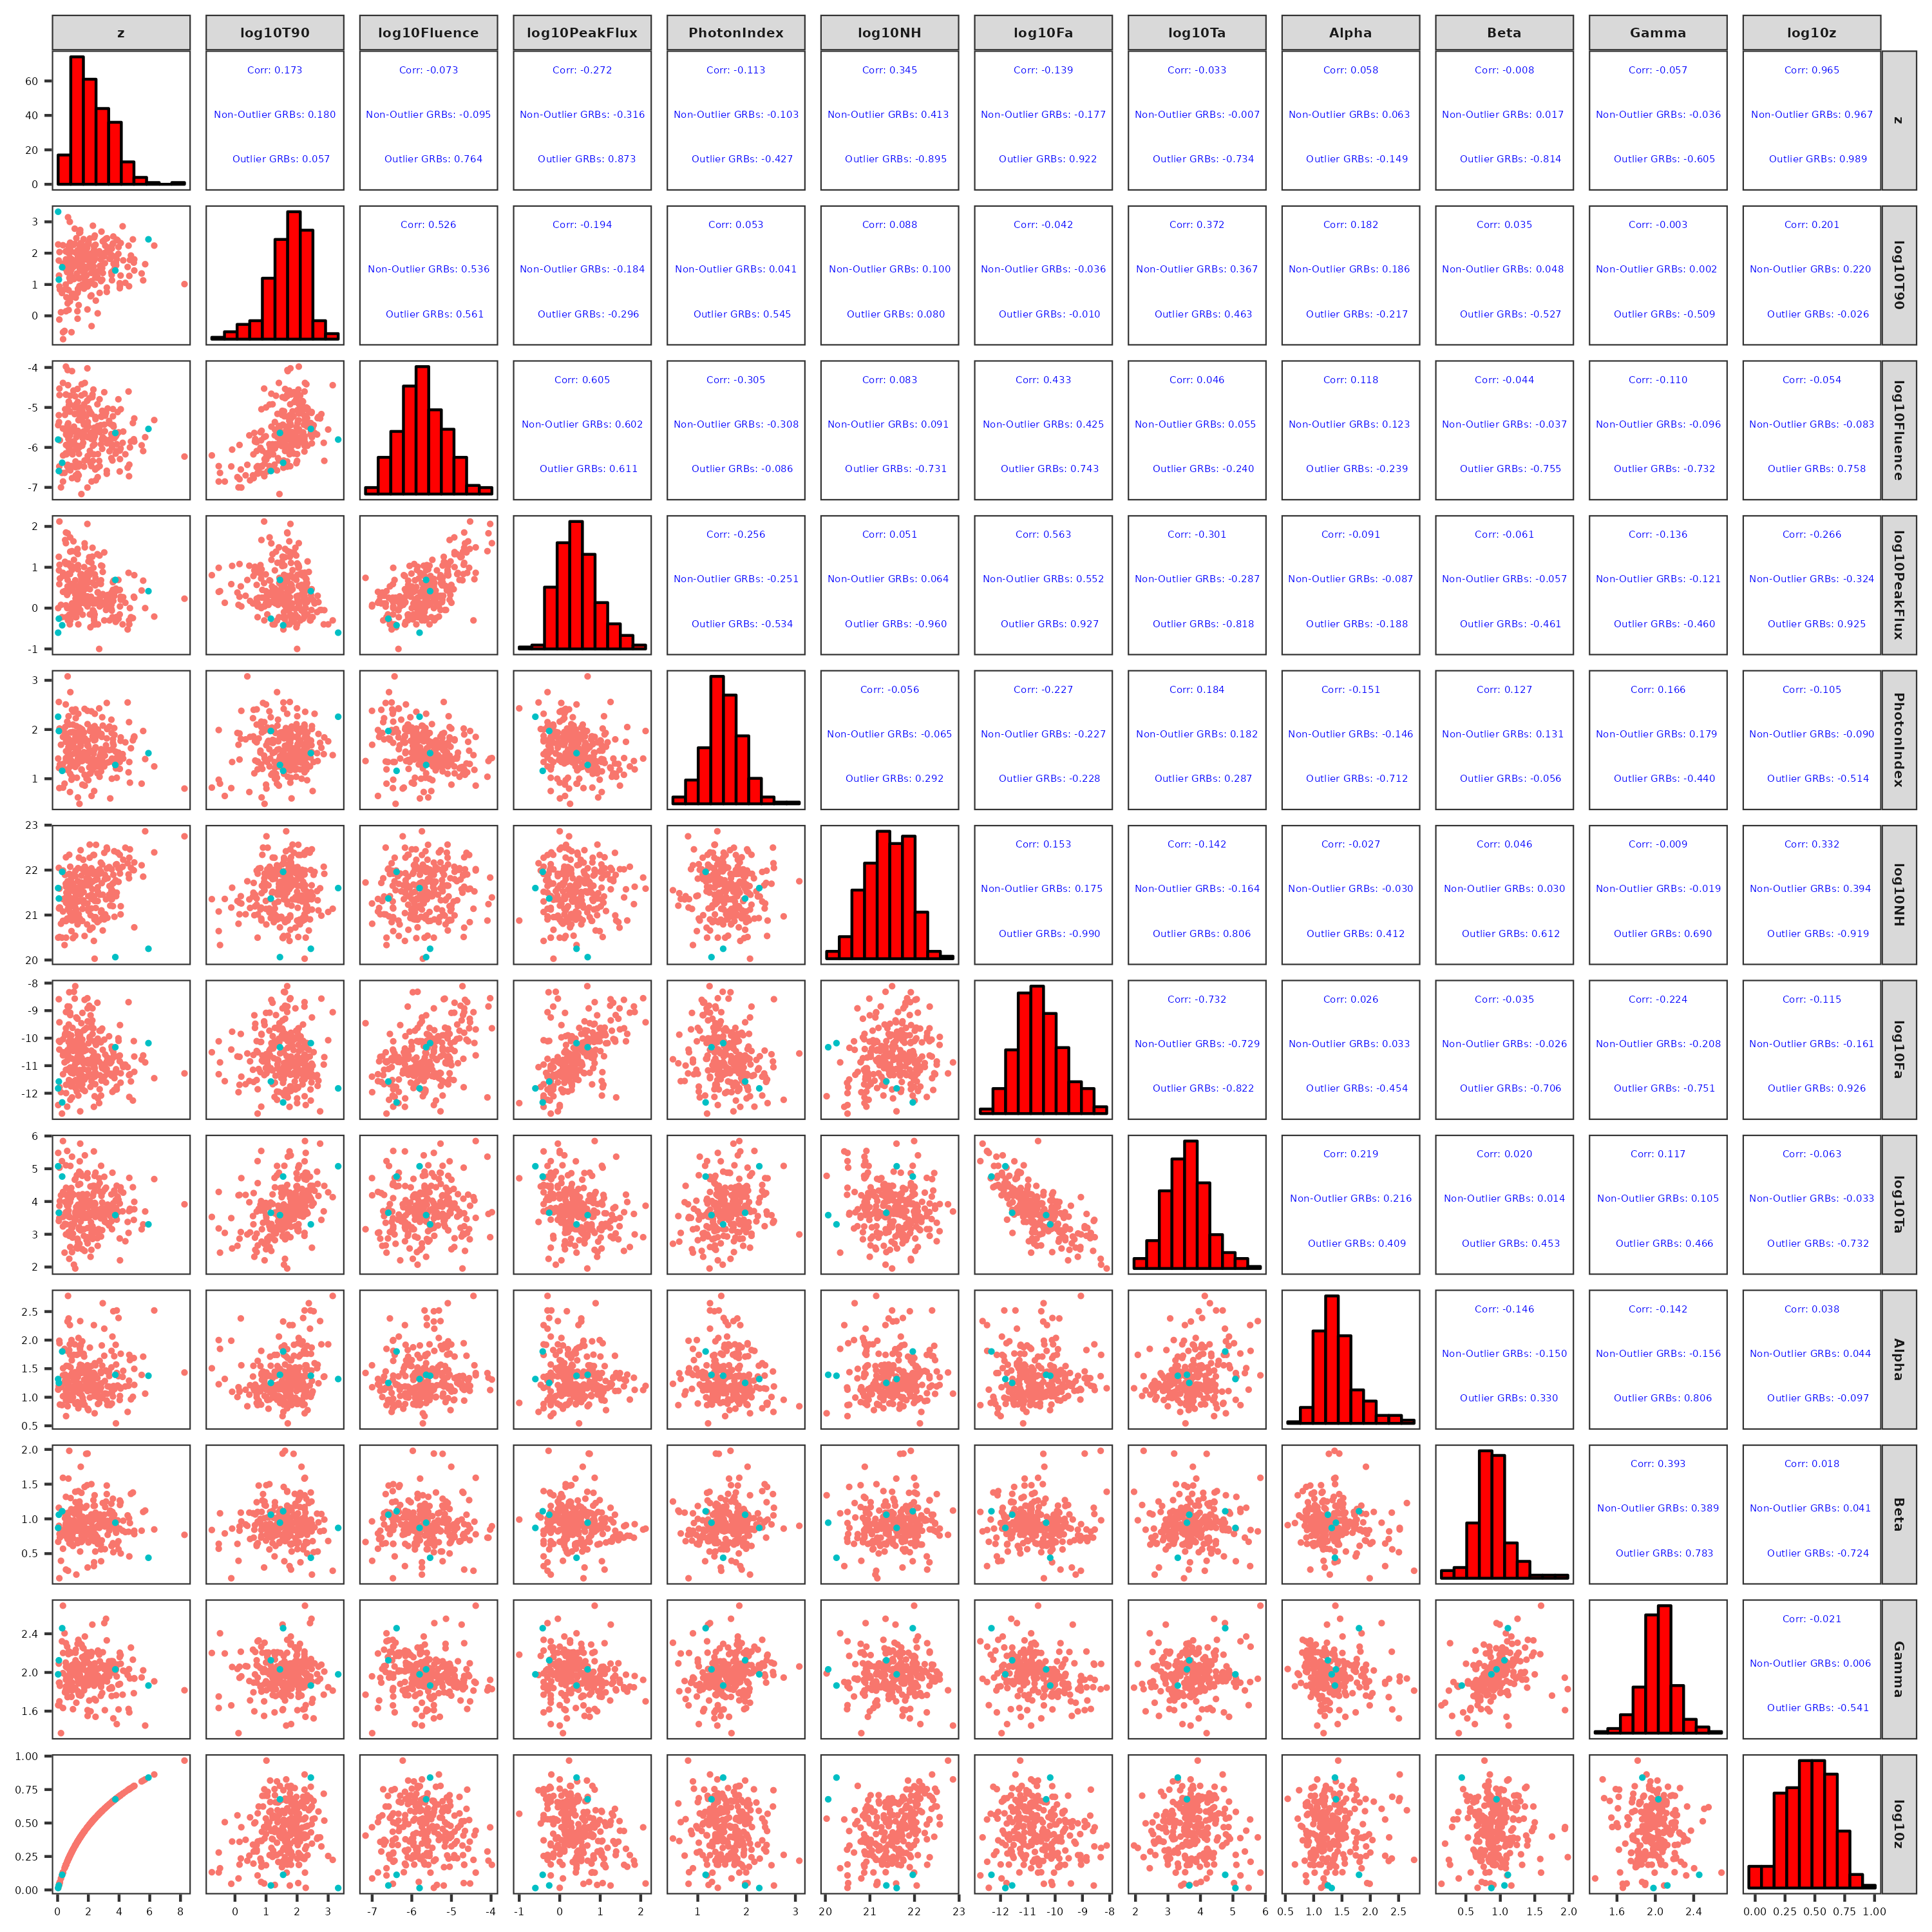
3. Data Sample
Figure 3. Scatter matrix plot of the data after the cleaning of the sample, variable transformation, MICE imputation, and M-estimator. Non-outliers are shown in red, while outliers in cyan.
Dainotti et al. (in prep.)
2024/07/08 MG17
<number>

Slide 14
4. Methodology
Feature Selection
The data has 10 observed properties.
An ML technique used to select optimal features best suited for estimating the response variable (here, to classify GRB z).
Least Absolute Shrinkage and Selection Operator (LASSO) is one of the methods we used for this purpose.
LASSO assigns weights to the variables, determining how effective the variable is in z prediction.
These weights can be 0 based on a tuning parameter, λ.
2024/07/08 MG17
<number>

Slide 15
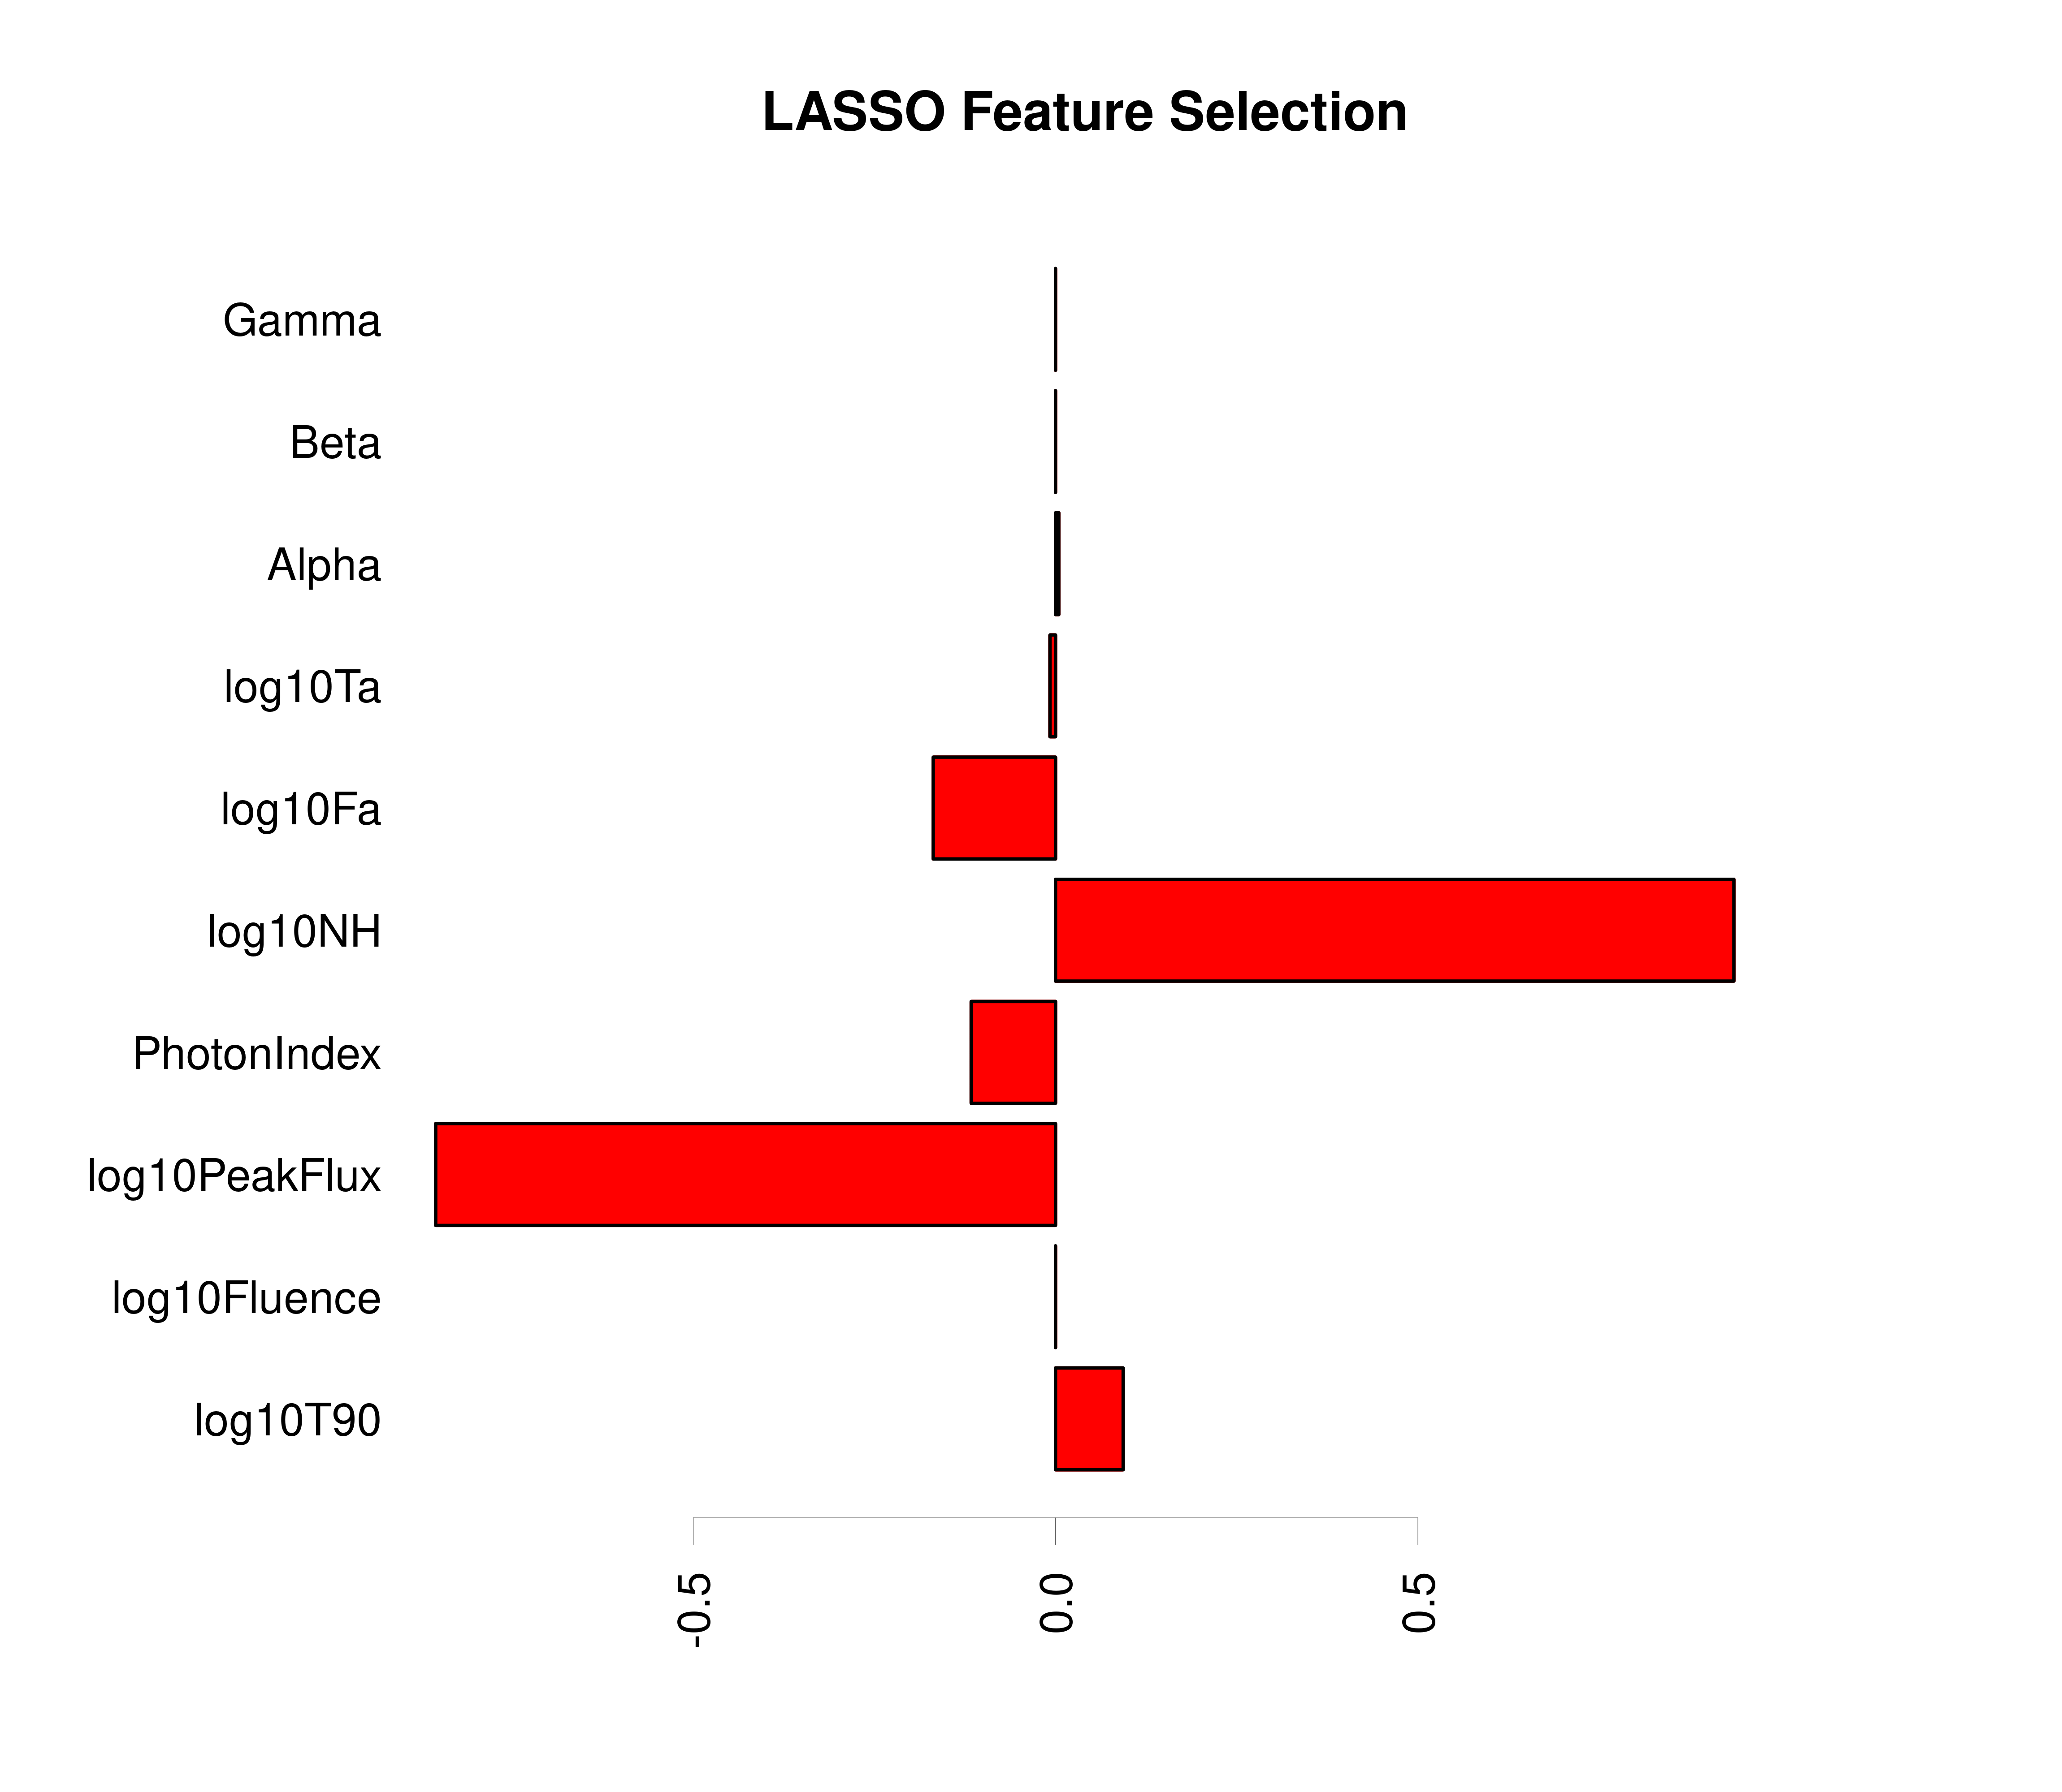
4. Methodology
Feature Selection
LASSO is performed 100 times for consistency.
Using LASSO, we picked 7 features (log(T₉₀), log(PeakFlux), Photon Index, log(NH), log(F_{a}), log(T_{a}) and Alpha) having LASSO weights > 0.02.
Figure 4. LASSO feature selection. The bars show the weights assigned by LASSO.
Dainotti et al. (in prep.)
2024/07/08 MG17
<number>

Slide 16
4. Methodology
Have been successfully applied
to AGNs (Dainotti et al. 2021;
Narendra et al. 2022), and GRBs
(Dainotti et al. 2024a,b)
ML with SuperLearner (SL)
An ML algorithm that works on an ensemble learning method.
Ensemble learning: an ML technique that combines multiple algorithms into a single one so that shortcomings of one ML algorithm may be overcome by another.
SL assigns the weights to each model to tell the importance of the individual model.
Σ_{i=0} ^{i=n} (weight)_{i} = 1; weight is always ≥ 0.
Then, create a weighted average of all those models.
SL algorithm uses k-fold cross-validation (CV) to estimate the performance of multiple ML methods.
CV: a model validation technique.
2024/07/08 MG17
<number>

Slide 17
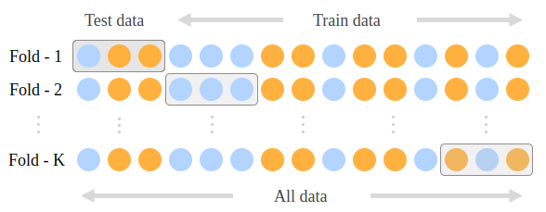
4. Methodology
SL
In this work, we used 10-fold cross-validation (10fCV).
In 10fCV, data is divided into 10 blocks, out of which 9 blocks are used to train the model, and the 10th block is used to test the trained model, as shown in the figure below.
Repeated for each subset, allowing each subset to serve as a testing set while the others are used for training.
Weights are assigned based on this 10fCV.
The 10fCV is a method to test the performance of our ML models.
10fCV is performed 100 times to derandomize and stabilize our results.
Credit: https://www.philschmid.de/k-fold-as-cross-validation-with-a-bert-text-classification-example
2024/07/08 MG17
<number>

Slide 18
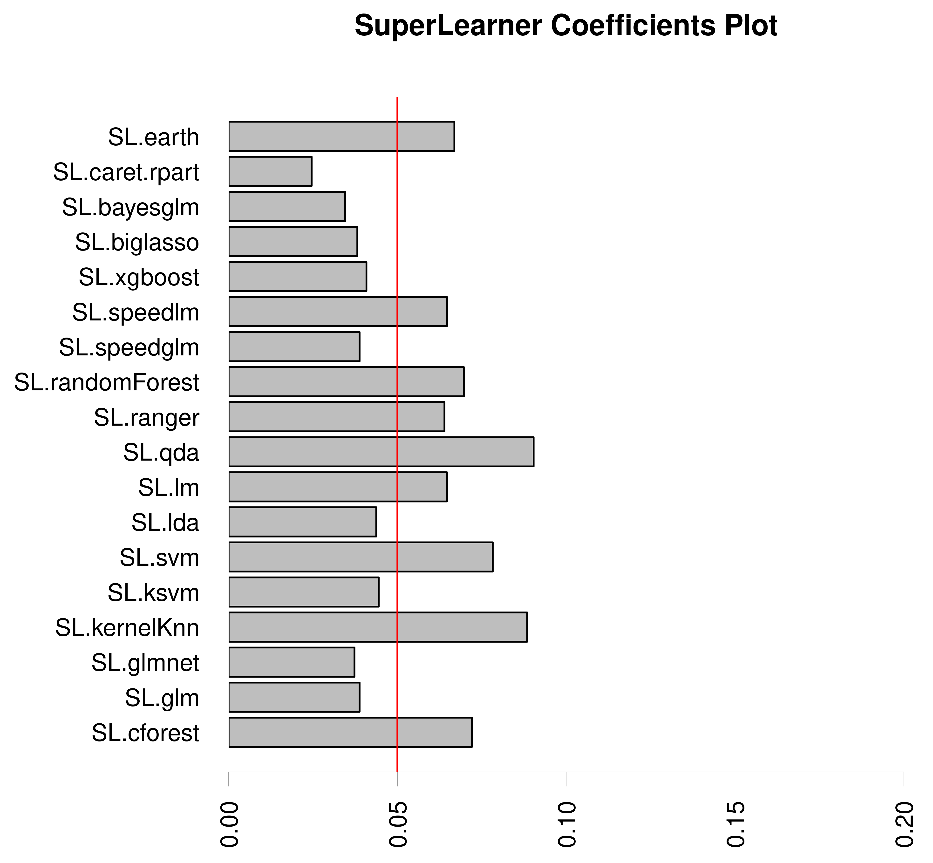
4. Methodology
SL
We tested 18 models with SL performing 100 10fCV.
Best models: models with weights > 0.05.
Figure 5. Weights assigned to algorithms by SL. The red line indicates the cutoff threshold for selecting the best algorithms. Algorithms above this line are chosen to train the ML model.
2024/07/08 MG17
Dainotti et al. (in prep.)
<number>

Slide 19
5. Results
Terminology
We aim to classify GRBs as low-z (<= cut off) and high-z (> cut off).
We perform 10fCV 100 times with the selected models on the training dataset (80% of full dataset) using the SL.
Here, we only present the results for z cutoff of 3.0.
We visualize the classifier's performance using Receiver Operating Characteristic (ROC) Area Under the Curve (AUC) plots.
ROC AUC curve is a classification error metric in graphical representation used to diagnose the performance of the machine learning algorithms.
ROC presents a binary classifier system’s diagnostic performance when its discrimination threshold is modified.
AUC helps in comparing one ROC curve to the other.
2024/07/08 MG17
<number>

Slide 20
5. Results
Terminology
ROC is a plot between true positive (TP) and false positive (FP).
TP: denotes the data points that are truly positive (high−z GRB) and are accurately categorized as positive.
FP: denotes the data points that are truly negative (low−z GRB) but are falsely categorized as positive.
Used to characterize the sensitivity/specificity tradeoffs for a binary classifier.
Sensitivity: percentage of TP.
Specificity: percentage of TN (1 - FP).
2024/07/08 MG17
<number>

Slide 21
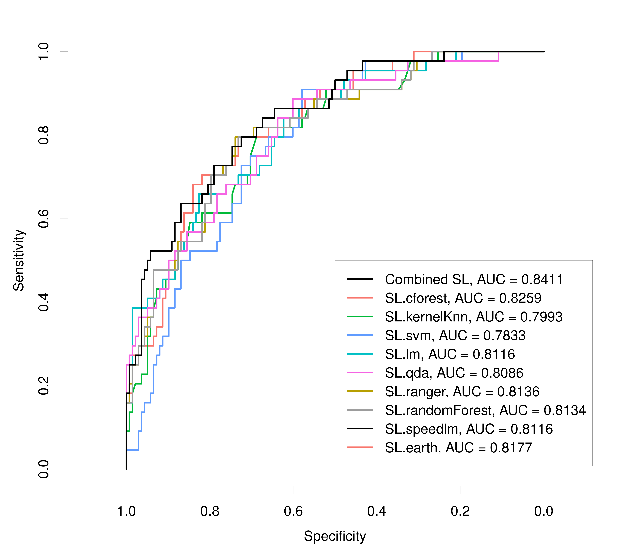
5. Results
From SL
Figure 6. ROC AUC plot showing ROC curves for various algorithms (shown by colored lines) used for the MICE imputed and outlier removed training dataset. The higher the AUC score, the better the algorithm’s performance. The black line indicates the combined AUC.
2024/07/08 MG17
Dainotti et al. (in prep.)
<number>

Slide 22
6. Conclusion and Future Work
Conclusion
Feature selection changes according to the size of the dataset (different z cutoff).
Removing the outliers significantly enhances results.
The predictions remain consistent across different numbers of loop runs (100, 200, 300, 500, 1000) for a particular z cutoff and the dataset.
100 loops | 200 loops | 300 loops | 500 loops | 1000 loops
0.8411 | 0.8341 | 0.8281 | 0.8351 | 0.8294
2024/07/08 MG17
<number>

Slide 23
6. Conclusion and Future Work
Future Work
Set up an automated system that gives z classification using our model as soon as a GRB is detected.
2024/07/08 MG17
<number>

Slide 24
Thank You
ありがとうございました!!
Shubham Bhardwaj
shubham.bhardwaj@grad.nao.ac.jp
2024/07/08 MG17
<number>

