Slide 1



A new era of fine structure constant measurements in the early universe
Dinko Milaković
Institute for Fundamental Physics of the Universe (IFPU)
Trieste
Marcel Grossmann meeting , 11. 7. 2024., Pescara

Slide 2
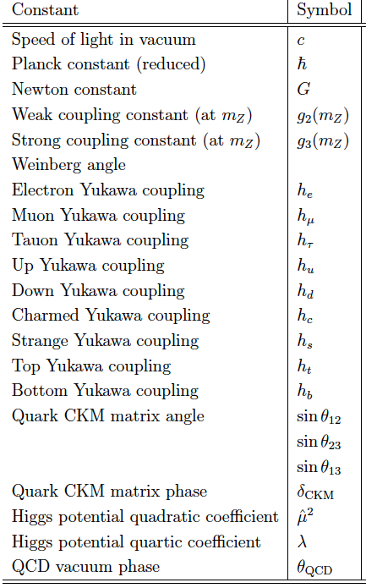
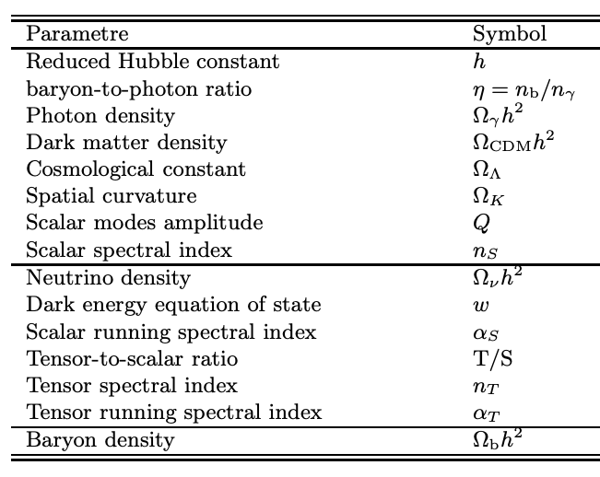
Today’s fundamental constants
are parameters of the Standard Cosmological Model
Based on Uzan 2011
Standard model
dark matter
Λ
General
relativity
Copernican
principle
Simply connected
topology
Dinko Milaković (IFPU) for 17th Marcel Grossmann meeting

Slide 3
Fundamental constants
Why these constants and why these values?
Assumed to be fixed (needs validation!) but
expected to vary beyond the Standard Model
(needs measuring!)
Precise measurements of variation on Earth,
but astronomical data are better posed for cosmology
Null-results constrain cosmological models
Dinko Milaković (IFPU) for 17th Marcel Grossmann meeting
Notes:
In short, fundamental constants are the free parameters of the Standard Model of particle physics and of LCDM. We have no idea why they have the values that they do, as this is not predicted by any known theory. They could have been determined at Big Bang from some hyper-prior space or they could be

Slide 4

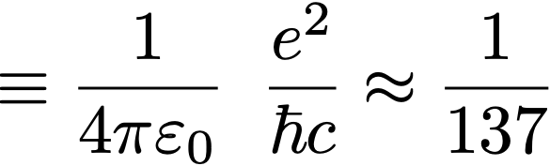
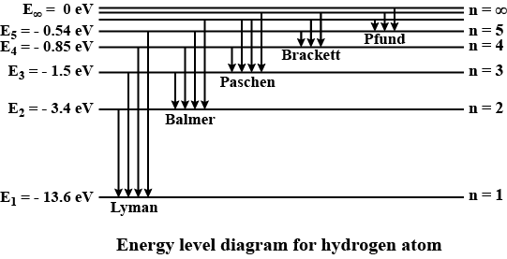


“fine structure constant”
electromagnetism
quantum mechanics
general relativity
sets the energy levels of atoms
Measurable
IF
Dinko Milaković (IFPU) for 17th Marcel Grossmann meeting
Notes:
\equiv\frac{1}{4\pi\varepsilon_0}\,\,\, \frac{e^2}{\hbar c}\approx\frac{1}{137}
E_{jn}&=-{\frac {\mu c^{2}\alpha ^{2}}{2n^{2}}}\left[1+{\frac {\alpha ^{2}}{n^{2}}}\left({\frac {n}{j+{\frac {1}{2}}}}-{\frac {3}{4}}\right)\right]\\
&= \frac{\hbar c}{\lambda}

Slide 5
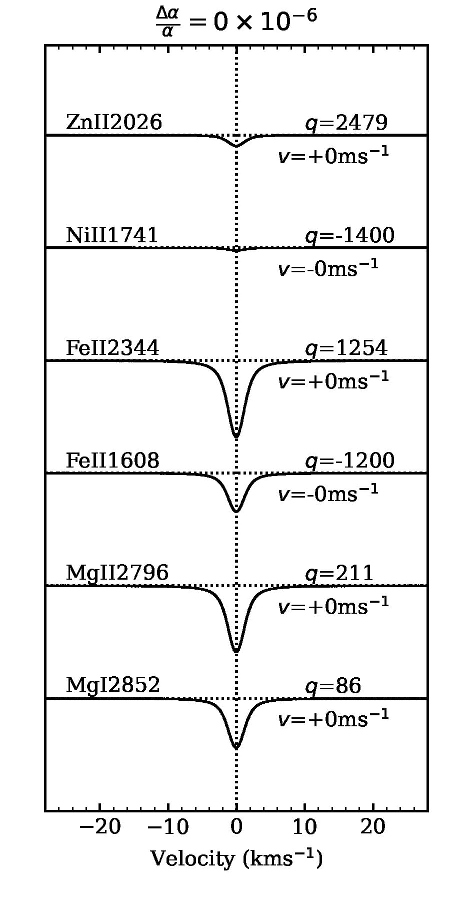
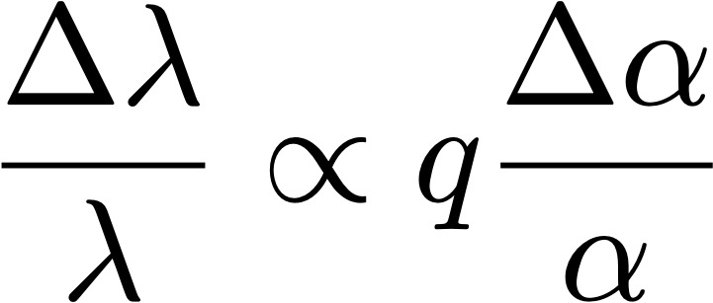

observed
wavelength shift
sensitivity
coefficient
q generally larger for heavy nuclei and transitions
close to the ground state
Every transition has a
different sensitivity to
Dinko Milaković (IFPU) for 17th Marcel Grossmann meeting

Slide 6
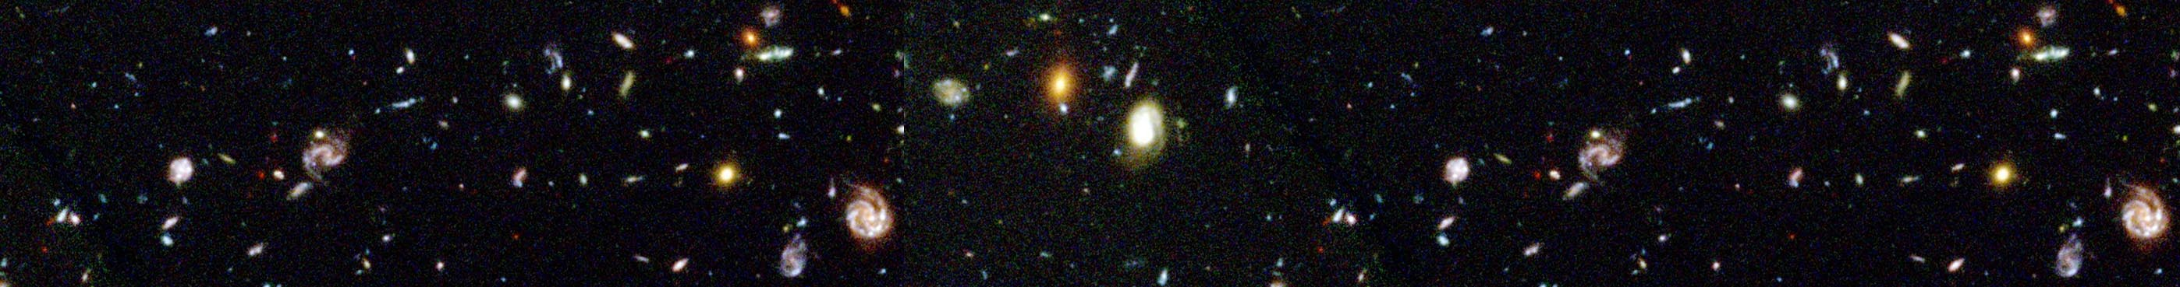

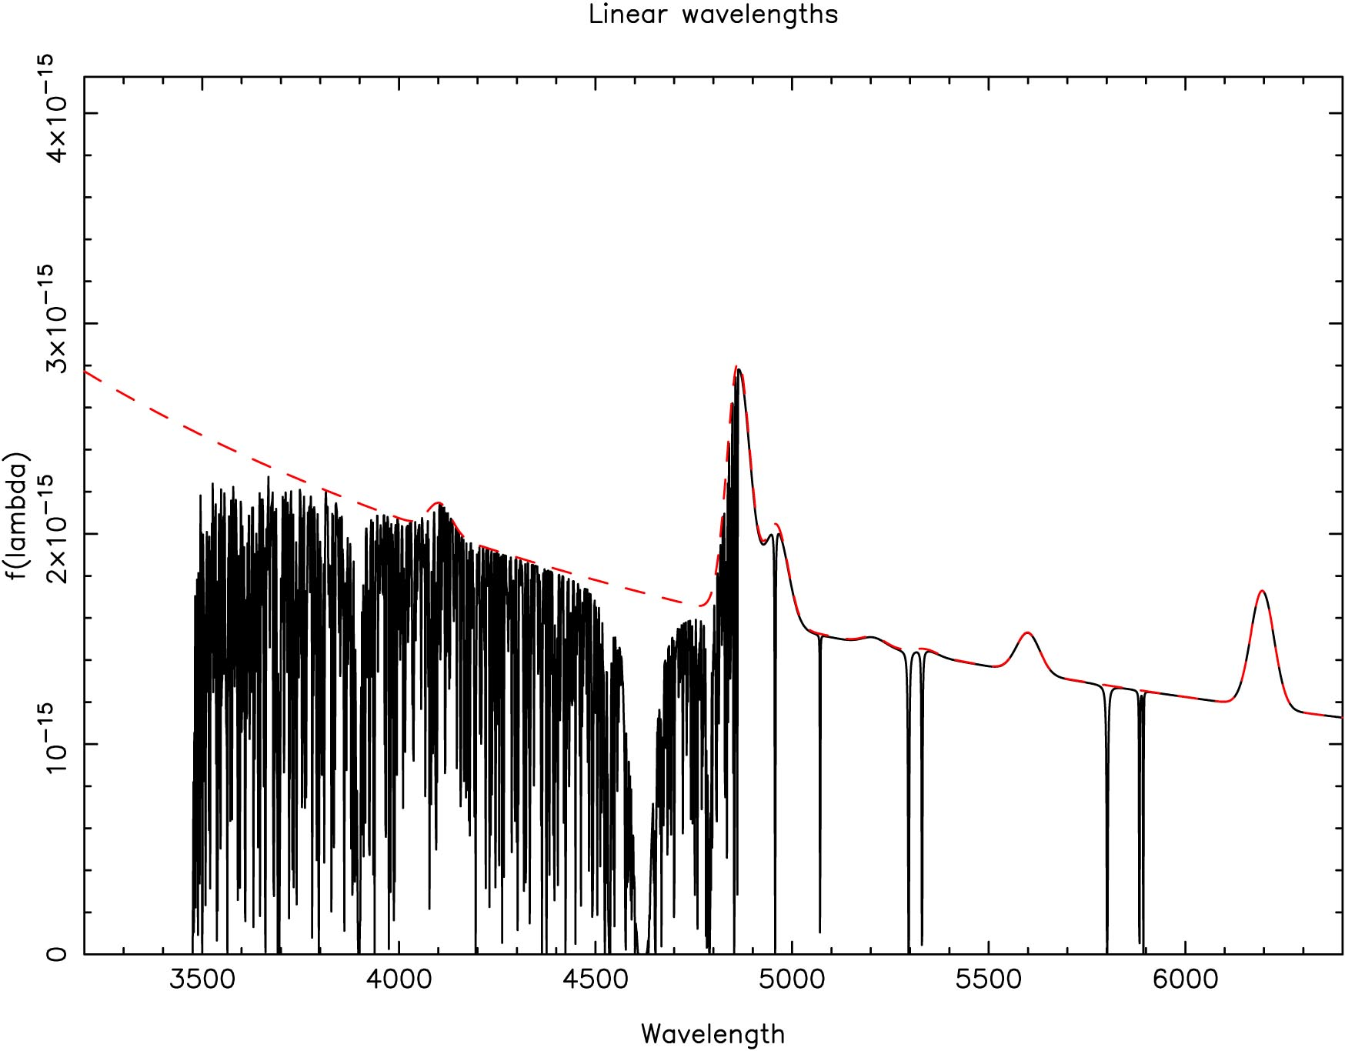
Quasar
To Earth
Hydrogen absorption due to galaxy
Emission lines from the Quasar
Heavy element absorption
DLA
Fundamental constants
Lyman 𝜶 forest
Observed wavelength (Å)
Adapted from a figure provided by John Webb
Dinko Milaković (IFPU) for 17th Marcel Grossmann meeting

Slide 7
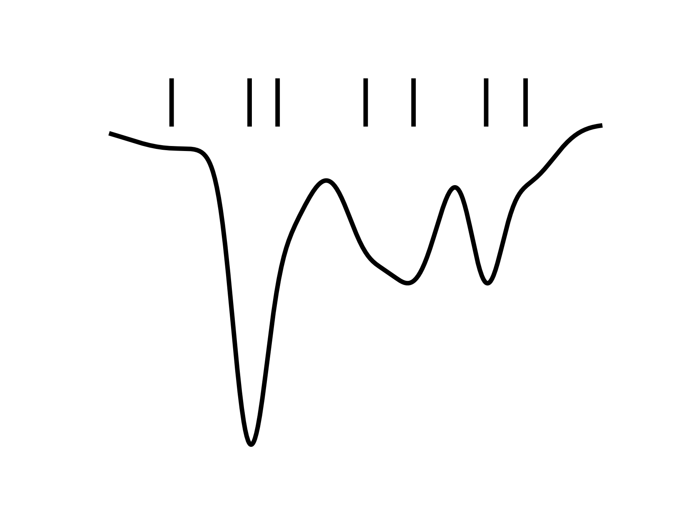
Complications
Blends of many clouds
Dinko Milaković (IFPU) for 17th Marcel Grossmann meeting

Slide 8
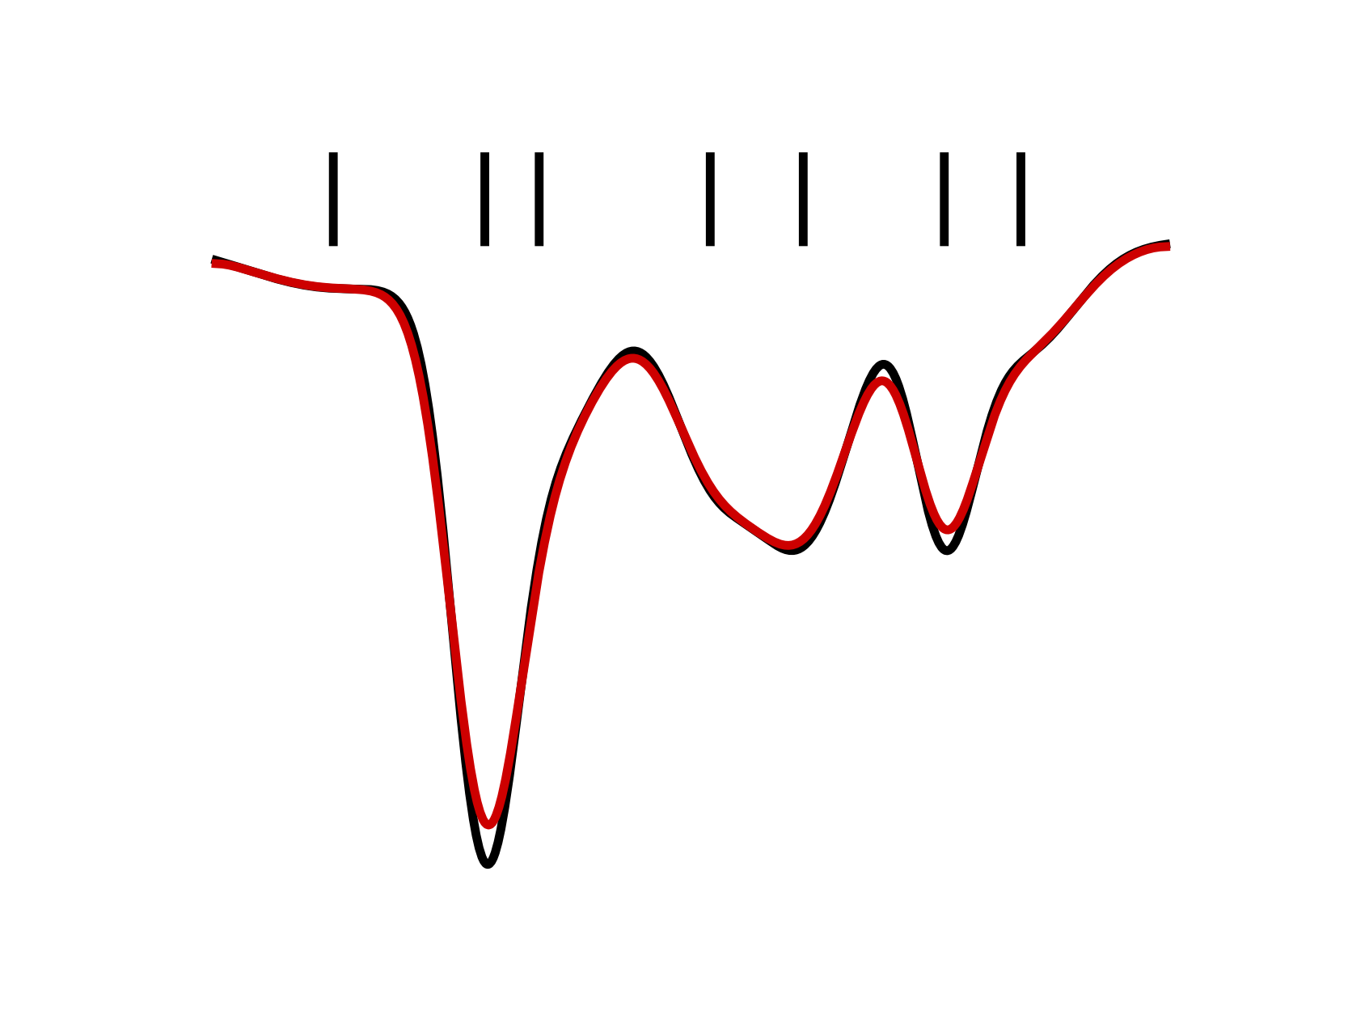
Complications
Blends of many clouds
Instrument smearing
Dinko Milaković (IFPU) for 17th Marcel Grossmann meeting

Slide 9
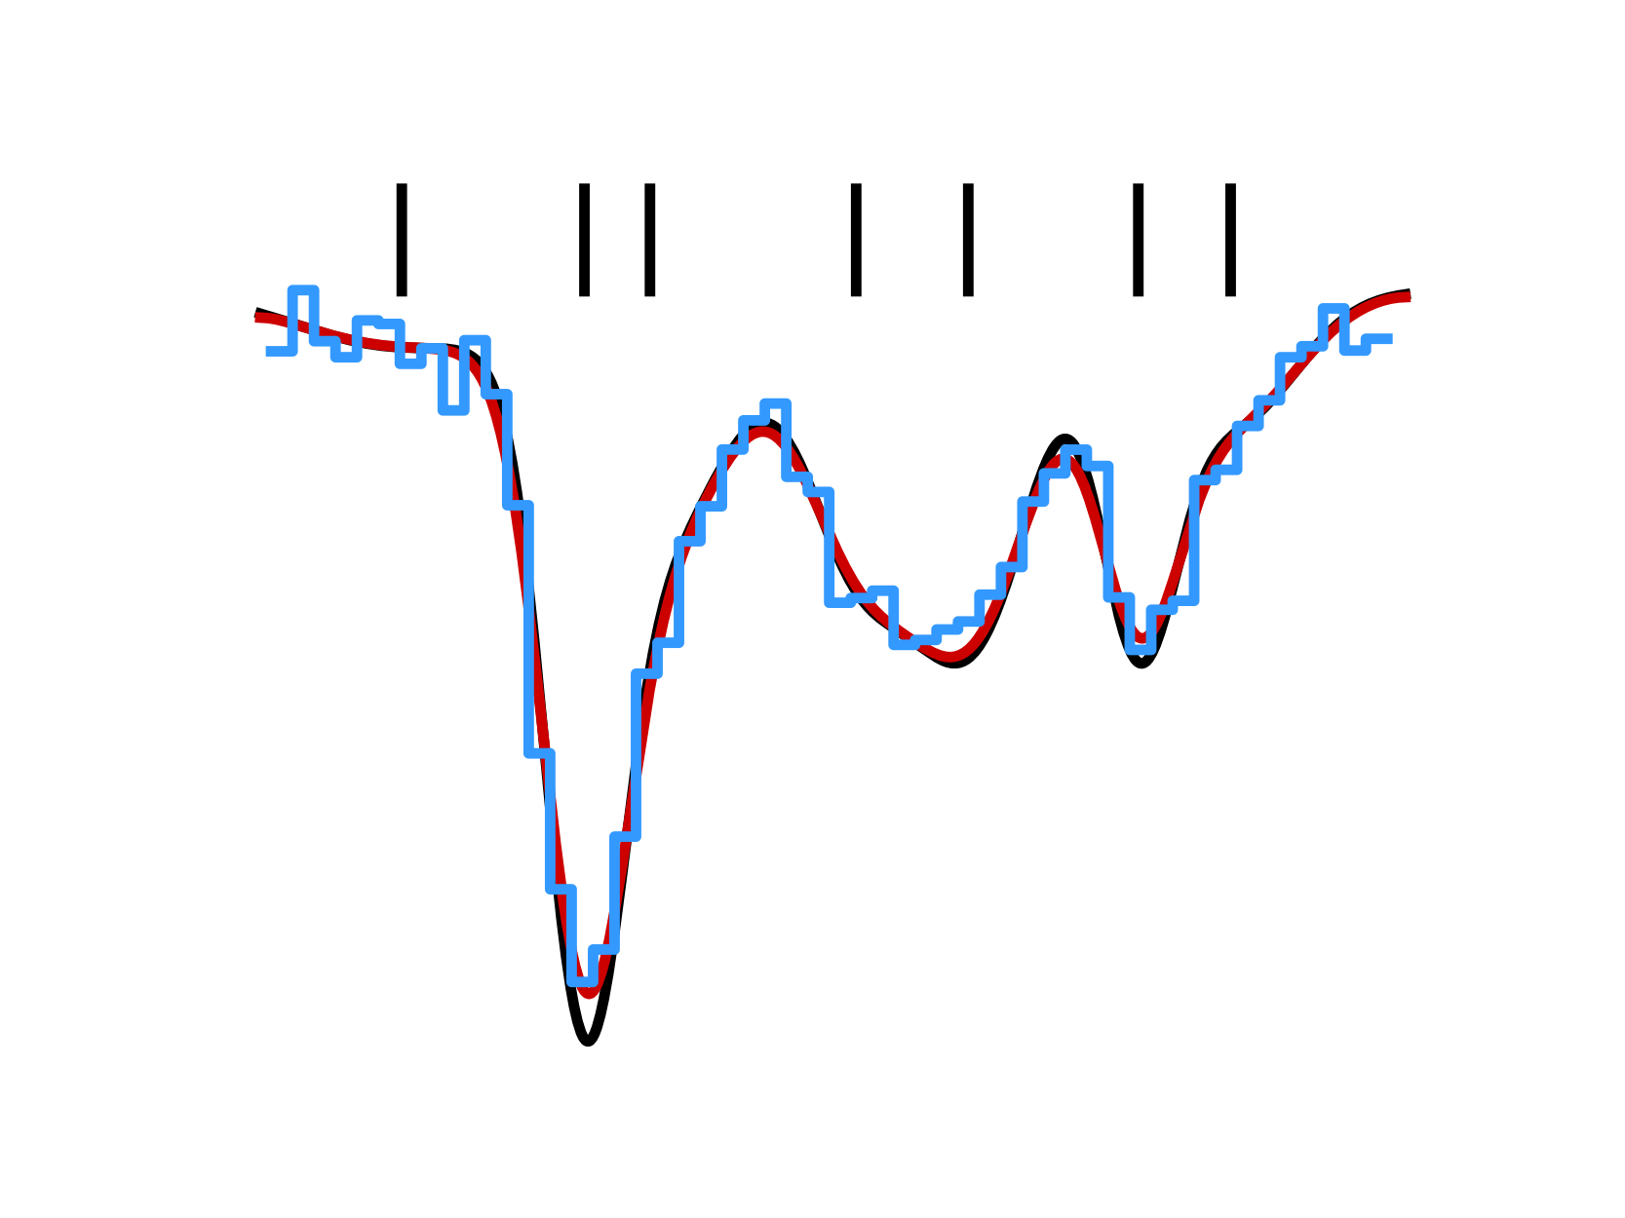
Complications
Blends of many clouds
Digitization & noise
& data processing
Instrument smearing
Dinko Milaković (IFPU) for 17th Marcel Grossmann meeting

Slide 10
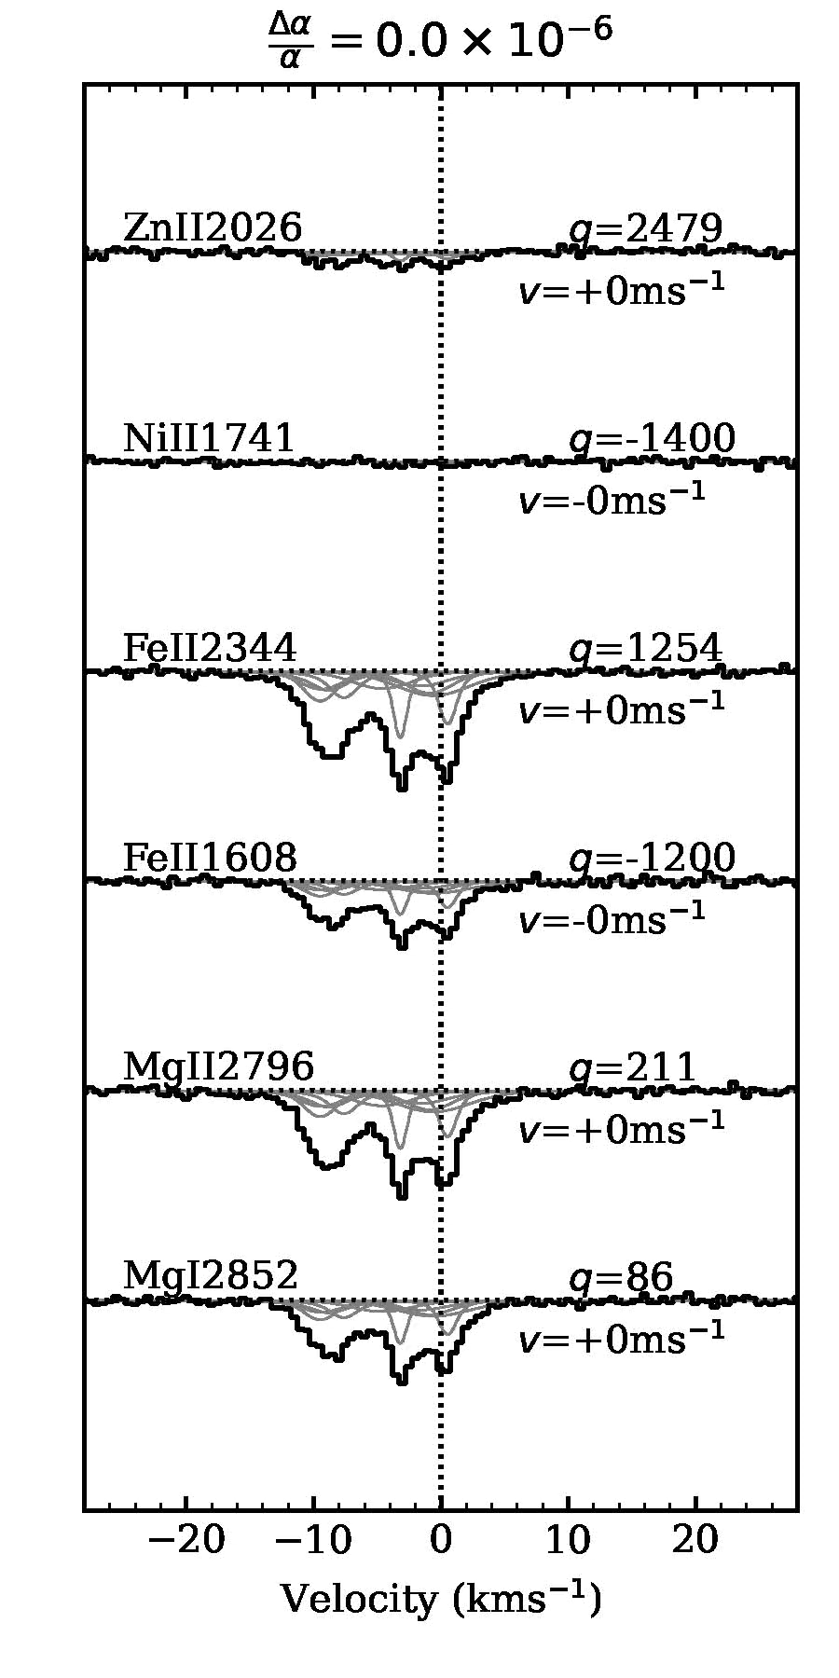
What we have in practice
Dinko Milaković (IFPU) for 17th Marcel Grossmann meeting

Slide 11
Basic algorithm for model construction
Can we accurately reconstruct
the correct distribution of gas clouds?
How many components?
Where?
Are there contaminants?
Make a model
(n free params)
Non-linear least-squares
minimization to obtain
best-fit model parameters
No
Is the model satisfactory?
Yes
Measurement!
Dinko Milaković (IFPU) for 17th Marcel Grossmann meeting

Slide 12
Basic algorithm for model construction
Can we accurately reconstruct
the correct distribution of gas clouds?
How many components?
Where?
Are there contaminants?
Make a model
(n free params)
Decisions!
Non-linear least-squares
minimization to obtain
best-fit model parameters
No
Is the model satisfactory?
Yes
Measurement!
Dinko Milaković (IFPU) for 17th Marcel Grossmann meeting

Slide 13
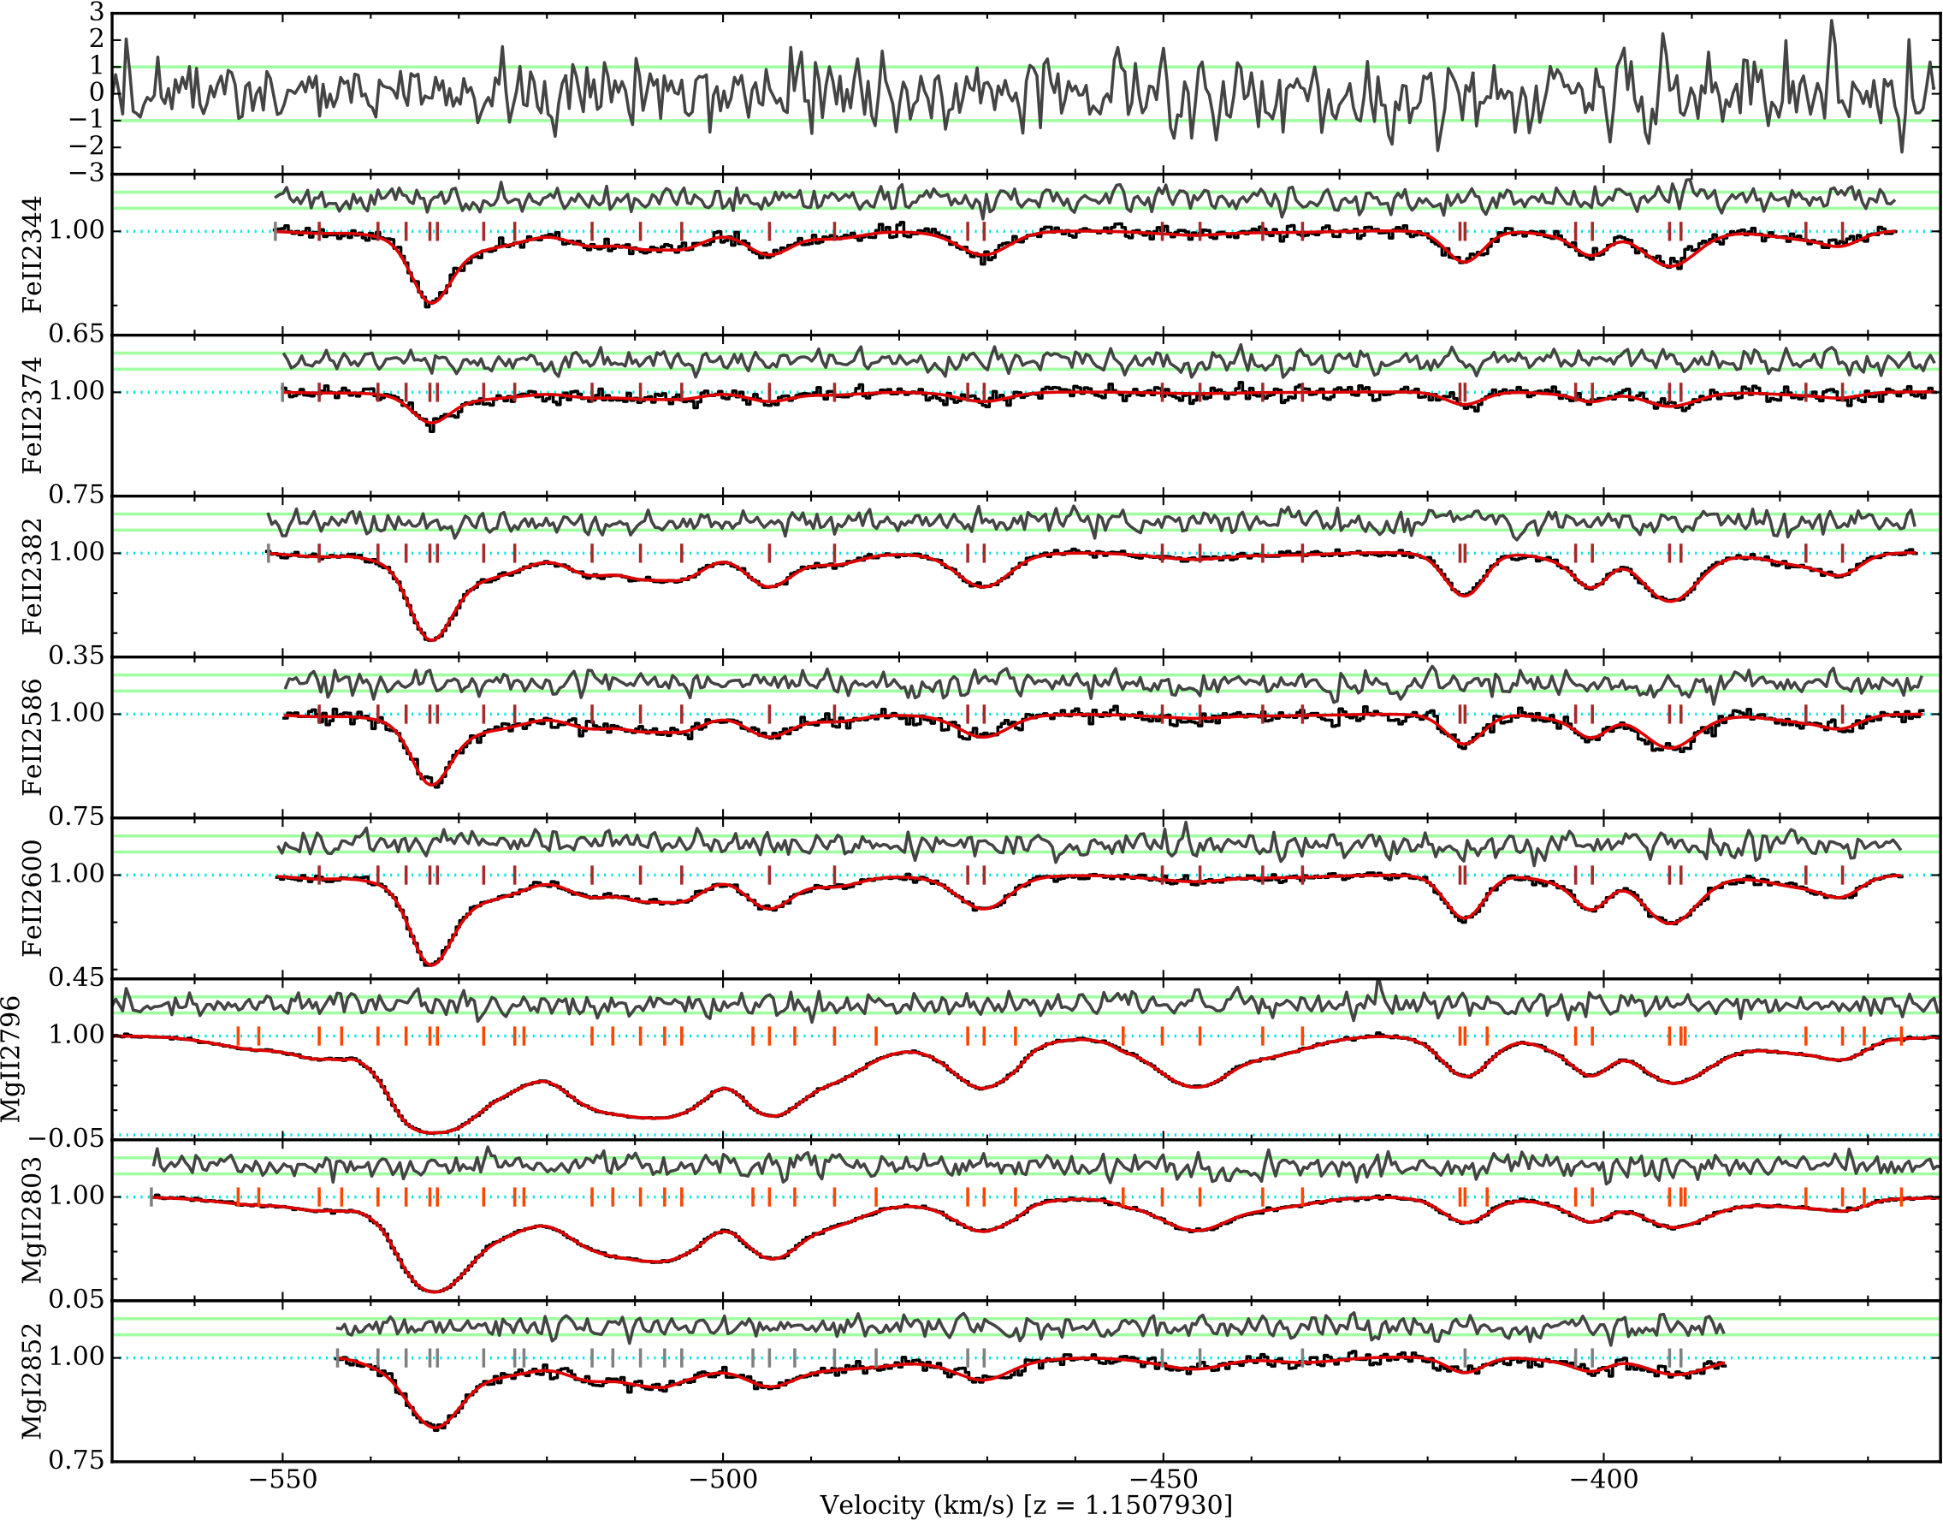
High-quality spectrum of a system at z=1.15
Dinko Milaković (IFPU) for 17th Marcel Grossmann meeting

Slide 14
AI-VPFIT
Bainbridge & Webb 2017; Lee et al. 2021; Webb et al. 2021;
Webb et al. 2022; Lee et al. 2022; Milaković et al. 2023; Webb et al. 2024
For objective and repeatable models
A combination of:
1. non-linear least-squares
2. genetic algorithms
3. information criterion
4. Monte Carlo
Supercomputers + AI-VPFIT offer a factor of 100 speed increase over a human modeller
No human decisions and no human bias!
Decisions!
Dinko Milaković (IFPU) for 17th Marcel Grossmann meeting

Slide 15
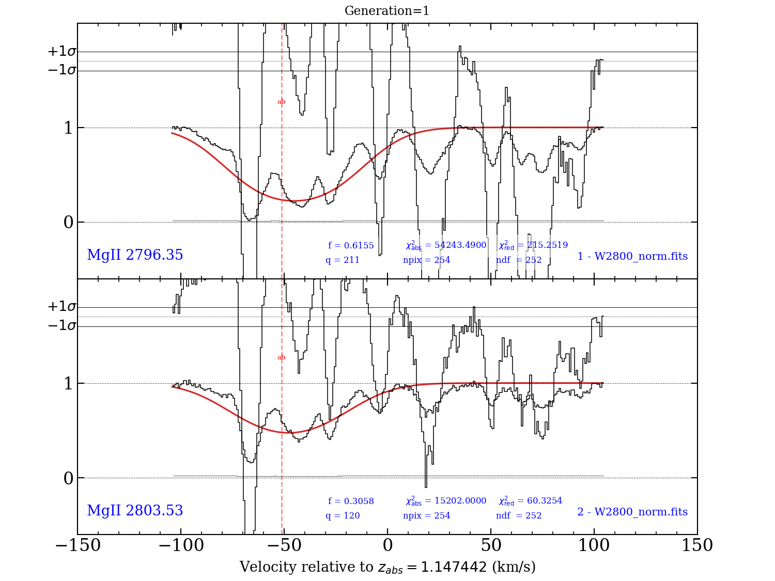
AI-VPFIT in action
Dinko Milaković (IFPU) for 17th Marcel Grossmann meeting

Slide 16
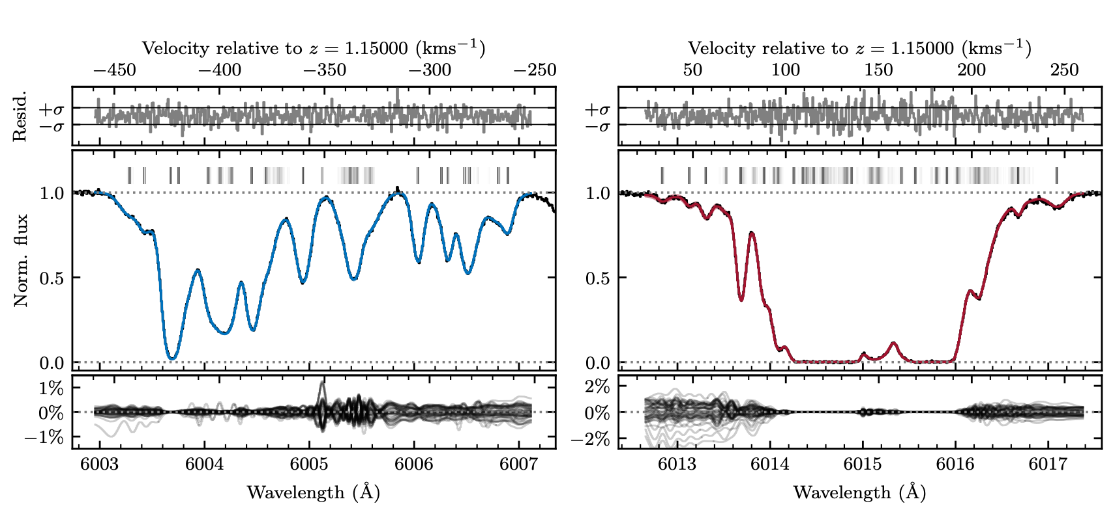
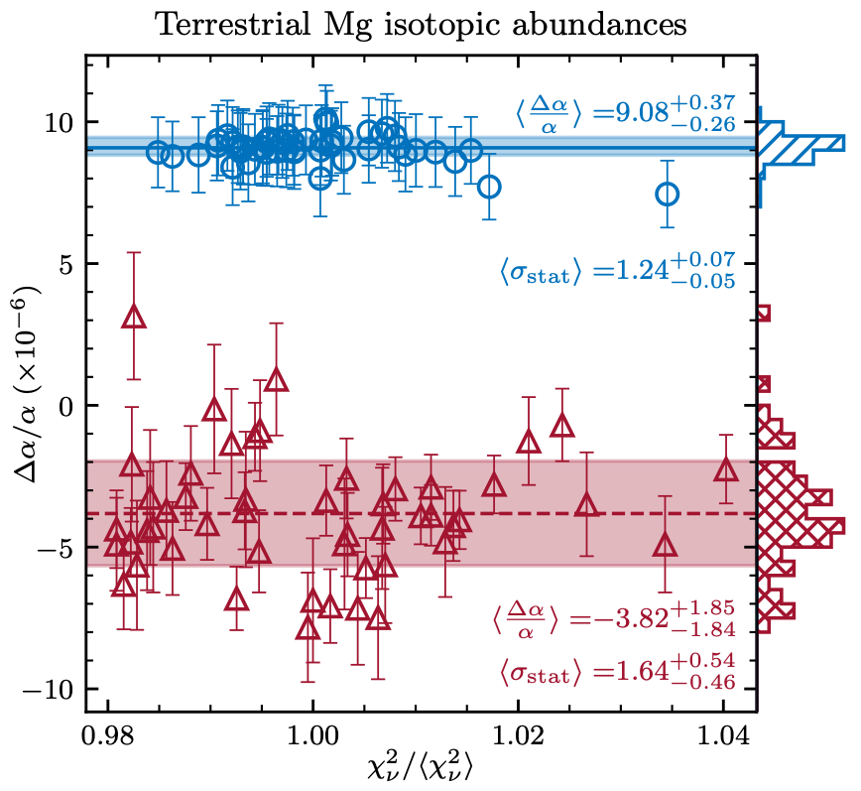
50 AI-VPFIT models
(in each panel)
7σ departure from zero
50 measurements
(per each colour)
Human modeller
Dinko Milaković (IFPU) for 17th Marcel Grossmann meeting

Slide 17
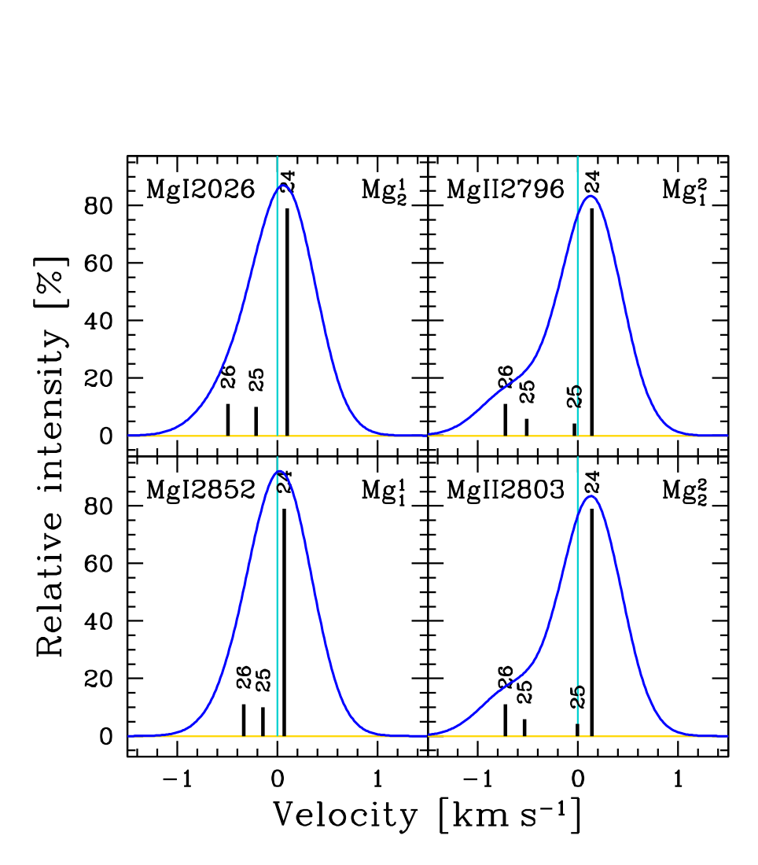




Assumptions on Mg isotopic abundances
Changes in relative abundances will change the measured line centre
Degenerate with shifts caused by potential alpha variations
Hence, a systematic uncertainty
Dinko Milaković (IFPU) for 17th Marcel Grossmann meeting

Slide 18
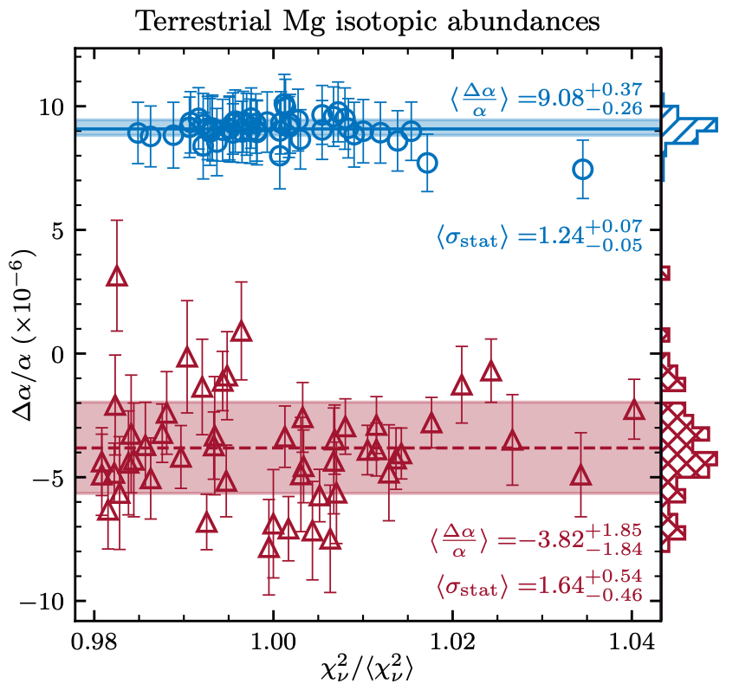
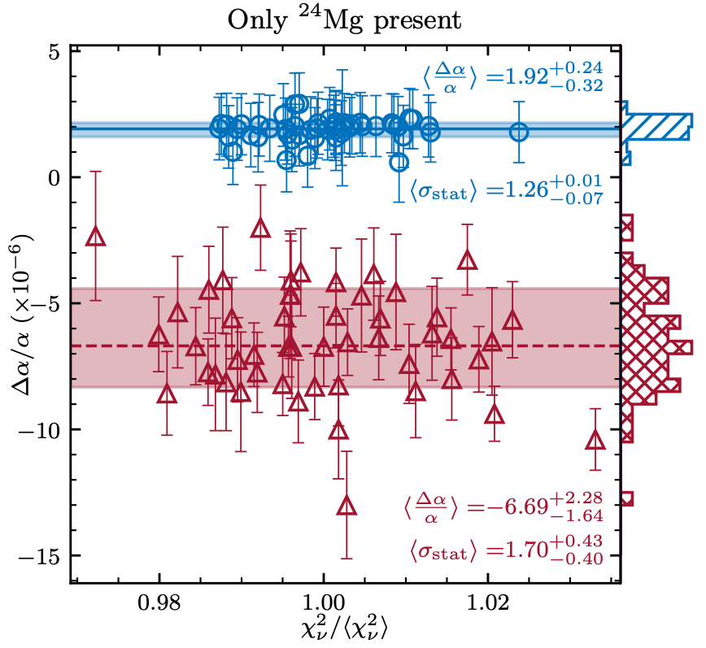
Non-terrestrial Mg isotopic abundances
Common y-axis
The same 50 measurements
(from the previous slide)
Another 50 measurements
(with different assumption on Mg)
0
Dinko Milaković (IFPU) for 17th Marcel Grossmann meeting

Slide 19
Interpretation
  Fundamental constants vary
  OR
  The first ever detection of spatial variations in magnesium isotopic abundances at high-z
    The system may arise from the merger of two proximate galaxies. One may be metal rich (terrestrial Mg) and other metal poor (only ²⁴Mg present).
    The measured [Z/H] of the metal rich one is ~ terrestrial, and Mg isotopes we find (to achieve da/a=0) are consistent with terrestrial.
Dinko Milaković (IFPU) for 17th Marcel Grossmann meeting

Slide 20
Conclusions
Fundamental constant measurements are a major science goal for the Extremely Large Telescope
AI-VPFIT is a major development in the field, and is indispensable for making all new measurements of this sort
Dinko Milaković (IFPU) for 17th Marcel Grossmann meeting

Slide 22
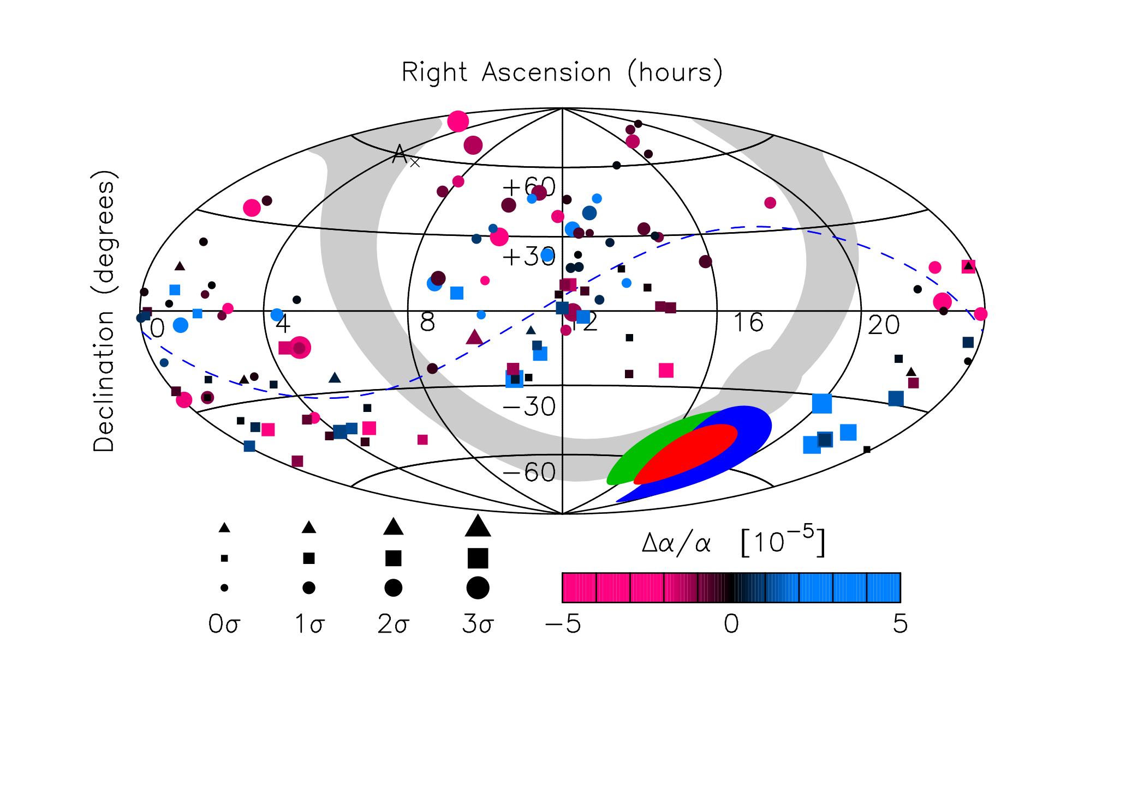


From 154 VLT/UVES + 141 Keck/HIRES archival observations
King et al. 2012 MNRAS 422 3370
Webb et al. 1999, Webb et al. 2001, Murphy et al. 2001, Murphy et al. 2003, Webb et al. 2003, Murphy et al. 2008, Webb et al. 2011, King et al. 2012, Wilczynska et al. 2019
Combined
Keck/HIRES
Keck+VLT
VLT/UVES
VLT
Keck
The best fit model is a spatial dipole with an amplitude
Notes:
Numbers: King et al. 2012, table 2, samples 7 & 8
sample 7: m &= -0.178 \pm 0.084 \times 10^{-5}\\ A &= 0.97^{+0.22}_{-0.20} \times 10^{-5}
sample 8: A = 1.02^{+0.22}_{-0.19} \times 10^{-5}

Slide 23
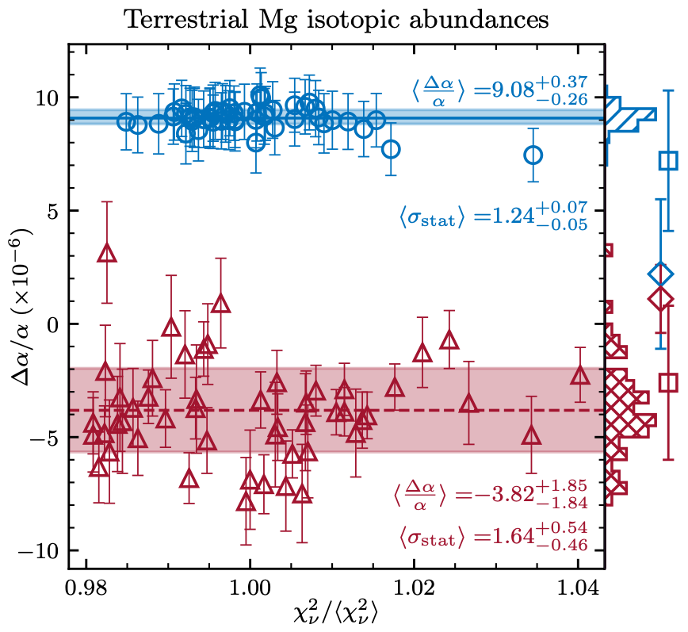
Non-terrestrial Mg isotopic abundances
AI-VPFIT,
other data
same system
Human,
same data
same system
AI-VPFIT,
other data
same system
Dinko Milaković (IFPU) for 17th Marcel Grossmann meeting

