Slide 1
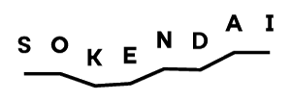
GRB Optical and X-ray Plateau Properties Classifier Using Unsupervised Machine Learning
Shubham Bhardwaj
Graduate University for Advanced Studies, SOKENDAI, Japan
National Astronomical Observatory of Japan
This work has been published in MNRAS, 2023, 525, 4, 5204–5223
MNRAS, Volume 525, Issue 4, November 2023, Pages 5204–5223, https://doi.org/10.1093/mnras/stad2593
https://doi.org/10.1093/mnras/stad2593
Shubham Bhardwaj, Maria Giovanna Dainotti, T.S. Sachin Venkatesh, Aditya Narendra, Anish Kalsi, Enrico Rinaldi, and Agnieszka Pollo
2024/07/08 MG17
1

Slide 2
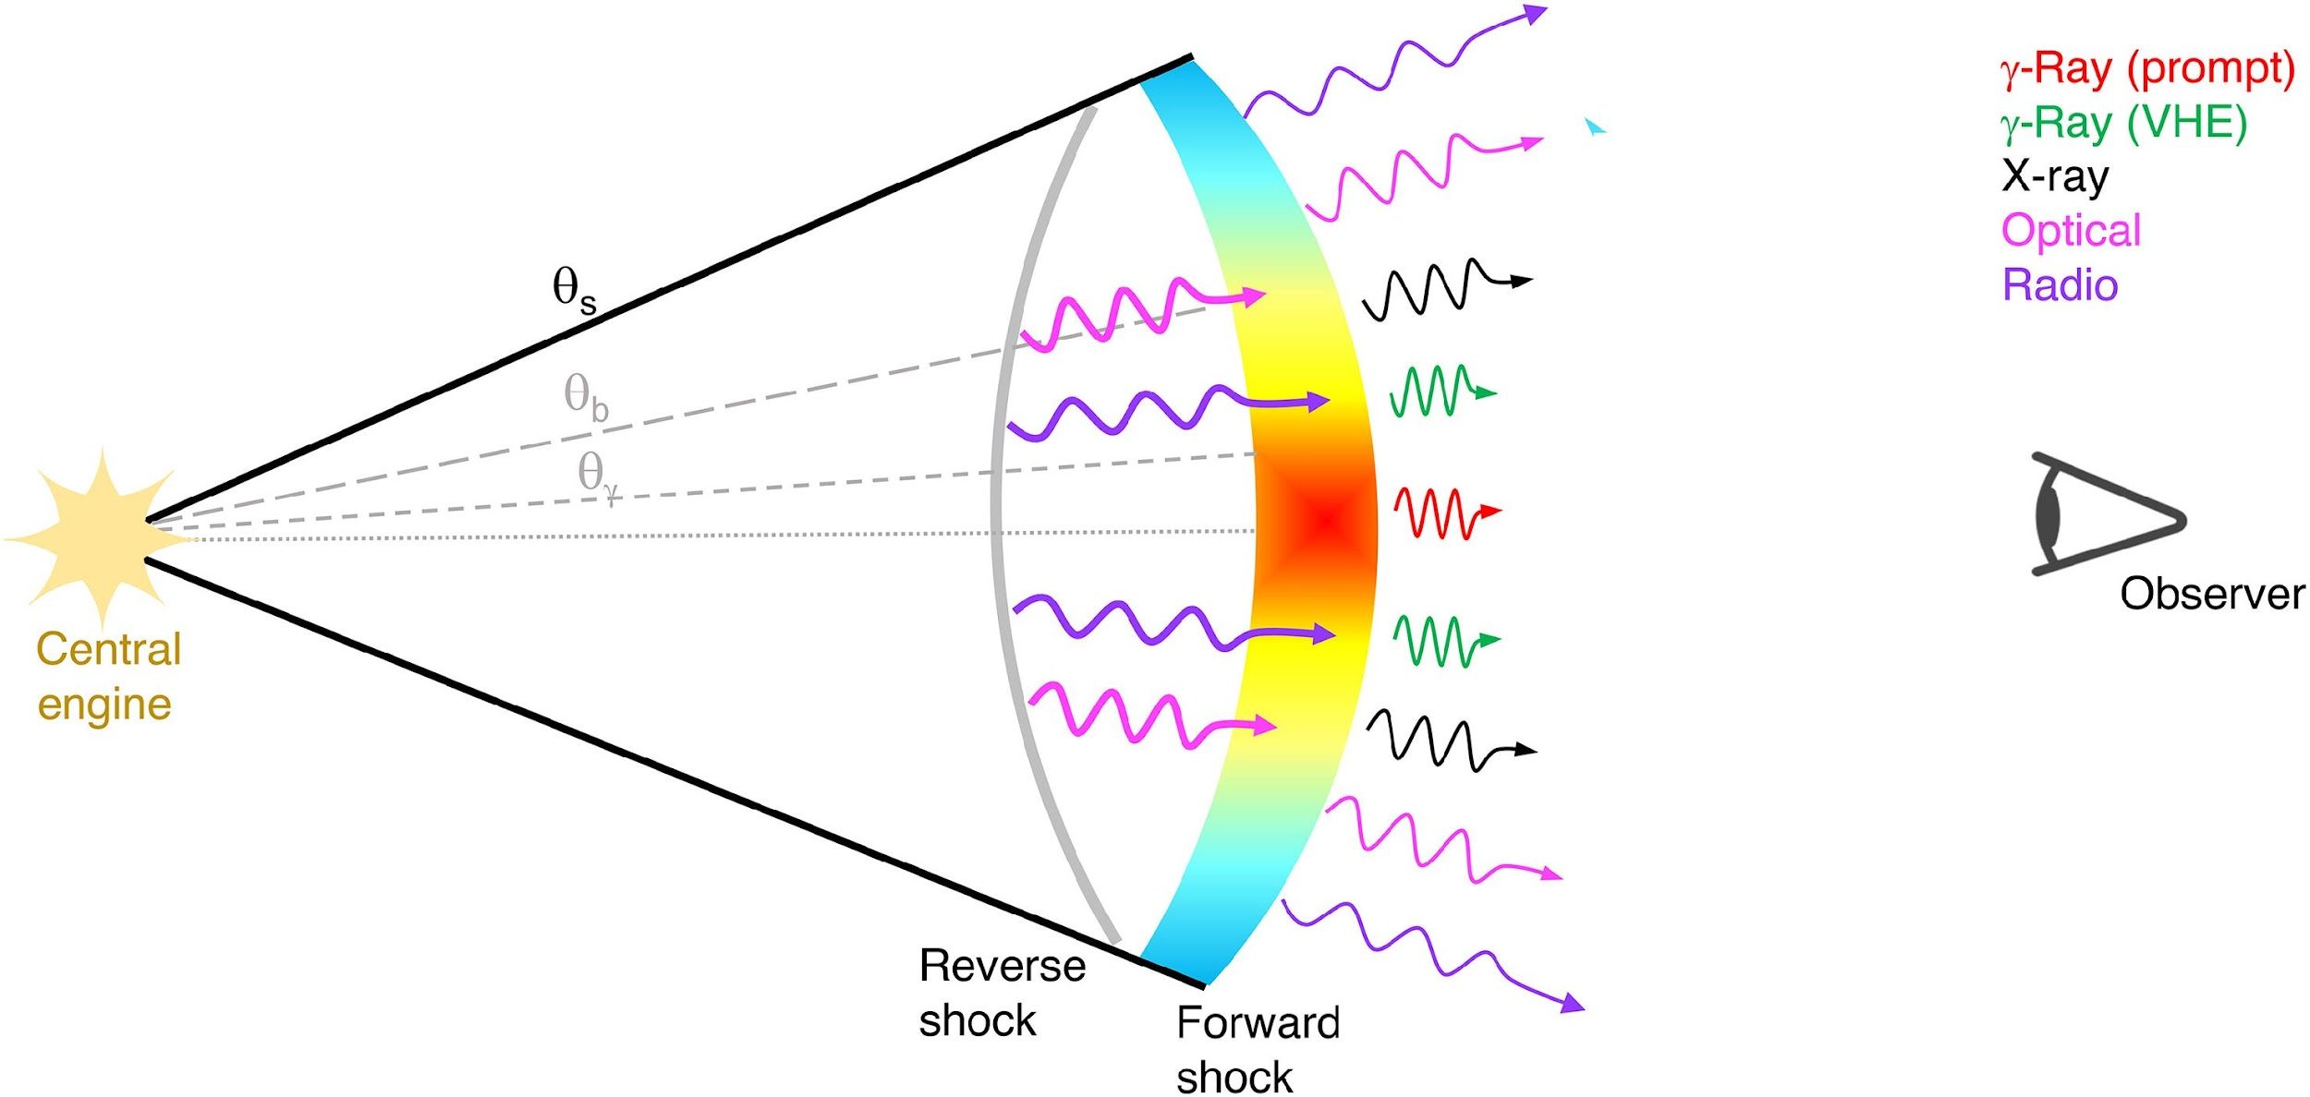
What are gamma-ray bursts (GRBs) ?
Most violent and powerful explosions in the universe.
Highly luminous and observed up to a redshift, z = 9.4.
Emit in a wide range of electromagnetic wavelengths (from gamma-rays to radio).
Credit: O’Connor et al. 2023
2024/07/08 MG17
1

Slide 3
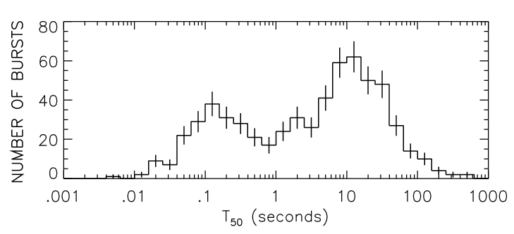
Classification of GRBs
Compact object mergers (NS-NS, NS-BH)
Short vs Long GRBs
Core collapse of massive stars (M > 30 M_{sun})
Long (soft)
Short (hard)
Short GRBs (SGRBs) → T₉₀ < 2s Long GRBs (LGRBs) → T₉₀ > 2s
T₉₀ is the prompt emission duration, namely the time in which 90% of the counts are detected from 5% to 95% of the total emission.
2024/07/08 MG17
1

Slide 4
More Classes!!
2024/07/08 MG17
1

Slide 5
Class | Duration of prompt emission | X-ray fluence/ᵞ-ray fluence
LGRB | > 2s | < 1
SGRB | < 2s | < 1
UL | > 1000s | < 1
VL | > 500s | < 1
GRB-SNe | > 2s | < 1
GRB-KNe | < 2s | < 1
IS | < 2s in rest frame | < 1
SEE | < 10s | < 1
XRF | > 2s | > 1
XRR | > 2s | > 1
Piro et al. 2014
Levan et al. 2014
Different environment of the same progenitor or different progenitors ?
Woosley & Bloom 2006
Gompertz et al. 2018
Rossi et al. 2002
Norris & Bonnell 2006
Soderberg et al. 2004
Soderberg et al. 2004
2024/07/08 MG17
1

Slide 6
This work
Train ML models on unlabeled data and find underlying trends and patterns, such as clustering.
Motivation
Existence of more GRB sub-classes, observationally.
Results so far are either conflicting or not statistically significant.
Aim
Plateau features (for the first time) + prompt features, in both X-ray and optical band.
Applying unsupervised machine learning (ML), clustering algorithm Gaussian Mixture Model (GMM).
To lead to a more profound understanding of the physical meaning of these sub-classes or to confirm previous findings (e.g., a different environment of the same progenitor or different progenitors).
2024/07/08 MG17
<number>

Slide 7
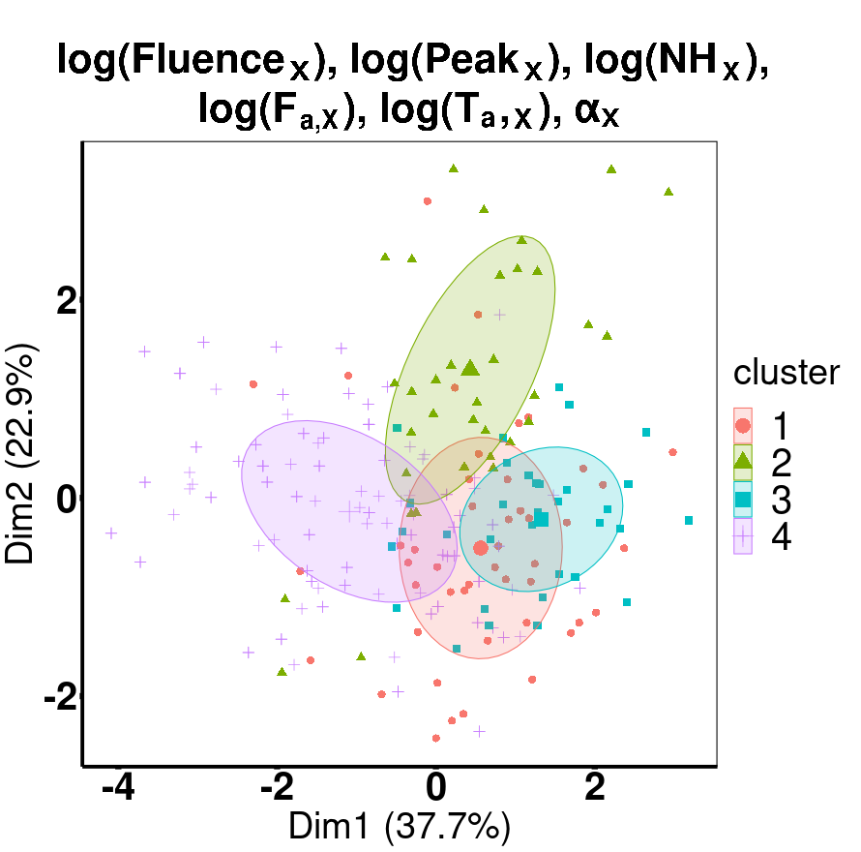
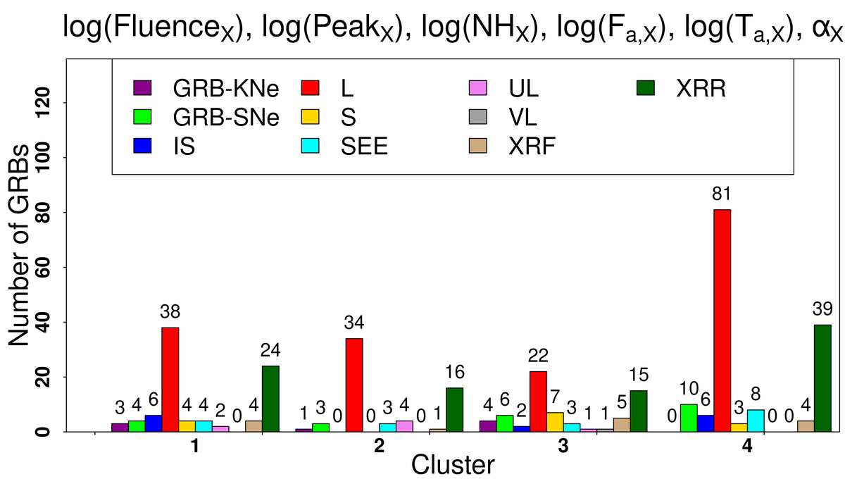
Results: X-ray Data
Fig. 1: Clustering result obtained for the X-ray sample using GMM. The left figure shows the scatter plot of the clusters obtained for “log(Fluence_{X}), log(Peak_{X}), log(NH_{X}), log(F_{a,X}), log(T_{a,X}), α_{X}”. The right figure shows the distribution of the GRBs within each cluster based on its ten major classes. ‘Dim1’ and ‘Dim2’ are the first two principal components used to describe the multi-parameter clustering graphically.
2024/07/08 MG17
<number>

Slide 8
Results: X-ray Data
Microtrends
Cluster with the highest occurrence of LGRBs exhibits the most XRR, XRF, and GRB-SNe.
Most ULs tend to be predominantly found within a distinct cluster that does not exhibit the highest occurrence of LGRBs.
In agreement with our expectation SGRBs are found in a cluster with the lowest number of LGRBs.
Contrary to our expectation, most IS and SEE samples are also primarily found in the cluster with the highest concentration of LGRBs.
SEE are claimed to be similar to the SGRBs (Barkov & Pozanenko 2011).
2024/07/08 MG17
<number>

Slide 9
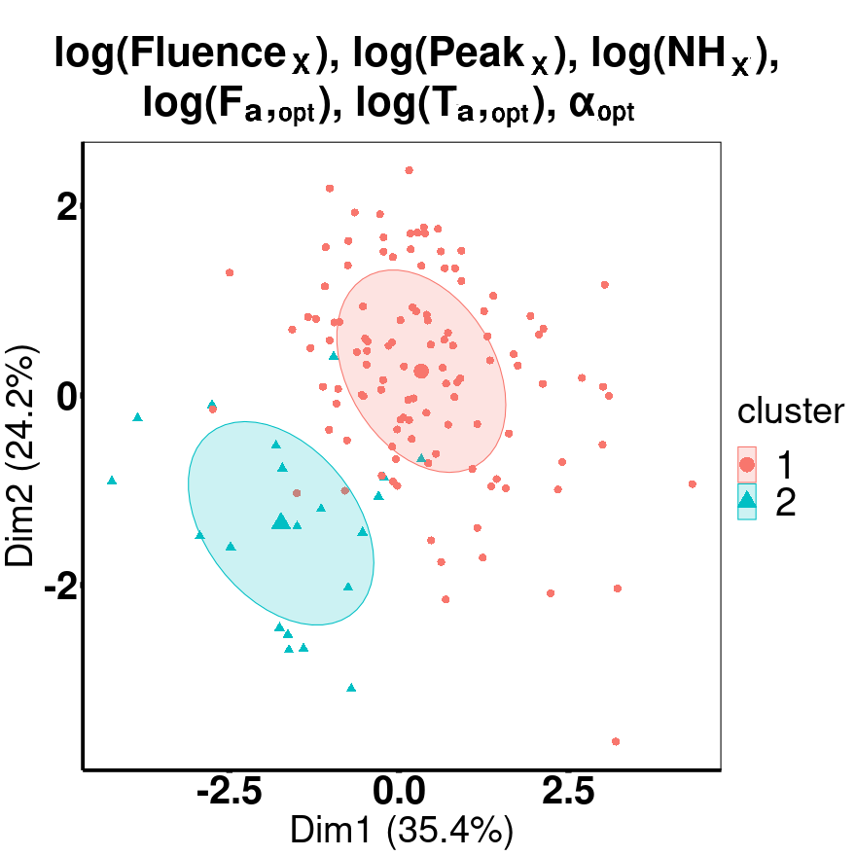
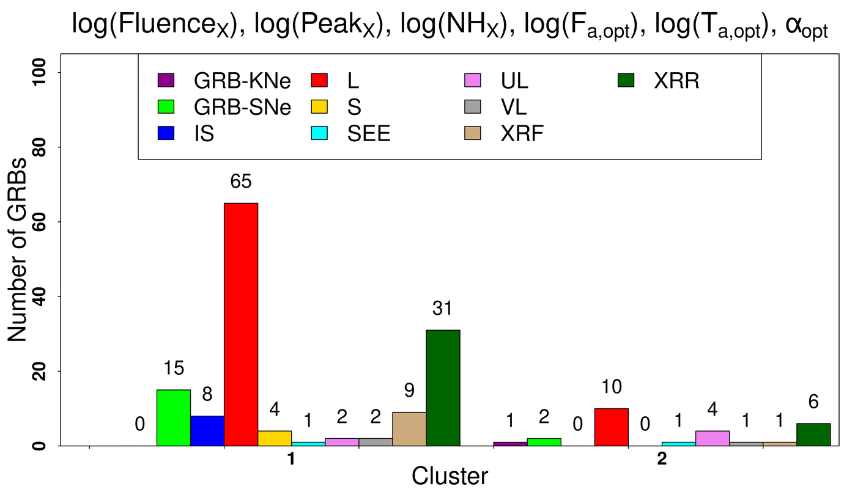
Results: Optical Data
Fig. 2: Clustering result obtained for the optical sample using GMM. The left figure shows the scatter plot of the clusters obtained for “log(Fluence_{X}), log(Peak_{X}), log(NH_{X}), log(F_{a,opt}), log(T_{a,opt}), α_{opt}”. The right figure shows the distribution of the GRBs within each cluster based on its ten major classes. ‘Dim1’ and ‘Dim2’ are the first two principal components used to describe the multi-parameter clustering graphically.
2024/07/08 MG17
<number>

Slide 10
Results: Optical Data
Microtrends
Majority of XRR, XRF, and GRB-SNe can be found within the cluster with the largest occurrence of the LGRBs.
Most ULs are found in a different cluster with a lower number of LGRBs.
Counter-intuitively, most of the four SGRBs are almost always grouped within the cluster containing most of the LGRBs.
Counter-intuitively, most IS samples they also go along the same cluster with the highest LGRBs, even when NO T_{90,X} in the parameter space.
Majority of VL belong to the cluster with the largest number of LGRBs.
2024/07/08 MG17
<number>

Slide 11
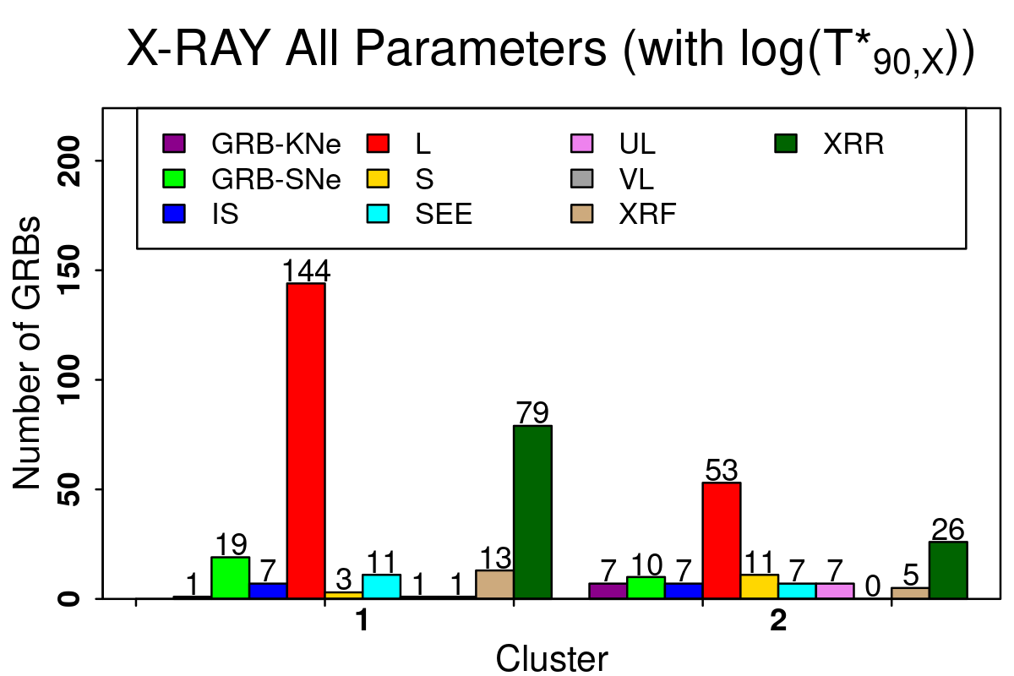
Results: MICE Imputed X-ray Data
We obtained almost similar microtrends as the X-ray microtrends (slide 8).
Multivariate imputation by chained equations (MICE): used to impute missing data.
Most of the XRR, XRF, and GRB-SNe belongs to the cluster with most LGRBs.
In contrast, IS and SEE samples are also grouped within the cluster with most LGRBs.
Most ULs are found in the cluster with the lowest LGRBs.
In agreement with our expectation SGRBs are found in a cluster with the lowest number of LGRBs.
Fig. 3: Histogram distribution of GRB classes with the MICE-imputed X-ray data.
T*_{90,X} is the rest frame T₉₀, calculated as T*_{90,X} = T_{90,X} / (1 + z), where z is the redshift.
2024/07/08 MG17
<number>

Slide 12
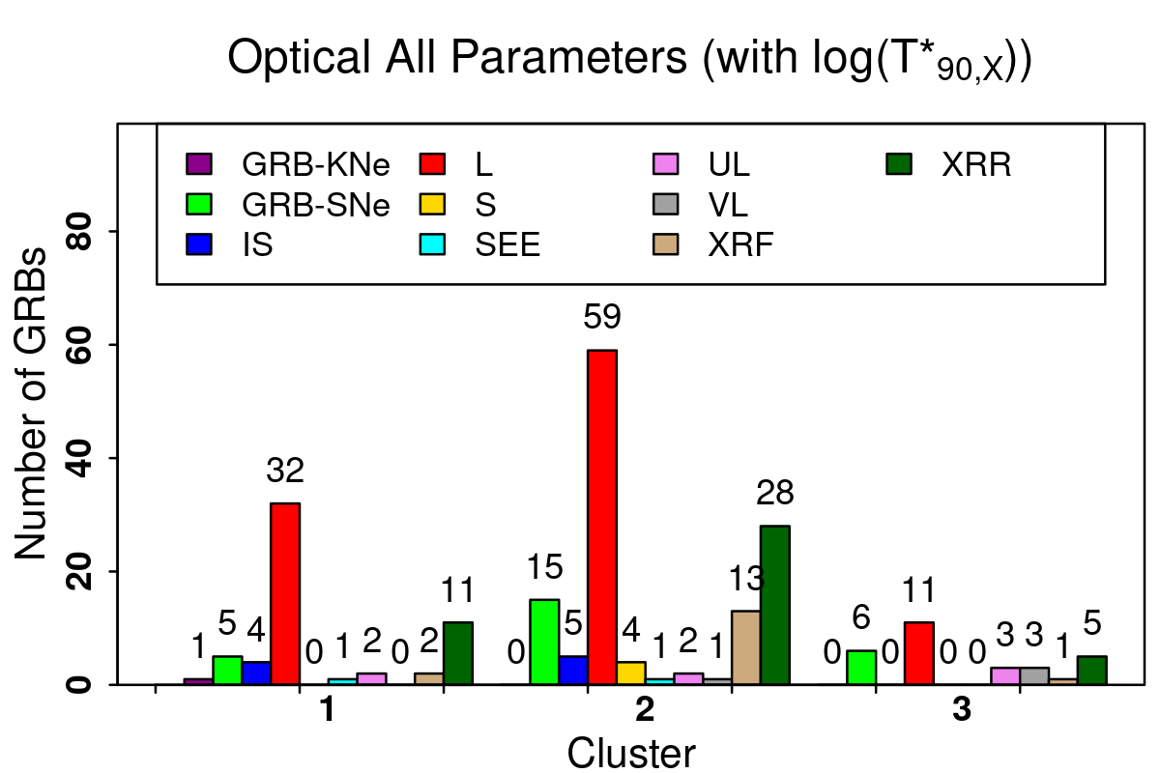
Results: MICE Imputed Optical Data
We obtained almost similar microtrends as the Optical microtrends (slide 10).
Most of the XRR, XRF, and GRB-SNe belongs to the cluster with most LGRBs.
Contrary to our expectations, most IS and four SGRBs are clustered with most LGRBs.
Most ULs are found in a cluster with the lowest LGRBs.
Fig. 4: Histogram distribution of GRB classes with the MICE-imputed optical data.
2024/07/08 MG17
<number>

Slide 13
Conclusion: Part I
Novelty: used plateau features for the first time.
Cross-verified and validated the results obtained from GMM with the observationally assigned GRB classes, hardly explored previously (Tsutsui & Shigeyama 2014; Zhang et al. 2016; Chattopadhyay & Maitra 2017).
Benchmark for future studies in this field and contribute to improving clustering techniques.
XRR, XRF, and GRB-SNe are clustered with LGRBs in optical and X-ray data.
These classes may originate from the same progenitor as LGRBs or the same progenitors as LGRBs but with different environments.
These are sub-classes of LGRBs, as already stated in Soderberg et al. 2004; Arimoto et al. 2007; Chincarini et al. 2010; Yi et al. 2016; Bi et al. 2018; Liu & Mao 2019; Woosley & Bloom 2006; Melandri et al. 2014.
2024/07/08 MG17
<number>

Slide 14
Conclusion: Part II
In both optical and X-ray data, we observe ULs clustered separately from LGRBs.
ULs might be a separate subclass of GRBs with a different progenitor that is highlighted using plateau properties. Gendre et al. (2013b), Levan et al. (2014), Piro et al. (2014), Boër et al. (2015), Perna et al. (2018), and Aloy & Obergaulinger (2021) also claim that ULs might have a different progenitor than conventional LGRBs.
They are thought to originate from the low metallicity blue supergiant or the collapse of stars with much larger radii than those attributed to LGRB progenitors.
This leads to the point that plateau properties can distinguish between LGRBs and ULs.
These microtrends potentially reflect underlying physics that can be explored using plateau properties.
2024/07/08 MG17
<number>

Slide 15
Future Work
Larger dataset with a more balanced distribution of samples in each GRB category is necessary to understand GRB clustering based on plateau properties.
We expect larger and accurate samples of GRBs from future satellite and ground-based surveys.
New data will be available with additional ML analysis to infer the z information (Dainotti et al. 2024) and to determine the plateau emission properties more precisely by implementing precise LC reconstruction methods (Dainotti et al. 2023).
Using a different set of ML techniques with additional parameter combinations might also reveal hidden patterns in GRB classes that GMM is currently unable to discover.
2024/07/08 MG17
<number>

Slide 16
Thank You
ありがとうございました!!
Shubham Bhardwaj
shubham.bhardwaj@grad.nao.ac.jp
2024/07/08 MG17
<number>

