Slide 1
Primordial Black-Hole Dark Matter from Warm Natural Inflation
G. J. Mathews, M. Correa – University of Notre Dame
M. R. Gangopadhyay, SGT U, N. Jaman, IISER
BH4
July 9, 2024
Pescara, Italy

Slide 2
Outline
Why the interest in Primordial Black holes? as Dark Matter?
PBH production
What is Warm Inflation?
Why natural potential (WNI)?
WNI equations
Observational constraints
  CMB
  PBH mass
  GWs

Slide 3
Evidence of Primordial Black Hole Dark Matter?
JWST observations of Galaxies at z~ 10-12
Chandra/JWST observations of SMBH at Z~10
Higher than expected masses of BH mergers observed by LIGO/VIRGO/KAGRA
Ultra-short time microlensing events
Excess of Cosmic Infrared Background coincident with Cosmic X-ray Background
Scaling of velocity dispersion with SMBH masses
NanoGRAV detection of the cosmic GW background

Slide 4
“Warm” inflation
Thermal Bath
V(φ)
φ

Slide 5
What is Natural Inflation?

Slide 6
WNI Dynamics

Slide 7
Primordial Power Spectrum

Slide 8
Primordial Black Hole Formation
Enhanced Perturbation
Power spectrum (φ)
Scale

Slide 9
Primordial Power Spectrum

Slide 10

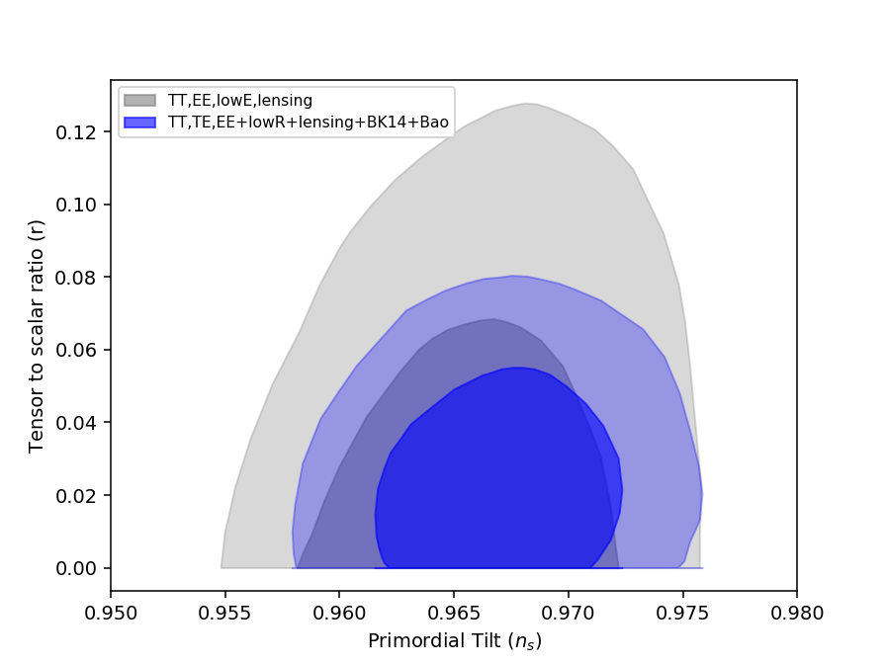
Satisfies Planck CMB constraints

Slide 11
Black Hole Mass
-

Slide 12
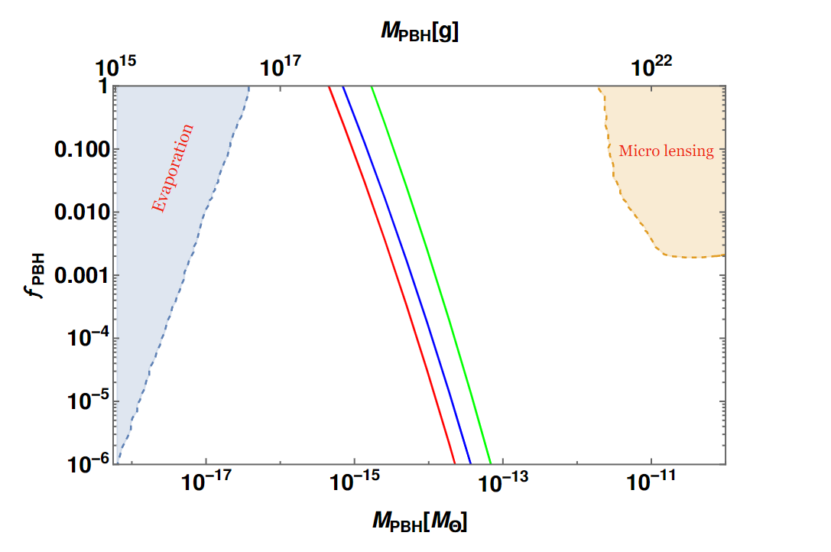
Black Hole Formation

Slide 13
Gravitational-Wave Constraints
BBN

Slide 14
Gravitational Wave Constraints

Slide 15
Chandra/JWST observations of 4x10⁷ M⦿ AGN SMBH at z~10
Natarajan et al. 2023

Slide 16



How is it that low-mass PBH’s can lead to SMBH’s and galaxies in a short time while$Λ$CDM cannot?
In $Λ$CDM stars must form and collapse and accrete to grow. This is a slow process
PBHs can cluster and merge
PBH
$Λ$CDM

Slide 17
Gravitational BH Merger Cross Section
Merger Rate
~ 1 M⦿ yr⁻¹
BH mass distribution shifts to higher mass
time

Slide 18
Gravitational BH Merger Cross Section
Merger Rate
~ 1 M⦿ yr⁻¹
BH mass distribution shifts to higher mass
time

Slide 20
Conclusions
WNI provides some intriguing features
Scale of inflation is below the Planck mass
Satisfies a low value for the tensor/scalar ratio
Can produces primordial black holes in sufficient quantity to provide all of the dark matter
Naturally produces black holes of a mass consistent with constraints
Is consistent with current limits on GW energy density
Spectrum of GWs from PBH’s may be detectable in next generation GW detectors

Slide 22
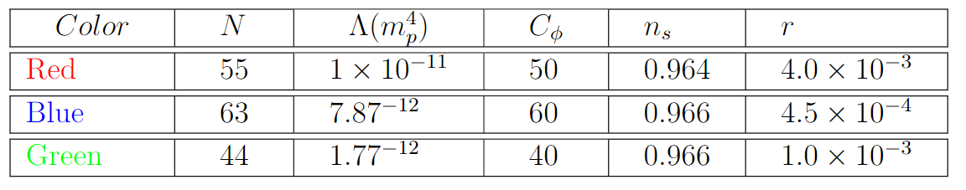
Parameter Table

Slide 23
Modified Slow Roll Condition

Slide 24

Relic PBH Abundance

Slide 25
Motivation:
JWST observes that Early Disk Galaxies Appear t < 400 Myr
z = 10
z = 12

