Slide 1
Relativistic Particles from the Sun
Costantino Sigismondi sigismondi@icra.it
Paolo Ochner, Asiago Astrophysical Observatory
Maria Dal Pian, Liceo Brocchi, Bassano del Grappa

Slide 2
Why this talk here in HR2 Historical Supernovae ?
Sun’s flares are the most energetic events occurring close to the Earth
In term of X-ray flux an X100 flare is 10⁻² W/m² at the Earth’s surface in the 1-8 Å band. The integrated flux is around 6 J/m²

Slide 3
A GRB in the CRAB at 2 Kpc how was energetic?
Using the GRB190114C as reference
10^{51~52} erg/s at t=0
10^{6~7} times a very strong solar flare, probably 10 ⁴ times a Myake event (a superflare from the Sun each 10 ⁴ yr)
Flux at 6.2∙10¹⁹ m: 2.6 ∙10^{11~12} erg/s/m²= 2.6 ∙10^{4~5} W/m²
Integrated flux of the power law dlogΦ/dlogt ~ -13/8 for 30 minutes:
8/13 Φ₀ or 10⁵⁰ erg that at the Earth were 2.6 ∙10^{2~3} J/m²
Form 50 to 500 times an X100 flare event
It has been studied that the safety zone is outside 15 Kpc from a GRB

Slide 4
Energy deposition’s quote [Km]
Sun, Weather, and Climate
J. R. Herman and R. A. Goldberg
NASA SP-426 (1978) repr. Dover Edition (1985)

Slide 5
Relativistic protons from this cycle (8 June ‘24)

Slide 6
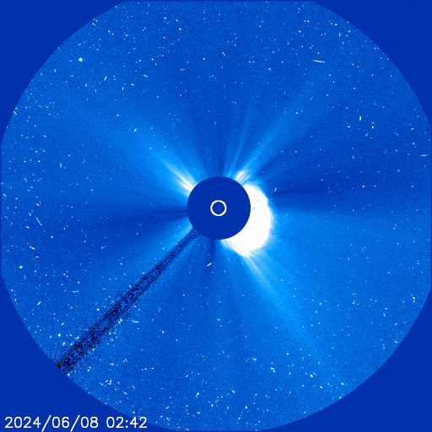
X-rays 8.5 minutes from Sun to Earth Protons 8.5+22 minutes
For an M9.75 flare,
say a flux of 10⁻⁴ W/m²
between 1-8 Å
Max Velocity: ~ 8/30 c
Energy ~100 MeV up to 500 MeV
The «snow» in the C3 video

Slide 7
Energy balances
Magnetic reconnection is the source energy of solar flares: energy available B²∙V with B=6000 Gauss and Volumes of ~ 10⁸ m of length strong X solar flares reach ~ 10²⁶ erg
Gravitational collapse is the source energy of a GRB (including the rotational energy after collapse) ~ 10⁵² erg
To the Earth the largest sources of energy have been solar superflares and occasionally Supernovae. A signal of SN 1054 is present in record of Antarctica ice-cores.
The signal of a GRB strong event of 30 minutes is «whashed» averaged over 20 year… so it cannot be as strong at it was…

Slide 8
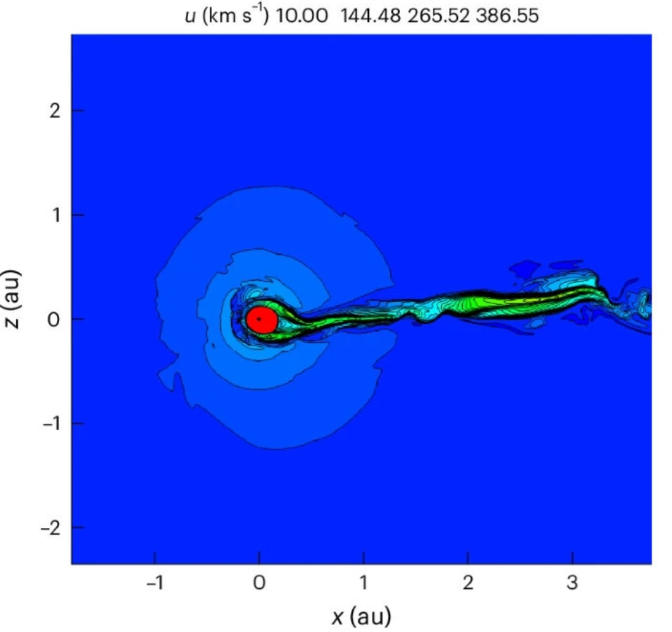
Heliosphere and cosmic rays -the case of cold H cloud-

Slide 9
Solar minima & ¹⁰Be peaks Dome Fuji, Anctartica The signal of SN 1054 cohincides with the end of Oort Minumum, but there is a peak instead of a lowering
Conclusions

