Slide 1
SN 1054 was a GRB?
Remo Ruffini
Costantino Sigismondi sigismondi@icra.it

Slide 2
The paper is fun, interesting, intriguing…

Slide 3
Prof. Ruffini at work on this paper, June 15 ‘24

Slide 4
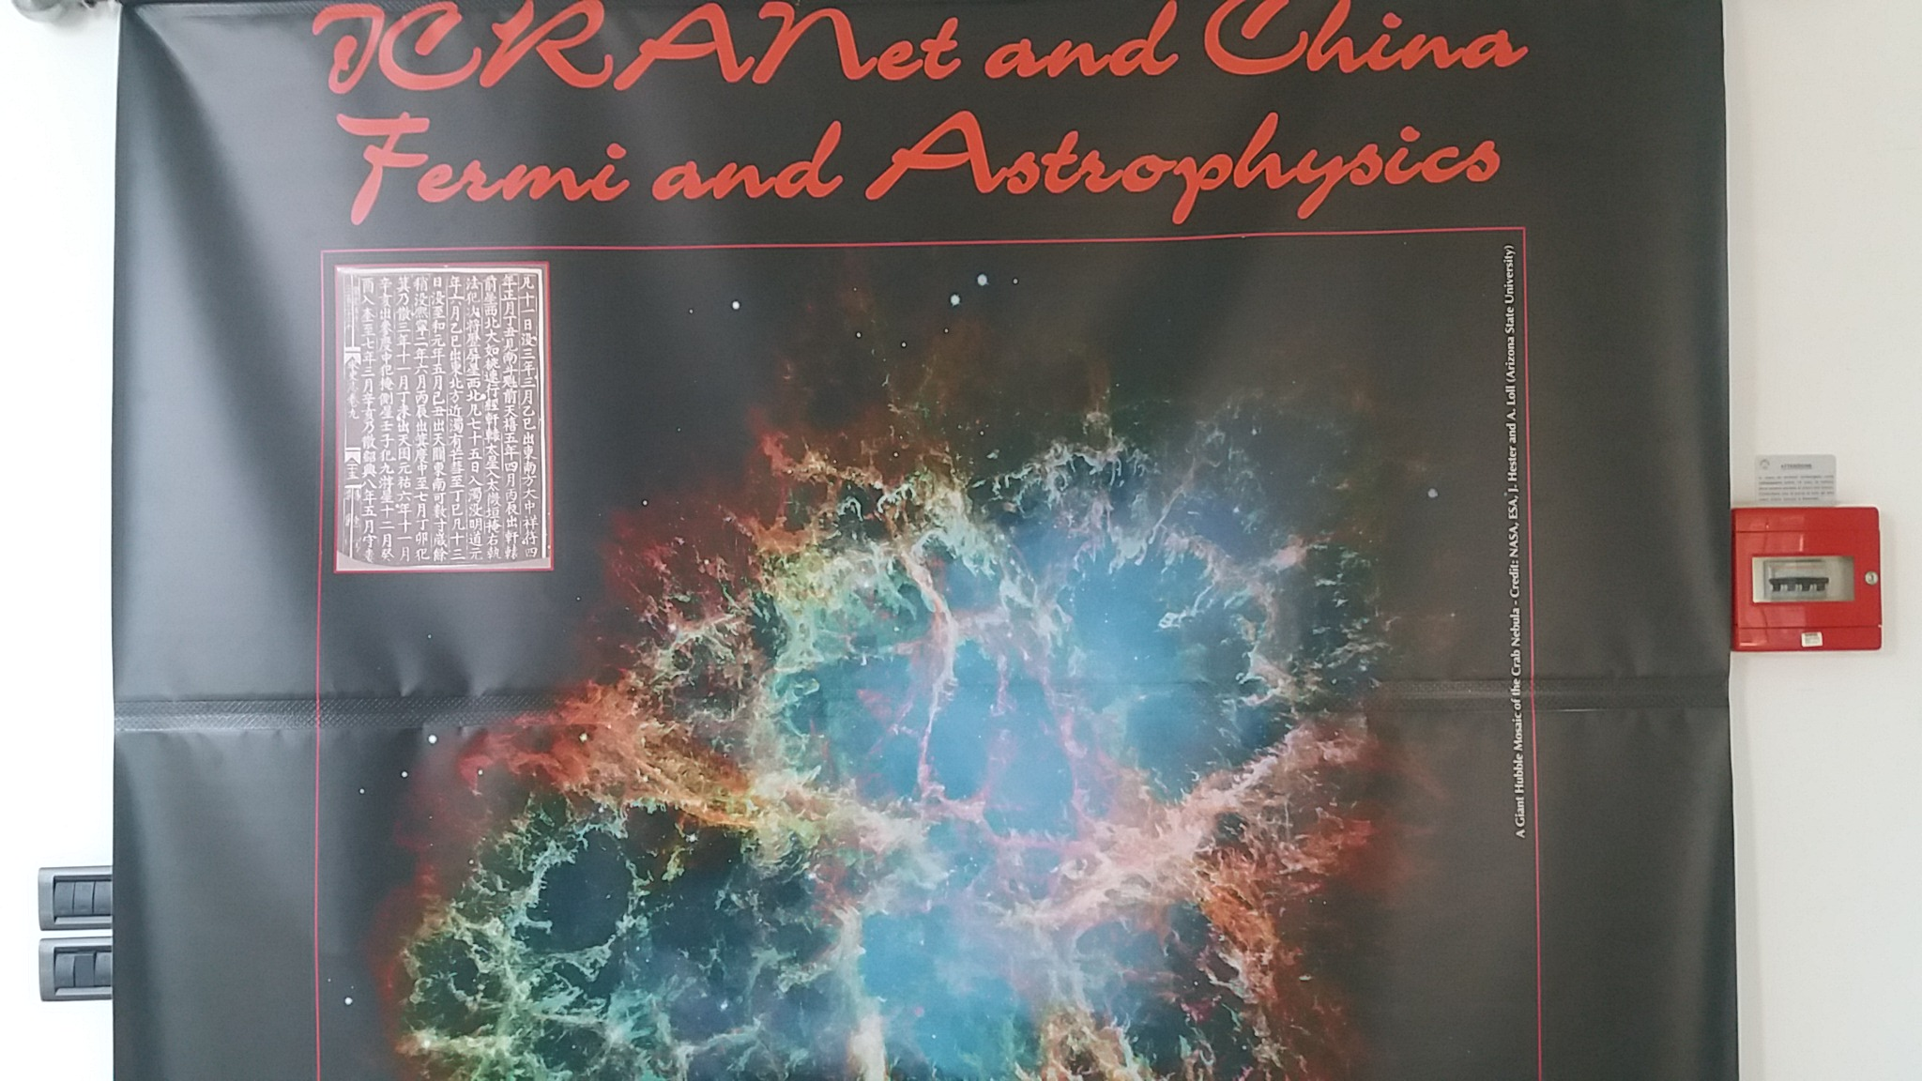
Historical background

Slide 5
Europe (chronicles) vs China (professional)
Total solar eclipses: accurate in date and occurrence
e.g. Annales Admuntenses Admont Annals (Austria, 2 aug 1133, 4.7 minutes of totality)
Hoc anno 4.Non.Augustii circa meridiem facta est eclypsis id est defectus solis tantus, ut apparentibus stellis tenebrae factae sunt per universam terram una hora.
In this year [1133] on August 2 about midday there was an eclipse, that is, a defect of the Sun so great that stars appeared in the darkness throughout the whole Earth for one hour. MGH SS,IX

Slide 6
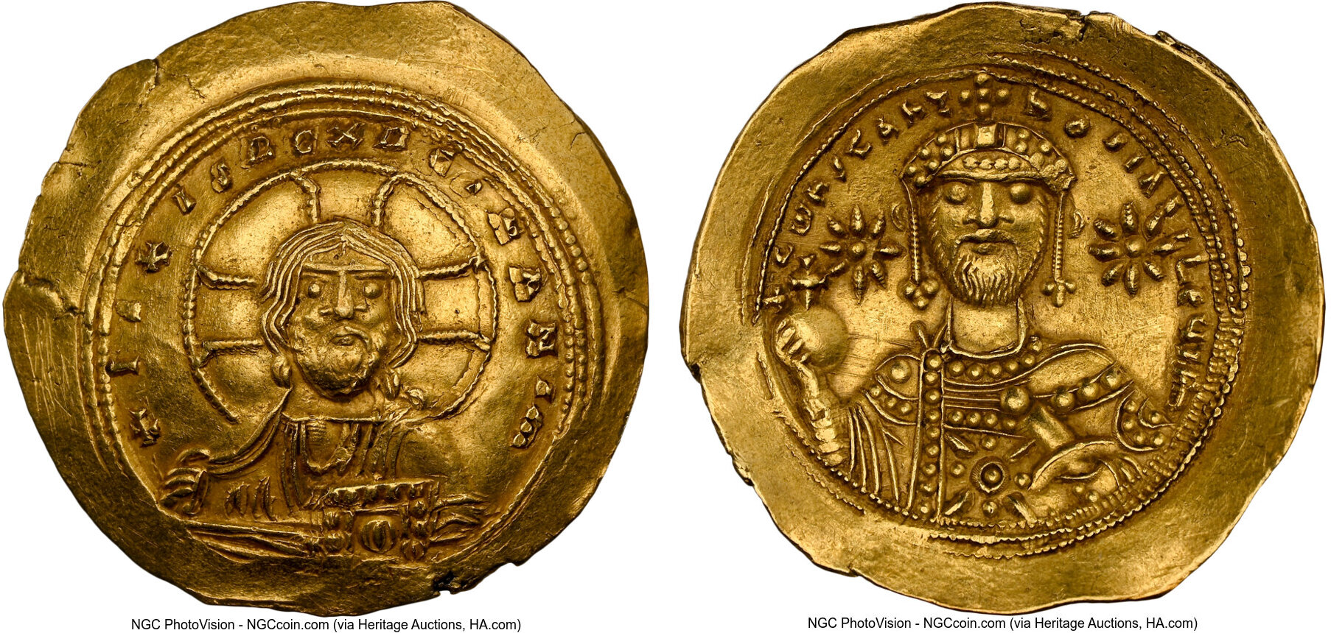
The strange case of 1054: numismatic evidences? Constantinus IX 1042- Jan 1055

Slide 7
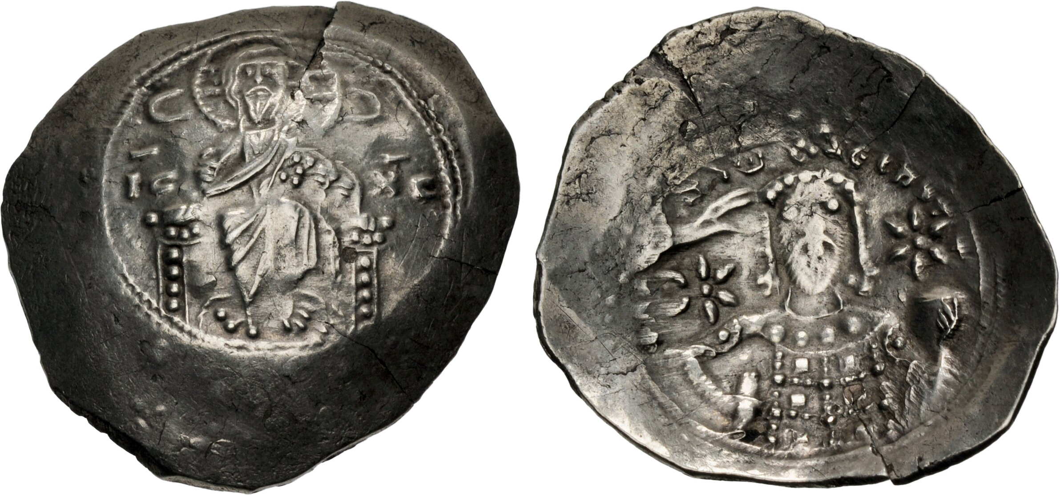
Alexius Comnenus I (1088-1118)
Studies by Bradley E. Schaefer (1996) and by Valerio Cerrone (2024)

Slide 8
11 april 1054, from Historia S. Petri Ecclesiae (Oudembourgh, Belgium)
“…on the 18th day before the first of May, a Monday, around midday […] all over the World there appeared to men a circle in the sky of extraordinary brightness which lasted about half an hour.
Supernatural Explanation:
Perhaps the Lord wished to say that he [the Pope] was worthy to received a crown in Heaven between those who love Him.”
V. F. Polcaro (photo) in 2005

Slide 9
Leo IX De Obitu Leonis + 19 april 1054
“as along a path strewn with shining garments and lit by innumerable brilliant lamps” (Libuinuis, De Obitu Leonis, Romae)

Slide 10
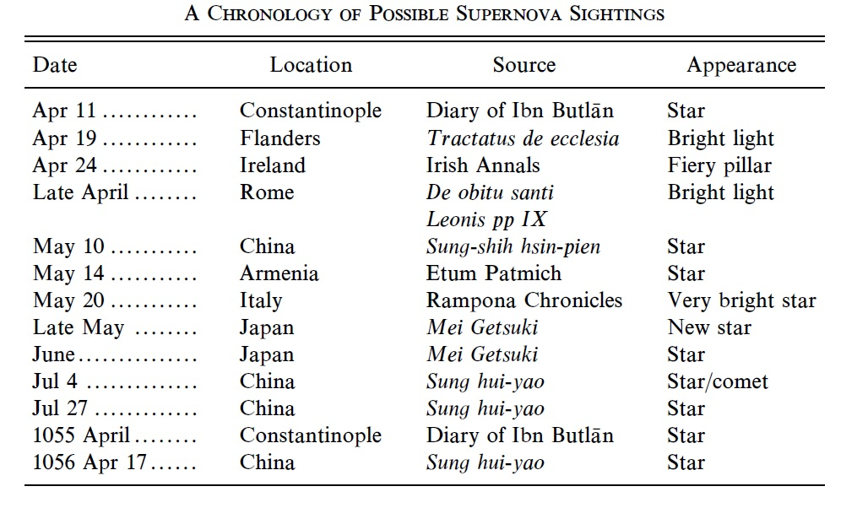
Chronology (Collins et al. 1999) compared
Irish sources: Pillars of fire… on St. George’s feast, 24 april
Aurorae?
Do they deserve a special mention in the chronicles?

Slide 11
Boreal Aurora (Pescara, 11 may 2024 naked eye) white moving pillars at North

Slide 12
Chinese chronicles
They are conflicts:
10 may 1054 solar eclipse AND? the new star
Japanese views in late may
1055 or 1054?
Damnatio memoriae of specific events, contrary to the living Emperor…
Transcriptions occurred from 1 century to a few centuries later

Slide 13
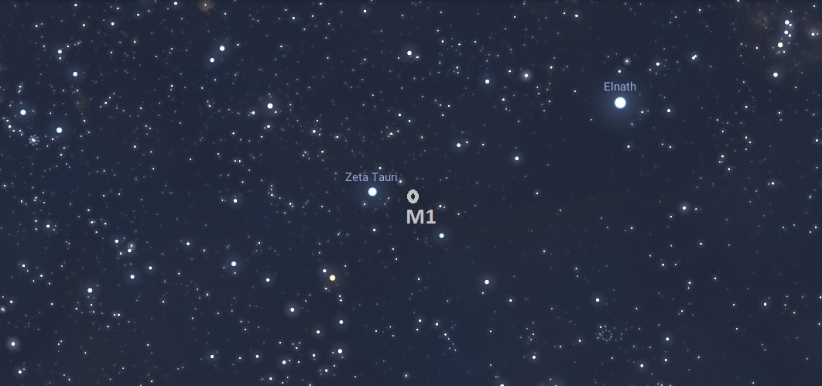
Beta and Zeta Tauri stellar field

Slide 14
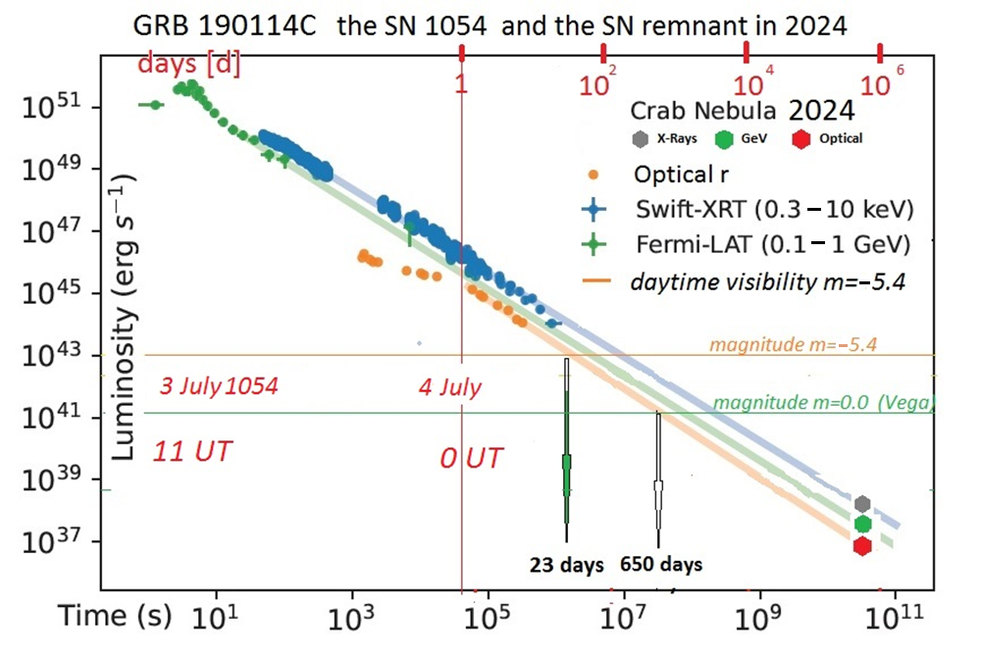
«3 July» Chronology

Slide 15
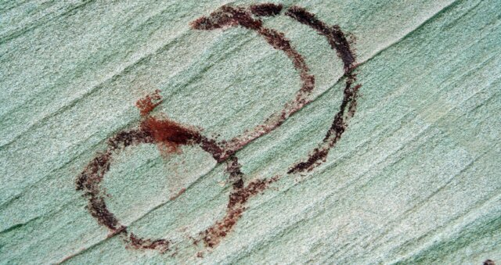
Gamma-Ray Burst: in twilight for American Indians, z~76°

Slide 16
GRB in Constantinoples z~48° Ibn Batlān
One of the well-known epidemics of our time is that which occurred when the spectacular star appeared in Gemini in the year 446 after the Hegira (from April 12, 1054 to April 1, 1055). […]

Slide 17
Radiation’s penetration in the atmosphere
The Atmosphere is optically thick below 8 km… but the energy in the first 30 minutes of GRB at 2 Kpc is enormous, and the exposed skin may have been burned. On July 3rd at noon people were reliably outside. Epidemics.

Slide 18
Conclusions & Perspectives
The paper we have presented brings again the attention to the European and American (possible) accounts of the 1054 event, the progenitor of the Crab Nebula
Even if the Core Collapse supernova (type II) is a well established model, some features observed in Europe (brilliant orb in day time) and the ones depicted in America by local indians (agricultural societies) may be fit with a GRB explosion
The energy of the present X and visible radiation, as well as the MeV/GeV radiation is compatible with the initial power-law radiation shown by the GRB 190114C extrapolated to 970 years after.
The quality of the Chinese observations is not against this hypotesis, being the Crab below their horizon at the moment of the explosion, which produced skin burns and a consequent epidemy in the countries under its «zenith» where the airmass at the explosion was minimal. Further studies of airshower’s models may improve this statement.

