Slide 1
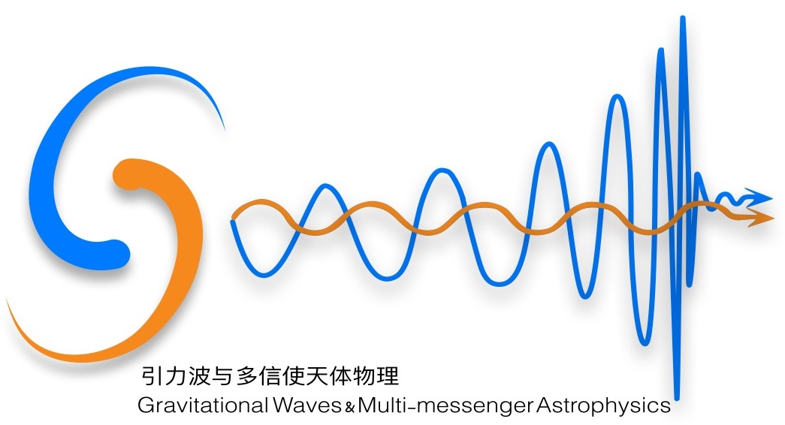


GW/Multi-messenger astrophysics in Institute of High Energy Physics, CAS
Original title: Multimessenger astrophysical studies with Gravitational Wave Universe Toolbox
Shu-Xu Yi (易疏序)
Institute of High Energy Physcis, CAS
2024.7.11 Pescara, Italy

Slide 2
Outline
IHEP’s preparation for high energy EMW follow-up in advance of LVK-O4
  Hardware
  Software
IHEP’s follow-up observation during LVK-O4 so far
Theoretical studies using simulation and catalogues
  The GW-Universe Toolbox
  The joint GRB-GW simulation
  The GW velocity studies
  Sub-threshold GW-EM detection
  Population studies

Slide 3
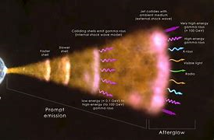
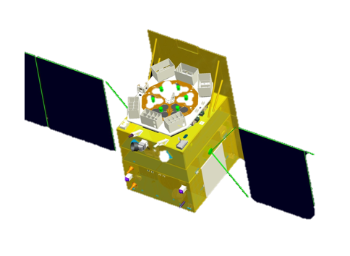
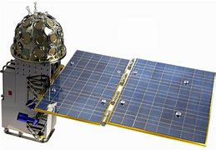


Preparation before O4
Follow-up in O4
Theoretical studies
Detectors
Insight/HXMT
6keV
GECAM-B
200 keV
5MeV
SATech-01/HEBS
10MeV
Type I Gamma-ray bursts
HE MEW
LVK-O4
~1 kHz
GW
2023.5
2024.4
2024.7
Inspiral & merger of binary NS/NS-BH
~10 Hz

Slide 4
automatic target search software (follow-us)
Preparation before O4
Follow-up in O4
Theoretical studies
Telescope | EMC
Insight、GECAM B/C | GRB prompt emission
Automatically do the following：
Find GRB and GW pairs that match in space and time
GW+GRB joint localization、host galaxy candidate ranking
process gamma-ray data and calculate gamma-ray flux upper limit in the region
Write GCN circulars

Slide 5
Preparation before O4
Follow-up in O4
Theoretical studies
The pipeline of follow-us
finial GCN
template 1
retraction GCN
retraction GCN
finial GCN
template 1
preliminary GCN
preliminary GCN
finial GCN
template 2
Case 1
Case 2

Slide 6


Host galaxies ranking
Preparation before O4
Follow-up in O4
Theoretical studies
Cross the joint localization area with GLADE v2 galaxy catalogue
Give a score to each galaxy according to its location：
Assign another score according to its B magnitude, because mergers of compact binary tend to appear in massive galaxies, and B magnitude can represent its mass
Give an overall score
Based on the algorithm and open source codes of
Salmonetal. 2019https://arxiv.org/pdf/1912.07304.pdf

Slide 7
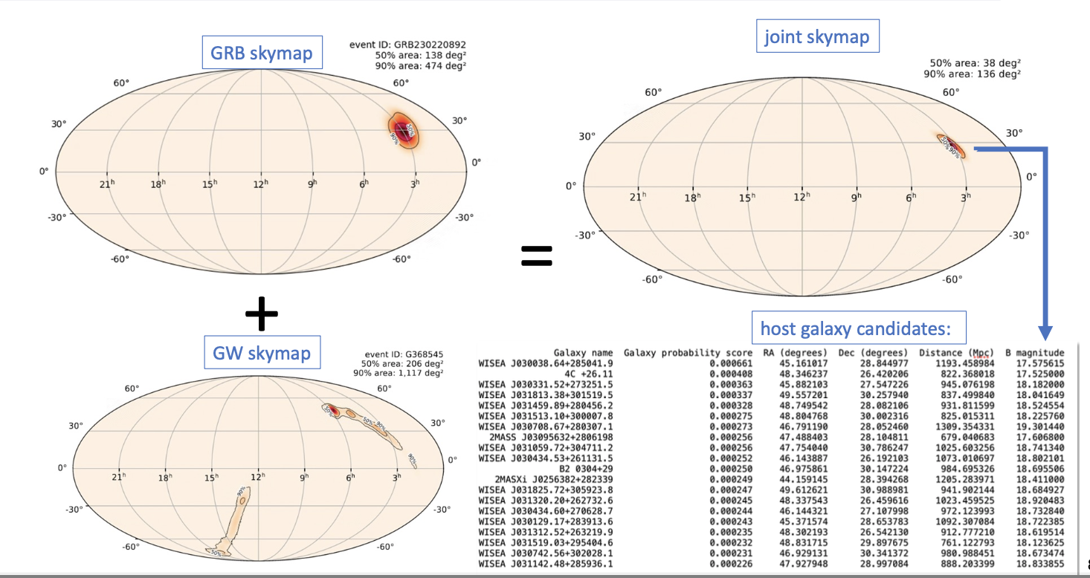
Results from tests
Preparation before O4
Follow-up in O4
Theoretical studies

Slide 8
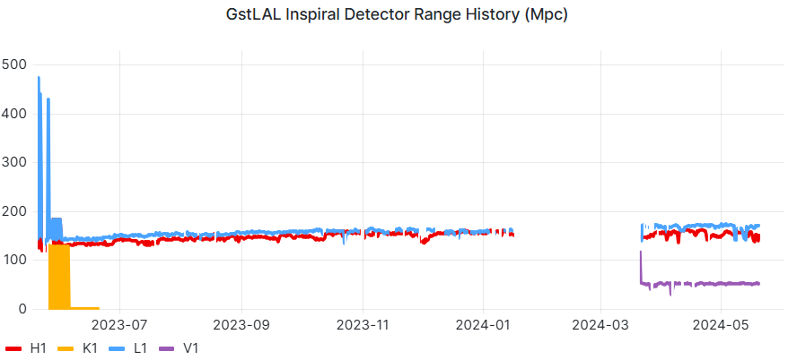
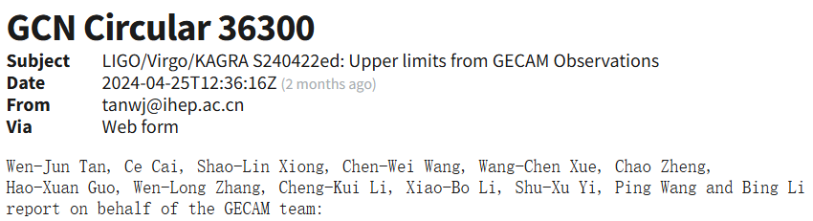
NS related GW events in LVK-O4
Preparation before O4
Follow-up in O4
Theoretical studies
GECAM conducted targeted search in the
localization area, no GRB counterpart found
Set upper limits on the GRB flux
high significance superevents: 112
Sub-threshold superevents: 2028
O4a
O4b
Timescale (s) | Soft | Normal | Hard
0.1 | 2.18 | 4.15 | 10.26
1 | 0.66 | 1.28 | 3.07
10 | 0.20 | 0.40 | 0.97
S230529ay NSBH (62%), BNS (31%),
S230627c NSBH (49%), BBH (48%)
S230802aq BBH (90%), NSBH (6%)
S231020ba BBH (91%), NSBH (8%)
S231118an BBH (74%), NSBH (1%)
  S240422ed NSBH (>99%),
  localization 259 deg2

Slide 9
Merger-originated GRBs observed by GECAM
Preparation before O4
Follow-up in O4
Theoretical studies
ID | class | comments
231205A | Short burst | No GW detected；GCN35266；GECAM-joint localization
231206A | Short burst | No GW detected；GCN35266；GECAM-joint localization
240112A | intermediate（T90~3s） | GW not observing；GCN35520；
240119A | Short burst | GW not observing；GCN35591；
240222A | intermediate | GW not observing；GCN35782
240402B | intermediate（6s） | LEIA counter part，GW not observing；GCN36017；
240415B | Short burst | No GW detected；GCN36145；
240603A | Short burst | No GW detected；GCN36602
GW-GRB time coincident candidates found by follow-us:
S231215I;
S240511an;
S240602ed
The probabilities of them being astrophysical origin were
low.

Slide 10
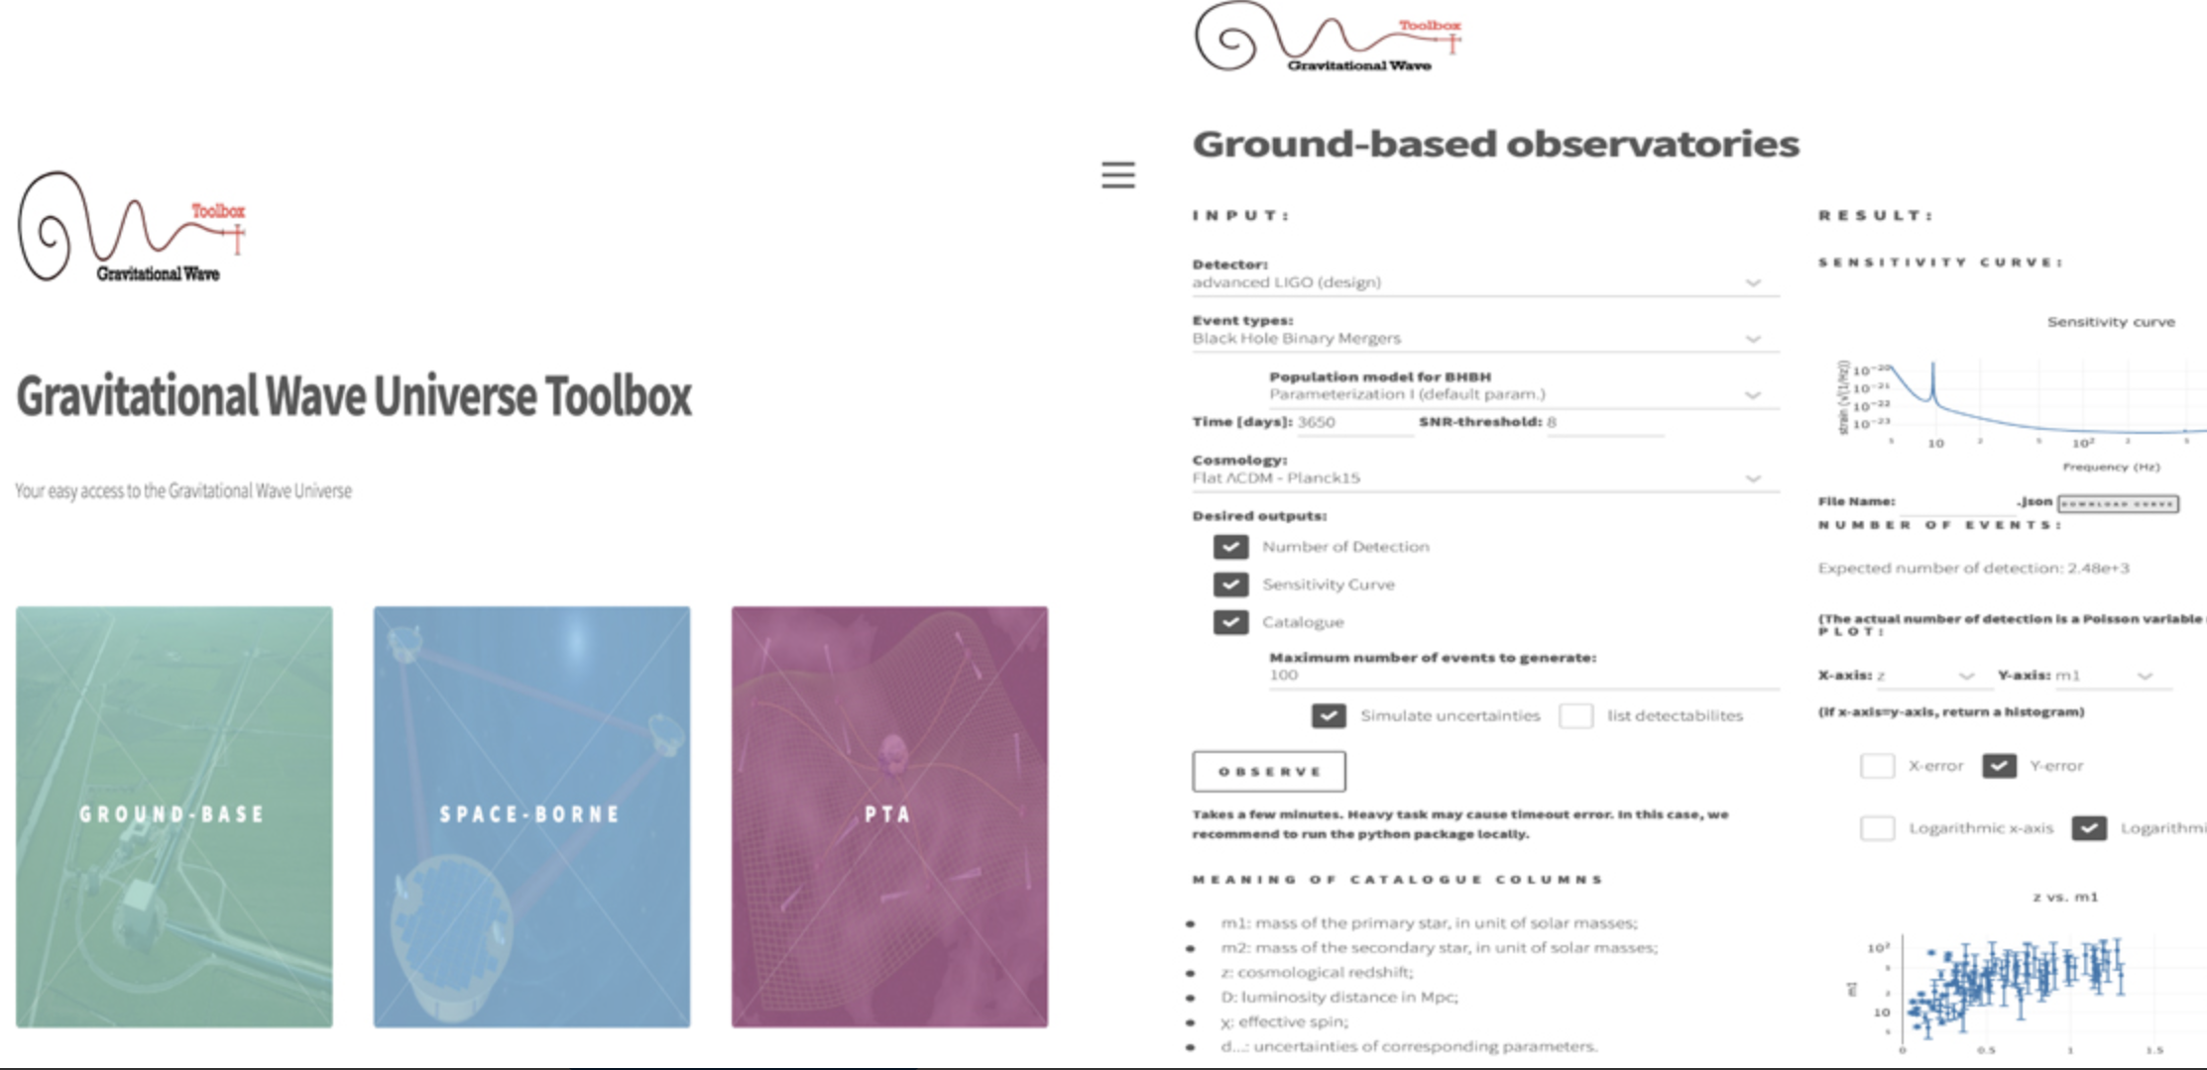
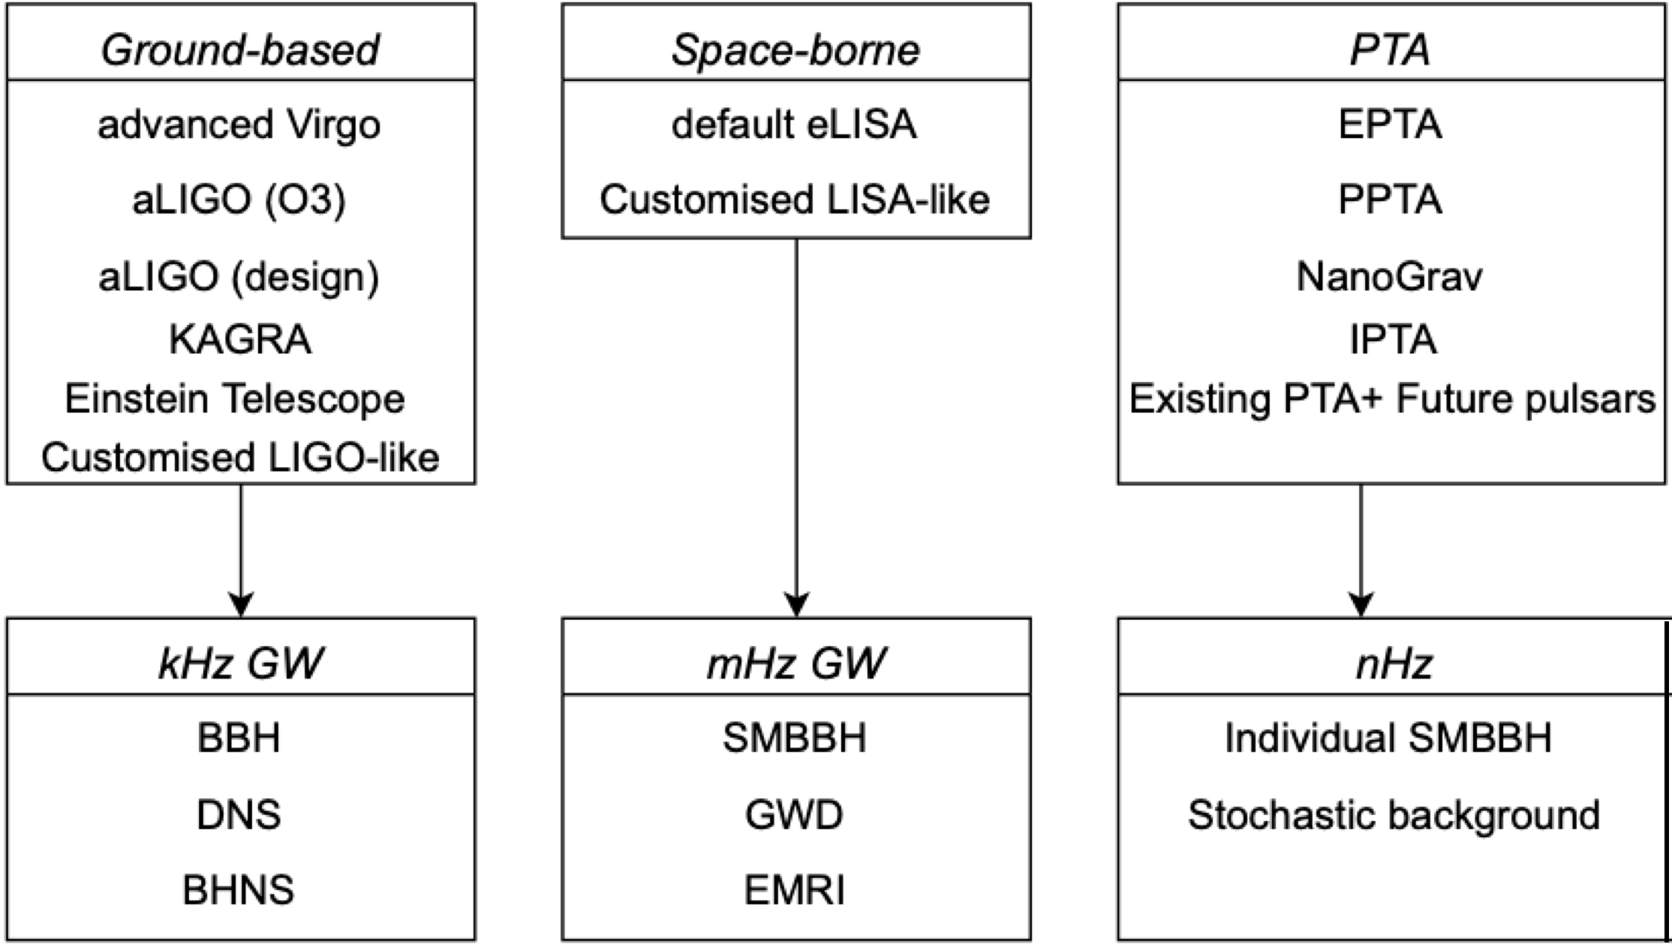
The GW Universe Toolbox
Preparation before O4
Follow-up in O4
Theoretical studies
gw-universe.ihep.ac.cn or gw-universe.org
The Gravitational Wave Universe Toolbox: A software package to simulate observations of the gravitational wave universe with different detectors, Shu-Xu Yi et al. A&A, 2022
The Gravitational Wave Universe Toolbox. II. Constraining the binary black hole population with second and third generation detectors, Shu-Xu Yi, et al. A&A, 2022

Slide 11
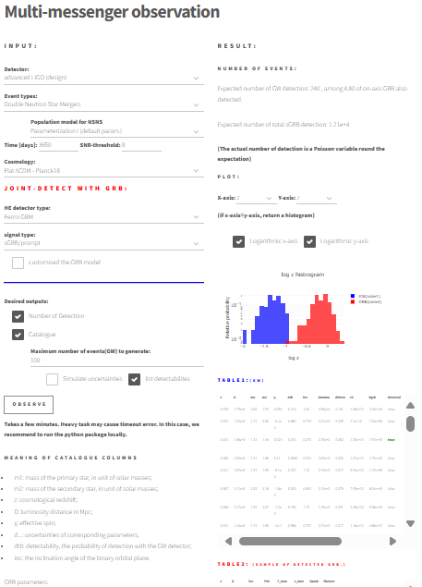

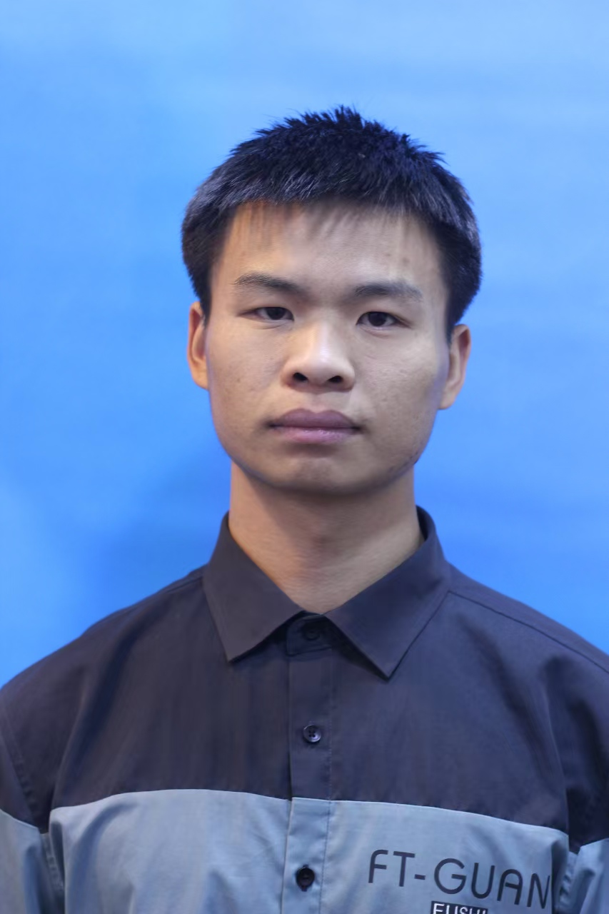
GW-GRB joint detection simulation
Preparation before O4
Follow-up in O4
Theoretical studies
GRB detectors
Insight/HE
GECAM/GRD
Fermi/GBM
Swift/BAT
Integral/BASTE
Kai Hendriks
@Radboud
Type I GRB
Rao JH
饶金辉
gw-universe.ihep.ac.cn

Slide 12
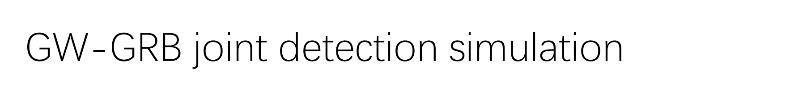
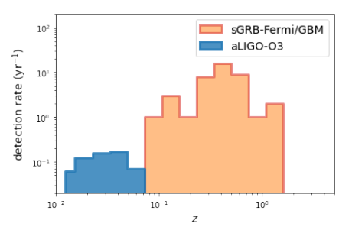
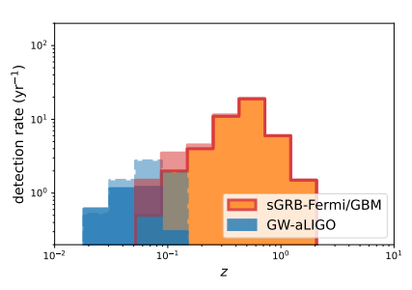
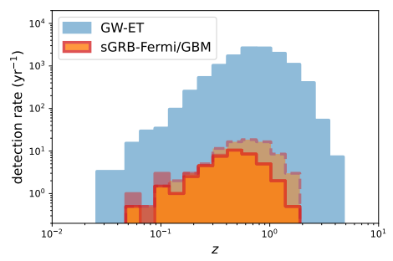

Preparation before O4
Follow-up in O4
Theoretical studies
Probability of joint GW-GRB is low in O4:
~10%
For 2G GW detectors:
Including subthreshold GW improve the
chance, while including subthreshold GRB
candidate will not help
GW170817
~200 Mpc
Hendriks et al. 2023, A&A 672,A74

Slide 13
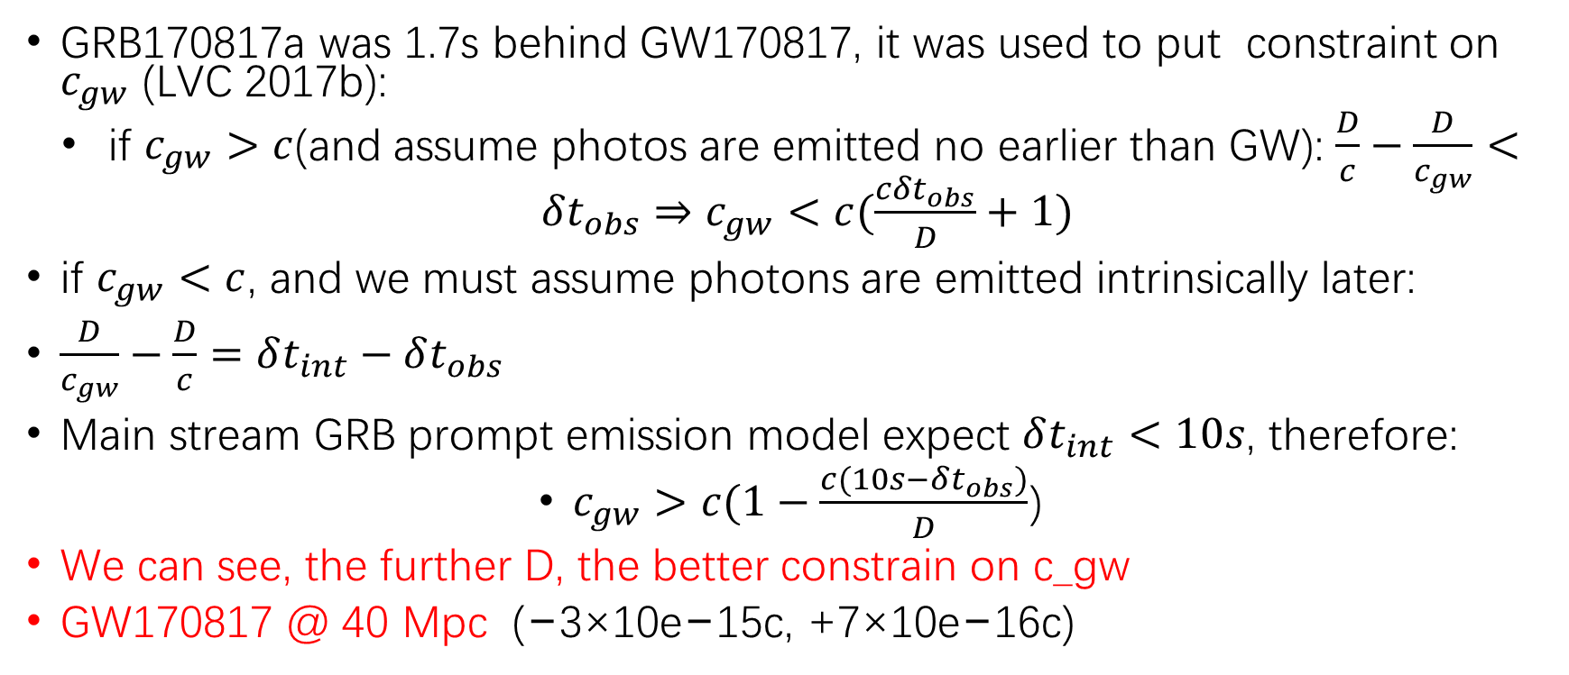
GW-GRB joint detection simulation
Science application
Preparation before O4
Follow-up in O4
Theoretical studies
GRB170817a was 1.7s behind GW170817, it was used to put constraint on $c_{gw}$ (LVC 2017b):
if $c_{gw}>c$(and assume photos are emitted no earlier than GW): $\frac{D}{c}−\frac{D}{c_{gw}}<δt_{obs}⇒c_{gw}<c(\frac{cδt_{obs}}{D}+1)$
if $c_{gw}<c$, and we must assume photons are emitted intrinsically later:
$\frac{D}{c_{gw}}−\frac{D}{c}=δt_{int}−δt_{obs}$
Main stream GRB prompt emission model expect $δt_{int}<10s$, therefore:
$c_{gw}>c(1−\frac{c(10s−δt_{obs})}{D}$)
We can see, the further D, the better constrain on c_gw
GW170817 @ 40 Mpc (−3×10e−15c, +7×10e−16c)

Slide 14
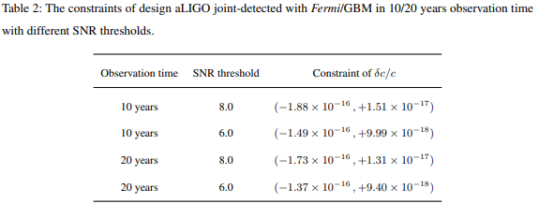
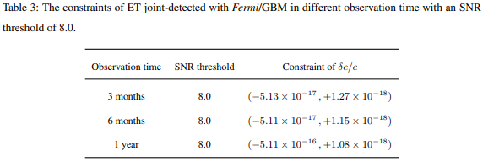





Preparation before O4
Follow-up in O4
Theoretical studies
GW-GRB joint detection simulation
Science application
If graviton has mass:
$$E=hf_{gw}$$
$${⇒m}_{g}<∼{10}^{−20}eV$$
~the best current constraints
Local Lorentz violation:
Rao JH 饶金辉 RAA accepted

Slide 15
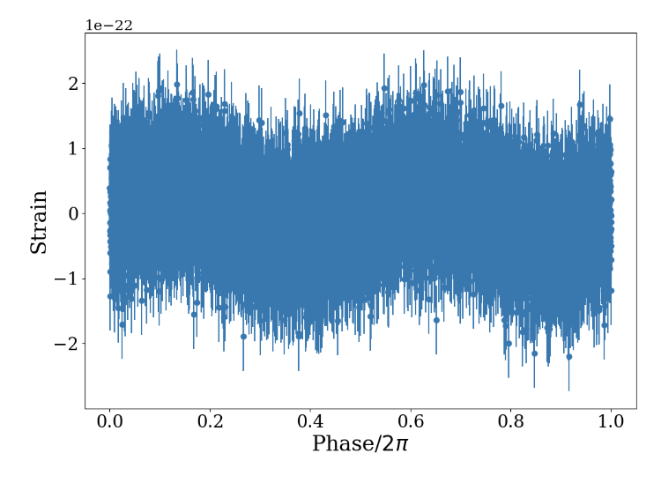
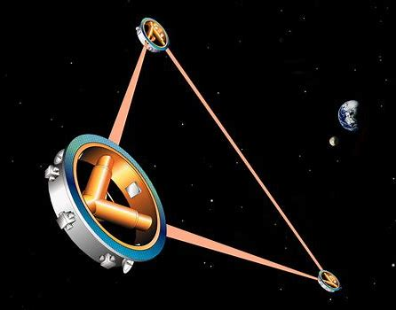
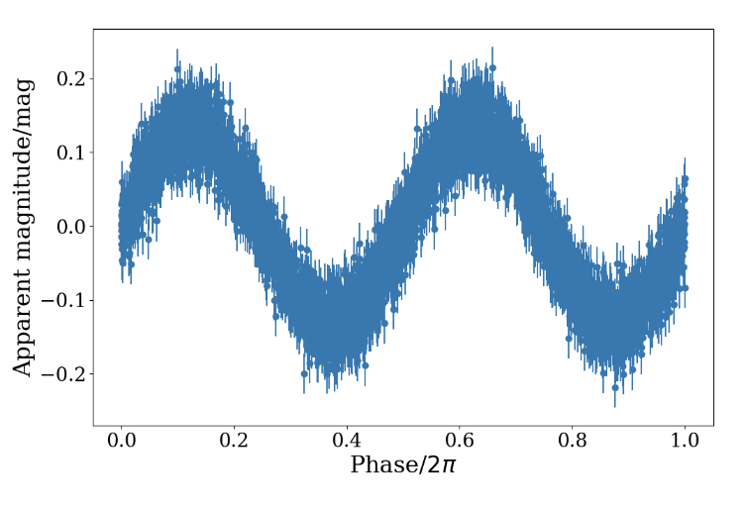
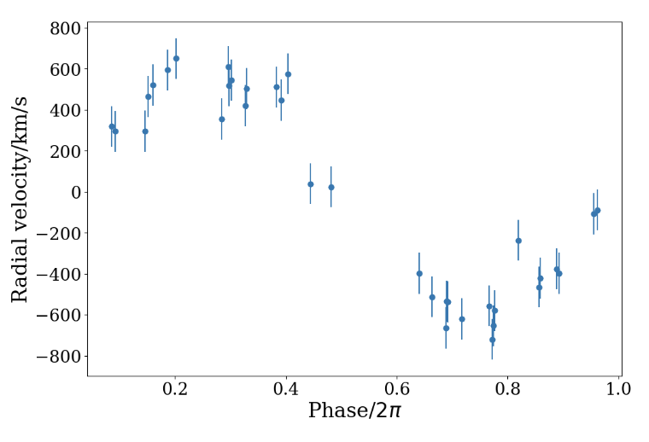


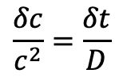



Simulation joint observation on verification white dwarf binaries with GW+Optical data
Preparation before O4
Follow-up in O4
Theoretical studies
GW
DW binary in Galaxy
space-borne GW detectors
optical signal
photometry/spectroscopy
projected area
(apparent magnitudes)
line of sight velocity
$$δφ_{0}≡φ_{0,GW}−φ_{0,AM/RV}$$
$$δt=δφ_{0}P$$
$$\frac{δc}{c^{2}}=\frac{δt}{D}$$
14 verification WD binary with LISA:
$$δc∈\left[−2.1,4.8\right]×{10}^{−12}$$
Cao TY 曹天涌 MNRAS submitted

Slide 16
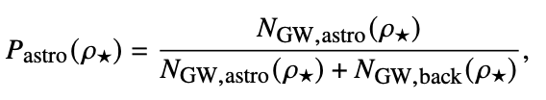
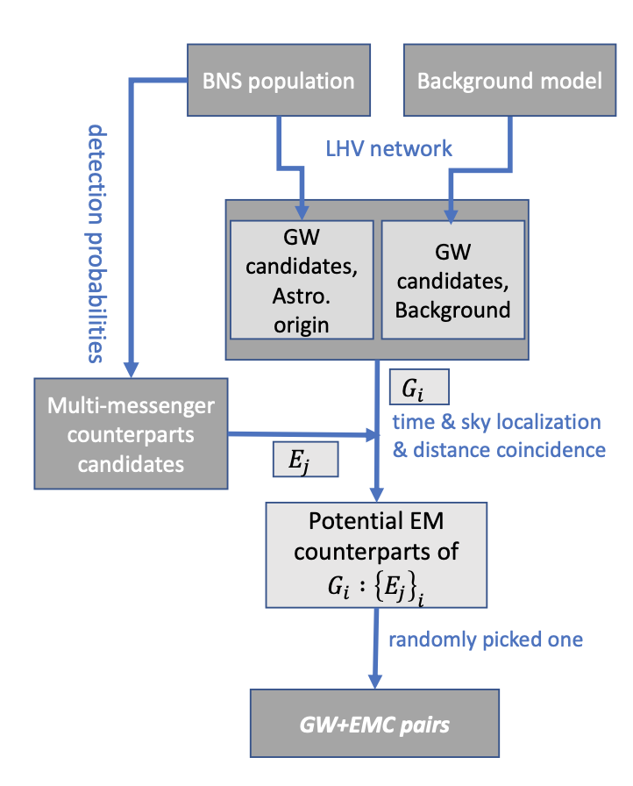
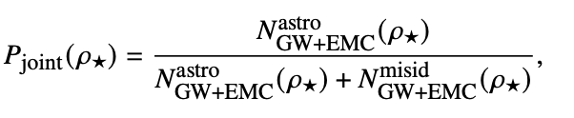
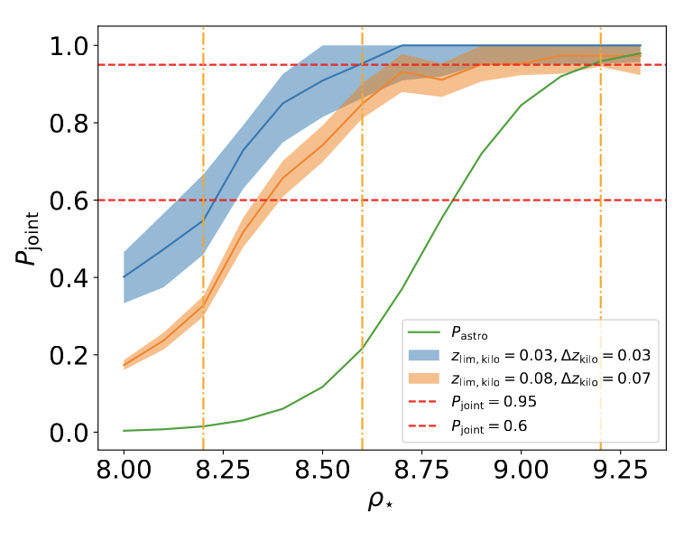





Sub-threshold joint GW-EMW observation
Preparation before O4
Follow-up in O4
Theoretical studies
$$P_{astro}→P_{joint}:$$
det. vol. of Universe $↑∼10\%$
${δH}_{0}/H_{0}$ 5% tighter constraint
$δc/c$ 10% tighter
Du YF (杜云飞) 2024, submitted

Slide 17

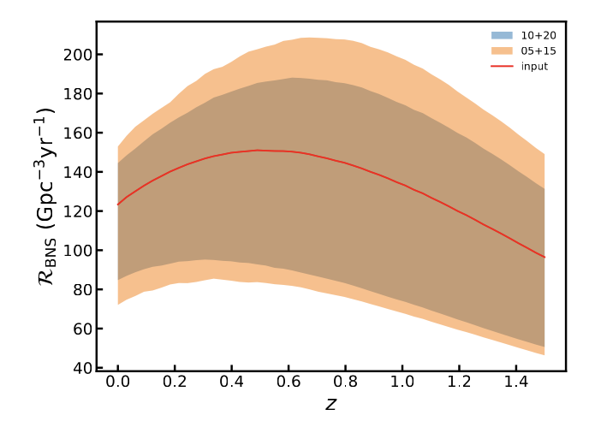
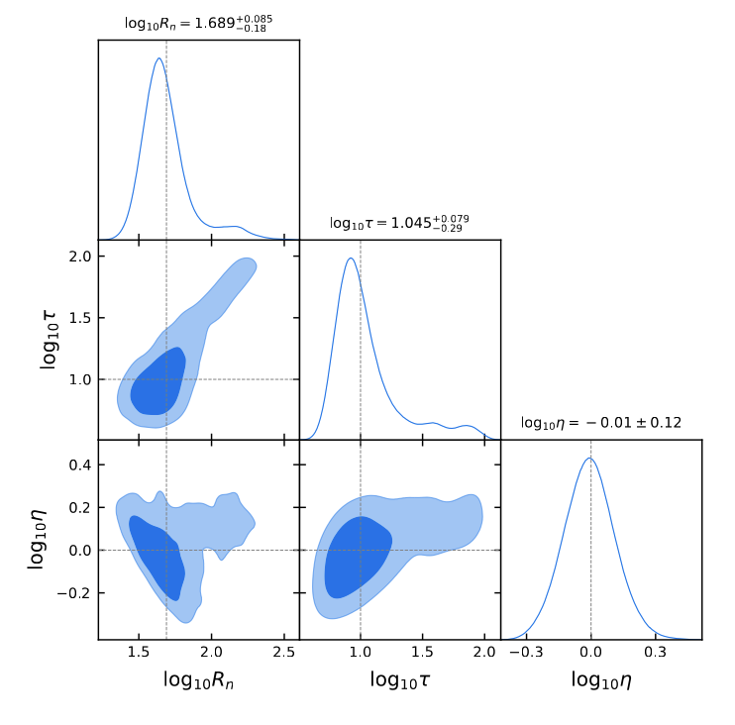
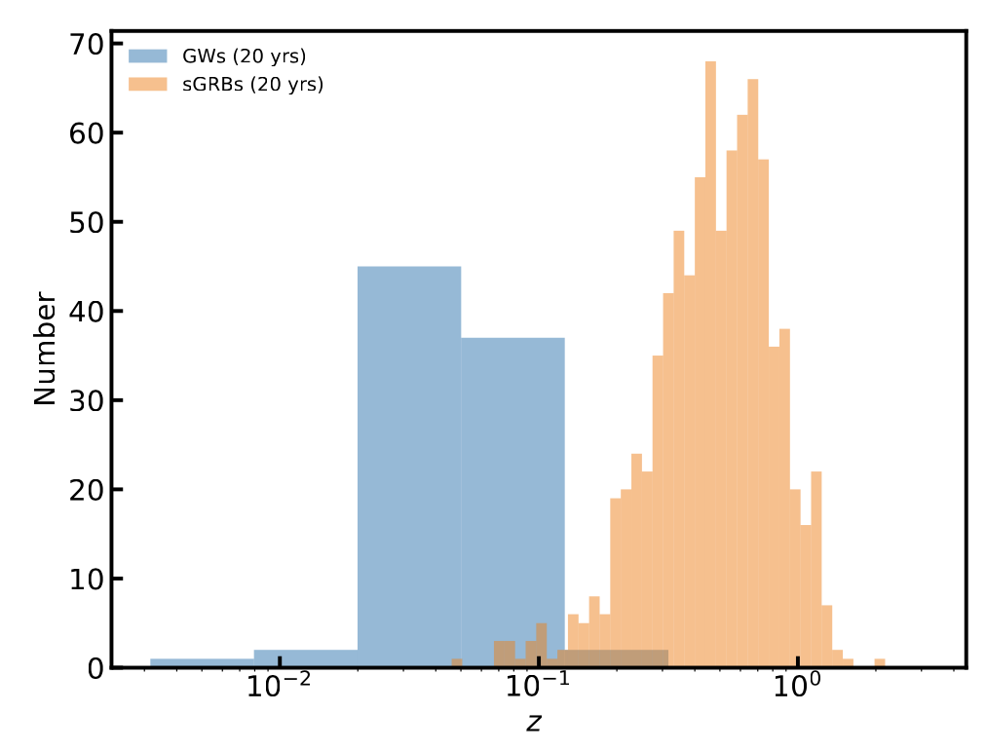
Population of binary neutron star
A population of binary neutron star-mergers
a sample of GWs
a sample of sGRBs
detect probability
preliminary
20 years aLIGO
+20 GMB:
preliminary from
Du Yunfei

Slide 18
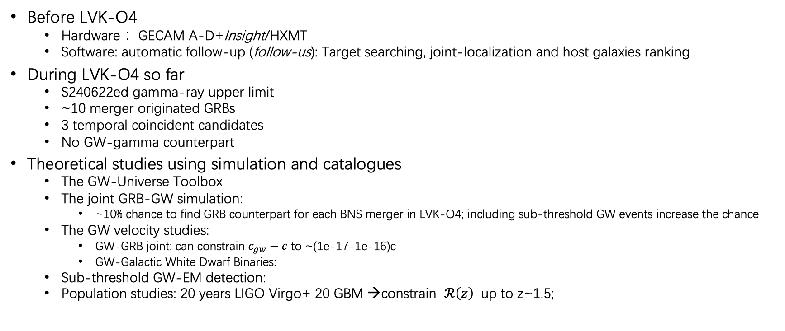


summary
Before LVK-O4
  Hardware： GECAM A-D+Insight/HXMT
  Software: automatic follow-up (follow-us): Target searching, joint-localization and host galaxies ranking
During LVK-O4 so far
  S240622ed gamma-ray upper limit
  ~10 merger originated GRBs
  3 temporal coincident candidates
  No GW-gamma counterpart
Theoretical studies using simulation and catalogues
  The GW-Universe Toolbox
  The joint GRB-GW simulation:
    ~10% chance to find GRB counterpart for each BNS merger in LVK-O4; including sub-threshold GW events increase the chance
  The GW velocity studies:
    GW-GRB joint: can constrain $c_{gw}−c$ to ~(1e-17-1e-16)c
    GW-Galactic White Dwarf Binaries:
  Sub-threshold GW-EM detection:
  Population studies: 20 years LIGO Virgo+ 20 GBM →constrain $ℛ\left(z\right)$ up to z~1.5;
det. vol. of Universe $↑∼10\%$
${δH}_{0}/H_{0}$ 5% tighter constraint
thank you!

Slide 19
LIGO/Virgo/KAGRA S240422ed 观测情况汇总

Slide 20
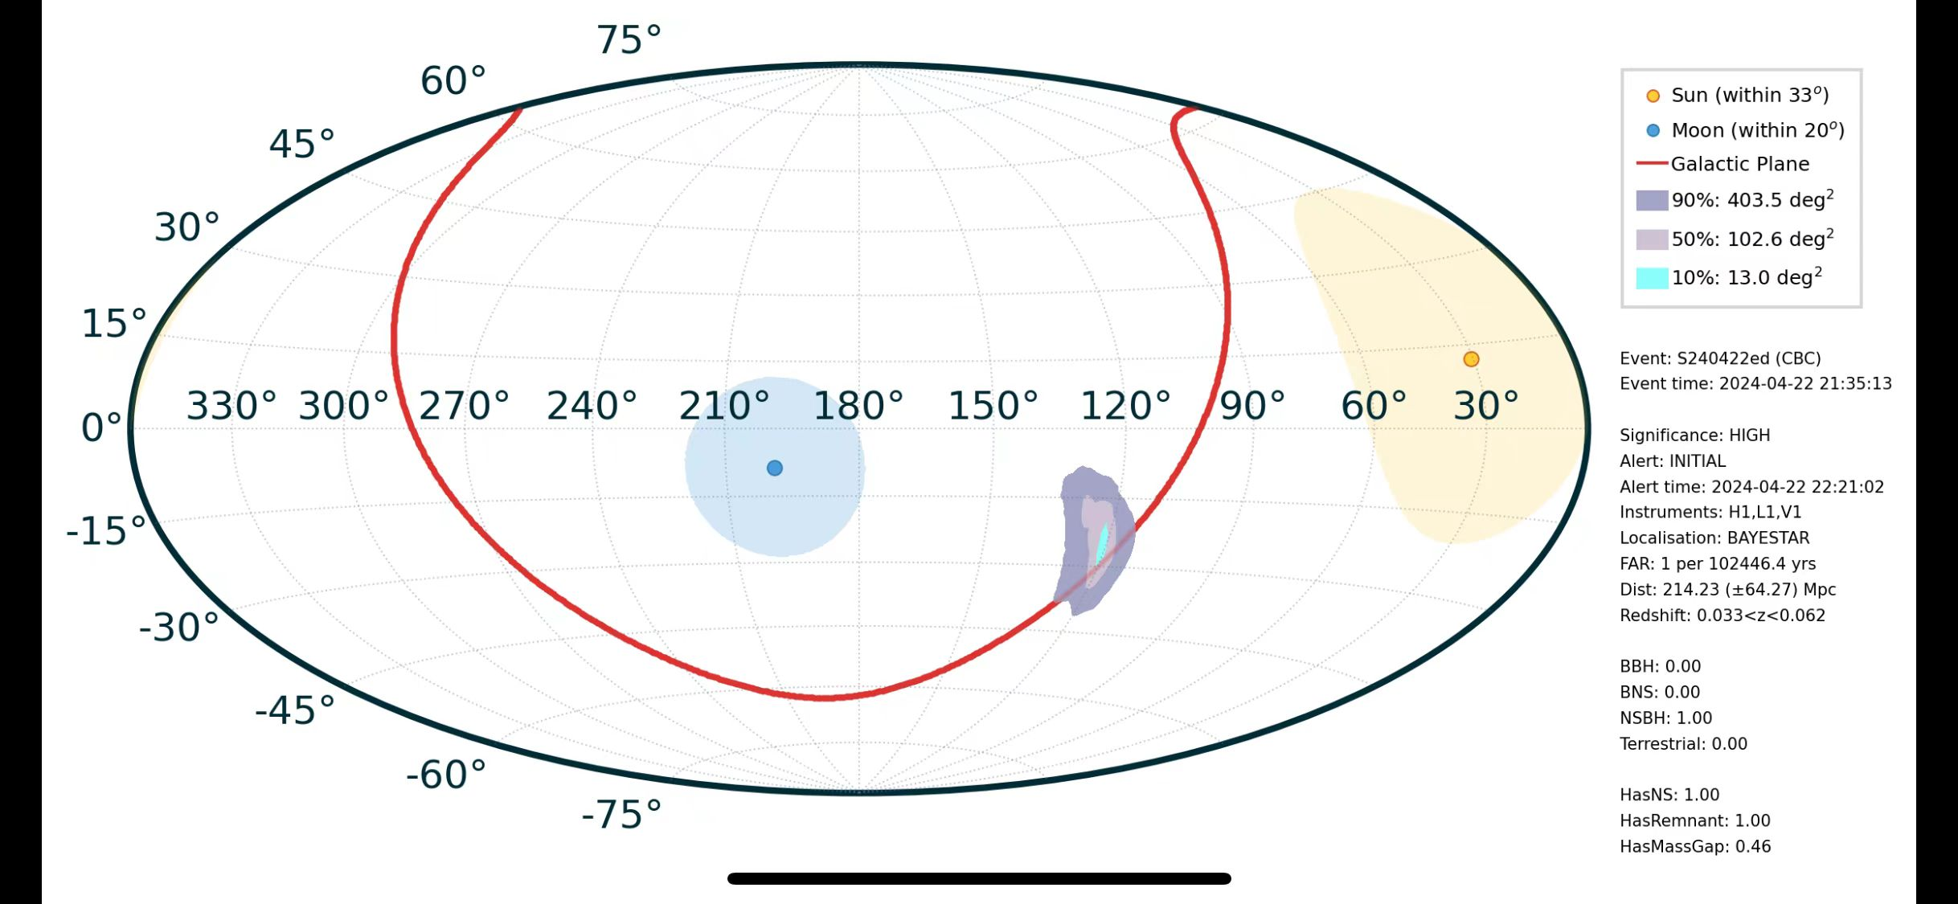
LIGO/Virgo/KAGRA S240422ed 基本信息
T0 = 2024-04-22T21:35:13.417
R.A. = 122.38°
Dec. = -20°
Distance： 188Mpc
Type：NSBH

Slide 21
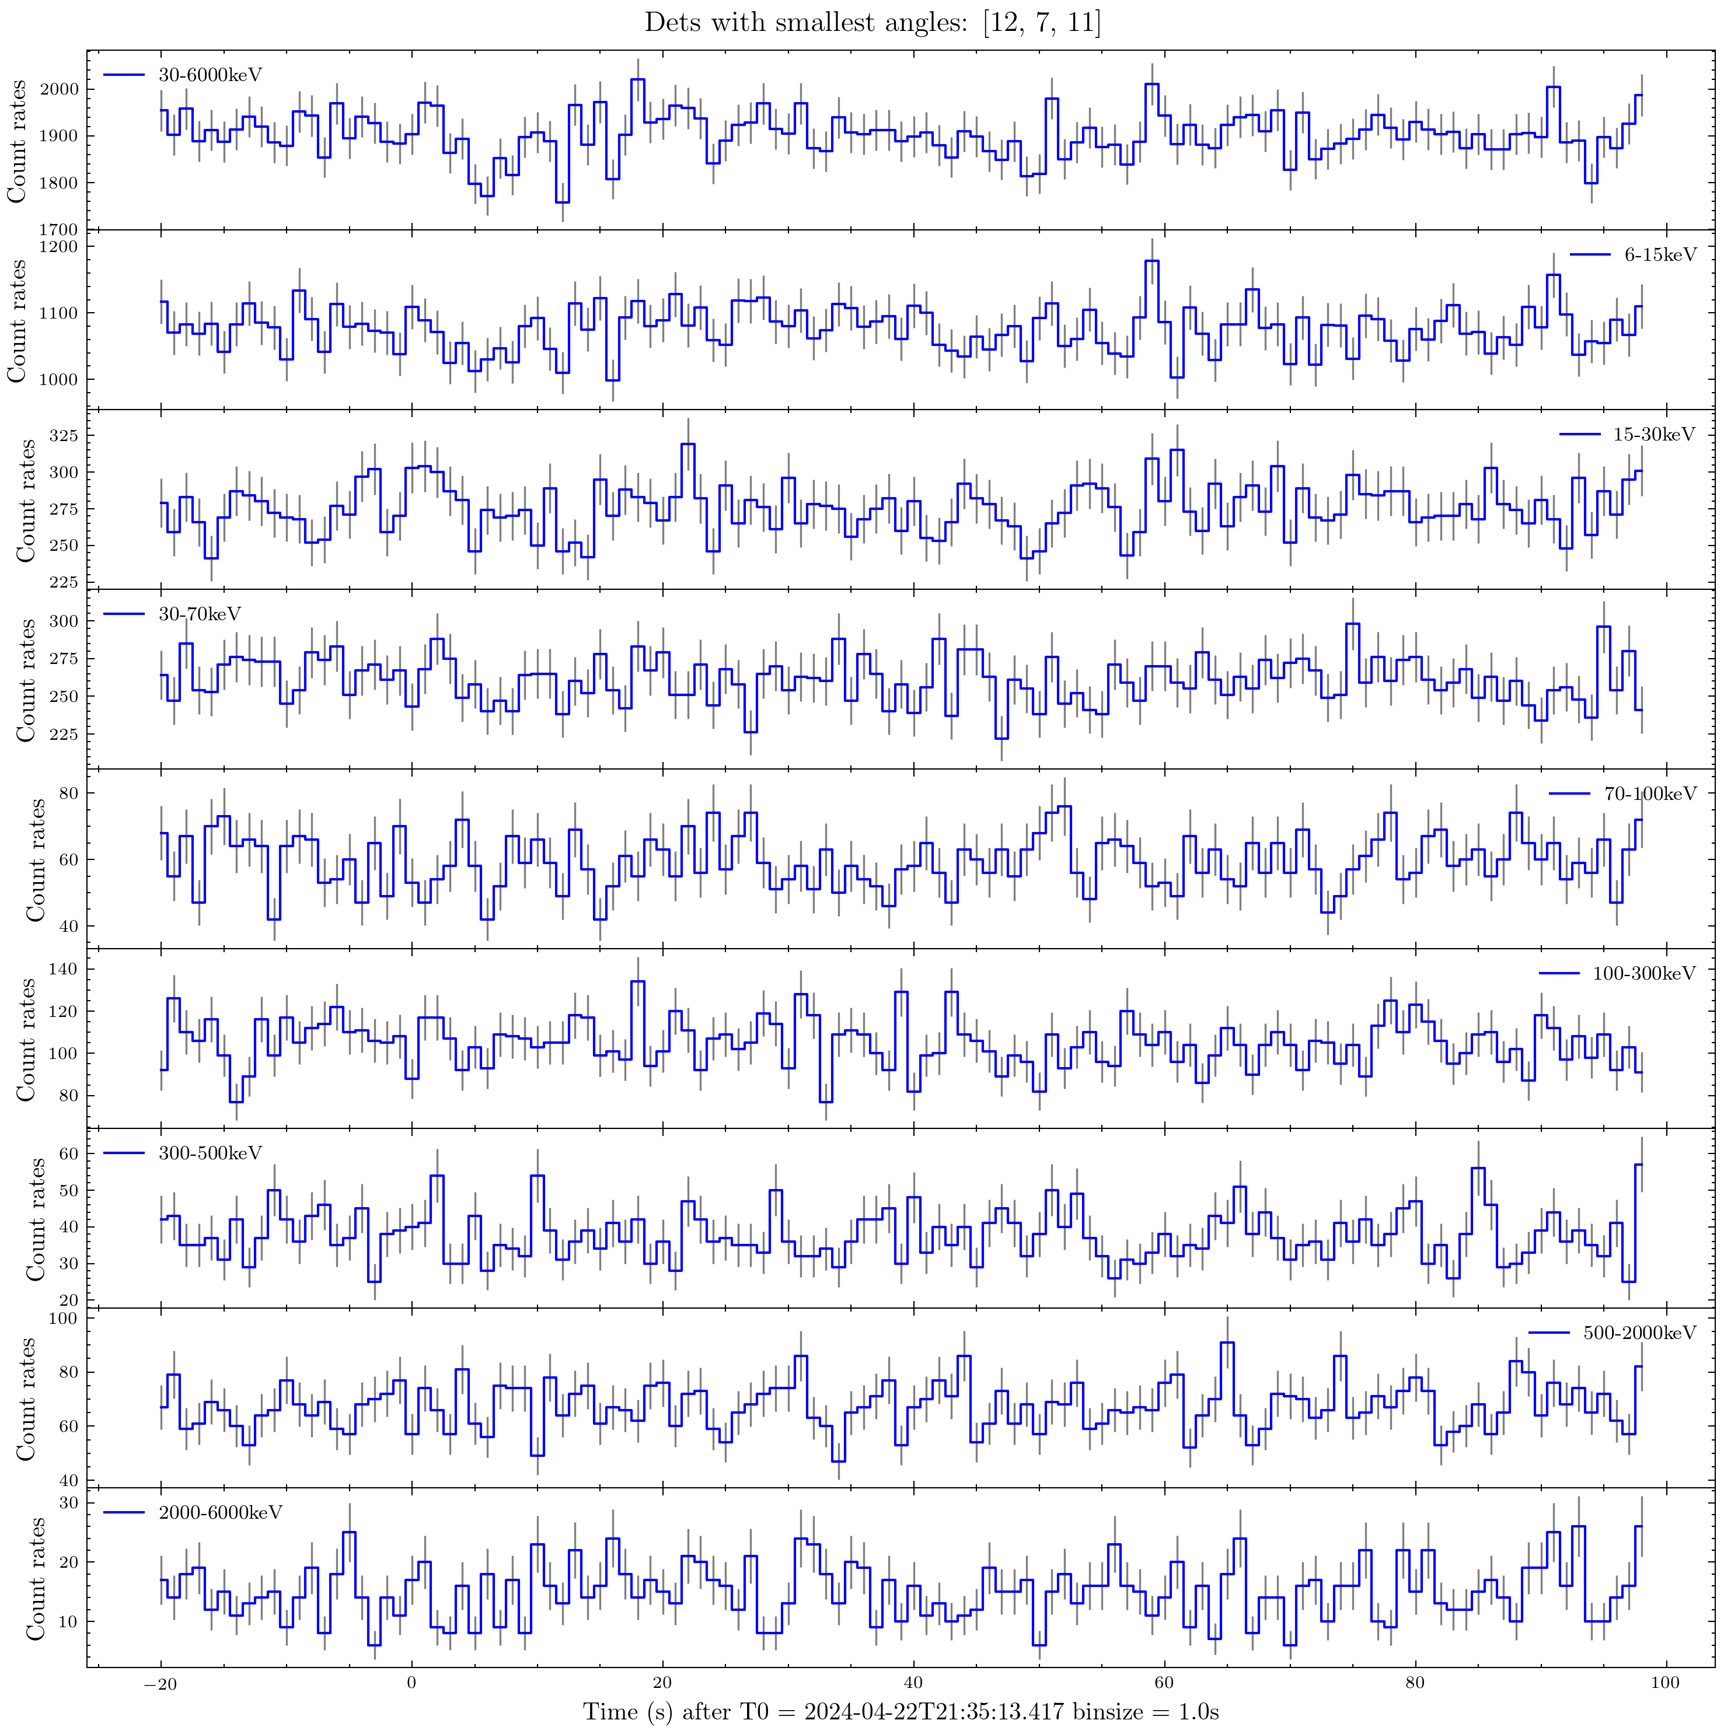
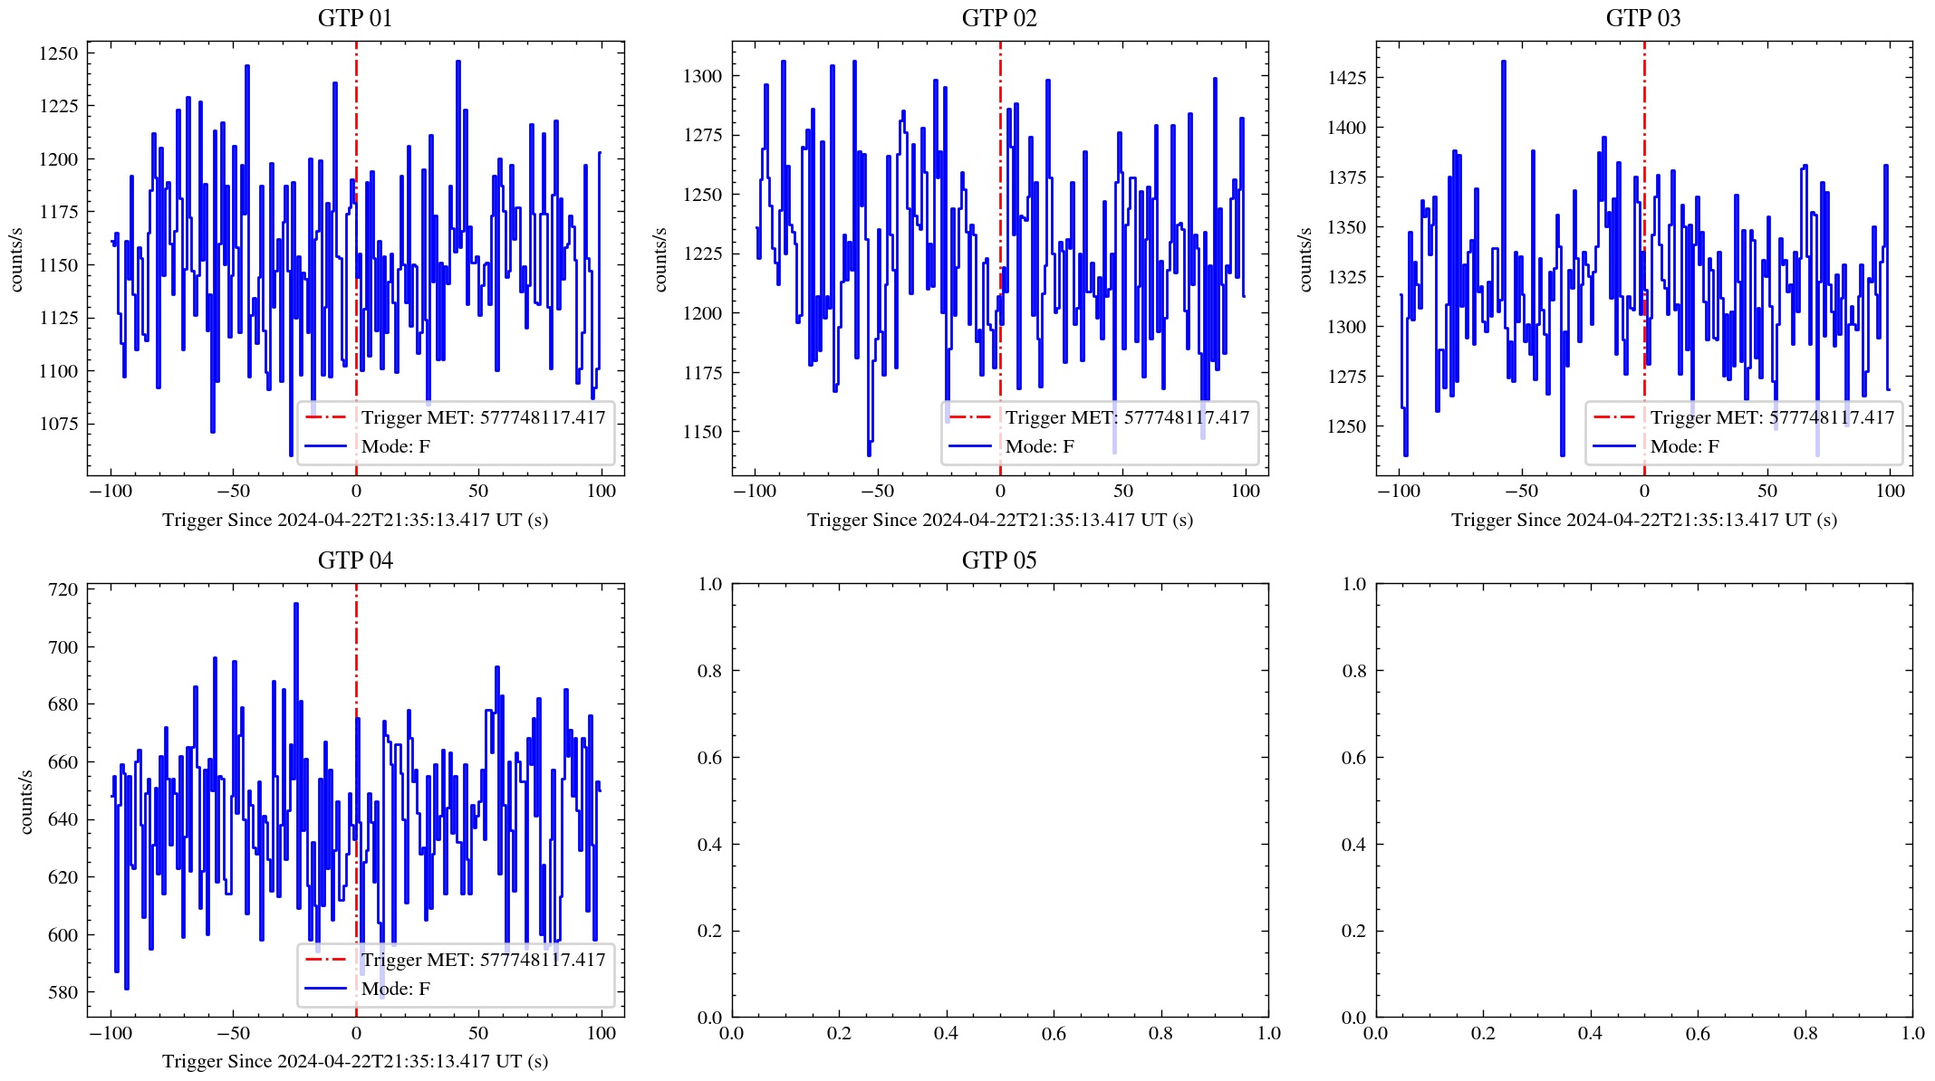
GTM及GECAM-C观测情况
GTM光变
GECAM-C光变

Slide 22
GECAM-C与GBM观测情况对比
 |  | GECAM-C | GBM | GECAM-C | GBM | GECAM-C | GBM
 |  | 0.1s | 0.128s | 1.0s | 1.024s | 10.0s | 8.192s
3 sigma flux upper limits (in units of 10^-7 erg/s/cm^2) | soft | 2.18 | 1.8 | 0.66 | 0.6 | 0.2 | 0.2
 | normal | 4.15 | 3.4 | 1.28 | 0.9 | 0.4 | 0.3
 | hard | 10.26 | 7.5 | 3.07 | 2.4 | 0.97 | 0.9
3 sigma luminosity upper limits (in units of 10^48 erg/s) | soft | 1.36 | 1.16 | 0.42 | 0.37 | 0.13 | 0.11
 | normal | 2.17 | 2.05 | 0.67 | 0.54 | 0.21 | 0.20
 | hard | 11.70 | 7.42 | 3.48 | 2.37 | 1.15 | 0.84
GECAM-C: 10-2000keV
GBM: 10-1000keV

Slide 23
GCN上其他设备观测情况总结：
1. 除EP/FXT 外的X射线望远镜都只能给出上限。
2. 光学望远镜要么没看到对应体，要么看到候选体【GCN 36276 （Magellan）、 GCN 36267 （Magellan）、GCN 36273（ GW-MMADS DECam）、 GCN 36298（ GW-MMADS DECam） 】后被其他仪器排除。
3. 红外波段的对应候选体【GCN 36333（Subaru/MOIRCS）】没有被其他设备看到。
4. Swift/XRT原先的三个候选体（GCN 36278）没有被光学望远镜看到。
5. EP/FXT的候选体观测EP240426a （GCN 36313）,被一些设备认为与AGN活动有关（ GCN 36317、 GCN 36325、 GCN 36329 、GCN 36331），被Swift/XRT报告有X-ray source S240422ed_X255 （GCN 36332），除此之外没有任何光学对应体被看到，均只能给出上限。
6. 关于EP240426a。EP定位：R.A. = 121.8567 deg, Dec. = -29.4609 deg
EP flux in 0.5-10 keV：~ 9.2 x 10 ^-13 erg/s/cm2
Swift/XRT flux in 0.5-10 keV ：~7.0 x 10^-13 erg/s/cm2

Slide 24
GCN上其他设备观测情况汇总

Slide 25
Circular | 观测设备 | 观测频段 | 观测时间 | 观测结果
36234 | MASTER-SAAO | C-band | 107s after T0 | upper limit up to 17.0 mag
36235 | NASA/IPAC Extragalactic Database (NED) |  |  | cross-matched the S240422ed Preliminary sky localization with the NED Local Volume Sample
36236 | LIGO & Virgo | GW | T0 | GW NSBH (>99%) candidate
36237 | MeerLICHT & BlackGEM | q-band | 2024-04-22 21:34 UTC
36238 | MAXI/GSC | hard X-ray | T0+3418 to T0+3713 s | upper limit up to 20 mCrab
36241 | Fermi/GBM | hard X-ray | prompt | upper limit flux up to 2.4*10^-7 erg/s/cm^2
36242 | AstroSat CZTI | hard X-ray | 100s window around T0 | upper limit flux up to 2.88e-07 ergs/cm^2/s
36244 | Magellan | i-band optical |  | no obvious transient sources
36245 | GW-MMADS DECam | optical | 2023-04-22 23:37 to 2024-04-23 03:40 UTC | upper limit up to 22.46 mag
36246 | Zwicky Transient Facility | g-, r- and i-band | 5.9 hours after T0 | All candidates were rejected
36247 | INTEGRAL SPI-ACS | hard X-ray | prompt | upper limit flux up to ~1.7e-07 erg/cm^2/s
36248 | WINTER | near-infrared J-band | ~5.5 to 8 hours after T0 | upper limit up to 16.6 mag
36251 | ATLAS | optical | ~1.6 hrs to 7.2 hrs after T0 | no candidate counterparts
36256 | DDOTI/OAN | optical | 5.7 to 7.5 hours after T0 | No Counterparts

Slide 26
Circular | 观测设备 | 观测频段 | 观测时间 | 观测结果
36257 | GOTO | optical | 2.7 minutes after T0 10.96 hours after T0 | no significant counterpart sources
36258 | Pan-STARRS | i-band and z-band | 8.2 hours after T0 | no candidate counterparts
36263 | Magellan | i-band optical |  | identify two sources
36264 | LAST | optical |  | no reference images
36265 | Subaru/MOIRCS | near-infrared | 7.8 hours after T0 | in progress
36266 | SAGUARO |  | 2024-04-23 03:22:01 UT | no credible candidates
36267 | Magellan | i-band |  | an apparent transient source Mag24a
36270 | EP-WXT | X-ray |  | no significant X-ray counterpart at the position of GCN 36267
36271 |  | J- band | 23.11 hours after T0 | no credible source
36272 | Magellan | i-band optical |  | two sources of 36263 are ruled out
36273 | GW-MMADS DECam | optical |  | 8 new transients
36274 | Archival DECaPSs2 | r- and z-band
36275 | CGEM | i-band and z-band |  | Mag24a is likely not a transient
36276 | (WIRC) on the 200-inch Hale Telescope at Palomar Observatory | J-band | 2024-04-24T04:24:14 | non-detection of Mag24a
36277 | EP-WXT | X-ray | T0+1487 to T0+36202 s | early X-ray upper limit up to 1.3 x 10^-11 erg/cm^2/s

Slide 27
Circular | 观测设备 | 观测频段 | 观测时间 | 观测结果
36278 | Swift-XRT | X-ray |  | 3 possible counterparts S240422ed_X61, S240422ed_X101, S240422ed_X190
36279 | MOSFIRE | J-band
36280 | ATCA | radio | ~6 to 10 hours after T0 | no radio emission at the position of GCN 36267 and GCN 36273
36281 | MOSFIRE | near-infrared |  | Z=0.12 for a transient in GCN 36273
36282 | EP-WXT | X-ray |  | X-ray upper limits for Swift-XRT counterparts
36284 | GRANDMA/FRAM |  | 2.46 hours after the GW trigger time | No significant candidates
36285 | SAGUARO |  |  | Vetting of DECam Candidates of 36273
36286 | HAWC | gamma ray | Around T0 | No significant counterpart candidates
36287 | Chandra | X-ray | 1.7 days after T0 | No afterglow in S240422ed_X101
36289 | BlackGEM/MeerLICHT | q-band |  | no the GW counterpart for 36273
36293 | SRG/eROSITA | X-ray |  | upper limits for Swift/XRT candidates
36296 | Magellan | optical |  | 36273 not associated with S240422ed
36297 | ANU 2.3m telescope |  |  | redshifts of the transients in 36273
36298 | GW-MMADS DECam | optical |  | 2 new transients
36299 | GRANDMA |  |  | No significant candidates
36300 | GECAM | hard X-ray | prompt | upper limit flux up to 3.07*10^-7 erg/s/cm^2

Slide 28
Circular | 观测设备 | 观测频段 | 观测时间 | 观测结果
36301 | EP-FXT | X-ray |  | no significant X-ray counterparts
36302 | J-GEM | near-infrared | 31.7 hours after T0 | in progress
36303 | Pan-STARRS |  | 32.0 hours after T0 | No compelling candidate optical counterpart
36305 | 2.5m PRL Telescope |  | 1.73 days after T0 | Non-detection of any source for Swift/XRT source S240422ed_X190
36306 | PRIME | near-infrared | 20 hours after T0 | in progress
36307 | BlackGEM/MeerLICHT | q band |  | A new candidate AT2024hgl
36308 | GOTO | optical |  | no source is detected at AT2024hgl in 36307
36310 | Zwicky Transient Facility |  |  | no new candidate counterparts
36311 | Magellan | optical |  | upper limits for Swift-XRT counterparts
36313 | EP-FXT | X-ray | 2024-04-26T04:23:21 | a possible X-ray counterpart candidate EP240426a
36314 | Swift-XRT | X-ray |  | S240422ed_X190 is not a real X-ray object
36315 | GMG | optical |  | No optical counterpart of EP240426a
36317 | GW-MMADS DECam | optical |  | EP240426a possible optical detection
36319 | EP-FXT | X-ray | 2024-04-25T11:57:54 | Detection of the Potential Opitcal Electromagnetic Counterpart AT 2024hfq Reported by 36298
36320 | BOOTES-4/MET | optical |  | Upper Limits for EP240426a

Slide 29
Circular | 观测设备 | 观测频段 | 观测时间 | 观测结果
36322 | XMM-Newton | X-ray |  | observation of EP240426a
36323 | YAHPT |  |  | optical upper limit of EP240426a
36325 | ESO/VISTA telescope | K-band |  | EP240426a has been observed multiple times in the during 2018-2019, and is probably not related to S240422ed
36326 | GRANDMA | optical |  | Upper Limits for EP240426a
36327 | BOOTES-6/DPRT | optical |  | No optical counterpart of EP240426a
36329 | Archival | radio |  | a persistent faint source at the location of EP240426a starting in December 2022，consistent with it being an AGN
36331 | Nordic Optical Telescope | optical |  | A source which is positionally consistent with the one found at DECam in 36317. the source is mostly likely due to AGN activity
36332 | Swift XRT | X-ray | 28.8 ks after the EP-FXT discovery | an X-ray source S240422ed_X255 which is consistent with the localisation reported by EP-FXT
36333 | Subaru/MOIRCS | near-infrared |  | a transient candidate J-GEM24a
36334 | 1.6m Mephisto |  | 2024-04-26T12:35:44 | non-detected of transient in 36333
36336 | DDOTI | optical |  | no significant optical counterparts for J-GEM24a
36337 | Wide-Field Infrared Camera (WIRC) | J-band |  | non-detection of J-GEM24a

Slide 30
Circular | 观测设备 | 观测频段 | 观测时间 | 观测结果
36341 | ENGRAVE VLT/XShooter |  | UT 2024-04-28 | spectrum of the potential host galaxy of J-GEM24a, identified at a redshift of 0.055，inconsistent with the S240422ed GW distance
36343 | GECKO/KMTNet |  | 3.3 hours afterafter T0 | in progress
36347 | SRG/eROSITA | X-ray |  | upper limit for EP240426a
36351 | DECam GW-MMADS | optical |  | 2 new transients
36352 | GECKO/7DT | optical
36367 | Zwicky Transient Facility | optical |  | Transients in 36298 are unrelated to the event S240422ed
36371 | GECKO/KMTNet |  |  | Transient Candidates
36403 | WINTER | near-infrared |  | no candidate transients
36410 | IceCube | neutrino | 2024-04-22T19:11:13.417 to 2024-05-06T21:35:13.417 | no significant excess
…

