Slide 1
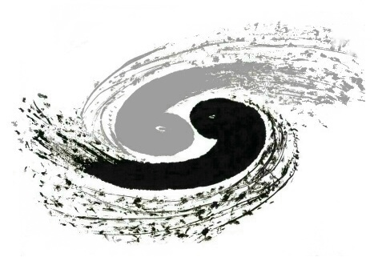

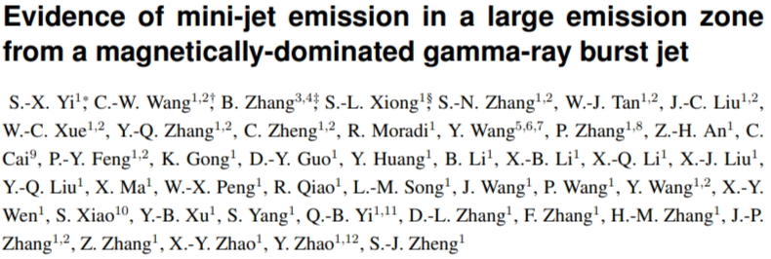
Research on the multi-band light curve of GRB230307A
Shu-Xu Yi@Pescara, 17th Marcel Grossmann Meeting
July, 2024

Slide 2

Research on the multi-band light curve of GRB230307A
Shu-Xu Yi@Pescara, 17th Marcel Grossmann Meeting
July, 2024
Notes:
Good morning dear colleagues, I’m happy to take this opportunity to report to you our recent results on this gamma-ray bursts, 0307A. I’m presenting this work on behalf of all the co-authors of this paper, which has been post on arXiv. I hope during this talk, you can be convinced that, this burst provides valuable and unique information on the prompt emission mechanism of GRB.

Slide 3
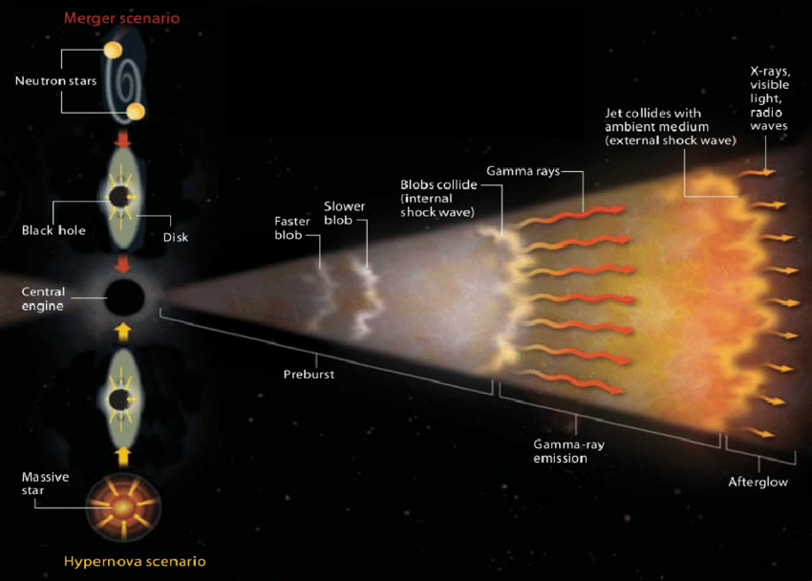
Internal shock vs. ICMART
Collision between fast and slower ejecta
 | Internal Shock | ICMART
Dominating energy | Kinetic energy dominated | Magnetic energy
Particle acceleration | Shock acceleration | Local turbulence induced magnetic reconnection in mini-jet
 | One shock, one pulse | One mini-jet, one pulse
Piron 2015
Notes:
Hear is the general picture of gamma-ray: the energy is first given from the central engine to the relativistic jet. And at some distance, the energy in the jet is further dissipated into radiation, and that’s what we see in the prompt emission of GRBs. Here we want to focus on two major branches of dissipation models, the first is the standard internal shock picture, where the energy of the jet is stored as the kinetic energy of particles, and the dissipation happens when a pair of jet shells collides and triggers shock; the other picture, is represent by the ICMART model, where the energy in the jet is mainly magnetic energy, and the dissipation mechanism are random reconnection in mini-jets.

Slide 4
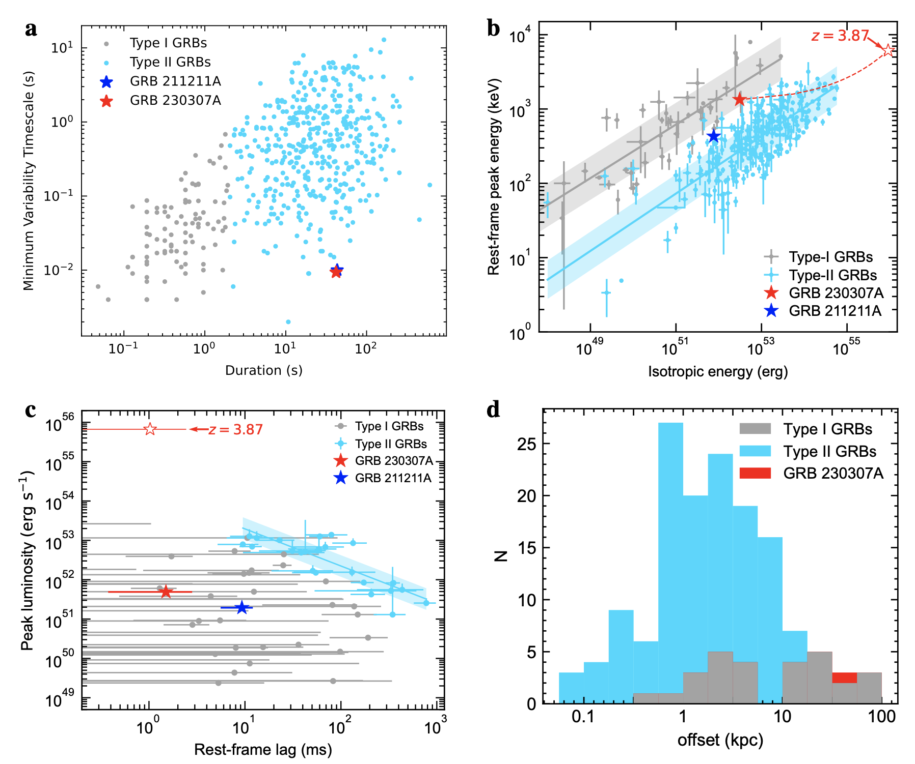
GRB230307A
Second brightest GRB
  Peak flux: 4.5e-4 erg/cm2/s
  Total fluence: 3e-3 erg/cm2
Triggered GECAM-B at 15:44:06 UT on 7th March and also detected by GECAM-C; Firstly reported by GECAM via GCN
The prompt emission also detected by LEIA (0.5-4 keV)
T90~41 second: Long in duration but similar to Type I in parameters space
Association of a Kilonova
Sun et al. 2023
Notes:
Come to this burst, the GRB230307A is the second brightest GRB, it was firstly reported by the GECAM. There is something special about the burst. its duration is 41s, we can say it’s a long gamma-ray burst. So it falls into the traditionally called long GRBs, or now days, people prefer to say type II GRBs. But its other properties indicate that it’s more like a type I GRB, or the merger induced GRB. One key evidence is that, it was found to be associated with a Kilonova. And we know that a kilonova requires a neutron rich environment, that again imply that there should be a neutron star in its progenitor system.

Slide 5

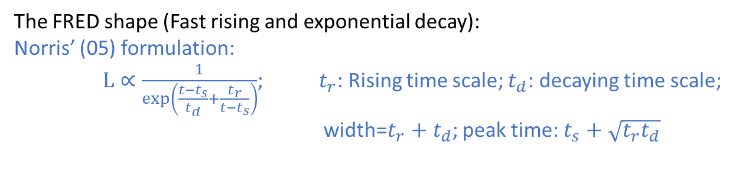
light curve in multi-E bands act like a single pulse
The FRED shape (Fast rising and exponential decay):
Norris’ (05) formulation:
$L∝\frac{1}{\exp\left(\frac{t−t_{s}}{t_{d}}+\frac{t_{r}}{t−t_{s}}\right)}$; $t_{r}$: Rising time scale; $t_{d}$: decaying time scale;
width=$t_{r}+t_{d}$; peak time: $t_{s}+\sqrt{t_{r}t_{d}}$
width and t_p following the same
E dependence power law;
New FRED formulation with one less
degree of freedom
$$L∝\frac{\left(t−t_{s}\right)}{τ_{E}}\exp{−\frac{{t−t}_{s}}{τ_{E}}}$$
Notes:
Here you can see the light curve of the burst, in multiple energy band. We can see two things:
The overall shape of the light curve in all the energy band follow similar shape. We call it a FRED shape, or the Fast rising and exponential decay shape.
The shape of the FRED is changing with observing energy: as you go to lower energy, the shape is wider, and peaks later. We found that the width of the FRED and its peaking time follow a power law with the energy. It’s a classic behavior of GRB pulse. So here the conclusion is that, the overall light curve seems to be dominated by a single broad pulse.

Slide 6
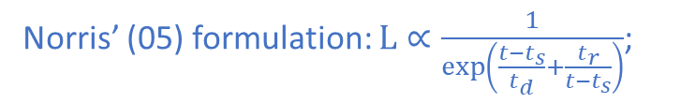
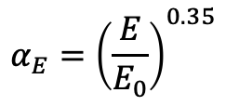

Self-similarity of the pulse
New FRED formulation with one less
degree of freedom
$$L∝\frac{\left(t−t_{s}\right)}{τ_{E}}\exp{−\frac{{t−t}_{s}}{τ_{E}}}$$
shape identities across E bands:
Norris’ (05) formulation: $L∝\frac{1}{\exp\left(\frac{t−t_{s}}{t_{d}}+\frac{t_{r}}{t−t_{s}}\right)}$;
“stretch” in time
$$α_{E}={\left(\frac{E}{E_{0}}\right)}^{0.35}$$
Notes:
An interesting feature of the broad pulse is that, if you stretch the pulse in time axis with an energy dependent scaling factor, you can find that the pulse shape become identical in all energy bands! It means the shape of the FRED can be describe by this new FRED formula. If you compare this new FRED formulation, with the traditional Norris formulation, you would think here the new formulation contain more physical implication: ]something is linearly growing, while another thing is exponential decay, the tradeoff of two that gives this overall shape.

Slide 7
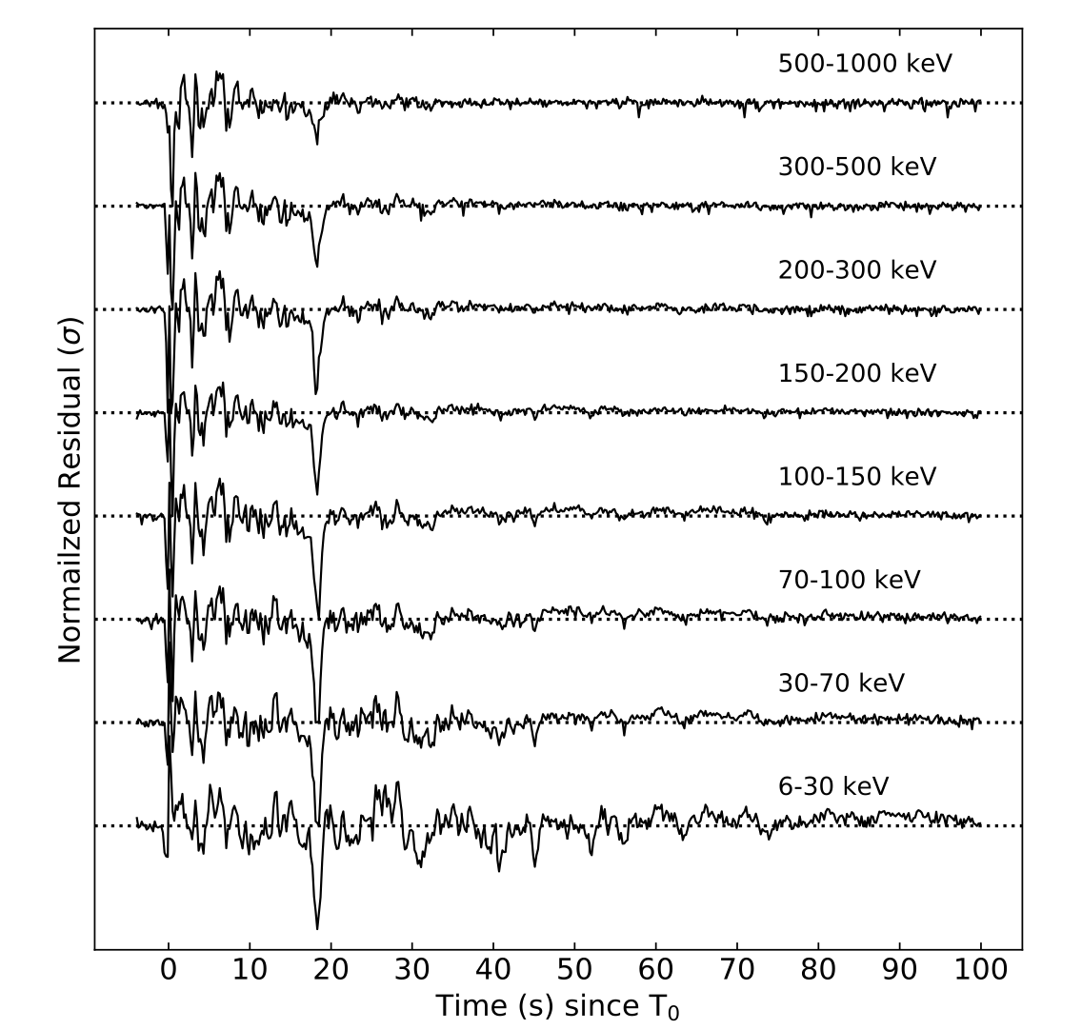
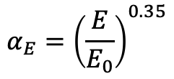
Fast components and the dip ~18s.
fast components aligned already!
only work for slow component!
“stretch” in time
$$α_{E}={\left(\frac{E}{E_{0}}\right)}^{0.35}$$
Notes:
OK, an overall FRED behavior is not something new. Here we can resolve many fast components in the light curve, on the top of the slow pulse, that’s not new either.
What makes the case new is that, we can see there is a very deep dent, or dip here. In the residual light curve, you can see it clearer, it aligns in time in all energy bands, and very deep with negative value.

Slide 8

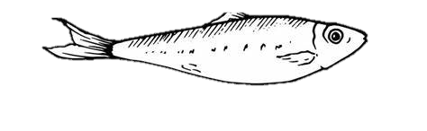

~18 s dip
No underlying big fish, but the school of fish coordinate themselves to mimic one big fish
Notes:
Now please allow me to make an analogue: suppose we see a big shadow of a huge sardine fish swimming in the sea, and around the big sardine there are shapes of smaller sardines, people will naturally think, well, there are a big mother sardine, and on top of her, there are many baby sardines, that’s what people always thought. But then, we suddenly see that, at the place where the mother sardine should be, there is a void, a transparent hole. So that immediately tell us, that, there is no mother sardine, there is only a school of small sardines, but they are coordinating themselves so that they are acting like a big sardine.

Slide 9
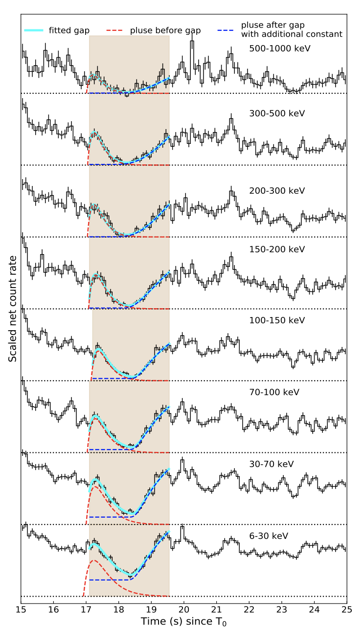
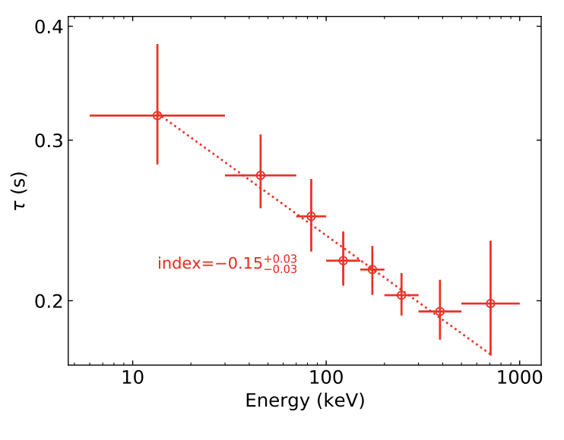
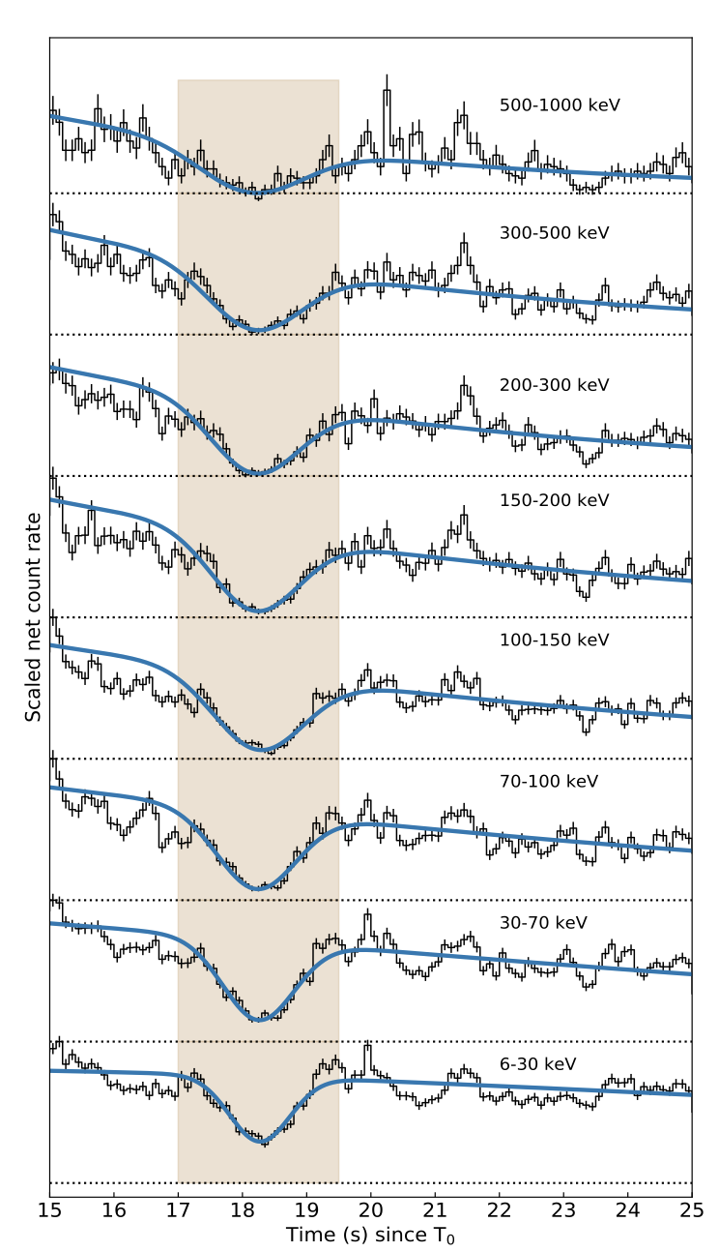
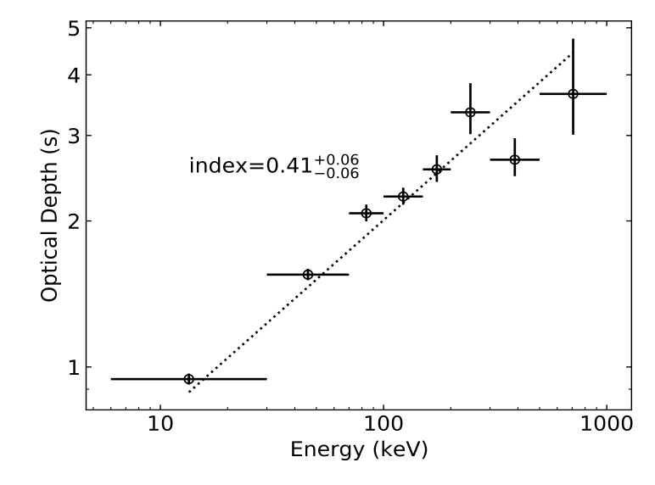
Dip around 18 s
Can’t be absorption feature
pulse width-E dependence
Effective optical depth
Notes:
We have also proven that the dip couldn’t be a feature of blocking or absorption.
if an absorbing object flies by the line-of-sight, and blocks the whole emission region for only 1s. That will require a superluminal transverse velocity. Otherwise, the absorbing object should be in our local Galaxy, that’s too coindencial.
If that’s absorption, then the optical depth has an positive energy dependence with a power index of 0.41 That means the absorption cross section depend on energy to the index 0.41. We don’t know any physics giving that cross-section-energy dependence.

Slide 10
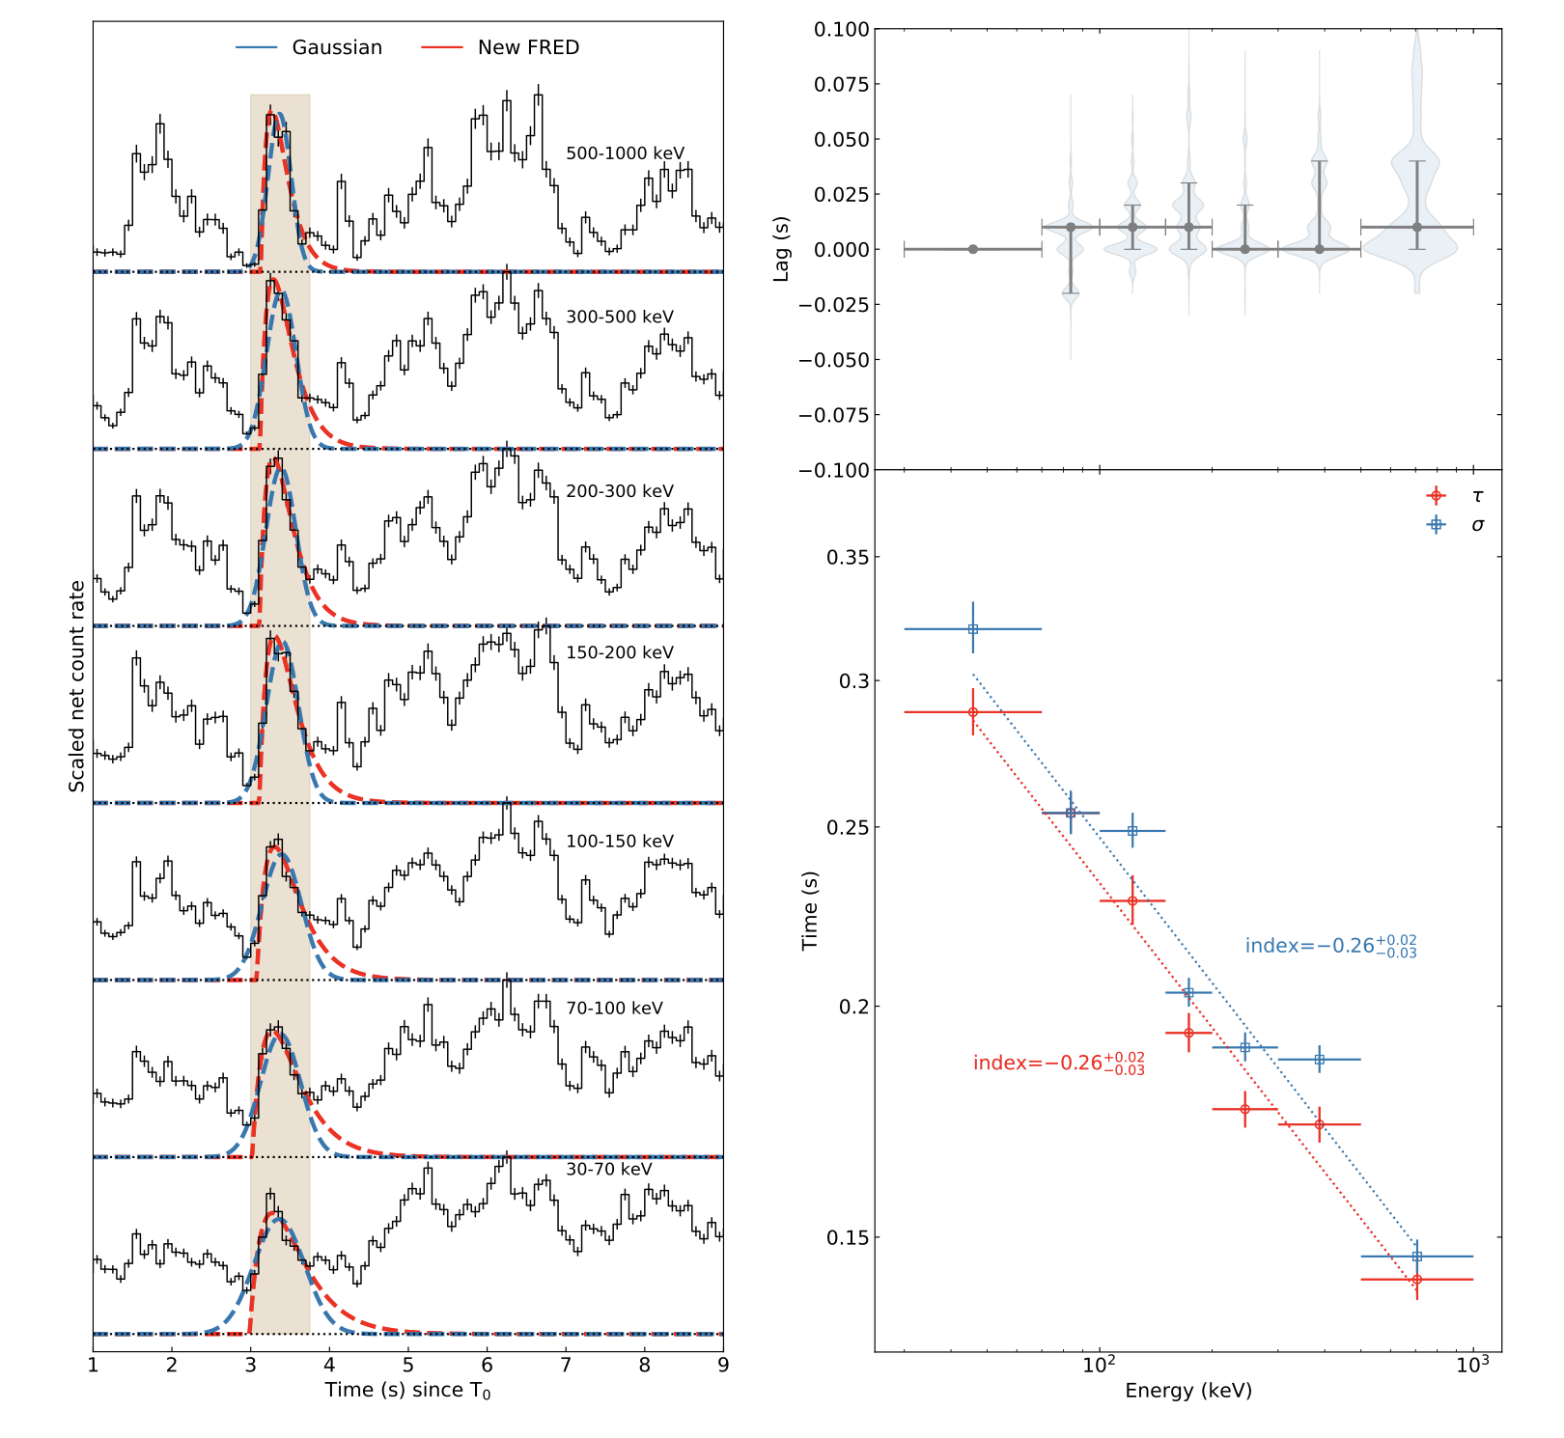



Fast components
Overall light curve= Elementary Slow component + Fast components?
or
Slow component = $Σ$Fast components ?
Negative residuals
Notes:
Here are some other evident that an underlying big sardine is not there.

Slide 11
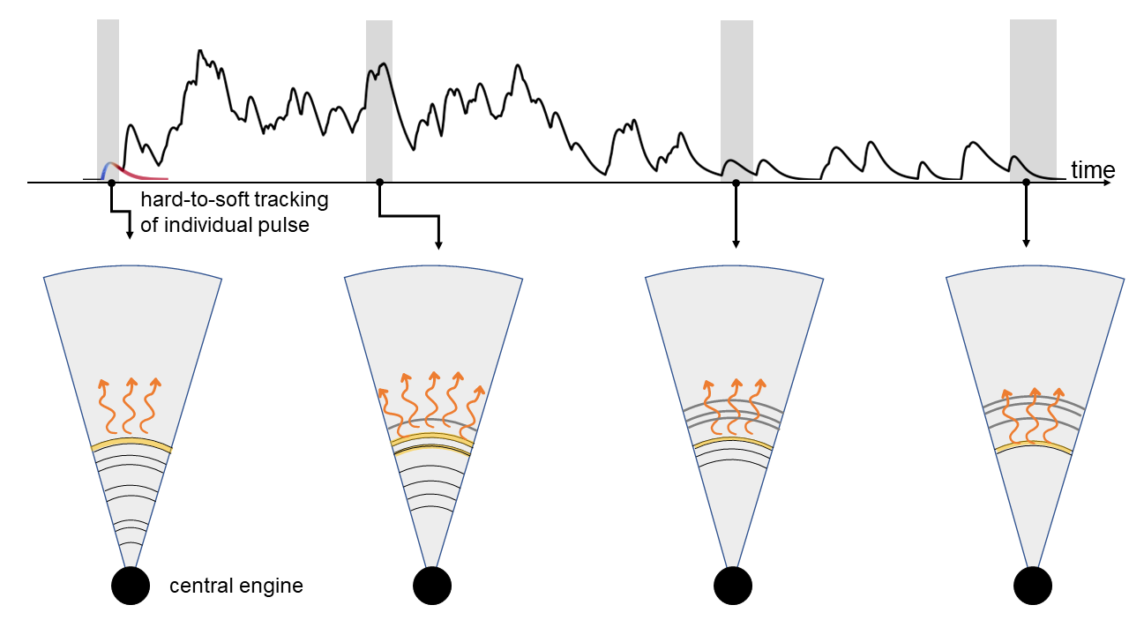

Difficult to explain with internal shock
There is no underlying elementary slow pulse.
$Σ$Fast components = typical broad pulse.
Internal shock (case A):
  No overall shape-E
  dependence
Notes:
So, the observational conclusion is that:
There is no underlying elementary slow component,
The fast pulses are correlated in time, to resemble a broad pulse, and show the classic overall shape-energy dependence.
These features are very difficult for internal shock model to reproduce. Because in the IS model, a fast pulse corresponds to a random collision between a shell pair. So how they could act in coordination to have a overall shape-energy dependence?

Slide 12
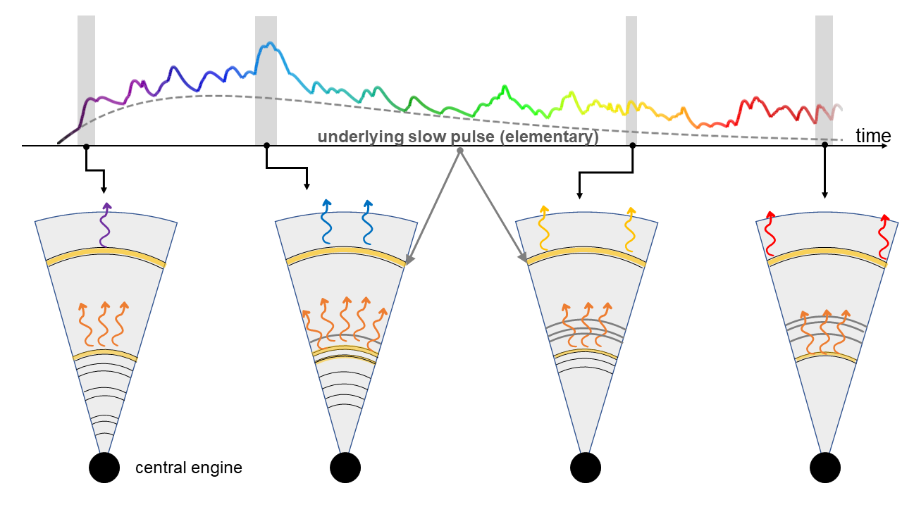

Difficult to explain with internal shock
There is no elementary slow component.
Slow component (E dependent) = $Σ$Fast components.
Internal shock (case B):
  overall shape-E
  dependence
  But:
  There is underlying
  Slow pulse
Notes:
Here we show another case in the internal shock picture. A shock at larger distance gives the overall broad pulse, and many shocks at a smaller distance gives the fast pulses. It is again require an underlying slow pulse, which has already been disproven.

Slide 13
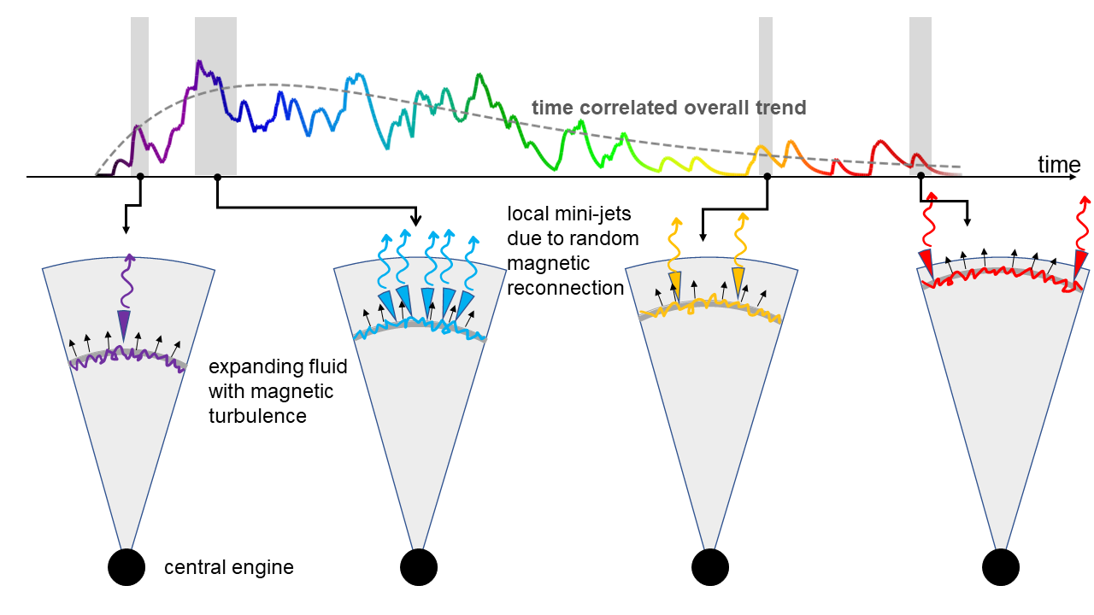
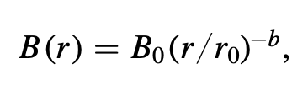


Nature in ICMART
There is no elementary slow component.
Slow component (E dependent) = $Σ$Fast components.
ICMART:
  overall shape-E
  dependence
  And no underlying
  Slow pulse
Notes:
Now, in the ICMART picture, one fast pulse corresponds to a mini-jet. But all the mini-jet are from a single expanding fluid. So as the fluid expands, the magnetic field strength decays. So we can have the overall pulse shape, overall shape-Energy dependence, very deep dent, and no underlying slow pulse required.

Slide 14
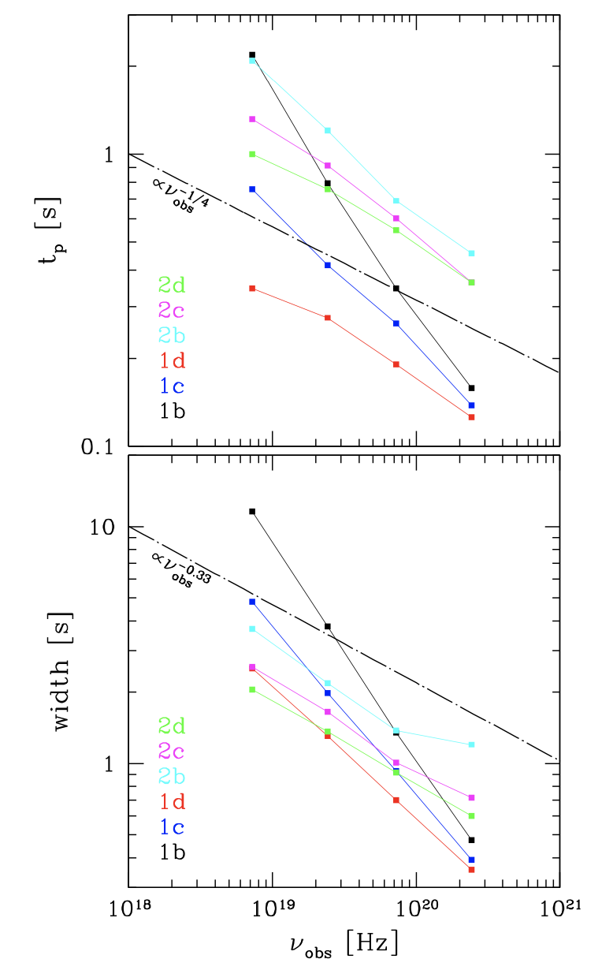
Natural in ICMART framework
Overall light curve: Expansion of a magnetic bubble
Fast pulses: local magnetic reconnection due to turbulence
As the bubble expands:
The spectrum of prompt emission
softer at later time:
Uhm et al.(2018)
Tuning in parameters to get the multi-band self-similarity

Slide 15



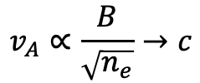





Towards a more natural self-similarity origin
Broad pulse: An ICMART event
a short pulse: random local reconnection and radation.
turbulence distance to initial collision: $r=v_{A}t$
decaying turbulence amplitude:$e^{−r}$
FRED profile: $re^{−r}=v_{A}te_{}^{−v_{A}t}$
So the decaying time scale $τ∝1/v_{A}$
$$v_{A}∝\frac{B}{\sqrt{n_{e}}}→c$$
Alfvén wave speed
Electron accelerated to energy $E_{e}$ by magnetic reconnection: $E_{e}∼\frac{B^{2}}{n_{e}}∼v_{A}^{2}$
Therefore, $τ∝E_{e}^{−0.5}$
Internal collision shell:
Energy inject at
small region initially
In case of pure synchrotron radiation: $E_{γ}∝E_{e}^{2}\overline{B}$
So: $τ_{E}∝E_{γ}^{−0.25}$

Slide 16
On its progenitor
Short single episode energy injection from centre engine → short centre engine activity → merger origin
consistent with the KN observation
Notes:
So in this picture, the central engine was only active for a short and single episode. That’s consistent with the compact merger origin picture.

Slide 17
Summary
Observation:
  Overall light curve of GRB 230307A is a single broad pulse with classic shape-E dependence;
  But this pulse is not “atom” of light curve, it can be decomposed into fast pulses.
Physical implication:
  IS-like model can’t explain this behavior
  Mini-jets in a single expanding magnetized fluid can naturally explain this.
Notes:
Now, let’s summary. Observationally, we demonstrate that:

