Slide 1



Cosmology and multi-messenger astrophysics with next-generation GRB space missions
Lorenzo Amati
(INAF – OAS Bologna)
Pescara, 11th July 2024

Slide 2
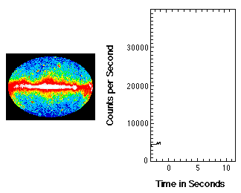
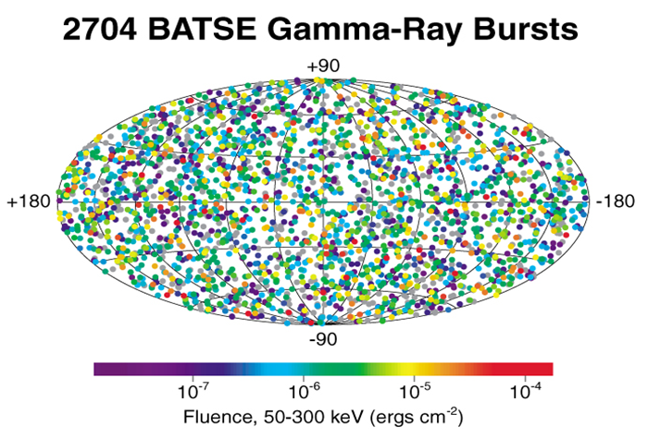
Gamma-Ray Bursts: the most extreme phenomena in the Universe
About 1 per day detected by gamma-ray photons detectos put on satellites operating in low-Earth (500-600 km) orbit (estimated true rate of 2-3 per day)
Coming from random directions and random times; non repeating
Huge intensity, overshining those of all other X/gamma-ray sources in the sky

Slide 3
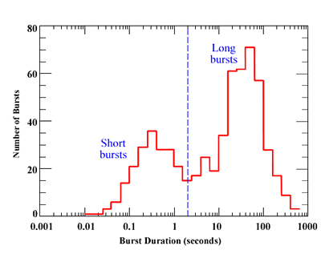
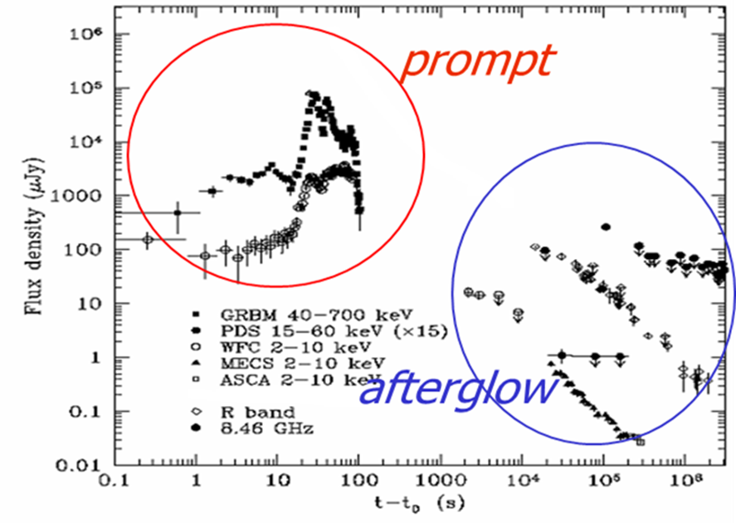
Gamma-Ray Bursts: the most extreme phenomena in the Universe
Two main flavors: short (lasting less than a few s) and long (more frequent, lasting typically from tens of s to minutes))
GRB are followed by a slowly decaying emission, the “afterglow”, detectable at any wavelength (X, UV, visibile, IR, radio,)

Slide 4
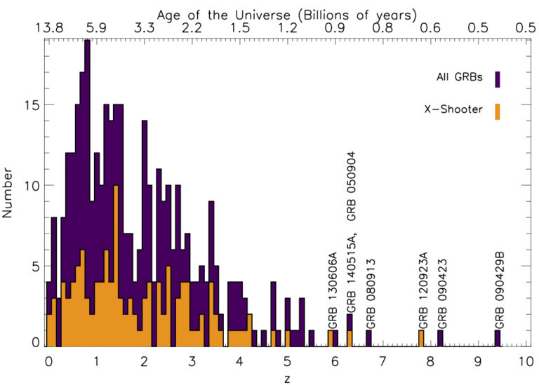
Gamma-Ray Bursts: the most extreme phenomena in the Universe
In 1997, first measurements of GRB distances (through the redshift of the spectral lines in the oprtical/NIR afterglow emission): GRBs are cosmological events with huge luminosities

Slide 5
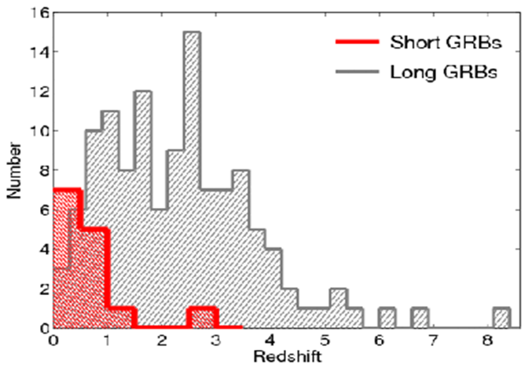
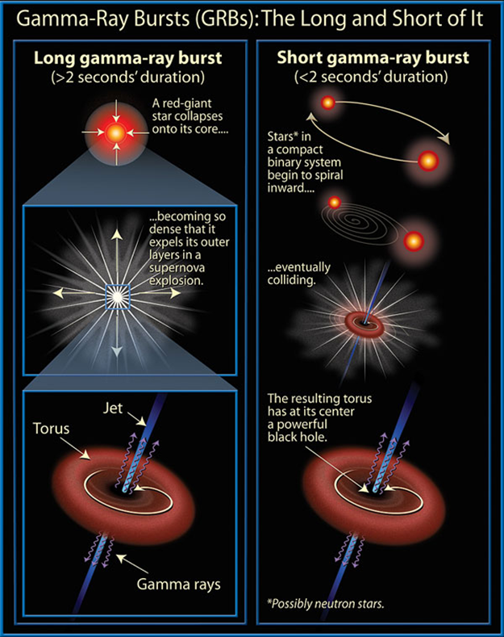
Gamma-Ray Bursts: the most extreme phenomena in the Universe
Long GRBs: core collapse of pecular massive stars, association with SN
Short GRBs: NS-NS or NS-BH mergers, association with GW sources

Slide 6
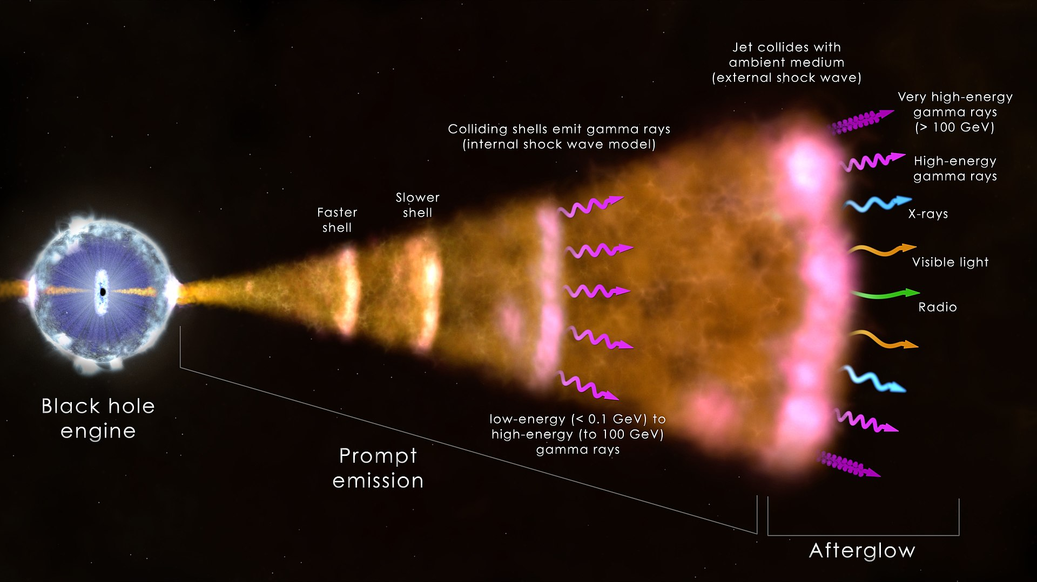
Gamma-Ray Bursts: the most extreme phenomena in the Universe
Long GRBs: core collapse of pecular massive stars, association with SN
Short GRBs: NS-NS or NS-BH mergers, association with GW sources

Slide 7
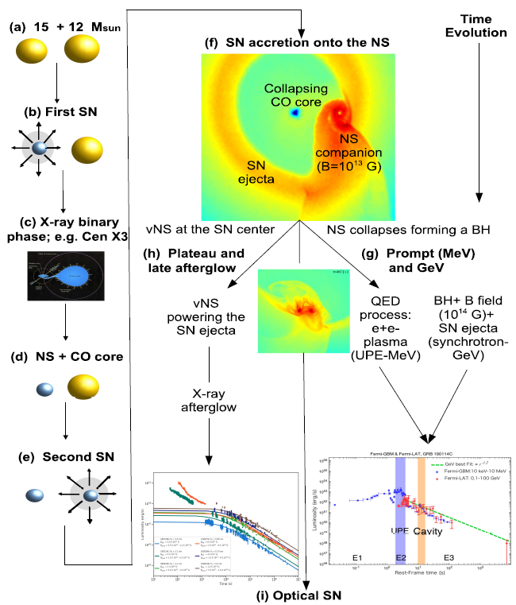
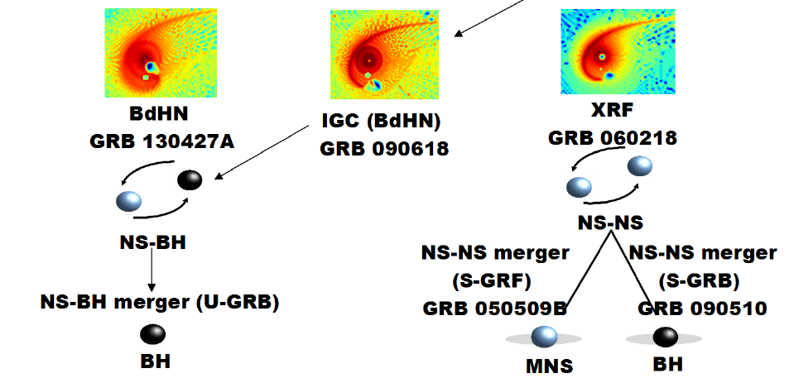
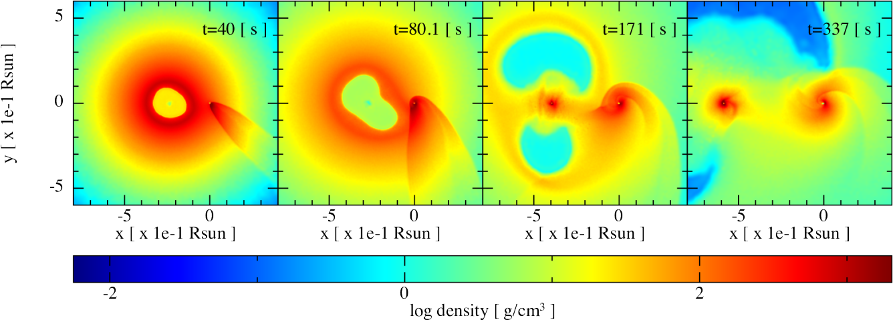
Gamma-Ray Bursts: the most extreme phenomena in the Universe
The binary-driven hypernova model
Bianco et al., ApJ 2024; Aimuratov et al. ApJ 2023; Rueda, et al., ApJ 2022; Ruffini, et al., MNRAS 2021; Moradi, et al., A&A 2021; Rueda, et al., ApJ 2020; Rueda & Ruffini, EPJC 2020; Ruffini, et al., ApJ 2019; Becerra, et al., ApJ 2019; Ruffini, et al., ApJ 2018; Ruffini, et al., ApJ 2018; Becerra, et al., ApJ 2016; Fryer et al., PRL 2015; Fryer, et al., APJL 2014; Rueda & Ruffini, APJL 2012

Slide 8
The ESA Cosmic Vision Programme
Selected missions
S1: CHEOPS (exoplanets, 2019)
M1: Solar Orbiter (solar astrophysics, 2020)
M2: Euclid (cosmology, 2023)
L1: JUICE (exploration of Jupiter system, 2023)
S2 (ESA-CAS): SMILE (solar wind-magneto/ionosphere, 2025)
M3: PLATO (exoplanets, 2026)
F1: COMET INTERCEPTOR (solar system origin, 2026)
M4: ARIEL (exoplanets, 2028)
F2: ARRAKIHS (cosmology through faint galaxies, 2030)
M5: ENVISION (exploration of Venus, 2032)
L3: LISA (gravitational wave observatory, 2035)
L2: NEWATHENA (X-ray obs., cosmology, MMA, 2037)

Slide 9
The ESA Cosmic Vision Programme
Selected missions
M1: Solar Orbiter (solar astrophysics, 2017)
M2: Euclid (cosmology, 2020)
L1: JUICE (exploration of Jupiter system, 2022)
S1: CHEOPS (exoplanets, 2017)
M3: PLATO (exoplanets, 2024)
L2: ATHENA (X-ray observatory, cosmology 2028)
[L3: gravitational wawes observatory (eLISA) 2032 ]
Resonant keywords: cosmology (dark energy, dark matter, re-ionization, structures formation and evolution), fundamental physics (relativity, quantum gravity, QCD, gravitational wave universe), life (exoplanets formation + evolution + census, solar system exploration)

Slide 10
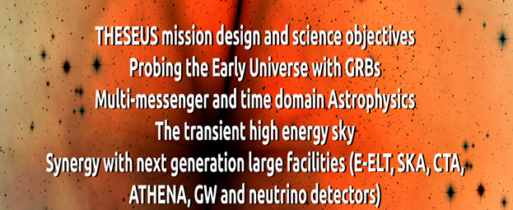
Next generation GRB missions (‘30s)
THESEUS (studied for ESA Cosmic Vision / M5), HiZ-GUNDAM (JAXA, under study), Gamow Explorer (proposal for NASA MIDEX): prompt emission down to soft X-rays, source location accuracy of few arcmin, prompt follow-up with NIR telescope, on-board REDSHIFT

Slide 11
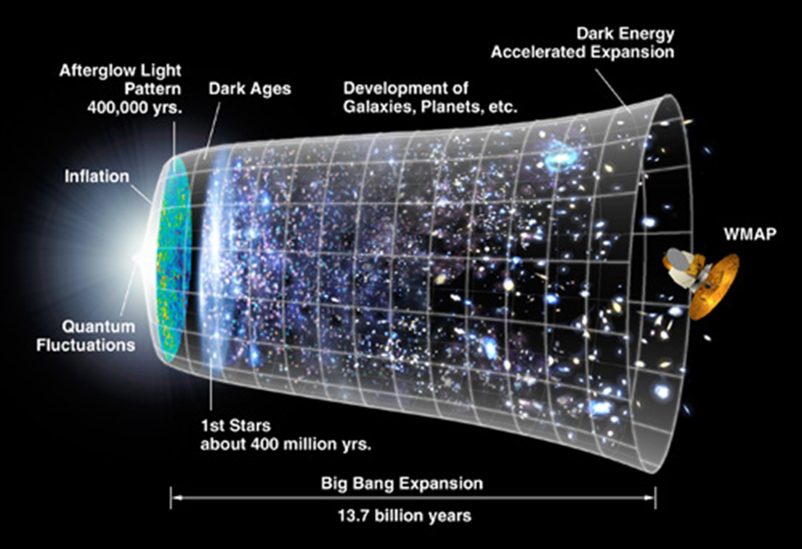
Shedding light on the early Universe with GRBs

Slide 12
Shedding light on the early Universe with GRBs

Slide 13
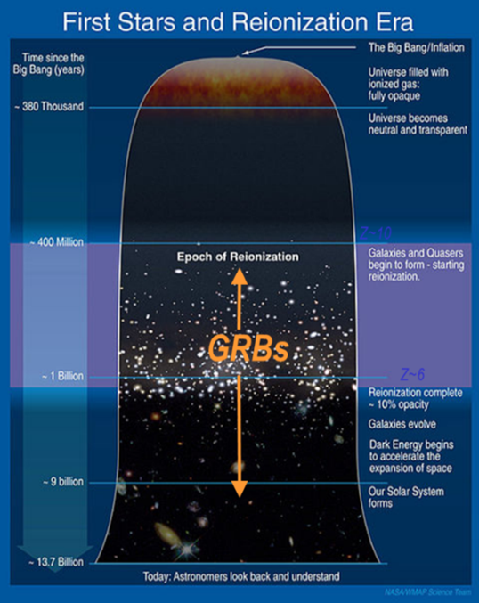
Shedding light on the early Universe with GRBs
Long GRBs: huge luminosities, mostly emitted in the X and gamma-rays
Redshift distribution extending at least to z ~9 and association with exploding massive stars
Powerful tools for cosmology: SFR evolution, physics of re-ionization, high-z low luminosity galaxies, pop III stars

Slide 14
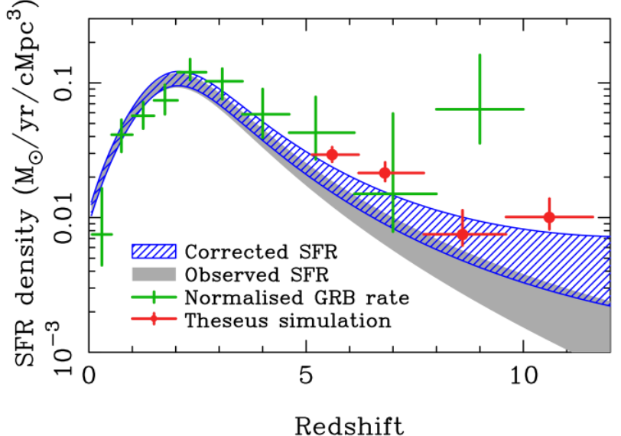
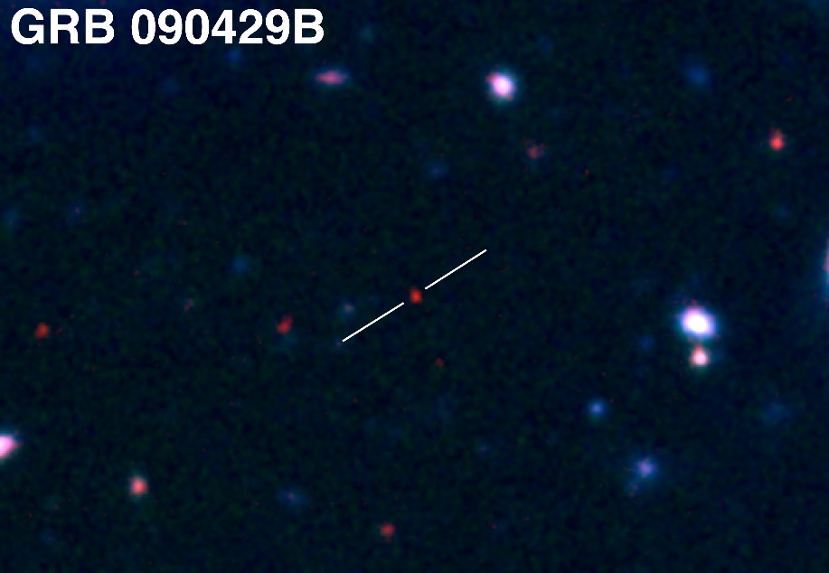
Shedding light on the early Universe with GRBs
A statistical sample of high–z GRBs can provide fundamental information:
measure independently the cosmic star–formation rate, even beyond the limits of current and future galaxy surveys
directly (or indirectly) detect the first population of stars (pop III)
Z = 9.2
Robertson&Ellis12

Slide 15
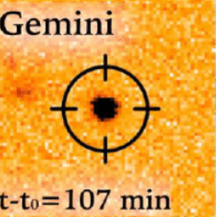
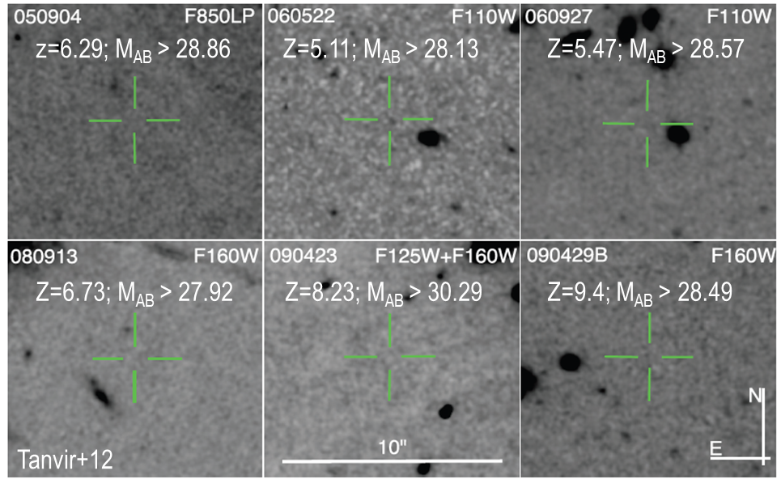
Detecting and studying primordial invisible galaxies
Robertson&Ellis12
Even JWST and ELTs surveys will be not able to probe the faint end of the galaxy Luminosity Function at high redshifts (z>6-8)

Slide 16
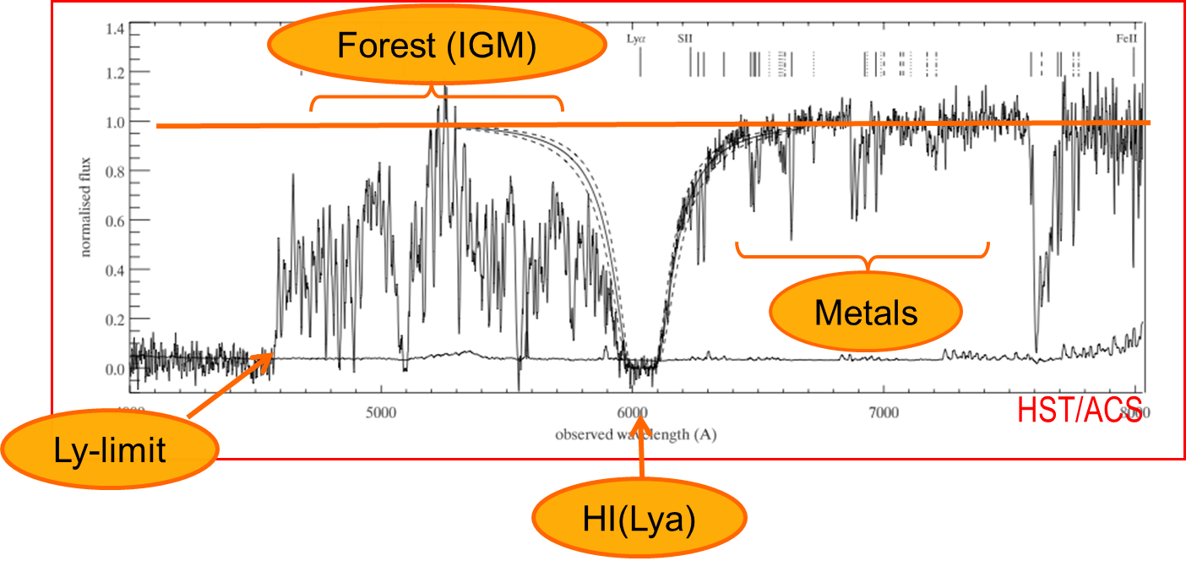
Detecting and studying primordial invisible galaxies
Robertson&Ellis12
Robertson&Ellis12

Slide 17
Detecting and studying primordial invisible galaxies
neutral hydrogen fraction
escape fraction of UV photons from high-z galaxies
early metallicity of the ISM and IGM and its evolution
Robertson&Ellis12
Robertson&Ellis12

Slide 18
Detecting and studying primordial invisible galaxies
neutral hydrogen fraction
escape fraction of UV photons from high-z galaxies
early metallicity of the ISM and IGM and its evolution
Beyond even JWST capabilities:
Primordial galaxies detection and characterization Independent on mass and luminosity
Allow absorption spectroscopy (needed because most metals are in neutral gas and and for dust ratio)
Properties of primordial IGM
Targets for JWST
Robertson&Ellis12
Robertson&Ellis12

Slide 19
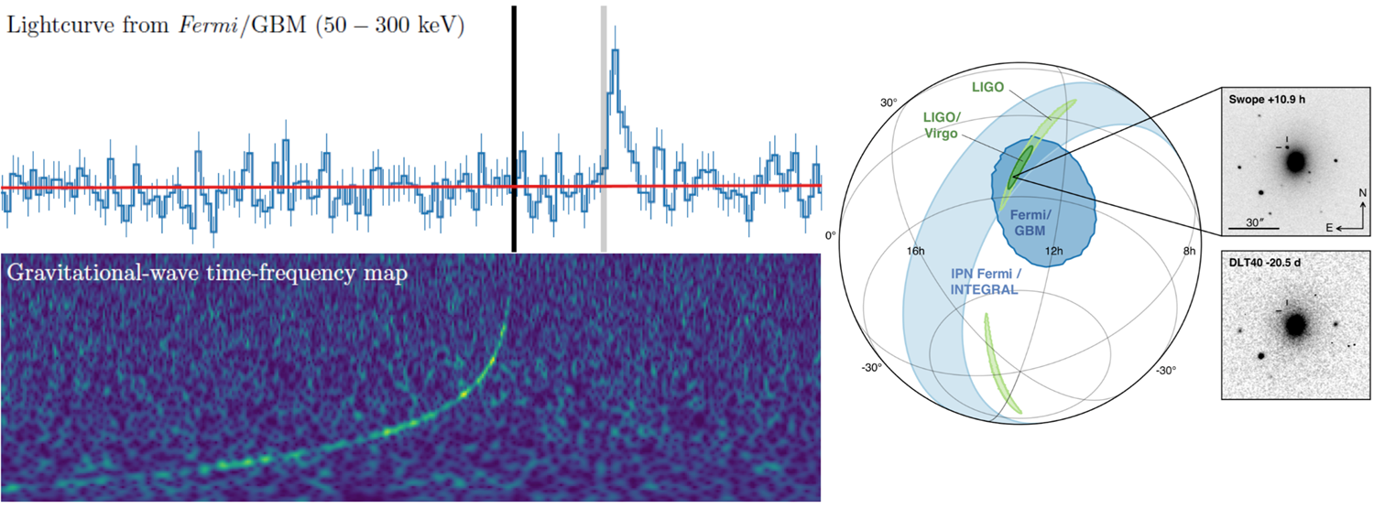
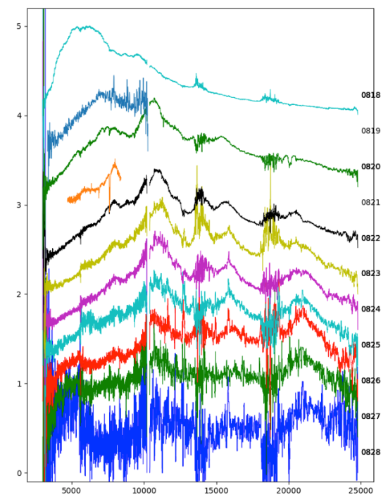
GRBs and multi-messenger astrophysics
GW170817 + SHORT GRB 170817A + KN AT2017GFO (~40 Mpc): the birth of multi-.messenger astrophysics
Notes:
Presenter’s note:

Slide 20
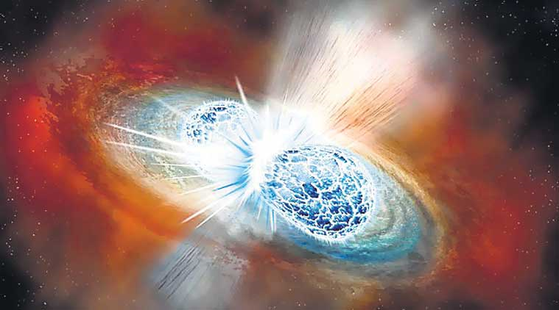
Short GRBs and multi-messenger astrophysics
GW170817 + SHORT GRB 170817A + KN AT2017GFO (~40 Mpc): the birth of multi-.messenger astrophysics
Notes:
Presenter’s note:

Slide 21
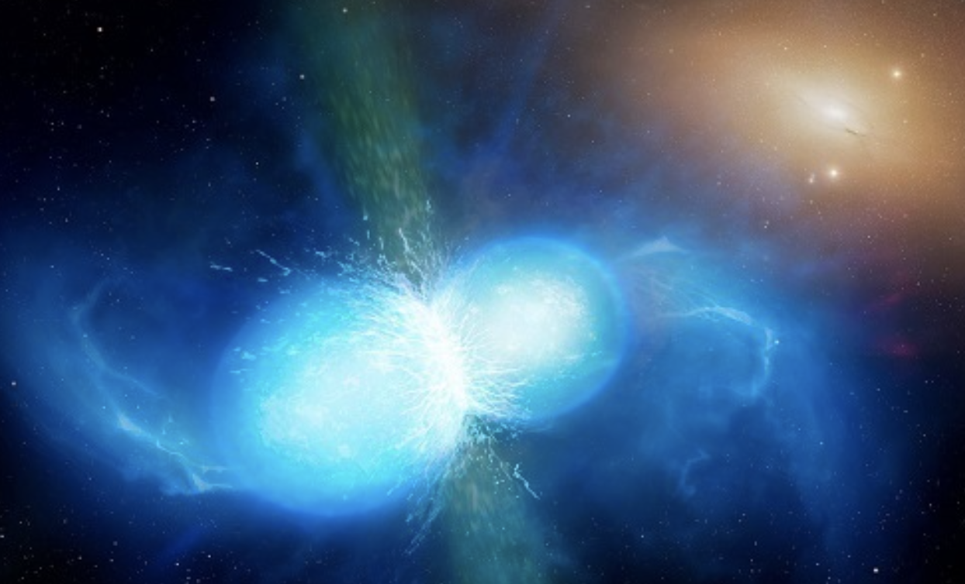
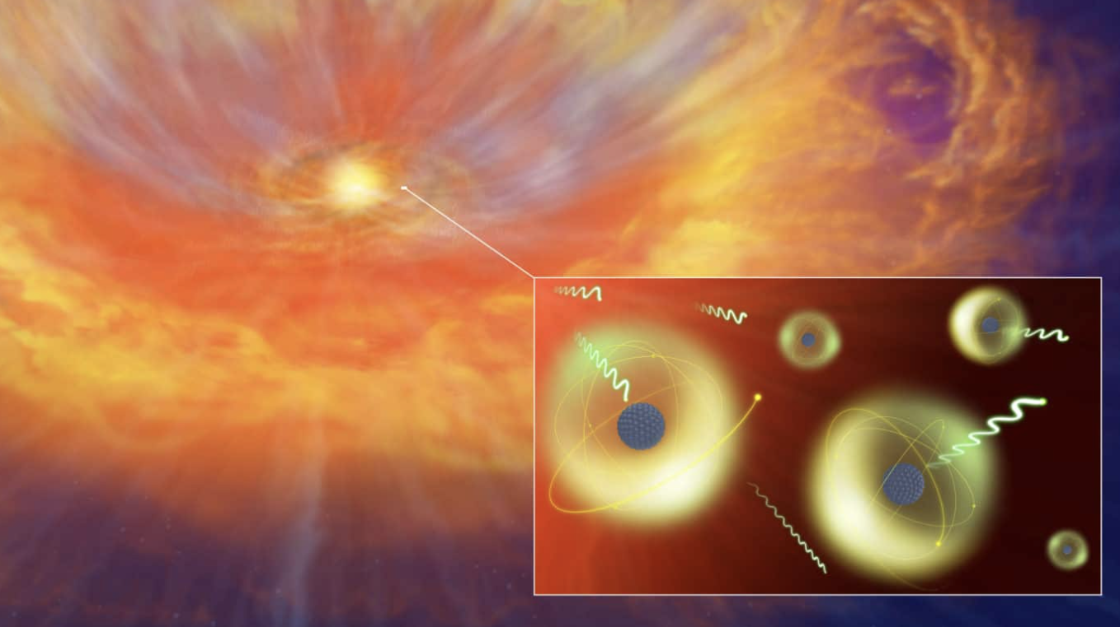
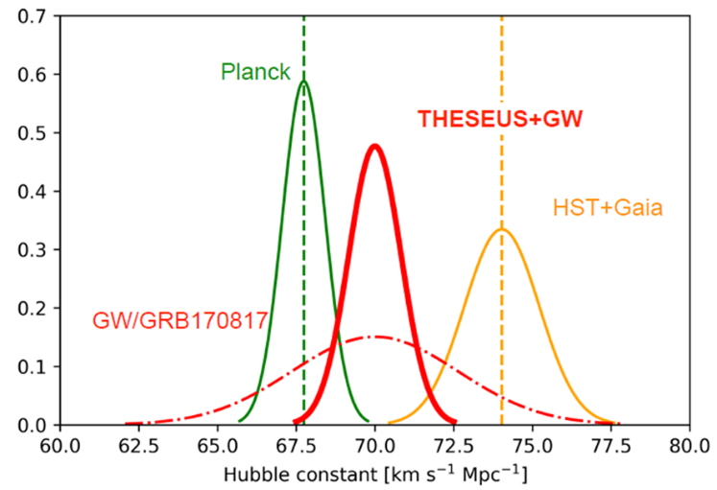
GRB: a key phenomenon for multi-messenger astrophysics (and cosmology)
Relativistic jet formation, equation of state, fundamental physics
Cosmic sites of r-process nucleosynthesis
New independent route to measure cosmological parameters
Notes:
Presenter’s note:

Slide 22
Expected progress in the near future (’20s)
Continuing operations of current main GRB / related missions (Swift, Fermi, Konus-WIND, GECAM, HXMT, MAXI, GRBalpha, …)
New / near future GRB / related missions (EP, SVOM, POLAR-2, COSI, …) and cubesats networks (e.g., HERMES)
Synergies with new / growing on-ground very large facilities (late ’20s): JWST, ELT, LSST, CTA, SKA, upgraded 2nd generation GW and neutrino detectors
Main improvements on GRB physics, incremental progress in GRB cosmology, little progress in multi-messenger astrophysics (mostly limited by capabilities of 2G detectors)

Slide 23
The breakthrough: next generation GRB missions for the ‘30s
THESEUS (under study by ESA as candidate M7 mission), HiZ-GUNDAM (JAXA, under study), Gamow Explorer (proposal for NASA MIDEX): prompt emission down to soft X-rays, source location accuracy of few arcmin, prompt follow-up with NIR telescope, on-board REDSHIFT

Slide 24

- 2018-2021: ESA Phase-A study (2018-2021) as M5 candidate
- 2022: Selected for Phase 0 study (2023) within M7 process
- 2023: Selected for Phase-A study (2024-2026) as M7 candidate
- M7 timeline: Phase-A (2024-2026), adoption 2028, launch 2037
Payload consortium: Italy, Germany, UK, France, Switzerland, Spain, Poland, Denmark, Belgium, Czech Republic, The Netherlands, Norway, Slovenia, Ireland (+ Hungary?)
Leads: L. Amati (INAF – OAS Bologna, Italy, lead proposer), A. Santangelo (Un. Tuebingen, D), P. O’Brien (Un. Leicester, UK), D. Gotz (CEA-Paris, France), E. Bozzo (Un. Genève, CH)
Amati et al. 2018 ( Adv.Sp.Res., arXiv:1710.04638 )
Stratta et al. 2018 (Adv.Sp.Res., arXiv:1712.08153)
Articles for SPIE 2020 and Exp..Astr. (all on arXiv)
http://www.isdc.unige.ch/theseus
http://www.isdc.unige.ch/theseus/

Slide 25
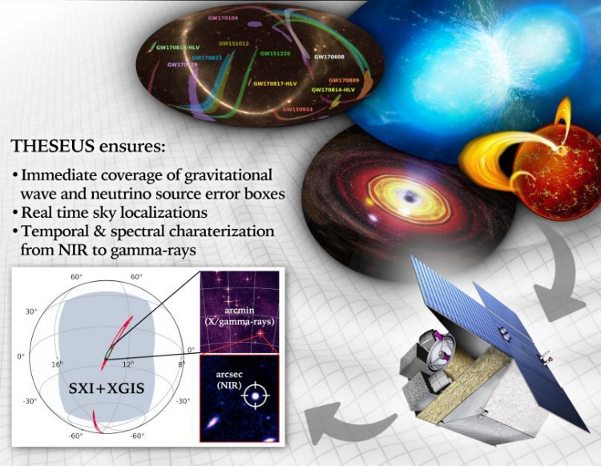
THESEUS core science goals
Probe the early Universe (first stars, first galaxies, cosmic reionization), by unveiling and exploiting the population of extremely distant cosmic Gamma - Ray Bursts (GRB)
Provide a fundamental contribution to multi-messenger astrophysics through GRB produced by merging neutron stars and other X/gamma-ray transient sources
Notes:
Presenter’s note:

Slide 26
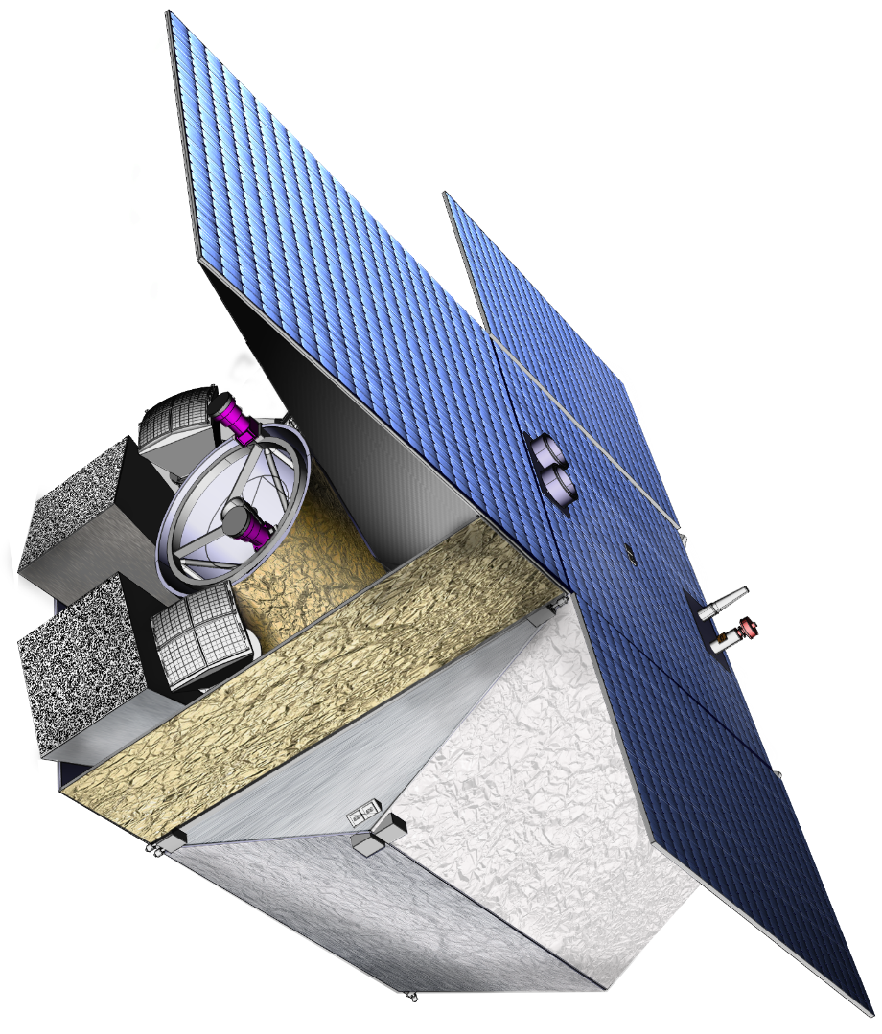
THESEUS Mission Concept
THIS BREAKTHROUGH WILL BE ACHIEVED BY A MISSION CONCEPT OVERCOMING MAIN LIMITATIONS OF CURRENT FACILITIES
Set of innovative wide-field monitors with unprecedented combination of broad energy range from gamma-rays down to soft X-rays, FOV and localization accuracy
Notes:
Presenter’s note:

Slide 27
THESEUS Mission Concept
THIS BREAKTHROUGH WILL BE ACHIEVED BY A MISSION CONCEPT OVERCOMING MAIN LIMITATIONS OF CURRENT FACILITIES
Set of innovative wide-field monitors with unprecedented combination of broad energy range from gamma-rays down to soft X-rays, FOV and localization accuracy
On-board autonomous fast follow-up in optical/NIR, arcsec location and redshift measurement of detected GRB/transients
Notes:
Presenter’s note:

Slide 28
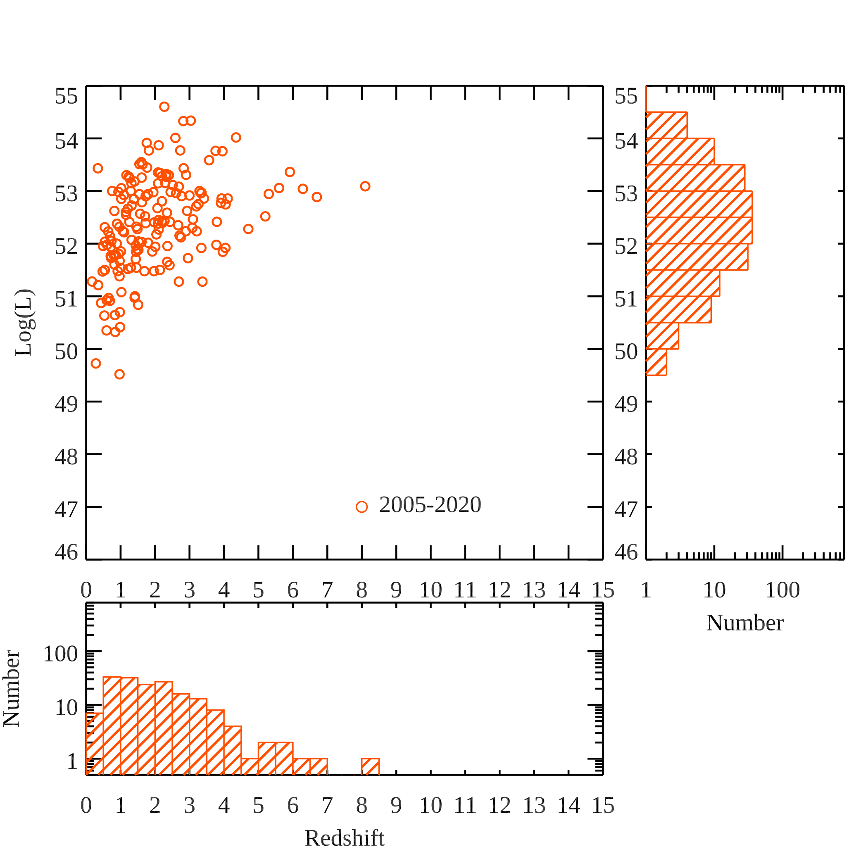
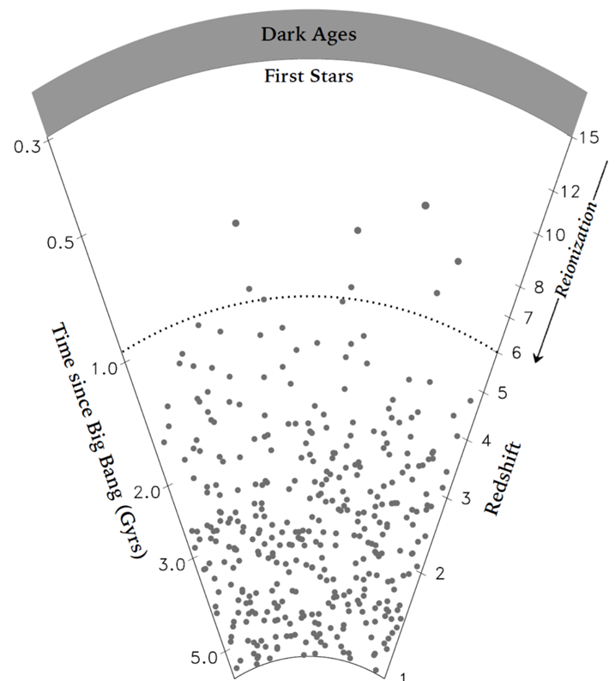
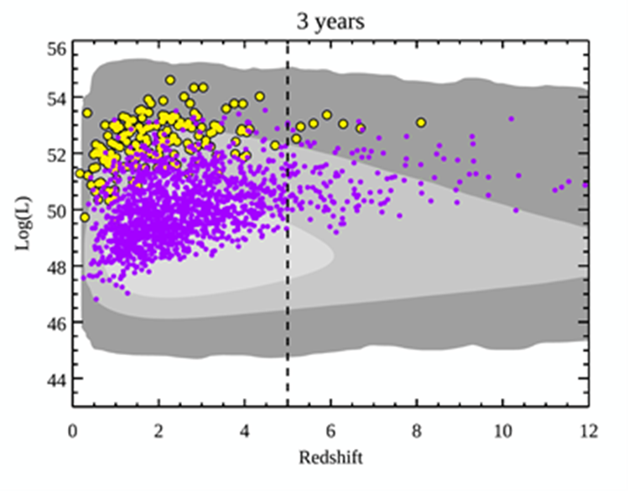
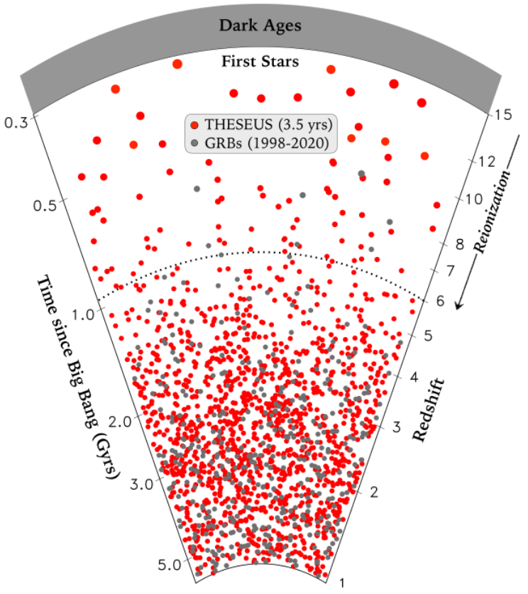
Expected performances: early Universe

Slide 29
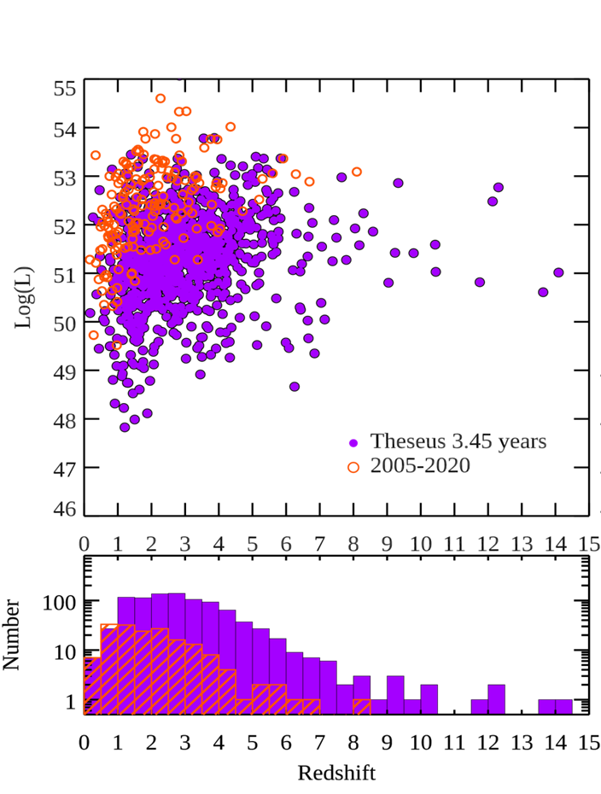
Expected performances: early Universe

Slide 30
Expected performances: multi-messenger astr.
GW170817 + SHORT GRB 170817A + KN AT2017GFO (~40 Mpc): the birth of multi-.messenger astrophysics
Notes:
Presenter’s note:

Slide 31

Expected performances: multi-messenger astr.
THESEUS:
short GRB detection over large FOV with arcmin localization
Kilonova detection, arcsec localization and characterization
Possible detection of weaker isotropic X-ray emission

Slide 32
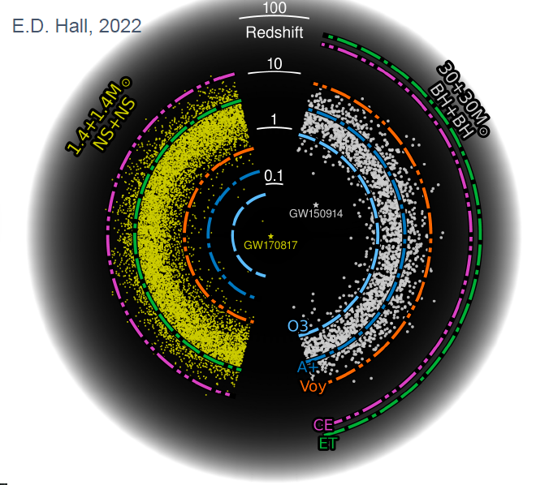
Multi-messenger science with THESEUS
  Late ’30s: great synergy with 3G GW detectors (ET, CE)
Notes:
Presenter’s note:
Very brief explanation of the red and blue KN (we can take in case another figure). Focus on explain 1) the “standard short GRB”-aligned and “soft short GRB”-misaligned issue 2) the synergy with upgraded 2G to study KN and jet structure with off-axis afterglow 3) the statistical studies possible with synergies with 3G

Slide 33

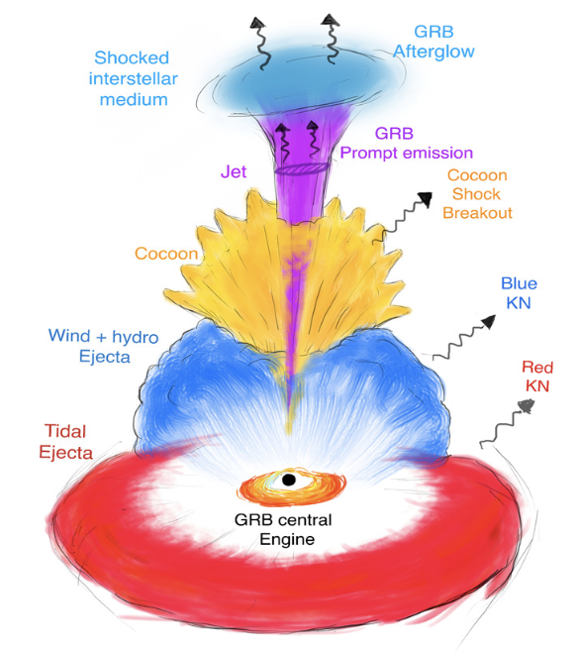
Multi-messenger science with THESEUS
INDEPENDENT DETECTION & CHARACTERISATION OF THE MULTI-MESSENGER SOURCES
Lessons from GRB170817A
Aligned GRBs
Misaligned GRBs
THESEUS + ET in 3 years:
~70 aligned+misaligned short GRB
additional long GRBs from mergers and possible GW-X-ray transients
Higher redshift events – X/𝛾 is likely only route to EM detection: larger statistical studies including source evolution, probe of dark energy and test modified gravity on cosmological scales
Notes:
Presenter’s note:
Very brief explanation of the red and blue KN (we can take in case another figure). Focus on explain 1) the “standard short GRB”-aligned and “soft short GRB”-misaligned issue 2) the synergy with upgraded 2G to study KN and jet structure with off-axis afterglow 3) the statistical studies possible with synergies with 3G

Slide 34
Multi-messenger science with THESEUS
THESEUS & 3G SCIENCE
Main topics | THESEUS role | What will we learn?
Physics of compact binaries | short GRB+GW detection and localization | relativistic jet formation mechanism/efficiency, remnant nature, NS EoS
Relativistic plasma | accurate sky coordinates of GW events associated with misaligned afterglows | Jet propagation, jet structure and its universality, NSBH vs NSNS
Physics of kilonova | accurate sky coordinates of GW events | Role of NS-NS/NSBH in r-process element nucleosynthesis
Fundamental physics | Identify counterparts for events at z>0.3 | Tests of modified gravity theories
Cosmology | accurate sky coordinates of GW events allowing redshift measurement | Independent H0 measure
:
Notes:
Presenter’s note:
With THESEUS & 2G++ we will move from GW+EM studies of single cases to a statistical approach, starting to build the full picture of compact binary coalescences and to answer questions that with 3G will find full confirmation

Slide 35
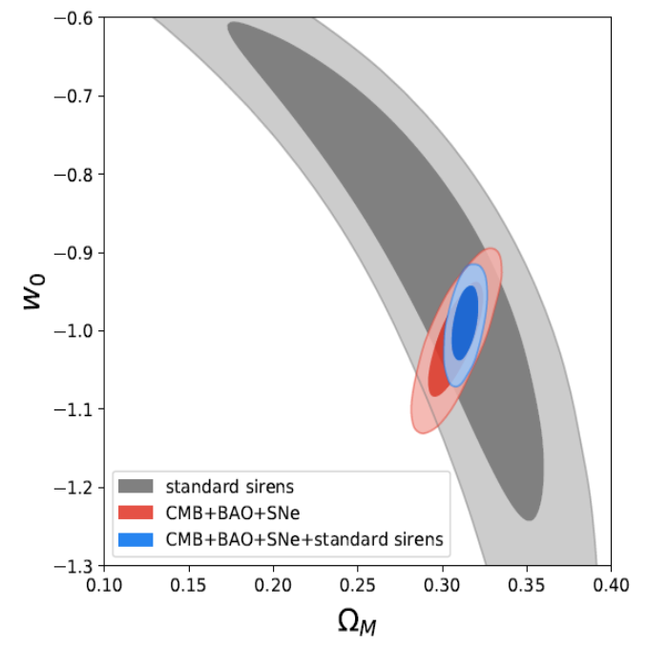
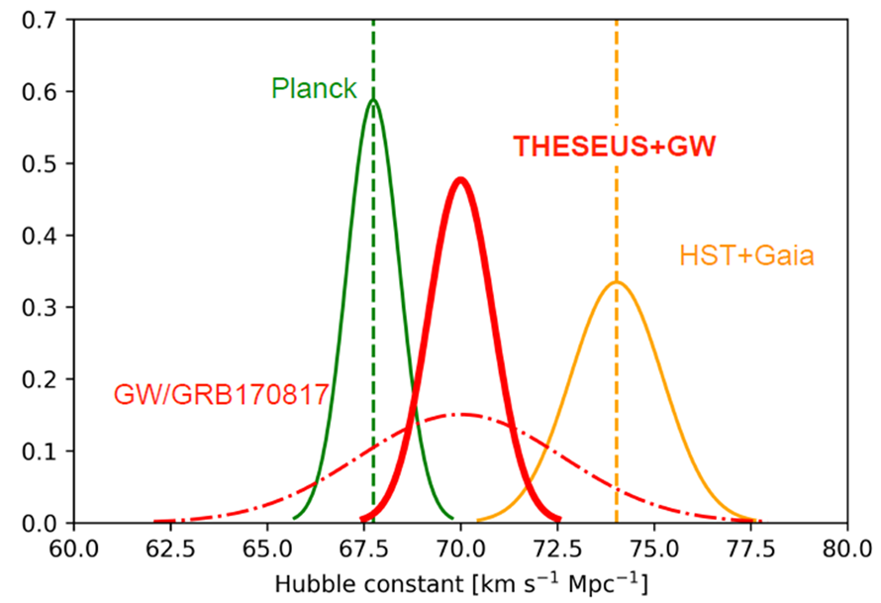
Multi-messenger cosmology
MEASURING THE EXPANSION RATE AND GEOMETRY OF SPACE-TIME
~20 joint GRB + GW events
ET collaboration
Notes:
Presenter’s note:

Slide 36
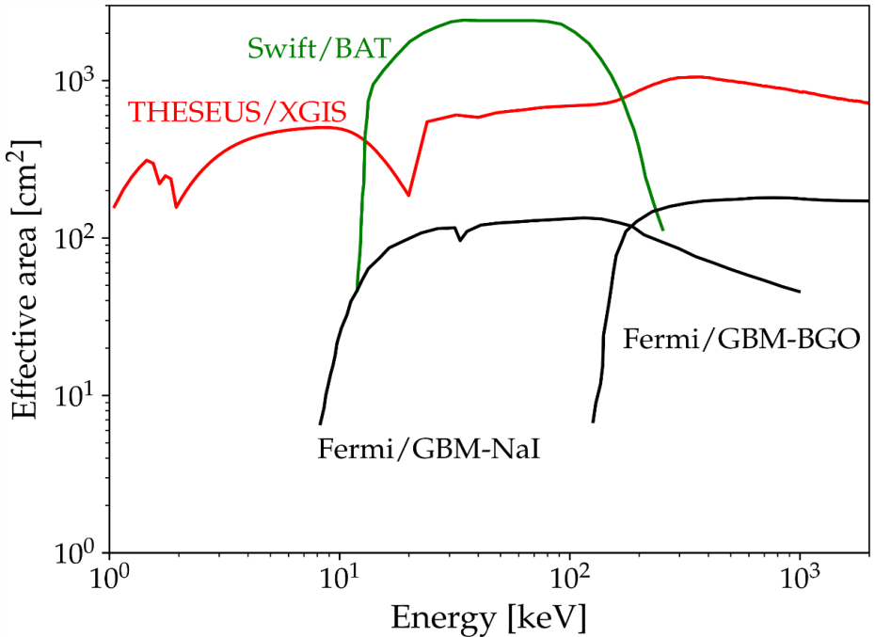
GRBs extreme and fundamental physics
THESEUS will measure the prompt and early afterglow emission of thousand GRBs over an unprecedented huge energy band (0.3 keV – 10 MeV) with great sensitivity, timing and spectroscopic capabilities, plus NR afterglow and redshift measurement

Slide 37
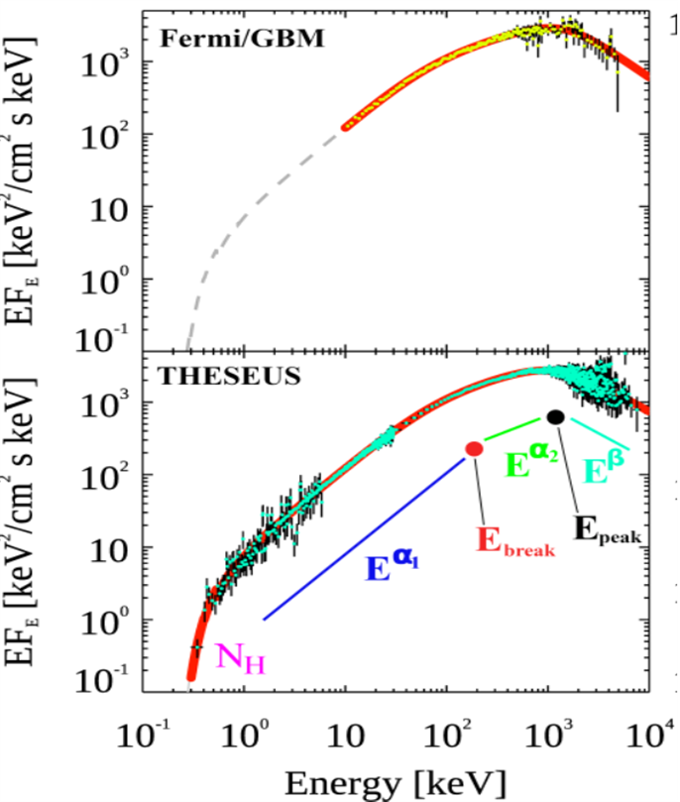
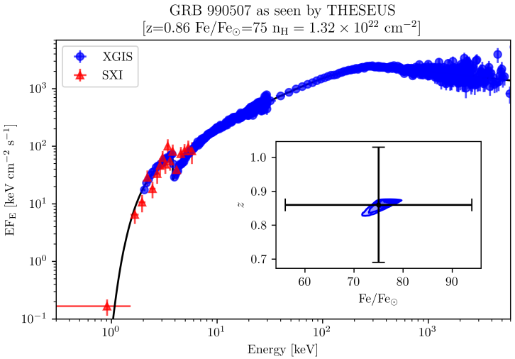
GRBs extreme and fundamental physics
Extreme prompt emission physics & jet structure
Central engine, sub-classes & progenitors,
Cosmological parameters & fundamental physics

Slide 38
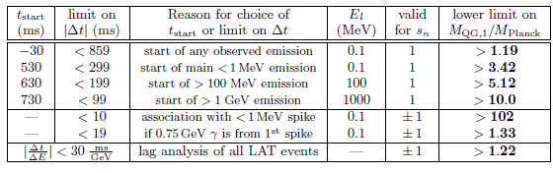
Fundamental physics: testing LI / QG
Using time delay between low and high energy photons to put Limits on Lorentz Invariance Violation
GRB 990510

Slide 39
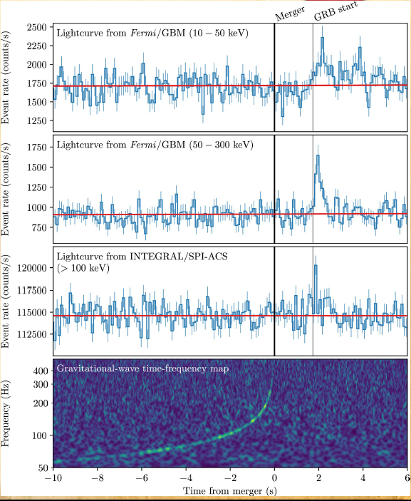
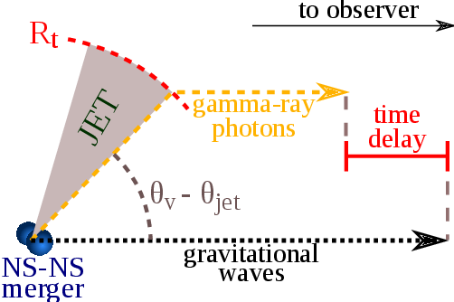


Fundamental physics: GW vs. light speed
GW170817/GRB170817A, D ~ 40 Mpc
|V_{gw}-C| / C <10⁻¹⁶

Slide 40

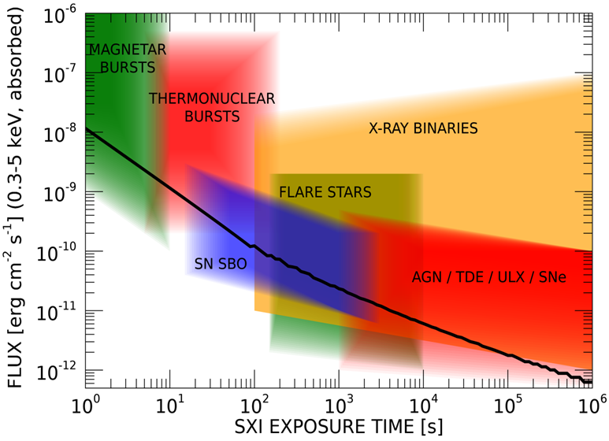
Exploring the transient sky
  GRBs extreme emission physics, central engine, sub-classes & progenitors, cosmological parameters & fundamental physics
  Study of many classes of X-ray sources by exploiting the simultaneous broad band X-ray and NIR observations
  Provide a flexible follow-up observatory for fast transient events with multi-wavelength ToO capabilities and guest-observer programmes

Slide 41
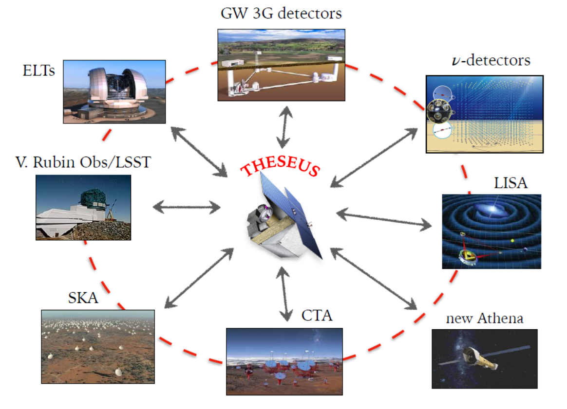
THESEUS: crucial synergies in the late ‘30s
The «M7» timeline will allow to widely broaden the mission scientific impact by taking advantage of the perfectly matched synergies with major facilities coming fully operative in the 2030s (e.g., 3G GW detectors)

Slide 42
In summary
GRBs are a key phenomenon for cosmology, multi-messenger astrophysics and fundamental physics
Next generation GRB missions like THESEUS, under study by ESA (M7 Phase-A) aim to ully exploit these potentialities, providing a substantial contribution to extreme GRB physics and time-domain astronomy
The ‘30s timeline will allow an unprecedented great synergy with future very large observing facilities in the e.m. and multi messenger domains, enhancing their scientific return and fully exploiting investments put in them.
The very strong synergy with Einstein Telescope and possibly cosmic explorer will provide a breakthough in multi-messenger astrophysics
THESEUS: ESA/M5 Phase A study and selected for M7 Phase A (->2037)
SPIE articles on instruments, Adv.Sp.Res. & Exp.Astr. articles on science
http://www.isdc.unige.ch/theseus/

Slide 43
Back-up slides

Slide 44
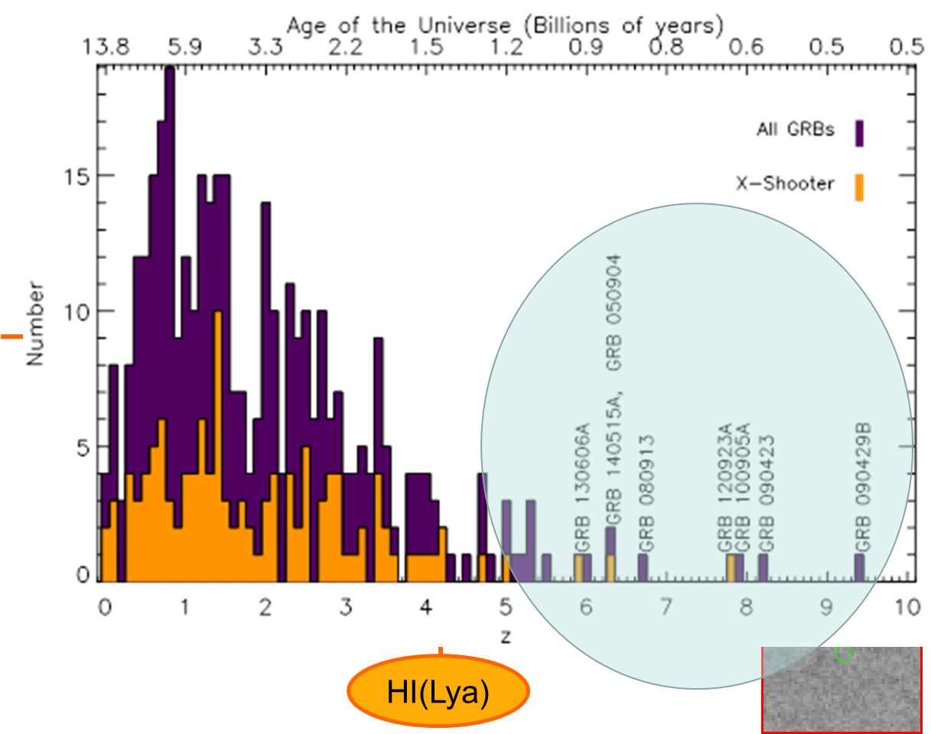
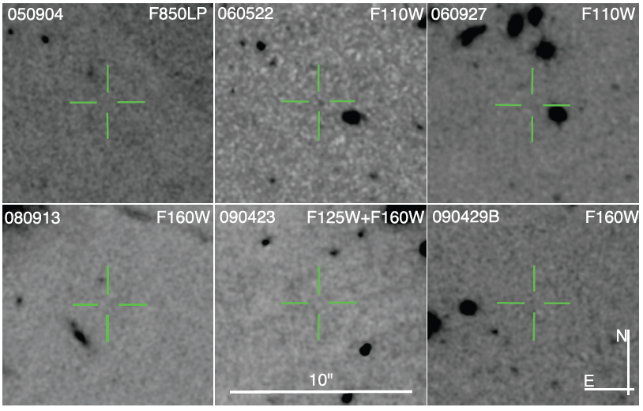
Shedding light on the early Universe with GRBs
z=6.29; M_{AB} > 28.86
Z=5.11; M_{AB} > 28.13
Z=5.47; M_{AB} > 28.57
Z=6.73; M_{AB} > 27.92
Z=8.23; M_{AB} > 30.29
Z=9.4; M_{AB} > 28.49
Tanvir+12
Robertson&Ellis12

Slide 45
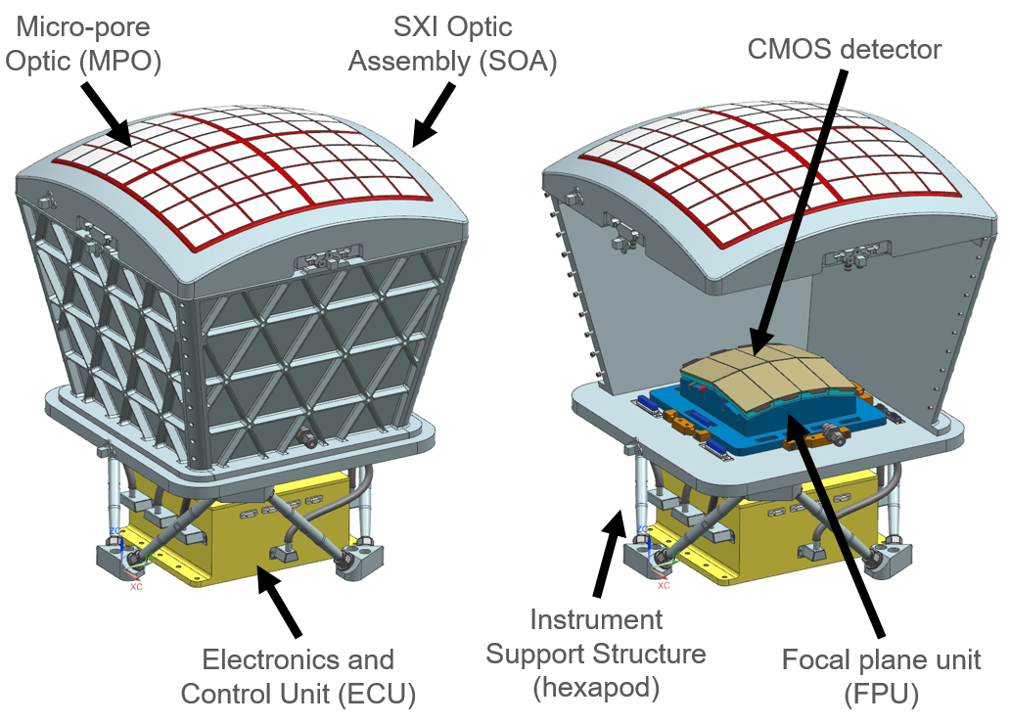
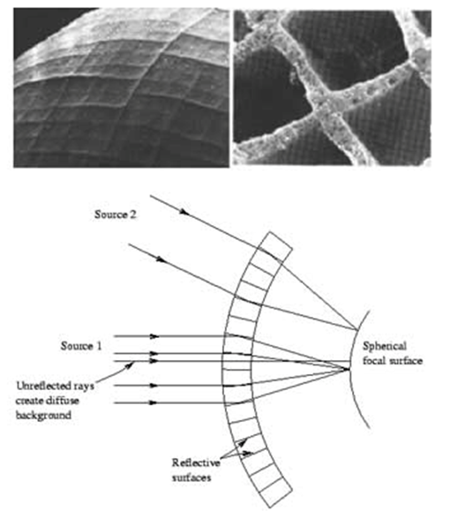
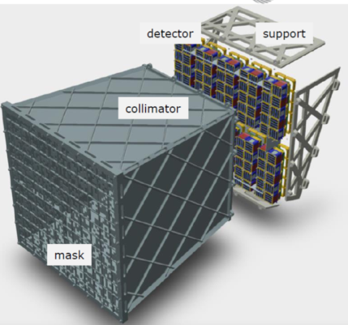
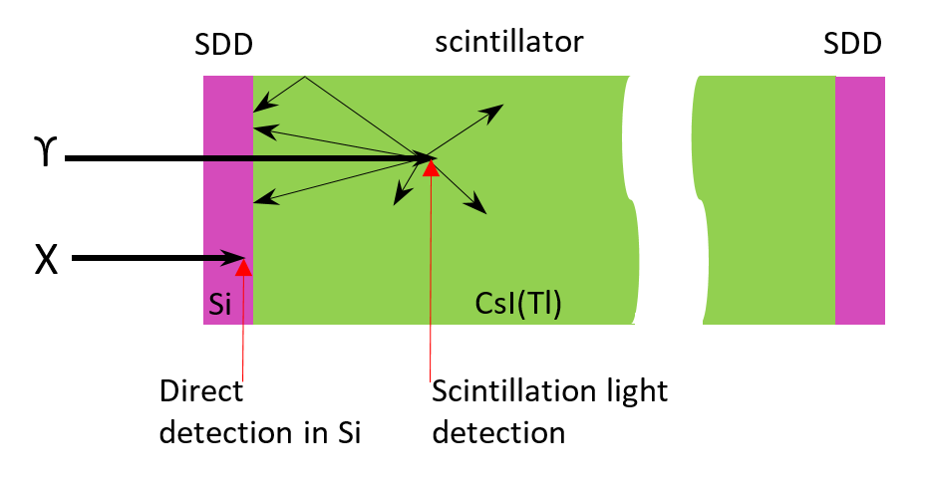

THESEUS Mission Concept
Soft X-ray Imager (SXI): a set of two sensitive lobster-eye telescopes observing in 0.3 - 5 keV band, total FOV of ~0.5sr with source location accuracy <2’
X-Gamma rays Imaging Spectrometer (XGIS): 2 coded-mask X-gamma ray cameras using Silicon drift detectors coupled with CsI crystal scintillator bars observing in 2 keV – 10 MeV band, a FOV of >2 sr, overlapping the SXI, with <15’ GRB location accuracy
InfraRed Telescope (IRT): a 0.7m class IR telescope observing in the 0.7 – 1.8 μm band, providing a 15’x15’ FOV, with both imaging and moderate resolution spectroscopy capabilities
Y_{IRTOR}
Z_{IRTOR}
Notes:
Presenter’s note:

Slide 46
THESEUS will have a combination of instrumentation and mission profile allowing the detection of all types of GRBs (long, short/hard, weak/soft, high-redshift) and provide accurate location and redshift measurement for a large fraction of them
Fermi/GBM
GRB170817A/GW170817
High-redshift

Slide 47


THESEUS Mission Concept
Fast slewing capability (>10°/min), granting prompt NIR follow-up of GRBs and transients
Low-Earth Orbit (LEO), with about 4° inclination and 550-640 km altitude, granting low and stable BKG for the monitors
The weight (about 2.3 tons) and dimensions are suitable for launch with VEGA-E
(ADS)
(THALES)
Notes:
Presenter’s note:

Slide 48

SFR(z) from JWST observations: lower limits consistent with previous estimates

Slide 49
Detecting and studying primordial invisible galaxies
neutral hydrogen fraction
escape fraction of UV photons from high-z galaxies
chemical abundances in the ISM and IGM and its evolution
JWST early results on primordial galaxies
lower limits only to total SFR(z), consistent with previous estimates and our assumptions
raised further interest: e.g., possible excess of high-luminosity galaxies
Beyond even JWST capabilities:
Primordial galaxies detection and characterization independent on mass and luminosity
Allow absorption spectroscopy (needed because most metals are in neutral gas and and for dust ratio)
Properties of primordial IGM
Targets for JWST
Robertson&Ellis12
Robertson&Ellis12

Slide 50

Independent measure of cosmic SFR at high-z (possibly including pop-III stars)
A sample of >40 high–z GRBs will give access to star formation in the faintest galaxies, overcoming limits of current and future galaxy surveys
THESEUS Consortium 2021
Notes:
Presenter’s note:

Slide 51

Detecting and studying primordial invisible galaxies
The proportion of GRB hosts below a given detection limit provides an estimate of the fraction of star formation “hidden” in such faint galaxies
m_{UV} ≈ 30
?
Bright
Faint
THESEUS Consortium 2021
Notes:
Presenter’s note:

Slide 52
Shedding light on cosmic reionization
Combination of massive star formation rate and ionizing escape fraction will establish whether stellar radiation was sufficient to reionize the universe, and indicate the galaxy populations responsible
THESEUS Consortium 2021
Notes:
Presenter’s note:

Slide 53

Cosmic chemical evolution at high-z
THESEUS Consortium 2021
Notes:
Presenter’s note:

Slide 54




Measuring cosmological parameters
Ep

Slide 55






The Soft X-Ray Imager (SXI)
Two sensitive “lobster-eye” X-ray telescopes (0.3 - 5 keV); total FOV of 0.5sr (>1000 $×$ conventional X-ray telescopes); 100ms photon timing; source location accuracy <2’
Mimic a lobster-eye using curved, square-pore MPOs
No single optical axis: get a wide field of view plus focusing with constant effective area
Spot (double reflection) Lines (single reflections)
Notes:
Presenter’s note:
LOFT is being designed to address one of the key science themes of Cosmic Vision: matter under extreme conditions.
Two are the objectives at the core of the LOFT mission:
- First, to probe the state of matter at supra nuclear densities, the ones only reached in the interiors of Neutron Stars.
- Second, to probe the theory of gravity, general relativity, in the very strong environment of Black holes.
LOFT is therefore an observatory designed to probe two key questions of nature, through astrophysics.
But of course LOFT is an observatory and will explore, in addition to its core science, the physics of hundred of
galactic and extragalactic sources.

Slide 56
The Soft X-Ray Imager (SXI)
2 identical SXI modules:
Focal length: 300mm
Optic: 8x8 array of plates
Focal plane: 8 CMOS detectors
0.5sr total field of view
SXI will show a unique combination of FOV and effective area (GRASP), enabling simulatneous detection and localization of many transients in parallel.
Notes:
Presenter’s note:
LOFT is being designed to address one of the key science themes of Cosmic Vision: matter under extreme conditions.
Two are the objectives at the core of the LOFT mission:
- First, to probe the state of matter at supra nuclear densities, the ones only reached in the interiors of Neutron Stars.
- Second, to probe the theory of gravity, general relativity, in the very strong environment of Black holes.
LOFT is therefore an observatory designed to probe two key questions of nature, through astrophysics.
But of course LOFT is an observatory and will explore, in addition to its core science, the physics of hundred of
galactic and extragalactic sources.

Slide 57


The X-Gamma Ray Imaging Spectrometer (XGIS)
Two coded-mask X-gamma ray cameras using innovative coupling between Silicon drift detectors (2-30 keV) and CsI crystal scintillator bars (20 keV–10 MeV)
Notes:
Presenter’s note:
LOFT is being designed to address one of the key science themes of Cosmic Vision: matter under extreme conditions.
Two are the objectives at the core of the LOFT mission:
- First, to probe the state of matter at supra nuclear densities, the ones only reached in the interiors of Neutron Stars.
- Second, to probe the theory of gravity, general relativity, in the very strong environment of Black holes.
LOFT is therefore an observatory designed to probe two key questions of nature, through astrophysics.
But of course LOFT is an observatory and will explore, in addition to its core science, the physics of hundred of
galactic and extragalactic sources.

Slide 58

The X-Gamma Ray Imaging Spectrometer (XGIS)
Unprecedented energy band (2 keV – 10 MeV)
Large effective area down to 2 keV
FOV >2 sr overlapping the SXI one
GRB location accuracy <15’ in 2-150 keV
Excellent timing (< a few μs)
Notes:
Presenter’s note:
LOFT is being designed to address one of the key science themes of Cosmic Vision: matter under extreme conditions.
Two are the objectives at the core of the LOFT mission:
- First, to probe the state of matter at supra nuclear densities, the ones only reached in the interiors of Neutron Stars.
- Second, to probe the theory of gravity, general relativity, in the very strong environment of Black holes.
LOFT is therefore an observatory designed to probe two key questions of nature, through astrophysics.
But of course LOFT is an observatory and will explore, in addition to its core science, the physics of hundred of
galactic and extragalactic sources.

Slide 59

The Infra-Red Telescope (IRT)
A 0.7 m class telescope with an off-axis Korsch optical design allowing for a large field of view (15’x15’) with imaging and moderate (R~400) spectroscopic capabilities
Mimic a lobster-eye using curved, square-pore MPOs
Teledyne H2RG sensitive in 0.7-1.8 microns
Expected sensitivity per filter (over 150 s): 20.9 (I), 20.7 (Z), 20.4 (Y), 21.1 (J), 21.1(H). Spectral sensitivity limit (over 1800 s), about 17.5 (H) over the 0.8-1.6 microns
Y_{IRTOR}
Z_{IRTOR}
Notes:
Presenter’s note:
LOFT is being designed to address one of the key science themes of Cosmic Vision: matter under extreme conditions.
Two are the objectives at the core of the LOFT mission:
- First, to probe the state of matter at supra nuclear densities, the ones only reached in the interiors of Neutron Stars.
- Second, to probe the theory of gravity, general relativity, in the very strong environment of Black holes.
LOFT is therefore an observatory designed to probe two key questions of nature, through astrophysics.
But of course LOFT is an observatory and will explore, in addition to its core science, the physics of hundred of
galactic and extragalactic sources.

Slide 60



The Infra-Red Telescope (IRT)
On-board photometric redshift for >90% detected GRB afterglows
On-board sensitive absorption spectrosocpy for medium-bright events
Notes:
Presenter’s note:
LOFT is being designed to address one of the key science themes of Cosmic Vision: matter under extreme conditions.
Two are the objectives at the core of the LOFT mission:
- First, to probe the state of matter at supra nuclear densities, the ones only reached in the interiors of Neutron Stars.
- Second, to probe the theory of gravity, general relativity, in the very strong environment of Black holes.
LOFT is therefore an observatory designed to probe two key questions of nature, through astrophysics.
But of course LOFT is an observatory and will explore, in addition to its core science, the physics of hundred of
galactic and extragalactic sources.

