Slide 1
The Ever-Changing World of Astrophysical Transients and Neutron Star/Black Hole Formation
The Study of astrophysical transients is a rapidly evolving field. Here I discuss the advances in supernovae and gamma-ray bursts in just my career.
Chris Fryer (LANL)

Slide 2
Understanding Mixing in Supernovae: SN 1987A (when I was an undergraduate)
Radioactive nickel is produced in the violent shocks of supernova explosions.
Its decay powers supernova light-curves and, once it is uncovered, emits gamma-rays
With SN 1987A, we could study this formation and we found that the nickel was extensively mixed.
A new engine was needed! Herant et al. (1994) argued for convection above the newly formed neutron star.
Pinto & Woosley 1988

Slide 3
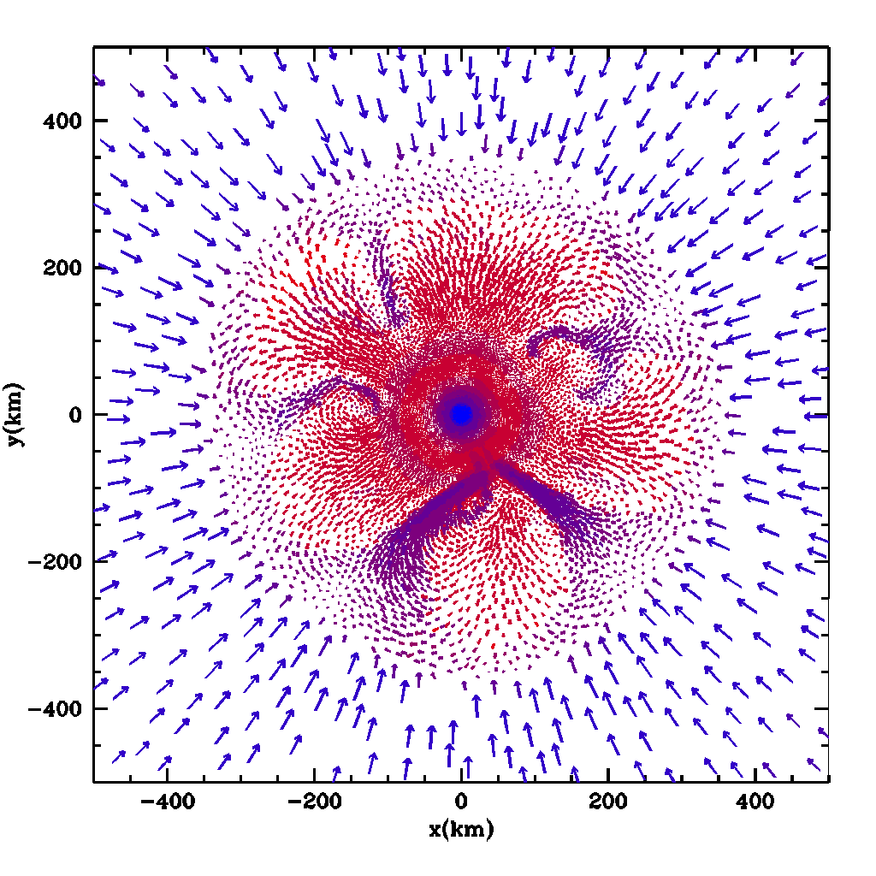
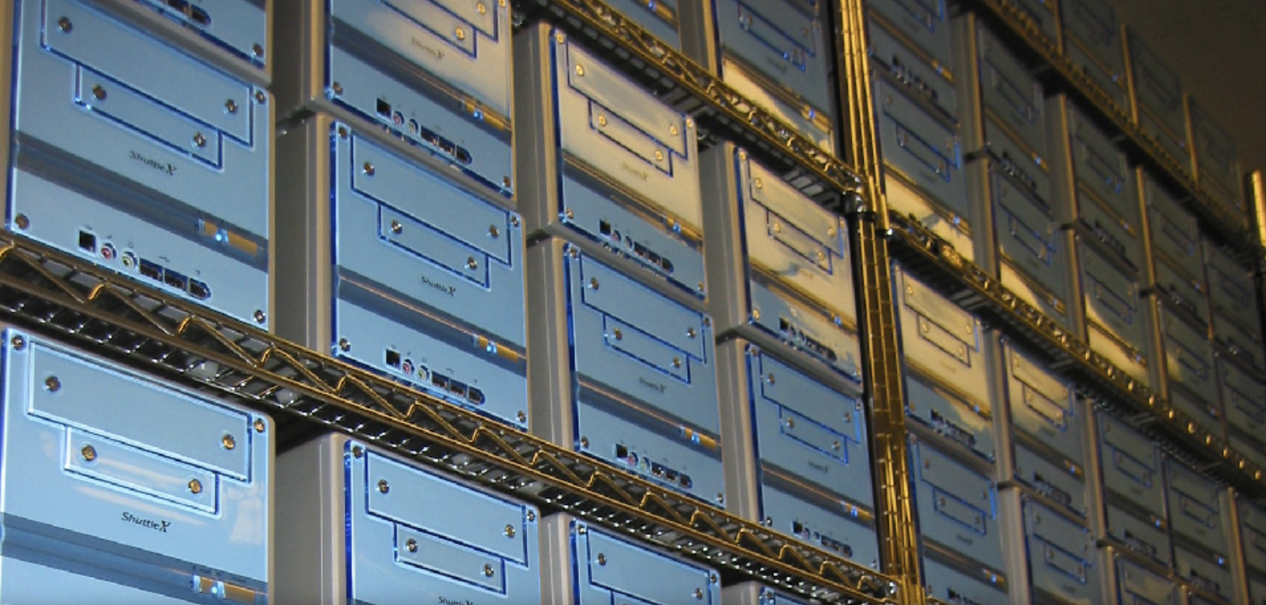
The Convective Supernova Engine (Herant et al. 1994)
Proto-neutron star
Accretion shock
Convective model current paradigm behind normal core-collapse supernovae: explains mixing, energies, progenitor masses, remnants?
But a lot of questions remain:
what is the nature of convection?
what are the progenitors (masses, red vs. blue)?
how prevalent are alternate explosion mechanisms?
Advances leveraged new computing: Beowulf/Commodity computing
Upflow
Downflow
Fryer & Warren 2002

Slide 4
Gamma-Rays
Hungerford et al. 2003
The convective engine produces asymmetric explosions.
With mild rotation, the convection is aligned with the rotation axis (the angular momentum gradient prevents convection on the equator).
Based on the convective engine, 3-dimensional SN calculations coupled with 3D gamma-ray transport calculations demonstrated how this engine could explain the features in SN 1987A.
Clumpy explosions (from low-mode convection) is critical.

Slide 5
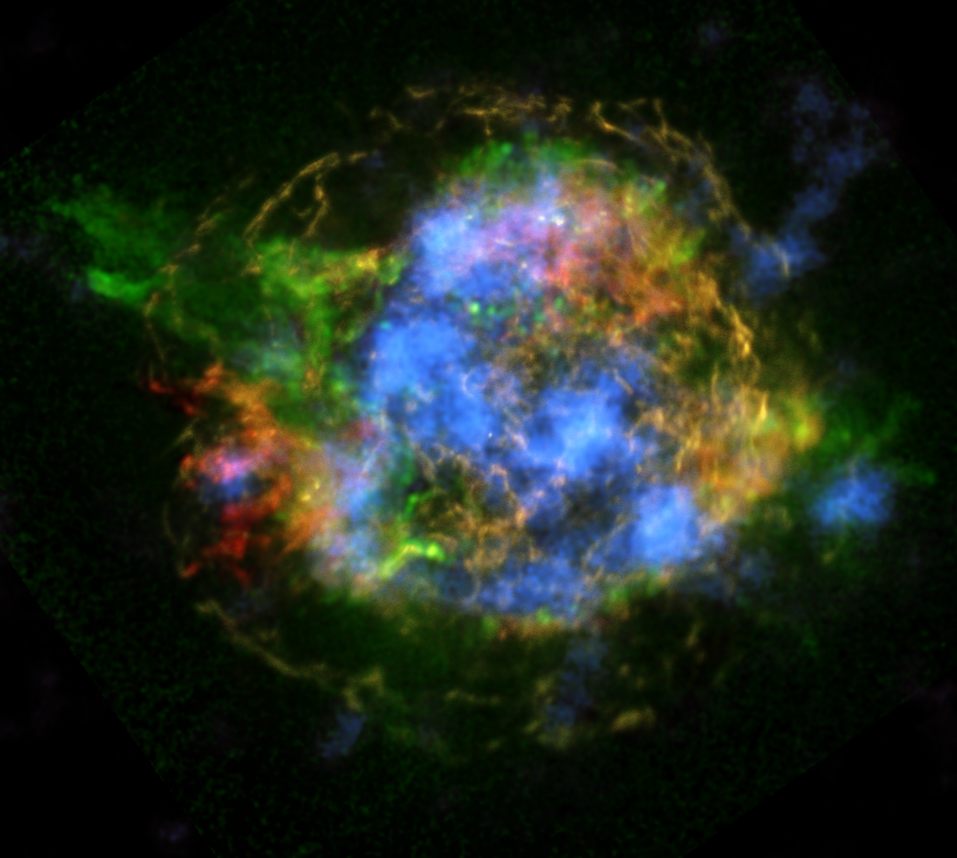
Convective Model Confirmed
The puzzle of the Cassiopeia A Supernova remnant:
Shock heated silicon features reminiscent of a jet (Huang et al. 2004). But this emission can be affected by the circumstellar media
⁴⁴Ti decay photons confirm the convective engine (Grefenstette et al. 2014)
Milisavljevic is leading a JWST team to probe unshocked material (first results out – Milisavljevic et al. 2024)

Slide 6
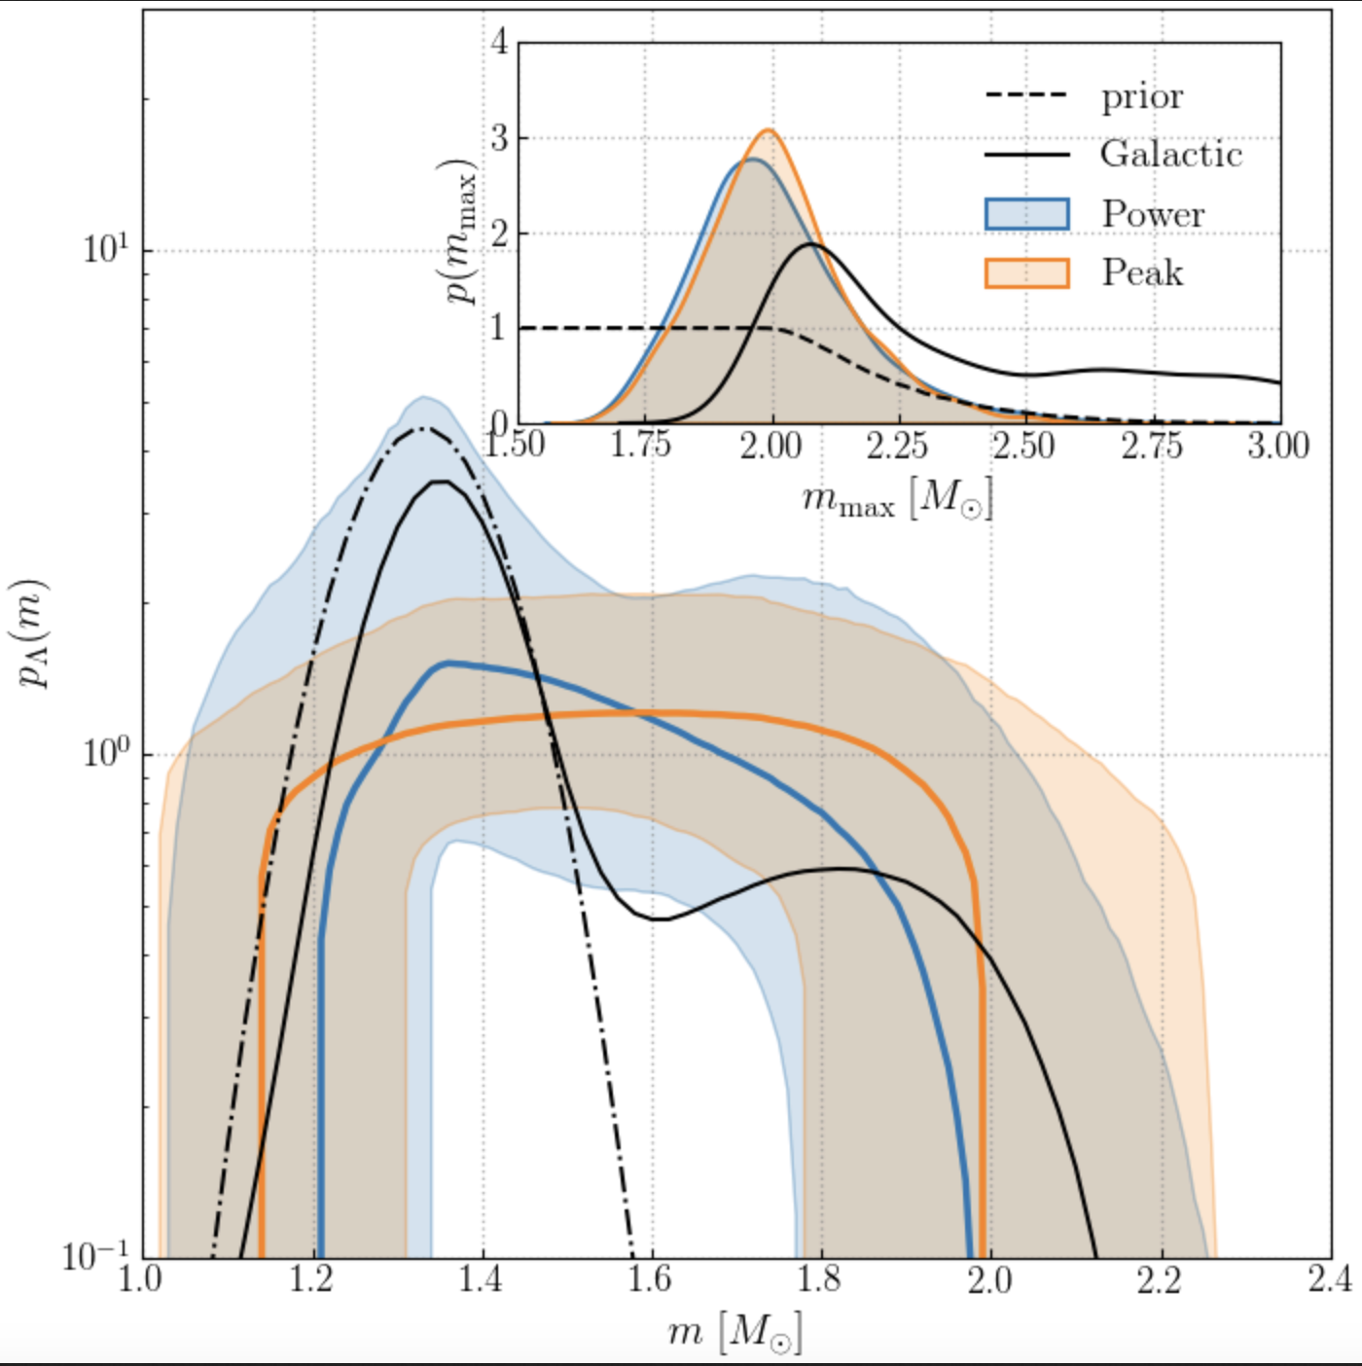
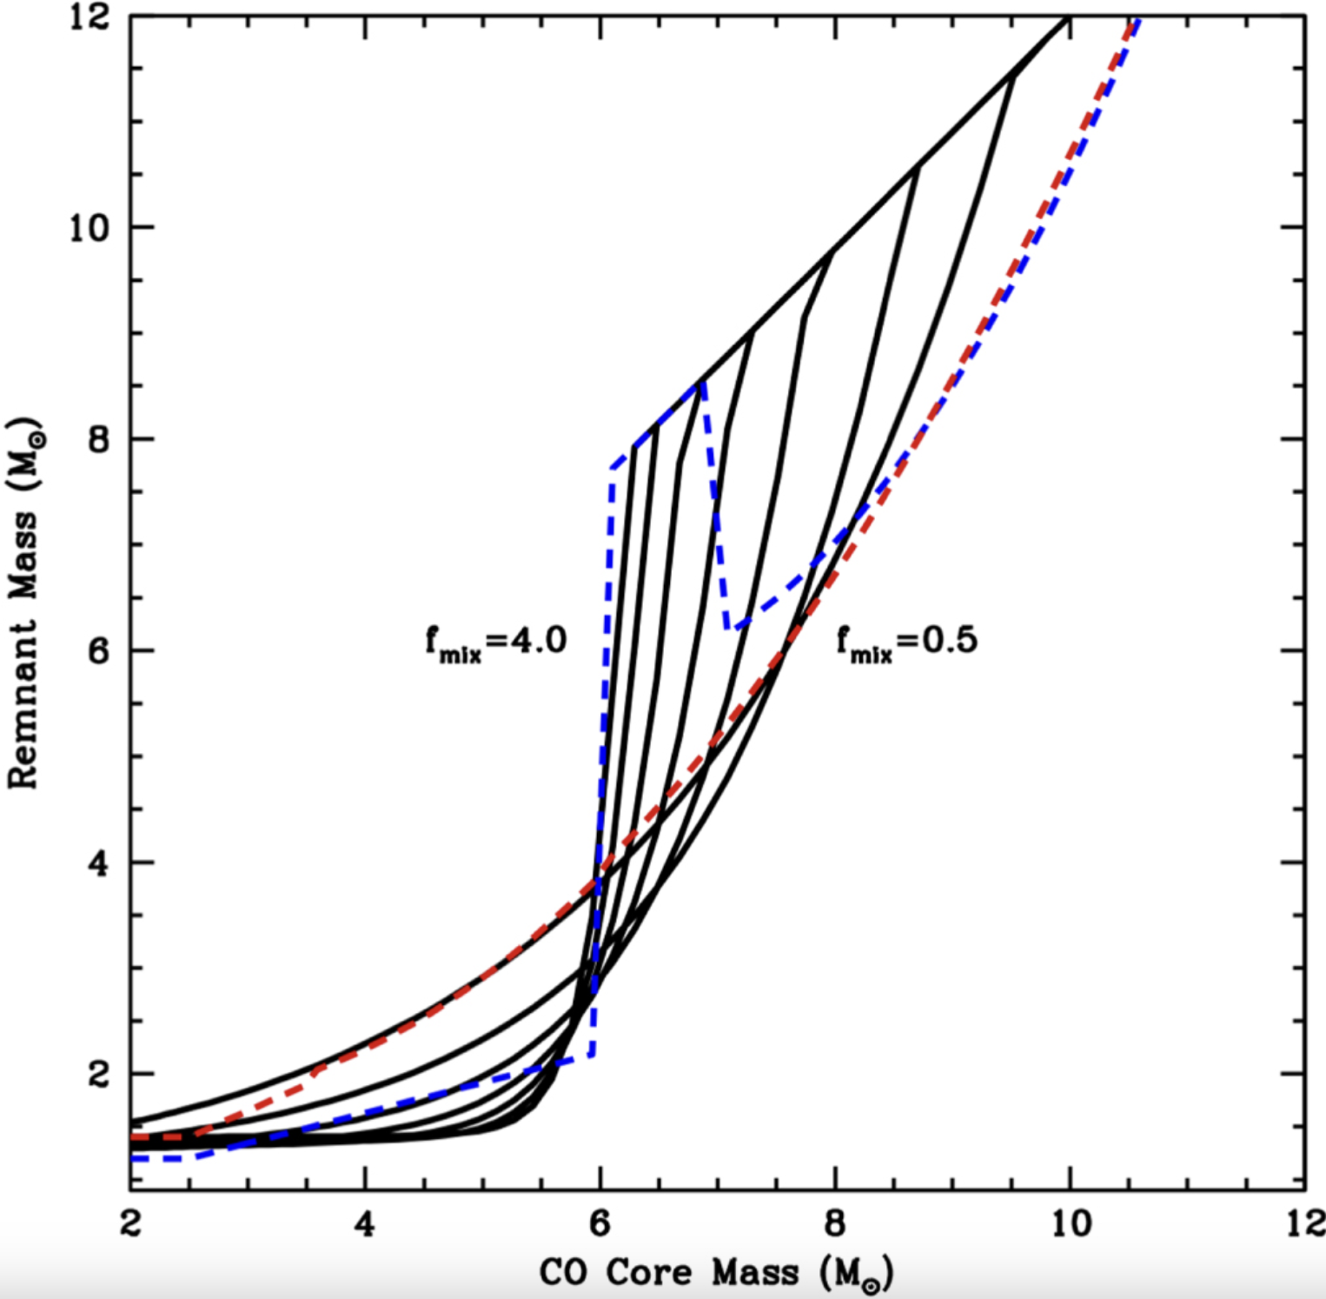
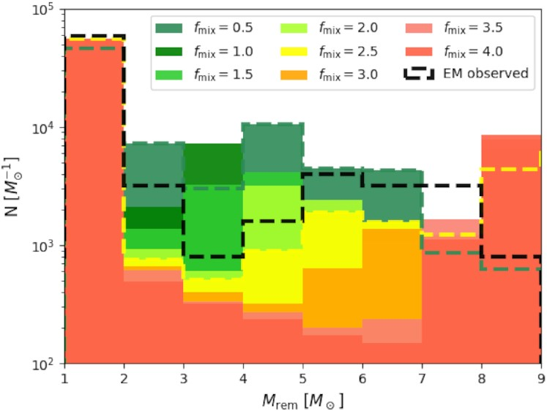
With the convective model, we can predict compact remnant mass distributions and compare to GW observations.
Coupling Stellar Models (also constrained by SN ejecta remnants, …), Supernova Engine and Explosion calculations with physical understanding.
Folding our knowledge of stellar evolution and supernovae with a knowledge of Binary Stars (e.g. stellar observations), physics of binary interactions (e.g. Luminous Red Novae, …).
Comparison to data requires understanding data systematics, analysis uncertainties, …
Fryer et al. 2022
Olejak et al. 2022
LIGO collaboration et al. 2021

Slide 7
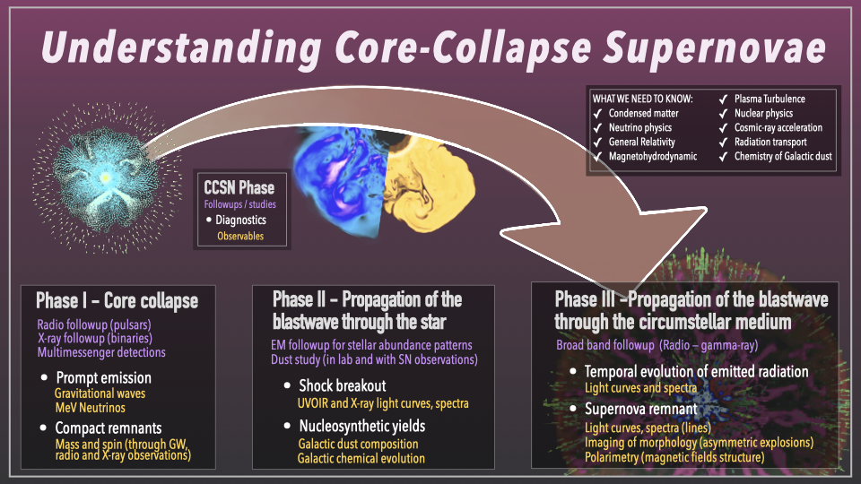
Chris Fryer (LANL)

Slide 8
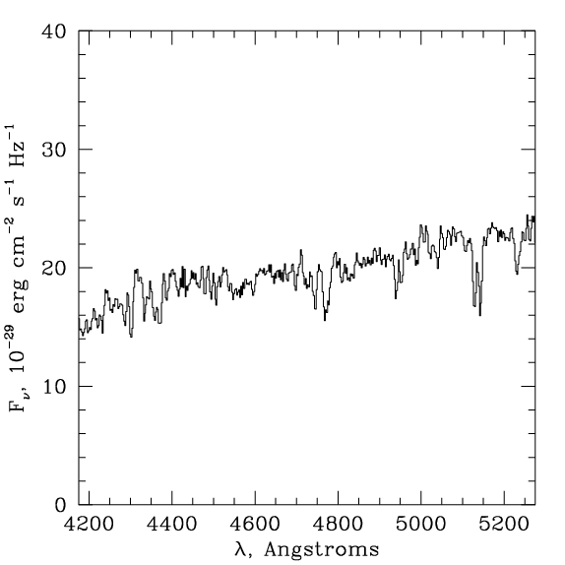
Long GRBs and a New Explosive Engine
Althoug
Metzger et al. 1997
Although the evidence that GRBs were extra-galactic was growing prior to 1997, the absorption lines from GRB 970508 proved it (I was a post-doc).
At these distances, the isotropic luminosities were the most powerful outbursts in the universe.
A number of engines were proposed to explain these luminous explosions:
Black Hole Accretion Disk (BHAD)
Magnetar
Neutron Star Accretion Disk (NSAD)
Induced Graviational Collapse
Optical Emission
Mg II
Fe II
Mg II I
Fe II

Slide 9
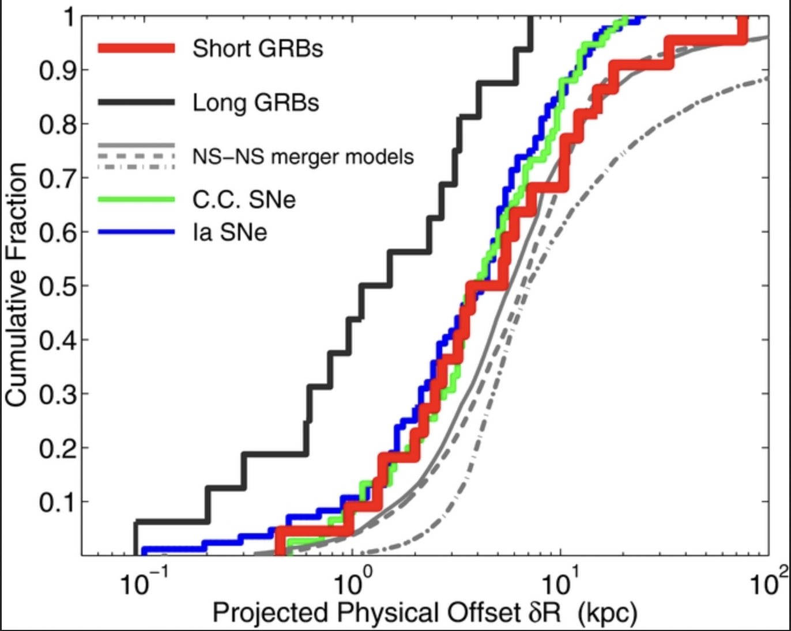
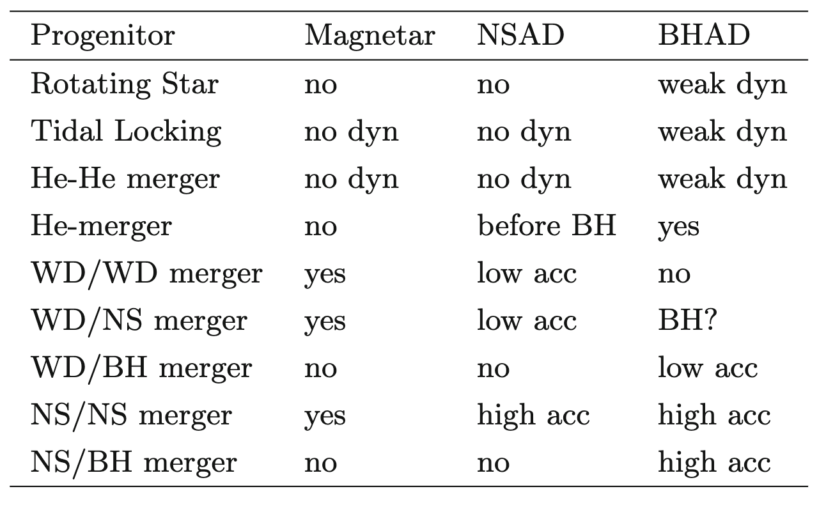
GRB Progenitors
Lots of progenitors were proposed for the different engines and these progenitors and engines are tested against observations. Although many of the observations support early predictions, counterexamples are stressing standard paradigms.
Fong & Berger 2013

Slide 10
Massive Star Models
For massive star progenitors, a number of scenarios have been proposed to achieve the high angular momenta need for the magnetar, NSAD, and BHAD engines. Only a few of the progenitors/engines can explain the spins and the observed associated supernovae, trends with redshift, and surrounding environments.
Fryer et al. 2007

Slide 11
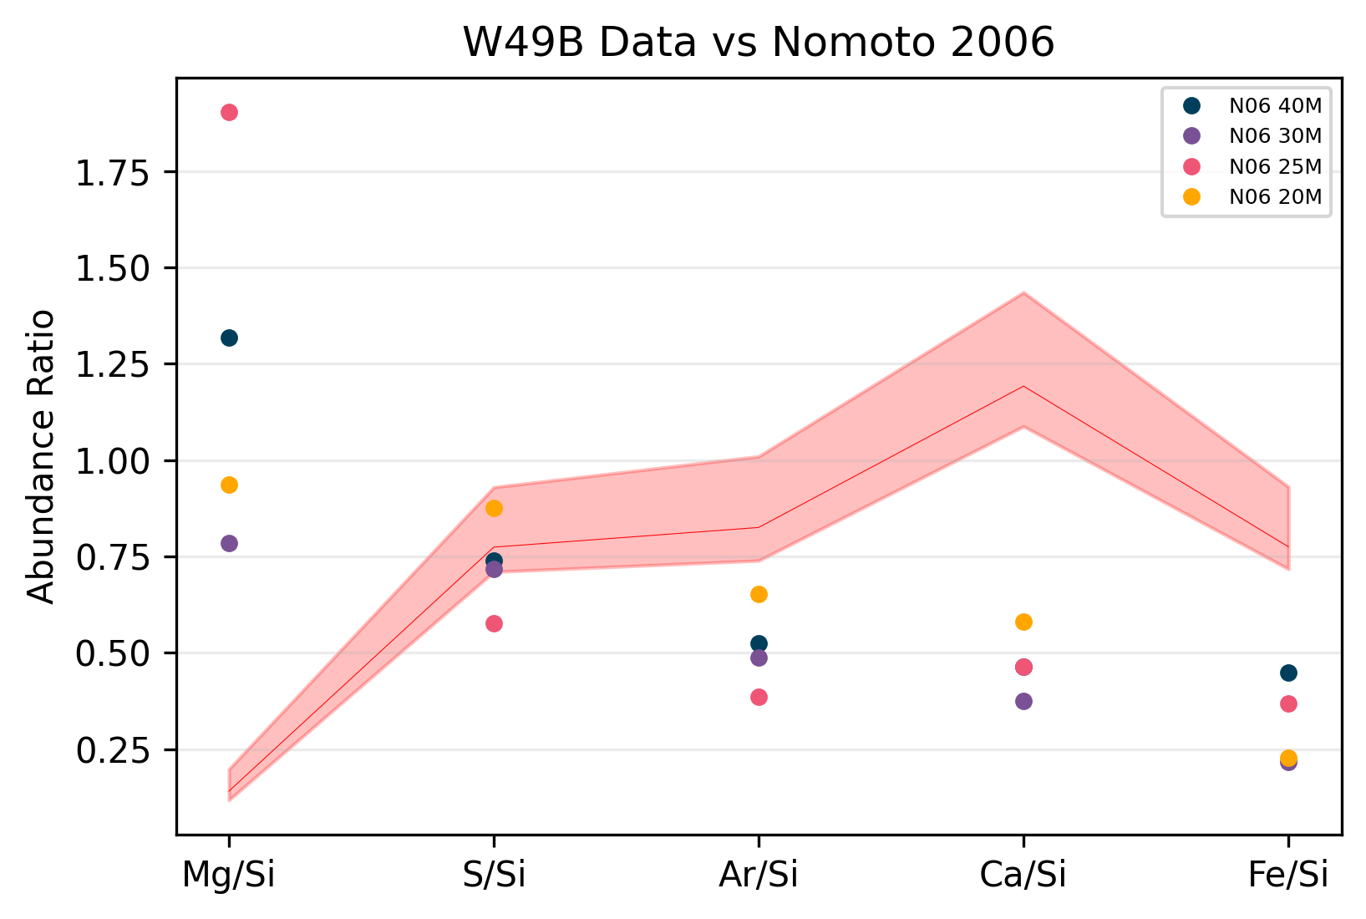
Lots of Open Questions and New Things to Discover
Supernovae:
Which stars explode?
Why don’t our yields match those observed in remnants? Are our progenitors or our explosions wrong?
What powers the observed emission?
Can we use these to probe fundamental physics (neutrinos, matter in the extremes, …)
Long GRBs:
How do we get the needed high angular momenta?
What drives the powerful jets (what is the GRB engine)?
What are the GRB progenitors?
…
Safi-Harb et al., in prep

Slide 12
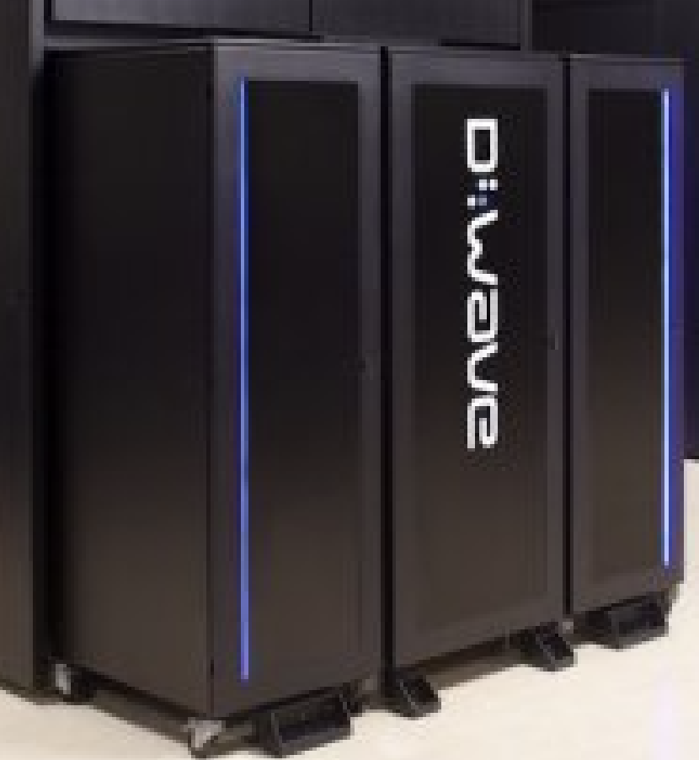
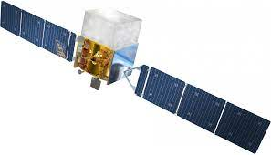
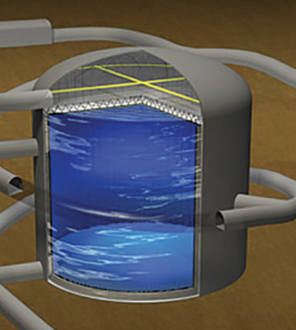
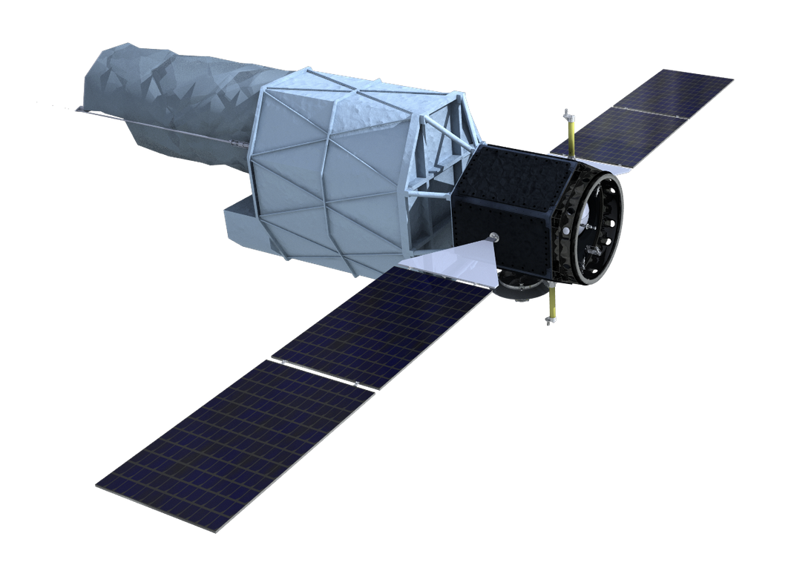
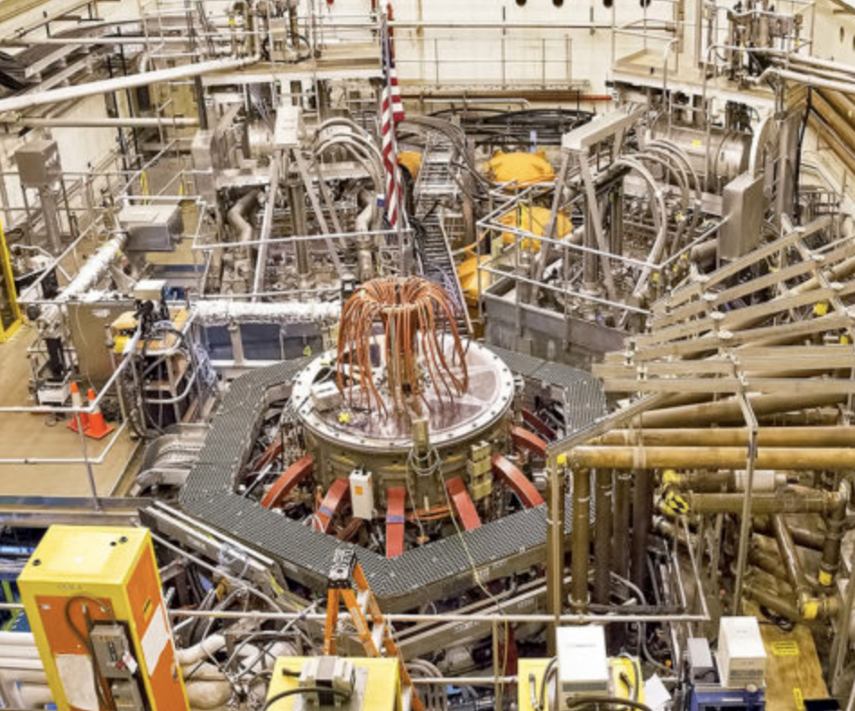
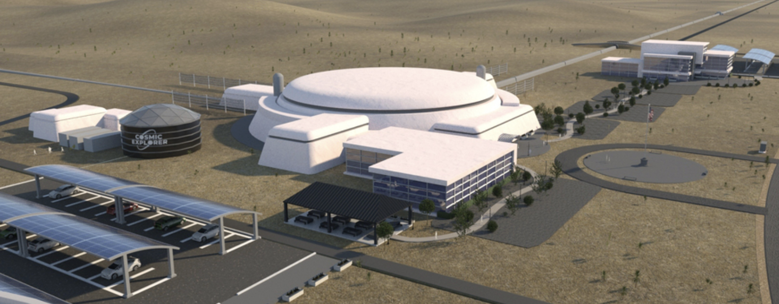
The Future is Bright! We Have New Tools and Techniques
In the next couple decades, our ability to study these explosions will continue to increase with new:
Observatories: COSI, UltraSat, Rubin, SVOM, SKAO, Cosmic Explorer, Hyper Kamiokande, UVEX?, …
Laboratory Experiments: Omega, NIF, FRIB, …
Computing Tools: For me it was Beowulf clusters (a.k.a. commodity computing), faster GPU machines, Quantum Computing
And we keep on discovering new events!

