Slide 1
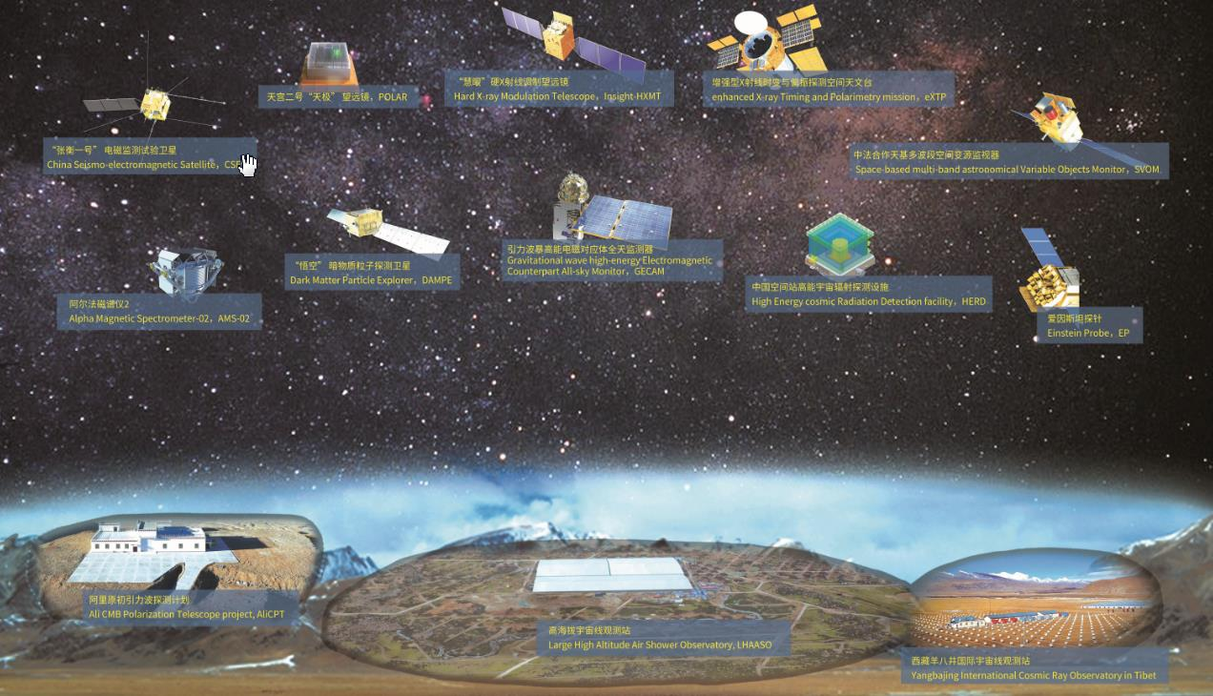
Highlights of the Insight-HXMT mission and the future eXTP mission
Shuang-Nan Zhang（张双南）
zhangsn@ihep.ac.cn
Particle Astrophysics Division
Institute of High Energy Physics
Chinese Academy of Sciences
MG17, 2024.07.09, Pescara, Italy

Slide 2
Congratulations to
Di Li, Victoria Kaspi and Christopher Fryer
for the MG17 award!

Slide 3
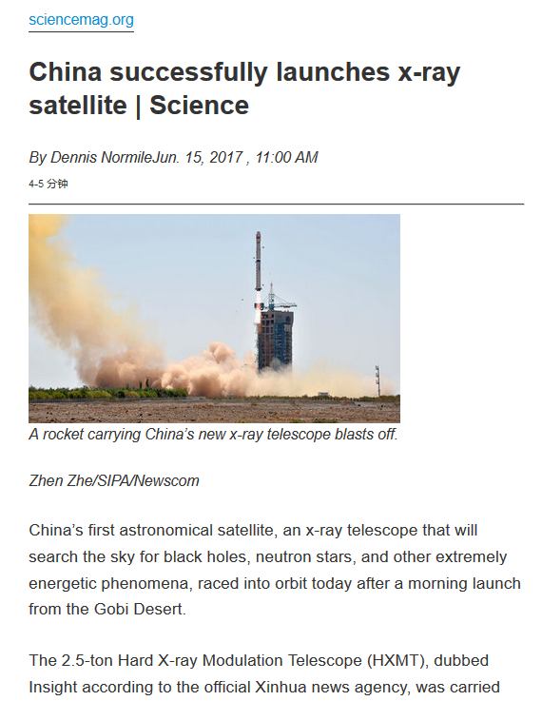
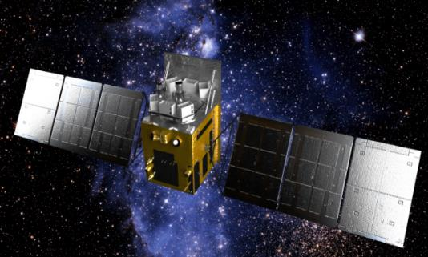
Insight-HXMT
CAS-CAST
The 1st X-ray satellite in China, proposed by T. P. Li and M. Wu in 1993, launched on 06/15/2017
Features:
  Large effective area @ > 30 keV
  High timing resolution: single event mode
  Wide energy bands (1-250 keV narrow FoV, 0.2-3 MeV as ASM）
Status:
  All instruments perform well
  Focus on bright sources
  Unrestricted number of ToOs
    Response time: hours to days
    Ad hoc ToO data public immediately
  In AO6: open for world wide
  To stay in orbit for several more years
Current PI (since Jan. 2016): Shuang-Nan Zhang (IHEP, CAS, China)

Slide 4
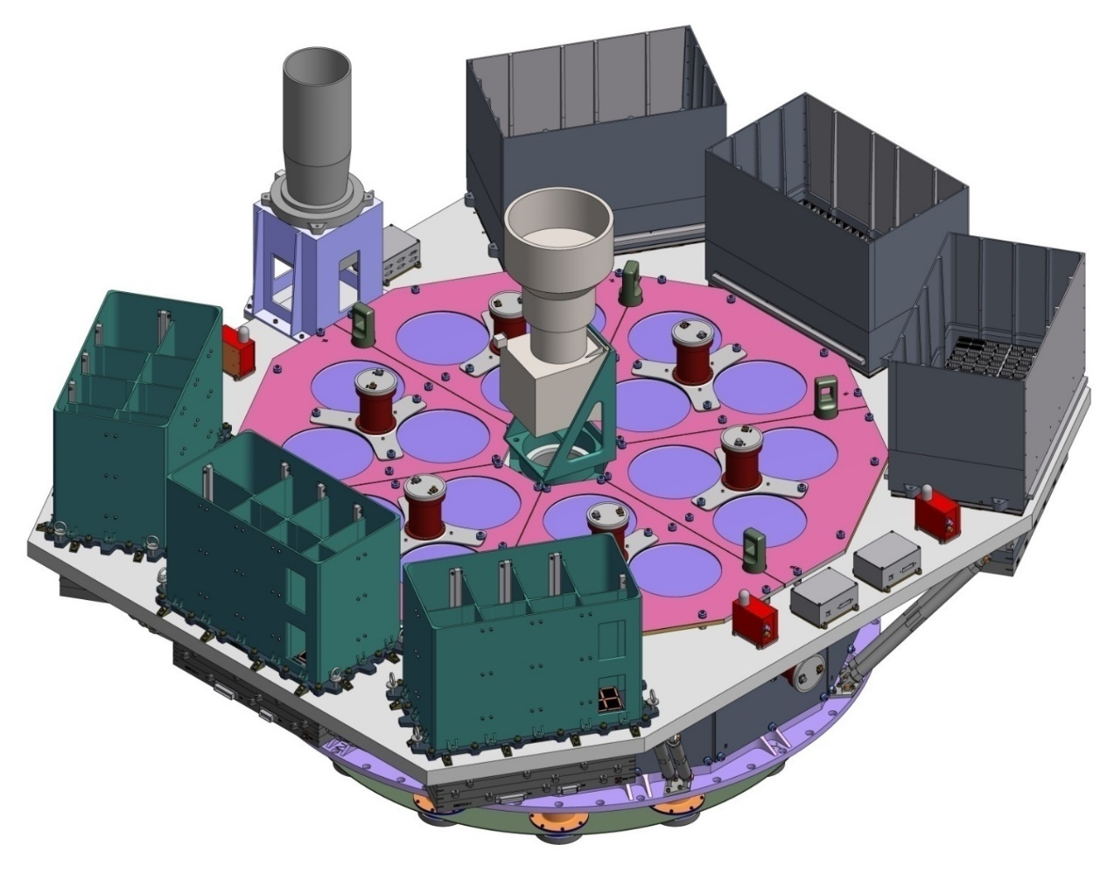
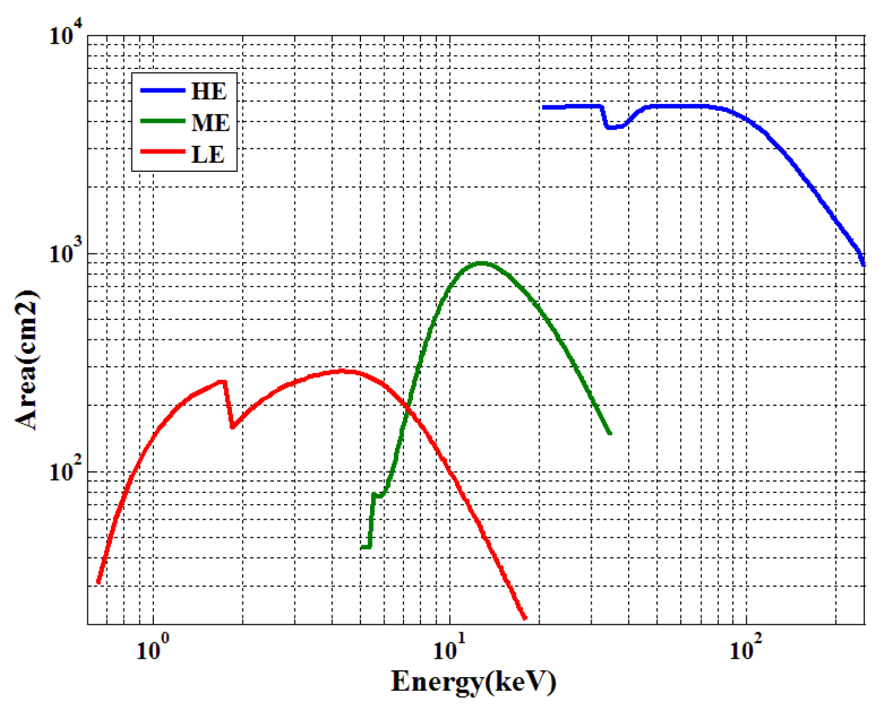
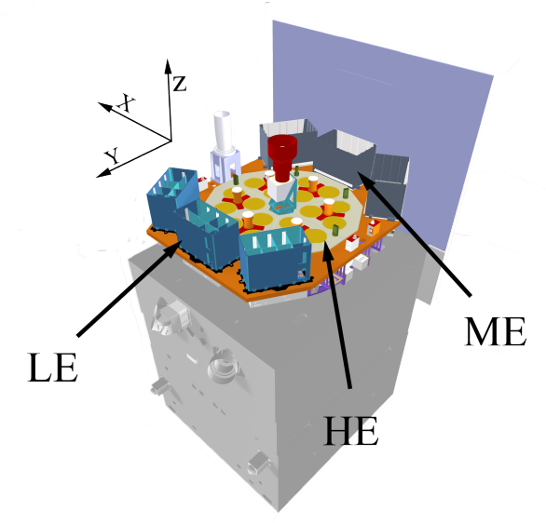
Science payload
ME:Si-PIN,5-30 keV, 952 cm²
Star tracker
LE:SCD,1-15 keV, 384 cm²
HE: NaI/CsI, 20-250 keV, 5000 cm²

Slide 5
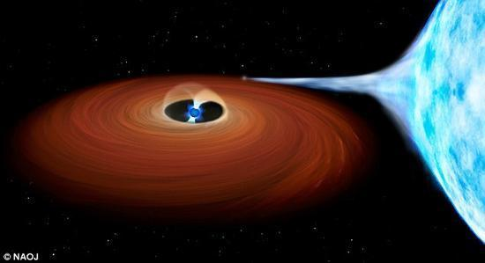
Extremely Complex Interactions in NSXBs
Companion Star
Neutron Star
Accretion Disk

Slide 6
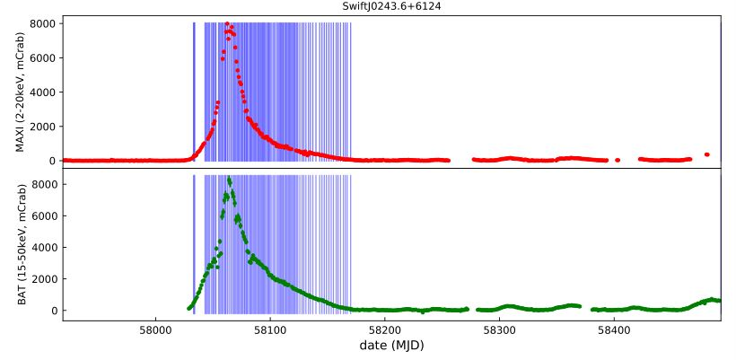
The 1st Galactic ULX Swift J0243.6+6124
2017 10.3 Swift BAT detected outburst
Insight-HXMT observations：122 pointings； exposure ~1800 ks

Slide 7
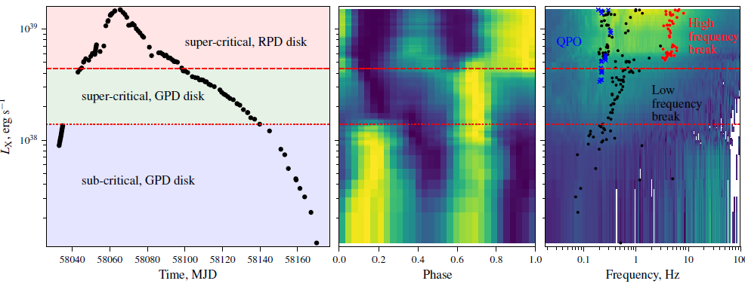
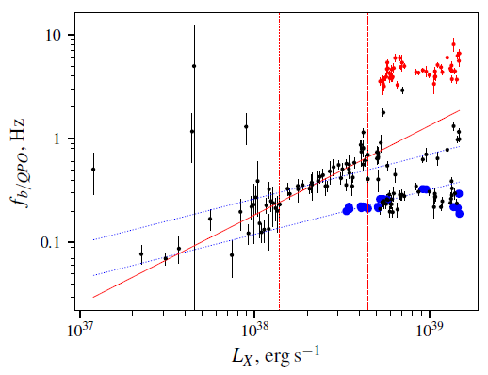
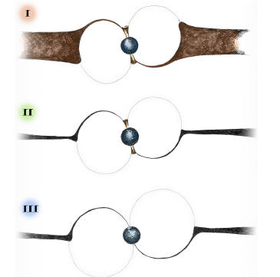
Insight-HXMT discovery of GPD to RPD transition
Doroshenko et al. 2019
Need low dipole B!
Notes:
两个特征光度的来源和定义？
从脉冲轮廓的变化得到两个特征光度。高特征光度附近的功率谱发生双拐折，给出RPD的证据。
脉冲双峰到单峰：可能是偶极B的fan到多极B的pencil转换，单峰到双峰：多级B主导的铅笔到风扇转换

Slide 8
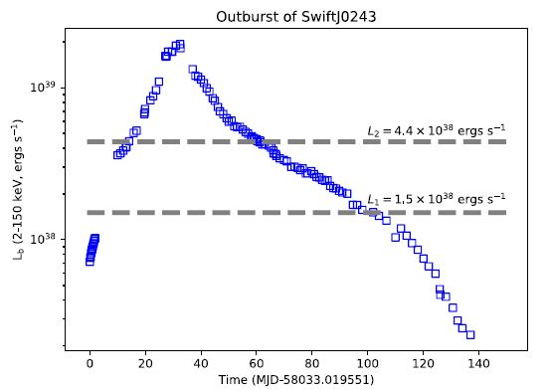
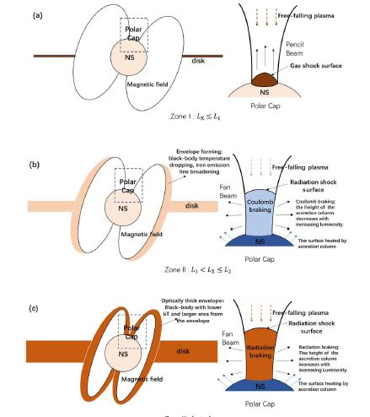
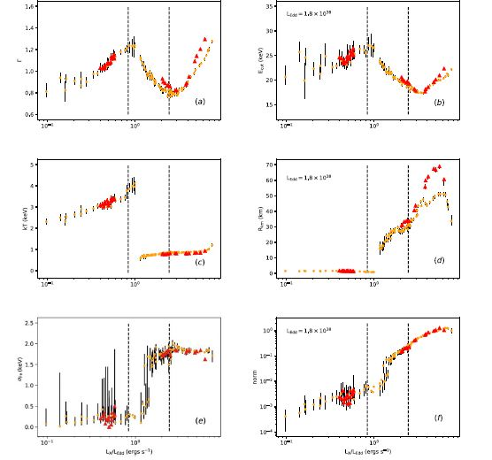
Spectral Transitions
Kong et al. 2020
Need high accretion column B!

Slide 9
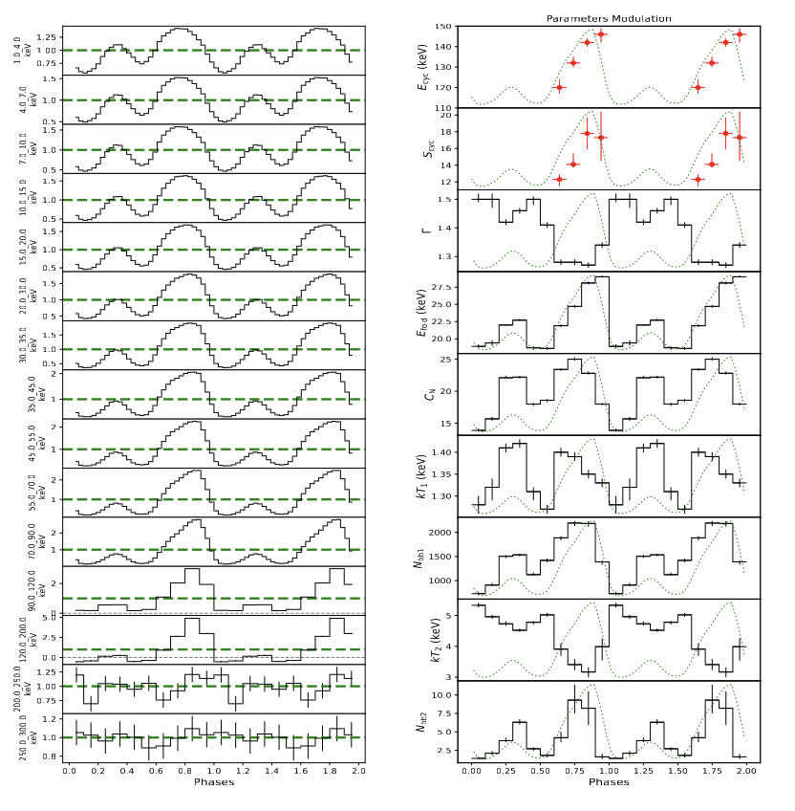
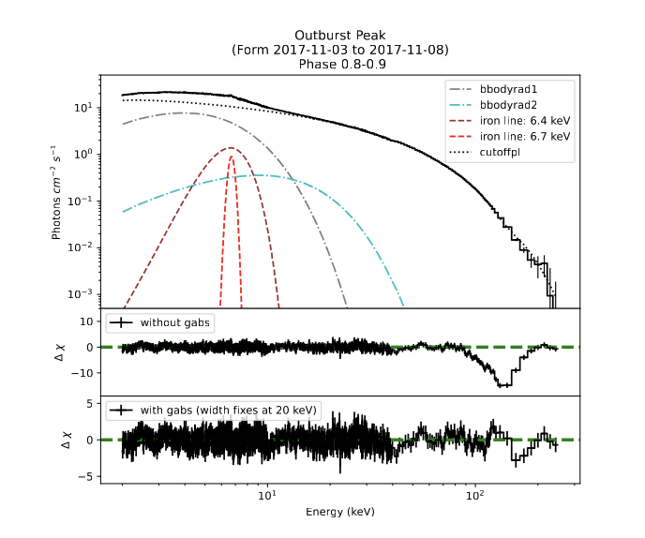
Highest-E Neutron star cyclotron absorption line
1st Galactic ultraluminous X-ray pulsar Swift 0243: 146 keV→1.6x10¹³ G >> ~10^12 G dipole B-field: evidence for multipole B-field? (Kong+2022)

Slide 10
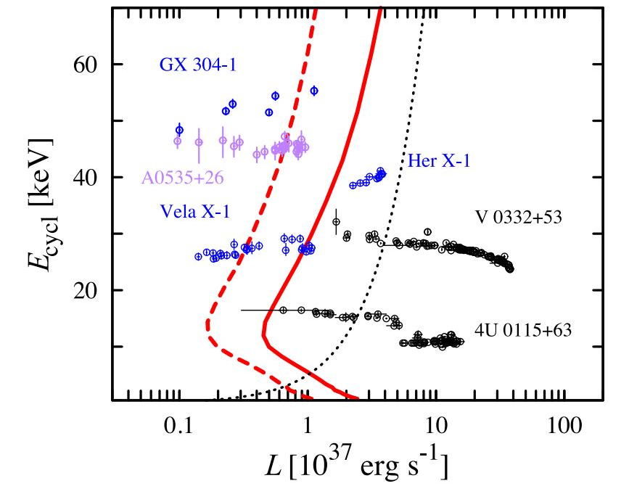
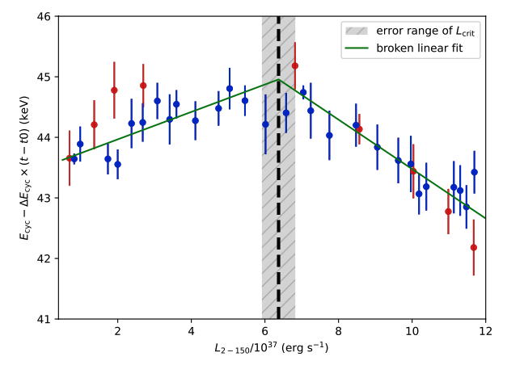
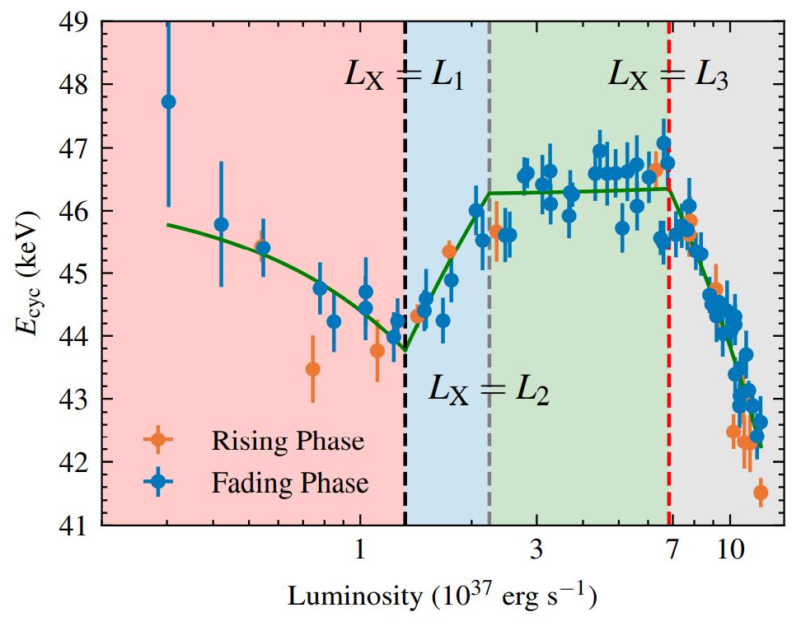
1A0535+262 ：CRSF evolution vs luminosity
Kong et al., 2021, ApJL
Shui et al., 2024, MNRAS

Slide 11
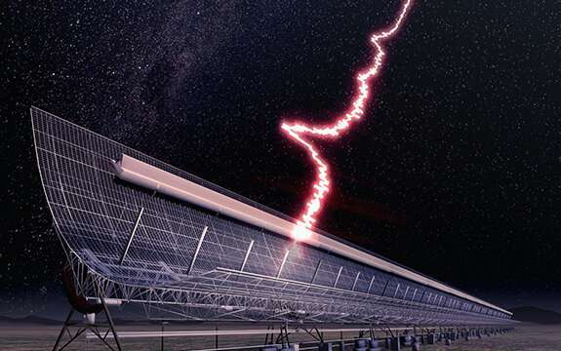
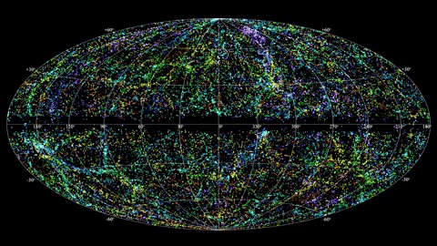
Fast Radio Bursts
First reported in 2007 (Lorimer et al. 2007): bright millisecond radio pulses, random arrival direction and time, some repeat and even periodic, but counterpart or radiation at any other wavelengths not known, until April 28th, 2020.

Slide 12
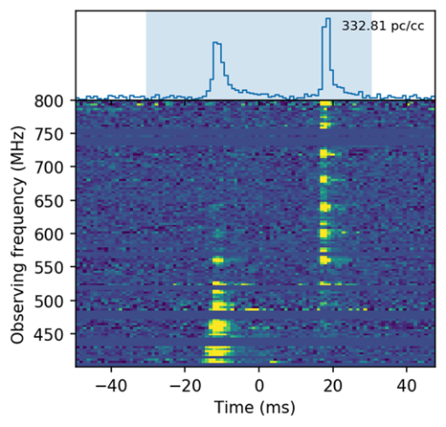
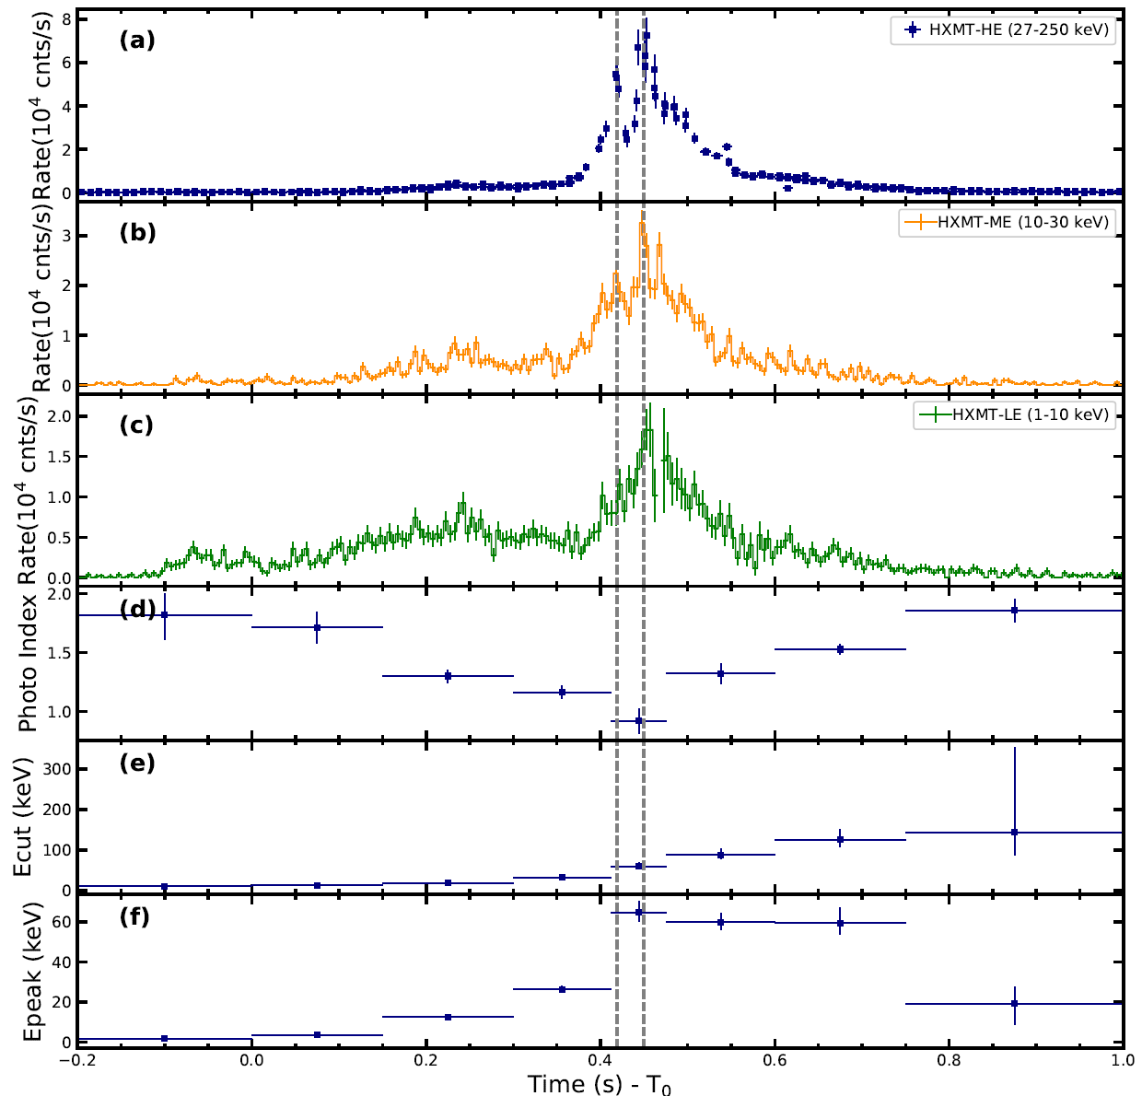
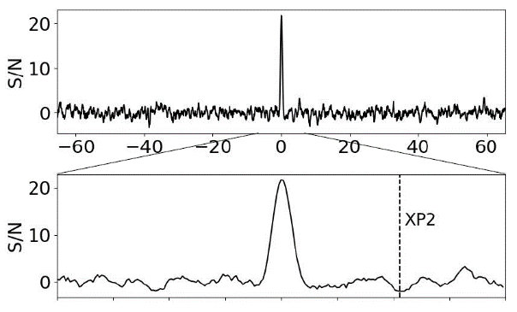
Historic event on April 28th 2020
CHIME
Insight-HXMT
Stare2
CHIME/FRB Collaboration+; Bochenek+; Li+, 2021, Nature Astronomy

Slide 13
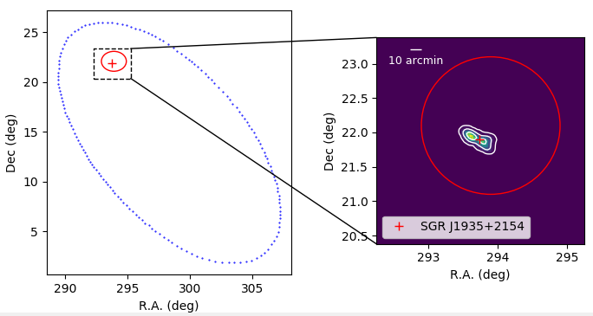
Localization of the X-ray burst
CHIME
Insight-HXMT
Stare2: 95%
X-ray burst 3.7’ off SGR1935 with σ=10’’
Identification of the X-ray burst with SGR1935, Li+ (Insight-HXMT team), 2021, Nature Astronomy

Slide 14
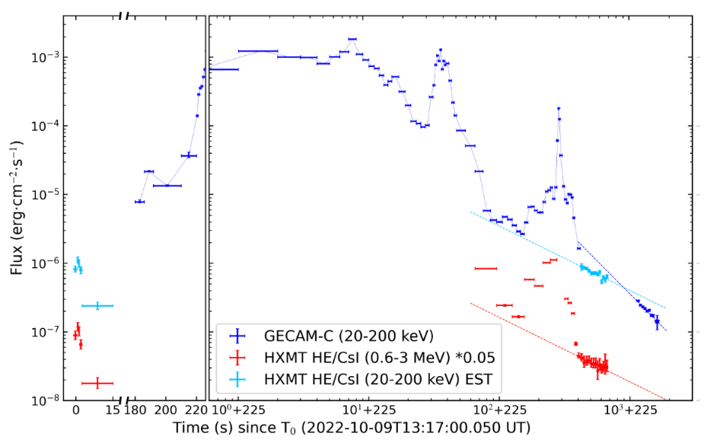
The brightest GRB: 221009A
HXMT and GECAM accurately observed the GRB: precursor, main burst, flare & early afterglow.
Brightest > 50 times
Largest isotropic energy 1.5x10⁵⁵ erg
Early afterglow break: very narrow jet~0.7°
Jet corrected energy 10⁵¹ erg: normal
Also VHE gamma-rays detected by LHAASO
Main burst
flare
Early afterglow
GRB 221009A
Precursor

Slide 15
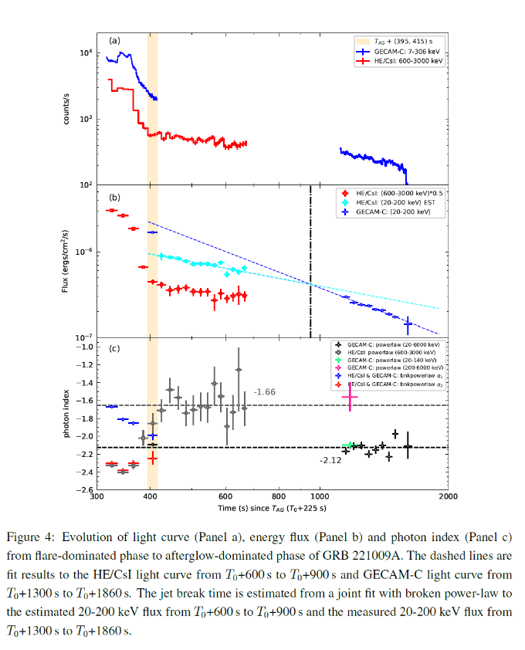
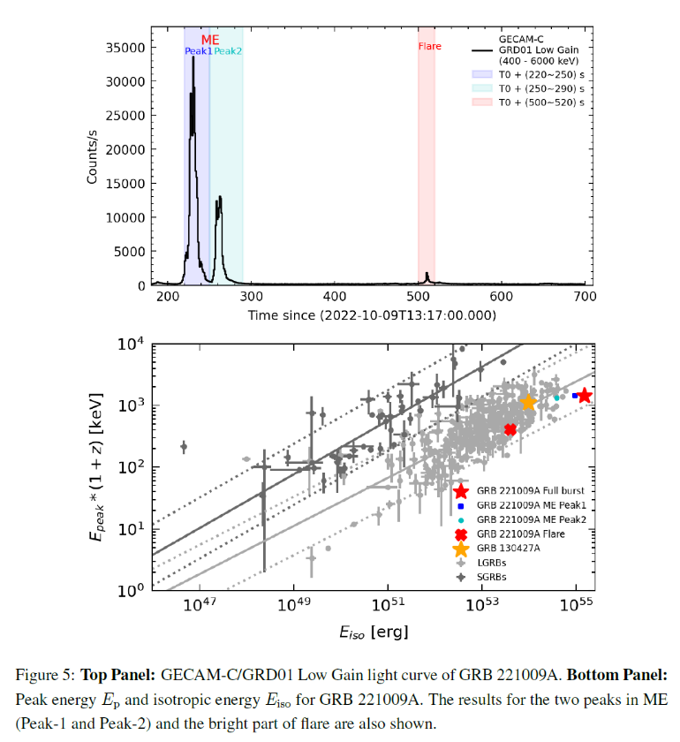
Early jet break: 950±50 s & highest E_{iso}~1.5x10⁵⁵ erg

Slide 16
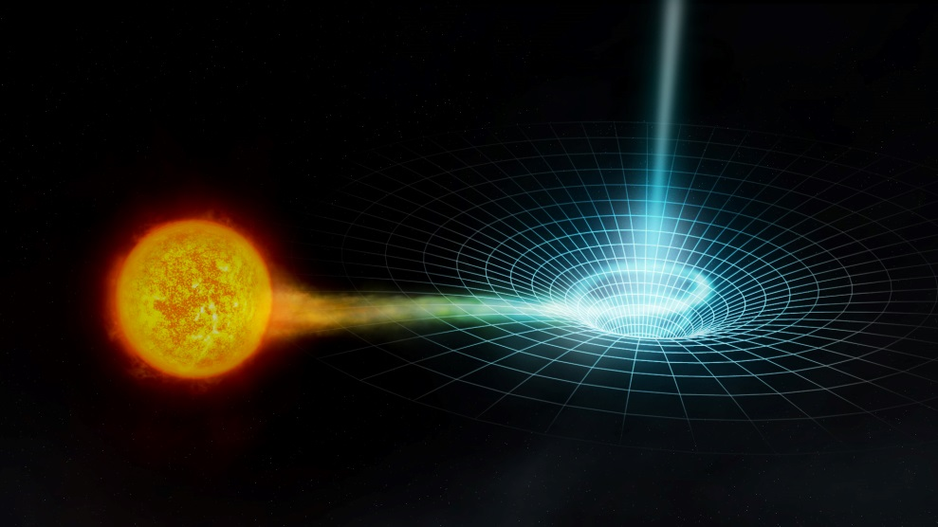
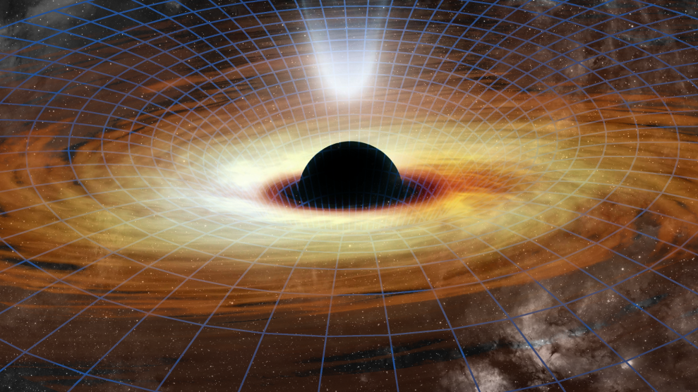
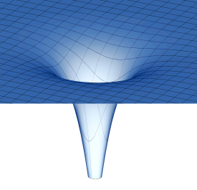
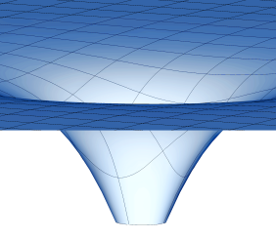
Extreme Gravity Near Black Holes
X-ray binary system
X射线双星
Active galactic nucleus
活动星系核
X-ray study covers wide mass range in uniform setting
Stellar mass black hole
(or neutron star)
Strongly curved spacetime.
(10¹⁶ times Solar)
Supermassive black hole
Weakly curved spacetime
(~Solar)
Tests of GR predictions in the strong field regime of Gravity. Complementary to gravitational wave experiments.

Slide 17
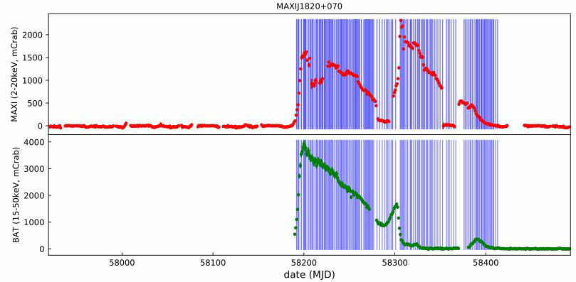
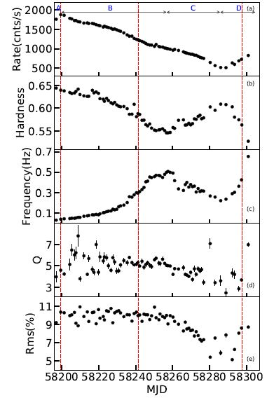
BHXB MAXI J1820+070
2018 3.11 outburst detected by MAXI Insight-HXNT: 146 pointings, exposure 2560 ks

Slide 18
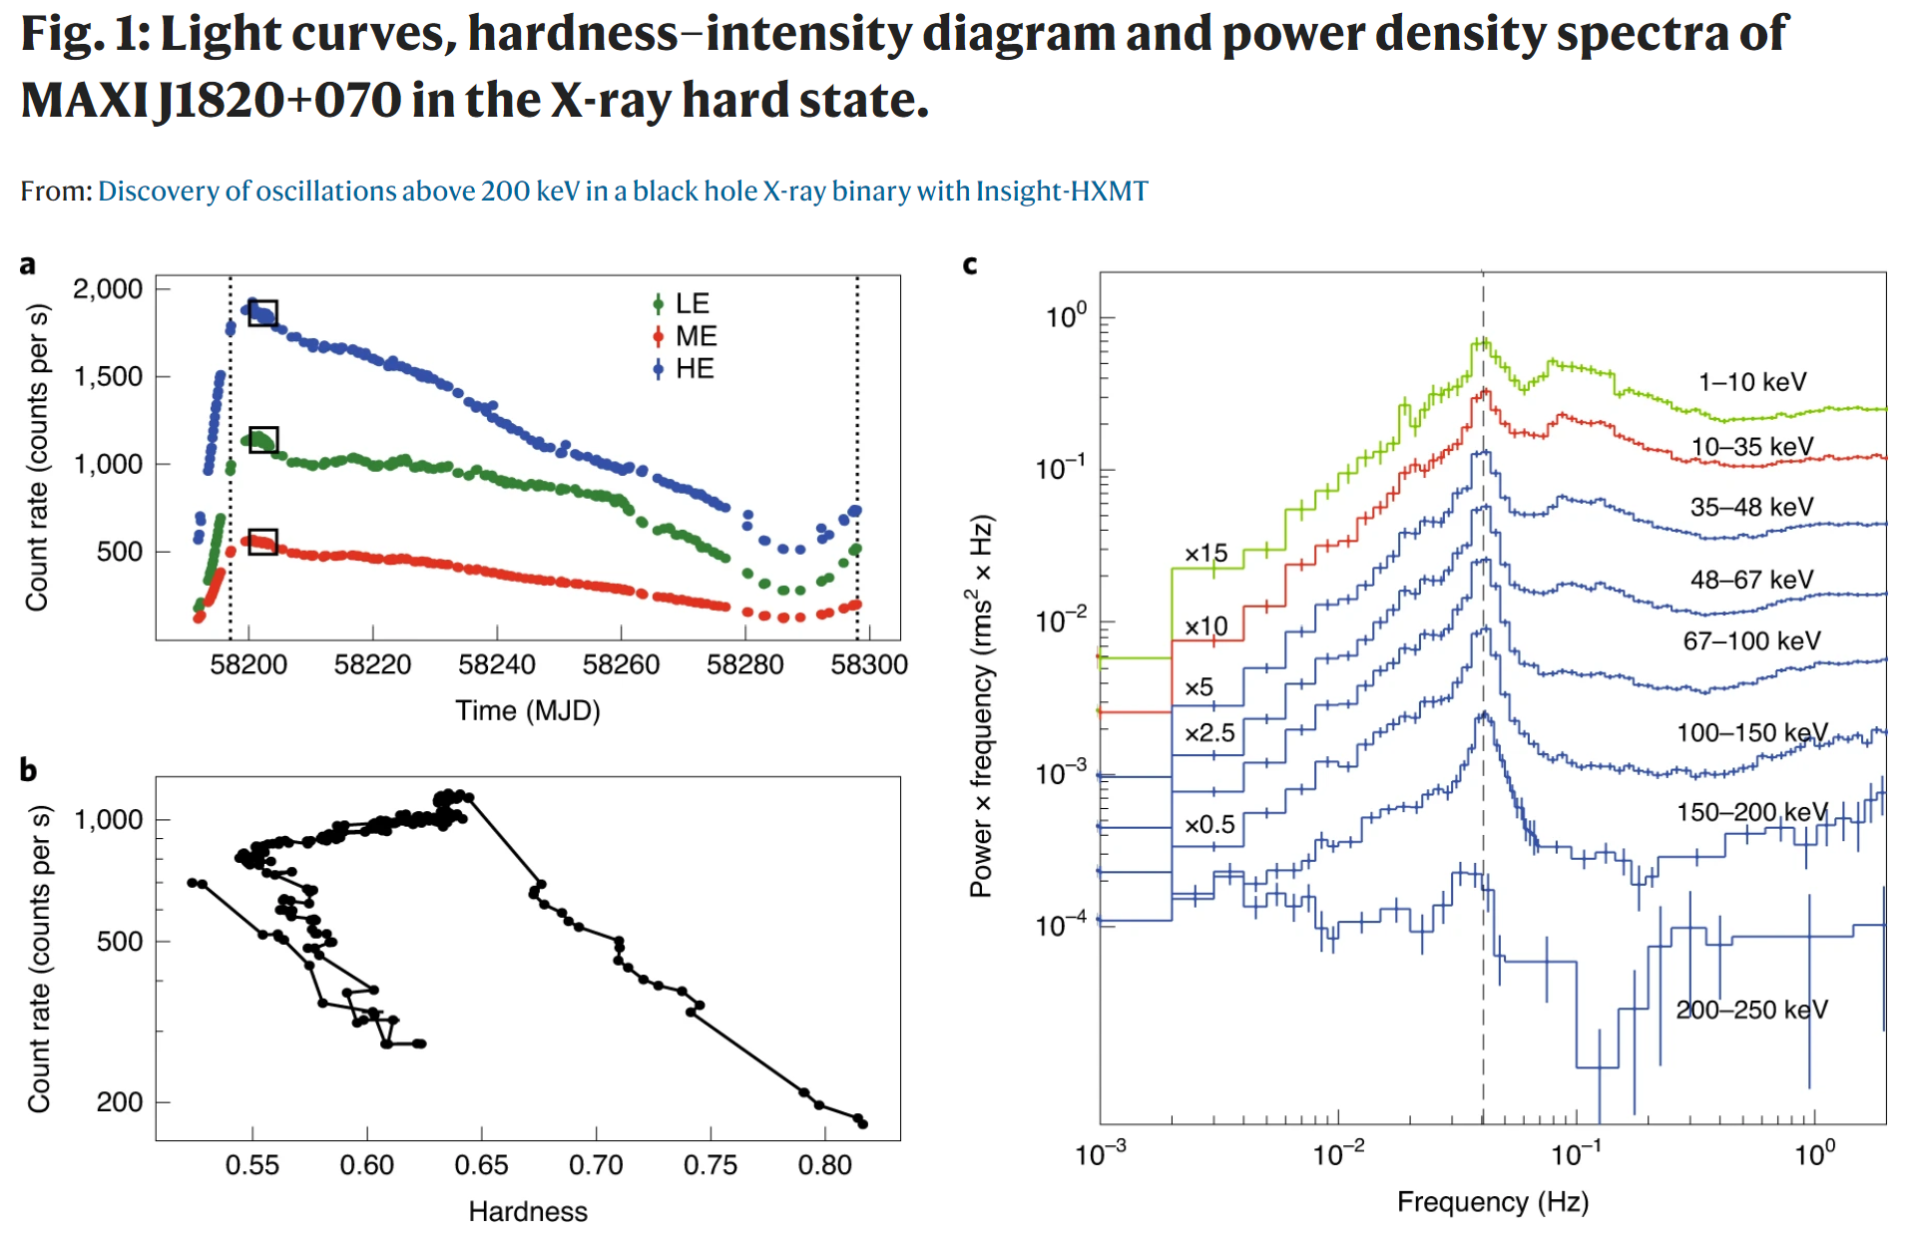
QPOs of BH binaries: < 30 keV → >200 keV
Ma, Tao, SNZ+ 2021, Nature Astronomy

Slide 19
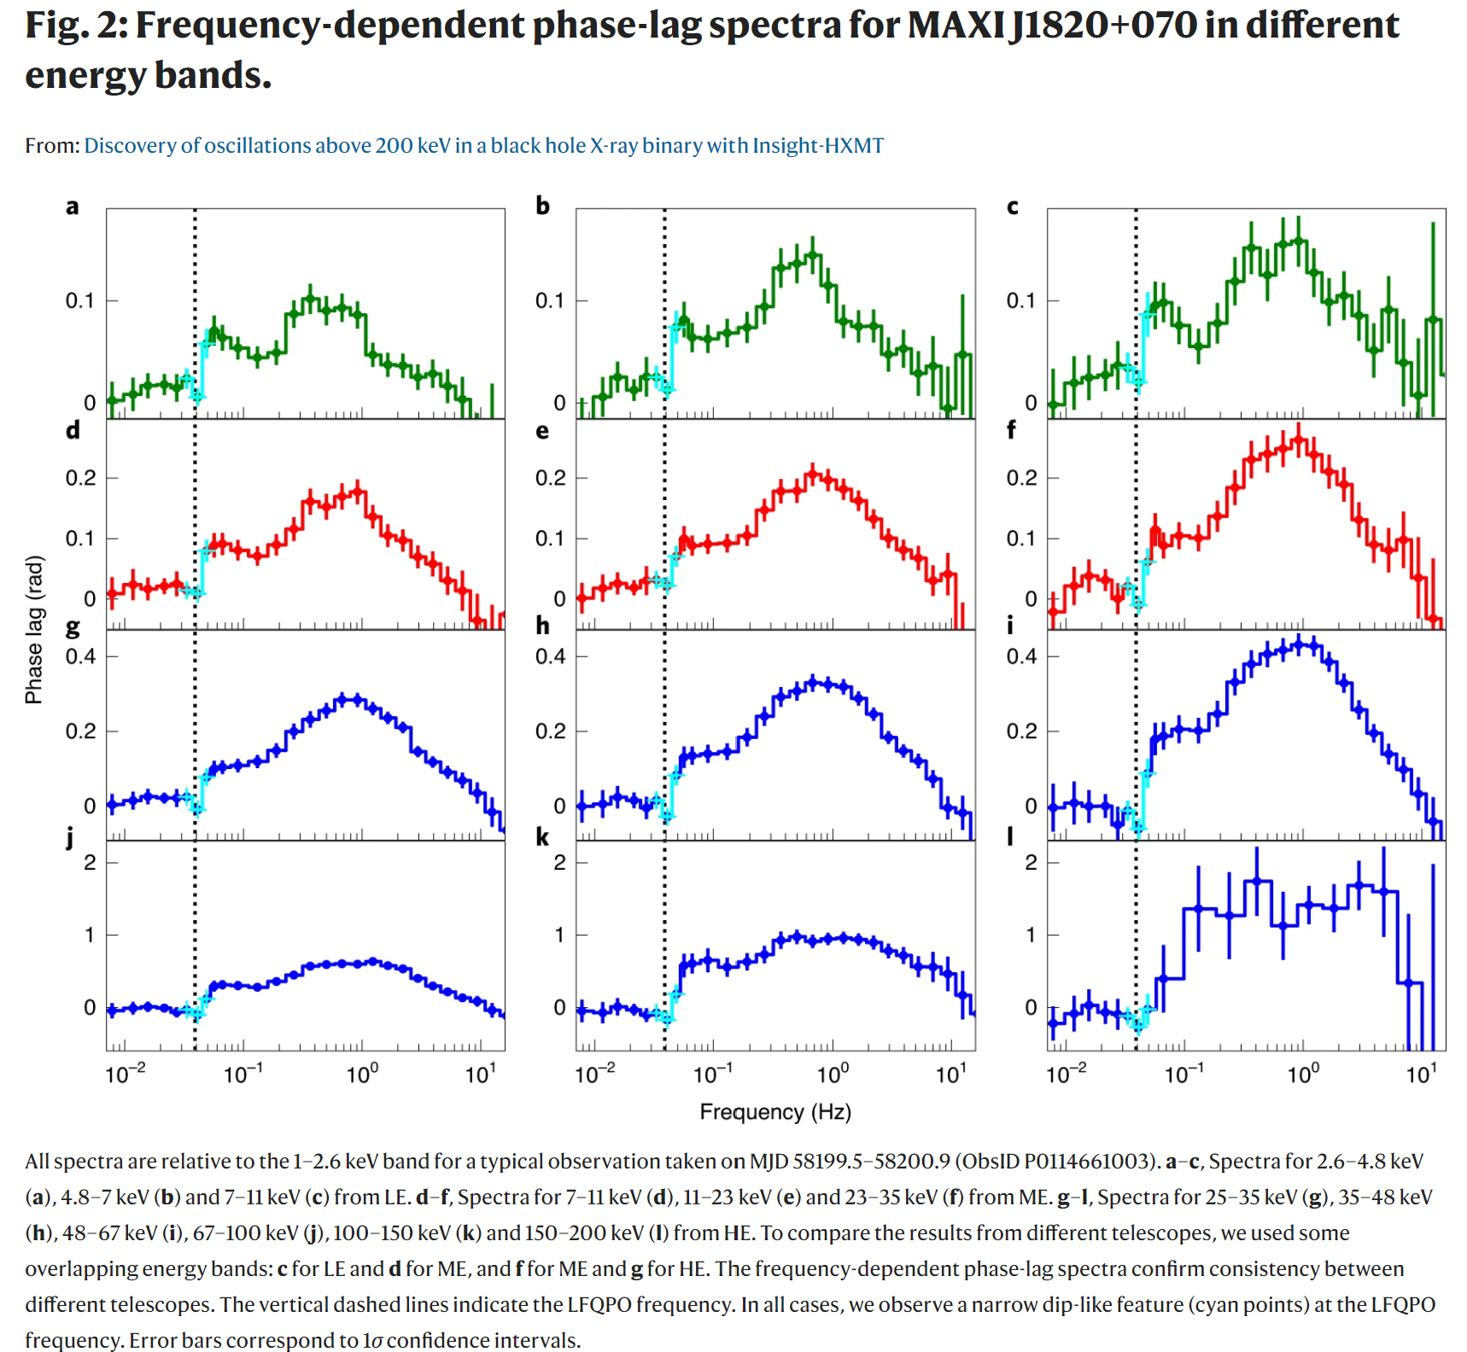
Dip in the lag-freq. spectra at QPO
All lags are relative to 1-2.6 keV; negative lag: behind
2.6-4.8 keV
150-200 keV
Ma, Tao, SNZ+ 2021, Nature Astronomy

Slide 20
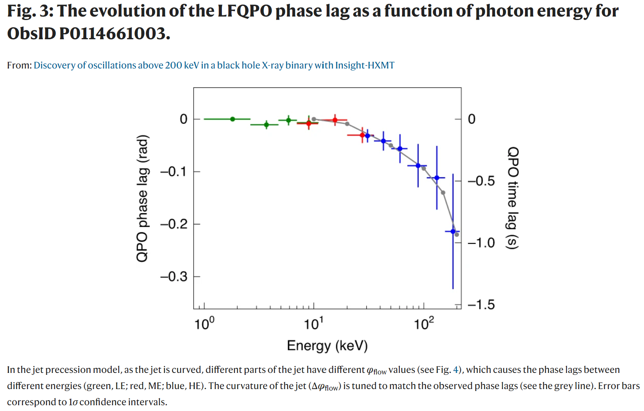
Lag contradicts Comptonization delay in corona:
Geometrical effect outside inner disk
Very large & soft lag:
not precessing corona
Ma, Tao, SNZ+ 2021, Nature Astronomy

Slide 21

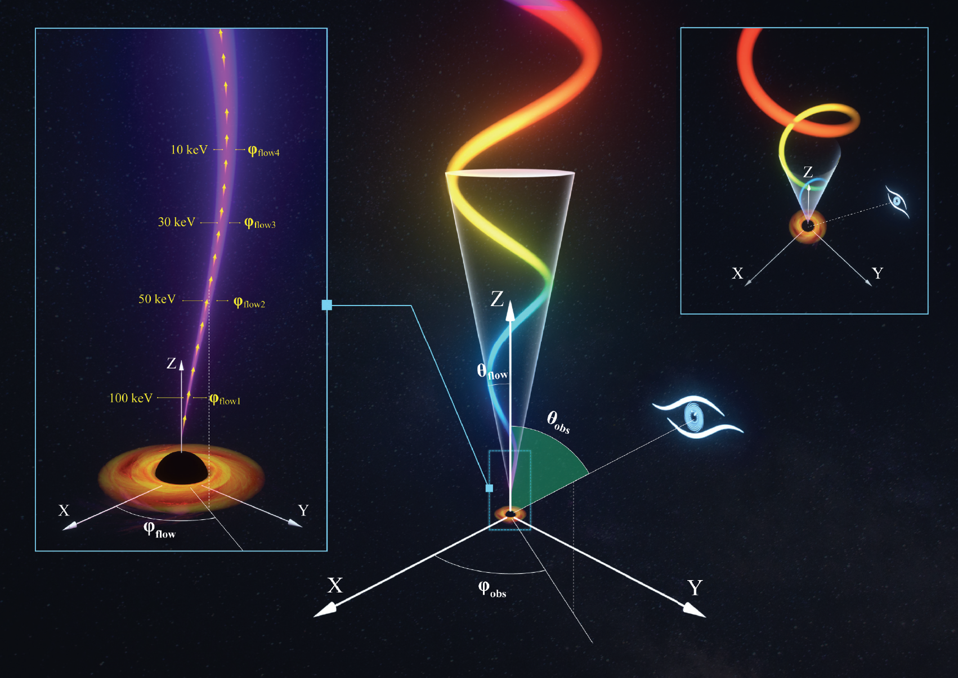
New model of BH QPOs: L-T precession Jet
Ma et al. 2020, Nature Astronomy

Slide 22
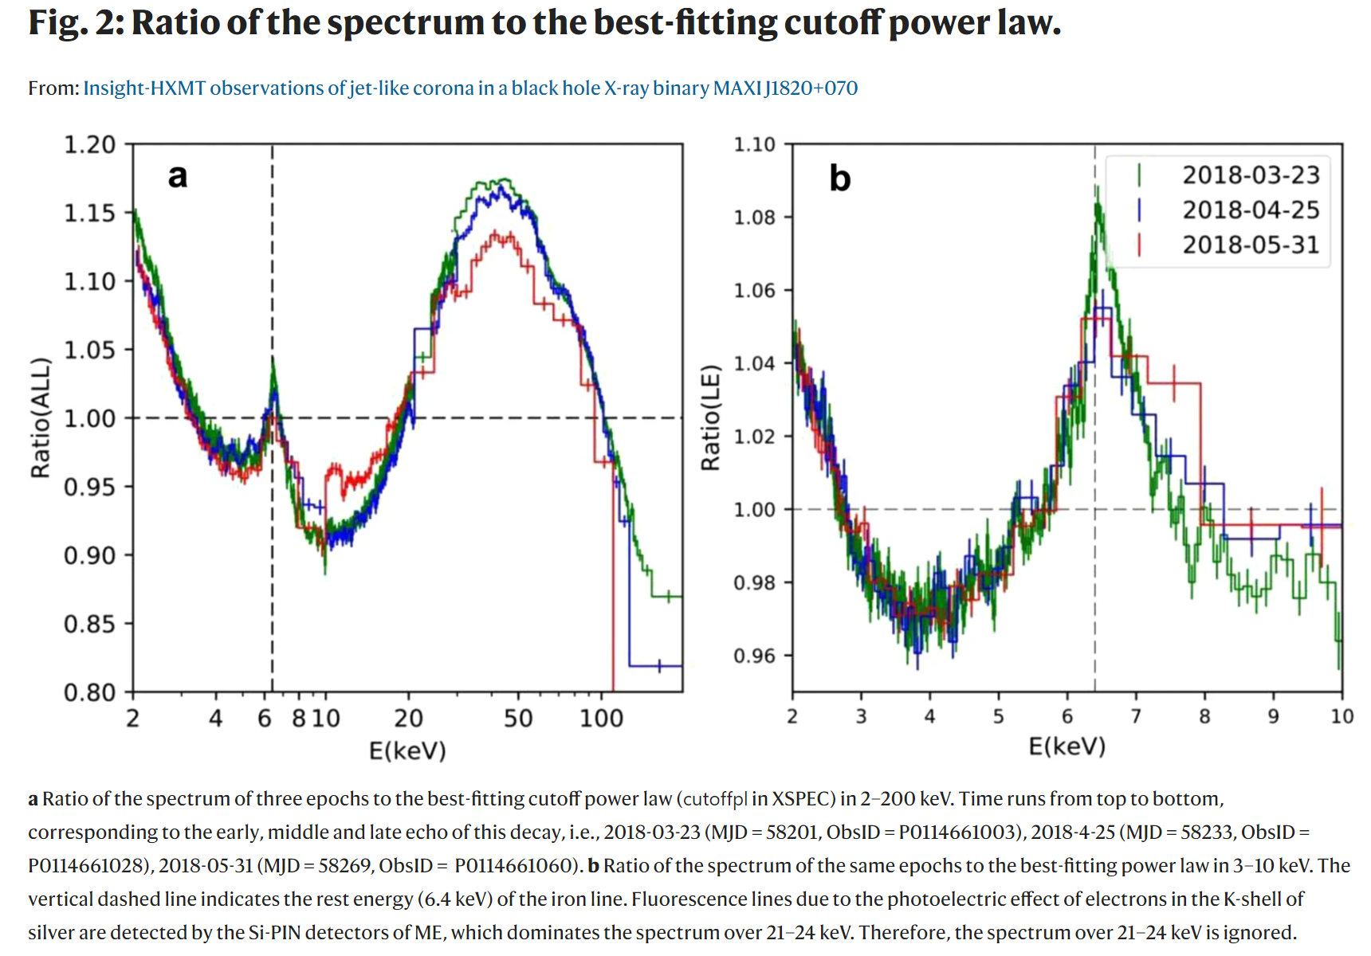
Broad band energy spectra with Insight-HXMT
You+2021, Nature Communications

Slide 23
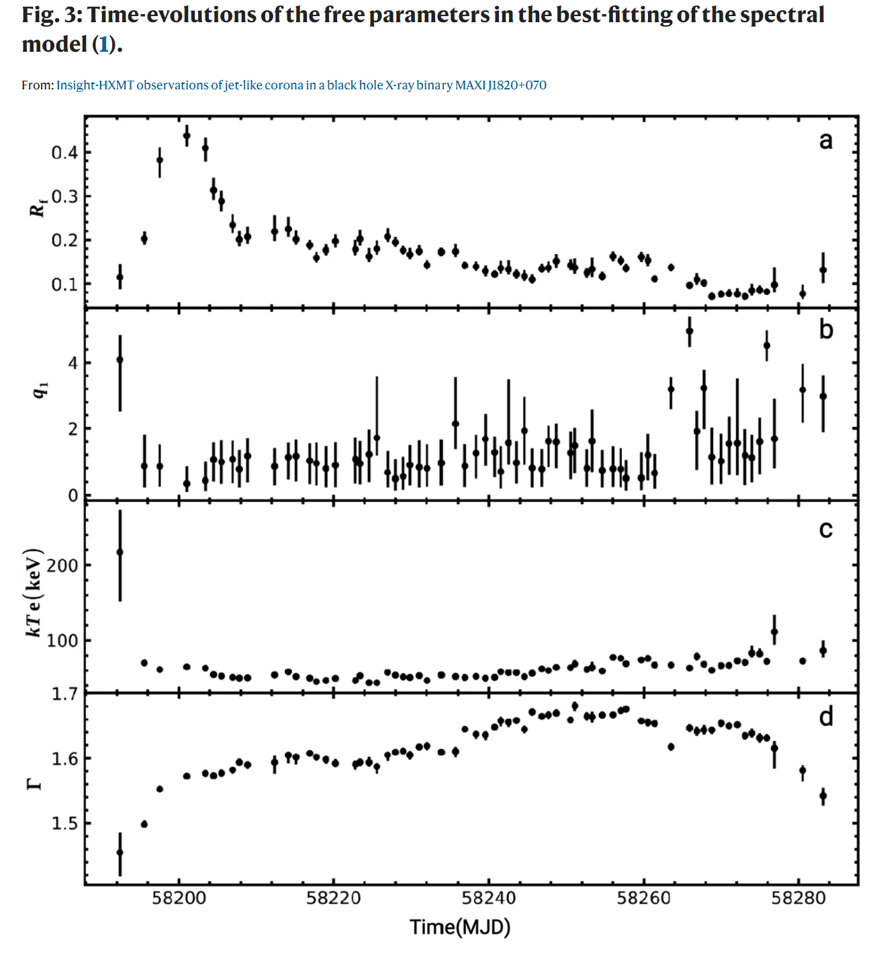
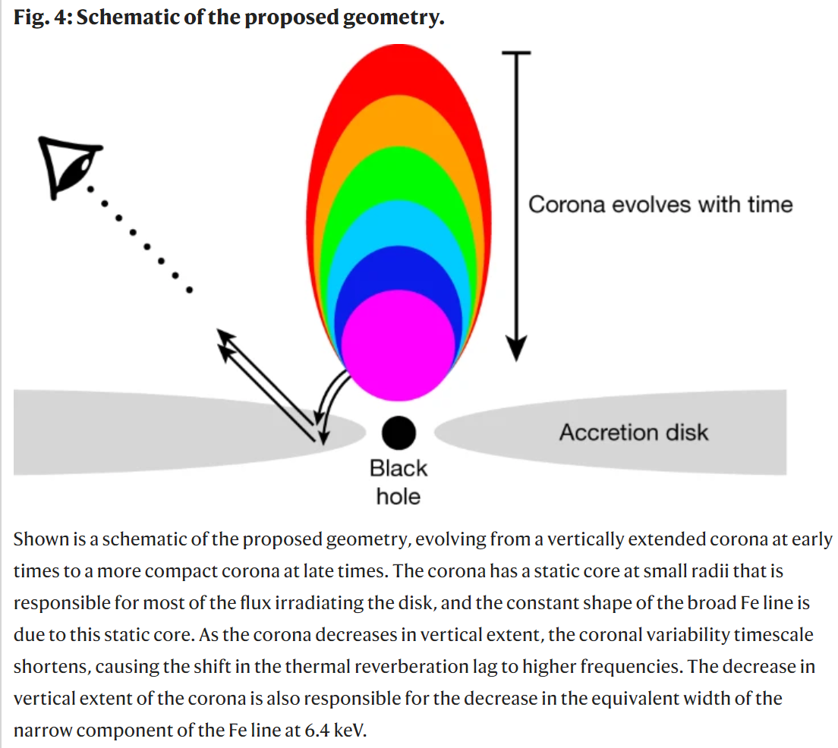
Decreasing reflection contradicts contracting corona
Reflection should increase, but actually decreases
You+2021, Nature Communications
Kara+2020, Nature

Slide 24
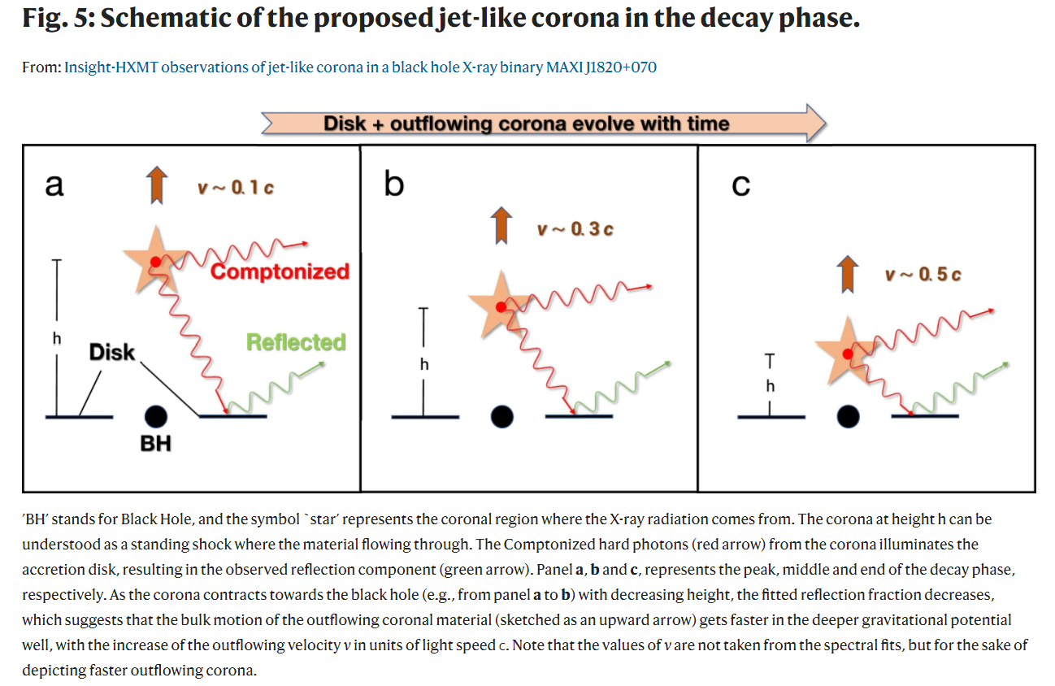
The contracting corona is an X-ray jet!
You+2021, Nature Communications

Slide 25
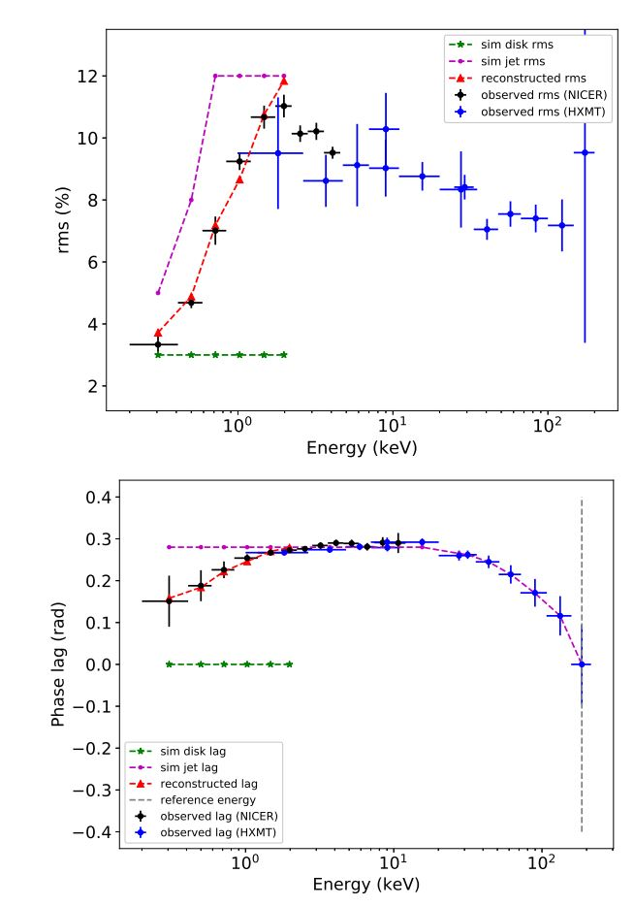
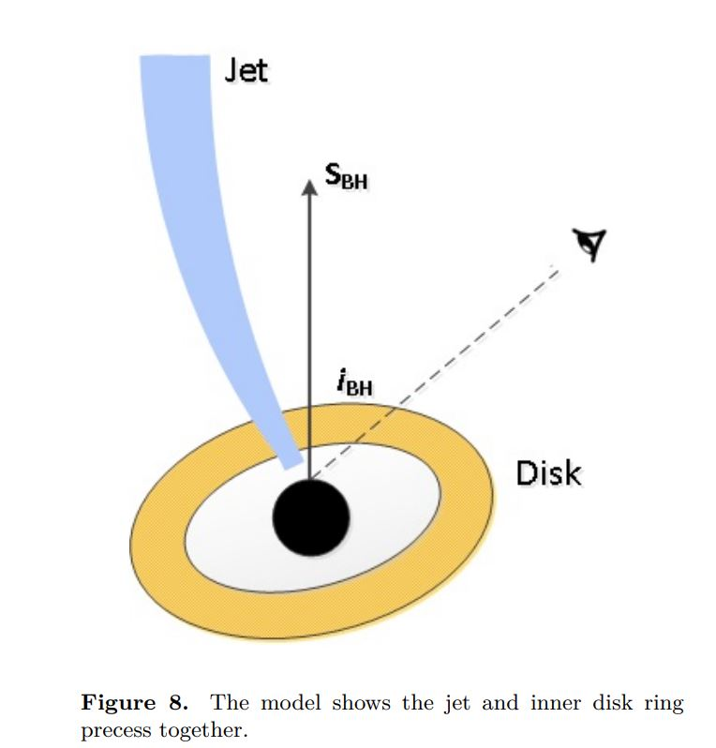
Disk-Jet co-precession with broad band QPO
Jet and inner disk precess together in MAXI 1820+070 (Ma et al. 2023, ApJ)

Slide 26
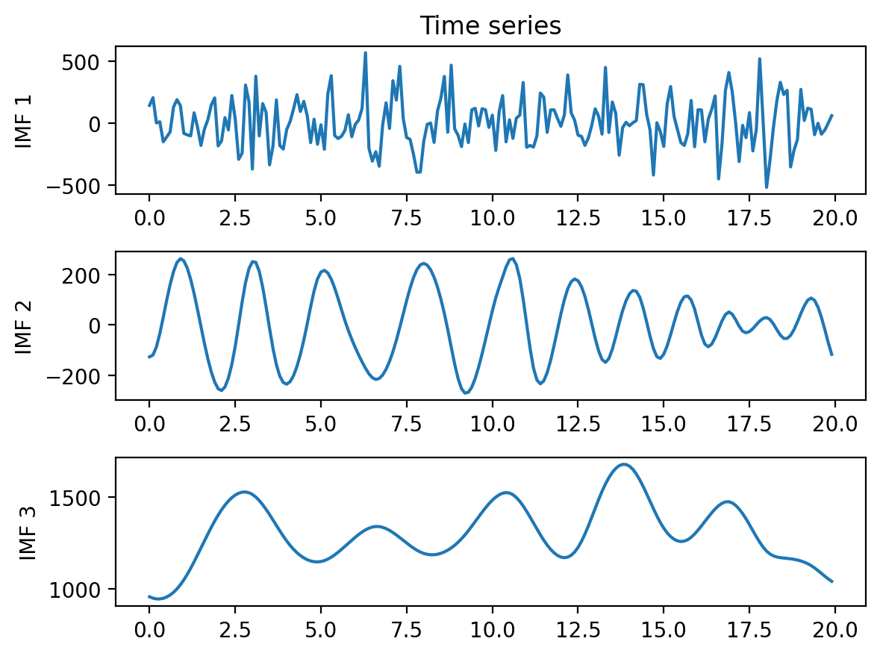
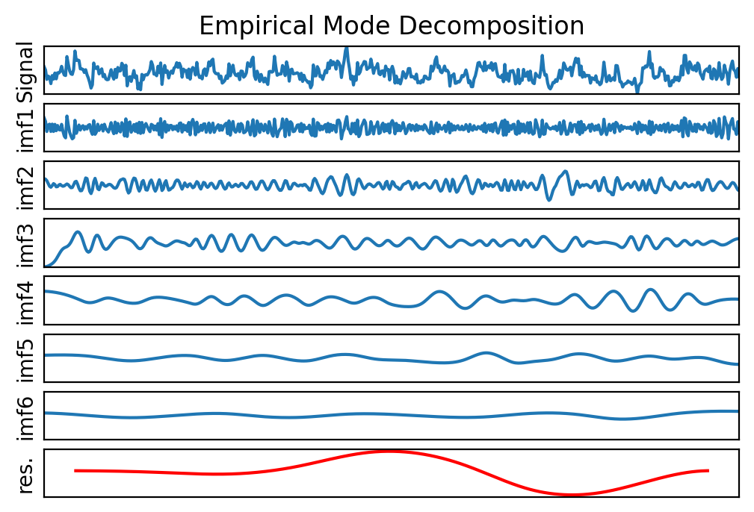
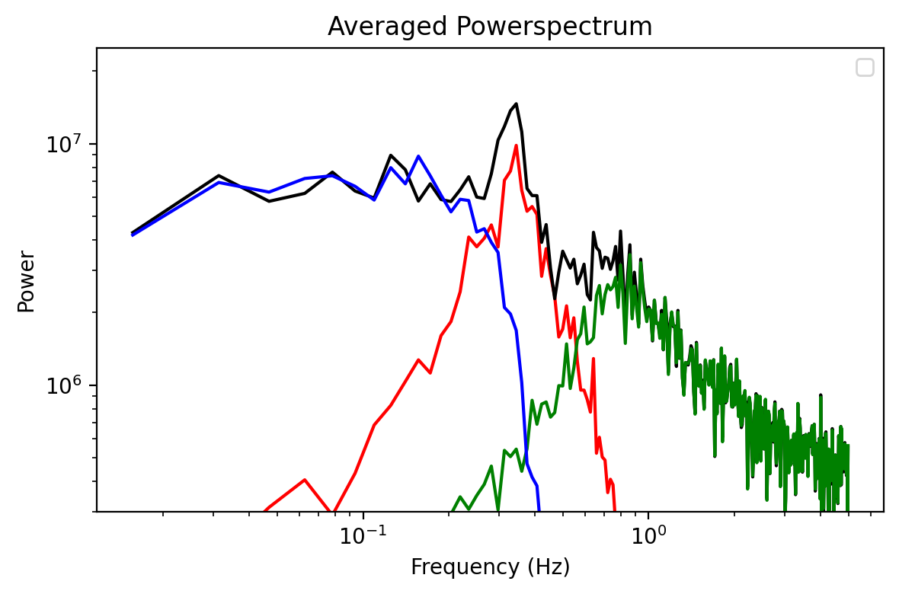
Hilbert-Huang Transformation (HHT)
Hilbert-Huang Transform (HHT) = Empirical Mode Decomposition (EMD) + Hilbert Transform (HT)
EMD ≈ narrow band filter：decompose adaptively a signal into several Intrinsic Mode Functions (IMFs)

Slide 27
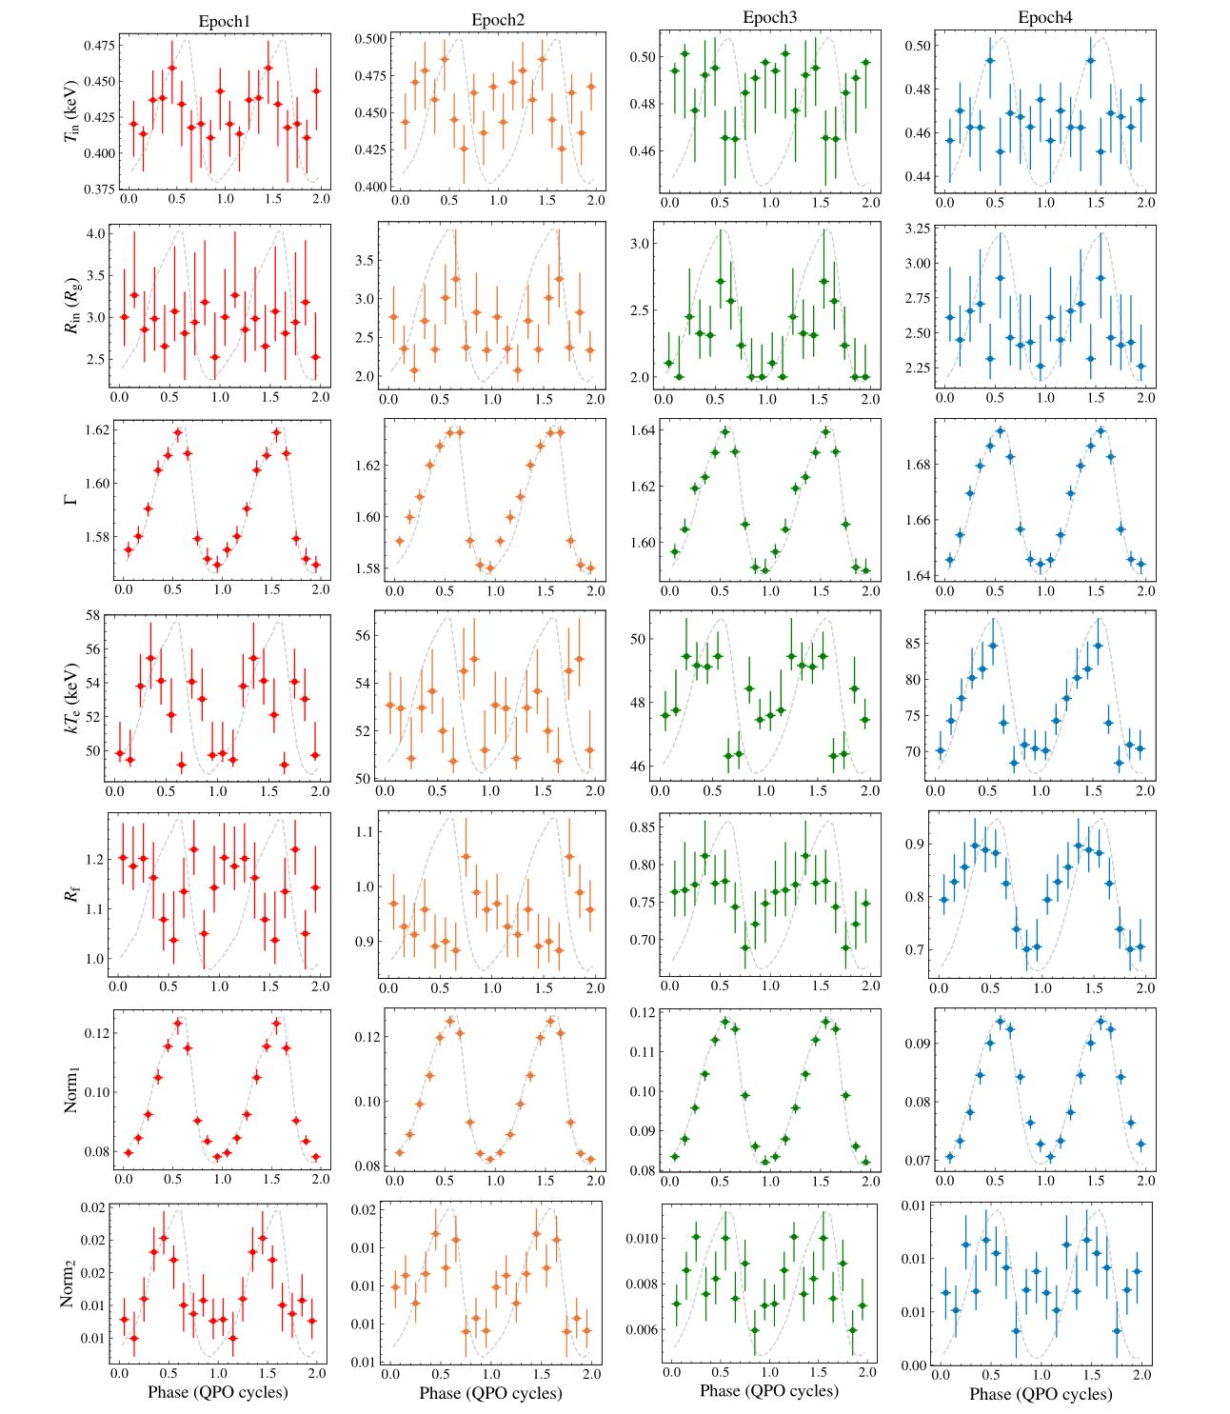

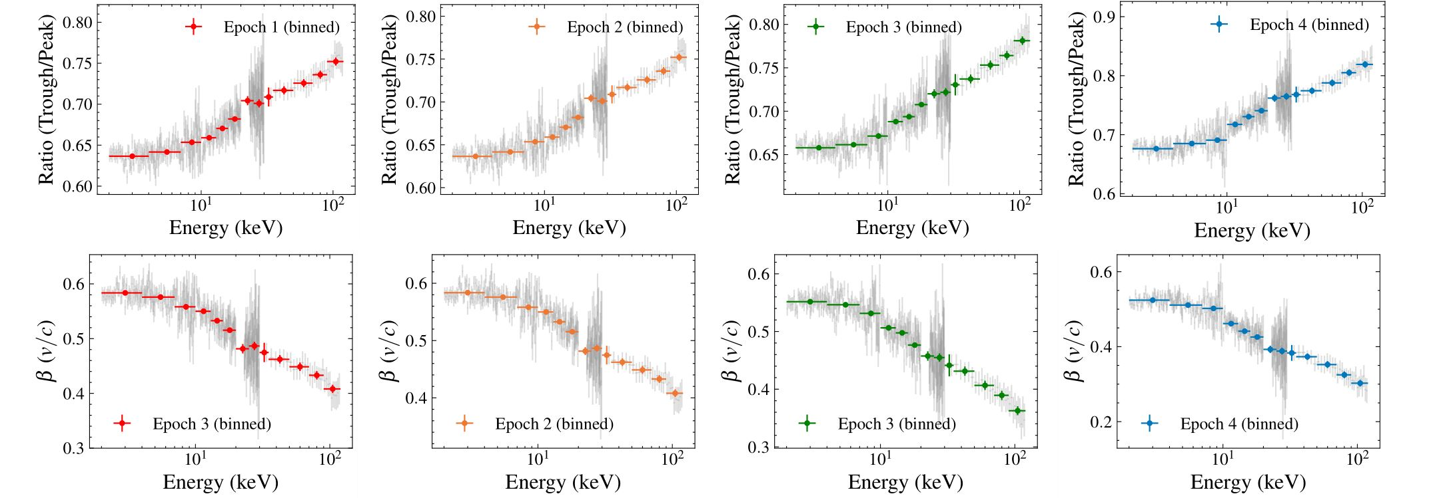

HHT QPO phase-resolved spectral analysis
Low-E
$$β$$
High-E
The modulation of the spectral index could be explained by either the coronal or jet precession model; the latter requires efficient acceleration within the jet. (Shui et al., 2023, ApJ)

Slide 28
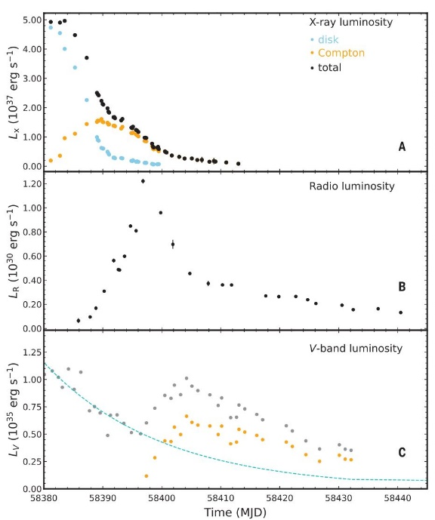

Evidence of MAD in MAXI J1820+070
Bei You*, Xinwu Cao* , Zhen Yan* et al. Science,2023

Slide 29


Evidence of MAD in MAXI J1820+070
Bei You*, Xinwu Cao* , Zhen Yan* et al. Science,2023

Slide 30

eXTP: enhanced X-ray Timing and Polarimetry Observatory
Next Generation Flagship Observatory
Important Sciences
  Extreme gravity, magnetism, density
  Neutron stars, black holes, etc
Mission Profile
  Orbit：5000*116500km HEO
  Weight：4.2 T
  Launcher：CZ-3BE
  Launch time: 2028-2030
Main Payload | Configuration | Eff. area (m²)
Spectroscopy Focusing Array (SFA) | 6 telescopes | >0.3m²@6keV
Polarimetry Focusing Array (PFA) | 3 telescopes | >350cm²@2keV
Wide-band Wide-field Camera (W2C) | 60°X60°; 10 - 600 keV | >300cm²@60keV
PI: Shuang-Nan Zhang (IHEP, CAS, China)
*This is a new configuration without the two large European payloads LAD and WFM, to remove the programmatic uncertainties related to the European participation.

Slide 31

White papers on eXTP
Five refereed papers have been published in a special issue of SCIENCE CHINA Physics, Mechanics & Astronomy, Feb. 2019
S.-N. Zhang, A. Santangelo, M. Feroci, Y.P. Xu, et al., The enhanced X-ray Timing and Polarimetry mission - eXTP
A. L. Watts, W.F. Yu, J. Poutanen, S. Zhang, et al., Dense matter with eXTP
A. De Rosa, P. Uttley, L.J. Gou, Y. Liu, et al., Accretion in Strong Field Gravity with eXTP
A. Santangelo, S. Zane, H. Feng, R.X. Xu, et al., Physics and Astrophysics of Strong Magnetic Field systems with eXTP
J. J. M. in 't Zand, B. Enrico, J.L. Qu, X.D. Li, et al., Observatory science with eXTP
Total ADS citation: 344 (as of 2024.6.16)

Slide 32


eXTP Payload: SFA – Spectroscopy Focusing Array
Large collecting area achieved by multiple optics with short focal length.
6 grazing incidence Wolter-I optics with 5.25m F.L., 45 shells/module , D=60cm
Non-imaging, 1′ (HPD), 3′ (W90), 12′ FoV
19-cell SDD array: multi-pixel to enable background subtraction
Energy range: 0.5-10 keV
Energy resolution: ≤ 180 eV @ 6keV
Time resolution: 10μs
Absolute timing accuracy: 2μs
Dead time: < 5% @ 1Crab
Sensitivity: 3x10⁻¹² erg/cm²/s (3σ, 10 s)
×6

Slide 33

eXTP Scientific Payload: PFA – Polarimetry Focusing Array
Large collecting area achieved by multiple optics with short focal length.
3 grazing incidence Wolter-I optics with 5.25m F.L., 45 shells/module, D=60cm
Imaging, resolution ≤ 30″(HPD, goal 15″)
Field of view: 8′
Gas Pixel Detector (GPD): photo-electron tracking
Energy range: 2-8 keV
Energy resolution: ≤ 1.8 keV @ 6keV
Time resolution: 500μs
Absolute timing accuracy: 2μs
MDP: < 3% (10⁶s, 1mCrab)
×3
Designed by the INFN-Pisa group (Bellazzini et al.)
GPD

Slide 34


Effective area: SFA & PFA
NewATHENA：2037？
eXTP-PFA
eXTP-SFA
IXPE：2021.12
Notes:
ATHENA已改为NewATHENA

Slide 35

Spectro-Timing-Polarimetry on Accreting BHs

Slide 36

Neutron Stars EoS
eXTP
(eXTP)
eXTP will study nucleonic matter in a unique regime, and exotic states of matter (e.g., quark stars) that could never exist in the laboratory.
Using only known sources, pulse profile modelling measurements will map the M-R relation and hence the Equation of State (EoS).

Slide 37


Extreme Magnetism
Accreting Pulsars and Magnetars hosts neutron stars with magnetic fields of 10¹²⁻¹⁵ Gauss
Strongest magnetic fields in lab. 10⁵ Gauss
Test Quantum Electro-Dynamics effects → vacuum fluctuations: is the propagation of light in vacuum modified by the magnetic field?
Has this been detected by IXPE? Maybe, as the predicted vacuum resonance, but needs eXTP to study further . (Lai, D. 2023, PNAS)

Slide 38

Compared to IXPE: A new ASIC will be used
Parameters | XPOL-III | XPOL-I
Number of pixels | 304 × 352 | 300 × 352
Physical pitch | 50 μm | 50 μm
Shaping time | 1 μs | 3-10 μs (adjustable)
Pixel gain | 200 mV fC⁻¹ | 400 mV fC⁻¹
Pixel noise | 30 e- ENC | 50 e- ENC
Full scale linear range | 30k e- | 30k e-
Trigger coupling mode | AC | DC
Minimum trigger threshold | ∼150 e-
Dead time | ∼150 μs | ∼1 ms
Maximum count rate | ∼6k * 4 c s⁻¹ | ∼0.9k * 3 c s⁻¹
9× higher (to compensate the larger effective area)
(Minuti et. al 2023)
(from Hua Feng)
Notes:
IXPE Crab: 70 counts/s/unit

Slide 39

Simultaneous observations are needed for spectroscopy/timing/phase-resolved polarimetry
(from Hua Feng)
Example: to compare the X-ray polarimetry during flares and quiescence.
Most of the flares that can be identified with NICER and HXMT cannot be seen in the IXPE light curve.

Slide 40

Really simultaneous? Difficult for LEO satellites
Overlapped time fraction
12%
8%
14%
(from Hua Feng)

Slide 41



eXTP is not only a larger version of IXPE
Example: timing-polarimetry
Need SFA to fold the QPOs
Ingram et al. 2017; Ingram & Maccarone 2017; Ingram & Motta 2019
(from Hua Feng)

Slide 42
IXPE + X vs. eXTP
IXPE + X
  Difficult to re-schedule multiple missions
  Low flexibility in response to transient sources
  Earth occultation: joint observations are not really simultaneous
eXTP
  All instruments point to the same target
  Bona fide simultaneous
  Almost no telemetry limit for bright sources
IXPE + X cannot fulfill the job
  if the source has variability on orbital timescale (~90 min)
  if one tries to study short-term variability (Δt < ~90 min)
For the same source, eXTP allows for
  polarimetry at a better timing/energy/phase resolution (~7 times better)
eXTP is more than a larger IXPE
(from Hua Feng)

Slide 43









The POLAR-2 experiment
Enhanced GRB polarimeter, successor of POLAR
Officially selected by CSS through UNOOSA in 2019
Announcement of selection
Jun./2019
Nature report
Ceremony of MOU signing
Nov./2019

Slide 44



POLAR-2 current design of instruments
High-energy Polarization Detector: HPD
E-range for polarimetry: ~30-800 keV
100 modules, 6400 plastic scintillator bars
Effective area: > 2000cm², > 1000cm² for Pol.
FOV: ~50% sky
Collaborations: UNIGE/IHEP/MPE/NCBJ
Has been approved through United Nations
Low-energy Polarization Detector: LPD, GXU, China
~2-10 keV X-ray polarimetry
Broad energy-band Spectrum Detector: BSD, IHEP/CAS, China
~10-2000 keV for spectroscopy
Accurate GRB localization: < 1°
Status: under final review for approval
BSD
LPD
PIs: Shuang-Nan Zhang (IHEP), Xin Wu (UniGe); launch in 2027

Slide 45


High Energy cosmic-Ray Detection (HERD)
HERD: flagship scientific experiment onboard the China's Space Station, ~2027
Scientific goals
  Dark matter search with high energy electrons and gamma-rays
  Precise CR spectrum and composition measurements up to knee energy
  Gamma-ray monitoring
PI: Shuang-Nan Zhang (IHEP); Europe Coordinator: Giovanni Ambrosi (INFN, Perugia)

Slide 46


HERD current baseline design
Silicon Strip Charge Detectors
Silicon Tracker
Tracks
γ conversion
Plastic
Scintillators
e/γ ID
Charge
Transition Radiation
Detector
TeV energy scale calibration
3D Imaging Calorimeter
Energy
Particle ID

Slide 47
HERD vs. other experiments
Experiment (time) | Energy (e/γ) | Energy (p) | ∆E/E (e/γ) | ∆E/E (p) | e/p ID | e accep. m²sr | p accep. m²sr
FERMI (2008) | 1GeV-300GeV | 30GeV-10TeV | 10% | 40% | 10³ | 0.9 | <0.28
ISS-AMS02 (2011) | 1GeV-1TeV | 1GeV-1.8TeV | 2% | - | 10⁶ | 0.12 | 0.12
ISS-CALET (2015) | 1GeV-10TeV | 50GeV-10TeV | 2% | 35% | 10⁵ | 0.12 | --
DAMPE (2015) | 5GeV-10TeV | 40GeV-100TeV | ≤1.5% | 25-35% | 3*10⁴ | 0.3 | 0.04
HERD (~2027) | 10GeV-100TeV (e) 0.5GeV-100TeV (γ) | 30GeV-PeV | 1% | 20% | 10⁶ | >3 (10X DAMPE) | >2 (50X DAMPE)
HERD is a next generation experiment, following AMS02, Calet & DAMPE, with much better performance on direct high energy e, p, gamma-ray detection.

Slide 48










China’s Space High Energy Astronomy Missions
  悟空DAMPE (2015)
  POLAR*(2016)
  慧眼-HXMT*(2017)
  GECAM#(A/B/C/D) (2020-)
  EP#(2024)
  SVOM#(2024)
  POLAR-2*(2027)
  HERD*(2027?)
  eXTP*(2029?)
DAMPE 2015
POLAR 2016
HXMT 2017
GECAM 2020-
EP 2024
SVOM 2024
*Led or #Initiated by me
POLAR-2 2027
HERD 2027?
eXTP 2029?
Thanks for your attention! (zhangsn@ihep.ac.cn)

