Slide 1


















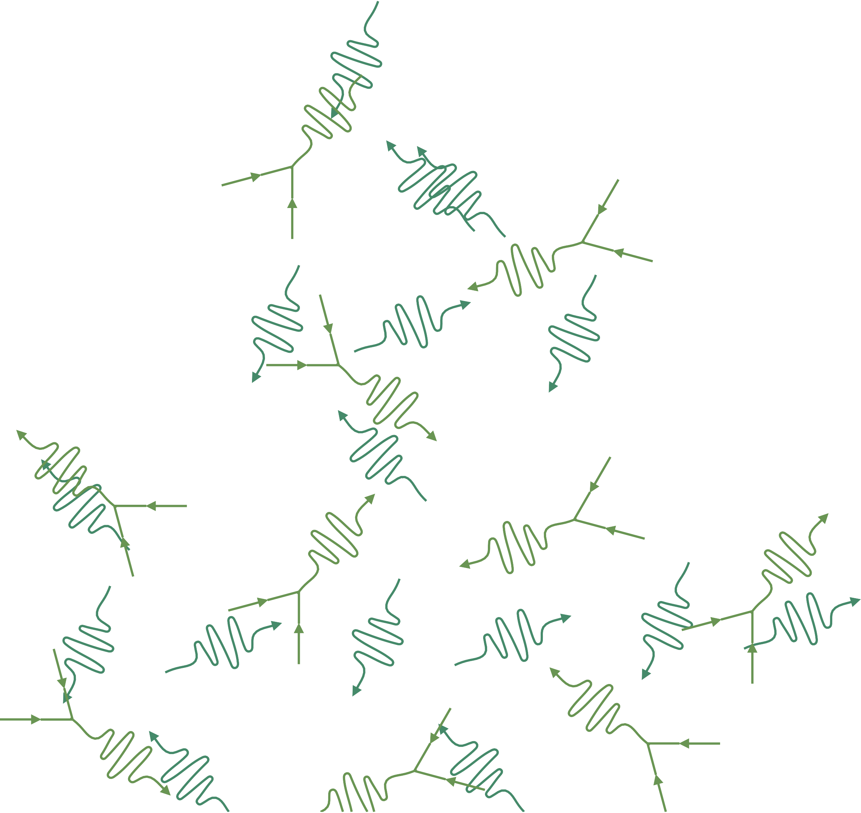
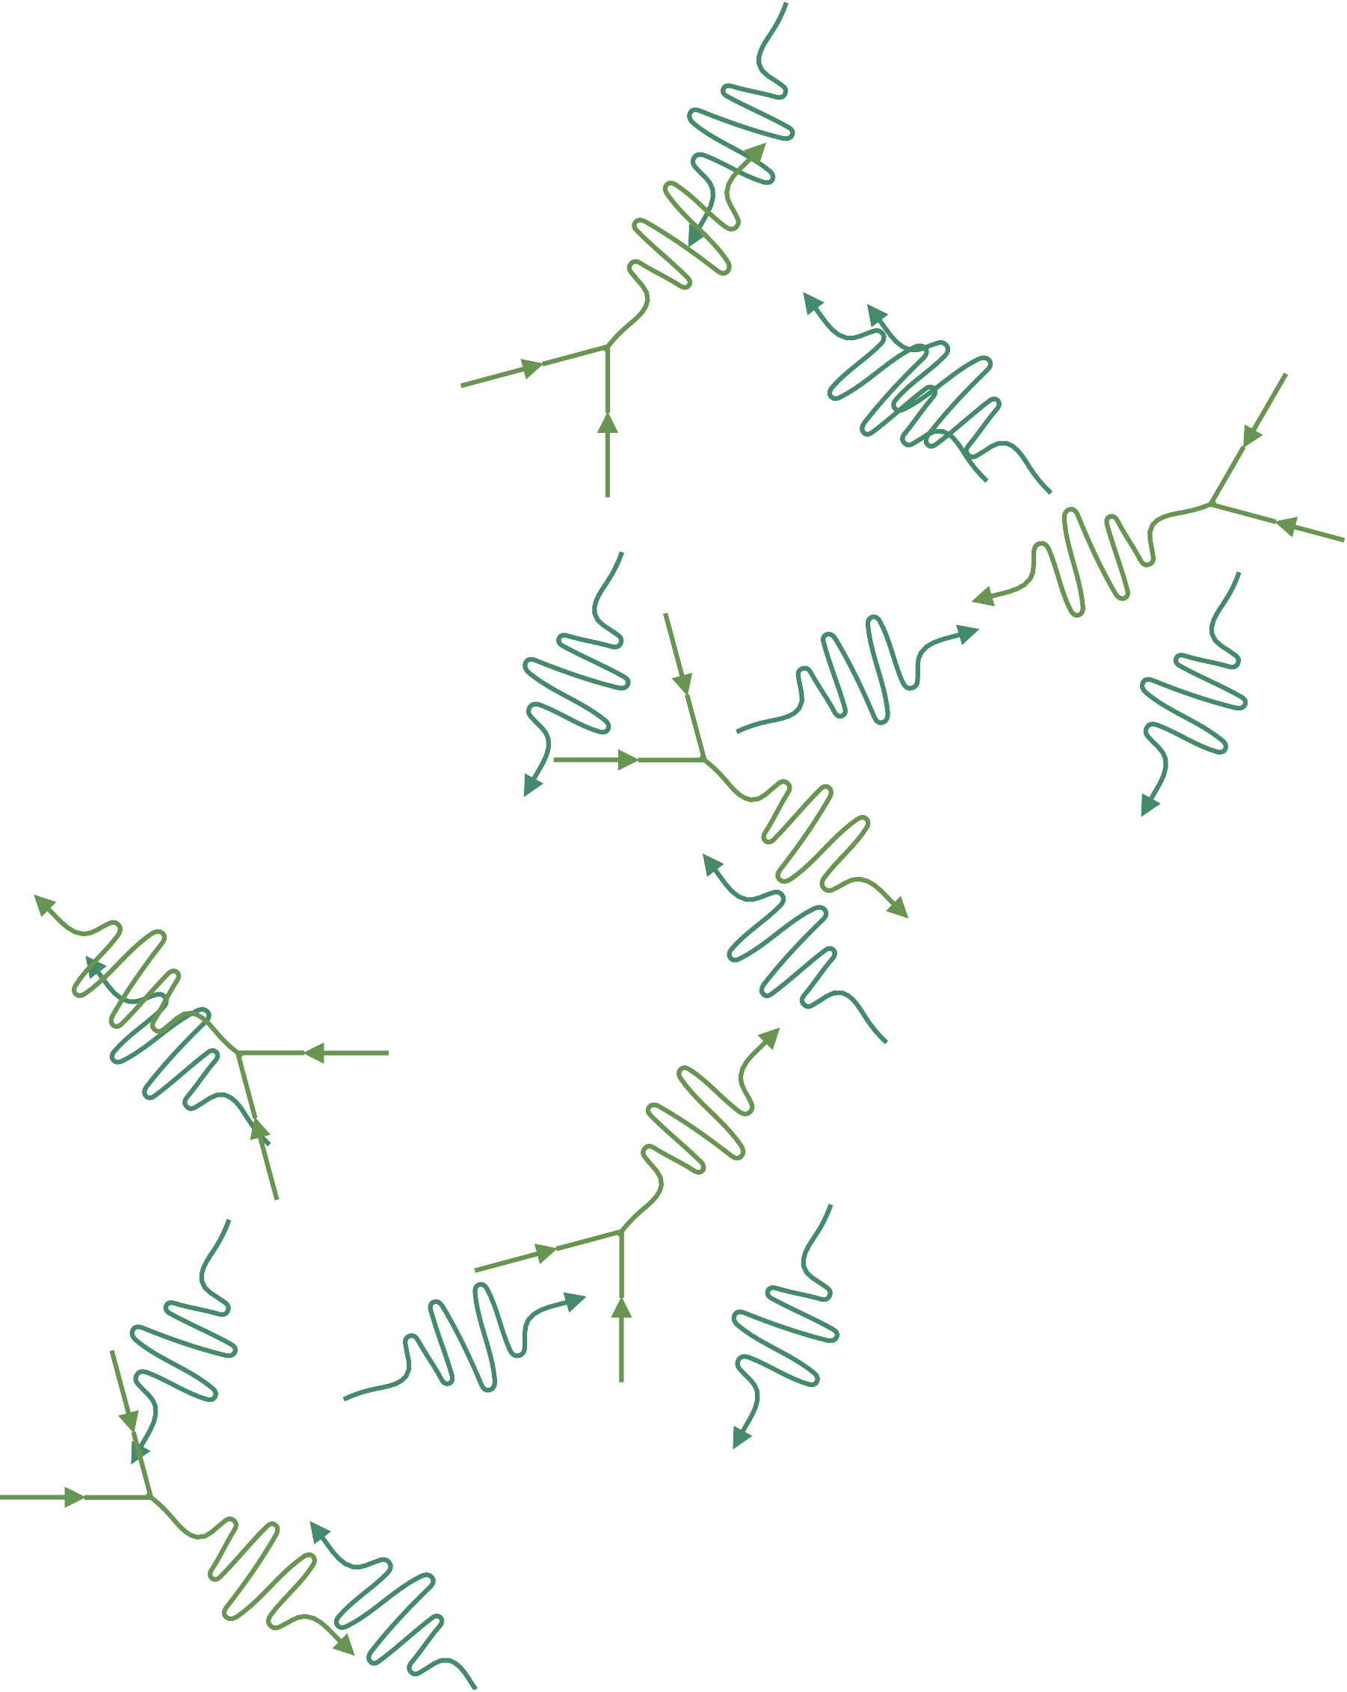





















































































































































































γ
γ
γ
γ
γ
γ
γ
γ
γ
γ
γ
γ
γ
γ
γ
γ
γ
Physics
of the Cosmos
γ
γ
γ
γ
γ
γ
γ
γ
γ
_{γ} γ
_{γ} γ
γ
γ
γ
γ
γ
γ
γ
γ
γ
γ
γ
γ
γ
γ
γ
γ
γ
γ
γ
γ
γ
γ
γ
γ
γ
γ
γ
γ
γ
γ
Drivers of Future Gamma-ray Astrophysics
γ
γ
γ
γ
γ
γ
γ
γ
γ
γ
γ
γ
γ
γ
γ
γ
γ
γ
γ
γ
γ
γ
γ
γ
γ
γ
γ
γ
γ
γ
γ
γ
γ
γ
γ
γ
γ
γ
γ
γ
γ
γ
γ
γ
Future Innovations of Gamma rays Science Analysis Group
γ
γ
γ
γ
γ
γ
γ
γ
γ
γ
γ
γ
γ
γ
γ
γ
γ
γ
γ
γ
γ
γ
γ
γ
γ
γ
γ
γ
γ
γ
γ
γ
γ
γ
γ
γ
γ
γ
γ
γ
γ
γ
γ
γ
γ
γ
γ
γ
γ
γ
γ
γ
γ
γ
γ
γ
γ
γ
γ
γ
γ
γ
γ
γ
γ
γ
γ
γ
γ
P. Coppi, Yale
γ
γ
γ
γ
γ
γ
γ
γ
γ
γ
γ
γ
γ
γ
γ
γ
γ
γ
γ
γ
γ
γ
γ
γ
γ
γ
γ
Collaborators:
MiG 17
Pescara
July 11, 2024
γ
γ
γ
γ
γ
γ
γ
γ
γ
γ
γ
γ
γ
γ
γ
γ
γ
Chris Fryer, C. Michelle Hui, Milena Crnogorčević, Tiffany Lewis, Marcos Santander, Zorawar Wadiasingh
https://pcos.gsfc.nasa.gov/sags/figsag.php
γ
γ
γ
γ
γ
γ
γ
γ
γ
γ
γ
γ
γ
γ
γ
γ
γ
γ
γ
γ
γ
γ
γ
γ
γ
γ
γ

Slide 2



Introduction
Gamma-ray astronomy has benefitted from a continuous set of missions capable of studying a broad range of astrophysical objects including persistent and transient phenomena, leading to remarkable discoveries that have revolutionized astrophysics.
Many of the current major missions are reaching the end of their extended operational phases and, at this time, only few comparable future missions have found support.
Ideal time to reassess the community’s future priorities and to provide recommendations to NASA based on the community’s vision of gamma-ray astronomy towards 2040.
2

Slide 3
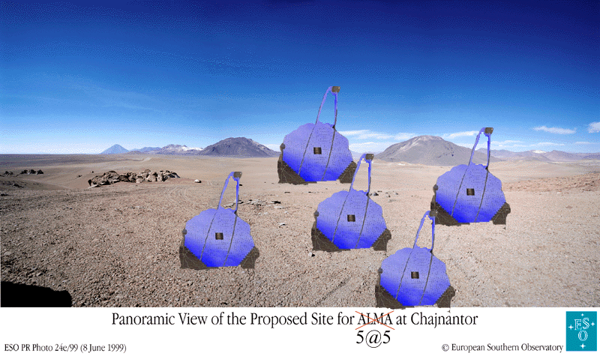
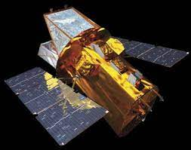
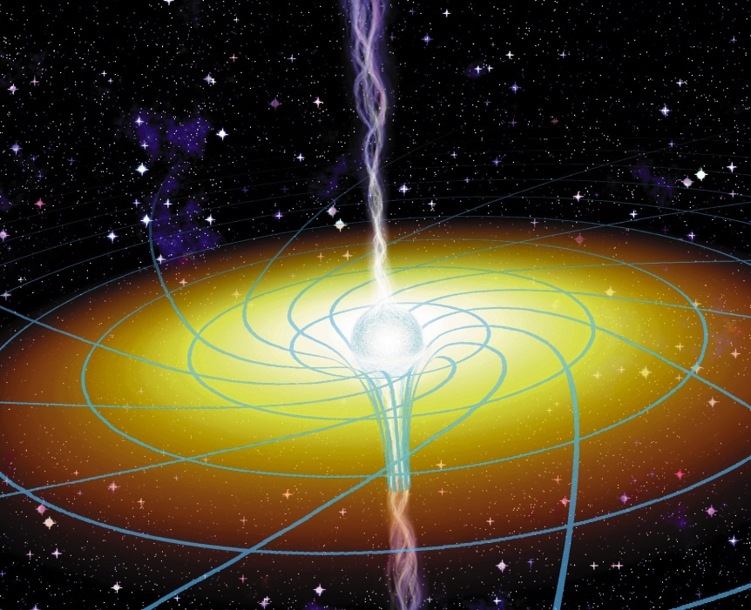
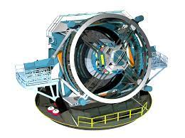
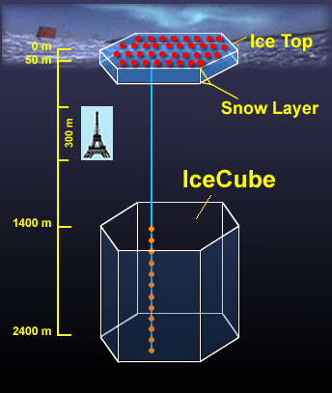
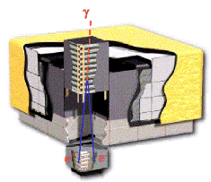
TDAMM! [Time Doman, Multi-Messenger]
λλ
Ground-Based γ-Ray Detectors
?
Space-Based γ-Ray Detectors
Example: How some hope to find
and study AGN in the next decade.
Fermi
?? neutrinos

Slide 4

Primary Question
What science has not or cannot be done with existing or funded space-based gamma-ray instrumentation? i.e beyond Fermi and COSI, in the fleet environment of the 2030s and 2040s.
  The space-based gamma-ray regime is bounded in energy at ~100 keV by the X-ray regime, and at ~30-100 GeV by the ground-based gamma-ray regime.
  Connections with other wavelengths and messengers. Additional stakeholders for gamma-ray astronomy.
  There is probably a ~10+ year lag to from concept to launch (even SMEX like COSI takes ~5+ years). Nothing in US/EU pipeline after COSI – Astro-H (SGD), AGILE already dead, SWIFT down to 1 gyro…
3

Slide 5
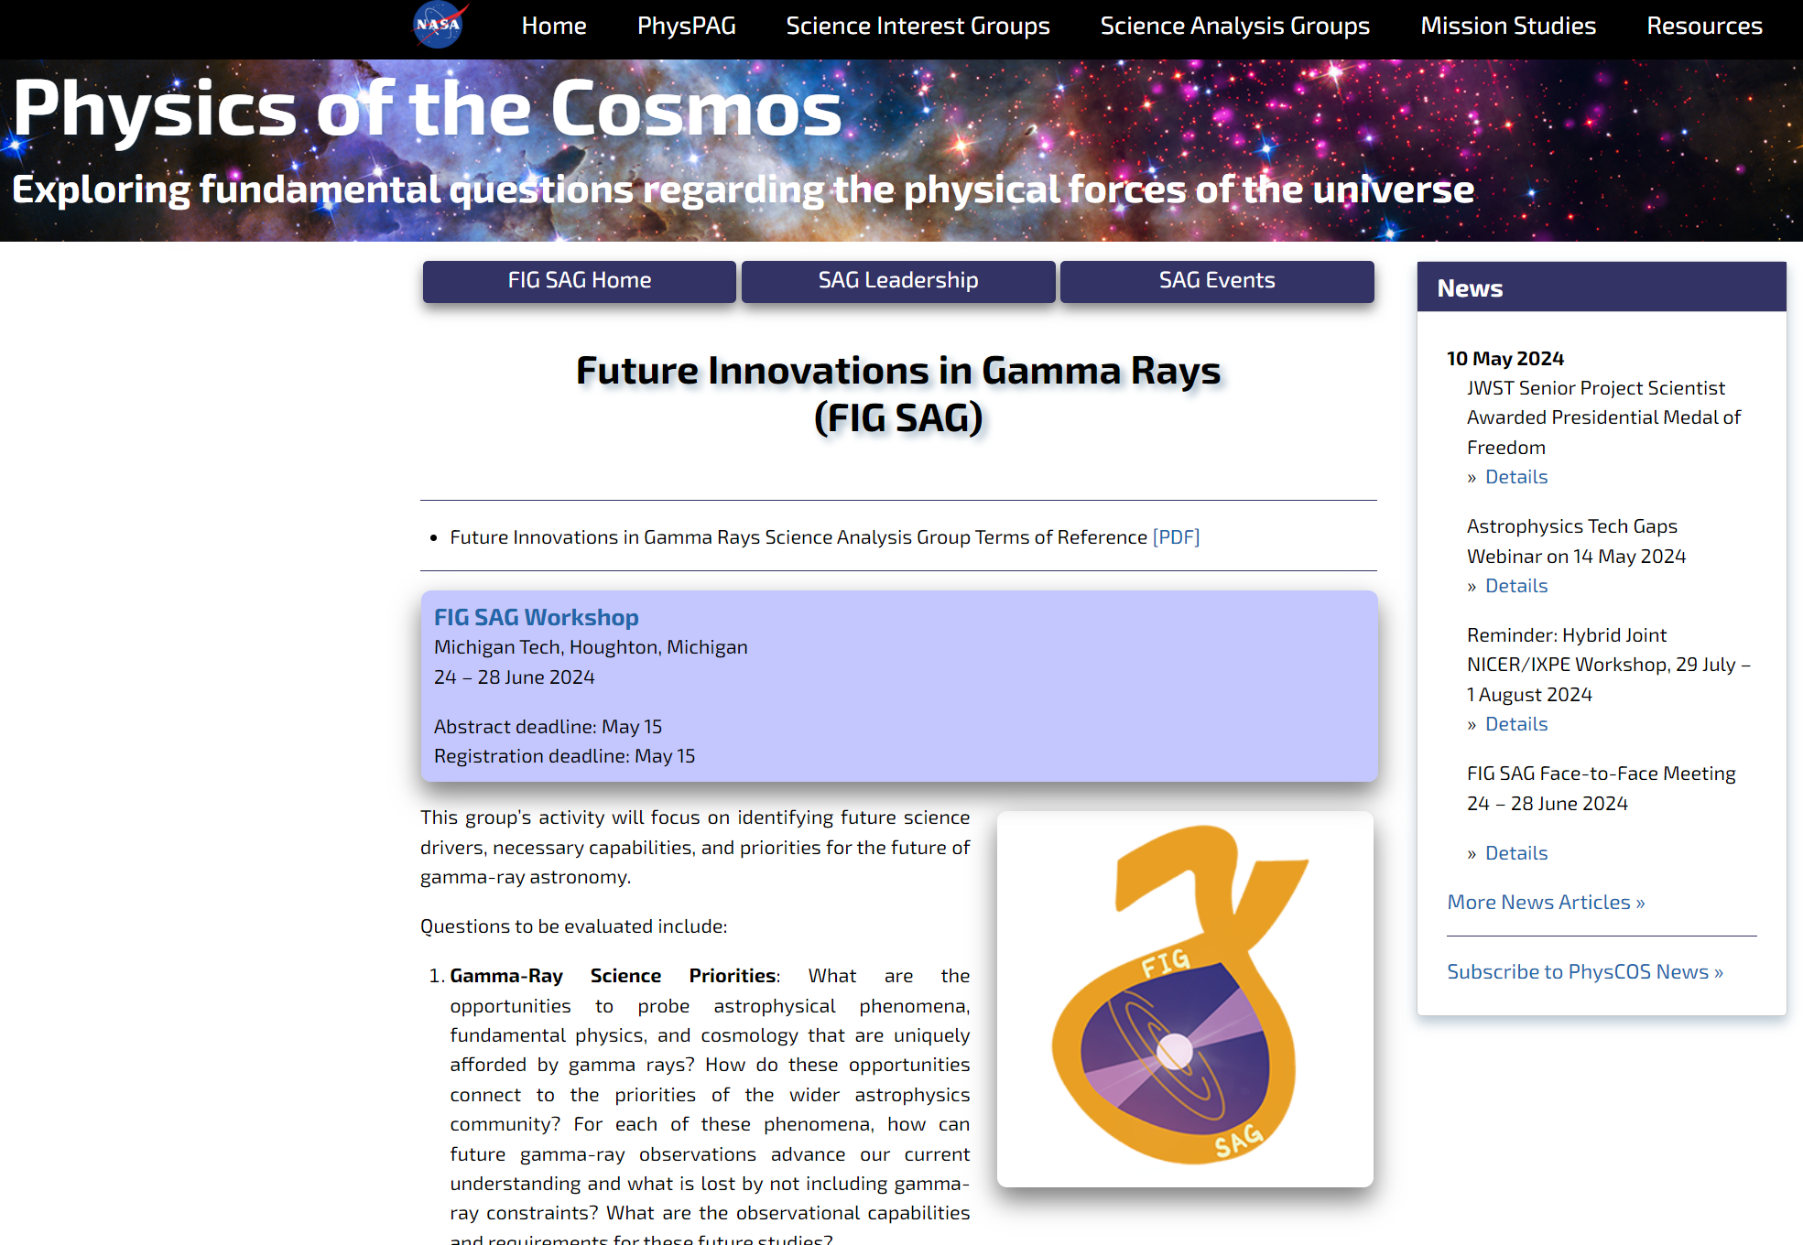

https://pcos.gsfc.nasa.gov/sags/figsag.php

Slide 6
Immediate goal for NASA – deliver ~50 page report to NASA administration to help set
NASA’s future priorities.
BUT probably any future mission will be international effort => we want to collect information
globally and then make our findings public to provide ammunition for other space agencies to invest
in gamma-ray instrumentation – and to help your mission concept proposal, so you don’t need to
start from scratch.
We need your help!
All our meeting materials (in-person and zoom) will be online [we’re working on website]. We are working
on getting a special issue of JHEP where we can publish whitepapers on science justification, suitable
detector technologies, and specific mission concepts.
Note: the NASA report is NOT supposed to be mission specific. Rather like report that led to Fermi, it
should outline what is technically feasible and what is scientifically interesting, which hopefully will lead
to NASA to issue a call for proposals for specific implementations/studies. [ But it doesn’t hurt to detailed
mission concept papers floating around] Also, for some timely science goals, the required technology may
yet not have the required ``TRL,” so we can call out areas for NASA technology (hardware and software)
development.
We don’t live in a vacuum: astro-politics – in US, need to get into Decadal Survey, Snowmass, P5 process.
what about EU/ASI/Japan/China, etc.? (e.g., E-Astrogram effort)

Slide 7







Timeline
Kickoff – Jan 2024 AAS meeting
Virtual:
  monthly meetings on specific topics
  slack channels for more in-depth discussions
In-person opportunities:
Please sign up
and share your thoughts!
FIG SAG
Future Innovations in Gamma Rays
We will explore gamma-ray science priorities, necessary capabilities, new technologies, and theory needs to inspire work toward 2040.
Get involved and stay informed:
https://forms.gle/VBijBgapMRwJm9dU6
Chairs:
Chris Fryer & Michelle Hui, Paolo Coppi, Milena Crnogorčević, Tiffany Lewis, Marcos Santander, and Zorawar Wadiasingh
APS April meeting in Sacramento, CA
AAS HEAD meeting in Horseshoe Bay, TX
FIGSAG brainstorming workshop at MTU (just happened)
Fermi Symposium (09/2024), likely afternoon parallel session
First report draft for comment ~12/2024, submit to NASA by ~spring 2024.
5

Slide 8
And finally feel free to talk/email with us! We’re trying to have at least one of us at the major upcoming gamma-ray related meetings (e.g., TeVPa, Gamma2024, Fermi Symposium).
FIG-SAG Leadership & Contact Information
Chris Fryer - fryer@lanl.gov
Michelle Hui - c.m.hui@nasa.gov
Paolo Coppi - paolo.coppi@yale.edu
Milena Crnogorčević - milena.crnogorcevic@fysik.su.se
Tiffany Lewis - tiffanyl@mtu.edu
Marcos Santander - jmsantander@ua.edu
Zorawar Wadiasingh - zorawar.wadiasingh@nasa.gov , zwadiasingh@gmail.com (easier access)

Slide 9

Topics of Interest
Gamma-ray Science Priorities: Identify opportunities uniquely afforded by gamma-ray observations.
Gamma-ray Mission Capabilities: Which science objectives are only done or best done by space-based gamma-ray missions, considering the current missions in extended operation and funded missions in development.
Technology Investment: What new technologies/methodologies exist and what is needed to achieve the science priorities.
Theory and Analysis Needs: What advances do we need to make in theory and analysis to achieve the science priorities.
Synergies with Other Programs: How do these goals tie to the broader astrophysics and physics community. What are the timelines to align with current priorities in multi-messenger astronomy.
4

Slide 10
FIGSAG Key Questions
  What are Gamma-Ray Science Priorities? [And why should broader
  physics/astronomy community care about them?]
  What are Theory / Modeling / Analysis / Fundamental Physics Needs?
  What are Technology Investment Needs?
  What are Gamma-Ray Mission Capabilities we need? [FOV vs. area vs.
  angular resolution vs. energy resolution?]
  What are Synergies with Other Programs?
Goal of FIGSAG is to foster discussion of these, collect all input in
one place, and then make available to space agencies and future planning
efforts like the 2030 Decadal Survey.

Slide 11
Why γ-rays [~100 keV-GeV+]?
Clean signature of extreme, non-thermal & nuclear universe (don’t have to worry about thermal/stellar contamination, e.g., in soft X-rays and optical)
Valuable multi-messenger partner since neutrino & cosmic ray production/propagation => γ-rays! Sources
relatively rare, so coincidence often significant.
Direct propagation from source, very penetrating (especially MeV)
Compact object energy scales, physical conditions => γ-rays! Though “rare,” non-thermal processes and magnetic fields more important than we thought… even for galaxy/star formation!

Slide 12
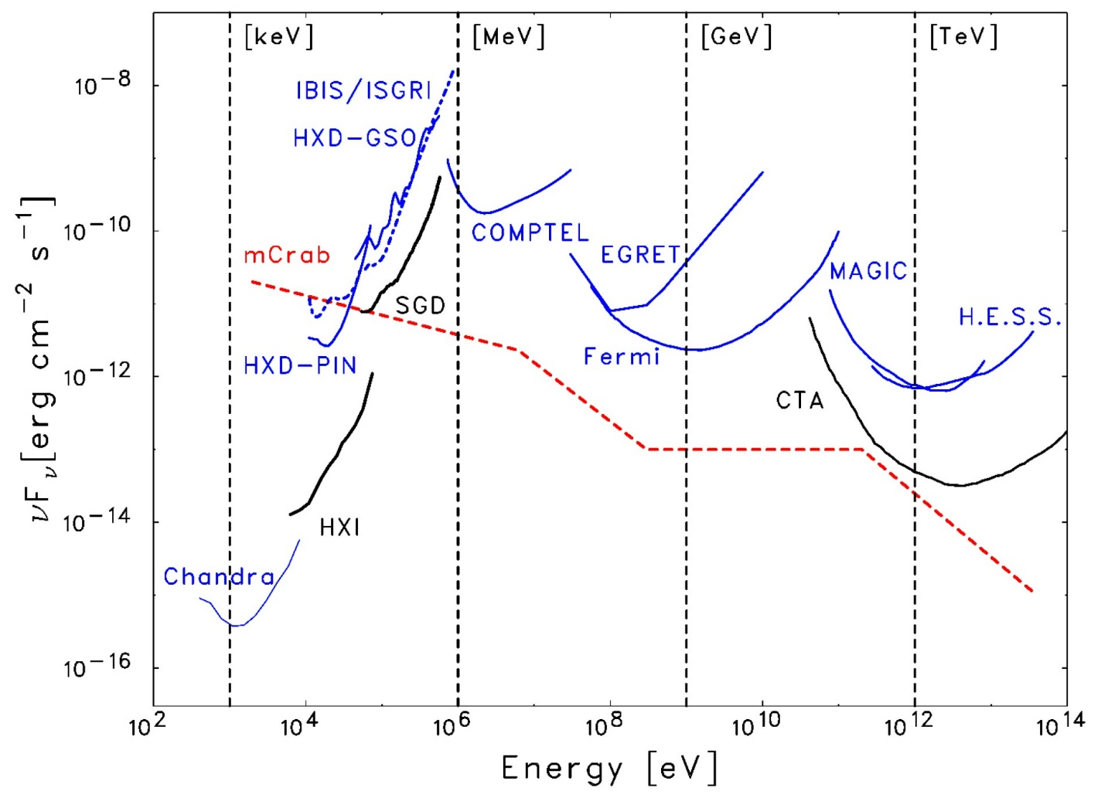
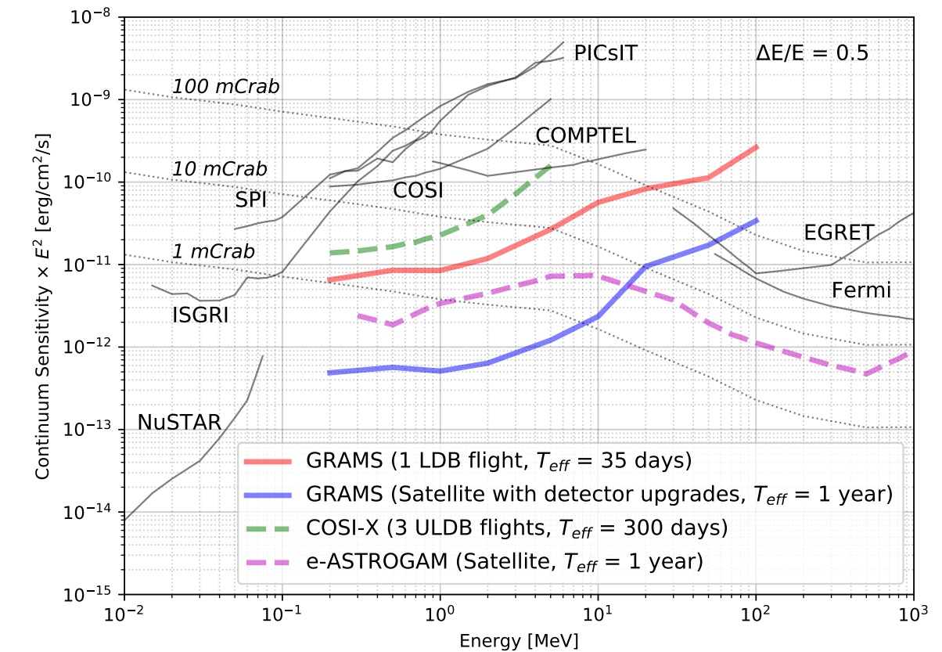
Why now? Energy Coverage – ~100 keV-MeV-GeV can only be
done from space … and there’s a big gap there!! Especially at ~MeV.
??
[Fermi out-of-date w/respect to CTA]
Hopefully will
have COSI
in ~2027, but
could do even
better with
more $$
CTA/LHAASO
Astro-H (100 ks)
(+NuSTAR)
Diﬀerential sensitivities for diﬀerent X-ray and γ-ray instruments looking at an isolated
point source. A spectral bin with ∆E/E = 1 is assumed for Chandra and ∆E/E = 0.5
for the other instruments.
Note also: due to EBL absorption, z>1 universe is not directly accessible at E>50-100 GeV (i.e., the ground).

Slide 13
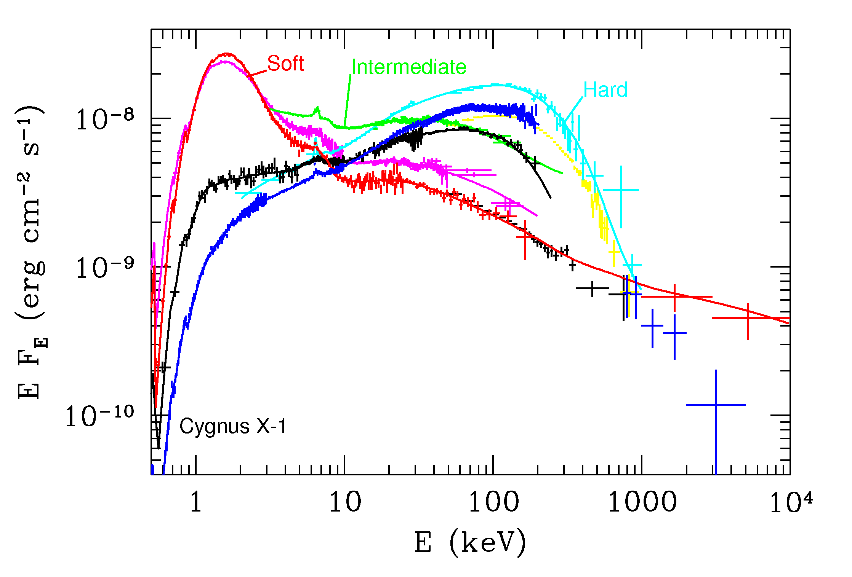
Why (soft) gamma-rays for non-jet AGN? Need broad-band spectra to constrain
physics, reprocessing, measure bolometric luminosity, etc…
X-Ray Binary
Pre- CGRO
Compilation by A. Zdziarski

Slide 14
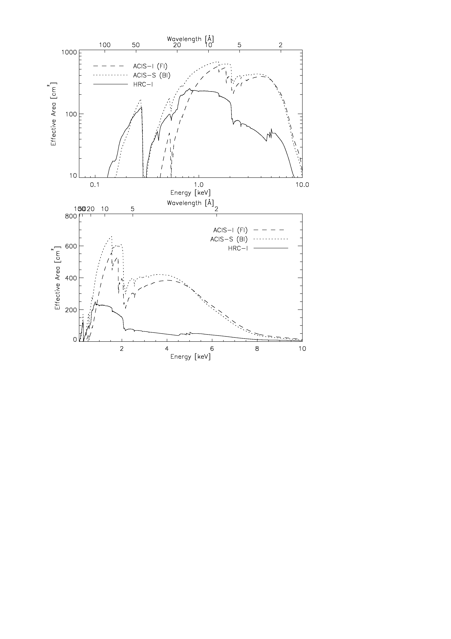
Spectra of this quality generally do not exist for AGN!
Chandra
??
Possible AGN spectral “states” not well-sampled!

Slide 15
Polarization: broad energy coverage important too!
Chandra
??
Possible AGN spectral “states” not well-sampled!

Slide 16
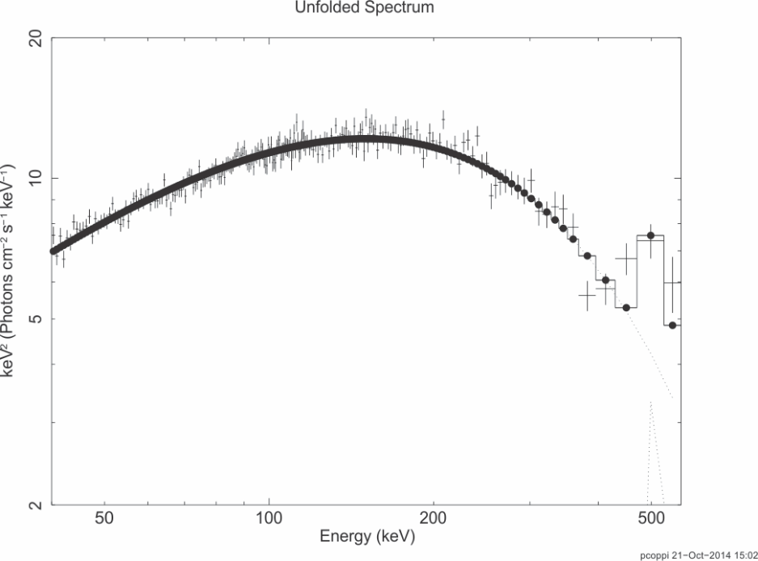
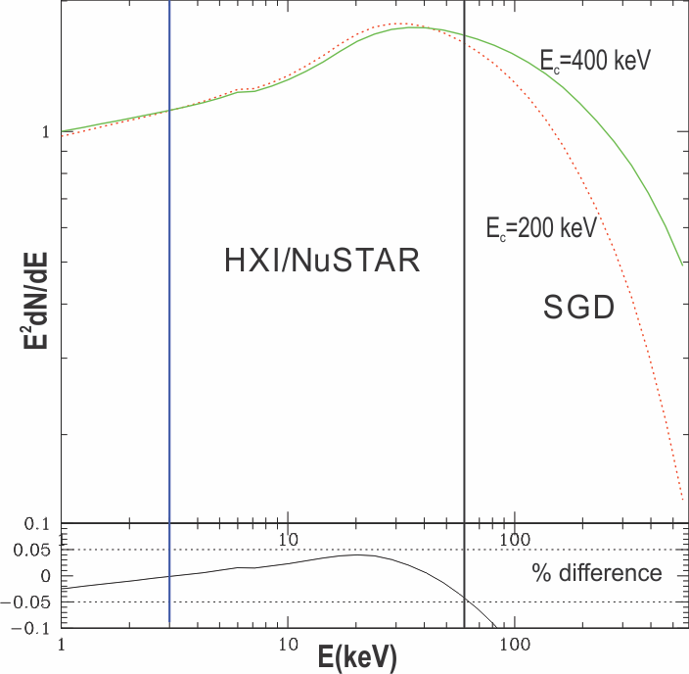
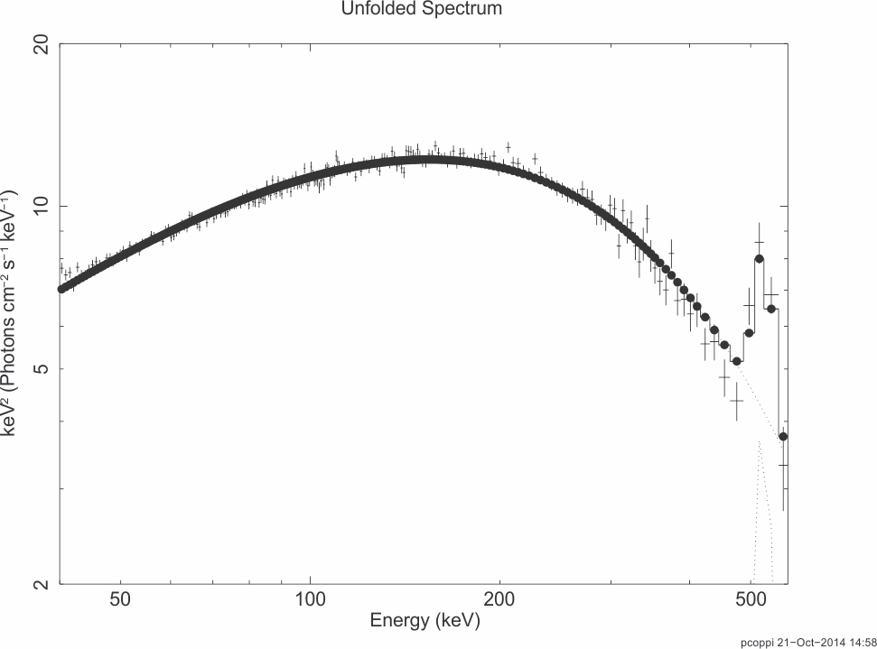
The high-energy break in the hard state of Cyg X-1: Another example of how the SGD/ASTRO-H comes into its own for brighter sources (>10⁻¹⁰ erg cm² s⁻¹), e.g., enabling science that cannot be done by NuSTAR alone.
Cyg X-1, 30ksec, EQPAIR+ 511 keV
line
SGD
Temperature determined to < 10%,
line clearly detected.
Cyg X-1, 100ksec, EQPAIR+ 511 keV
line
SGD
Even with sensitivity to ~60 keV, i.e., past the peak
of the Compton reflection hump, modeling degeneracies
remain for NuSTAR/HXI alone. Above, the temperature
of the Comptonizing electrons cannot be constrained
to better than a factor 2.
Now line width accurately measured!
Standard PEXRAV models ruled out
because of wrong cutoff shape.

Slide 17
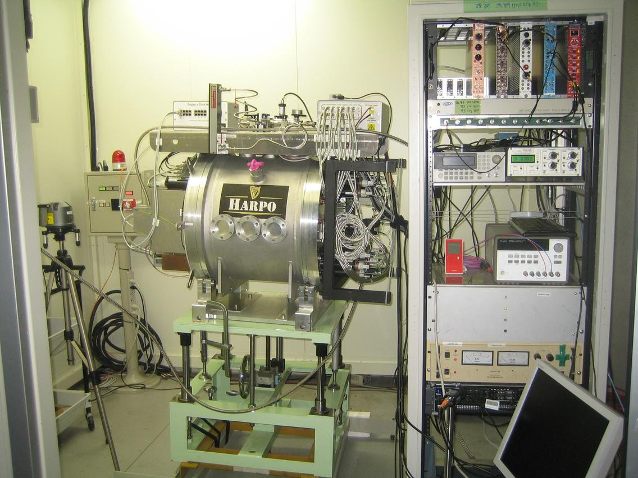
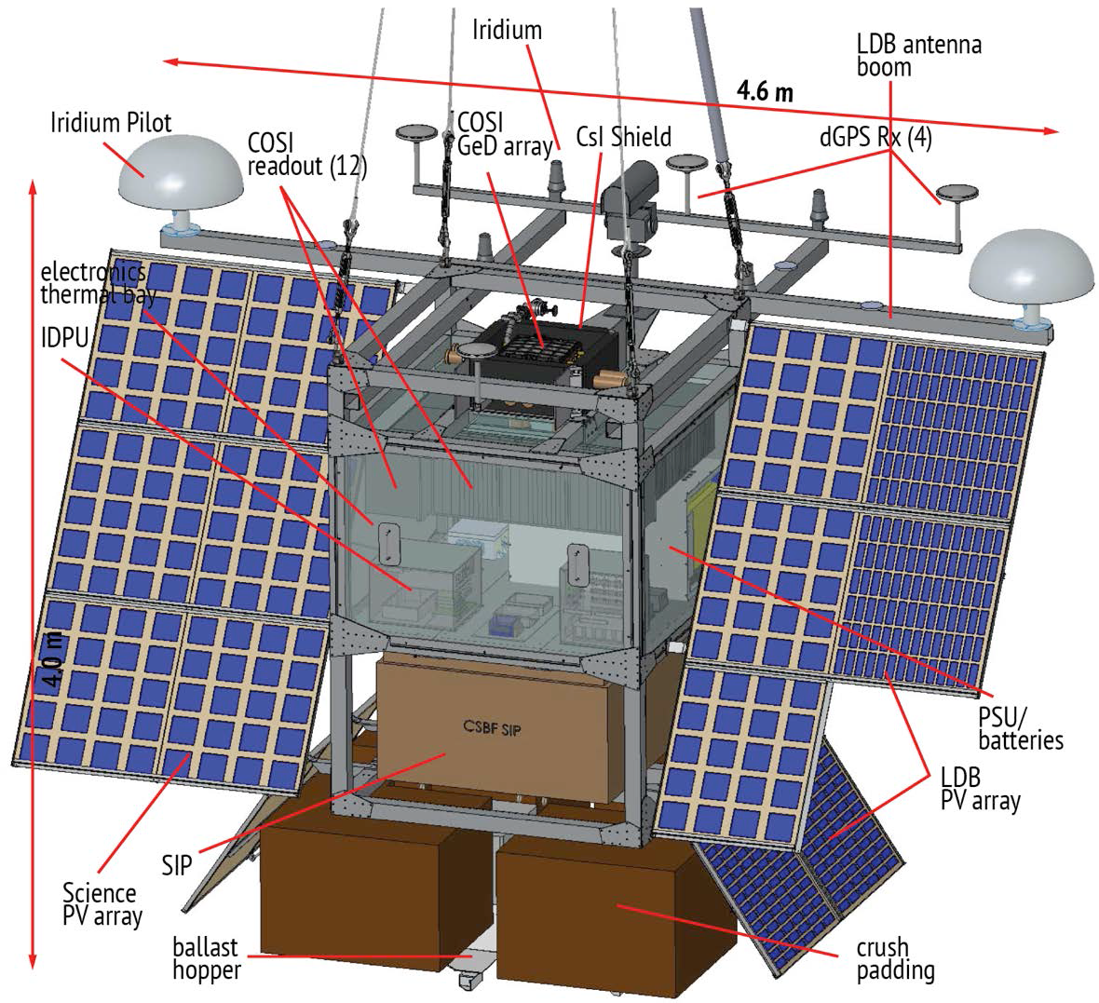
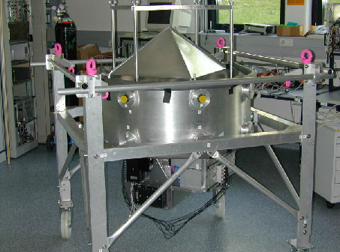
MeV Gamma-ray Instrument Landscape
From J. McEnry lecture
Understanding the MeV universe requires a multi-instrument, multi-technique approach.
Time Projection Chambers (pair): (AdEPT, HARPO, LArGO) high angular resolution, good polarization capability, no background veto
Spectrometers / mappers (Compton):
(COSI, GRX) high resolution spectroscopy, wide field of view, some polarization capability
Coded mask/Occulation
(Theseus, Swift-BAT, Fermi-GBM, LOX…), no background veto, very good for transients
2016 COSI Balloon Flight!
Continuum / survey mappers (Pair & Compton): (AMEGO, ComPair, MEGA, AstroGAM) high flux sensitivity, moderate resolution spectroscopy, wide field of view, broad energy coverage, some polarization capability

Slide 18
Angular resolution?? Can we match the
~arcminutes resolution of ground-based
Cherenkov arrays? Not so easy…

Slide 19
Hybrid – Coded Aperture mask at low energies (~0.2-1 Mev??) + Compton telescope
E.g., GECCO [ https://arxiv.org/pdf/2112.07190 ]

Slide 21
Advice we’ve received: Fermi was great, “obvious” next step – but don’t make mistake of boxing yourself in with one technology/mission. CGRO was actually a hybrid instrument (“Christmas Tree” – which some don’t like).
Most other bands, e.g., X-ray, have been allowed multiple instruments/band, e.g., Chandra (angular resolution) vs IXPE (polarization) vs XRISM (energy resolution), with very different science strengths/goals. Why not gamma-rays? COSI is good example of targeted, pathfinder instrument. Definitely not the ultimate observatory we could build, but gets new science done now.
E-Astrogram/AMEGO concept had broad range of science applications but maybe didn’t excel enough at any of them/$ to win?
Advice/thoughts??

Slide 22
Another question for audience : what do you think of “constellation” concept?
Instead of super Fermi launched by Space X Falcon Heavy rocket, launch 100x mini-Fermi Cubesats? [Starlink approach]
Or, if we worried about Fermi but think it’s performance is o.k. for upcoming
TDAMM, why not just launch another Fermi or 2? Could probably build better, cheaper version and while old Fermi operates, get 2 x collection area
for steady sources and more continuous sky coverage?
Not necessarily sexy, but it gets job done, and has built-in redundancy + can add (improved) nodes as funding allows? Avoid self-contamination/background/activation issues by splitting up mass?
CTA will have joint telescope trigger. If can have good communication between spacecraft/formation flying (future dream),
For bright time variable sources (GRB, but maybe blazars), use time delay between spacecraft to improve localization [like IPN]?

Slide 23
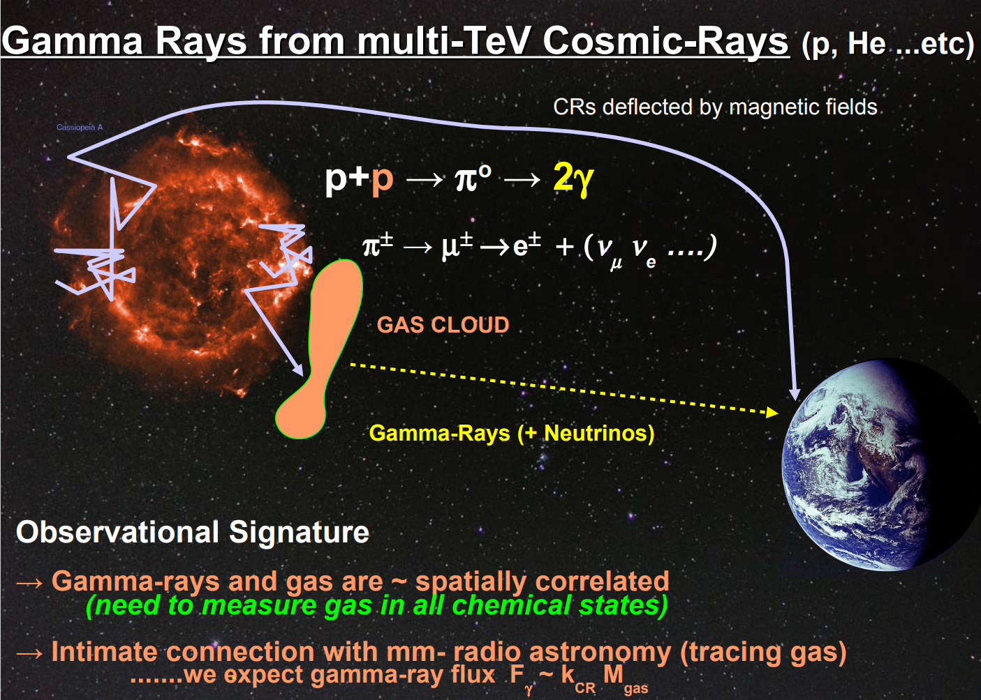

Slide 24
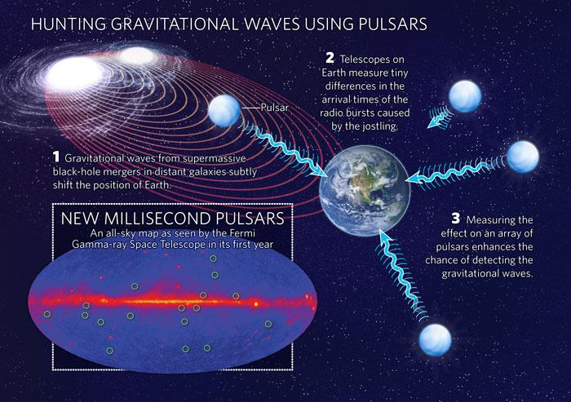
Gamma-Ray Pulsar Timing Array
Fermi Team,
Nature, Science

Slide 25
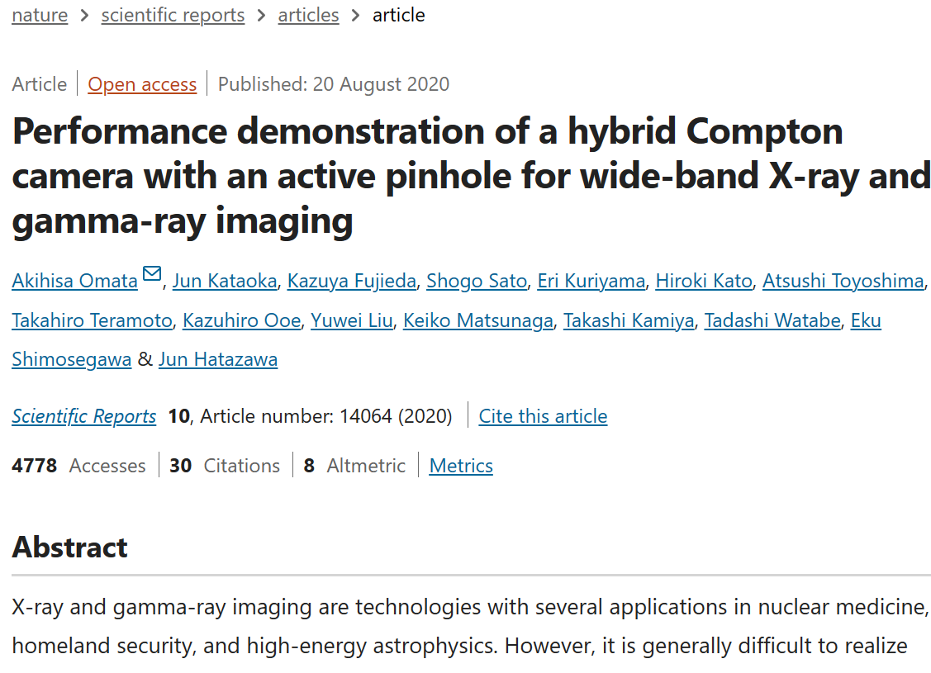
Relevance to non-astrophysics applications --
especially nuclear (medicine), ~MeV range
[Also direct dark
matter detection,
e.g., LUX, liquid Xe,
liquid Ar]
E,g., first GRB detected by non-NASA (USAF, Vela) satellite looking for
nuclear detonations…

Slide 26
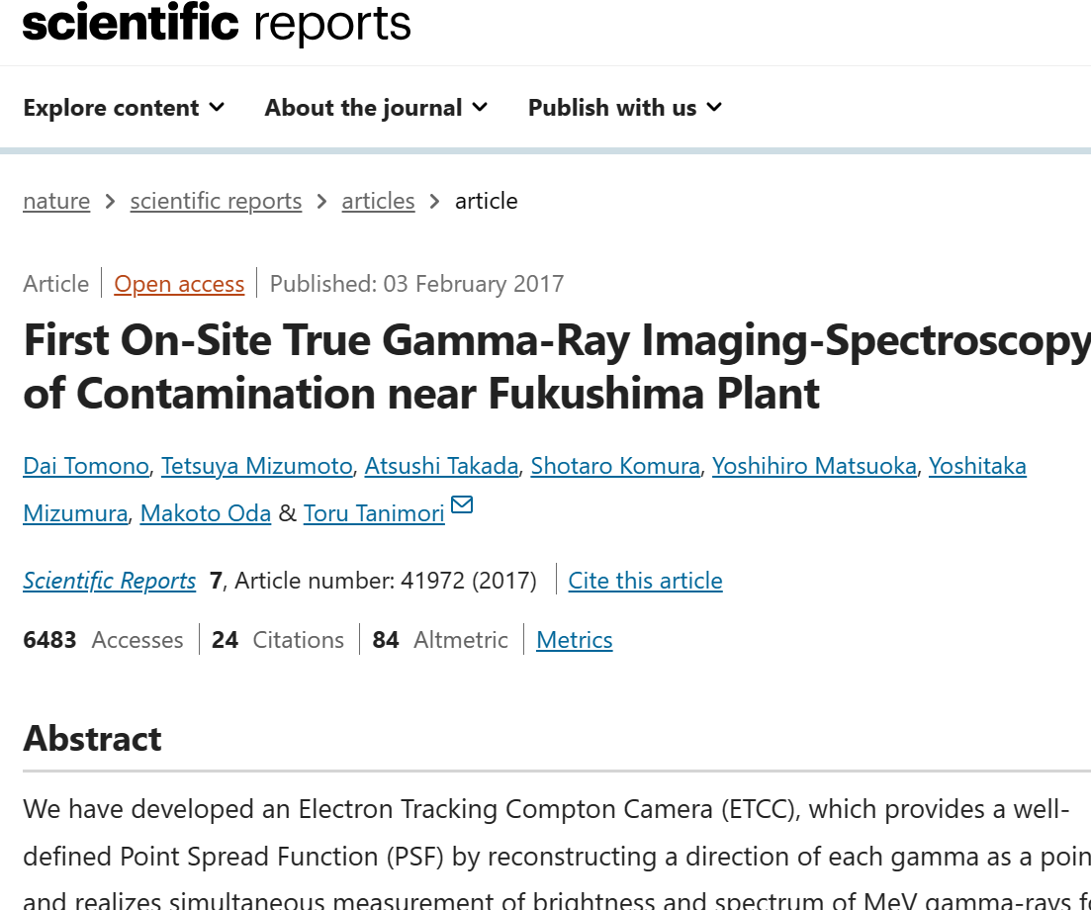

Slide 27
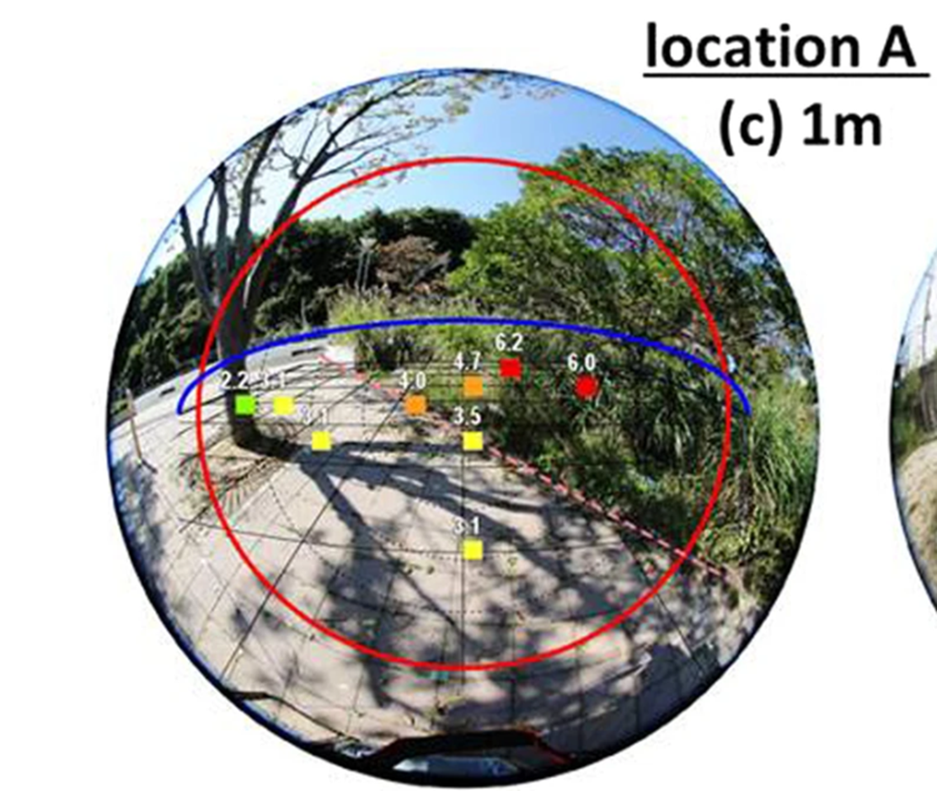
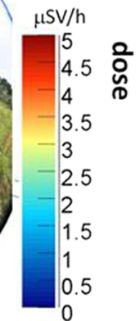
An (almost) decontaminated parking lot in Fukushima,
Japan
Dose measurements obtained
by person walking around
(and possibly getting exposed)
using conventional hand-held
dosimeter.
Oops, forgot about bush!

Slide 28
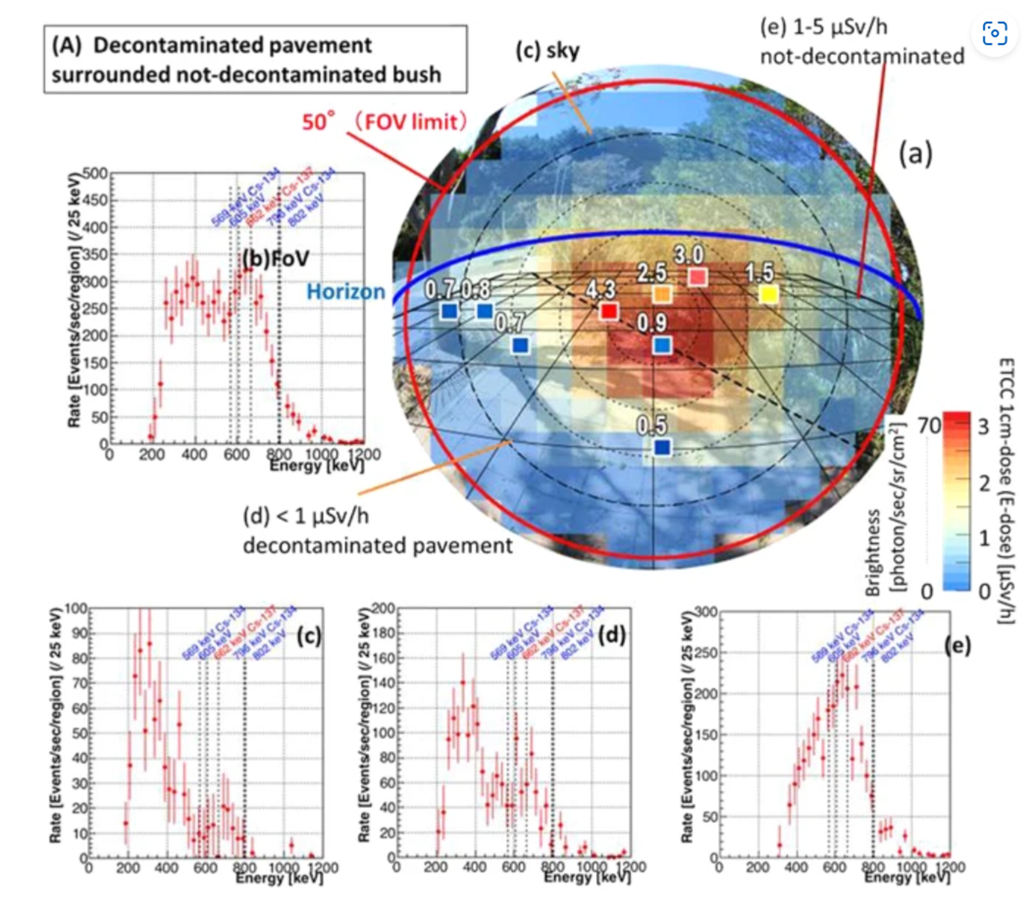
Vs. one
snapshot
from Compton
camera
(ASTRO-H
legacy), taken
from
safe distance.
From spectra,
can tell
composition
of contaminants
-- let’s do this
for SNR ☺ !

Slide 29
TDAMM! [Time Doman, Multi-Messenger]
λλ
Ground-Based γ-Ray Detectors
?
Space-Based γ-Ray Detectors
Example: How some hope to find
and study AGN in the next decade.
Fermi
?? neutrinos

Slide 30
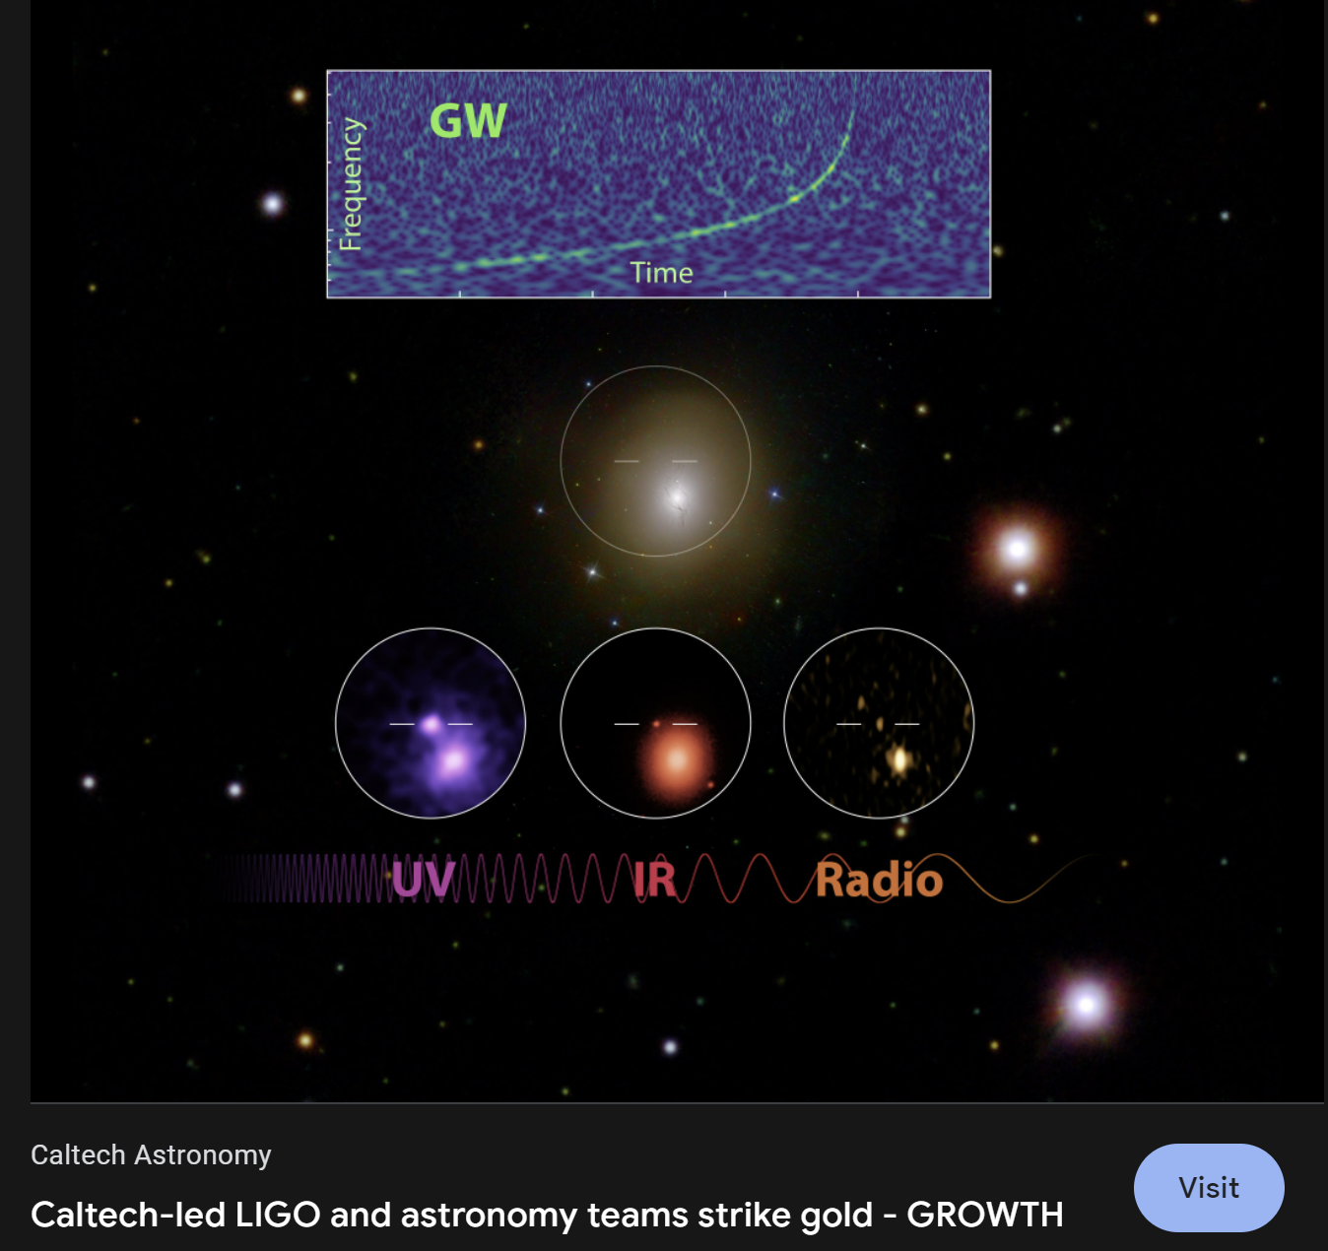
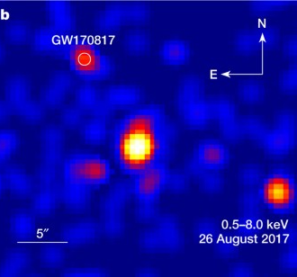
And don’t forget gravitational waves!
The “kilonova” (neutron star-neutron star merger) GW 170817

Slide 31
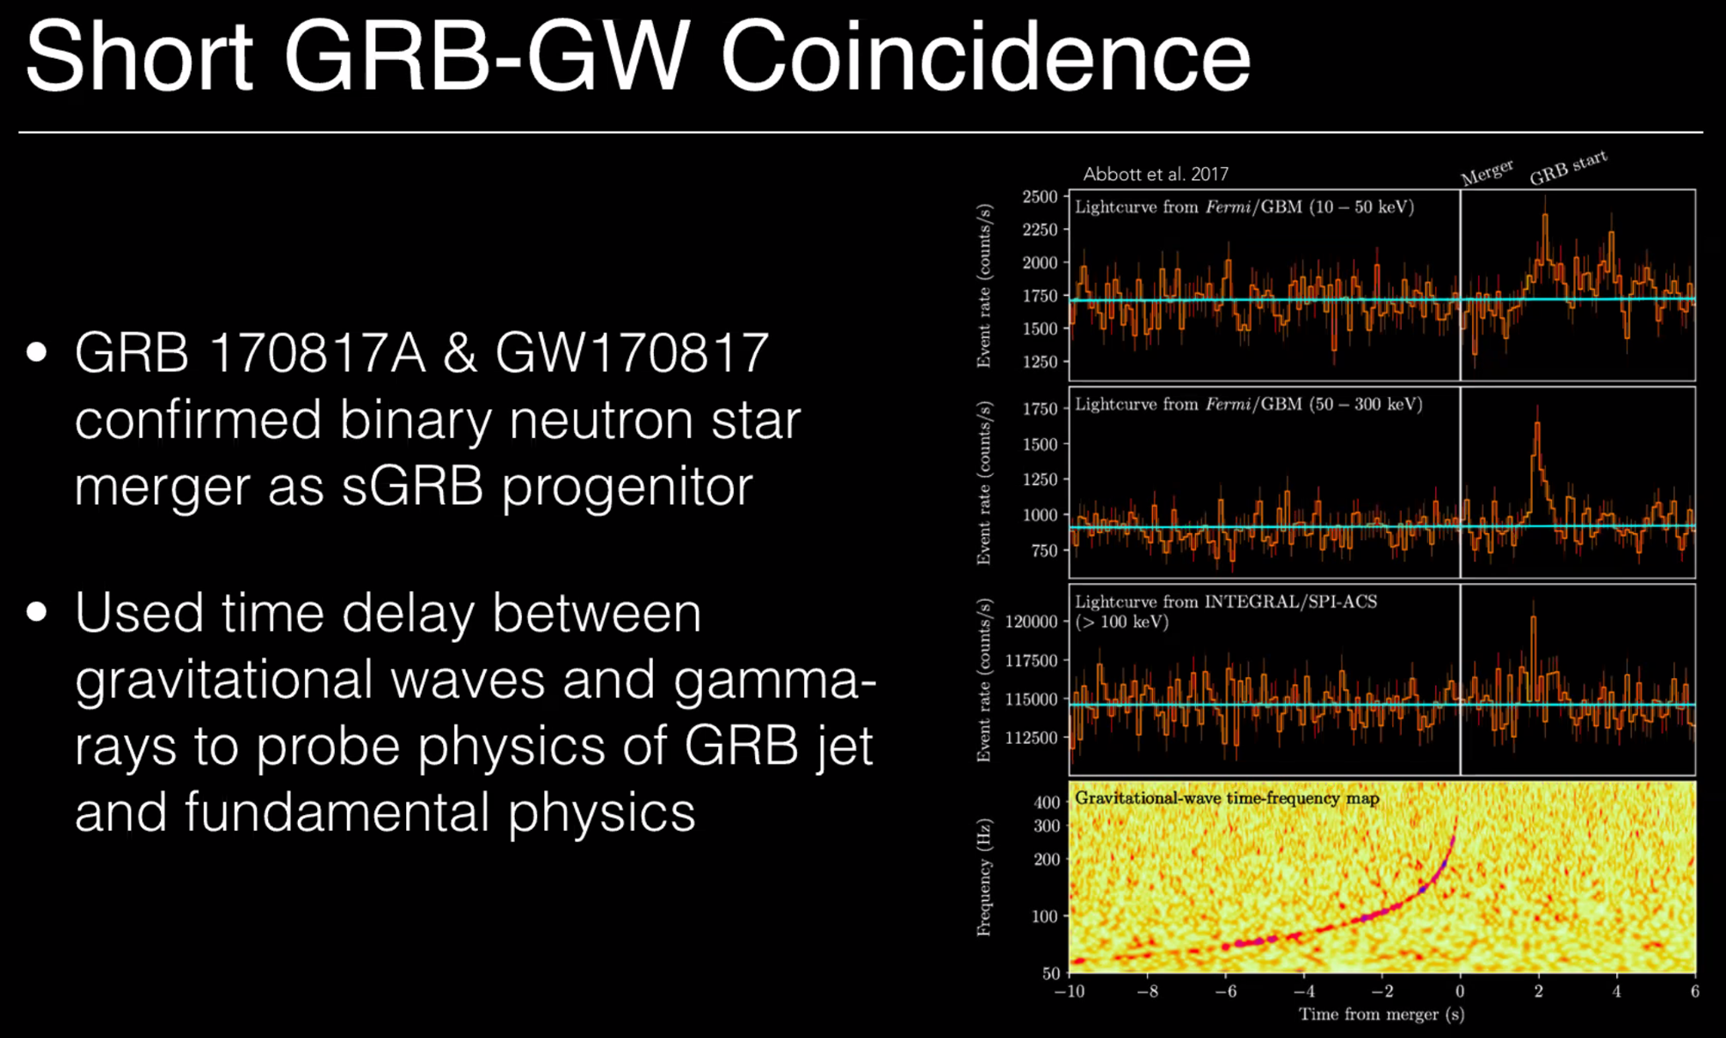
But only Fermi GBM was looking and caught event w/in 2 sec of ns-ns merger!
And because of low background event rate in gamma-rays, GW-sGRB association likely vs. association w/random fading optical or even X-ray source => GBM localization
used to narrow search box.
COSI Time Domain talk, yesterday

Slide 32
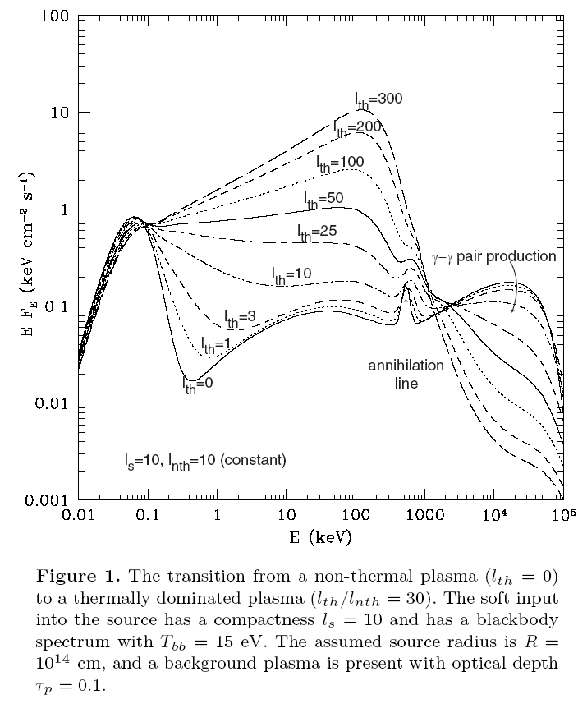
Why ~MeV? Is there anything special there?
[A “hidden” 100 MeV source]
E~511 keV
special energy
for physics:
Klein-Nishina,
pair production,
pair annihilation
Spectral features
expected!
Constraints
if not seen!
Note: 511 keV NOT special energy from
binding energy/particle, energetics, etc.
considerations
ASTROGAM
ASTRO-H
(straddles
511 keV!)

Slide 33
F. Halzen

Slide 34
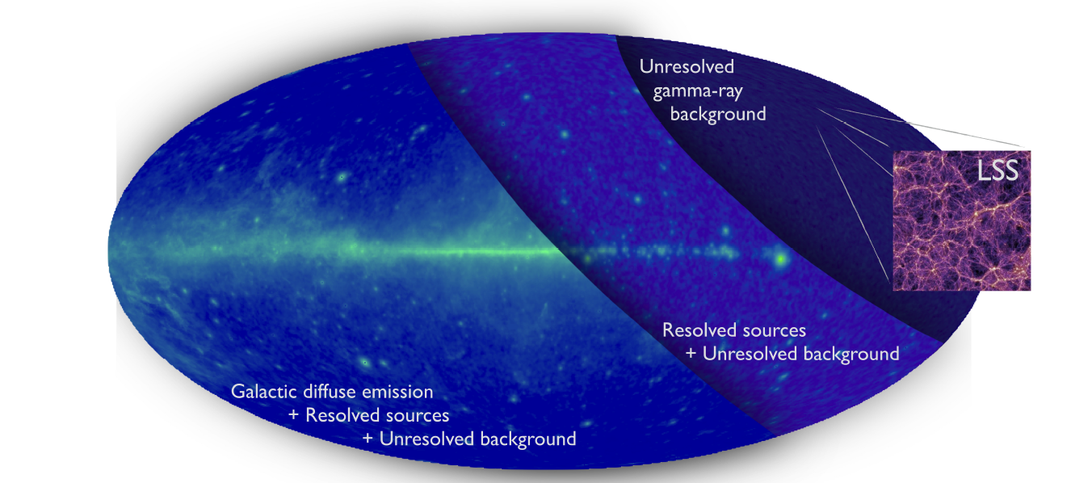
GeV background often “calorimeter” for non-thermal activity in the Universe!
Snowmass gamma-ray whitepaper
A next generation instrument could look for
LSS signal/correlations…

Slide 35
NGC 1068 – ICECUBE!
There are definitely TeV+ energetic particles
associated with a non-jetted black hole !
Complication: neutrino flux ~steady (80 neutrinos over 8 years)
while can corona luminosity usually varies a lot.
F. Halzen, CDY

Slide 36
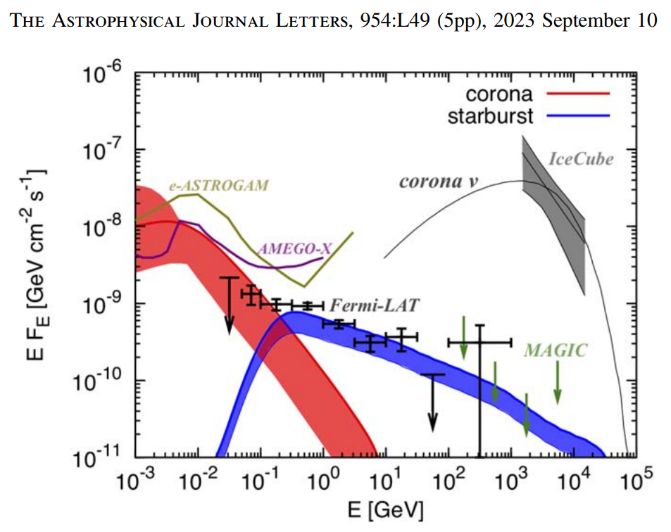
NGC 1068

Slide 37
SUMMARY – we are well past the era where one γ-ray = Nature paper,
3 = Rossi prize. It’s time to think about next steps and not losing
capabilities that already have.
~MeV-GeV important and can’t be done effectively from the ground.
Several different science cases => one mission likely can’t do all well.
γ-ray astronomy can have broad impact, not just for those studying
esoteric physics and objects.
Some other topics I didn’t have time to mention:
SETI
Dark matter annihilation
Baryogenesis constraints
Lorentz invariance
Axion-like particles
Primordial black holes
Probing Extragalactic Background Light (EBL)
and Intergalactic Magnetic Field (IGMF)
Your Favorite (please let us know!)

Slide 38
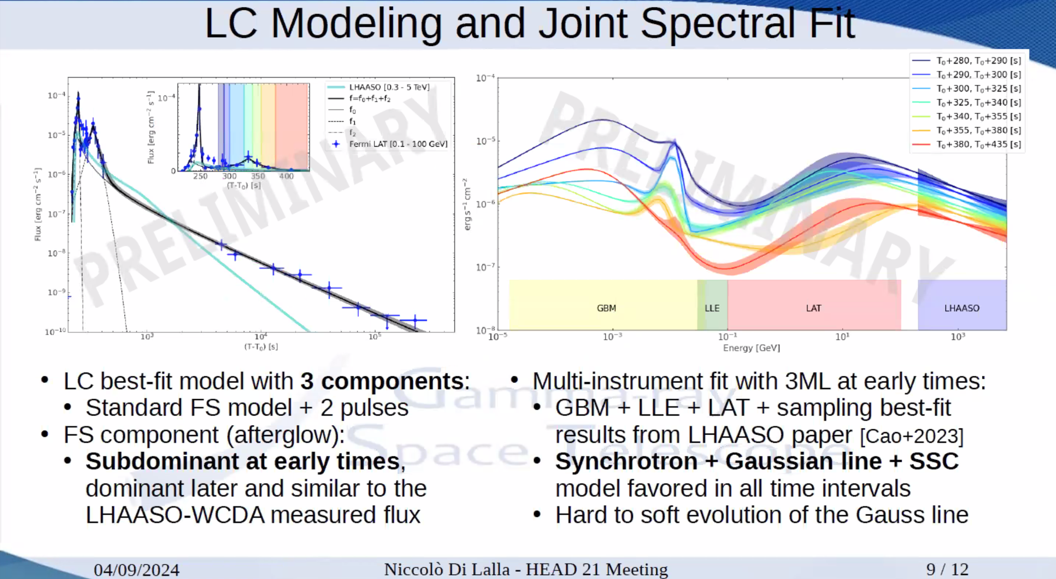
The BOAT [Brightest GRB Of All Time]
?
COSI/GRAMS/
AMEGO

Slide 39
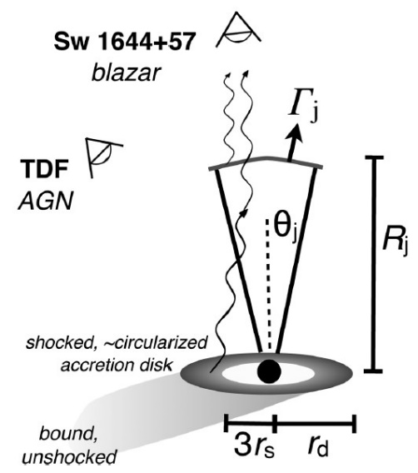
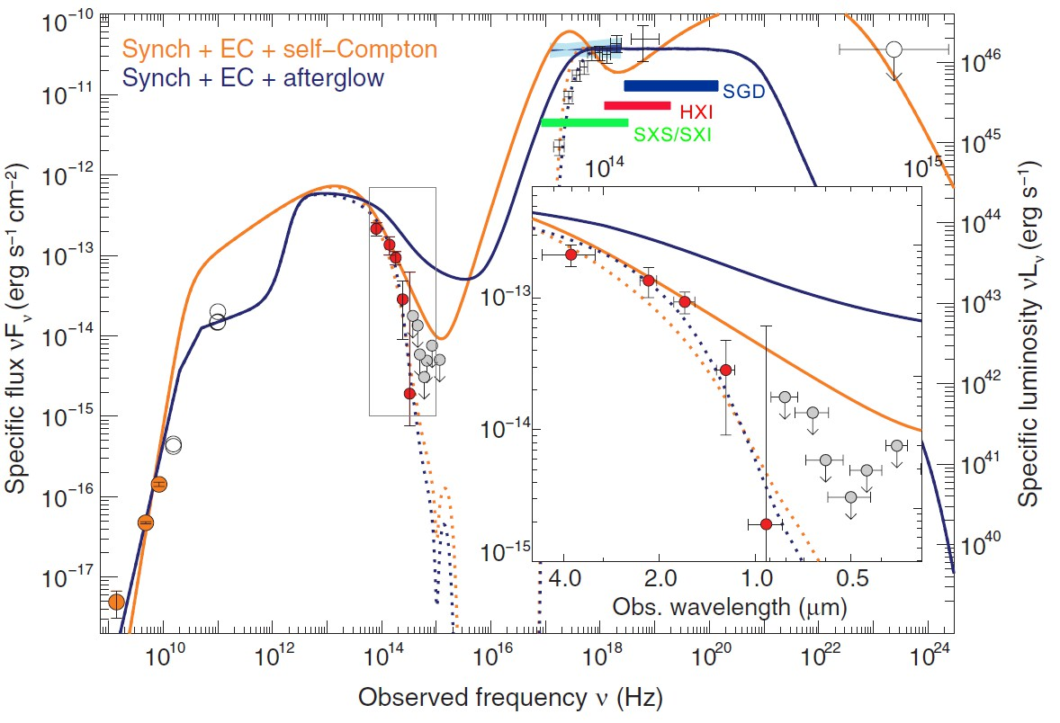
Variability and ASTROGAM Serendipity:
Re-activated Jet? (Tidal Disruption Flare)
Fermi saw nothing!
ASTROGAM
Bloom
et al 2012

Slide 40
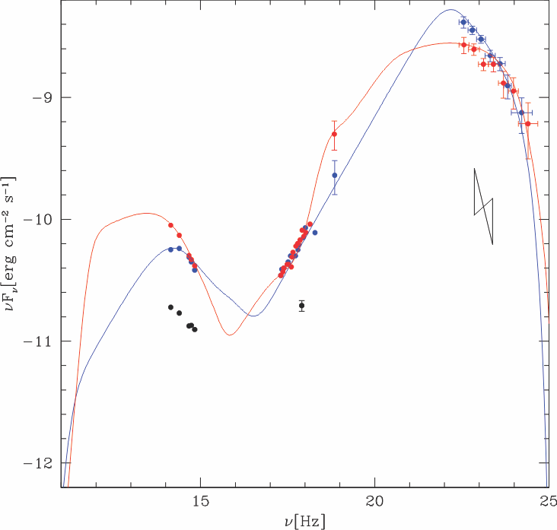
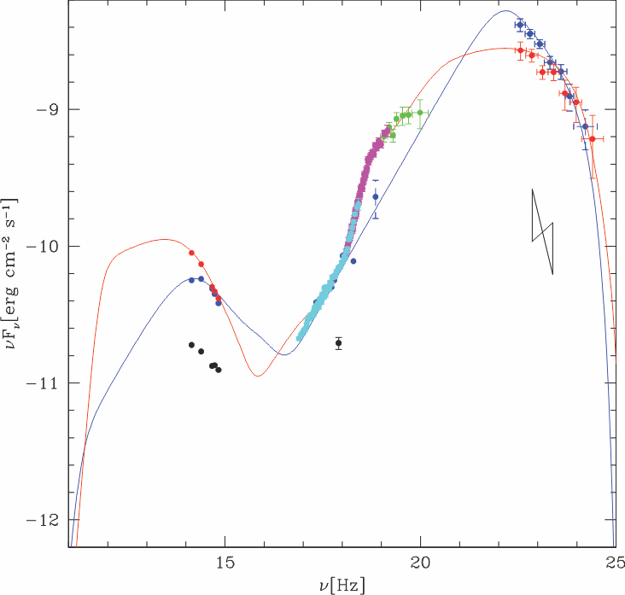
If ASTRO-H had been available during big Fermi blazar flares, we would
have significantly better understanding of source like 3C454.
Before ASTRO-H
Fermi
Dec. 3, 2009
Dec. 2, 2009
??
+POLARIZATION!
(MDP ~25 %, 10 ks)
SMARTS
With ASTRO-H
SWIFT
ASTROGAM
1 hr , 3.6ks exposure
(vs. 12 hr for Fermi)
SGD
HXI
Big change?
Not much going on?
SXI
3C454 on two nights in
December 2009…
Possible breaks due to K-N effects clearly
resolved. And can follow their evolution on
<3hr variability timescale seen by Fermi!

Slide 41
The Fossati (yes) vs.
Giommi-Padovani (no!) controversy:
Best guess answer – “sort of,”
but huge scatter and overlap of classes?
??
BTW, peak energy in ASTROGAM, not FERMI!
From talk by Ciprini
In real life, individual objects change peak energy/class! (E.g., 3C454.3, next slide)
Can go down to MeV! High z blazars also best detected in ~MeV-GeV.
Without accurate characterization of peak and break, physics constraints suffer!
(Any theorist can fit a power law ….)

Slide 42
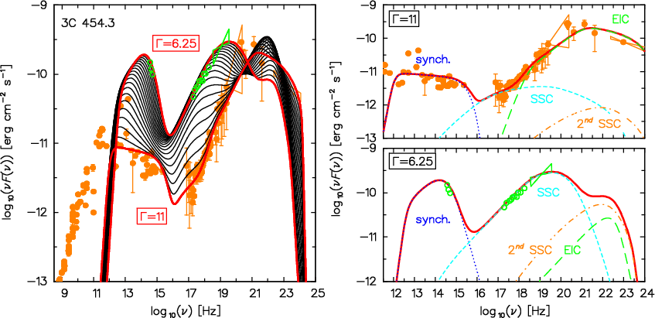
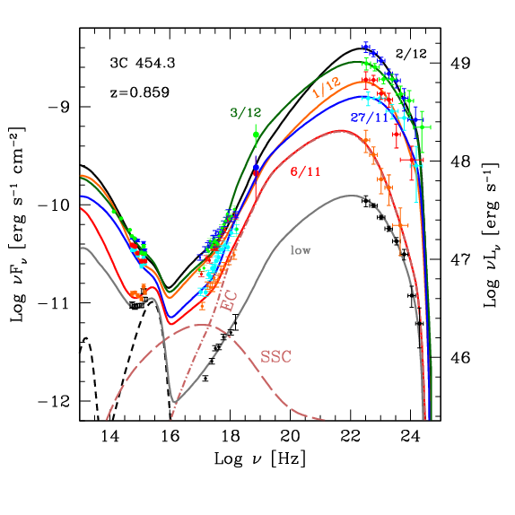
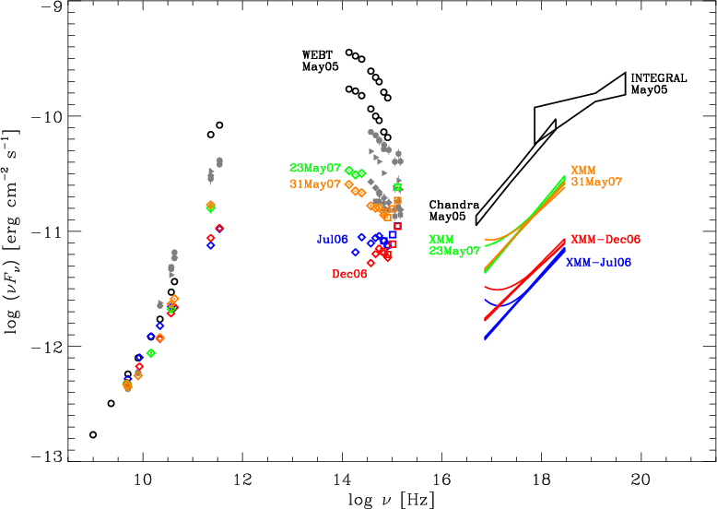
Another example of messy blazar behavior:
Here is well-known (?) MeV blazar, 3C 454 (at least in low state)
Katarzynski & Ghisellini
Tavecchio & Ghisellini
?
??, If spectrum really rolls over as
INTEGRAL suggests,what about
Compton dominance?
(May 05 is huge flare
for synch component… )
Raiteri et al. 2008

Slide 43
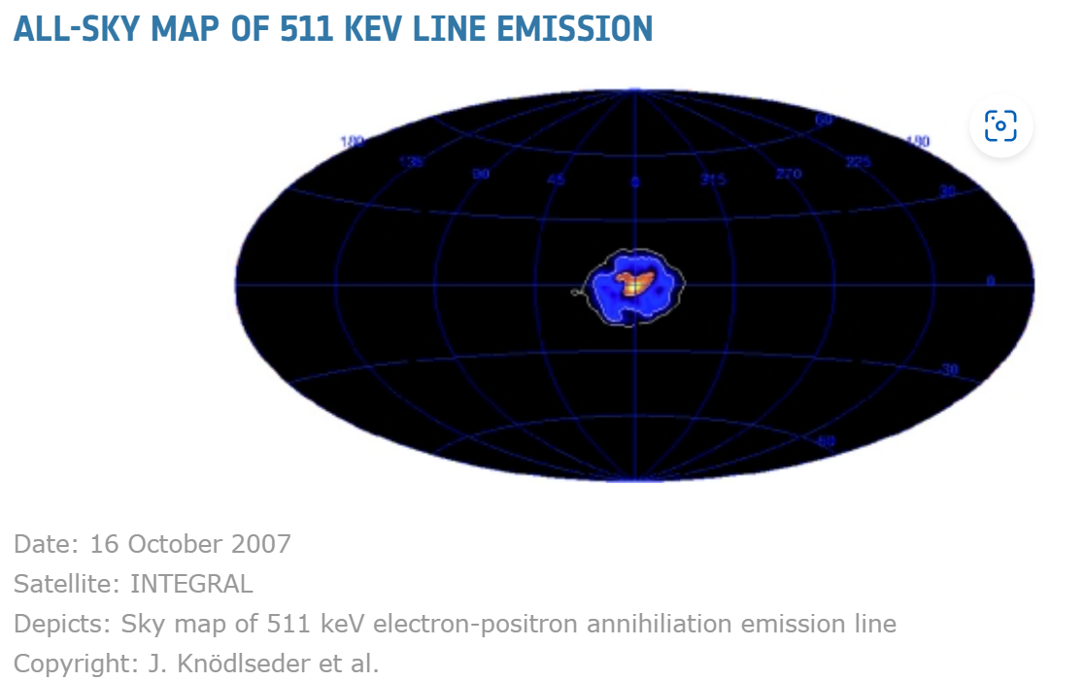
Note: INTEGRAL is coded aperture instrument - not good/robust for faint extended source!
Galactic Center

Slide 44
Major/rich science area (deserves own high
spectroscopic resolution mission?):
~MeV sensitivity => probe nuclear lines!

Slide 45
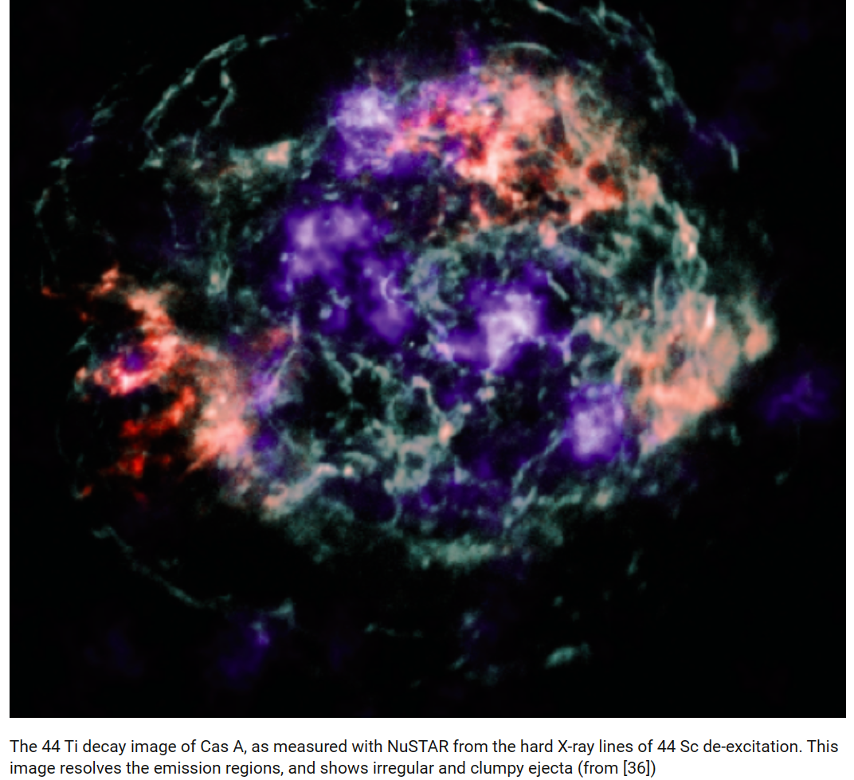
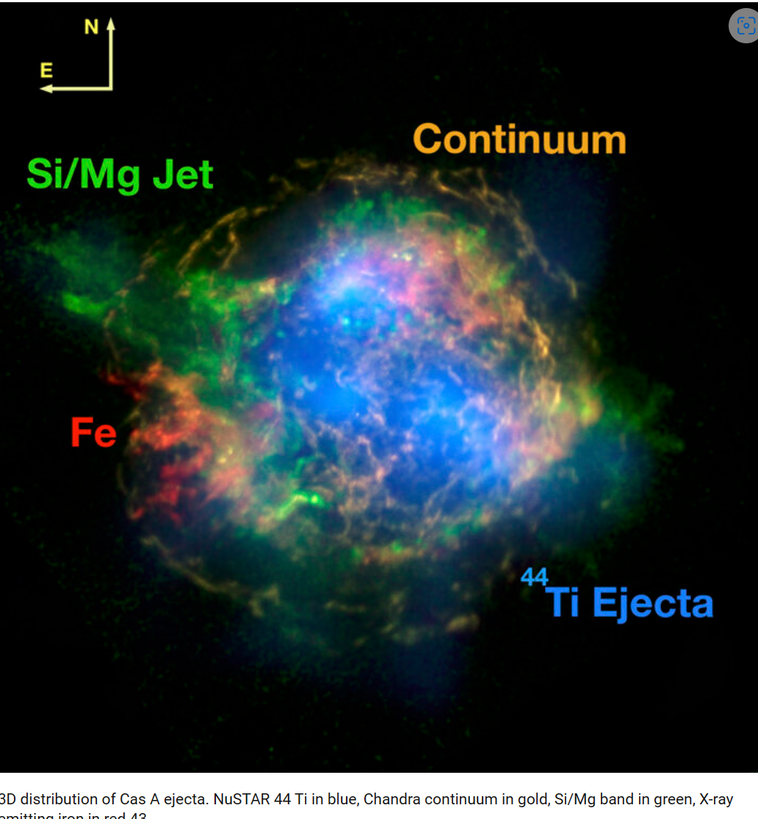
NuSTAR Ti⁴⁴ map – turbulence/anisotropy!
NuSTAR + Chandra

Slide 46
²⁶Al - Measures integrated, recent (~few million year) SNe/star formation activity
If have enough energy resolution to reach < 100 km/sec Doppler shifts, can measure
galactic velocity contribution – helps constrain source distance as for molecular clouds

Slide 47
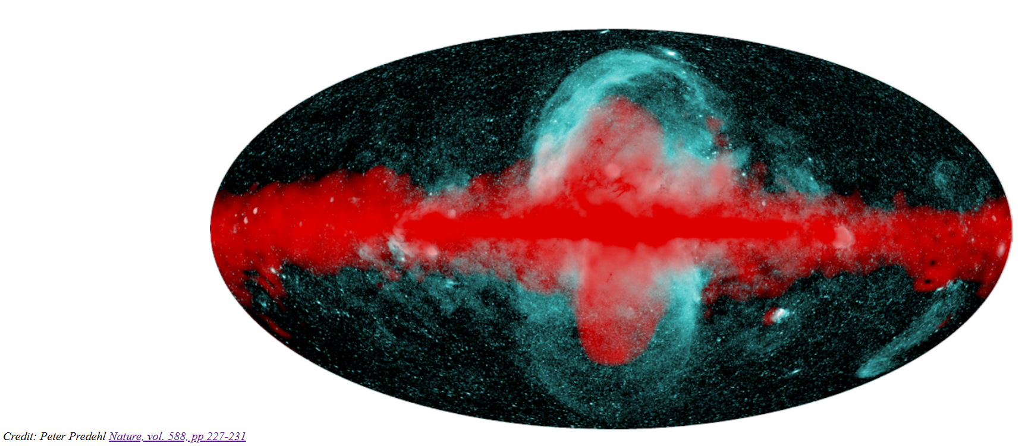
Fermi (red) and eROSITA (blue) “bubbles” -- AGN or star formation-related feeback in action?

Slide 48
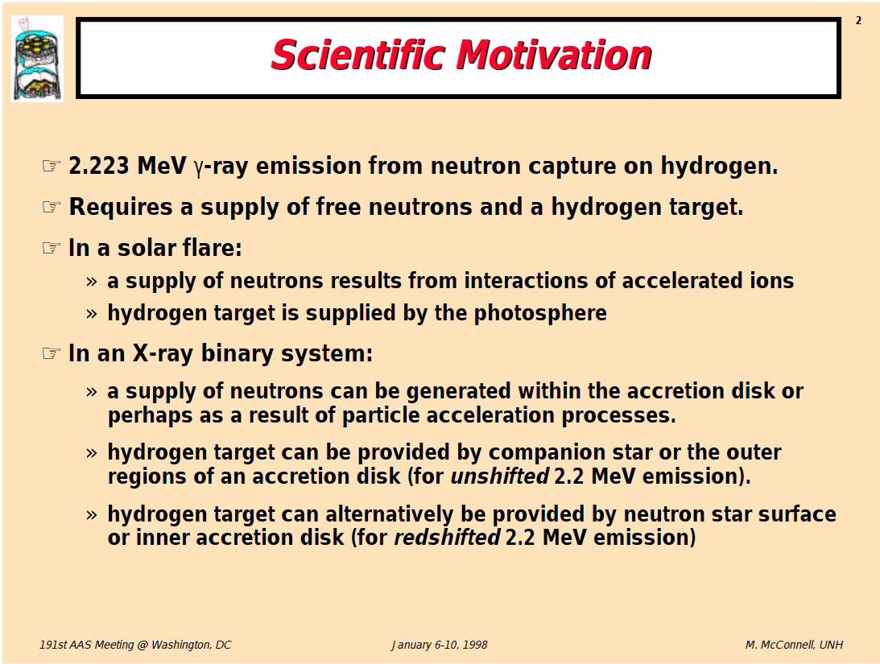

Slide 49
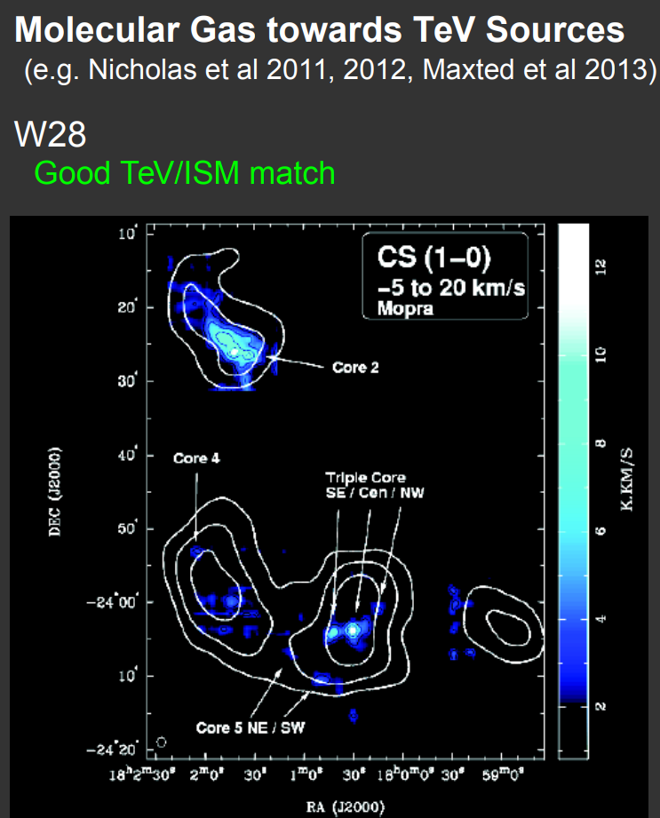

Slide 50
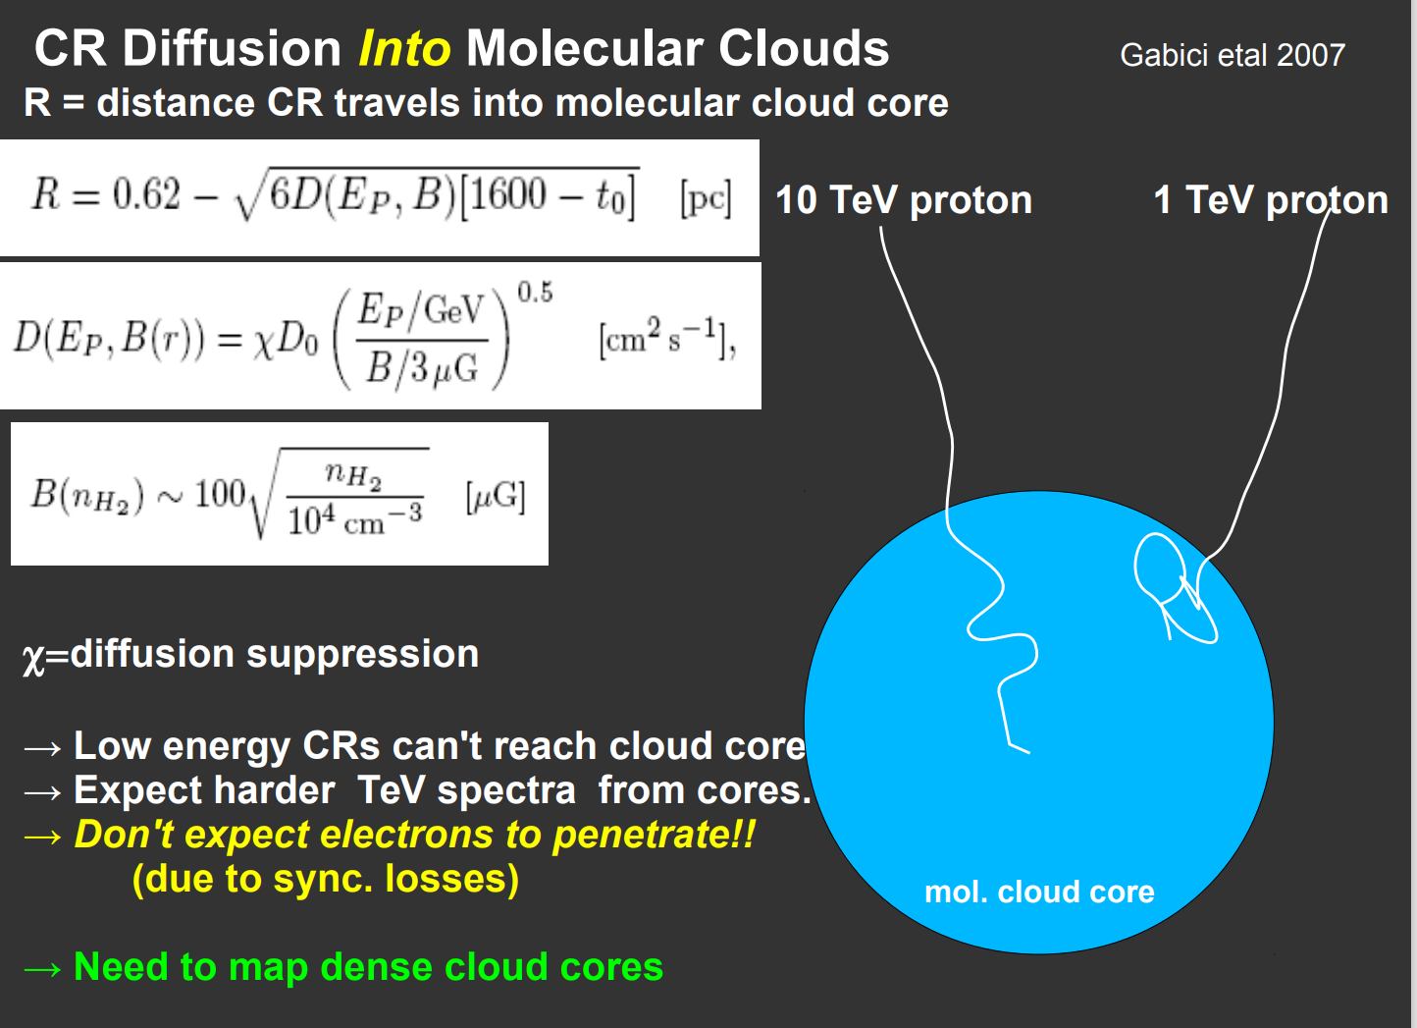

Slide 51
