Slide 1

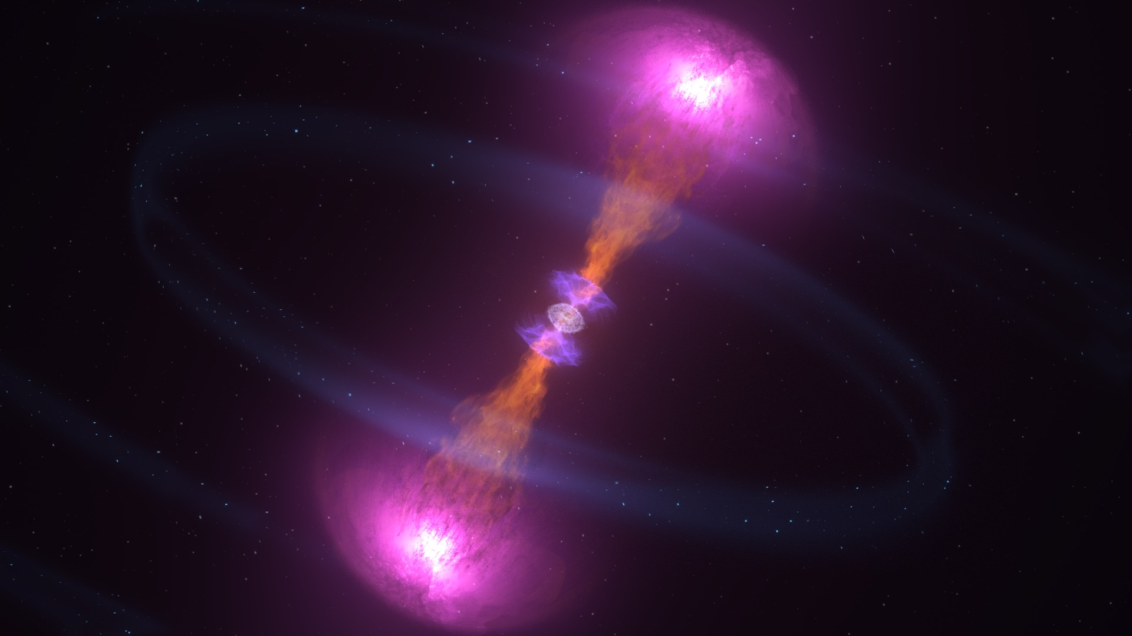
MG 17, Pescara, Italy
Binary neutron star mergers with a crossover to quark matter: Comparing the QHC21 and QHC19 equations of state
Grant Mathews
Collaborators: Wei Sun, Atul Kedia, Hee II Kim, In-Saeng Suh
Notes:
My talk explores the quark-hadron crossover EOS of neutron stars. In particular I consider densities just above the nuclear saturation energy density. I am studying the implications for detecting signals of the quark-hadron crossover from binary neutron star post-mergers. We'll delve into the QHC19 EOS models and the latest published QHC21. I'll present preliminary results from general relativistic hydrodynamics simulations, comparing these equations of state.

Slide 2
Question
Is there an observable signal of the formation of quark matter during binary neutron star mergers?

Slide 3

Phys. Rev. D 106, 103027 (2022).
Fully relativistic BSSN simulations of neutron star mergers based upon the Einstein Toolkit

Slide 4
There have been a number of studies on the formation of quark matter during the collapse
Bauswein et al (2012) PRD, 86, 063001
Most et al. (2019) PRL, 122, 061101
Weih et al. (2020) PRL, 124, 171103
Liebling et al. (2021) , CQG, 38, 115007
Prakash et al. (2021) PRD, 104, 083029
Koto et al. (2022) arXiv:2111.11909
Tootle et al. (2022) arXiv:22205.o5691
Blacker et al. (2023) arXiv:2307.03710.
Mallick (2022) EPJ. Web Conf. 274, 07002
Ren & Zhang arXiv 2022, arXiv:2211.12043.
Tajima et al. (2023) Symmetry, 15, 333.
Many consider 1st order transition to quark matter
Leads to a rapid collapse of the remnant
What about a crossover

Slide 5
A crossover transition could probe the rich physics of quark matter
Unknown
Non-Perturbative
QCD
Schäfer (2003)

Slide 6
QHC19, QHC21 EoS
(Baym et al. 2019, Kojo, Baym, Hatsuda. APJ 2022)
Transition treated as smooth crossover
  (Easier to treat numerically)
Quark matter treated with NJL effective Lagrangian
4-quark
6-quark

Slide 7
4-quark Lagrangian
3 coupling constants
Pseudo-scalar
Di-quark
Vector

Slide 8
QHC19 Parameter sets
Baym et al (2019)

Slide 9
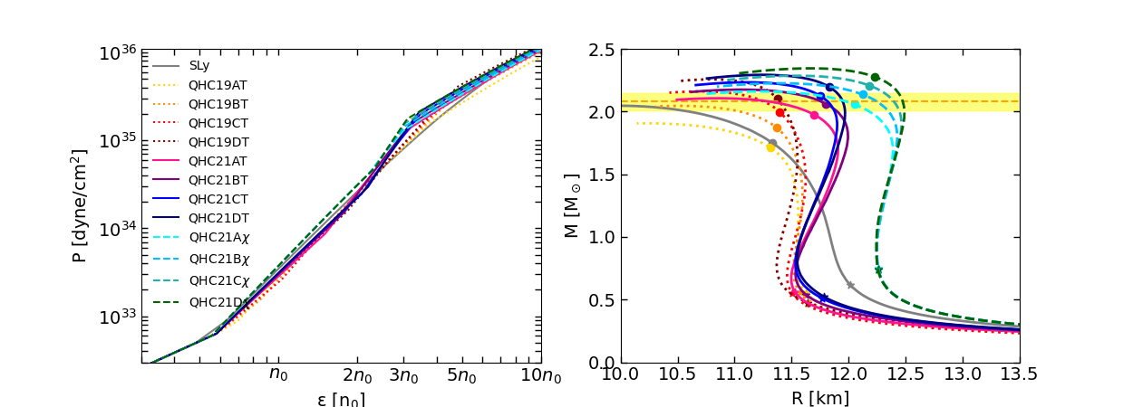
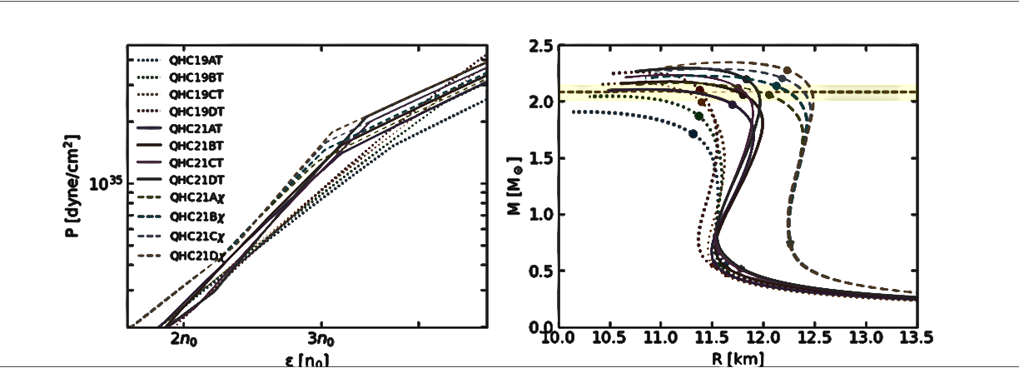
Quark-hadron-continuum EoS
Pure quark matter
~2-5 n₀
19T
~1.5-3.5 n₀
21𝛘
21T
QHC21T, 𝛘
Pure hadronic
QHC19T
NICER data indicated larger radii
Radius as the mass increases from 1.4 to 2.08 M☉ strongly points to a very rapid growth of pressure with density in the range ~ 2-4 n₀, which agrees with NICER’s latest data.
Kojo, Baym, Hatsuda. APJ 2022
Miller, et al. APJ 2021
Notes:
The QHC models utilize nuclear EOS in the low-density region and transition to pure quark EOS at higher densities. This transition is marked by a crossover region where the EOS smoothly interpolates between the two states, with continuous changes in pressure and baryon density.
We explore EOS stiffness through pressure-density plots, where a 'stiffer' EOS is indicated by higher pressures at given densities, essential for supporting massive neutron stars.
Specifically, the 'T' and 'Chi' models, namely the Togashi and chi-EFT for the nuclear region, show that the Chi models exhibit a stiffer EOS between 0.5-2 times the saturation density, correlating with larger neutron star radii and this is particularly aligned with NICER's recent observations. The distinction between the 21 and 19 models, is the 21 model's earlier shift to quark matter, introducing a stiffness increase noticeable at 3-5 times the saturation density.
Thus, the stiffness ranking is concise: QHC21chi exhibits the stiffest EOS, followed by QHC21T and QHC19T.”
QHC incorporates quark matter by exploring wide range of the NJL model parameters consistent with NS observables. Gv describe the short range density repulsion in QCD, and H describes the attraction between quarks.

Slide 10
Quark-hadron-continuum EoS
Pure quark matter
~2-5 n₀
19T
~1.5-3.5 n₀
21𝛘
21T
QHC21T, 𝛘
Pure hadronic
QHC19T
Our Work:
Understand and compare the crossover behavior of QHC19T, 21T, 21𝛘
Extract the post-merger signals, including the density evolution, GW strain and frequency
Consider the possible universality relations of crossover EoSs and compare with hadronic EoSs
Notes:
With these crossover models, we conducted simulations to observe the density evolution, gravitational wave (GW) strain, instantaneous GW frequency, and the frequency peak in the power spectral density. Our aim is to uncover distinctive observational features of crossover EOS in binary neutron star mergers.

Slide 11

Effect of a crossover transition is to delay the post-merger ringdown
SLy4
QHC19c

Slide 12
Gravitational Radiation
QHC19b
QHC19c
SLy4
GNH3
High frequency GWs extended by formation of quark phase

Slide 13
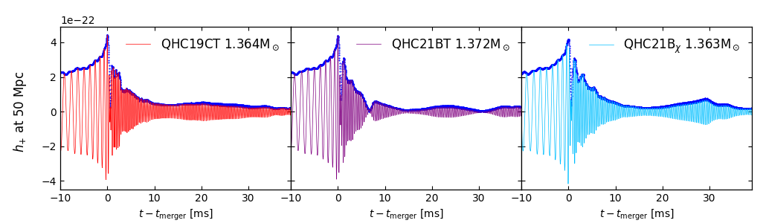
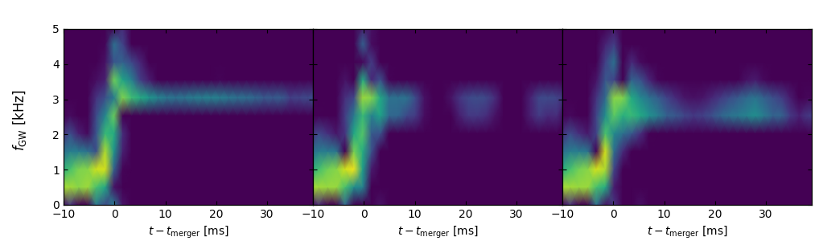
GW Strain and Spectrogram
Possible evidence of a crossover EoS is the formation of a hypermassive neutron star after merger!
Notes:
Gravitational wave (GW) strains can also provide insights into the type of remnant in the post-merger phase. We analyzed the GW strain for models 19CT, 21BT and 21Bchi, alongside their spectrograms. Unlike pure nuclear EOS models that quickly collapse into a black hole, the crossover models exhibit late-time high frequency gravitational wave emission with smaller amplitudes. These fluctuate initially but continue persistently with non-zero amplitudes. Remarkably, within our simulation timeframe of approximately 40 ms post-merger, these models do not collapse, indicating the potential stability of the remnant.

Slide 14
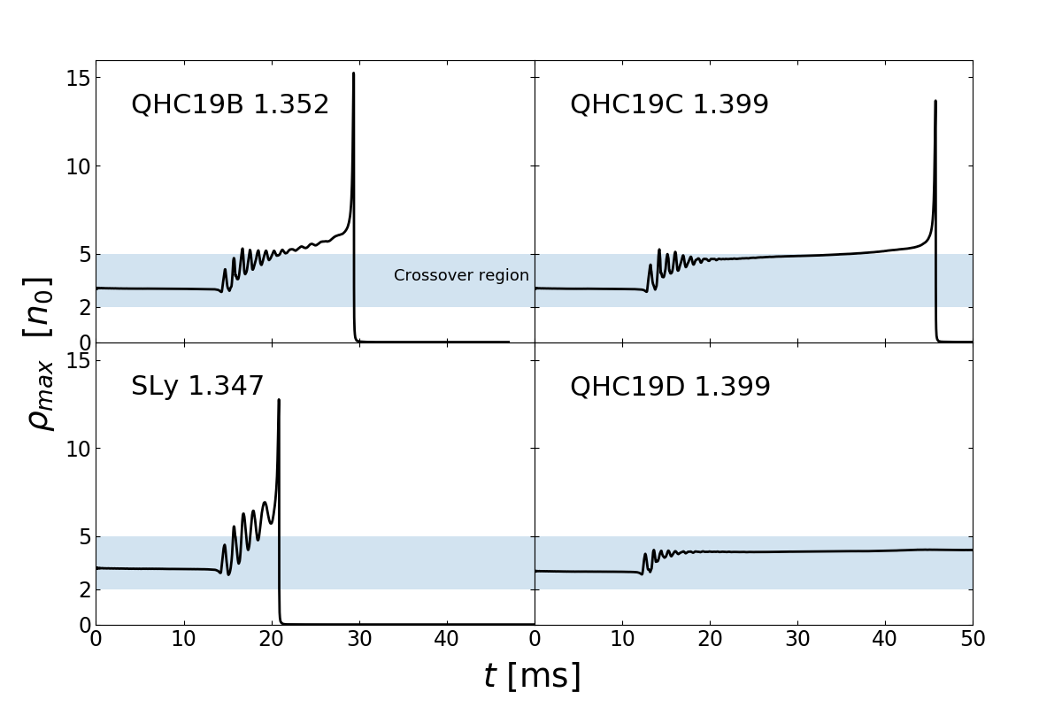
What density range is affecting the inspiral?

Slide 15
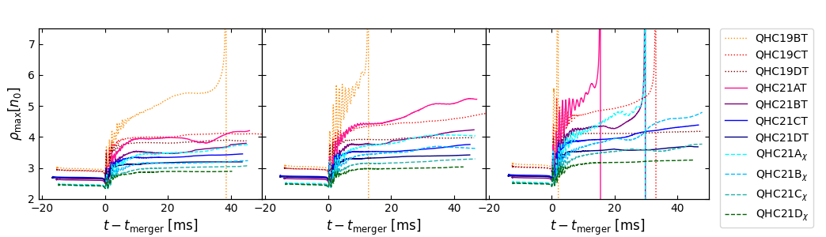
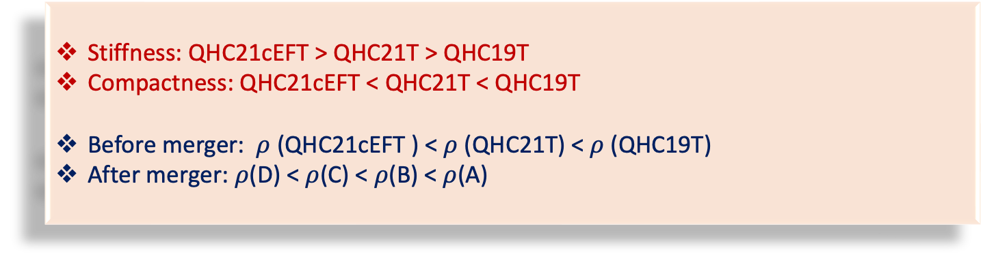
Density Evolution
M~1.32 M☉
M~1.36 M☉
M~1.40 M☉
Stiffness: QHC21cEFT > QHC21T > QHC19T
Compactness: QHC21cEFT < QHC21T < QHC19T
Before merger: $ρ$ (QHC21cEFT ) < $ρ$ (QHC21T) < $ρ$(QHC19T)
After merger: $ρ$(D) < $ρ$(C) < $ρ$(B) < $ρ$(A)
Notes:
In our analysis of density evolution, we observed systematic trends across three panels, representing a spectrum from lower to higher gravitational masses. The 19T group, known for its softer EOS, initially shows higher densities but less compactness than its counterparts. During merger, which happens in the crossover density region, even minor variations in EOS stiffness lead to different evolutionary paths. Specifically, the softer models within each group quickly reach higher densities, hinting at a higher chance of early black hole formation post-merger. This trend holds for both 21T and 21chi groups.

Slide 17
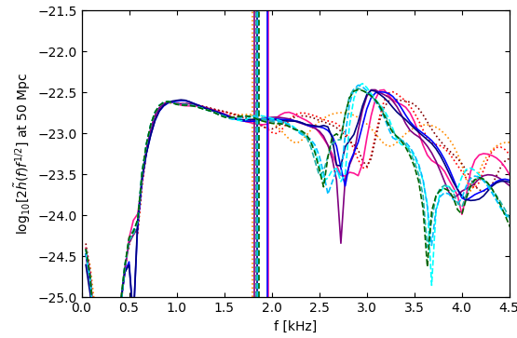
Power spectral density
M~1.36 M☉
21𝛘
21T
19T
f_{max}
f_{peak}
Characteristic large peak in the PSD at ~ 3 kHz
Notes:
"We examine two key frequencies: fmax​, the instantaneous frequency at merger, and fpeak​, which corresponds to the peak in the PSD plots. The divergence among different EOS groups becomes pronounced starting at the merger, making fpeak​ a crucial identifier for distinguishing these groups. Notably, the stiffest group, 21chi, presents the lowest fpeak values, whereas 19T, the softest group, exhibits the highest fpeak​ values. This pattern suggests that as EOS stiffness increases, fpeak​ values tend to shift towards lower frequencies."

Slide 18
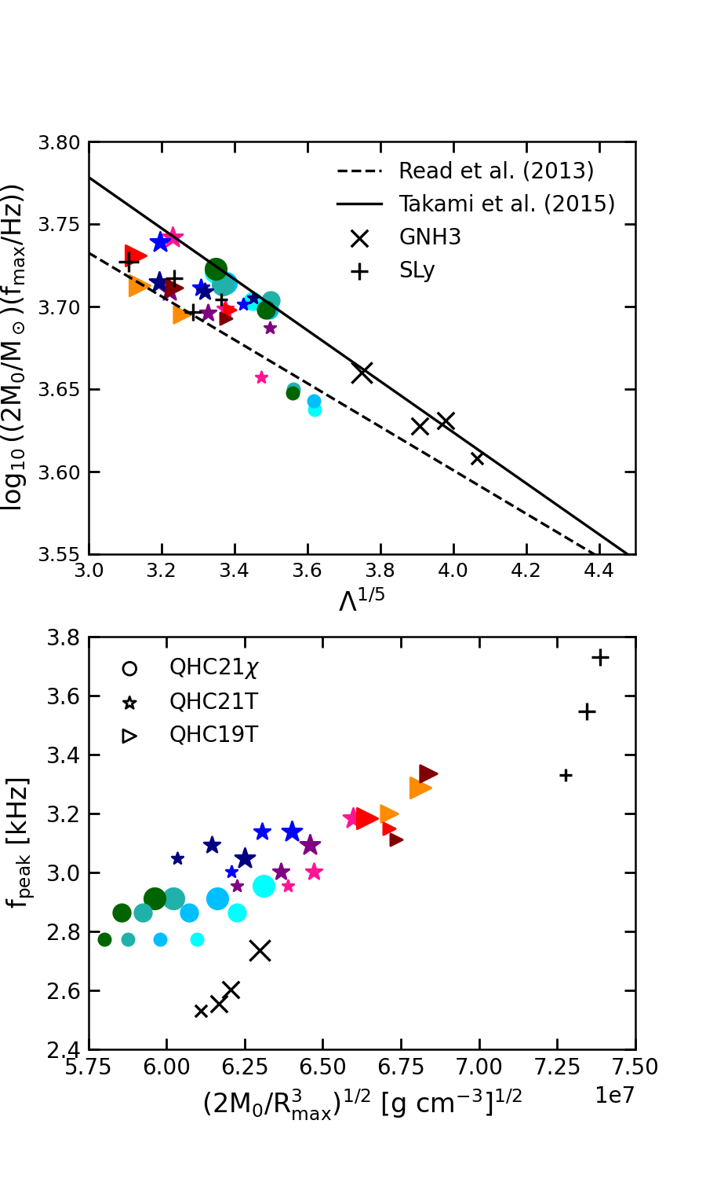
Universality Relation
Notes:
"We also explore universality relations between key physical quantities, such as the relationship between fmax​ and tidal deformability, and fpeak with pseudo-average density. In the left panel, two black lines represent universal relations identified in Read's and Takami's studies, calculated across several nuclear EOS groups. Our crossover data points fall within the range defined by these two universal relations.
For the right panel, our commentary extends to QHC19's position, notably situated between the softer Sly EOS and the stiffer GNH EOS. This placement reflects the duality of the crossover EOS, aligning more closely with softer EOS below 3n0n0​ and shifting towards stiffer EOS above 10n0n0​, exhibiting a blend of soft and stiff characteristics. However, QHC21 diverges from this pattern; its earlier transition around 2.5n0n0​ distances it from softer EOS affiliations."

Slide 19
Summary
QHC21 EoSs are stiffer compared to the QHC19 EoSs.
Crossover EoSs tend to have a long duration of HMNS after merger.
The PSD behavior can be used to distinguish a crossover to quark matter
Thank you!
Einstein Toolkit community
Lorene community
US DoE Nuclear Theory Grant DEFG02-95-ER40934.

Slide 20
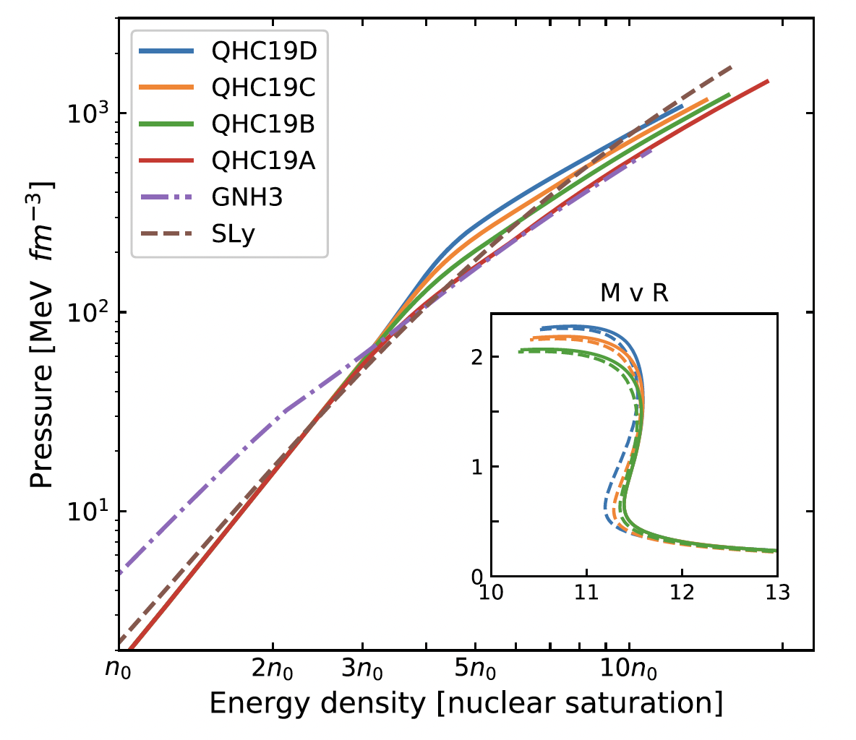
Universality Relation
Notes:
"We also explore universality relations between key physical quantities, such as the relationship between fmax​ and tidal deformability, and fpeak with pseudo-average density. In the left panel, two black lines represent universal relations identified in Read's and Takami's studies, calculated across several nuclear EOS groups. Our crossover data points fall within the range defined by these two universal relations.
For the right panel, our commentary extends to QHC19's position, notably situated between the softer Sly EOS and the stiffer GNH EOS. This placement reflects the duality of the crossover EOS, aligning more closely with softer EOS below 3n0n0​ and shifting towards stiffer EOS above 10n0n0​, exhibiting a blend of soft and stiff characteristics. However, QHC21 diverges from this pattern; its earlier transition around 2.5n0n0​ distances it from softer EOS affiliations."

Slide 21
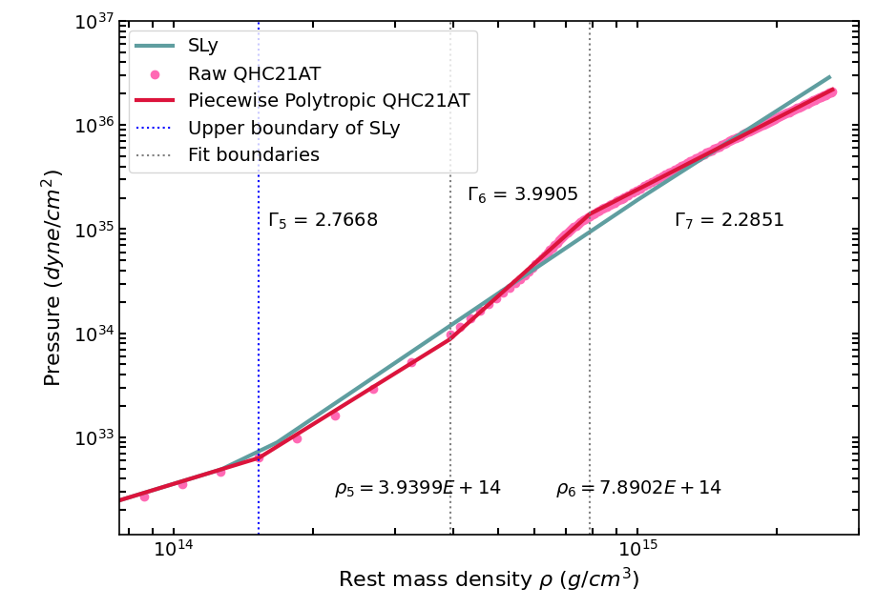
Piecewise-polytropic method
PP Residual = 0.015
JS Reed, et al. PRD 2009
Pietri, et al. PRD 2016
Notes:
"We utilized the Piecewise-polytropic method to construct our EOS models, applying P=ρΓP=ρΓ across seven segments. The initial four segments delineate the lower density region, while the final three address the higher density area. The maximum discrepancy in our models is approximately 0.02, indicating a reliable approximation of the original data.

Slide 22
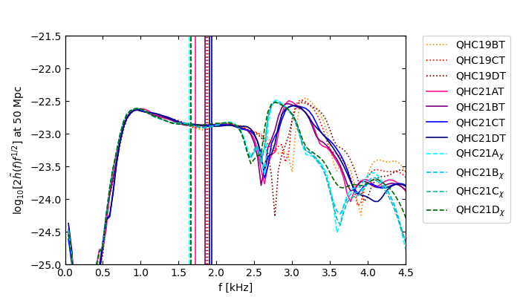
Back-up slides
M~1.32 M☉

Slide 23
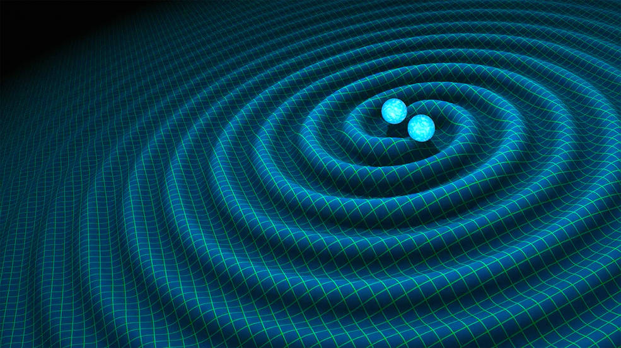
Outline
Equations of State
Postmerger Analysis
Summary
Notes:
“Let’s start with the construction of the three EOS models and identify their distinct features.”

Slide 24
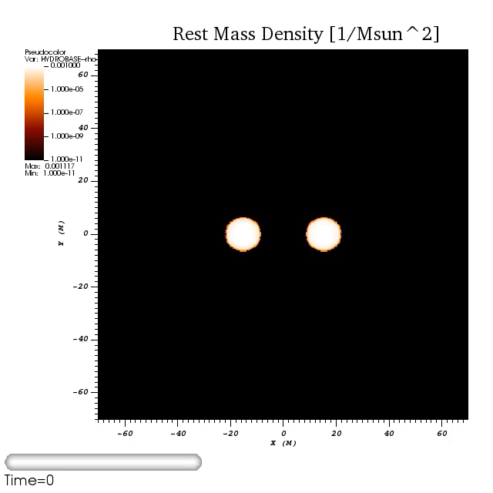
BNS Merger of QHC21A 𝛘
Possible evidence of a crossover EoS is the formation of a hypermassive neutron star after merger!
Notes:
Echoing the discoveries from QHC19, the 21 models further support the idea that a crossover EOS often leads to the formation of a HMNS after merger. I'll now show a simulation highlighting this process. It begins with two neutron stars 45 km apart. They orbit each other several times before merging into a rapidly rotating HMNS, a phase lasting tens of milliseconds. Throughout, the system emits gravitational waves, ejects mass, and ultimately the central region collapses into a black hole.

Slide 25
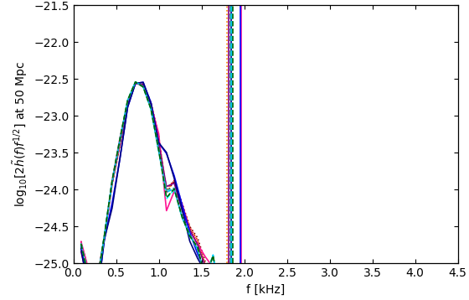
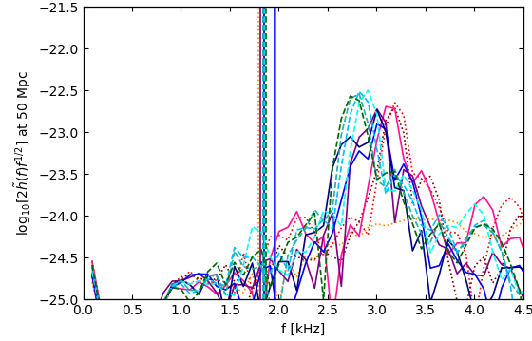
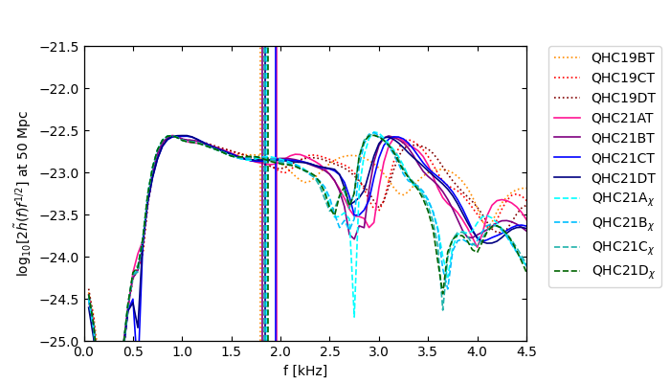
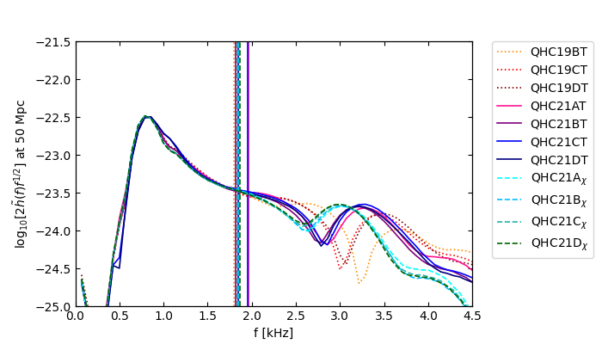
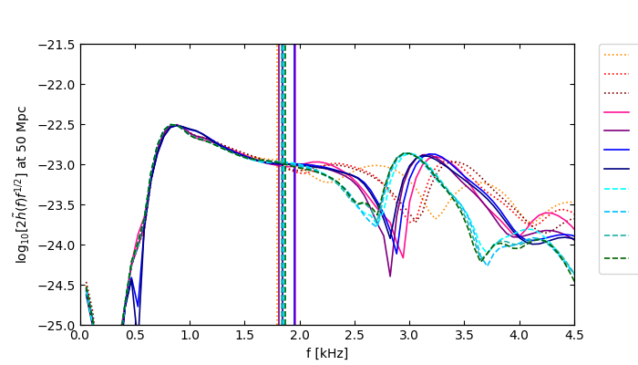
Power spectral density
[-11,0]ms
[0,11]ms
[-11,3]ms
[-11,6]ms
[-11,9]ms
The inspiral phase mostly contributed to f <1.5kHz
The post-merger phase mostly contributed to f > 1.5kHz
Notes:
Next, let's explore the power spectral density (PSD) plots, which shift our view from time to frequency domain. Through PSD plots from different time intervals, we gain insight into power distribution during the merger phases. Essentially, the inspiral phase contributes power mainly at frequencies below 1.5kHz, while the post-merger phase dominates above 1.5kHz.

