Slide 1
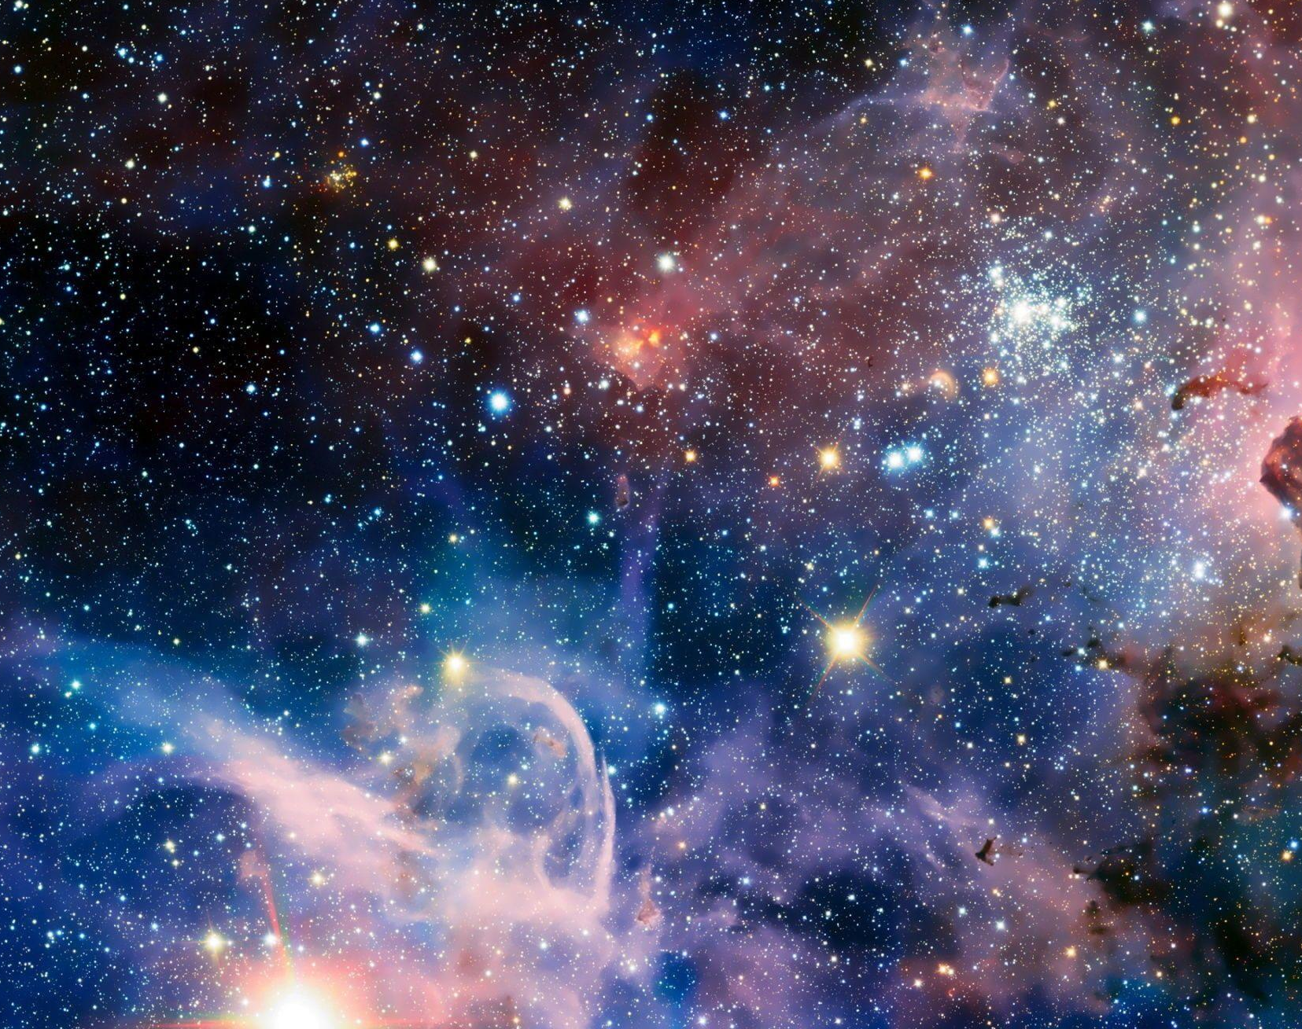
Atomic inputs and opacity numerical estimation concerning early-stage kilonova ejecta
Speaker: Ph.D. Student Matteo Bezmalinovich Supervisor Dr. Sergio Cristallo

Slide 2
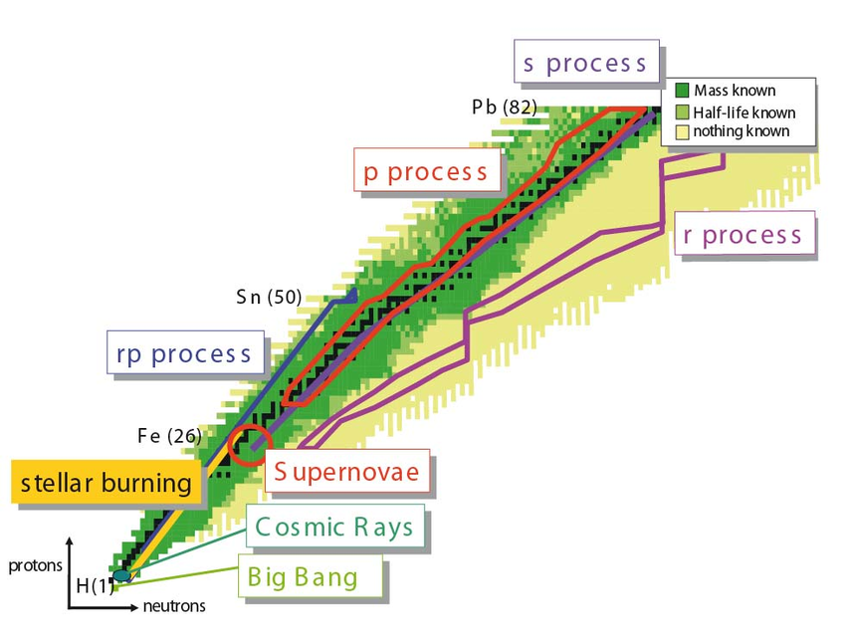
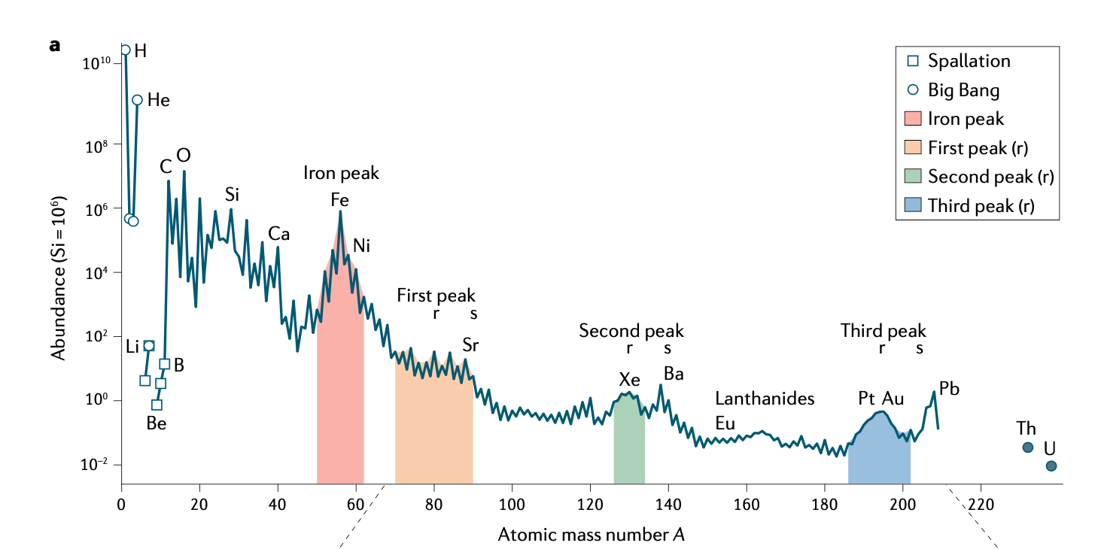
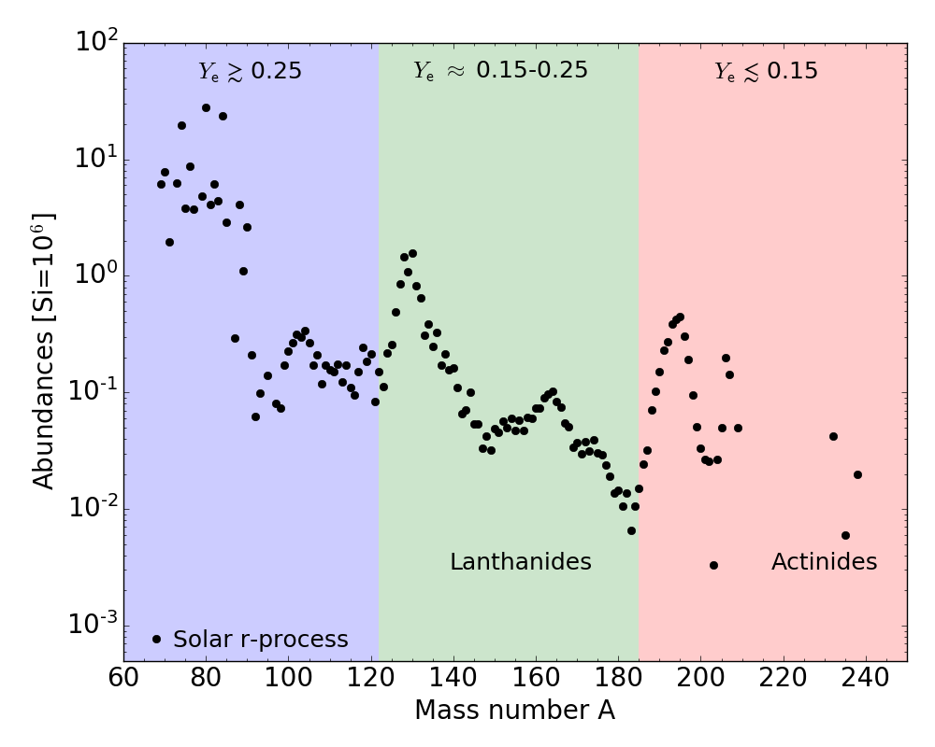
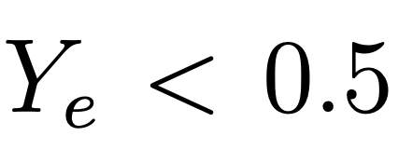
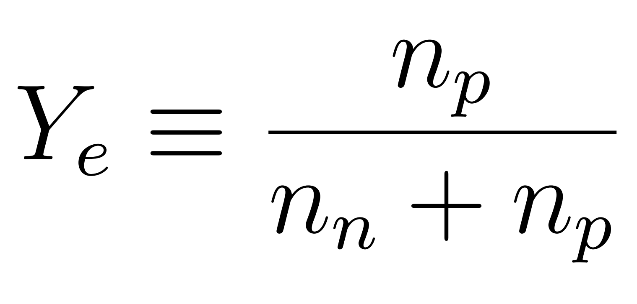
Rapid (r-) neutron capture process
How to build heavier neutron-rich isotopes beyond ⁵⁶Fe?
Chart of nuclides
Siegel D. M., Nat. Rev. Phys. 4, 306-318 (2022).
Blaum K., Novikov Yu. N., Werth G., Contemporary Physics 51, 2 (2010).
r- process
Neutron-rich nuclei far from the stability valley

Slide 3
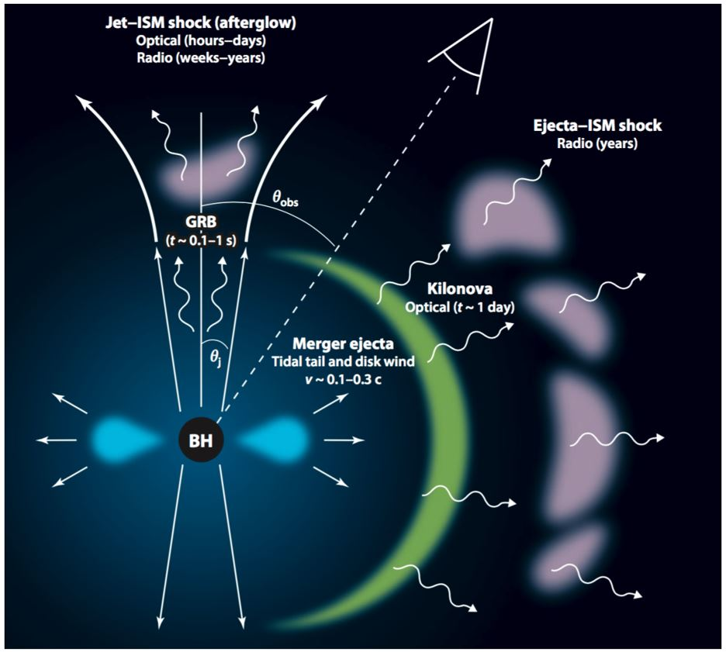
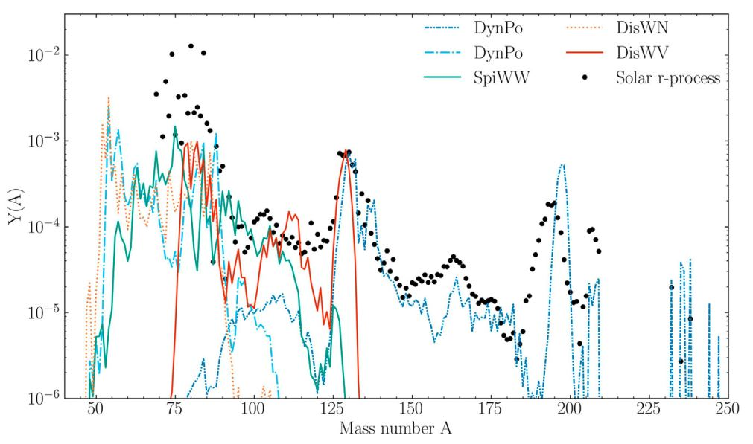
Neutron Star Mergers
Neutron star mergers
Electromagnetic counterparts
Merger of compact objects between two neutron stars (NS²) or a neutron star - black hole (NS - BH)
Vescovi D. et al, Frontiers in Astronomy and Space Science, 9:994980 (2020)
Metzger B.D., Living Review in Relativity (2020)

Slide 4
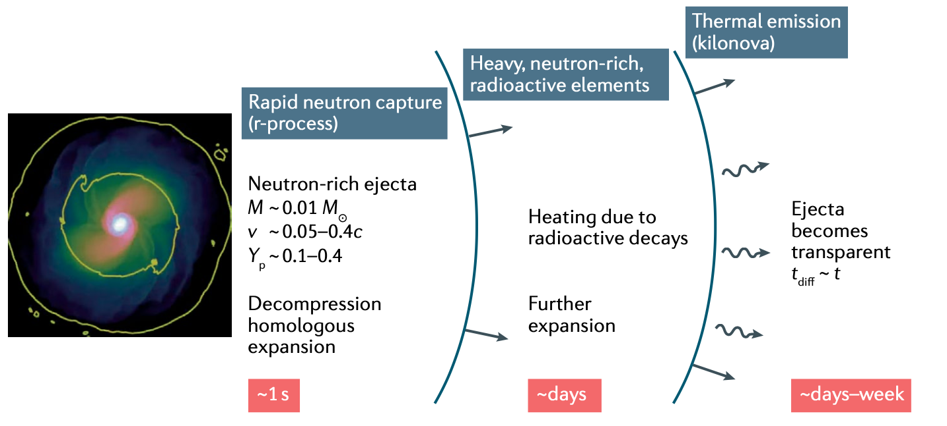
The Kilonova
Luminosity peak
Heating rate Q (and thus from nucleosynthesis)
Opacity κ
Siegel D. M., Nat. Rev. Phys. 4, 306-318 (2022).
Low-opacity for lanthanide-poor ejecta (Y_{e} ≿ 0.25)
‘Blue kilonova emission’
High-opacity for lanthanide-rich ejecta (Y_{e} ≲ 0.25)
‘Red kilonova emission’
Kasen D. et al., Nature 551, 80–84 (2017).

Slide 5
Kilonovae light-curve model
KN (kilonova) light-curve model
WinNet
POSSIS code
(M. Bulla)
KN abundance
Opacity
Input
Preliminary works: Numerical simulation of opacity (Se,Sr,Zr,Nd - Pidatella+,Frontiers 2022)
(Ar - Bezmalinovich+,N.Cimento,inRev,2024)
RTE equation
✓ PhD main goal: provide opacity (atomic inputs) for the KN model (POSSIS)

Slide 6
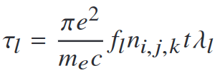
Expansion opacity
POSSIS code
Outcomes:
KN 3D model light-curve angular dependent
Requirements
Expansion opacity
Nucleosynthesis trace (input Ye for the spherical grid)
Homologous expansion t=dr/dv
Initial density and temperature correlated to the input trace
Expansion opacity as input
with Sobolev optical depth
Priority task: numerical computations to obtain atomic inputs and calculate the opacity
How?
GRASP

Slide 7
Atomic state wave function
Real case
Standard case
Same n but different electron configuration
Different n
1s²4s¹
Multi-configuration
n=4
1s²3s¹
Excited state
5d⁹6s²
5d⁹6s¹6p¹
n=3
1s²2p¹
Transition
n=6
n=2
Ground level
Excitation n-quantum number
Complex wave functions
[Xe] 4f¹⁴5d¹⁰6s¹
1s²2s¹
Gold example
Lithium example
State wave function
Large expansion set of Electron configurations The final state will be a linear combination of the all possible upper states of the transitions
Multi-configuration
7

Slide 8
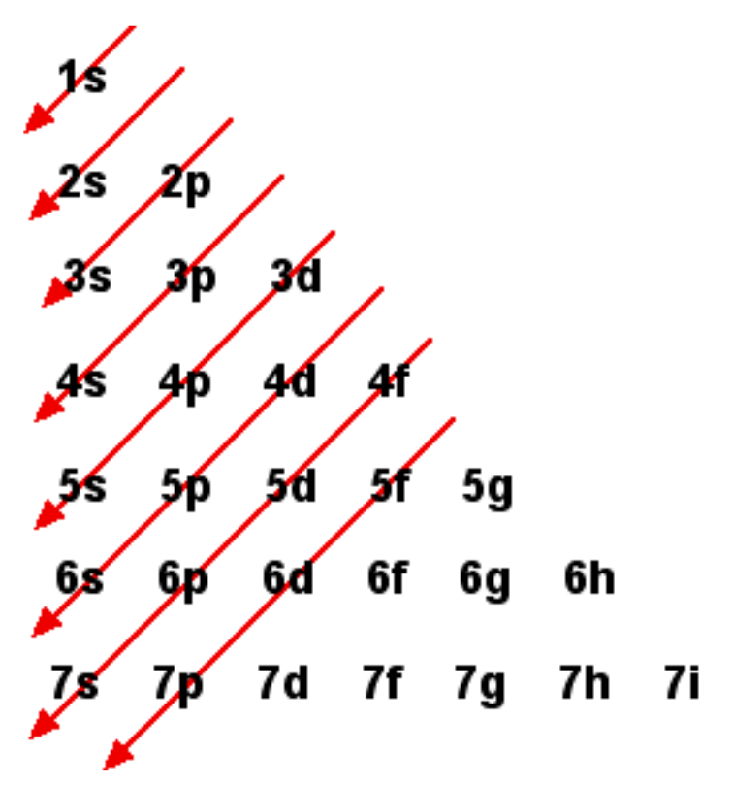
Atomic electron configurations
How to choose the electron configurations (ECs) as input for grasp2018?
Deal between NIST available data + Quantum mechanics rules
Just an example… Se I
This criterion increases the # of ECs which increase the accuracy of the energy levels and the number of transitions
n=1
extend #EC (not available in NIST) 4s2 4p2 5s 5p
4s2 4p2 5s2
4s2 4p2 5s 4d
NIST ECs 4s2 4p4
4s2 4p3 5s
4s2 4p3 5p
4s2 4p3 4d
4s2 4p3 5d
4s2 4p3 4f
n=2
…
Time consuming
8s 8p …

Slide 9
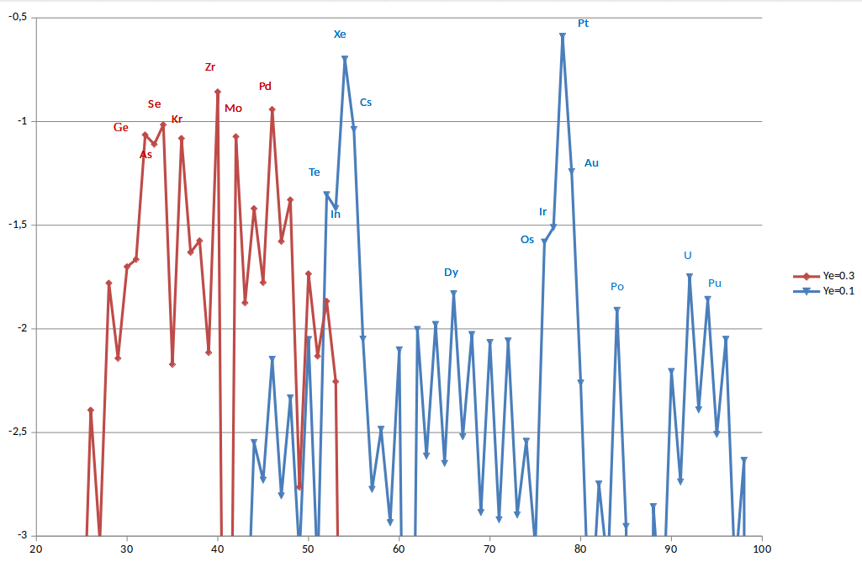
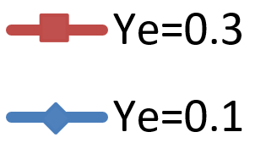
r-process abundances
We decided to perform opacity simulations on the basis of Ye r-process abundances
Abundances
Early-stage (Ye=0.3):
ne=10^11 cm-3
Te=1-2 eV
Late-stage (Ye=0.1):
ne=10^7 cm-3
Te=0.1-1 eV
Au, Se, Sr, Sn, Te, Zr, Y
(priority)
Z (Atomic number)

Slide 10
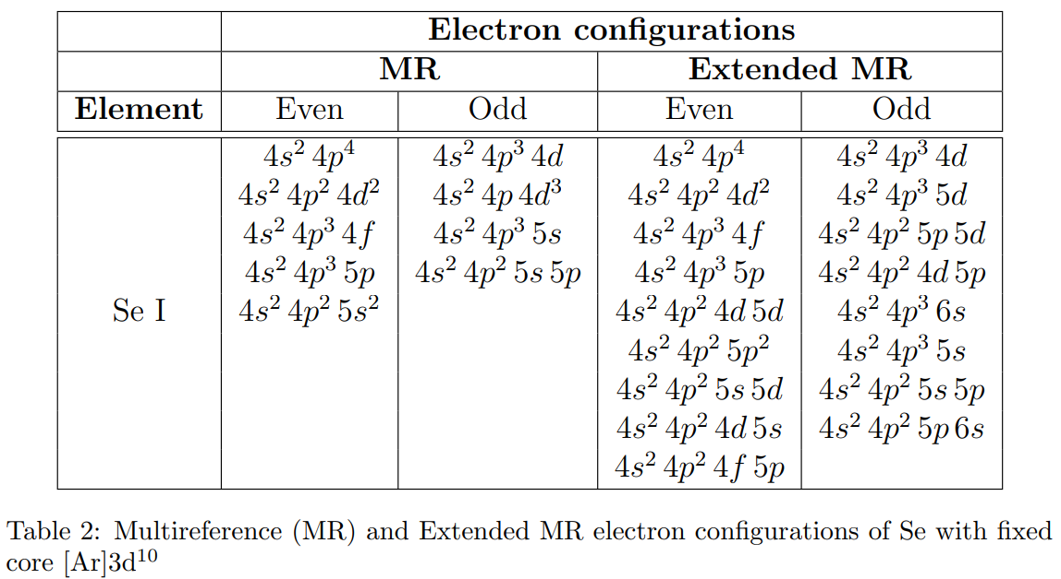
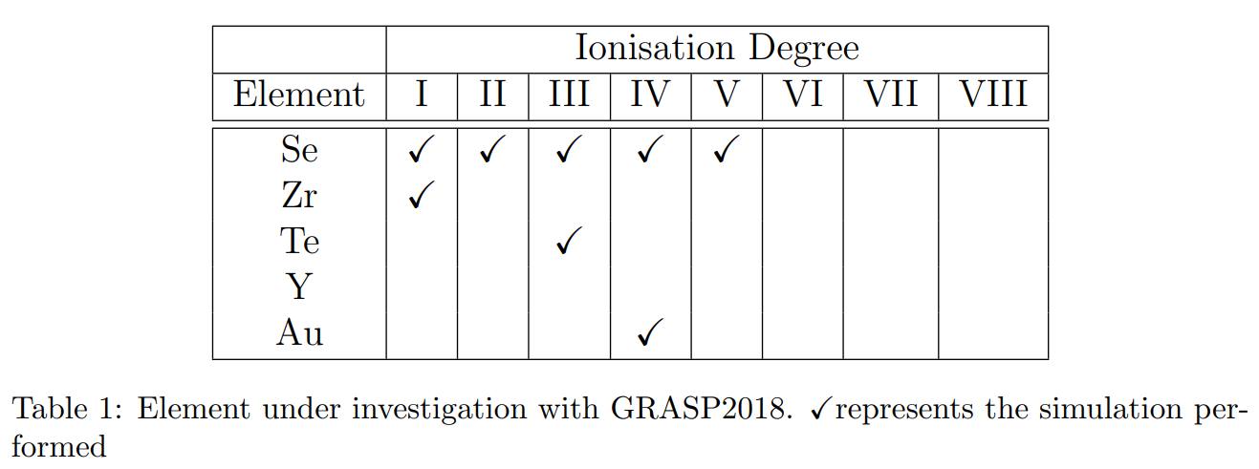
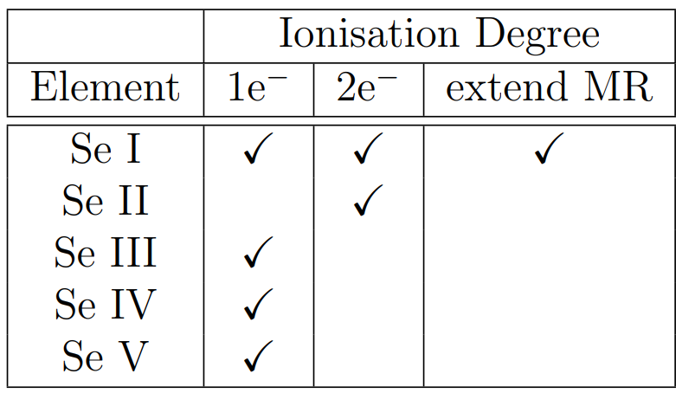
Selenium study
It has been done a comparison between single (1e⁻) vs. double (2e⁻) excitation
We also took into account an extended MR set for the calculation of Se I

Slide 11
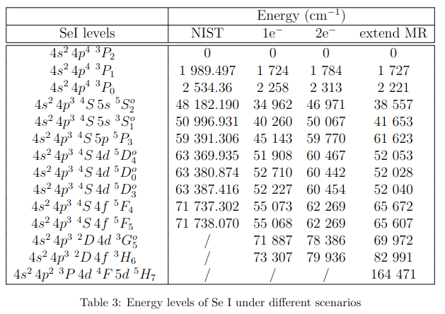
Se I energy levels
Double excitations (2e-) optimize the energy levels
Single excitation (1e-) strengthens the transitions accuracy
Extending the MR set not always optimise the energies (warning!). There is discrepancy between NIST and Extended MR
Double excitation estimates NIST data level energies in a good approximation

Slide 12
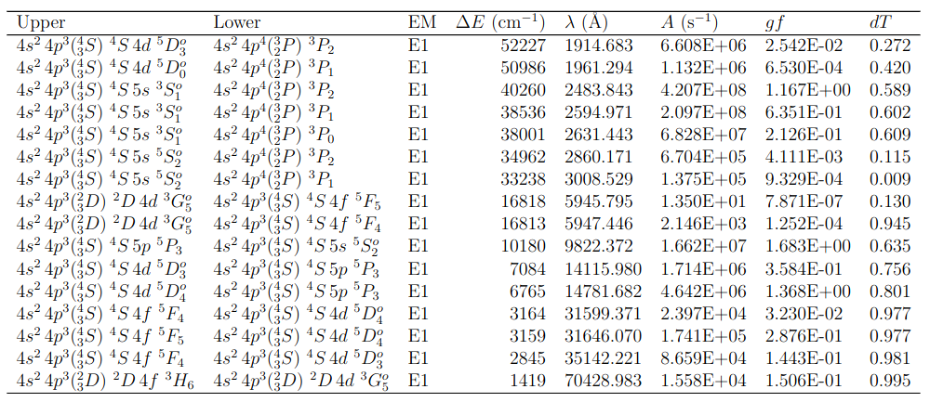
Se I transitions 1e⁻
Se I transitions with single (1e-) excitation
Optical window
Only dipole transitions (E1)

Slide 13
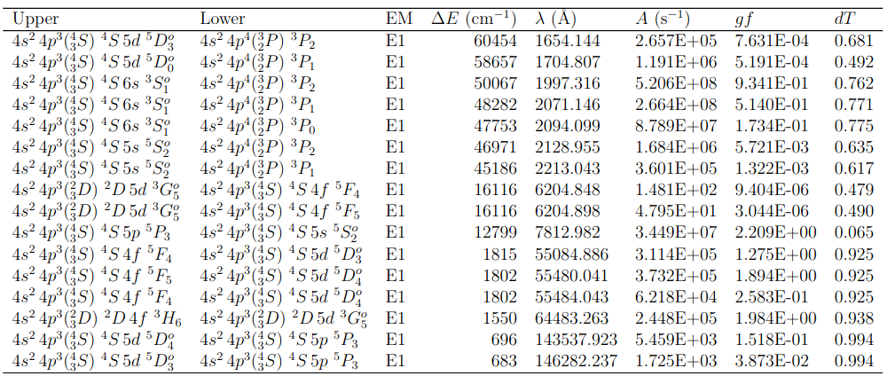
Se I transitions 2e⁻
Se I transitions from double (2e-) excitation
Optical window

Slide 14
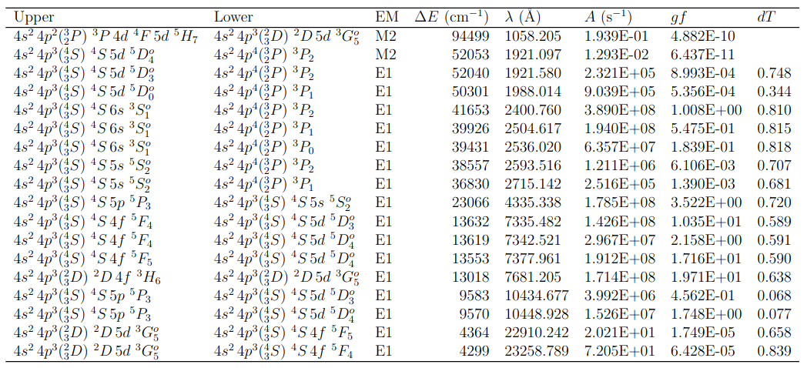
Se I transition analysis
Se I transitions from an extended set with double (2e-) excitation
Optical window
Dipole transitions (E1) and quadrupole (M2)

Slide 15
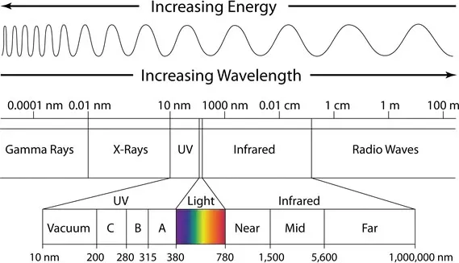
Se Transition analysis
Se transition results:
Se I
[192,7042] nm
э
Se III
[65,418] nm
э
Se V
[62,114] nm
э
Se I
Se III
Se V

Slide 16
Saha equation problem
Saha equation to establish the ionisation degree of a selected specie in the plasma medium
r - ionisation degree
g - level degeneracy
E - level energy
0,1,2,... - # of excited states
… where the partition function expression …
How to set a cut-off to the partition function?

Slide 17
Conclusions
grasp2018
Saha- ionisation
Work schedule:
perform Se I simulation with more ECs to obtain large # of transitions
perform with the same criterion Se II, Se III, Se IV, Se V …
Work schedule:
Insert grasp g and E outcomes as input for the partition function Ur(T) - ground
Use the NIST database to insert g and E values in Ur+1(T)
Compute Saha and see to which degree of ionisation we have to simulate the element
When all simulations will be done, use grasp output for both Ur(T) and Ur+1(T) and compare if the result is coherent
1° stage: use GRASP to provide atomic inputs for selected isotopes (extend
simulations to further elements such as Se, Zr, Y)
2° stage: apply to POSSIS (together with abundance from nucleosynthesis codes)
3° stage: reproduce opacity data for a selected elements of interest to recreate KN early-stage environment (GRASP)
17

Slide 19
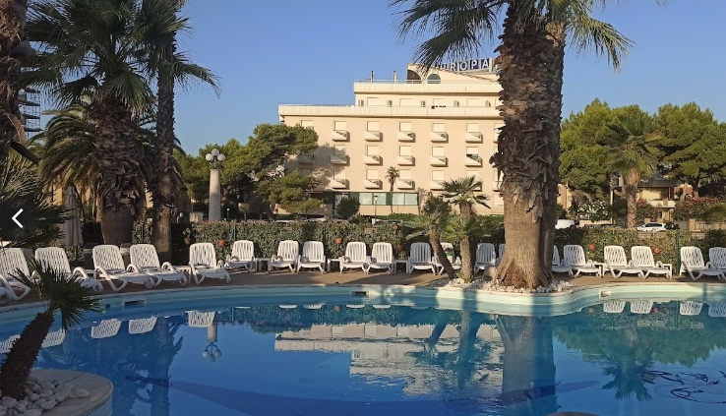
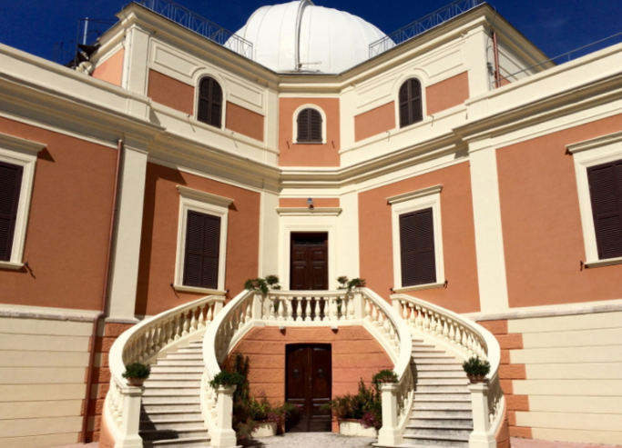
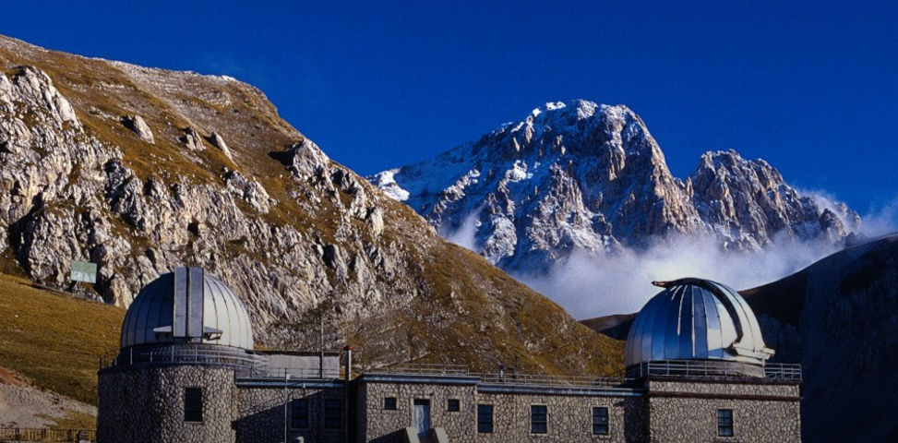

Slide 20
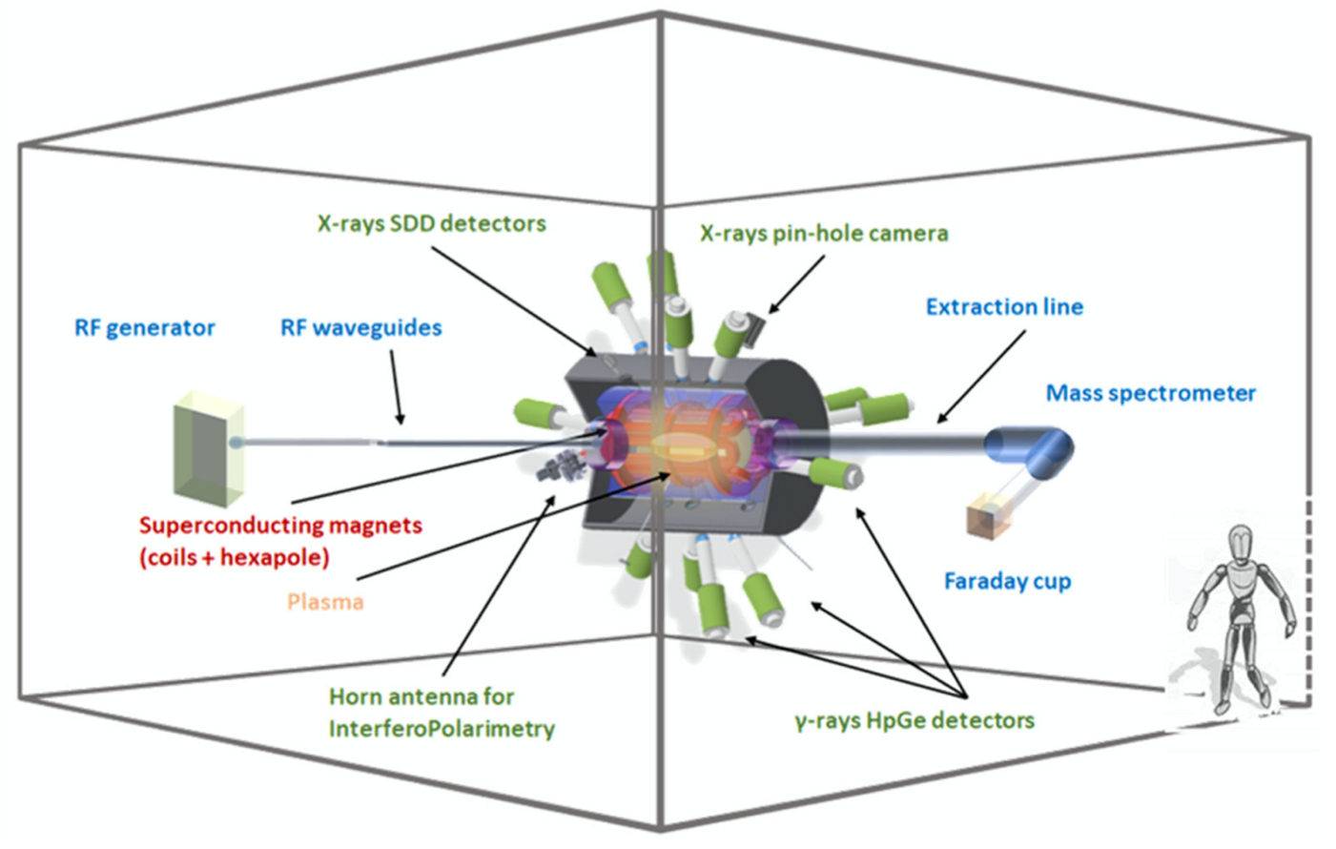
Extra - PANDORA
Superconducting magnetic plasma trap where plasma are generated via the electron cyclotron resonance (ECR) mechanism, sustained via microwave, and confined by the magnetic trap
Interdisciplinary research with a multi-diagnostics setup:
Measure in-plasma 𝛽-decays of selected radioactive isotopes (¹⁷⁶Lu, ¹³⁴Cs, and ⁹⁴Nb)
Reproduce the plasma environments of KN in laboratory and study plasma opacity
Kilonovae theoretical scenario
n_{e}: 10¹⁰ - 10¹³ cm⁻³
T_{e}: few eV
D. Mascali et al., Universe 8, 80 (2022).
20

Slide 21
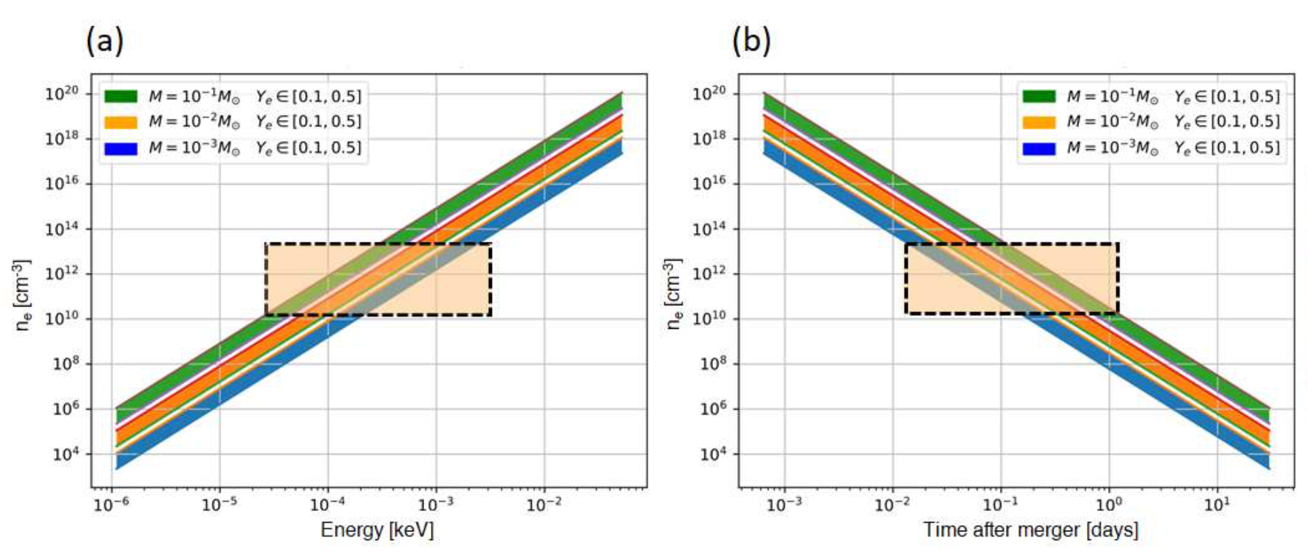
Extra - Ejecta stage vs. in-laboratory plasma conditions
max n_{e}
min n_{e}
min E
max E
𝚫T
Pidatella A. et al., IL NUOVO CIMENTO C 44, 65 (2021).
For the modeled ejecta:
Densities n_{e}∼ 10¹⁰ − 10¹⁴ cm⁻³ in an energy range of few eV
Time after merger 𝚫T ∼ 10⁻² – 10⁰ [days]
Kilonovae theoretical scenario
n_{e}: 10¹⁰ - 10¹³ cm⁻³
T_{e}: few eV
21

Slide 22
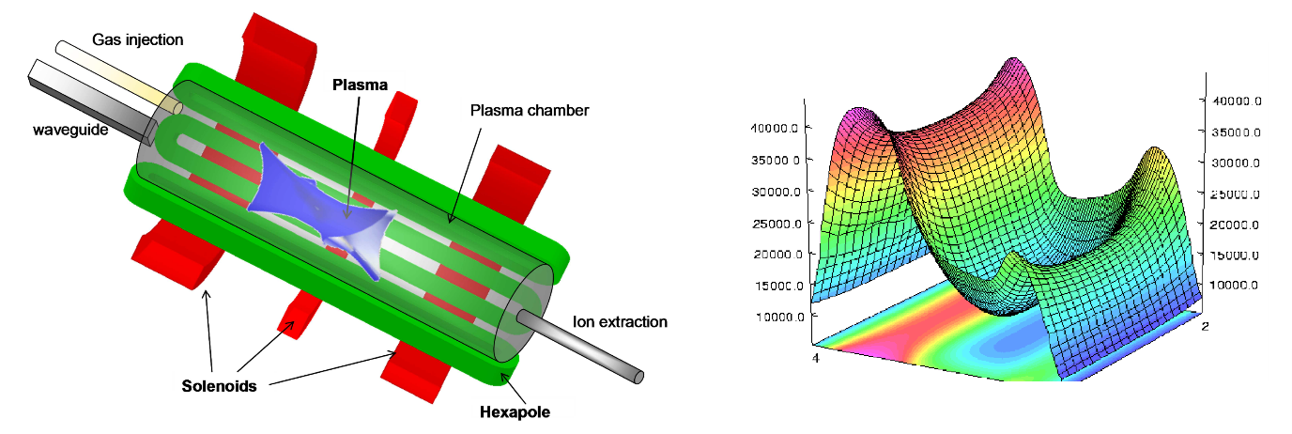
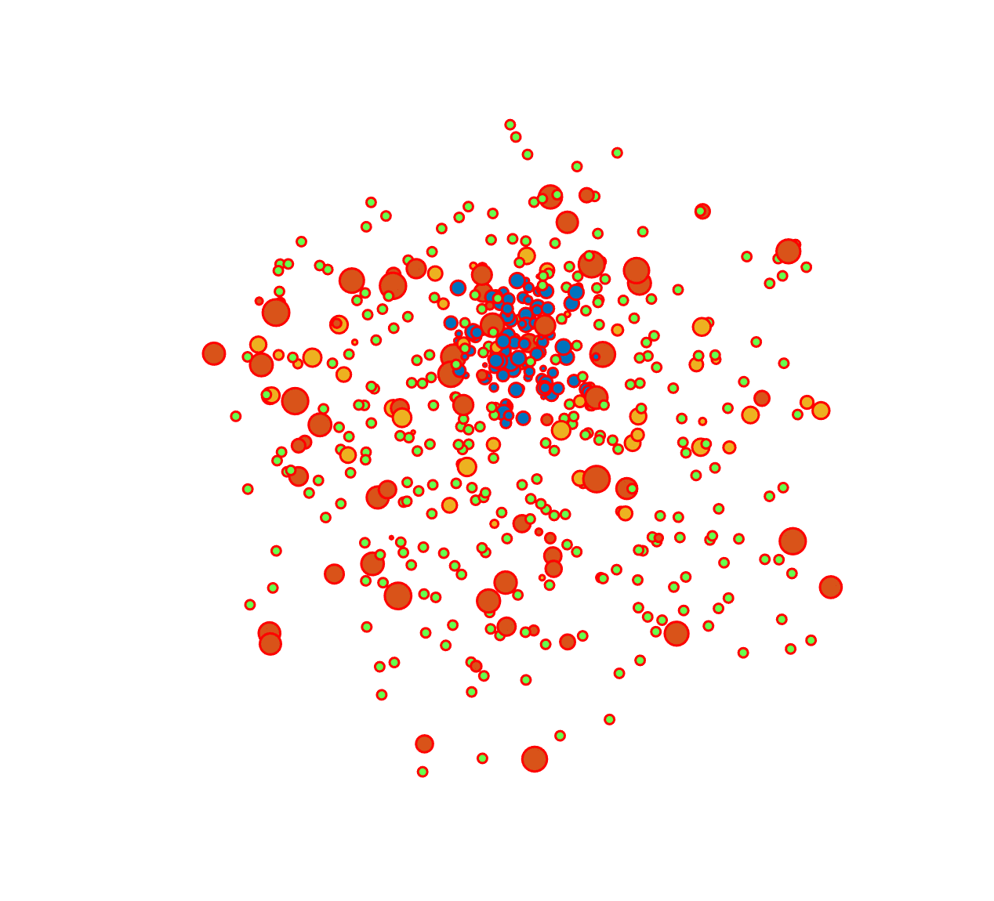
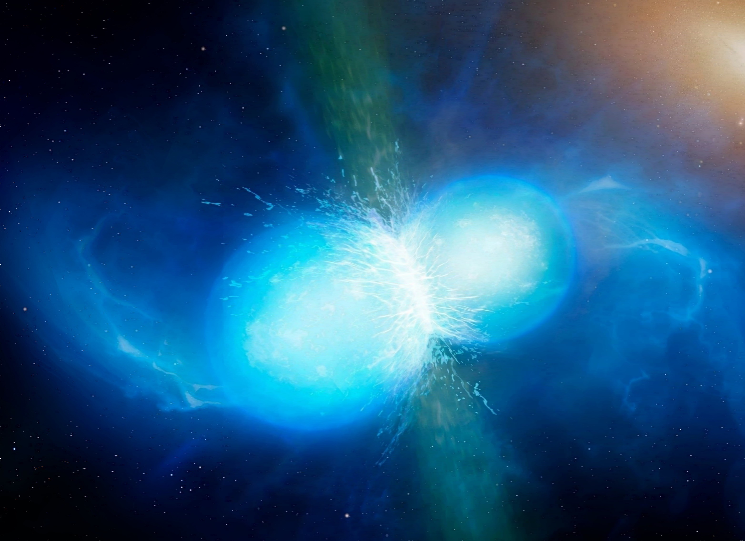
Extra – PhD model
Numerical Model
KN light-curve numerical code
- Different densities and temperatures of the medium
- Opacity numerical estimation
- Atomic abundances prediction
- Energy transport through the plasma
Theoretical Scenario
Layers of ejecta
Different densities and temperatures
Photon-matter collisions
Radiation attenuation by opacity
Experiment
In-laboratory compact magnetic plasma trap
Suitable plasma species for experimental measurements
Non-homogeneous and anisotropic medium
Opacity measurements

Slide 23
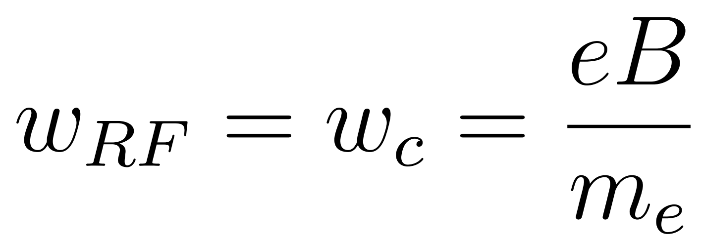
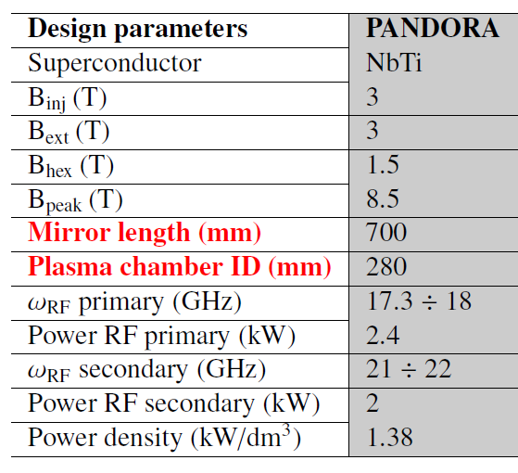
Extra - Electron cyclotron resonance (ECR) plasma
Electron Cyclotron Resonance (ECR) magneto-plasmas have historically served the accelerator community as source for multi-charged ion beams to be accelerated
Microwaves igniting and sustaining plasma, 5 kW and 18-21 GHz
ECR mechanism:
B-min magnetic field structure (max 3 T)
ECR surface
$$B_{ECR}=\frac{ω_{RF}m}{q}$$
23

Slide 24
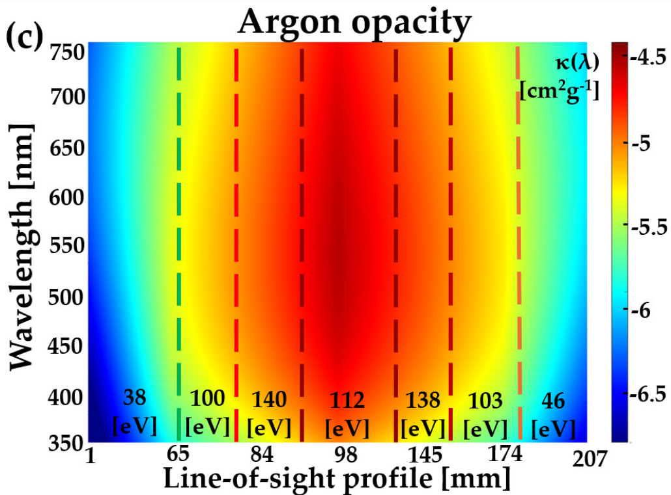
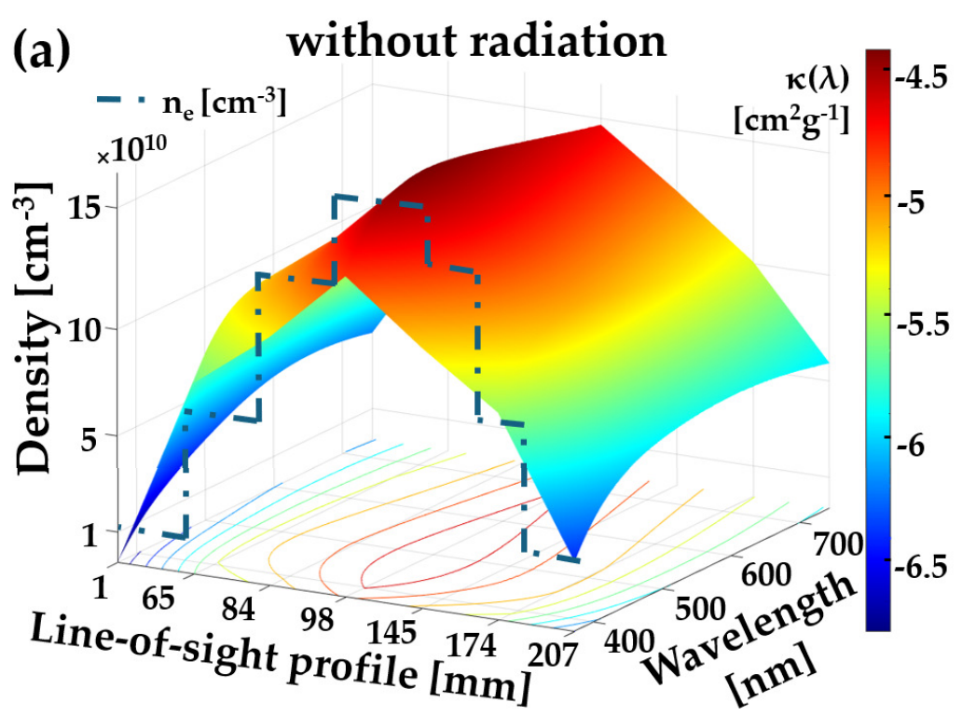
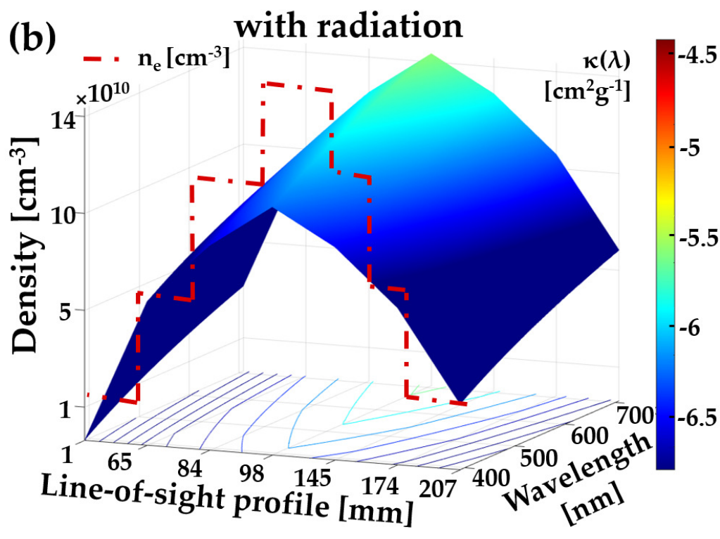
Extra – Ar plasma opacity
M. Bezmalinovich et all. Il Nuovo Cimento, InReview, 2024
Absorption Coefficient
24

Slide 25
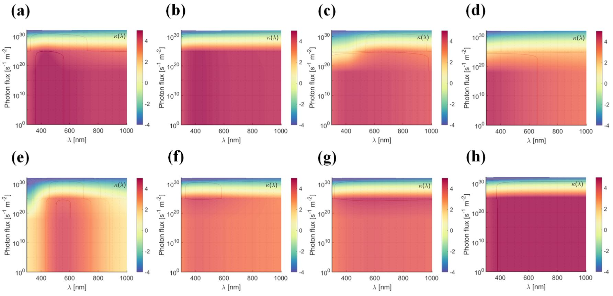
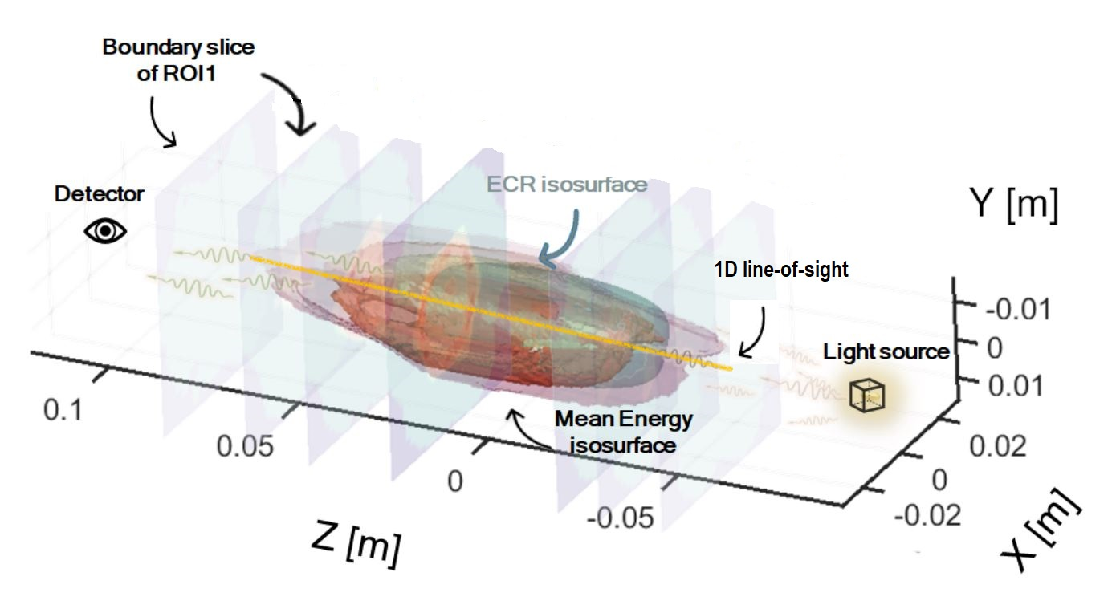
Numerical Estimation of Opacity
Thermodynamic parameters achieved in Flexible Plasma Trap (FPT)
Configuration (a-d) - Density
Temperature
Configuration (e-h) - Density
Temperature
Absorption Coefficient
Elements of interest:
Selenium (34) (a,e)
Strontium (38) (b,f)
Zirconium (40) (c,g)
Niobium (41) (d,h)
A. Pidatella et all. Frontiers in Astronomy and Space Science 9, 931744, 2022
25

